Slide 1
Plans of XFELO in Future ERL Facilities
Shogo Sakanaka
High Energy Accelerator Research Organization (KEK)
Talk at FLS2012, March 5-9, 2012, at Jefferson Lab.
v1

Slide 2
Outline
XFELO Plan in KEK-ERL
XFELO Plans for Cornell’s X-ray ERL
Summary

Slide 3
XFELO Plan in KEK-ERL

Slide 4
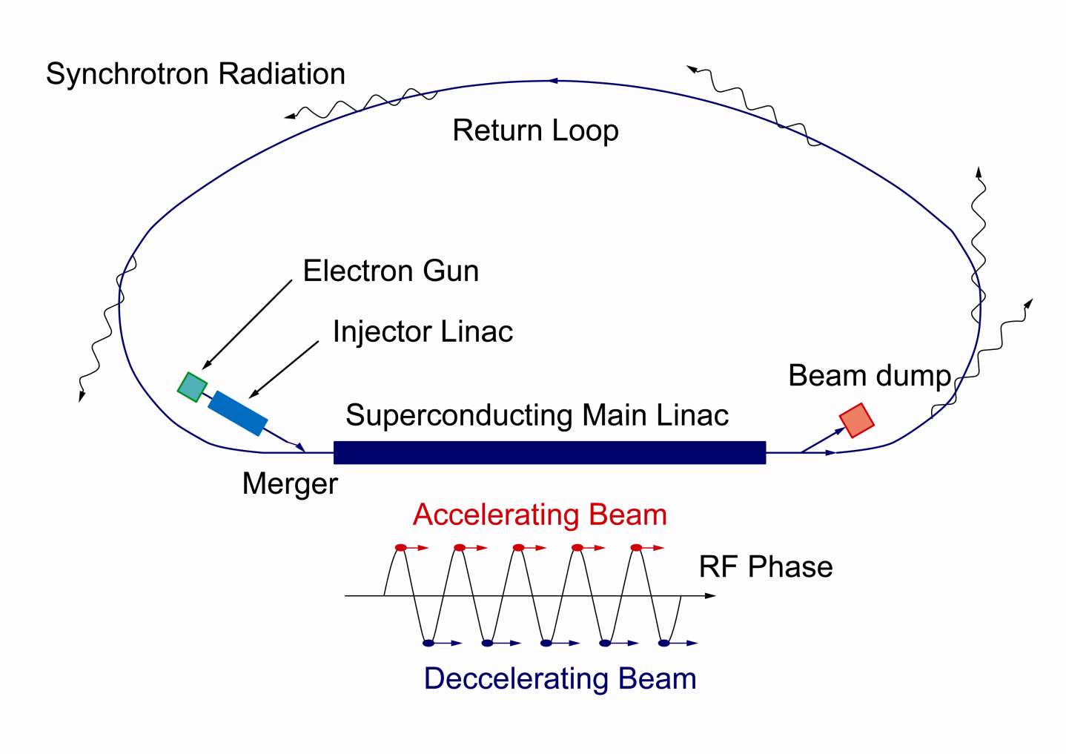
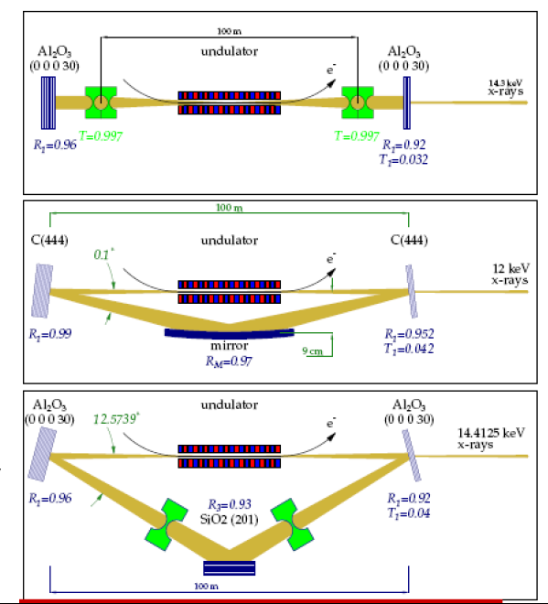
3GeV ERL Light Source Plan at KEK
Needs for future light source at KEK
Driving cutting-edge science
Succeeding research at the Photon Factory (2.5 GeV and 6.5 GeV rings)
3-GeV ERL that is upgradable
to an X-ray free-electron-laser
oscillator (XFELO) [1]
[1] See, for example, K.-J. Kim, Y. Shvyd’ko,
S. Reiche, Phys. Rev. Lett. 100, 244802 (2008).
λ_{rf}/2 path-length
changer
6 (7) GeV
3GeV ERL
in the first stage
XFEL-O in 2nd stage

Slide 5
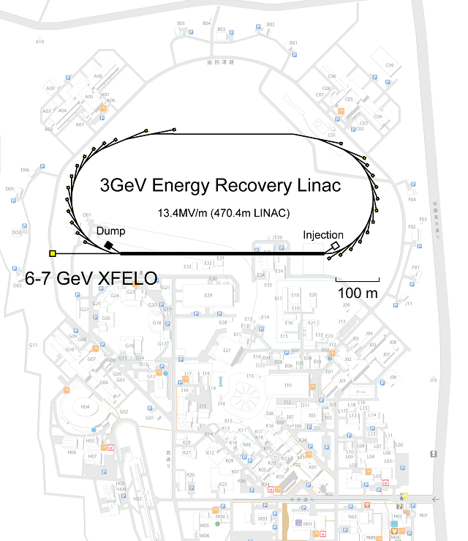
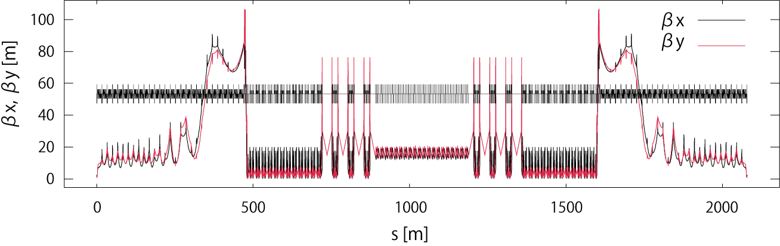
Tentative Layout of 3-GeV ERL at KEK
Courtesy: N. Nakamura, M. Shimada, Y. Kobayashi
Beam energy
  Full energy: 3 GeV
  Injection and dump :10 MeV
Geometry
  From the injection merger to the dump line : ~ 2000 m
  Linac length : 470 m
Straight sections for ID’s
  22 x 6 m short straight
  6 x 30 m long straight
Overall beam optics (merger → dump)
Acceleration
Deceleration
Notes:
5

Slide 6
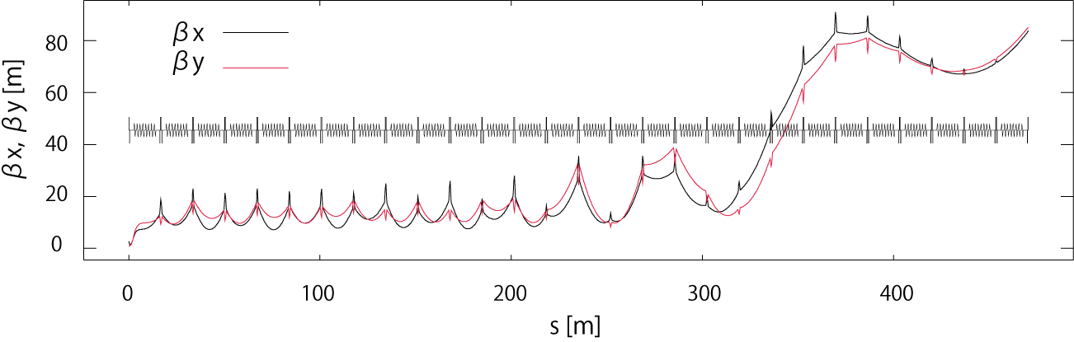
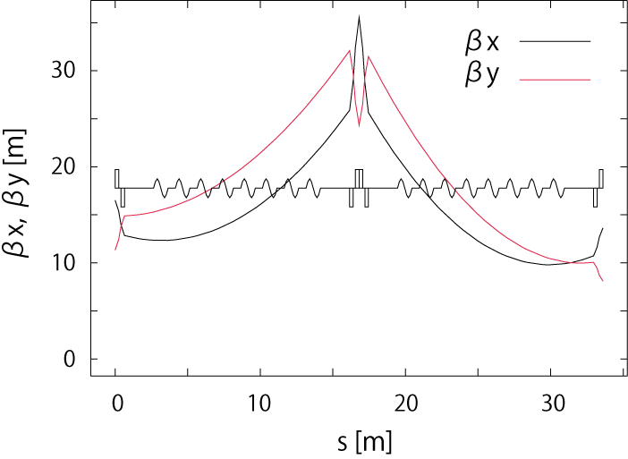
Beam Optics in 3-GeV Linac
Courtesy: N. Nakamura, M. Shimada, Y. Kobayashi
Cavities
  Eight 9-cell cavities in a cryomodule.
  28 cryomodules (252 cavities).
  Field gradient: 13.4 MV/m
Layout
  Focusing by triplets.
  Gradient averaged over the linac is 6.4 MV/m
Optics
  Minimization of beta functions to suppress the HOM BBU (optimized with SAD code)
  Body and edge focusing effects of the cavities are included with elegant code
  Deceleration is symmetric to the acceleration.
triplet
6

Slide 7
Target Parameters for XFELO
High-brilliance light source
XFELO
 | High coherence (HC) mode | High flux (HF) mode | Ultimate mode (future goal) | XFELO
Beam energy | 3 GeV |  |  | 7 (6) GeV¹⁾
Beam current | 10 mA | 100 mA | 100 mA | 20 μA
Charge/bunch | 7.7 pC | 77 pC | 77 pC | 20 pC
Bunch repetition rate | 1.3 GHz | 1.3 GHz | 1.3 GHz | 1 MHz
Normalized beam emittance (in x and y) | 0.1 mm·mrad | 1 mm·mrad | 0.1 mm·mrad | 0.2 mm·mrad
Beam energy spread (rms) | 2×10⁻⁴ | 2×10⁻⁴ | 2×10⁻⁴ | 2×10⁻⁴
Bunch length (rms) | 2 ps | 2 ps | 2 ps | 1 ps
1) Parameters were estimated at 7 GeV. We are interested in 6-GeV operation.

Slide 8
Simulation of XFELO (5 GeV with velocity bunching)
saturation
After the saturation:
pulse duration
τ=1.2 ps (FWHM)
photons/pulse (intra cavity)
N_{p} = 2x10¹⁰
photons/pulse (extracted)
N_{p} = 7x10⁸
8
R. Hajima, Presentation at FLS2010, March 4, 2010, at SLAC.
Notes:
8

Slide 9
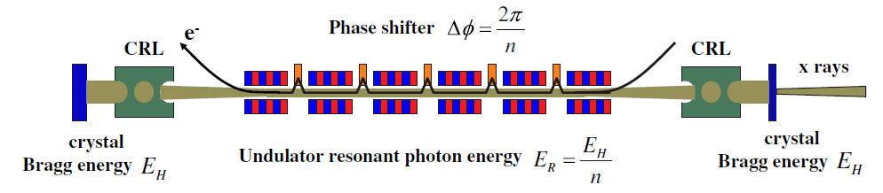
Possibility of XFELO at Lower Beam Energies
We expect the possibilities of:
driving XFELO at 6 GeV, or
harmonic lasing scheme at 3 - 3.5 GeV [2].
[2] J. Dai, H. Deng, Z. Dai, Phys. Rev. Lett.
108, 034802 (2012).
Figure is cited from [1]
(2) XFEL-O at E=3 GeV
3GeV ERL
λ_{rf}/2 path-length
changer
6 GeV
(1) XFEL-O at E=6 GeV

Slide 10

2. XFELO Plans for Cornell’s X-ray ERL
As described in the
Cornell Energy Recovery Linac
Project Definition Design Report
Eds. Georg Hoffstaetter, Sol Gruner, Maury Tigner

Slide 11
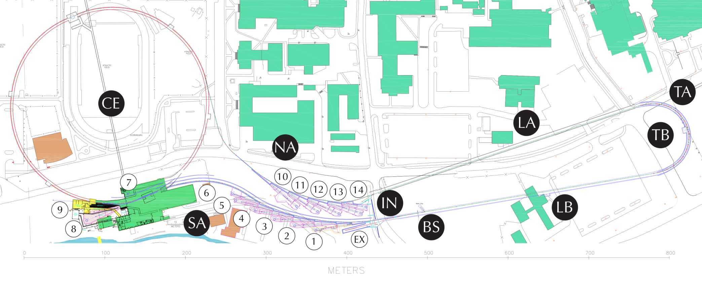
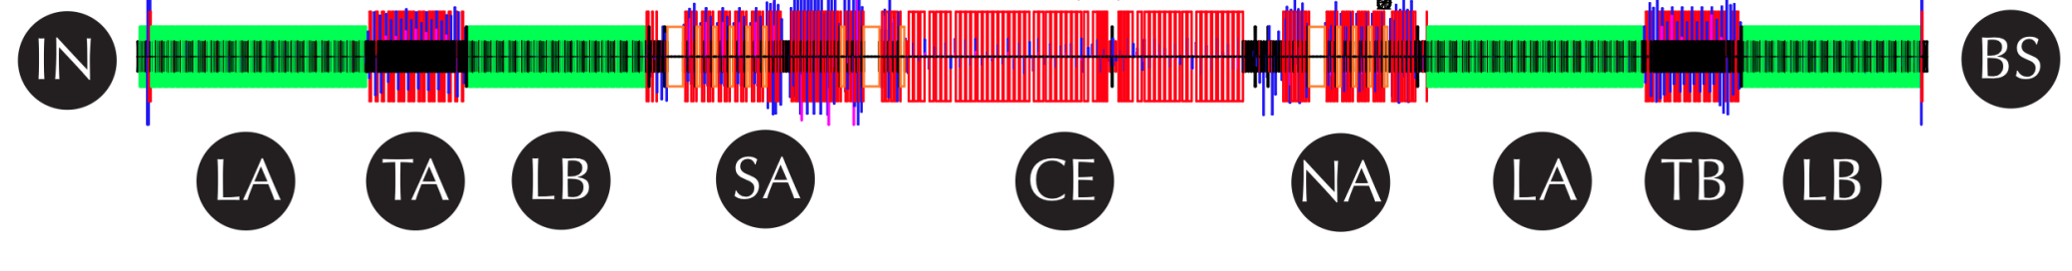
Cornell ERL Layout
The 15MeV injector IN sends electrons into a 2.8GeV Linac LA to be turned around by TA into a 2.2GeV Linac LB. After X-ray production in the south arc SA, return through CEsr and X-rays in the north arc NA, the beam energy is recovered in the Linacs before being stopped at DU.
11

Slide 12
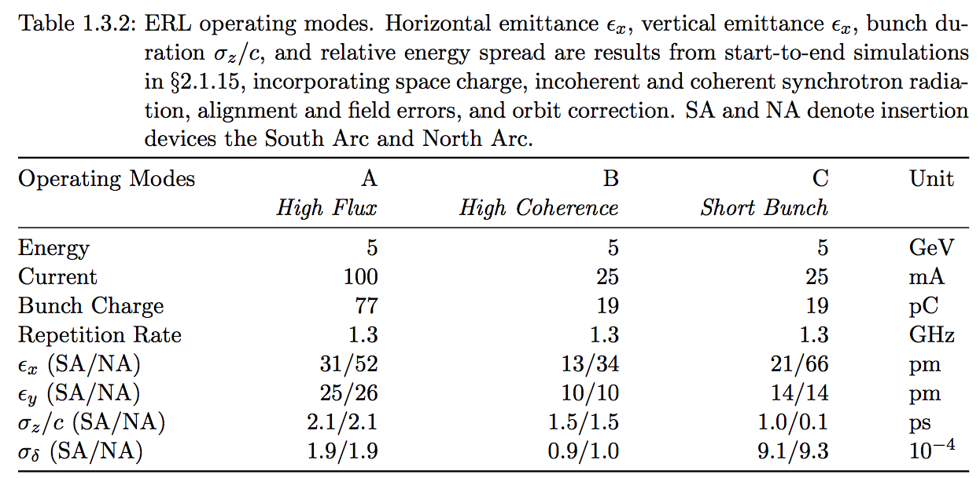
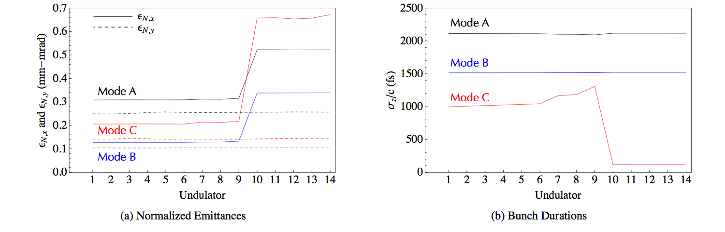
Start to End simulation results
12

Slide 13
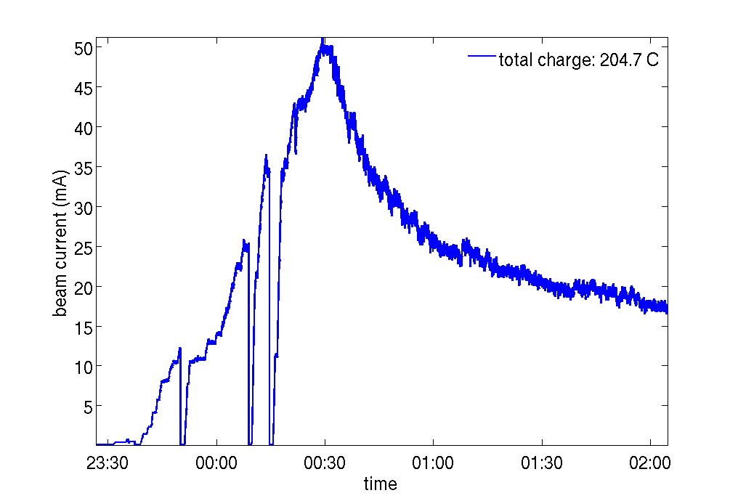
Existing Prototype Injector
photocathode
DC gun
cryomodule
beam stop
experimental beamlines
buncher
Cornell currently operates a prototype ERL injector. The team has measured core emittances (the central 2/3 of the bunch) of 0.3 mm-mrad for 80 pC bunches and 0.15 mm-mrad for 20 pC bunches, and expect these numbers to improve as the gun voltage is increased.
In February 2002, Cornell’s prototype injector delivered a continuous-duty current of 50 mA. This is the world record for any laser-driven photocathode electron gun.
13

Slide 14
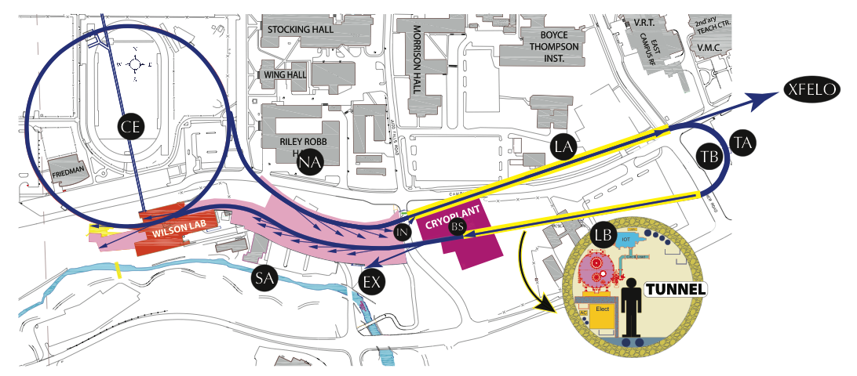
XFELO Option in the Cornell ERL
The Cornell ERL normally injects electron bunches at 15 MeV, accelerates them to 2.8 GeV in Linac A (LA), and another 2.2 GeV in Linac B (LB) to yield 5 GeV in the user region, followed by deceleration. By taking an extra acceleration turn through LA, an XFELO could be operated at 7.8 GeV.
[Cornell ERL PDDR 2011]
14

Slide 15
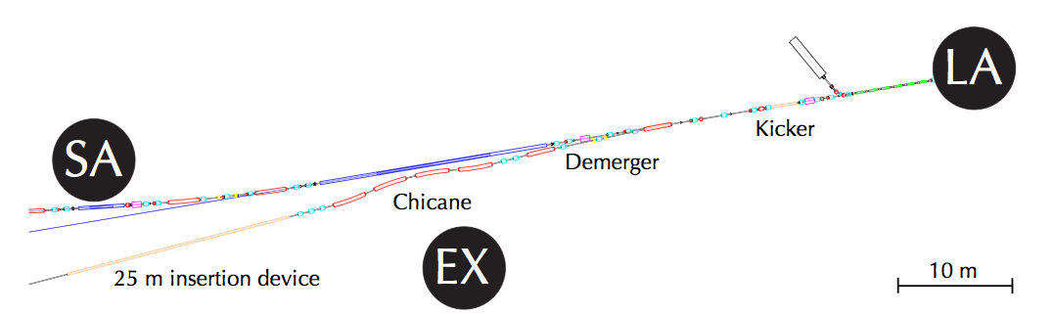
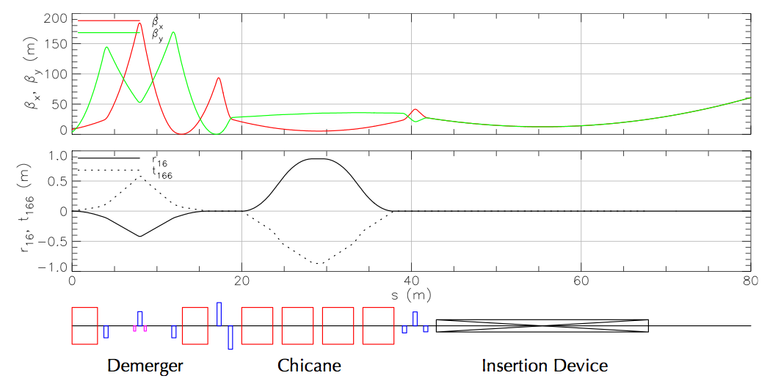
XFELO Options in the Cornell ERL
The design also allows for an extracted beamline (EX) that can compress 5 GeV bunches directly out of LB for accelerator physics experiments, including a 5 GeV XFELO.
Nonlinear optics in the Linac region allows for a very simple bunch compressor.
15

Slide 16
XFELO Options in the Cornell ERL
Calculated intra-cavity power of a hard x-ray FEL Oscillator driven by the Cornell ERL at 7 GeV. Shown is the saturation power as a function of transverse beam emittance and bunch duration. A bunch charge of 25 pC is assumed, and the undulator has 3000 periods with a period length of 15 mm. The radiation wavelength is 0.103 nm. We assume losses in the resonator on the order of 15% per round trip, including a 4% out-coupled power.
16

Slide 17
3. Summary
XFELO plans in future ERL facilities will boost the performance of these facilities.
Phased upgrade allows us to develop key technologies steadily.
Operating ERLs as multi-pass linacs is expected to be a cost-effective plan to realize the XFELO.
Harmonic lasing scheme may allow us to incorporate the XFELO into the return loop of ERL in KEK design.

