Slide 1
The Heavy Photon Search experiment in Hall B
Searching for a New Gauge Boson at Jlab
September 20-21, 2010
Takashi Maruyama
SLAC

Slide 2
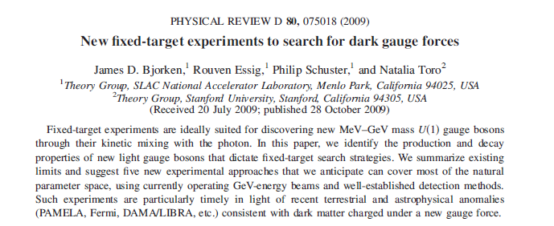
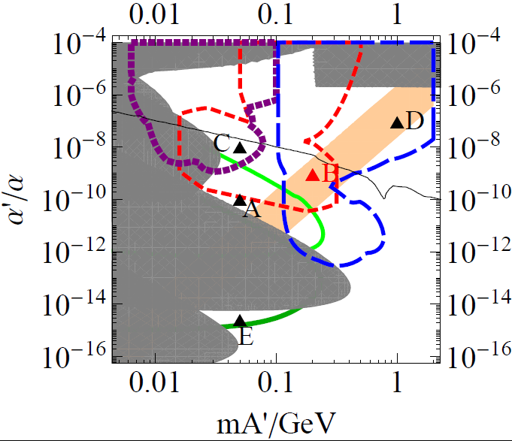
Springboard
Focus on Point B

Slide 3

HPS
HEAVY PHOTON SEARCH
A Proposal to Search for Massive Photons
at Jefferson Laboratory

Slide 4
Authors
W. Cooper, M. Demarteau
Fermi National Accelerator Laboratory, Batavia, IL 60510-5011
S. Bueltmann, L. Weinstein
Old Dominion University, Norfolk, VA 23529
A. Grillo
University of California, Santa Cruz, CA 95064
M. Holtrop, K. Slifer, S. Phillips, E. Ebrahim
University of New Hampshire, Durham, NH 03824
P. Schuster, N. Toro
Perimeter Institute, Ontario, Canada N2L 2Y5
R. Essig, C. Field, M. Graham, G. Haller, R. Herbst, J. Jaros (Co-Spokesperson), C. Kenney, T. Maruyama,
K. Moffeit, T. Nelson, H. Neal, A. Odian, M. Oriunno, R. Partridge, D. Walz
SLAC National Accelerator Laboratory, Menlo Park, CA 94025
S. Boyarinov, V. Burkert, A. Deur, H. Egiyan, A. Freyberger, F.-X. Girod,
V. Kubarovsky, S. Stepanyan (Co-Spokesperson)
Thomas Jefferson National Accelerator Facility, Newport News, VA 23606
A. Fradi, B. Guegan, M. Guidal, S. Niccolai, S. Pisano, E. Rauly, P. Rosier and D. Sokhan
Institut de Physique Nucleaire d'Orsay, 91405 Orsay, France
M. Khandaker, C. Salgado
Norfolk State University, Norfolk, VA 23504
N. Dashyan, N. Gevorgyan, R. Paremuzyan, H. Voskanyan
Yerevan Physics Institute, 375036 Yerevan, Armenia
M. Battaglieri, R. DeVitta
INFN, Sezione di Genova, 16146 Genova, Italy

Slide 5
Philip Schuster
Fixed Target Experiments are an
Ideal Hunting Ground

Slide 6
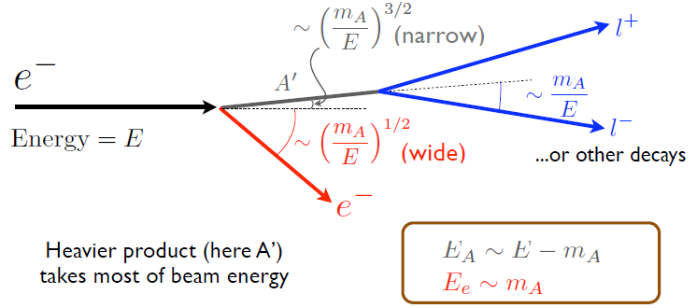
Philip Schuster
Unique Fixed-Target Kinematics

Slide 7
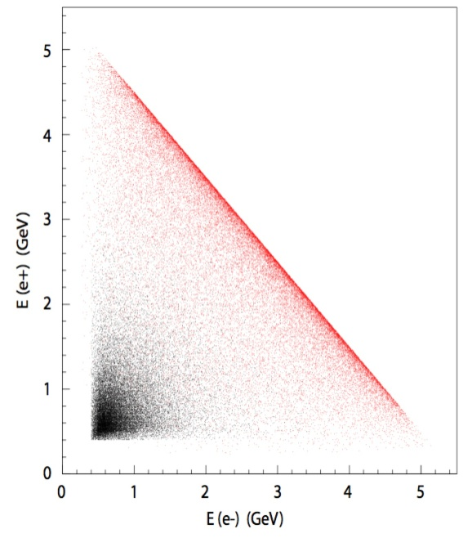
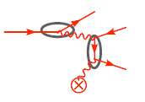
Backgrounds
Multiple Coulomb scattering in the target
Secondary particle production in the target
  Bremstrahlung
  Delta-rays
Thin target to reduce the rate
Magnetic field to remove low energy e-
Define dead zone
Pair conversion of bremstrahlung photon
  Two step process; the rate ~(target thickness)²
Target thickness is 0.25% X₀
  σ(γ→ee) << σ(γ*→ee)
A’
Virtual photon conversion and Bethe-Heitler processes

Slide 8

Heavy Photon Signatures
A heavy photon appears as an e⁺e⁻ resonance on a large background of QED tridents.
S/B depends on ε and resolution.
The heavy photon lifetime depends on mass and ε. For suitable values, a secondary decay vertex can be identified, distinguishing the A’ from the trident background.
γcτ ~ 1 mm (γ/10)(10⁻⁴/ε)² (100 MeV/m_{A’})
Trident Background
A’ Signal
∝ ε²/δm

Slide 9
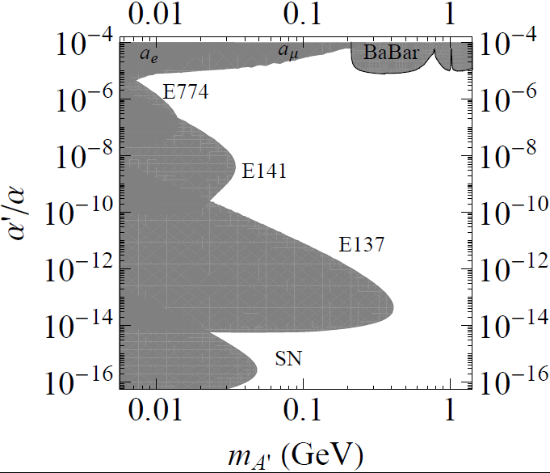
Present Limits
Prompt decays
cm-m decays
> m decays
Region preferred by
Astrophysics DM Models

Slide 10

Designing a 6 GeV Fixed Target Experiment
Detecting A’ Decays needs large, forward acceptance
Remember E_{A’} ≈ E_{beam}
θ_{A’} ≈ 0
θ_{decay} = m_{A’}/E_{A’} (~200 MeV/6 GeV = 33 mrad)
Accept θ_{decay} /2 < θ < 2 θ_{decay} ( 16 mrad < θ < 66 mrad )
Sensitivity to small cross-sections requires large luminosity
Need Q_{tot} ~ 1C for T=.25% X₀
Manageable occupancies require high duty cycle, fast electronics.
Need to spread out 1 C worth of angry electron backgrounds
as much as possible.
Jlab Bkg (data at 40 MHz) <<<<< SLAC Bkg (data at 100 Hz)
Good Mass and Vertex Resolution Needed for low momentum tracks
→ low mass, high precision detector

Slide 11
Layout of the HPS experimental setup behind the CLAS detector in Hall B
CLAS
Quads
M1
M2
M3
ECal
Muon
W target
M2/Tracker

Slide 12
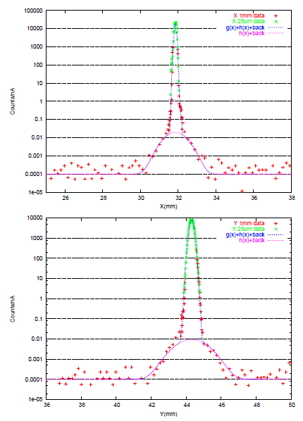
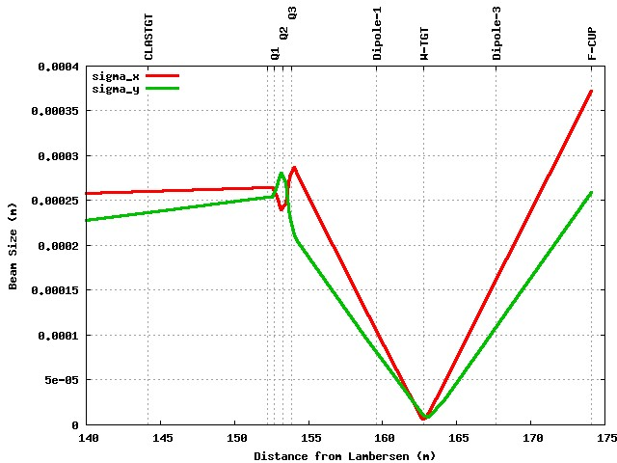
HPS Beamline
Excellent beam quality, stability
10 μm spots possible with additional quads
Beam Tail ~ 10⁻⁵
Constrains A’ decay and allows
significant background reduction
Hall B Optics
With New Quads
~40 μm
~10 μm

Slide 13
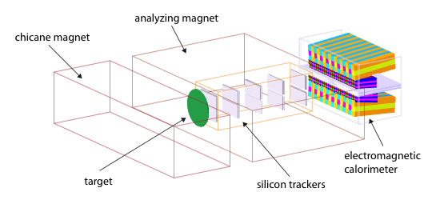
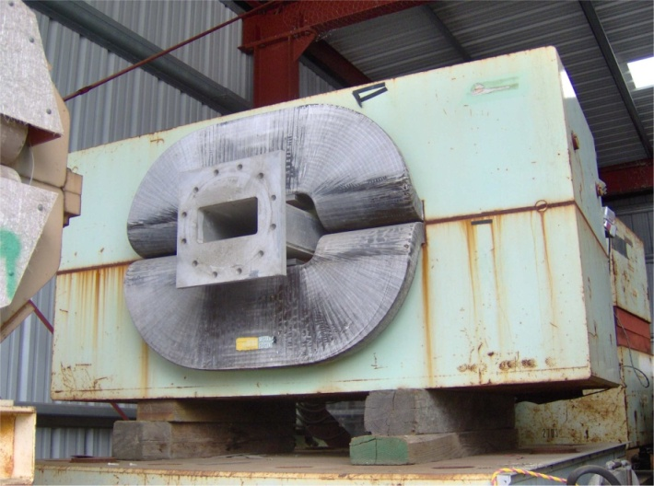
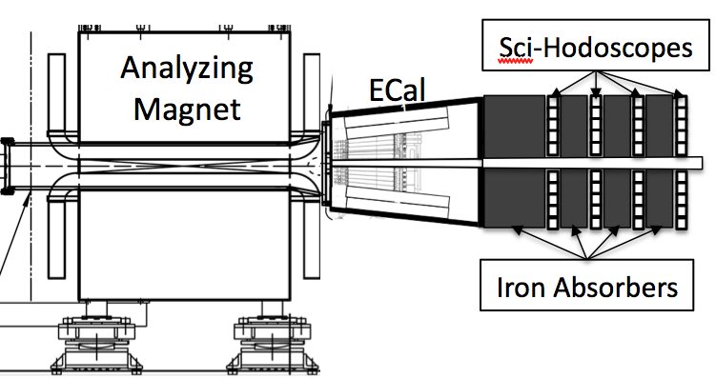
HPS Concept
Thin Target Close to Tracker for vertexing
Compact Si Tracker/Vertexer in 1T dipole
Fast, segmented Ecal for triggering, e ID
Muon detector for alternate trigger, muon ID
Split detectors vertically to avoid “Dead
Zone” occupied by primary beam, brem
photons, etc.

Slide 14
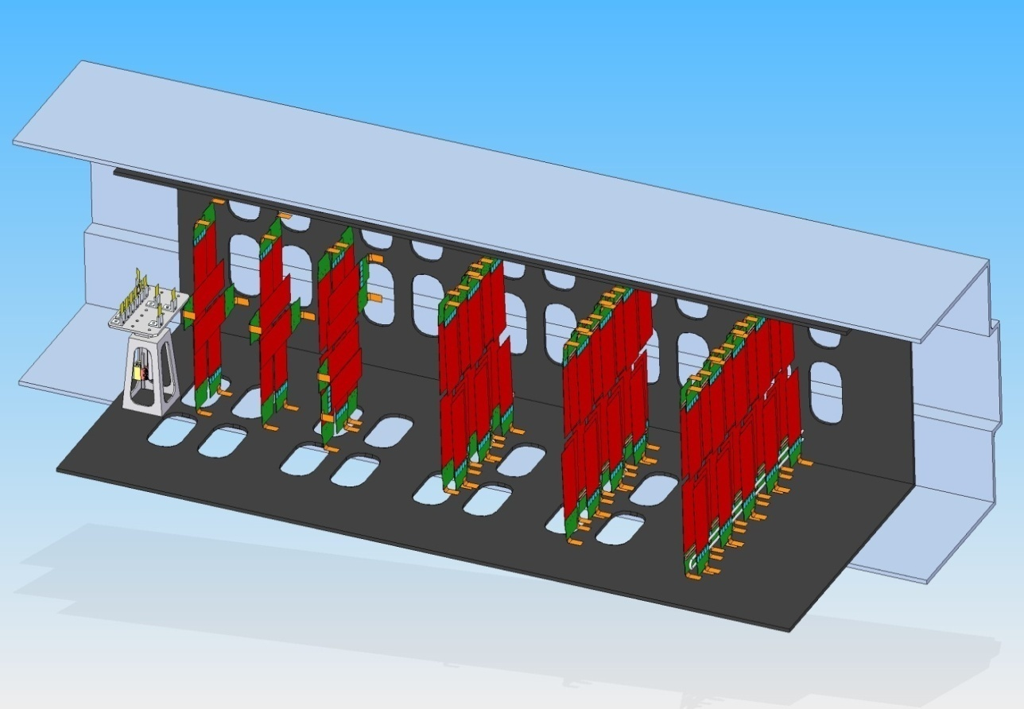
Set Up: Si Tracker/Vertexer (Nelson)
6 Layers of Si detectors mounted
on CF modules supports, split into
upper and lower planes:
Layers 1-3: VH, VH, VH
Precision vertexing
Layers 4-6: VS, VS, VS
Robust track finding and
precision momentum analysis
Entire assembly in vacuum to
minimize backgrounds
Rolls in/out for installation and
servicing.

Slide 15
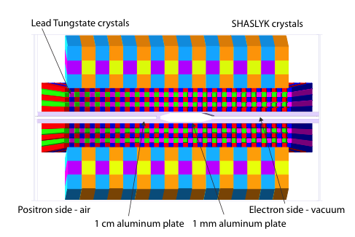
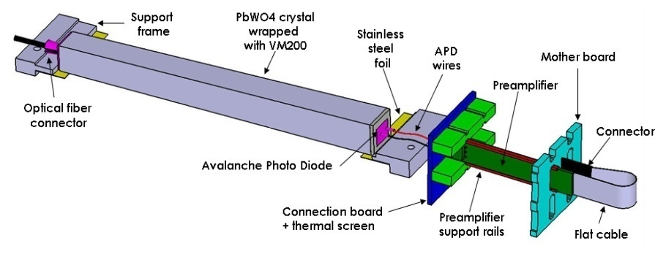
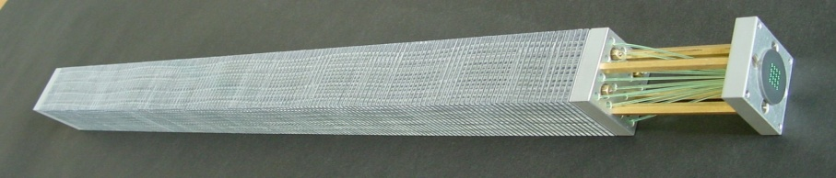
Set Up: Electromagnetic Calorimeter (Holtrop)
PbWO₄ Crystal
Shashlyk Tower
Inner cal uses 1.3 cm² PbWO₄ crystals, readout with APDs, at 250 MHz
Outer cal uses 4 cm² Pb/scint Shashlyk Towers, readout with PMTs
No crystals in “dead zone”
Beam, radiated photons, and off energy e- pass through in vacuum

Slide 16
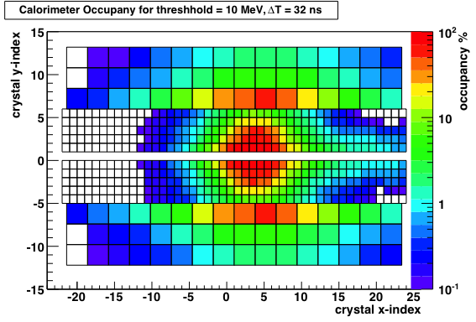
HPS Trigger (Holtrop)
GEANT4 simulations are used to study trigger occupancies and rates.
High occupancies for 32ns window,
10 MeV thresholds
Manageable occupancies for 8ns
window and 100 MeV thresholds
Cluster, Energy, and Geometry cuts
can produce a trigger rate < 20 kHz
Background trigger rate: 17 kHz
Trigger
≥2 clusters
0.5 < E_{1,2}< 4.4 GeV
E1 + E2 < 5.1 GeV
ΔE < 3.2 GeV
Co-planar

Slide 17
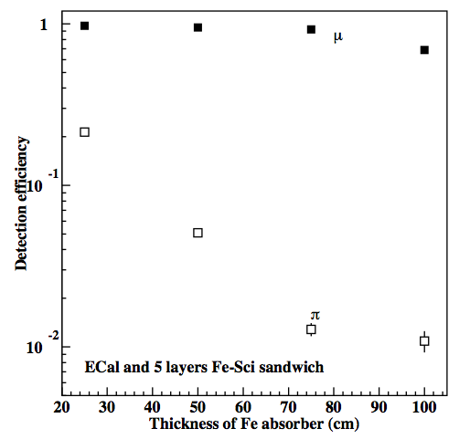
Set Up: Muon System (Holtrop)
Additional decay mode A’ →μ⁺μ⁻ for m_{A’} > 200 MeV
Provides independent trigger
and muon ID
Much reduced EM backgrounds
4 layers of 5 cm wide horizontal
scintillator strips, readout at both
ends with MAPMTs.
75 cm Fe absorber
~1% pion punchthrough
ε(π,μ) vs thickness Fe

Slide 18
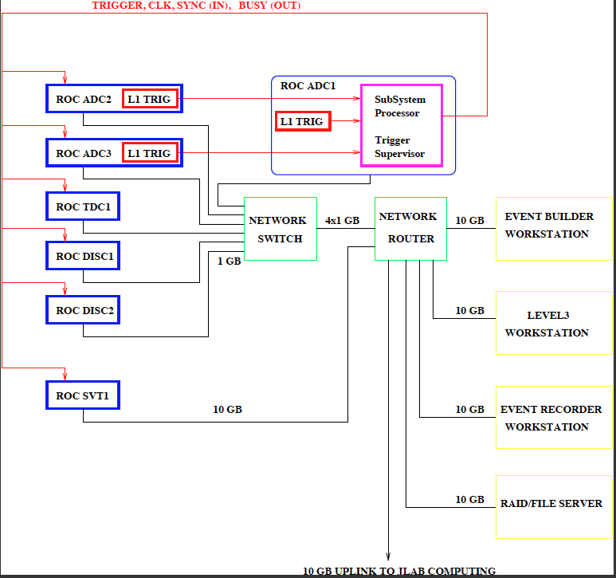
DAQ (Boyarinov)
Ecal and Muon data in 250 MHz FADCs
*Crate Trigger Processors receive
signal every 16ns and perform
cluster finding
*Subsystem Processor generates
final trigger decision
Tracker uses SLAC ATCA crates
*APV25 signals go to Readout
Boards every 25 ns
*Trigger Interface board accepts
and distributes Jlab trigger
*Cluster Interconnect Module
connects to Jlab DAQ
Level 1 Trigger <50 kHz
Level 3 Selection 1/10
Data Rate <100 Mbyte/s

Slide 19
HPS Reach: Bump Hunt and Vertex Search
(Graham)
1 month run @400nA
Bump hunt
HPS 5.5 GeV
Vertexing
HPS 3.3 GeV

Slide 20
Search for True Muonium
True muonium will decay to e⁺e⁻ with m=2m_{μ}, a decay length of γcτ=14mm, and kinematics just like those of the A’
.
The production cross section is low, but within reach. The dissociation cross section is large, so most dimuons dissociate before leaving the target.
For E_{beam}=5.5 GeV, 400nA beams, 3 x 10⁶ sec, expect
20 n=1 triplet states produced
2 events detected
Not good enough, but within reach with longer running, higher energies, and multiple targets. Under study.
An important test of QED made more topical by recent anomalies in the muonium Lamb shift result.

Slide 21
Conclusions
The vertexing capability has a potential of discovering heavy photon with cm ~ m decay length.
Together with bump-hunting, the A’ search can be extended into a large parameter region.
The experiment capitalizes on CEBAF’s excellent duty cycle and recent advances in very high rate detector readout technologies.

Slide 22
Backup

Slide 23
Hall B “Photon Dump” was also considered, but rejected.
100 nA, 6 GeV e-, post-radiator “primary beam”
Beam size ≤ 100 μm
Tight ~5m space
Beam must be directed to the dump.
  Chicane magnets
Parasitic run with CLAS
Photons
CLAS
Chicane
Dump
Possible location for heavy photon search
The degraded beam compromises the physics reach.

