Slide 1
Workshop on N* Excitations at High Q²
Welcome
to
Participants in the
Workshop on Nucleon Resonance Excitations at high Q² with CLAS12
Volker D. Burkert
Jefferson Lab

Slide 2
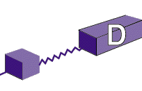
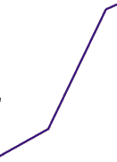
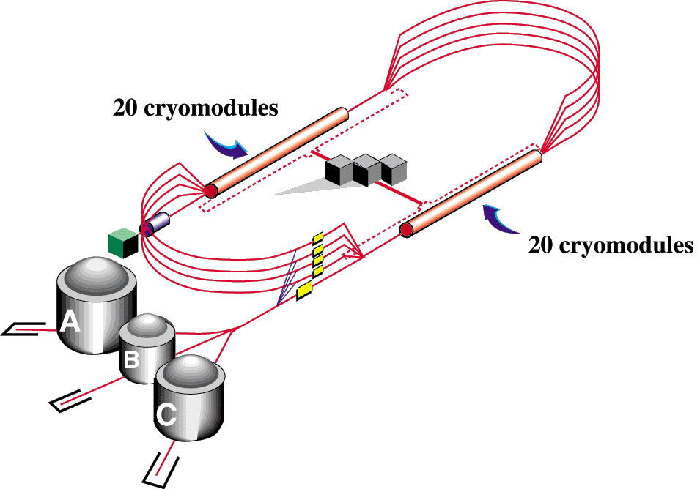
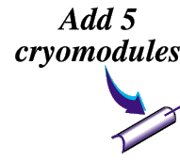
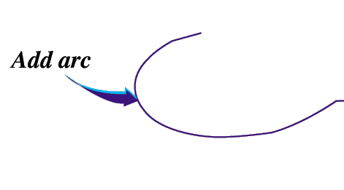
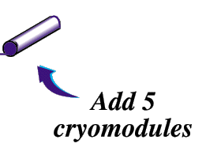
JLab Upgrade to 12 GeV
Add new hall
CHL-2
Enhance equipment in existing halls
Notes:
A major focus of hadron physics with electromagnetic probes is the determination of new multi-dimensional parton distribution functions in a large kinematics range. This requires experiments at high luminosity and at sufficiently high energy. For this the existing accelerator will be equipped with accelerating superconducting RF cavities with much higher gradients. The additional 5 cryo modules will provide the same energy boost as the 20 existing ones. In addition some of the lower gradient cryo modules will be refurbished

Slide 3
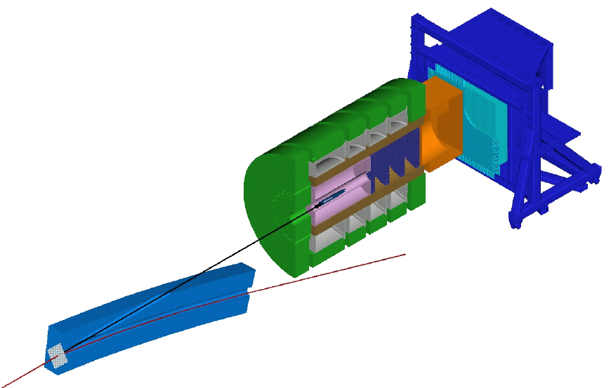
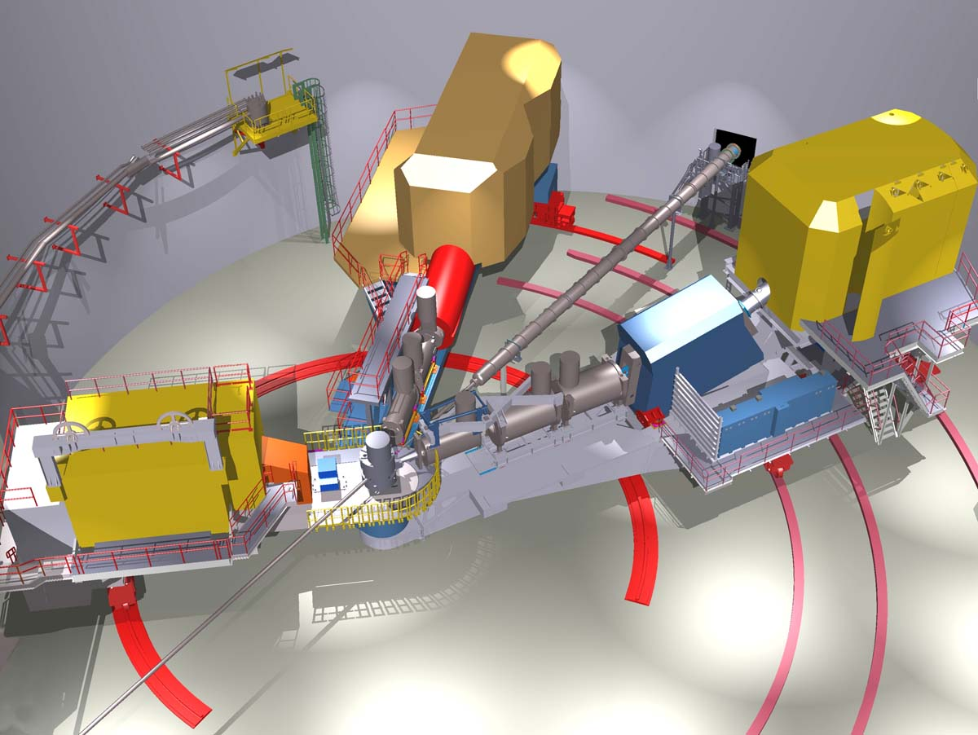
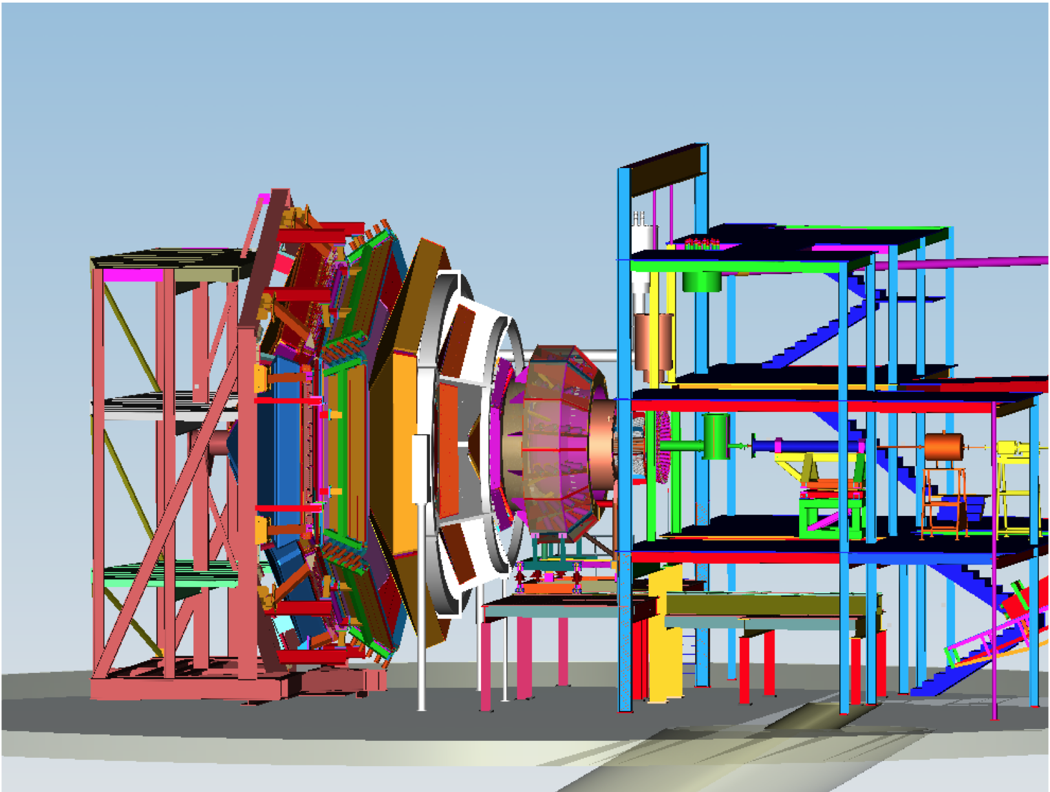
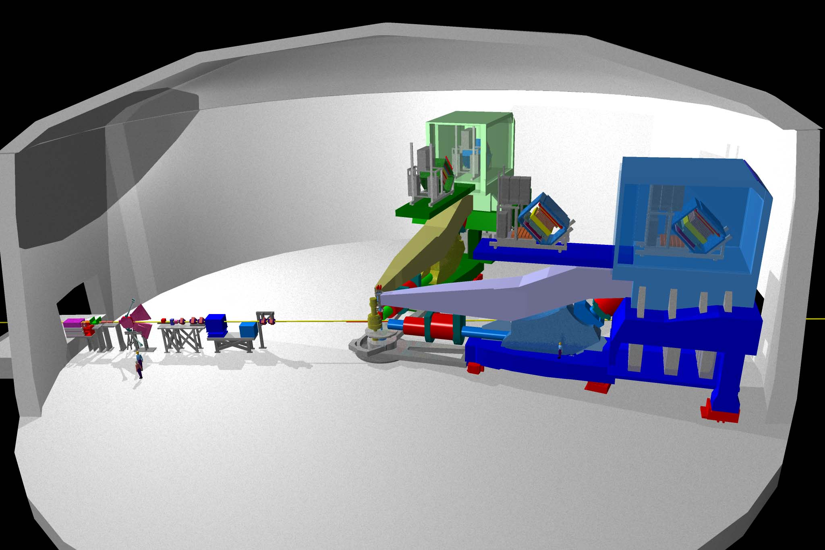
New Capabilities in Halls A, B, & C, and a New Hall D
D
C
9 GeV tagged polarized photons and a 4π hermetic detector
Super High Momentum Spectrometer (SHMS) at high luminosity and forward angles
B
A
High Resolution Spectrometer (HRS) Pair, and specialized large installation experiments
CLAS12 high luminosity, large acceptance.
Notes:
A new Hall will be constructed to house the GlueX detector, that will conduct a search for excited mesons with gluonic components, and the existing Halls will be upgraded with new equipment as well. Hall C will have an additional super high momentum spectrometer. Hall A will retain the existing spectrometers and provide space for new specialized equipment to address a variety of physics topics. Hall B will house the CLAS12 detector which is the focus of this of workshop. At 12 GeV JLab will be ideal for precision studies at large Bjorken x.

Slide 4
CLAS12 Assembly in Hall B
High luminosity 10³⁵cm⁻²s⁻¹
Particle identification to high momentum
Forward angle acceptance Θ ≥ 5º

Slide 5
CLAS12 - Institutions

Slide 6
CLAS12 - Institutions
Armenia:
- Yerevan Physics Institute, Yerevan
United States of America:
Argonne National Laboratory, Argonne, Il
California State University, Dominguez Hills, CA
- Catholic University of America, Washington, DC
- College of William and Mary, Williamsburg, VA
- Christopher Newport University, Newport News, VA
- Fairfield University, Fairfield, CT
Florida International University, Miami, FL
Hampton University, Hampton, VA
- Idaho State University, Pocatella, ID
- James Madison University, Harrisionburg, VA
- Norfolk State University, Norfolk, VA
- Ohio University, Athens, OH
- Old Dominion University, Norfolk, VA
- Rensselaer Polytechnic Institute, Troy, NY
- Temple University, Philadelphia, PA
- Jefferson Lab, Newport News, VA
- University of Connecticut, Storrs, CT
- University of New Hampshire, Durham, NH
- University, of Richmond, Richmond, VA
- University of South Carolina, Columbia, SC
University of Virginia, Charlottesville, VA
Chile:
- University Santa Maria, Valparaiso
France:
- Grenoble University, IN2P3, Grenoble
- Orsay University, IN2P3, Paris
- CEA Saclay, IRFU, Paris
Italy:
- INFN - LNF, Roma
- INFN - Genova, Genova
INFN - University Bari, Bari
INFN - University Ferrara, Ferrara
- INFN - ISS, Roma
- INFN - Roma II, Tor Vergata, Roma
Republic of Korea:
- Kyungpook National University, Daegu
Russian Federation:
- MSU, Skobeltsin Institute for Nuclear Physics, Moscow
- MSU, Institute for High Energy Physics, SiLab, Moscow
- Institute for Theoretical and Experimental Physics, Moscow
United Kingdom:
- Edinburgh University, Edinburgh
- Glasgow University, Glasgow
38 Institutions, November 2010

Slide 7
Science at the Forefront of Hadron Physics
Physics Focus | Approved experiments
3D Structure of the Nucleon GPDs & TMDs | 8
Parton Distribution Function | 2
Elastic & N* Resonance Transition Form Factors | 2
Hadron Spectroscopy as Probe of QCD | 1
Hadrons & Cold Nuclear Matter | 2
Science beyond the Standard Model | HPS test
Total | 15
Requested beam time | 1,320 days
Approved experiments correspond to 5-6 years of scheduled beam operation .

Slide 8
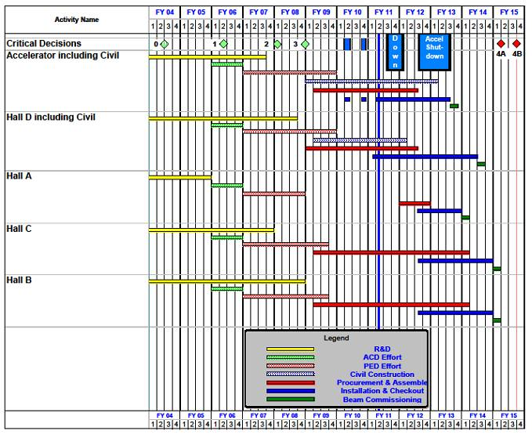
12 GeV Upgrade Schedule
Two short parasitic installation
periods in FY10
6-month installation
May – Oct 2011
12-month installation
May 2012 – May 2013
Hall A commissioning start
October 2013
Hall D commissioning start
April 2014
Halls B/C commissioning start
October 2014
Project Completion
June 2015
Notes:
Construction Phase started in September 2008.
Overall the project is being maintained, Project Management metrics such as Cost Performance Index and Schedule Performance Index are within the “green zone”.
Schedule emphasizes first Civil Construction, then Accelerator, then Physics Components.
Note that a difficulty that many projects in the past have faced is taking decisions for the Physics Components, R&D can go on forever. Designs need to be fixed and then executed.
Often better is the enemy of good (enough)

Slide 9
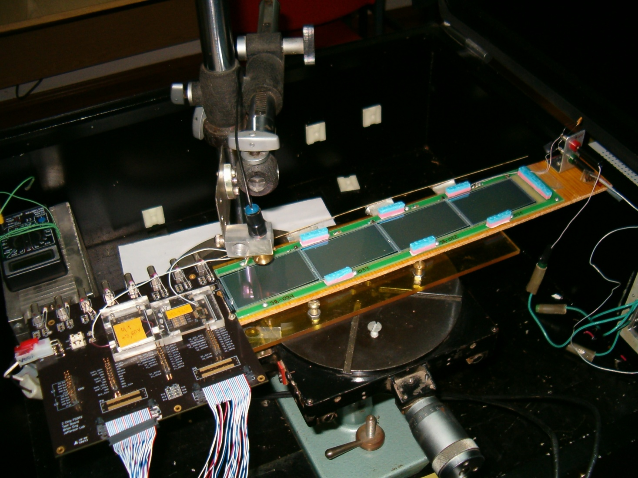
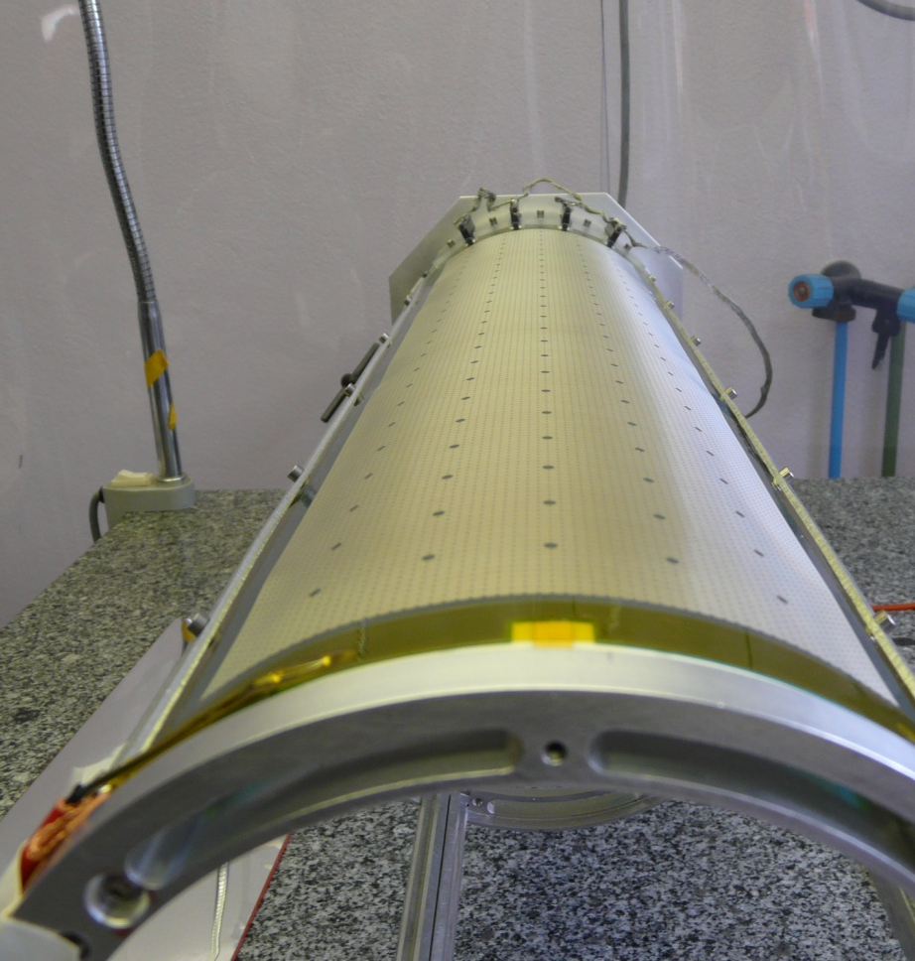
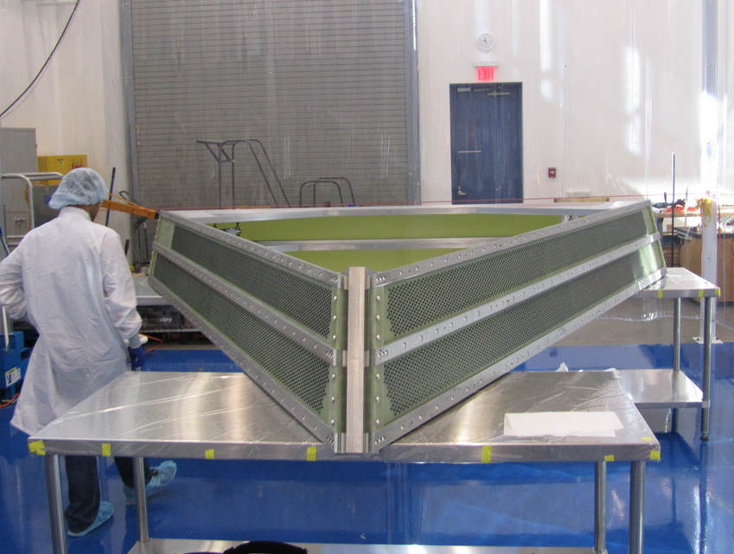
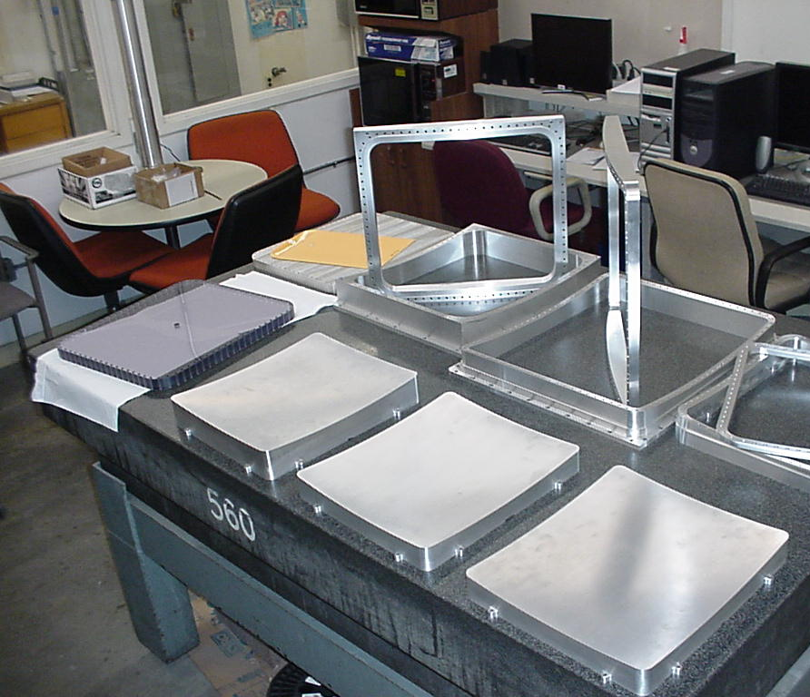
CLAS12 – Detectors in construction
Moscow State U.- SVT module
Saclay Micromegas tracker element
Wang NMR – Torus coil case
DC R2 frame in the ODU clean room
HTCC tooling for mirror fabrication

Slide 10
Welcome !

