Slide 1
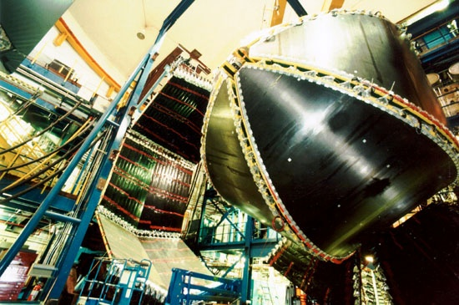
N* Electrocouplings from π⁺π⁻p Electroproduction with CLAS
V.I. Mokeev,
Jefferson Lab
N,N* quark core
FDSA 2014 Workshop

Slide 2
The Major Objectives in the Studies of N*-Structure
The experimental program on the studies of N* structure in exclusive meson electroproduction with CLAS seeks to determine:
  γ_{v}NN* electrocouplings at photon virtualities up to 5.0 GeV² for most of the excited proton states through analyzing major meson electro-production channels independently and in global multi-channel analyses;
  extend available knowledge on resonance hadronic decays, in particular, for the multi-meson final states.
Access to relevant degrees of freedom in the N* structure and their evolution with distance scale;
A unique source of information on different manifestations of the non-perturbative strong interaction in generating different excited nucleon states as relativistic bound systems of quarks and gluons.
Review papers:
I.G. Aznauryan and V.D.Burkert, Progr. Part. Nucl. Phys. 67, 1 (2012).
I.G. Aznauryan et al., Int. J. Mod. Phys. E22, 133015 (2013).
I.C. Cloët and C.D. Roberts Prog. Part. Nucl. Phys. 77, 1 (2014).

Slide 3
γ_{v}NN* Electrocouplings from the Exclusive Meson Electroproduction Data
Resonant amplitudes
Non-resonant amplitudes
e’
π, η, ππ,..
π, η, ππ,..
γ_{v}
e
*
N*,△
+
N
N’
N’
N
Real A_{1/2}(Q²), A_{3/2}(Q²), S_{1/2}(Q²)
or
G₁(Q²), G₂(Q²), G₃(Q²)
or
G_{M}(Q²), G_{E}(Q²), G_{C}(Q²)
I.G.Aznauryan and V.D.Burkert, Progr. Part. Nucl. Phys. 67, 1 (2012).
Definition of N* photo-/electrocouplings
employed in the CLAS data analyses :
Γ_{γ} stands for N* electro-
magnetic decay widths at
W=M_{N*} in real energy axis.
  Consistent results on γ_{v}NN* electrocouplings from different meson electroproduction channels and different analysis approaches demonstrate reliable extraction of these quantities.
  It remains to be seen how the aforementioned γ_{v}NN* electrocouplings are related to their values provided by amplitude analyses from the residues at the N* pole positions.

Slide 4
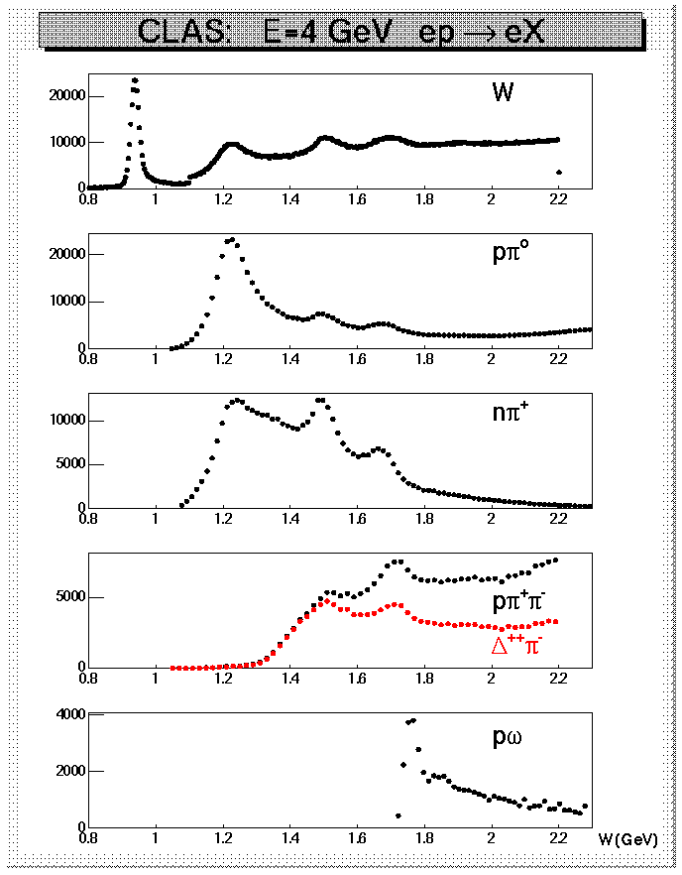

N* Electroexcitation in Exclusive Meson Electroproduction off Protons
Hadronic decays of prominent N*s at W<1.8 GeV
CLAS data on yields of meson
electroproduction at Q²<4 GeV²
State | Bran. Fract. to Nπ. | Bran. Fract. to Nη | Bran.Fract. Nππ
Δ(1232)3/2⁺ | 0.995
N(1440)1/2⁺ | 0.55-0.75 |  | 0.3-0.4
N(1520)3/2⁻ | 0.55-0.65 |  | 0.4-0.5
N(1535)1/2⁺ | 0.48±0.03 | 0.46±0.02
Δ(1620)3/2⁻ | 0.20-0.30 |  | 0.70-0.80
N(1650)1/2⁺ | 0.60-0.95 | 0.03-0.11 | 0.1-0.2
N(1685)5/2⁺ | 0.65-0.70 |  | 0.30-0.40
Δ(1700)3/2⁻ | 0.1-0.2 |  | 0.8-0.9
N(1720)3/2⁺ | 0.1-0.2 |  | > 0.7
π⁺π⁻p electroproduction is the preferential way to explore electrocouplings of high lying N* (M_{N*}>1.6 GeV) and to check electrocouplings from Νπ electroproduction in a independent analysis of this channel.

Slide 5
The CLAS Data on π⁺π⁻p Differential Cross Sections and their Fit within the Framework of Meson-Baryon Model JM
G.V.Fedotov et al., PRC 79, 015204 (2009), 1.30<W<1.56 GeV; 0.2<Q²<0.6 GeV²
M.Ripani et al., PRL 91, 022002 (2003), 1.40<W<2.30 GeV; 0.5<Q²<1.5 GeV²
full JM calc.
π⁺Δ⁰
ρp
π⁺ N⁰(1680)5/2⁺
π⁻Δ⁺⁺
2π direct
π⁺N⁰ (1520)3/2⁻

Slide 6
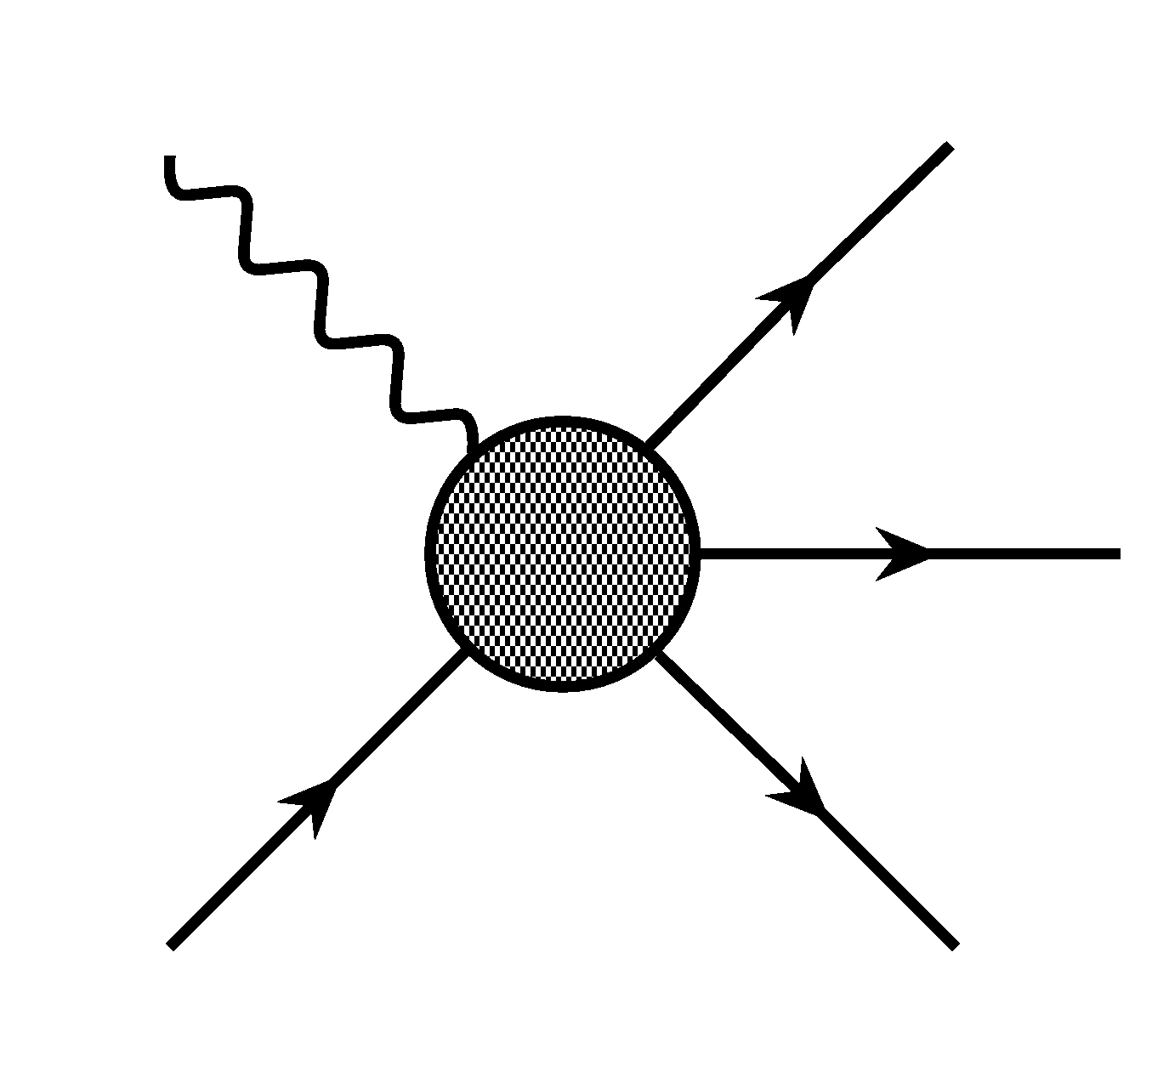
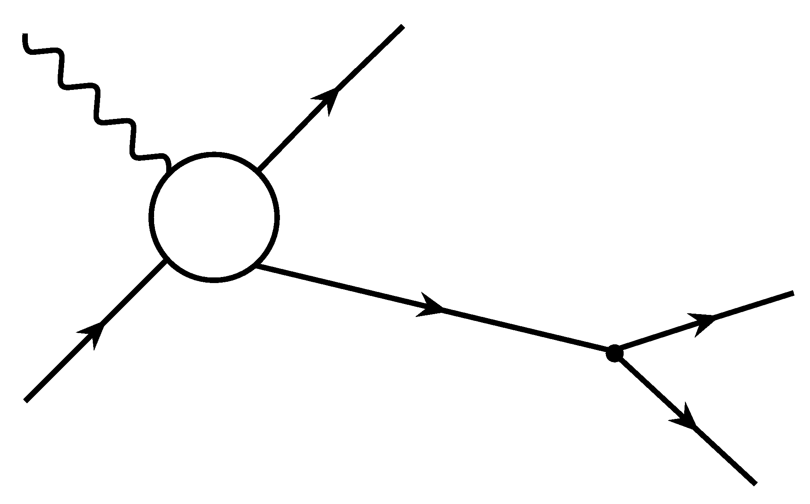
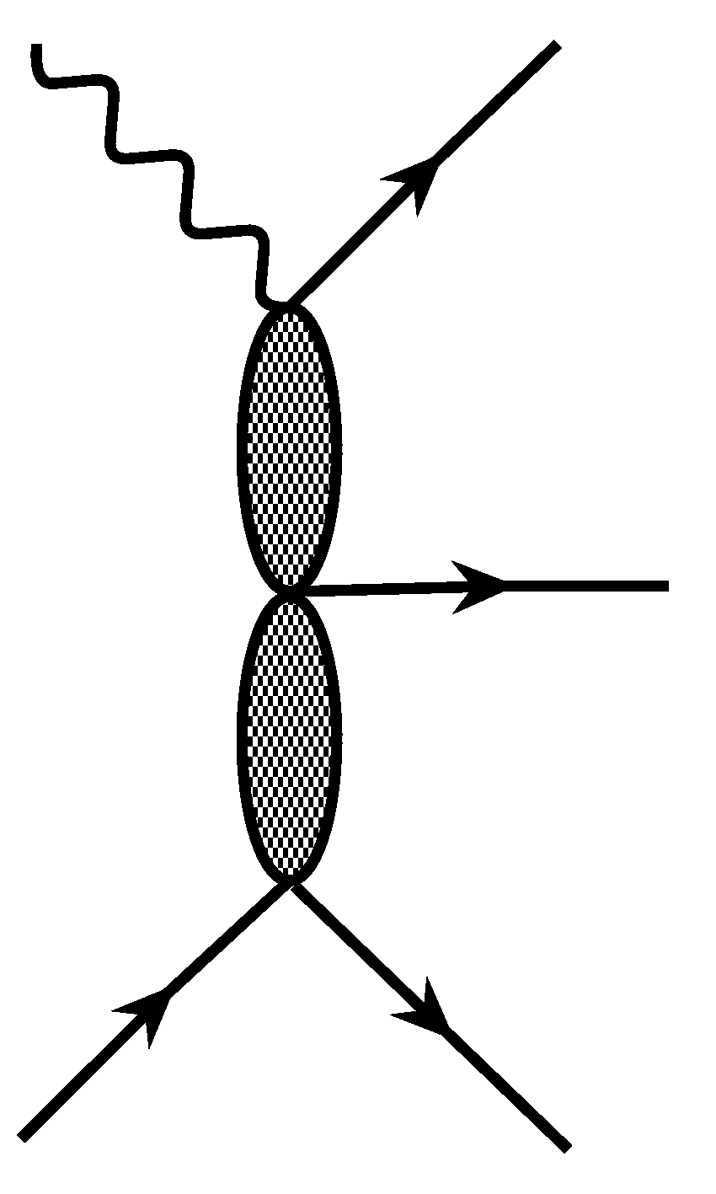
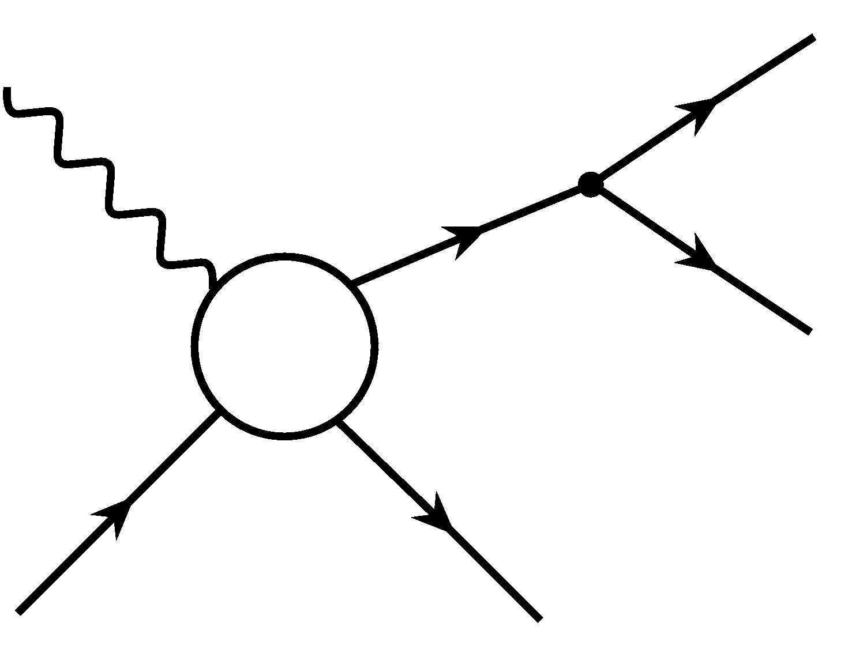
JM Model Analysis of π⁺π⁻p Electroproduction
Major objectives: extraction of γ_{v}NN* electrocouplings and πΔ, ρp decay widths
γ
π⁻
γ
π^{−/+}
Δ^{++/0} (1232)3/2⁺, N⁰ (1520)3/2⁻,
Δ⁺⁺ (1600)3/2⁺, N⁰(1680)5/2⁺
π⁺
=
seven channels with
unstable intermediate
meson/baryon and direct
π⁺π⁻p production;
N* contribute to πΔ
and ρp channels only;
unitarized Breit-
Wigner ansatz for
resonant amplitudes;
subtraction of partial
waves with resonance
contributions from non-
resonant amplitudes
(in progress Hall-B &
JPAC).
π
p
p
p’
γ
p’
γ
π⁻
π⁻, π⁺, …
ρ,σ
π⁺
+
+
π⁺, π⁻, …
p
p’
p
p’,p’, …
V.I. Mokeev, V.D. Burkert et al., (CLAS Collaboration) Phys. Rev. C86, 035203 (2012).
V.I. Mokeev, V.D. Burkert et al., Phys. Rev. C80, 045212 (2009).
Notes:
Last diagram 1&2) meson meson 3) meson baryon exchange bubbles, more generally 2q and 3q exchange.

Slide 7
Unitarized Breit-Wigner Ansatz for Resonant Amplitudes
Resonant amplitude :
Inverse of the JM unitarized N* propagator:
N*_{α}
N*_{α}
diagonal
N*_{α}
N*_{β}
Off-diagonal transitions incorporated into the full resonant amplitudes of the JM model:
off-diagonal
N(1535)1/2⁻ ↔ N(1650)1/2⁻
N(1520)3/2⁻ ↔ N(1700)3/2⁻
3/2⁺(1720) candidate ↔ N(1720)3/2⁺
Full resonant amplitude of unitarized Breit-Wigner ansatz is consistent with restrictions imposed by a general unitarity condition. See details in Ref. 1 in slide # 6

Slide 8
Non-Resonant Contributions to πΔ Channels
Minimal set of current conserving
Born terms:
Analytical expressions for the Born terms can be found in Ref. 2 on slide #6.
Born terms were reggeized, current conservation was kept,
and extra contact term was
added to account for other
contributions (See Ref. 2 on
slide # 6).
contact
pion in flight
nucleon term
delta in flight
Effective FSI treatment in πΔ channels within the framework of the absorptive
ansatz (M.Ripani et al., Nucl Phys. A672, 220 (2000)).
Request for theory support : evaluation of the FSI in πΔ and ρp meson-baryon channels employing coupled channel approaches capable to account for 3-body FSI .

Slide 9
Eliminating Double Counting in πΔ Amplitudes
The recent updates proposed by A.P.Szczepaniak and M.R.Pennington
γ
π
γ
π
N*,Δ*
R
p
Δ
p
Δ
The contributions from all N*,Δ* resonances to s-channel and t-channel are dual
(G.Veneziano, Nuovo Cimento 57A, 190 (1968))
Possibility for double counting of resonant contributions to s-channel and
π-Regge-trajectory.
Prescription to eliminate double counting:
Subtract the partial waves originated by reggeized π-in-flight term with total angular momenta equal to spins of N*s contributing to s-channel.
At W<1.8 GeV, where only N*-states of spins <7/2 contribute, the partial waves of total angular momenta J=1/2,3/2,5/2 originated by reggeized π-in-flight-term were subtracted.

Slide 10
Subtraction Procedure employed for πΔ Amplitudes in the JM Model
Reggeized π-in-flight term f_{λμ Rπ} and full unsubtracted Born amplitude f_{λμ} were decomposed
over PW’s of total angular momenta J :
Full Born term amplitudes implementing subtraction, ISI & FSI :
The contributions to the Born terms from PWs with J>5/2 f_{λμ}^{rest} are not affected by
subtraction and ISI & FSI
The prospect: Updated subtraction procedure under development by JPAC capable to provide amplitude
consistent with the restrictions imposed by analiticity and unitarity for physical and unphysical
regions.

Slide 11
Studies of the Subtraction Procedure for the Born Terms in π⁻Δ⁺⁺ Channel
Full Born terms:
σ _{integ,} mcbn
Q²=0.65 GeV²
after subtraction
before subtraction
Born terms, PW’s J=1/2,3/2,5/2:
after subtraction
before subtraction
Reggeized π-in flight PW’s, J=1/2,
3/2,5/2:
after subtraction
before subtraction
Born terms PW’s J>5/2
W, GeV
Impact of the subtraction procedure decreases with W reflecting growth of the
contributions from PW’s of J>5/2, which are not affected by subtraction.

Slide 12
Impact of Subtraction Procedure on the Data Description
Fully integrated γ_{v}p→π⁺π⁻p cross sections
σ _{integ,} mcbn
σ _{integ,} mcbn
Q²=0.95 GeV²
σ _{integ,} mcbn
Q²=1.30 GeV²
Q²=0.65 GeV²
Full π⁺π⁻p :
W, GeV
W, GeV
W, GeV
π⁻Δ⁺⁺ full :
Preferential areas for the N* studies in π⁺π⁻p
electroproduction
after subtraction
after subtraction
before subtraction
before subtraction
π⁻Δ⁺⁺ background :
after subtraction
extra contact
term in π⁻Δ⁺⁺ :
before subtraction
The impact of the subtraction procedure is maximal at W<1.6 GeV
and decreases with W and Q²

Slide 13
Direct 2π Production Mechanisms in the Current Version of the JM Model
Examples of the CLAS data description achieved
employing the direct 2π production mechanisms
depicted above can be found on slide #5
The details on amplitude paramete-
rization are in Ref 2, slide #6.

Slide 14
Direct 2π Production Amplitudes: Current Status and Future Developments
phase implementation allowed
us to improve description of all
differential cross sections,
in particular α−angular
distributions
Possible future improvements:
explore opportunity to
replace phenomenological
parameterization by the
double-Regge limit of B₅
Veneziano model allowing
us to decrease the number of
fit parameters;
develop the procedure for
subtraction of the partial waves
which are dual to resonances in
s-channel from direct 2π produc-
tion amplitudes
Support from JPAC is needed.
phases=0
phases fit to the data
W=1.51 GeV
Q²=0.65 GeV²
W=1.51 GeV
Q²=0.65 GeV²
W=1.54 GeV
Q²=0.65 GeV²
W=1.54 GeV
Q²=0.65 GeV²
the color code is the same as on slide #5

Slide 15
Charting Meson-Baryon Mechanisms of the JM Model
Q²=0.95 GeV²
Q²=1.30 GeV²
Q²=0.65 GeV²
π⁺D₁₃(1520)
ρp
2π direct
π⁻Δ⁺⁺
π⁺Δ⁰
π⁺F₁₃(1680)
π⁻Δ⁺⁺ meson-baryon channel accounts for the major part of π⁺π⁻p electroproduction cross section. Relative resonant contribution to π⁻Δ⁺⁺ channel increases with Q².
2π direct production decreases substantially at W from 1.5 to 1.7 GeV offering an indication for sizable final hadronic interactions between the π⁺π⁻p final state and others open meson-baryon channels.
πΔ, ρp-amplitudes decomposed over PW’s of angular momenta J can be provided from the data fit.
The request for reaction theory: guidance for the development of analytical continuation of πΔ , ρp-amplitudes allowing us to extract resonance electrocouplings from residues at the resonance pole positions.

Slide 16
Resonant /Non-Resonant Contributions from the Fit of π⁺π⁻p Electroproduction Cross Sections within the JM Model
W=1.51 GeV, Q²=0.38 GeV²
W=1.51 GeV, Q²=0.43 GeV²
Reliable isolation of the resonant cross sections is achieved
full cross sections
within the JM model
resonant part
non-resonant part

Slide 17
Electrocouplings of Low-Lying Resonances - Impact of the Subtraction Procedure
Resonance electrocouplings
obtained:
N(1440)1/2⁺
S_{1/2}
N(1440)1/2⁺
A_{1/2}
employing subtraction - black
without subtraction - blue
N(1520)3/2⁻
A_{1/2}
N(1520)3/2⁻
S_{1/2}
N(1520)3/2⁻
A_{3/2}
The subtraction procedure does not change γ_{v}NN* electrocouplings. CLAS data allow
credible isolation of resonance contributions within the framework of the JM model.

Slide 18
γ_{v}NN* Electrocouplings from Nπ and π⁺π⁻p Electroproduction
CLAS data:
S_{1/2}
N(1440)1/2⁺
Nπ
2009
π⁺π⁻p
2012
π⁺π⁻p
prelim.
A_{1/2}
N(1440)1/2⁺
A_{3/2}
N(1520)3/2⁻
  Consistent values of low-lying resonance electrocouplings determined in independent analyses of Nπ and π⁺π⁻p exclusive channels strongly support:
  reliable electrocoupling extraction;
  capabilities of the reaction models to obtain resonance electrocouplings in independent analyses of Nπ and π⁺π⁻p electroproduction channels.

Slide 19
Preliminary Δ(1700)3/2⁻ Electrocouplings from the π⁺π⁻p CLAS Data
Nππ CLAS
preliminary
N* hadr. coupl.
are varied
fixed D(1700)3/2⁻
hadr. couplings
Nπ Q²=0,
CLAS
Nπ world
Δ(1700)3/2⁻
BF(Nππ): 80-90%
A_{1/2}
V.D.Burkert,
et al., PRC
67, 035204
(2003).
M.Dugger,
et al., PRC 79,065206
(2009).
A_{1/2}*1000 GeV^{-1/2}
Studies of π⁺π⁻p electroproduction for the first
time provided accurate information on Δ(1700)3/2⁻
electrocouplings.
They were determined varying both
electrocouplings and πΔ , ρp hadronic decay
widths of all excited states contributing to
the third resonance peak.
A_{3/2}
A_{3/2}*1000 GeV^{-1/2}
Computed from N(1520)3/2⁻ and N(1535)1/2⁻
electrocouplings within the SQTM approach:
I.G. Aznauryan and V.D. Burkert,
Progr. Nucl. Part. Phys. 67, 1 (2012).

Slide 20
Status and Prospects on Extraction of High-Lying N* Electrocouplings from CLAS Data
Preliminary
Δ(1620)3/2⁻
S_{1/2}
Δ(1700)3/2⁻
A_{1/2}
Preliminary
N(1720)3/2⁺
A_{3/2}
Independent fits in different W-intervals:
green: 1.46<W<1.56 GeV
magenta: 1.56<W<1.66 GeV
red: 1.61<W<1.71 GeV
blue: 1.66<W<1.76 GeV
black: 1.71<W<1.81 GeV
consistent electrocoupling values offer
sound evidence for their reliable extraction.
π⁺π⁻p electroproduction channel provided first preliminary results on Δ(1620)1/2⁻, N(1650)1/2⁻, N(1680)5/2⁺, Δ(1700)3/2⁻ , and N(1720)3/2⁺ electrocouplings with good accuracy.
Prospect: evaluation of high-mass N* electrocouplings
from independent analyses of KY channels.
Reaction models capable of extracting resonance
electrocouplings from the fit of unpolarized cross
sections and polarization asymmetries measured in
KY electroproduction are needed !
.

Slide 21
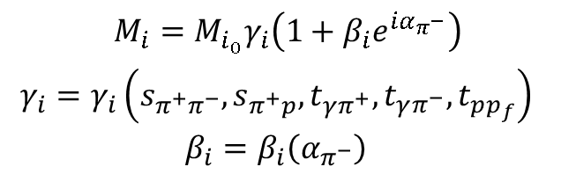
Preliminary Results on π⁺π⁻p Photoproduction
E.N.Golovach, MSU
Only available data on:
9 one-fold differential cross sections;
28 correlated two-fold differential cross
sections
at W from 1.61 GeV to 2.84 GeV
Photoproduction data description requires 3-body final
state interaction parameterized as :
$$M_{i}=M_{i_{0}}γ_{i}\left(1+β_{i}e^{iα_{π^{−}}}\right)$$
$${\begin{aligned}γ_{i}=γ_{i}\left(s_{π^{+}π^{−}},s_{π^{+}p},t_{γπ^{+}},t_{γπ^{−}},t_{pp_{f}}\right) \\ β_{i}=β_{i}\left(α_{π^{−}}\right)\end{aligned}}^{}$$
i= π⁻Δ⁺⁺, π⁺Δ⁰, ρp, π⁺N(1520)3/2⁻, π⁻Δ⁺⁺(1600)3/2⁺,
π⁺N(1680)5/2⁺, σp, 2π direct
The factors γ_{i} and β_{i} were inferred from the data.
Data error bars: quadratic sum of statistical and systematical
σp
legend for other lines is the same on slide #5
Most detailed information on the contributing mechanisms from the experimental data.
Comparison of the results on N* parameters from JM and BoGa models will offer valuable cross checks
Studies of 3/2⁺(1720) candidate state signal in combined analysis π⁺π⁻p photo- and electroproduction.
Improve knowledge on photo-, πΔ and ρp couplings of high-lying resonances (M_{N*}>1.6 GeV).

Slide 22
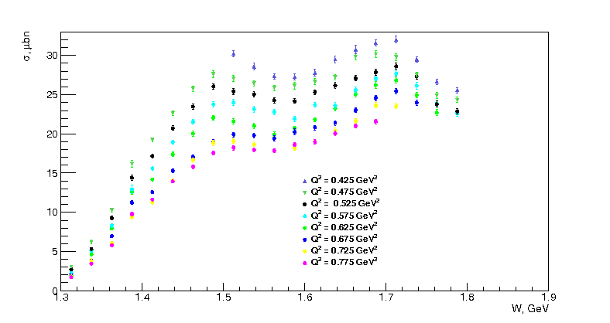
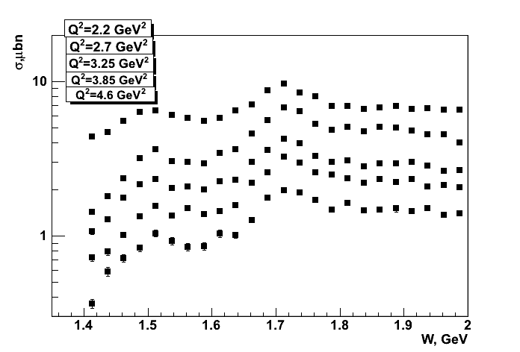
Extension of the CLAS π⁺π⁻p Electroproduction Data
Fully integrated π⁺π⁻p electroproduction cross
sections off protons
Nine 1-fold differential cross sections are
available In each bin of W and Q² shown in
the plots.
Resonance structures are clearly seen at
W ~1.5 GeV and ~1.7 GeV at 0.4< Q²< 5.0 GeV²
(red lines) .
R.W.Gothe,
G.V.Fedotov,
USC
Analysis objectives:
Extraction of γ_{v}NN* electrocouplings and πΔ ,
ρp decay widths for most N*s in mass range up
to 2.0 GeV and 0.4< Q²< 5.0 GeV² within the
framework of JM-model.
Exploration of the signals from 3/2⁺(1720)
candidate-state (M.Ripani et al., Phys. Rev. Lett
91, 022002 (2003)) with a goal to achieve decisive
conclusion on the state existence and structure.
First results on electrocouplings of high-lying
(M_{N*}>1.6 GeV) orbital nucleon excitations and
high-lying parity partners.
E.L. Isupov, K.Hicks
MSU/Univ. of Ohio

Slide 23
Conclusions
High quality π⁺π⁻p electroproduction data from the CLAS allowed us to develop the data-driven phenomenological model JM for extraction of resonance electrocouplings and πΔ, ρp hadronic decay widths from fit of all available observables. Good data description (χ²/d.p.<2.8) and credible isolation of resonance contribution was achieved at W<1.8 GeV and Q²<1.5 GeV² .
Consistent electrocoupling values for the transitions to N(1440)1/2⁺ and N(1520)3/2⁻ states obtained in independent analyses of Nπ/Nππ exclusive channels demonstrated capabilities of the JM model for reliable extraction of N*-parameters in independent analysis of π⁺π⁻p electroproduction data.
Preliminary results on electrocouplings for Δ(1620)1/2⁻, N(1650)1/2⁻, N(1680)5/2⁺, Δ(1700)3/2⁻, and N(1720)3/2⁺ resonances from π⁺π⁻p electroproduction data at 0.5<Q²<1.5 GeV² have become available for the first time.
The data on resonance electrocouplings of different N* states in mass range <1.8 GeV open up promising new opportunities for the further development of Dyson-Schwinger Equations of QCD, Lattice QCD and advanced quark models with inputs from QCD field theory approaches for description of these resonance electrocouplings.

Slide 24
Outlook
Support from the amplitude analysis experts is needed for the further development of the JM model allowing us to:
a) determine N* parameters at the resonance pole positions employing analytical
continuation of πΔ and ρp amplitudes extracted from fit of observables;
b) explore the possibility to incorporate the double-Regge limit of B₅ Veneziano
model for description of direct 2π production mechanisms reducing the number of
the fit parameters;
c) get rid of double counting between resonant contributions in s-channel and dual
t-channel processes.
Future analyses of the CLAS Nπ, π⁺π⁻p and KY photo/electroproduction data will allow electrocouplings to be obtained for all prominent N* states in mass range up to 2.0 GeV at photon virtualities Q²<5.0 GeV². Reaction models for extraction of N* parameters from KY electroproduction data are urgently needed.

Slide 25
Back up

Slide 26
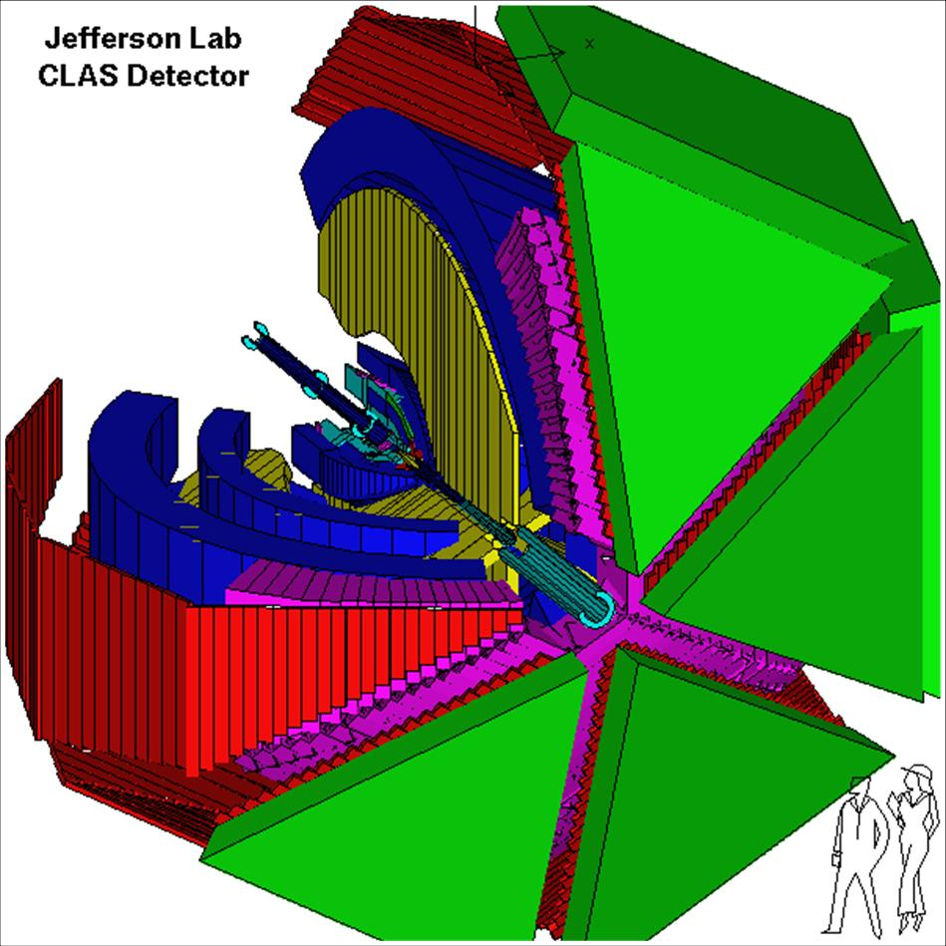
CEBAF Large Acceptance Spectrometer
Torus magnet
6 superconducting coils
Large angle calorimeters
Lead/scintillator, 512 PMTs
Liquid D₂ (H₂)target +
γ start counter; e minitorus
Gas Cherenkov counters
e/πι separation, 216 PMTs
Drift chambers
argon/CO₂ gas, 35,000 cells
Time-of-flight counters
plastic scintillators,
684 PMTs
Electromagnetic calorimeters
Lead/scintillator, 1296 PMTs
The unique combination of the CEBAF continuous electron beam and the CLAS detector makes Hall-B@JLAB the only facility operational worldwide, that is capable of measuring unpolarized cross sections and polarization asymmetries of most exclusive meson electroproduction channels with substantial contributions at W<3.0 GeV and Q²<5.0 GeV².
V.I.Mokeev, NSTAR 2013 Workshop Peniscola, Spain, May 27-30, 2013

Slide 27
Summary of the CLAS Data on Exclusive Meson Electroproduction off Protons in N* Excitation Region
Hadronic final state | Covered W-range, GeV | Covered Q²-range, GeV² C | Measured observables
π⁺n | 1.1-1.40 1.1-1.55 1.1-1.7 | 0.15-0.40 0.3-0.6 1.7-4.2 | dσ/dΩ dσ/dΩ dσ/dΩ, A_{b}
π⁰p | 1.1-1.40 1.1-1.7 1.1-1.7 | 0.15-0.40 0.4-0.7 0.75-6.0 | dσ/dΩ dσ/dΩ, A_{b},A_{t},A_{bt} dσ/dΩ
ηp | 1.5-2.0 | 0.2-4.0 | dσ/dΩ
K⁺Λ | 1.65-2.35 1.65-2.35 | 0.65-2.55 1.4-2.6 | dσ/dΩ P’
K⁺Σ⁰ | 1.7-2.1 1.8-2.5 1.7-2.6 | 0.5-2.55 1.5-3.50 1.8-3.50 | dσ/dΩ P’ dσ/dΩ
π⁺π⁻p | 1.3-1.6 1.4-2.1 | 0.2-0.6 0.5-1.5 | Nine 1-fold differential cross sections
dσ/dΩ−CM angular
distributions
A_{b},A_{t},A_{bt}-longitudinal
beam, target, and
beam-target asym-
metries
P’ –recoil polarization
of strange baryon
The data are available in the CLAS Physics
Data Base:
http://depni.sinp.msu.ru/cgi-bin/jlab/db.cgi

Slide 28
Accounting for the ISI & FSI in πΔ Channels
Absorptive ansatz proposed in K.Gottfried, J.D.Jackson, Nuovo Cimento 34, 736 (1964) and developed for the use in the JM model in M.Ripani et al., Nucl Phys. A672, 220 (2000).
Non-resonant parts of πΔ amplitudes computed from
tree diagrams T^{J tree}_{λμ} are multiplied by the absorptive
factors in the initial an final states f^{J} _{ISI} , f^{J} _{FSI} :
Possible improvement: absorptive ansatz can be replaced by the results of coupled
channel analyses on the ratio R: πΔ (photo) electroproduction amplitudes accounting
for FSI T^{J full} _{πΔ} over their values computed from tree diagrams T ^{J tree} _{πΔ}:

Slide 29
Parameterization of Direct 2π Production Amplitudes Based on the CLAS Data Description.
W=1.49 GeV
W=1.51 GeV
data descriptions achieved
with 2π direct production mechanisms described as:
phase space
exchange mechaniss:
Q²=0.65 GeV²
Q²=0.43
GeV²
Q²=0.95 GeV²
Further improvements in description of direct
2π production mechanisms were implemented.
Contributions of 2π direct
production described by
exchange processes

Slide 30
Signals from N* states in the CLAS KY electroproduction data
D.Carman, private communication
Q²=1.8 GeV²
Q²=2.6 GeV²
Q²=3.45 GeV²
3/2 ⁻ 5/2⁻
(1950)
KΛ
the structures in W-dependencies of C_{l} –moments at the same W-values in all Q²-bins are consistent with the contributions from resonances of spin-parities listed in the plots
1/2 ⁺3/2⁺
(1850)
1/2⁺3/2⁺
(2000)
KΣ
reaction model(s) are needed
for extraction of N* parameters
from KY electroproduction
KΣ
3/2⁻5/2⁻
(2050)
W GeV

Slide 31
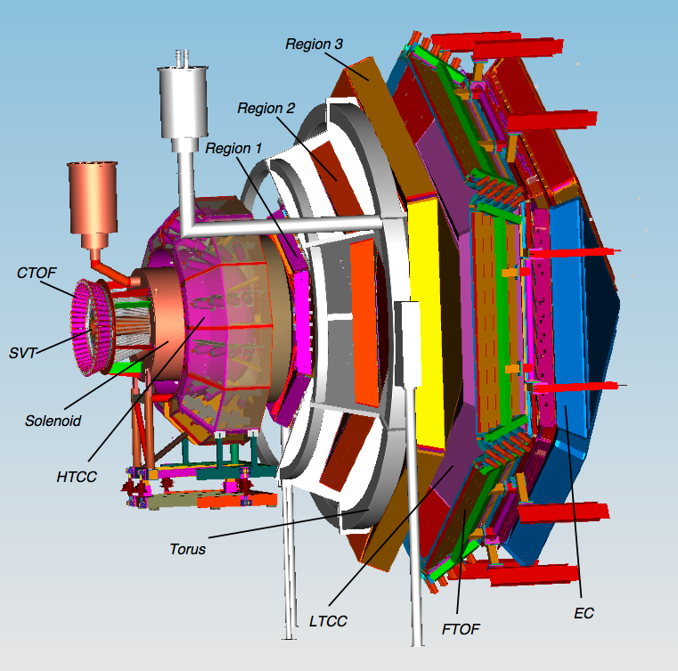
CLAS12
Central
Detector
CLAS12 supports a broad program in hadronic physics.
Plans to study excited baryons and mesons:
Search for hybrid mesons and baryons
Spectroscopy of Ξ* , Ω⁻
N* Transition form
factors at high Q².
Forward
Detector

