Slide 1
HADRON2015, Sep 15, 2015
Spectroscopy of Charmed Baryon Resonances at J-PARC
H. Noumi, RCNP, Osaka University
1. Introduction
2. High-p BL and CHARM Spectrometer
3. Missing Mass Spectroscopy of baryons w/ heavy flavors
  production and decay
  charmed and strange baryons
4. Summary

Slide 2

How Hadrons are formed?
High E
Low E
Current
Quark
$α_{s}=∞$
at Λ_{QCD}
Hadrons are hardly described from current quarks
Quarks drastically change themselves below Λ_{QCD}.
Notes:
“How hadrons are formed from quarks?” is a fundamental question in Hadron physics.
But the question is still difficult to answer even though the QCD is believed to be a principle that the strong interaction should be obeyed.
This is due to the non-perturbative nature of the strong interaction in low energy.
The coupling constant of the strong interaction becomes very large when close to the Lambda QCD, it becomes very hard to describe hadrons by solving the QCD equation in low energy, where quarks drastically change their nature.

Slide 3
Composite Quasi-Particle
High E
Low E
Effective DoF as building blocks of Hadrons
Confined in hadrons
Notes:
A variety of Effective Degrees of Freedom, such as diquarks and hadrons, are discussed for a long time to describe hadrons with the so-called exotic states.
If we call these EDoF as “Composite or Colored Quasi-Particles”, which are invented by Oka-san, they cannot be directly observed because they are confined in hadrons.
Hadron spectroscopy to look into more details of internal structure or motions of the composites in hadrons is important.

Slide 4
What we can learn from baryons with heavy flavors
q
qq
q
q
Q
Quark motion of “qq” is singled out by a heavy Q
  Diquark correlation
Level structure, Production rate, Decay properties
  sensitive to the internal quark(diquark) WFs.
Properties are expected to depend on a Q mass.
Notes:
Here, we could we can learn quark motions in baryons by introducing heavy flavors.
Particularly, a diquark correlation may be singled out by a heavy quark.
The nature of the quark motions is expected to be reflected to not only the level structure but also production rate and decay properties of excited states.
These properties are expected to depend on a quark mass systematically.

Slide 5



Schematic Level Structure of Heavy Baryons
λ and ρ motions split (Isotope Shift)
HQ spin multiplet （${\overset{⃑}{s}}_{HQ}±{\overset{⃑}{j}}_{Brown Muck}$）
$$\frac{{ℏω}_{ρ}}{{ℏω}_{λ}}=\sqrt{\frac{3m_{Q}}{2m_{q}+m_{Q}}} →\sqrt{3} (m_{Q}→ ∞)$$
(qq)
ρ
P-wave
ρ mode
q
Q
...
q
[qq]
λ mode
...
$${\overset{⃑}{s}}_{HQ}±{\overset{⃑}{j}}_{BM}$$
q
λ
Spin-dep. Int.
G.S.
Q
m_{Q} = m_{q}
m_{Q} > m_{q}
5
Notes:
When a quark is replaced by a heavy quark, the excited states split into two states, so called rho-mode and lambda-mode. The rho mode is a relative motion between a light quark pair. The lambda mode is a collective motion of the diquark. This is nothing but a so-called isotope shift. These states further form heavy quark multiplet by a nature of the heavy quark spin symmetry.

Slide 6
Lambda Baryons (P-wave)
strange
charm
bottom
Λ(1830, 5/2⁻)
Λ_{c}(2940, ??)
Λ(1690, ??)
Λ_{c}(2880, 5/2⁺)
Λ(1670, 1/2⁻)
Λ_{c} oｒ Σ_{c} (2765, ??)
Λ(1520, 3/2⁻)
Λ_{c}(2625, 3/2⁻)
Λ(1405, 1/2⁻)
Λ_{c}(2595, 1/2⁻)
Λ_{b}(5920, 3/2⁻)
Σ∗(3/2⁺)
Λ_{b}(5912, 1/2⁻)
Σ_{c}*(3/2⁺)
Σ_{b}*(3/2⁺)
Σ_{c}(1/2⁺)
Σ_{b}(1/2⁺)
Σ(1/2⁺)
Λ(GS)
Λ_{c}(GS)
Λ_{b}(GS)
Λ(1/2⁺)

Slide 7
Lambda Baryons (P-wave)
qq
ρ
λ
s
c
b
Q
Λ(1830, 5/2⁻)
ρ
Λ_{c}(2940, ??)
Λ(1690, ??)
Λ_{c}(2880, 5/2⁺)
Λ(1670, 1/2⁻)
ρ
Λ_{c} oｒ Σ_{c} (2765, ??)
Λ(1520, 3/2⁻)
λ
Λ_{c}(2625, 3/2⁻)
Λ(1405, 1/2⁻)
Λ_{c}(2595, 1/2⁻)
Λ_{b}(5920, 3/2⁻)
Σ∗(3/2⁺)
Λ_{b}(5912, 1/2⁻)
Σ_{c}*(3/2⁺)
Σ_{b}*(3/2⁺)
Σ_{c}(1/2⁺)
Σ_{b}(1/2⁺)
Σ(1/2⁺)
Λ(GS)
Λ_{c}(GS)
Λ_{b}(GS)
Λ(1/2⁺)
non-rel. QM:H=H₀ +V_{conf} +V_{SS}+V_{LS}+V_{T}
ρ−λ mixing (cal. By T. Yoshida)
Notes:
In fact, more detailed calculation based on the Constituent Quark mode has been made, where more generalized feature of diquark mode in baryon resonances can be seen, as shown in this figure.
This illustrates the level structure of excited states, particularly the rho/lambda-mode excited states as a function of the mass of heavy quark.
Six excited states of different diquark motions are moved as changing the heavy quark mass.
Here, one finds that the rho-lambda mode separation becomes clearer in heavier quark mass.
This point is important to extract information of diquark motions in baryons.
After we learn the diquark correlations in charmed baryons, we could understand lighter baryons much better.
This is our strategy…

Slide 8
Lambda Baryons (P-wave)
qq
ρ
λ
s
c
b
Q
Λ(1830, 5/2⁻)
ρ
Λ_{c}(2940, ??)
Λ(1690, ??)
?
Λ(1670, 1/2⁻)
ρ
Λ_{c}(2880, 5/2⁺)
Λ_{c} oｒ Σ_{c} (2765, ??)
Λ(1520, 3/2⁻)
λ
Λ_{c}(2625, 3/2⁻)
Λ(1405, 1/2⁻)
Λ_{c}(2595, 1/2⁻)
Λ_{b}(5920, 3/2⁻)
Σ∗(3/2⁺)
Λ_{b}(5912, 1/2⁻)
Σ_{c}*(3/2⁺)
Σ_{b}*(3/2⁺)
Σ_{c}(1/2⁺)
Σ_{b}(1/2⁺)
Σ(1/2⁺)
Λ(GS)
Λ_{c}(GS)
Λ_{b}(GS)
Λ(1/2⁺)
non-rel. QM:H=H₀ +V_{conf} +V_{SS}+V_{LS}+V_{T}
ρ−λ mixing (cal. By T. Yoshida)
Notes:
In fact, more detailed calculation based on the Constituent Quark mode has been made, where more generalized feature of diquark mode in baryon resonances can be seen, as shown in this figure.
This illustrates the level structure of excited states, particularly the rho/lambda-mode excited states as a function of the mass of heavy quark.
Six excited states of different diquark motions are moved as changing the heavy quark mass.
Here, one finds that the rho-lambda mode separation becomes clearer in heavier quark mass.
This point is important to extract information of diquark motions in baryons.
After we learn the diquark correlations in charmed baryons, we could understand lighter baryons much better.
This is our strategy…

Slide 9
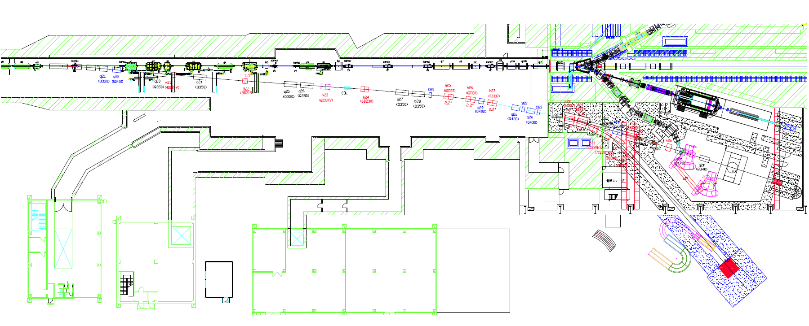
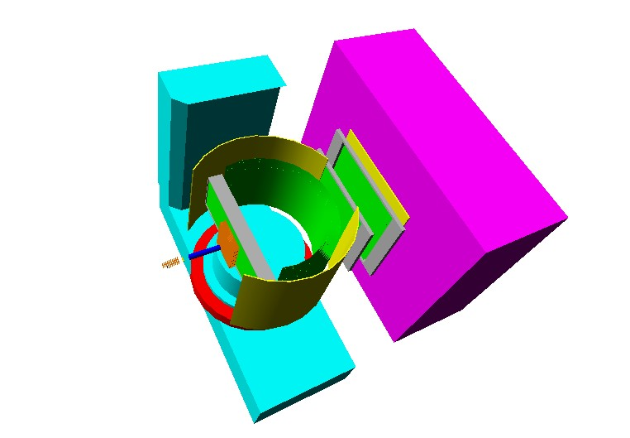
High-res., High-momentum Beam Line
High-intensity secondary Pion beam
  1.0 x 10⁷ pions/sec @ 20GeV/c
High-resolution beam: Δp/p~0.1%
30 GeV
proton beam
Production
Target
Charmed Particles
decay
p(π⁺)
RICH
K⁺
Dipole mag.
Sanford-Wang
15 kW Loss on Pt
Acceptance :1.5 msr%, 133.2 m
ITOF
DC
DC
TOF
π⁻
T1
DC
π_{s}⁻
Prod. Angle = 0 deg. (Neg.)
H₂ TGT
Fiber
Tracker
2m
Pion Beam
Up to 20 GeV/c
π⁻
K⁻
p_{bar}
Spectrometer

Slide 10
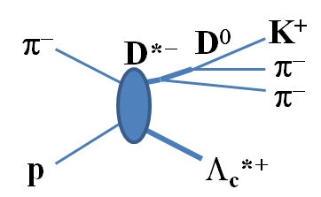
CHARM Spectrometer Design
Inclusive p(π⁻,D*⁻) Y_{c}*⁺
Cross Section:
σ (Λ_{c}) ~ 1 nb (no meas.)
PTEP2014, 103D01(2014)
p(π⁻,D*⁻p)D⁰
p(π)
( p(π⁻,D*⁻π)Y_{c}’ )
Y_{c}^{*+}
(Target)
D⁰(Y_{c}’)
RICH
decay
p(π⁺)
K⁺
Large Acceptance:
~ 60% for D*,
~ 80% for decay π⁺
Good Resolution:
Δp/p~0.2% at ~5 GeV/c
（Rigidity： ~2.1 Tm)
Dipole mag.
ITOF
DC
TOF
DC
DC
π⁻
π_{s}⁻
20 GeV/c π⁻
H₂ TGT
Fiber
Tracker
2m
R&D works in progress.

Slide 11

Charmed Baryon Spectroscopy
Using Missing Mass Techniques
π⁻
π⁻
π⁻
D^{*-}
D⁰
K⁺
q_{eff}
D*, D
p
L
p (π)
Y_{c}^{*+}
PTEP2014, 103D01(2014)
submitted to PRD
$$\overline{D^{0}} (Y_{c}^{∗^{′}})$$
Production and Decay reflect [qq] correlation…
  λ mode excitation to be favored in t-channel.
C.S. DOES NOT go down at higher L when q_{eff} >1 GeV/c.
Notes:
The production cross sections are dependent on the structure of the produced baryons.
This is the case of the pion-induced production of the heavy baryon at a forward angle, as already described by the previous talker, Hosaka-san.
Here, a u-quark is converted into a c-quark, where residual diquark acts as a spectator. In this reaction, the lambda mode excited states are well populated.
We find that relative strength of the cross section does not go down even at the higher orbital angular momentum, L, due a large momentum transfer of the reaction.

Slide 12
Missing Mass Spectrum (Sim.)
CS -> PTEP2014, 103D01(2014)
~1000 Y_{c}*/nb/100 days
Sensitivity: σ ~0.1 nb for
Y_{c}* w/ Γ =100 MeV
LS partner
(HQS doublet)
LS partner?
(HQS doublet?)
1/2+
1/2-
3/2-
5/2+?
3/2+?
L = 0
L = 1
L = 2
Λ_{c}(2625)
σ ~1 nb
Λ_{c}(2880)
Λ_{c}
Λ_{c}(2595)
Λ_{c}(2940)
1 : 2
Σ_{c}*
Σ_{c}(2800)
Σ_{c}
3 : 2
Notes:
This is a simulation of the missing mass spectrum of the (pi-,D*-) reaction on a hydrogen target.
Here, we assume a cross section of the GS lambda-c is as small as 1 nb.
We can clearly observe the chrmed baryons even at higher angular momentum states. Particularly, if these states are HQ spin doublet states, the expected production ratios should be 1:2 for L=1 states or 3:2 for L=2 states, say L:L+1, as is well known in the case of the LS splitting states of nuclei
We estimate the back ground with a hadron code, JAM.
Huge background of Kaon productions associated with pions, which are main sources of fake D*- events. By reconstructing D mass in addition to D*-, we can reduce the background drastically.

Slide 13
Y_{c}* Decay Pattern
Y_{c}*
Y_{c}*
Y_{c}*’
D
π
N
ρ mode
λ mode
Notes:
We can measure the decay products
In the missing mass spectra with additional light particles,
the decay products are clearly seen.
The decay partial widths carry important imformation on diquark modes in charmed baryons.
We would like to remind that the decay branching ratio is rather easy to measure by means of the missing mass technique.

Slide 14
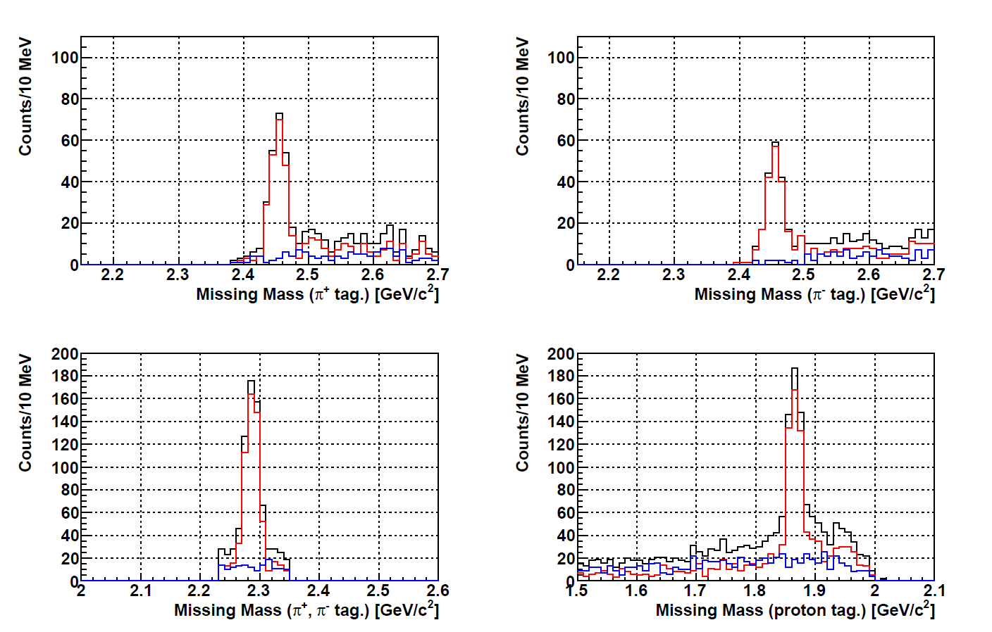
Y_{c}* Decays (sim.)
Λ_{c}(2940)−>Σ_{c}⁰ π⁺
Λ_{c}(2940)−> p D⁰
with Λ_{c}⁺ π⁺ π⁻ selected
N_{πΣc} ~ 200
N_{pD} ~ 320
D⁰
Σ_{c}⁺⁺ π⁻
N_{πΣc} ~ 200
SUM
(BR_{πΣc} =13%)
Σ_{c}⁰
(BR_{pD} =20%)
Signal
Σ_{c}⁺⁺
Main BG
* Branching ratios: Diquark corr. affects Γ(Λ_{c}*->pD)/Γ(Λ_{c}*->Σ_{c}π).
Notes:
We can measure the decay products
In the missing mass spectra with additional light particles,
the decay products are clearly seen.
The decay partial widths carry important imformation on diquark modes in charmed baryons.
We would like to remind that the decay branching ratio is rather easy to measure by means of the missing mass technique.

Slide 15
Level Structure of double-Q baryons
λ and ρ mode excitations interchange
σ_{q}σ_{QQ} (+SO)
QQ
λ
Ξ(1/2-, 3/2-, 5/2-)
P-wave
q
Ξ(1/2-,3/2-)
λ mode
q
Q-Q
q
ρ
ρ mode
Ξ(1/2-, 3/2-)
q
Ξ*(3/2+)
G.S.
q
Ξ(1/2+)
15
Notes:
As a natural extension, we can consider the case of double-Q baryons…

Slide 16
Xi Baryons
Q
ρ
Q
Double Strange
λ
s
c
Double charm
s
c
Ξ(2030, ??)
q
Ξ(1950, >=5/2?)
λ
Ξ(1820, 3/2⁻)
Ξ_{cc}(1/2⁻,3/2⁻)
λ
Ξ(1690, ??)
Ξ_{cc}(1/2⁻,3/2^{−,} 5/2⁻)
ρ
ΚΣ
Ξ_{cc}(1/2⁻,3/2⁻)
Ξ∗(1530, 3/2⁺)
Ξ_{cc}(3/2⁺)
Ξ(GS, 1/2⁺)
Ξ_{cc}(GS, 1/2⁺)
non-rel. QM:H=H₀ +V_{conf} +V_{SS}+V_{LS}+V_{T}
ρ−λ mixing (cal. By T. Yoshida)
Notes:
More generalized feature of diquark mode in baryon resonances can be seen in this figure.
This illustrates the level structure of excited states, particularly the rho/lambda-mode excited states as a function of the mass of heavy quark.
Six excited states of different diquark motions are moved as changing the heavy quark mass.
Here, one finds that the rho-lambda mode separation becomes clearer in heavier quark mass.
This point is important to extract information of diquark motions in baryons.
After we learn the diquark correlations in charmed baryons, we could understand lighter baryons much better.
This is our strategy…

Slide 17

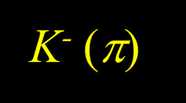
Double Strange Baryon Spectroscopy
Using Missing Mass Techniques
Κ⁻
L
$$Y_{s}^{∗^{′}}({\text{X}}_{ss}^{ ∗^{′}})$$
Ξ_{ss}^{*0}
Y*, Y
K⁻ (π)
p
K^{*0}
π⁻
K⁺
Production and Decay reflect [QQ] correlation…
u-channel production plays a role…
  ρ mode excitation may be favored
Notes:
The production cross sections are dependent on the structure of the produced baryons.
This is the case of the pion-induced production of the heavy baryon at a forward angle, as already described by the previous talker, Hosaka-san.
Here, a u-quark is converted into a c-quark, where residual diquark acts as a spectator. In this reaction, the lambda mode excited states are well populated.
We find that relative strength of the cross section does not go down even at the higher orbital angular momentum, L, due a large momentum transfer of the reaction.

Slide 18

Little is known for Ξ
 | JP | rating | Width [MeV] | →Ξπ [%] | →ΛΚ [%] | →ΣΚ [%]
Ξ(2500) | ?? | 1* | 150?
Ξ(2370) | ?? | 2* | 80? |  |  |  | ΩK~9±4
Ξ(2250) | ?? | 2* | 47+-27?
Ξ(2120) | ?? | 1* | 25?
Ξ(2030) | >=5/2? | 3* | 20⁺¹⁵₋₅ | small | ~20 | ~80
Ξ(1950) | ?? | 3* | 60+-20 | seen | seen
Ξ(1820) | 3/2- | 3* | 24⁺¹⁵₋₁₀ | small | Large | Small
Ξ(1690) | ?? | 3* | <30 | seen | seen | seen
Ξ(1620) | ?? | 1* | 20~40?
Ξ(1530) | 3/2+ | 4* | 19 | 100
Threshold
ΩΚ(2166)
ΣΚ∗(1983)
Σ∗Κ(1878)
ΛΚ∗(1908)
Ξ∗π(1665)
ΣΚ(1685)
ΛΚ(1610)
Ξπ(1450)
Narrow width: ~ a few 10 MeV
Decay mode: $Ξ→YK$ dominant?

Slide 19
Summary
A general purpose spectrometer at the J-PARC High-p BL
  CHARM spectrometer will open a new platform to study hadron physics.
Quark-diquark structure of heavy baryons
  Mass spectrum, Production Rate, and Decay Branching ratio
  Information to access “wave function” of quark/diquark in baryons
Systematic studies with different flavors are important to understand the internal quark-quark correlation in baryons further.
  Charmed, Strange, and Double Strange Baryons.
Notes:
Cooperative efforts of potential users at the High-p BL are of essential importance to push forward this field.

Slide 20
Backup slide

Slide 21
Collaboration
  E50 collaboration:
  Jung-Kun Ahn¹, Shuhei Ajimura², Kazuya Aoki³, Johann Goetz⁴, Ryotaro Honda⁵, Takatsugu Ishikawa⁶,
  Chih-hsun Lin¹¹, Yue Ma⁷, Koji Miwa⁸, Yoshiyuki Miyachi⁹, Yuhei Morino³, Ryotaro Muto³,
  Takashi Nakano², Megumi Naruki¹⁰, Hiroyuki Noumi², Kyoichiro Ozawa³, Fuminori Sakuma⁷,
  Shiin’ya Sawada³, Takahiro Sawada¹¹, Kotaro Shirotori², Yorihito Sugaya², Tomonori Takahashi²,
  Kiyoshi Tanida¹², Wen-Chen Chang¹¹, and Takumi Yamaga²
  ¹ Physics Department, Korea University, Seoul 136-713, Korea
  ² Research Center for Nuclear Physics (RCNP), Osaka University, Osaka 567-0047, Japan
  ³ Institute of Particle and Nuclear Studies (IPNS), High Energy Accelerator Research
  Organization (KEK), Ibaraki 305-0801, Japan
  ⁴ Institute of Nuclear and Particle Physics, Ohio University, OH 45701, USA
  ⁵ Department of Physics, Osaka University, Osaka 560-0043, Japan
  ⁶ Research Center for Electron Photon Science (ELPH), Tohoku University, Miyagi 982-0826, Japan
  ⁷ RIKEN Nishina Center, RIKEN, Saitama 351-0198, Japan
  ⁸ Physics Department, Tohoku University, Miyagi 980-8578, Japan
  ⁹ Physics Department, Yamagata University, Yamagata 990-8560, Japan
  ¹⁰ Department of Physics, Kyoto University, Kyoto 606-8502, Japan
  ¹¹ Institute of Physics, Academia Sinica, Taipei 11529, Taiwan
  ¹² Department of Physics, Seoul National University, Seoul 151-747, Korea

Slide 22
Next Term Plan at RCNP
JFY2015 | JFY2015 | JFY2016 | JFY2017 | JFY2018 | JFY2019 | JFY2020～
Sub-atomic Science Research Center
R&D for High Speed Elesctronic/DAQ system
Spectroscopy of Exotic/Charm Hadrons
Start Collaboration＠J-PARC
CHARM for
User Based
Research
2ndary Beam Diagnostic Device
High Res. Beam Linei
Startup CHARM Exp.
LEPS Facility
PID Detectors for CHARM
High Res. PID detectors for LEPS2
Start up LEPS2 Exp
CHARM Spectrometer
Commissioning
Commisioning LEPS2 Main Spectrometer
Start Exotic Hadron spectroscopy
Exp with BGOegg (Tohoku/ELPH)
LEPS2 for User Based Research
Spectroscopy of Hyper-deformed Nuclei
Cyclotron Facility
Position Sensitive γ-ray detectors
High performance Ge Detector
User Based
Research
Start up Exp. of Hyper-deformed nuclei
R&D for γ-ray Tracking Algorism
Coincidence Algorism
CAGRA Exp.
Radactive Beam Line
Research for Superdeformed Nuclei
Start up
Fundamental/Application Science w/ DC Muon
Intense Surface Muon Beam
Start up
Start up Exp. by means of Muon Spin Rotation
User Based
Research
MuSIC
Commissioning
Ultra-High time res.
Muon Spin Rotation Meas.
3D-muon detection system

Slide 23
Lambda Baryons (P-wave)
qq
ρ
λ
s
c
b
Q
Λ(1830, 5/2⁻)
ρ
Λ_{c}(2940, ??)
Λ(1690, ??)
Λ_{c}(2880, 5/2⁺)
Λ(1670, 1/2⁻)
ρ
Λ_{c} oｒ Σ_{c} (2765, ??)
Λ(1520, 3/2⁻)
λ
Λ_{c}(2625, 3/2⁻)
Λ(1405, 1/2⁻)
Λ_{c}(2595, 1/2⁻)
Λ_{b}(5920, 3/2⁻)
Σ∗(3/2⁺)
Λ_{b}(5912, 1/2⁻)
Σ_{c}*(3/2⁺)
Σ_{b}*(3/2⁺)
Σ_{c}(1/2⁺)
Σ_{b}(1/2⁺)
Σ(1/2⁺)
Λ(GS)
Λ_{c}(GS)
Λ_{b}(GS)
Λ(1/2⁺)
non-rel. QM:H=H₀ +V_{conf} +V_{SS}+V_{LS}+V_{T}
ρ−λ mixing (cal. By T. Yoshida)
Notes:
In fact, more detailed calculation based on the Constituent Quark mode,
More generalized feature of diquark mode in baryon resonances can be seen in this figure.
This illustrates the level structure of excited states, particularly the rho/lambda-mode excited states as a function of the mass of heavy quark.
Six excited states of different diquark motions are moved as changing the heavy quark mass.
Here, one finds that the rho-lambda mode separation becomes clearer in heavier quark mass.
This point is important to extract information of diquark motions in baryons.
After we learn the diquark correlations in charmed baryons, we could understand lighter baryons much better.
This is our strategy…

Slide 24
Designed Spectrometer
Inclusive p(π⁻,D*⁻) Y_{c}*⁺
p(π⁻,D*⁻p)D⁰
(Target)
p(π)
( p(π⁻,D*⁻π)Y_{c}’ )
Y_{c}^{*+}
D⁰(Y_{c}’)
20 GeV/c
Beam π⁻
Large acceptance ~ 60% (for D*), ~85% (for decay π⁺)
Good resolution: Δp/p~0.2% at ~5 GeV/c
Notes:
Then we proposed charmed baryon spectroscopy by using the missing mass techniques.
We will measure the level structure of the excited charmed baryons and the production rate in the inclusive (pi-,D*-) spectrum.
Decay productions will be also measured to assist the missing mass spectroscopy.

Slide 25
R&D for Key Devices
Particle Identification (RCNP/Kyoto/Tohoku/RIKEN…)
  Ring Image Cherenkov Detector (RICH)
High rate tracker (Tohoku/Osaka/RCNP…)
  Scintillating Fiber Tracker (SFT)
  Developed in experiments at K1.8
High-speed DAQ system (RCNP/Osaka/Taiwan/KEK…)
  PC cluster-based DAQ scheme
    Flexible “trigger”: not only (π⁻,D*) but also (K⁻,K*),…
  Grand designing is in progress

Slide 26
RICH: Design
Reconstructed
Cherenkov angle
High-momentum PID
  Mom. range: 2-16 GeV/c
⇒ Hybrid RICH
  Aerogel + C₄F₁₀ gas
  MPPC detector plane
  Spherical mirror
Design Performances
  Efficiency: ~99%
  Wrong PID: 0.10~0.14%
  ⇒ Background level×1.05

Slide 27
RICH: Test Exp. at Tohoku/ELPH
e-Beam + Air 1.5m
Mirror
Ring Image
Measured
Cherenkov angle
24 mm
σ_{θ} ~ 3.1 mrad < 4 mrad (requirement)

Slide 28
Fiber Tracker
Scintillating fiber tracker
＊J-PARC beam: time structure
⇒ Narrower time gate is more essential to suppress accidental hits.
  E50: 60 M/spill (30 MHz)
Requirements
  1 MHz/1 mm fiber
  Tracking efficiency: ~99%
  Thin material thickness
Focal plane & Beam tracking
Target downstream tracking
  Detector design
  Simulation study
  Readout electronics development
DC 1.5-mm DL
50 ns
E10: 12 M/spill (6 MHz) beam

Slide 29
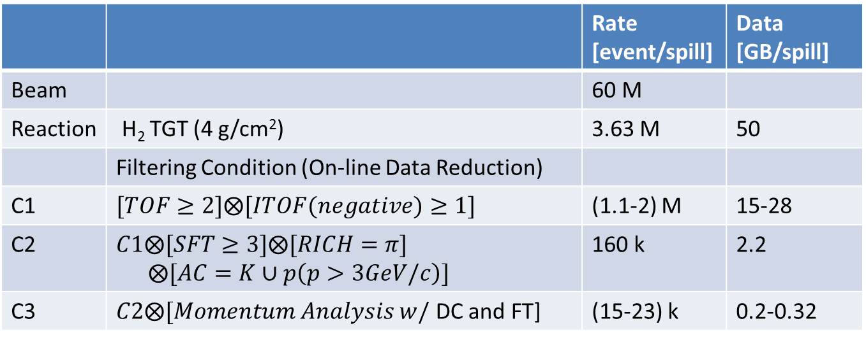
High-speed DAQ system
Event Rate and Data Reduction
 |  | Rate [event/spill] | Data [GB/spill]
Beam |  | 60 M
Reaction | H₂ TGT (4 g/cm²) | 3.63 M | 50
 | Filtering Condition (On-line Data Reduction)
C1 | $$[TOF≥2]⨂[ITOF(negative)≥1]$$ | (1.1-2) M | 15-28
C2 | $C1⨂[SFT≥3]⨂[RICH=π]$ $$⨂[AC=K∪p\left(p>3GeV/c\right)]$$ | 160 k | 2.2
C3 | $C2⨂[Momentum Analysis w/$ DC and FT] | (15-23) k | 0.2-0.32
Total # of Channels: ~30,000
  Tracker >17,100 ch
  RICH: 10,000 ch
  Hi-Res Timing/TOT: ~500 ch

Slide 30
High-speed DAQ system
Streaming DAQ(~50 GB/spill)
Frontend modules
＊Signal digitalization
  Pipelined system
Buffer PCs
＊Data accumulation
  Several 10 GB memories
＊High-speed data link
(Local)
~50 GB/spill
Filter PCs
＊Event reconstruction
  100−200 CPUs
<0.5 GB/spill
Storage
  Local storage
  Transferred to KEKCC/RCNP

Slide 31
Ξ Baryon Spectroscopy w/ the High-p Secondary Beam
LoI submitted by M. Naruki and K. Shirotori
Sizable yields are expected for a month.
p(K-,K+) spectra
Past exp.
C.M. Jenkins et al., PRL51, 951(1983) →
Inclusive Ξ prod.
in πp
5 GeV/c
5 GeV/c
150 μb
5 μb
Inclusive Ξ prod.
in K⁻p

Slide 32







${P_{c}\left(4380\right),P_{c}(4450)}_{}$
Is $P_{c}^{+}$ the N* with a hidden c-cbar?
$P_{c}$ can be excited on its mass with 10 GeV/c pion beam at J-PARC.
Its decay modes to $Y_{c}+\overline{D}$.
Its family?
$$π$$
$$\overline{D}$$
$$P_{c}$$
$$N$$
$$Y_{c}$$

Slide 33
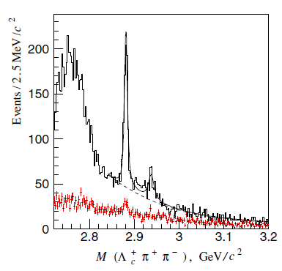
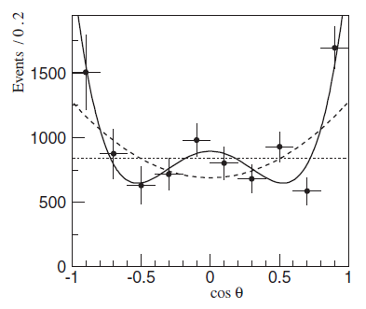
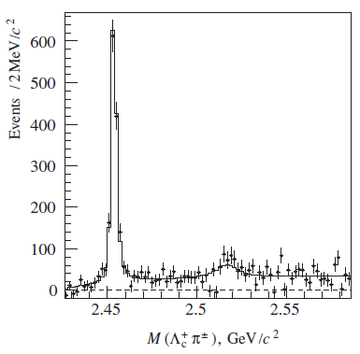
Λ_{c}(2765)?
Lc(2880)Belle, PRL98, 262001(’07)
Λ_{c}(2880)
Λ_{c}(2880)->πΣ_{c}(2455)
Λ_{c}(2940)
J=5/2 → J’=1/2
Σ_{c}(2455)
Γ(Λ_{c}(2880)->πΣ_{c}*(2520))
L_{π}=3 transition
Γ(Λ_{c}(2880)->πΣ_{c}(2455))
L_{π}=1 contribution may affect…
J^{P}=5/2⁺ for Λ_{c}(2880)
Σ_{c}*(2520)
Is it a D-wave Lambda-c Baryon?
If so, where is a spin partner ?

Slide 34
Lambda Baryons (P-wave)
qq
ρ
λ
s
c
b
Q
Λ(1830, 5/2⁻)
ρ
Λ_{c}(2940, ??)
Λ(1690, ??)
Λ_{c}(2880, 5/2⁺)
Λ(1670, 1/2⁻)
ρ
Λ_{c} oｒ Σ_{c} (2765, ??)
Λ(1520, 3/2⁻)
λ
Λ_{c}(2625, 3/2⁻)
ΚΝ
Λ_{c}(2595, 1/2⁻)
Λ_{b}(5920, 3/2⁻)
Λ(1405, 1/2⁻)
Σ∗(3/2⁺)
Λ_{b}(5912, 1/2⁻)
Σ_{c}*(3/2⁺)
Σ_{b}*(3/2⁺)
Σ_{c}(1/2⁺)
Σ_{b}(1/2⁺)
Σ(1/2⁺)
Λ(GS)
Λ_{c}(GS)
Λ_{b}(GS)
Λ(1/2⁺)
non-rel. QM:H=H₀ +V_{conf} +V_{SS}+V_{LS}+V_{T}
ρ−λ mixing (cal. By T. Yoshida)
Notes:
Interest in strange sector.
As already suggested that the L1405 state is closely coupled to the KbarN, its level is obviously deviated from the indicated line of the lambda mode.

Slide 35

Strange Baryon Spectroscopy
Using Missing Mass Techniques
π⁻
π⁻
K^{*0}
K⁺
q_{eff}
K*, K
p
L
K⁻ (π)
Y_{s}^{*0}
$$p (Y_{s}^{∗^{′}})$$
Production and Decay reflect [qq] correlation…
Notes:
The production cross sections are dependent on the structure of the produced baryons.
This is the case of the pion-induced production of the heavy baryon at a forward angle, as already described by the previous talker, Hosaka-san.
Here, a u-quark is converted into a c-quark, where residual diquark acts as a spectator. In this reaction, the lambda mode excited states are well populated.
We find that relative strength of the cross section does not go down even at the higher orbital angular momentum, L, due a large momentum transfer of the reaction.

Slide 36
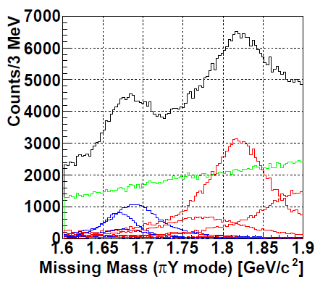
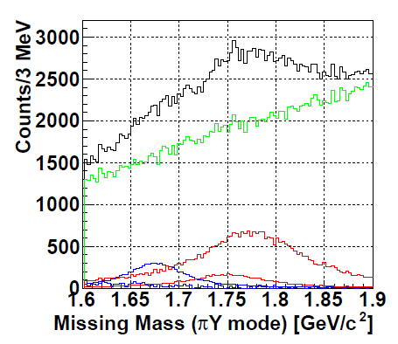
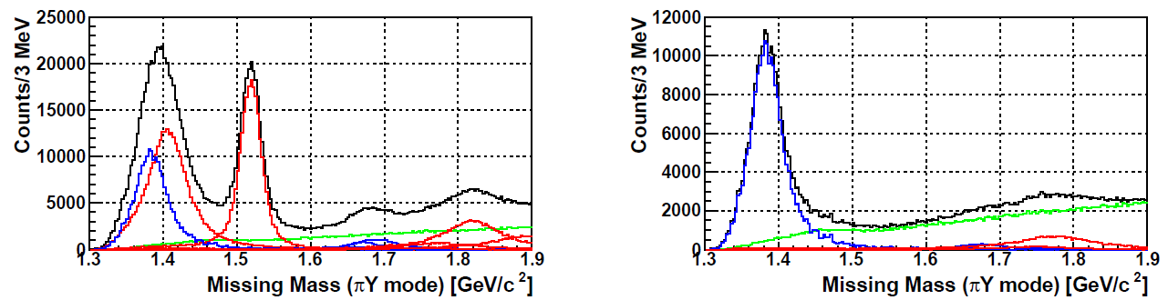
Λ(1405)
I = 0, 1
I = 1 only
(a)(π⁻,K^{*0}) w/ πΣ decay
(b)(π⁺,K^{*+}) w/ πΣ decay
Λ(1520)
Σ(1385)
Σ(1775)
Λ(1405)
Σ(1775)
Σ(1385)
Production rate tells how Λ(1405)/Λ(1520) deviates from/follows the quark-diquark configuration.

Slide 37
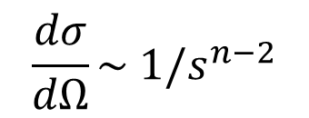
Quark counting rule in hadron reactions
H. Kawamura, et al., PRD 88, 034010 (2013)
$$\frac{dσ}{dΩ}\sim {1/s}^{n−2}$$
1-100 pb
J-PARC
Taken from T. Sekihara’s Slide
Notes:
pQCD predicts the production cross section obeying the quark counting rule.

Slide 38
High-speed DAQ system
Common features
  TDC base data taking
  Pipelined data transfer with a high-speed data link.
MPPC readout
  Upgraded EASIROC: CITIROC/PETIROC chips
  ⇒ Open-It project with KEK electronics group
Wire chamber readout
  ASD + TDC readout modules
High resolution TDC module
  TDC + discrete amp
  TDC LSB: ~25 ps
＊Module R&D needs resources. However, those modules can be standard modules for the hadron hall experiments and so on.

Slide 39
High-speed DAQ system
Conventional trigger
  Hardware trigger
  Specific modules
⇒ Special trigger system
Difficulties and disadvantages
  No flexibility for byproducts
  Module developing needs cost and resources
  Only available for E50
Planned E50 trigger
  On-line event reconstruction
  PC clusters
⇒ Flexible trigger system
Advantages
  Flexibility for byproducts
  Cost of PCs having many CPUs are low.
Disadvantage
  Members have no experience.

Slide 40
Decay Properties
ρ mode (qq)
λ mode [qq]
  Γ(Σ_{c}π ) > Γ(pD)
  Γ(Σ_{c}π ) < Γ(pD)
Notes:
We also measure decay properties of charmed baryons.
Again, it should be stressed that the branching ratios can be rather easily deduced in the missing mass spectroscopy.
The rho mode states are expected to favor a decay into a light meson and heavy baryon.
While, the lambda mode states favor a decay into light baryon and heavy meson.

Slide 41
Strategy
Charmed baryon spectroscopy.
  Key issue is the p(π⁻,D*⁻)Λ_{c} cross section…
  “C.S. ~ 1 nb” can be confirmed in ~10 days or so.
  Go to the 2nd step when the C.S. << 1 nb.
Hyperon spectroscopy via (π⁻,K*⁰)…
  Diquark motions (λ/ρ mode ID) for known states
    Production Rate: favor λ-mode
    ↔ ρ-mode through λ/ρ mixing
    Decay Branching Ratio: Γ(NK)/Γ(πY) in terms of λ/ρ modes
  x1000~10000 higher statistics
Notes:
We propose the charmed baryon spectroscopy.
The key concern is the level of cross section by the (pi-,D*-) reaction.
Our strategy is as follow:
We can check if the cross section is at the level of 1 nb in 10 days or so.
When we found it is much less than 1 nb unfortunately, we will move to hyperon spectroscopy.
Below, we demonstrate the hyperon spectroscopy via the (pi-,K*0) reactions with the same setup.
We investigate the diquark motions for known hyperon states through measuring production rates and decay branching ratios based on very much higher statics compared with those for charmed baryons.

Slide 42
Populated states via p(π⁻,K^{*0})X
L |  | state | Rate (Rel.)
0 |  | Λ^{1/2+}(1116) | 1000
 |  | Σ^{1/2+}(1192) | 49
 |  | Σ^{3/2+}(1385) | 244
1 | λ | Λ^{1/2-}(1405) | 72
 |  | Λ^{3/2-}(1520) | 127
 | ρ | Λ^{1/2-}(1670) | 7
 |  | Σ^{3/2-}(1690) | 4
 |  | Λ^{3/2-} (1690) | 13
 | λ | Σ^{1/2-} (1750) | 4
 |  | Σ^{5/2-} (1775) | 18
2 |  | Λ^{3/2+}(1890) | 25
 |  | Λ^{5/2+}(1820) | 52
Cal. w/ t-channel K* ex. reaction
at p_{π} = 5 GeV/c
λ mode states
well populated
ρ mode states
excited through λ / ρ mixing (P_{mix})
P_{mix}(strange) is given,
P_{mix}(charm) could be deduced.
P_{mix}(strange) > P_{mix}(charm)
S.H. Kim, A. Hosaka, H.C. Kim, HN, K. Shirotori,
arXiv:submit/0978210, 14 May, 2014.
Notes:
Here we show calculated production rates for hyperons at the beam momentum of ~5 GeV/c.
We find lambda mode states are populated well.
The rho mode states are also populated through the mixing.
This mode mixing is expected to be smaller as the quark mass is larger.
So, it must be important to determine the magnitude of the mixing by measuring the production rates of the rho mode states.

Slide 43
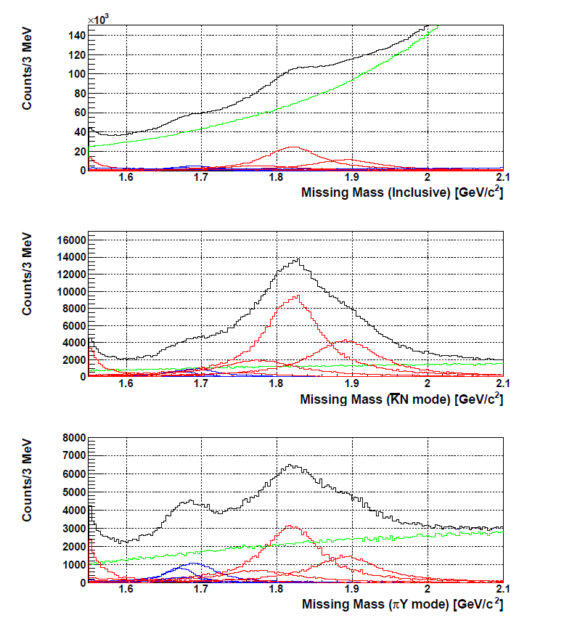
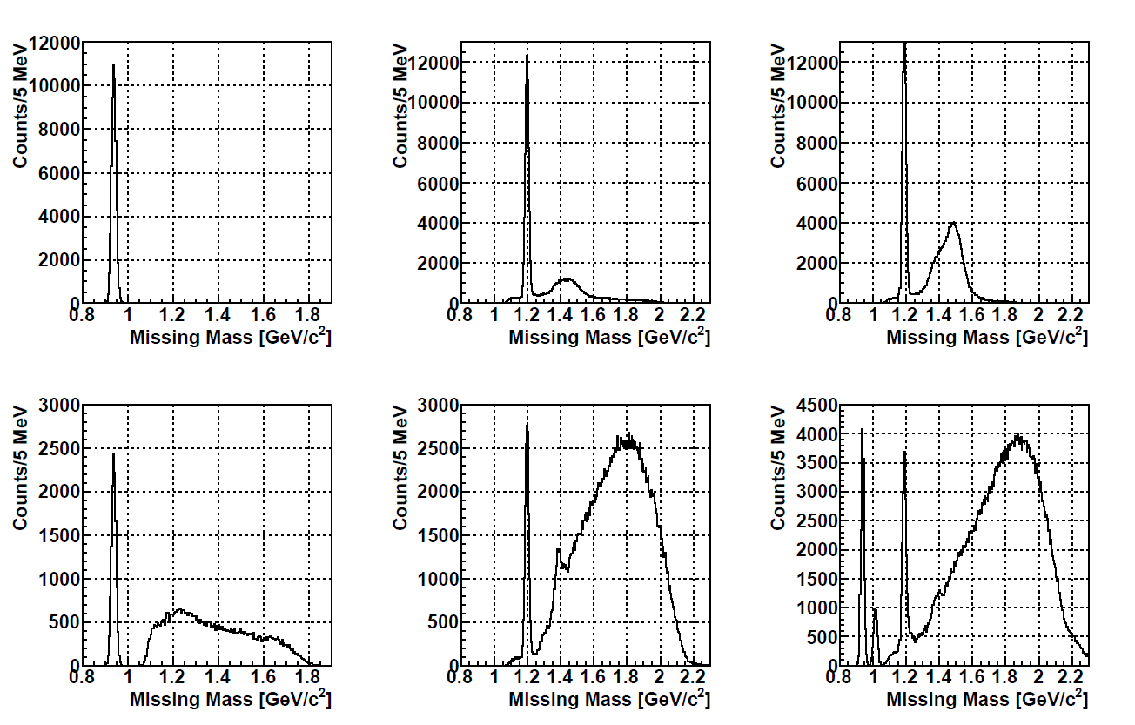
Hyperon production via p(π⁻,K*⁰)X
4x10¹¹ pions (3 days)
K⁻ p decay
  K⁻ tagged, Missing “p” gated
π⁺Σ⁻ decay
  π⁺ tagged, Missing “Σ” gated
Inclusive
Green: BG
p
BG
K⁻ p decay
Σ
π⁺ Σ⁻ decay
BG
Notes:
Based on this calculation, we simulate expected spectra.
Top figure shows the inclusive spectrum of the (pi-,K*0) reaction.
BG is estimated by JAM.
Here we could identify the decay modes, by detecting the decay particles and gating associate particles identified in the missing mass.
The BG levels are reduced much in the decay modes.

Slide 44
Hyperon production via p(π⁻,K*⁰)X
4x10¹¹ pions (3 days)
K⁻ p decay
  K⁻ tagged, Missing “p” gated
π⁺Σ⁻ decay
  π⁺ tagged, Missing “Σ” gated
Inclusive
Green: BG
p
BG
K⁻ p decay
Σ
π⁺ Σ⁻ decay
BG
Notes:
We recognize 7 know states in the excited energy region.
By tagging the K-p decay mode, the lamda mode states are enhanced
On the other hand, the rho mode states are enhanced in the piSigma mode.

Slide 45
Hyperon production via p(π⁻,K*⁰)X
HQ Doublet
K⁻ p decay
  K⁻ tagged, Missing “p” gated
π⁺Σ⁻ decay
  π⁺ tagged, Missing “Σ” gated
5/2+
Inclusive
3/2+
L = 2
p
3 : 2
BG
K⁻ p decay
Σ
π⁺ Σ⁻ decay
BG
Notes:
Here, we expect to see a HQ doublet.
If they are the doublet states, the production ratio should be 3 to 2.
So…, you may worry about if these states can be extracted in reality.

Slide 46
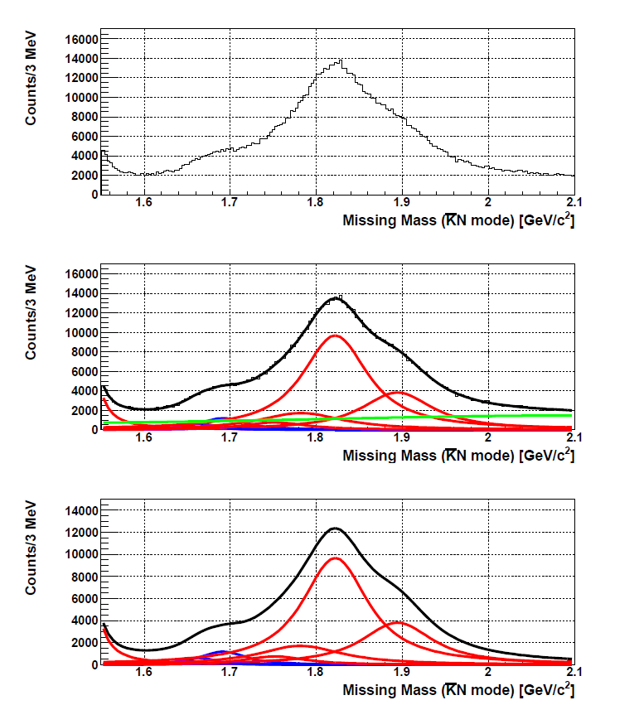
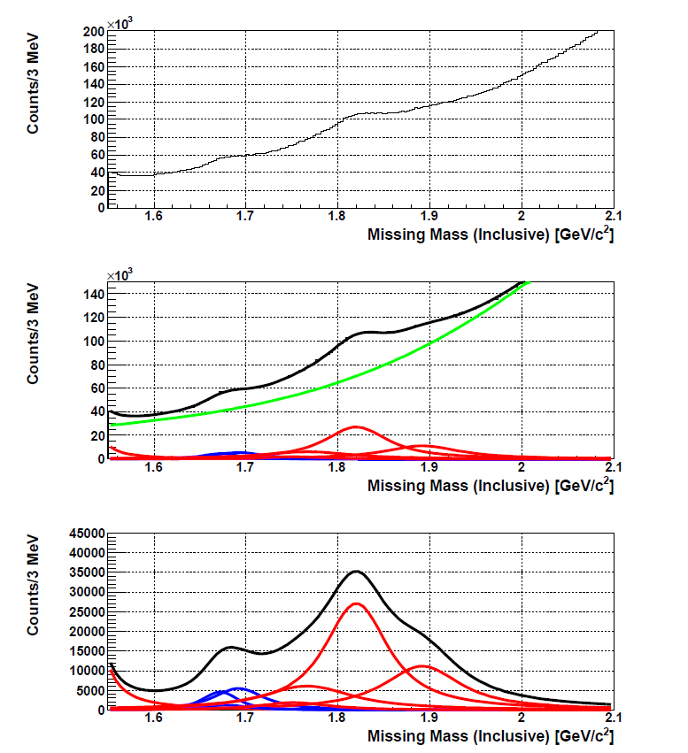
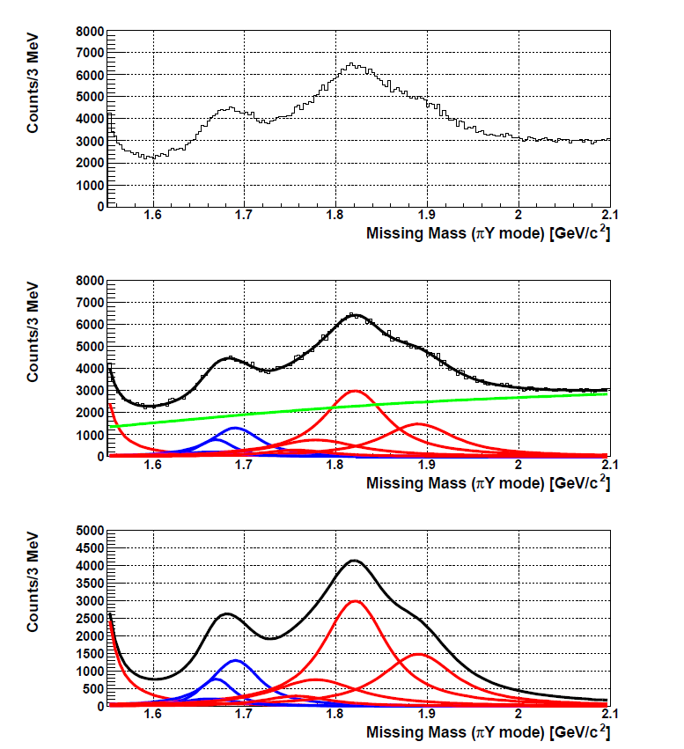
Hyperon Production (Fitting Results)
Λ(1690)(3/2-)
Σ(1750)(1/2-)
Σ(1775)(5/2-)
Inclusive
Extract 7 states.
  Constraint from known M & Γ
  BG: 5th O. Polynomial F.
Cross Section
  λ / ρ mode ID
  λ / ρ mixing: P_{mix}(strange)
  (ρ-mode C.S.)
  HQ spin multiplets
Γ (KN)/Γ (πY)
  λ / ρ mode ID
Λ(1670)(1/2-)
Λ(1820)(5/2+)
Σ(1670)(??)
Λ(1890)(3/2+)
K⁻ p decay
π⁺ Σ⁻ decay
Notes:
You may worry about if these states can be extracted in reality.
This shows fitting results.
Here, BG could be reproduced by using the 5th order polynomial function.
Actually, we could successfully demonstrate to extract 7 known states.
It is quite helpful that we could apply proper constraints for the states w/ known masses and widths to some extent.
In addition to this, the peak enhancements in the decay modes are also helpful to fix the peak positions and widths.

Slide 47
Decay mode: Γ (NK)/Γ (πΣ)
PDG Data
Λ(1890)3/2+
Λ(1820)5/2+
λ/ρ mode ID by productions
correlate w/ Decay Ratios
→ to be established
The ratios <-> P_{mix}(strange)
Σ(1775)1/2-
Λ(1690)3/2-
Σ(1750)1/2-
Σ(1670)3/2-
Λ(1670)1/2-
Λ(1520)3/2-
ρ
λ
Hyperon data indicate mode dependence
→ Errors should be improved.
No data in charmed baryons
Notes:
Lam/rho modes states identified by production rates are expected to correlate with their decay ratios.
Actually, the hyperon data reported by PDG suggest the mode dependence.
But the errors are still sizable.
We have to establish the dependence with high accuracy.
We could measure the ratios at an error level of that for L(1520).
It should be noted that no such data are available in charmed baryons.

Slide 48
Decay mode: Γ (NK)/Γ (πΣ)
PDG Data
Expected
Λ(1890)3/2+
Λ(1890)3/2+
Λ(1820)5/2+
Λ(1820)5/2+
Σ(1775)1/2-
Σ(1775)1/2-
Λ(1690)3/2-
Σ(1750)1/2-
Λ(1690)3/2-
Σ(1750)1/2-
Σ(1670)3/2-
Λ(1670)1/2-
Σ(1670)3/2-
Λ(1670)1/2-
Λ(1520)3/2-
Λ(1520)3/2-
ρ
λ
Hyperon data indicate mode dependence
→ Errors should be improved.
No data in charmed baryons

Slide 49
Baryon spectroscopy in different flavors
Strange baryons
Charmed baryons
s
c
Λ(1/2⁻,3/2⁻,5/2⁻)
ρ
Λ_{c}(1/2⁻,3/2⁻,5/2⁻)
Σ(1/2-,3/2-)
ρ
Σ_{c}(1/2⁻,3/2⁻)
Σ(1/2⁻,3/2⁻,5/2⁻)
λ
ρ
Λ_{c}(1/2⁻,3/2⁻)
Σ(1/2-,3/2-)
Λ(1/2⁻,3/2⁻)
λ
Σ_{c}(1/2⁻,3/2⁻,
5/2⁻)
Σ_{c}(1/2⁻,3/2⁻)
Λ(1/2⁻,3/2⁻)
λ
Λ_{c}(1/2⁻,3/2⁻)
Σ(3/2⁺)
Σ_{c}(3/2⁺)
Σ_{c}(1/2⁺)
Σ(1/2⁺)
Λ(1/2⁺)
Λ_{c}(1/2⁺)
non-rel. QM:H=H₀ +V_{conf} +V_{SS}+V_{LS}+V_{T}
ρ−λ mixing (cal. By T. Yoshida)
Notes:
More generalized feature of diquark mode in baryon resonances can be seen in this figure.
This illustrates the level structure of excited states, particularly the rho/lambda-mode excited states as a function of the mass of heavy quark.
Six excited states of different diquark motions are moved as changing the heavy quark mass.
Here, one finds that the rho-lambda mode separation becomes clearer in heavier quark mass.
This point is important to extract information of diquark motions in baryons.
After we learn the diquark correlations in charmed baryons, we could understand lighter baryons much better.
This is our strategy…

Slide 50
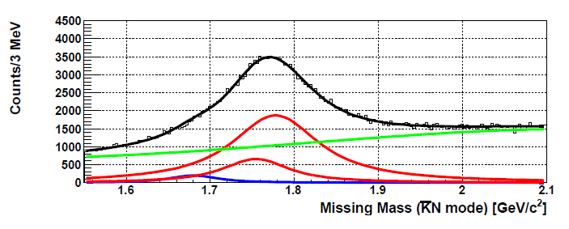
Peak fitting for p(π⁺,K^{*+})Σ^{*+}
Σ(1750)(1/2-)
Σ(1775)(5/2-)
(π⁺,K^{*+}) w/ KN decay
Σ(1670)(??)
M and Γ of 3 Σ^{*+}’s are fixed first.

Slide 51
Expected Yield
Conditions
  σ(p(π⁻,K^{*0})Λ)= 53 μb, others: cal. by t-ch. K* ex. model
  t-channel dominance: ~exp{2.5(t-t₀)}
  10 MeV mass resolution, ΔΩ(K^{*0}) ~ 70%
  BG source: JAM at p_{π}=5 GeV/c
Yield for 10¹³ pions ( 100 days w/ 7 Mpps)
  4 g/cm² H₂ TGT
  Large production yield: ~6 M/1μb (w/ ε_{ana}~0.5)
  Large decay events: ΔΩ(πΣ/KN) ~ 70%
    210 k for Λ* -> K-p, 140 k for Λ* -> π⁻Σ⁺ if br(10%)

Slide 52
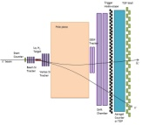
High-res., High-momentum Beam Line
High-intensity secondary Pion beam
High-resolution beam: Δp/p~0.1%
Exp. Target (FF)
Pion Beam
Up to 20 GeV/c
Collimator
15kW Loss Target
(SM)
Dispersive Focal Point (DFP)
Δp/p~0.1%
Notes:
Let me start from this naive question in hadron physics;
“What are good building blocks of hadrons?”
We know that a constituent quark is a very good building block of hadrons,
which successfully describes hadron properties, such as masses, classifications based on spin/flavor symmetry, and even magnetic moments. This is good for ground state hadrons.
However, the constituent quark model sometimes fails in resonance states.
Hadrons can be good building blocks, as recently Meson-meson and Meson-Baryon molecular states are intensively discussed. Here, they are all color singlet states.
“Diquark” is considered as a building block of baryons.
Although this object is discussed for a long time. it has not been settled yet.

Slide 53
High-res., High-momentum Beam Line
High-intensity secondary Pion beam
High-resolution beam: Δp/p~0.1%
collection
Dispersion
Spectrometer
QQ
QQ
QQ
DDQD
QQ
(QQQQ)
D
D
DD
S
S
S
Production
Target
Collimator for Beam Re-define
Exp.
Target
Dispersive Focal Plane
For Mom. Meas.
Notes:
Let me start from this naive question in hadron physics;
“What are good building blocks of hadrons?”
We know that a constituent quark is a very good building block of hadrons,
which successfully describes hadron properties, such as masses, classifications based on spin/flavor symmetry, and even magnetic moments. This is good for ground state hadrons.
However, the constituent quark model sometimes fails in resonance states.
Hadrons can be good building blocks, as recently Meson-meson and Meson-Baryon molecular states are intensively discussed. Here, they are all color singlet states.
“Diquark” is considered as a building block of baryons.
Although this object is discussed for a long time. it has not been settled yet.

Slide 54
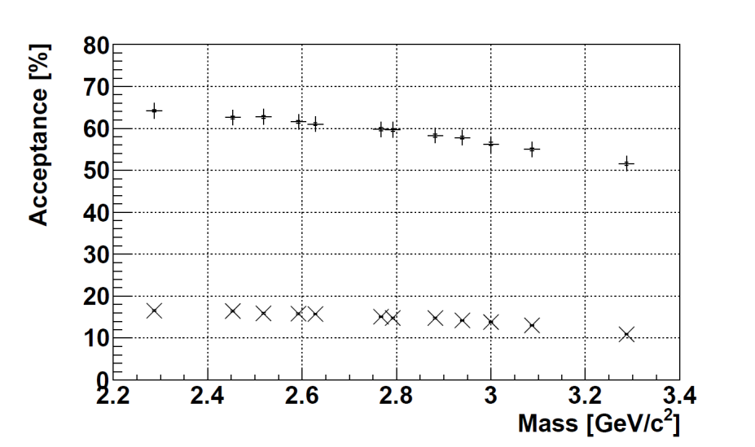
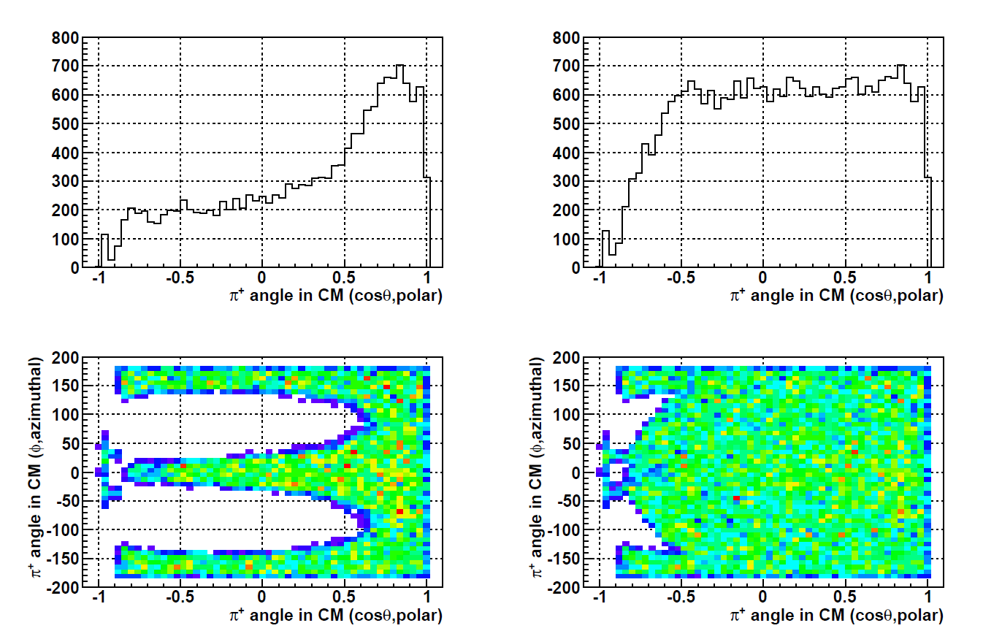
Basic performances
Acceptance: D*⁻ detection
Resolution
  Missing mass resolution
    Λ_{c}⁺: 16.0 MeV
    Λ_{c}(2880)⁺: 9.0 MeV
Acceptance
  for D*⁻ (K⁺p⁻p⁻): 50−60%
  for decay particles: ~85%
    ＊complete coverage cosθ > −0.5
exp(bt)
Isotropic in CM
Λ_{c}(2940)⁺ → Σ_{c}(2455)⁰ + π⁺
Forward direction
(Beam direction)

Slide 55
Backup slides for estimation of the production Cross Section

Slide 56
Calculated production rates (revised)
p_{π}=20 GeV/c | Mass (GeV/c) | “ud” isospin factor | Y_{c}* Spin factor | q_{eff} (GeV/c) | Rate (Relative)
Λ_{c}^{1/2+} | 2286 | 1/2 | 1 | 1.33 | 1
Σ_{c}^{1/2+} | 2455 | 1/6 | 1/9 | 1.43 | 0.03
Σ_{c}^{3/2+} | 2520 | 1/6 | 8/9 | 1.44 | 0.17
Λ_{c}^{1/2-} | 2595 | 1/2 | 1/3 | 1.37 | 0.93
Λ_{c}^{3/2-} | 2625 | 1/2 | 2/3 | 1.38 | 1.75
Σ_{c}^{1/2-} | 2750 | 1/6 | 1/27 | 1.49 | 0.02
Σ_{c}^{3/2-} | 2820 | 1/6 | 2/27 | 1.50 | 0.04
Σ_{c}^{1/2- ’} | 2750 | 1/6 | 2/27 | 1.49 | 0.05
Σ_{c}^{3/2- ’} | 2820 | 1/6 | 56/135 | 1.50 | 0.21
Σ_{c}^{5/2- ’} | 2820 | 1/6 | 2/5 | 1.50 | 0.21
Λ_{c}^{3/2+} | 2940 | 1/2 | 2/5 | 1.42 | 0.49
Λ_{c}^{5/2+} | 2880 | 1/2 | 3/5 | 1.41 | 0.86
L=0
L=1
L=2

Slide 57
Populated states: (π⁻,K^{*0})
 | p_{π}=4.5 GeV/c | Mass (GeV/c) | isospin factor | Spin factor | q_{eff} (GeV/c) | Rate (Relative) | σ(μb)
 | Λ^{1/2+} | 1116 | 1/2 | 1 | 0.29 | 1 | 53(+-2)*
 | Σ^{1/2+} | 1192 | 1/6 | 1/9 | 0.32 | 0.049 | 2.6
 | Σ^{3/2+} | 1385 | 1/6 | 8/9 | 0.38 | 0.244 | 12.9
λ | Λ^{1/2-} | 1405 | 1/2 | 1/3 | 0.36 | 0.072 | 3.8
 | Λ^{3/2-} | 1520 | 1/2 | 2/3 | 0.40 | 0.127 | 6.7
ρ | Λ^{1/2-} | 1670 |  |  |  | 0.007 | 0.4
 | Σ^{3/2-} | 1690 |  |  |  | 0.004 | 0.2
 | Λ^{3/2- ’} | 1690 |  |  |  | 0.013 | 0.7
λ | Σ^{1/2- ’} | 1750 | 1/6 | 2/27 | 0.53 | 0.004 | 0.2
 | Σ^{5/2- ’} | 1775 | 1/6 | 2/5 | 0.55 | 0.018 | 1.0
 | Λ^{3/2+} | 1890 | 1/2 | 2/5 | 0.56 | 0.025 | 1.3
 | Λ^{5/2+} | 1820 | 1/2 | 3/5 | 0.52 | 0.052 | 2.8
L=0
L=1
excited through
λ/ρ mixing
L=2

Slide 58
Production Rate
Production Rates are determined by the overlap of WFs
π⁻
D^{*−}
D* (q: mom. transfer)
u
c
L
and depend on:
1. Spin/Isospin Config. of Y_{c}
2. Momentum transfer (q_{eff})
“ud”
“ud”
p
Y_{c}⁺
Spin/Isospin Factor
t-channel D* Reggeon
at a forward angle
A. Hosaka et al.,
paper in preparation.
A~0.42 GeV ([Baryon size]⁻¹)
q_{eff}~1.4 GeV/c
Notes:
Next, we considered a t-channel D* exchange at a forward angle, in order to estimate the production rate of excited Yc relative to the ground state Lambda-c.
Here, a “u” quark in a proton is converted to a “c” quark.
Residual diquark is a spectator.
The production rate is expressed as overlapping of initial and final baryon wfs,
Which depends on the spin/isospin configurations of charmed baryons
This formula is nothing but the fourier transformation of the wave function density.
As a result, the production rate is decomposed into 2 parts.
The production rate is proportional to the momentum transfer.
The absolute strength is reduced much by the factor of the exponential func.
One we take the ratio of the L state to the ground state.
The quantity does not depend very much on the orbital angular momentum L.

Slide 59
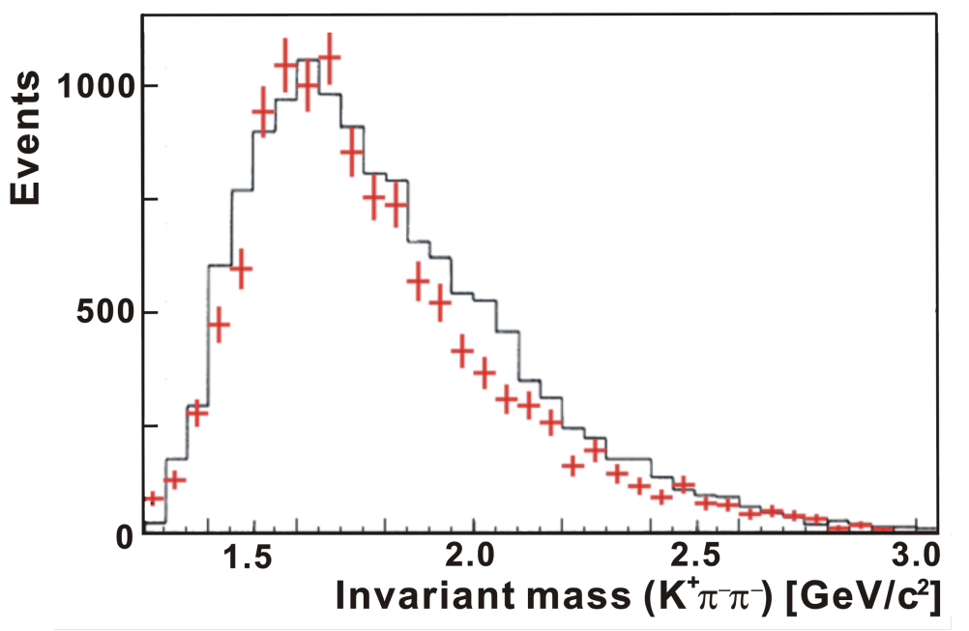
Production Cross Section
A. Hosaka et al., paper in preparation.
Experimental data:
  σ (p(π⁻⁻,D*⁻)Λ_{c}) < 7 nb (68%CL) (BNL exp., 1985)
  BG spectrum is well reproduced by a MC simulation w/ JAM
Regge Theory suggests 10⁻⁴ of the hyperon production
  σ (p(π⁻⁻,D*⁻)Λ_{c}) ~ a few nb
D*
+ JAM
− Data
Regge Theory
exp.
p(π⁻,K*)Λ
σ (μb/sr)
<7nb
at BNL
p(π⁻,D*)Λ_{c}
10 nb
0.1 nb
p_{π}=20 GeV/c
s/s₀
J.H. Christensen et al., PRL55, 154(1985)

Slide 60
Comment on the Coupling Constant
Comparison of g_{D*D*π}/g_{K*K*π} and g_{ΛcND}/g_{ΛNK*}
  Estimated by means of the Light Cone QCD Sum Rule
  Exp. Data
Taking g_{D*D*π}/g_{K*K*π}∼1, g_{ΛcND*}/g_{ΛNK*}∼0.67
→ We still expect σ (p(π⁻,D*)Λ_{c}) ∼a few nb.
g_{K*K*π} | g_{D*D*π} | g_{D*D*π}/g_{K*K*π}
3.5* | 4.5 | 1.3
g_{K*Kπ} | g_{D*Dπ} | g_{D*Dπ}/g_{K*Kπ}
4.5* | 7.5 | 1.7
g_{ΛNK*} | g_{ΛcND*} | g_{ΛcND*}/g_{ΛNK*}
-6.1^{+2.1}_{-2.0} | -5.8^{+2.1}_{-2.5} | 0.95^{+0.35}_{-0.28}
g_{ΛNK} | g_{ΛcND} | g_{ΛcND}/g_{ΛNK}
7.3^{+2.6}_{-2.8} | 10.7^{+5.3}_{-4.3} | 1.47^{+0.58}_{-0.44}
M.E. Bracco et al.
Prog. Part Nucl. Phys. 67, 1019(2012)
A. Khodjamirian et al.
EJPA48, 31(2012)
*note:g[Bracco]/2=g[Khodjamirian]
g_{K*Kπ} | g_{D*Dπ} | g_{D*Dπ}/g_{K*Kπ}
~4.5 | 8.95+-0.15+-0.9 | ~2+-0.2

Slide 61
Comparison in strange sector
σ(μb)
σ∝s^{-α}
s/s₀

Slide 62
Backup slides for the BG studies

Slide 63
Considered BG for BG reduction
Main background
  Strangeness production including the (K⁺, π⁻, π_{s}⁻) final state
Wrong particle identification
  Dominant cases: (π⁺, π⁻, π_{s}⁻), (p, π⁻, π_{s}⁻)
    PID miss-identification of π/p as K⁺: ~3%
    Productions of π and p are ~10 times higher than K.
  Contribution of other combinations are negligible.
    (K⁺, K⁻, π_{s}⁻), (K⁺, π⁻, Κ_{s}⁻), (π⁺, K⁻, π_{s}⁻), (p, K⁻, π_{s}⁻), …
  Semi-leptonic decay channels: (K⁺, μ⁻, π_{s}⁻) (K⁺, e⁻, π_{s}⁻)
    D⁰ mass cannot be reconstructed.
Associated charm production: Including D*⁻
  D** production: D**^{0, −}→D*⁻ + π^{+,0}
  D^{0,+} + D*⁻, D*^{0,+} + D*⁻ pair production
  Hidden charm meson (J/ψ, ψ, χ_{c}) production: Decay to D*⁻
3.4 mb
JAM (PRC61 (2000) 024901）
26 mb
Very Small and No peak structure：shoulder at ~2.45 GeV/c²

Slide 64
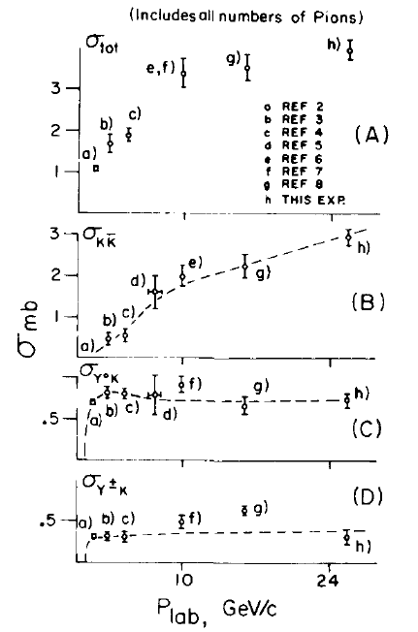
Main background
All events including K⁺, π⁻, π⁻
  ＊Less information from old experiments
  σ _{Total} of π⁻ p @ 16 GeV/c : 25.7 mb
  ⇔ Strangeness production: 3.4 mb
⇒ A few mb
  More than 10⁶ times
  higher than Y_{c}* signals (1 nb)
Background source
  K*⁰(→K^{+,} π⁻) + π⁻
  KK_{bar} (K*K*_{bar}) production + π⁻
  Y K⁺ + π⁻
  Non-resonant multi-meson production
  ＊No special channel contributes to background
Background generation Y. Nara et.al. Phys. Rev. C61 (2000) 024901
  JAM (Jet AA Microscopic transport model)
    Use K⁺ and π⁻ distribution from π⁻ p reaction at 20 GeV/c
      σ = 2.4 mb for (K⁺, π⁻, π⁻)
    ss_{bar} production multiplicity: ~1 (2 K⁺event: ~3%)
Strangeness production C.S.
π⁻ p reaction
@ 16 GeV/c
J. W. Waters et al, NPB17 (1970) 445

Slide 65
String model for JAM
String model region in JAM: 4 GeV <√s < 10 GeV (~6.2 GeV for 20 GeV/c)
String production by hadron-hadron collision
  String(hadron) + String(hadron)→st(qq_{bar}) + st(qqq) + st(qq_{bar}) + …
String collision
  Not considered: Hadronization at first ⇒ Hadron-hadron collisions
  Color flux between strings was not also considered.
Hadronization model: Lund model
qqbar production rate: uu_{bar}: dd_{bar} : ss_{bar}: cc_{bar} = 1 : 1 : 0.3 : 10⁻¹¹
Input of production rate not obeyed to the spin (³S₁, ¹S₀) statistics
  ρ/(π+ρ) = 0.5, K*/(K+K*)=0.6, D*/(D+D*)=0.75
＊Almost same as of PYTHIA
Difference from PYTHIA
  String collision: Used simplified input model
  Hadronization process: Input parameters of resonances are different.
  Hard process
⇒To be checked by experimental data

Slide 66
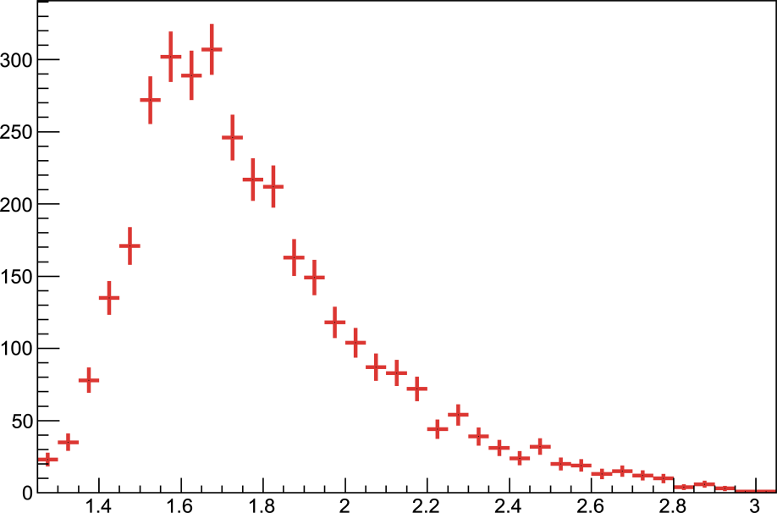
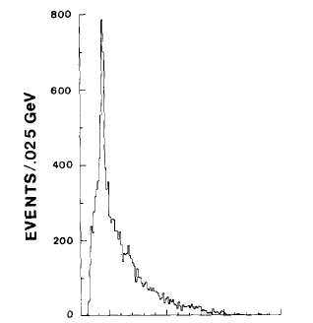
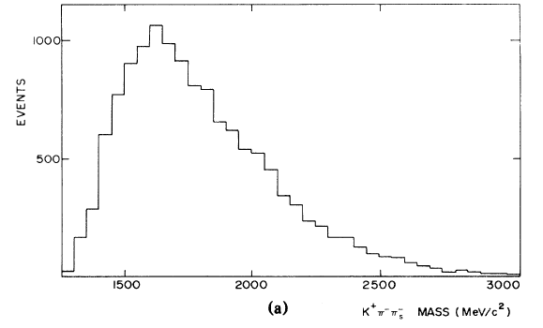
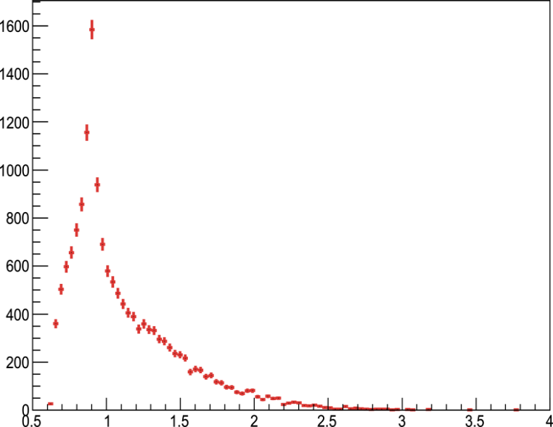
JAM simulation check
_
BNL
13 GeV/c data
J.H. Christenson et al.
PRL 55, 154 (1985)
CERN
19 GeV/c data
B. Ghidini et al.
NPB 111, 189 (1976)
D*⁻ mass
_
D⁰ mass
M(K⁺π⁻π⁻) [GeV/c²]
M(K⁺π⁻) [GeV/c²]
Data
Old data by BNL & CERN:
Invariant mass: M(K⁺π⁻π⁻) & M(K⁺ π⁻)
  π⁻ + p →Y_{c}* + D*⁻ @ 13 GeV/c, 19 GeV/c
Background shape: Reproduced
D*⁻ mass region (±20 MeV) events (BNL: 13 GeV/c data)
  Data: 230 ± 15 counts (stat.) ⇔ Simulation: 240 ± 50 counts (stat. + sys.)
⇒ Old data background reproduced with small ambiguity (20-30%)
JAM simulation
_

Slide 67
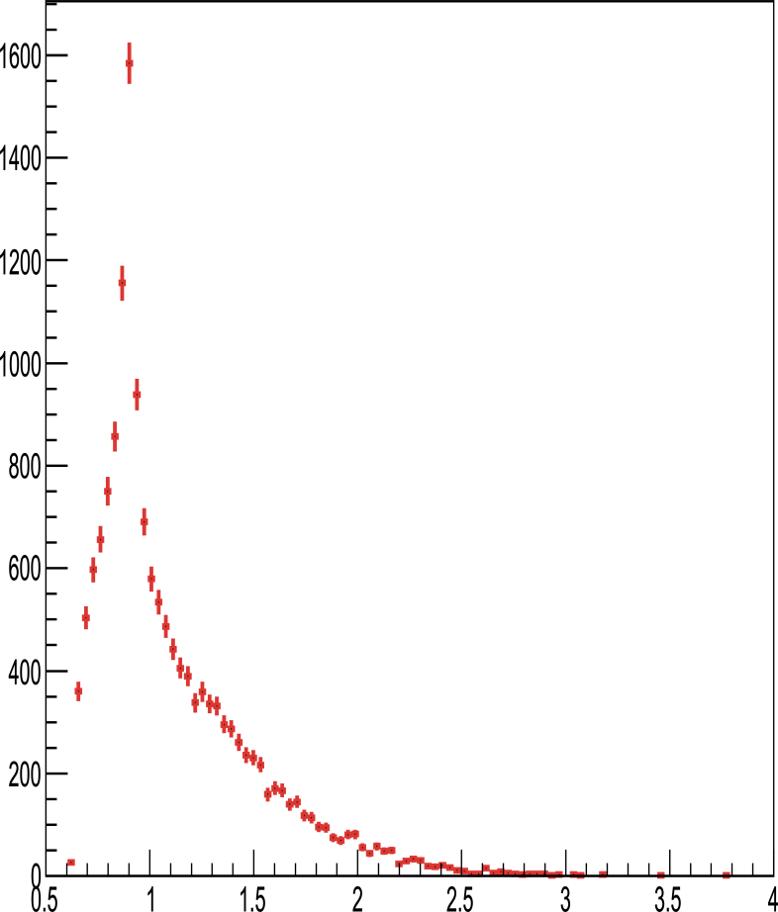
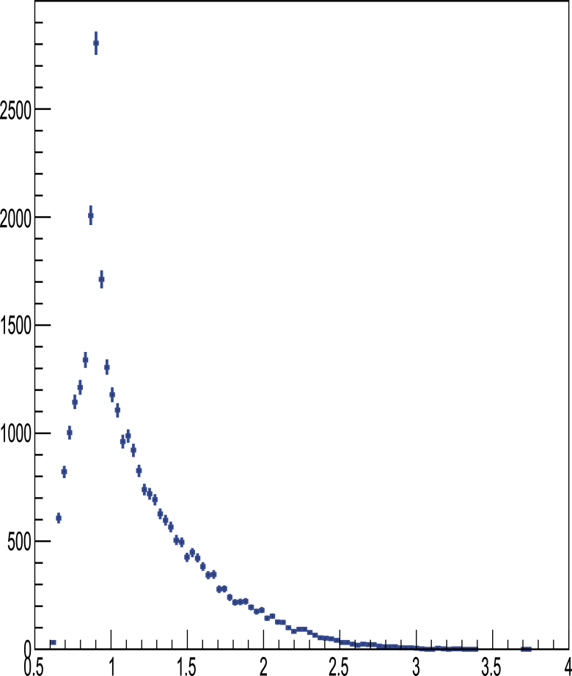
JAM simulation check: M(K⁺ π⁻)
Data
CERN
19 GeV/c data
B. Ghidini et al.
NPB 111, 189 (1976)
JAM simulation
PYTHIA simulation
_
_
D⁰ mass
D⁰ mass
M(K⁺π⁻) [GeV/c²]
M(K⁺π⁻) [GeV/c²]
Peak position normalized

Slide 68
Backup slides for the BG reduction

Slide 69
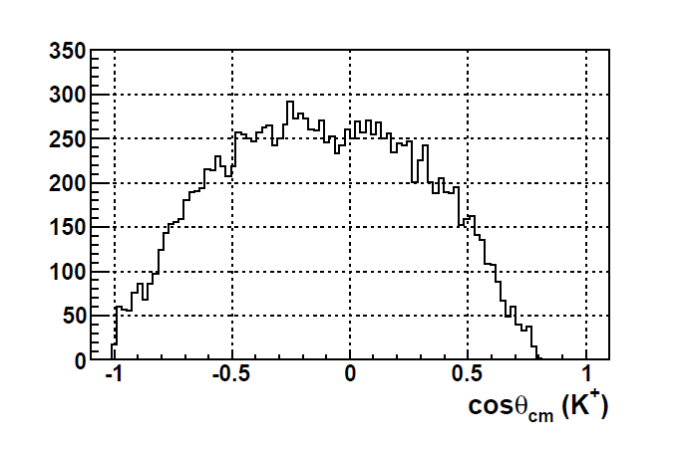
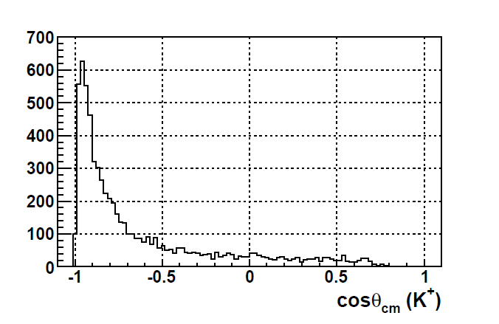
Background reduction
S/N improvement (reduction factor):
  Mass resolution: 2x10⁶
  Decay angle cut: 2
  Production angle cut 4 (depends on dσ/dt)
Signal
Background
p_{K}
K⁺
p_{K}
K⁺
“True D⁰”
mass
“Fake D⁰”
mass
π⁻
p_{π}
p_{π}
π⁻
K⁺ scattering angle in CM
K⁺ scattering angle in CM
Acceptance
= 0.58
Reduction
= 3.8
Signal
Simulation
w/ acceptance
JAM
Simulation
w/ acceptance
Notes:
We have improved the S/N by mass reconstruction resolution by a factor 4.
In true events, K,pi is much ligher than D0, both K/pi are energetic.
As a result, both K/pi momenta are balanced.
In this case, the CM angle of one particle is rather isotropic.
On the other hand, in fake events, K pi may originally come from ligher particles.
To make heavier mass, one of the two particles are tend to be energetic.
In this case, the slower particle seems to be emitted backwards in the CM system.

Slide 70
Background reduction
Total cross section @ 20 GeV/c: 25.1 mb
  (K⁺, π⁻, π⁻) final state: 2.43 mb
  D⁰ mass region (1.852−1.878 GeV/c²): 21.7 μb (1/112)
  D^{*−} tagging (Q = 4.3−7.5 MeV): 50.2 nb (1/434)
    Old experiment: 1/100 by 4 time worse resolution
  Acceptance: 1.2 nb (1/43)
    Detector: 50% for D* tagged background events
    Momentum cut (p_{K+} & p_{π−} > 2.0 GeV/c, Soft π⁻ = 0.5−1.7 GeV/c)
Total reduction: 112×434×43 ~ 2×10⁶

Slide 71
S/N ratio
Background reduction
Total reduction: 112×434×43 ~ 2×10⁶
Event selection: 16
Signal: 12 nb (1 nb×12 states)
  B.R.×0.026 ⇒ 0.312 nb
  Event selection×1/2 ⇒ 0.156 nb
BG: 2.43 mb ((K⁺, π⁻, π⁻) final state)
  0.081 nb
⇒ S/N = 2.1 for D⁰ and D* mass region
S/N estimation
Signal: 12×1000 = 12000 counts
BG: 12000/2.1 = 5700 counts
⇒ Mass region: 2.2-3.4 GeV ⇒ ~5 counts/MeV
⇒ S/N = 1000/150 ~ 7
  30 MeV region: 150 counts
S/√N = 100/√1000 ~ 3
  Signal: σ= 0.1 nb, Γ = 100 MeV: ⇒ 100 counts
  BG: 200 MeV region ⇒ 1000 counts

Slide 72
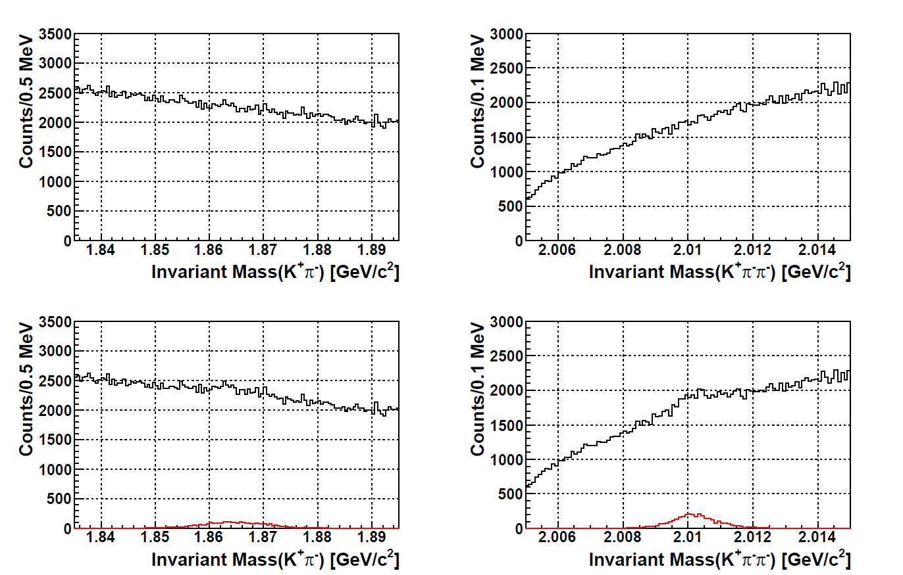
D⁰, D*⁻ spectrum
Full conditionの1/7 event, 12 nb in total: ~ 3200 events
Invariant massを組むだけだとpeakは見えない
  BGが連続的な分布なのでfittingすれば有意なpeakと認識される

Slide 73
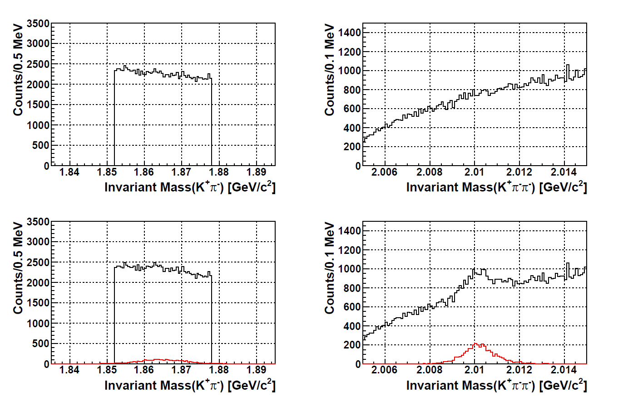
D⁰, D*⁻ spectrum
BG only
BG only
BG + Signal
BG + Signal
1/7 event, 12 nb in total: ~ 3200 events
D⁰ cutでD*⁻のpeakが確認できる

Slide 74
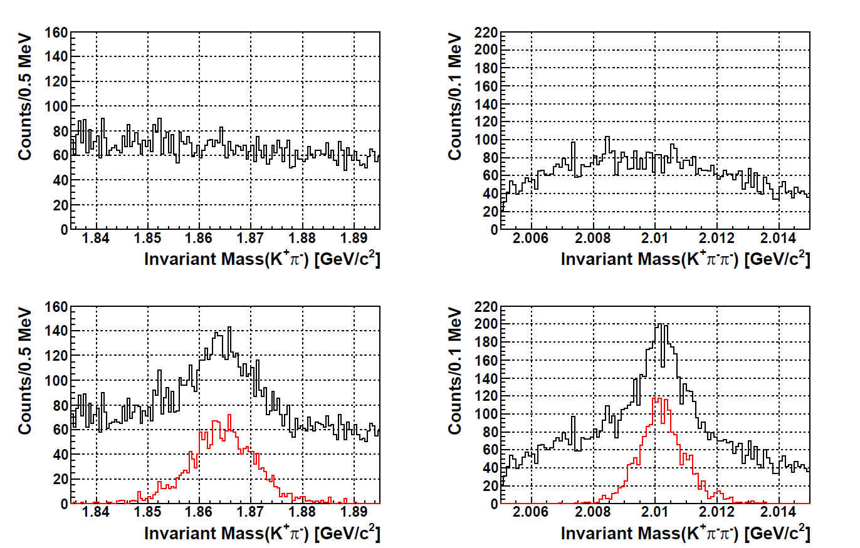
D⁰, D*⁻ spectrum
Full conditionの1/7 event, 12 nb in total: ~ 2000 events
t-channel dominanceを利用したevent selection
  Clearなpeakが見える

Slide 75
Decay measurement
Setup modification
Performances

Slide 76
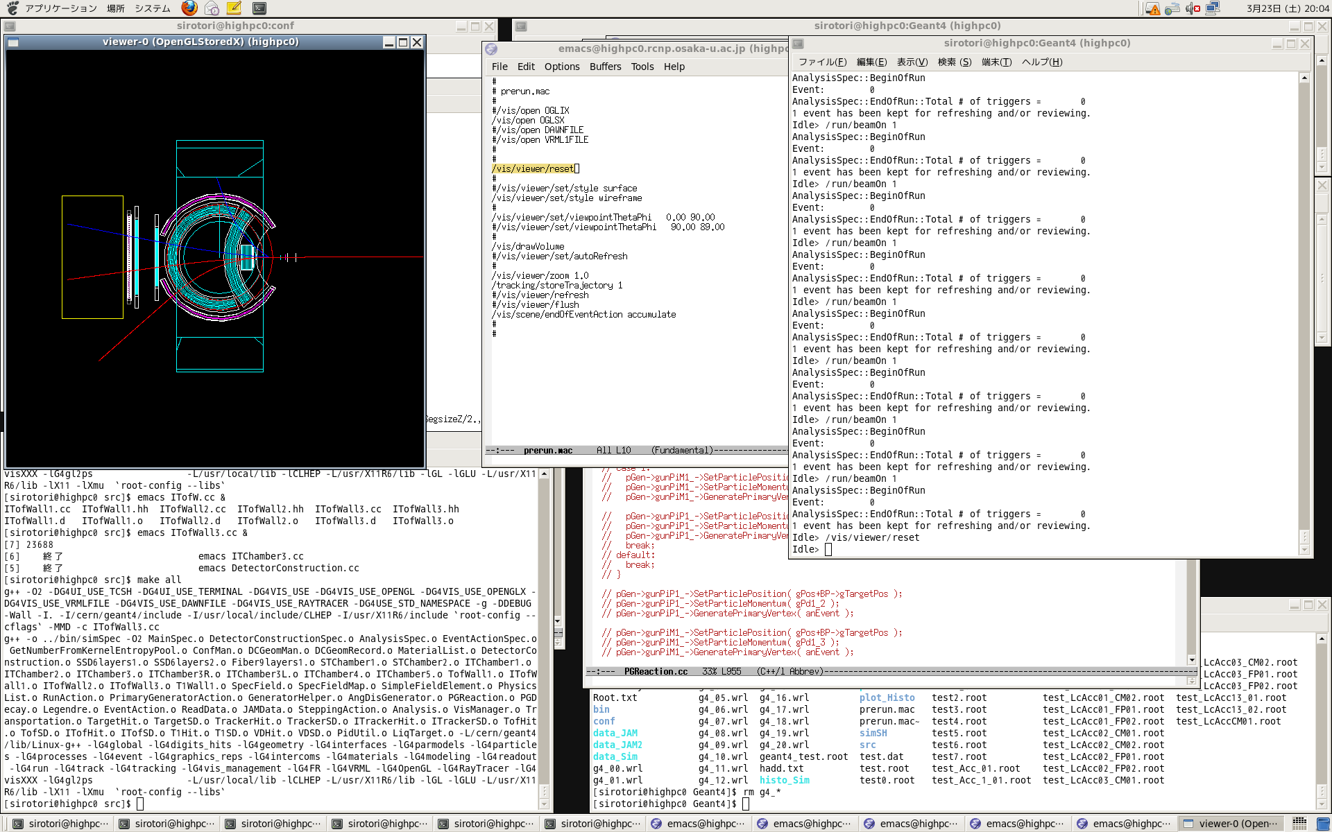
Decay measurement
Internal tracker
Magnet pole
Beam
Beam
Target
Target
Magnet pole
Surrounding TOF wall
Pole PAD TOF wall
Method: Mainly Forward scattering due Lorentz boost (θ < 40°)
  Horizontal direction: Internal tracker and Surrounding TOF wall
  Vertical direction: Internal tracker and Pole PAD TOF detector
Mass resolution: ~ 10 MeV(rms)
  Only internal detector tracking at the target downstream
PID requirement: TOF time difference (π & K) ⇒ ΔT > 500 ps
  Decay particle has slow momentum: < 1.0 GeV/c

Slide 77
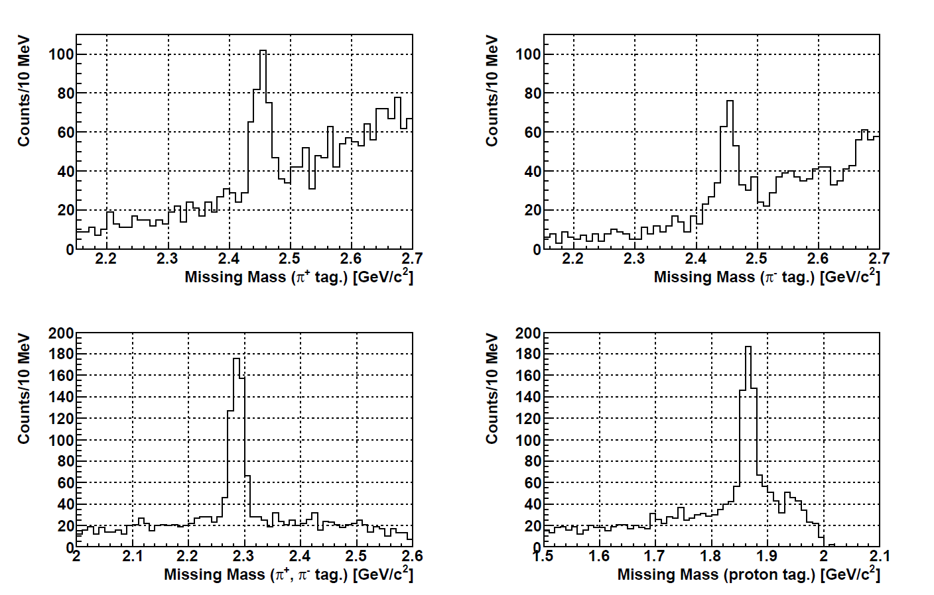
Decay missing mass spectrum: SUM
Σ_{c}⁰ π⁺
Σ_{c}⁺⁺ π⁻
Σ_{c}⁰
Σ_{c}⁺⁺
Λ_{c}⁺ π⁺ π⁻
p D⁰
D⁰
Λ_{c}⁺
＊Full event w/ background/ No “Λ_{c}⁺ π⁺ π⁻ gated”
Continuum background shape around Σ_{c} mass region
Background events from Λ_{c} were the same as of (K⁺π⁻π⁻)
Better S/N of π⁻ tag. event than π⁺ tag.

Slide 78
Study condition
Assumed decay mode for Λ_{c}*⁺(J^{P} = 3/2⁺, M = 2.94 GeV/c²)
  N + D: Γ = 0.4 ⇒ p D⁰: 0.2, n D⁺ :0.2
  Σ_{c} + π: Γ = 0.4 ⇒ Σ_{c}⁺⁺ π⁻: 0.4/3, Σ_{c}⁺ π⁰: 0.4/3, Σ_{c}⁰ π⁺: 0.4/3
    Decay to Σ_{c}(2455) assumed
  Λ_{c} + π + π: Γ = 0.2 ⇒ Λ_{c}⁺ π⁺ π⁻: 0.1, Λ_{c}⁺ π⁰ π⁰: 0.1
Yield estimation @ 1 nb case (~1900 counts)
  p D⁰: 0.2 ⇒ 1900×0.2×0.8 = ~300
  Σ_{c}^{++,0} π^{−,+}: 0.4/3 ⇒ 1900×0.4/3×0.8 = ~200
    Forward scattering of protons
    Wider scattering angle of pions
    Combined with 4-body D⁰ decay mode: 3 times larger yield
      D⁰→K⁺ π⁻ (B.R.= 3.88%, acceptance = ~60%)
      + D⁰→ K⁺ π⁻ π⁺ π⁻ (B.R.= 8.07%, acceptance=~50%)
      Background level of 4-body case is larger. But, it can be combined.

Slide 79
Comments
Decay measurement
  Forward charged particle detection
    Particles scattered to θ<40° due to Lorentz boost
  Enough acceptance and angular coverage
    Pole PAD detector & internal TOF wall are used.
Signal counts
  Combine 2-body and 4-body D⁰ decay channels
    Σ_{c} π mode: > 500 counts
    p D mode: > 800 counts
  Braining ratio obtained with ~5% statistical error
    Assumed branching ratio @ 1 nb case & 100 days beam time
  Angular distribution
    S, P, D-wave can be measured.
    Both polar and azimuthal angle can be measured.
Other decay channels: Neutral channels
  π⁰ detection: Adding collimator
  n D⁺ mode: Downstream neutron counter

Slide 80
“Schematic” Level Structure of Heavy Baryons
λ and ρ motions split (Isotope Shift)
Spin-dependent Int.
+ Σ_{ij} σ_{i}σ_{j}
λ/ρ mode split
(Isotope shift)
Λ_{c}(P_{ρ},χ^{s}) ^{1/2-, 3/2-, 5/2-}
q-q
ρ
Σ_{c}(P_{ρ},χ^{ρ}) ^{1/2-, 3/2-}
P-wave
ρ mode
Λ_{c}(P_{ρ},χ^{λ}) ^{1/2-, 3/2-}
Σ_{c}(P_{λ},χ^{s}) ^{1/2-, 3/2-, 5/2-}
Q
Σ_{c}(P_{λ},χ^{λ}) ^{1/2-, 3/2-}
q-q
λ mode
Λ_{c}(P_{λ},χ^{λ}) ^{1/2-, 3/2-}
λ
Σ_{c}*(3/2+)
Q
Σ_{c}(1/2+)
G.S.
m_{Q} = m_{q}
m_{Q} > m_{q}
Λ_{c}(1/2+)
80
Notes:
This nature is expected to be reflected in the level structure of charmed baryons…

Slide 81
“Schematic” Level Structure of Heavy Baryons
λ and ρ motions split (Isotope Shift)
Spin-dependent Int.
+ Σ_{ij} σ_{i}σ_{j}
λ/ρ mode split
(Isotope shift)
q-q
ρ
Σ_{c}(P_{λ},χ^{s})
Λ_{c}(P_{ρ},χ^{s})
P-wave
ρ mode
Q
Λ_{c}(P_{ρ},χ^{λ})
Σ_{c}(P_{ρ},χ^{ρ})
q-q
λ mode
λ
Λ_{c}(P_{λ},χ^{λ})
Σ_{c}(P_{λ},χ^{λ})
Q
G.S.
m_{Q} = m_{q}
m_{Q} > m_{q}
81
Notes:
This nature is expected to be reflected in the level structure of charmed baryons…

Slide 82
Baryon spectroscopy in different flavors
Strange baryons
Charmed baryons
s
c
Λ(1/2⁻,3/2⁻,5/2⁻)
ρ
Λ_{c}(1/2⁻,3/2⁻,5/2⁻)
Σ(1/2-,3/2-)
ρ
Σ_{c}(1/2⁻,3/2⁻)
Σ(1/2⁻,3/2⁻,5/2⁻)
λ
ρ
Λ_{c}(1/2⁻,3/2⁻)
Σ(1/2-,3/2-)
Λ(1/2⁻,3/2⁻)
λ
Σ_{c}(1/2⁻,3/2⁻,
5/2⁻)
Σ_{c}(1/2⁻,3/2⁻)
Λ(1/2⁻,3/2⁻)
λ
Λ_{c}(1/2⁻,3/2⁻)
Σ(3/2⁺)
Σ_{c}(3/2⁺)
Σ_{c}(1/2⁺)
Σ(1/2⁺)
Λ(1/2⁺)
Λ_{c}(1/2⁺)
non-rel. QM:H=H₀ +V_{conf} +V_{SS}+V_{LS}+V_{T}
ρ−λ mixing (cal. By T. Yoshida)
Notes:
More generalized feature of diquark mode in baryon resonances can be seen in this figure.
This illustrates the level structure of excited states, particularly the rho/lambda-mode excited states as a function of the mass of heavy quark.
Six excited states of different diquark motions are moved as changing the heavy quark mass.
Here, one finds that the rho-lambda mode separation becomes clearer in heavier quark mass.
This point is important to extract information of diquark motions in baryons.
After we learn the diquark correlations in charmed baryons, we could understand lighter baryons much better.
This is our strategy…

Slide 83
Level structure (Exp.)
900
Λ
Σ
Λ_{c}
Σ_{c}
Threshold
Threshold
800
K*N(1830)
1830 5/2-
700
2940 ??
D*N(2950)
1800 1/2-
1775 5/2-
Ση(1740)
1750 1/2-
600
1690 3/2-
1690 ??
Λη(1663)
1670 1/2-
1670 1/2-
2880 5/2+?
2800 ??
500
1620 1/2-
2765 ??
DN(2800)
1580 3/2-
Σ∗π(1520)
400
1520 3/2-
2628 3/2-
Σ∗π(2650)
KN(1432)
300
1405 3/2-
1383 3/2+
Σπ(2590)
2593 1/2-
2519 3/2+
Σπ(1330)
200
2455 1/2+
100
1192 1/2+
0
1116 1/2+
2286 1/2+
Notes:
チャームセクターでは、まだ未発見の状態が多く、スピンパリティも確定していない。
モードのアサインもできていない。

Slide 84
 |  | JP | rating | Width [MeV] | →NK [%] | →Λπ [%] | →Σπ [%]
 | Σ(1940) | 3/2- | 4* | 220 | <20 | seen | Seen
 | Σ(1915) | 5/2+ | 3* | 120 | 5-15 | seen | Seen
Λ(1890) |  | 3/2+ | 4* | 95 | 20~35 |  | 3~10
 | Σ(1880) | 1/2+ | 2* | 220?
 | Σ(1840) | 3/2+ | 1* | 120?
Λ(1830) |  | 5/2- | 4* | 95 | 3~10 |  | 35~75
Λ(1820) |  | 5/2+ | 4* | 80 | 55~65 |  | 8~14
Λ(1810) |  | 1/2+ | 3* | 150 | 20~50 |  | 10~40
Λ(1800) |  | 1/2- | 3* | 300 | 25~40 |  | Seen
 | Σ(1775) | 5/2- | 4* | 120 | 37~43 | 14-20 | 2-5
 | Σ(1750) | 1/2- | 3* | 90 | 10~40 | seen | <8 | (Ση)15~55
 | Σ(1690) | ?? | 2*
Λ(1690) |  | 3/2- | 4* | 60 | 20~30 |  | 20~40
 | Σ(1670) | 3/2- | 4* | 60 | 7~13 | 5~15 | 30-60
Λ(1670) |  | 1/2- | 4* | 35 | 20~30 |  | 25~55
 | Σ(1620) | 1/2- | 1*
 | Σ(1580) | 3/2- | 1*
Λ(1520) |  |  | 4* | 19 | 45+-1 |  | 42+-1
Threshold
K*N(1830)
Ση(1790)
Λη(1710)
KN(1432)
Σπ(1330)
Σ∗π(1520)

Slide 85
Y* production and decay channels
Production
  π⁻ + p → Λ*, Σ^{*0} + K^{*0} (K_{s}⁰)
    From K^{*0} → K⁺ π⁻ reconstruction
  π⁻ + p → Σ^{*−} + K^{*+} (K⁺)
    From K^{*+} → K_{s}⁰ + π⁺ → π⁺ π⁻ π⁺ reconstruction
  ＊Both channels are needed to study each Y* resonance
Decay
  K_{bar}N mode
    Λ* → K⁻ p, K⁰_{bar} n, (Σ^{*0} →K⁻ p, K⁰_{bar} n)
    Σ^{*−} → K⁻ n
  πY mode
    Λ* → Σ⁻ π⁺, Σ⁰ π⁰, Σ⁺ π⁻ (Σ^{*0} → Λ π⁰, Σ⁻ π⁺, Σ⁰ π⁰, Σ⁺ π⁻ )
    Σ^{*−}→ Λ π⁻, Σ⁻ π⁰, Σ⁰ π⁻
  ＊Detection of charged π or K

Slide 86
Simulation conditions
JAM simulation: π⁻ + p reaction @ p_{π} = 5 GeV/c (√s = 3.21 GeV)
  w/ Charmed baryon spectrometer system
⇒ To check background
  K^{*0} → K⁺ π⁻ reconstruction (B.R. = 0.67)
  K^{*+} → K_{s}⁰ + π⁺ → π⁺ π⁻ π⁺ reconstruction (B.R. = 0.67×0.5×0.69 = 0.23)
  Production angle: Isotropic in CM
Yield
＊N_{π} = 1.0×10¹²
  7 M/spill ×10 days
  10 M/spill×7 days
⇒ N_{Y*} = 1.0 [μb] × 10⁻⁶ ×10⁻²⁴×4.0 [g/cm²]×6.02×10²³
×1.0×10¹²×0.5 (acceptance)×0.5 (efficiency)
= ~6.0×10⁵ events (no branching ratio)

Slide 87
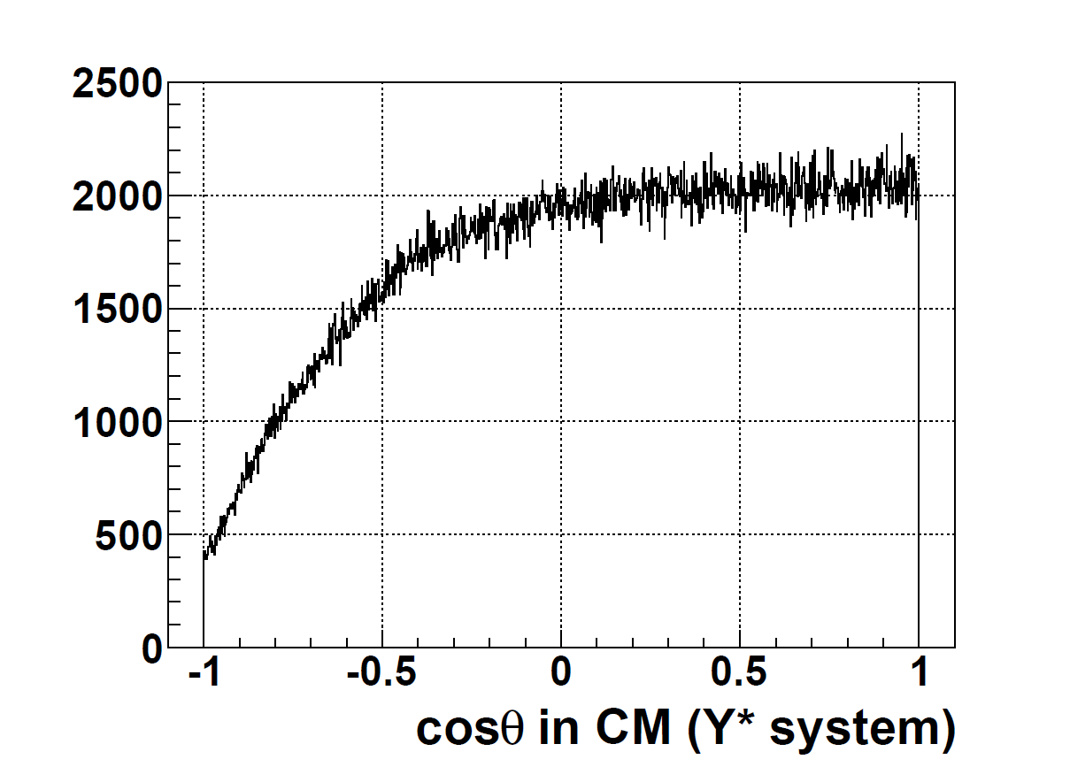
Acceptance
Internal tracker
Magnet pole
Beam
Beam
Target
Target
Magnet pole
Surrounding TOF wall
Pole PAD TOF wall
Method: Mainly Forward scattering due Lorentz boost (θ < 40°)
  Horizontal direction
    Internal tracker and Surrounding TOF wall
  Vertical direction
    Internal tracker and Pole PAD TOF detector
  ⇒ ~70% acceptance for K* detection
Decay measurement: Angle in CM
⇒ Both pole and azimuthal angles: cosθ > −0.5
  ＊Minor change of detector system needed

Slide 90
Signal responses
  p(π⁻,K^{*0})Λ,Σ⁰ and p(π⁻,K^{*+})Σ⁻

Slide 91
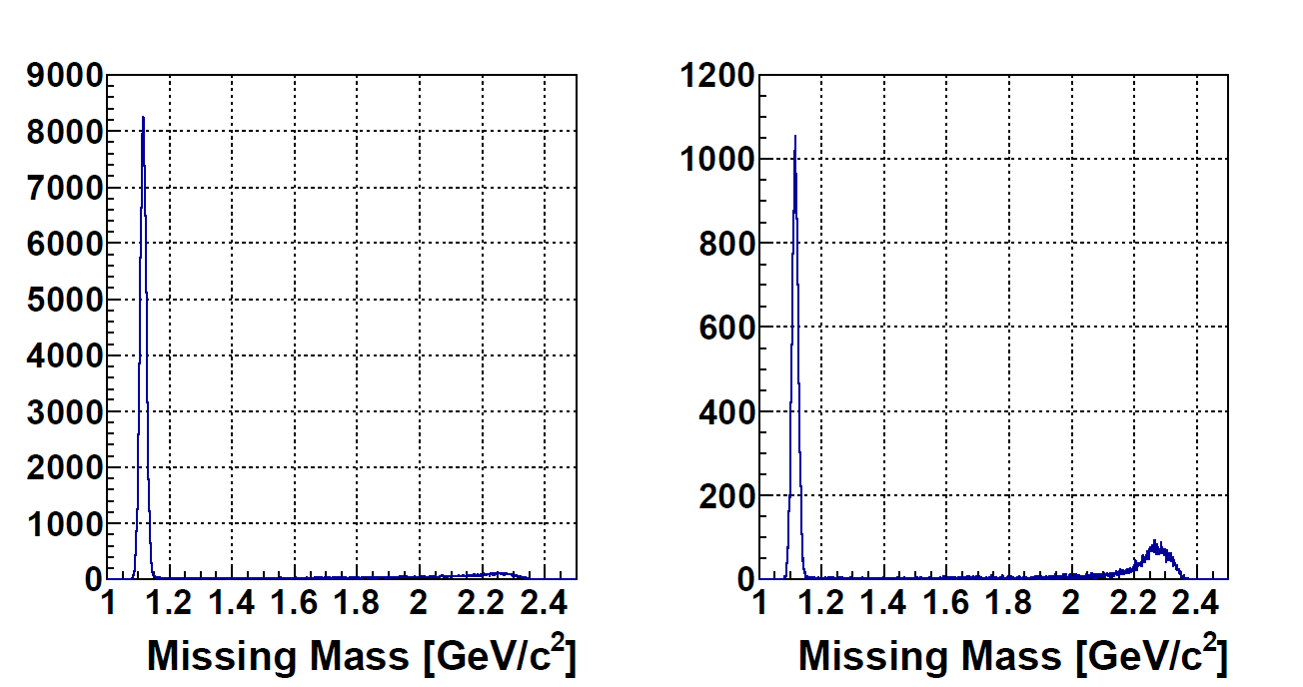
Peaking background
π⁻ p -> Λ K^{*0}
K^{*0} mass selection
π⁻ p -> Λ K^{*0}
K^{*0} mass selection
+ θ_{K*} < 10°
Continuum structure
up to a fake peak
Wrong combination of the K*⁰ background makes a fake peak.
  K*⁰ inv. mass background: K⁺ + slow π⁻ from Λ→p π⁻ event
θ_{K*} selection enhanced peak structure
⇒ Only around 2.2 GeV/c region: All states have same structure.
  Peak with depends on width of the state.
  Continuum structure
Contribution from higher K* resonance: Being checked

Slide 92
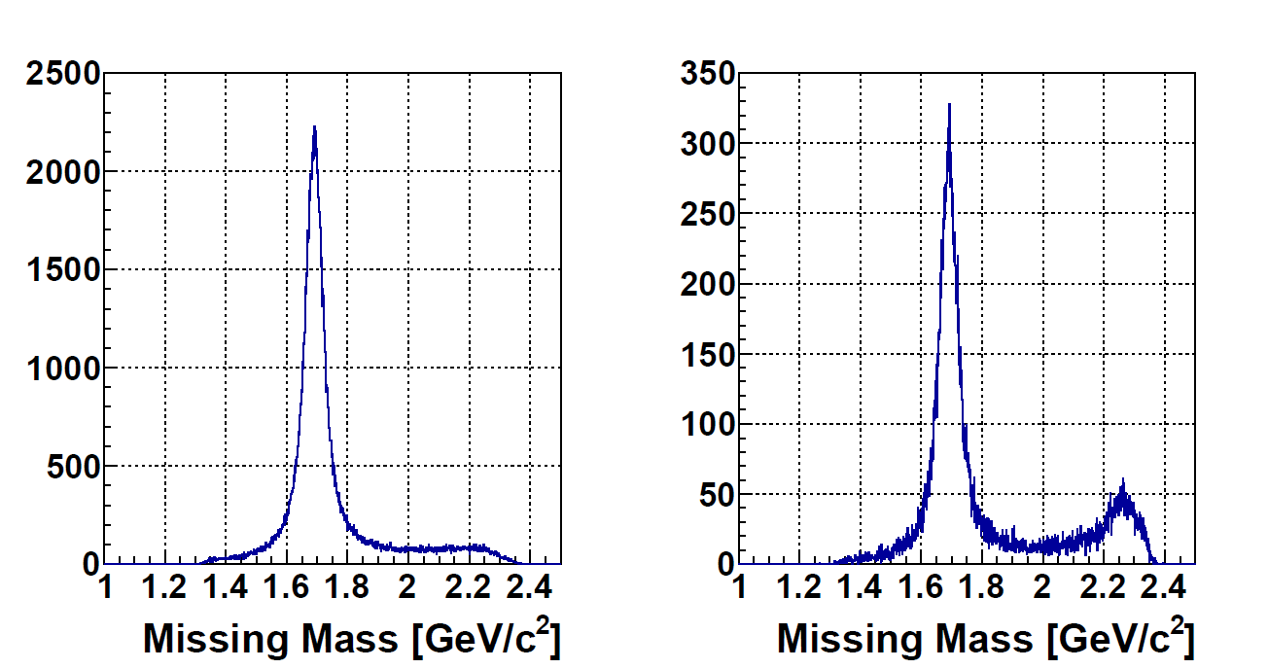
Peaking background
π⁻ p -> Λ(1690) K^{*0}
K^{*0} mass selection
π⁻ p -> Λ(1690) K^{*0}
K^{*0} mass selection
+ θ_{K*} < 10°
Continuum structure
up to a fake peak
Wrong combination of the K*⁰ background makes a fake peak.
  K*⁰ inv. mass background: K⁺ + slow π⁻ from Λ→p π⁻ event
θ_{K*} selection enhanced peak structure
⇒ Only around 2.2 GeV/c region: All states have same structure.
  Peak with depends on width of the state.
  Continuum structure
Contribution from higher K* resonance: Being checked

Slide 93
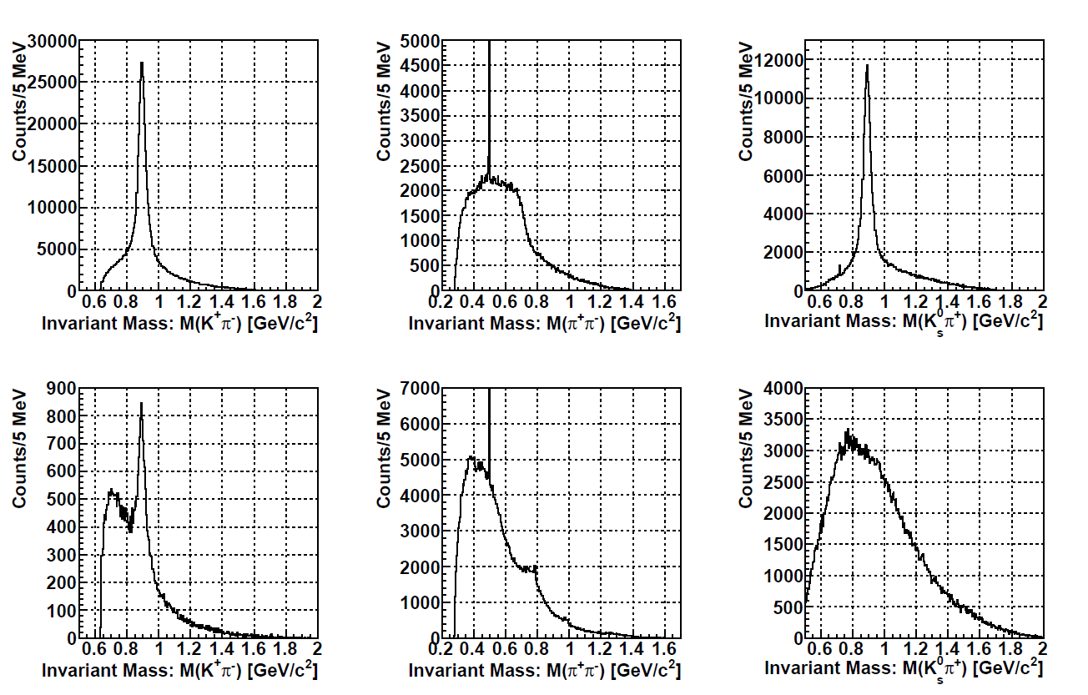
Invariant mass spectrum
Signal
Signal
Signal
K^{*0}
K_{S}⁰
K^{*+}
Background
Background
Background
K^{*0}
K_{S}⁰
K^{*+}
ρ
Signal: Only signals generated
Background: JAM simulation output result

Slide 94
Decay missing mass: K^{*0} channel (Λ*)
Signal: K⁻ p mode
Signal: π⁺ Σ⁻ mode
Signal: π⁻ Σ⁺ mode
p
Σ⁻
Σ⁺
BG: K⁻ p mode
BG: π⁺ Σ⁻ mode
BG: π⁻ Σ⁺ mode
p
Σ⁻
Σ⁺
Λ
p
Signal: Only signals generated
Background: JAM simulation output result

Slide 95
Summary
Large Acceptance
Peaking background
  K⁺ (K⁰) + slow π: wrong combination makes a fake peak at ~2.2 GeV/c²
    No affect < 2 GeV
  Continuum BG above the Resonance mass
    No affect peak shapes
Missing mass spectrum
  Major structure can be observed in the inclusive spectrum.
  λ/ρ mode separation
    Improve S/N in coincidence with a decay mode
  Possible selection: Prod./Decay modes/Angular Dist.
    Decay Branching Ratios
    Production rate, density matrix
Background Estimation
  Major structure can be observed at the signal level of 1 μb.
  BG shape seems a smooth function.
    BG subtraction should be demonstrated.

Slide 96
Trigger

Slide 97
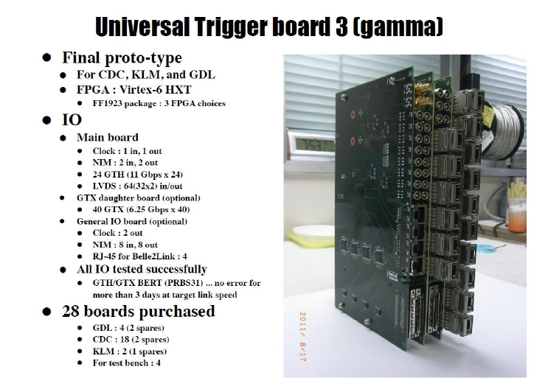
DAQ for charm experiment
Front-end
  Fiber tracker: EASIROC
  DC: Belle2 CDC system
  SSD: APV25s1
  PMT1 (RICH): DRS4 or EASIROC
  PMT2 (Timing counter): DRS4
  ＊LVDS signals are used for trigger.
Trigger generation⇒ FPGA (UT3)
  Trigger merger: Event tagging
    Signalを64 nsごとにevent tagをつけUT3に転送
    (c.f. E16: Detector→merger（LVDS）、merger→UT3（光））
  UT3: Trigger generation
    ここがいわゆるFPGA triggerを作る場所
  Trigger distributer
    各distributerをclock同期させUT3からのtrigger信号をmoduleに送る
＊Trigger生成関連moduleはE16と共通
  Module数は読みだすchannel数に依る (c.f. E16: 97156 ch)
Trigger: Mass trigger
  Momentum analysis by DCs and fiber tracker

Slide 98
Trigger rate estimation for charm
Reaction rate: 3.63×10⁶ /2.0 sec spill (LH₂:4.0 g/cm², 6.0×10⁷ /spill)
  Charged track rate: 3×10⁶ /2.0 sec spill
  Average charged track multiplicity: 4
Momentum analysis in trigger level
  TOF >=2 & ITOF(negative) >=1 & SFT >=3
  Momentum analysis by DC & Fiber
  Charge information
  ⇒ Mass calculation from any positive and negative charge particles
    Mass assumed as positive = K⁺ and negative = π⁻
  ⇒ Mass > 1.50 GeV/c & p⁺ + p⁻ > 11.0 GeV/c : 5−10 kHz
    5% mass resolution (~4σ from D⁰ mass)
    No accidental hits
DAQ system trigger rate capability: 20 kHz (90% efficiency)
  Less than 10 kHz needed for by-product trigger
Momentum analysis
  Tracking: Trackers at the entrance and exit of the dipole magnet
  Transfer matrix: A few order of matrix needed
  Momentum resolution: 2−5% (Cell size position resolution)

Slide 99
Trigger Rate and Yield Estimations
Reaction rate: 7.2×10⁵ /2.0 sec spill (360 kHz)
  LH₂: 4.0 g/cm², 10 M /spill
  Charged track rate: 6.8×10⁵ /2.0 sec spill (340 kHz)
  Average charged track multiplicity: 2.8 ⇒ 2(56%), 4(37%), 6(4.2%)
Momentum analysis in trigger level
  TOF or ITOF >= 2 & SFT >= 2
  Momentum analysis by DC & Fiber
  Charge information
  ⇒ Mass calculation from any positive and negative charge particles
    K^{*0} : Mass assumed as positive = K⁺ and negative = π⁻
    K_{S}⁰ : Mass assumed as positive = π⁺ and negative = π⁻
  Trigger rate
  ＊K^{*0}: 0.8 < Mass < 1.0 GeV/c²: 45 kHz @ 4 g/cm², 10 M/spill
  ＊K_{S}⁰: 0.44 < Mass < 0.55 GeV/c²: 31 kHz @ 4 g/cm², 10 M/spill
  DAQ system trigger rate capability: 20 kHz (90% efficiency)
＊N_{π} = 1.0×10¹²
  7 M/spill ×10 days
  10 M/spill×7 days
⇒ N_{Y*} = 1.0 [μb] × 10⁻⁶ ×10⁻²⁴×4.0 [g/cm²]×6.02×10²³ ×1.0×10¹²
×0.5 (acceptance)×0.5 (efficiency)
= ~6×10⁵ events (no branching ratio)

Slide 100
How to check trigger system
Use known reaction: Hyperon production
  π⁻ p → Λ K_{S}⁰ (~300 μb @ 4.5 GeV/c)
  π⁻ p → Λ K^{*0} (~130 μb @ 4.5 GeV/c)
  (π⁻ p → n ρ⁰)
＊100 μb ⇒ ~1.0×10⁴ events/h @ 1 g/cm², 1 M/spill
  CH₂ target is available for checking displaced vertex method.
From Λ detection study w/ and w/o mass trigger
  Beam rate responses: Start from low beam intensity
    Efficiency
  Bias of trigger
    Momentum dependence: Detector position dependences
    Errors: Event slip
＊Trigger system can be checked by various methods.
  With semi-online analysis
  Including momentum calibration and so on

Slide 101
Backup slides for
Spectroscopy of QQq system

Slide 102
qQQ Baryon spectroscopy
Double Strange
s
c
Double charm
Ξ(1/2⁻,3/2⁻,5/2⁻)
λ
Ξ(1/2⁻,3/2⁻)
Ξ_{cc}(1/2⁻,3/2⁻,5/2⁻)
λ
Ξ(1/2⁻,3/2⁻)
Ξ_{cc}(1/2⁻,3/2⁻)
ρ
Ξ(3/2⁺)
Ξ_{cc}(1/2⁻,3/2⁻)
Ξ(1/2⁺)
Ξ_{cc}(1/2⁺)
non-rel. QM:H=H₀ +V_{conf} +V_{SS}+V_{LS}+V_{T}
ρ−λ mixing (cal. By T. Yoshida)
Notes:
More generalized feature of diquark mode in baryon resonances can be seen in this figure.
This illustrates the level structure of excited states, particularly the rho/lambda-mode excited states as a function of the mass of heavy quark.
Six excited states of different diquark motions are moved as changing the heavy quark mass.
Here, one finds that the rho-lambda mode separation becomes clearer in heavier quark mass.
This point is important to extract information of diquark motions in baryons.
After we learn the diquark correlations in charmed baryons, we could understand lighter baryons much better.
This is our strategy…

Slide 103
Structure and Decay Partial Width
ρ mode (QQ)
λ mode [QQ]

