Slide 1
Spectroscopy: Experimental Status and Prospects
Curtis A. Meyer
Carnegie Mellon University

Slide 2
Outline
Baryons
Mesons
QCD Exotics
  Glueballs
  Hybrid Mesons
Summary

Slide 3
The Baryon Spectrum
****, *** Known **,* Hints
In the quark model picture,
allow individual quarks to
be excited to higher levels:
baryon: q(1s)q(1s)q(1s)
P₁₁(1440) + ****
P₁₁(1710) + ***
P₁₁(1880) +
P₁₁(1975) +
P₁₃(1720) + ****
P₁₃(1870) + *
P₁₃(1910) +
P₁₃(1950) +
P₁₃(2030) +
F₁₅(1680) + ****
F₁₅(2000) + **
F₁₅(1995) +
F₁₇(1990) + **
1s -> 2s, 1s -> 2p
Nucleon
L_{2I,2J} (Mass) Parity Status
P₁₁(938) + ****
S₁₁(1535) - ****
S₁₁(1650) - ****
D₁₃(1520) - ****
D₁₃(1700) - ***
D₁₅(1675) - ****

Slide 4
The Baryon Spectrum
****, *** Known **,* Hints
Missing Baryons
In the quark model picture,
allow individual quarks to
be excited to higher levels:
baryon: q(1s)q(1s)q(1s)
P₁₁(1440) + ****
P₁₁(1710) + ***
P₁₁(1880) +
P₁₁(1975) +
P₁₃(1720) + ****
P₁₃(1870) + *
P₁₃(1910) +
P₁₃(1950) +
P₁₃(2030) +
F₁₅(1680) + ****
F₁₅(2000) + **
F₁₅(1995) +
F₁₇(1990) + **
1s -> 2s, 1s -> 2p
Nucleon
L_{2I,2J} (Mass) Parity Status
P₁₁(938) + ****
S₁₁(1535) - ****
S₁₁(1650) - ****
D₁₃(1520) - ****
D₁₃(1700) - ***
D₁₅(1675) - ****

Slide 5
The Baryon Spectrum
****, *** Known **,* Hints
Treat a quark and a diquark
as the fundamental particles.
Allow excitations as before:
P₁₁(1440) + ****
P₁₁(1710) + ***
P₁₁(1880) +
P₁₁(1975) +
P₁₃(1720) + ****
P₁₃(1870) + *
P₁₃(1910) +
P₁₃(1950) +
P₁₃(2030) +
F₁₅(1680) + ****
F₁₅(2000) + **
F₁₅(1995) +
F₁₇(1990) + **
Nucleon
L_{2I,2J} (Mass) Parity Status
P₁₁(938) + ****
S₁₁(1535) - ****
S₁₁(1650) - ****
D₁₃(1520) - ****
D₁₃(1700) - ***
D₁₅(1675) - ****

Slide 6
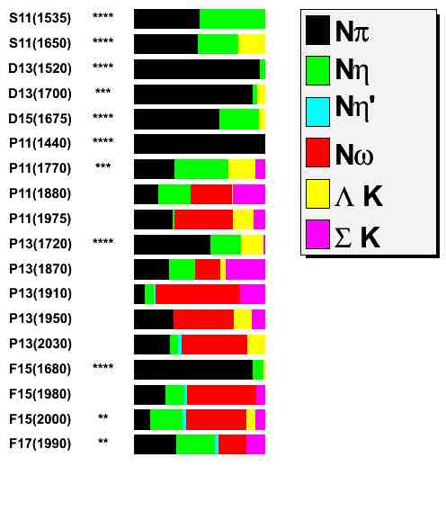
Looking in the wrong place
Nearly all the data used to
identify baryons has come
From π N scattering.
π N → π N
What if the missing states
do not couple to π N ?
(1/2)⁻
(1/2)⁻
(3/2)⁻
(3/2)⁻
(5/2)⁻
(1/2)⁺
(1/2)⁺
(1/2)⁺
(1/2)⁺
(3/2)⁺
(3/2)⁺
(3/2)⁺
(3/2)⁺
(3/2)⁺
(5/2)⁺
(5/2)⁺
(5/2)⁺
(7/2)⁺
Quark model predictions that
many of the missing states
have strong couplings to
other final states:
Nη Nω …

Slide 7
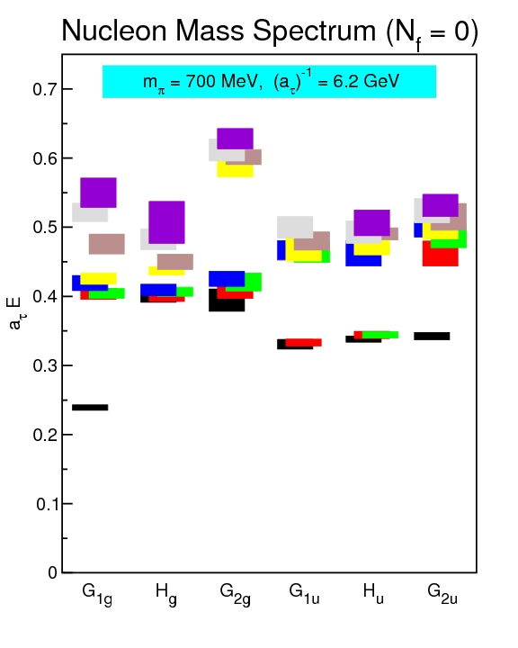
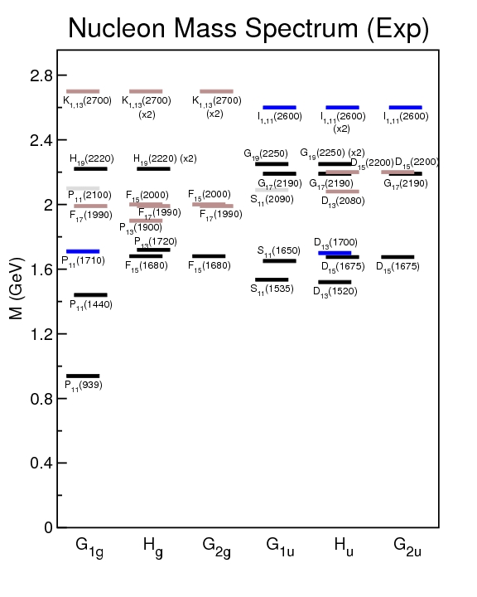
Lattice Calculations
First lattice calculation for baryons (2009). Many
approximations, but shows what will be possible.

Slide 8
Observables in Photo-production
Photo-production of pseudo scalar mesons:
γN ➔ M(0⁻⁺) N’
Photon beam Target Recoil Target-Recoil
x’ y’ z’ x’ x’ x’ y’ y’ y’ z’ z’ z’
x y z x y z x y z x y z
Unpolarized σ T P T_{x’} L_{x’} Σ T_{z’} L_{z’}
Linearly P_{γ} Σ H P G O_{x’} T O_{z’} L_{z’} C_{z’} T_{z’} E F L_{x’} C_{x’}T_{x’}
Circular P_{γ} F E C_{x’} C_{z’} O_{z’} G H O_{x’}
There are 16 observables for these reactions.
Program in place with CLAS at Jefferson Lab to measure these for several systems.

Slide 9
Photo-production Data
CLAS, CBELSA
CLAS
CLAS,CBELSA,LNS,GRAAL
CLAS
CLAS
CLAS
Extensive data sets have recently been published. A large effort is pushing polarization measurements
Analysis of the physical observables is being undertaken by several groups to achieve a consistent description of these data sets. EBAC, SAID, η-MAID, Bonn-Gatchina.
Analyses hint at missing baryons:

Slide 10
Analysis
Bonn-Gatchina PWA coupling data from many channels together into a single analysis. Includes cross section, beam asymmetries, target asymmetries, recoil asymmetries, double-polarization observables and data to resolve isospin contributions. Data are not sufficient to converge to a unique solution.

Slide 11
Analysis
New Baryons from this Analysis.
Bonn-Gatchina PWA coupling data from many channels together into a single analysis. Includes cross section, beam asymmetries, target asymmetries, recoil asymmetries, double-polarization observables and data to resolve isospin contributions. Data are not sufficient to converge to a unique solution.

Slide 12
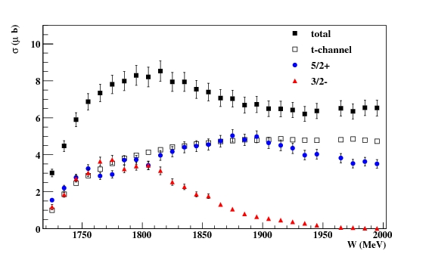
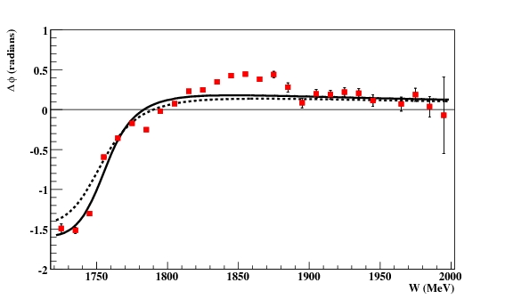
CLAS PWA Results
γp→ωp
Fit showing three amplitudes.
(3/2)⁻ D₁₃
(5/2)⁺ F₁₅
t-channel
Intensities
Not Expected
Phase Difference
Strong evidence for:
(3/2)⁻ N(1700) ***
(5/2)⁺ N(1680) ****
(7/2)⁻ N(2190) ****
The strong signals are well known states!

Slide 13
What is seen?
(1/2)⁻
(1/2)⁻
(3/2)⁻
(3/2)⁻
(5/2)⁻
(1/2)⁺
(1/2)⁺
(1/2)⁺
(1/2)⁺
(3/2)⁺
(3/2)⁺
(3/2)⁺
(3/2)⁺
(3/2)⁺
(5/2)⁺
(5/2)⁺
(5/2)⁺
(7/2)⁺
Strong evidence for:
(3/2)⁻ N(1700) ***
(5/2)⁺ N(1680) ****
(7/2)⁻ N(2190) ****
Hints?
Good Evidence for:
(5/2)⁺ N(2000)
(7/2)⁻ G₁₇(2190) ****

Slide 14
Baryon Summary
A lot of work currently underway to add new data using polarized targets.
Analysis efforts are taking advantage of large data sets.
Starting to see results on missing baryons, but more work is still required.

Slide 15
Positronium
Spectroscopy
A probe of QED
e⁺
e⁻
Spin: S=S₁+S₂=(0,1)
Orbital Angular Momentum: L=0,1,2,…
Total Spin: J=L+S
L=0, S=0 : J=0 L=0, S=1 : J=1
L=1 , S=0 : J=1 L=1, S=1 : J=0,1,2
… …
Reflection in a mirror:
Parity: P=-(-1)^{(L)}
Particle<->Antiparticle:
Charge Conjugation: C=(-1)^{(L+S)}
Notation: J^{(PC)} 0⁻⁺, 1⁻⁻, 1⁺⁻, 0⁺⁺, 1⁺⁺, 2⁺⁺
^{(2S+1)}L_{J} ¹S₀, ³S₁, ¹P₁, ³P₀, ³P₁, ³P₂,…

Slide 16
Spectroscopy and QCD
Quarkonium
Mesons
q
q
radial
Consider the three lightest quarks
4⁺⁺
L=3
3⁺⁺
2⁺⁺
9 Combinations
3⁺⁻
3⁻⁻
L=2
2⁻⁻
1⁻⁻
2⁻⁺
2⁺⁺
L=1
1⁺⁺
0⁺⁺
1⁺⁻
1⁻⁻
S=1
S=0
L=0
0⁻⁺

Slide 17
Mesons
Spectroscopy an QCD
Quarkonium
q
q
4⁺⁺
L=3
3⁺⁺
2⁺⁺
3⁺⁻
ρ,K*,ω,φ
Mesons come in
Nonets of the same
J^{PC} Quantum Numbers
3⁻⁻
L=2
2⁻⁻
π,K,η,η’
1⁻⁻
2⁻⁺
a,K,f,f’
2⁺⁺
L=1
1⁺⁺
b,K,h,h’
SU(3) is broken
Last two members mix
0⁺⁺
1⁺⁻
ρ,K*,ω,φ
1⁻⁻
S=1
S=0
L=0
0⁻⁺
π,K,η,η’

Slide 18
Spectroscopy an QCD
Quarkonium
Mesons
q
q
4⁺⁺
L=3
3⁺⁺
2⁺⁺
Allowed J^{PC} Quantum numbers:
3⁺⁻
3⁻⁻
0⁻⁻ 0⁺⁻
1⁻⁺
2⁺⁻
3⁻⁺
4⁺⁻
5⁻⁺
0⁺⁺ 0⁻⁺
1^{–-} 1⁺⁺ 1⁺⁻
2⁻⁻ 2⁺⁺ 2⁻⁺
3⁻⁻ 3⁺⁺ 3⁺⁻
4⁻⁻ 4⁺⁺ 4⁻⁺
5⁻⁻ 5⁺⁺ 5⁺⁻
L=2
2⁻⁻
1⁻⁻
2⁻⁺
2⁺⁺
L=1
1⁺⁺
0⁺⁺
1⁺⁻
S=1
S=0
Exotic Quantum Numbers
non quark-antiquark description
1⁻⁻
L=0
0⁻⁺

Slide 19
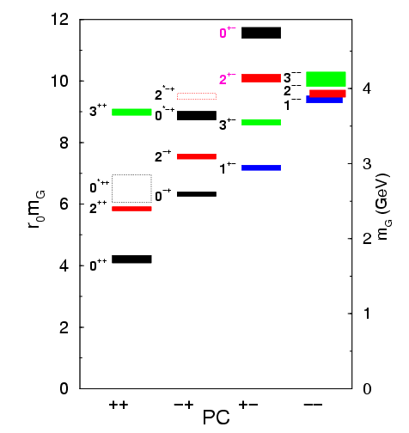
Lattice QCD Glueball Predictions
Gluons can bind to form glueballs
EM analogue: massive globs
of pure light.
Lattice QCD predicts masses
The lightest glueballs have
“normal” quantum numbers.
Glueballs will Q.M. mix
The observed states will
be mixed with normal
mesons.
Strong experimental evidence
For the lightest state.

Slide 20
Identification of Glueballs
Lightest Glueball predicted near two states of same Q.N..
“Over population” Predict 2, see 3 states
Glueballs should decay in a flavor-blind fashion.
Production Mechanisms:
Certain are expected to by Glue-rich, others are
Glue-poor. Where do you see them?
Proton-antiproton
Central Production
J/ψ decays

Slide 21
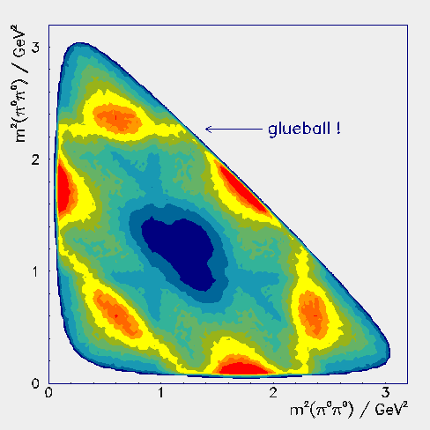
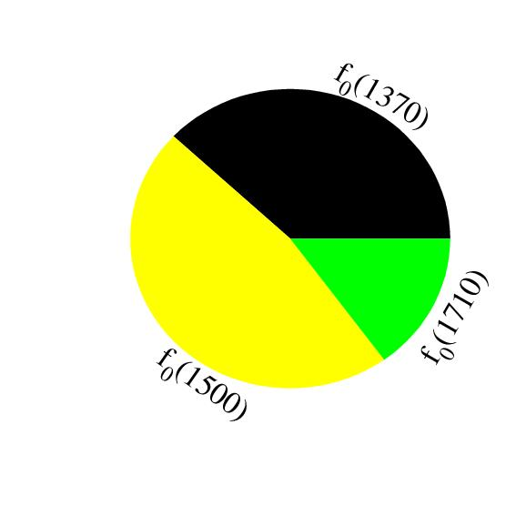
Experimental Evidence
Scalar (0⁺⁺) Glueball and two
nearby mesons are mixed.
f₀(1710)
f₀(1500)
a₀(1450)
K*₀(1430)
f₀(1370)
Glueball
spread
over 3
mesons
a₀(980)
f₀(980)
Are there other glueballs?

Slide 22
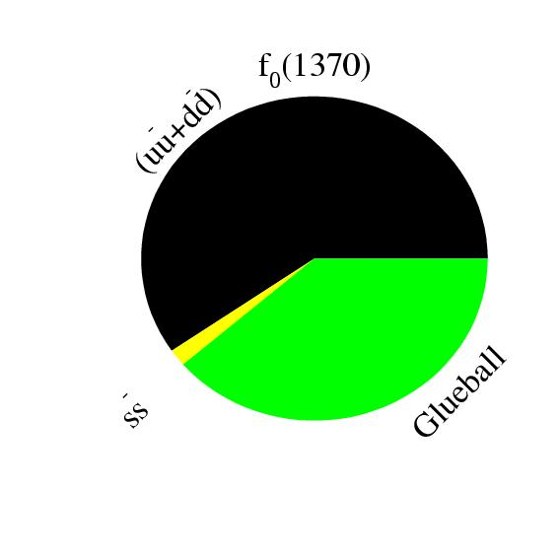
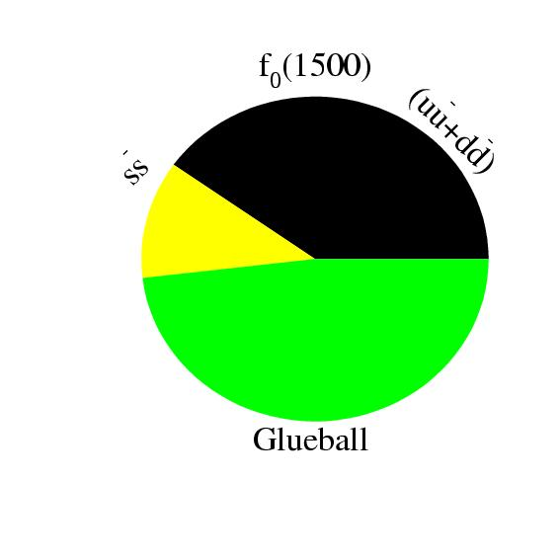
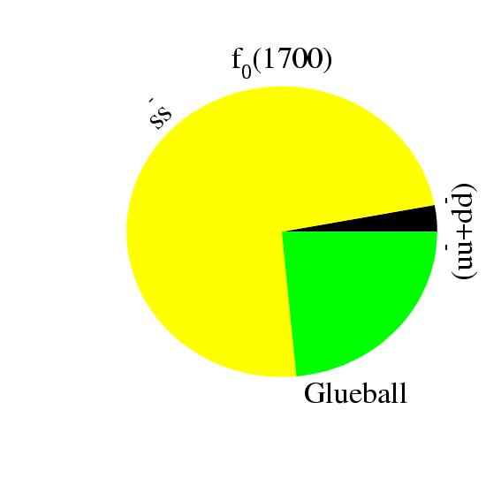
Glueball-Meson Mixing
meson
meson
1
meson
meson
Glueball
r₂
meson
meson
Glueball
r₃
meson
flavor blind? r
Solve for mixing scheme

Slide 23
Higher Mass Glueballs?
Part of the BES-III program will be to search for glueballs in radiative J/ψ decays. Also part of the PANDA program at GSI.
Lattice predicts that the 2⁺⁺ and the 0⁻⁺ are the
next two, with masses just above 2GeV/c^{2.}
Radial Excitations of the 2⁺⁺ ground state
L=3 2⁺⁺ States + Radial excitations
f2(1950), f2(2010), f2(2300), f2(2340)…
2’nd Radial Excitations of the η and η’,
perhaps a bit cleaner environment! (I would
Not count on it though….)
I expect this to be very challenging.

Slide 24
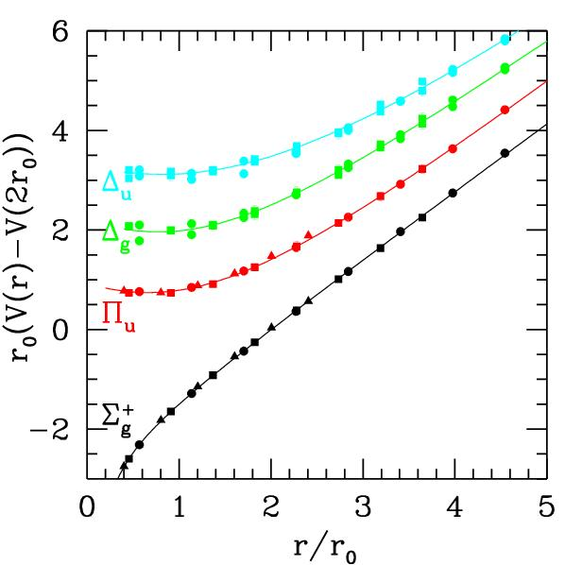
QCD Potential
ground-state
flux-tube
m=0
excited flux-tube
m=1
linear potential
Gluonic Excitations provide an
experimental measurement of
the excited QCD potential.
Observations of the nonets on the excited potentials are
the best experimental signal of gluonic excitations.

Slide 25
Hybrid Predictions
Flux-tube model: 8 degenerate nonets
1⁺⁺,1⁻⁻ 0⁻⁺,0⁺⁻,1⁻⁺,1⁺⁻,2⁻⁺,2⁺⁻ ~1.9 GeV/c²
S=0
S=1
Lattice QCD Calculations
1^{-+ ~}1.9
2⁺⁻ ~2.2
0^{+- ~}2.2
At the physical pion mass?
In the charmonium sector:
1⁻⁺ 4.39 ±0.08
0⁺⁻ 4.61 ±0.11
Many models predict exotic-QN hybrids.
Lattice QCD Calculations

Slide 26
LQCD: The Spectrum of Mesons
Dynamical calculation of the isospin-one light-quark mesons.
3 identical quarks, pion mass~700MeV
Two lattice volumes.
(exotic)
J^{PC}
J^{PC}
J^{PC}
J.J. Dudek (et al.) arXiv:1004.4930

Slide 27
LQCD: The Spectrum of Mesons
Dynamical calculation of the isospin-one light-quark mesons.
Extra
states ???
Non-exotic
QN hybrids.
0⁻⁺
1—
2⁻⁺
1⁺⁻
1⁺⁺
Large overlap with non-trivial operators in the gluonic fields
(exotic)
J^{PC}
J^{PC}
J^{PC}
J.J. Dudek (et al.) arXiv:1004.4930

Slide 28
LQCD: The Spectrum of Mesons
Dynamical calculation of the isospin-one light-quark mesons.
Extra
states ???
Non-exotic
QN hybrids.
0⁻⁺
1—
2⁻⁺
1⁺⁻
1⁺⁺
Large overlap with non-trivial operators in the gluonic fields
This does not look like the flux-tube spectrum. At first glance, it looks more like the bag model predictions?
(exotic)
J^{PC}
J^{PC}
J^{PC}
J.J. Dudek (et al.) arXiv:1004.4930

Slide 29
Looking for Hybrids
Decay Predictions
Analysis Method
Partial Wave Analysis
Meson
Fit n-D angular distributions
Fit Models of production and
decay of resonances.
Meson
L_{glue}
Meson
Angular momentum
in the gluon flux stays confined.
π₁ I^{G}(J^{PC})=1⁻(1⁻⁺)
K₁ I^{G}(J^{PC})= ½ (1⁻)
Nine state
η’₁ I^{G}(J^{PC})=0⁺(1⁻⁺)
η₁ I^{G}(J^{PC})=0⁺(1⁻⁺)
This leads to complicated multi-particle final states.

Slide 30
Hybrid Decays
L_{flux}
The angular momentum in the flux
tube stays in one of the daughter
mesons (an (L=1) and (L=0) meson).
L_{flux}
Exotic Quantum Number Hybrids
π₁→ πb₁ , πf₁ , πρ , ηa₁
η₁→π(1300)π , a₁π
b₂ → a₁π , h₁π , ωπ , a₂π
h₂ → b₁π , ρπ , ωη
b₀ → π(1300)π , h₁π
h₀ → b₁π , h₁η
Mass and model
dependent
predictions
Populate final states with
π±,π⁰,K±,K⁰,η, (photons)

Slide 31
Hybrid Decays
L_{flux}
The angular momentum in the flux
tube stays in one of the daughter
mesons (an (L=1) and (L=0) meson).
L_{flux}
Exotic Quantum Number Hybrids
π₁→ πb₁ , πf₁ , πρ , ηa₁
η₁→π(1300)π , a₁π
b₂ → a₁π , h₁π , ωπ , a₂π
h₂ → b₁π , ρπ , ωη
b₀ → π(1300)π , h₁π
h₀ → b₁π , h₁η
Mass and model
dependent
predictions
Populate final states with
π±,π⁰,K±,K⁰,η, (photons)
The good channels to look at with amplitude analysis.

Slide 32
Hybrid Decays
L_{flux}
The angular momentum in the flux
tube stays in one of the daughter
mesons (an (L=1) and (L=0) meson).
L_{flux}
Exotic Quantum Number Hybrids
π₁→ πb₁ , πf₁ , πρ , ηa₁
η₁→π(1300)π , a₁π
b₂ → a₁π , h₁π , ωπ , a₂π
h₂ → b₁π , ρπ , ωη
b₀ → π(1300)π , h₁π
h₀ → b₁π , h₁η
Mass and model
dependent
predictions
Populate final states with
π±,π⁰,K±,K⁰,η, (photons)
The good channels to look at with amplitude analysis.
Other interesting channels for amplitude analysis.

Slide 33
Experimental Evidence for Hybrids
The most extensive data sets to date are from the BNL E852 experiment.
There is also data from the VES experiment at Protvino and some results from the Crystal Barrel experiment at LEAR. Finally, there is a CLAS (Jefferson Lab) result. We have also just started to see results from the COMPASS experiment at CERN.

Slide 34
Experimental Evidence for Hybrids
The most extensive data sets to date are from the BNL E852 experiment. There is
also data from the VES experiment at Protvino and some results from the Crystal
Barrel experiment at LEAR. Finally, there is a CLAS (Jefferson Lab) result. We have
Also just started to see results from the COMPASS experiment at CERN.
Diffractive production
E852: 18 GeV/c
VES 37 GeV/c
COMPASS:160 GeV/c
M: spin projection
: reflectivity
Natural-parity-exchange: J^{P}=0⁺,1⁻,2⁺, …
Unnatural-parity-exchange: J^{P}=0⁻,1⁺,2⁻, …

Slide 35
Experimental Evidence for Hybrids
Mode Mass Width Production
ηπ⁻ 1370±15+50-30 385±40+65-105 1⁺
ηπ⁰ 1257±20±25 354±64±60 1⁺
ηπ 1400 310 seen in annihilation
π₁(1400)
Mode Mass Width Production
3π 1598 ±8+29-47 168±20+150-12 1⁺,0⁻,1-
η’π 1597±10+45-10 340±40±50 1⁺
b₁π 1664±8±10 185±25±38 0⁻ ,1⁺
f₁π 1709±24±41 403±80±115 1⁺
3π 1660 ±10+64-0 269±21+42-64 1⁺
π₁(1600)
Mode Mass Width Production
b₁π 2014±20±16 230±32±73 1⁺
f₁π 2001±30±92 332±52±49 1⁺
π₁(2015)

Slide 36
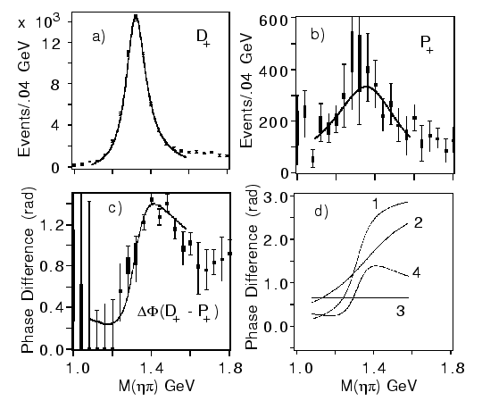
Experimental Evidence for Hybrids
Mode Mass Width Production
ηπ⁻ 1370±15+50-30 385±40+65-105 1⁺
ηπ⁰ 1257±20±25 354±64±60 1⁺
ηπ 1400 310 seen in annihilation
π₁(1400)
E852 + CBAR (1997)
While everyone seems to agree that there is intensity in the P⁺ exotic wave, there are a number of alternative (non-resonant) explanations for this state.
Unlikely to be a hybrid based on its mass. Also , the only observed decay should not couple to a member of an SU(3) octet. It could couple to an SU(3) decuplet state (e.g. 4-quark).

Slide 37
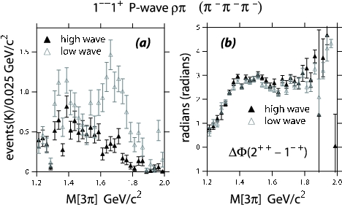
Experimental Evidence for Hybrids
Mode Mass Width Production
3π 1598 ±8+29-47 168±20+150-12 1⁺,0⁻,1⁻ E852
η’π 1597±10+45-10 340±40±50 1⁺ E852,VES
b₁π 1664±8±10 185±25±38 0⁻ ,1⁺ E852,VES,CBAR
f₁π 1709±24±41 403±80±115 1⁺ E852,VES
3π 1660 ±10+64-0 269±21+42-64 1⁺ COMPASS
π₁(1600)
Decay mode sensitive to model
But not in
COMPASS
Exactly the same mass and width as the
Confused production in E852??
This is consistent with a hybrid meson

Slide 38
Experimental Evidence for Hybrids
π₁(2015)
Mode Mass Width Production
b₁π 2014±20±16 230±32±73 1⁺ E852
f₁π 2001±30±92 332±52±49 1⁺ E852
Need two J^{PC}=1⁻⁺ states
π₁(2000)→b₁π
M = 2014±20±16 MeV/c²
Γ = 230±32±73 MeV/c²
Seen primarily in natural
parity exchange.
The natural dominates
m^{ε}=0⁻
1⁻⁺b₁π
m^{ε}=1⁺
1⁻⁺b₁π
Seen in one experiment with low statistics It needs confirmation. If this exists, it is also a good candidate for an exotic hybrid meson.

Slide 39
QCD Exotics
We expect 3 nonets of exotic-quantum-number mesons: 0⁺⁻, 1⁻⁺, 2⁺⁻
π₁ I^{G}(J^{PC})=1⁻(1⁻⁺)
K₁ I^{G}(J^{PC})= ½ (1⁻)
Lattice shows two states here.
η’₁ I^{G}(J^{PC})=0⁺(1⁻⁺)
η₁ I^{G}(J^{PC})=0⁺(1⁻⁺)
π , η , η’ , K → π₁ , η₁ , η’₁, K₁
What are the mixing angles between the isoscalar states?
1⁻⁺
0⁺⁻
2⁺⁻
b₀, h₀, h₀’, K₀
b₂, h₂, h₂’, K₂

Slide 40
Future Prospects:
COMPASS at CERN collected a large data set in 2009. Analysis is underway.
BES III in China has been running for over a year. Analysis on χdecays are looking for light-quark exotics.
GlueX at Jefferson Lab will use photo-production to look for exotic mesons at Jefferson Lab. First physics in 2015.
PANDA at GSI will use antiprotons to search for charmed hybrid states.
CLAS12 at Jefferson Lab will look at low-multiplicity final states in very-low Q**2 reactions.

