Slide 1


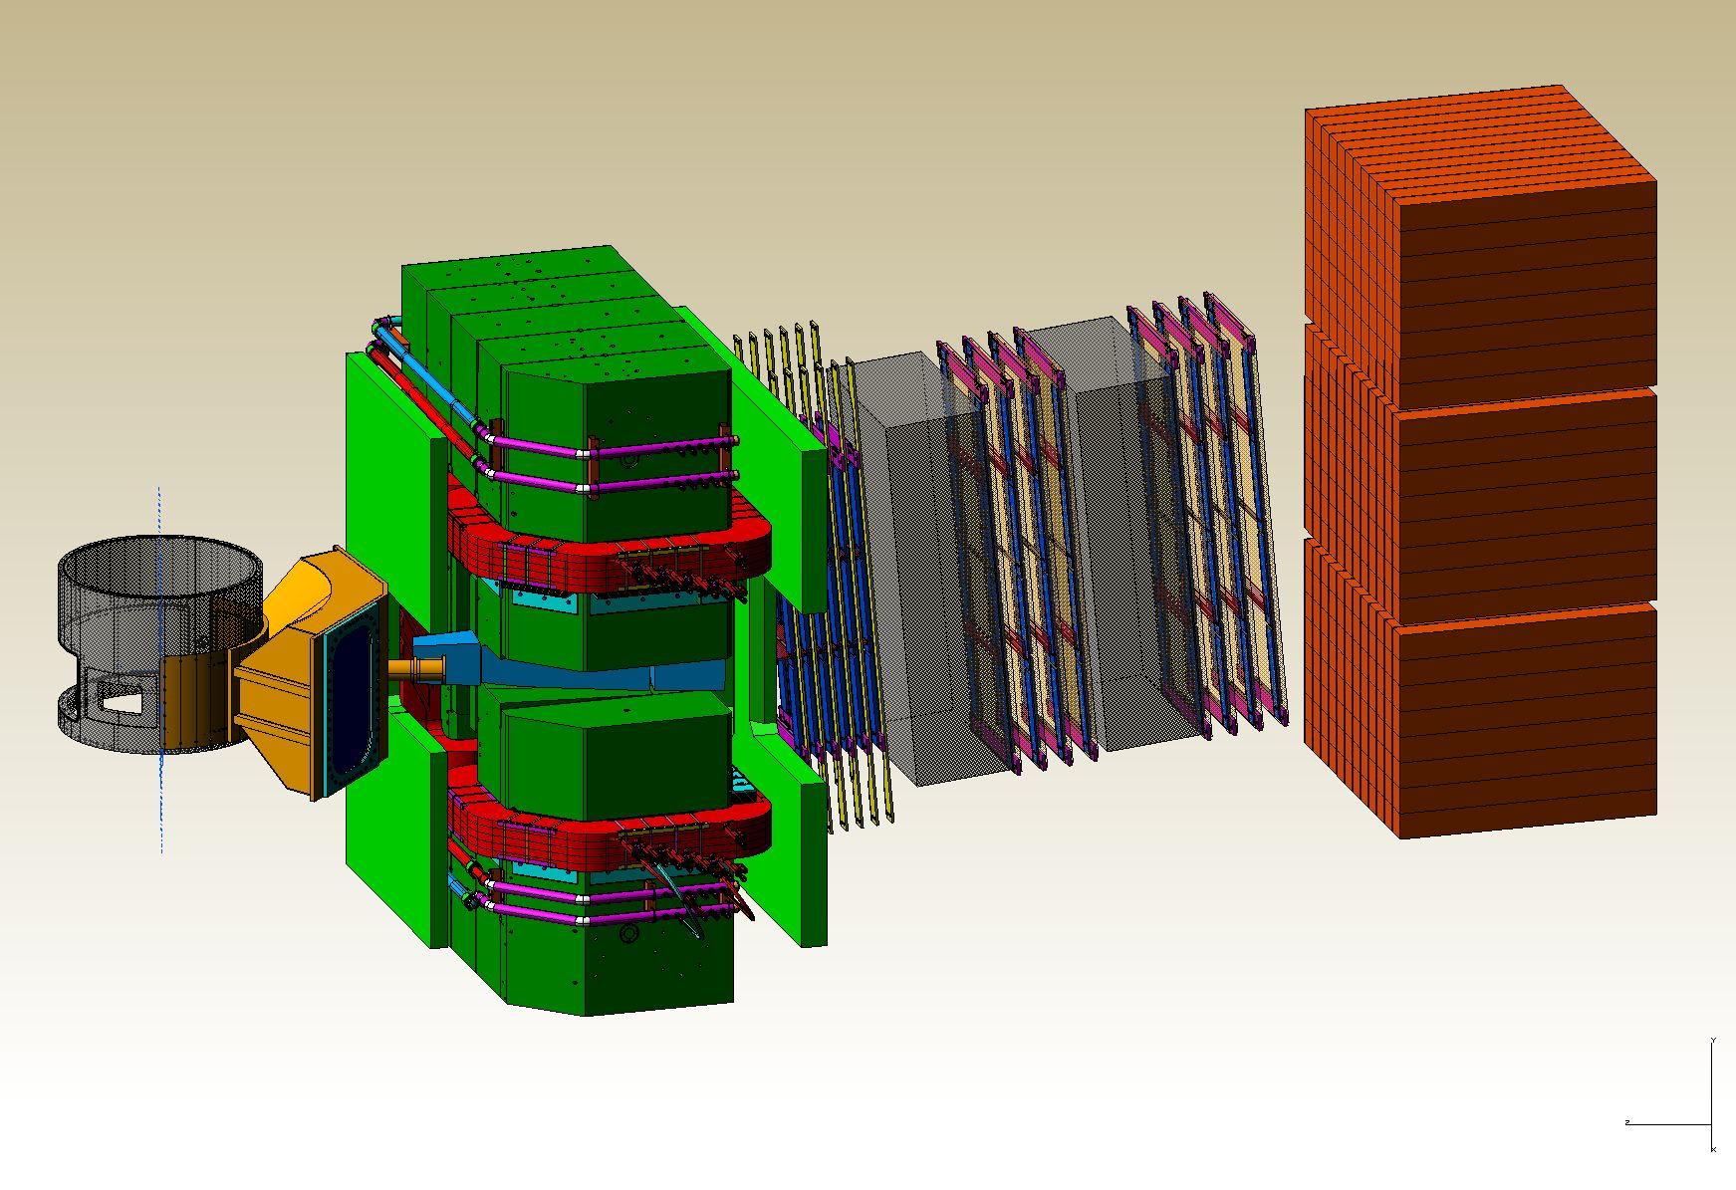
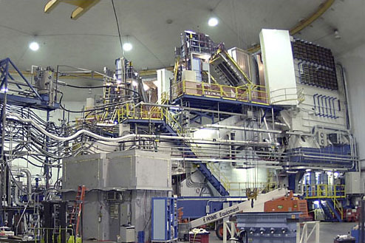
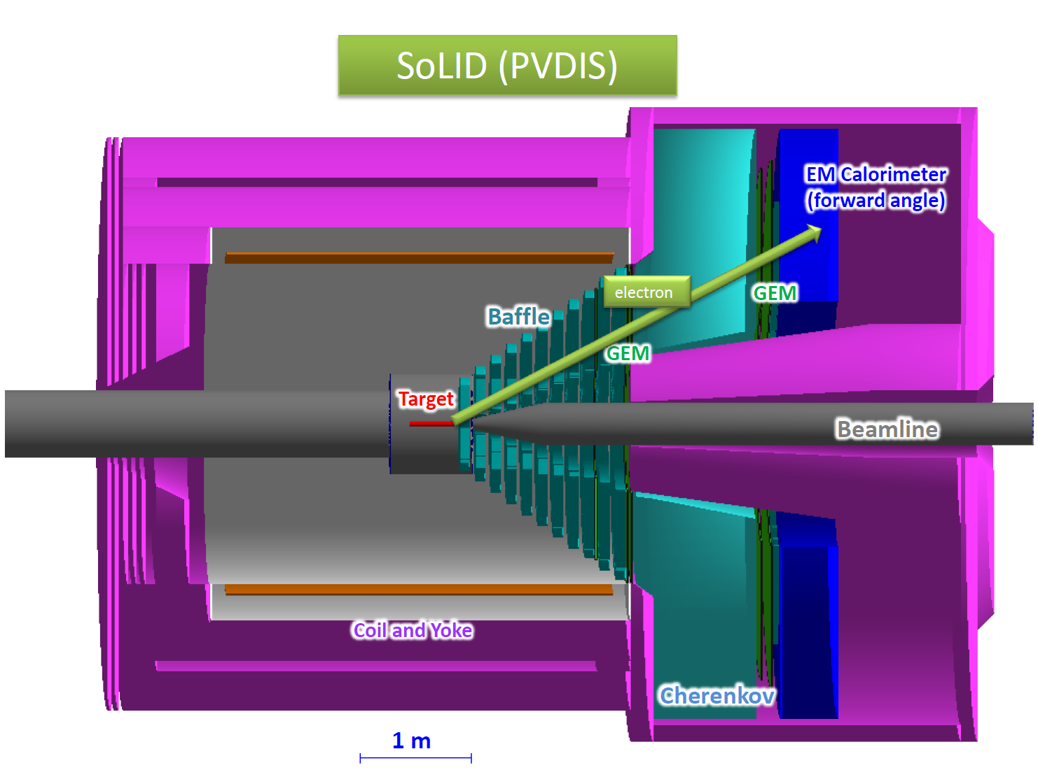
Hall A Update
Thia Keppel
Hall A Collaboration Meeting
January 2016

Slide 2
Hall A Projected Experiment Schedule, updated 2/2015
Experiments in red represent PAC42 “high impact” experiments
Spring | Fall | Spring | Fall | Spring | Fall | Spring | Fall
DVCS –I/ GMp | DVCS –I/ GMp
 |  | DVCS –I/ GMp | ³H/³He group Ar(e,e’p*
 |  |  |  | ³H/³He group Ar(e,e’p)* | TBD: APEX PREX12 CREX A₁^{n} DVCSII | TBD: APEX PREX12 CREX A₁^{n} DVCSII
 |  |  |  |  |  |  | SBS Start?
run “group”
run “group”
CY
2015
X
CY 2016
CY
2017
CY
2018
*best effort

Slide 3
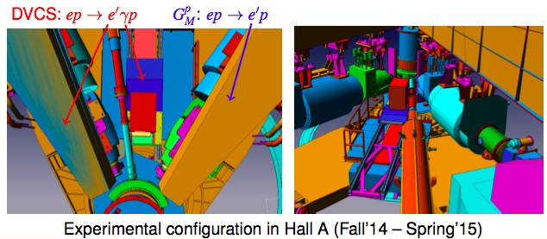
Hall A over the past year
Spring 2015:
E = 9.6 GeV, then E = 2.2 GeV (no physics)
New raster system commissioning
BPM & BCM calibrations
Compton polarimeter commissioning
HRS optics calibrations (R-HRS with SOS quad)
Target boiling studies
Fall 2015:
(no planned physics, so no target or
  spectrometers)
11 GeV successfully delivered to Hall
High current (up to ~55+ uAmps,
many trips at highest current)
New high field Moller polarimeter
  commissioning
Parity beamline instrumentation tests
Beam delivered through Compton
chicane
Now ready for physics!
Notes:
F2 and C12 scans good for acceptance studies

Slide 4
DVCS-I and G_{M}^{p}: Concurrent Experiments in Hall A at 11 GeV
10 calendar weeks in Spring’16
High impact experiment for 3D nucleon imaging
  Deeply Virtual Compton Scattering (DVCS) provides access to Generalized Parton Distributions (GPDs)
Will provide highest available Q² measurement of the DVCS cross section
  Demonstration of scaling critical to full JLab 12 GeV GPD program
DVCS
6.6
8.8
11 GeV
Fall’14
x
x
x
2
3
1 days
G_{M}^{p}
x
x
x
x
6.6
8.8
11 GeV
5 days
4
4
4
x
x
x
x
8.8
11 GeV
13
16 days
13
20
High Q² Form Factors
  Reducing G_{M}^{p} uncertainties will enable Super BigBite high impact program of Form Factor Measurements

Slide 5
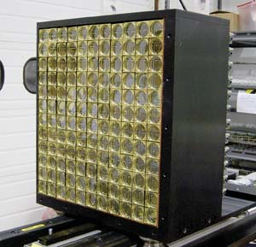
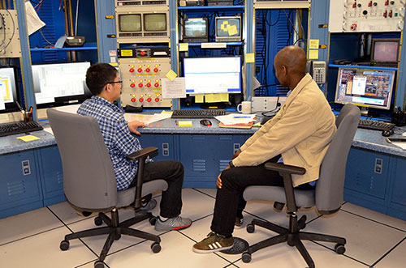
DVCS / G_{M}^{p} Experiments in the Hall now
Start up again ~February 5 with high current (20 uAmp DVCS), 11 GeV beam
Q1-R permanently replaced with old SOS quad
Problems with HRS Q1-L still a concern (new resistive quad to arrive in June)
New Moller polarimeter, additional beamline instrumentation
10 Graduate students
Notes:
F2 and C12 scans good for acceptance studies

Slide 6
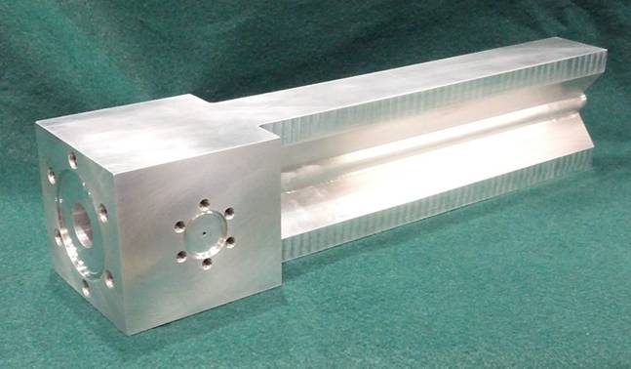
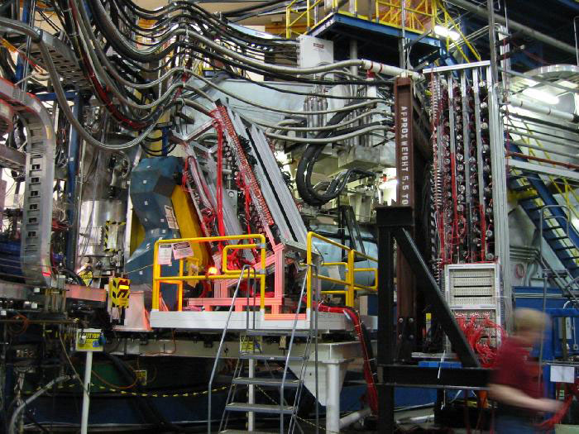
Tritium Experiment Preparations
Four ³H experiments, 2 PAC 40 “high impact”
  12 graduate students
Successful target safety/design review September 2015
  Still a lot to do!
  Integration into the Hall
Combined experiment planning meeting December 2015
  Prepare for readiness review March 16
BigBite under (re-)construction Modified Cerenkov
  Just determined will not be used

Slide 7
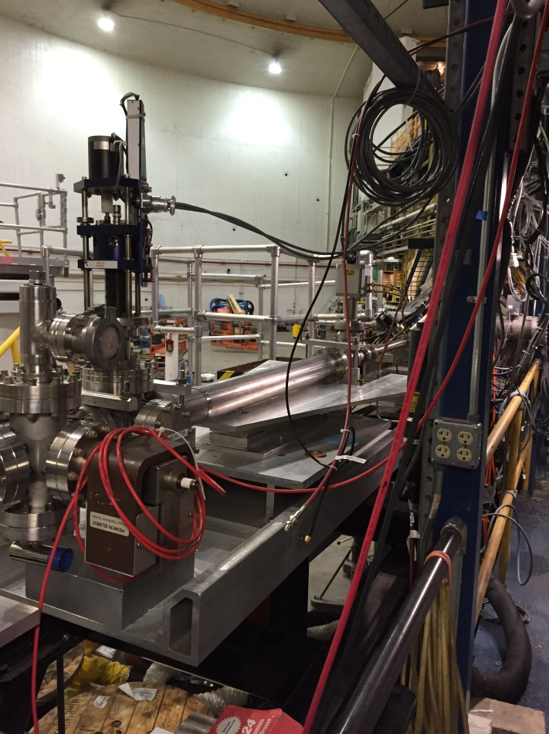
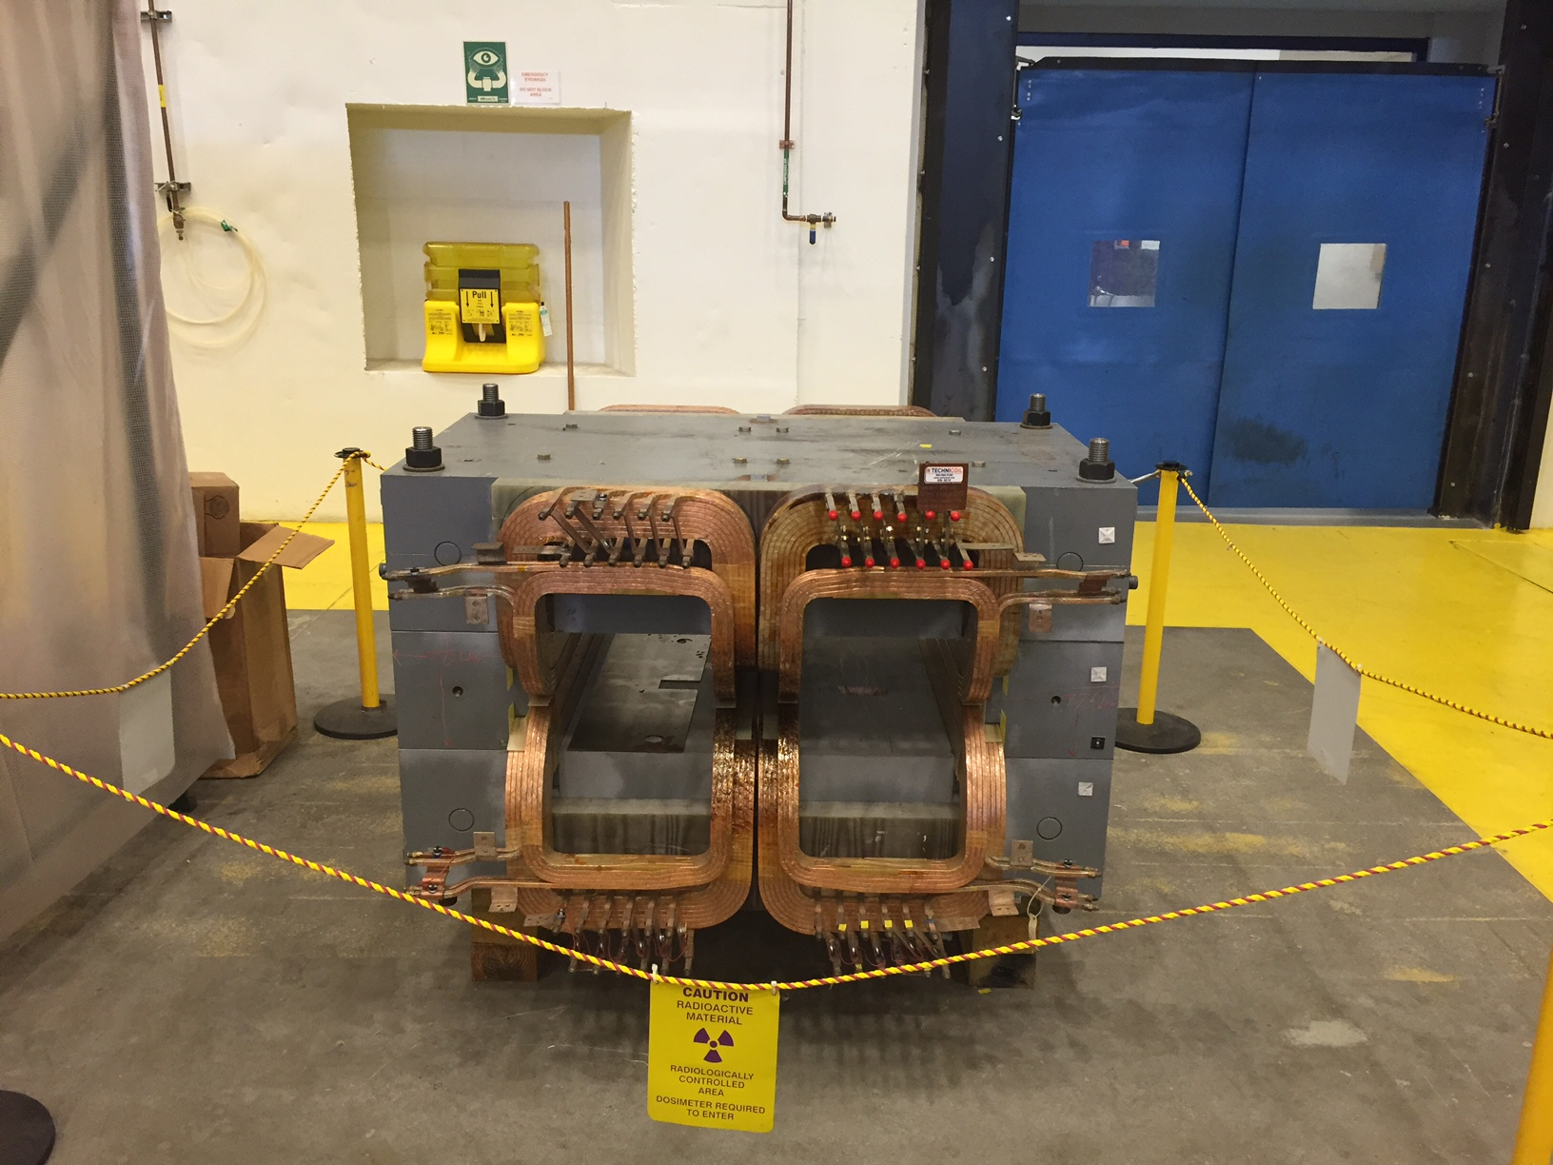
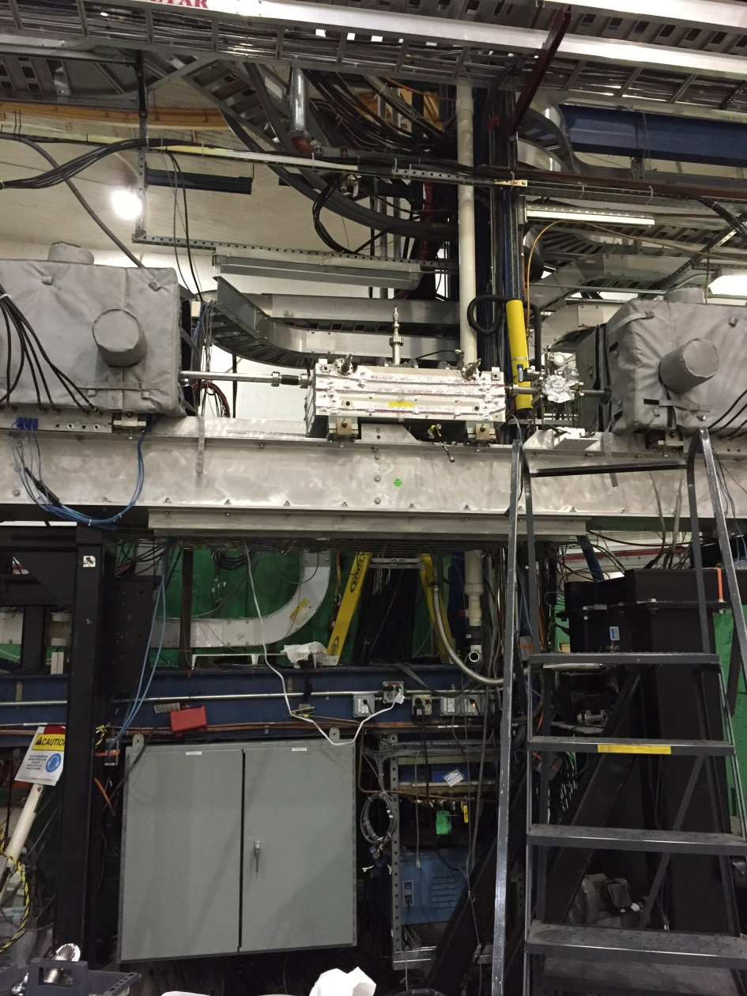
Beyond ³H
    PREX-II/CREX
      Combined target chamber (CREX upstream),
      Shielding design underway
      Computation fluid dynamics for target design
      Pb and diamond targets, new coils purchased (and here at lab)
      Beamline upgrades completed
        Second x,y,Q girder (from Hall C), new “Musson” cavity electronics, Hall C halo monitor, lumi monitors installed in A and first pass tests started Fall 2015 run
      Polarimetry
        Plan to continue to test Compton in Spring 2016 Run
        New high field Moller commissioning started

Slide 8
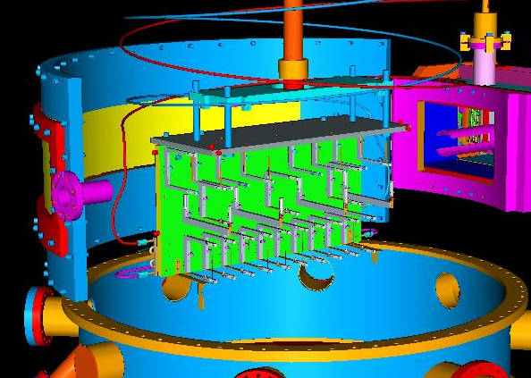
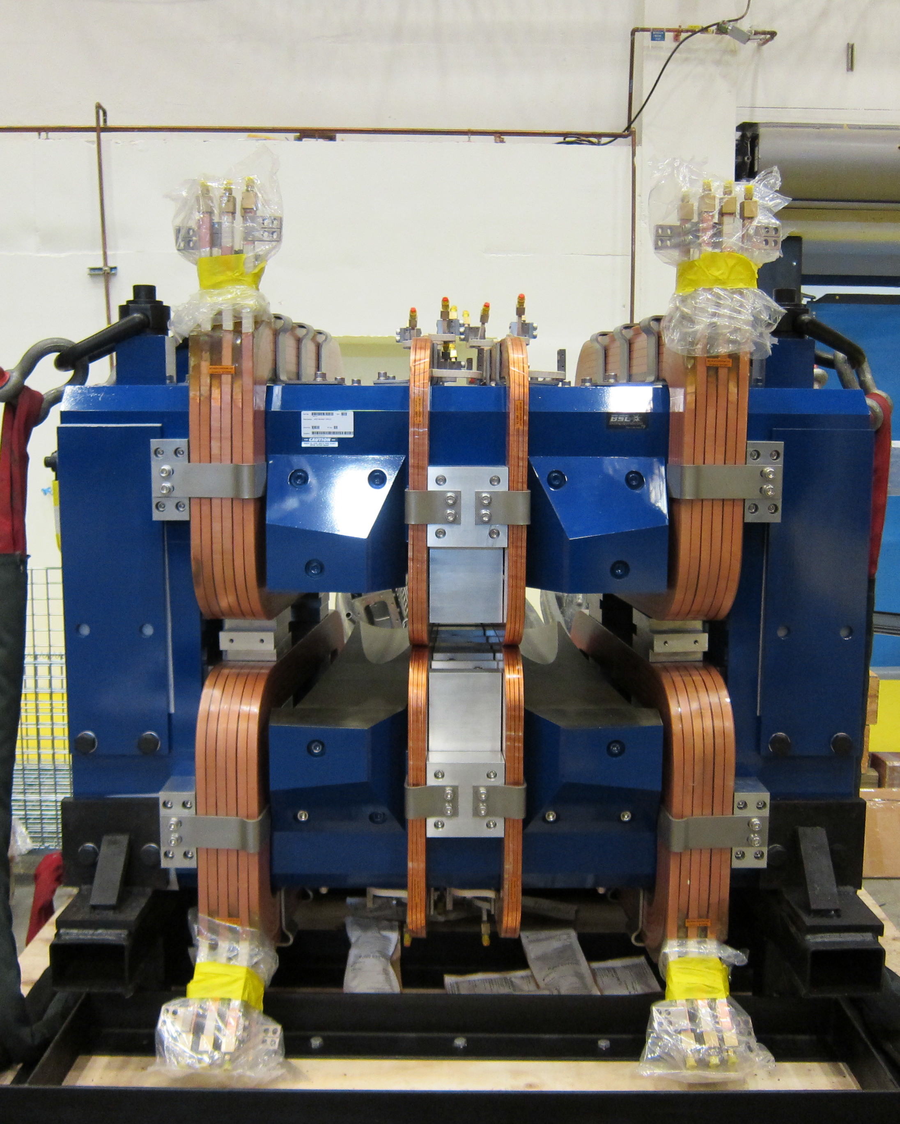
Beyond ³H
    APEX
      New septum magnet purchased by collaboration
        Water fittings, busbar, connections near complete (JLab)
      Shielding designs underway
      Computation fluid dynamics for target design
    Polarized ³He target improvements and continued development
      Convection, new lasers, metal windows, …
      Design report in January

Slide 9
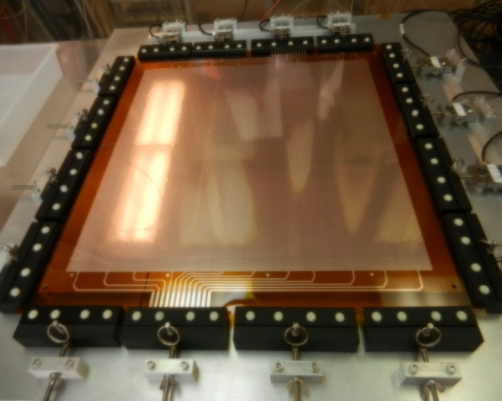
SBS Construction
Project started October 2012 (FY13)
  Successfully passed third annual review November 2015
  Some concerns about thermal annealing/design of ECAL and 3He target timelin
  Overall very positive, project on track
Spectrometer, ECAL work at JLab
  Power Supply in hall
  48D48 magnet modified, assembled, tested in test lab
  Working on support, stand (here at lab) beamline
GEM construction at UVA
Coordinate detector at Idaho State
HCAL Hadron calorimeter at CMU and JLab (103/288 modules)

Slide 10
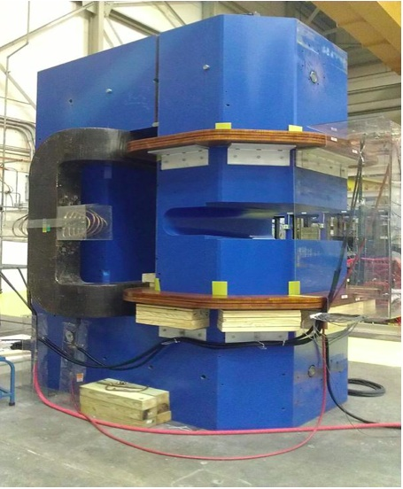
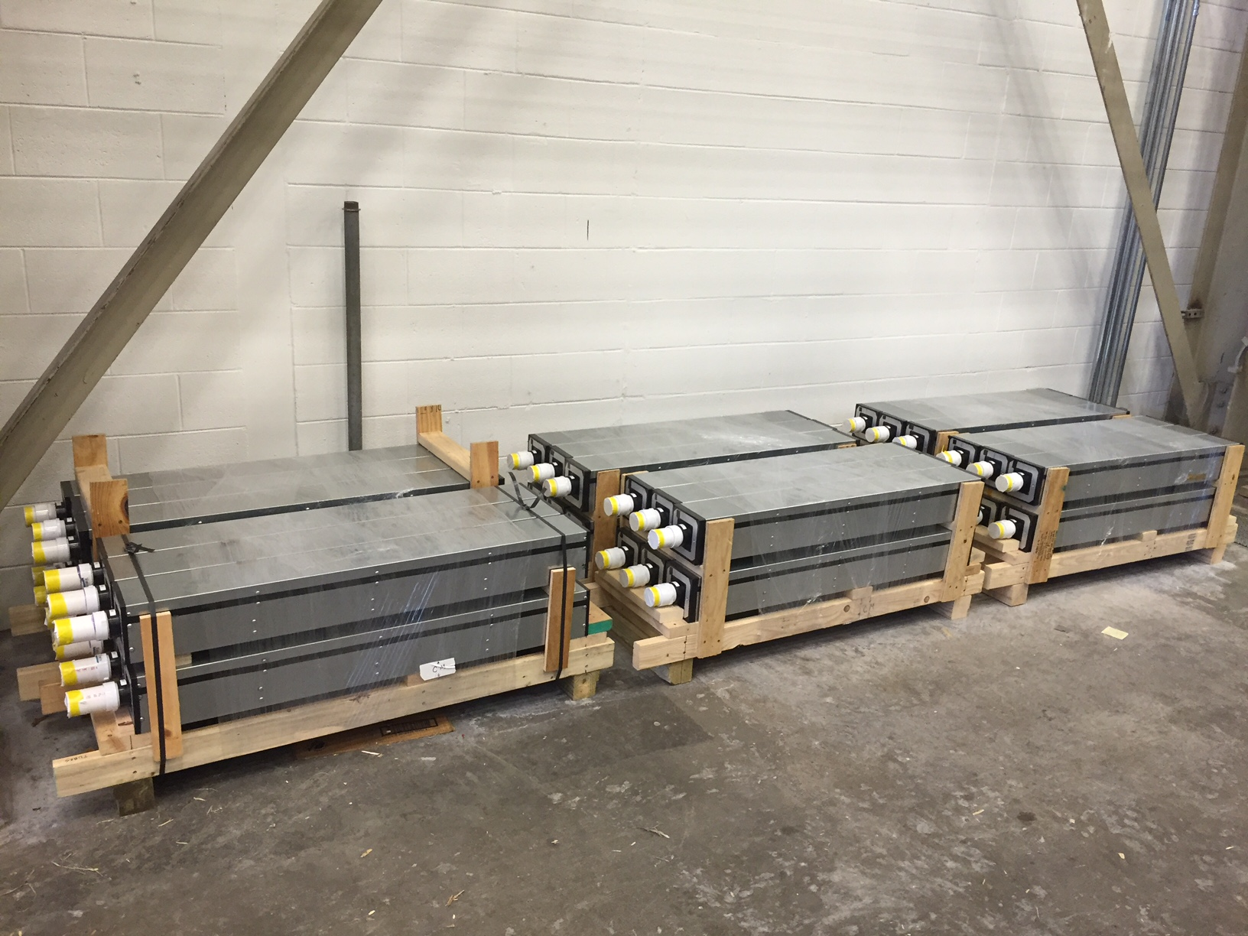
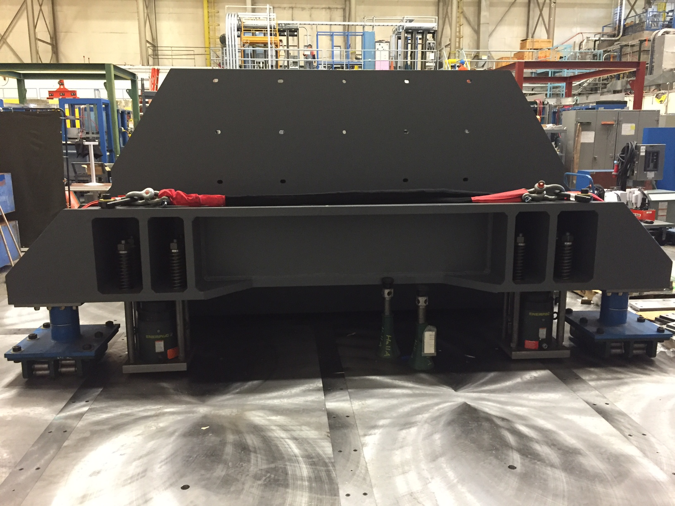

Slide 11
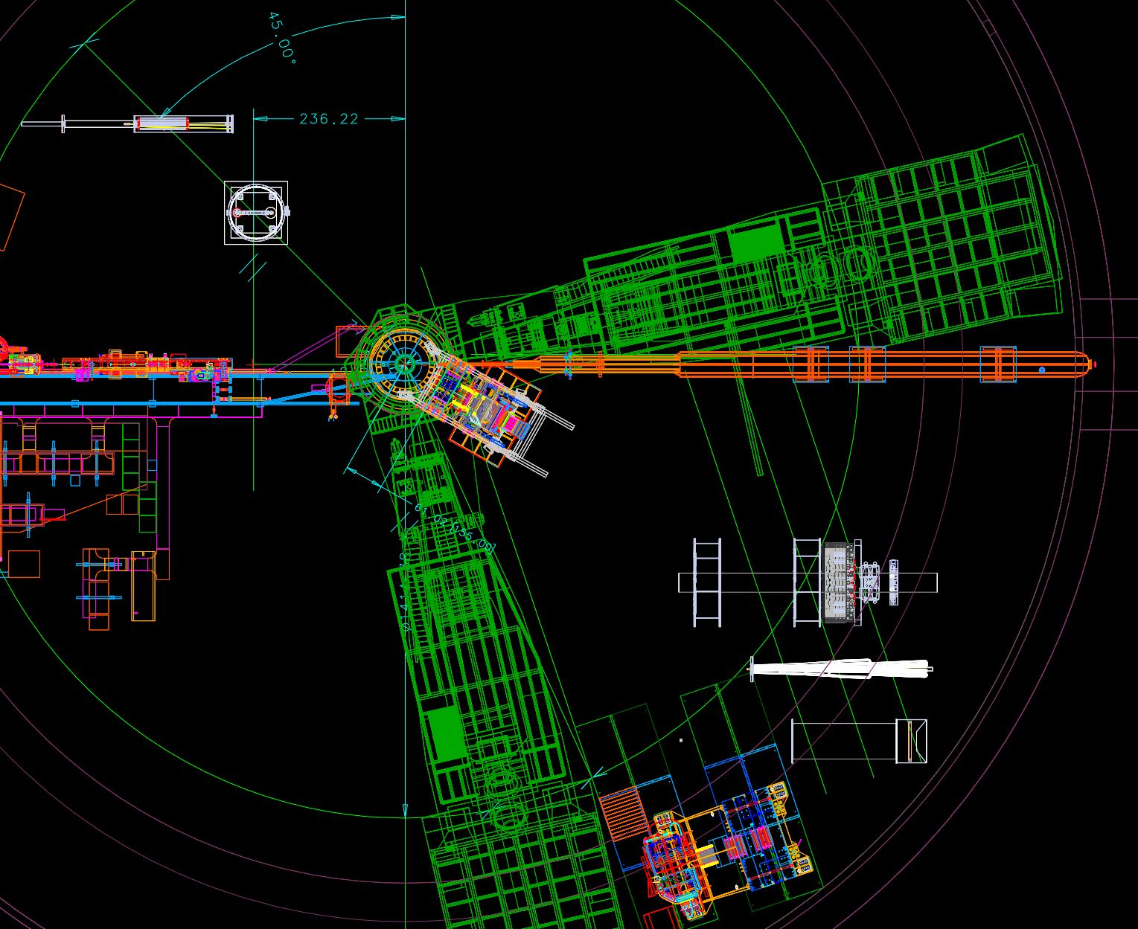
Moving to more future installations – MOLLER and SoLID

Slide 12
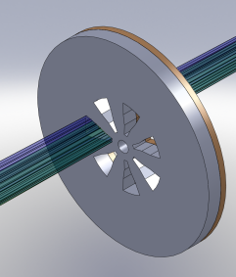
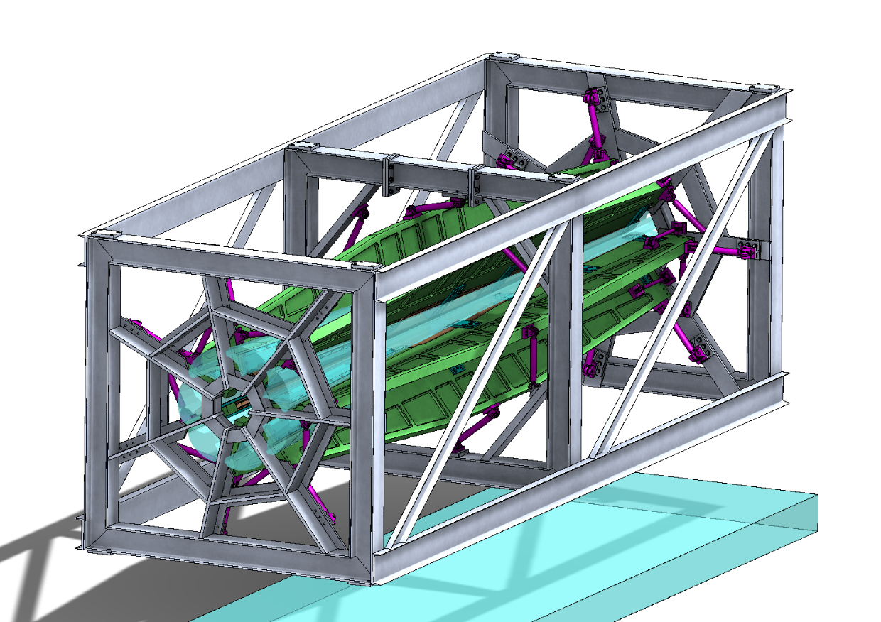
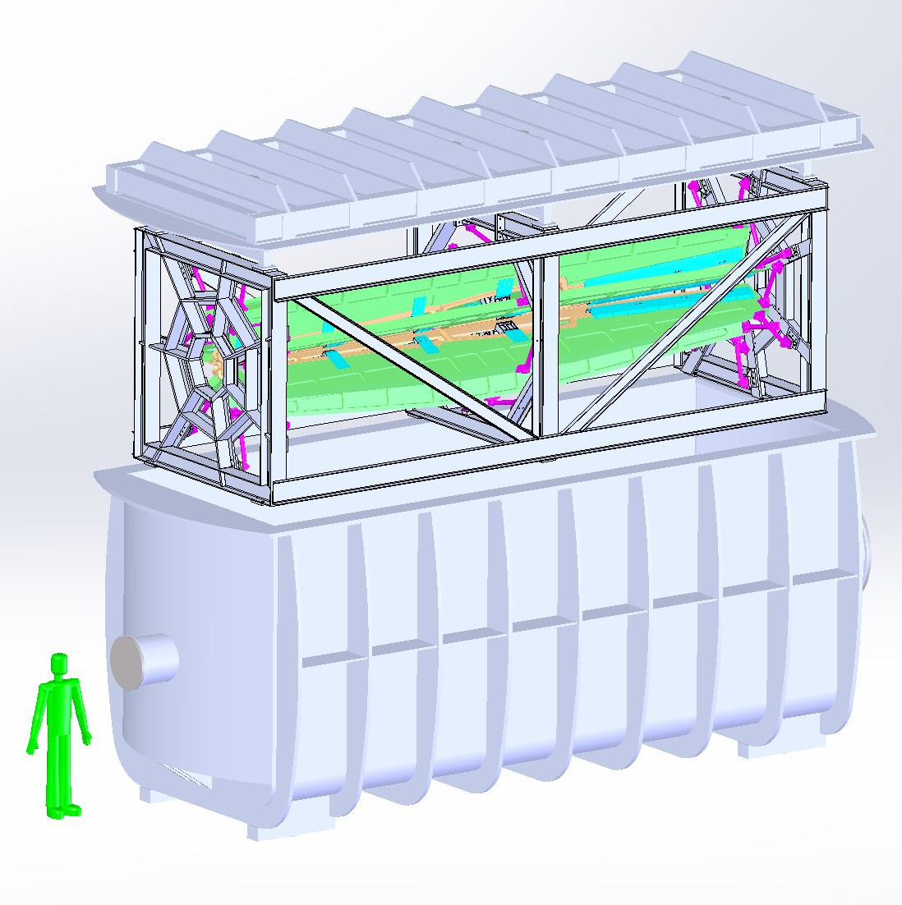
MOLLER
    Successful Science Review September 2014
    Supporting ongoing magnet and collimator development work at MIT
    New Moller polarimeter (in place)
    Anticipate Director’s cost, schedule, technical review in 2016
      Working on updating documentation
      Advanced conceptual design
    Looking towards CD0

Slide 13

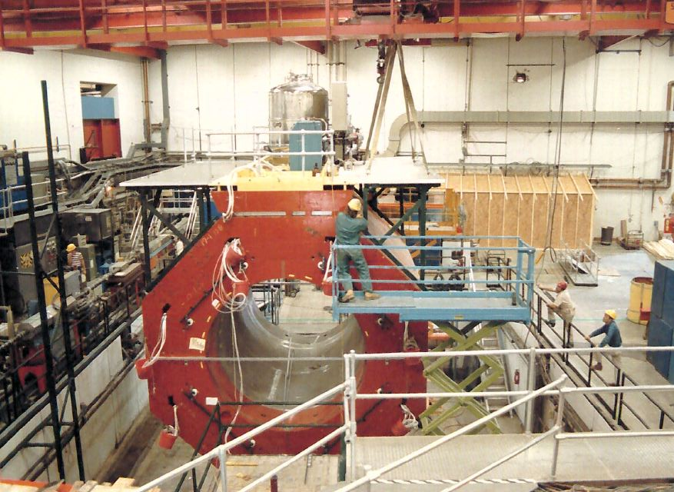
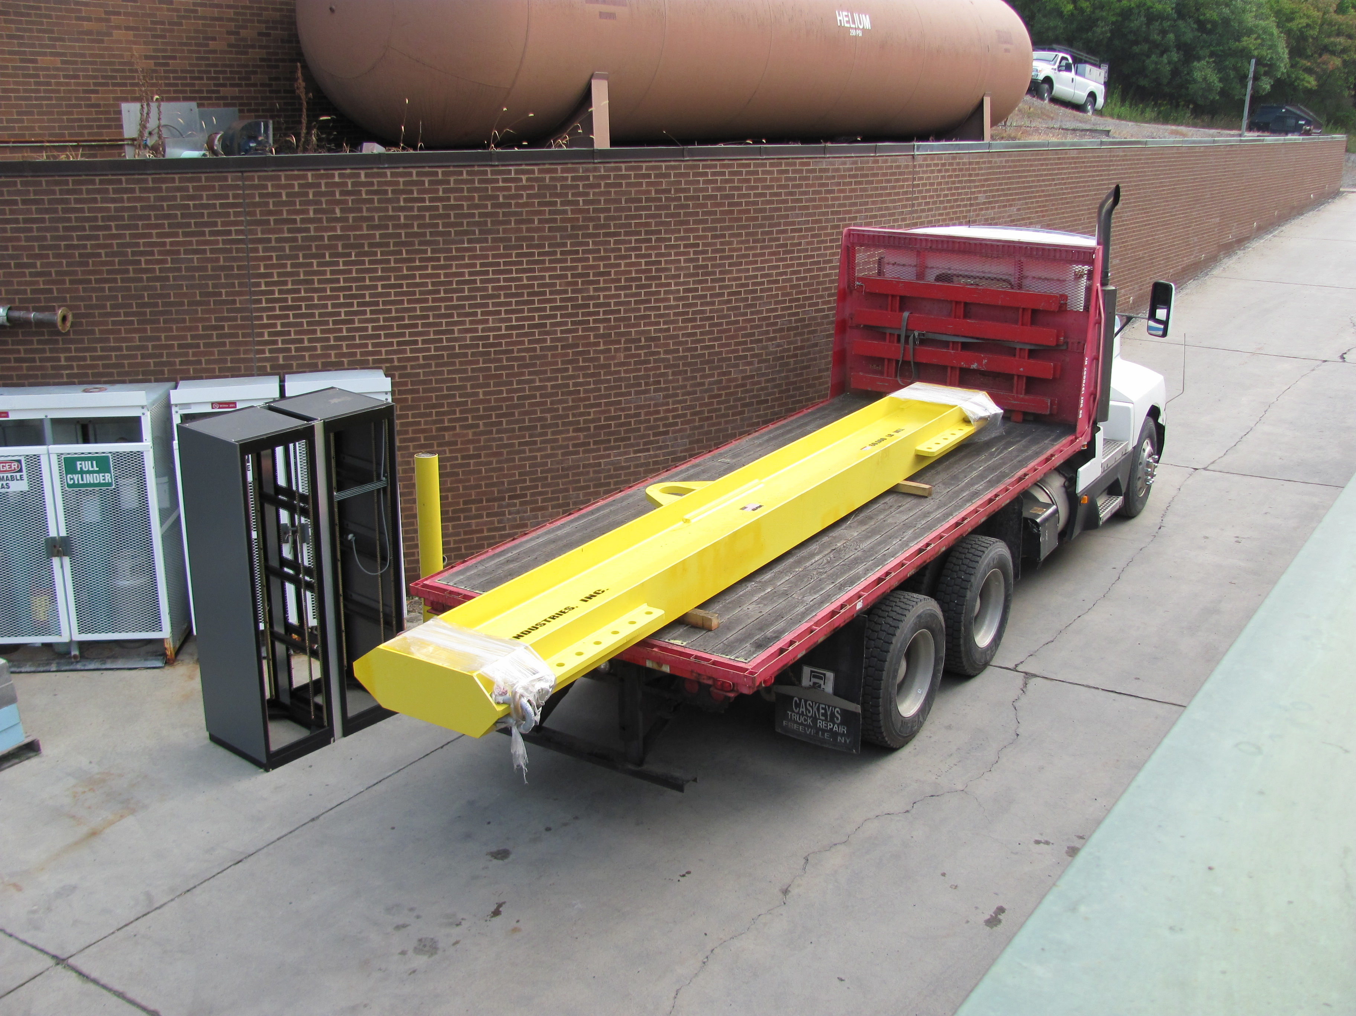
SoLID
    Director’s Review February 23,24, 2015
      addressing recommendations
    TMD Workshop at Stony Brook Jan 28-30
    Cornell to disassemble solenoid through Summer 2016
      Assist and observe (Ed Folts Fall 2015 trip)
      Anticipate move to JLab FY 2017
    Looking towards Science Review in 2017, CD0 in 2018

Slide 14
Back to 6 GeV! 2015 Publications (in no order….More?)
M. Defurne et al., Phys.Rev. C92 (2015) 5, 055202
Y.W. Zhang et al., Phys.Rev.Lett. 115 (2015) 17, 172502
Y.X. Zhao et al., Phys.Rev. C92 (2015) 1, 015207
K. Chirapatpimol et al., Phys.Rev.Lett. 114 (2015) 19, 192503
D. Wang et al., Phys. Rev. C91 (2015) 4, 045506
Higinbotham et al., Phys.Rev.Lett., 114 (2015) 169201
Mihovilovic et al., Phys.Rev.Lett., 113 (2014) 232505
Parno et al., Phys. Lett., B744 (2015) 309-314
Urciuoli et al., Phys. Rev., C91 (2015) 034308
A. Blomberg et al., arXiv:1509.00780 (2015)
6 GeV era closing out ☺
Still waiting for ….. (you know who you are!)

Slide 15
JLAB Publications and Public Access Timeline
Disclaimer: Next 3 slides are from JLab Publications and Records Management
2013 – Public Access mandated by White House
2014 – DOE’s Public Access Plan approved by White House
JLAB must provide final, peer-reviewed accepted manuscripts or final published documents that are
authored by JLAB authors or
produced as a result of work done at JLAB.
2015 – DOE launches Public Access Plan in test phase, live in FY2016
2016 - New PEMP metrics for DOE sites, & JLAB Notable Outcome
  JLAB working toward compliance success

Slide 16
Collaborator Responsibilities
Refer to User/Collaborator agreement which you signed:
Part 4. Publications
4.1 The Collaborator will submit to JSA/JLab a copy of each professional publication produced in whole or part pertaining to all collaborative efforts performed at Jefferson Lab. A “professional publication” is defined as any professional work suitable for a journal or conference proceedings that is presented for public consumption. It may be in the form of a paper document, an electronic document (e-print or Internet), an audio or video recording, or other media. When feasible, copies of publications citing JSA/JLab publications should also be provided.
4.2 All experiments, research, and/or other collaborative endeavors conducted pursuant to this agreement shall be nonproprietary in nature, publishable in open literature, and considered a part of the public domain.

Slide 17
JLab Publications Procedure for Collaborations
Write collaboration paper (journal article, conference proceedings paper, eprint, etc.) Papers must include proper contract acknowledgement.
A JLAB collaboration member will submit into JLAB publications system and receive JLAB number.
Submit to arxiv and/or publisher.
Contact Rhonda Scales (JLAB Legal Counsel) for all copyright and licensing activities.
UNLESS published Open Access , provide final, peer-reviewed, accepted manuscript to Kim Edwards (kindrew@jlab.org) OR
Submit the final, peer-reviewed version to eprint arxiv and notify Kim Edwards when it is available.
Notes:
Red Interior Page Design 2

Slide 18
Happy Birthday Juliette!
Thanks!

