Slide 1
Accelerator status after the 12 GeV upgrade
Yves R. Roblin
Center for Advanced Studies of Accelerators (CASA), Jefferson Lab

Slide 2
Overview
2015 Goals:
Define setup for main machine
Commission pathlength system (doglegs)
Quad center, perform beam matching and characterizations
Push for full energy, CW to Hall A and Hall
Commission 750 Mhz separator for D+3 program
Work on stabilizing and improving the RF trip rate
Demonstrate a high power CW capability at full energy onto the Hall A dump
Establish machine setup for the spring 2016 physics run

Slide 3
Summer 2015
Main 12 GeV upgrade projects were completed:
Updated CHL2 heat exchanger in the cryo facility
Installed ARC tunnel air conditioning
Other projects towards preparing the machine for a full energy run for that fall were done:
Cooling towers upgraded on accelerator site (for LCW)
2K cryo cold box replacement
Dogleg upgrade (pathlength correction system)
750 Mhz separator work (for D+3 capability)
Helium processing of CEBAF cavities (for energy reach and trip rate management)
Various I&C projects (Hall D FFB , nA bpms)
Notes:
Show picture of the temperature in the ARC tunnel when running ? There is one in december by A. Comer after conditioning was installed.

Slide 4
Fall 2015
Main Goal: Establish full 12GeV reach at full CW power
Systematic machine setup and characterization arc by arc
Quadrupole centering of the majority of the machine
Optics validation and refinements
Establish the 11GeV, 750 Mhz separation for a D+3 capability
Demonstrate high power operations to Hall A and D.
Establish machine setup for physics running in spring 2016

Slide 5
Horizontal geometric emittance
Notes:
Measurements very reproducible. (green points grouped together).
Red is the design value we expect.
Still trying to understand the systematic multiplier (it’s a log scale). Maybe an overall renormalization problem.
Nevertheless, it is behaving exactly as we predict as far as synch rad is concerned.
It meets the initial year specifications.

Slide 6
vertical geometric emittance
Notes:
Same pattern as in the horizontal one. We meet spec as well

Slide 7
Longitudinal measurements
Mahmoud Ahmad ODU grad student
Notes:
Slightly bigger than we predict/expect.
We now have a robust method to measure this and this will help us in controling things such as the halo as well
As the transverse emittance (a large bunchlength can degrade the beam in transverse as well)

Slide 8
The Quest for Energy Reach
Notes:
Maintenance means helium reprocessing and gradient management and adding a C75 zone every year.
Most of the program is at full energy so we need a solid setup at this energy with a reasonable trip rate.

Slide 9
HALLA optics
The Hall A standard optics were not optimized for high energy
Excessive emittance growth in the 1C arc
Excessive dispersive peak at 1C12
Difficulty in reaching a small beam spot at compton and target
New optics were proposed to alleviate these problems.
This resulted in upgrading the power supplies for five quadrupoles in Hall A (from MQA to MQK)
Notes:
MQA1C07, MQA1C10, MQA1C11, MQA1C13,
and MQA1C14

Slide 10
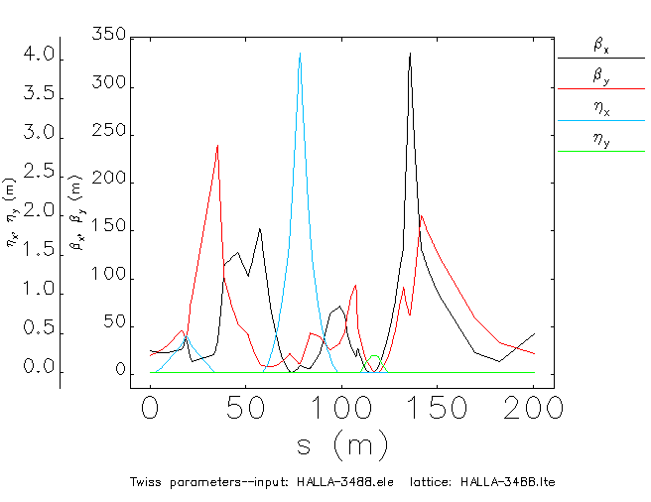
Old Hall A optics

Slide 11
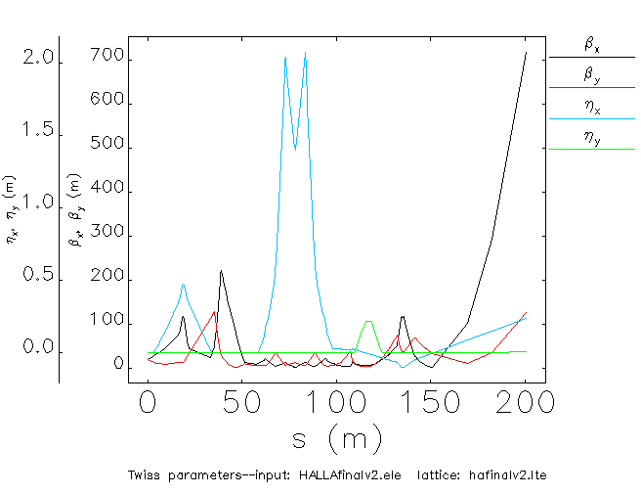
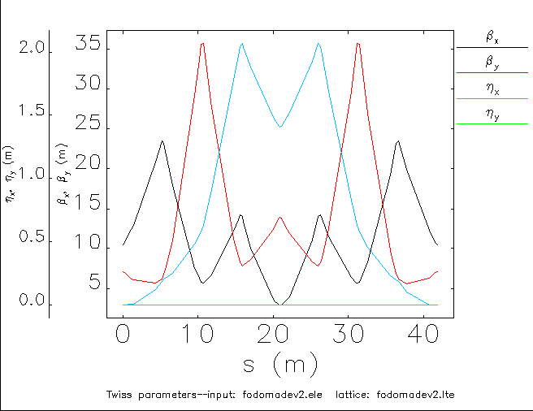
New HALLA optics
<200 μm at target
Compton 110x70μm
Notes:
We used these to do a full power CW run in Hall A.

Slide 12
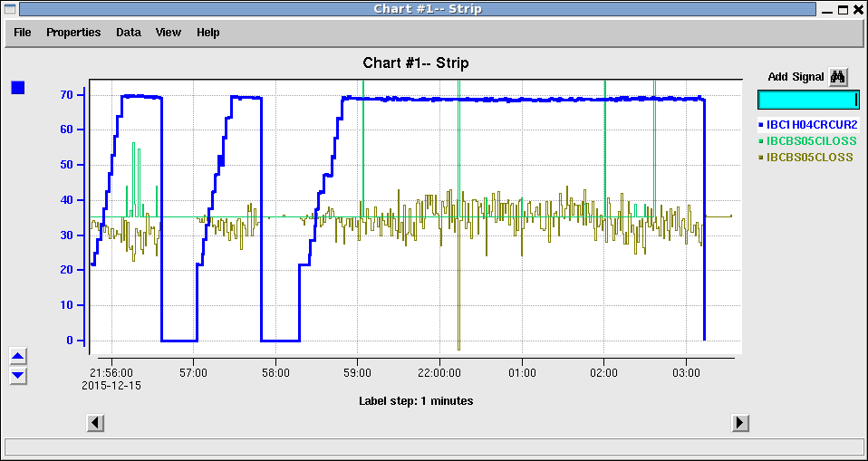
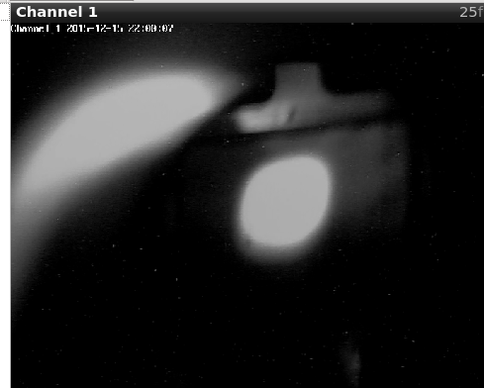
HALLA to 70 μA CW at 11GeV
Notes:
We went right up to the machine envelope (800 kW). That’s 70*11=770 kW.
This had only be done once in the past in the lab.
Almost no losses, but quite a few RF trips. This gave us information on what to do to make the machine more stable.

Slide 13
Upcoming run
HALLA at full energy.
Harps 1C07A/B and 1C18A/B updated to standard accelerator harps (rather than photomultipliers)
Need to:
Establish beam to Hall A
Recommission raster after B. Gunning repairs
Test the new optics setup method (pre-match at 1C05 with dumplette on then another match at 1C07 or 1C08

Slide 14
Upcoming run (cont)
Will need 2 shifts to match the beam into Hall A once it is in Hall A.
Dedicated time to tune for Compton ?
Moeller run ?
Energy measurement ?
Issues pending:
The MQM1H02 power supply can not meet 315 amps without tripping a lot (voltage drops below 40Volt)
The field map calibration for the Compton dipole is off by quite a bit. I determined the optimal BDL last run for 11GeV.
Notes:
Coordinate with me on these tasks.

Slide 15
Upcoming run schedule
Access from OPS logbook under useful links->12GeV CEBAF status
Notes:
Start restoring the machine january 28th.
We are planning to start physics in hall A february 4th.

Slide 16
Summary
12 GeV energy reach was established for both Hall A and Hall D at full power.
Initial year specifications fully met.
750 Mhz separator cavity commissioned. We delivered beam to Hall A and D simultaneously with the RF separator.
Laser table will be modified to add a fourth laser to reach D+3 capabilities
We are planning to increase the robustness of the machine by adding a new C75 module every year in the linac to replace the older C20 modules. This will drastically reduce the trip rate and give us margin
We developed a robust setup method as well as metrics and performance data for downtime analysis,

