Slide 1
Hall A Tritium Target Status
Dave Meekins
7 December 2015

Slide 2
Overview
Target Design
System design
Cell design
Exhaust system
Beamline
Performance
Status
Review Status
Documentation
Construction
Timeline

Slide 3
Information and Documentation
New wiki for the tritium target:
https://wiki.jlab.org/jlab_tritium_target_wiki/index.php/Main_Page
Reports: design and technical
Drawings
Procedures
Calculations
Presentations
Review
Presentations, Responses, Committee reports

Slide 4
Target System
Repurposed Qweak H2 Target
Alter existing Cryostat
Alter internal piping
Add two valves
H2 Loop piping and cell removed
Alter cryo piping and instruments
15 K He from ESR
Motion in “X” and “Y” directions
Control system is similar to Hall A cryotarget
“New Construction” pressure system

Slide 5
Target Ladder
Heat sink cooled by ESR to 40K
Stabilized by heater

Slide 6
Target Cell
Main Body and Entrance Window
ASTM B209 AL 7075-T651
Valve assy:
SST 316 and 304
1090 Ci of T2 (0.1 g)
~200 psi at 295K
25 cm long
ID of 12.7mm
Volume = 34 cc
Aluminum CF seals

Slide 7
Cell Cross Section
0.018” wall

Slide 8
Operational Limits
Beam Current
$I_{max}=20 μA on T2 cell$ 25 µA on all others
Raster
2x2 mm minimum
Beam Trip limit (18000 trips)
Temperature
Heat sink must be ~40K
Target Operator 24/7 when cold
Tritium effects access procedures and training requirements

Slide 9
Exhaust System
36” OD 20m tall Stack
12000 cfm blower multispeed
2” pump exhaust
Run parallel to stack
Stack must also serve as smoke removal
Provides controlled release of secondary and tertiary containment
Pump exhaust is continuous
Blower activated:
Manual
Interlocks

Slide 10
Exhaust Routing

Slide 11
Beamline Alterations
No plans to substantially alter beamline
Upstream beamline shall be isolated by a Be window
0.008” thick 1” ID.
Water cooled (3W beam power 25 µA)
Reentrant (Resides in chamber)
Downstream beamline to be isolated if effects to the physics are not unacceptable
Window is 15 cm from entrance to cell
Densimet collimator 10 cm long installed in tube upstream of window. (W 90% , Cu 8%, Ni 2%)
Maintenance is possible if required.
12 mm thick collimator attached to cells
Collimators should prevent steering error from affecting cell
Last steering element is 8 m upstream and 2” radius beam pipe.

Slide 12
Be Isolation Window
0.008” Be window
Cooled by self contained water chiller to 10C
Integrated collimator Densimet

Slide 13
Cryo-System
ESR 15K He for cooling
Must return ~25K
PID Control heater
40K
Return mixed with bypass.
Bypass valve on PID
Alarms/interlocks on TS-5 (a/b) and TS-6 (a/b)
Similar controls to Cryotarget

Slide 14
Performance Characteristics
½ life for tritium is ~12 .5 years
5% conversion to He-3 over 1 year run
Conversion starts immediately
Fill as close to run date as possible
Fill purity 99.8% T2 +/- 0.02%
Quantity of T2 from $PV=nRTZ$
Where $Z=1.01$ is the compressibility of tritium at the fill pressure of 200 psia.
The uncertainties on the quantities above are:
$$δP=0.2 psia \\ δV= 0.5 cm^{3} \\ δT=0.025K$$
This gives an uncertainty of
r=0.0026 g/cm^3 $δ\text{r}=1.5\%$

Slide 15
Density Change in Beam

Slide 16
Status
Successful review on 15 September 2015
Report available on wiki
Pressure system calculations reviewed by 2/1/2016
Final ladder assembly fixed by 3/1/2016
ERR 3/16/2016
Design of platform complete
Construction of handling hut complete
Cell design and prototyping/testing complete
Fabrication underway for actual cells
Modifications to Qweak target underway
Cryo sytem/piping ~50% complete
Material testing is underway at SRS/SRTE/SRNL
Working through unresolved issues regarding shipping
NEPA analysis is complete should be presented to our site office by 2/1/2016

Slide 17
Schedule
Hut and Platform
Fabrication complete by 3/1/2016
Test install June 2016
T2 Exhaust system
Internal vent install April 2016
External May and June 2016
Target
Complete modifications to Qweak 3/1/2016
Assembly complete 8/1/2016
T2 cell install 10/1/2016
Interlocks
Checkout complete 8/30/2016
ERR 3/16/2016
Checkout review 9/1/2016
Dates are estimates

Slide 18
What We Need from Experiments
Decision on Bit Bite
Affects access and work procedures
Affects installation plan
Affects experiment scheduling
Target Ladder
Final list of targets due by 3/1/2016
ERR preparation
Training

Slide 19
Materials-2
Al 7075 is unlisted
Design basis
$S­_{ut}=72 ksi$
$S_{y}=61 ksi$
$S_{a}=\min\left(\frac{1}{3}S_{ut},\frac{2}{3}S_{y}\right)=24 ksi$ for tension
= 80% of 24 ksi for shear
= 150% OF 24 ksi bending
Other wetted materials are SST
304/304L
316/316L
ER316L Filler for welds

Slide 20
Materials 3
Tritium and Hydrogen Compatibility
Extensive experience with H2
Beam induced corrosion not expected below 180K (Flower et. al.)
Beam assisted embrittlement
$T_{2}→T+T$ Increases fugacity
Atomic tritium recombines rapidly
Modeled room fugacity ~3100 psi
Below threshold for H2 embrittlement
Many orders of magnitude below He-3 swelling threshold (Louthan)
Test SRNL/SRTE using precracked coupons exposed to 2500 psi T2 underway
Test follows ASTM 1820 G168 (Precracked Stress Corrosion Testing)
Samples exposed for 4, 8, 12 months
M. Morgan, A. Duncan (SRNL)
Tritium is expected to permeate through the cell and seals
~0.5 Ci /year very conservative
Calculations given in TGT-CALC-103-010

Slide 21
Load Conditions
At room temp
P = 200 psi
At 40K Beam Off
Pressure = ~30 psi
Max Temperature = 40K
Beam On
Pressure = 36 psi (avg temp of T2 = 53K)
Max Temperature = ~125K
Cyclic loads
Cool down/warm up operating cycles = 20
17800 beam trips (cycles between Beam On and Off)
150 days, 33% duty factor, 15 trips/hr

Slide 22
Analysis
Applicable Code ASME B31.3 (2014)
Section 304.7.2 because of odd geometry
Used both Hand Calculations and FEA
Analysis conforming to ASME BPVC VIII D2 with load factors from B31.3 (i.e. 3 instead of 2.4 on P)
Used cyclic screening analysis from D2
Depth of loads do not require a fatigue analysis
175 psi pressure cycle (it is closer to 10 psi)
Considers temperature cycle from 40K to 125K
Design pressure 675 psi
No source of overpressure
Calculations: TGT-CALC-103-002, 7, 8, 12, 13, 14, 15, 17.

Slide 23
Thermo-Mechanical Model-1
Full temperature load
Beam on at 20 µA 2x2 mm raster
Pressure load 400 psi internal (more than 10x)
Cooling using 40K heat sink
Using an elastic-plastic model
Model solves and stresses are still below allowable even for over conservative case
Local plastic failure requirements met
Analysis not required because of screening analysis

Slide 24
Thermo-Mechanical Model-2

Slide 25
Thermo-Mechanical Model-3

Slide 26
Mech Therm Model of Raster Off

Slide 27
Raster Off Time Dependence

Slide 28
Density Model
T2 properties derived from H2
Viscosity, Thermal Conductivity, Heat Capacity, etc.
Assumed a Real Gas model
Buoyancy, convection on wall included
Assumed fixed 2.8W from 20 µA and 2x2 mm raster (11 mW/mm linear power density)
Did not correct heat load for density
Averaged 20% reduction in density along beam path

Slide 29
Vacuum System
Scattering chamber (standard Hall A)
1900 liters
Thin sections for recoil particles (0.014” aluminum)
Two 800 l/s turbos backed by Leybold D60 Mech pump
NEG Pump with backing turbo and mech pumps
Vacuum exhaust part of Tritium Exhaust System and is continuously purged with N2 (1 cfm)
Isolated from upstream beamline vacuum (Be window)
Remote RGA may help diagnose leaks. Serve as leak detector.

Slide 31
Materials
Main Body and Entrance
Aluminum 7075-T651 ASTM B209
Extensive use of this allow for 15 years
Strong, ductile, hard, non weldable
Seals are Al 1100
Valve assembly
SST 304/304L Fitting
Swagelok valve all metal bellows sealed (316L)
Butt welded ER316L (100% VT in process and RT)

Slide 32
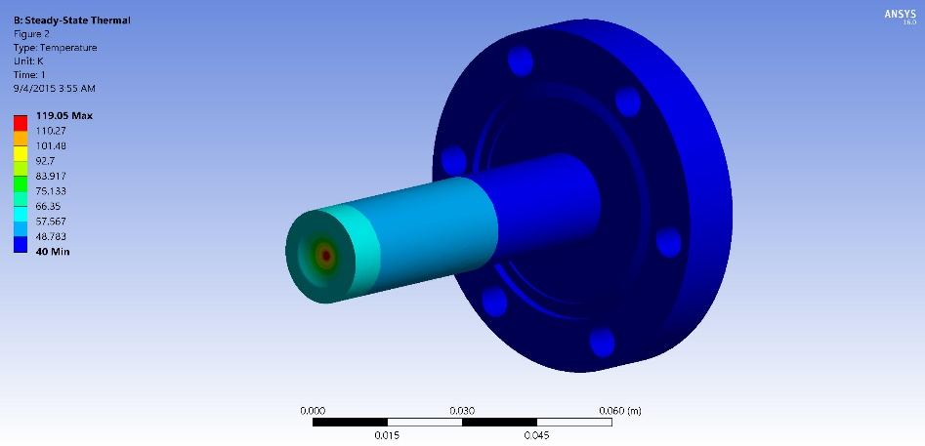
Beam Heating
$I_{beam}=20μA$ Max beam current $A_{raster}=2x2mm^{2}$ min raster
3W in Entrance
3.3 W in Exit
$T_{max}=125K$ on exit $T_{max}=120K$ on entrance

Slide 33
Summary of Test Results
Multiple hydrotests on components and assemblies
Entrance: Minimum burst above 2900 psi
Main body: Minimum burst above 3400 psi (0.014” section)
Assembly with covers
Leaked above 4000 psi (seal was damaged)
Failed above 5500 psi

Slide 34
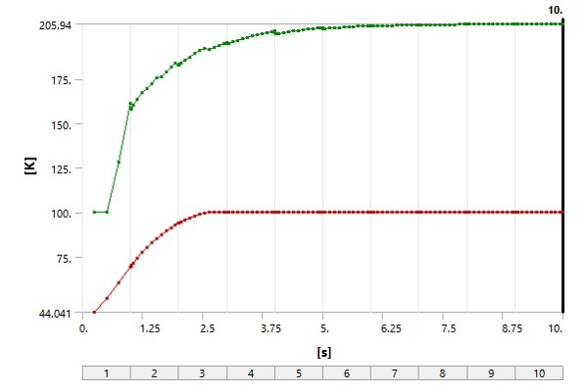
Raster Off
Initial conditions:
Beam on full raster
20 microA
Exit window is worst case
Beam spot no raster
0.150 mm diameter
Square profile
For high energy beam this spot size is very conservative
Tune shall be checked at each energy
Long term operations at these conditions are forbidden
Typical FSD for raster failure
< 10 ms
Red curve is upstream section temperature

Slide 35
General Requirements
Collect T2 from any release inside Hall A and exhaust in a controlled fashion
Exhaust point shall be 20 m above grade at site boundary
Must serve as part of the smoke removal system (at least 1/3 of the 36000 cfm required)
Must have at least two modes to service hut and to exhaust from Hall A. (500 and 12000 cfm)
Must stack vacuum pump exhaust
Scattering chamber, dump line, getter system
Makeup air comes from new louvered door at bottom of ramp.
Prevents overpressure on ramp door.
Test required for louver system
Air from outside from smoke removal system on ramp with damper removed

Slide 36
Exhaust Summary
Exhausts secondary (vacuum chamber) and tertiary (Hall A) containment to 20 m stack
Two speed
~500 cfm
12000 cfm
Exhaust system activated
Vacuum switch failure (interlock)
Truck ramp lower door (interlock)
Manual activation (Hall and Counting House) (manual)
Low speed activated manually for hut (manual)
T2 monitor (interlock)

