Slide 1
SoLID status and Chinese contribution
Wang Yi
Department of Engineering Physics
Tsinghua University, Beijing, China
1

Slide 2
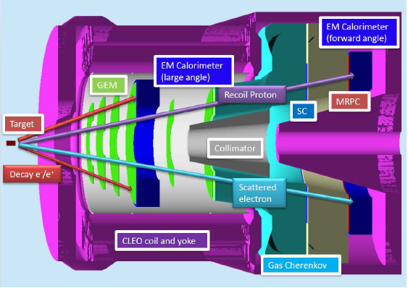
Outline
Status of SoLID
Chinese activities on GEM
Development of SoLID-TOF
Development of ECAL
Summary

Slide 3
Why SoLID
Solenoidal Large Intensity Device
JLab 6 GeV: precision measurements
high luminosity (10³⁹) but small acceptance (HRS/HMS: < 10 msr)
or large acceptance but low luminosity (CLAS6: 10³⁴)
JLab 12 GeV upgrade opens up a window of opportunities (DIS, SIDIS, Deep Exclusive Processes) to study valence quark (3-d) structure of the nucleon and other high impact physics (PVDIS, J/ψ, …)
High precision in multi-dimension or rare processes requires very high statistics → large acceptance and high luminosity
CLAS12: luminosity upgrade (one order of magnitude) to 10³⁵
To fully exploit the potential of 12 GeV, taking advantage of the latest technical (detectors, DAQ, simulations, …) development
→SoLID: large acceptance detector can handle 10³⁷ luminosity (no baffles)
10³⁹ with baffles

Slide 4
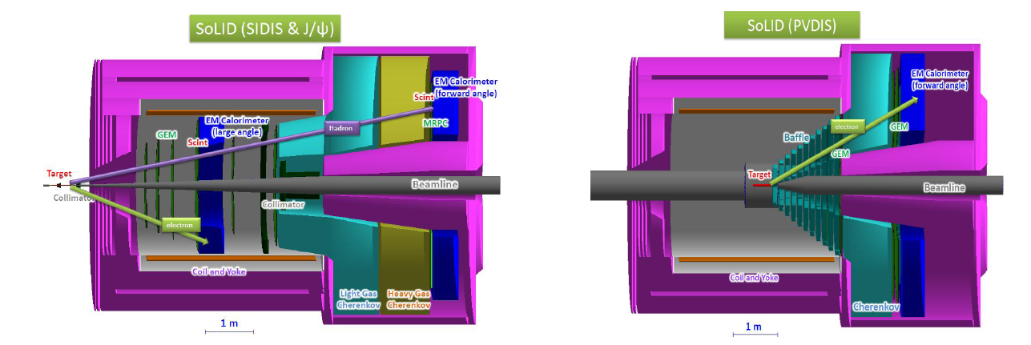
Overview of SoLID
Full exploitation of JLab 12 GeV Upgrade
→ A Large Acceptance Detector AND Can Handle High Luminosity (10³⁷-10³⁹)
Take advantage of latest development in detectors , data acquisitions and simulations
Reach ultimate precision for SIDIS (TMDs), PVDIS in high-x region and threshold J/ψ
5 highly rated experiments approved (+3)
Three SIDIS experiments, one PVDIS, one J/ψ production (+ three run group experiments)
Strong collaboration (250+ collaborators from 70+ institutes, 13 countries)
Significant international contributions (Chinese collaboration)

Slide 5
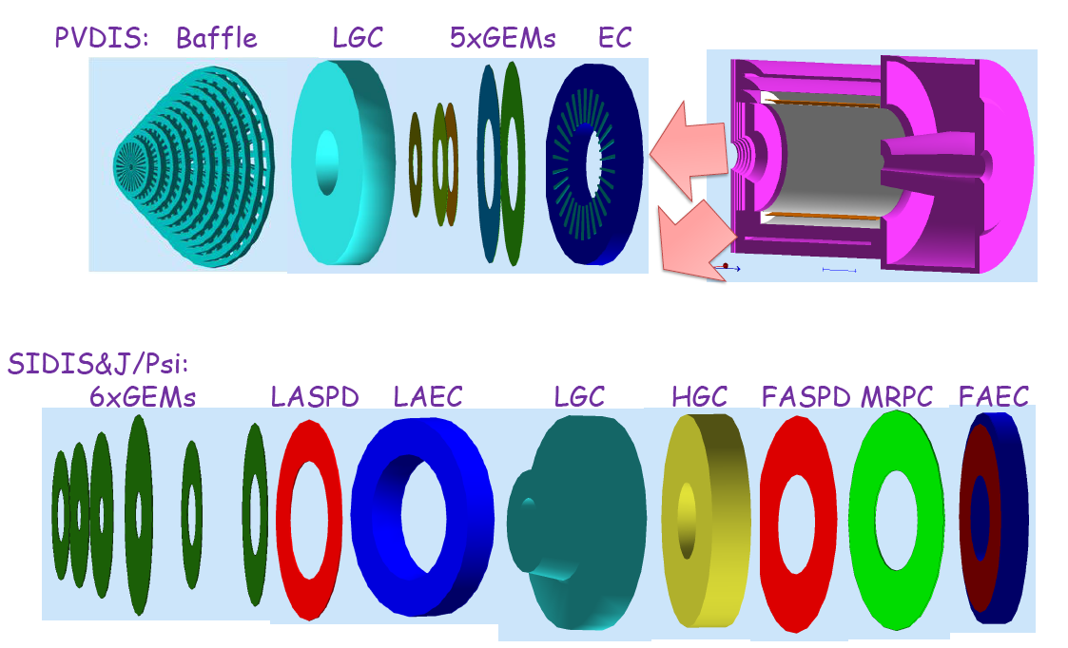
SoLID Detector Overview
Strong collaboration (250+ collaborators from 70+ institutes,13 countries
GEM detectors and MRPC: Chinese Collaboration in Hall A at JLab

Slide 6
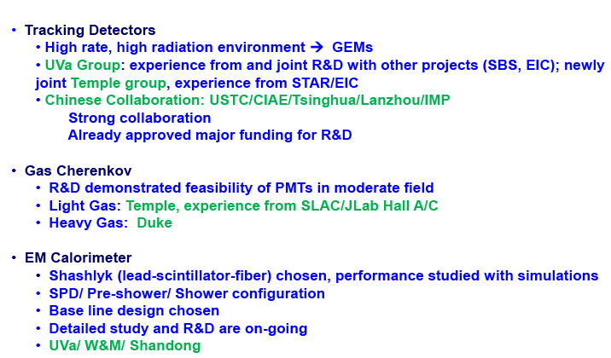
SoLID Detector Overview

Slide 7
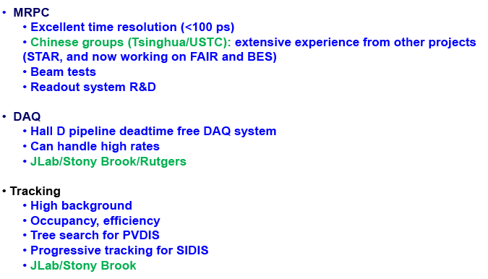
SoLID Detector/DAQ/Tracking
/Duke

Slide 8
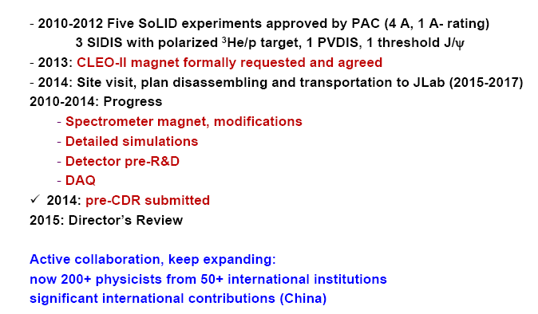
SoLID Status
Review committee: “The project was in a good state to move
forward”.
Long range plan: SoLID white paper, SoLID presentations
QCD Hadron highest recommendation include SoLID
On DOE radar screen, support pre-R&D, plan science review

Slide 9

Chinese SoLID collaboration
SoLID-MRPC: Tsinghua University, USTC, JLab, Duke
ECAL： SDU (China), UVA, W&M.

Slide 10
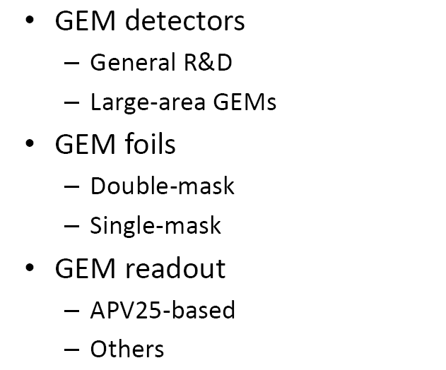
R&D on GEM

Slide 11
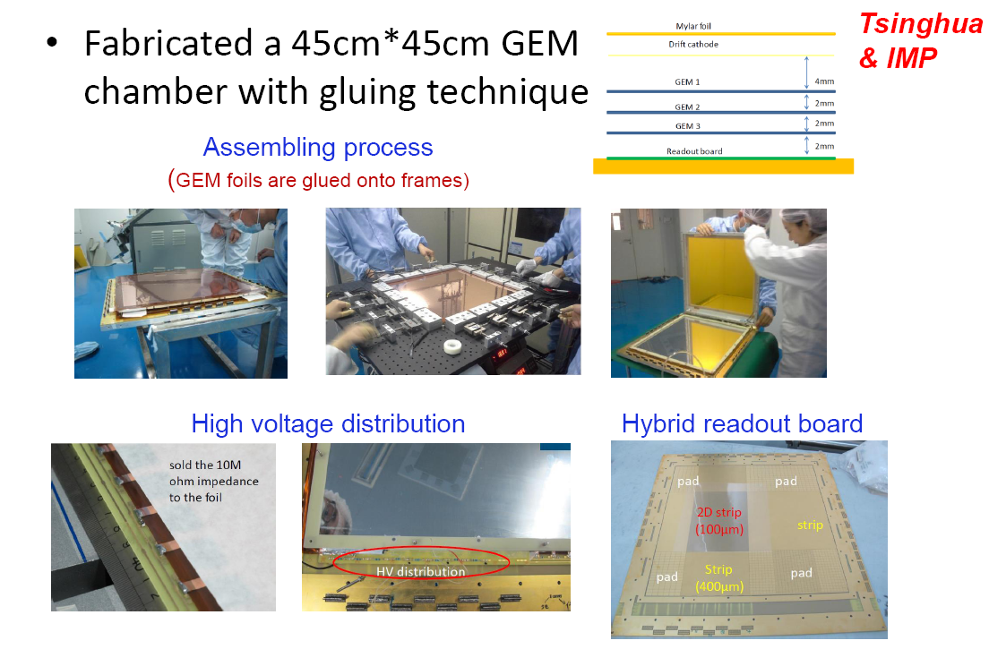
Large-area GEM R&D at Tsinghua & IMP

Slide 12
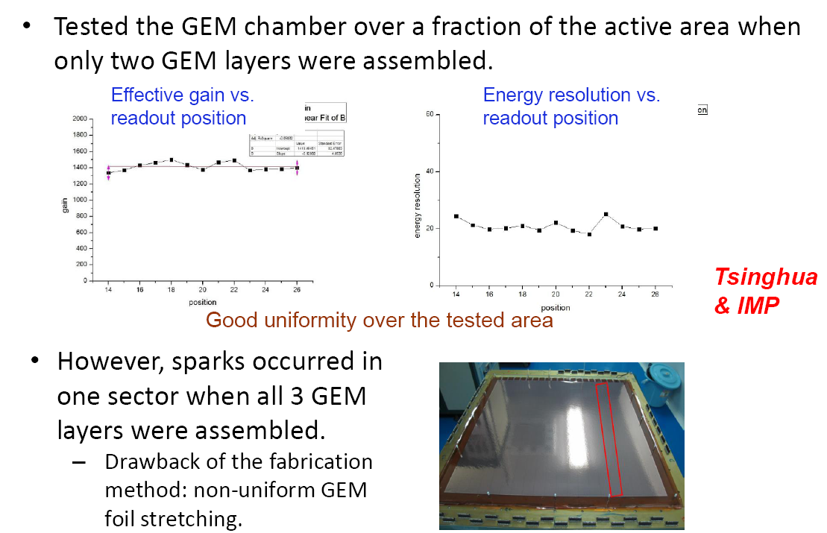
Performance

Slide 13
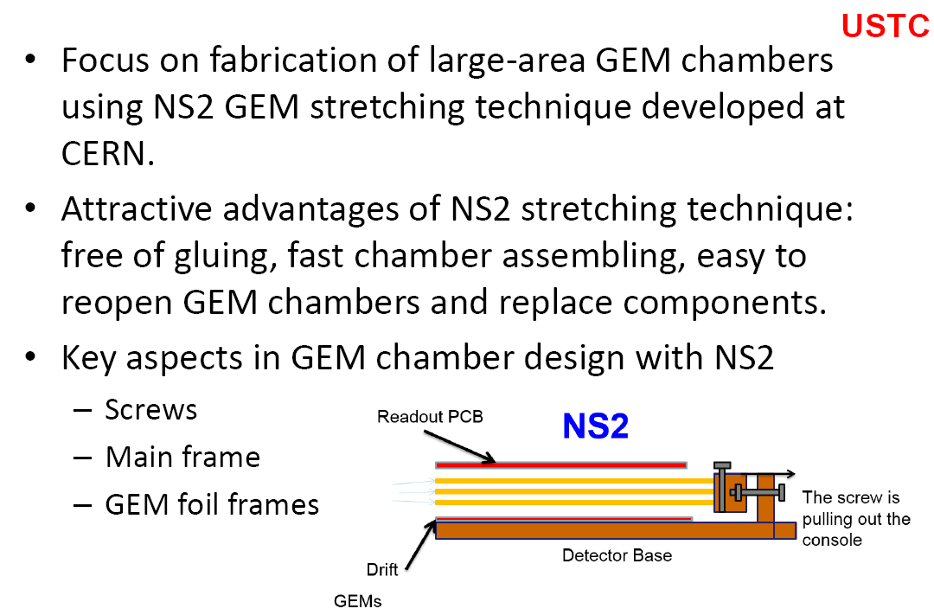
Large-area GEM R&D at USTC

Slide 14
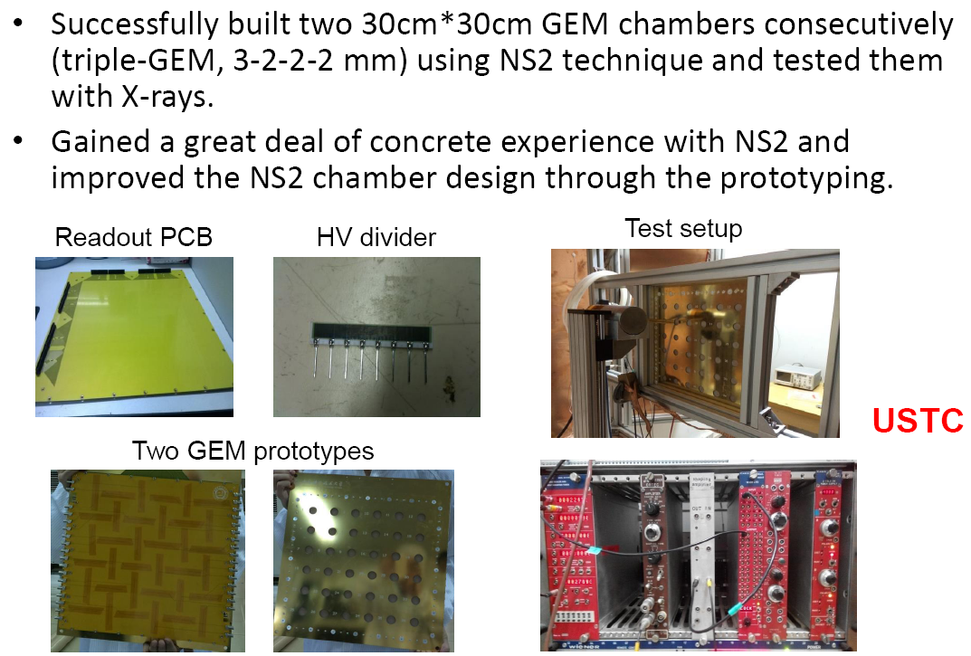
Large-area GEM Prototypes

Slide 15
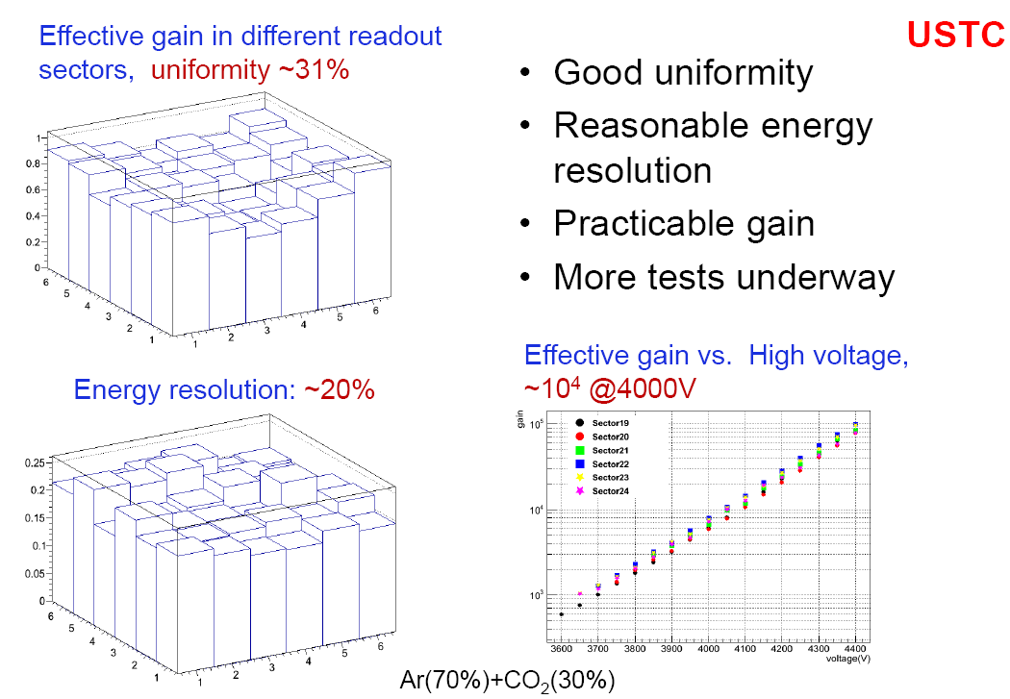
Performance

Slide 16
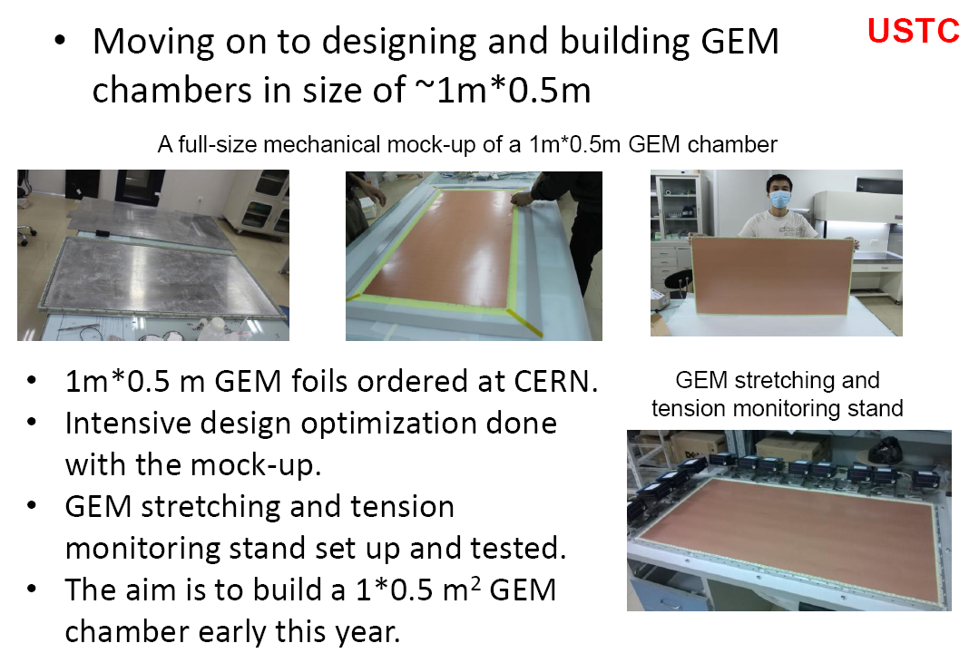
Going to Soild-GEM Size (~1m x 0.5m)

Slide 17
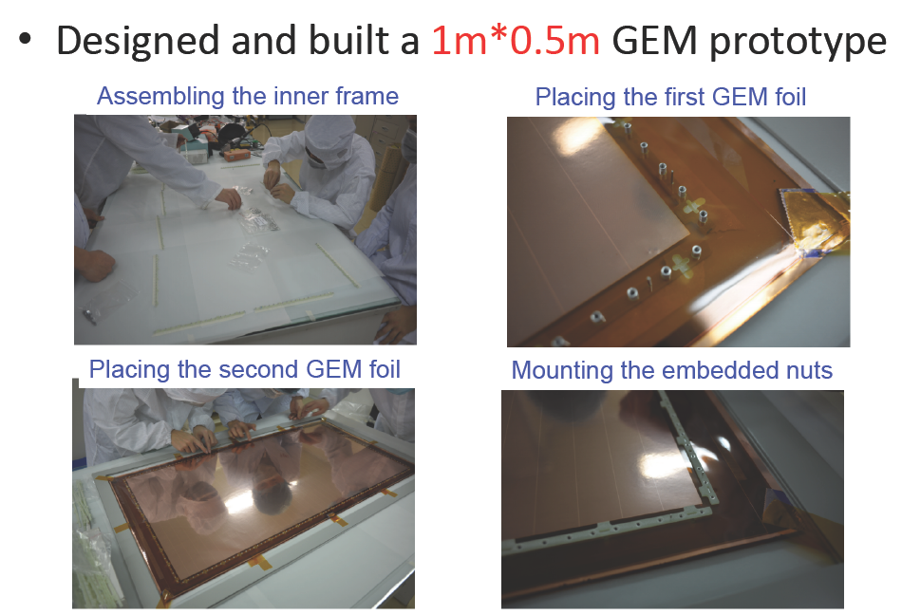

Slide 18
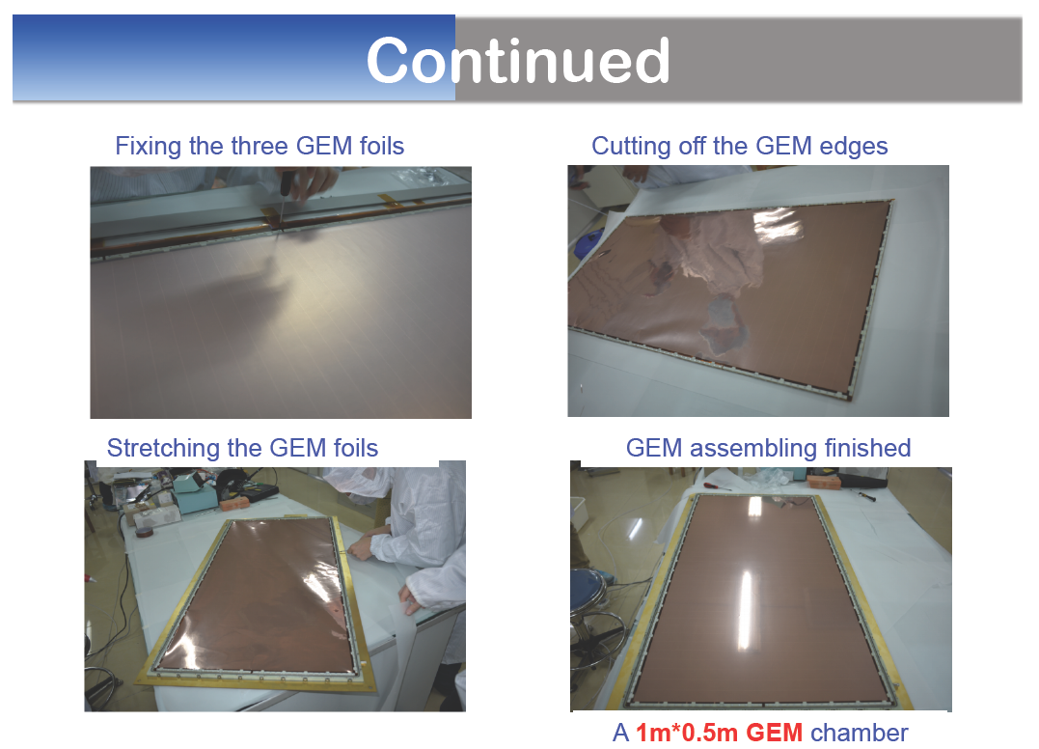
Continued

Slide 19
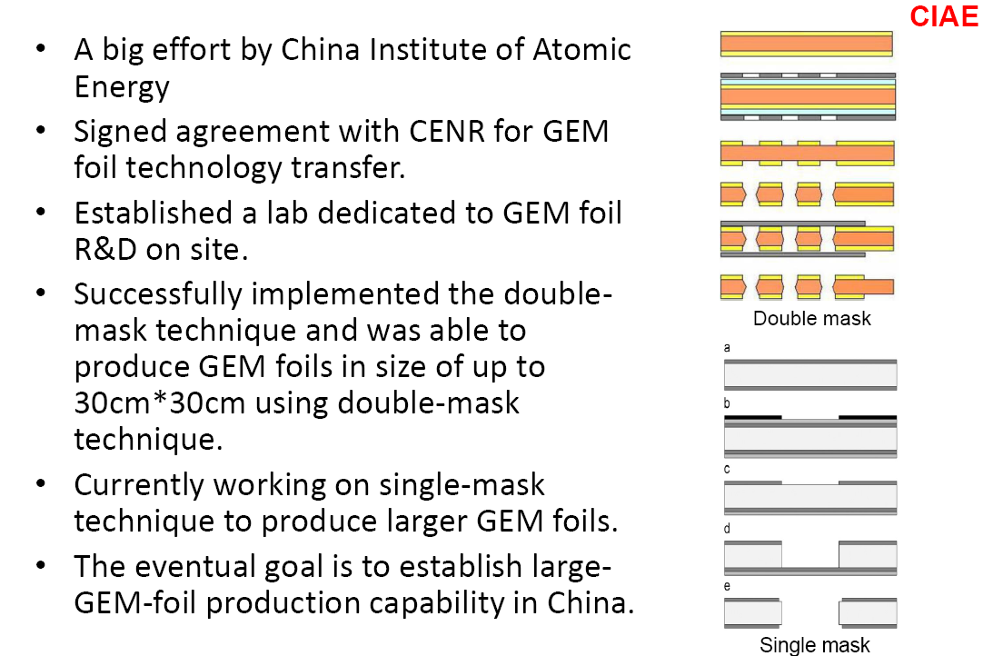
R&D on GEM foils

Slide 20
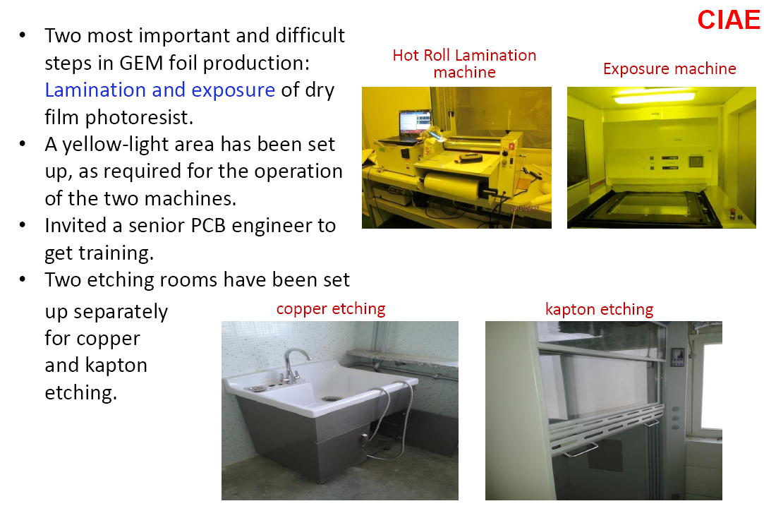
GEM foil Lab

Slide 21
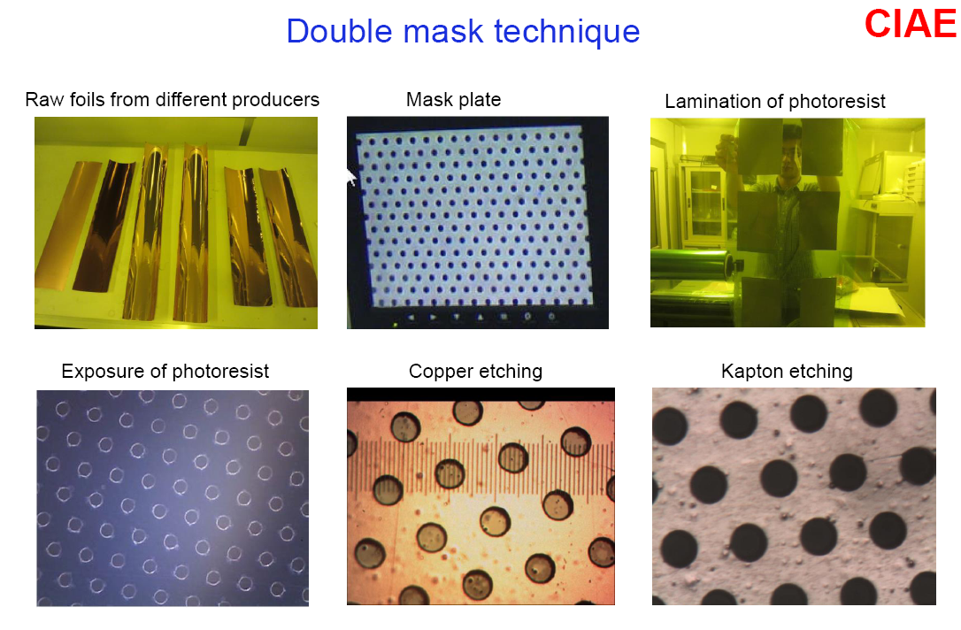
GEM foil production process

Slide 22
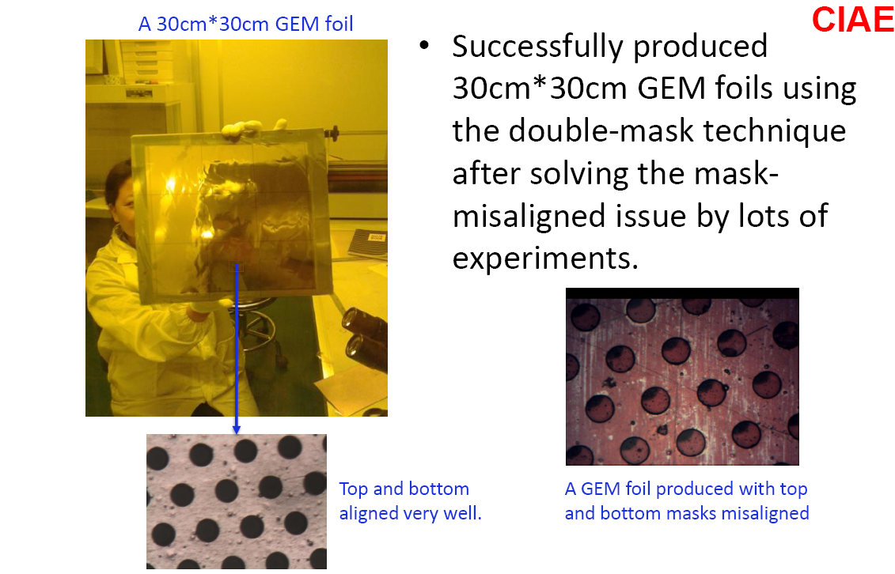
GEM foils produced (30cm x 30cm)

Slide 23
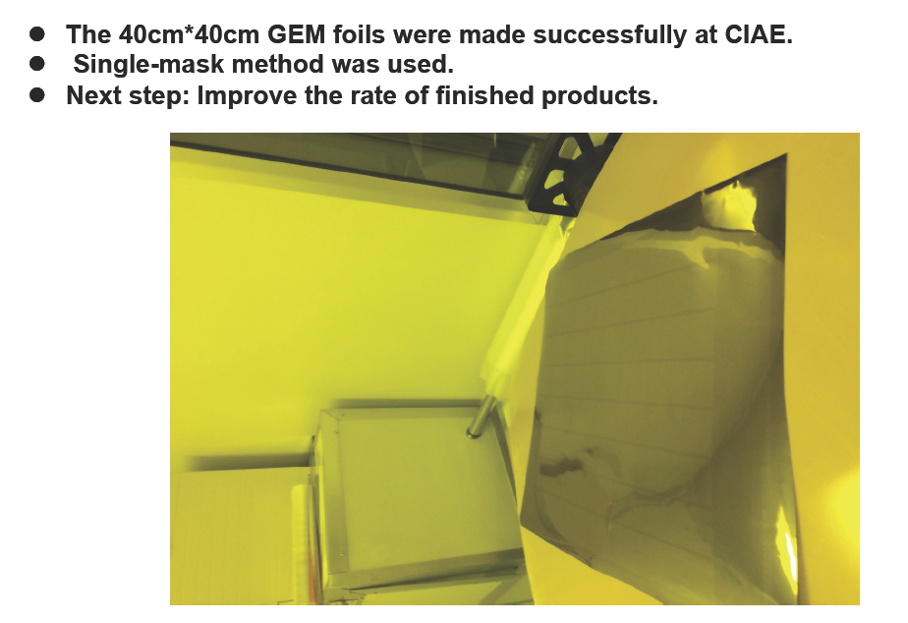
GEM foils produced (40cm x 40cm)

Slide 24
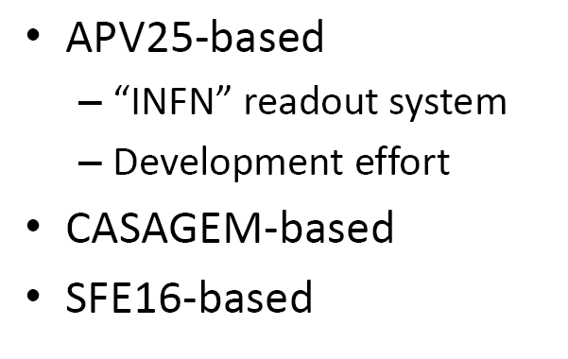
GEM readout

Slide 25
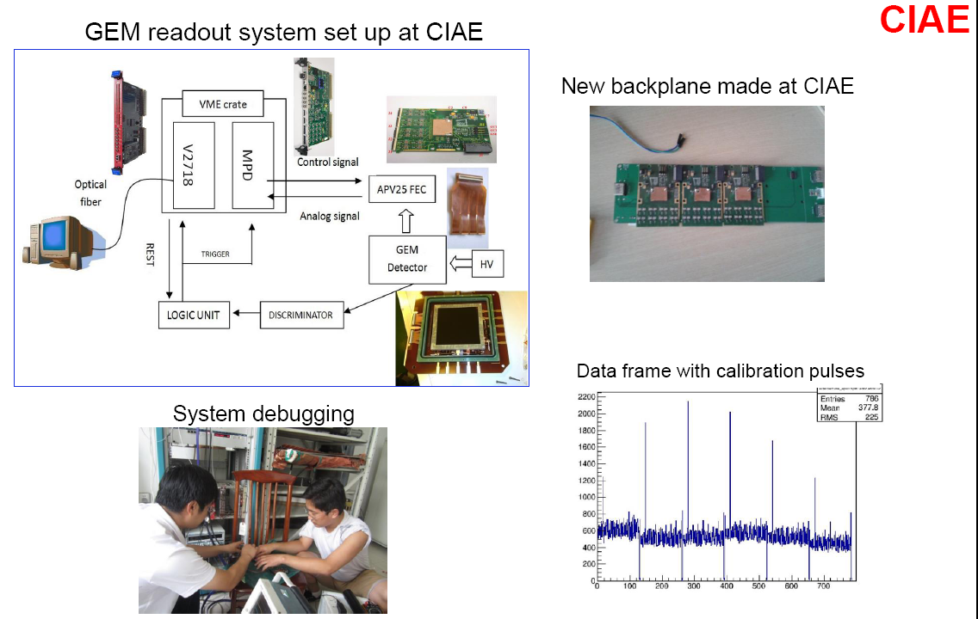
“INFN” readout system

Slide 26
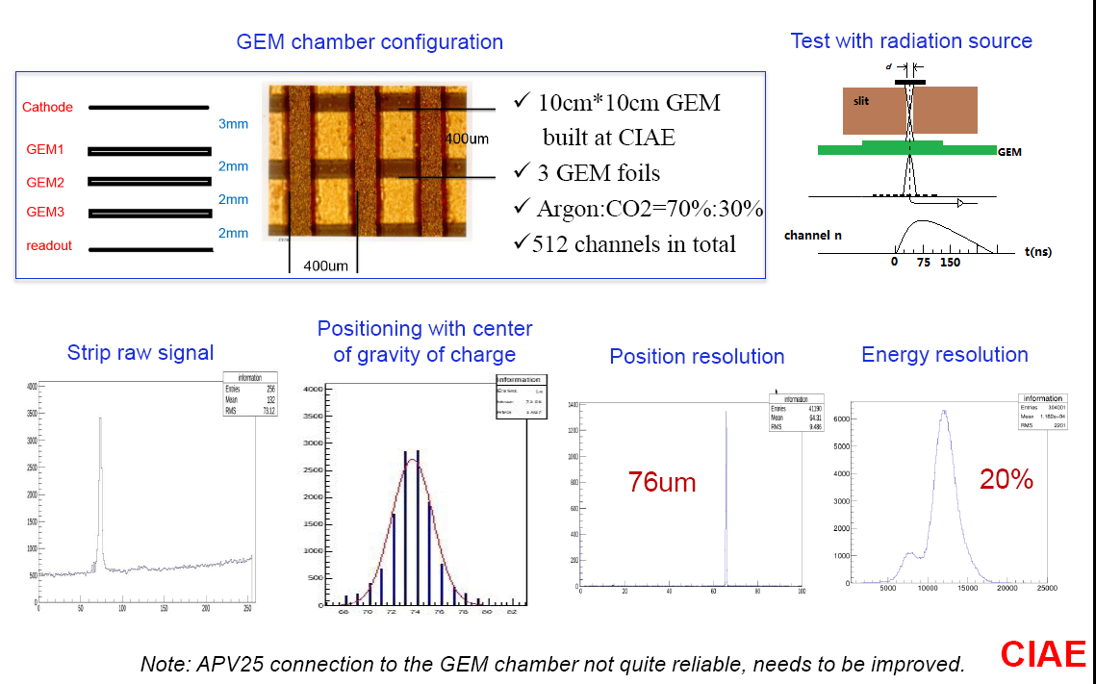
Readout test with a GEM chamber

Slide 27
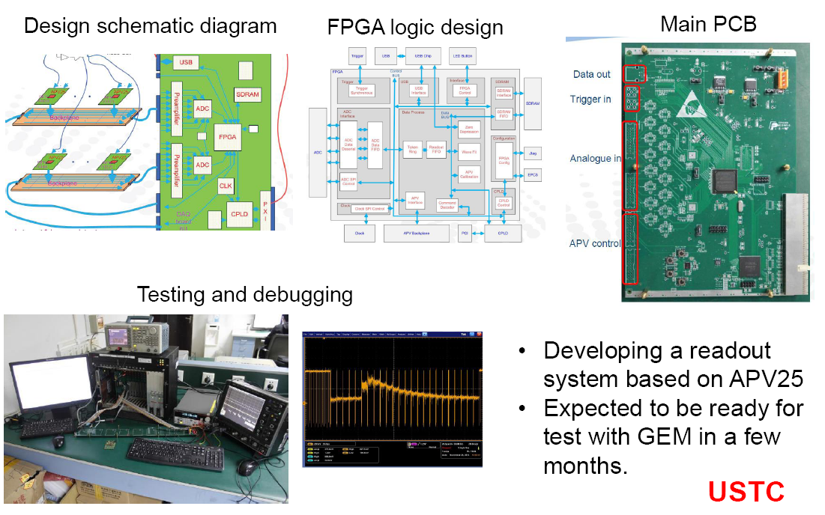
Development effort at USTC

Slide 28
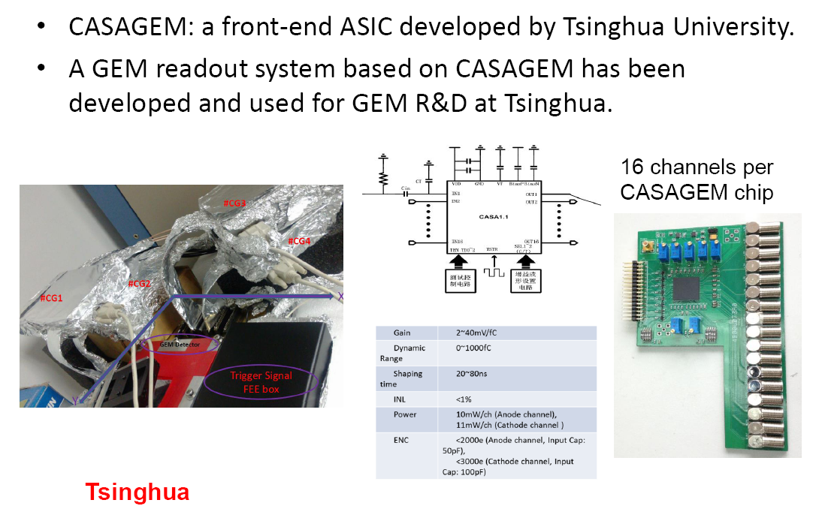
CASAGEM-based readout

Slide 29
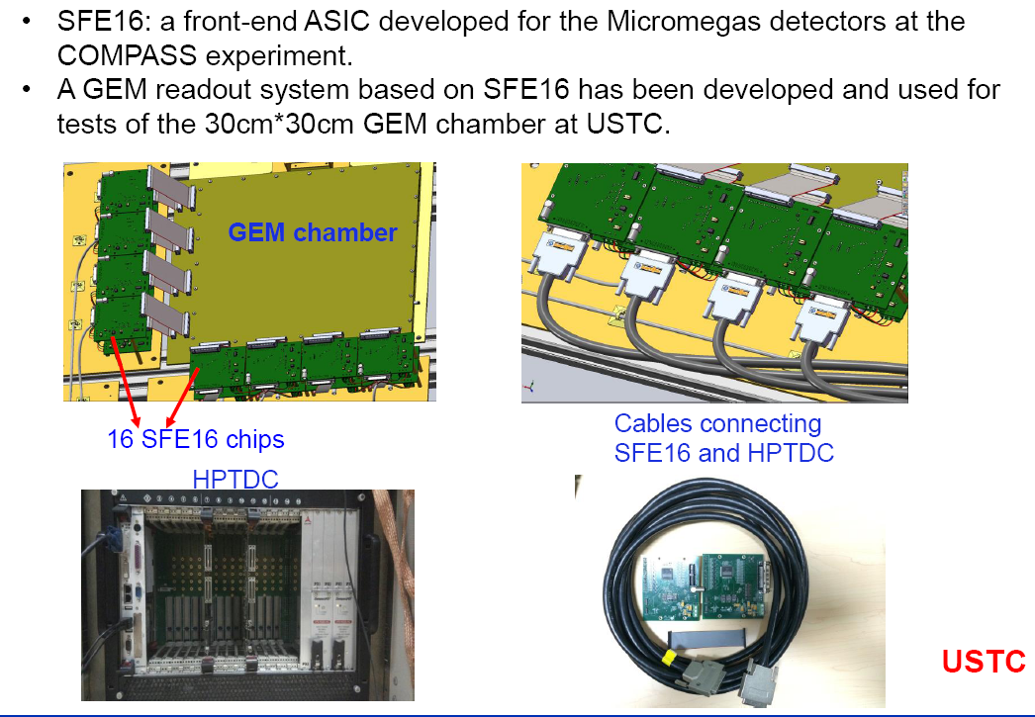
SFE16-based readout

Slide 30
Development of SoLID-TOF
SoLID-TOF requirement and structure
Development of MRPC prototype
Beam test of MRPC
Production workshop

Slide 31
Main requirements for TOF
The MRPC is developed for the TOF of SoLID
Main Requirements for TOF:
  π/k separation up to 2.5GeV/c
  Time resolution < 100ps
  Rate capability > 10kHz/cm²

Slide 32
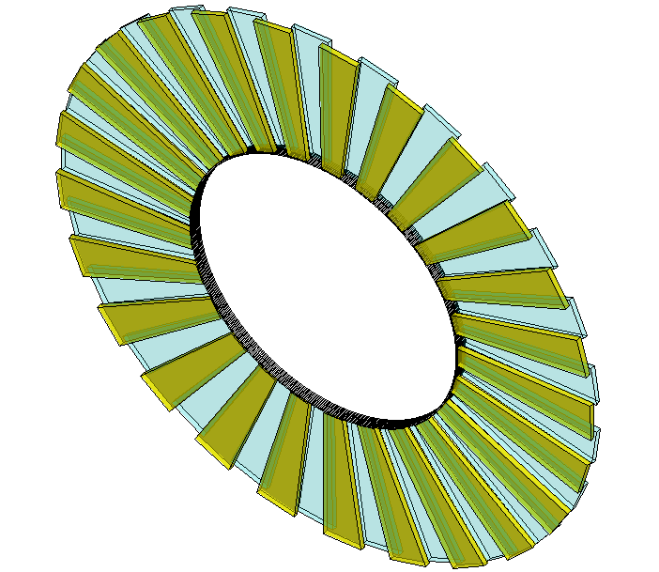
Conceptual design of SOLID-TOF
MRPC TOF wall we designed contain 150 MRPC modules in total, with 50 gas boxes and 3 counters in each box, covering the area of 10m².
MRPC3
28cm
MRPC2
16cm
100cm
MRPC1
Total channel ~3600
The MRPC module we tested is the prototype of smallest one.

Slide 33
Working mechanism of MRPC
Read out
MRPC is made of thin
glass, large area and cheap
The inner glasses are
floating, take and keep
correct voltage by
electrostatics. it is
transparent to fast signals
Thin gap->good timing
Multi-gap-> high efficiency
Insulator
Carbon
Resistive plate
Insulator
Read out
Standard parameters:
Resistivity of glass: ~10¹² Ω.cm
Time resolution <100ps
Efficiency >95%
Dark current: a few nA
Noise ~1Hz/cm²
Rate <100 Hz/cm²

Slide 34
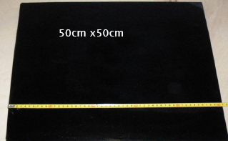
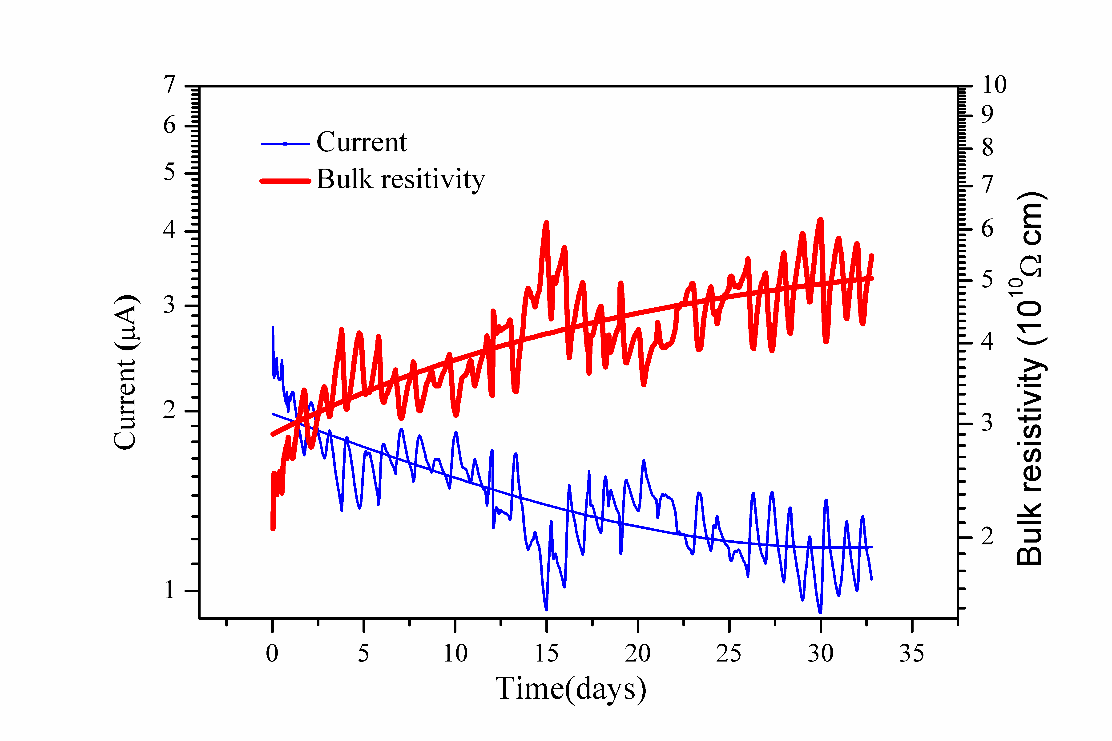
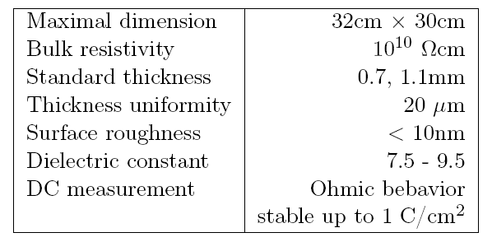
Performance of low resistive glass
32cm x 30cm
Performance of low resistive glass

Slide 35
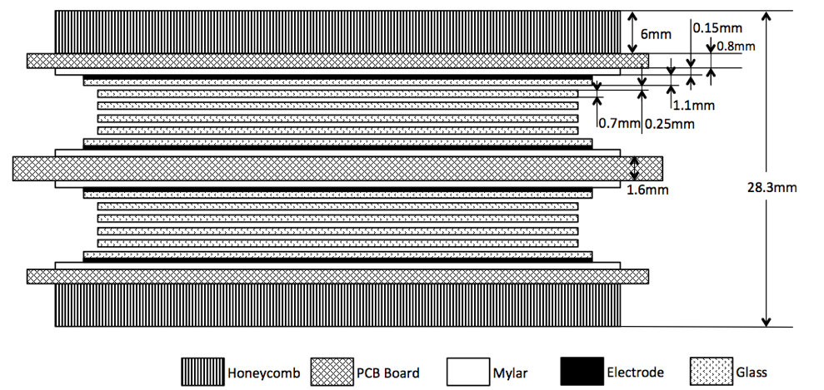
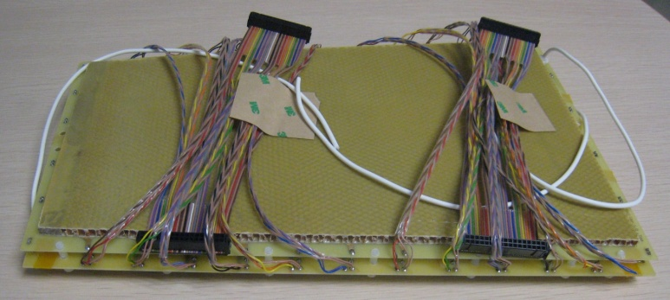
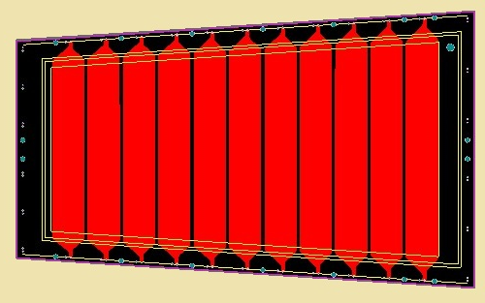
A MRPC prototype for SoLID-TOF
Volume resistivity: ~10¹⁰Ω.cm
25mm
Material dimensions
 | Length/mm | Width/mm | Thickness/mm
Gas gap | - | - | 0.25×10
Inner glass | 320 | 130-171 | 0.7
Outer glass | 330 | 138-182 | 1.1
Mylar | 335 | 153-198 | 0.18
Inner PCB | 350 | 182-228 | 1.6
Outer PCB | 350 | 172-218 | 0.8
Honeycomb | 330 | 153-198 | 6
171mm
219mm
363mm

Slide 36
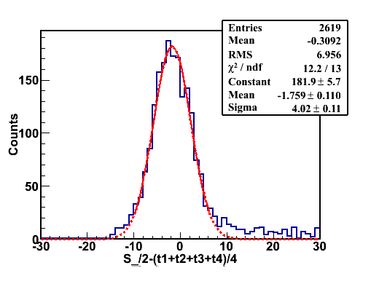
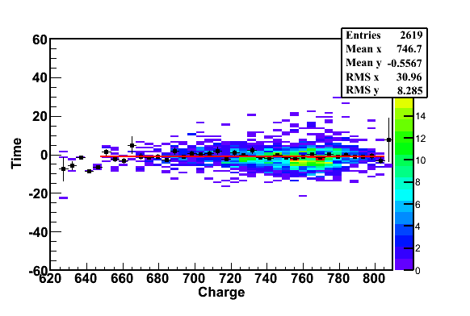
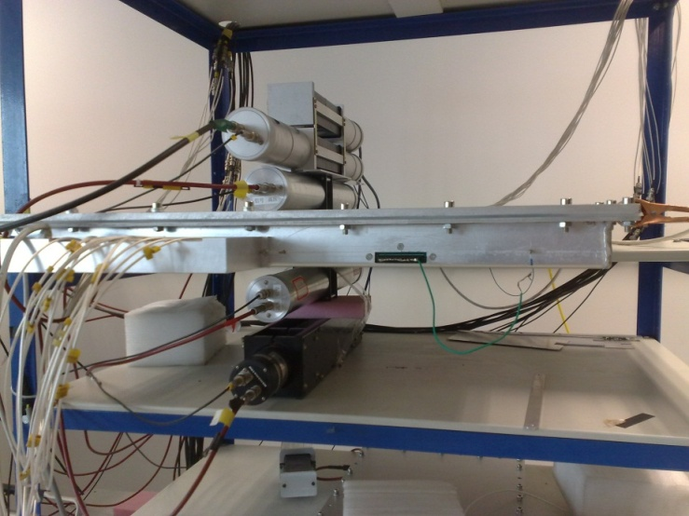
Cosmic test
Cosmic ray test@Tsinghua August, 2011
PMT0
PMT1
PMT2
MRPC
PMT3
PMT4
Cosmic Ray Muon
Efficiency > 95% @ 96kV/cm (6.0kV)
Time resolution: ~ 52ps

Slide 37
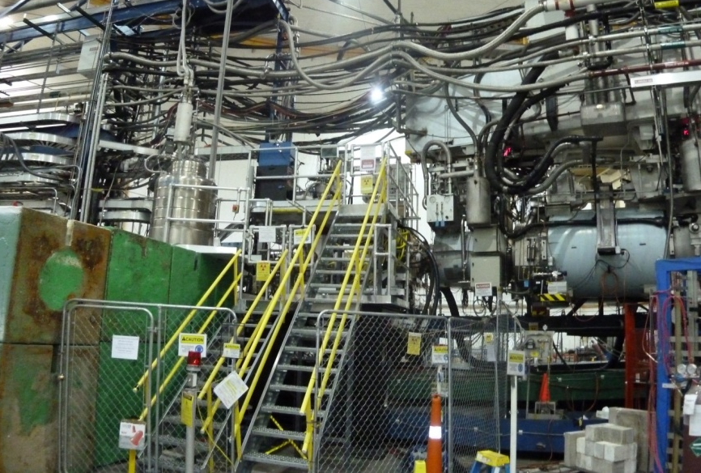
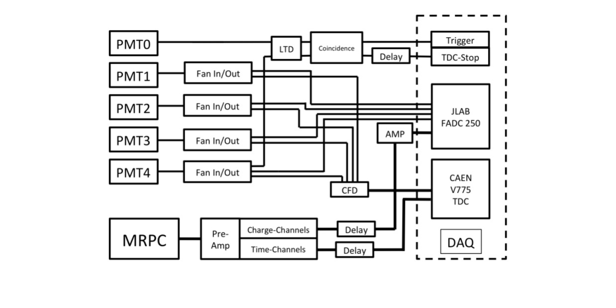
Beam test @ Hall A
High Energy e-
Shield
PMT1
PMT3
Target
PMT0
PMT2
PMT4
Top View
The diagram of DAQ system
Target
Test setup
37

Slide 38
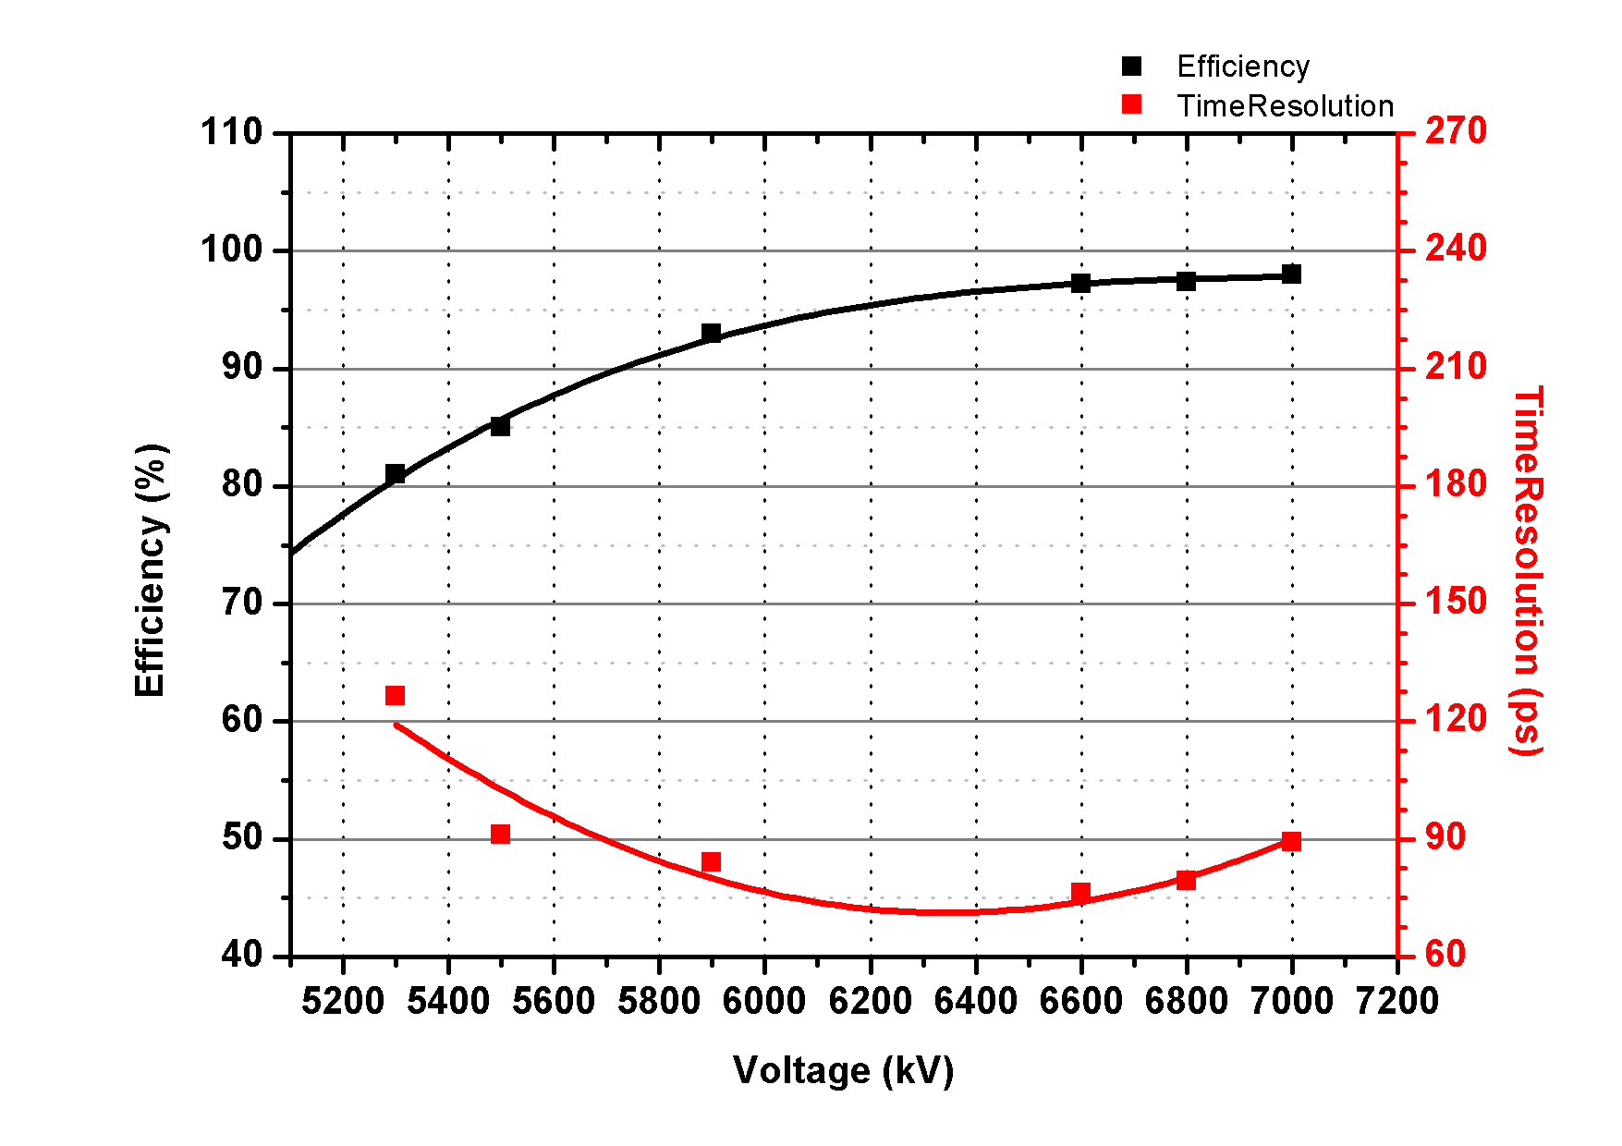
Test results (1)
Efficiency: >95%
Time Resolution: ~75ps
38

Slide 39
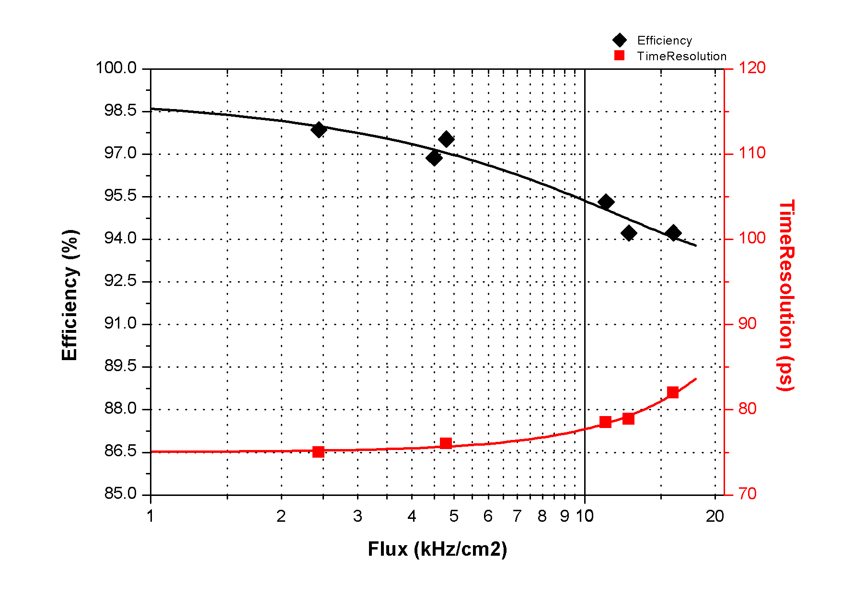
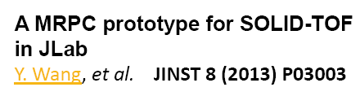
Test results (2)
Voltage: 6800V
Flux:11kHz/cm²
Efficiency:~95%
Time Resolution: 78ps
Flux:16kHz/cm²
Efficiency:~95%
Time Resolution: 82ps

Slide 40
TOF electronics
Fast preamplifier：
Maxim3760 (Tsinghua and RICE Univ.)
Ninos (TOT) (ALICE)
Padi (TOT) (GSI)
CAD (TOT) (Tsinghua)
QDC (CAEN, 25fC/bin)
TDC
HPTDC (ALICE, 25ps/ch)
GET4 (GSI, 25ps/ch)
FPGA TDC (GSI and other)
DAQ

Slide 41
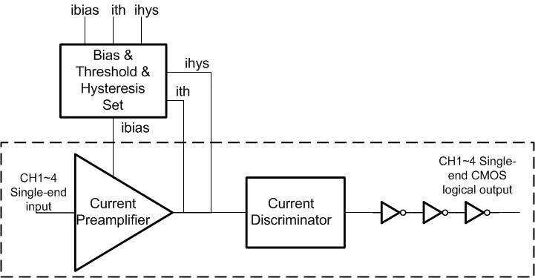
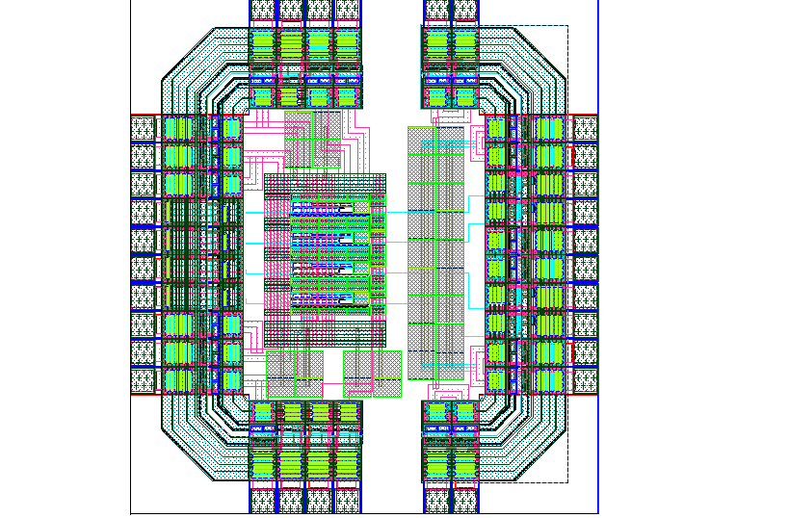
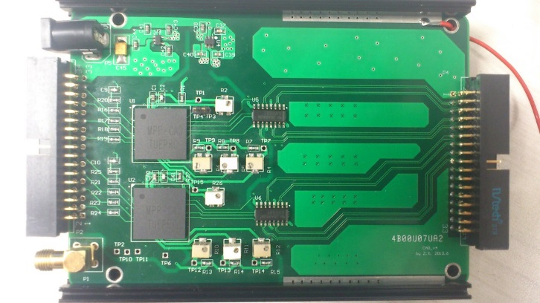
CAD: Tsinghua amplifier
Specifications
Supply Voltage | 3.3 V
Technology | 0.35μm CMOS
Chip Package | BGA package
Preamplifier Current Gain | 2
Preamplifier Bandwidth | >100 MHz
Power Consumption | <10 mW/ch
input | Single-end input
output | Single-end CMOS logical output

Slide 42
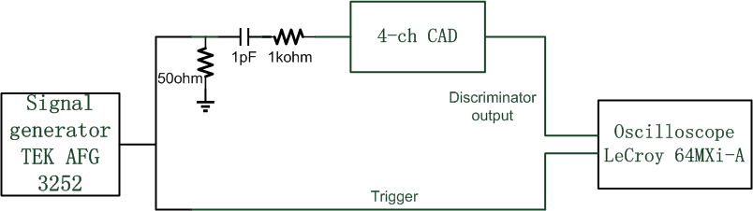
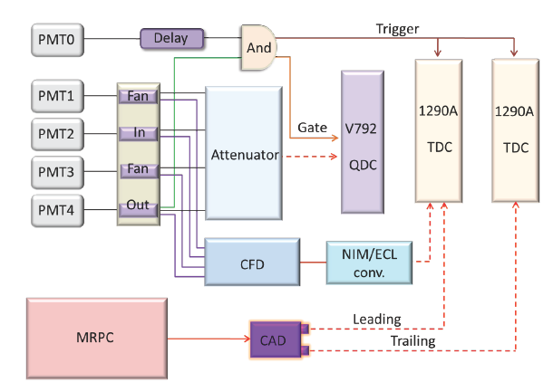
Test with signal generator and MRPC

Slide 43
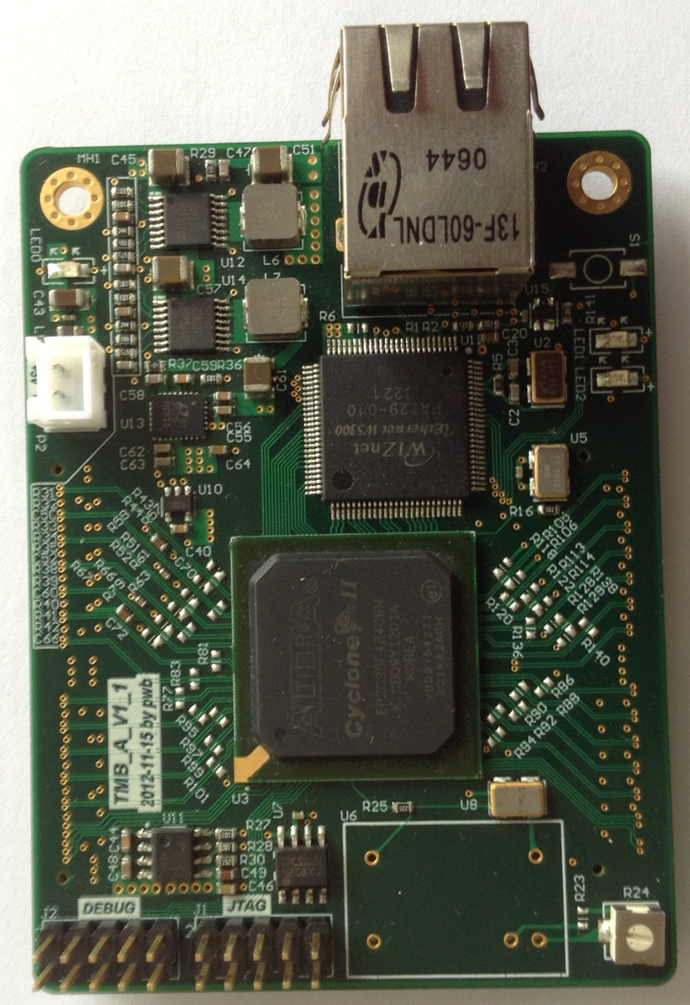
Tsinghua-FPGA TDC
100M Ethernet
Readout with
TCP/IP support
Cyclone-II
FPGA
EP2C35F484C6
Socket for TCXO
(opt.)
24 channels, Ethernet readout
Resolution ~30ps

Slide 44
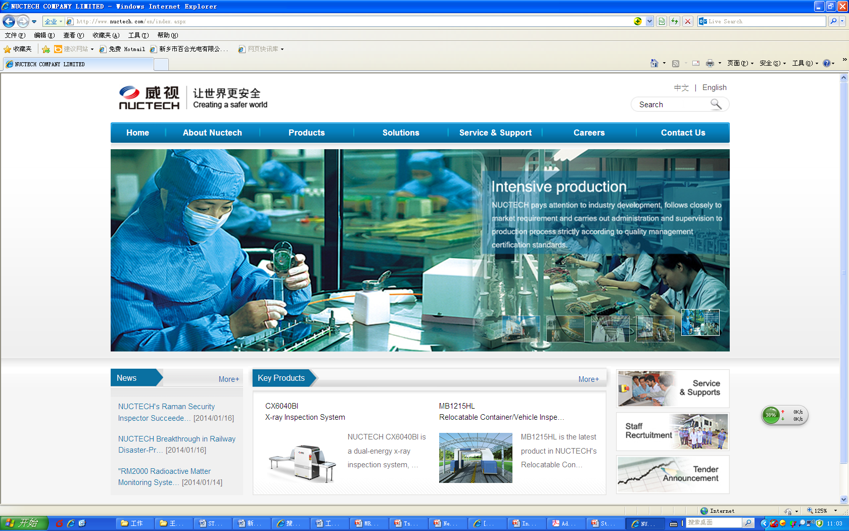
RPC workshop: http://www.nuctech.com/en/index.aspx

Slide 45
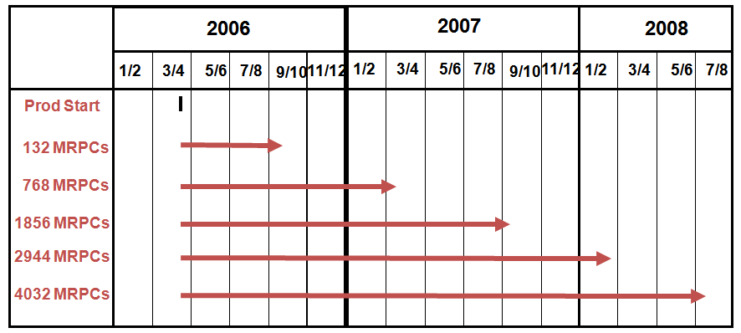
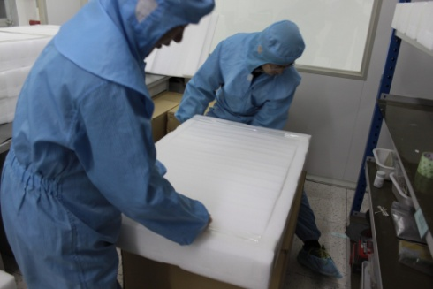




MRPC mass production

Slide 46


EM calorimeter of SoLID
One EM calorimeter unit: Shashlyk detector + pre-shower
HADRON2014, C. Feng
46

Slide 47



Pre-shower detector prototype
Hexagon scintillator with groove for light fiber, Make in Kedi company, China.
Light yield of the prototype for single MIP. More than 60 photos are collected for MIP.
Scintillator couple to wave length shift light fiber, and packet with tyvek.

Slide 48
Summary
Full exploitation of JLab 12 GeV Upgrade
→ SOLID: A Large Acceptance Detector that can handle High Luminosity (10³⁷-10³⁹)
Highest rated physics program: TMDs, PVDIS, threshold J/ψ and GPDs
Chinese group has deep collaboration in SoLID-GEM, TOF and ECAL
We are trying to get funding for the construction of GEM and MRPC

Slide 49
Thank you!
谢谢大家！

