Slide 1

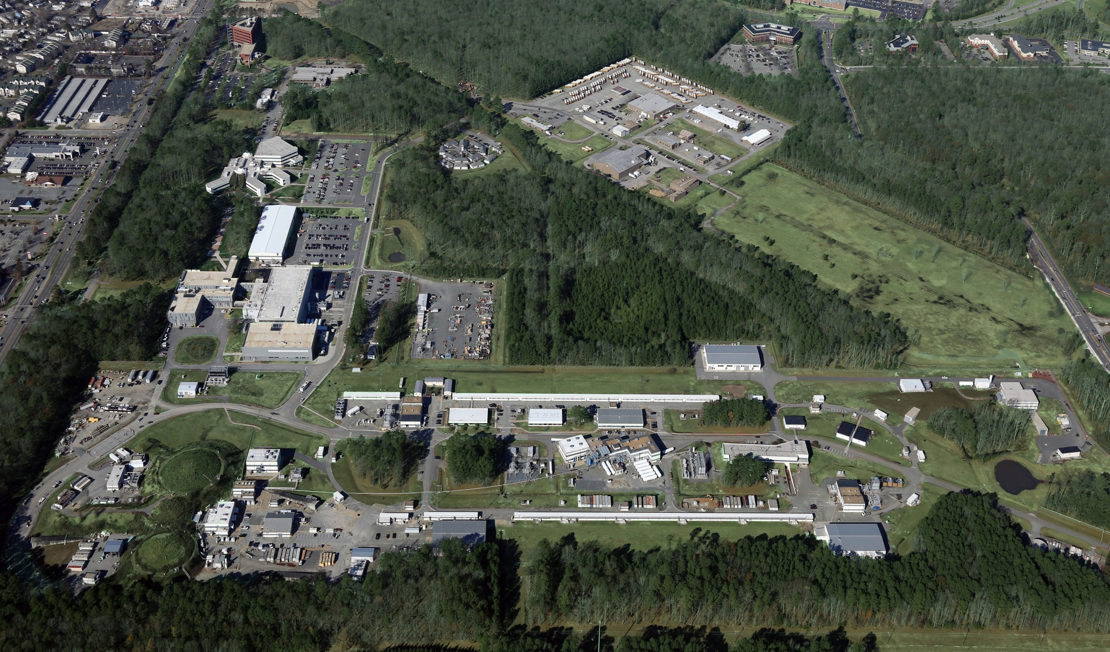
Jefferson Lab Status
Bob McKeown
June 23, 2016

Slide 2
Outline
Recent Highlights
Personnel news
Upgrade project
Experimental equipment
- SBS
- Hall B ERRs
MOLLER, SoLID status
PAC
Budgets
JLEIC

Slide 3

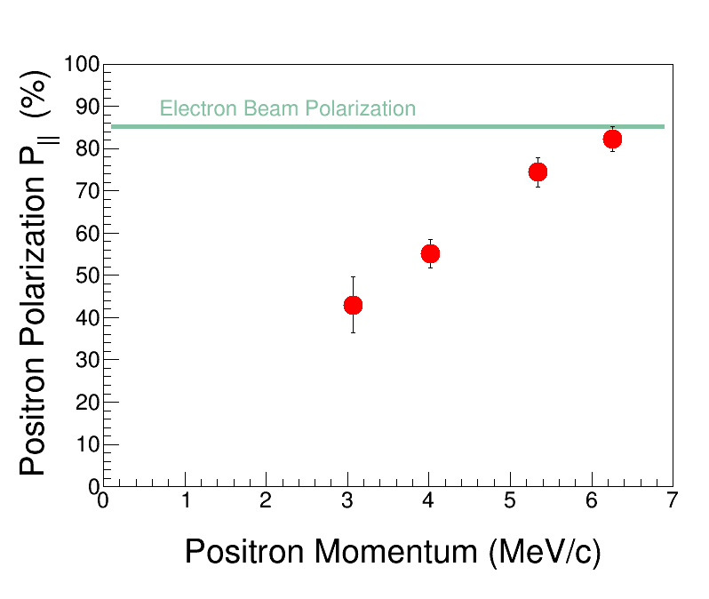

Polarized Positrons for Research
The Polarized Electrons for Polarized Positrons (PEPPo) experiment in Jefferson Lab’s CEBAF injector demonstrated a new technique for production of polarized positrons.
When an energetic electron beam strikes matter, it produces photons that can further convert their energy in pairs of an electron and a positron. A positron is the anti-particle twin to the electron. It was shown that if the original electron beam is polarized (electrons “spin” in one direction), this polarization can be transferred to the positrons with nearly 100% efficiency.
Electron-positron pairs (e⁻ e⁺) result when an energetic electron beam strikes matter. If the electron beam is polarized, the polarization can be passed on to the new electrons and positrons.
At low energies, there is no remnant radioactivity, so universities and industry may benefit from this proof-of-principle. This could allow for the exploitation of polarized positron beams for a wide range of applications and research, such as improved product manufacturing and polarized positron beams for the proposed International Linear Collider and Electron-Ion Collider to power breakthrough scientific research.
Measurements of positron polarization. The blue line indicates electron beam polarization.
D. Abbott et al. (PEPPo Collaboration). “Production of highly polarized positrons using polarized electrons at MeV energies.” Phys. Rev. Lett. 116, 214801 (2016).
doi: 10.1103/PhysRevLett.116.214801

Slide 4
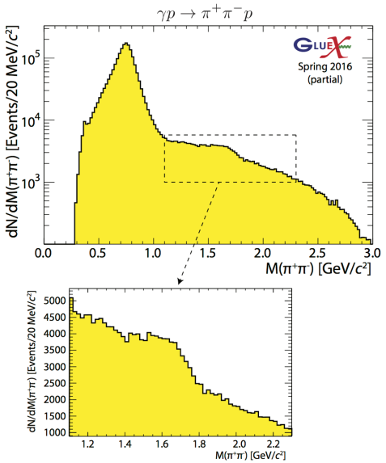
New Results from GlueX
ρ’
Study polarization observables!

Slide 5
More New Results from GlueX
Four photon final states
Clear signals for σ, f₀(980), f₂(1270),
a₀(980) and a₂(1320).

Slide 6

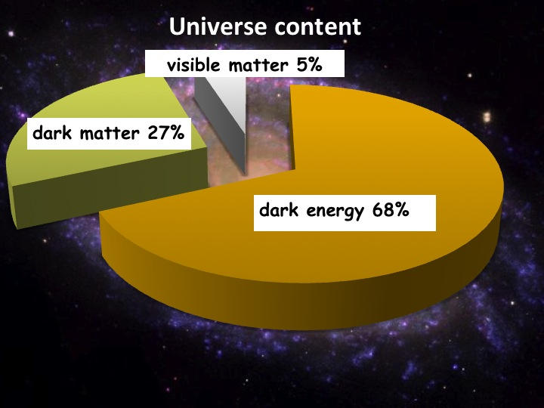
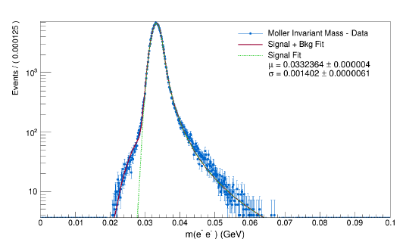
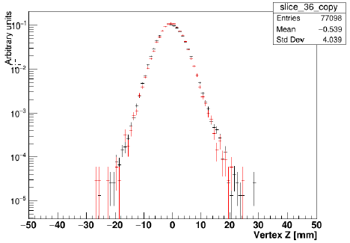
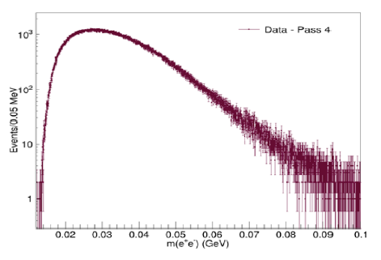
Heavy Photon Search
HPS searches for an electro-produced hidden sector photon (A’) which decays to e⁺e⁻ pairs
A’s could mediate dark matter annihilations and interactions with our matter
HPS identifies A’s with invariant mass and separated vertices
Successful 2015 Engineering Run at 1.05 GeV
HPS Works as Designed
JLAB has granted approval for full HPS run request
Mass Resolution ~ Design
Vertex Tails as Simulated
Measured e⁺e⁻ Masses

Slide 7
Search Underway. Results Soon!
First results at 1.05 GeV (~1.6 PAC days)
  Bump hunt due late summer will
  cross-check well trod region.
  Vertex search end of 2016 will cover virgin territory. New physics?
Results at 2.3 GeV (~ 5 PAC days)
  Both bump hunt and vertex search analyses cover a higher mass window
  More new territory!
  Hope for results in 2017
HPS Future
  Hope to install upgrade before 2018 which will boost reach considerably
  Extended run at 4.4 GeV (2018?)
  More runs at 1.1 and 2.3 GeV
2 PAC days at 1 GeV
Bump
Vertex
1 GeV
2.2 GeV
4.4 GeV
1 week 1.1 GeV
1 week 2.2 GeV
2 week 4.4 GeV

Slide 8
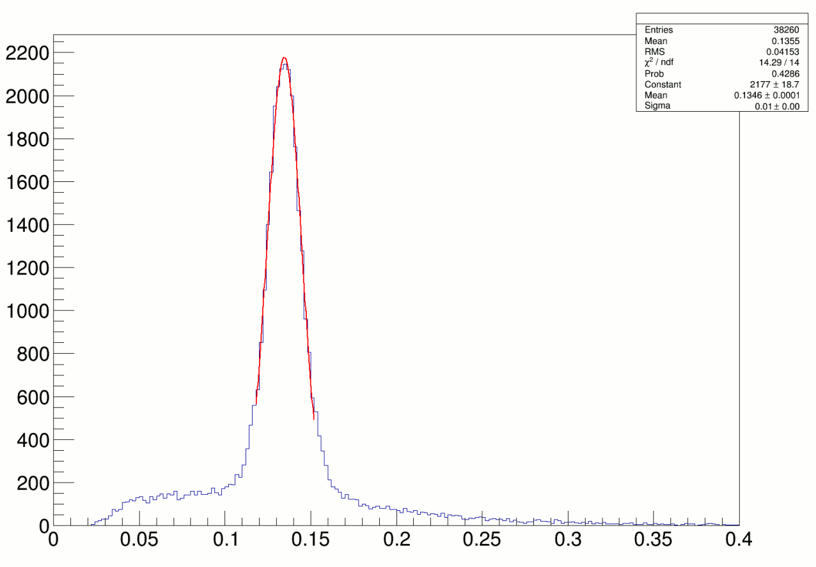
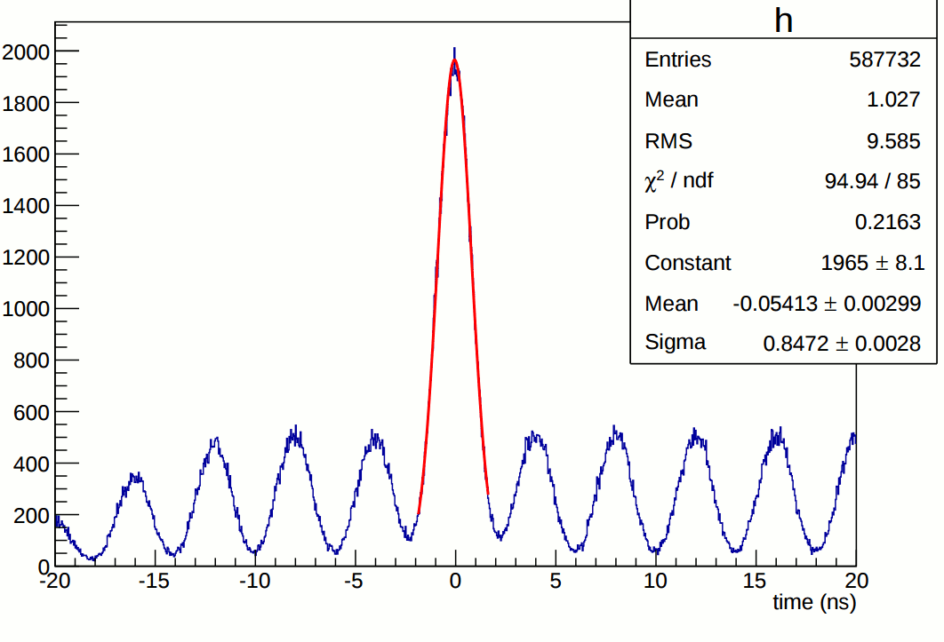
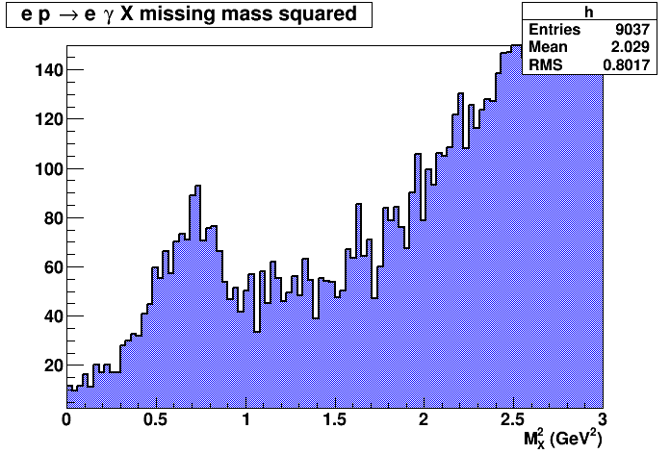
E12-06-114 DVCS/Hall A experiment at 11 GeV
Excellent coincident time resolution:
250 MHz beam structure
π⁰ ’s reconstructed in DVCS calorimeter
100 PAC days approved:
High impact experiment for nucleon 3D imaging program
High precision scaling tests of the DVCS cross section at constant x_{B}
CEBAF12 will allow to explore for the first time the high x_{B} region
DVCS events
(1.5 h of beamtime)
16% of experiment completed in 2014-2016

Slide 9
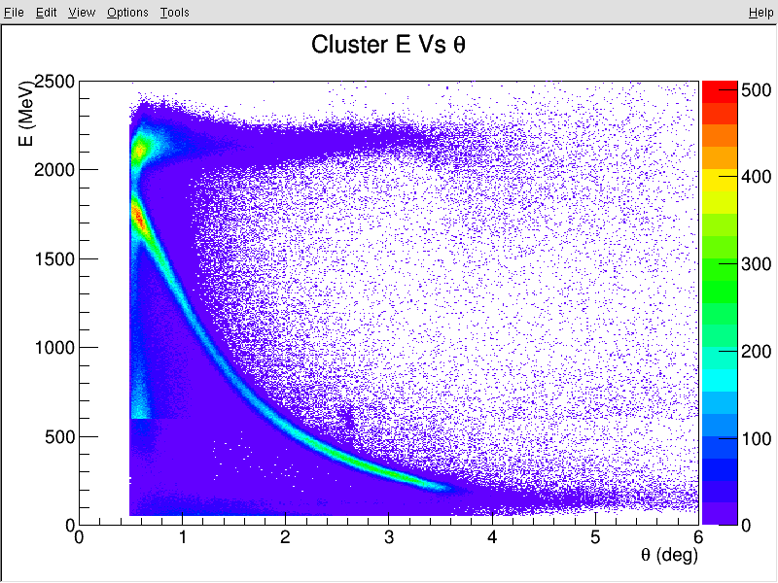
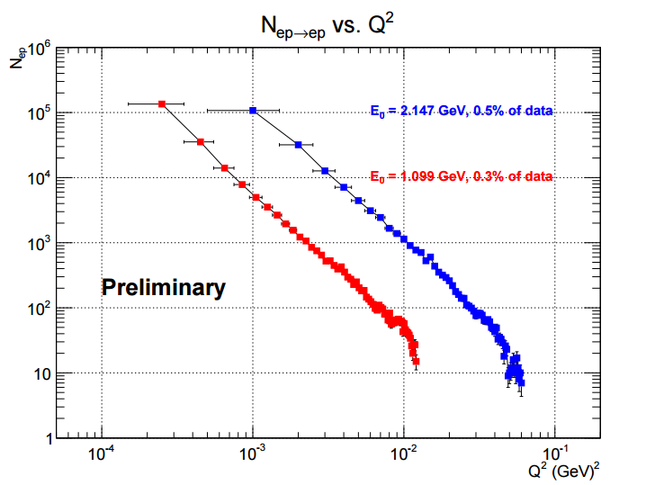
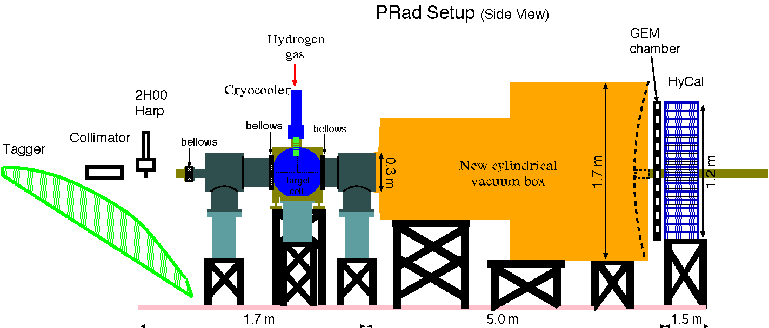
PRad
Experimental goals:
reach very low Q2 range (~ 10 times less
than the Mainz experiment)
reach sub-percent precision in rp extraction
Suggested solutions:
1) Non-magnetic-spectrometer method:
use high resolution high acceptance calorimeter
and high position resolution GEM detector
2) Simultaneous detection of ee → ee Moller scattering
(best known control of systematics)
3) Use high density windowless H2 gas flow target:
minimize experimental background
Two beam energies: 1.1, 2.2 GeV; Q² = (2x10⁻⁴ – 1x10⁻¹ ) GeV²
ep
Preliminary
e-e

Slide 10
Personnel News
Electron Ion Collider Physics Leadership
  Rik Yoshida (ex ZEUS, ATLAS, ANL) joined Jefferson Lab as leader of our EIC Physics Group
Head of Theory
  Position was advertised
  Co-chairs Joe Carlson, LANL & Bob McKeown, Jefferson Lab
  Members Charlotte Elster (Ohio U.), Franz Gross (Jefferson Lab emeritus), Frithjof Karsch (Bielefeld U. & BNL), Krishna Rajagopal (MIT), and Feng Yuan (LBNL)
  Search is well advanced
Celebratory Workshop for Mike Pennington
Thursday and Friday this week
Lab Director Search
  20 Member committee appointed
  Chaired by D. Geesaman

Slide 11


    Leadership Enhancement
    New Chief Operating Officer
      Michael Maier, formerly PAE Vice President for Space System Operations, has accepted the position of COO effective May 2, 2016.
    Chief Planning Officer
      Allison Lung, 12 GeV Upgrade Deputy Project Manager, has accepted the positon of Chief Planning Officer effective May 2, 2016 → a new position generated as a result of the recruitment process to strengthen the directorate and facilitate Jefferson Lab expansion.
      Both DOE Approved Key Contractual Positions

Slide 12
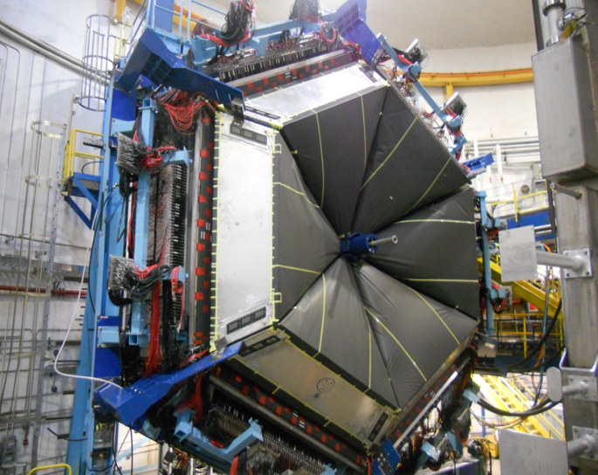
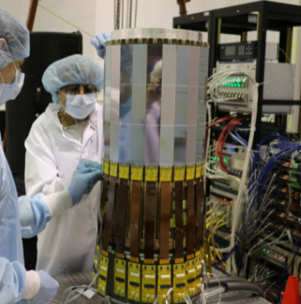
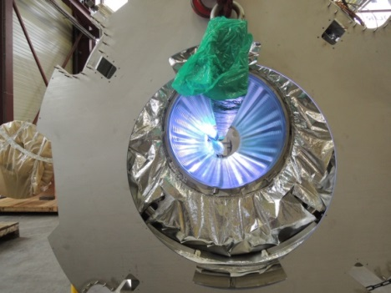
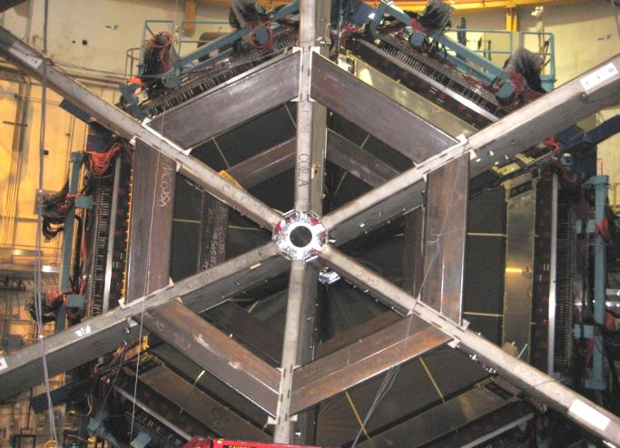
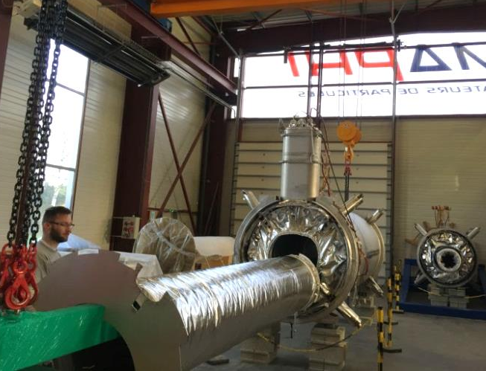
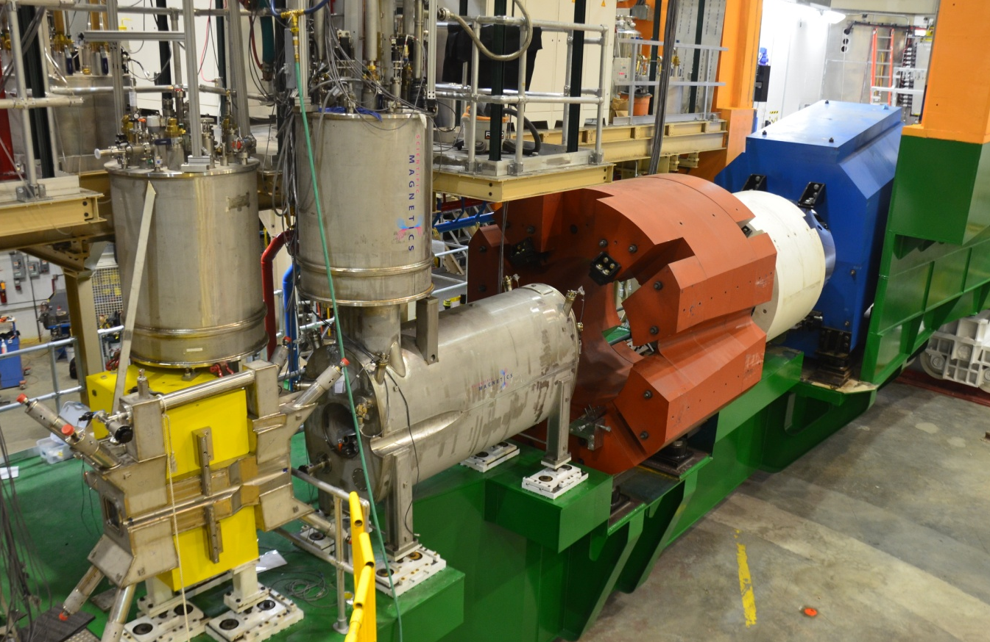
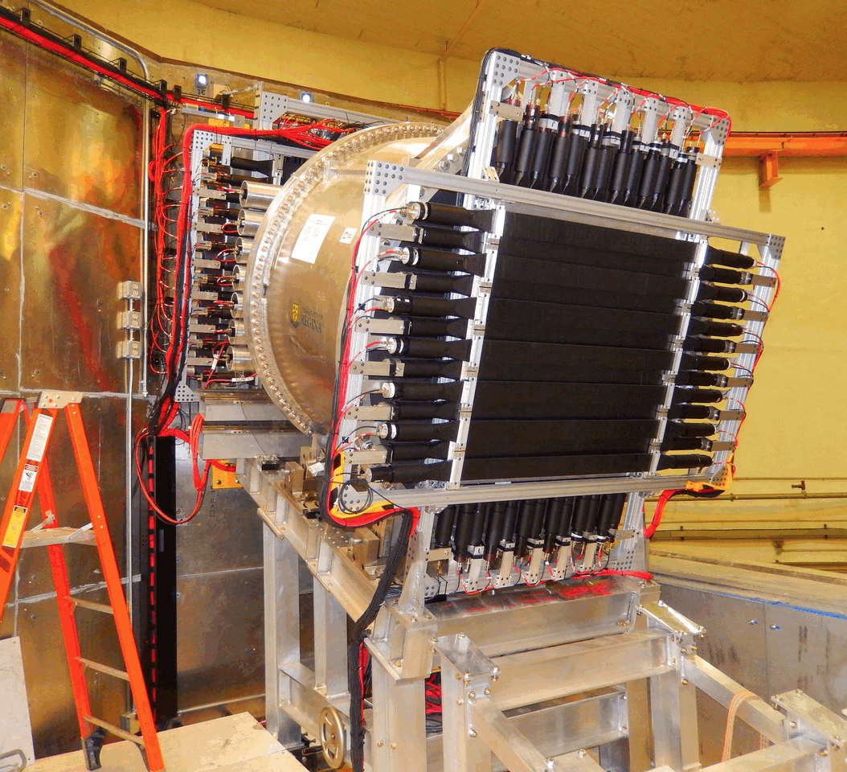
12 GeV Upgrade Project
TPC = $338M
ETC = ~$9M
Project Scope (~98% complete):
Doubling the accelerator beam energy – DONE
New experimental Hall D and beam line – DONE
Civil construction including utilities – DONE
Upgrades to Experimental Halls B & C – ~94%
  Halls B & C Detectors – DONE

Slide 13
CEBAF Three-Year Schedule
Feb 2016
Calendar Year
2016
2017
2018
Fiscal Year
2016
2017
2018
Accelerator
Activity
Opportunistic
Physics
Physics
Physics
Beam
Activity
SBS Construction
Hall A
Activity
Opportunistic
Physics
Physics
Physics
Beam
CLAS12 Construction/Installation
Hall B
Activity
Activity
Non-CLAS12 Ops*
Physics
Physics
Beam
Hall C
Activity
SHMS Construction/Installation
Activity
Comm.
Physics
Physics
Beam
Opportunistic
Physics
Physics
Physics
Hall D
Activity
Beam
* Potential PRad Summer 2016 run
Beam for Commissioning
Beam for Physics
Non-CLAS12 Ops

Slide 14
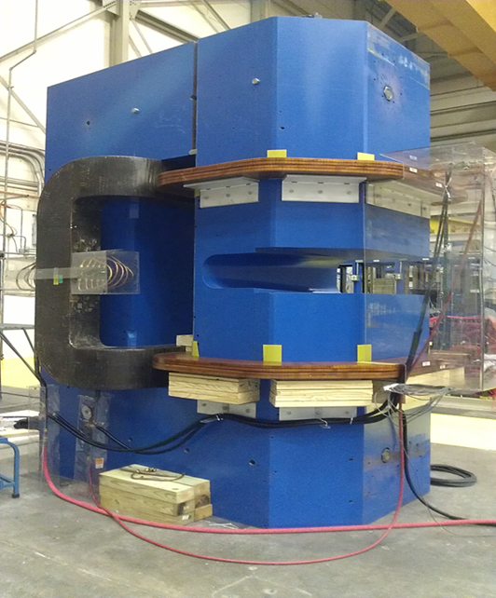
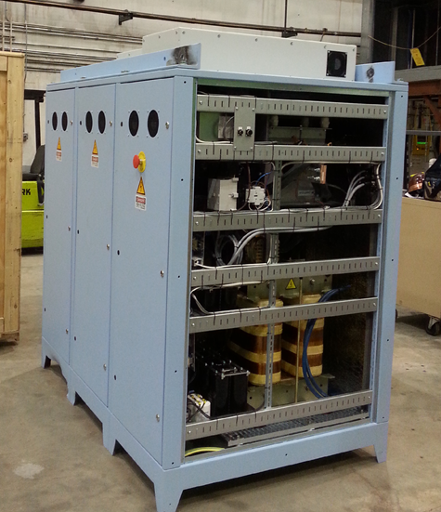
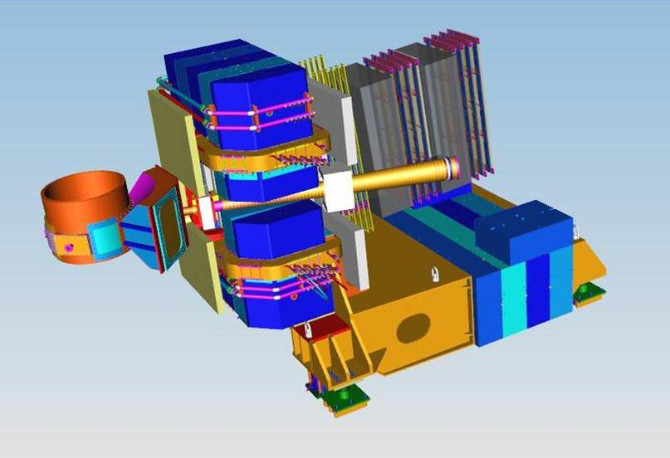
Super Bigbite Spectrometer (SBS)
New spectrometer to support three form factor experiments (G_{E}^{P} high impact), and one SIDIS experiment in Hall A.
  Magnet and infrastructure (JLab)
  2400 channel scintillator hodoscope (ISU)
  40 GEM modules ( each area = 50x60cm²) for rear tracker (UVa)
  Other equipment: Hadron calorimeter (CMU), Cerenkov (W&M), Front Tracker GEMs (INFN), Electron Calorimeter (SBU & JLab) and polarized helium target (UVa)
Magnet tested at JLab
CAD drawing of SBS magnet and infrastructure
Power supply tested at JLab

Slide 15
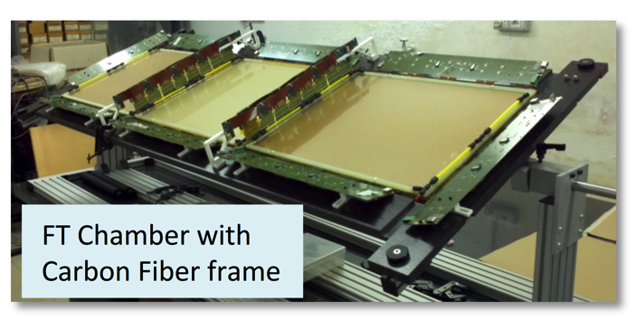
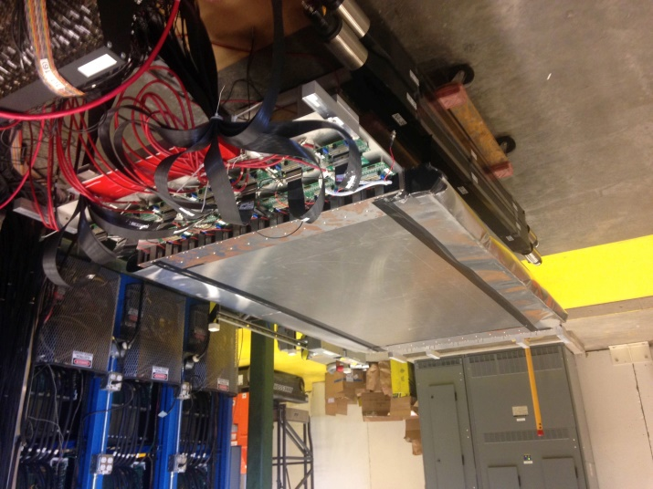
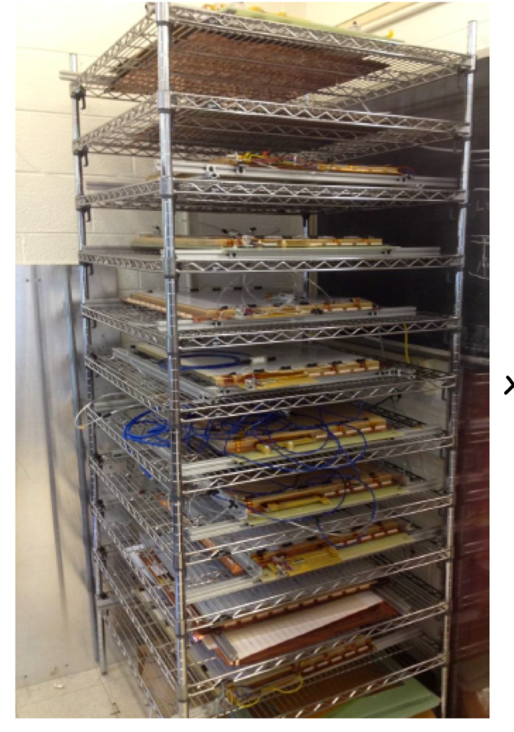
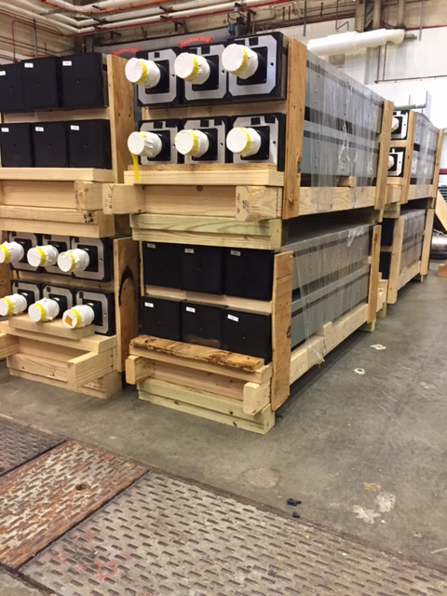
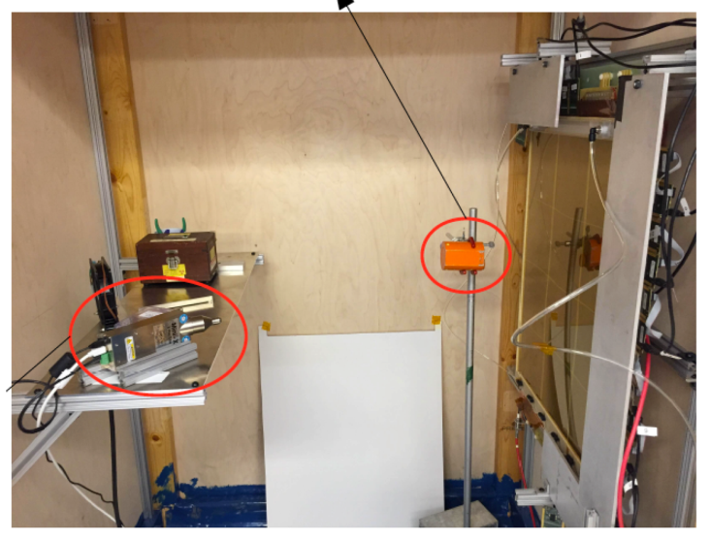
Super Bigbite Spectrometer (SBS)
CDET module 1 ready for cosmic testing with full data acquisition
INFN Front Tracker GEM chamber with carbon fiber frame at JLab
Rear GEM tracker modules at UVA, 32 constructed + 28 tested
UVa High rate X-ray testing setup for GEMs
168 out of 288 Hadron Calorimeter modules at JLab

Slide 16
Enhancements beyond 12-GeV Upgrade
• Hall A DVCS Calorimeter (France - Orsay) installed
• Hall A SBS – WBS1 complete, WBS2,WBS3 ongoing (Capital Equipment (CE))
• Hall A SBS GEMs (Italy INFN, UK), Hadron Cal. (CMU+INFN) ongoing (ops)
• Hall A pre-R&D toward PV (MOLLER magnet concept, with MIT) ongoing (ops)
• Hall A SOLID (China, Temple, Duke, ANL, …) ongoing (magnet - CE)
• Hall A APEX septum magnet (Canada, Stony Brook) complete
• Hall B longitudinally polarized target (ODU …, NSF/MRI) ongoing (infrastr. - CE)
• Hall B forward tagger (Italy INFN & NSF/MRI) complete
• Hall B RICH sector(s) (Italy INFN, Chile) ongoing (PMTs, materials - CE)
• Hall B MicroMegas (France - Saclay) near-complete
• Hall B Central Neutron Detector (France - Orsay) complete
• Hall B Heavy Photon Search (HPS) (DOE HEP, France, INFN) installed
• Hall B H Gas Target for Proton Charge Radius (NSF/MRI) complete
• Hall C Kaon Detection System (CUA …, NSF/MRI) installed
• Hall B,C Backward nucleon detection system (Israel/ODU/MIT) ongoing
• Hall C Neutral-Particle Spectrometer (CUA …/France/UK/Armenia, NSF/MRI) ongoing
• Hall D DIRC-based PID/Cherenkov system (JLab/IU/MIT) ongoing (CE)
• Hall D Discussions with China on calorimeter upgrades planning
• LERF: DarkLight Phase-I Equipment (MIT …, NSF/MRI) ongoing
• Injector: Bubble Chamber for ¹⁶O(γ,α)¹²C inverse kinematics (ANL) ongoing

Slide 17
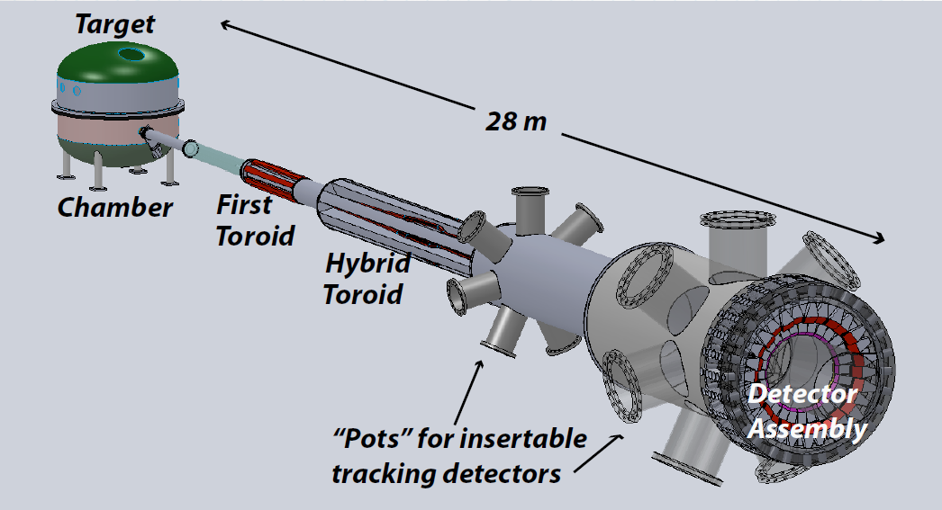

Future Projects
MOLLER experiment
(Possible MIE – FY17-20)
– Standard Model Test
– DOE science review (September 2014) – strong endorsement
– Director’s review to be scheduled for Nov. 2016 –
Technical, cost & schedule
– Now hope for FY18 start
SoLID
– CLEO Solenoid 
– Chinese collaboration
– Director’s review (Feb. 2015)
 lots of good feedback
– Collaboration briefing to DOE-NP
(Nov. 2015)

Slide 18
12 GeV Approved Experiments by Physics Topics
Topic | Hall A | Hall B | Hall C | Hall D | Other | Total
The Hadron spectra as probes of QCD (GluEx and heavy baryon and meson spectroscopy) |  | 1 |  | 3 |  | 4
The transverse structure of the hadrons (Elastic and transition Form Factors) | 5 | 3 | 2 | 1 |  | 11
The longitudinal structure of the hadrons (Unpolarized and polarized parton distribution functions) | 2 | 3 | 6 |  |  | 11
The 3D structure of the hadrons (Generalized Parton Distributions and Transverse Momentum Distributions) | 5 | 9 | 7 |  |  | 21
Hadrons and cold nuclear matter (Medium modification of the nucleons, quark hadronization, N-N correlations, hypernuclear spectroscopy, few-body experiments) | 6 | 3 | 7 |  | 1 | 17
Low-energy tests of the Standard Model and Fundamental Symmetries | 3 | 1 |  | 1 | 1 | 6
TOTAL | 21 | 20 | 22 | 5 | 2 | 70

Slide 19
12 GeV Approved Experiments by PAC Days
Topic | Hall A | Hall B | Hall C | Hall D | Other | Total
The Hadron spectra as probes of QCD |  | 119 |  | 540 |  | 659
The transverse structure of the hadrons | 145.5 | 85 | 102 | 25 |  | 357.5
The longitudinal structure of the hadrons | 65 | 230 | 165 |  |  | 460
The 3D structure of the hadrons | 409 | 872 | 212 |  |  | 1493
Hadrons and cold nuclear matter | 180 | 175 | 201 |  | 14 | 570
Low-energy tests of the Standard Model and Fundamental Symmetries | 547 | 180 |  | 79 | 60 | 866
Total Days | 1346.5 | 1661 | 680 | 644 | 74 | 4405.5
Total Days – Without MIE Days | 697.5 | 1661 | 680 | 644 | 28 | 3710.5
Total Approved Run Group Days (includes MIE) | 1346.5 | 826 | 637 | 424 | 74 | 3307.5
Total Approved Run Group Days (without MIE) | 528.5 | 826 | 637 | 424 | 28 | 2443.5
Total Days Completed | 20 | 15 | 0 | 25 | 0 | 60
Total Days Remaining | 508.5 | 811 | 637 | 399 | 28 | 2383.5

Slide 20
PAC44
3 returning C2
9 new proposals
1 returning C2 run group
2 new run groups (Hall B)
3 run group additions
9 LOI’s
Scheduled for week of July 25
Proposals were due Monday, June 6, 2015
Charge:
Review new proposals, previously conditionally approved proposals, and letters of intent for experiments that will utilize the 12 GeV upgrade of CEBAF and provide advice on their scientific merit, technical feasibility and resource requirements.
Identify proposals with high-quality physics that, represent high quality physics within the range of scientific importance represented by the previously approved 12 GeV proposals and recommend for approval.
Also provide a recommendation on scientific rating and beam time allocation for proposals newly recommended for approval.
Identify other proposals with physics that have the potential for falling into this category pending clarification of scientific and/or technical issues and recommend for conditional approval. Provide comments on technical and scientific issues that should be addressed by the proponents prior to review at a future PAC.

Slide 21
Jeopardy
Process
Requested a proposal from UGBOD at January 2016 meeting. UGBOD gave some guidance, but not consensus.
Generated a proposal in April, sent to hall leaders and UGBOD. Got email feedback from UGBOD.
Added explanatory text to address feedback from UGBOD.
May 2016 – reached consensus on present draft for discussion at user meeting.
Rationale
Use normal yearly PAC for ~4 years to address all presently approved proposals that have not been scheduled, plus new proposals in the next few years. Estimate ~5-10 proposals per meeting
Will start in 2019 to reach steady state in 2024 - proposals that have been approved for 4 years or more but are not scheduled will be considered in Jeopardy.
More details at the User Meeting

Slide 22
Budget: FY16; FY17 Discussion
Omnibus FY16: JLab allocation is $1.5M below Pres. budget.
  Keep 16 weeks running; Retain staff
  Delay some activities, accelerator spares  increased risk, little margin
FY2017
  Pres. Budget release Feb. 9: NP at $636M, an increase of $18M (3%)
    Major increases in isotope program ($8M) and RHIC/BNL ($7.5M)
    JLab ops up $5.5M but insufficient for full operation
  Senate mark: $636M
    Language for FRIB construction and RHIC ops
  House Mark: $620M
    Language for FRIB construction, RHIC and CEBAF ops

Slide 23
JLab Operations Budget
During FY01-FY12, CEBAF ops averaged 34.5 weeks/year (best year FY05 at 42 weeks)
For 12 GeV era we estimate “optimal” operations at
37 weeks per year
FY17 Pres. Budget includes JLab ops at $104M.
- would fund 23 weeks (+ 3 weeks from 12 GeV project)
FY18+ at cost of living implies 23 weeks/year running
(62% of optimal)
We propose FY18+ at 30 weeks/year (81%), will require ~$6M increase in operations budget.

Slide 24

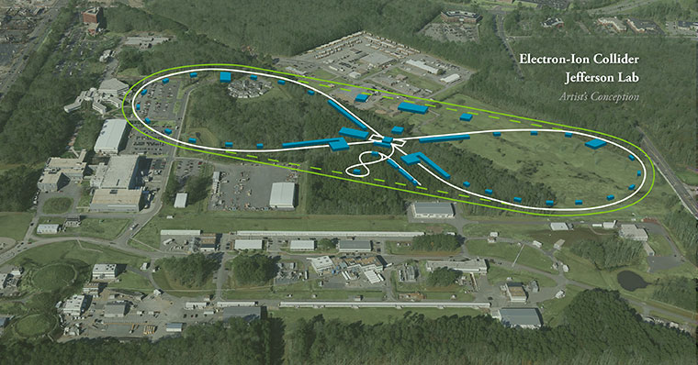
EIC at Jefferson Lab
JLab JLEIC Figure 8 Concept
Initial configuration:
  3-10 GeV on 20-100 GeV ep/eA collider
  Optimized for high ion beam polarization:
    polarized deuterons
  Luminosity:
    up to few x 10³⁴ e-nucleons cm⁻² s⁻¹
    Low technical risk
    Upgradable to higher energies
    250 GeV protons + 20 GeV electrons
    Flexible timeframe for Construction
    consistent w/running 12 GeV CEBAF
    Thorough cost estimate completed
    presented to NSAC EIC Review
    Cost effective operations
    Fulfills White Paper Requirements
Current Activities
Site evaluation (VA funds)
Accelerator, detector R&D
Design optimization
Cost reduction
Notes:
Deleted
Brightened graphic (no more shame); added current activities from previous version;
Mary Beth please format text

Slide 25
EIC Developments
EIC User meeting – Berkeley Jan. 6-9
NAS study being planned for this year
SLAC, LBNL will increase involvement in JLEIC
Rik Yoshida joined JLab March 2016 to lead the JLEIC physics/detector effort
Next EIC User meeting at ANL July 7-10, 2016
DOE-NP will increase EIC accel. R&D in FY17
– Through ‘tax’ on JLab/BNL
– Peer review planned for summer 2016

Slide 26


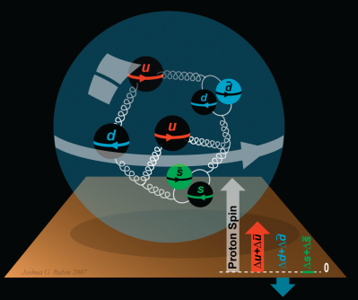
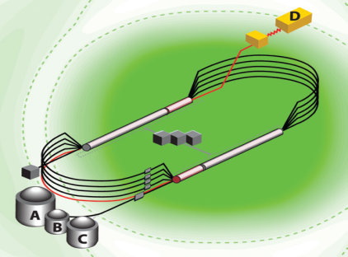
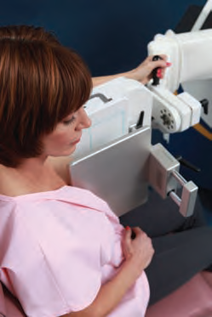
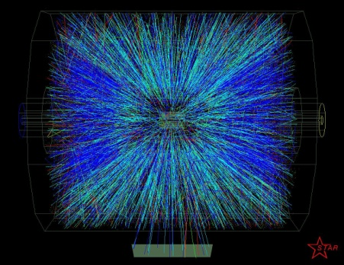


Summary and Outlook
Experiments on the floor have done well – hope for early results soon
Plan to complete upgrade, begin commissioning and full operations during the next year
PAC44 very active, new procedures being tested
Jeopardy proposal under discussion
Operations budgets appear challenging
EIC science and designs are making good progress

