Slide 1



Status of the Front-End Electronics
5 June 2013
R. Chris Cuevas
    Brief status update of DAQ/Trigger production hardware
    Firmware development for HPS application
    CLAS12 CTP ‘upgrade’ notes
    Summary

Slide 2
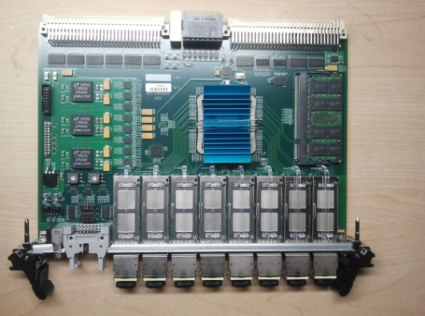
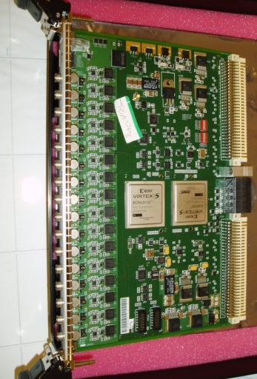
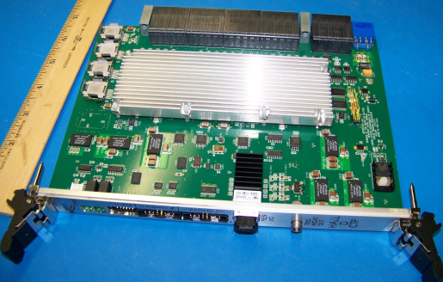
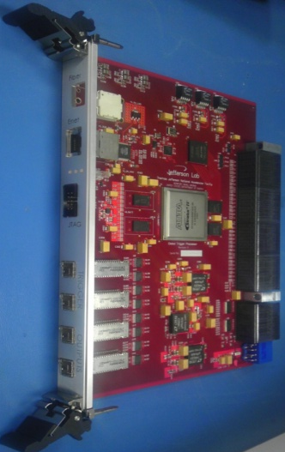
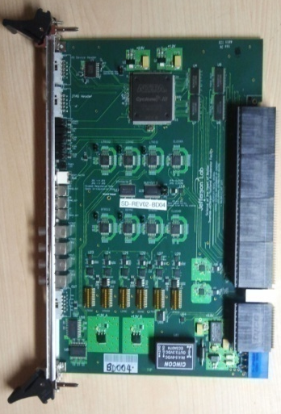
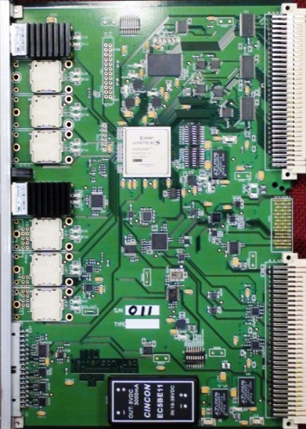
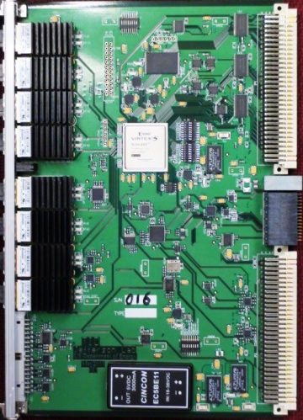
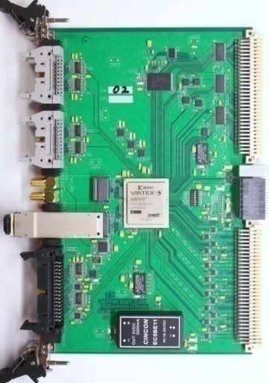
All Trigger Modules In Production
FADC250
CTP
SSP
SSP
GTP
L1 Trigger ‘Data’
MTP Ribbon Fiber
Global Trigger Crate
Sub-System Processor
Global Trigger Processor
SD
TI
TD
Trigger ‘Link” Control
Clock, Sync
MTP Ribbon Fiber
TS
Front End Crate
FADC250, (FADC125), (F1TDC)
Crate Trigger Processor
Signal Distribution
Trigger Interface
Trigger Control/Synchronization
Trigger Supervisor
Trigger Distribution
2

Slide 3
Hardware Status
All 726 VXS FADC250 boards have been received
  -- There will be plenty of spare units for HPS
  -- Overall production lot had ~10% of boards that did not pass initial
  acceptance testing. These boards will be evaluated and repaired.
All Signal Distribution boards have been received and tested.
Trigger Interface boards have been received and tested. At least one TI unit will operate in Trigger Supervisor mode for HPS.
Hall D Crate Trigger Processor is in production.
  -- Requirements for CLAS12 Trigger Processor have been defined
  -- CLAS12 Trigger Processor will have upgrades that allow for new requirements defined for HPS cluster finding and other advanced triggering needs. (See Scott Kaneta’s talk for details)
Sub-System Processors have been received and tested by Ben.
  -- Production SSP take advantage of a single FPGA to manage up to 8 front end crates and will communicate to new CLAS12 Trigger Processor at 5Gbps.
3

Slide 4

Present Flash ADC Implementation
Energy Sum Trigger (Hall D application)
CH-1
12 Bits
VXS Gigabit serial Transfer rate of 4Gb/s* per board
*(2 full duplex lanes @2.5Gb/s * 8/10b)
Transfer 16-bit Energy Sum every 4ns
Energy Sum
16 Channels
To Crate
Trigger
Processor
(VXS Switch Card)
Xilinx FPGA Trigger Function
Pre-Processing
APD Signals
+
CH-16
12 Bits
CH-16
CH-1
Global Trigger
Round Trip Latency <3us
8μs ADC Sample Pipeline
Energy & Time Algorithms
VME
Readout
4

Slide 5
Technique for using channel sums and timing for cluster finding
32ns ‘frame’ begins with SYNC
Each channel sum value is a selectable 5-bits of 20-bit sum
Common threshold register for all channels
Common registers for Number of Samples Before and After Threshold
  NSA
  NSB
If channel does not pass threshold transfer zero sum and clock bits
Retain existing FADC250 features for channel readout
  -- Counters (scalers) for every channel
  -- EPICs or CODA readout for scalers
Definitions of ‘framing’ technique for synchronous transfer of individual sum
for every channel
Methods for cluster finding algorithm defined for Crate Trigger Processor
Multi-crate cluster collection and final trigger → Sub-System Processor
HPS Test Run
5

Slide 6
Framing the Trigger Data from the FADC250
HPS Test Run
5 bit value extracted from
Channel energy sums
3 timing bits used to encode
4ns clock for TOT sample time
16 Bytes every 32ns
(5ADC + 3 timing bits)
1 Byte per channel
HPS trigger process runs @4ns
‘Integrate’ over 4 frames
Report every 128ns
FADC250 retains functions for
VME data readout of signals
when system trigger is received
For HPS a 13 bit value will be
extracted for the channel energy
sums. 3 bits will be used for timing
encoding to resolve 4ns TOT.
Requires 32bytes in 32ns so serial transfer speed must double to 5Gbps per lane
6

Slide 7
Implementation for encoding data to CTP
Hall B – HPS Test Run Implementation
CH-1
12 Bits
VXS Gigabit serial fabric
Transfer rate of 4Gb/s per board
(2 full duplex lanes @2.5Gb/s)
Use 32ns ‘frame’ to Transfer 16-bytes
Each channel is 1 byte:
5 bit Sum + 3 bits for timing
To Crate
Trigger
Processor
(VXS Switch Card)
Xilinx FPGA Channel Sum
Processing
APD Signals
CH-16
12 Bits
3 bit clock encoding
Allows 4ns clock recovery
in 32ns ‘frame’
CH-1
16 Bytes in 32ns
Meets the 4Gb/s transfer bandwidth
Per board
32 ns
CH-16
The TDC algorithm feature of the FADC250 was removed to allow for the
HPS firmware modifications
The TDC feature provided 6-bits of resolution with 62.5ps LSB
7

Slide 8
Performance Summary
(Updated since September Collaboration Meeting)
Successful implementation of full two crate FADC250 system for HPS spring 2011 test run!
FADC250 boards were not final production versions, but this was
the first time that a two crate system was installed and operated
in a beam experiment. Gigabit serial lanes @2.5Gb/s from all boards in two crates without any significant issues with VME 2eSST readout
The requirements for the new CLAS12 Trigger Processor include
5Gbps links from each of the FADC250 boards for much higher charge resolution from each channel. The new information will be used for the Calorimeter cluster finding algorithm.
All issues identified during HPS Test Run have been documented and will be resolved. Need significant test time to verify 5Gbps requirement.
8

Slide 9
CLAS12 (HPS) Firmware Upgrade Notes
New FADC250 Firmware and New CTP Design
CH-1
12 Bits
VXS Gigabit serial fabric
Transfer rate of 8Gb/s* per board
*(2 full duplex lanes @5Gb/s
=10Gb/s * 8/10b encoding)
Use 32ns ‘frame’ to Transfer 16-bytes
Each channel is 16 bit word:
13 bit Sum + 3 bits for timing
To Crate
Trigger
Processor
(VXS Switch Card)
Xilinx FPGA Channel Sum
Processing
APD Signals
CH-16
12 Bits
CH-1
Existing CTP used close to 70% of FPGA resources
For HPS Test Run Trigger Application
CLAS12 will use CTP for three plane calorimeters
- PCAL, ECAL
- Possibility for more complex trigger algorithms
Proposal for CLAS12 wire chambers to use CTP
Output Fiber Transceiver will be upgraded
Requirements document complete
New hardware design
3 bit clock encoding
Allows 4ns clock recovery
in 32ns ‘frame’
32 ns
CH-16
32 Bytes in 32ns
Will require that the FADC250 transfer bandwidth doubles to 8Gb/s
9

Slide 10
Design Goals for FADC250 Firmware and Trigger Boards
Double the transmission speed from FADC250 boards to CTP
  Allows for higher energy resolution information from each channel
  Allows for timing resolution of 4ns
  Preliminary testing shows promising results with 5Gb/s per ‘lane’
  Must continue testing @5Gb/s with VME 2eSST bus activity to resolve issues
Restore the TDC function to FADC250
  -Will require firmware optimization and timing verification efforts
  -Successful implementation would eliminate need for signal splitting, discriminators, TDC modules and additional Crates.
Add ‘coefficient’ (Gain) registers to be programmed for each FADC250 channel
10

Slide 11
Draft Activity Schedule for Two Quarters
( June-13 → January-14)
June-13 | July-13 | Aug-13 | Sep-13 | Oct-13 (FY14) | Nov-13 | Dec-13 | Jan-14
Hall D GTP Testing | Hall D GTP Testing | Initial testing with Hall D Global Trigger crate | Continue Hall D Global Trigger Testing | Pre-commissioning Hall D | → | →
CLAS12 Trigger Processor Requirements | Begin Schematic changes. Evaluate parts | Initial Layout and design analysis | Post layout modeling evaluation and analysis | Firmware Engineering for new FPGA including HPS requirements | Firmware development Timing verification Initial testing
 | HPS proposal approved! ☺ |  |  | Prepare procurement strategy for ALL Trigger Processors |  | Place order for CLAS12 Trigger Processors
 |  | Review changes required for Calorimeter APD mother board and connection board | → New APDs? Calorimeter Geometry change? Muon detector electronics? | →
11

Slide 12
Design Goals for FADC250 Firmware and Trigger Boards
Double the transmission speed from FADC250 boards to CTP
  Allows for higher energy resolution information from each channel
  Allows for timing resolution of 4ns
  Preliminary testing shows promising results with 5Gb/s per ‘lane’
  Must continue testing @5Gb/s with VME 2eSST bus activity to resolve issues
Restore the TDC function to FADC250
  -Will require firmware optimization and timing verification efforts
  -Successful implementation would eliminate need for signal splitting, discriminators, TDC modules and additional Crates.
Add ‘coefficient’ (Gain) registers to be programmed for each FADC250 channel
12

Slide 13
Summary
ALL 12GeV pipelined DAq and Trigger custom electronic modules are in production with most designs completely tested and accepted.
Many detector groups are using FADC250 boards for testing and full crate performance testing is ongoing for each Hall Group.
New requirements for CLAS12 Trigger Processor have been completed and include all trigger processing ideas for each detector subsystem. Planned FPGA device will exceed requirement specification but will allow for future improvements of triggering applications.
Significant challenges remain and testing is crucial to verify that FADC250 boards will be reliable at the 5Gbps serial transmission rate.
Electronics group will support re-design work needed for Inner_Calorimeter circuit boards and any other electronic needs for the experiment.
Acknowledgement of continued significant hardware and firmware contributions from:
Hai Dong, Scott Kaneta, Nick Nganga, Ben Raydo, Ed Jastrzembski, and Bryan Moffit, William Gu
13

Slide 14
Backup Slides
All sorts of good stuff

Slide 15
Successful HPS Beam Test with New 12GeV Cluster Finding Trigger App
Two crate Trigger Signal
From SSP to TI(TS)
HPS Test Run in Hall B used two full VXS crates
432 APD channels → 27 FADC250
Cluster finding algorithm in Crate Trigger Processor -- Pushing the resource limit!
New firmware to encode individual channel sums
CTP firmware will report cluster centroid to SSP
SSP will create trigger from CTP output
Exploits the use of the 4Gb/s VXS bandwidth from each FADC250 module
New technique to report signal threshold crossing with 4ns resolution and 5bit amplitude for every channel
Experiment shows that Hall D L1 Energy Sum algorithm for Calorimetry will clearly ‘fit’ into CTP
Ebeam 5.55 GeV
Radiator 10^{^-4} r.l. Au
Collimator 6.4 mm
Pair spectrometer convertor 1.8x10^{^-3}, 4.5x10^{^-3} and 1.6x10^{^-2} r.l.
Pair spectrometer field - -760A and +760A
LINUX
MTP Fiber
MTP Fiber
CODA
LINUX
HPS DAq rates:
Ecal +20KHz
With Si Tracker: 4KHz
8

Slide 16
HPS Firmware Design – Implementation
Brief History
26-May-2011 HPS collaboration meeting
-- Initial ideas on what information was needed for HPS trigger
-- Existing stable firmware was designed for Hall D Energy sum
18-Oct-2011 HPS collaboration meeting
-- Firmware requirements document created
-- Clear definition of what information was required for cluster finding
-- Methods were coded, simulated, and verified (FADC250)
-- Crate Trigger Processor firmware requirements defined
-- Sub-System Processor firmware requirements started
Nov-11->Feb-12
    --Pre-Production FADC250 units configured in a two crate
    test station for full test of new trigger firmware
    -- Test station includes Trigger Interface, Signal Distribution (Timing)
    and CODA library development plus GUI
March-2012
    -- CTP cluster finding algorithm fine tuning and test with fully instrumented crates
13-April-2012
    -- Installation of FADC250 and Trigger modules in Hall B
    -- Cabling, debug, interface to APD electronics, TEST
17-May-2012
    -- HPS test run with beam in Hall B! (Even the flooding could not stop this event)
2

Slide 17
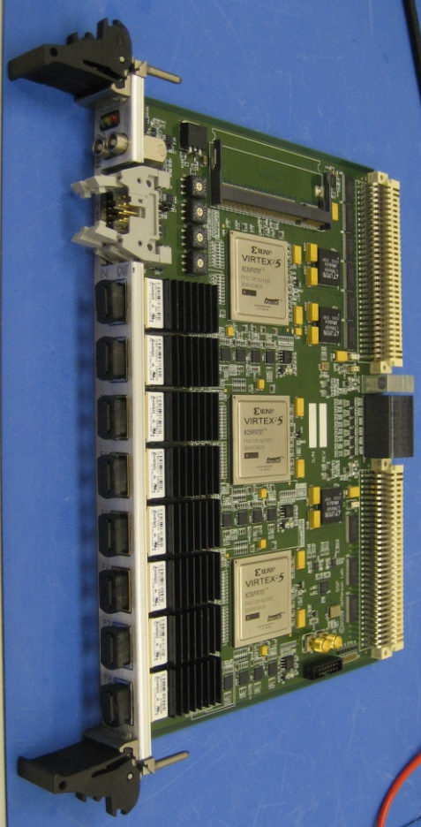
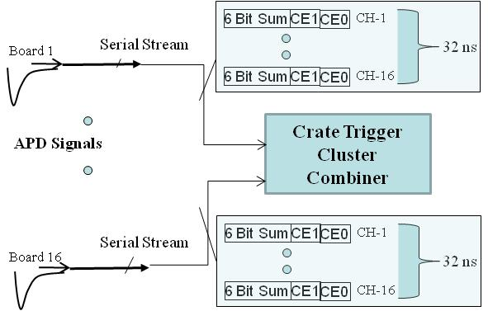
Crate Trigger Processor Point of View
Cluster Finding with Energy Resolution/Channel
6 Bit Sum
CE1
CE0
CH-1
Sub-System Processor
Board 1
Serial Stream
32 ns
6 Bit Sum
CE1
CE0
CH-16
4 x 2.5Gb/s fiber links
From crates to
Sub-System Processor
Final Cluster Algorithm
To process all calorimeter channels
Cluster Energy Trigger
Will have much more resolution than initial DVCS implementation
Crate Trigger
Cluster Combiner
8Gb/s
APD Signals
Serial Stream
6 Bit Sum
CE1
CE0
CH-1
Board 16
32 ns
6 Bit Sum
CE1
CE0
CH-16
8Gb/s
11

Slide 18
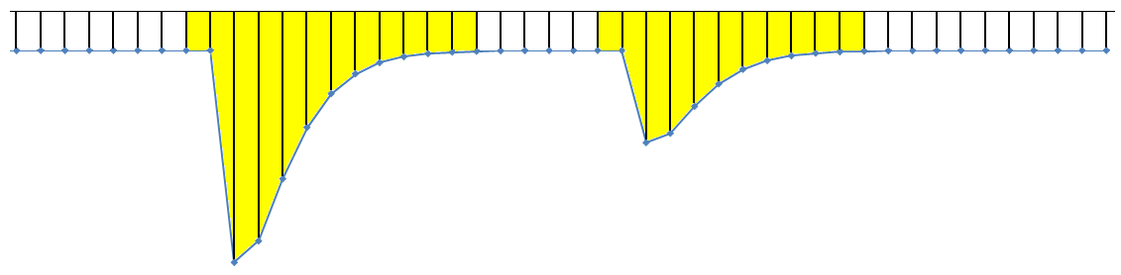

Flash ADC Implementation
To trigger
logic
Trigger Pulse
Pre-Processing
Capture Window
Energy & Time Algorithms
Readout
Sample Clock
Event #1
Event #2
detector
signal
FADC
8μs ADC Sample Pipeline
Trigger #1
Trigger #2
Trigger Input
Sampling Flash ADC stores digitized signal in 8us memory
Trigger input copies a window of the pipeline and extract pulse charge and time for readout
Trigger output path contains detailed information useful for cluster finding, energy sum, etc.
Hardware algorithms provide a huge data reduction by reporting only time & energy
estimates for readout instead of raw samples
21

Slide 19
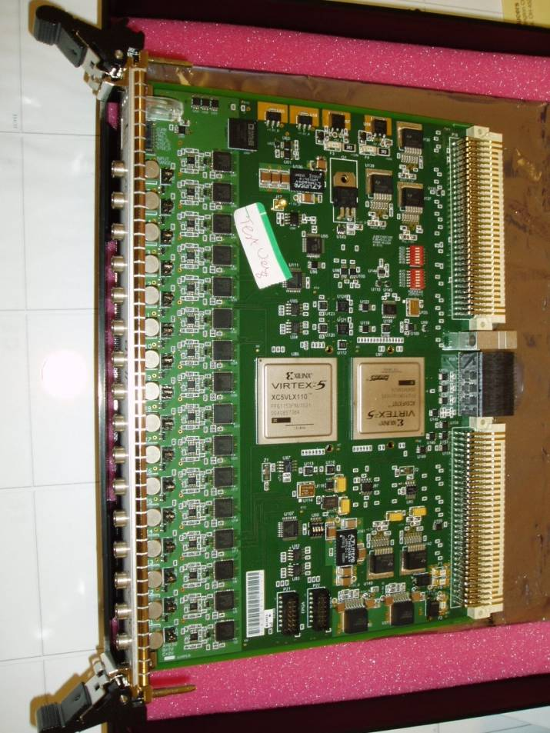
Flash ADC 250MHz
Fast Electronics
DAQ Groups
23-Sept-2011
16 Channel, 12-bit
  4ns continuous sampling
  Input Ranges: 0.5V, 1.0V, 2.0V
  (user selectable via jumpers)
  Bipolar input, Full Offset Adj.
  Intrinsic resolution – σ = 1.15 LSB.
  2eSST VME64x readout
  Several modes for readout data format
    Raw data
    Pulse sum mode (Charge)
    TDC algorithm for timing on LE
  Multi-Gigabit serial data transport of trigger information through VXS fabric
  On board trigger features
    16 Channel SUM every 4ns
    Channel coincidence, Hit counters
  Automatic Test Station is complete
  Engineering Run – 40 Delivered!
    18 Hall D
    17 Hall B
    Production Procurement FY12
      ~ 700 Boards for all Halls
2

