Slide 1
HPS ECal Trigger Status
Scott Kaneta
Fast Electronics Group – Jefferson Lab
June 5, 2013

Slide 2
Overview
FADC Firmware Development
5 Gbps Testing
ECal Trigger Setup
Hardware Status
Diagnostics and Trigger Improvements
Summary

Slide 3
FADC Firmware
Production Run Changes
TDC Mode
FPGA to FPGA DDR data bus
Algorithm Updates
Diagnostics and Monitoring
Development Resources
5 Gbps
Required to increase energy resolution 5->13 bits
Testing ongoing
Promising results but challenges remain

Slide 4
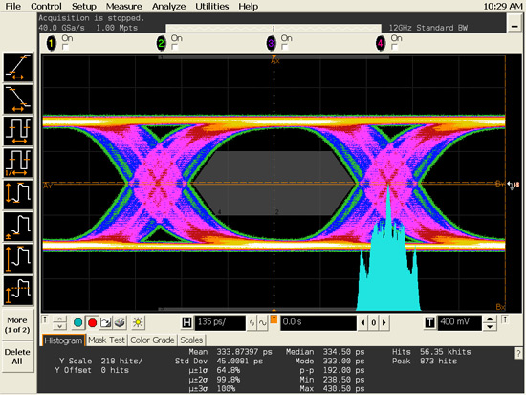
5 Gbps FADC Testing
Increasing the rate reduces bit period, accentuating imperfections in the signal
Compensation settings
Transmitter pre-emphasis
Receiver equalization
FPGAs have tools to measure the eye width after the equalization stage using bit-error rate (BER)
Example Waveform

Slide 5
5 Gbps FADC Testing
Measure BER at regular intervals across the eye
Locations where no errors are receive in the time tested indicate an open eye
Sweep transmit and receive parameters to maximize eye width
FADC Pre-emphasis Sweep
BER vs Phase step

Slide 6
5 Gbps FADC Testing
Hardware Test Setup
TCL Scripting allows sweep of multiple parameters on two boards
PC sends commands via JTAG
GTP sends transmit parameters to FADC
FADC
TX
Back
Channel
Transceiver
Link
GTP RX
JTAG
PC

Slide 7
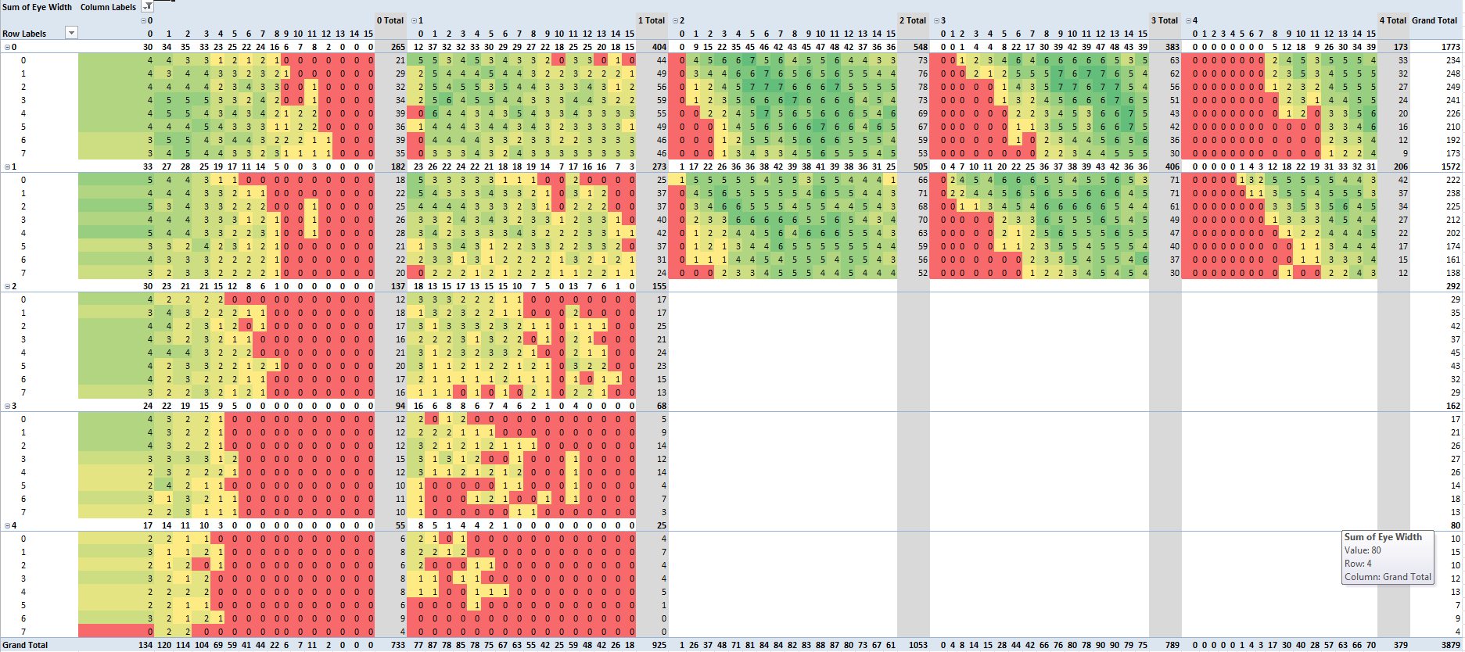
5 Gbps FADC Testing
Eye width vs Pre-emphasis, TX Swing, Equalization, DC Gain

Slide 8
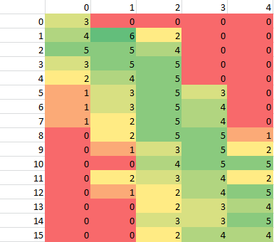
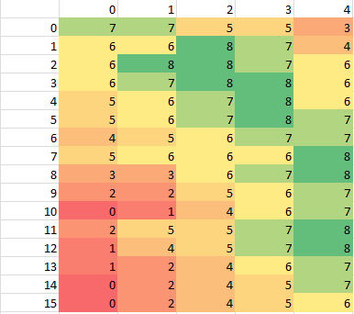
5 Gbps FADC Testing
Slot dependent results
PP1&2 near switch slots appear to be worst
Slot specific settings may be required
PP2
PP14

Slide 9
ECAL Trigger Overview
FADC (Flash Analog-to-Digital Converter)
250Msps, 12bit pulse digitizer for: Readout & Trigger (energy, timing)
Sends pulse energy & times to CTP for trigger processing
CTP (Crate Trigger Processor)
Collects pulse data from all FADC channels in crate
Searches for clusters on half (top or bottom) of the ECAL
Sends cluster energy, time, position to SSP for trigger processing
SSP (Sub-System Processor)
Collects cluster data from top & bottom halves of ECAL from CTP
Performs cuts on individual clusters: energy
Performs cuts on paired clusters: energy sum/difference, coplanar, distance energy
Delivers Yes/No trigger signal(s) to TS (Trigger Supervisor) for readout

Slide 10
CTP Data Path
CTP Algorithm:
Add energy from hits together for every 3x3 square of channels in ECAL
Hits are added together if they occur (leading edge) within a programmable number of clock cycles (4ns ticks)
If 3x3 energy sum >= cluster energy threshold report cluster to SSP (time, energy, position and 3x3 hit pattern )
Not in Test Run, but will be added in Production Run
Notes:
Reported cluster information has 4ns timing resolution based on when cluster condition is satisfied
Reported cluster position is not centroid – it is within +/-1 crystal index of centroid

Slide 11
Test Run CTP
CTP hardware was the weak link in the trigger chain
FPGA implementation tool had difficulty with cluster finding algorithm
Interconnect
Logic
Memory
Failed timing -> possible intermittent errors
Requested features not implemented
Few diagnostics
Options
Global Trigger Processor prototypes
Completely new hardware

Slide 12
GTP Prototypes
Hall D Global Trigger Processors in production now
Compared to CTPs used in the test run
1.6x logic
2.1x internal memory
Ethernet
Restrictions (same as CTP)
2 lanes per payload port -> 5 Gbps challenges
Fiber transceiver: 2.5 Gbps per lane
Production SSP supports 5 Gbps
Production GTP supports 5 Gbps

Slide 13
ATP Development
Advanced Trigger Processor
Research in progress, Xilinx Virtex 7 550T
Replaces GTP and CTP for CLAS12
Logic Density
5x Test Run CTP (main FPGA)
3x GTP Prototype
80 Transceiver Lanes
4 lanes per Payload Port
4-lane PCIe Gen 3 to CPU
4 QSFP Transceivers (4th shared with PCIe)
Other Features
Gigabit Ethernet (proven on GTP prototype)
DDR3 SODIMM
Trigger Out to TS (GTP specific)
Front Panel LVDS I/O

Slide 14
ATP Development
Front Panel
VXS Backplane
DDR3
User
Flash
TI I²C
Clock, Sync
Trig1, Trig2
Ethernet
PHY
RGMII
Xilinx
Virtex 7
550T
4
/
Config Flash
PP1
JTAG
4
/
:
PP16
4
/
4
/
LVDS GPIO
/
4
Trigger Out
/
32
X
PCIe
4
/
QSFP 0
QSFP 1
Legend
QSFP 2
High Speed Serial
QSFP 3
General Purpose
Configuration

Slide 15
ATP Development
Risk
Development time
Prototype October, Production March 2014
Parallel effort with Hall D firmware
New prototype
2 working prototypes could be used for HPS
Cost
Hall B needs to have ATP funds available in FY14
GTP cost significantly reduced
Latest estimate: <$7k per ATP, Quantity 25
Reward
Extended life of trigger processors
Ready for HPS
High energy resolution
Diagnostics
SSP Bandwidth

Slide 16
Diagnostics
ECal monitoring on FADC!
Energy histograms per channel
From Sho
Scalars
FADC hits on given crystal
Cluster Seed Count
Number of clusters centering on given crystal
Cluster Add Count
Number of clusters with contributions from given crystal
Priority?
Others?

Slide 17
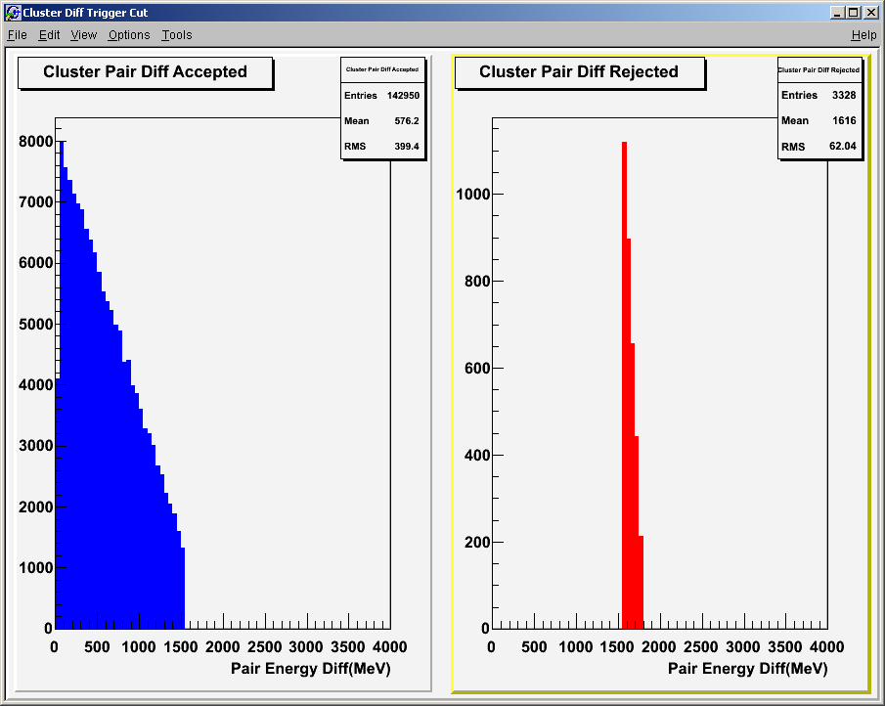
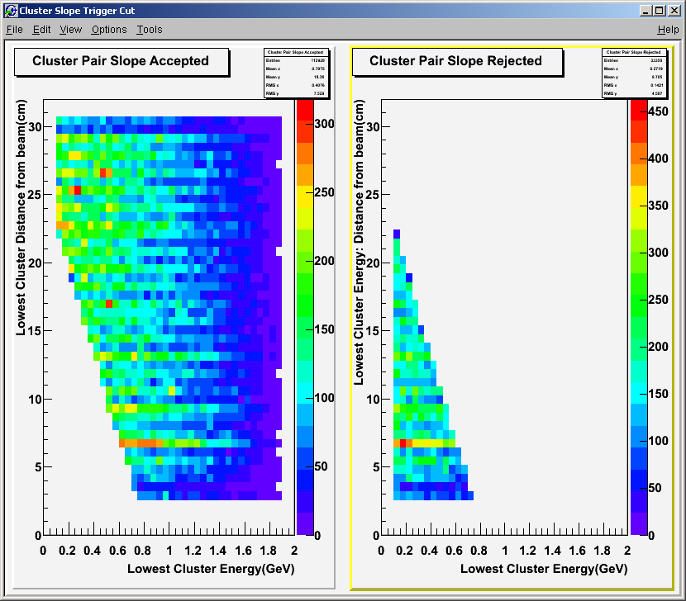
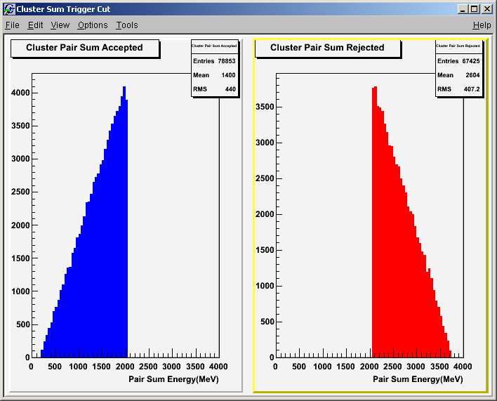
H/W Histograms
FADC
Scalars per channel (readout threshold based)
Individual ADC channel pulse energy histograms
CTP
Cluster Hits (Position)
Cluster Hits (Position+Energy)
SSP
Trigger cut accept/reject:

Slide 18
Trigger Improvement Summary
FADC | Test Run | Production Run
Trigger Energy Resolution | ~50MeV-100MeV | 1MeV
Trigger Energy Dynamic Range | 31:1 | 8191:1
Trigger Channel Gain Matching | Factor 2 | +/-2%
CTP | Test Run | Production Run
Energy Units | ~50MeV-100MeV | 1MeV
3x3 Cluster Hit Pattern | No | Yes
Trigger on # of crystals hit | No | Yes
Cluster position | Crystal | Fraction of a Crystal
SSP | Test Run | Production Run
Energy Units | ~50MeV-100MeV | 1MeV
Hit Based Triggering | No | Yes

Slide 19
Diagnostic Additions Summary
FADC | Test Run | Production Run
Scalars | No | Yes
Energy Histograms | No | Yes
CTP | Test Run | Production Run
Cluster Position | No | Yes
Cluster Energy | No | yes
Reporting | VME | Ethernet
SSP | Test Run | Production Run
Event Readout | Minimal | Clusters: energy, position, time, passed cuts
Scope | No | Yes
Trigger Cut Histograms | No | Yes
In addition to trigger system diagnostics:
Online event analysis needs to be compared against trigger event data for immediate verification (for each trigger cut, cluster energies, & positions) – at least a fraction of events need this prompt verification.
With identical ADC readout/trigger pulse processing and high trigger energy resolution, very precise agreement can be expected between trigger & readout

Slide 20
Conclusion
Hall B Trigger Processor specification should be finalized soon to ensure best hardware is available for the production run
Trigger logic changes will be moderate to support increased energy resolution and hit pattern reporting
Remaining effort will be invested in diagnostics for real-time feedback and additional offline analysis support

Slide 21
Backup/Source

Slide 22
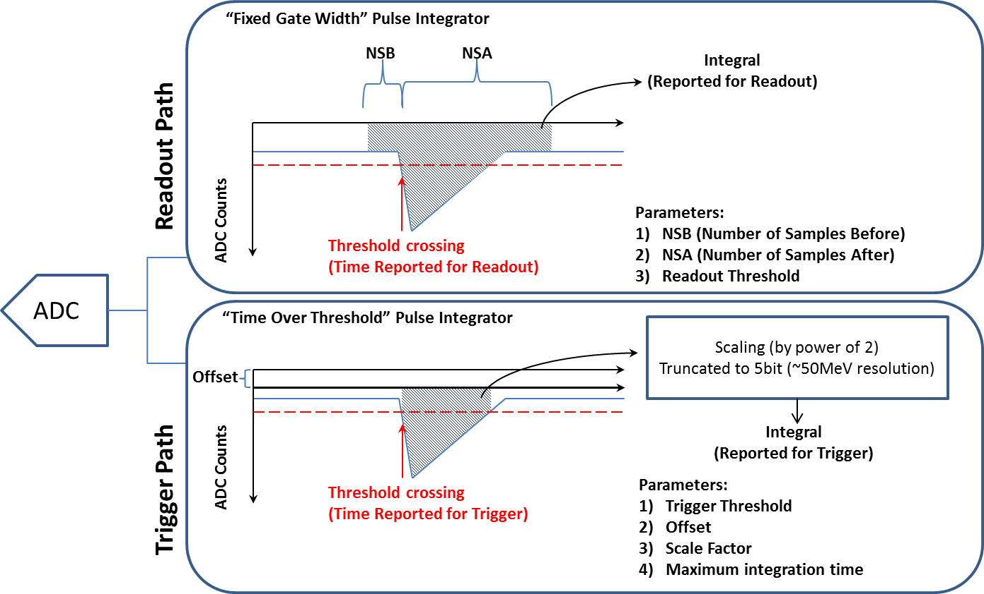
2.0 FADC Data Paths (Test Run)
Notes:
Readout and trigger pulse processing quite different and requires several different parameters (even through they’re related)
Very coarse trigger energy resolution (5bits)…Significantly limits ability channel gain matching, energy resolution and dynamic range.

Slide 23
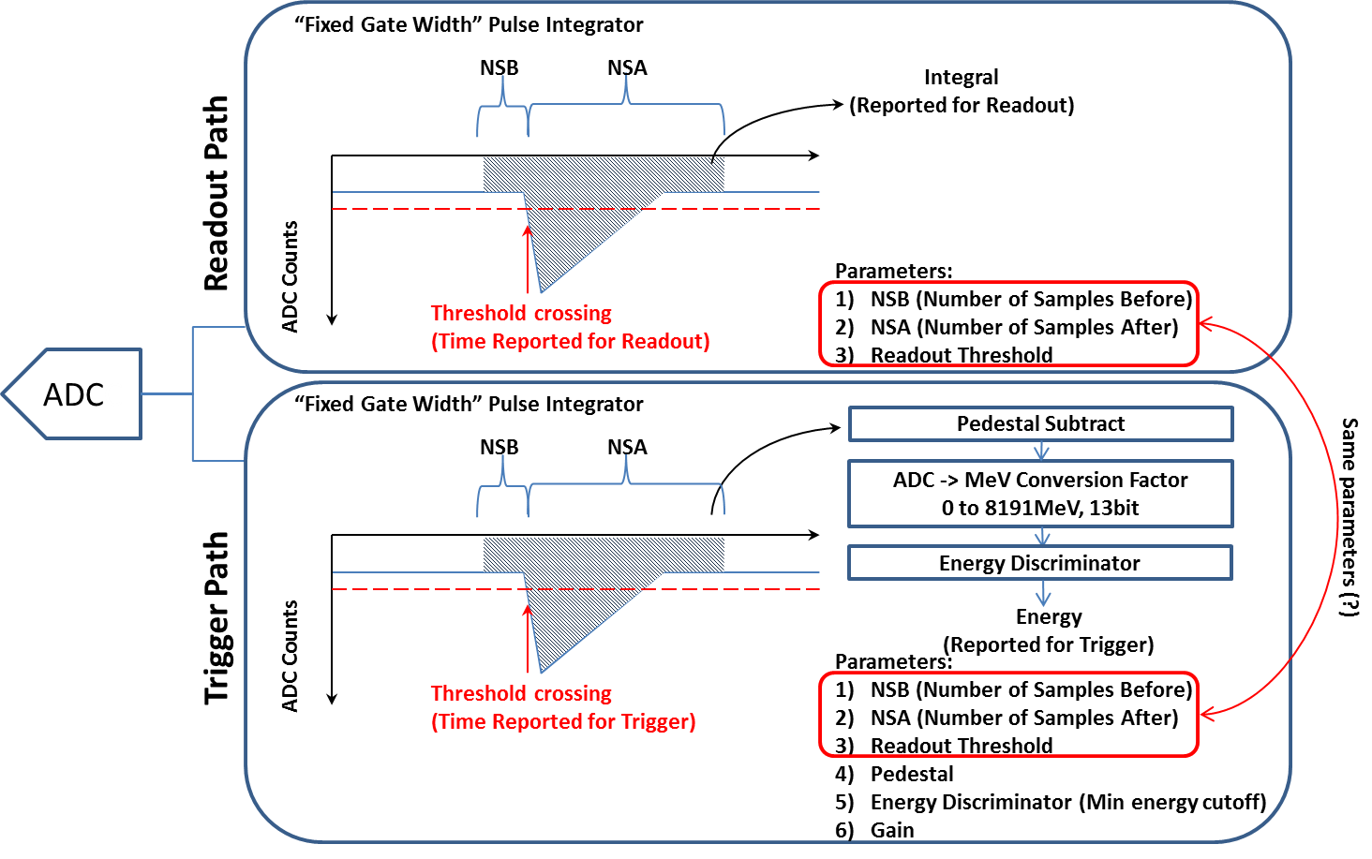
2.1 FADC Data Paths (Production Run)
Notes:
Trigger pedestal parameter would be the same as measured pedestal from readout (very easy to get)
Trigger gain parameter sets energy units in MeV (+/-~2%) early on in trigger system so CTP and SSP work in MeV units…Of coarse this will require a calibration effort, but it will be the same data used for readout calibration/analysis.

Slide 24
2.2 FADC Charge Resolution
FADC is: 12bit 250Msps, 50Ω Termination
Front-end input range: -0.5V, -1V, -2V
Set input range above maximum pulse height to ensure no signal clipping (-1V used in HPS test run)
Charge resolution is:
Input Range | Nominal Charge Resolution
-0.5V | 9.76fC per ADC count
-1V | 19.53fC per ADC count
-2V | 39.06fC per ADC count

Slide 25
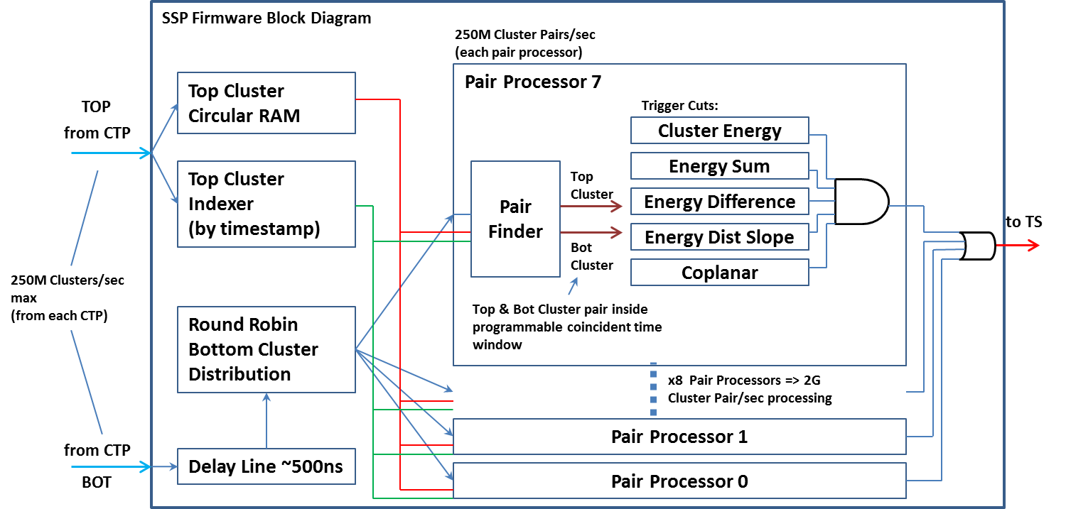
4.0 SSP Data Path
Singles Trigger
Energy Discriminator: ThresholdMin_{Energy} ≤ Cluster_{Energy} ≤ ThresholdMax_{Energy}
Pairs Trigger
Energy Discriminator: ThresholdMin_{Energy} ≤ Cluster_{Energy} ≤ ThresholdMax_{Energy}
Pair Time Coincidence: |ClusterTop_{Time} – ClusterBottom_{Time}| ≤ CoincidenceMax_{Time} (in 4ns units)
Energy Sum: ClusterTop_{Energy} + ClusterBottom_{Energy} <= SumThresholdMax_{Energy}
Energy Difference: |ClusterTop_{Energy} - ClusterBottom_{Energy}| <= DifferenceThresholdMax_{Energy}
EnergySlope: PairMinEnergyCluster_{Energy} + PairMinEnergyCluster_Beam_{Distance} x EnergyDistance_{Factor} < ThresholdSlopeDistance_{Energy}
CoplanarClusters: |tan⁻¹(ClusterTop_{x} / ClusterTop_{y}) – tan⁻¹ (ClusterBot_{x} / ClusterBot_{y})| ≤ Coplanar_{Angle}
HitBased: #hits_{3x3window} ≥ HitTheshold_{count}
Implemented, but not aware of it being used for Test Run
New for Production Run
Helps filter out noisy ECAL channels (hopefully no noisy channels this round!)
Will be used to improve cluster position accuracy (rough approximation of cluster centroid)

Slide 26
SSP Cluster Processing

Slide 27
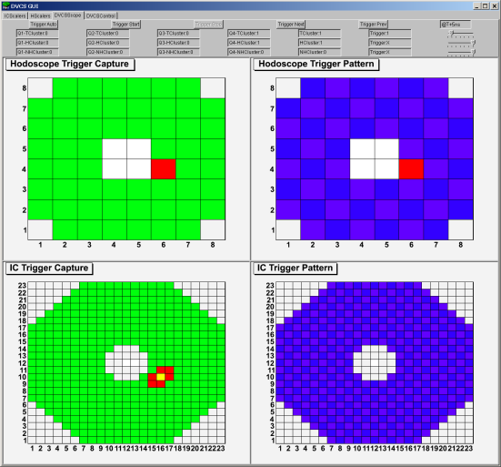
5.0 Diagnostic Scope
2D Logic Analyzer Details:
Goal was to provide a remote debug interface to identify bad channels, verify cluster finding algorithm, check timing
Logic analyzer runs in parallel, non-intrusive, to calorimeter trigger
Can setup trigger on any IC/Hodoscope pixel arrangement and/or cluster count.
After trigger, you can move forward/backward in time by ~250ns to see timing details
Will be customized for HPS geometric and hardware (a lot more information can be provided)
Triggered logic analyzer output:
Setup logic analyzer trigger (hodoscope pixel & 1 cluster):
Geometric Match
Not Hit Tower/Pixel
Hit Tower/Pixel
Cluster Found
Don’t care trigger

Slide 28
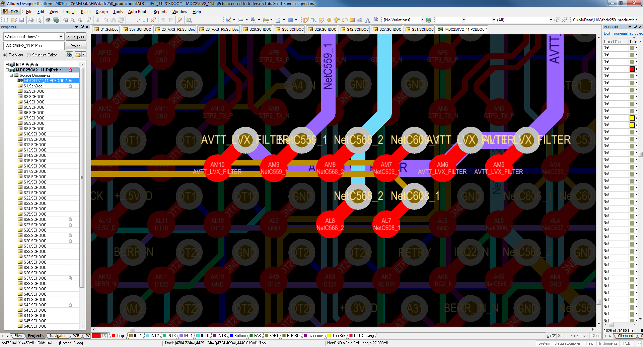
Power and Reference Clock

Slide 29
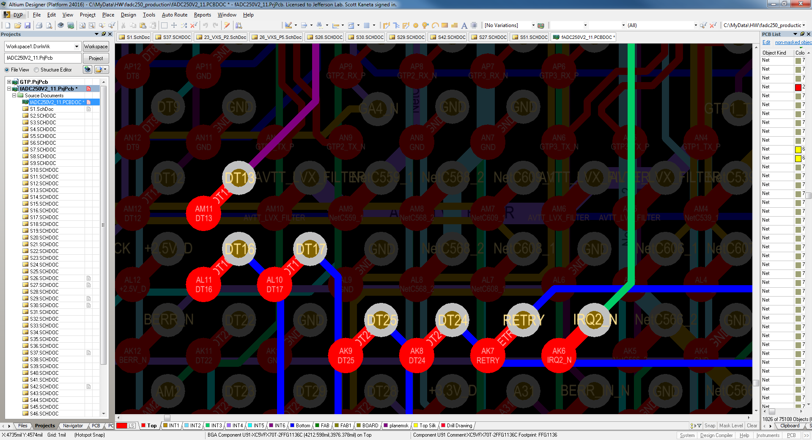
Adjacent Signals

