Slide 1
Questions for the Workshop

Slide 2
Questions as Identified on the Workshop Website
What is necessary to understand the elementary process of electro-production of strangeness
Experimental study of light hypernuclei and YN interaction including Charge Symmetry Breaking (CSB) effect and ΛN- ΣN-coupling.
What can be learned from precise determination of Λ binding energies
Deformation of core-nucleus and energy levels of Λ hypernuclei
Detailed spectroscopy of heavy hypernuclei and potential impacts of measurement to mean-field theory, shell-models and single particle nature of Λ in deep inside of nuclei.
Uniqueness of JLab hypernuclear program in contrast to other facilities such as J-PARC, Mainz, future FAIR

Slide 3
Questions as Posed by Brad Sherill
I might be wrong, but the big questions are:
What are the ultimate goals of the hyper-nuclear program?
What measurements are required to reach the goals? It is very likely that complementary approaches will be important.
What is the special role that the JLAB program will play in the world-wide hyper-nuclear program? Is there anything every agrees is unique to JLAB and absolutely must be done there?
Given the measurements you want to make, how long will it take to complete them? What equipment is needed? Is there a spectrum of equipment from adequate to ideal and what are you shooting for?

Slide 4
“Charge” from Bob McKeown
The PAC deferred on approving the proposal, stating:
“The beam time required for the full program constituted about 100 days. A significant setup time for this experiment requires both resources and significant planning. The PAC felt that the case had not yet been made for such a significant investment, and would encourage, as PAC39 had done, that the proponents work closely with the theory community to identify the most important cases for study. A future proposal should also clearly state the impact of measurements for our understanding of the Λ-N interactions. A careful analysis of how these sets of measurements and their uncertainties constrain
nuclear theory would be of value. A dedicated Workshop focused on these questions could be very helpful. The PAC needs to see a sense of priority from the proponents.”
It would be helpful if the workshop could provide guidance to the proponents, specifically to:
Identify the most important one or two key measurements to be pursued at JLab that would provide a substantial advance in our knowledge of hypernuclear physics. These measurements could form the initial program motivating the mounting of a more extensive hypernuclear physics program at JLab.

Slide 5
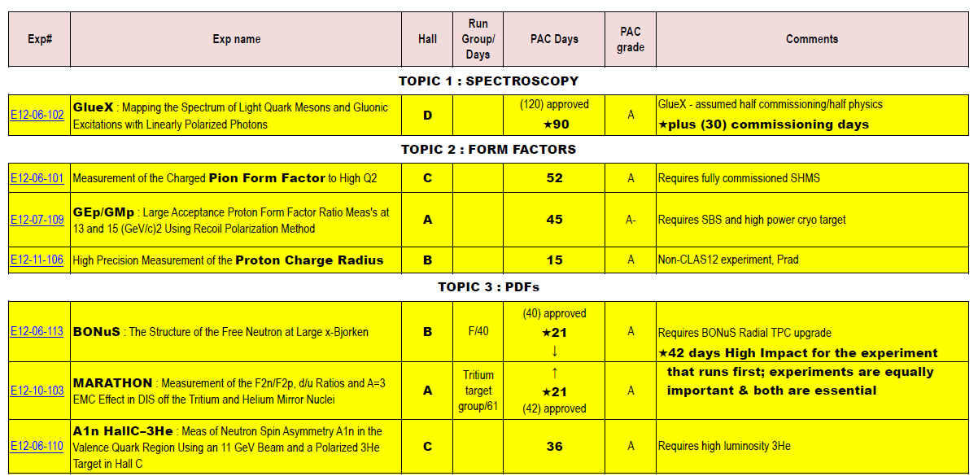
“High Impact” Experiments as Identified by PAC41

Slide 6
“High Impact” Experiments as Identified by PAC41

Slide 7
“High Impact” Experiments as Identified by PAC41
Your mission, should you decide to accept it, is …………………

Slide 8
“High Impact” Experiments as Identified by PAC41
Your mission, should you decide to accept it, is “to identify the most important one or two key measurements to be pursued at JLab that would provide a substantial advance in our knowledge of hypernuclear physics “ (and belong on this list of “high impact” experiments).

