Slide 1
Structure of light Λ hypernuclei by (e,e’K⁺) reaction
E. Hiyama (RIKEN)

Slide 2
Using these targets, we have these light Λ hypernucei by
(e, e’K⁺) reaction at Jlab. Here I will focus on these Λ hypernuclei.
p
n
n
n
n
n
n
Λ
n
Λ
４
n
p
⁴He
４
n
⁴He
n
³H
³n
⁷Li
⁷He
Λ
Λ
p
n
n
Λ
Λ
n
n
p
n
n
４
⁴He
４
４
４
４
４
⁴He
⁴He
⁴He
⁴He
⁴He
⁶ Li
⁶ He
Λ
¹⁰B
¹⁰Be
Resultant
hypernucleus
Λ
target
Resultant
hypernucleus
target

Slide 3
Outline
(1) Introduction
(2)
n
n
n
Λ
Λ
Λ
n
n
Λ
４
４
n
４
４
⁴He
⁴He
⁴He
⁴He
³n
⁶ He
⁷He
¹⁰Be
Λ
Λ
Λ
Λ
These Λ hypernuclei can be produced by (e, e’K⁺) at Jlab.
What is interesting and important to study these
Λ hypernuclei?

Slide 4
Sec.1 Introduction
Notes:
Let’s begin.

Slide 5
Major goals of hypernuclear physics
1) To understand baryon-baryon interactions
2) To study the structure of multi-strangeness systems
In order to understand the baryon-baryon interaction, two-body scattering
experiment is most useful.
Total number of
Nucleon (N) -Nucleon (N) data: 4,000
Study of NN intereaction
has been developed.
YN and YY potential models so far proposed
(ex. Nijmegen,
Julich, Kyoto-Niigata) have large ambiguity.
・ Total number of differential cross section
Hyperon (Y) -Nucleon (N) data: 40
・ NO YY scattering data
since it is difficult to perform YN scattering experiment even at J-PARC.

Slide 6
2) To study the structure of multi-strangeness systems
Hypernucleus =
Many-body system of
neutrons,
protons,
hyperons
nn
n
p
p
n
Y
n
n
n
p
p
Y
Once the Hamiltonian is determined,
it is possible , using few-body calculation method (Gaussian
Expansion Method), to precisely calculate
the structure of many-body systems consisting of
neutrons, protons and hyperons.
As a result, we can predict new phenomena
such as we have never imagined before.

Slide 7
No Pauli principle
Between N and Λ
Λ particle can reach deep inside, and attract the surrounding nucleons towards the interior
of the nucleus.
N
Λ
Due to the attraction of
Λ N interaction, the
resultant hypernucleus will
become more stable against
the neutron decay.
Hypernucleus
Λ
neutron decay threshold
γ
nucleus
hypernucleus

Slide 8
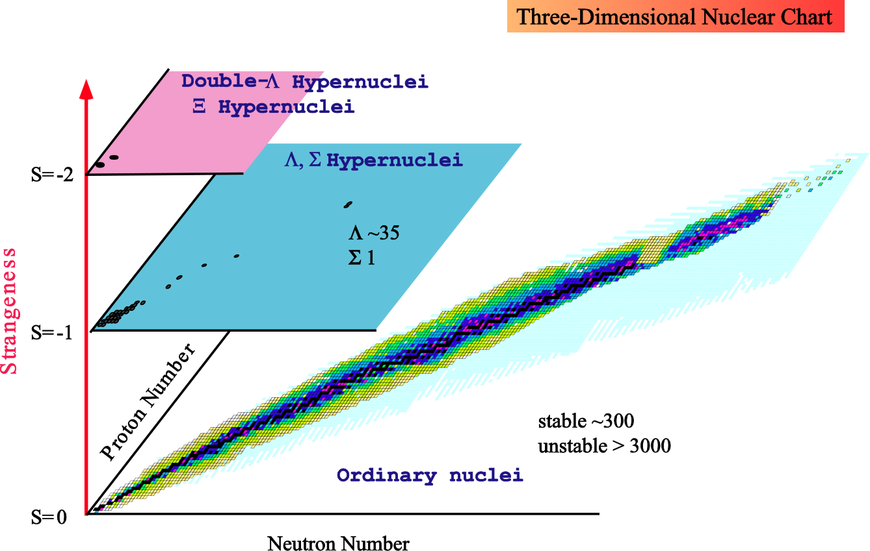
Nuclear chart with strangeness
Multi-strangeness system such as Neutron star
Extending drip-line!
Λ
Interesting phenomena concerning
the neutron halo have been
observed near the neutron drip line
of light nuclei.
How is structure change when a Λ particle is injected
into neutron-rich nuclei ?
Notes:
8
Outline

Slide 9
Question: How is structure change when a Λ particle
is injected into neutron-rich nuclei ?
n
n
n
n
⁷He
Λ
Λ
α
Λ
³n
Λ
JLAB experiment-E011,
Phys. Rev. Lett. 110,
12502 (2013).
C. Rappold et al., HypHI collaboration
Phys. Rev. C 88, 041001 (R) (2013)
n
Λ
⁶He
Λ
α

Slide 10
Section 2
three-body calculation of
³n
Λ
n
n
E. Hiyama, S. Ohnishi,
B.F. Gibson, and T. A. Rijken,
The paper will be publised in
PRC as a Rapid communication soon.
Λ

Slide 11
What is interesting to study nnΛ system?
n
n
Λ
S=0
The lightest nucleus to have a bound state is deuteron.
n+p threshold
n
p
J=1⁺
d
-2.22 MeV
Exp.
S=-1 (Λ hypernucear sector)
n+p+Λ
n
p
Lightest hypernucleus to have a bound state
d+Λ
³H (hyper-triton)
Λ
0.13 MeV
J=1/2⁺
Λ
Exp.

Slide 12
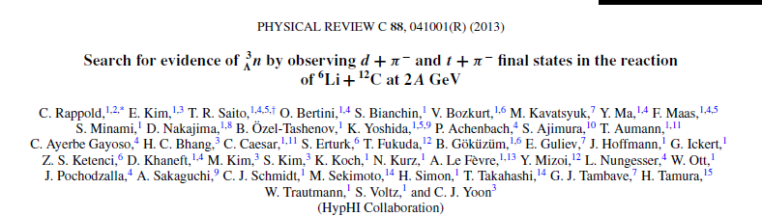
-23.7fm
nnΛ breakup threshold
n
n
?
They did not report the
binding energy.
Λ
scattering length:-2.68fm
Observation of nnΛ system (2013)
Lightest hypernucleus to have a bound state

Slide 13
Theoretical important issue:
Do we have bound state for nnΛ system?
If we have a bound state for this system, how much is
binding energy?
n
n
nnΛ breakup threshold
?
They did not report the
binding energy.
Λ
NN interaction : to reproduce the observed binding energies
of ³H and ³He
NN: AV8 potential
We do not include 3-body force for nuclear sector.
How about YN interaction?

Slide 14
Non-strangeness nuclei
N
Δ
Nucleon can be converted into Δ.
However, since mass difference between
nucleon and Δ is large, then probability
of Δ in nucleus is not large.
N
N
On the other hand, the mass difference
between Λ and Σ is much smaller, then
Λ can be converted into Σ particle
easily.
Δ
300MeV
N
Λ
Σ
N
80MeV
Σ
Λ
N
Λ
Notes:
In non-strangeness nuclei, nucleon can be converted into Delta. However, since mass difference between nucleon and Delta is large, then, probability of Delta in nucleus is not large. On the other hand, the mass difference between Lambda and Sigma is smaller, then, there is significant probability of Sigma in Lambda hypernuclei.

Slide 15
To take into account of Λ particle to be converted into
Σ particle, we should perform below calculation using
realistic hyperon(Y)-nucleon(N) interaction.
n
n
n
n
+
Λ
Σ
YN interaction: Nijmegen soft core ‘97f potential (NSC97f)
proposed by Nijmegen group
reproduce the observed binding energies of ³H, ⁴H and ⁴He
Λ
Λ
Λ

Slide 16
-B_{Λ}
p
0 MeV
d+Λ
n
³H
Λ
Λ
1/2⁺
1/2⁺
-0.13 ±0.05 MeV
-0.19 MeV
Exp.
Cal.

Slide 17
n
p
⁴He
n
n
Λ
Λ
⁴H
Λ
-B_{Λ}
⁴He
p
Λ
-B_{Λ}
p
Λ
Λ
⁴H
Λ
0 MeV
³He+Λ
0 MeV
³H+Λ
1⁺
1⁺
1⁺
1⁺
-0.57
-1.24
-0.54
-1.00
0⁺
0⁺
0⁺
-2.39
-2.04
0⁺
-2.28
-2.33
Exp.
Cal.
Exp.
Cal.
What is binding energy of nnΛ?

Slide 18
-B_{Λ}
1/2⁺
nnΛ threshold
n
n
0 MeV
Λ
We have no bound state in nnΛ system.
This is inconsistent with the data.
Now, we have a question.
Do we have a possibility to have a bound state in nnΛ system tuning
strength of YN potential ?
It should be noted to maintain consistency with the binding energies
of ³H and ⁴H and ⁴He.
Λ
Λ
Λ
V_{T} ^{ΛN-ΣN}
X1.1, 1.2

Slide 19
How to tune YN interaction
³H
J=1/2⁺
Λ
n
p
T=0, S=1
Λ
S=0 state dominates
between Λ and nucleons.
We multiply tensor part of ΛN-ΣN potential (V^{T}_{ΛN-ΣN})
by factor 1.1 and 1.2.
nnΛ J=1/2⁺
n
n
T=1, S=0
Both S=0 and S=1
Components
of YN interaction contribute.
S=1
Λ
S=0

Slide 20
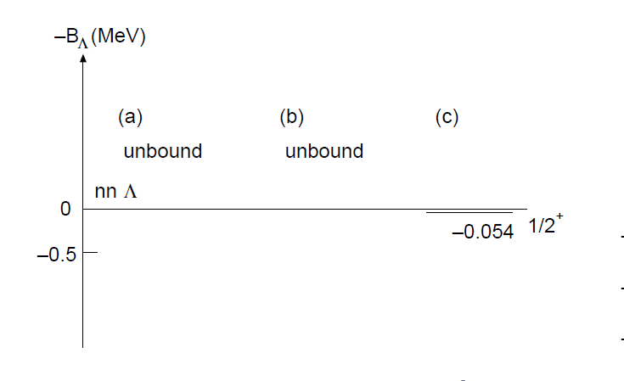
n
n
Λ
V_{T} ^{ΛN-ΣN}
X1.1
V_{T} ^{ΛN-ΣN}
X1.2
When we have a bound state in nnΛ system, what are binding energies of ³H and A=4 hypernuclei?
Λ

Slide 21
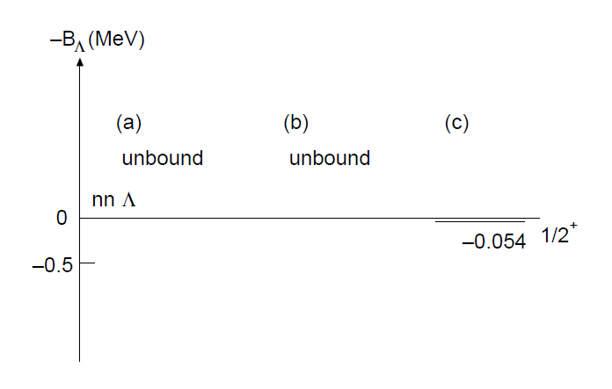
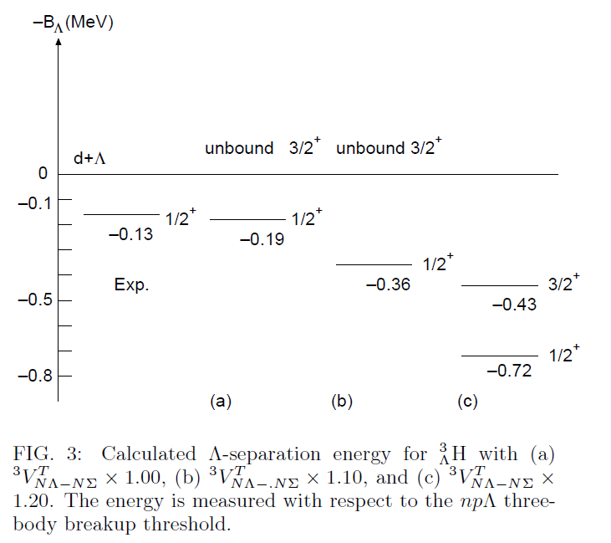
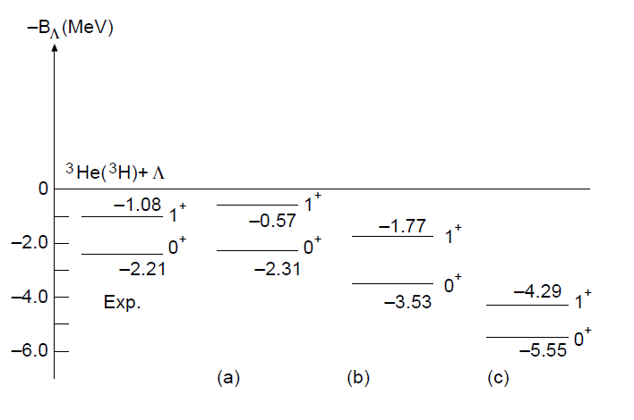
p
n
Λ
n
n
Λ
We have no possibility
to have a bound state
in nnΛ system.
n
Λ
p
n

Slide 22
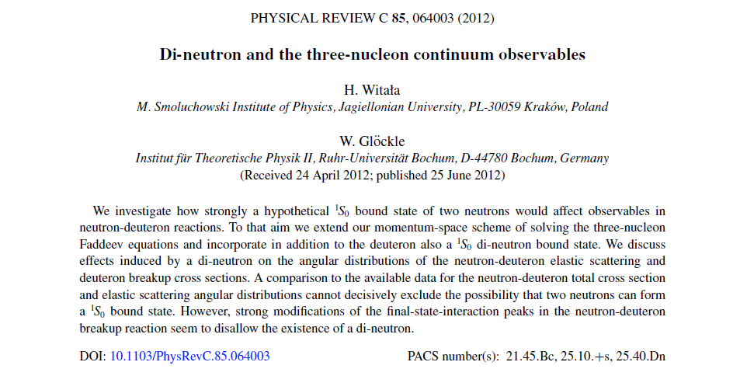
Question: If we tune ¹S₀ state of nn interaction,
Do we have a possibility to have a bound state in nnΛ?
In this case, the binding energies of ³H and ³He reproduce
the observed data?
Some authors pointed out to have dineutron bound state in
nn system. Ex. H. Witala and W. Gloeckle, Phys. Rev. C85,
064003 (2012).
n
n
T=1, ¹S₀ state
I multiply component of ¹S₀ state by 1.13 and
1.35. What is the binding energies of nnΛ？
Λ

Slide 23
n
n
unbound
nn
0 MeV
-0.066MeV
-1.269 MeV
¹S₀X1.13
¹S₀X1.35
n
n
unbound
unbound
0 MeV
nnΛ
Λ
1/2⁺
-1.272 MeV
We do not find any possibility to have a bound state
in nnΛ.
N+N+N
³H (³He)
-8.48 (-7.72)
-7.77(-7.12)
-9.75 (-9.05)
1/2⁺
-13.93 (-13.23)MeV
Exp.
Cal.
Cal.
1/2⁺
Cal.

Slide 24
Summary of nnΛ system:
Motivated by the reported observation of data suggesting
a bound state nnΛ, we have calculated the binding energy
of this hyperucleus taking into account ΛN-ΣN explicitly.
We did not find any possibility to have a bound state in this
system. However, the experimentally they reported
evidence for a bound state. As long as we believe the data,
we should consider additional
missing elements in the present calculation. But, I have no idea.
Unfortunately, they did not report binding energy.
Then, I would like to suggest experimentalists:
To perform search experiment of nnΛ system to conclude
whether or not the system exists as bound state experimentally.
n
n
n
n
³H
³n
Λ
Λ
p
n
(e,e’K⁺)

Slide 25
⁶He
Λ
Λ
n
α
⁶He
Λ

Slide 26
Λ
0.89 MeV
P_{3/2}
0 MeV
α +n+Λ
α +n
⁵He
⁵He+n
Λ
-3.12 MeV
0.17 MeV
1⁻
n
⁶He
Λ
α
Λ
Λ
α
L=0
⁵He
Valence neutron is very loosely
coupled to the α+Λ system.
Λ
⁶He
Λ
Question: Can we reproduce the data ?
How do the 3 particle locate to each other?
Is there neutron halo in ⁶He hypernucleus?
Λ

Slide 27
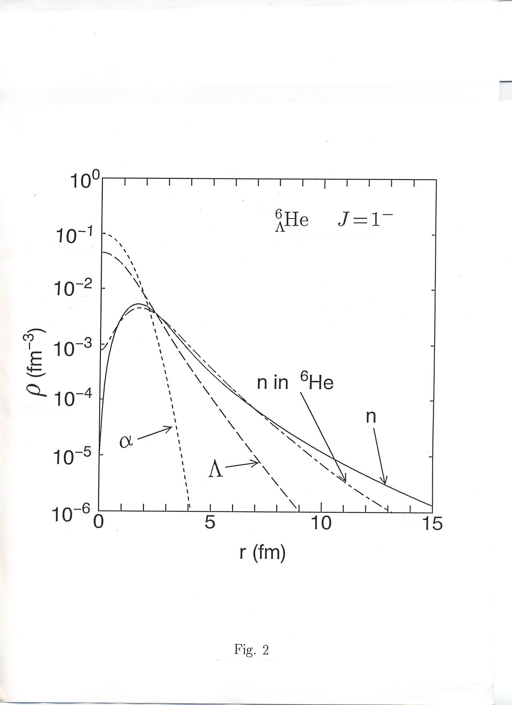
^
密度 ρ_{n}(r) = ∫|Ψ(⁶He)|²dRdr
Λ
Λ
α
r
n
Three-layer structure
r.m.s α-Λ 2.8 fm
α-n 5.0 fm
Larger than ⁶He
Halo nucleus ⁶He
α-n 4.5 fm

Slide 28
⁷He
Λ
n
n
α
Λ
⁷He
Λ
Notes:
28
28
28

Slide 29
n
n
⁶He : One of the lightest
n-rich nuclei
⁶He
α
Λ
n
n
⁷He: One of the lightest
n-rich hypernuclei
⁷He
Λ
Λ
α
Λ
Observed at JLAB,
Phys. Rev. Lett. 110, 12502 (2013).

Slide 30
CAL: E. Hiyama et al., PRC 53, 2075 (1996), PRC 80, 054321 (2009)
6He
7He
Λ
2+
0 MeV
α+Λ+n+n
0 MeV
α+n+n
One of the excited
state was observed at Jlab.
5He+n+n
0+
Λ
Λ
Exp:-0.98
-1.03 MeV
5/2+
Neutron
halo states
3/2+
-4.57
B_{Λ}: CAL= 5.36 MeV
B_{Λ}： EXP= 5.68±0.03±0.25
1/2+
Observed at J-Lab experiment
Phys. Rev. Lett.110,
012502 (2013).
-6.19 MeV

Slide 31
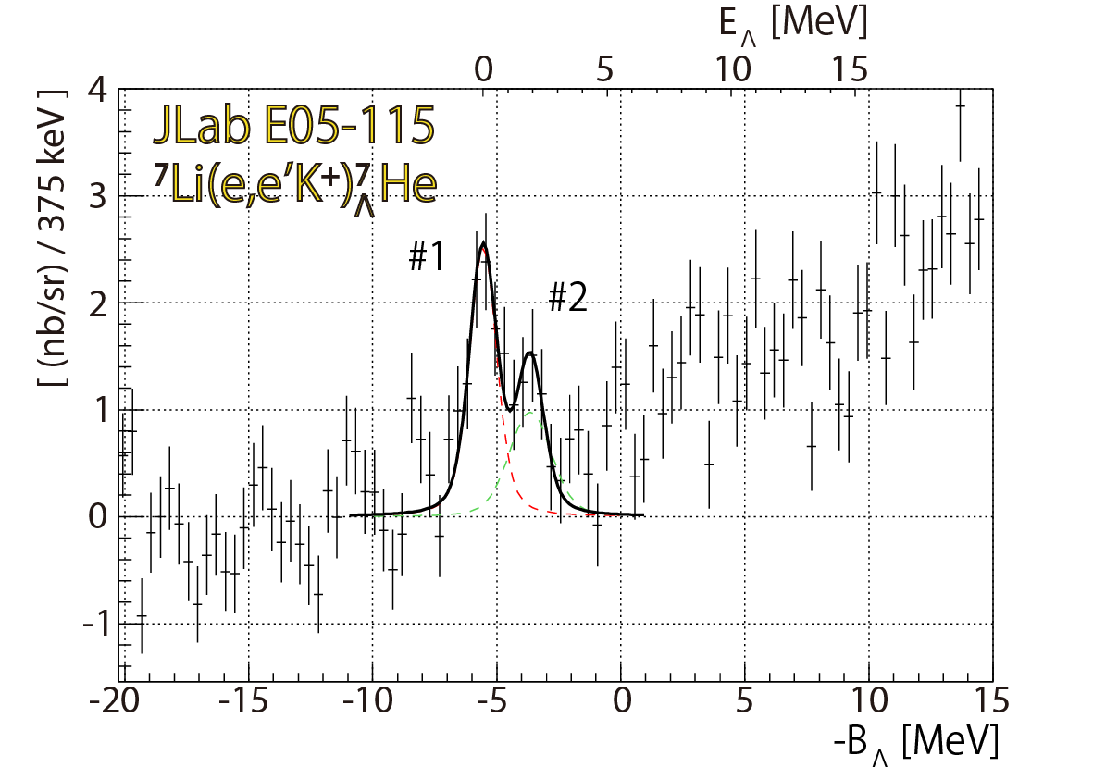
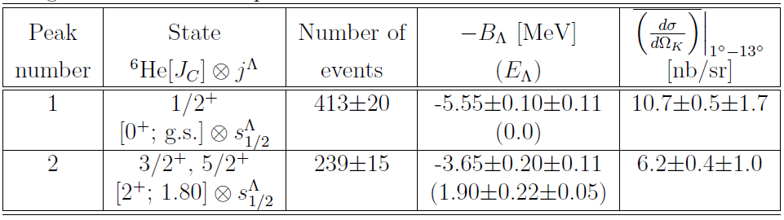
⁷Li(e,e’K⁺)⁷_{Λ}He
At present, due to poor statics,
It is difficult to have the third peak.
Theoretically, is it possible to
have new state?
Let’s consider it.
Third peak?
(FWHM = 1.3 MeV)
Fitting results

Slide 32
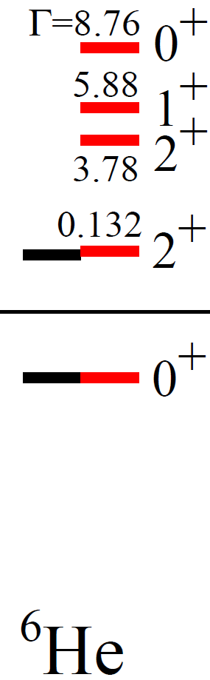
Γ＝12.1 ±1.1 MeV
(2⁺,1⁻,0⁺)?
2.5 MeV
Γ=
Γ=113 ±20 keV
Γ=
2+
1.797 MeV
1.79 MeV
0 MeV
α+n+n
-0.98
0+
-0.97 MeV
⁶He
theory
Exp.
Myo et al., PRC 84, 064306 (2011).
Core nucleus

Slide 33
7He
n
n
Λ
7He
Λ
α
Λ
0 MeV
α+Λ+n+n
5/2⁺
-1.88 Γ=0.7 MeV
New prediction
3/2⁺
-2.04, Γ=0.5 MeV
5He+n+n
Λ
-3.12
5/2+
Neutron
halo states
3/2+
-4.57
1/2+
-6.19 MeV

Slide 34

Γ＝12.1 ±1.1 MeV
⁷He
Λ
(2⁺,1⁻,0⁺)?
If we find these two excited states at Jlab,
in ⁶He, existence of the second 2⁺ state
is promising. Please search the second 2⁺
state in ⁷He at Jlab.
2⁺
2+
1.797 MeV
Λ
Γ=113 ±20 keV
0 MeV
α+Λ+n+n
0 MeV
α+n+n
5/2⁺
-1.88 Γ=0.7 MeV
-0.98
-2.04, Γ=0.5 MeV
0+
3/2⁺
⁵He+n+n
Λ
-3.12
5/2+
Neutron
halo states
⁶He
3/2+
-4.57
Exp.
1/2+
If we find these two states at Jlab, these existence
contribute to unstable nuclear physics.
-6.19 MeV

Slide 35
Section 3
Response of super-deformed states
by addition of Λ particle
¹⁰Be
Λ
Notes:
35
35
35

Slide 36
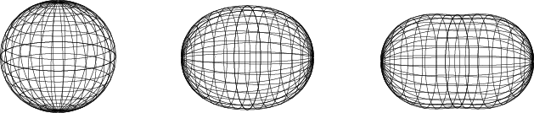
What happens when a Λ particle is added to such ND and SD states?
Λ
Λ
spherical
Normal deformed (ND)
Super-deformed
(SD)
We have various kinds of nuclear shape, such as spherical,
normal deformed and super-deformed shapes. Especially,
it is known that super-deformed shape is related to the appearance of
a large shell gap at a 2:1 axis ratio of the nuclear deformation
for specific particle numbers.

Slide 37
What happens when a Λ particle is added to such ND and SD states?
Super-
deformed
(SD) states
Does energy gain go
in parallel way for both types
of states?
Normal
Deformed
(ND) states
No !
2+₂
0+₂
2+₁
2+₂
0+₁
Λ
0+₂
core nucleus
2+₁
0+₁
Λ hypernucleus
Notes:
37

Slide 38
Energy gain by Λ-particle addition
ΔE (ND state) > ΔE (SD state)
ND state
SD state
ND state
Level crossing
core nucleus
One example in
Λ hypernucleus
¹⁰Be
Λ

Slide 39
¹⁰Be
Λ
Λ
¹⁰Be
⁹Be
Λ
Y. Zang, E. H., and Y. Yamamoto, Nucl. Phys. A 881, 288 (2012):
E. H. and Y. Yamamoto,
Prog. Theor. Phys. 128, 105, (2012).
Notes:
39
39
39

Slide 40
Interesting phenomena such as level crossing
is seen in ⁹Be and ¹⁰Be combination.
Λ
It is well known that , in the 1/2⁺ state,
a valence neutron is located in 1S _{1/2} orbit
in the simple shell model configuration.
It is a kind of SD state.
5/2-
ND
SD
1/2+
α+α+n
When a Λ particle is injected into each state,
is there any change of energy spectra?
ND
3/2-
⁹Be
Λ
¹⁰Be
Λ
Notes:
ND

Slide 41
MeV
5/2
+0.6 MeV
1/2⁺
α＋α＋ｎ
α＋α＋ｎ＋Λ
+0.1
SD
ND
3/2-
Level reversion is occurred
by addition of a Λ particle.
¹⁰B(e,e’K+)¹⁰Be
(Jlab E01-11)
-1.58
9Be
ND
Λ
EXP
CAL
Small spin-splitting is
neglected to show.
B_{Λ} = 8.94 MeV
If we observe
positive states and
negative states,
we find that
Λ-separation
energies are dependent
on the degree of
deformation.
Please observe the positive parity states at Jlab.
-7.35
( B_{Λ} = 9.11 0.22 MeV)
0+ , 1+
2-, 3-
-8.14
-10.52 MeV
1-, 2-
10Be
Λ
Notes:
41

Slide 42
Summary
p
n
n
Λ
n
４
n
n
n
n
n
⁴He
４
n
⁴He
Λ
p
n
⁷Li
⁷He
Λ
³H
³n
Λ
Please observe
second 3/2⁺ and 5/2⁺ state.
This is important for the study
of neutron-rich nuclei.
Please confirm whether or
not we have bound state,
n
Λ
p
p
n
n
n
n
Λ
n
４
４
４
４
４
⁴He
４
⁴He
⁴He
⁴He
⁴He
⁴He
⁶ Li
¹⁰B
¹⁰Be
⁶ He
Λ
Λ
Please observe
the positive parity state.
It is interesting to have a
huge halo structure.

Slide 43
In this way, the experiment at Jlab is
very important for theorists to study the structure of
multi-strangeness systems.
I hope we have many data at Jlab in the future.

Slide 44
Thank you!

