Slide 1
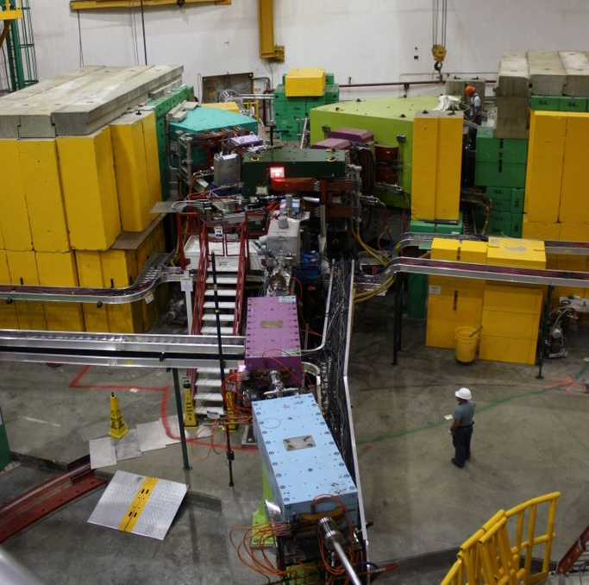
JLab Hypernuclear Workshop 27th May 2014
Results from Hall-C
HES
HKS
Satoshi N Nakamura, Tohoku University
Notes:
Including discussion 30min

Slide 2
Lattice QCD
Modern baryon Interaction models
QCD
Baryon Interaction
Quark degree of freedom
SU_{f}(3) Symmetry
Nuclear Force
Hyperon Force
Lots of NN scattering data
Limited YN/YY scattering data
Established Calculation Tech.
Cluster Model
Shell Model
Mean Field
Nuclear Structure
Nuclear Structure
Normal/Exotic nuclei
Hypernuclei

Slide 3
Characteristics of Λ hypernuclear study by (e,e’K) reaction
EM Interaction
p to Λ
primary e beam
Electron BG
Small C.S.
Coin. measure
High Quality Beam
Sophisticated Detectors

Slide 4
Three generation experiments at Hall-C
E89-009 (2000) : Existing spectrometers, SOS + Enge
Proof of Principle
E01-011 (2005) : Construction of HKS, Tilt Method
Λ, Σ⁰, ⁷_{Λ}He, ¹²_{Λ}B, ²⁸_{Λ}Al
Light Hypernuclei
E05-115 (2009) : HES, new Beamline, Splitter
Λ, Σ⁰, ⁷_{Λ}He , ¹²_{Λ}B, ⁵²_{Λ}V
Light to medium-heavy Hypernuclei

Slide 5
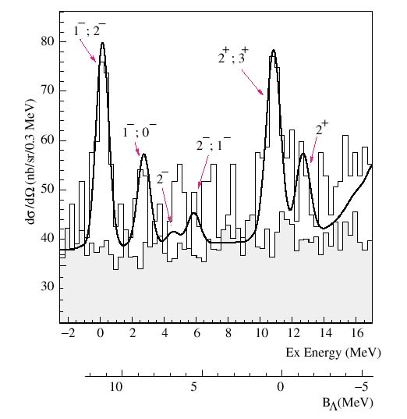
Proof of Principle (E89-009, HNSS)
¹²C(e,e’K⁺) ¹²_{Λ}B
Demonstrated that
the (e,e’K) hypernuclear spectroscopy is possible!
s_{Λ}
p_{Λ}
Good energy resolution
<900 keV (FWHM)
PRL 90 (2003) 232502, PRC 73 (2006) 044607

Slide 6
Improvement of the E89-009 experiment
Resolution & acceptance are limited
New Spectrometer
High resolution Kaon Spectrometer (HKS)
Zero degree e’ measure
BG from Bremsstrahlung (200 MHz for e’ arm)
Tilt Method
The 2nd Generation Experiment was approved by Jlab PAC19
E01-011 (Spokesmen: Hashimoto, Tang, Reinhold, Nakamura)
Notes:
Beam intensity was limited

Slide 7
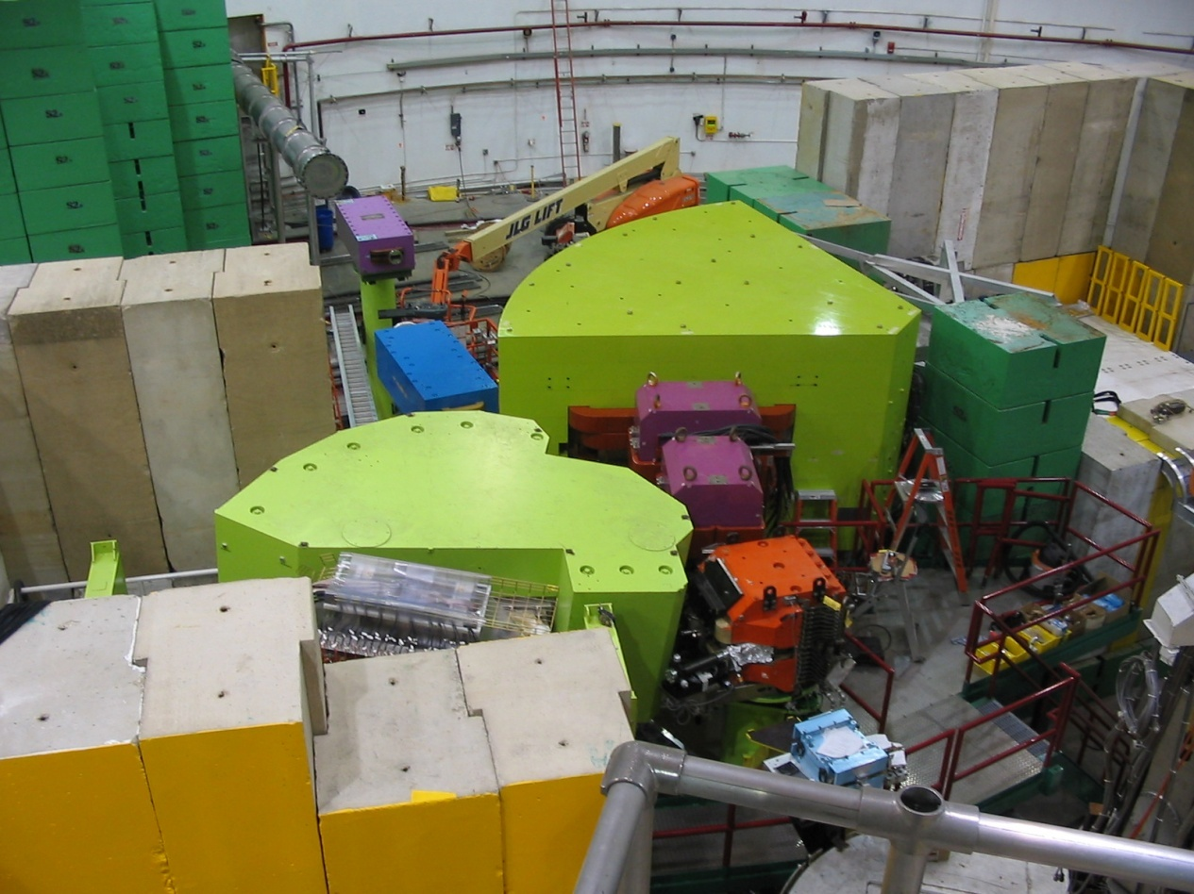
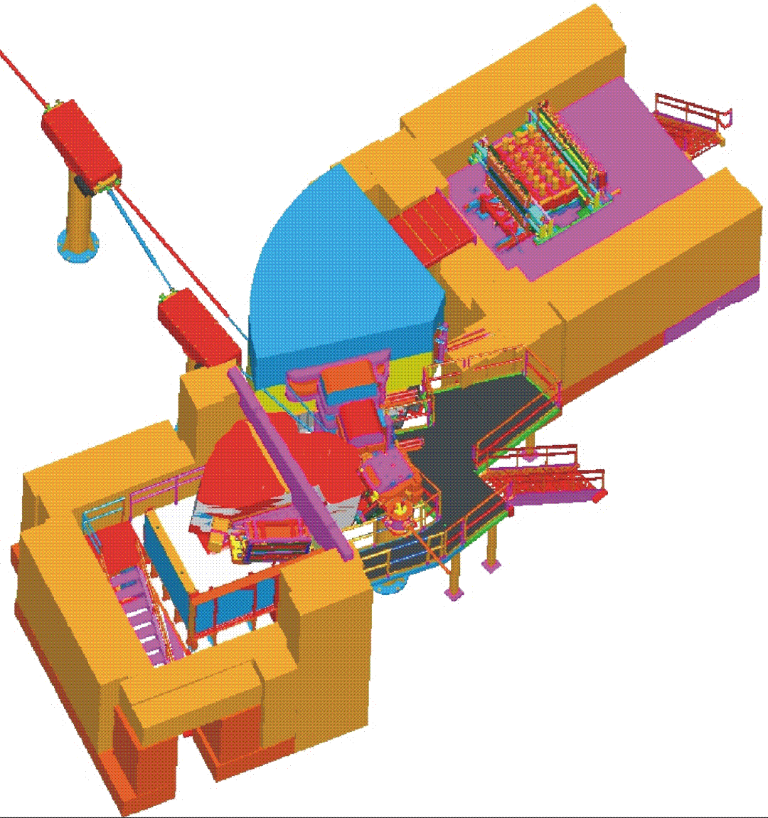
Second Generation Exp. at JLab
2005 E01-011 (Hall C)
First step to beyond p-shell hypernuclei (²⁸_{Λ}Al, ¹²_{Λ}B, ⁷_{Λ}He)
To beam dump
HKS
Two Major Improvements
New HKS
ENGE
Splitter
Tilt Method
Target
Beam: 30 μA , 1.8GeV
HKS: Δp/p=2 x 10 ^{-4 [FWHM]}
Solid angle 16msr(w/ splitter)
Electron beam

Slide 8
Charge Symmetry Breaking Effect of ΛN interaction
1⁺
0.24 MeV
0.35 MeV
0⁺
⁴_{Λ}H
Λ
n
Λ
n
⁴_{Λ}He
n
p
p
p
Coulomb effect is small.
Charge Symmetry Breaking
cf) B(³H)-B(³He)-ΔB_{c} = 764-693 = 71 keV

Slide 9
B_{Λ} of light hypermultiplets
NO reliable B_{Λ}
Exp. Data : Emulsion
⁷_{Λ}He
Λ
α
¹⁰_{Λ}Be
n
⁴_{Λ}H
n
67 events
3 event
Λ
n
Λ
α
⁷_{Λ}Li*
n
p
Λ
167 events
n
α
α
p
n
¹⁰_{Λ}B
⁴_{Λ}He
p
98 events
Λ
Λ
⁷_{Λ}Be
α
Λ
15 events
n
p
p
α
α
p
Experimental B_{Λ}
Δ_{CSB}
p
10 events
Hiyama et al. PRC80.(2009) 054321
PTP 128 (2012) 105.

Slide 10
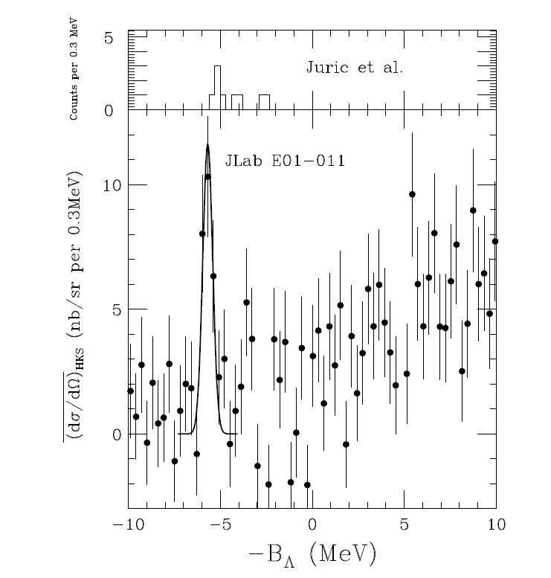
⁷Li(e,e’K⁺)⁷_{Λ}He
First reliable observation of ⁷_{Λ}He w/ good statistics
M.Juric et al. NP B52 (1973) 1
Last missing information of
A=7 hypernuclear iso-triplet
E01-011(HKS) 90 counts
E05-115(HKS-HES) >500 counts
FWHM 0.63 MeV
PRL 110 (2013) 012502.

Slide 11
Third Generation Experiment at Jlab Hall C
2009 E05-115
Wide mass range hypernuclear spectroscopy (⁷_{Λ}He~⁵²_{Λ}V )
e⁻
γ
1.2 GeV /c K⁺
HKS+ new HES
spectrometers
0.9 GeV e’
2.34 GeV e⁻
Tilt method
suppress electron
background
by >10000

Slide 12
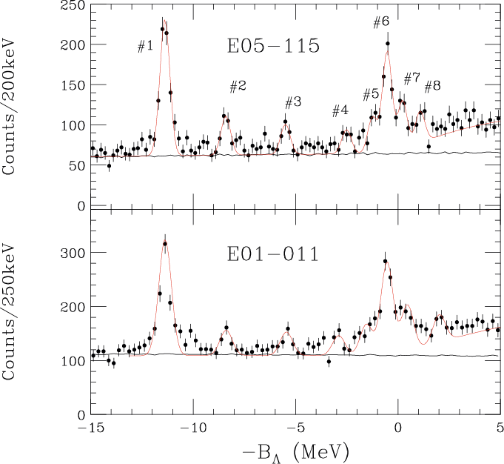
¹²C(π⁺,K⁺)¹²_{Λ}C @ BNL-AGS,KEK-PS ¹²C(e,e’K⁺)¹²_{Λ}B @ JLab Hall C
Resolution ~ 2MeV
Excitation energy
(gs energy from emulsion)
Resolution ~ 1.6 MeV
JLab E05-115 ¹²C(e,e’K⁺)¹²_{Λ}B
Resolution ~ 0.5MeV
Absolute binding energy
Paper is going to submit soon.

Slide 13
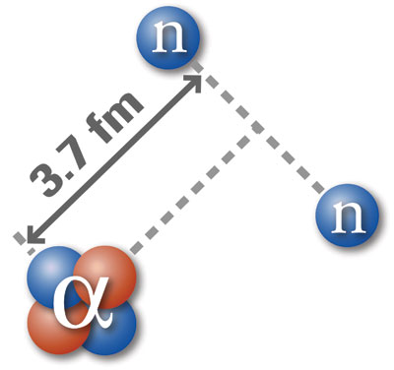
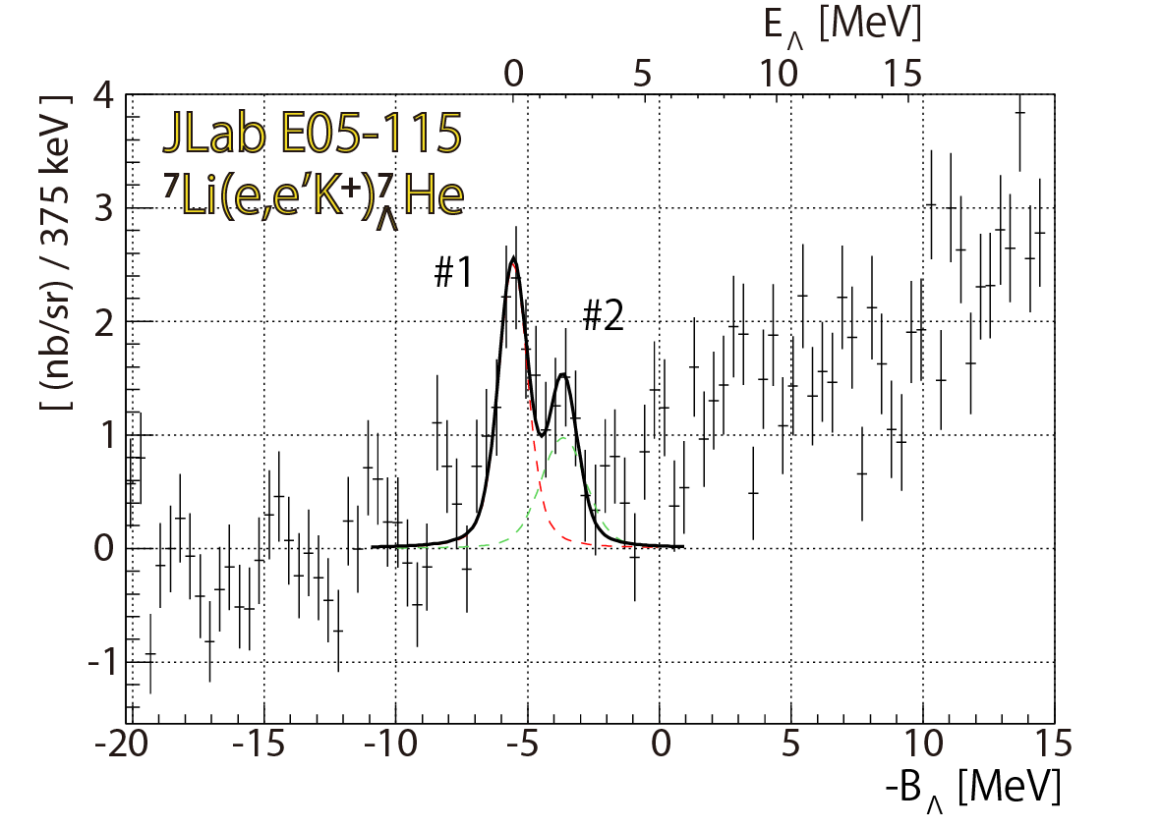
⁷_{Λ}He spectrum of E05-115
⁶He : 2n halo
T. Gogami, Doctor Thesis (Tohoku U.)
E.Hiyama et al. PRC 80, 054321 (2009)

Slide 14
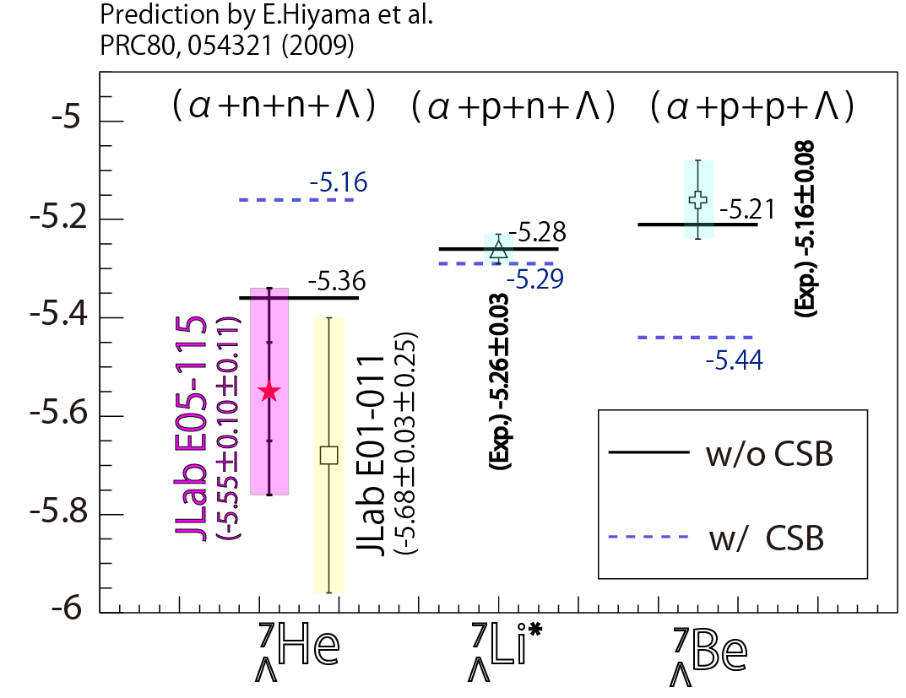
⁷_{Λ}He spectrum of E05-115
T. Gogami, Doctor Thesis (Tohoku U.)
Assumed CSB potential may be too naïve
Further study on A=4 hypernuclear systems

Slide 15
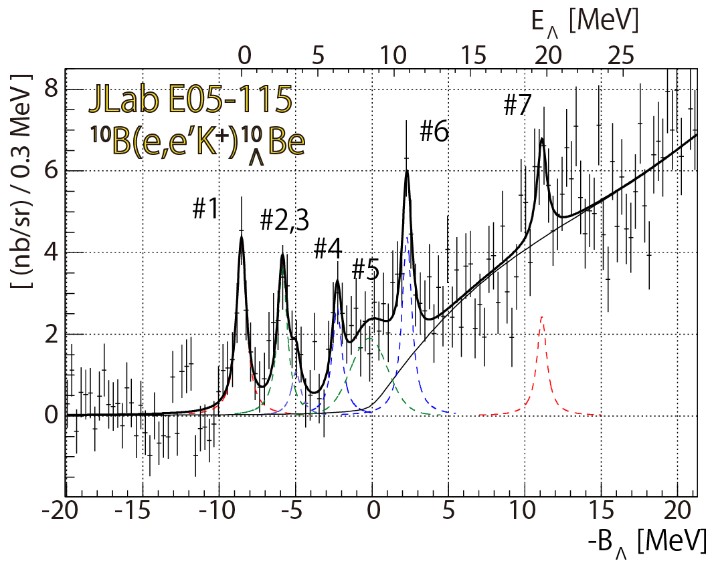
¹⁰B(e,e’K⁺)¹⁰_{Λ}Be
⁹Be
¹⁰Be
_{Λ}
α
n
α
α
n
+
α
Λ
Λ
CSB effect
Present work
T. Gogami, Doctor Thesis (Tohoku U.)

Slide 16
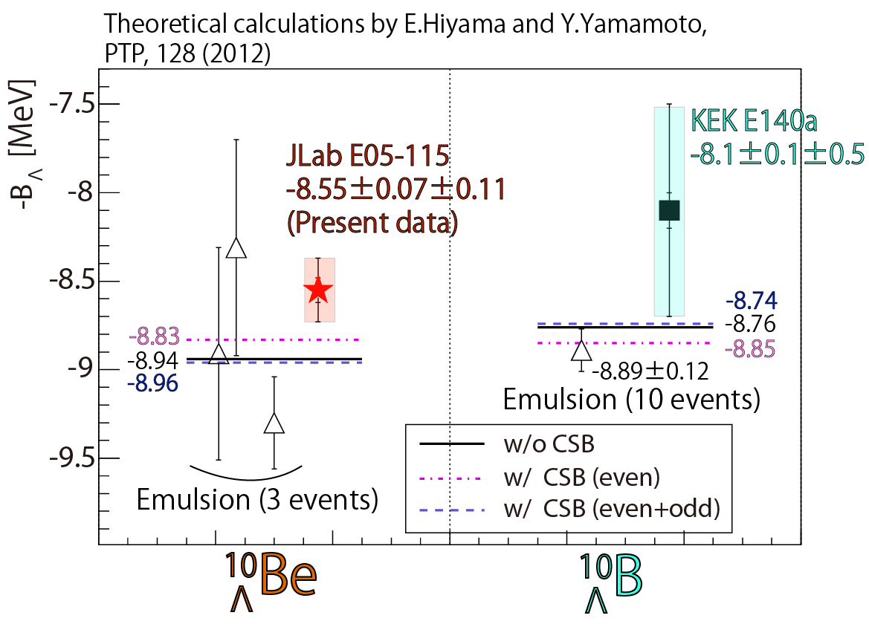
Comparison of ¹⁰_{Λ}Be and ¹⁰_{Λ}B
$${dσ}/{dΩ}$$
Experiments
Theoretical calc.
CSB off : +0.22 MeV
CSB on : -0.02 MeV

Slide 17
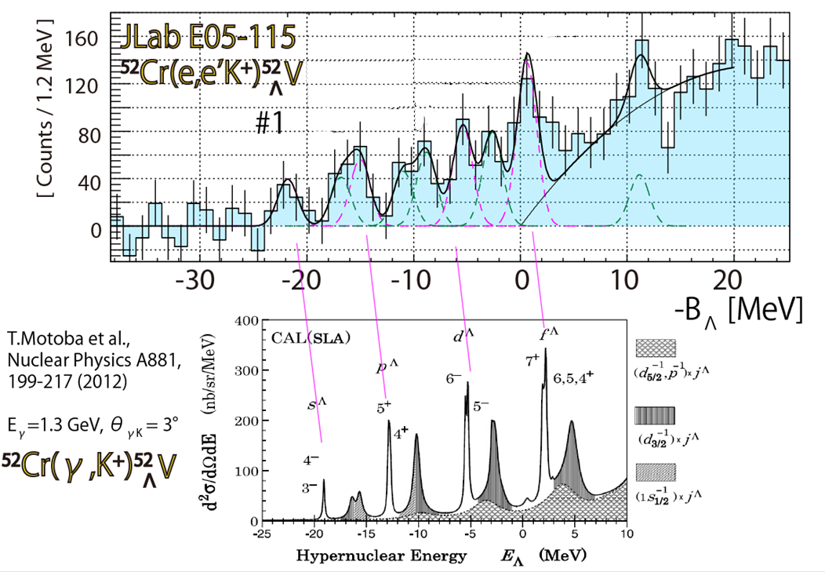
⁵²Cr(e,e’K⁺)⁵²_{Λ}V
Theory

Slide 18
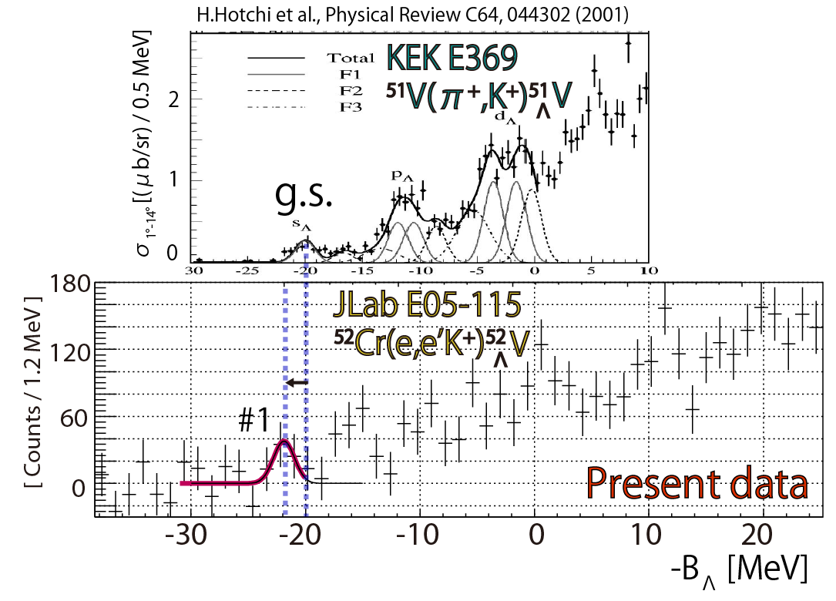
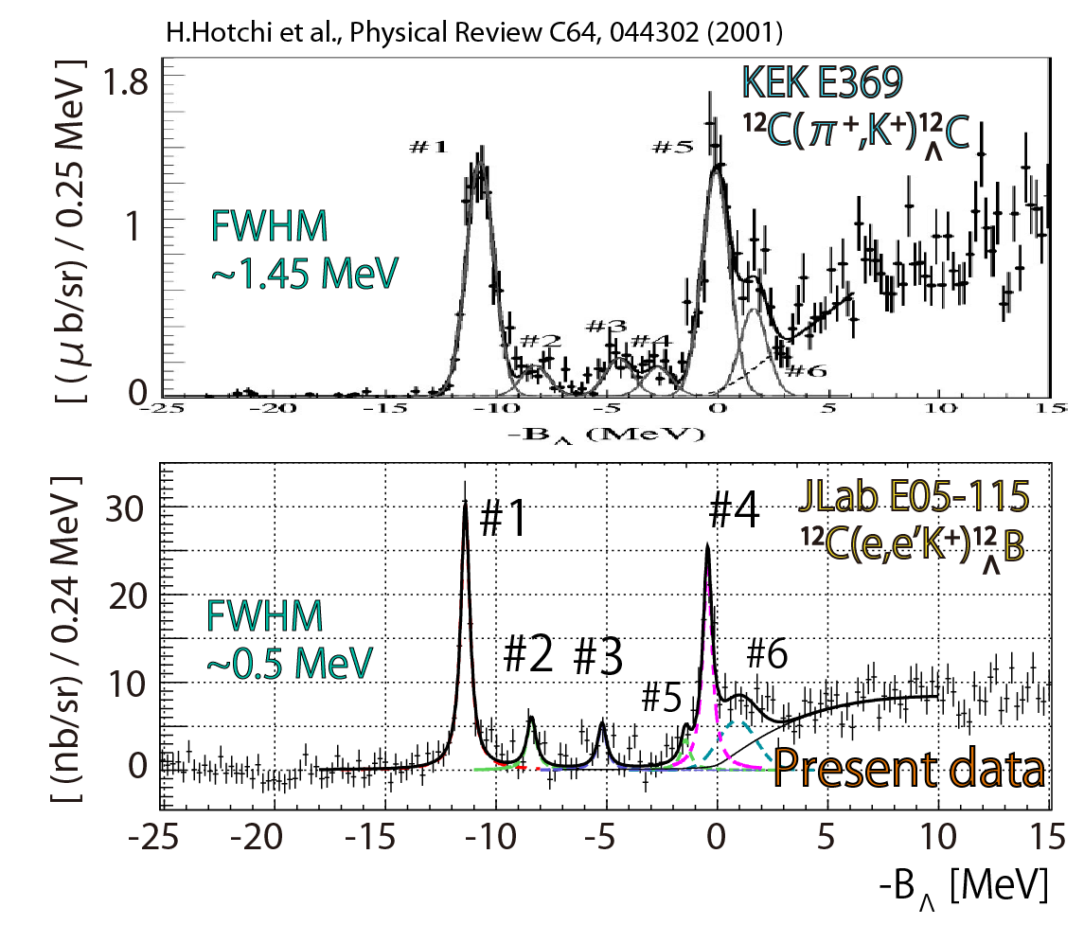
¹²_{Λ}C : Ref. for all (π,K) data
¹²_{Λ}C: Emulsion data (6 events)
¹²_{Λ}B: Calibrated by p(e,e’K⁺)Λ, Σ⁰
Shift ¹²_{Λ}C gs by $0.5$MeV
Power of Absolute E Calib.

Slide 19
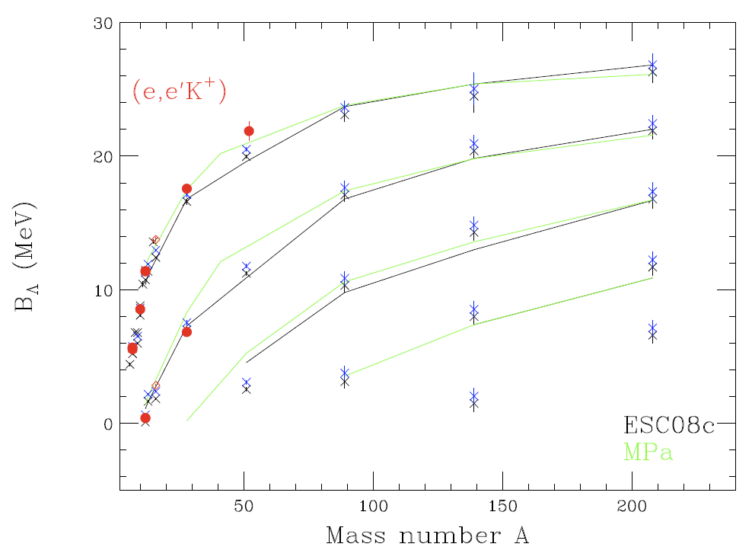
Measured hypernuclei & expected A dependence
E05-115
Λs
Λp
Λd
Λf
Λg
Calculation from Y.Yamamoto

Slide 20
Present Status of Λ Hypernuclear Spectroscopy
⁵²_{Λ}V
Updated from: O. Hashimoto and H. Tamura, Prog. Part. Nucl. Phys. 57 (2006) 564.

Slide 21
Summary
Three generations of experiment at JLab Hall-C
two major magnetic spectrometers (HKS, HES)
novel techniques in the last decade.
E89-009 : Feasibility of (e,e’K) hypernuclear spectroscopy
E01-011 : ⁷_{Λ}He, CSB and
first beyond p-shell ²⁸_{Λ}Al
E05-115 : ⁷_{Λ}He, ¹⁰_{Λ}Be : CSB and detailed spectroscopy
¹²_{Λ}B, best resolution & absolute B_{Λ} calibration
⁵²_{Λ}V: First medium-heavy hypernucleus
(e,e’K) HY spectroscopy is now established at JLab
and JLab is unique.
Next Step: Detailed structures for lighter targets
Major shell structures for heavier targets

