Slide 1
A Study with High Precision on the Electro-production of Λ and Λ-hypernuclei
in the Full Mass Range
Liguang Tang
On behalf of the unified JLab hypernuclear physics collaboration
A new experimental program created on the foundation of achievements from the 6 GeV programs separately carried out in Hall A and Hall C
Hypernuclear Workshop, Jlab, May 27-29, 2014

Slide 2
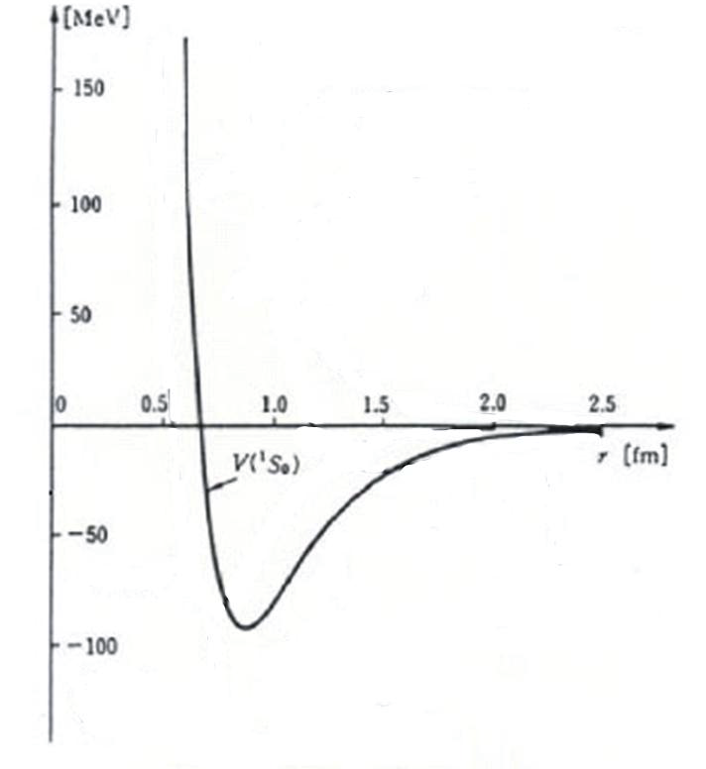
Introduction
Strong Interaction – Nuclear Physics
Short Range
Long Range
QCD
NN Interaction Model
Asymptotic Freedom
Lots of NN scat. data
Quark Degree of Freedom
Various Data of Nuclei
Recent development of LQCD has been successful on the non-strangeness sector
YN and YY are the missing parts to fully understand the flavor SU(3) breaking
ΛN
Hypernuclear physics is a unique tool and a gateway to other flavors
Λ-hypernuclei are unique to study the short range B-B interactions, such as
Origin of repulsive core
Origin of LS force
OPE

Slide 3
Introduction – cont.
Two-body effective Λ-Nucleus potential (p-shell hypernuclei):
V_{ΛN}(r) = V_{c}(r) + V_{s}(r)(S_{Λ}•S_{N}) + V_{Λ}(r)(L_{N}•S_{Λ}) + V_{N}(r)(L_{Λ}•S_{N}) + V_{T}(r)S₁₂
These spin-dependent interactions are essential to correctly describe the Λ-N interaction. Systematic study on the elementary process, wide variety of hypernuclei and their characteristic structures, and various production mechanisms are needed.
A novel feature of Λ-hypernuclei
  Short range interactions
    ΛΣ coupling, ΛNN 3-B forces
  Change of core structures
  Drip line limit
No Pauli blocking to Λ
  Probe the nuclear interior
  Baryonic property change or single
  nature of Λ in heavy baryonic system
ΛN
OPE

Slide 4
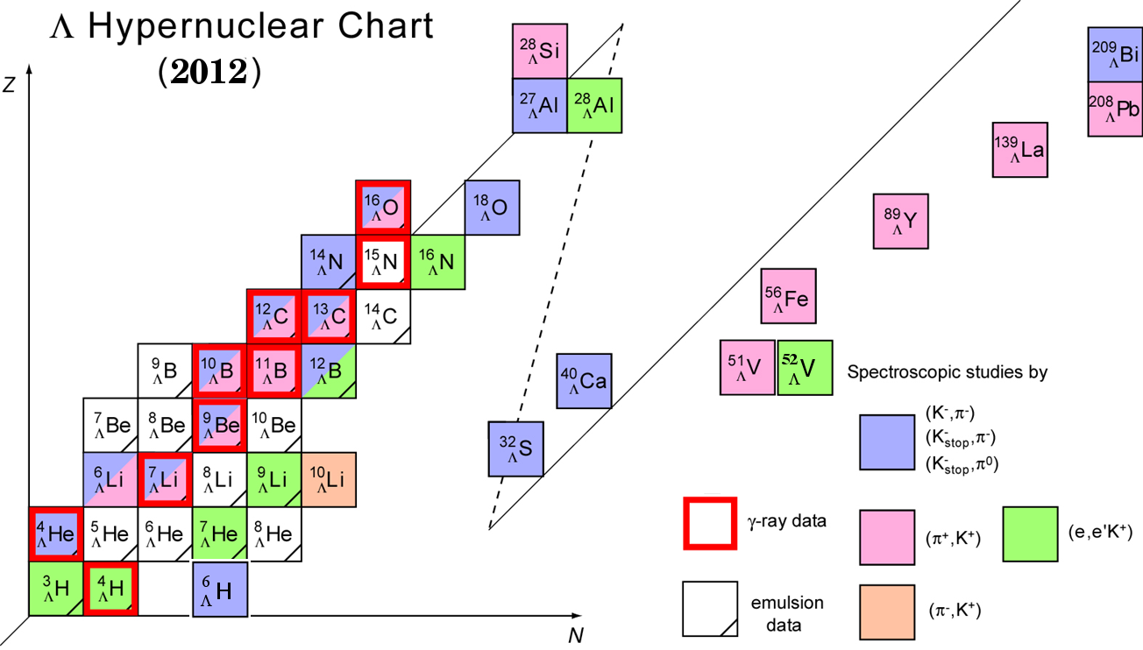
Hypernuclear Chart
²⁷
_{Λ}
_{Λ}
Tl
Mg
²⁰⁸
⁴⁸
¹²
_{Λ}
_{Λ}
B
Sc
⁴⁰
_{Λ}
⁴⁰
_{Λ}
⁴⁴
_{Λ}
⁴⁸
K
_{Λ}
K
K
K
_{Λ}
⁴
H
[ΛΝ]
Λ

Slide 5
Hypernuclei in wide mass range
Hypernuclear Spectroscopy Prospectives at JLab
E89-009, E01-011, E05-115(Hall C)
E94-107(Hall A)
1
20
50
200
10⁵⁷
A
H, ⁷Li, ⁹Be, ¹⁰B, ¹²C, ¹⁶O, ²⁸Si, ⁵²Cr
Future mass spectroscopy (new proposal)
Elementary Process
Strangeness electro-production
  Neutron/Hyperon star,
  Strangeness matter
  Hyperonization →
Softening of EOS ?
Light Hypernuclei (s,p shell)
  Fine structure
  Baryon-baryon interaction in SU(3)
  ΛΣ coupling in large isospin hypernuclei
  Cluster structure
Medium/heavy Hypernuclei
  Single particle potential
  Distinguish ability of a Λ hyperon
  U_{o}(r), m_{Λ}*(r), V_{ΛNN}, …
Precision
Cleanness
Characteristics

Slide 6
Hypernuclear Experiments at JLab Using
CW Electron Beam
The (e, e’K⁺) Reaction
e
e’
γ
K⁺
p
Λ
^{Z}A
^{Z-1}_{Λ}A
Large momentum transfer (~300-400MeV/c)
Deeply bound, highest possible spin, both unnatural and natural parity states
Small production cross section but compensated by high beam intensity
Neutron rich hypernuclei and high iso-spin states (important to study Λ-Σ coupling)
Capable of high precision which is important for hypernuclear spectroscopy
Complimentary to spectroscopy produced by other mechanisms

Slide 7
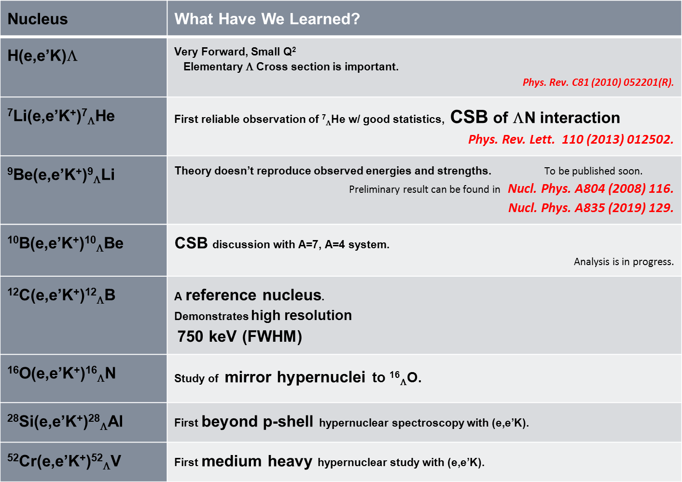
JLab Hypernuclear Program To Date
Part of proposed program.
Phys. Rev. Lett. 90 (2003) 232502.
Phys. Rev. C73 (2006) 044607.
Phys. Rev. Lett 99 (2007) 052501.
Nucl. Phys. A835 (2010) 129.
Phys. Rev. Lett. 103 (2009) 202501.
Nucl. Phys. A835 (2010) 129.
Analysis in progress.
Preliminary result can be found in Nucl. Phys. A804 (2008) 125.
Analysis in progress.

Slide 8
Future Project: Super Hypernuclear Physics Experiment at JLab
Unified collaboration from the previous Hall A and C collaborations
Enge (π)
Septum
HRS (e’)
Combine the features of previous Hall A and C experiments, create an optimized future program w/ the CEBAF CW beam
Septum
HES (π)
HKS (K)
HRS – HKS: (e, e’K⁺) experiments for mass spectroscopy
HKS – Enge or HKS – HES: New decay π⁻ spectroscopy experiment

Slide 9
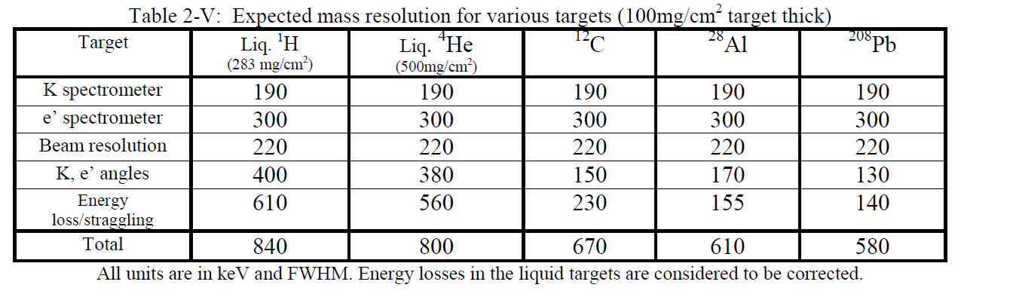
Expected Mass Resolution
Calibration for independent K, e’ spectrometers.
Established in E94-107.
Absolute missing mass calibration with Λ & Σ° masses
Established in E05-115.

Slide 10
Goal of The Future Project
High physics yield rate and productivity
Clean from background
High precision
Wide range of mass
New technique and new program (decay pion)
Only at Jefferson Lab !!

Slide 11
Study of Light Λ-Hypernuclei by Spectroscopy of Two Body Weak Decay Pions
This previous PR12-10-001 is now proposed as a part of combined experiments that can run at same time to maximize physics outcome
Fragmentation of Hypernuclei
and
Mesonic Decay inside Nucleus
Free: Λ→ p + π ⁻
2-B: ^{A}_{Λ}Z → ^{A}(Z + 1) + π ⁻
Liguang Tang
Department of Physics, Hampton University
Jefferson National Laboratory (JLAB)
JLab PAC40, June 18, 2013

Slide 12
Decay Pion Spectroscopy to Study Λ-Hypernuclei
Direct Production
Fragmentation Process
Example:
e’
e’
K ⁺
K ⁺
¹²C
¹²C
e
γ*
e
γ*
p
Fragmentation
(<10⁻¹⁶s)
γ
p
¹²_{Λ}B*
Λ
s
⁴_{Λ}H
Λ
E.M.
¹²_{Λ}B_{g.s.}
Λ
γ
Low lying Hypernuclear States
Highly Excited
Hypernuclear States
⁴_{Λ}H_{g.s.}
Λ
α
Λ
α
¹²C
⁴He
π ⁻
π ⁻
Weak mesonic two body decay (~10⁻¹⁰s)

Slide 13
Study of Light Hypernuclei by Pionic Decay at Jlab
Illustration on the Main Features
Comparison of Spectroscopic and Background π⁻ Production
SPECTROSCOPY
BACKGROUND
e
e′
e
e′
γ*
K⁺
π⁻
γ*
K⁺
p
Λ
p(n)
π⁻
^{A1}_{Λ}Z_{1 stop}
VS
Λ,Σ°(Σ⁻)
^{A}Z
N
^{A}Z
^{(A-1)}Z’
^{A2}Z₂
^{A}_{Λ}(Z-1)
^{A1}(Z1+1)
K and π accidentals – 0.027counts/hr/bin(25keV)
(Z-1) = Z₁+Z₂; A=A1+A2
Light Hypernuclei to Be Investigated
p
Previously measured
S/A ranges from ~50:1 to ~0.5:1
6
(b)
Mirror pairs
⁸_{Λ}B
⁹_{Λ}B
Additions from ⁹_{Λ}Li and its continuum
(Phase II: ⁹Be target)
5
1/2⁺
J^{p}=?
3/2⁺
¹⁰_{Λ}B
¹¹_{Λ}B
¹²_{Λ}B
⁷_{Λ}Li
⁸_{Λ}He
⁹_{Λ}Li
1⁻
⁸_{Λ}Be
⁸_{Λ}Li
¹⁰_{Λ}Be
¹¹_{Λ}Be
4
⁶_{Λ}Li
⁹_{Λ}Be
3B background
1⁻ ?
1/2⁺
⁷_{Λ}H
3/2⁺
⁶_{Λ}Li
5/2⁺
⁹_{Λ}Li
¹⁰_{Λ}Li
3
⁷_{Λ}Li
⁸_{Λ}Li
2⁻
0
1
E_{x}
0
1
E_{x}
0
1
E_{x}
2
⁶_{Λ}He
⁷_{Λ}He
⁸_{Λ}He
⁹_{Λ}He
0
2
E_{x}
1
³_{Λ}H
⁴_{Λ}H
⁵_{Λ}H
⁶_{Λ}H
⁷_{Λ}H
⁸_{Λ}H
A
1
2
3
4
5
6
7
8
9
10
11
12

Slide 14
Physics Goal of Decay Pion Spectroscopy
Precise measurement of ground state B_{Λ} (±20keV) for a series of light hypernuclei (A=3-12) with high resolution (<130keV FWHM), spin-parity determination of g.s., charge symmetry breaking (CSB) from mirror pairs
Neutron rich light hypernuclei (Λ-Σ coupling) and neutron drip line limit (⁶_{Λ}H and ⁸_{Λ}H)
Formation of quasi free continuum and fragmentation mechanism
Provide precise input for theoretical description of Λ-N interaction. Since B_{Λ} and excitation are the only sources of experimental information, study wide range of hypernuclei is needed.

Slide 15
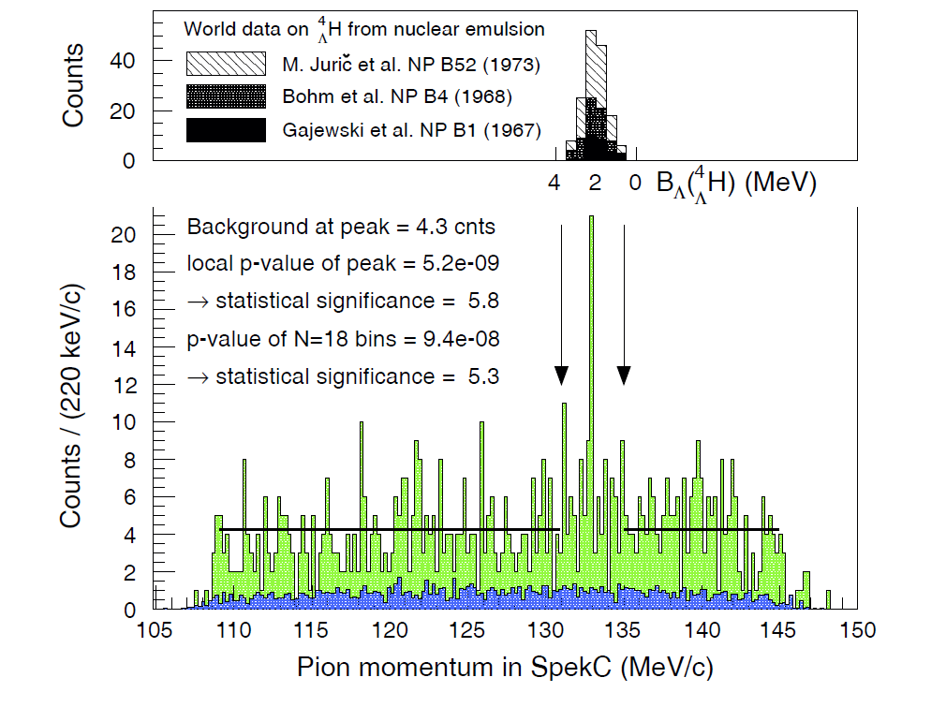
Preliminary Results from MAMI-C
KAOS – SPEC-C
2012 Data
We are convinced at least on ⁴_{Λ}H observation

Slide 16
Advantages of Jlab Experiment
Higher production rate (~9 times over MAMI 2012)
Excellent PID for both K⁺ and π⁻
Less background (accidental or real)
Full coverage of the interesting π⁻ momentum range
Can take data together with the (e, e’K⁺) experiment
Required Beam Time
70 days (1680 hours) of beam time
~2100 ⁴_{Λ}H (highest in yield rate)
~100 counts for the hypernuclei at the low yield limit

Slide 17
Summary
High intensity CW beam at JLAB and the characteristics of electro-production make possible for high precision hypernuclear programs, among which the decay pion program is unique.
The decay pion spectroscopy program is able to provide precise and fundamental information needed to understand the YN and Y-Nucleus interactions.
We are convinced from the MAMI-C test runs that the technique works.

Slide 18
Illustration of Decay Pion Spectroscopy
(c)
1⁻
¹²_{Λ}B
Additions from ¹²_{Λ}B and its continuum
(Phase III: ¹²C target)
⁹_{Λ}Be
¹⁰_{Λ}Be
⁹_{Λ}B
⁸_{Λ}Be
¹¹_{Λ}B
¹¹_{Λ}Be
⁹_{Λ}He
¹⁰_{Λ}Li
¹⁰_{Λ}B
J^{p}=?
5/2⁺
⁸_{Λ}H
⁸_{Λ}B
3B background
(b)
3/2⁺
Additions from ⁹_{Λ}Li and its continuum
(Phase II: ⁹Be target)
1/2⁺
1⁻
⁷_{Λ}Li
⁸_{Λ}He
⁹_{Λ}Li
⁸_{Λ}Li
⁶_{Λ}Li
1/2⁺
3B background
1⁻ ?
3/2⁺
5/2⁺
⁷_{Λ}H
2⁻
(a)
E_{x}
E_{x}
E_{x}
2-B decay from ⁷_{Λ}He and its continuum
(Phase I: ⁷Li target)
0
1
0
1
0
1
0
2
E_{x}
1⁻ ?
³_{Λ}H
1/2⁺
0⁺
⁶_{Λ}He
1/2⁺
⁴_{Λ}H
⁶_{Λ}H
⁷_{Λ}He
3B background
3/2⁺
⁵_{Λ}H
5/2⁺
P_{Min}
0
2
E_{x}
E_{x}
P_{Max}
0
2
90.0
100.0
110.0
120.0
130.0
140.0
π⁻ Momentum (MeV/c)

