Slide 1
Epicyclic Helical Channels for
Parametric-resonance Ionization Cooling
Andrei Afanasev, Hampton U/Muons, Inc
Yaroslav Derbenev, JLab
Rolland P. Johnson, Muons, Inc
Valentin Ivanov, Muons, Inc
+Muons, Inc collaborators

Slide 2
Generating Variable Dispersion
Modified Helical Solenoid
This is a demo of a beamline that satisfies conditions for alternating dispersion function needed for Parametric-resonance Ionization Cooling (PIC)
Detailed simulations for the proposed beamline are in progress

Slide 3
PIC Concept
Muon beam ionization cooling is a key element in designing next-generation high-luminosity muon colliders
To reach high luminosity without excessively large muon intensities, it was proposed to combine ionization cooling with techniques using parametric resonance (Derbenev, Johnson, COOL2005 presentation)
A half-integer resonance is induced such that normal elliptical motion of x-x’ phase space becomes hyperbolic, with particles moving to smaller x and larger x’ at the channel focal points
Thin absorbers placed at the focal points of the channel then cool the angular divergence of the beam by the usual ionization cooling mechanism where each absorber is followed by RF cavities

Slide 4
PIC Concept (cont.)
Comparison of particle motion at periodic locations along the beam trajectory in transverse phase space
Ordinary oscilations vs Parametric resonance
Conceptual diagram of a beam cooling channel in which hyperbolic trajectories are generated in transverse phase space by perturbing the beam at the betatron frequency
Absorber plates
Parametric resonance lenses

Slide 5
PIC Challenges
Large beam sizes, angles, fringe field effects
Need to compensate for chromatic and spherical aberrations
  Requires the regions with large dispersion
Absorbers for ionization cooling have to be located in the region of small dispersion to to reduce straggling impact
Suggested solution (Derbenev, LEMC08; AA, Derbenev, Johnson, EPAC08):
  Design of a cooling channel characterized by alternating dispersion and stability provided
  by a (modified) magnetic field of a solenoid; avoid fringe fields by introducing a continuous periodic helical-type structure

Slide 6
Helical Cooling Channel (HCC)
Proposed to use for 6D muon cooling with homogeneous absorber, see for details
Derbenev, Johnson, Phys.Rev.ST Accel.Beams 8, 041002 (2005)
Under development by Muons, Inc.
  Y. Derbenev and R. Johnson, Advances in Parametric Resonance Ionization Cooling, ID: 3151 - WEPP149, EPAC08 Proceedings
  V. Kashikhin et al., Design Studies of Magnet Systems for Muon Helical Cooling Channels, ID: 3138 - WEPD015, EPAC08 Proceedings

Slide 7
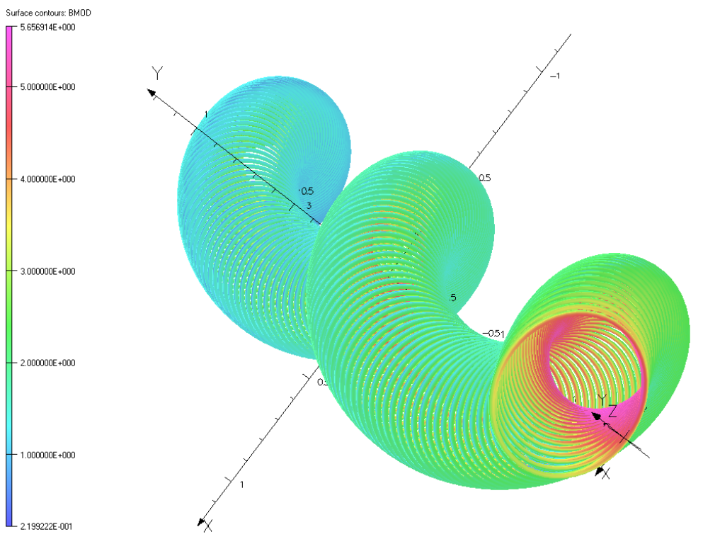
Helical Solenoid
Helical Solenoid geometry and flux density for the Helical Solenoid magnet

Slide 8
Straight (not helical) Solenoid
B_{z}=B₀, B_{x}=B_{y}=0
Dispersion= 0
XY-plane

Slide 9
Helical Solenoid
Derbenev, Johnson, Phys.Rev.ST Accel.Beams 8, 041002 (2005)
Dispersion= const
Orbit is constrained by a ring (adiabatic case)
Periodic orbit is a circle for a particular choice of initial conditions(non-adiabatic case)
XY-plane

Slide 10
Our Proposal:
Epicyclic Helical Solenoid
Superimposed transverse magnetic fields with two spatial periods
Variable dispersion function
XY-plane
k₁=-2k₂
B₁=2B₂
_{EXAMPLE}

Slide 11
Epicyclic Helical Solenoid (cont.)
Wave numbers k₁,k₂ may be opposite-sign or same-sign
Beam contained (in the adiabatic limit) by
  Epitrochoid (same sign) - planet’s trajectory in Ptolemy’s system
  Hypotrochoid (opposite-sign)- special case is an ellipse
k₁=2k₂
B₁=2B₂
k₁=-2k₂
B₁=2B₂
k₁=-k₂
B₁=2B₂

Slide 12
Particle Trajectory in Solenoid
+Double-Periodic Transverse Field
In the adiabatic limit k₁=-k₂<<k_{c} transverse-plane trajectory is bound by an ellipse

Slide 13

Periodic Orbits in EHS
,
.
Equation of motion
b₁, b₂ - transverse helical fields with spatial periods described by wave-number parameters k₁ and k₂,
Cyclotron wave number
Approximation p_{z}=const gives analytic solution for eqs. of motion
.

Slide 14
Oscillating Dispersion
.
The dispersion function for such an orbit is a superposition of two oscillating terms,
The dispersion function has nodes if
For example, k₁=-k₂=k_{c}/2, then B₂=9B₁ , solution for the orbit is
Dispersion function is periodic and sign-changing
Numerical analysis with Mathematica (with no p_{z}=const approximation) gives close results

Slide 15
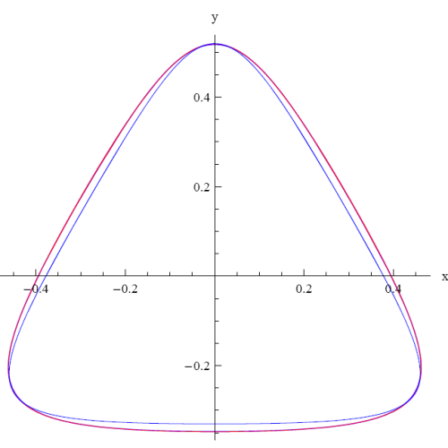
Transverse-plane Trajectory in EHS
B₁≠0, B₂=0 (HS) → B₁≠0, B₂≠0 (Epicyclic HS)
p→p+Δp
k₁=-k₂=k_{c}/2 k₁=-k₂/2=k_{c}/4
Change of momentum from nominal shows regions of zero dispersion
and maximum dispersion
Zero dispersion points: Locations of plates for ionization cooling
Maximum dispersion: Correction for aberrations

Slide 16
Periodic orbit in Epicyclic HS
HS
Epicyclic HS
Conditions for the periodic orbit need to be satisfied
-Derbenev, Johnson, PRST (2005)
Numerical analysis (using Mathematica for tracking):
Transverse-plane periodic orbit is elliptic at low kappa (~0.1-0.2),
but deviates from ellipse at large kappa (>1)

Slide 17
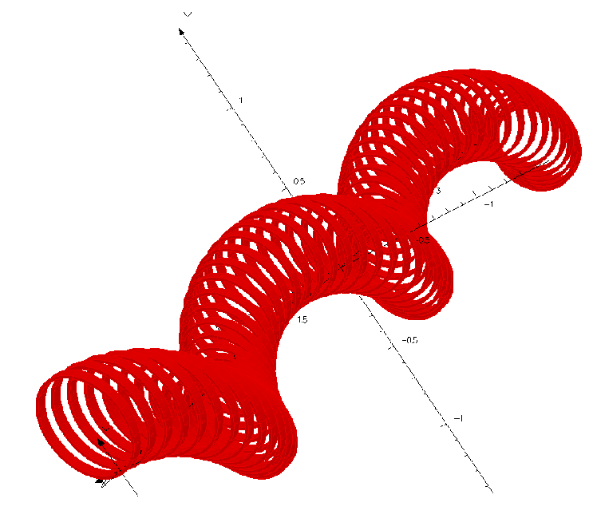
Designing Epicyclic Helical Channel
Solenoid+direct superposition of transverse helical fields, each having a selected spatial period
Or modify procedure by V. Kashikhin and collaborators for single- periodic HCC [V. Kashikhin et al., Design Studies of Magnet Systems for Muon Helical Cooling Channels, ID: 3138 - WEPD015, EPAC08 Proceedings
  Magnetic field provided by a sequence of
  parallel circular current loops with centers
  located on a helix
    (Epicyclic) modification:
    Circular current loops are centered
    along the epitrochoids or hypotrochoids.
    The simplest case will be an ellipse (in transverse plane)
Detailed simulations are needed

Slide 18
Implementing in PIC
Plan to develop an epicyclic helical solenoid as part of PIC cooling scheme and Reverse-Emittance Exchange
Elliptic option looks the simplest
Detailed theory, numerical analysis and simulations are in progress
  V. Ivanov, G4BL simulations
  +Muons, Inc collaborators

