Slide 1

Muon Collider Design Workshop
December 12, 2008
Cooling Simulations and Experiments
Summary
Kevin Beard, Muons, Inc

Slide 2
Big View of Muon Cooling….

Slide 3
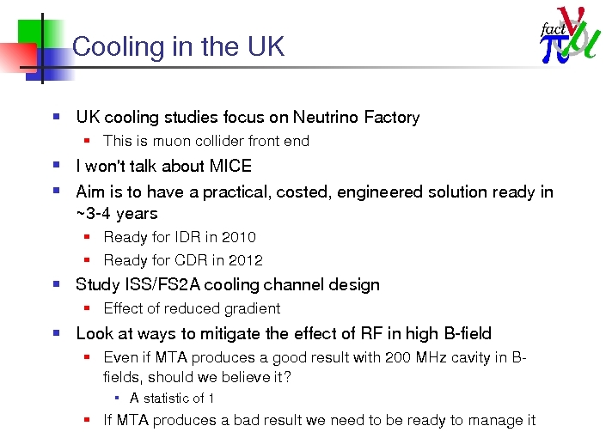
Chris Rogers’ Overview of Cooling Studies in the UK

Slide 4
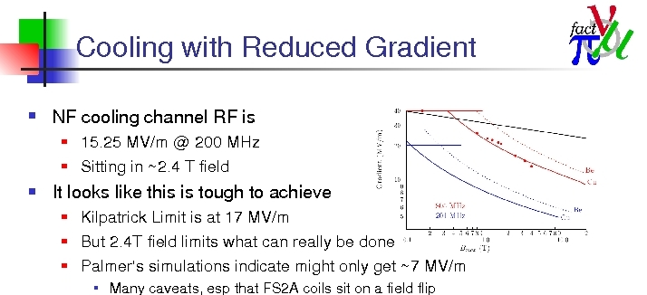
Chris Rogers’ Overview of Cooling Studies in the UK

Slide 5
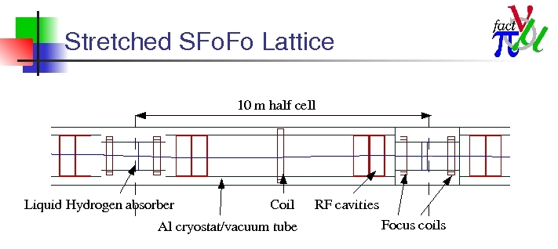
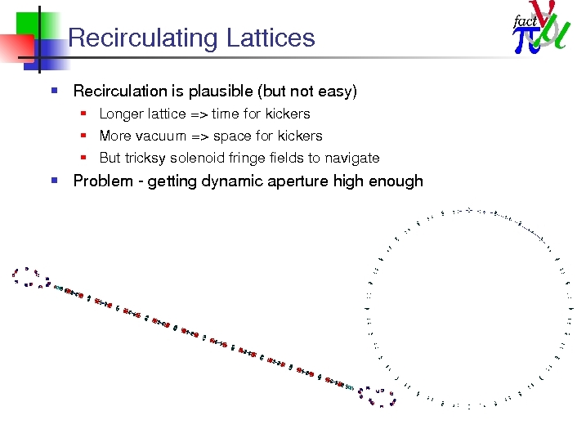
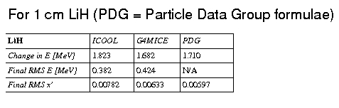
Chris Rogers’ Overview of Cooling Studies in the UK

Slide 6
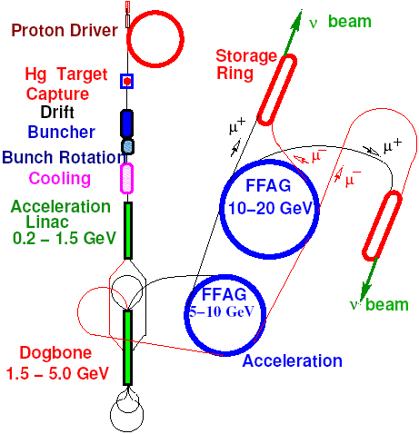
Dave Neuffer’s
Front End Capture/Phase Rotation & Cooling Studies
ν-Factory Front end
Capture and Φ-E rotation
  High Frequency buncher/rotation
    Study 2B ν-Factory
Shorter version
  ν-Factory→μ+-μ- Collider

Slide 7
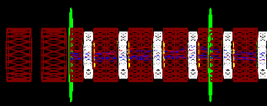
MC Front End Layout in G4beamline
12.9 m
43.5 m
31.5 m
36 m
capture
drift
buncher
rotator
50 cm 201.25 MHz RF cavity
75 cm cell
1 cm LiH
23 cm vacuum
Rotator 36 m long
“Cool and Match” 3 m (4x75 cm cells)
“Cool” 90 m of 75 cm cells

Slide 8
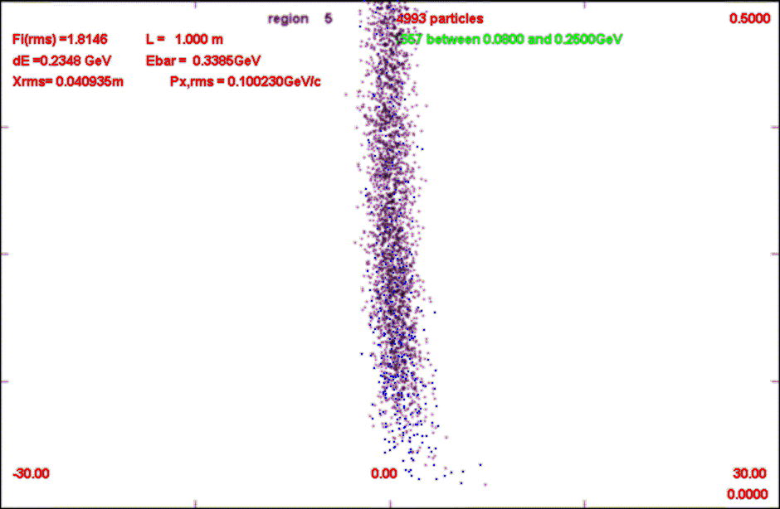
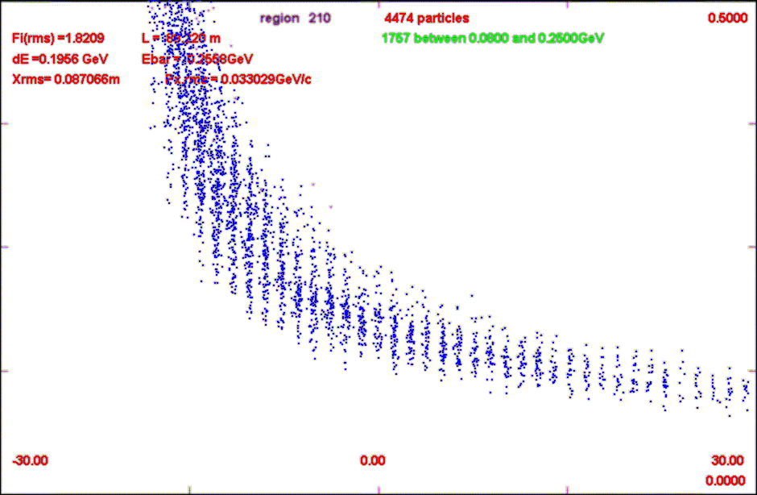
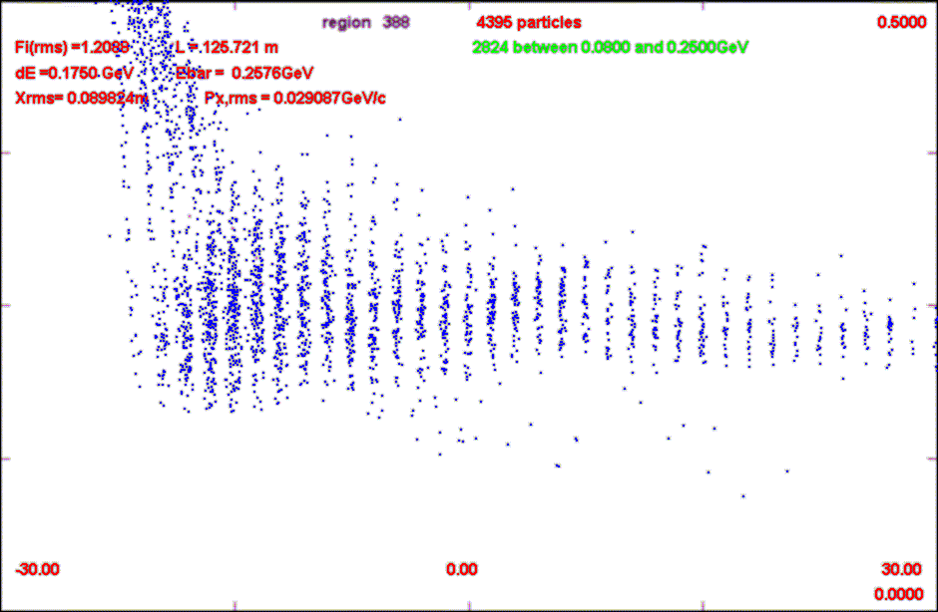
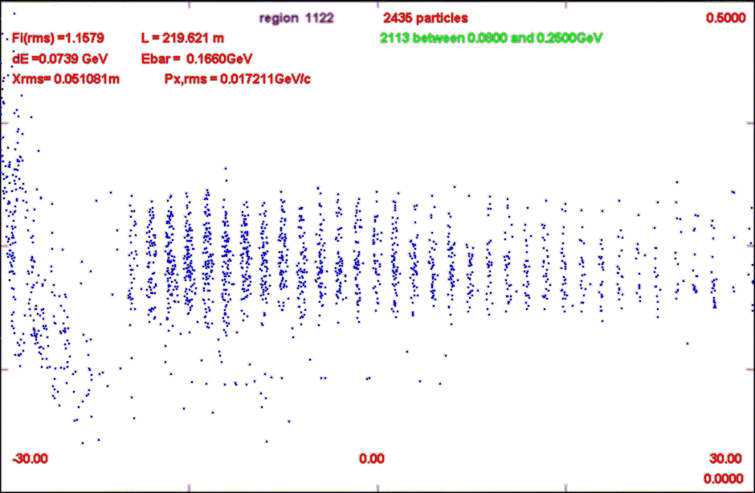
Simulations (N_{B}=10)
Dave Neuffer’s Front End Capture/Phase Rotation & Cooling Studies
s = 1m
s = 89m
Drift and
Bunch
Rotate
500 MeV/c
s = 125m
s = 219m
Cool
0
-30m
30m

Slide 9
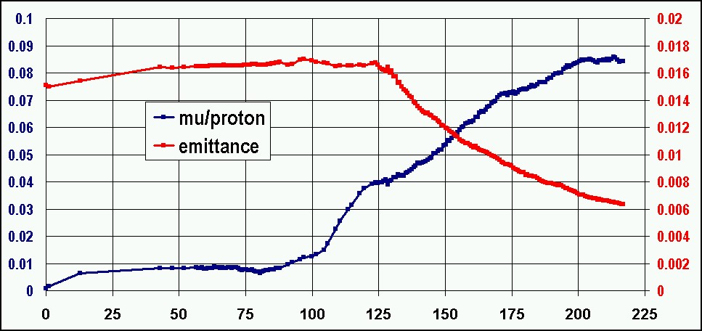
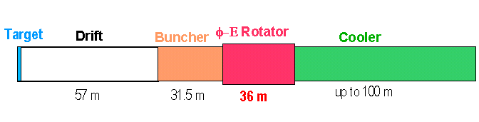
Front end simulations
Dave Neuffer’s Front End Capture/Phase Rotation & Cooling Studies
Initial beam is 8GeV protons, 1ns bunch length

Slide 10
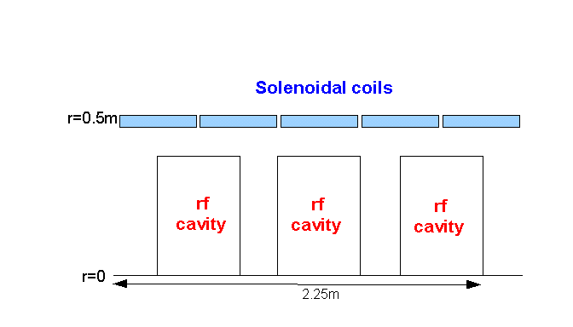
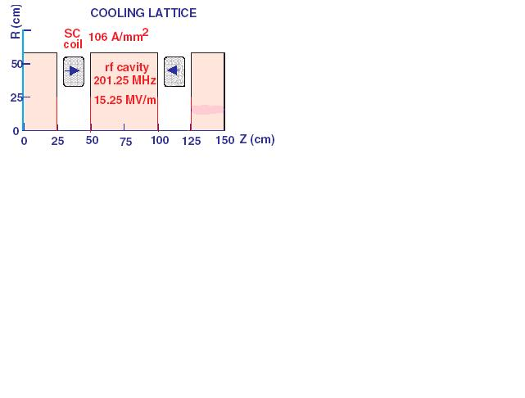
Variations - focusing
Dave Neuffer’s Front End Capture/Phase Rotation & Cooling Studies
Buncher and Rotator have rf within 2T fields
  Field too strong for rf field ??
  Axial field within “pill-box” cavities
Solutions ??
  Open-cell cavities ??
  “magnetically insulated” cavities
    Alternating Solenoid lattice is approximately magnetically insulated
    Use ASOL throughout buncher/rotator/cooler
  Use gas-filled rf cavities
ASOL lattice

Slide 11
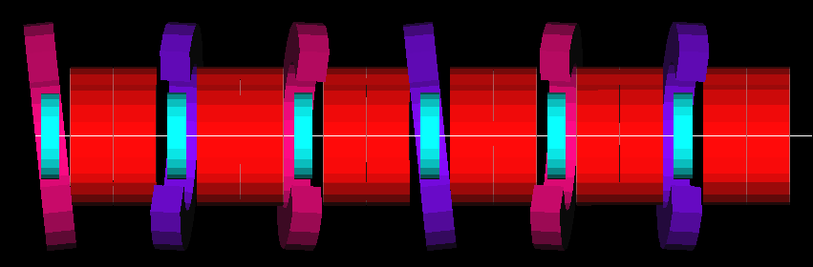
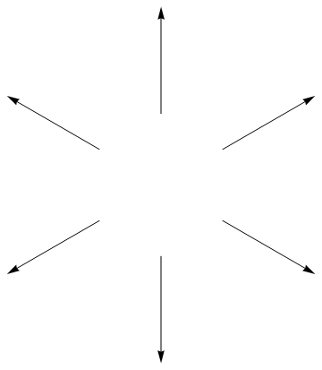
Yuri Alexahin’s Helical FOFO Snake Simulations
3
Create rotating B⊥ field by tilting (or displacing) solenoids in rotating planes
x*cos(φ_{k})+y*sin(φ_{k})=0, k=1,2,…
Example for 6-cell period:
Solenoid # 1 2 3 4 5 6
Polarity + - + - + -
Roll angle φ_{k} 0 2π/3 4 π/3 0 2 π/3 4 π/3
B⊥
1
2
6
3
5
Channel parameters:
200 MHz pillbox RF 2x36cm, Emax=16MV/m
Solenoids: L=24cm, Rin=60cm, Rout=92cm,
Absorbers: LH2, total width (on-axis) 6x15cm,
Total length of 6-cell period 6.12m
4
MCTF Scenario Update - Y. Alexahin 2nd MCD workshop, JLab, December 10, 2008

Slide 12
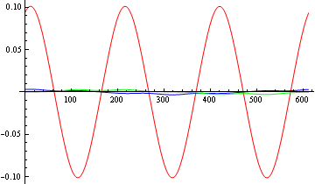
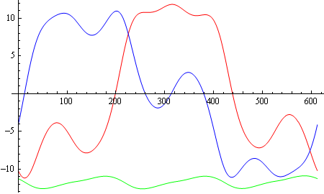
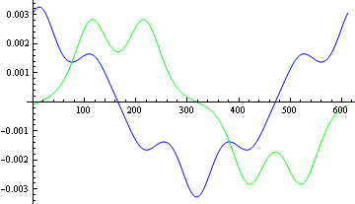
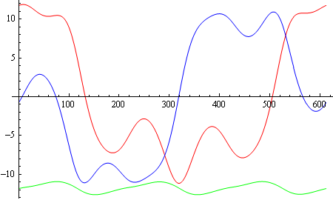
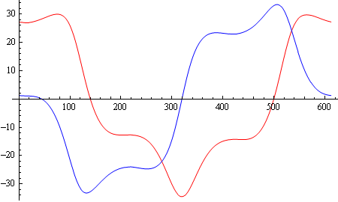
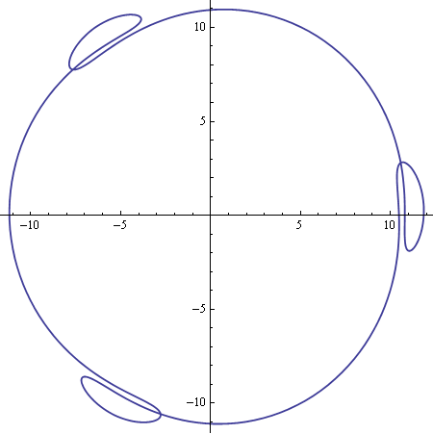
Helical orbits
4
20mrad pitch angle, BLS=25.2 for p=200MeV/c
y
x
Bz/BLS
μ+
z
z
z-v0*t
Bx/ BLS
x
y
μ-
z
z
By /BLS
z-v0*t
y
Dx
Dy
μ-
μ-
z
μ+
x
Helical FOFO snake – good for cooling both μ+ and μ-!
MCTF Scenario Update - Y. Alexahin 2nd MCD workshop, JLab, December 10, 2008

Slide 13
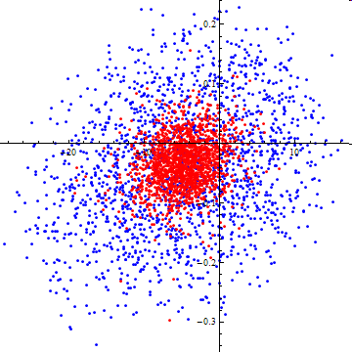
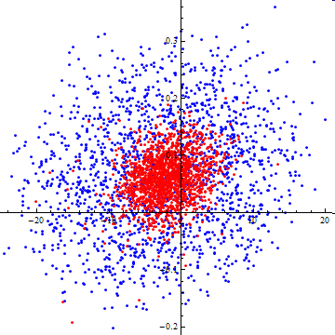
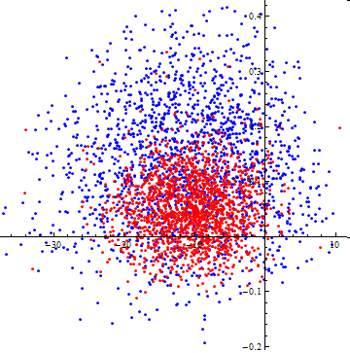
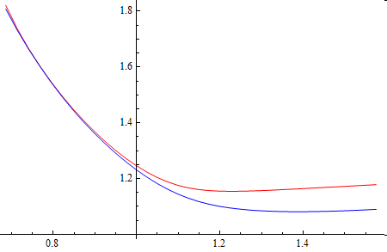
Phase space distributions
6
px
py
δp
blue - initial, red - final
x
y
z-v0*t
“Emittances” (cm) initial final
6D 10.3 0.07
Trans. average 1.99 0.29
Longitudinal 3.75 1.46
Why momentum acceptance is so large (>60%) in the resonance case?
Nice surprise:
Large 2nd order chromaticity due to nonlinear field components keeps both tunes from crossing the integer !
MCTF Scenario Update - Y. Alexahin 2nd MCD workshop, JLab, December 10, 2008

Slide 14
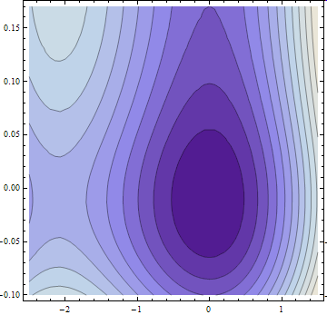
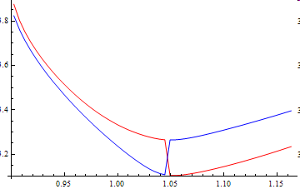
Helical snake for final 6D cooling
10
By increasing B-field strength it is possible to get phase advance >180°/cell and small β-function at the solenoid center ⇒ much smaller emittance.
Tune/period > odd_integer for resonant orbit excitation
Puzzle:
2-cell period (planar snake), Q>1
6-cell period, Q>3
4-cell period, Q>3
6-cell period, Q>5
α_{p} < 0
α_{p} > 0
QI
QII
p/100
Longitudinal acceptance limited by nonlinearity, not by insufficient RF bucket height
MCTF Scenario Update - Y. Alexahin 2nd MCD workshop, JLab, December 10, 2008

Slide 15
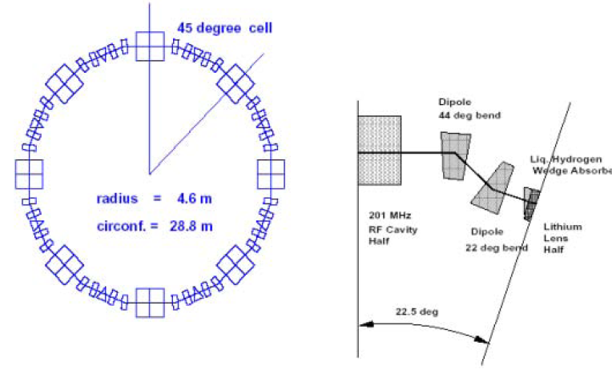
David Cline’s Study of Ring Coolers for μ+ μ- Colliders
Dispersion big,
Beta small

Slide 16
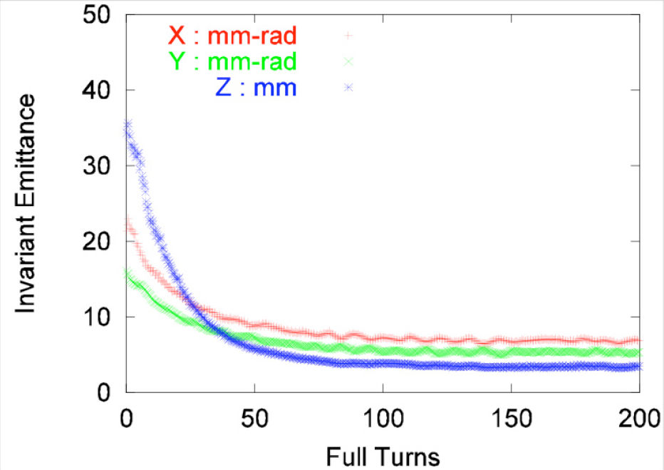
David Cline’s Study of Ring Coolers for μ+ μ- Colliders

Slide 17
David Cline’s Study of Ring Coolers for μ+ μ- Colliders

Slide 18
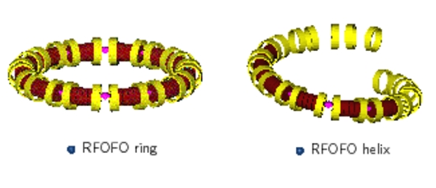
Pavel Snovak’s Recent Progress on Guggenheim Simulations
liquid H₂
solenoids
RF

Slide 19
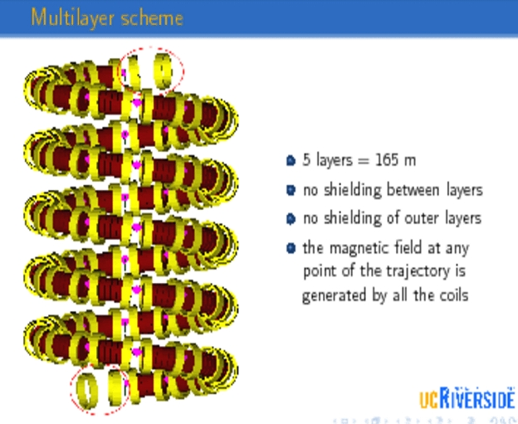
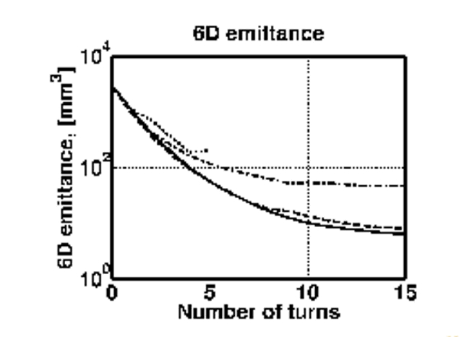
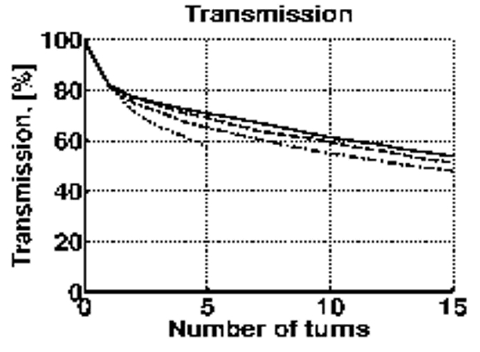
Pavel Snovak’s Recent Progress on Guggenheim Simulations

Slide 20
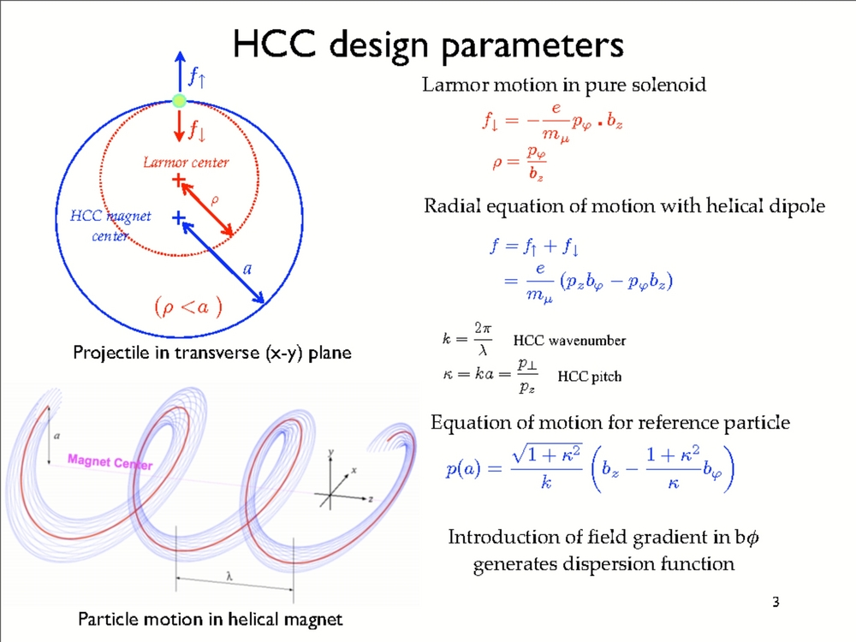
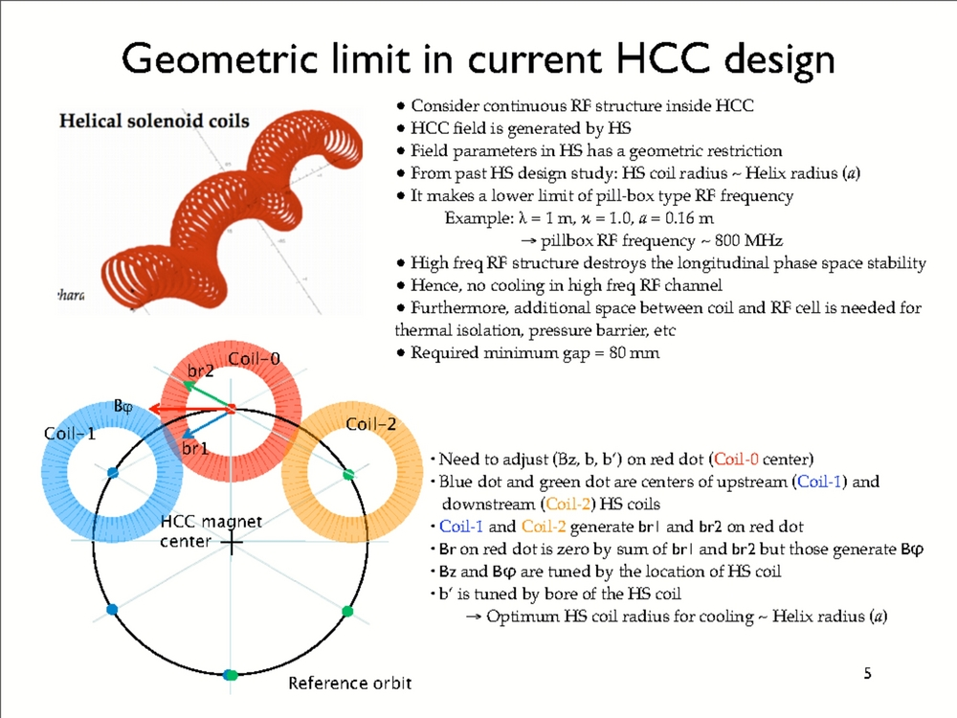
Katsuya Yonehara’s
Recent Progress in Design of Helical Cooling Channel

Slide 21
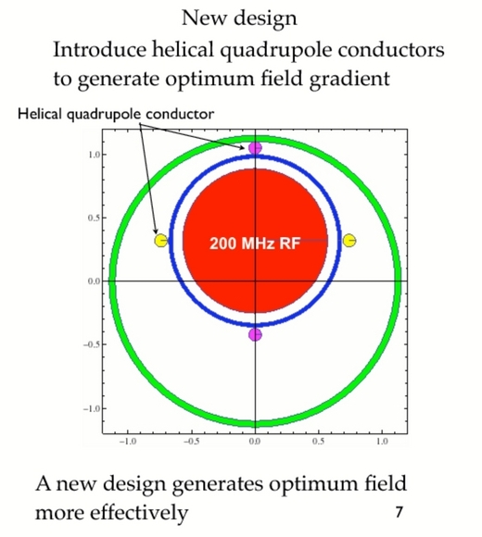
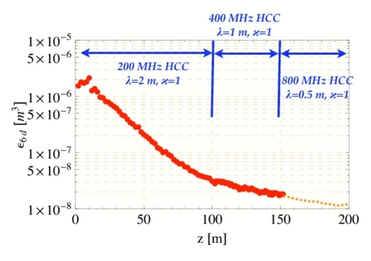
Katsuya Yonehara’s
Recent Progress in Design of Helical Cooling Channel

Slide 22
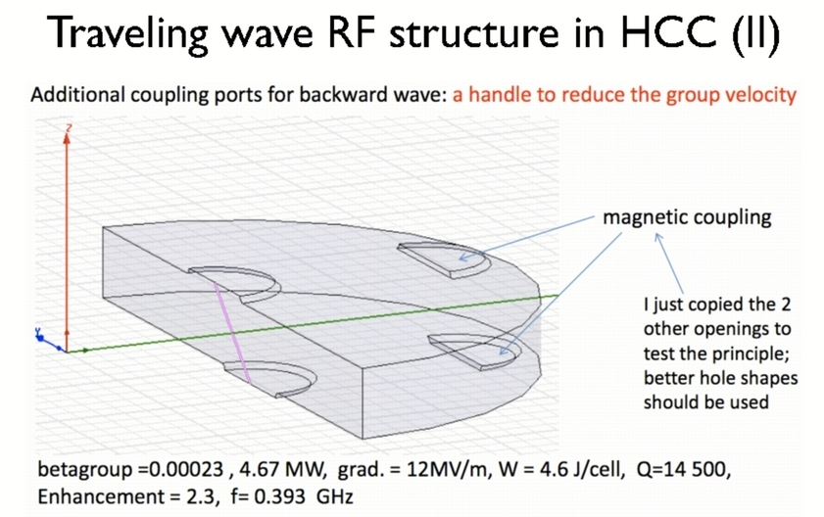
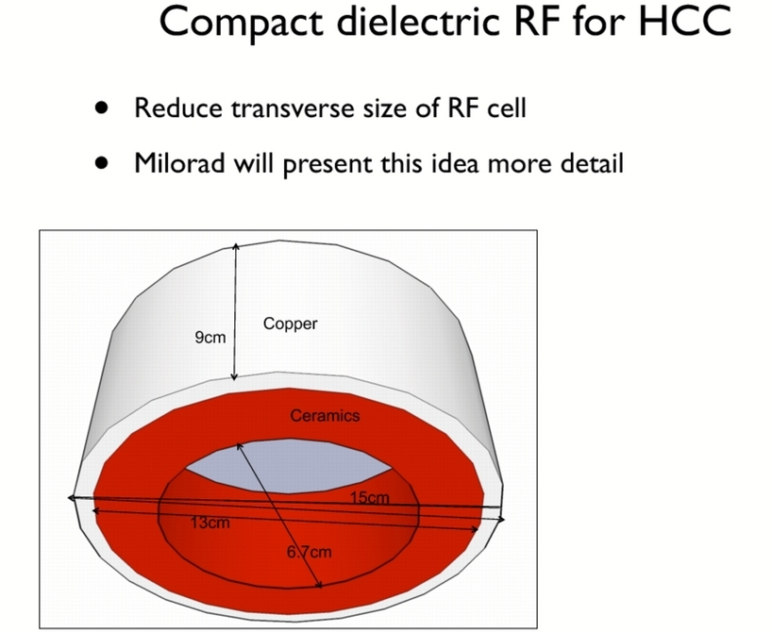
Katsuya Yonehara’s
Recent Progress in Design of Helical Cooling Channel

Slide 23
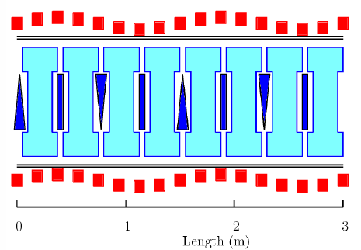
Valeri Balbekov’s HCC simulation with wedge absorbers
B. Palmer: Low κ helix cooling (08/26/08)
helical solenoid channel (HSC)

Slide 24
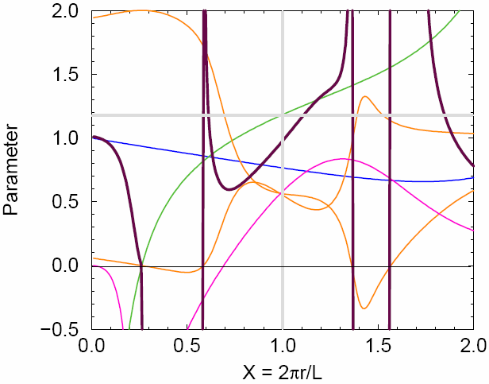
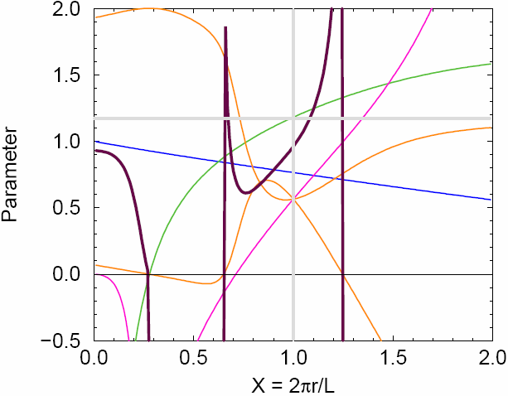
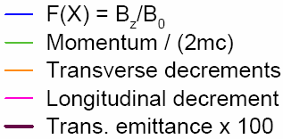
V.Balbekov, 12/09/08
Example 1: HCC (Yonehara design)
F’ = -0.2545, F” = 0.0777, F”’=0,…
Example 2: HSC
R_{coil} /L = 0.2733, B_{as}/B_{hs}=-0.283
In both cases: homogeneous H₂ absorber,
LB_{sol} = 6.97 T-m to get P_{refer} = 250 MeV/c at X_{refer}(=κ) = 1
(unite length is L/2π)
Normalization of the decrements: D_{t1}+D_{t2}+D_{l} = 2β²
!!! No stability at X < ~0.60 -- 0.65 !!!
4

Slide 25
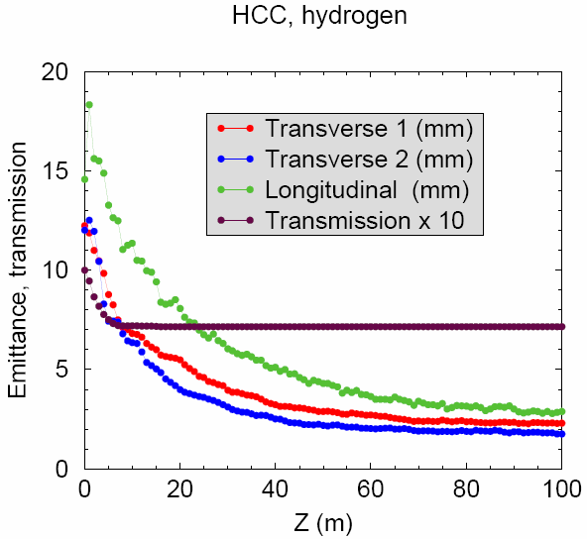
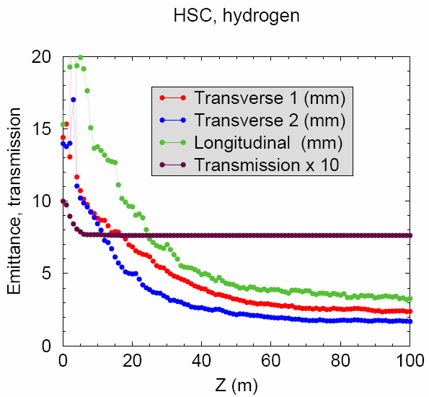
V.Balbekov, 12/09/08
Cooling simulation
at ionization energy loss 14.7 MeV/m, RF 200 MHz, 29.4 MV/m
Example 1: HCC
Example 2: HSC
The results are very similar:
Transverse emittances are about 2 mm ≈ L/500, longitudinal one ~3 mm ≈ L/300.
Transmission 72% - 76 % at 200 MHz, but falls at higher frequency (reasonable requirement λ >~L ).
5

Slide 26
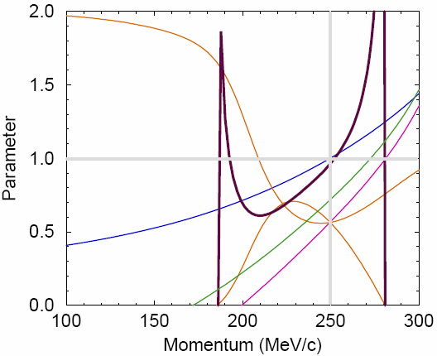
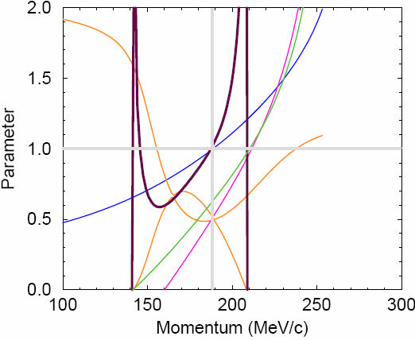
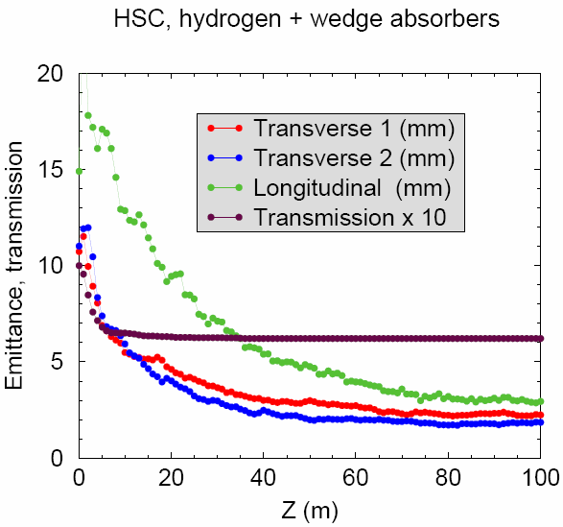
V.Balbekov, 12/09/08
Example 2: HSC without/with wedge absorber
W/o wedge
Antisol/Sol -0.2733=>-0.283 Rcoil/L = 0.2733 2πR_{helix}/L = 1
W = 0 => 0.07 L = 1 m B_{sol} = 6.98 => 5.24 T X_{refer} (=κ) = 1 P_{refer} = 250 => 189 MeV/c, E’_{refer} = 14.7 MeV/m (wedge absorber – 7%) RF 200 MHz, 29.4 MV/m
With wedge
9

Slide 27


V.Balbekov, 12/09/08
Lower momentum HCC with wedge absorber
Parameters Cooling simulation
F’ = -0.196
F” = 0...
W = 0.57
L = 1 m
B_{sol} = 5.23 T
FX_{refer} (=κ) = 0.62,
P_{refer} = 159 MeV/c,
F = 50 MHz
V’ = 29.4 MV/m
E’_{refer} = 14.7 MeV/m
Longitudinal ph. space Parameters vs momentum
HCC or HSC with small transverse field and small pitch-factor (kappa) are unsuitable for 6D cooling, both with and without wedge absorbers.
Blue – longitudinal phase trajectory at betatron oscillations
12

Slide 28

Andrei Afanasev’s
Epicyclic Helical Channels for Parametric-resonance Ionization Cooling
PIC Concept
Ordinary oscilations vs Parametric resonance
Absorber plates
Parametric resonance lenses
Helical Solenoid

Slide 29
Our Proposal:
Epicyclic Helical Solenoid
Superimposed transverse magnetic fields with two spatial periods
Variable dispersion function
XY-plane
k₁=-2k₂
B₁=2B₂
_{EXAMPLE}

Slide 30

Transverse-plane Trajectory in EHS
B₁≠0, B₂=0 (HS) → B₁≠0, B₂≠0 (Epicyclic HS)
p→p+Δp
k₁=-k₂=k_{c}/2 k₁=-k₂/2=k_{c}/4
Change of momentum from nominal shows regions of zero dispersion
and maximum dispersion
Zero dispersion points: Locations of plates for ionization cooling
Maximum dispersion: Correction for aberrations

Slide 31

Designing Epicyclic Helical Channel
Solenoid+direct superposition of transverse helical fields, each having a selected spatial period
Or modify procedure by V. Kashikhin and collaborators for single- periodic HCC [V. Kashikhin et al., Design Studies of Magnet Systems for Muon Helical Cooling Channels, ID: 3138 - WEPD015, EPAC08 Proceedings
Magnetic field provided by a sequence of
  parallel circular current loops with centers
  located on a helix
    (Epicyclic) modification:
    Circular current loops are centered
    along the epitrochoids or hypotrochoids.
    The simplest case will be an ellipse (in transverse plane)
Detailed simulations are needed

Slide 32
Terry Hart’s Simulations of Muon Cooling With an Inverse Cyclotron
R. Palmer’s ICOOL model
θ₂
r₂
θ₁
r₁
1st G4beamline model
r_{max}
r_{ave}
r_{min}
B_{z} = 2 T
B_{z} = -0.5 T

Slide 33

Kevin Paul’s Inverse Cyclotrons for Intense Muon Beams – Phase I
VORPAL Results – 3D Simulations

Slide 34

Ejection from the Trap
Kevin Paul’s Inverse Cyclotrons for Intense Muon Beams – Phase I
B₀
z
Flip the voltage of the upper end-cap to -V
Ramp the voltage of the ring electrode to 0
Assume this takes a total time of 100 ns
This produces ~0.1 G magnetic fields, which are ignored in the simulation
Particles measured at z = ~16 cm
-V
r
0
E
+V

Slide 35




Kevin Paul’s Inverse Cyclotrons for Intense Muon Beams – Phase I
Normalized Emittance after Ejection:
  1D Transverse Emittance: 380 mm-mrad
  Longitudinal Emittance: 1.6 mm-mrad

Slide 36



David Cline’s Study of Ring Coolers for μ+ μ- Colliders

Slide 37



Kevin Lee’s Lithium Lens for Muon Final Cooling
Beam Profiles in 10 T, 2 cm x 15 cm Li Lens

Slide 38

Frictional Cooling
Tom Robert’s The Particle Refrigerator
Operates at β ~ 0.01 in a region where the energy loss increases with β, so the channel has an equilibrium β.
In this regime, gas will break down – use many very thin carbon foils.
Hopefully the solid foils will trap enough of the ionization electrons in the material to prevent a shower and subsequent breakdown.
Experiments on frictional cooling of muons have been
performed with 10 foils (25 nm each).
Frictional
Cooling
Ionization
Cooling

Slide 39

Tom Robert’s The Particle Refrigerator
10 m
Solenoid
1,400 thin carbon foils (25 nm), separated by 0.5 cm and 2.4 kV.
μ⁻ climb the potential, turn around, and come back out via the frictional channel.
μ⁻ In
(3-7 MeV)
…
20
cm
μ⁻ Out
(6 keV)
Gnd
Resistor Divider
-5.5 MV
HV Insulation
First foil is at -2 MV, so outgoing μ⁻ exit with
2 MeV kinetic energy.
Solenoid maintains transverse focusing.
Device is cylindrically symmetric (except divider); diagram is not to scale.
Remember that 1/e transverse cooling occurs by losing and
re-gaining the particle energy. That occurs every 2 or 3 foils
in the frictional channel.

Slide 40


Why a Muon Refrigerator is so Interesting!
Difference is just input beam emittance
Refrigerator
Transmission=12%
Refrigerator
Transmission=6%
“Lost” muons
at higher energy
G4beamline simulations,
ecalc9 emittances.
(Same scale)

Slide 41
Bob Abrams’ The MANX Proposal
DRAFT MANX following MICE at RAL DRAFT
Robert Abrams¹, Mohammad Alsharo’a¹, Charles Ankenbrandt¹, Emanuela Barzi²,
Kevin Beard¹, Alex Bogacz³, Daniel Broemmelsiek², Yu-Chiu Chao³,
Mary Anne Cummings¹, Yaroslav Derbenev³, Henry Frisch⁴, Ivan Gonin²,
Gail Hanson⁵, David Hedin⁷, Martin Hu²,
Rolland Johnson¹, Stephen Kahn¹, Daniel Kaplan⁶,
Vladimir Kashikhin², Moyses Kuchnir¹, Michael Lamm², Valeri Lebedev²,
David Neuffer², Milord Popovic², Robert Rimmer³, Thomas Roberts¹, Richard Sah¹,
Linda Spentzouris⁶, Alvin Tollestrup², Daniele Turrioni², Victor Yarba²,
Katsuya Yonehara², Cary Yoshikawa², Alexander Zlobin²
¹Muons, Inc.
²Fermi National Accelerator Laboratory
³Thomas Jefferson National Accelerator Facility
⁴University of Chicago
⁵University of California at Riverside
⁶Illinois Institute of Technology
⁷Northern Illinois University
Muons, Inc. is largely responsible for the current draft.
We need to build a larger collaboration

Slide 42

MICE Phases + MANX
MANX in MICE (Conceptual)
MANX w/Matching
Off-Axis MANX

Slide 43
Trackers Inside HCC
Cryostat Vessel
Detectors
Coils
Signals out
Power in
Active area, fibers
MPPCs
Power in
Signals out
Electronics
Feedthroughs
Support/mounting frame
Scintillating fiber planes
Similar to MICE spectrometer.
Use MPPCs(SiPMs) and onboard readout electronics
Consider 4 trackers (x, u, v(?) per set
and possibly 2 more outside.
Purpose: Verify trajectories inside HCC
- Helps in commissioning
- Provides measure of track quality, losses within HCC
Bob Abrams and Vishnu Zutshhi (NIU) have an SBIR proposal on this topic.

Slide 44
MANX Objectives
Measure 6D cooling in a channel long enough for significant reduction of emittance
Study the evolution of the emittance along the channel by making measurements inside the channel as well as before and after
Test the Derbenev-Johnson theory of the HCC
Advance muon cooling technology
Much discussion!

Slide 45




Chris Roger’s Further Cooling Experiments

Slide 46


Katsuya Yonehara’s Study high pressure hydrogen gas filled RF cell

Slide 47



Katsuya Yonehara’s Study high pressure hydrogen gas filled RF cell

