Slide 1
Summary of MuCool/MTA RF workshop
Jansson
The workshop was organized by A. Bross and Y. Torun, both of whom are in currently China, and thus unable to give a report.

Slide 2
Goals
Brief Review of Status
Examination of RF Breakdown Theory
Exploration of possible new RF R&D that we should pursue in the next 1-2 years
Produce a document outlining our desired R&D program and identifying our priorities for the next year

Slide 3
Agenda
http://mice.iit.edu/mta/mtarf3/
Room: Comitium (Wilson Hall 2SE)
08:30-08:40 | Intro | Alan Bross
08:40-09:00 | 201 Data Review | Al Moretti
09:00-09:20 | HP Test Cell Results | Katsuya Yonehara
09:20-09:40 | MTA Status | Yagmur Torun
09:40-10:00 | RF Breakdown Theory I | Jim Norem
10:00-10:30 | Break
10:30-11:00 | RF Breakdown Theory II | Bob Palmer
11:00-11:20 | RF Breakdown Theory III | Alvin Tollestrup
11:20-11:50 | Discussion | All
11:50-12:30 | Multipacting Simulation of the 805 button cavity | Chet Nieter
12:30-12:50 | Electron Motion in a RF Cavity with external Magnetic Fields | Ditkys Stratakis
12:50-13:40 | Lunch
13:40-14:00 | Refurb on 805 Button Cavity | Bob Rimmer
14:00-14:20 | Test Plan with Button Cavity | Arash Zarrebini-esfahani
14:20-14:50 | New 805 MHz Cavity Design Concept | Derun Li/Bob Rimmer
14:50-15:10 | Tests of Magnetic Insulation Concept | Bob Palmer
15:10-15:40 | ALD Test Plans | Jim Norem
15:40-16:10 | Break
16:10-16:40 | MICE RFCC Status | Mike Zisman
16:40-17:10 | 201 Test Program in MTA | Moretti/Li
17:10-17:30 | Summary and Outlook | Ralph Pasquinelli
17:30-18:20 | Discussion and Action Items | All
19:30 | Dinner at Mapo (cash bar)

Slide 4
Official conclusions
The list below contains the consensus reached at the recent workshop for the proposed new R&D priorities for FY09. We feel that all these tasks are of high priority but the ordering shown here comes from weighting their priorities by cost in order to indicate the tasks we have a reasonable chance of accomplishing in FY09:
Fabricate a true pill-box cavity that can be tested in the Lab G magnet with E parallel and E perpendicular to B. Depending on the cost, multiple bodies will be fabricated. A basic design exists. The design will be reviewed by an external reviewer and then fabrication drawings will be produced. Questions regarding what processing should be done on this cavity still need to be resolved.
Begin a detailed design of an 805 MHz model of the 201 MHz prototype. The initial test cavities will be windowless, however. Again, depending on cost, multiple bodies will be fabricated. The cavity design must allow for operation in the Lab G magnet with E parallel and E perpendicular to B.
Continue refurbishment of the 805 button (pillbox) cavity. A decision on whether or not to EP the cavity had not yet been made. This will have to be made in the coming few weeks. A decision on the optimum configuration for button tests (one button, two button, etc) still needs to be made. The cavity must be first tested, however, in the pillbox configuration with Be windows. It must operate at sufficiently high gradient without sparking to allow for meaningful button tests.
HP Test Cell II. A detailed design effort on a more realistic (and thinner) HP 805 MHz cavity should begin.
ALD processing of 805 MHz model of 201 MHz cavity
For all of the above: Improve instrumentation (add and use Faraday cups where appropriate, thermal imaging, etc.).

Slide 5
On-going program
These tasks are a continuation of what we have already been doing and the consensus was that we should attempt to do them in FY09:
Test the refurbished 805 cavity in the Lab G magnet (with Be windows) with coil 1 @ full current and coil 2 @ -1/2 full current.
Offset the 201 MHz cavity relative to the Lab G magnet so that higher B field can be applied to the coupler and repeat gradient v. B tests.
Operate the 201 in the field of the coupling coil (not likely to occur in FY09).
Not explicitly mentioned in the summary document, but implicitly assumed:
Do first beam tests with existing HPRF test a.s.a.p.

Slide 6
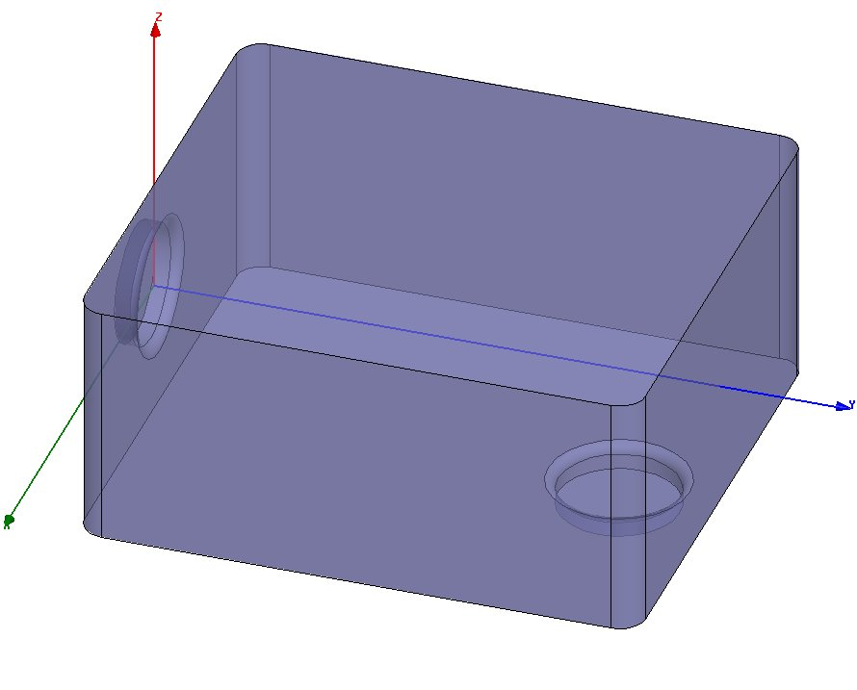
Status of simple “true” pillbox
Al Moretti proposed a square pillbox design, which has been internally reviewed.
Discussing with AD Mech Dept to get designer/drafter.
276.50 mm
250 mm
123.82 mm

Slide 7
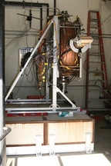
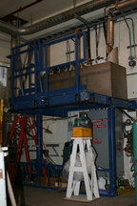
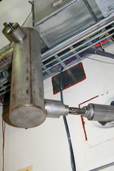
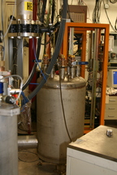
Current MTA status
Hall reconfiguration, cryo plant hookup and RF re-routing work in progress
Shielding in the pit and hatch may be put back end December
Some hall work will continue afterwards.

Slide 8
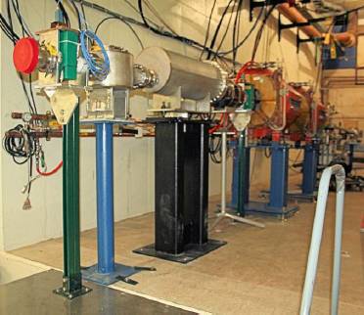
Current MTA beam status
Beam to first beamstop (11/21).
Some issues with instrumentation.
Still working on shielding analysis.
Required for beam into hall.
Expect ~3 months for approval once submitted

Slide 9
Summary
A number of crucial RF tests to be done in the next couple of years (ideally the next year).
At the 1-day RF workshop, some detail about these tests were hashed out, and a plan generated.
All high priority. Cost may determine order (at least while in CR)
NB. The RF tests discussed at this workshop are also the highest short term priorities on the 5-year R&D plan, which was recently presented to the DOE
http://apc.fnal.gov/groups2/MCCC/

