Slide 1
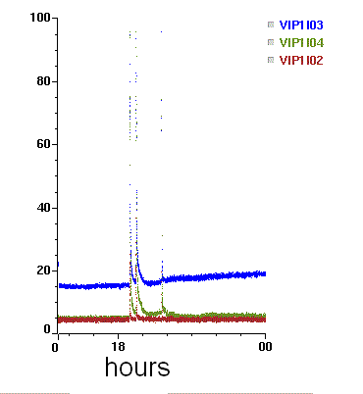
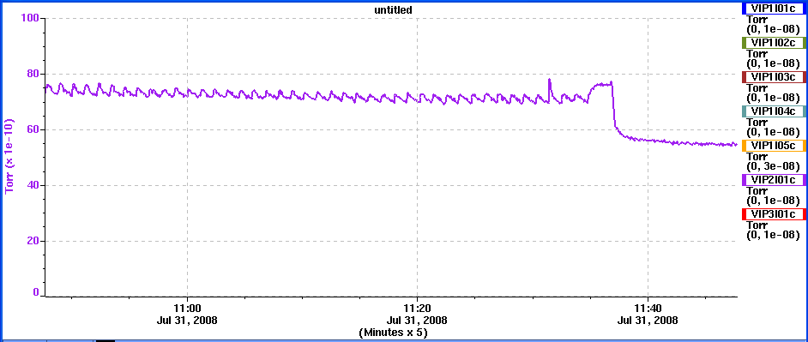
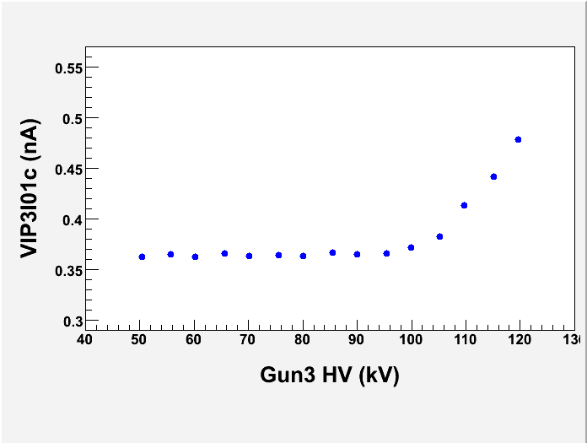
Sensitive Ion Pump Current Monitoring using an In-House Built Ion Pump Power Supply
J. Hansknecht, P. Adderley, A. Comer, M. L. Stutzman
Notice: Authored by Jefferson Science Associates, LLC under U.S. DOE Contract No. DE-AC05-06OR23177.
ABSTRACT
UHV supplies monitor ion pump current to 0.1nA, corresponding to ~10⁻¹¹ Torr
Supplies used on CEBAF injector baked beamline monitor vacuum activity associated with
Onset of field emission during gun high voltage processing
Viewer discharge events when running from unanodized photocathode with beam halo
Provide additional laboratory diagnostic for pressure in UHV systems
UHV supply current during RGA scan. Sawtooth period corresponds to RGA scan frequency.
~10⁻¹⁰ Torr
Full Scale
Discharge event in beamline
Current (10⁻¹⁰A)
RGA on and scanning
RGA off
Onset of field emission
during HV processing
Voltage dependence
Lowering voltage past threshold results in reduction in pumping, evidenced by higher extractor gauge pressure

