Slide 1
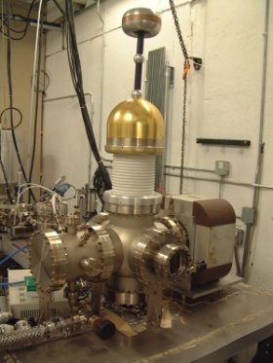
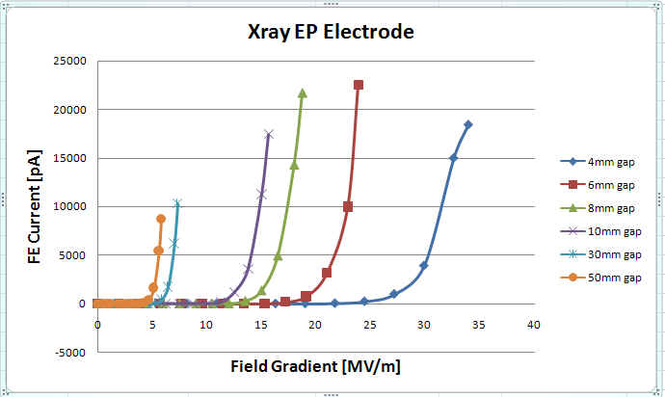
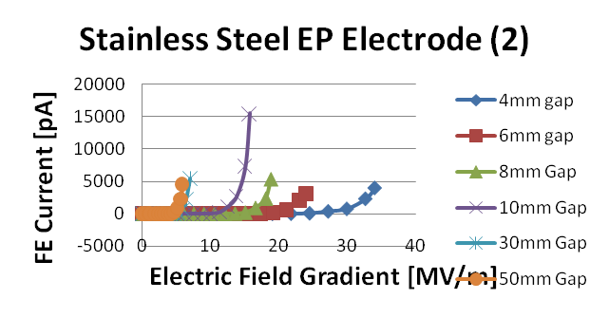
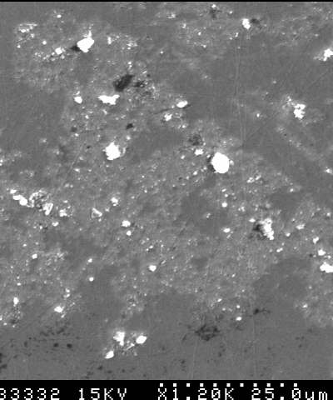
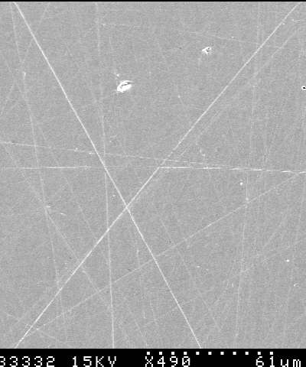
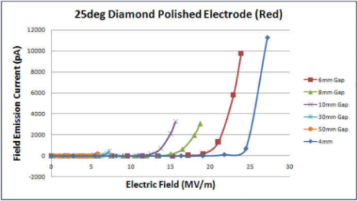
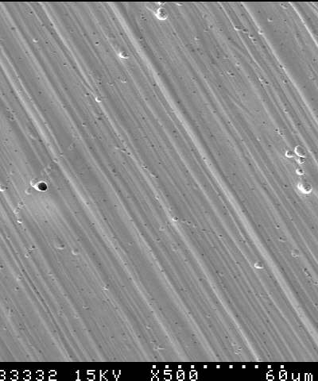
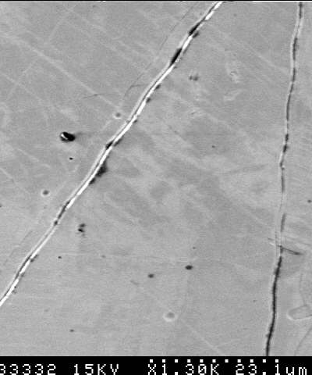
Field Emission Measurements from Cathode Electrodes Prepared Using Diamond Paste Polishing and Electro/Chemical Polishing
K. Surles-Law, M. Poelker, J. Clark, P. Adderley
Authored by Jefferson Science Associates, LLC under U.S. DOE Contract No. DE-AC05-06OR23177.
Experimental Program
Raising gun voltage from 100 to 200 keV decreases emittance and increases transmission of an electron beam, which is essential for high average current applications in a compact, high polarization gun.
Field emission from diamond-paste polished electrodes does not allow scaling of gun designs to 200 keV – field emission starts at 7 MV/m and we need field-emission free operation at 10 MV/m for a 200 keV gun.
Field emission data and SEM surface analysis for various surface preparation techniques
Diamond paste polishing
Electropolishing stainless steel and niobium
BCP niobium
High pressure water rinsing
Electrode geometry effects
Flat electrode
25⁰ Pierce electrode
Electropolished stainless steel electrode (1)
Variable Gap
High Voltage Test Stand
Results
FE depends on gap as well as gradient – can’t extrapolate 4 mm data to 50 mm gun geometry
Smoother / cleaner surface results in less field emission
Need Quality Assurance /Quality Control for electropolished /chemical etched surfaces
Awaiting results of 25 degree Pierce type, bcp single crystal niobium electrodes
DP 1200X
DP 500X
Diamond polished stainless steel electrode
EP(1) 500X
EP (2) 1300X

