Slide 1
Part of EIC’s Most Important Scientific Questions:
Sea Quarks Contribution to Nucleon Spin
Xiaodong Jiang (LANL)
EIC is a precision machine for new discoveries !
New phenomena. New Dynamics. New Structure.
EIC will allow us to unambiguously discover the non-perturbative properties of nucleon sea, for example:
Sea quark helicity, polarized sea flavor asymmetry.
Sea quark’s transverse spin (transversity).
Sea quark’s angular motion (Sivers distribution).
Spin surprises: SSA in SIDIS e+N⬆->e’+h+X, SSA in p⬆+p->h+X,
e+N⬆->h+X

Slide 2

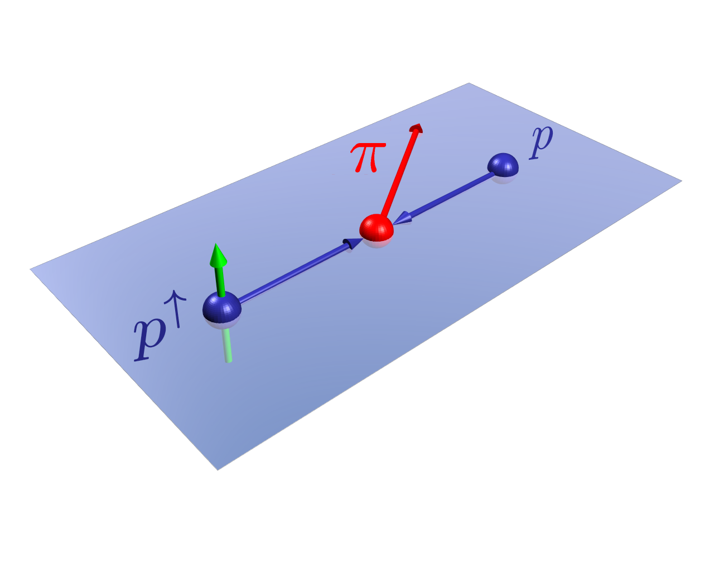
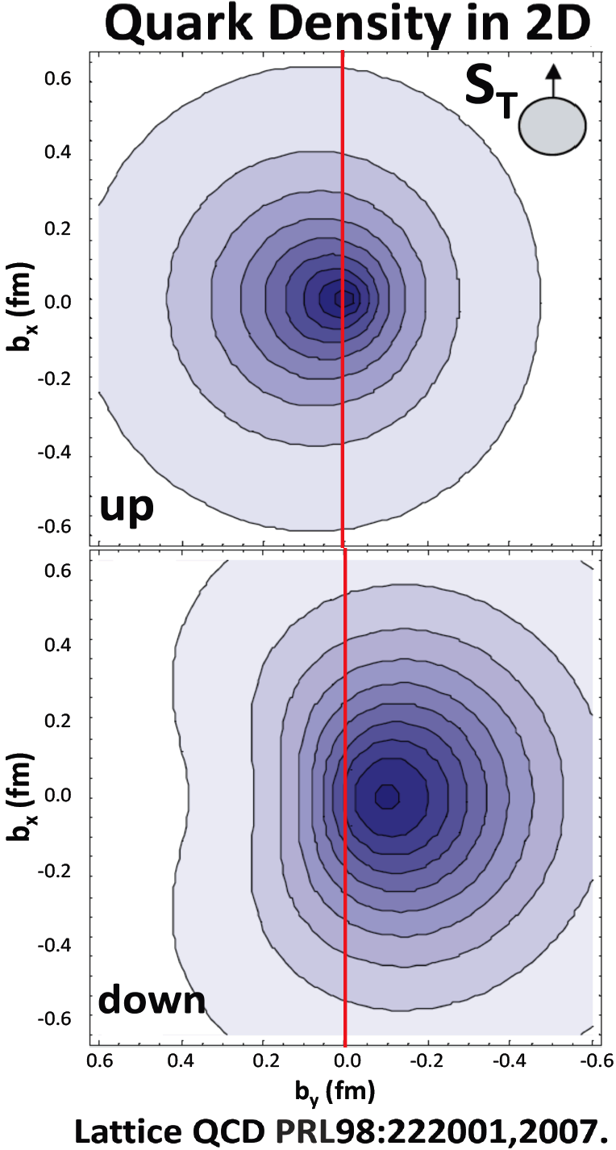
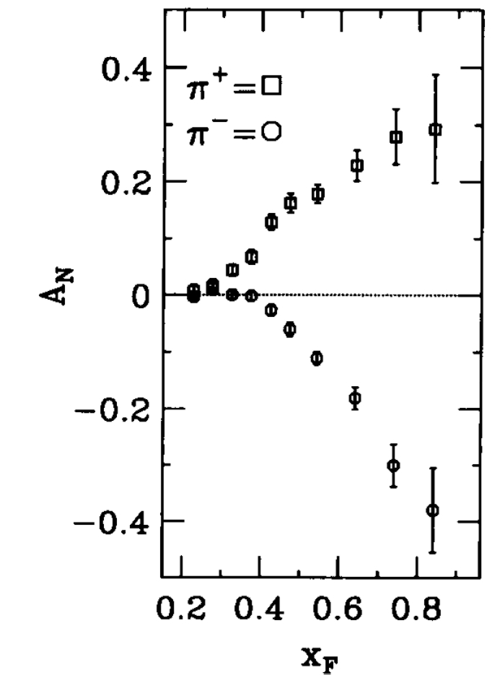
Quarks can tell left-right in
One explanation (Sivers effect): quark’s transverse motion generates a left-right bias.
FNAL-E704: PLB 264 (1991) 462.
up-quarks favor left (L_{u}>0), down-quarks favor right (L_{d}<0).

Slide 3
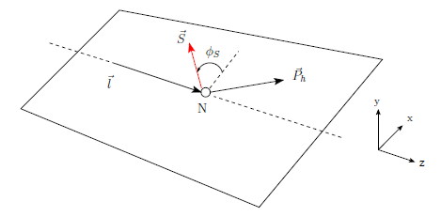

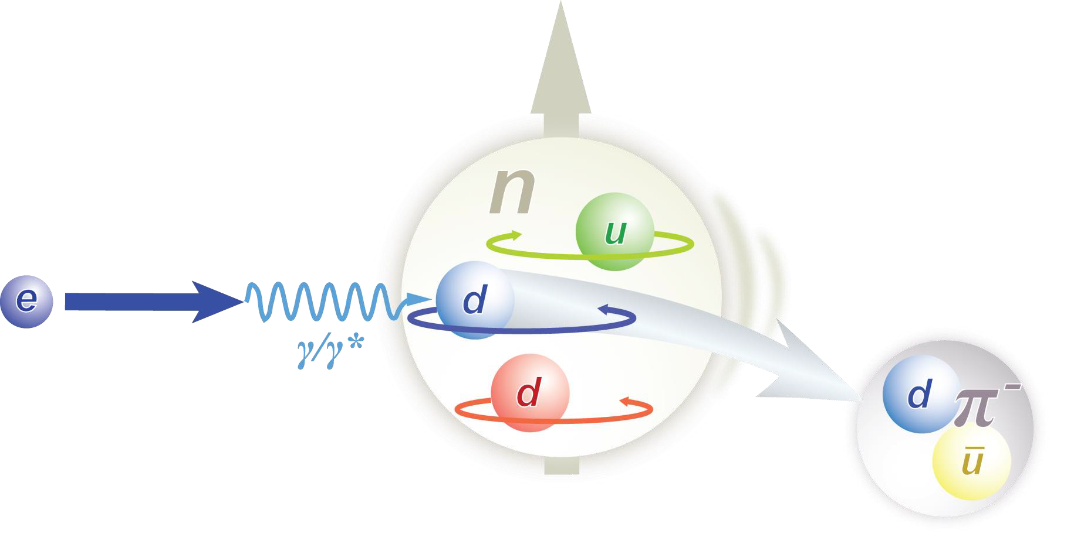
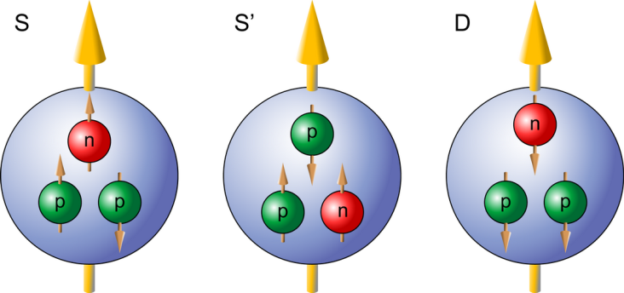
A Recent Surprise in e+N⬆->h+X
Polarized ³He as an effective polarized neutron target.
~90% ~1.5% ~8.4%

Slide 4

Consider the valence quarks’ contribution to nucleon’s anomalous magnetic moments:
Z. Lu and I. Schmidt, Phys. Rev. D 75, 073008 (2007).
In neutron:
“u-quark-term”/”d-quark-term”= -2.43
we observed SSA in size:
π+/π- ~ -2.5
K. Allada et al, Phys. Rev. C 89, 042201(R), 2014

Slide 5
An Earlier Surprise
Hints of Non-Vanishing Sea Quark Sivers Distribution ?
Sea quark generates left-right bias ?
Secondary string-breaking ?
Left-right bias generated through fragmentation process ?

Slide 6
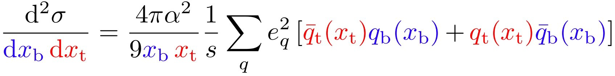
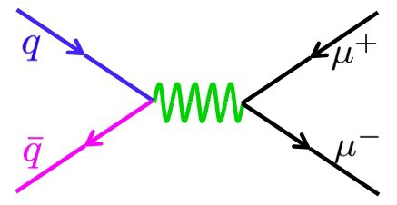
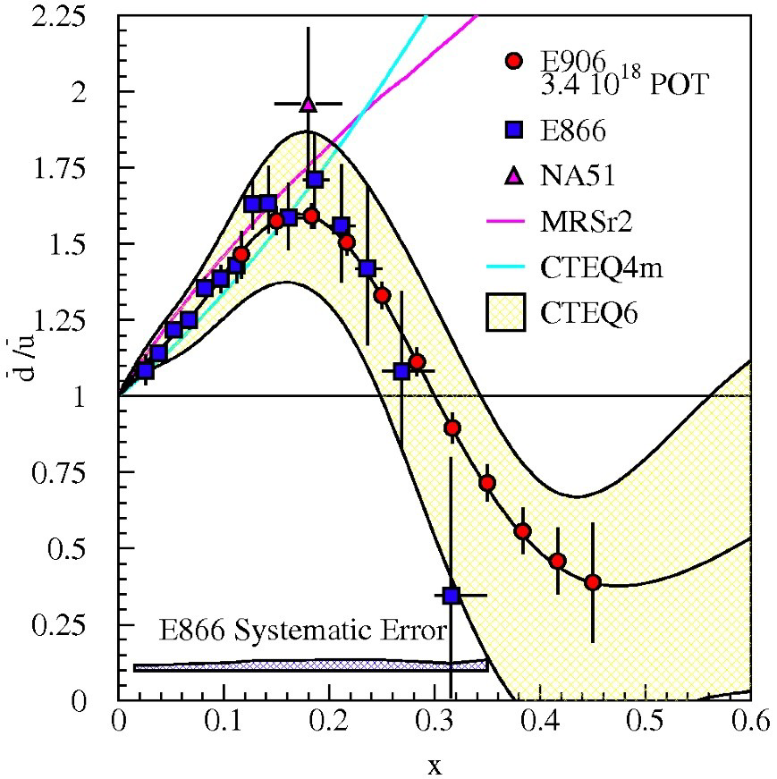
Drell-Yan at SeaQuest (E906): a Clean Access to Sea Quark
small
target sea quark
beam valence quark
dominates
projected
FNAL E866
x_{target}
Strong flavor asymmetry in the sea.
Could sea quarks carry a significant amount of angular momentum ?

Slide 7
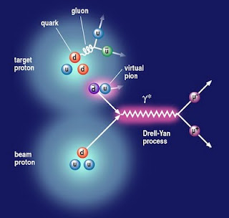
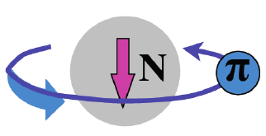
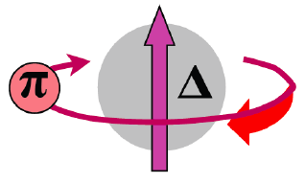
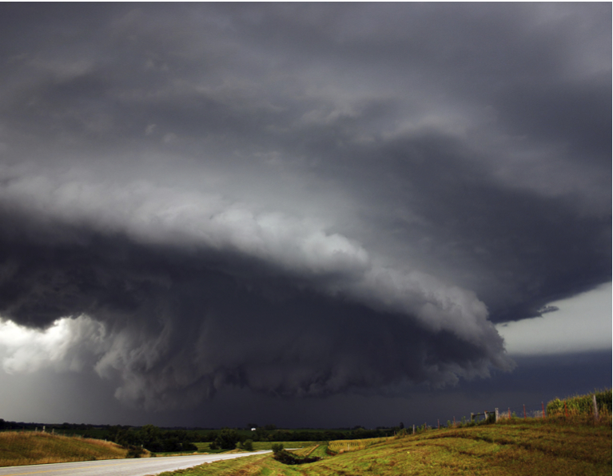
The meson cloud model explains the flavor asymmetry in the sea, and requires quarks to carry angular momentum.
|p>=p + Nπ + Δπ +…
Pions J^{p}=0⁻ Negative Parity
Need L=1 to get proton’s J^{p}=½⁺
π⁺
L_{π} = 1
Sea quarks should carry orbital angular momentum.

Slide 8
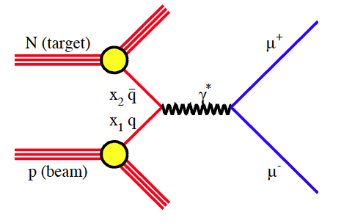
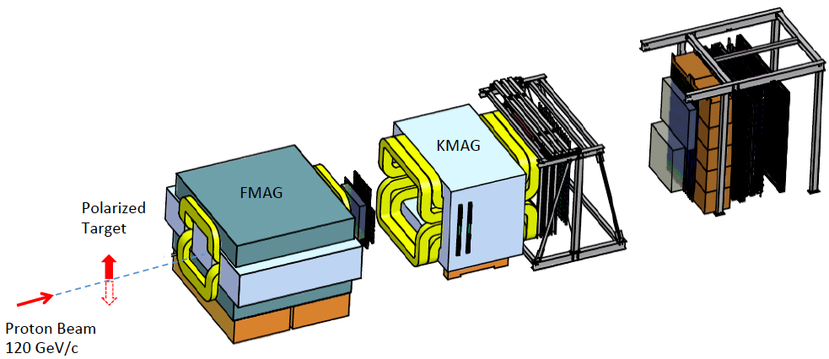
Fermilab E-1039
Polarized Target Drell-Yan Single-Spin Asymmetry Measurement to Access Sea Quarks’ Angular Momentum
Measure Drell-Yan yield dependence on the target’s spin direction.
Strong constraints on sea quarks’ angular momentum.
Add a polarized proton (NH₃) target to SeaQuest (E906) setup.
Approved for two calendar years of beam time, will be running in FY2016~FY2017 following the completion of E906.
Notes:
Instead of : Measure Drell Yan yield dependence say
Measure Drell Yan single spin asymmetry on the sea quarks and then explain with words what that means
Also, could we not include on first slide:
Measure Sivers Asymetry

Slide 9
Projected Precision with a Polarized Target at SeaQuest
Existing data do not put enough constraints on the sea quark Sivers distribution, neither in sign nor value.
If A_{N}≠0, major discovery:
“Smoking Gun” evidence for L_{ubar}≠0
Determine sign and value of ubar Sivers distribution
Confirm Lattice QCD and Meson Cloud Model expectations
Help shape physics direction at EIC
If A_{N}=0:
L_{ubar}=0, spin puzzle more dramatic ?
Sea flavor asymmetry hard to explain.
In contradiction to Lattice QCD and Meson Cloud Model.
Statistics shown for one calendar year of running :
L_{int} = 1.4 *10⁴³ /cm² ⬅➔ POT = 2.1*10 ¹⁸
Approved for two calendar years of beam time

Slide 10
My Answers to: “So What”
Before EIC, over the next ten years, we will have many new results, many new surprises,
JLab12 GeV, RHIC p+p, p+A, COMPASS, FNAl Drell-Yan with pol. target and/or pol. beam…
Without EIC, we will not have clear answers to:
Sea quark helicity, and polarized sea flavor asymmetry.
Sea quark’s transverse spin (transversity).
Sea quark’s angular motion (Sivers distribution).

