Slide 1
Some thoughts on the pointing measurement
Nilanga Liyanage

Slide 2
Q² Measurements
Beam Dump
LHRS
RHRS
e⁻
θ₀
θ_{tg}
Central sieve slit hole
Point of reference for spectrometer angle
Center of the spectrometer or
Central sieve slit hole
Target
e⁻

Slide 3
Q² Measurements
Spectrometer Angle Measurement
Survey: accuracy ~ 0.8 mrad (1% for PREX)
Pointing Measurement:
Use watercell target (with several central momentum settings), find the separation in elastic scattered energies of ¹⁶O and ¹H.
Find the spectrometer angle using the least squared method
Nuclear
Recoil
Energy

Slide 4
Pointing measurement with H and a heavy nucleus in the same target
Most systematics cancel in the difference:
Energy loss in target
Bean energy shifts
Beam position shifts

Slide 5
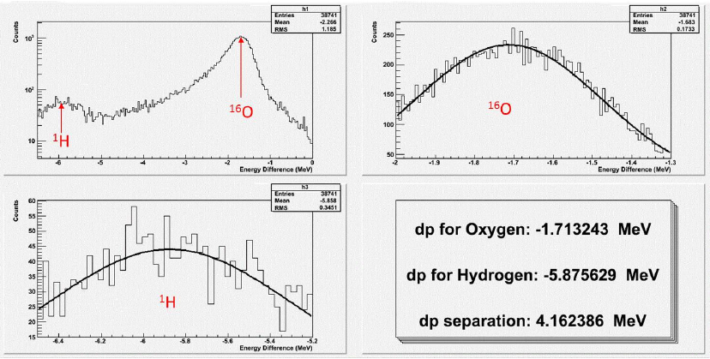
Challenges
For the kinematics of PREX the separation between the two elastic peaks is only about 4 MeV; a 1% measurement of angle requires measuring this separation to < 40 keV accuracy
Small H peak sitting on the sloping radiative tail of Oxygen; need a simulation and a careful peak fit to get the separation right.

Slide 6
Q² Measurements
Pointing Measurement
LHRS | 88.4±0.35 mrad
RHRS | 86.1±0.35 mrad
LHRS
RHRS

Slide 7
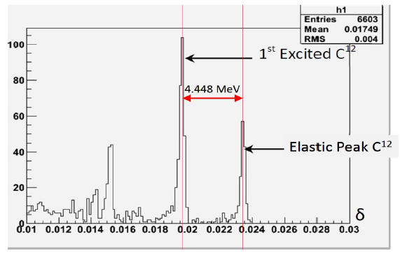
In general the absolute momentum accuracy of the HRS ~ 10⁻⁴ : 100 keV
But we can measure momentum differences with better accuracy over small momentum ranges.
Luckily we can verify this in the 4-10 MeV range using the elastic states of ¹²C
Achieved the required < 40 keV accuracy for PREX-I

Slide 8
Issues with different targets
Water-foil:
Small H peak
Fe elastic peak next to oxygen, need to separate.
LiH powder sandwiched between steel foils :
H, Li and Fe peaks well separated
3 foils for calculation instead of 2
optimize the amount of power to window thickness
Mixed gas target: H and Ar (?) or Xe
Can mix gas so that the two peaks are about the same.
But effects due to extended target (range of angles): different angular variations for the two nuclei – average angle is different for the two, need to simulate carefully.
Can use a software cut to make a “thin” target: 1 cm (?)
But how long we need to run to get enough stats. with this cut ?

