Slide 1
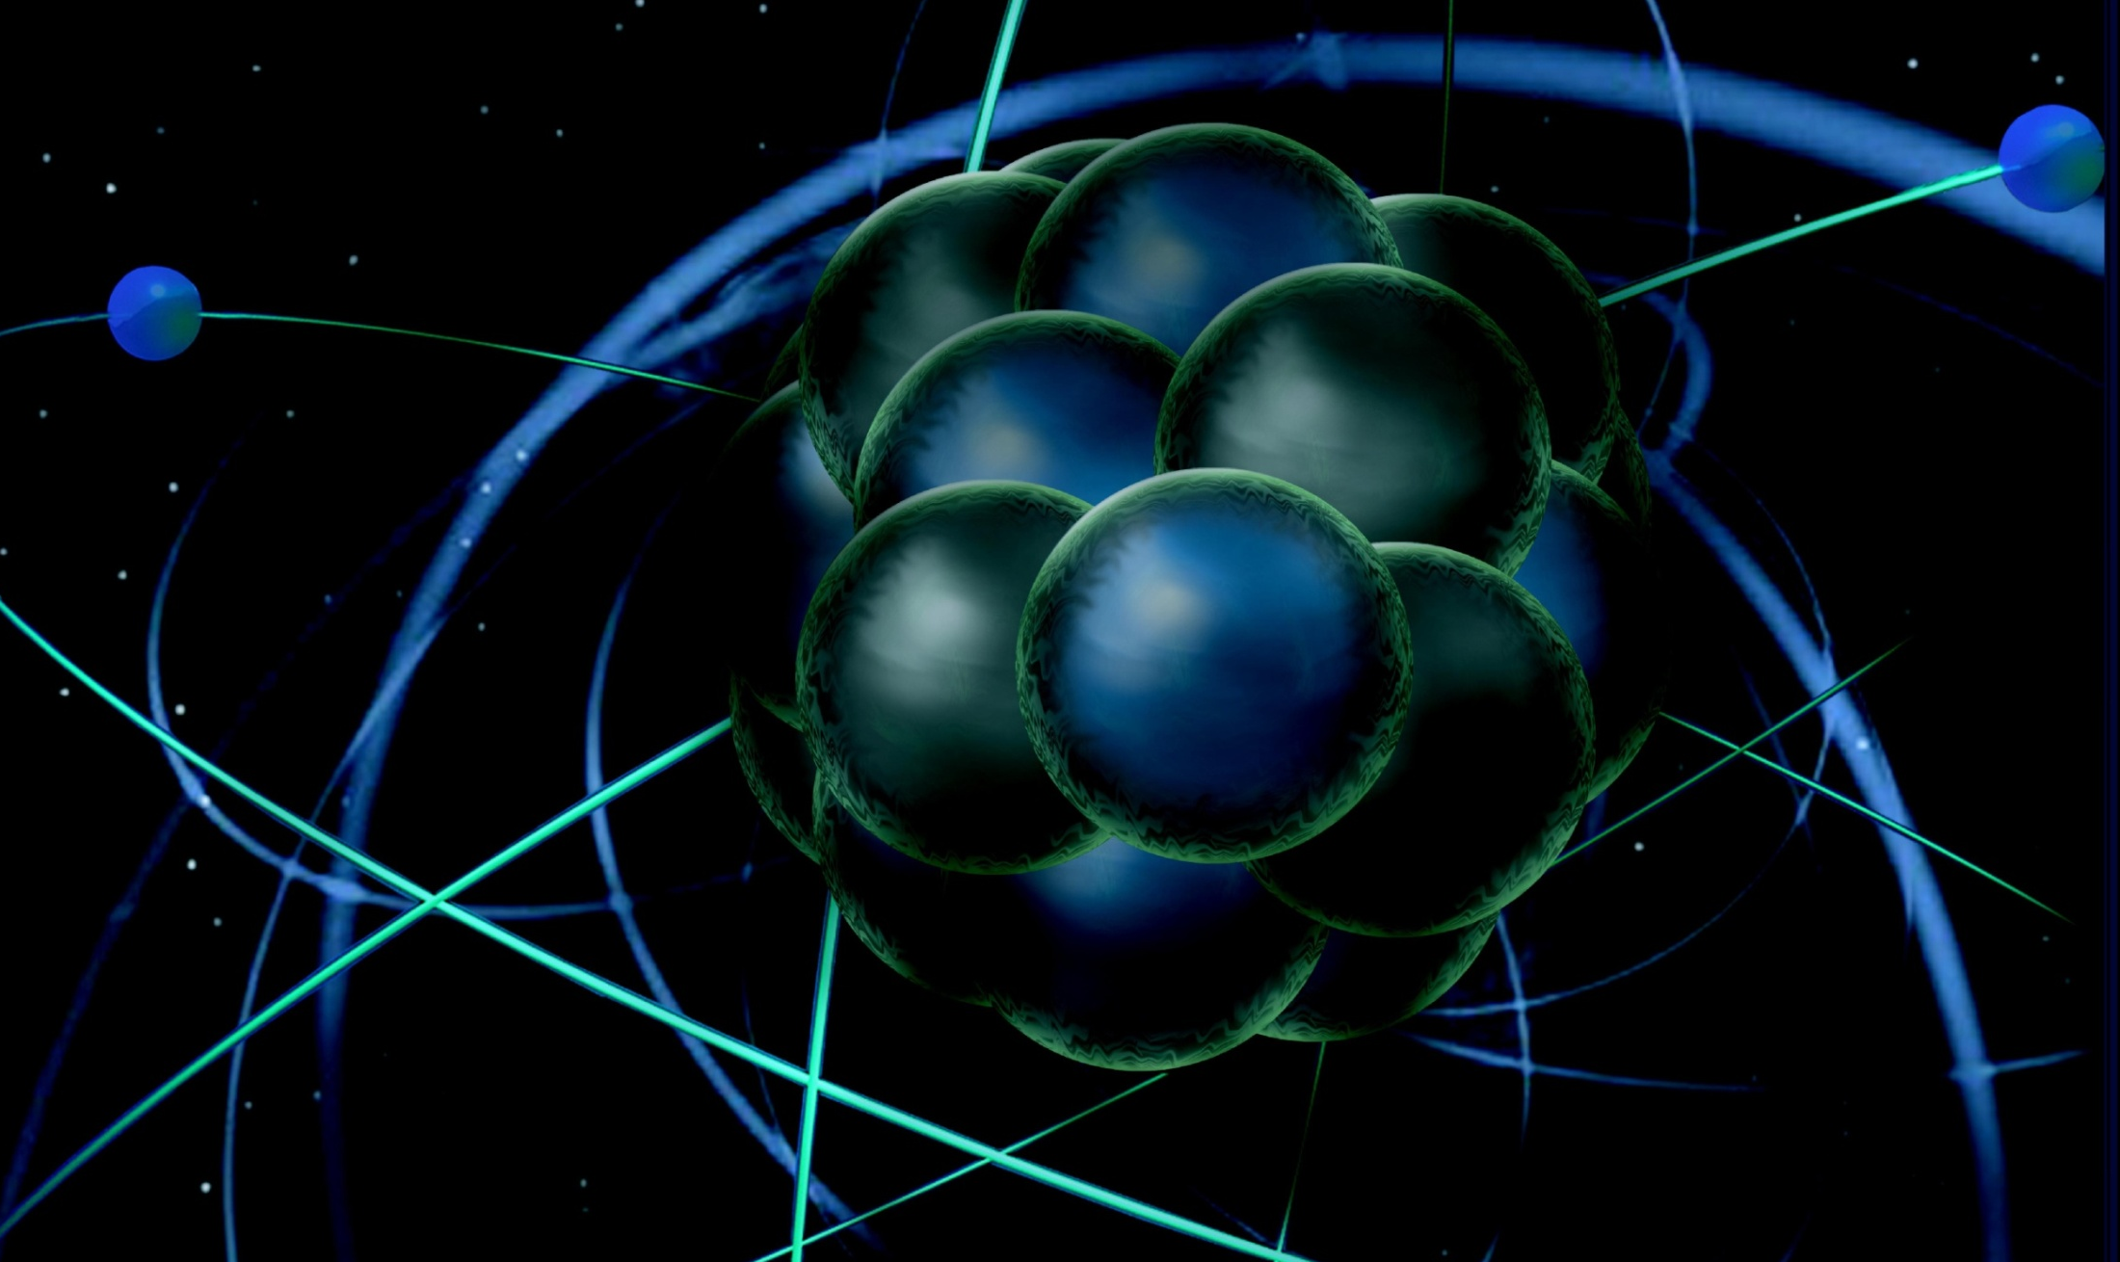
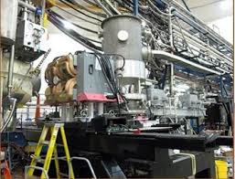
Readiness Review and Beam Scheduling
Thia Keppel
PREX/CREX Collaboration Meeting
February 2016

Slide 2
Hall A Projected Experiment Schedule, updated 1/2016 Experiments in red represent PAC42 “high impact” experiments
Spring | Fall | Spring | Fall | Spring | Fall | Spring | Fall
DVCS –I/ GMp | DVCS –I/ GMp
 |  | DVCS –I/ GMp | DVCS –I/ GMp Ar(e,e’p*
 |  |  |  | ³H/³He group | ³H/³He group | TBD: APEX PREX12 CREX A₁^{n} DVCSII
 |  |  |  |  |  |  | SBS Start?
CY
2015
X
CY 2016
CY
2017
CY
2018
*possible best effort
Why we’re here today

Slide 3
Comments on Schedule
Not a lot of time for a major installation during winter down
We have looked into possibility of installing PREX/CREX in this short time
Would at minimum require overtime, increased manpower
And would still need summer as well….
Unclear what result of tritium ERR will be (March 16)
– Under what conditions will we be able to work in Hall next Summer (Controlled Access only?)?
SBS absolutely needs a summer installation
Expect pressure will come from DOE to run SBS
Modularity in design will assist in de-installation
Single pass may require change of box supply resistive load to dogleg (?) magnets, few days to a week to change over (and then back again)
Can’t run anything but single pass for this time??
Caveat: not sure I have this completely correct
Scheduling conflicts with other Halls possible
Hall D can’t run with single pass tune at all

Slide 4
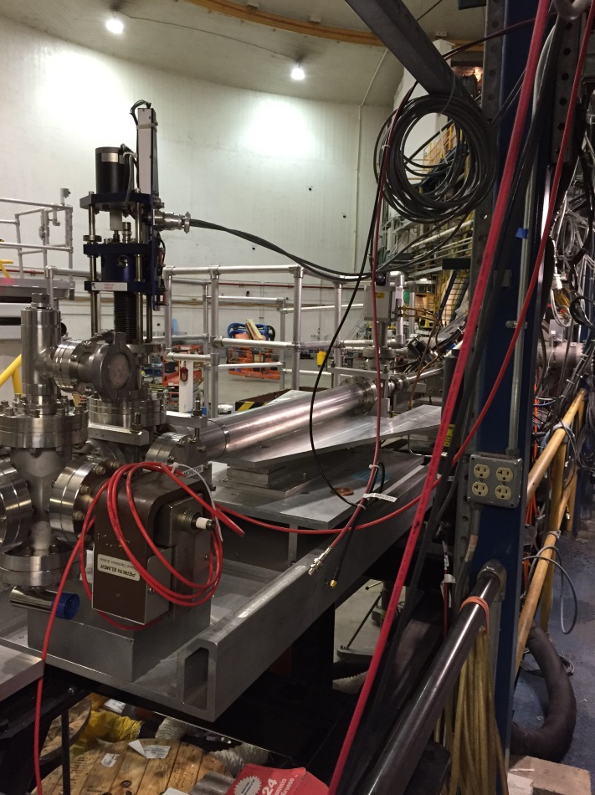
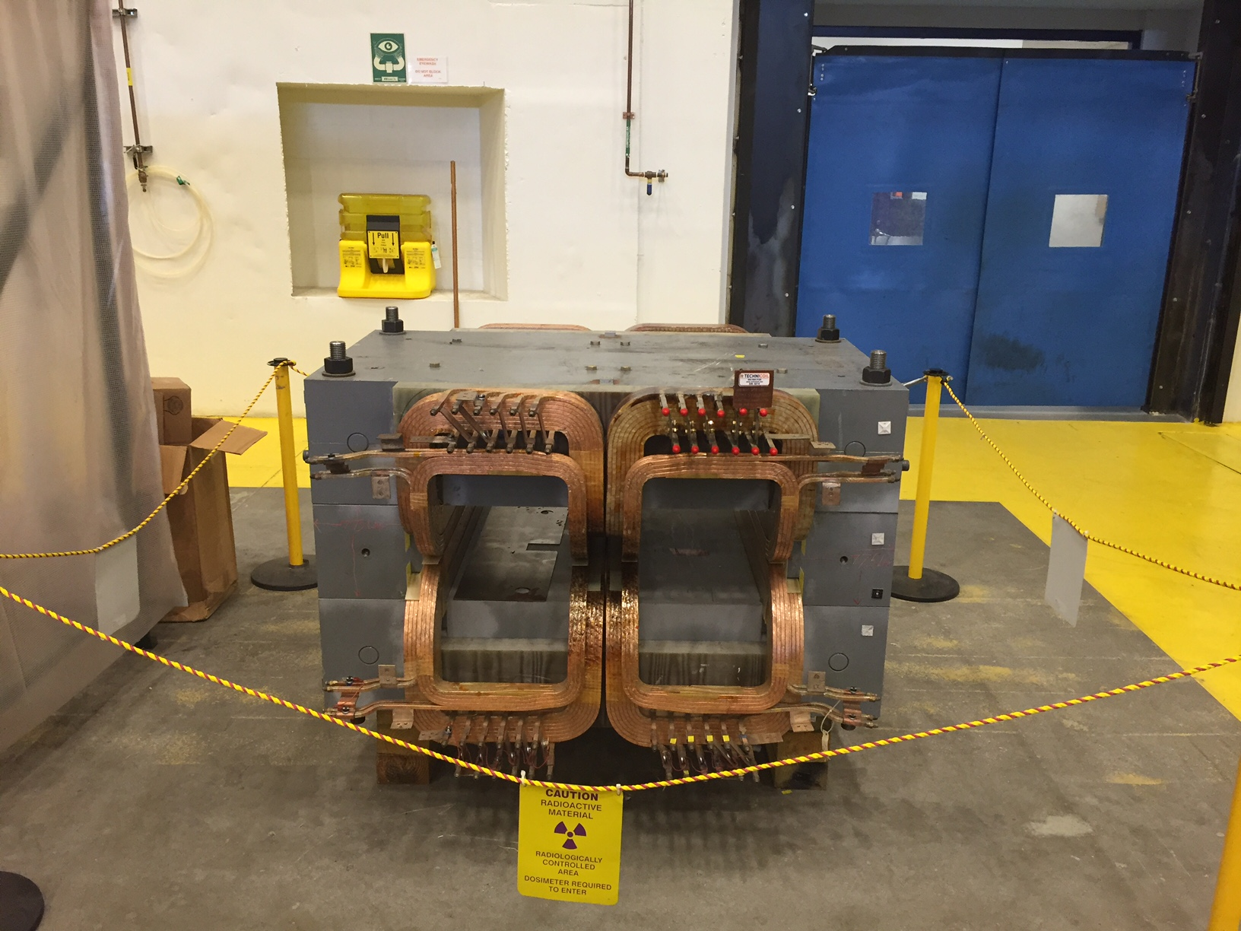
Hall Activities (in support of PREX/CREX)
Beamline instrumentation installed
Second x,y,Q girder (from Hall C), new “Musson” cavity electronics, Hall C halo monitor
Also lumi monitors (more recent)
Polarimetry
New high field Moller commissioned for DVCS polarimetry and taking production data
First Compton measurements underway
Established combined target chamber (CREX upstream) approach
Hall A E&D assisting
Computation fluid dynamics for target design
Design effort
Possible heating tests
Pb and diamond targets, new septum coils purchased (and here at lab)
Parity quality beam working group

Slide 5
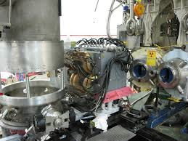
“New” Q1 Magnets
SOS quad functioning on HRS-R
Multiple optics studies, data obtained by GMp/DVCS
HRS-L twin due at lab this June 2016
Will permanently replace superconducting quads
Mounts to allow forward/backward movement
– Forward 30 cm for ³H
Backward for septum experiments
Optics for the latter should be studied!

Slide 6
You are here!
http://www.jlab.org/div_dept/physics_division/experiments/scheduling.html

Slide 8
Physics Division Readiness Process
This review is largely about safety and operation, not science
– think differently
Design must be frozen after this review
No charge yet
Radiation shielding will be a critical element
De-installation must be considered
Will need documentation (PESAD) for any new or substantially redesigned equipment
Target(s), Septum, Collimator(s), Shielding,…
For each, present conceptual design and PESAD draft
Hall A has 3 ERR reviews this Spring – very busy!

Slide 9
Other Scheduling Topics for Consideration
Thinking science now…
Has the requisite polarization measurement uncertainty been demonstrated?
How will “parity quality beam” be demonstrated, what are key parameters? Do we have adequate equipment to address this?
Solution for the compromised Ca target?
Quad optics
The usual… DAQ, detectors,…

Slide 10
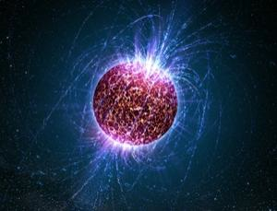
Thanks!

