Slide 1

CEBAF Source and Injector Status
PREx-II Collaboration Mtg
Feb. 26, 2016
Matt Poelker and Joe Grames
Center for Injectors and Sources

Slide 2
CEBAF Polarized Electron Injector
Experiment | Beam Energy (GeV) | Pol (%) | I (µA) | Target (Length) | A_{pv} (ppb) | Charg Asym (ppb) | Position Diff (nm) | Angle Diff (nrad) | Size Diff (δσ/σ)
HAPPEx-I (Achieved) | 3.3 | 38.8 68.8 | 100 40 | ¹H (15 cm) | 15,050 | 200 | 12 | 3
G0-Forward (Achieved) | 3.0 | 73.7 | 40 | ¹H (20 cm) | 3,000-40,000 | 300±300 | 7±4 | 3±1
HAPPEx-II (Achieved) | 3.0 | 87.1 | 55 | ¹H (20 cm) | 1,580 | 400 | 2 | 0.2
HAPPEx-III (Achieved) | 3.484 | 89.4 | 100 | ¹H (25 cm) | 23,800 | 200±10 | 3 | 0.5±0.1 | <10⁻³
PREx-I (Achieved) | 1.056 | 89.2 | 70 | ²⁰⁸Pb (0.5 mm) | 657±60 | 85±1 | 4 | 1 | <10⁻⁴
QWeak-I (Achieved) | 1.155 | 89.0 | 180 | ¹H (35 cm) | 281±46 | 8±15 | 5±1 | 0.1±0.02 | <10⁻⁴
QWeak | 1.162 | 90 | 180 | ¹H (35 cm) | 234±5 | <100±10 | <2±1 | <30±3 | <10⁻⁴
PREx-II | 1.0 | 90 | 70 | ²⁰⁸Pb (0.5mm) | 500±15 | <100±10 | <1±1 | <0.3±0.1 | <10⁻⁴
MOLLER | 11.0 | 90 | 85 | ¹H (150 cm) | 35.6±0.74 | <10±10 | <0.5±0.5 | <0.05±0.05 | <10⁻⁴

Slide 3
Spring 2016
Laser System
  Still operating with 3-lasers
  Each now has capability for 249.5 or 499 MHz
High-Polarization Photocathode
  Retired 5247-1 work horse of 6 GeV era 2009-2012
  Installed 5756-4 for 12 GeV (QE > 1%, P ~87%)
Gun
  Still operating at -130 kV (more on upgrade later…)
  Baked gun/activated NEG’s => Charge lifetime >150C
Parity Controls
  Intact from 6 GeV program

Slide 4
Summer 2016
Must add support for an additional 4th laser – big job
  New laser table layout, RF sources and SCAM (beam mode)
3-laser
configuration
IA
RWP
Pockels Cell
IHWP

Slide 5
Summer 2016
Retain geometry downstream of polarization combining cube
New
4-laser
configuration
RWP
IA
Pockels Cell
IHWP

Slide 6
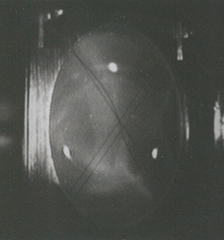
12 GeV CEBAF Polarized Electron Injector
DC HV Load Lock
Polarized e⁻ Source
(130 keV)
Bunching & Warm Acceleration
(500 keV)
SRF Acceleration
(6.3 MeV)
SRF Acceleration
(123 MeV)
10 MeV
Spectrometer
5 MeV Mott
Polarimeter
Synchrotron
Light Monitor
Stewart
Platform
Brock
Cavity
Chopper
Cryounit
Cryomodules
Apertures
Buncher
Capture
Bunchlength
Gun#2
FC#1
Cavity
FC#2
C20
R100
Injection Chicane
V-Wien Filter
H-Wien Filter
Helicity
Magnets
Spin Solenoids
500 keV Spectrometer
PreBuncher
Gun#3
10 MeV R&D
Beam line
123 MeV
Spectrometer
Synchronous RF Photoinjection, Longitudinal Acceptance
Spin Control, Bunching, Transverse Acceptance

Slide 7
New Points to Know About
Stewart Platform – remote positioning of Pockels cell
  Wes Moore wrote EPICS driver for embedded machine linux
  John Hansknecht planning for 3D printing of components
  Summer intern for calibration and testing
Brock Cavity – non-invasive charge asymmetry monitor
  Installed after A1 for bunch length profile measurement
  Brock & BCM0L02 span (A2+Chopper+A3+A4)
Helicity Magnets
  Retained if needed for sensitivity or feedback, but…
  ...if desired requires ioc/hardware upgrade + new? locations.
Mott Polarimeter
  3 year upgrade + study effort wrapping up

Slide 8
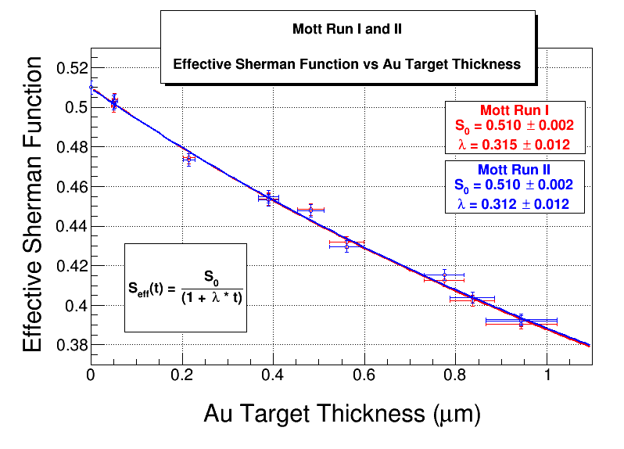
CEBAF 5 MeV Mott Polarimeter
Run I – January 2015
Instrument systematics
Extrapolation I (SLSP-5247)
Run II – October 2015
Beam systematics
Extrapolation II (SLSP-5756)
Expected Range of Uncertainty
Source | 2014 Expectation | 2016 Preliminary
Theory | 0.5 – 1.0% | 0.5 – 0.6%
Extrapolation | 0.2 – 0.5% | 0.2 – 0.3%
Instrumental | 0.2 – 0.4% | 0.2 – 0.3%
BUDGET | 0.6 – 1.2% | 0.6 – 0.7%
We are planning publication this Spring, but Users benefit immediately from this work
Future Run 3 may test largest systematic (theory) with low-Z target

Slide 9
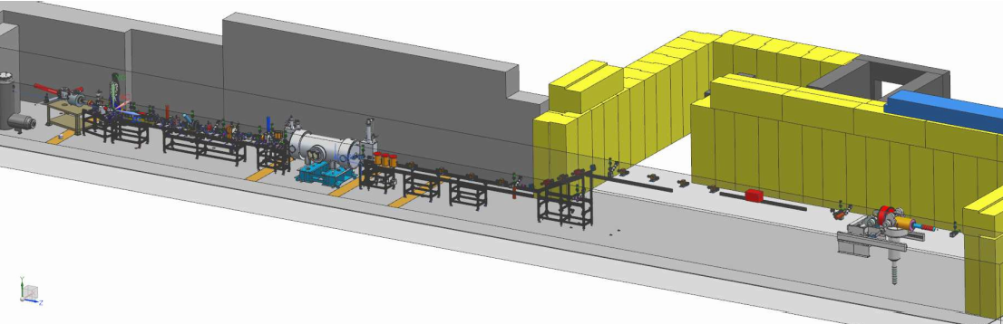
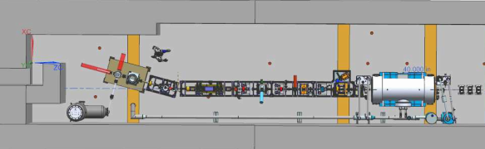
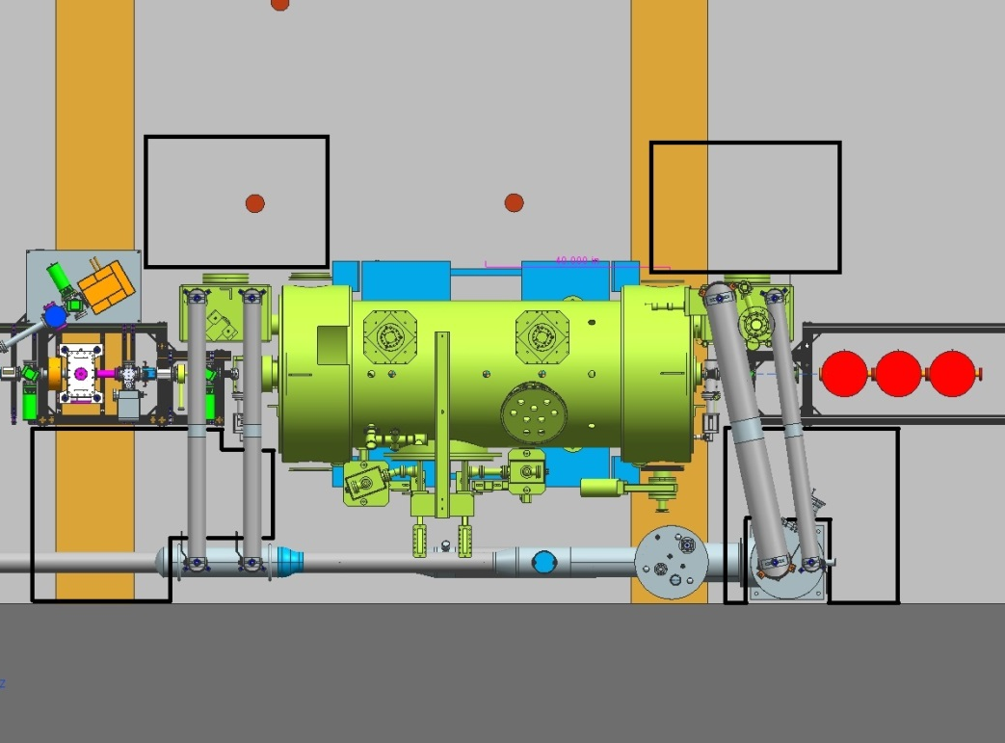
Commissioning of CEBAF Upgrade at UITF
TESTING MORE ROBUST (>300KV) INVERTED GUN
TEST 200KV WIEN FILTER
COMMISSIONING NEW 2/7 CELL CRYOUNIT

Slide 10

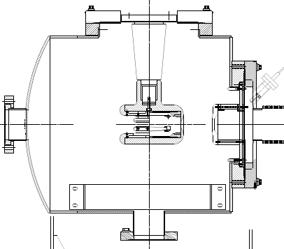
CEBAF – ILC 200 kV Inverted Gun
Developed and ready for installation
Commissioned at Test Cave to 225 kV w/o field emission
Large grain Niboium electrode
-200kV
light in
e- out
photocathode

Slide 11
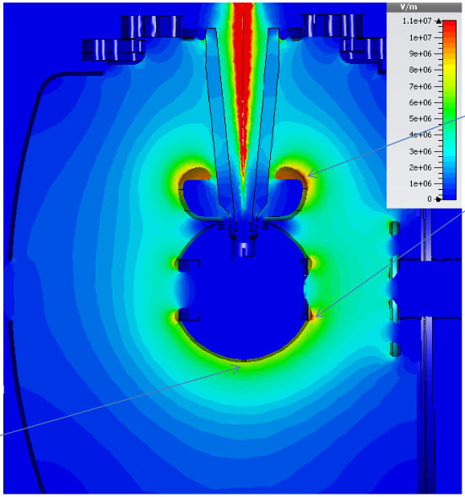
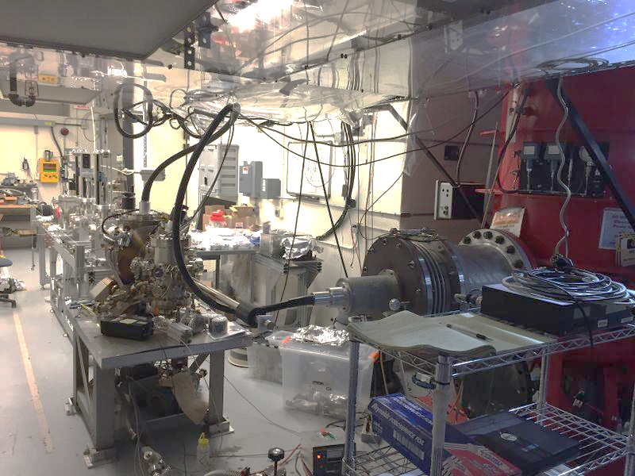
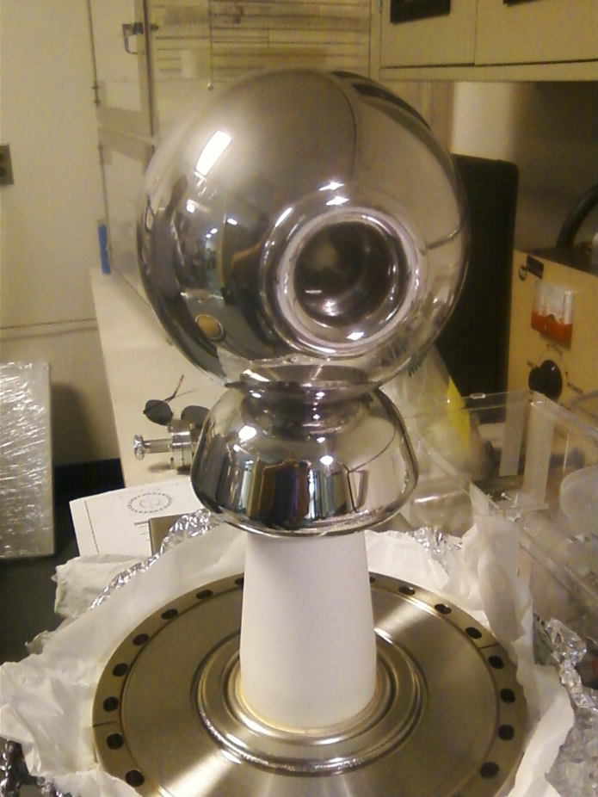
Testing > 300 kV Inverted Guns at GTS / UITF
11 MV/m
Commissioned to 325 kV
8 MV/m

Slide 12
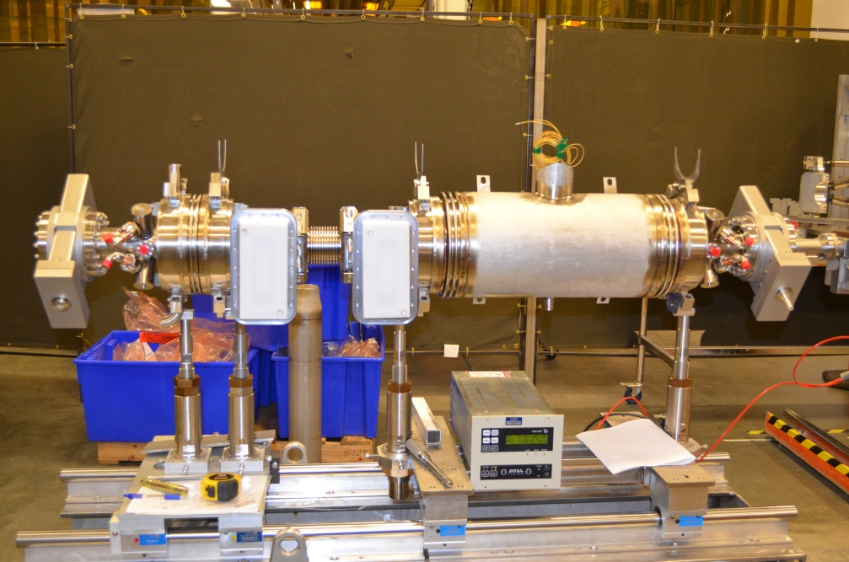

Status of New ¼ CM
2016 Commissioning plan at Test Lab
  Spring, ¼ assembly + cryo/RF @ UITF
  Summer, SRF commissioning @ CMTF
  Fall, install ¼ beam planned up to ~8 MeV (klystrons)
Installation timeline at CEBAF in advance of Moller TBD

Slide 13
Summary
CEBAF Injector
  Reliable high polarization (~85%) polarized electron source
  6 GeV era source basis for initial parity program
  4-Laser Upgrade / Laser Table configuration planned summer 2016
  We will allocate time for setup and characterization
Polarized beam R&D
  Stewart platform development highest PQB R&D priority for FY16
  Brock cavity and helicity magnets are available
  Submit Mott results for publication late-Spring
CEBAF Injector Upgrade and UITF Operations
  200 kV “tee” inverted gun is ready, likely consider “ball” inverted gun
  New ¼ assembly/testing/beam ops planned for 2016
  Extend Wien filter capability from 130kV to 200kV planned
  PQB tests at UITF e.g. low-noise receiver can be considered

