Slide 1
PREX II Vacuum Box, Shielding and Septum Design Status
Alan Gavalya
11 APR 14

Slide 2
Septum Mount w/ Absorber

Slide 3
Vertical Section

Slide 4
Horizontal Section

Slide 5
Septum Magnet

Slide 6
Septum Status
PREX-II utilizes the eight large coils in the existing Septum Magnet
Existing Magnet has one large coil damaged
Need to replace damaged coil, estimated at $10k, drawings exist, 7 to 9 months from procurement to delivery of coil.

Slide 7
Vacuum Box w/ Collimator

Slide 8
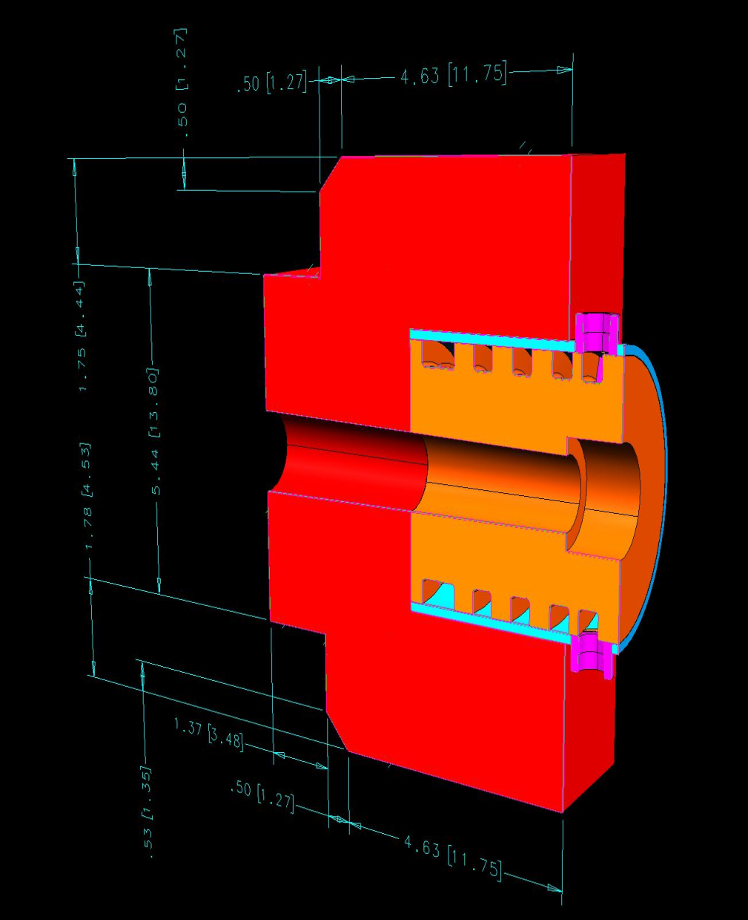
Tungsten Collimator
Inner cylinder
30% Cu-70% W
Water-cooled slug with Cu sleeve brazed, similar to Qweak collimator
Outer box Tungsten
Power deposited:
Inner cylinder 25.7 W/μA
70μA results in 1800W
Outer box 3.1 W/μA

Slide 9
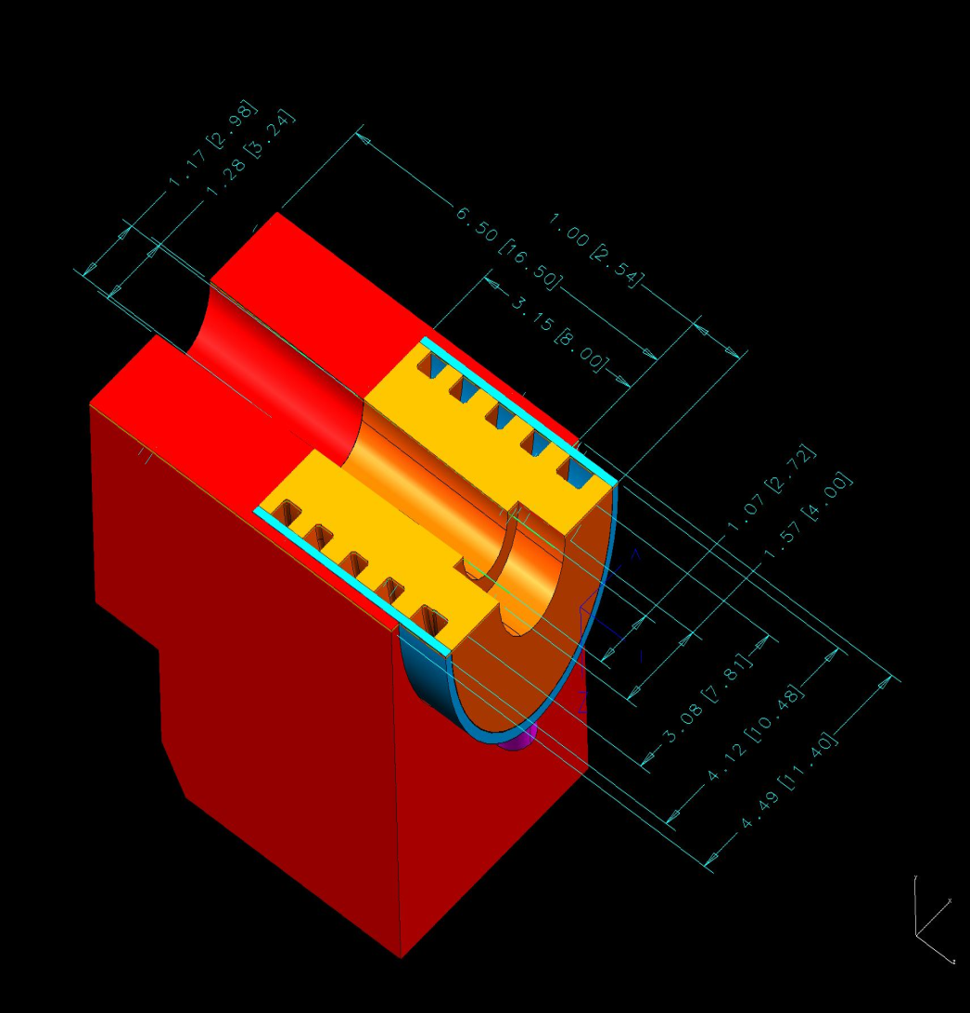
Tungsten Collimator
“Rough” calculation on initial design gives max temperature of Cu-W cylinder at 57.8 C
With use of Dynaflux pump-cooler system at max flow of 4 GPM
Recommend FEA simulation be done for more accuracy
Need request of 3-4 weeks to analyze

Slide 10
Slow and Steady Pace
Questions?

