Slide 1
Experiment | Energy (GeV) | Pol (%) | I (µA) | Target | A_{pv} (ppb) | Maximum Charge Asym (ppb) | Maximum Position Diff (nm) | Maximum Angle Diff (nrad) | Maximum Size Diff (δσ/σ)
HAPPEx-I (Achieved) | 3.3 | 38.8 | 40 | ¹H (15 cm) | 15,050 | 200 | 12 | 12
G0-Forward (Achieved) | 3.0 | 73.7 | 40 | ¹H (20 cm) | 3,000-40,000 | 300±300 | 7±4 | 3±1
HAPPEx-II (Achieved) | 3.0 | 87.1 | 55 | ¹H (20 cm) | 1400 | 400 | 1 | 0.2
HAPPEx-III (Achieved) | 3.484 | 89.4 | 100 | ¹H (25 cm) | 16900 | 200±100 | 3±3 | 0.5±0.1 | 10⁻³
PREx-I (Achieved) | 1.056 | 89.2 | 100 | ²⁰⁸Pb (0.5 mm) | 657±60 | 100±130 | 2±3 | 1 | 10⁻⁴
QWeak-I (Achieved) | 1.155 | 89.0 | 180 | ¹H (35 cm) | 281±46 | 8±15 | 5±1 | 0.1±0.02 | 10⁻⁴
QWeak | 1.162 | 90 | 180 | ¹H (35 cm) | 234±5 | 100±10 | 2±1 | 30±3 | 10⁻⁴
PREx-II | 1.0 | 90 | 70 | ²⁰⁸Pb (0.5mm) | 500±15 | 100±10 | 1±1 | 0.3±0.1 | 10⁻⁴
Møller | 11.0 | 90 | 85 | ¹H (150 cm) | 35.6±0.74 | 10±10 | 0.5±0.5 | 0.05±0.05 | 10⁻⁴

Slide 2
Experiment | Energy (GeV) | Pol (%) | I (µA) | Target | A_{pv} (ppb) | Maximum Charge Asym (ppb) | Maximum Position Diff (nm) | Maximum Angle Diff (nrad) | Maximum Size Diff (δσ/σ)
HAPPEx-I (Achieved) | 3.3 | 38.8 | 40 | ¹H (15 cm) | 15,050 | 200 | 12 | 12
G0-Forward (Achieved) | 3.0 | 73.7 | 40 | ¹H (20 cm) | 3,000-40,000 | 300±300 | 7±4 | 3±1
HAPPEx-II (Achieved) | 3.0 | 87.1 | 55 | ¹H (20 cm) | 1400 | 400 | 1 | 0.2
HAPPEx-III (Achieved) | 3.484 | 89.4 | 100 | ¹H (25 cm) | 16900 | 200±100 | 3±3 | 0.5±0.1 | 10⁻³
PREx-I (Achieved) | 1.056 | 89.2 | 100 | ²⁰⁸Pb (0.5 mm) | 657±60 | 100±130 | 2±3 | 1 | 10⁻⁴
QWeak-I (Achieved) | 1.155 | 89.0 | 180 | ¹H (35 cm) | 281±46 | 8±15 | 5±1 | 0.1±0.02 | 10⁻⁴
QWeak | 1.162 | 90 | 180 | ¹H (35 cm) | 234±5 | 100±10 | 2±1 | 30±3 | 10⁻⁴
PREx-II | 1.0 | 90 | 70 | ²⁰⁸Pb (0.5mm) | 500±15 | 100±10 | 1±1 | 0.3±0.1 | 10⁻⁴
Møller | 11.0 | 90 | 85 | ¹H (150 cm) | 35.6±0.74 | 10±10 | 0.5±0.5 | 0.05±0.05 | 10⁻⁴

Slide 3
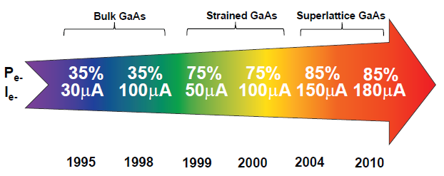
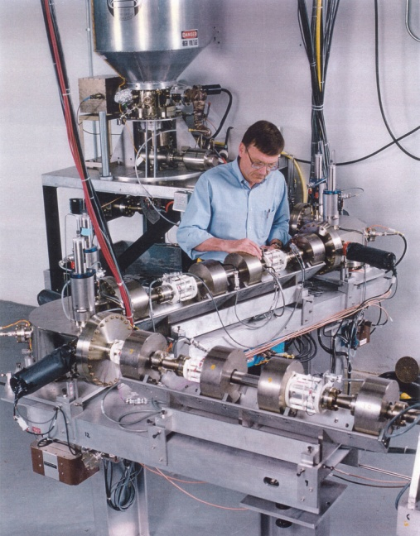
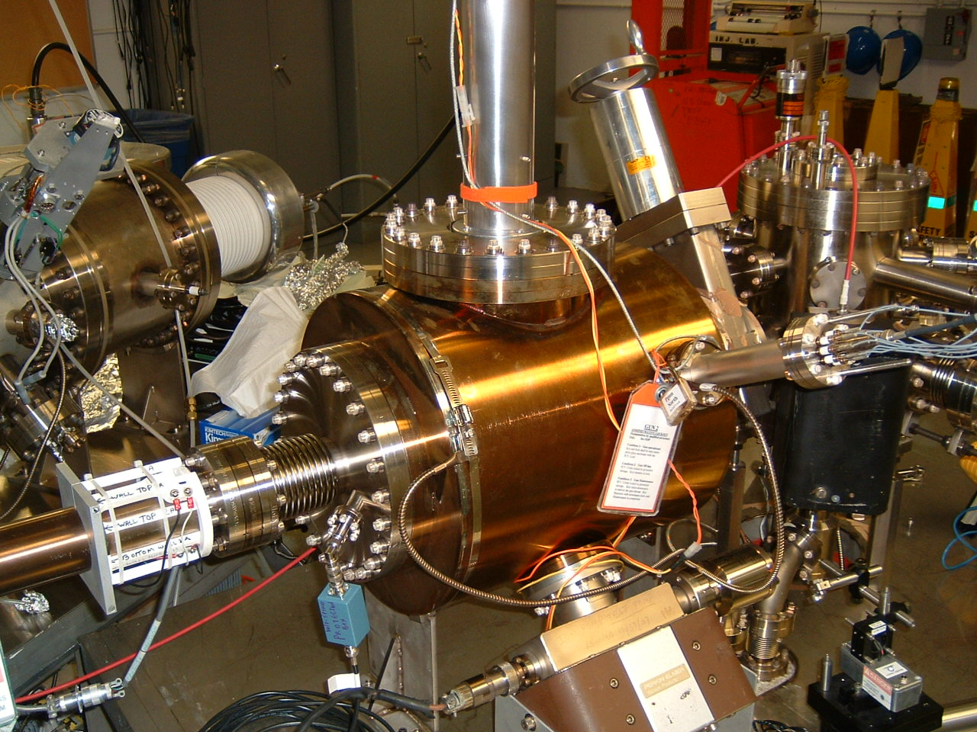
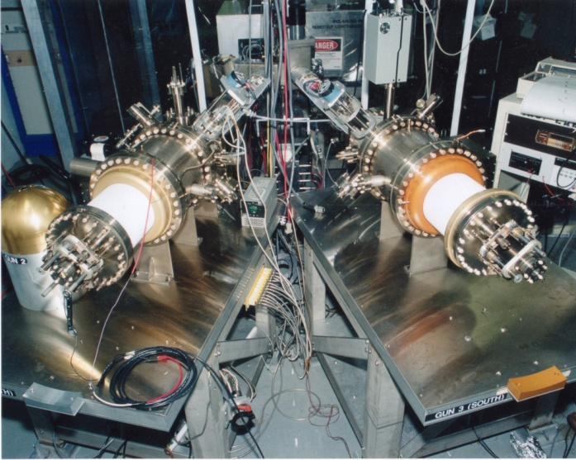
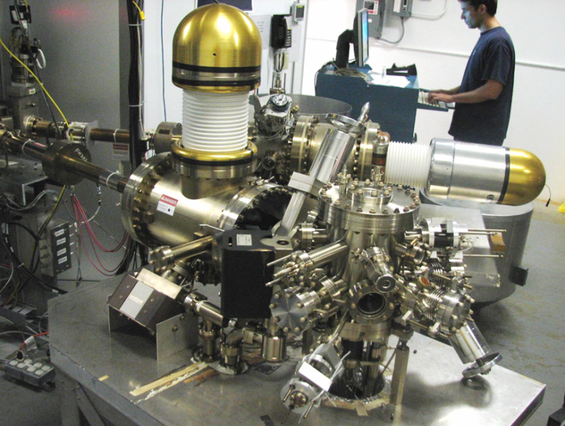
Always Tweaking the Design
1
4
Endless (?) quest for perfection
The photogun works well,
No anticipated changes
2
3

Slide 4
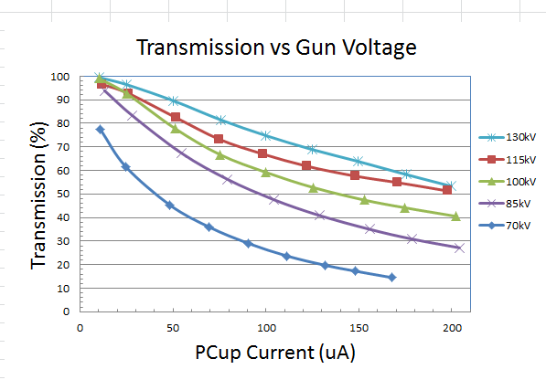
130 kV Inverted Gun
Higher Voltage = Better Transmission = Better Beam Quality
(and maybe longer lifetime)
Prebuncher operating at modest power takes care of the rest

Slide 5
Improve Lifetime with Large Laser Spot?
(Best Solution – Improve Vacuum, but not easy)
Bigger laser spot, same # electrons, same # ions
Ionized residual gas
strikes photocathode
Ion damage distributed
over larger area

Slide 6
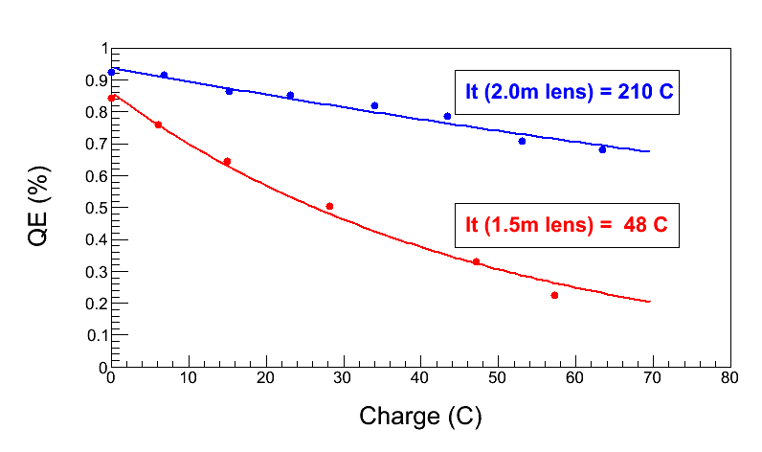
Enhanced lifetime for Qweak
Increase size of laser beam from ~ 0.35 mm to ~ 0.7 mm dia.
Can we use ~ cm size laser beams? Not in today’s CEBAF photogun.
How far can we extrapolate? Need a better cathode/anode optic
“Charge and fluence lifetime measurements of a DC high voltage GaAs photogun at high average current.,” J. Grames, R. Suleiman, et al., Phys. Rev. ST Accel. Beams 14, 043501 (2011)

Slide 7
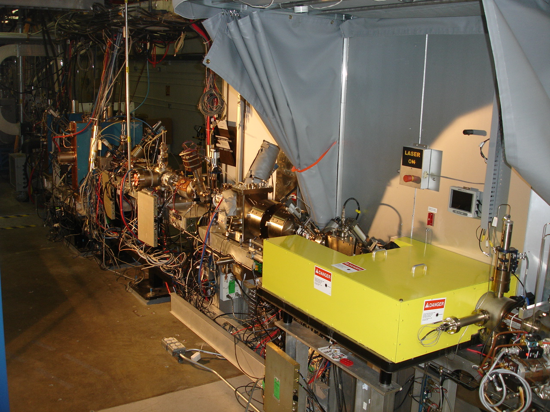
4π Electron Spin Manipulation
Horizontal Wien Filter
Two Solenoids
Vertical Wien Filter
Harder to flip spin than we imagined, more “things” change than just spin direction
Beam orbit downstream of HWien sensitive to laser/prebuncher (mis-)phasing
Don’t know what to do about this….

Slide 8
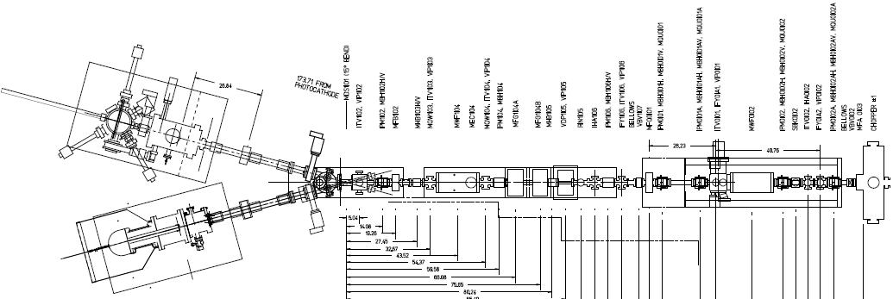
Electron Spin Reversal for PV
From Gun
“Spin Reversal”
Vertical Wien = 90 deg
Two Solenoids = ±90 deg
“Longitudinal Polarization”
Horizontal Wien = {-90…+90}
LEFT
RIGHT
Pondering a new beamline, but will it behave differently? Reluctance to move prebuncher. Modification would provide an opportunity to improve beamline vacuum….

Slide 9
TMONO Harmonic Resonant Cavity
Bunched electron beam can be described as Fourier series….
I(t) = a₀ + a₁ cos (ω_{o}t + θ₁) + a₂ cos (2ω_{o}t + θ₂) + a₃ cos(3ω_{o}t + θ₃) + …
…..a bunchlength monitor (Brock Roberts)

Slide 10
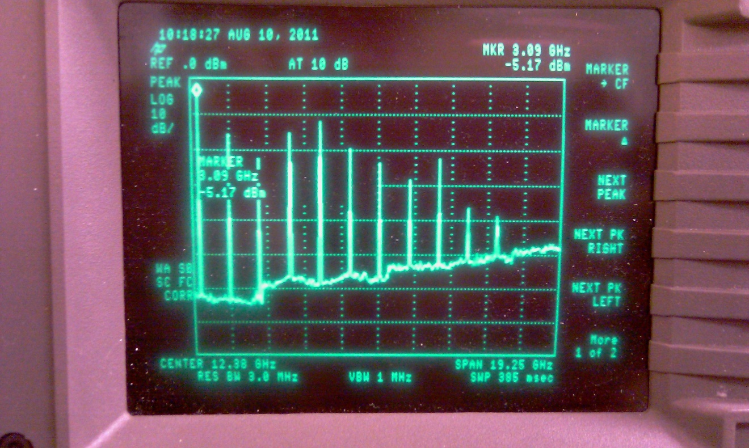
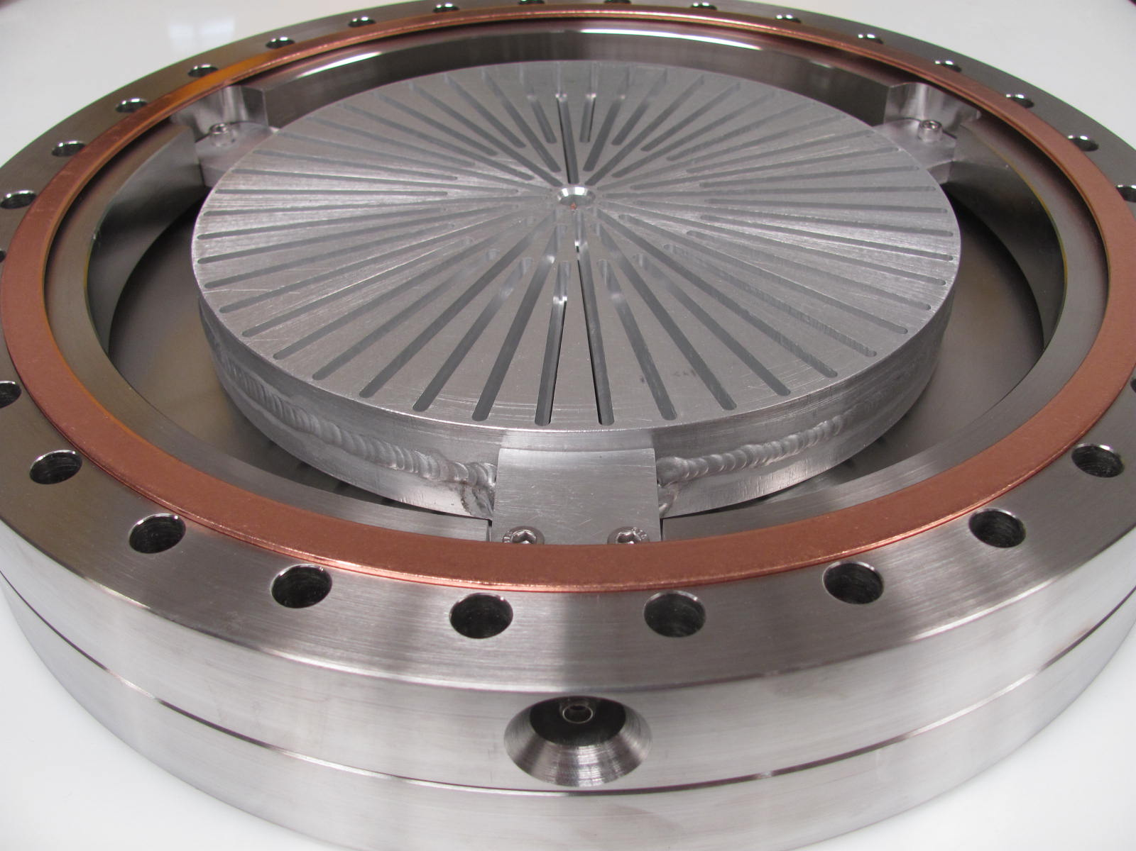
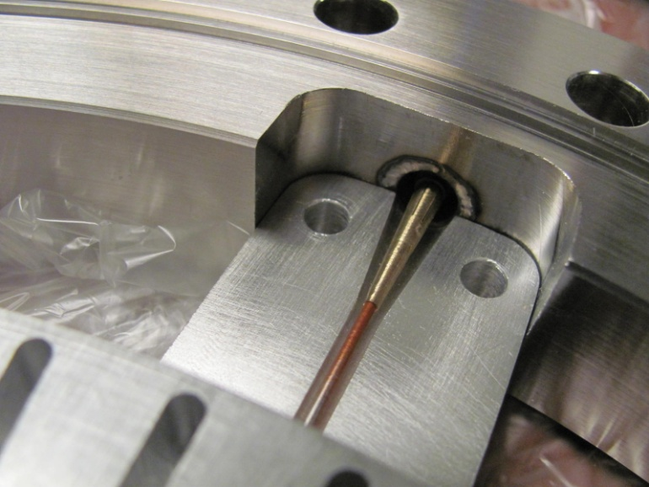
On the bench
“antenna/radiator” placed where the e-beam would travel. The antenna was driven with a 20 dBm,1556 MHz signal through a step recovery diode. Yes, cavity resonates at many harmonic modes.

Slide 11
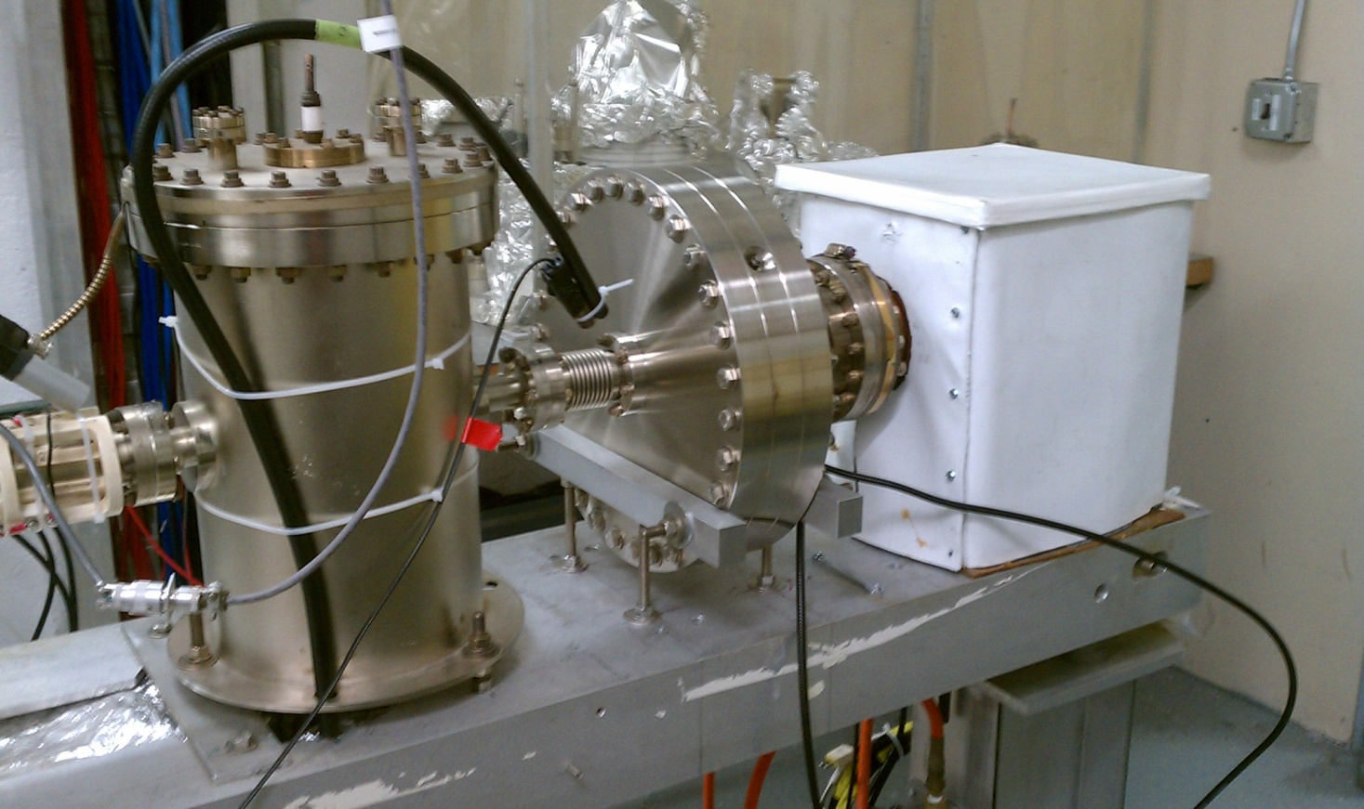
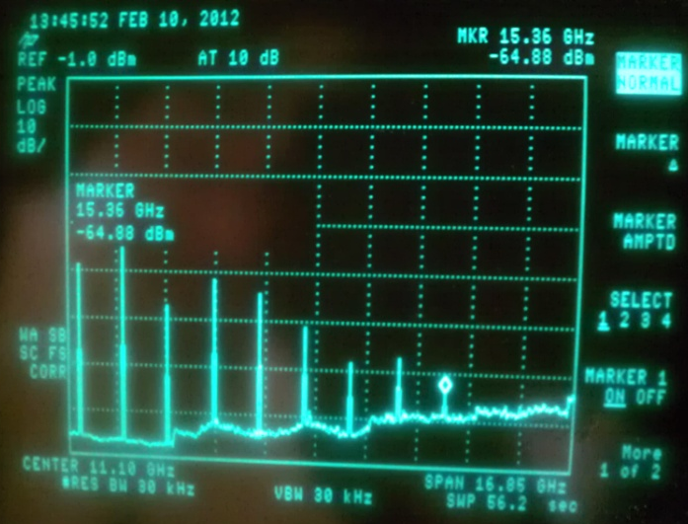
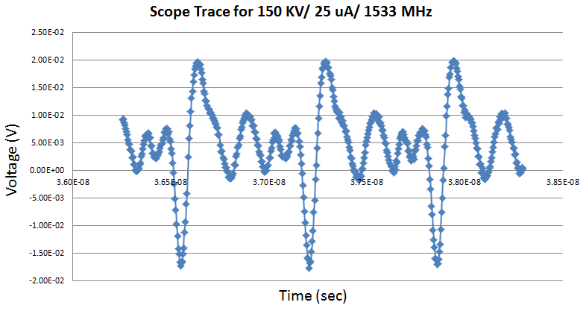
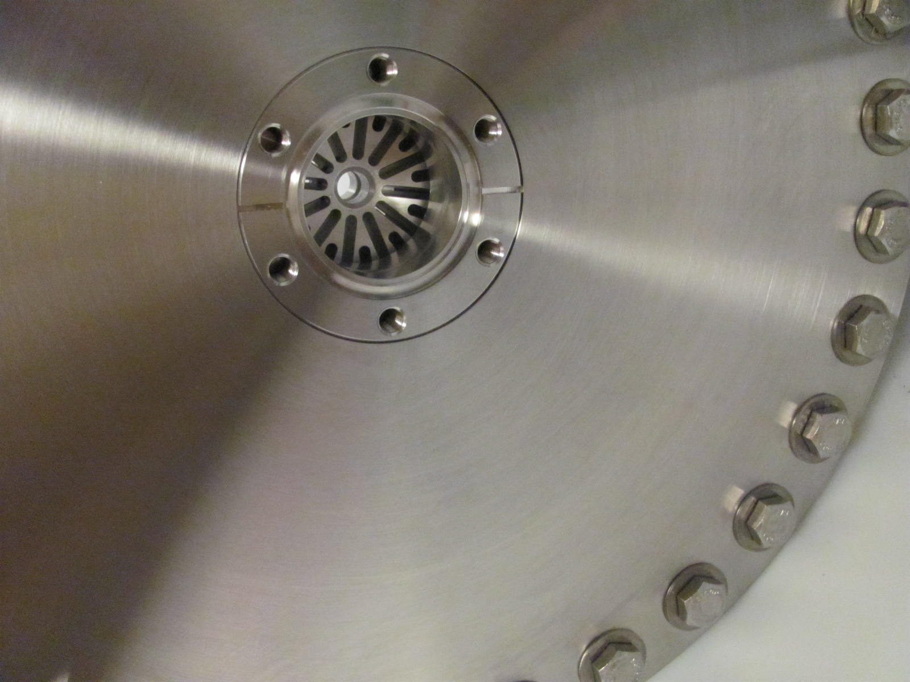
Installed at ITS
With beam delivered to dump, spectrum analysis shows harmonics visible to 18.396GHz, the 12th harmonic of 1533MHz (measurement made at 150kV, 25uA, superlattice cathode)

Slide 12
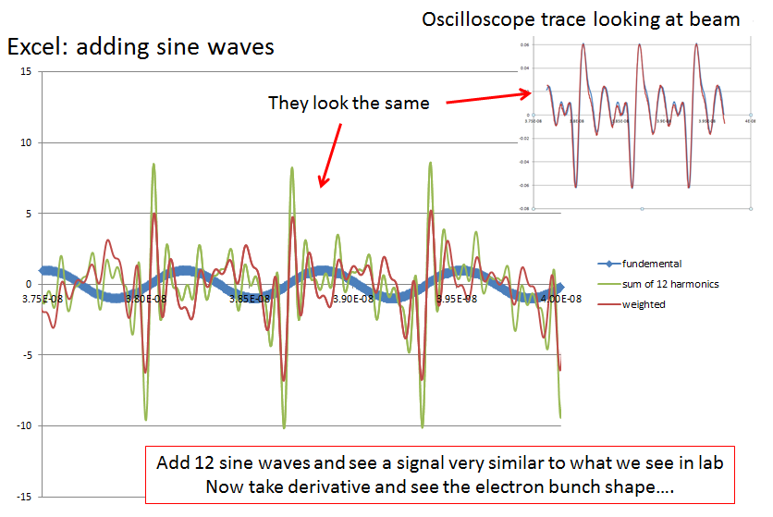
Bandwidth determines Resolution

Slide 13
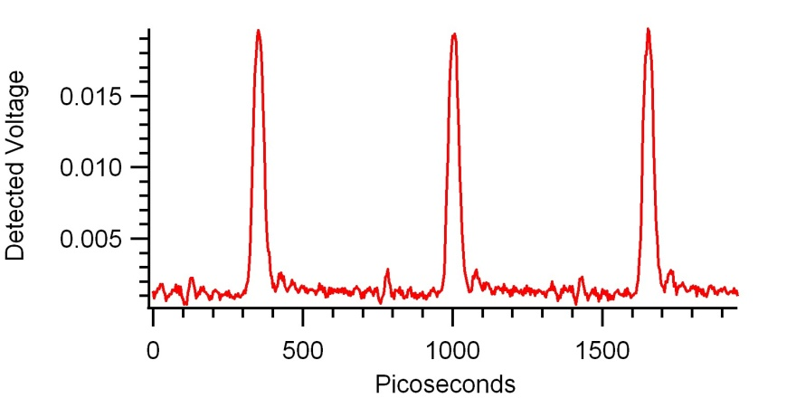
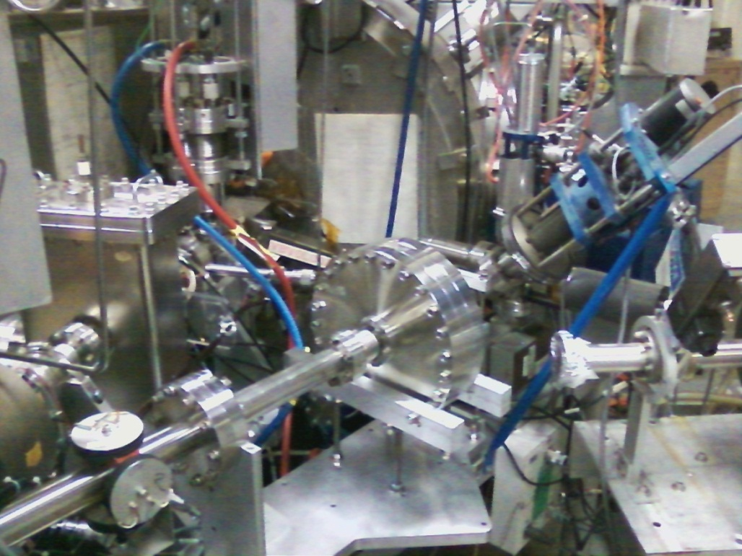
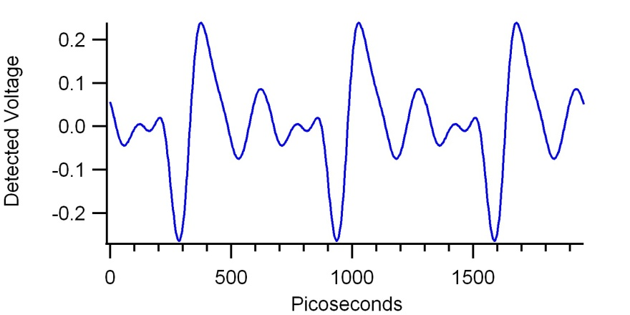
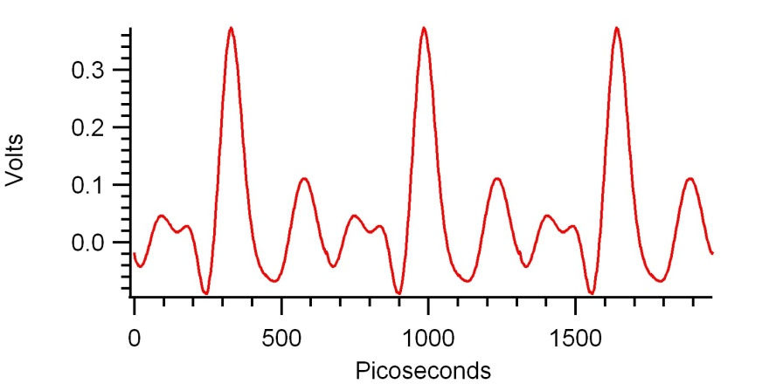
Laser optical pulse
At CEBAF 500 kV spectrometer line
(a)
O-scope Brock cavity
(b)
(c)
Brock will use RF model of cavity to see if it is sensitive to transverse beam motion and beam size variation…. helicity correlated beam size monitor?
Electron bunch
500 kV spectrometer line

Slide 14
Attenuator
IA
Rotatable GaAs
Photocathode
Gain-switched Diode Laser and Fiber Amplifier
LP HWP LP
PC WP LP
Shutter
Helicity Fiber
Helicity Generator
HV Supply
(0 – 90 V)
15° Dipole
nHelicity
Fiber
Vacuum
Window
Delayed
Helicity Fiber
T-Settle
Fiber
Hall
RHWP
Charge Feedback (IA)
V-Wien Filter
Target
Parity
DAQ
Spin Solenoids
BCM
Charge Feedback (PITA)
H-Wien Filter
BPMs
Position
Feedback
Pockels
Cell
HV Supply
(0 – 4 kV)
CEBAF
5 MeV
Helicity Magnets
PZT
Mirror
IHWP
Electron
Beam

Slide 15
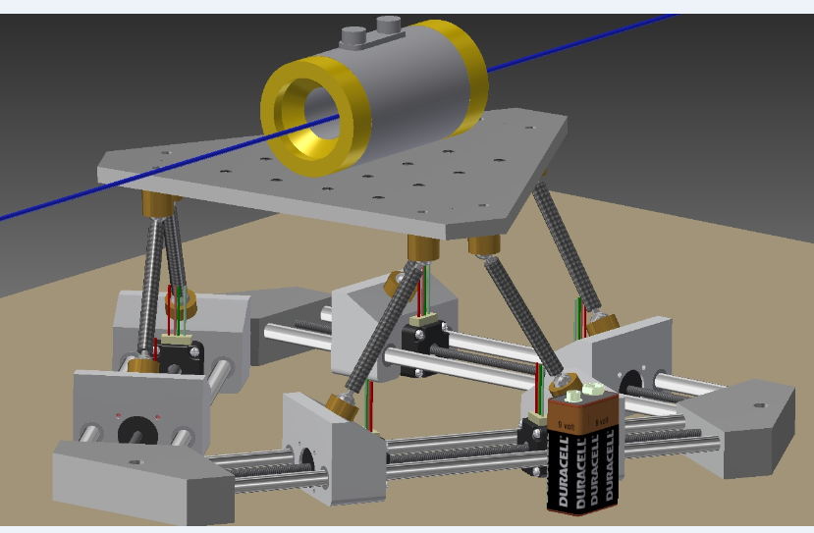
Stewart Platform: complete RC of PC alignment
LINUX-based software/freeware from hobbyists who build flight simulators
X, Y, pitch, roll and yaw

Slide 16
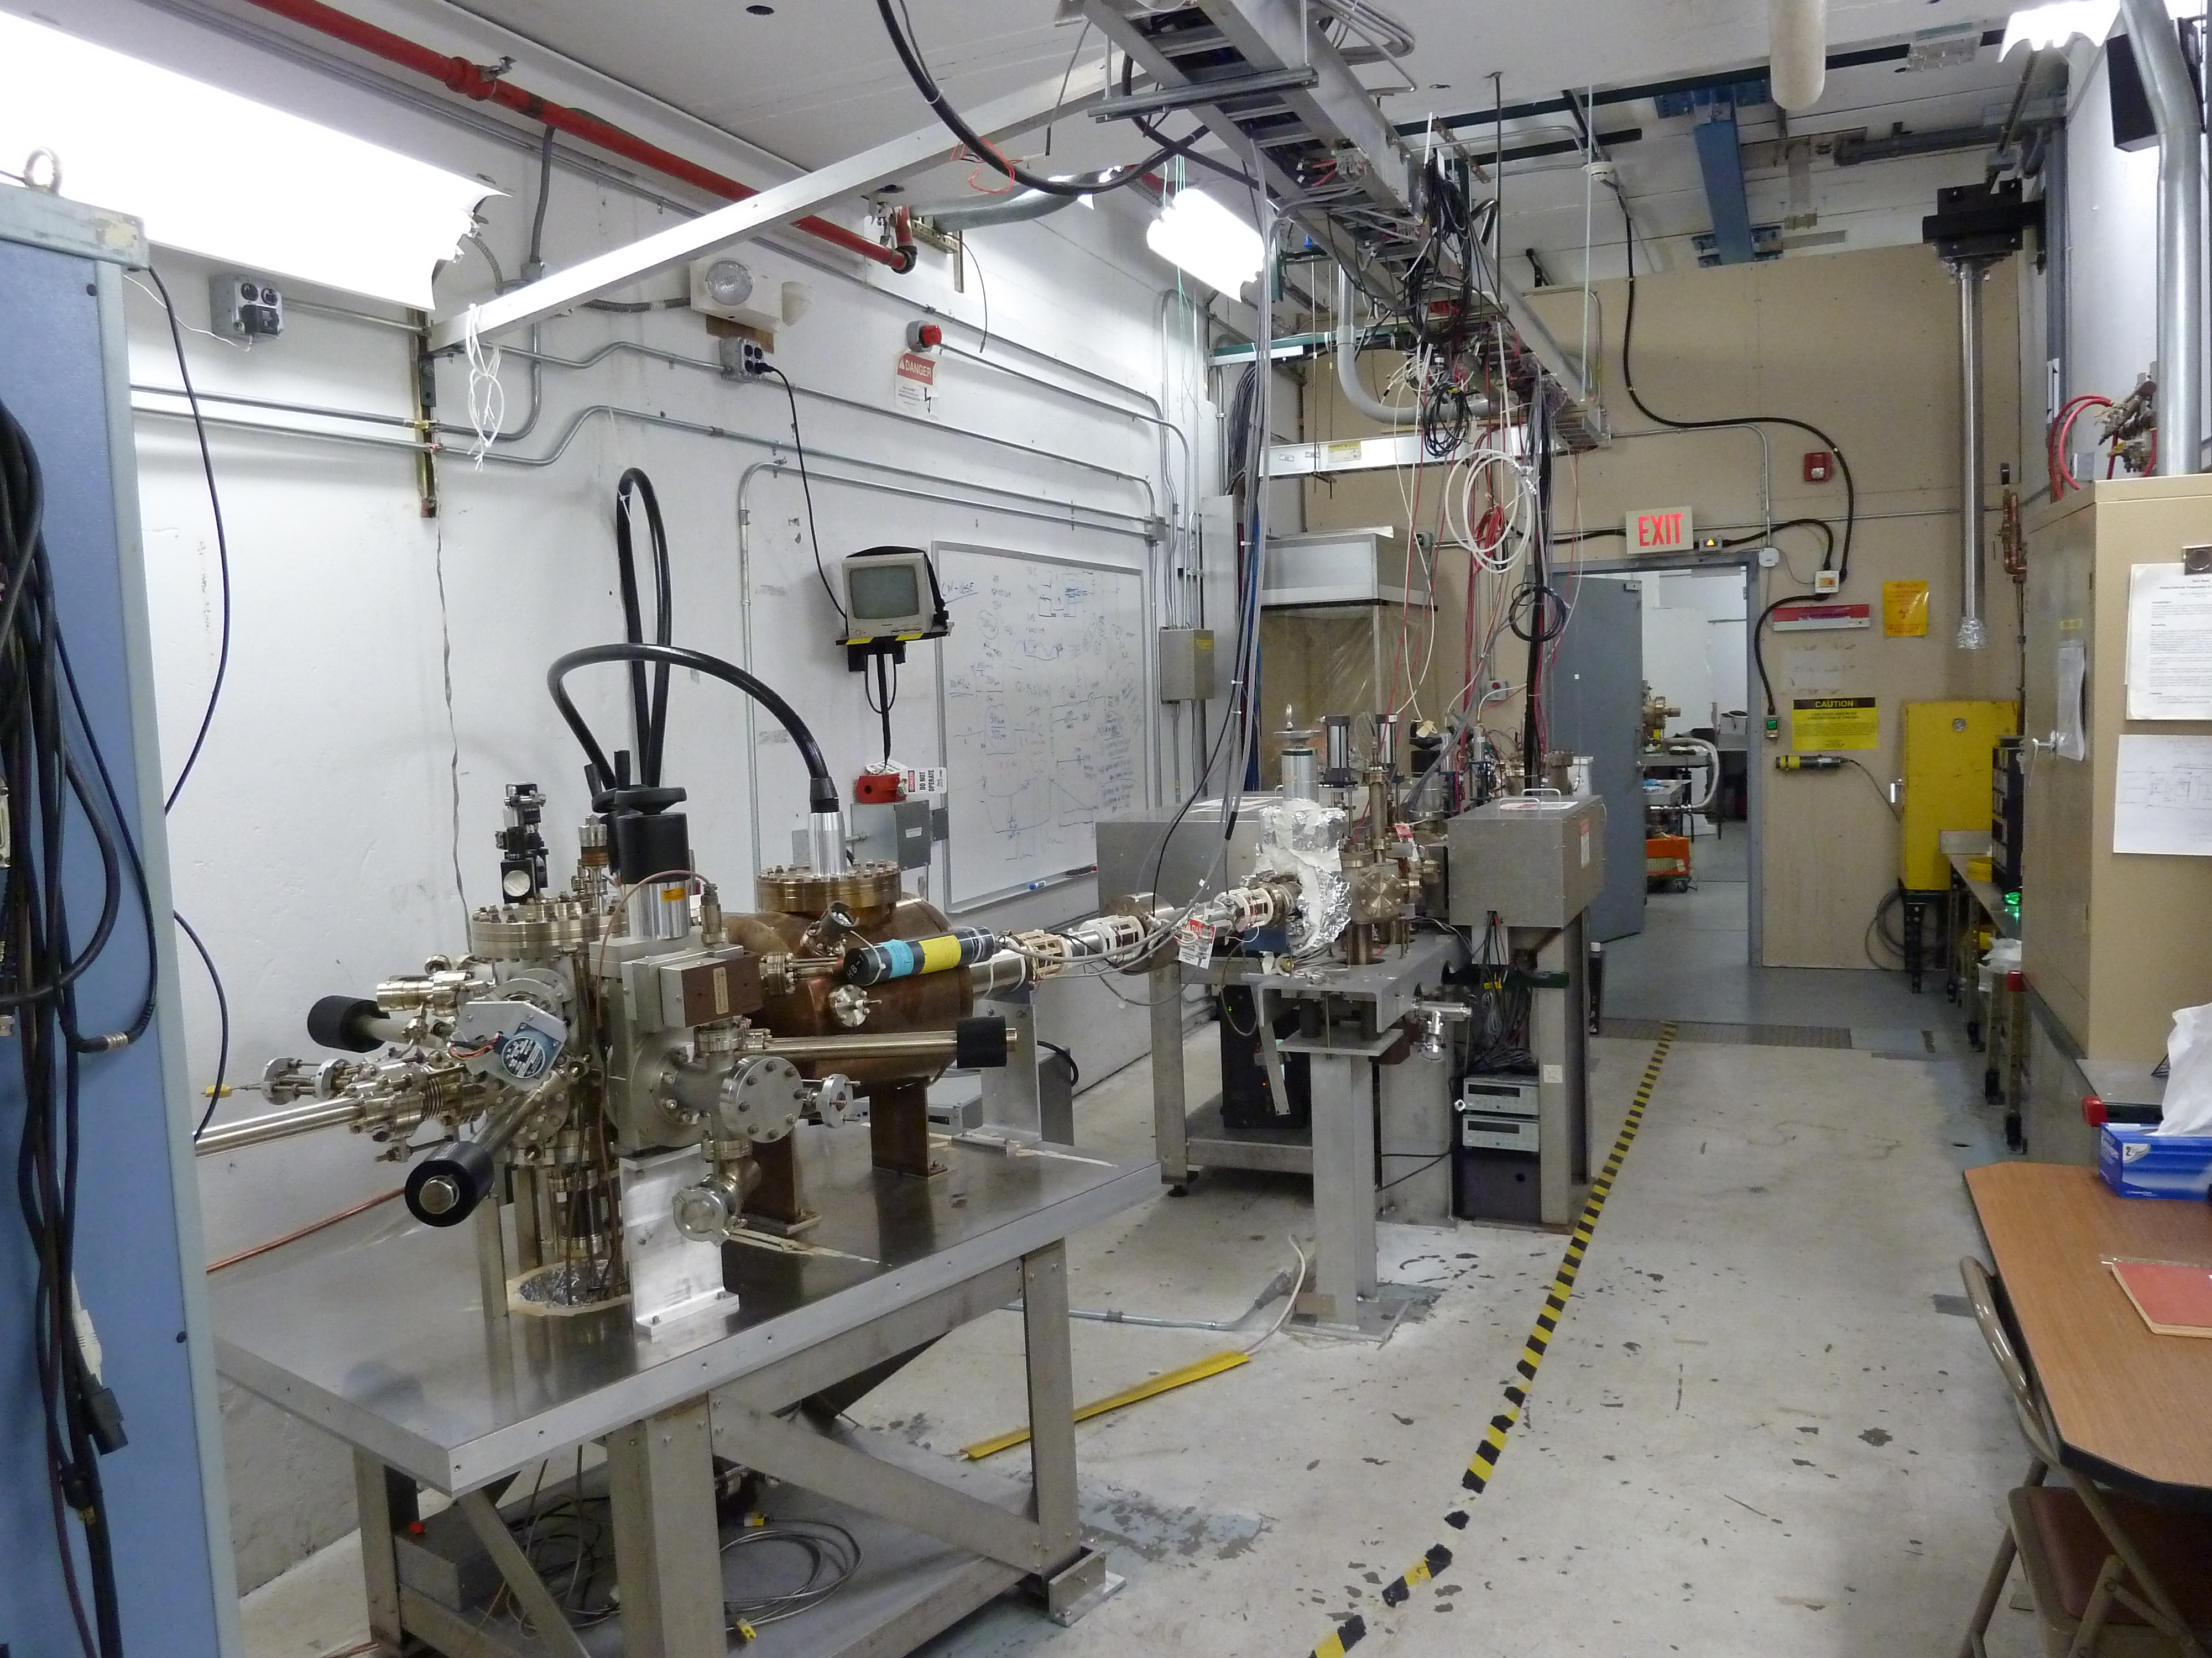
Load-locked photogun
and baked beamline:
Pressure ~ 4 e-12Torr

Slide 17
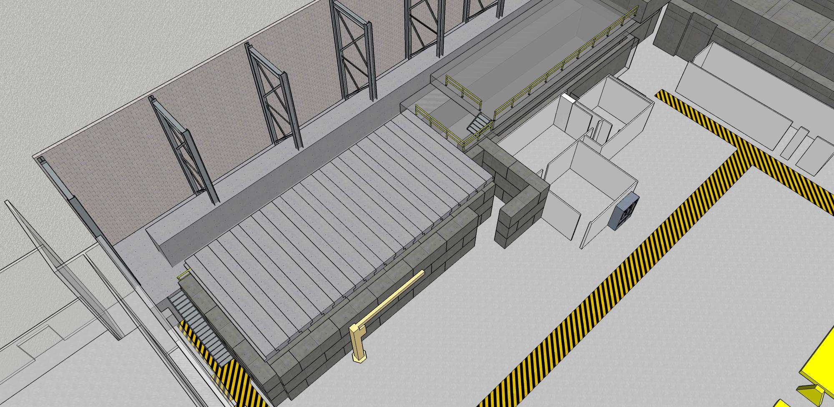

Slide 18
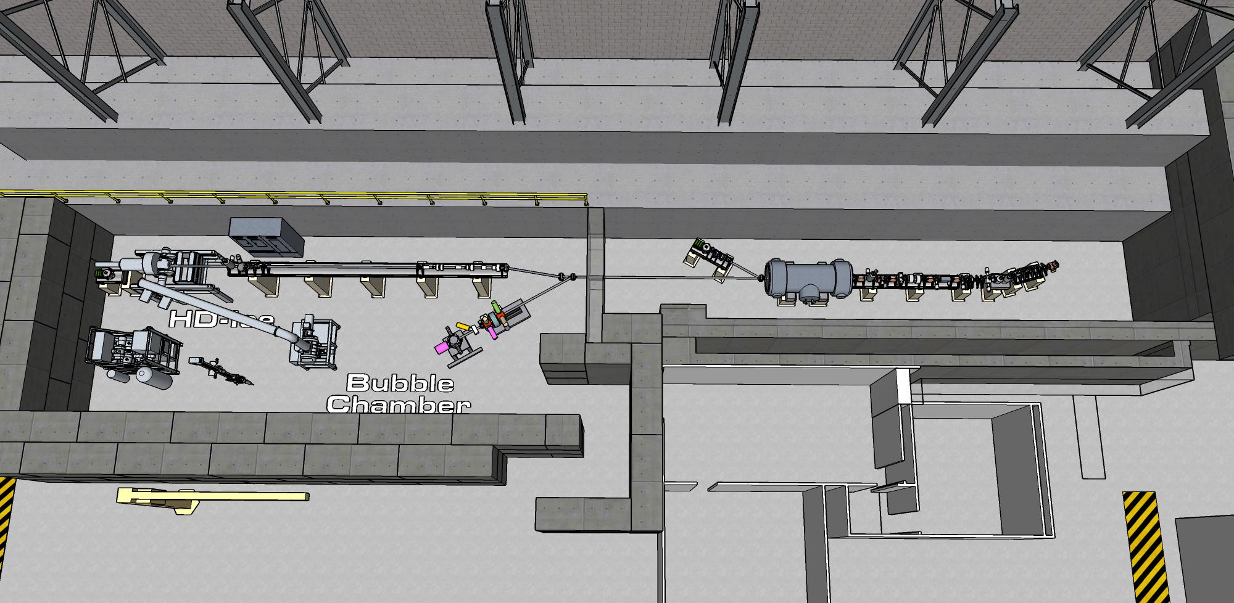

Slide 19
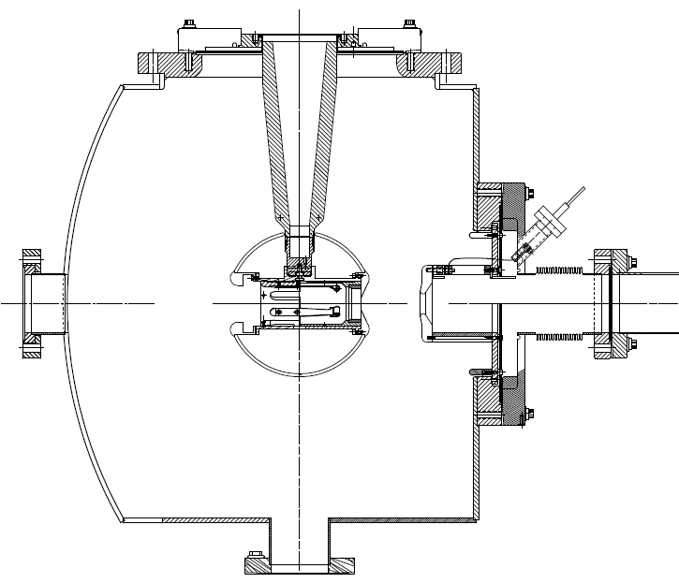
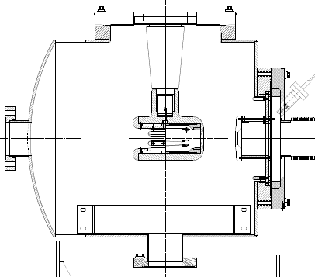
350kV Inverted Gun
200kV Inverted Gun
Longer insulator
Spherical electrode
Thin NEG sheet to move ground plane further away

Slide 20
12GeV CEBAF Commissioning Report
Arne Freyberger
Operations Dept.
Accelerator Division, JLAB
2014-04-08/09/10

Slide 21
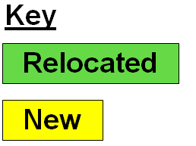
D+1
$507K
D+2
$1,946K
D+3
$2,581K
D+2 & D+3
$2,821K

Slide 22
Benchmarking PARMELA Simulation Results Against Beam-Based Measurements at CEBAF/Jefferson Lab – work of Ashwini Jayaprakash, JLab
Measurements at CEBAF/JLab
PARMELA Simulation Results
Similar Trends
Message: Beam quality, including transmission, improves at higher gun voltage

