Slide 1
HRSMC, A Geant4 Simulation for HRS
Jixie Zhang
CREX Collaboration Meeting
April 2014

Slide 2
Introduction
HRSMC is a Geant4 program developed to simulate the physics for HRS, especially for the G2P and GEP experiments. It was also designed to support other HRS experiments.
Geometry:
Full G2P|GEP geometry: g2p target, target field coil, g2p scattering chamber, local dump, septum, platform itself, 3rd arm
HRS QQDQ magnet geometry (no field, using SNAKE transportation )
BigBite
Hall A Neutron Detectors (HAND)
BoNuS RTPC
SuperBigBite
HMS
CREX: HallA scattering chamber, CREX target, Septum.
Fields: g2p chicane fields, target field, septum fields, BigBite field. HRS QQDQ fields are not included yet.
The HRS transportation came from the program SNAKE and MUDIFI.(Thanks to J. LeRose and M. Huang)

Slide 3
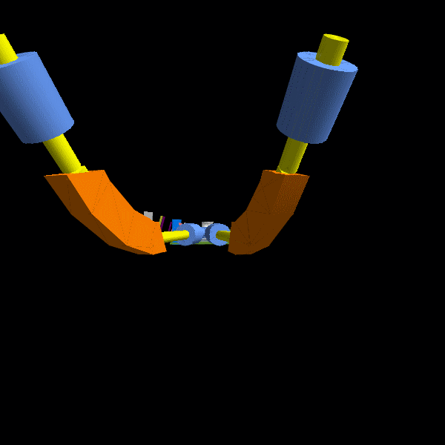
Geometries in HRSMC
Detectors and fields can be turned on or off in configuration files.

Slide 4
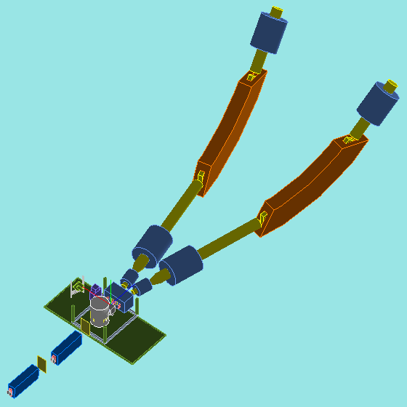
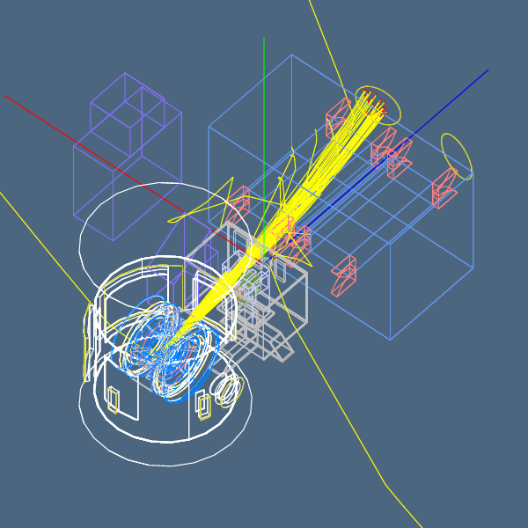
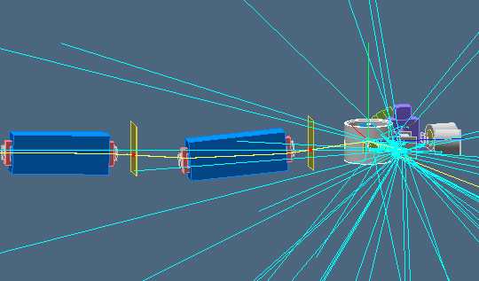
G2P|GEP Geometries
G2P|GEP Geometries include the following: chicane magnet, target platform, scattering chamber, target coil, target nose and the target itself, local dump, sieve slits, septum magnet, plastic shielding blocks, 3rd arm.

Slide 5
CREX Geometries
NO SNAKE model yet!
CREX Geometries include the following:
scattering chamber (need tuned), target
sieve slits (same as G2P’s)
septum magnet(same as G2P’s)
From http://ace.phys.virginia.edu/HAPPEX/2866

Slide 6
Reference

Slide 7
Target Reference

Slide 8
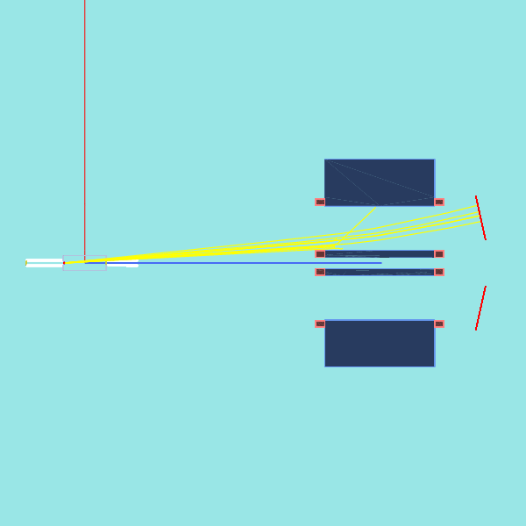
Adding New Geometries
Different experiments usually vary from geometries on the target platform.
Each target or detector is hard coded, associated with a configuration file to turn each individual component on or off.
RTPC
Detector_RTPC.ini
SBS
Detector_SBS.ini
HMS
Detector_HMS.ini
HRS
Detector.ini
G2P
Detector_G2P.ini
CREX
Detector_CREX.ini
XXX, Future Exp
Detector_XXX.ini
CREX target + G2P septum
HRSMC can support any new experiment by adding a new geometry class.
All sensitive detectors share a standard hit processing but vary in Sensirtive Detector ID. All hits will be recorded automatically.

Slide 9
How to simulate HRS
transportation and reconstruction
in G2P|GEP ?

Slide 10
Strategy for without Target Field
Vertex plane
Focal plane
Sieve plane
Virtual boundary
Target plane
Snake forward
Propagated by Geant4
Snake backward
Vertex to Sieve: propagated by Geant4 with a physics model (i.e. MSC, Decay, Ionization, EM physics...)
Sieve to Focal: linear project the particle from sieve to target then using SNAKE forward model, 8-10 software collimator cuts are applied along the trajectory to make sure that particle can really hit the focal plane.
Focal to target: using SNAKE backward model or real optics matrix.
Target to Vertex: linear projection.

Slide 11
Strategy for with Target Field
Vertex plane
Focal plane
Sieve plane
Virtual boundary
Target plane
Snake forward
Propagated by Geant4
Snake backward
Drift-In-Field
Vertex to Sieve: propagated by Geant4 with a physics model
Sieve to Focal: project sieve to target then using SNAKE forward model, 8-10 software collimator cuts are applied along the trajectory to make sure particle is really hitting the focal plane.
Focal to Sieve: using SNAKE backward model or real optics matrix from focal to target, then project from target to sieve.
Sieve to Target: using Drift-In-Field model.
Target to Vertex: using Drift-In-Field model.

Slide 12
Sieve to Focal
Vertex plane
Focal plane
Sieve plane
Virtual boundary
Target plane
Snake forward
Hit at sieve, propagated in Geant4
Image the hit at sieve plane to target plane, this is the effective vertex ... Very important
Sieve2Focal = Sieve2Target + Target2Focal
Sieve to Target: linear projection to get the effective vertex
Target to Focal: using SNAKE forward model to propagate effective vertex to focal plane, 8-10 software collimator cuts are applied along the trajectory to make sure particle is really hitting the focal plane.

Slide 13
Effective BPM X0_tr and Theta_tr
X0_tr is the BPM vertical measurement, it will be used to reconstruct the focal plane to the target plane. When the target field is on, the BPM measurement is no longer the one we should use in the NO target field SNAKE model.
Thrown variable in target plane
Variable in target plane imaged by NO target field SNAKE model
5.0 T target field

Slide 14
With Target Field: Focal to Sieve
Vertex plane
Focal plane
Sieve plane
Virtual boundary
Target plane
Snake backward
Drift-In-Field
Focal2Sieve = Focal2Target + Target2Sieve
Focal to Target: using SNAKE backward model or real optics matrix
Target2Sieve: linear projection
Sieve to Target: using Drift-In-Field model to swing the particle in a field.

Slide 15
HRS Transportation
HRS transportation function usually come from SNAKE and MUDIFI.
Always fitting from target plane to focal plane.
There will be 8 -10 end planes along the trajectory to make sure that the particle do not hot the magnet blocks.
Currently the following SNAKE models are ready to use:
Standard HRS, 12.5 degrees, NO septum
Two models of 6 degrees HRS with septum for E97-110. One is for larger X0 and the other is for normal X0
Several models of 5.65 degrees HRS with septum and 3 cm circular raster for G2P|GEP, varying in the active septum coils in the right septum: 48-48-16 No Shims, 48-48-16, 40-32-16 and 40-00-16
Can add more SANKE models (Min Huang and John LeRose are the experts)
Usually need to make correction in focal plane in order to match real data
Alternate method: use optics calibration result, generate data from focal plane to target, then run MUDIFI to fit a forward transportation function. this will guarantee to match the real data!

Slide 16
Documentation
Source code is available in SVN: https://jlabsvn.jlab.org/svnroot/halla/groups/g2p/HRSMC/
Instruction for Geant4 installation, environment setup and update history are available.
Usage manual will be printed by typing these commands:
HRSMC -h, HRSMC --h, HRSMC -help, HRSMC --help
Usage: HRSMC [option1 argument_list] [...] [optionN argument_list]
To get the detail usage of an option, just type 'help' after it. For example: HRSMC -physicsmodel help
Description for internal commands (html format) are already: https://jlabsvn.jlab.org/svnroot/halla/groups/g2p/HRSMC/Menu/
Output root ntuple structure description is ready here: https://jlabsvn.jlab.org/svnroot/halla/groups/g2p/HRSMC/HRS_nt_structure.txt
A lot of macro files and root scripts are available: https://jlabsvn.jlab.org/svnroot/halla/groups/g2p/HRSMC/macros

Slide 17
Resolution of HRSMC Using SNAKE Model 484816+shim, No Target Field
Raster=2.4cm, BPM resolution: 1 mm in vertical, No target field

Slide 18
Resolution of HRSMC Using SNAKE Model 484816+shim, Stop at Target Plane,5T
Raster=2.4cm, BPM resolution: 1 mm in vertical, 5.0 T target field
Reconstructed to the target center

Slide 19
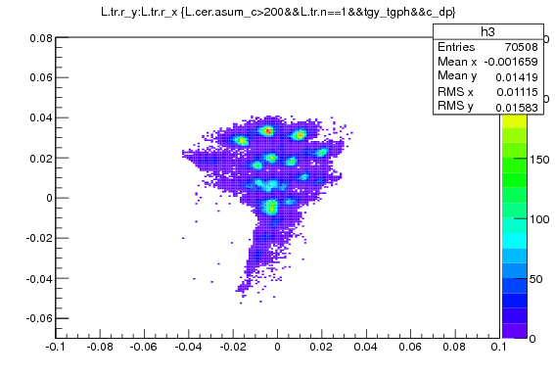
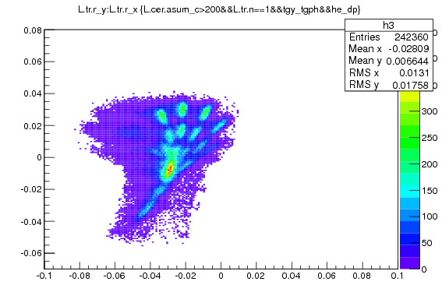
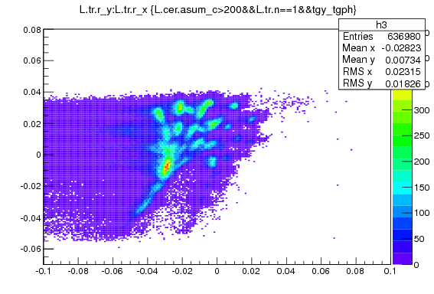
G2P Optics Data, All Sieve Holes
¹²C
⁴He
5.5 cm width
5.5 cm width
G2P Optics data:
HRS Angle = 5.7 deg
HRS P0 = 2.251 GeV/c
No target field
Delta_P = 4.4 MeV/C
Y_{fp}
¹²C and ⁴He
Can not separate in focal plane!
Thanks to M. Huang
X_{fp}

Slide 20
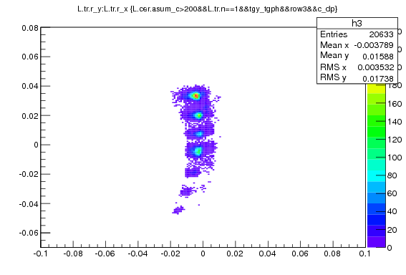
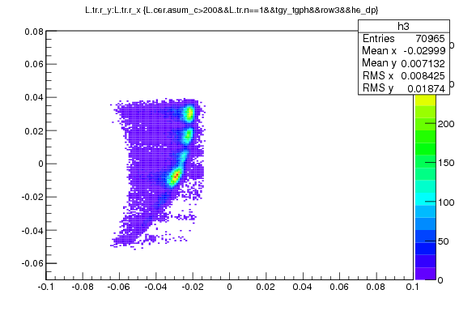
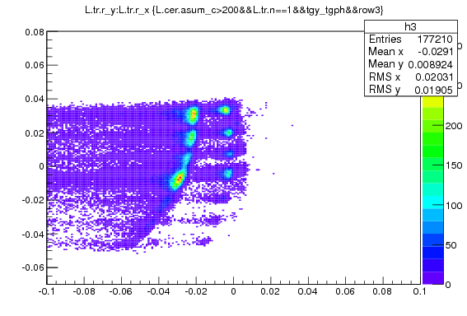
G2P Optics Data, 3rd Row Sieve Holes
¹²C
⁴He
G2P Optics data:
HRS Angle = 5.7 deg
HRS P0 = 2.251 GeV/c
No target field
Delta_P = 4.2 MeV/C
Y_{fp}
¹²C and ⁴He
Can separate in the focal plane if cut by vertical sieve position (Out-Plane-Angle|Position)
X_{fp}

Slide 21
To Separate 2 Elastic Peaks
Y_{fp}
¹²C and ⁴He
G2P Optics data:
HRS Angle = 5.7 deg
HRS P0 = 2.251 GeV/c
No target field
Delta_P = 4.2 MeV/C
X_{fp}
At center hole: dP = 0.19% ➔ dX_{fp} = 2.6 cm
To separate 2 elastic peaks in the focal plane without other helps, the difference between these 2 deltas should larger than 0.4%!
Only for NO Raster beam.

Slide 22
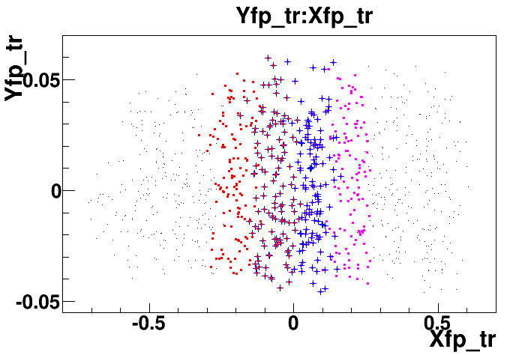
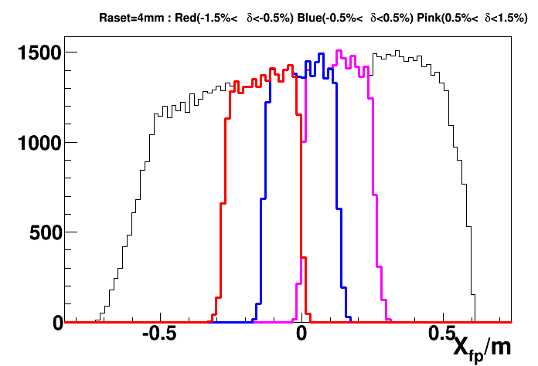
Test SNAKE: to Separate 2 Elastic Peaks
From snake: to separate 2 elastic peaks in the focal plane without other helps, the difference between these 2 deltas should larger than 1%!
For 4 mm raster beam. Not consider energy loss and multipole scattering yet for outgoing electrons.

Slide 23
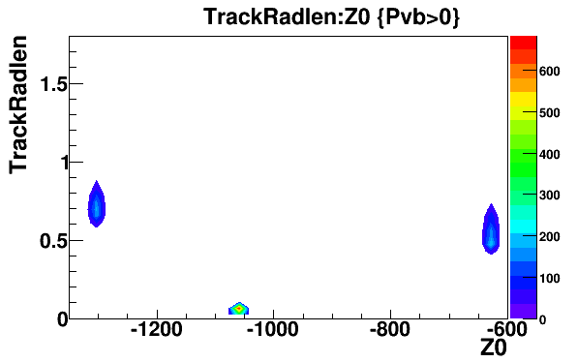
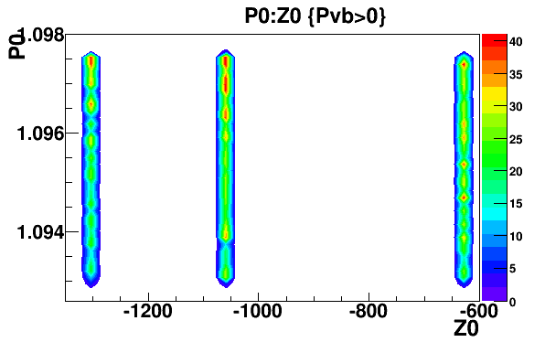
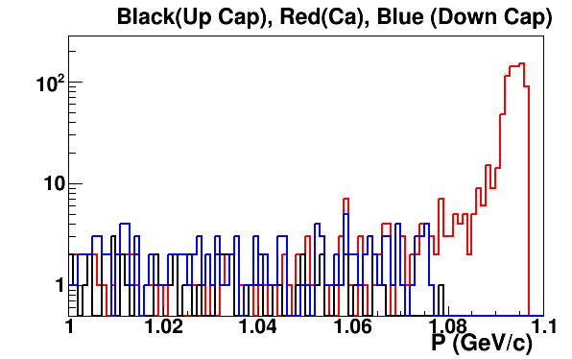
Geant4 Simulation: The Target
Momentum at Sieve Plane

Slide 24
Summary
HRSMC is designed for multiple HRS experiments, especially for G2P and GEP.
SBS, BB, HMS, HAND and RTPC are ready to use. It can be easily modified to support other experiments by adding the geometries.
HRSMC has been used to simulate the optics for G2P|GEP. We have another dedicated program, g2psim, too.
One can use real optics matrix to reconstruct simulated focal plane data. In other words, HRSMC can cross check the quality of optics matrix and help to improve it, which is useful for those experiments with large raster.
The strategy of the reconstruction with target field is:
No-Target-Field-HRS + Drift-Sieve-to-Target-in-field .
A lot advance features are included.
Need support for SNAKE models. Thanks to Min Huang and John, need their continuous contribution.

Slide 25
Acknowledgment
Thank John LeRose for providing guidance and SNAKE models
Thank Min Huang for providing SNAKE models and her hard work in optics optimization for real data
Thank Chao Gu for helping in both simulation and optics optimization
Thanks to all G2P Collaborators

