Slide 1




Spin Physics at STAR
W and Forward Physics
Akio Ogawa
BNL
2015 May 26
QCD Evolution 2015 @ Jlab

Slide 2

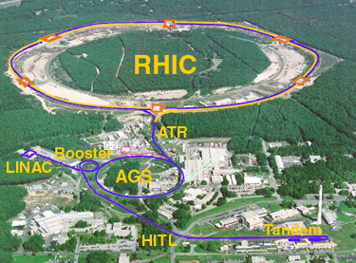
The Relativistic Heavy Ion Collider
Brhams
pp2pp
Au+Au
Polarized p+p
d+Au
Polarized p + Au
RHIC is a QCD lab
PHENIX
STAR

Slide 3
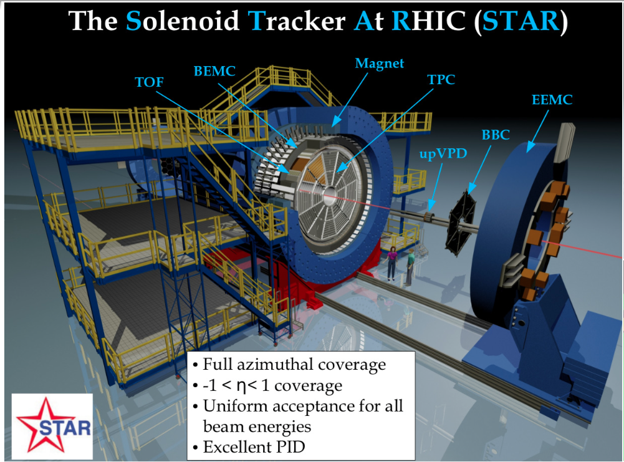

Slide 4
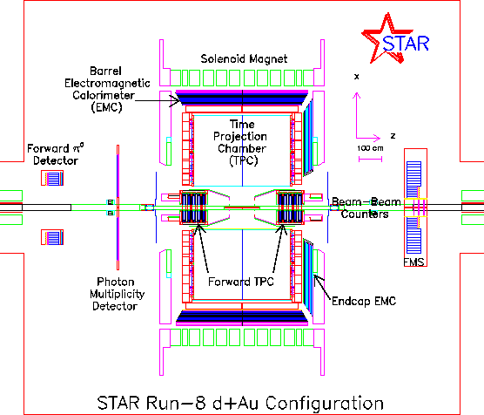
The STAR Detector
TPC: -1.4 < η < 1.4
BEMC: -1.0 < η < 1.0
EEMC: 1.0 < η < 2.0
FMS: 2.5 < η < 4.2
Mid Rapidity : Charged particles & EM Calorimeter
Forward Rapidity : EM Calorimeter

Slide 5
STAR Spin Program
Mid Rapidity TPC BEMC EEMC | Jet Di-Jet | σ High-x gluon density
 |  | A_{LL} Gluon Spin
 |  | A_{N} Collins
 |  | A_{N} IFF
 | W,Z | σ
 |  | A_{L} Sea Quark Spin
 |  | A_{N} Sivers
Forward Rapidity EEMC FMS | pi0, eta, EM-Jet (Photon, DY) | A_{LL} Gluon Spin
 |  | A_{N} Twist-3, Collins, Sivers
Roman-Pot | proton | Elastic and Diffraction
R. Fatemi’s
talk
This talk
Wide range of physics in the past and future !

Slide 6
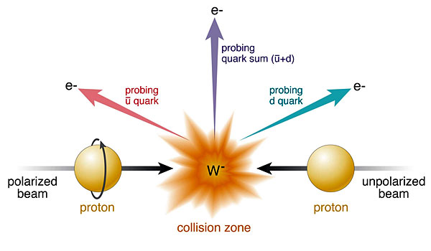

Physics with W⁺/W⁻/Z⁰
Sensitive to u-bar & d-bar at
x>0.1
very high Q²
Single Longitudinal Spin Parity Violating A_{L}
Single Transverse Spin A_{N}
Sivers effect and its sign change:
TMD Q² Evolution
(Unpolarized) W⁺/W⁻ cross section ratio
Sivers_{DIS} = - Sivers (DY or W or Z)

Slide 7
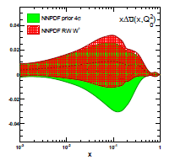
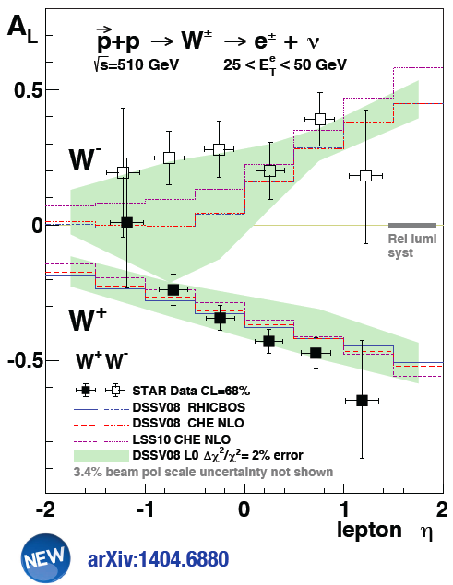

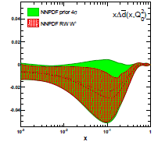

W A_{L} Results
first result from muon arms
arXiv:1406.5539

Slide 8
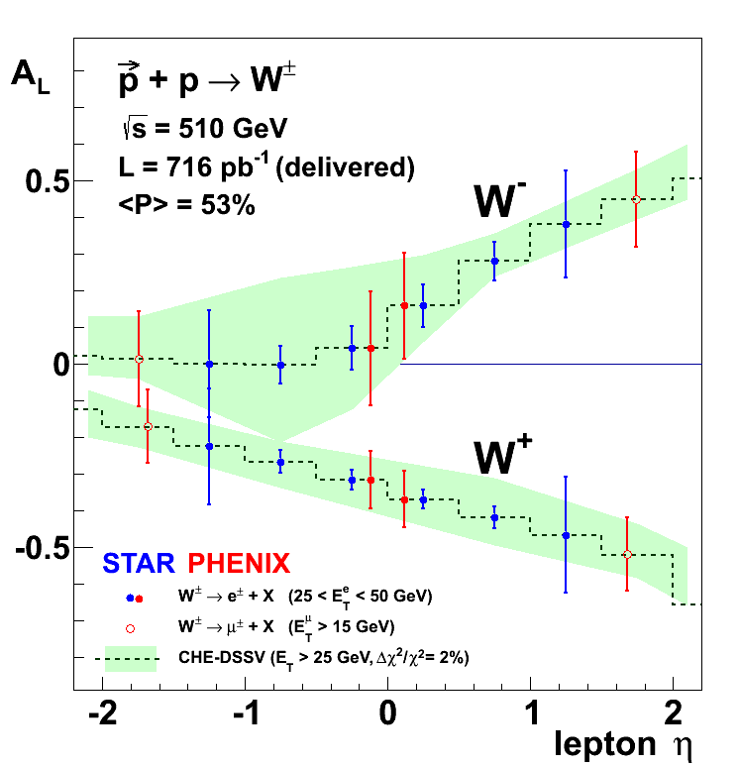
“On tape” W-Pseudo-Results
Pseudo-data randomized around DSSV
uncertainties correspond to 2009-2013
arXiv:1304.079
RHIC W± data will be a strong constraint for

Slide 9
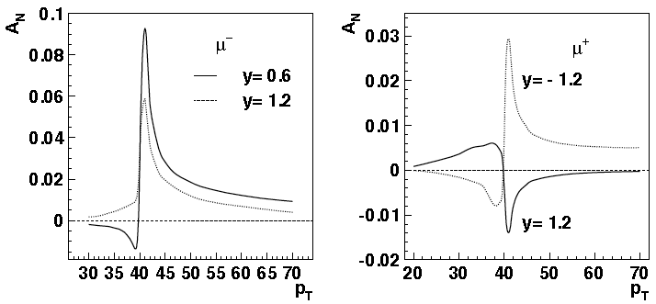
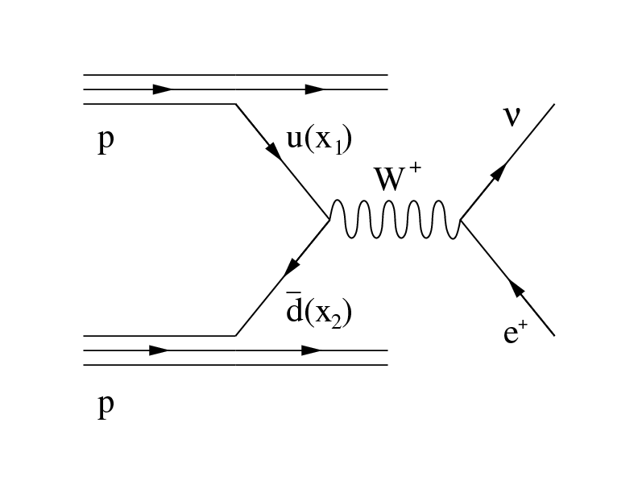
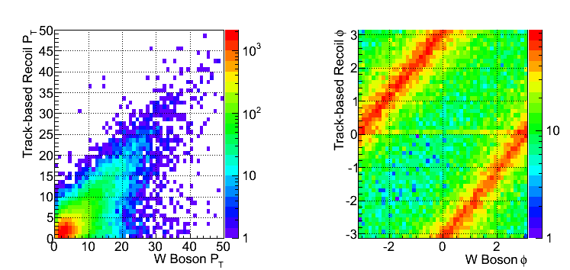
W reconstruction with recoil
Decay Lepton Asymmetries
Decay lepton A_{N} is small and hard to measure
W p_{T} ~ few GeV << ~40GeV from W decay
Z.-B. Kang & J.-W. Qui arXiv:0903.3629
W momentum reconstruction well tested at FermiLab and LHC
[CDF: PRD 70, 032004 (2004); ATLAS: JHEP 1012 (2010) 060]

Slide 10
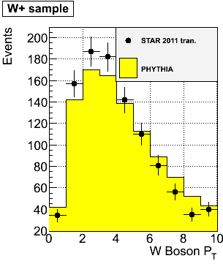
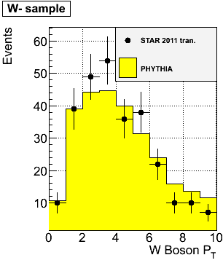
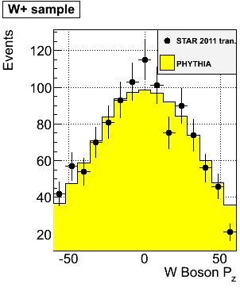
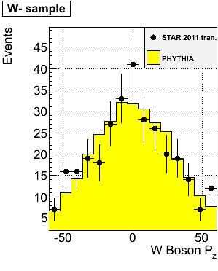
W kinematics reconstruction
Data vs MC comparison for W p_{T} and P_{Z}
Track-P_{T} in the recoil > 0.2 GeV
Total recoil-P_{T} > 0.5 GeV
Good data/MC agreement for reconstructed P_{T} of W⁺ and W⁻
This enables W A_{N} measurement
This helps W⁺/W⁻ x-section ratio

Slide 11
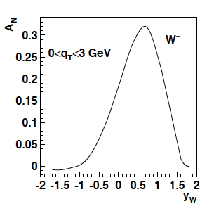
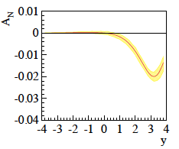
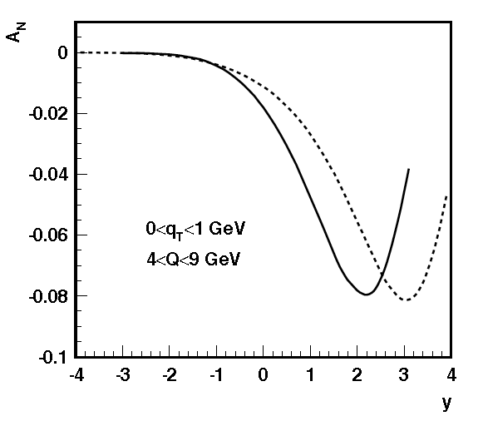
The TMD evolution
Z.-B. Kang & J.-W. Qui arXiv:0903.3629
Z. Kang: original paper arXiv:1401.5078
before evolution
after evolution
much stronger than
any other known
evolution effects
needs input from
data to constrain
non-perturbative
part in TMD evolution
current data extremely limited
further constraints
cannot come from fixed
target SIDIS
→ too small lever arm in
Q² & p_{T}
STAR W (and DY) data will
be the key measurement
for Sivers (TMD) evolution
÷ ~10
Z.-B. Kang & J.-W. Qui Phys.Rev.D81:054020,2010
Z. Kang et al. arXiv:1401.5078
before evolution
after evolution
DY
÷ ~4
200 GeV
500 GeV
4 < Q < 9 GeV
0 < q_{T} <1 GeV

Slide 12
W A_{N} Results
Run2011 transverse spin → 25/pb and P=53%
Systematics estimated via a Monte Carlo
We use the “left-right” formula to cancel dependencies on geometry and luminosity

Slide 13
Z⁰ Asymmetry
Clean experimental momentum reconstruction
Negligible background
electrons rapidity peaks within tracker accept. (|η|< 1)
Statistics limited
Z⁰ boson selection criteria
Two tracks each pointing to a cluster (no isolation requirements)
E_{T} > 25 GeV for both candidates
The two candidate tracks have opposite charge
|Zvertex|< 100 cm
Invariant Mass within ± 20% from the nominal M_{Z}
A_{N} measured in a single y, P_{T} bin
2011 pp-tran. ~25 pb⁻¹: 50 events pass selection

Slide 14
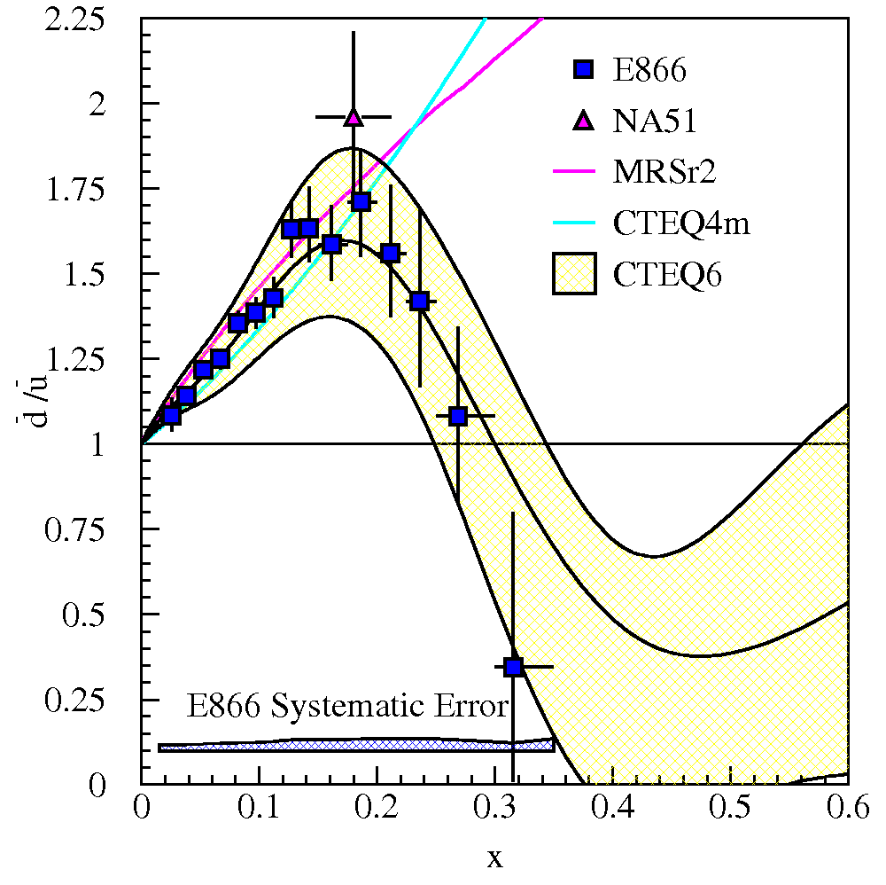
unpolarized W+/W- ratios
Current data: E866/NuSea (Drell-Yan)
Unpolarized asymmetries: Quantitative calculation of Pauli blocking does not explain ratio
→ Non-pQCD effects are large for sea quarks?
LHC coverage: ~10⁻³ < x < 10⁻¹
RHIC coverage: x > ~10⁻¹
STAR data
pp – run11 transverse @ √500 GeV Integrated Luminosity ~25 pb⁻¹
pp – run12 long @ √510 GeV Integrated luminosity: ~ 77 pb⁻¹
Total Int. lumi: 102 pb⁻¹

Slide 15
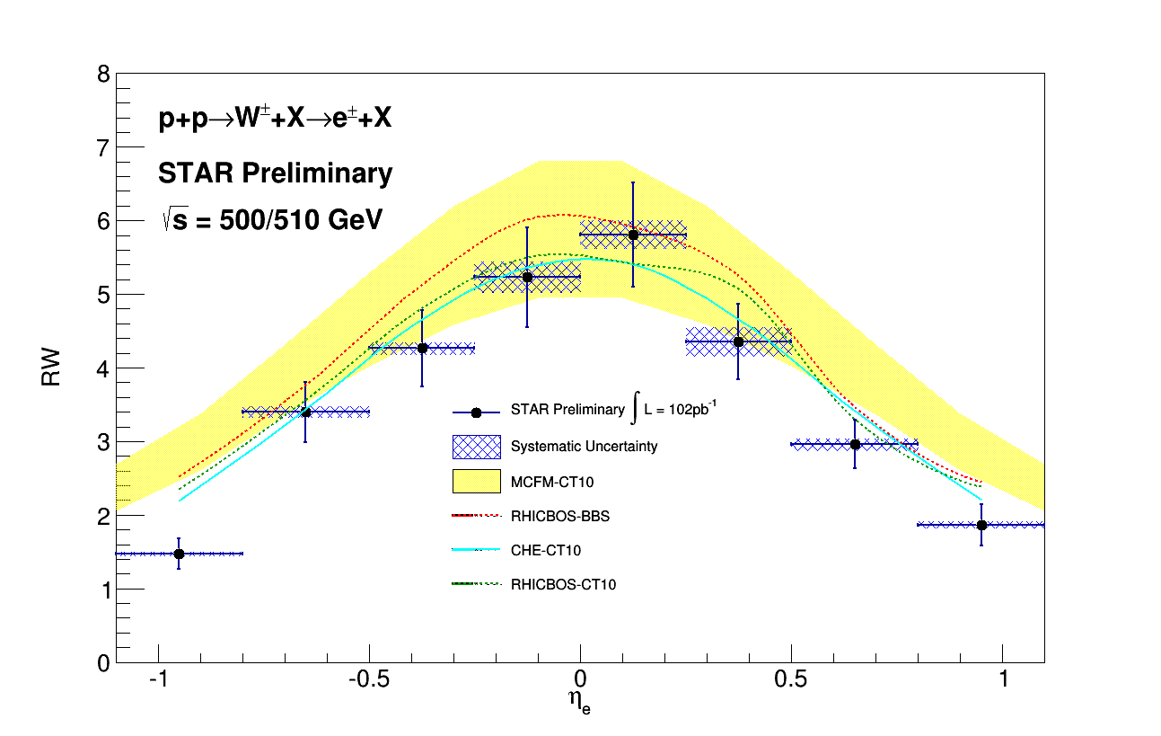
W+/W- versus Electron-Eta
Collected Lumi = 102 pb⁻¹
σ(W+) / σ(W-)
Systematics uncertainties (blue shades) come from background subtraction:

Slide 16
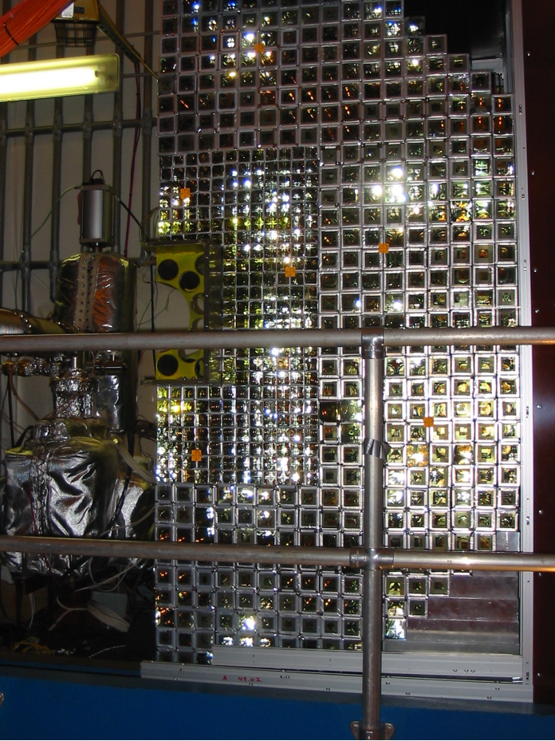
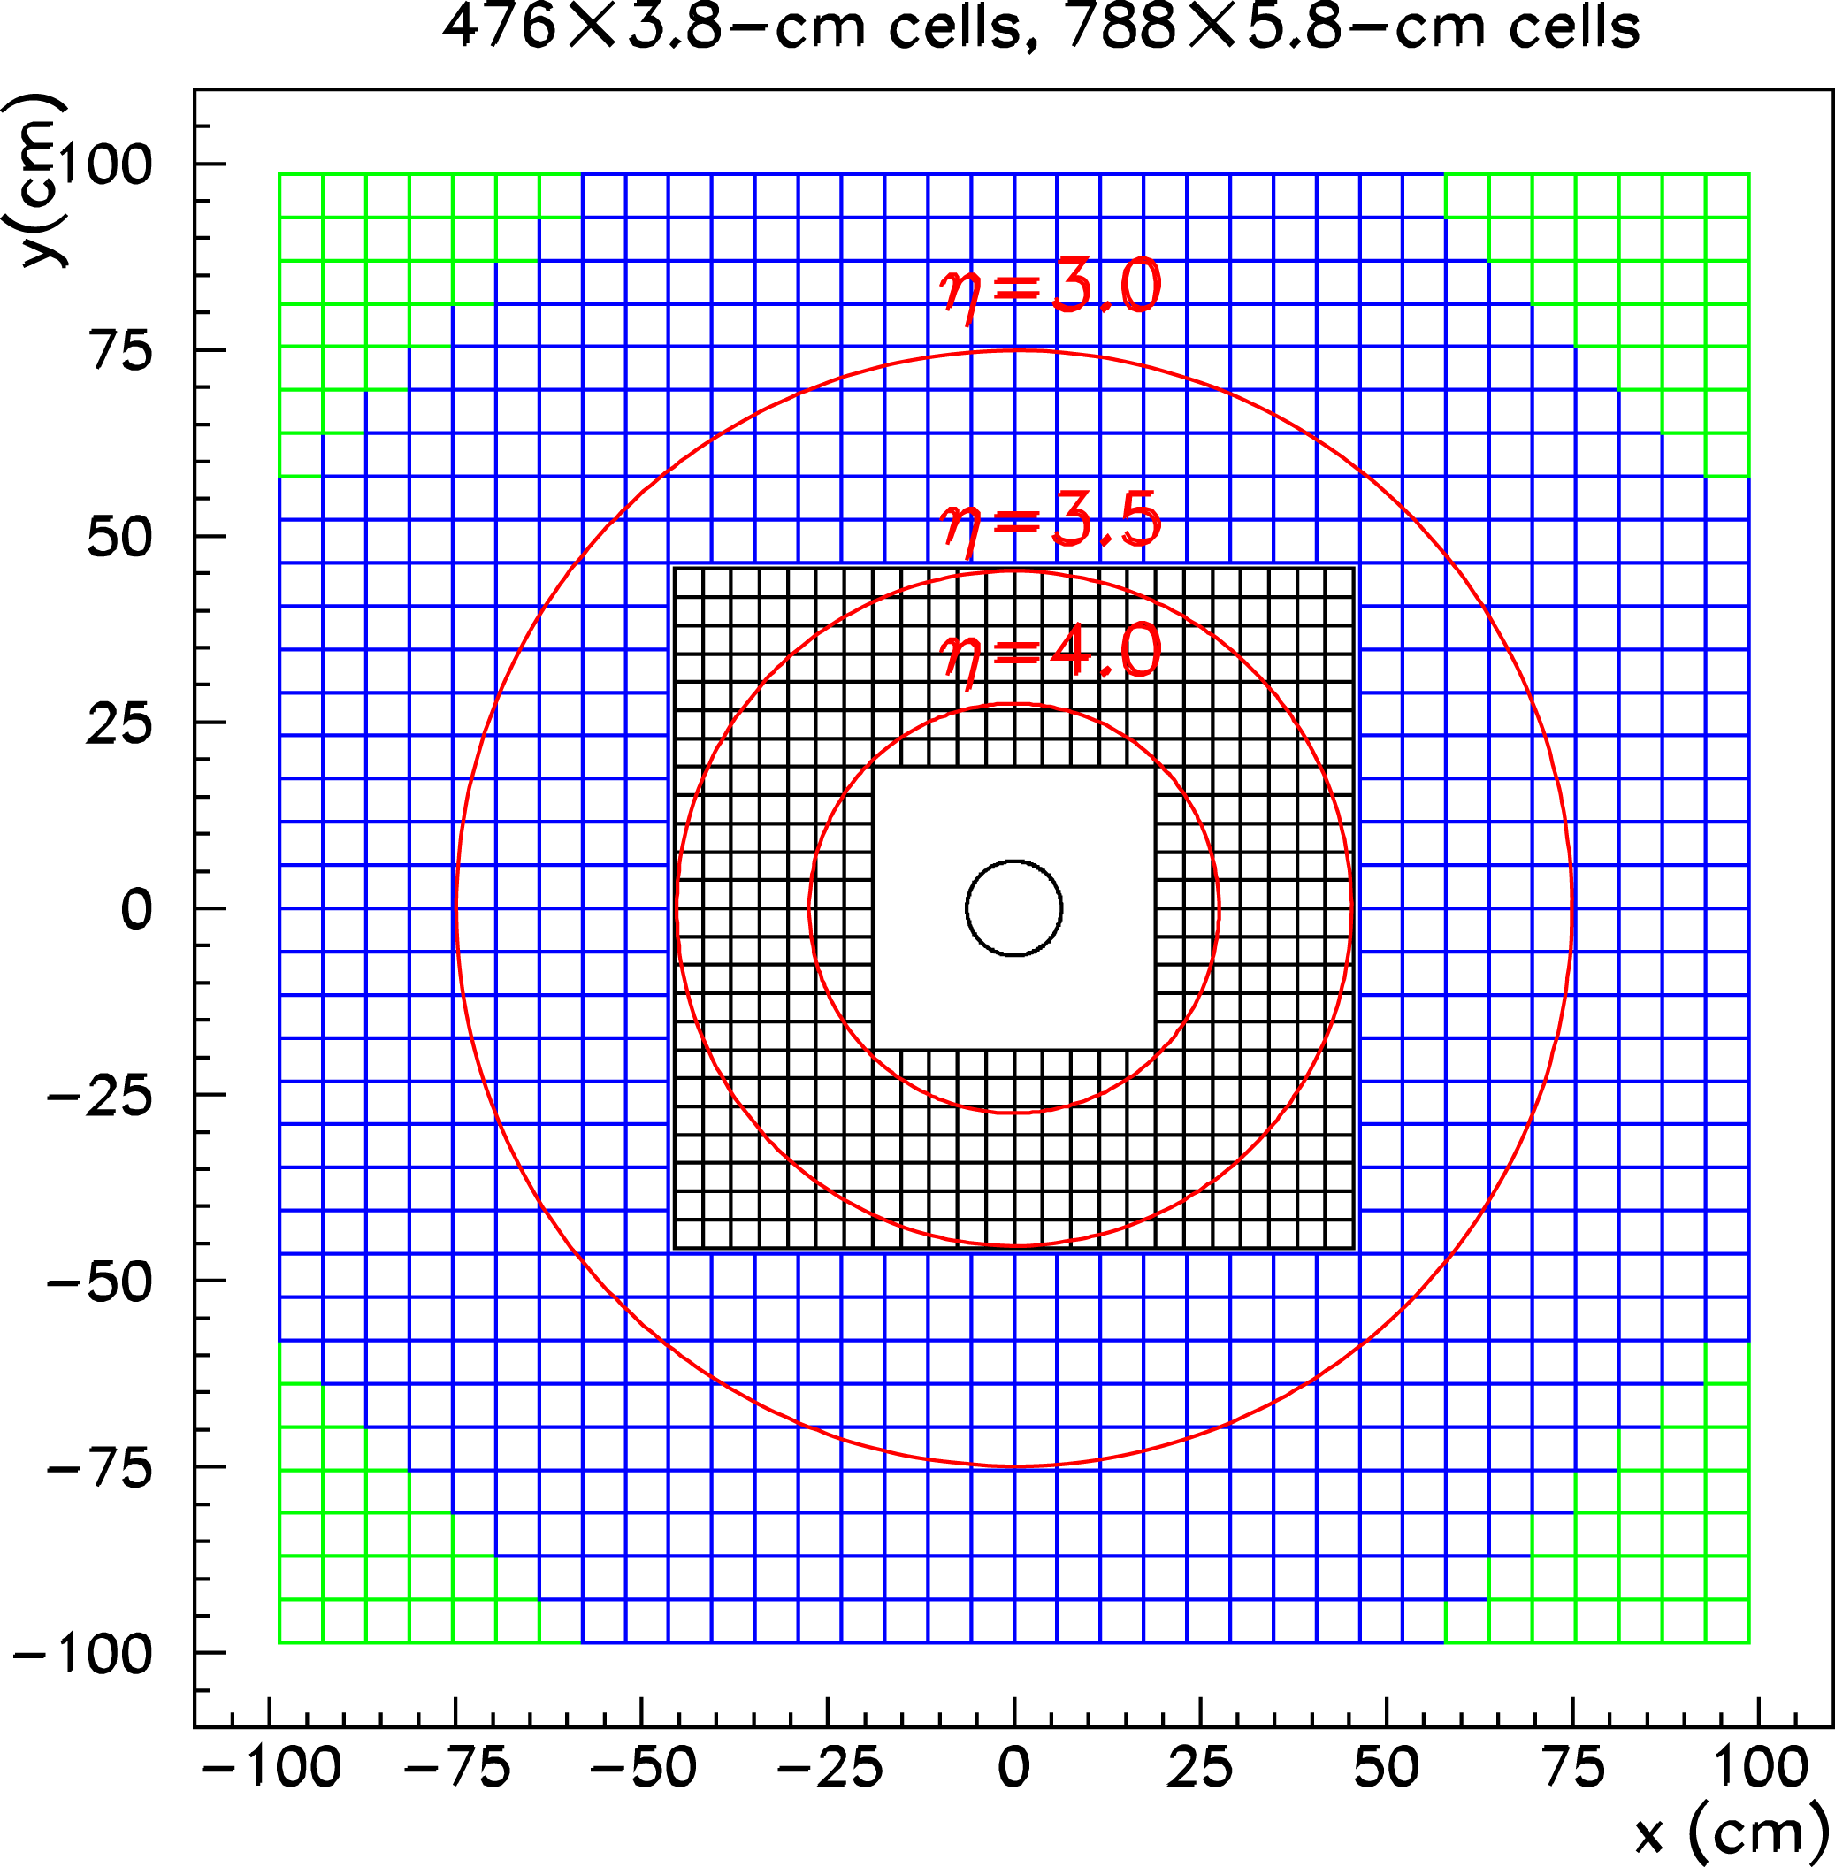
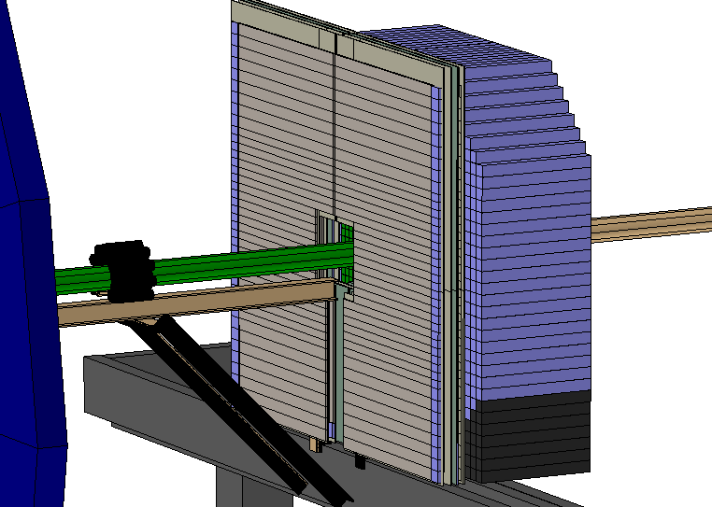
Forward Physics

Slide 17
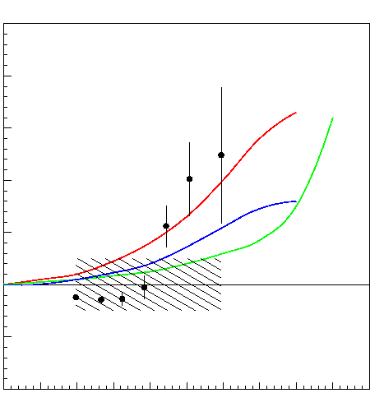
13 years ago @ SPIN2002
A_{N} (π⁰)
Theory predictions
at p_{T} = 1.5 GeV/c
Collins effect
Anselmino, et al.
PRD 60 (1999) 054027.
Sivers effect
Anselmino, et al.
Phys. Lett. B442 (1998) 470.
Twist 3 effect
Qiu and Sterman,
Phys. Rev. D59 (1998) 014004.
STAR FPD Preliminary Data
Assuming A_{N}(CNI)= 0.013
p_{T}=1.1 - 2.5 GeV/c
0.4
0.2
0.0
sqrt(s)=200GeV
-0.2
x_{F} ~ E / 100 GeV
0
0.2
0.4
0.6
0.8
1.0

Slide 18
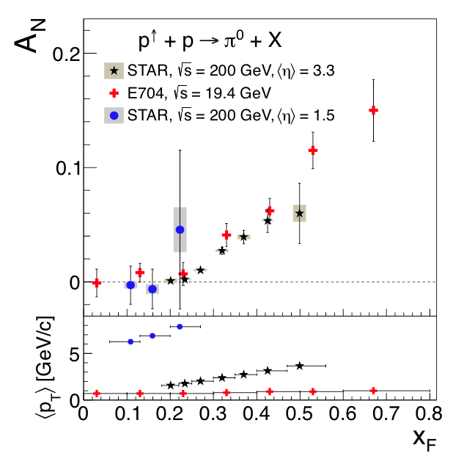
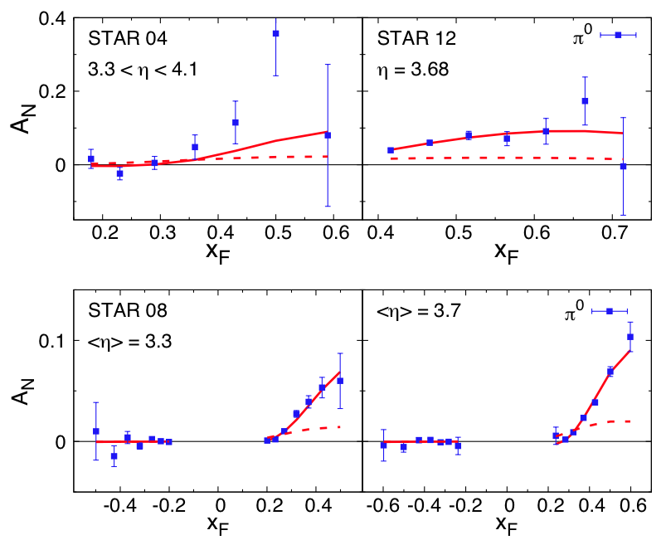
Inclusive pi0 A_{N}
A_{N} from STAR FMS and EEMC
arXiv:1404.1033
“We show for the first time that it is possible to simultaneously describe spin/azimuthal asymmetries in proton-proton collisions, semi-inclusive deep-inelastic scattering, and electron-positron annihilation”

Slide 19
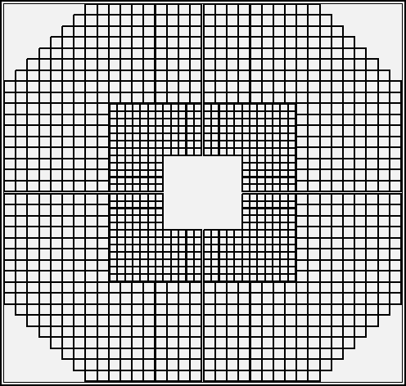
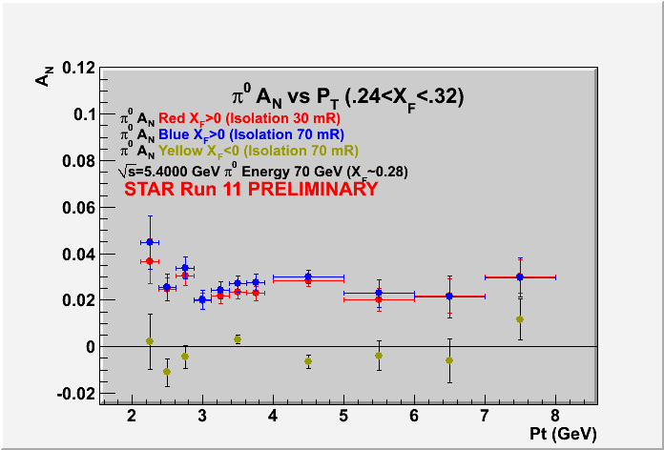
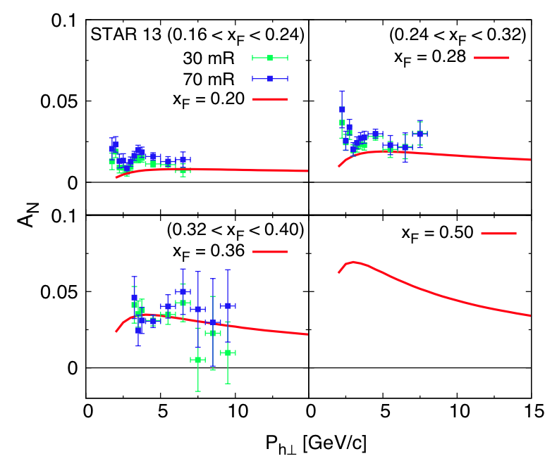
Pi0 A_{N} P_{T} Dependence

Slide 20
Inclusive pi0 A_{N}
arXiv:1404.1033
“We repeat that the fragmentation contribution in twist-3 factorization goes beyond the pure Collins effect. Independent information on the FFs H^{π/q}, Hˆ^{π/q},I from other sources is needed before one can ultimately claim the intriguing data on A_{N}^{π} is fully understood.”
Kanazawa,Koike,Metz,Pitonyak

Slide 21
“EM-Jet”
EM-Jet Energy 60-80 GeV
# Jets
dE/d(ΔR) (arbitrary scale)
No. of photons in leading EM-Jets
EM-Jet Energy 60-80 GeV
Z _{ϒϒ}<0.8, no. photons =2
# Jets
dE/d(ΔR) distribution of EM-Jets
2-photon jets are mostly π⁰
Events with more than 2 photons show
jet-like energy flow
m_{γγ} (GeV/c²)
γγ invariant mass 2-photon EM-jets

Slide 22
A_{N} for different # photons in EM-Jets
1-photon events, which include a large π⁰ contribution in this analysis, are similar to 2-photon events
Three-photon jet-like events have a clear non-zero asymmetry, but substantially smaller than that for isolated π⁰’s
A_{N} decreases as the event complexity increases (i.e., the "jettiness”
A_{N} for #photons >5 is similar to that for #photons = 5
Jettier events

Slide 23
A_{N} vs. EM-Jet Energy
π⁰-Jets
2γ-EM-Jets with
m_{γγ} <0.3 GeV/c²
Z_{γγ} <0.8
EM-Jets
with no. photons >2
Asymmetries for jettier events are much smaller

Slide 24
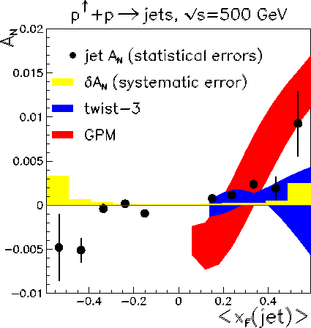
Jet A_{N} at A_{N}DY
From fits to SIDIS Sivers moments
Projected for pp forward jet A_{N}
M. Anselmino et al
PhysRevD.88.054023
arXiv:1304.7691
Leonard Gamberg, Zhong-Bo Kang, Alexei Prokudin
Phys. Rev. Lett. 110, 232301(2013)
arXiv:1302.3218

Slide 25
Collins Asymmetry with EM-Jet
Collins angle and Z_{EM} are calculated w.r.t. the “EM-Jet”
Background asymmetries are subtracted statistically
One sided systematic uncertainty accounts for Collins angle resolution
Hint of possible non-zero Collins asymmetries for pi0?

Slide 26
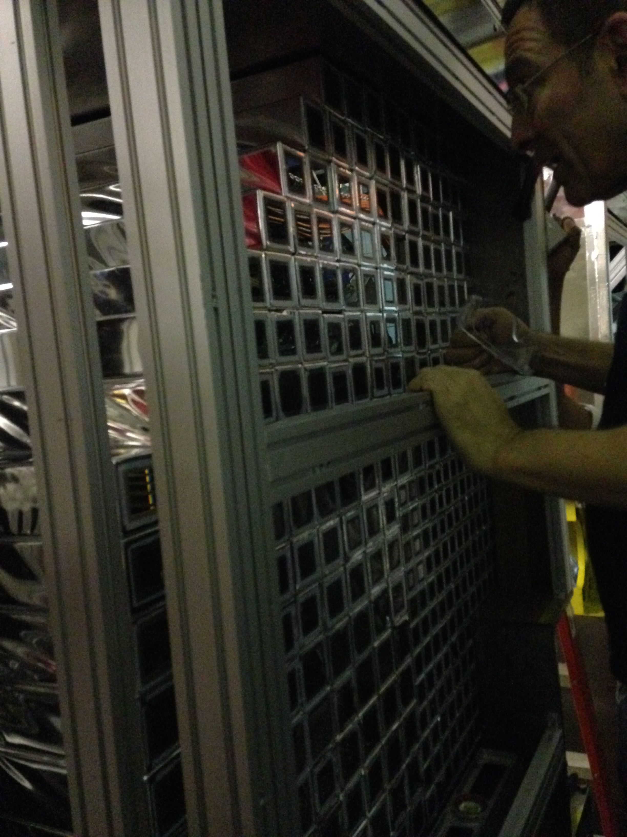
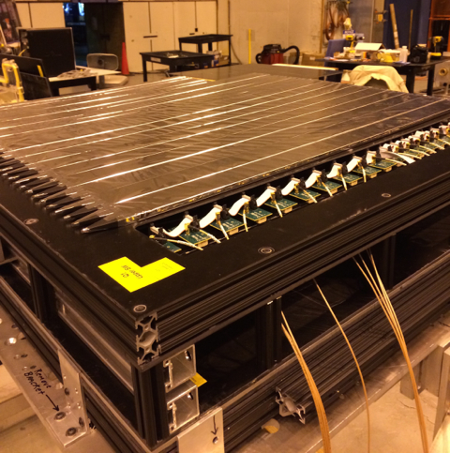
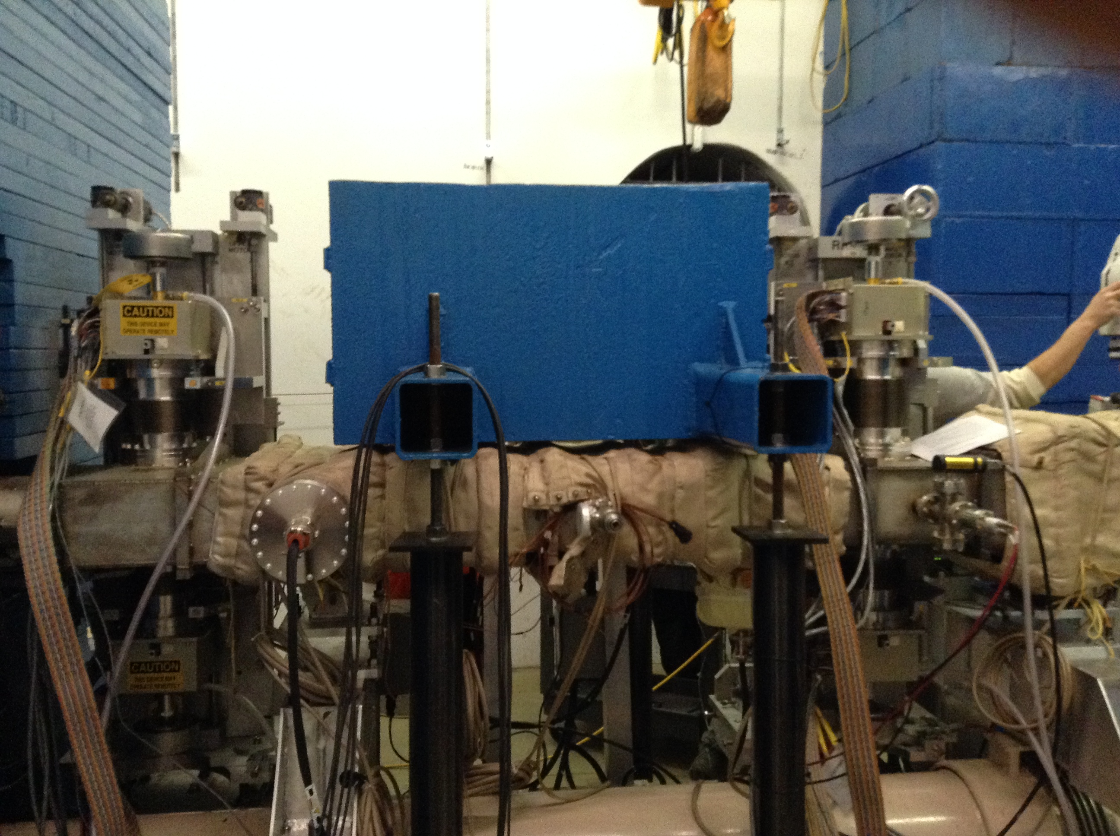
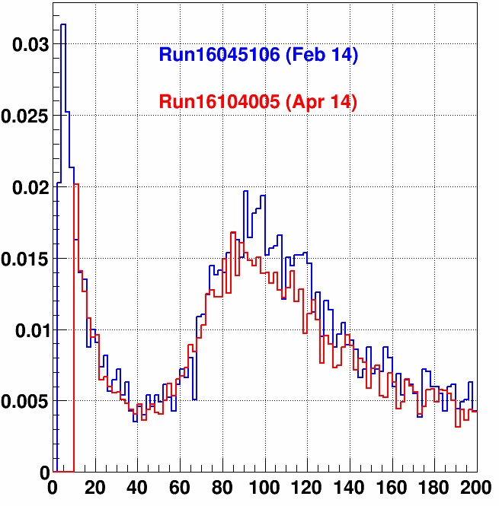
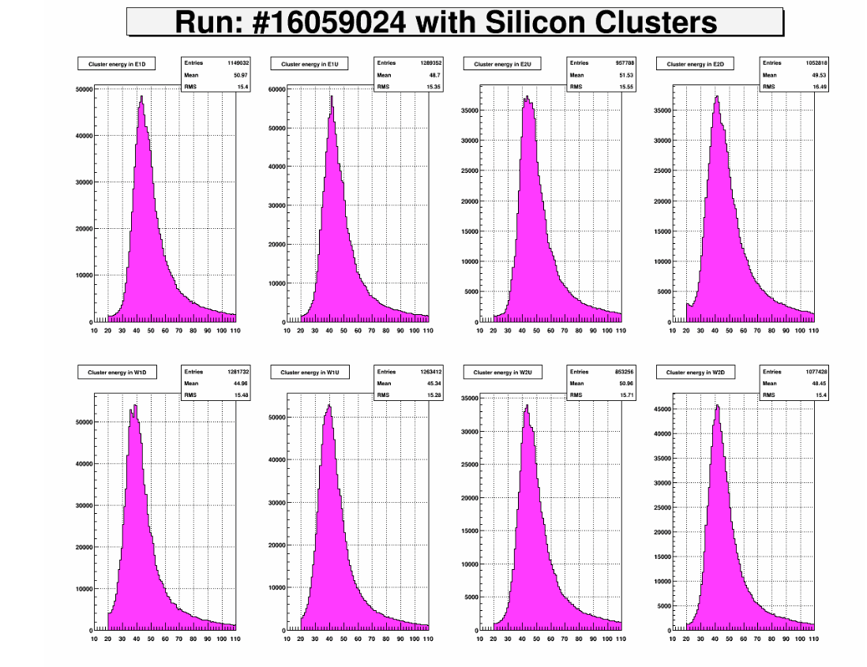
Run 15
FMS refurbishment
  Annealing PbG with sun light and re-stack
  Replaced unstable PMT-bases
  Trigger upgrade
FPS for photon/electron/hadron PID
  SiPM (Hamamatsu S12572) readout
  3 layer scinti. with Pb conveter in front of FMS
Roman-Pot
  Elastic and Diffractive physics
  Pi0 A_{N} with tagging diffractive proton
  GPD E_{g} by J/psi UPC
p+p 200 GeV Transverse Spin ~40/pb P~60%
p+p 200GeV Longitudinal Spin ~50/pb P~60%
p+Au 200GeV Transverse Spin ~300/nb P~60%
(2012 was 22/pb P= 63%)
Si Detector Performance
ADC Ch (0.25pC/ch)

Slide 27
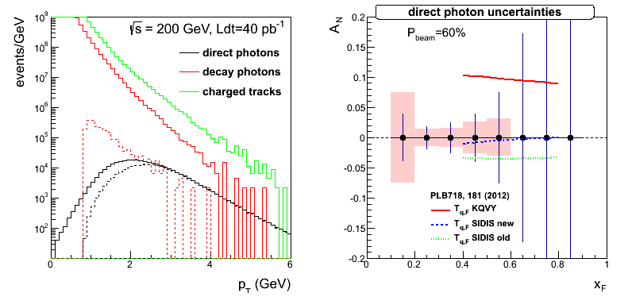
RUN15 Goal
Direct Photon x-section & A_{N} at pT>2.0GeV <- FPS
Pi0 / eta A_{N}
  x_{F} and P_{T} dependences
  Jetty vs Isolated
  Diffractive vs non-diffractive <- Roman Pot
  pp vs pA
Study di-electron channel (J/psi) towards DY <- Trigger upgrades, FPS
Last call for PRE-dictions!!!
Photon A_{N}
Pi0 A_{N} with diffractive proton tagged
Pi0 A_{N} at p+Au collisions

Slide 28
Run17 Plan
RHIC plans to deliver ~400 pb⁻¹ transverse p-p 500GeV in 2017
  Measure A_{N} for γ, W±, Z⁰, DY
  DY and W±, Z⁰ give Q² evolution
  W± give sea-quark Sivers
  All three A_{N} give sign change
Constrain TMD evolution sea-quark Sivers function
Test sign-change if TMD-evolution suppression factor ~5 or less

Slide 29

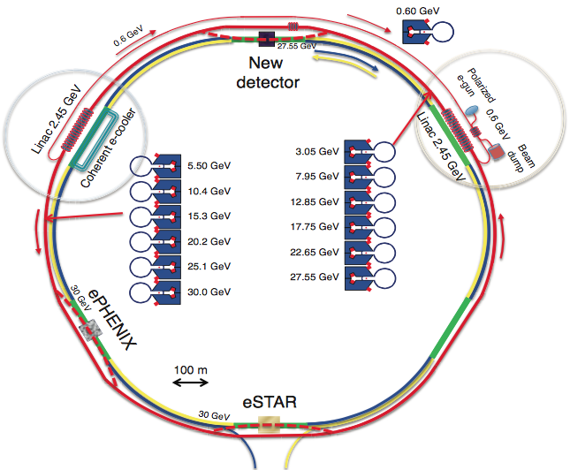
future!

Slide 30
Summary
STAR has a rich spin program : pi0, jets to W bosons with unpol, longitudinal and transverse polarized proton, and now pol p+Au as well.
Run13 data on A_{L} of W± at RHIC will be a strong constraint for
First measurement of A_{N} for W± and Z⁰ production at RHIC by reconstruction of the boson kinematics
Preliminary measurement of unpolarized W+/W- cross section ratios
Forward A_{N}
  Isolated pi0/eta continued to show large A_{N} How to measure Twist-3 FF?
  “EM-jet” has small A_{N}
  A hint for non-zero pi0 Collins asymmetry around “EM-jet”
  Successful Run15 with improved FMS, FPS, Roman-Pot for both p+p and p+Au
      Last call for prediction : A_{N} for photons, diffraction, pAu!
Run17 with 400/pb can give statistical significance to test the Sivers’ sign change and pin down TMD evolution. STAR can have access to A_{N} for photons, W±, Z⁰, DY

Slide 31
STAR Spin Program
Mid Rapidity TPC BEMC EEMC | Jet Di-Jet | σ High-x gluon density
 |  | A_{LL} Gluon Spin
 |  | A_{N} Collins
 |  | A_{N} IFF
 | W,Z | σ
 |  | A_{L} Sea Quark Spin
 |  | A_{N} Sivers
Forward Rapidity EEMC FMS | pi0, eta, EM-Jet (Photon, DY) | A_{LL} Gluon Spin
 |  | A_{N} Twist-3, Collins, Sivers
Roman-Pot | proton | Elastic and Diffraction
R. Fatemi’s
talk
This talk
To be continued to R.Fatemi’s Talk on Thursday

Slide 32
Backup

Slide 33
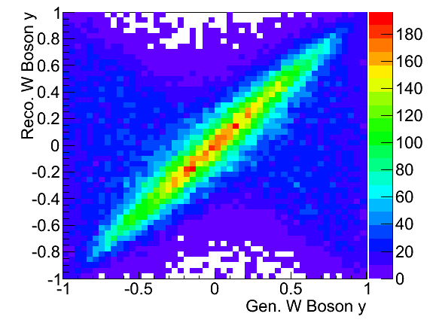
W P_{Z} reconstruction
W longitudinal momentum (along z) can be calculated from the invariant mass. Currently we assume constant M_{W} (for W produced on shell)
Neutrino longitudinal momentum component from quadratic equation
Two solutions!
Smaller |Pz| → first solution
Larger |Pz| → other solution
better Fraction of correctly reconstructed events (Pz is reconstructed within +/- 30 GeV)
We select the first solution →
We cut at
|Pz| < 50 GeV → |W-y| < 0.6 to minimize misreconstructions
NOTE: We only use the first solution. This can be improved at a later stage.

Slide 34
Efficiency study
Uncertainties calculated binomially (not visible)
The efficiency depends on the period
Run 12 less efficient than run 11 because of the lower reconstruction efficiency at higher rates due to pile up effects in the TPC
The efficiency depends very little on the charge
-> it plays negligible role in this measurement

Slide 35
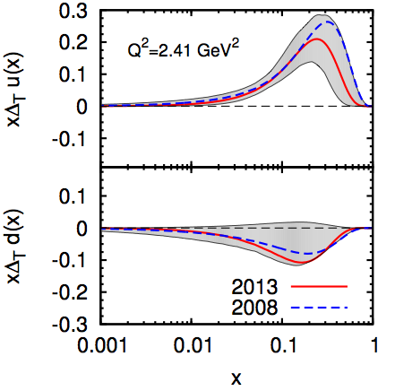
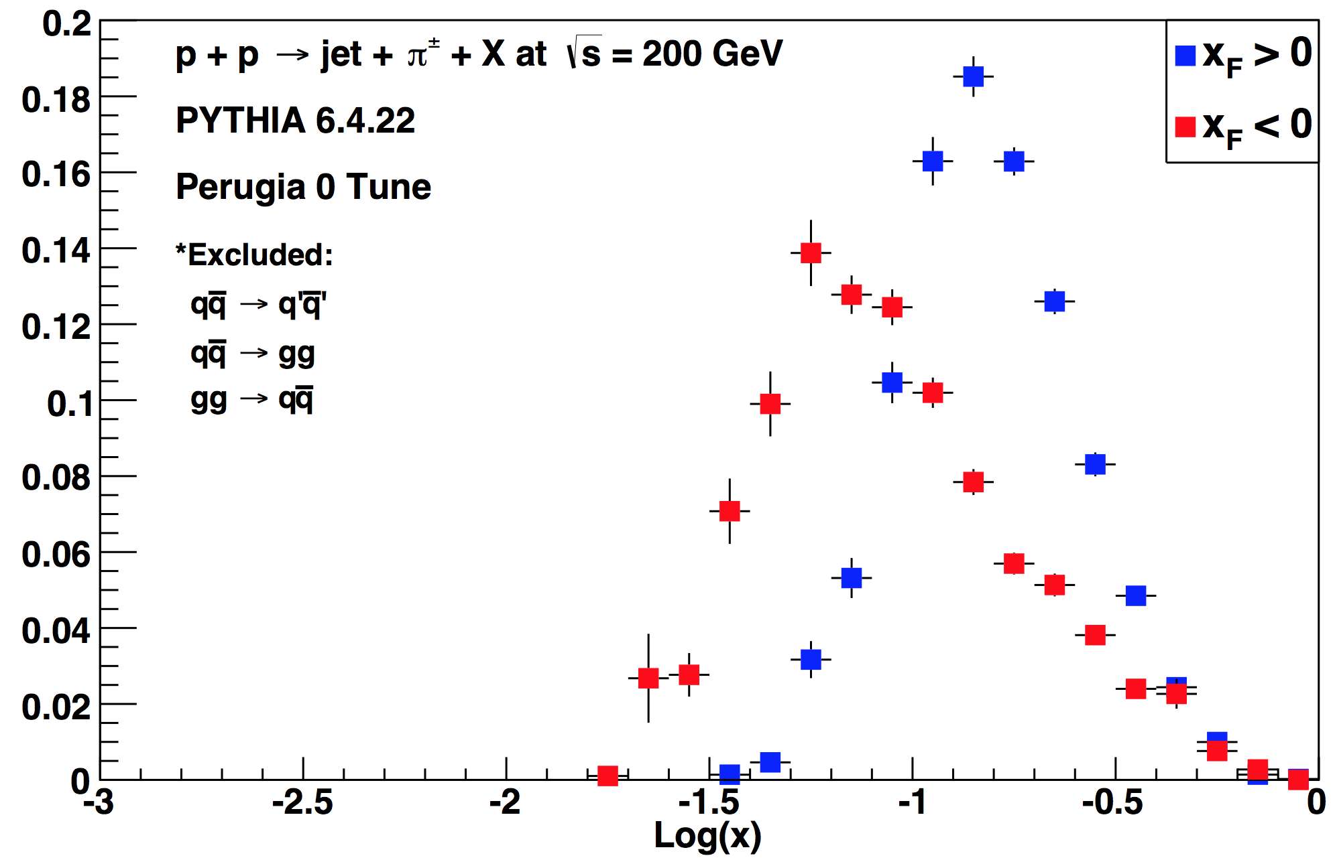
Recent Polarized-proton Datasets at STAR
2011
25 pb⁻¹ at √s = 500 GeV
Average polarization = 53%
2012
22 pb⁻¹ at √s = 200 GeV
Avg polarization = 63%
Compare to ≈2 pb⁻¹ at 57% polarization in 2006
J.K. Adkins, APS2015
Torino, PRD 87, 094019 (2013)
Access to transversity in region with limited constraints
Notes:
Now our 2006 measurements are though-provoking, however, we want to do better than that. Fortunately, STAR took successful p+p runs with transverse polarization in both 2011 and 2012 with significantly larger luminosity than in 2006. These give us the chance to analyze these effects in far greater precision not only at 200 GeV but for the first time in 500 GeV collisions. Here you see the quark-x sensitivity for jets with p_T greater than 10 GeV/c in 200 GeV collisions. This is based upon an unpolarized PYTHIA Monte Carlo. You see we have good sensitivity in this range from 0.1-0.3 or so; and we note that in this region the current extractions of transversity still have somewhat limited constraints. So, these data provide a very interesting opportunity to probe our understanding of transversity.
----- Meeting Notes (4/28/15 12:08) -----
less time, here

Slide 36
Monte Carlo correction
The Correction method –
Read recoil P_{T} bin from data
Project correction factor for corresponding P_{T}-bins
Normalize the projection distribution to 1
Pick a correction value sampled from the projection distribution
MC test:
After MC correction
→ very good agreement with RhicBOS (fully re-summed NNL/NLO calculation) and PYTHIA predictions

Slide 37
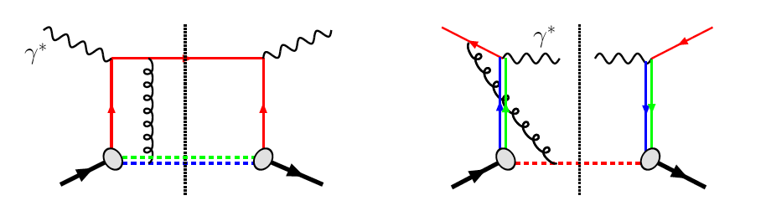
The much discussed sign change of the Sivers’ function
Motivations – Transverse Single Spin Asymmetry (A_{N})
QCD:
DIS: γq scattering
attractive FSI
pp: annihilation
repulsive ISI
Sivers_{DIS} = - Sivers (DY or W or Z)
critical test for our understanding of TMD’s and TMD factorization
Advantages of weak boson production
Very low background
Very high Q²-scale (~ W/Z boson mass)
STAR goal: measure sign change and pin down TMD-evolution by measuring A_{N} for all the processes: γ, W±, Z⁰, DY

Slide 38
The unpolarized W+/W- cross section ratio
We measure the observable
N_{obs} = observed W events
N_{bkg} = background events
ε = efficiency
Same selection as for A_{N}
Background estimated in the same way
W boson kinematics are reconstructed in the same way
  We do not care of the polarization direction in measuring RW
  We added the STAR 2012 longitudinal run at root(s)= 510 GeV (Collected Lumi ~77pb⁻¹)
Data sample
pp – run11 transverse @ √500 GeV Integrated Luminosity ~25 pb⁻¹
pp – run12 long @ √510 GeV Integrated luminosity: ~ 77 pb⁻¹
Total Int. lumi: 102 pb⁻¹

Slide 39
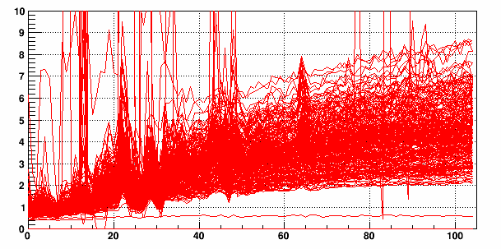
FPS
Gain adjusted to MIP=100ch
Pedestal RMS @ PHYSICS voltage & beam off
Q1L1S4
FPS pedestal run# (twice/day)
Radiation damage to SiPM
Increased leakage currents from ~0.1uA to ~40uA
Increased pedestal RMS from ~1ch to ~5ch
Still way below MIP peak ~100ch
No sign of gain change
ADC Ch (0.25pC/ch)
FPS will add photon/electron/charged hadron PID capability to FMS

Slide 40
A_{N} for correlated central jets and no central jet cases
Asymmetries for the forward isolated π⁰ are low when there is a correlated away-side jet.

Slide 41
W+/W- Vs boson Rapidity
W kinematics reconstructed as for A_{N}
Preliminary
Stat. errors
Blue points -> After subtracting the backgrounds
Subtraction of background has an impact below statistical error
Adding run 12 significantly improves statistical precision
Collected Lumi = 25 pb⁻¹
Preliminary
Stat. errors
Preliminary
Stat. errors
Collected Lumi = 77 pb⁻¹
Collected Lumi = 102 pb⁻¹

Slide 42
MC correction: depends on the charge sign?
Projections
dots -> mean value
Bars -> RMS
RUN 12
RUN 12
Correction Factor
No difference for the correction factor calculated from positive and negative-charge MC samples
No difference in the correction factor due to interaction rates
The Correction factor
is not charge-dependent -> does not impact the W+/W- ratios!
Is not interaction rates dependent -> we can combine different run periods

Slide 43
Systematics on W reconstruction
Systematics on background subtraction (as for the decay lepton)
Systematics on the reconstruction smearing
  Calculate the ratio with generated pure MC
  Calculated the ratio with reconstructed MC after all the analysis
  Assign the difference as systematic uncertainty
Relative Systematics

Slide 44

W+/W- versus Boson-Rapidity
σ(W+) / σ(W-)
Total systematics account for
Syst. from bkd. subtraction
Syst. from W reconstruction

Slide 45
Motivations – Transverse Single Spin Asymmetry (A_{N})
What is the sea-quark Sivers fct.?
  Sea quarks are mostly unconstrained from existing SIDIS data... but they can give a relevant contribution!
  W’s ideal → rapidity dependence of A_{N} separates quarks from antiquarks
M. G. Echevarria, A. Idilbi, Z-B Kang, and I. Vitev arXiv:1401.5078
Revised error bands (private communication) use positivity bounds for the sea quarks
0 < p_{T} <3 GeV
W± data can constrain the sea-quark Sivers function
Asymmetry from lepton-decay is diluted → Full kin. reconstruction of the boson needed
  Z⁰ easy to reconstruct (but small cross-section)
  W kin. can be reconstructed from the hadronic recoil (first time at STAR)

Slide 46
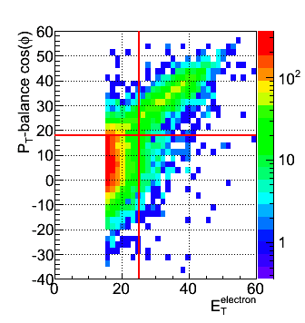
Data & Selection
Monte Carlo
PYTHIA reconstructed through GEANT3 simulated STAR detector
Perugia0 tune
PYTHIA embedded into real zero-bias pp events
Data sample
pp – run11 transverse @ √500 GeV Integrated Luminosity ~25 pb⁻¹
pp – run12 long @ √510 GeV Integrated luminosity: ~ 77 pb⁻¹
Total Int. lumi: 102 pb⁻¹
Selection Criteria – decay electron
Isolation: (P^{track}+E^{cluster}) / Σ[P^{tracks} in R=0.7 cone] > 0.9
Imbalance: no energy in opposite cone (E<20 GeV)
Electron E_{T} > 25 GeV
Electron Track |η| < 1
|Z-vertex|<100 cm
Charge separation (avoids charge misidentification):
0.4 < |Charge (TPC) x E_{T} (EMC) / P_{T} (TPC)| < 1.8
Signed P_{T} balance > 18 GeV (rejects QCD Background)
For boson-PT reconstruction
Track-P_{T} in the recoil > 0.2 GeV
Total recoil-P_{T} > 0.5 GeV
For boson-PL reconstruction
|W-PL| < 50 -> |W-y| < 0.6
SIGNAL
QCD
See M. Posik and D. Guanarathne for more details on W selection

