Slide 1
TMDPDF: A proper Definition And Its Evolution
Ahmad Idilbi
University Of Regensburg
QCD Evolution 2012 Workshop
Jefferson LAB, May 15
M. G. Echevarria, A. Idilbi, I. Scimemi, arXive: 1111.4996[hep-ph]

Slide 2
Outline
Relevance Of TMDPDFs/TMDFFs For High-Energy Processes
Problems With Existing Definitions
``New Definition’’: On-The-LC vs Off-The-LC Of Collins
Properties: Free From Light-Cone Singularities, Universality, Gauge Invariance, PDF From TMDPDF
Evolution: Anomalous Dimension At Second And Third Orders In The Strong Coupling
Conclusions And Outlook

Slide 3
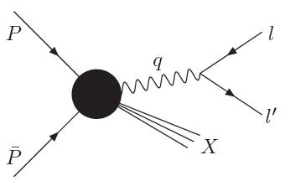
Factorization For q_T-Dependent Observables
Collinear Matrix Element:
Soft Function:

Slide 4
q_T Dependent Observables/ME
Semi-Inclusive DIS:
Factorize Into TMDPDF, Fragmentation Function and Soft Function With All Quantities Have TMD
[Ji, Ma, Yuan,03]
q_T-Higgs Boson Production [With Or Without Jets Production]
[Gluon TMDPDF]
Plenty (Or A ``Zoo’’) Of Such ME. However The TMDPDF Although Is The Simplest. Its ``Accepted’’ Definition Remains Illusive For Almost 30yr

Slide 5
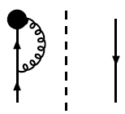
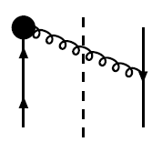
Collins-Soper TMDPDF
Partonically:
[Collins-Sopers,82]
Problems: Light-Cone Divergences
The Vertex With The Wilson Line:
Real Gluon Emission Has The Same Pathology But No Rescue!
For The PDF We Have Similar Light-Cone-Singularities But ``Things Are Fine’’.
It Is easy To Understand Why!
THE ``TMDPDF’’ Is Not Well-Defined Even After Regulation!!

Slide 6
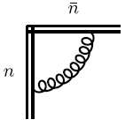
Soft Function: Similar Issues
THE Soft Function Is Also Not Well-Defined

Slide 7
The Issue Of Double-Counting
The Hadronic Tensor , M, Calculated (Partonically) In Full QCD Is Free From Mixed
Divergences
The Supposedly ``Collinear’’ MEs Are Plagued With Soft Contamination!

Slide 8
Definition Of The TMDPDF
To Cancel The Mixed Divergences , Avoid Double Counting Among Soft
And Collinear And As Imposed By SCET Power Counting
We Define The TMDPDF
Six Different Definitions of TMDPDF
1. Collins 82, Collins 2011
Ji, Ma and Yuan 03
Cherednikov and Stefanis 08-
Mantry and Petriello, 2010
Becher and Neubert, 2010
6. Rothstein et.al 2011

Slide 9
TMDPDF ON-The-Light-Cone (I)

Slide 10
TMDPDF On-The-Light-Cone (II)
The Real Gluon Contribution Is Free From Mixed Divergences

Slide 11
Anomalous Dimension Of TMDPDF
[Manohar 03,
Idilbi, Ji 03]
The TMDPDF—On The LC—Evolves ONLY With The Hard Probe.
No Extra Auxiliary (And Non-Physical Parameters) Are Needed!
Going Beyond One-Loop Order Needs More Sophistication
(No Brute Force Is Needed!)

Slide 12
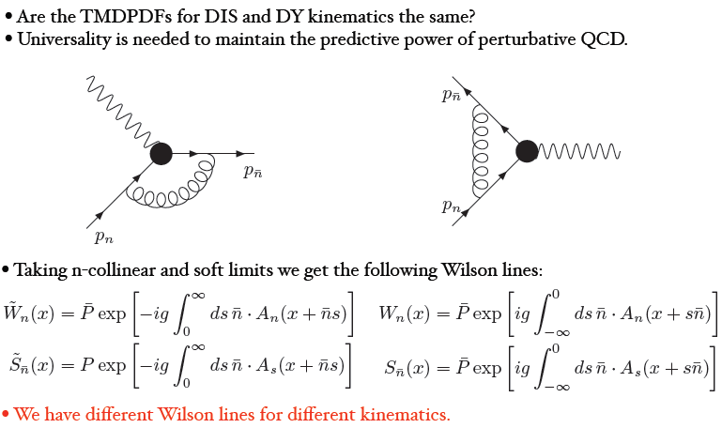
Universality(I)

Slide 13
Universality Of The Soft Function

Slide 14
Universality Of The Collinear Function

Slide 15
Gauge Invriance
Hadronic ME Should Be Gauge Invariant!
This Issue Is Especially Tricky when TMD Is Present!
Consider The Light-Cone Gauge
Ji et.al 03,
CS 08--,
M.E, A.I, I.S,10
The Collinear And Soft Function Are Identical –At The Integrand Level In Mandelstam-
Leibbrandt Prescription. Thus Gauge Invariance Is Realized

Slide 16
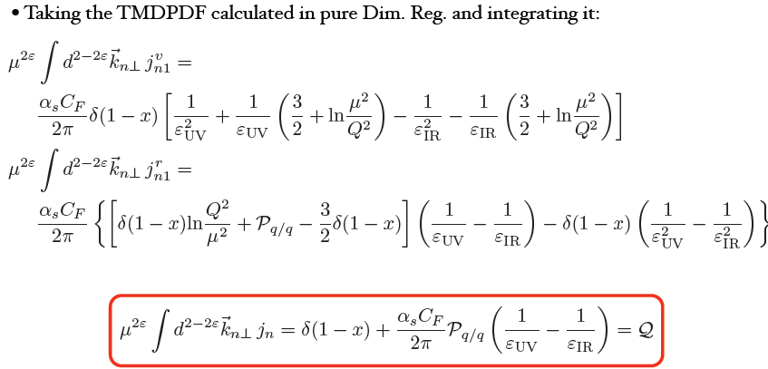
From TMDPDF To PDF

Slide 17
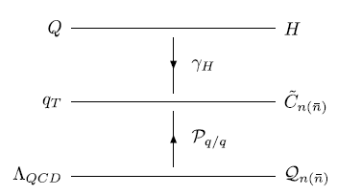
Operator Product Expansion And The Q^2 Dependence
For Perturbative q_T
At Higher Orders In PT The Q^2-Dependence Cannot Be eliminated By Any
Single Choice Of The Intermediate Scale. Thus Their Resummation Is A Must

Slide 18
Q^2-Resummation
From The Definition Of The TMDPDF
By Dimensional Arguments And Lorentz Invariance
Recall:
Since The PDF And The Wilson Coefficient Are Free From Rapidity Divergences
To All Orders In PT

Slide 19
Q^2-Resummation Continued
The Naïve Collinear And The Soft Functions Are Linear In Their Last Arguments
Q^2-Independent
All The Large Logarithms of Q^2 Are Resummed In First Exponent

Slide 20
The D-Term(I)
[A Is Twice The Cusp Anomalous Dimension]
Recursion Relations Which Uniquely Determine The D-Term

Slide 21
The D-Term(II)
By Knowing The Cusp Anomalous Dimension At Three Loop Order

Slide 22
AD At Higher Orders In PT
The AD Of H Is Known From Previous Full QCD Calculations Up to
Third Order In The strong Coupling. Based On The Factorization Theorem And RG Invariance:
[Idilbi, Ji and Yuan 06]
The A And B Are Known To Third Order! So We Can Extract The AD Of The
TMDPDF To Third Order

Slide 23
Putting Things Together
Resummed TMDPDF
All Large Logarithms Of Q/q_T Are Resummed In The Exponential Factors!
Evolved And Resummed TMDPDF

Slide 24
Collins Approach
The Collinear Part Is Kept On-The-LC While Only The Soft Function
Is ``Tilted’’. With This
[Collins 2011]
Collins TMDPDF Evolves With Two Variables. One Is Un-Physical!
Compare With:
If You Stay On-The-LC You Only Run With Hard Probe Q!

Slide 25
Going Off-The-LC Is Meant To Regularize Rapidity Divergences. This Can Be Achieved While Staying On The LC.
There Is No Natural Choice Of y_n That Takes You Back To The LC!!

Slide 26
Conclusions
We Introduced A TMDPDF Defined On-The-Light-Cone Emphasizing The Role Of The Soft Function Contribution
General Features: Free From RD, Enables Us To Recover The Integrated PDF, Gauge Invariance And Universality
The Evolution Is Controlled Only By The Hard Probe
Higher Order ADs Are Easy To Extract Based On Factorization Theorems.
Going Of-The-LC Has No Special Importance
Generalizations To Other TMD Quantities Is Straightfoward

