Slide 1
Experimental Study of Single Spin Asymmetries and TMDs
Jian-ping Chen , Jefferson Lab
QCD Evolution Workshop, JLab, May 6-10, 2013
Recent SSA Results from JLab Hall A with a Transversely Polarized ³He (n)
Collins/Sivers Asymmetries on pi+/pi- (published)
Worm-gear II Asymmetries on pi+/pi- (published)
New Preliminary SSA Results from JLab Hall A with a Transversely polarized ³He (n)
Collins/Sivers Asymmetries in K+/K-
Pretzelosity Asymmetries on π+/π-
Inclusive hadron SSA
Inclusive electron SSA (DIS, QE)
TMD study at JLab 12 GeV in Hall A:
SoLID Program on SSA/TMDs: 3 Approved Experiments on ³He and p
New LOI on dihadron production
Long-term Future: TMDs study with Electron-Ion Colliders (EIC)
MEIC@ JLab and E-RHIC@BNL
A New Opportunity: an EIC in China (EIC@HIAF)

Slide 2
Single Spin Asymmetries with
A Transversely Polarized ³He (n)
JLab Hall A E06-010

Slide 3




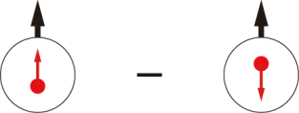
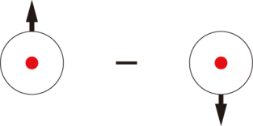
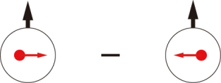
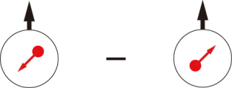
Leading-Twist TMD PDFs
 |  | Quark polarization
 |  | Unpolarized (U) | Longitudinally Polarized (L) | Transversely Polarized (T)
Nucleon Polarization | U
 | L
 | T
f₁ =
h₁⊥ =
Boer-Mulders
h_{1L}⊥ =
g₁ =
Helicity
Worm Gear
h₁ =
f _{1T}⊥ =
Transversity
g_{1T} =
Sivers
h_{1T}⊥ =
Worm Gear
Pretzelosity
Nucleon Spin
: Probed with transversely pol target
HERMES, COMPASS, JLab E06-010
Quark Spin
Notes:
! relate g1, f1 -> collinear w/ pT dep.
Say: Noval new information on structure of nucleon, spin-orbital cor and multi-parton cor.

Slide 4
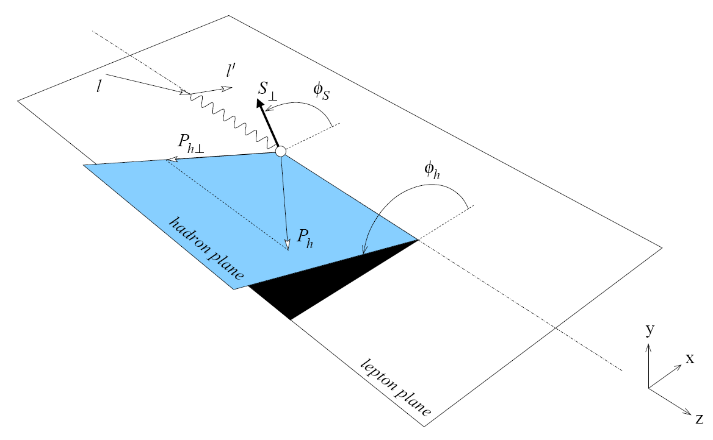
Separation of Collins, Sivers and pretzelocity effects through angular dependence

Slide 5

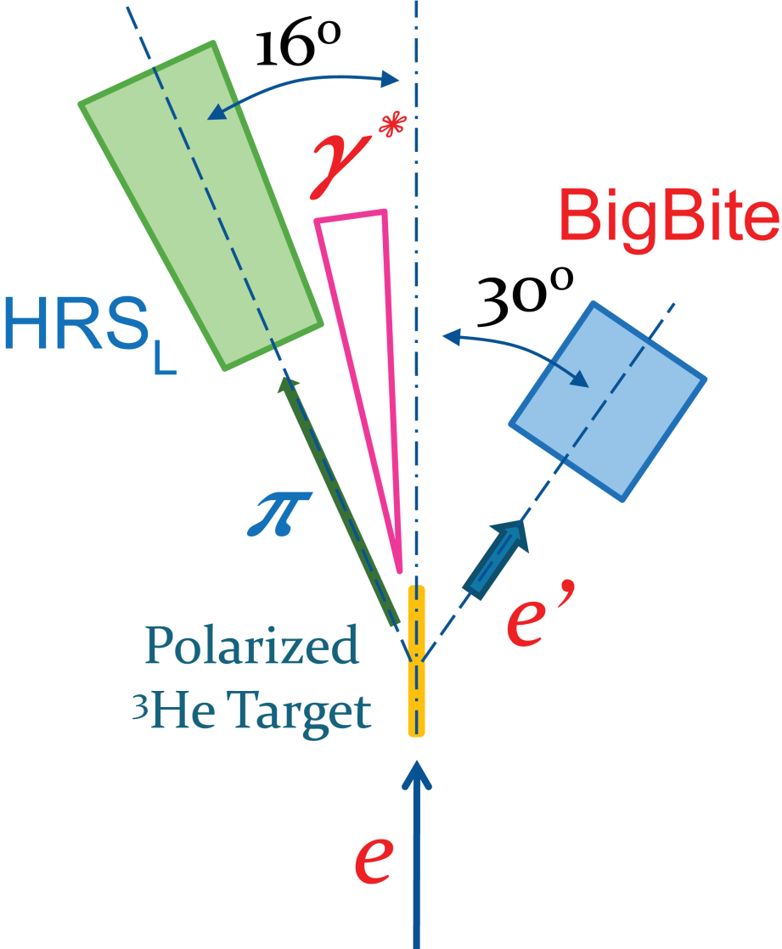
E06‑010 Experiment
Spokespersons: Chen/Evaristo/Gao/Jiang/Peng
First measurement on n (³He)
Polarized ³He Target
Polarized Electron Beam, 5.9 GeV
BigBite at 30º as Electron Arm
  P_{e} = 0.7 ~ 2.2 GeV/c
HRS_{L} at 16º as Hadron Arm
  P_{h} = 2.35 GeV/c
  Excellent PID for π/K/p
7 PhD Thesis Students (All graduated)
+ new students
Luminosity
Monitor
Beam Polarimetry
(Møller + Compton)
Notes:
What’s new:
Neutron Target
Helicity Flip -> Cancel drift/cancel false asym.
Beam charge feed back -> PPM level Charge Asym

Slide 6
Published Results (I) from JLab Hall A E06-010 with a Transversely Polarized ³He (n)
Collins/Sivers Asymmetries on π+/π-
X. Qian at al., PRL 107:072003(2011)

Slide 7
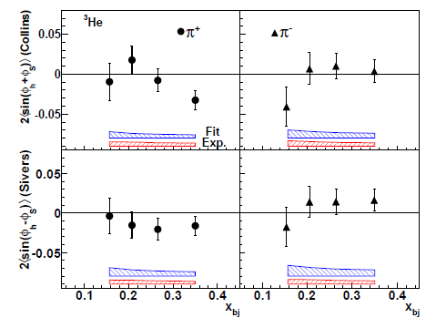
E06-010 ³He Target Single-Spin Asymmetry in SIDIS
³He Collins SSA small
Non-zero at highest x for π+
³He Sivers SSA:
negative for π^{+,}
Blue band: model (fitting) uncertainties
Red band: other systematic uncertainties

Slide 8
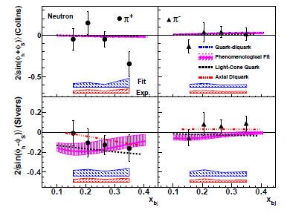
Neutron Results with Polarized ³He from JLab
Collins
asymmetries are not large, except at x=0.34
Sivers
negative
Blue band: model (fitting) uncertainties
Red band: other systematic uncertainties

Slide 9
Published Results (II) from JLab Hall A E06-010 with a Transversely Polarized ³He (n)
Worm-Gear II: Trans-helicity on π+/π-
J. Huang et al., PRL. 108, 052001 (2012).

Slide 10
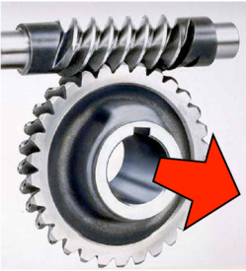
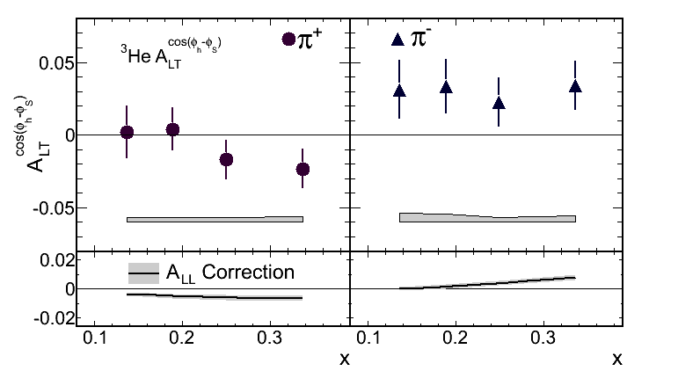
Asymmetry A_{LT} Result
To leading twist:
³He A_{LT :} Positive for π-
Notes:
Physics meaning
If Non zero on neutron -> existence of angular momentum?

Slide 11
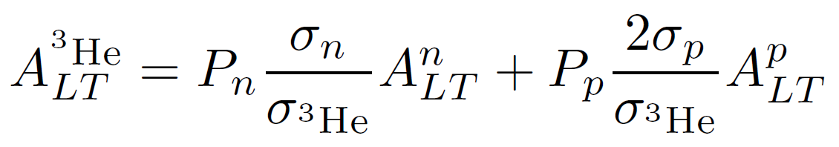
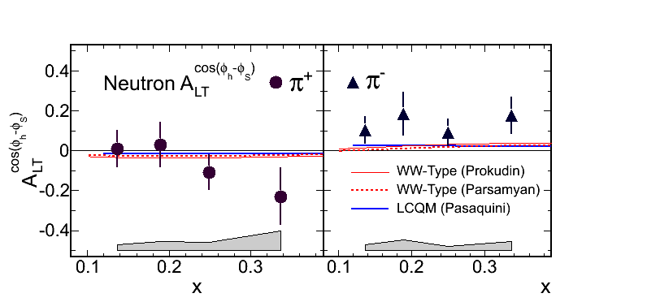
Neutron A_{LT} Extraction
  Corrected for proton dilution, f_{p}
  Predicted proton asymmetry contribution < 1.5% (π⁺), 0.6% (π⁻)
  Dominated by L=0 (S) and L=1 (P) interference
Consist w/ model in signs, suggest larger asymmetry
Trans-helicity

Slide 12
Preliminary New Results (I) from JLab Hall A E06-010 with a Transversely Polarized ³He (n)
Collins/Sivers Asymmetries on K+/K-
Analysis by Y. Zhao (USTC), Y. Wang (UIUC)

Slide 13
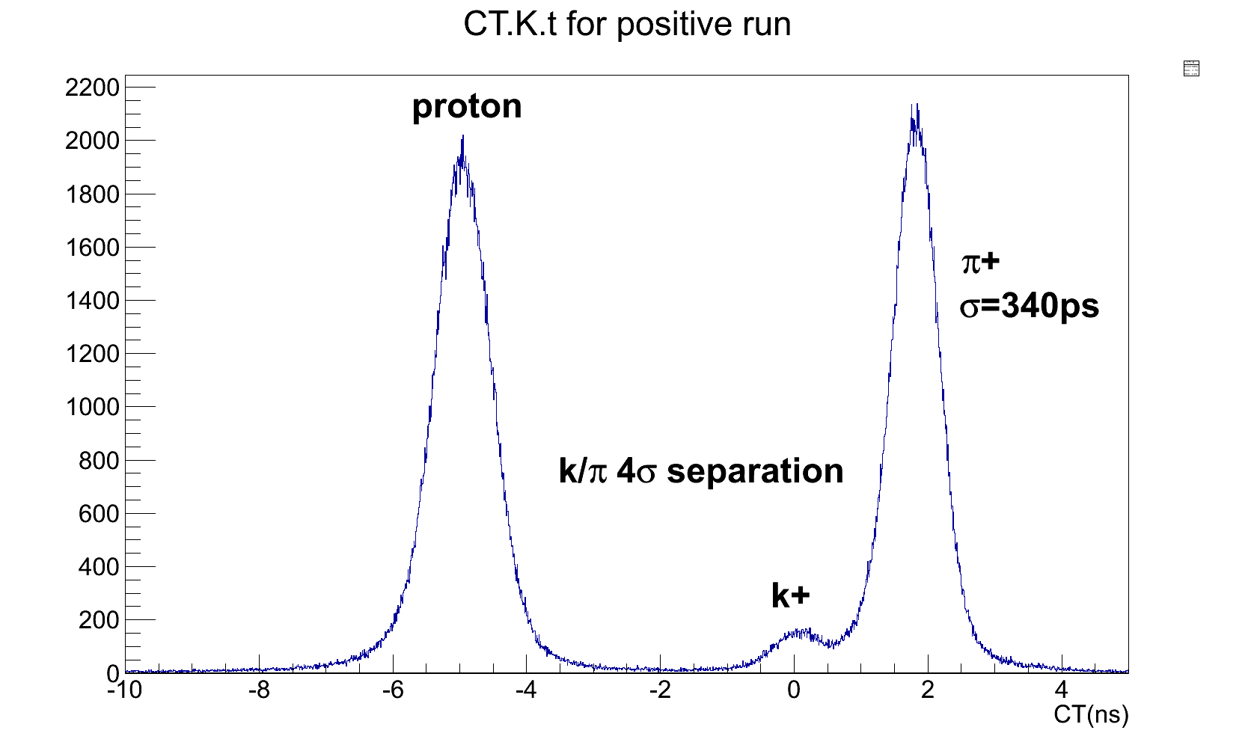
Kaon PID by Coincidence time of flight
Cross checked with RICH results
K+/π+ ratio: ~5% K-/π- ratio: ~1%

Slide 14
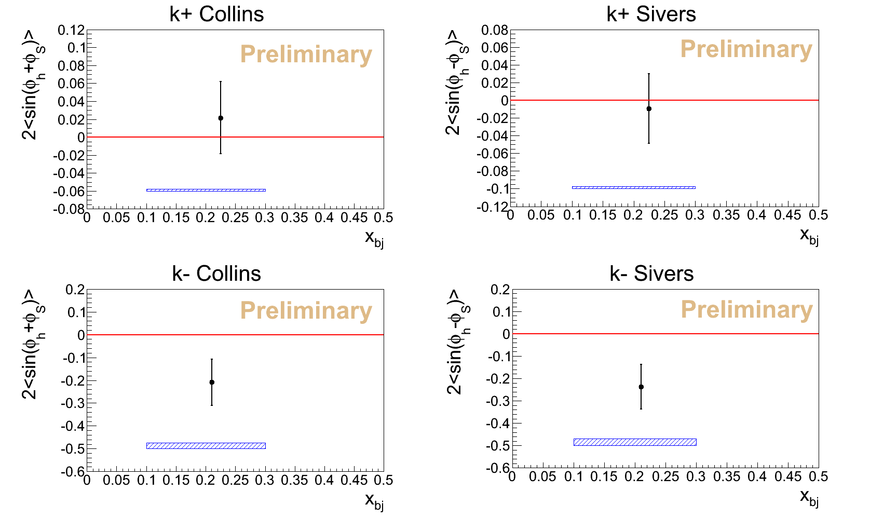
Preliminary K+/K- Collins and Sivers Asymmetries on ³He

Slide 15
Preliminary New Results (II) from JLab Hall A E06-010 with a Transversely Polarized ³He (n)
Pretzelosity on π+/π-
Analysis by Y. Zhang (Lanzhou) and X. Qian (Caltech)

Slide 16
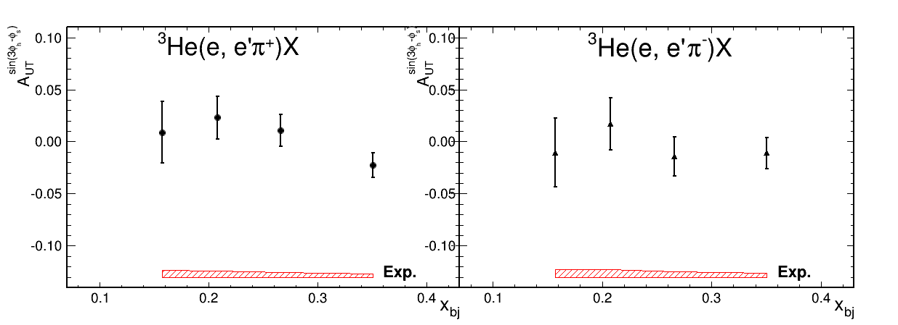

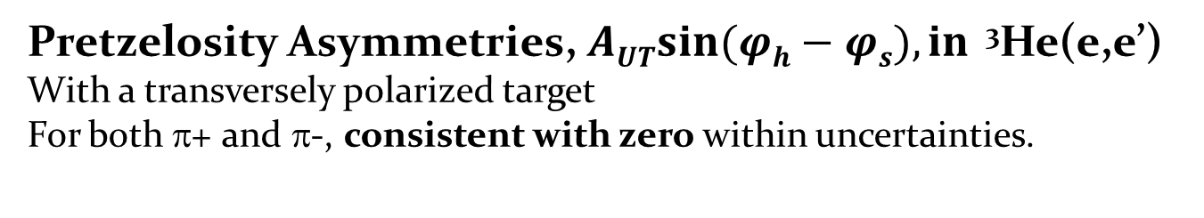
Pretzelosity on π+/π-
Pretzelosity Asymmetries, $\operatorname{AUTsin}{(φh}−φs), in$ ³He(e,e’)
With a transversely polarized target
For both π+ and π-, consistent with zero within uncertainties.
Preliminary

Slide 17
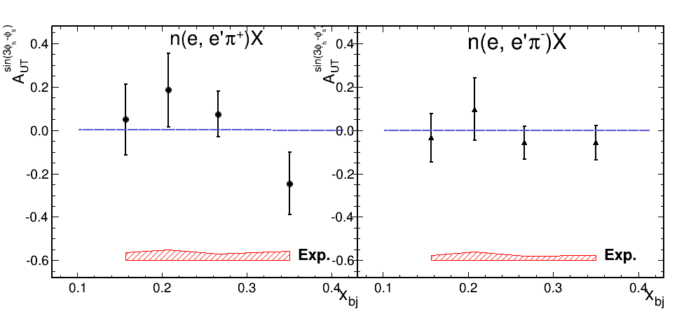
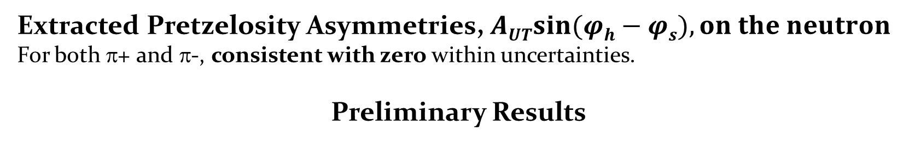
Extracted Results on Neutron
Extracted Pretzelosity Asymmetries, $\operatorname{AUTsin}{(φh}−φs), on the neutron$
For both π+ and π-, consistent with zero within uncertainties.
Preliminary Results

Slide 18
Preliminary New Results (III)from JLab Hall A E06-010 with a polarized ³He (n)
Inclusive Electron SSA
Analysis by J. Katech(W&M), X. Qian (Caltech)

Slide 19

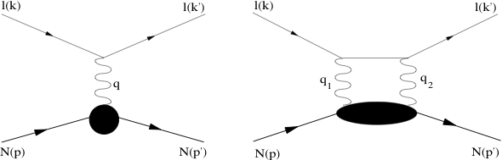
Inclusive Target Single Spin Asymmetry: DIS
θ
³He
e⁻
Unpolarized e⁻ beam incident on ³He target polarized normal to the
electron scattering plane.
However, A_{y}=0 at Born level,
→ sensitive to physics at order α²; two-photon exchange.
In DIS case: related to integral of Sivers
Physics Importance discussed in A. Metz
and M. Schlegel’s talks (Tuesday)

Slide 20

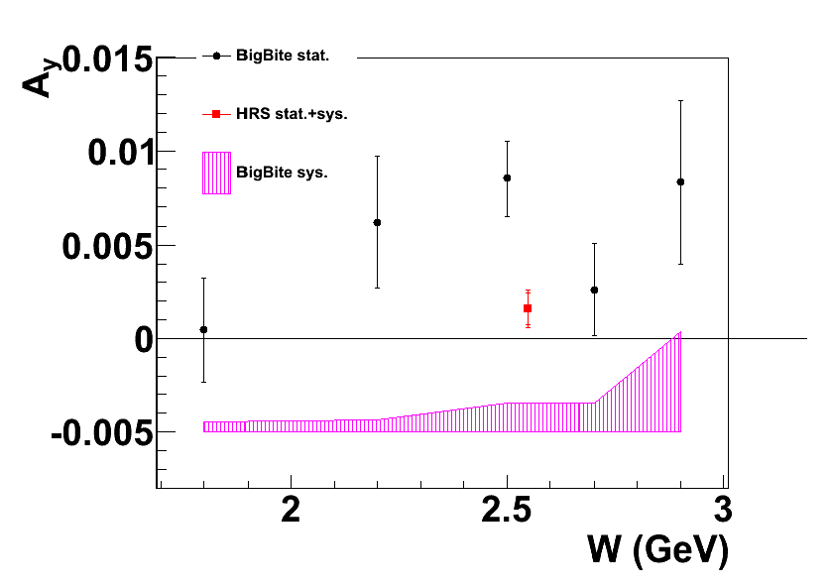
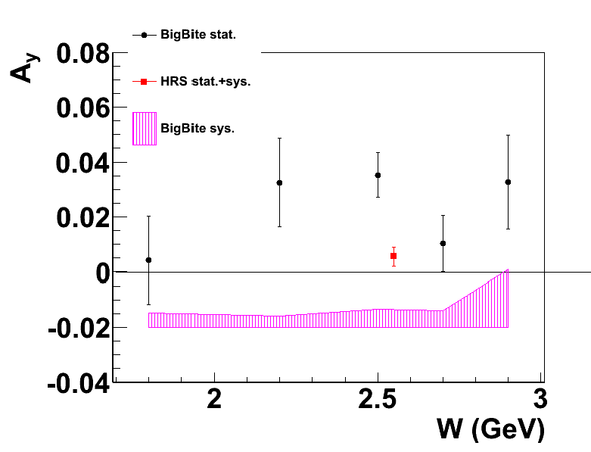
Inclusive Target Single-Spin Asymmetry
Extracted neutron SSA
Vertically polarized target

Slide 21
Preliminary New Results from JLab Hall A E05-015 with a polarized ³He (n)
Inclusive Electron SSA in Quasi-Elastic Scattering
Analysis by Y. Zhang (Rutgers), B. Zhao (W&M)

Slide 22
Incluisve Target Single Spin Asymmetry: QE
θ
³He
e⁻
Unpolarized e⁻ beam incident on ³He target polarized normal to the
electron scattering plane.
However, A_{y}=0 at Born level,
→ sensitive to physics at order α²; two-photon exchange.
(Q)Elastic: Calculable at large Q² using moments of GPD’s
Measurement of A_{y} at large Q² provides access to GPD’s

Slide 23
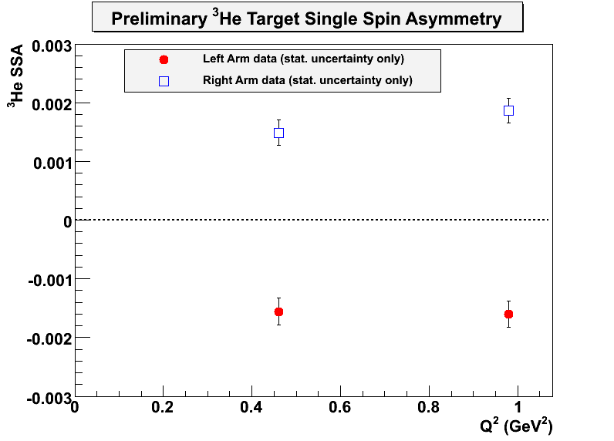
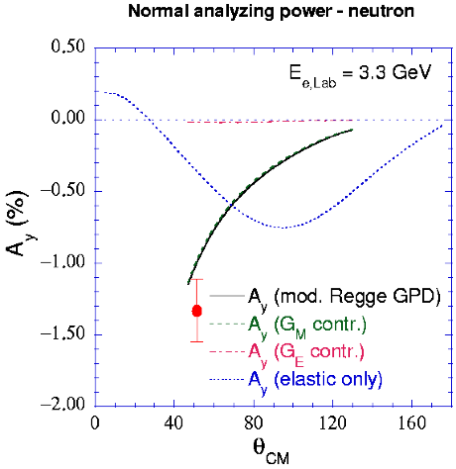
Preliminary ³He results at Q²=0.5 and 1.0 GeV²
³He(e,e’) A_{y}^{3He}
Prediction below is for Q²= 1 GeV²
Carlson et al.--Neutron
Preliminary
Data above is for helium-3
23

Slide 24
Preliminary New Results (IV) from JLab Hall A E06-010 with a transversely polarized ³He (n)
Inclusive Hadron SSA
Analysis by K, Allada (JLab), Y. Zhao (USTC)

Slide 25
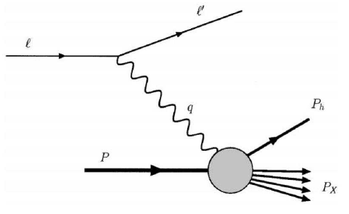
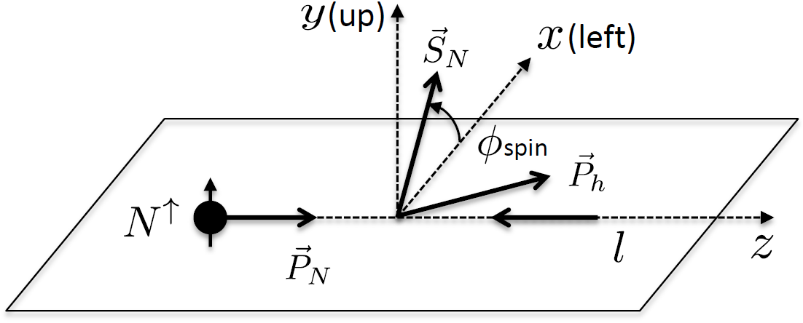
Inclusive Hadron Electroproduction
e + N↑ h + X (h = π, K, p)
p_{T}
Why a non-zero A_{N} is interesting?
  Analogues to A_{N} in collision
  Simpler than due to only one quark channel
  Same transverse spin effects as SIDIS and p-p collisions (Sivers, Collins, twist-3)
  Clean test TMD formalism (at large p_{T} ~ 1 GeV or more)
  To help understand mechanism behind large A_{N} in in the TMD framework

Slide 26
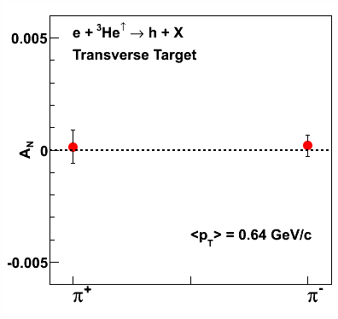
Transverse SSA in Inclusive Hadron
Preliminary
π⁺
π⁻
Target spin flip every 20 minutes
Acceptance effects cancels
Overall systematic check with A_{N} at ϕ_{S}= 0
  False asymmetry < 0.1%
False Asymmetry

Slide 27
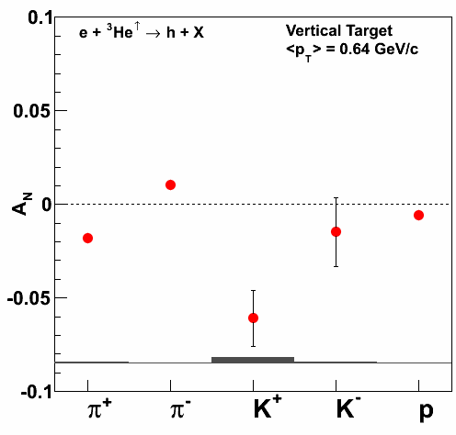
E06-010: Inclusive Hadron SSA (A_{N})
Clear non-zero target SSA
Opposite sign for π⁺ and π⁻
Preliminary

Slide 28
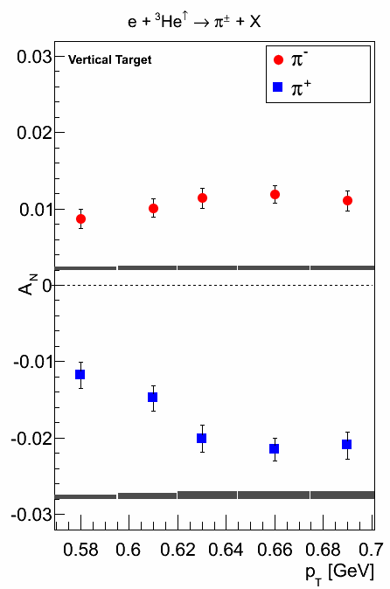
E06-010: Inclusive Hadron SSA (A_{N})
Clear non-zero target SSA
Opposite sign for π⁺ and π⁻
A_{N} at low p_{T} not very well
understood
Preliminary
Preliminary

Slide 29
Future: TMD study with SoLID at 12 GeV JLab Hall A
Precision 4-D mapping of Collins/Sivers/Pretzelosity
Worm-Gear I/II
with Polarized ³He (Neutron) and Proton

Slide 30
JLab 12 GeV Era: Precision Study of TMDs
From exploration to precision study with 12 GeV JLab
Transversity: fundamental PDFs, tensor charge
TMDs: 3-d momentum structure of the nucleon
→ Quark orbital angular momentum
Multi-dimensional mapping of TMDs
  4-d (x,z,P┴,Q²)
  Multi-facilities, global effort
Precision → high statistics
  high luminosity and large acceptance

Slide 31
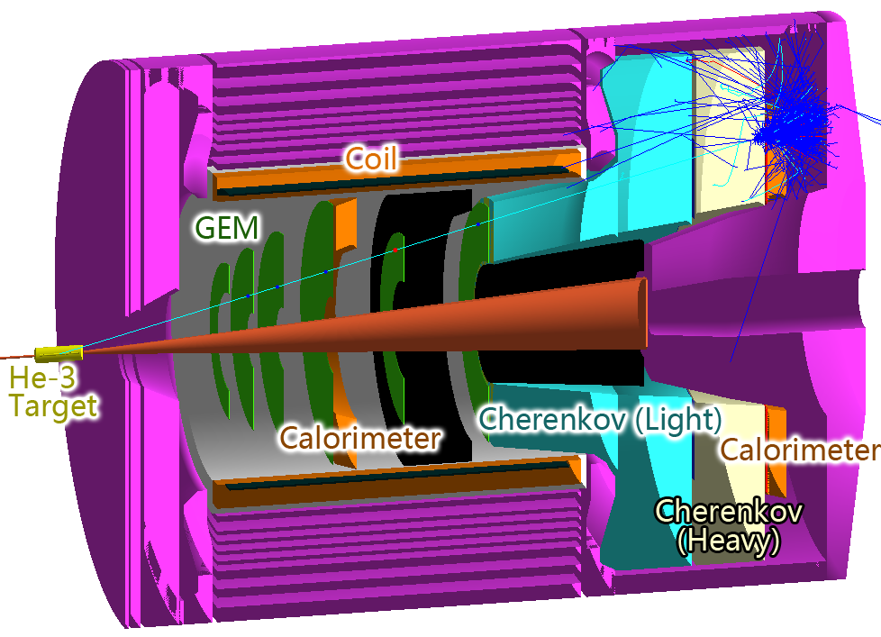
SoLID for SIDIS/PVDIS with 12 GeV JLab
Exciting physics program:
Five approved experiments:
three SIDIS “A rated”, one PVDIS “A rated”, one J/Psi “A- rated”
International collaboration: eight countries and 50+ institutions
CLEOII Magnet
GEMs for tracking
Cherenkov and EM Calorimeter for electron PID
Heavy Gas Cherenkov and MRPC (TOF) for pion PID

Slide 32
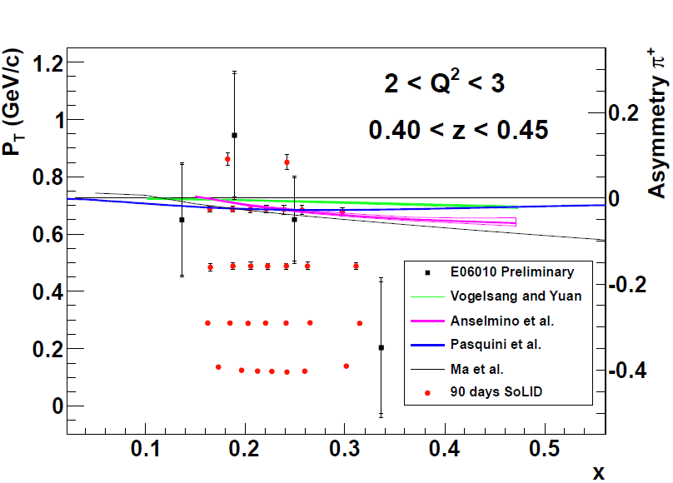
E12-10-006/E12-11-108, Both Approved with “A” Rating
Mapping of Collins(Sivers) Asymmetries with SoLID
Both π+ and π-
Precision Map in region
x(0.05-0.65) z(0.3-0.7)
Q²(1-8)
P_{T}(0-1.6)
<10% d quark tensor charge
Collins Asymmetry

Slide 33
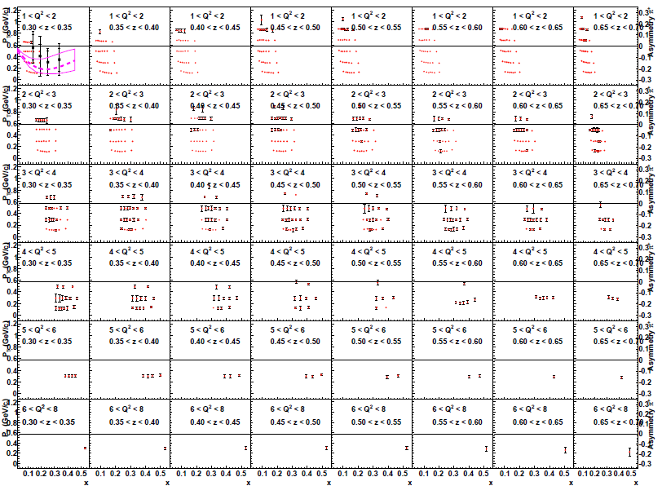
Map Collins and Sivers asymmetries in 4-D (x, z, Q², P_{T})

Slide 34
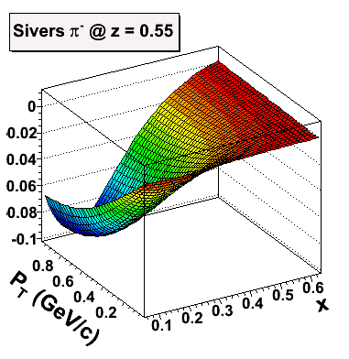
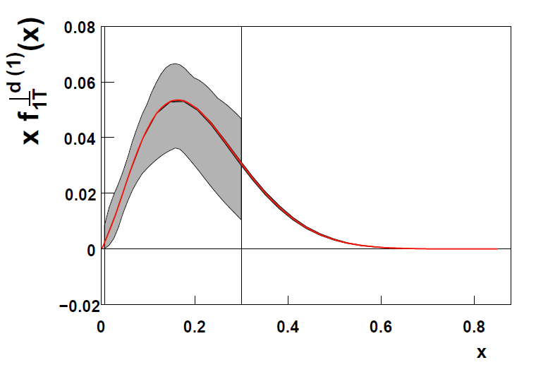
Expected Improvement: Sivers Function
f _{1T}⊥ =
Significant Improvement in the valence quark (high-x) region
Illustrated in a model fit (from A. Prokudin)

Slide 35
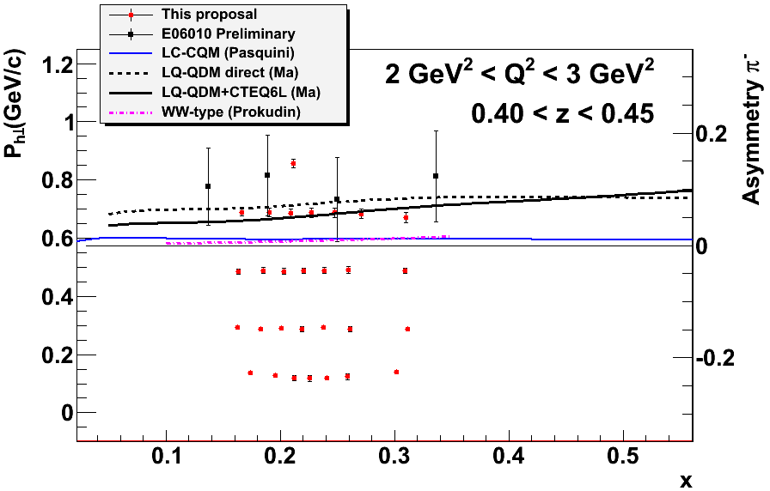
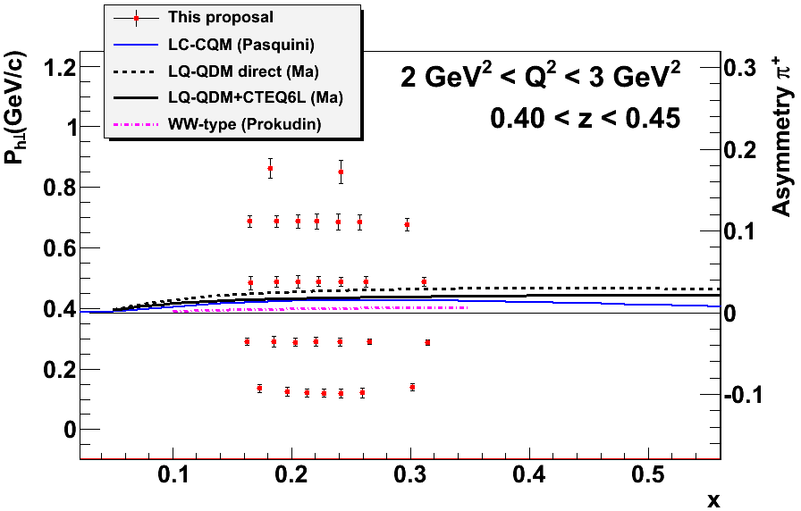
E12-11-107: Worm-gear functions (“A’ rating: )
Spokespersons: Chen/Huang/Qiang/Yan
h_{1L}⊥ =
g_{1T} =
Dominated by real part of interference
between L=0 (S) and L=1 (P) states
No GPD correspondence
Lattice QCD -> Dipole Shift in mom. space.
Model Calculations -> h_{1L}⊥ =? -g_{1T} .
Longi-transversity
Trans-helicity
Center of points:

Slide 36
Future: TMD study with SoLID at 12 GeV JLab Hall A
New Letter Of Intent: Dihadron Production

Slide 37
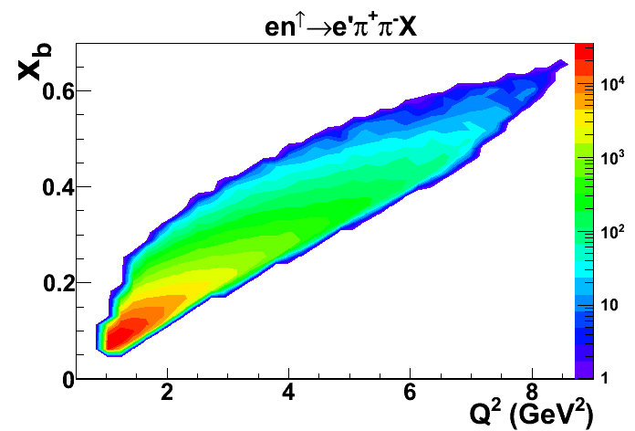
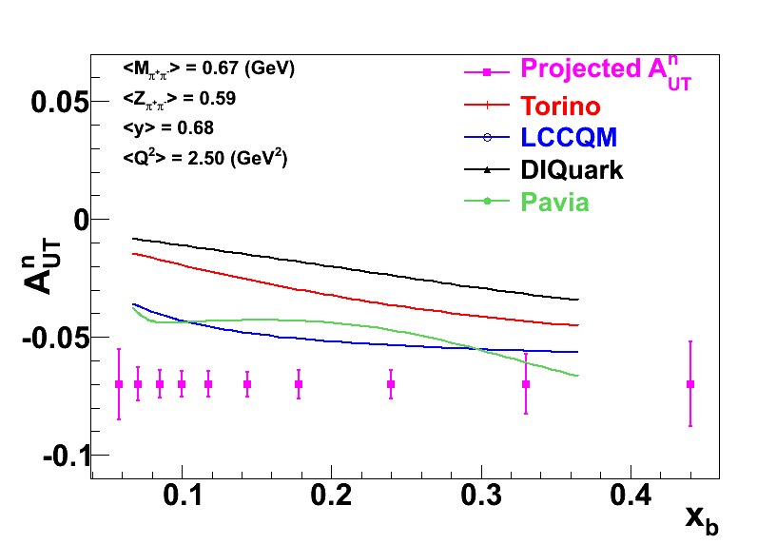
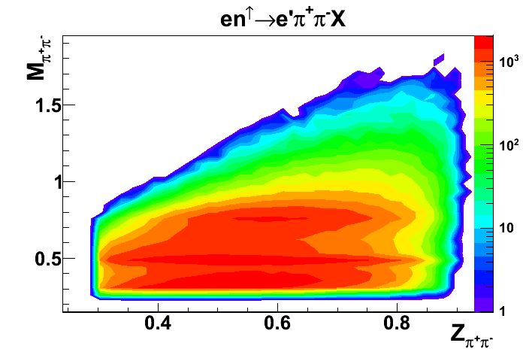
Measure Transversity via Dihadron with SoLID
LoI submitted to Jlab PAC 40, J. Zhang, A. Courtoy, et al.
Precision dihadron (π+/π-) production on a transversely polarized ³He (n)
Extract transversity on neutron
Provide crucial inputs for flavor separation of transversity
talk by M.Radici
Projected Statistics error for one (M_{ππ},z_{ππ}) bin, integrated over all y and Q².
Wide x_{b} and Q² coverages

Slide 38
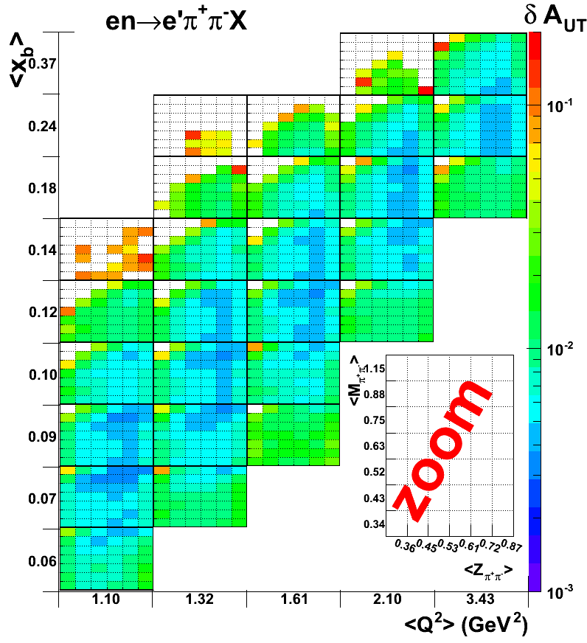
Projected Statistics Error
Hall A, SoLID program
Polarized ³He target, (~60% polarization)
Lumi=10³⁶ (n)/s/cm²
Wide x_{b}and Q² coverages
Bin central values labeld on axises
4-d (x_{b}, Q², Z_{π+π-},M_{π+π-}) mapping
Z scale (color) represent stat. error

Slide 39
Summary on SoLID TMD Program
Unprecedented precision 4-d mapping of SSA
  Collins, Sivers, Pretzelosity and Worm-Gear
Both polarized ³He (n) and polarized proton with SoLID
Study factorization with x and z-dependences
Study P_{T} dependence
Combining with the world data
  extract transversity and fragmentation functions for both u and d quarks
  determine tensor charge
  study TMDs for both valence and sea quarks
  learn quark orbital motion and quark orbital angular momentum
  study Q² evolution
Global efforts (experimentalists and theorists), global analysis
  much better understanding of multi-d nucleon structure and QCD
Long-term future: EIC to map sea and gluon SSAs

Slide 40
Long-term Future: TMD study with EIC
MEIC@JLab and E-RHIC@BNL
New Opportunity: EIC in China

Slide 41
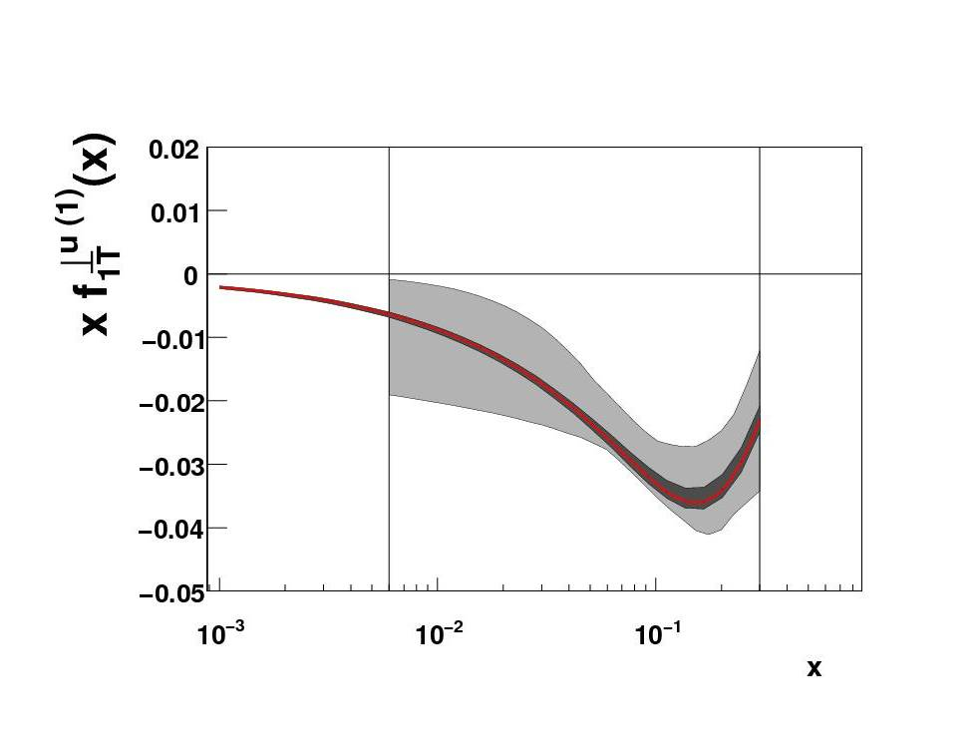
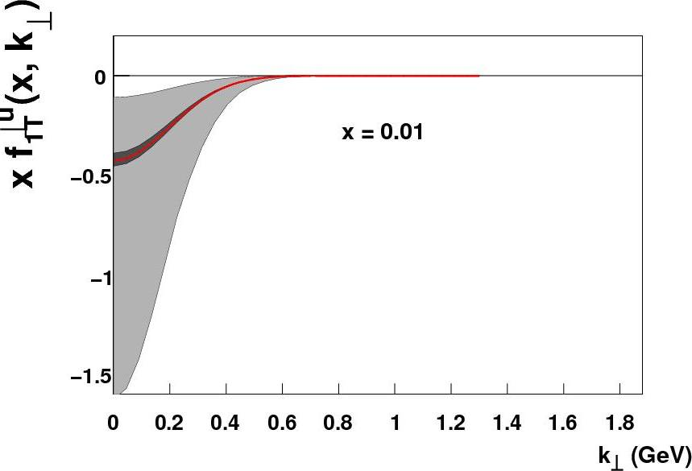
Image the Transverse Momentum of the Quarks
Prokudin, Qian, Huang
Only a small subset of the (x,Q²) landscape has been mapped here.
An EIC with good luminosity & high transverse polarization is the optimal tool to to study this!
Prokudin
Exact k_{T} distribution presently essentially unknown!

Slide 42
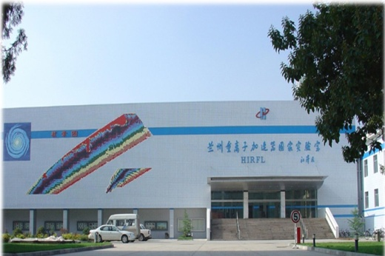
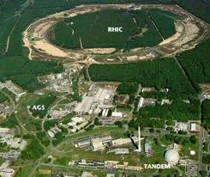
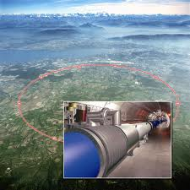
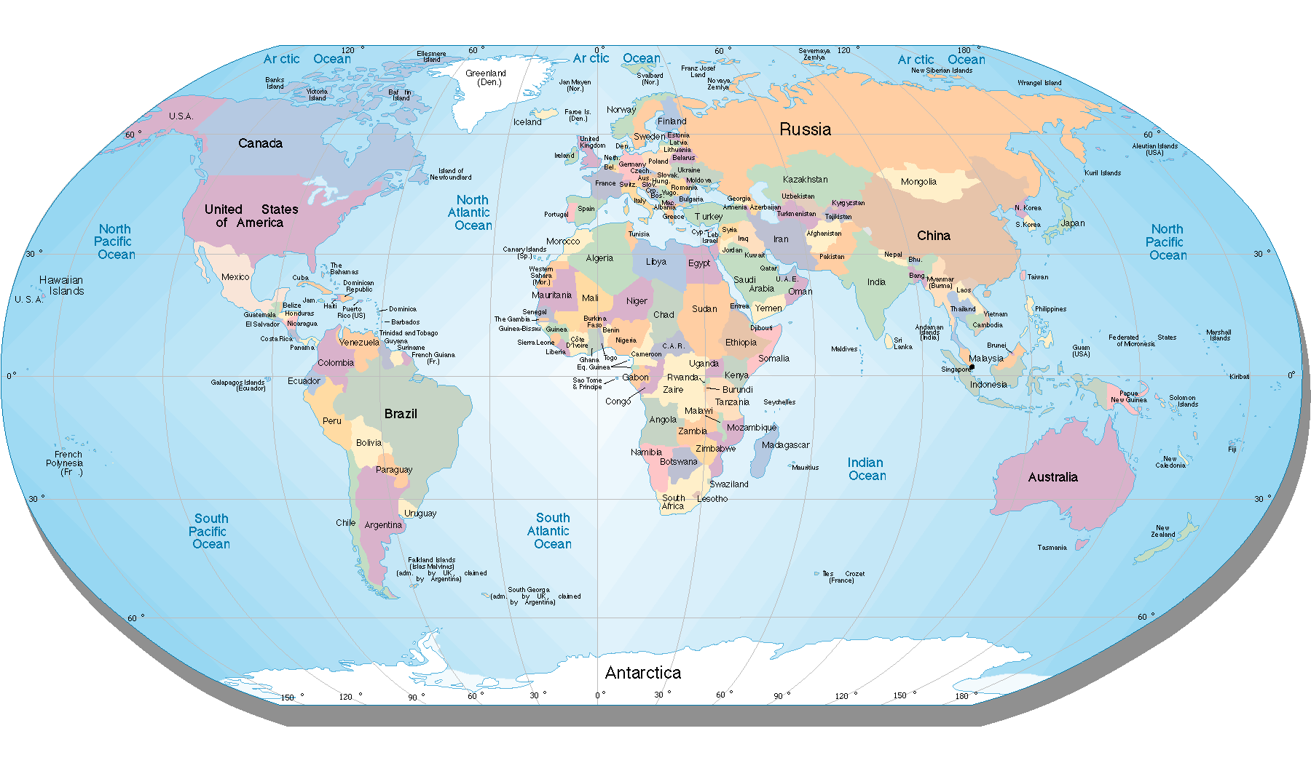
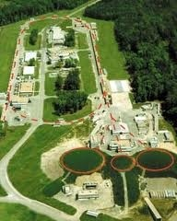
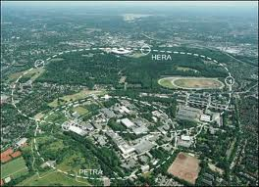
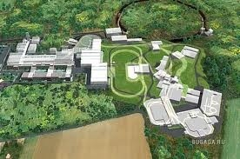
Electron Ion Colliders on the World Map
EIC@HIAF
LHC ➔ LHeC
RHIC ➔ eRHIC
CEBAF ➔ MEIC/EIC
HERA
FAIR ➔ ENC

Slide 43
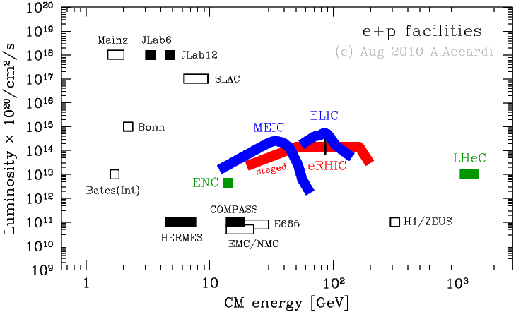
Lepton-Nucleon Facilities
EIC@HIAF: e(3GeV) +p(12GeV), both polarized, L(max)=10³³cm²/s
JLAB12
HIAF

Slide 44
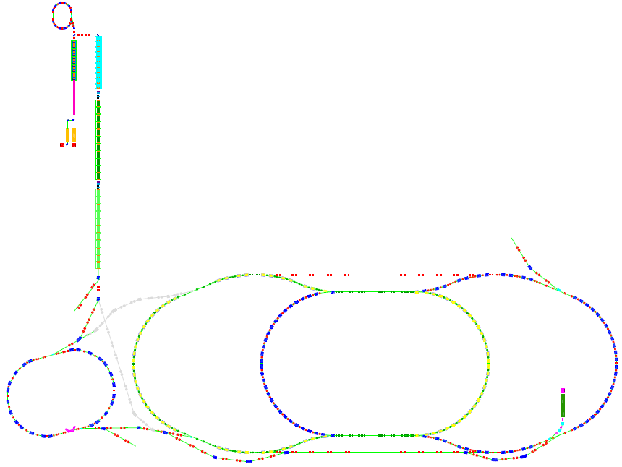
High Intensity Accelerator Facility (One Option)
SHE
Slide courtesy of Xurong Chen
Design Goal
L~10³³ 1/cm²s
 | Electron |  | proton
Energy | 3.0GeV |  | 12GeV
n [particle/bunch 10^{10]} | 30 |  | 4.0
I_{b} [bunch current mA] | 25 |  | 3.0
I [total current A] | 4.0 |  | 0.6
SC-LINAC
MCR-45
MCR-45
CSR-45
EIC

Slide 45

EIC@HIAF Kinematic Coverage Comparison with JLab 12 GeV
e(3GeV) +p(12GeV), both polarized, L(max)=10³³cm²/s
EIC@HIAF:
study sea quarks (x > 0.01)
deep exclusive scattering at Q² > 5-10
higher Q² in valance region
range in Q² allows study gluons
Timeline:
Funding Approved for HIAF
EIC under design/discussion
Construction 2014-2019
plot courtesy of Xurong Chen

Slide 46
Science Goals
The Science of eRHIC/MEIC
Goal: Explore and Understand QCD:
Map the spin and spatial structure of quarks and gluons in nucleons
Discover the collective effects of gluons in atomic nuclei
(role of gluons in nuclei & onset of saturation)
Emerging Themes:
Understand the emergence of hadronic matter from quarks and gluons & EW
The Science of EIC@HIAF
One Main Goal: Explore Hadron Structure
Map the spin-flavor, multi-d spatial/momentum structure of valence & sea quarks

Slide 47
TMD Study and other Programs at EIC@HIAF
Unique opportunity for TMD in “sea quark” region
reach x ~ 0.01 (JLab12 mainly valence quark region, reach x ~ 0.1)
Significant increase in Q² range for valence region
energy reach Q² ~40 GeV² at x ~ 0.4 (JLab12, Q² < 10)
Significant increase in P_{T} range
reach >1 GeV? (TMD/co-linear overlap region) (JLab12, reach <1 GeV)
Other Physics Programs:
Nucleon spin-flavor structure (polarized sea, Δs)
3-d Structure: GPDs (DVMP, pion/Kaon)
e-A to study hadronization
Pion/Kaon structure functions?
……
2nd Conference on QCD and Hadron Physics: http://qcd2013.csp.escience.cn/dct/page/1
Whitepaper on EIC@China is being worked on:
need inputs and help from international community

Slide 48
Summary
SSA and TMD study have been exciting and fruitful
Recent and Preliminary Results from JLab Hall A with a transversely polarized ³He (n) target
Collins/Sivers asymmetries for π+/π-/K+/K-
Pretzelosity on pi+/pi-
SSA: inclusive hadron
SSA: inclusive electron DIS
SSA: inclusive electron (Quasi)Elastic
Planned SoLID program with JLab12
Precision 4-d mapping of TMD asymmetries
EIC@HIAF opens up a new window
  Exciting new opportunities
  Precision experimental data + development in TMD theory (QCD evolution…)+…
  lead to breakthrough in understanding QCD?

