Slide 1
Cédric Lorcé
The proton spin decomposition:
Path dependence and gauge symmetry
IPN Orsay - LPT Orsay
May 7 2013, JLab, Newport News, VA, USA

Slide 2
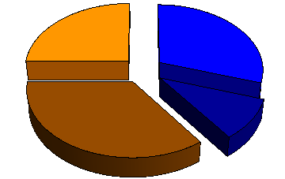
The decompositions in a nutshell
Jaffe-Manohar (1990)
L_{q}
S_{q}
L_{g}
S_{g}

Slide 3
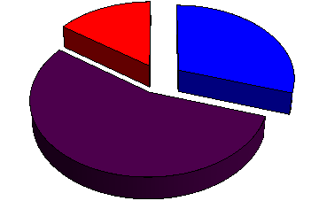
The decompositions in a nutshell
Jaffe-Manohar (1990)
Ji (1997)
L_{q}
S_{q}
L_{q}
S_{q}
L_{g}
S_{g}
J_{g}

Slide 4
The decompositions in a nutshell
Jaffe-Manohar (1990)
Ji (1997)
L_{q}
S_{q}
L_{q}
S_{q}
L_{g}
S_{g}
J_{g}
Chen et al. (2008)
L_{q}
S_{q}
L_{g}
S_{g}
Gauge-invariant extension (GIE)

Slide 5
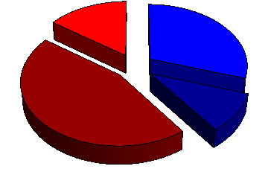
The decompositions in a nutshell
Jaffe-Manohar (1990)
Ji (1997)
L_{q}
S_{q}
L_{q}
S_{q}
L_{g}
S_{g}
J_{g}
Chen et al. (2008)
Wakamatsu (2010)
L_{q}
L_{q}
S_{q}
S_{q}
L_{g}
S_{g}
L_{g}
S_{g}
Gauge-invariant extension (GIE)

Slide 6
The decompositions in a nutshell
Canonical
Kinetic
Jaffe-Manohar (1990)
Ji (1997)
L_{q}
S_{q}
L_{q}
S_{q}
L_{g}
S_{g}
J_{g}
Chen et al. (2008)
Wakamatsu (2010)
L_{q}
L_{q}
S_{q}
S_{q}
L_{g}
S_{g}
L_{g}
S_{g}
Gauge-invariant extension (GIE)

Slide 7
The Chen et al. approach
[Chen et al. (2008,2009)]
[Wakamatsu (2010,2011)]

Slide 8
The Chen et al. approach
[Chen et al. (2008,2009)]
[Wakamatsu (2010,2011)]
Gauge transformation

Slide 9
The Chen et al. approach
[Chen et al. (2008,2009)]
[Wakamatsu (2010,2011)]
Gauge transformation
Pure-gauge covariant derivatives

Slide 10
The Chen et al. approach
[Chen et al. (2008,2009)]
[Wakamatsu (2010,2011)]
Gauge transformation
Pure-gauge covariant derivatives
Field strength

Slide 11
The canonical formalism
[C.L. (2013)]
Textbook
Lagrangian
Dynamical variables

Slide 12
The canonical formalism
[C.L. (2013)]
Textbook
Lagrangian
Dynamical variables
Gauge covariant

Slide 13
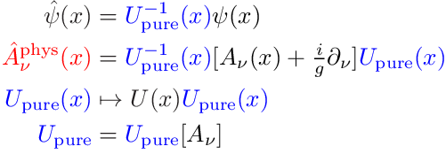
The canonical formalism
[C.L. (2013)]
Textbook
Lagrangian
Dynamical variables
Gauge covariant
Gauge invariant
Dirac variables
[Dirac (1955)]
[Mandelstam (1962)]
Dressing field
Gauge transformation

Slide 14
The analogy with General Relativity
[C.L. (2012,2013)]
Dual role

Slide 15
The analogy with General Relativity
[C.L. (2012,2013)]
Dual role
Pure gauge
Physical polarizations
Degrees of freedom

Slide 16
The analogy with General Relativity
[C.L. (2012,2013)]
Dual role
Pure gauge
Physical polarizations
Degrees of freedom
Parallelism
Curvature
Geometrical interpretation

Slide 17
The analogy with General Relativity
[C.L. (2012,2013)]
Dual role
Pure gauge
Physical polarizations
Degrees of freedom
Parallelism
Curvature
Geometrical interpretation
Inertial forces
Gravitational forces
Analogy with General Relativity

Slide 18
The geometrical interpretation
[Hatta (2012)]
[C.L. (2012)]
Parallel transport

Slide 19
The geometrical interpretation
[Hatta (2012)]
[C.L. (2012)]
Parallel transport

Slide 20
The geometrical interpretation
[Hatta (2012)]
[C.L. (2012)]
Parallel transport

Slide 21
The geometrical interpretation
[Hatta (2012)]
[C.L. (2012)]
Parallel transport
Path dependent!
Stueckelberg symmetry

Slide 22
The gauge symmetry
[C.L. (in preparation)]
Quantum electrodynamics
« Physical »
« Background »

Slide 23
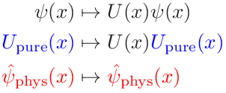
The gauge symmetry
[C.L. (in preparation)]
Quantum electrodynamics
« Physical »
« Background »
Passive

Slide 24
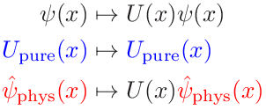
The gauge symmetry
[C.L. (in preparation)]
Quantum electrodynamics
« Physical »
« Background »
Passive
Active

Slide 25
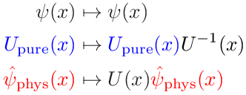
The gauge symmetry
[C.L. (in preparation)]
Quantum electrodynamics
« Physical »
« Background »
Passive
Active
Active x (Passive)⁻¹

Slide 26
The gauge symmetry
[C.L. (in preparation)]
Quantum electrodynamics
« Physical »
« Background »
Stueckelberg
Passive
Active
Active x (Passive)⁻¹

Slide 27
The semantic ambiguity
Quid ?
« physical »
« measurable »
« gauge invariant »

Slide 28
The semantic ambiguity
Quid ?
« physical »
« measurable »
« gauge invariant »
Observables
Measurable, physical, gauge invariant (active and passive)
E.g. cross-sections

Slide 29
The semantic ambiguity
Quid ?
« physical »
« measurable »
« gauge invariant »
Observables
Measurable, physical, gauge invariant (active and passive)
E.g. cross-sections
Path
Stueckelberg
Background
Expansion scheme
dependent
E.g. collinear factorization

Slide 30
The semantic ambiguity
Quid ?
« physical »
« measurable »
« gauge invariant »
Observables
Measurable, physical, gauge invariant (active and passive)
E.g. cross-sections
Path
Stueckelberg
Background
Expansion scheme
dependent
E.g. collinear factorization
Quasi-observables
« Measurable », « physical », « gauge invariant » (only passive)
E.g. parton distributions

Slide 31
The local limit
Local limit of quasi-observables
Path dependence

Slide 32
The local limit
Local limit of quasi-observables
Path dependence
Genuine local quantities are path independent !
Parametrized by form factors

Slide 33
The local limit
Local limit of quasi-observables
Path dependence
Genuine local quantities are path independent !
Parametrized by form factors
Passive and active
Passive and path independent
Passive and local
« True » gauge invariance :
[Ji (2009)]

Slide 34
The twist-2 OAM
[C.L., Pasquini (2011)]
[C.L., Pasquini, Xiong, Yuan (2012)]
[Hatta (2012)]
Quark Wigner operator

Slide 35
The twist-2 OAM
[C.L., Pasquini (2011)]
[C.L., Pasquini, Xiong, Yuan (2012)]
[Hatta (2012)]
Quark Wigner operator
Quark OAM operator

Slide 36
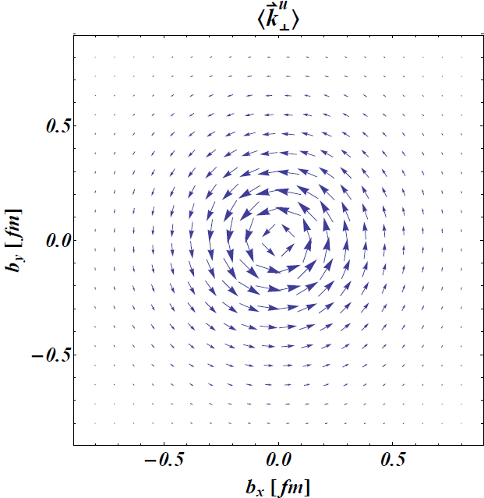
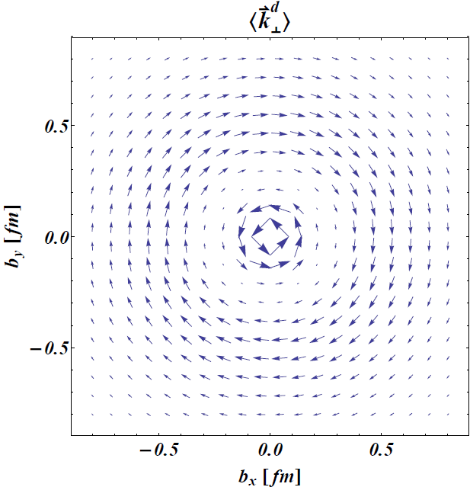
The twist-2 OAM
[C.L., Pasquini (2011)]
[C.L., Pasquini, Xiong, Yuan (2012)]
[Hatta (2012)]
Quark Wigner operator
Quark OAM operator
Exact relation
« Vorticity »

Slide 37
The path dependence
[Ji, Xiong, Yuan (2012)]
[Hatta (2012)]
[C.L. (2013)]
Canonical quark OAM operator

Slide 38
The path dependence
[Ji, Xiong, Yuan (2012)]
[Hatta (2012)]
[C.L. (2013)]
Canonical quark OAM operator
x-based Fock-Schwinger
Coincides locally with kinetic quark OAM

Slide 39
The path dependence
[Ji, Xiong, Yuan (2012)]
[Hatta (2012)]
[C.L. (2013)]
Canonical quark OAM operator
x-based Fock-Schwinger
Light-front
ISI
FSI
Drell-Yan
SIDIS
Coincides locally with kinetic quark OAM
Naive T-even

Slide 40
The summary
Canonical
Kinetic
Jaffe-Manohar (1990)
Not observable
Ji (1997)
Observable
L_{q}
S_{q}
L_{q}
S_{q}
L_{g}
S_{g}
J_{g}
Chen et al. (2008)
Quasi-observable
Wakamatsu (2010)
Quasi-observable
L_{q}
L_{q}
S_{q}
S_{q}
L_{g}
S_{g}
L_{g}
S_{g}

Slide 41
Backup slides

Slide 42
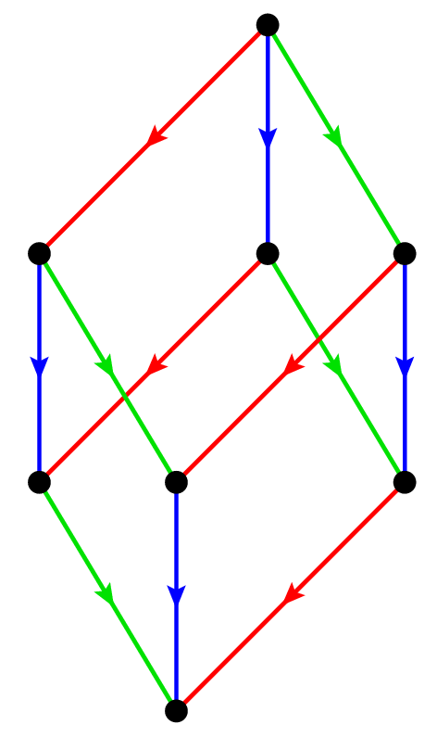
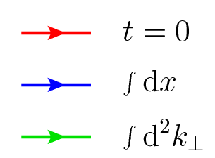
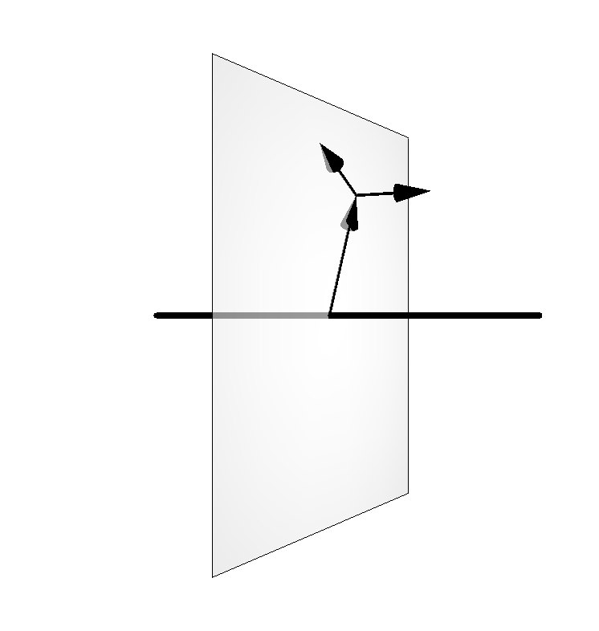
The parton distributions
GTMDs
[PRD84 (2011) 014015]
[PRD85 (2012) 114006]
[PRD84 (2011) 034039]
[PLB710 (2012) 486]
TMDs
TMFFs
GPDs
[JHEP1105 (2011) 041]
TMCs
PDFs
FFs
[PRD79 (2009) 014507]
[Nucl. Phys. A825 (2009) 115]
[PRL104 (2010) 112001]
[PRD79 (2009) 113011]
Charges
Phase-space densities
[PRD74 (2006) 054019]
[PRD78 (2008) 034001]
[PRD79 (2009) 074027]

Slide 43
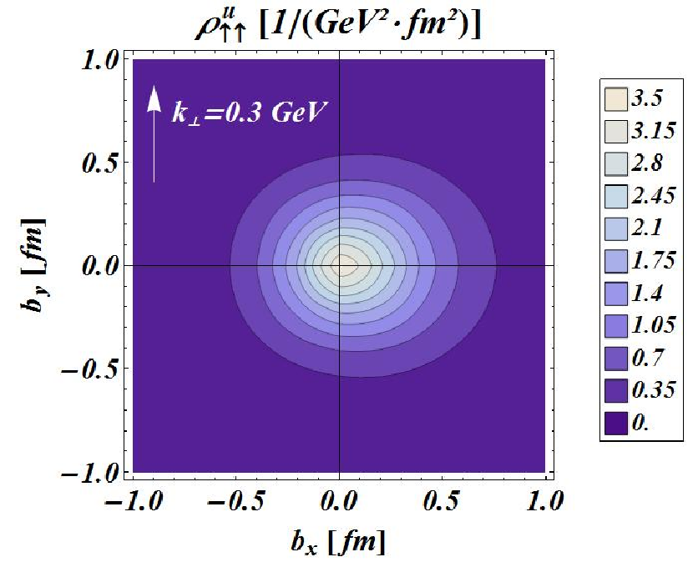
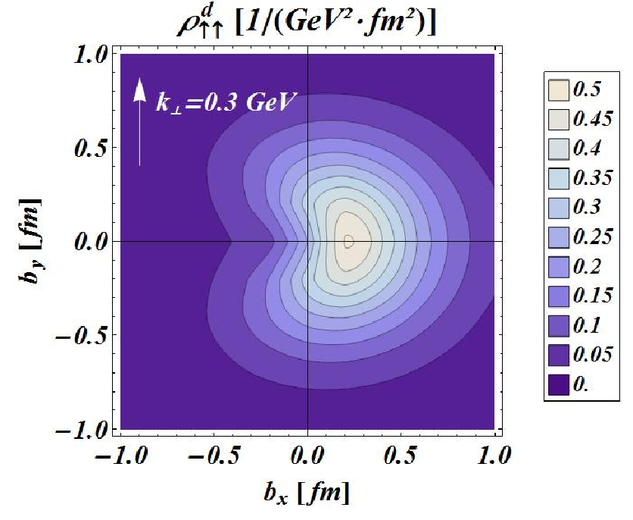
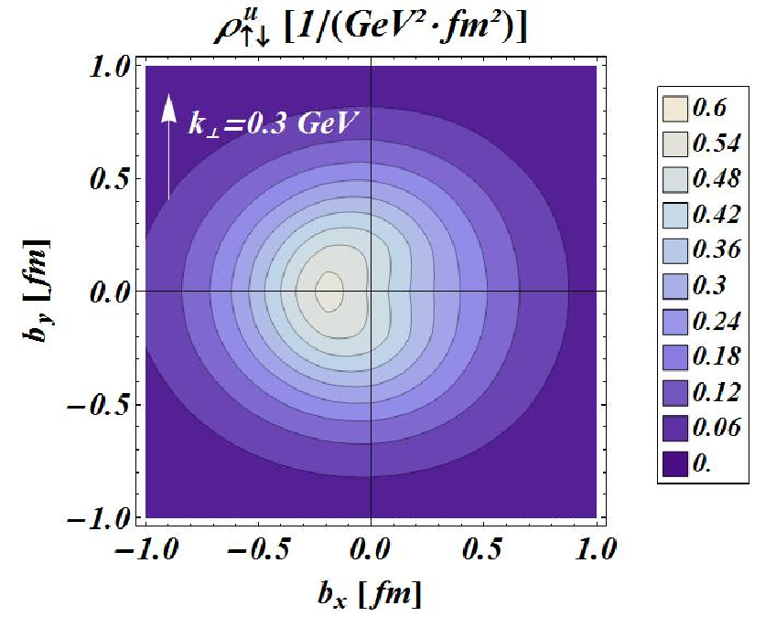
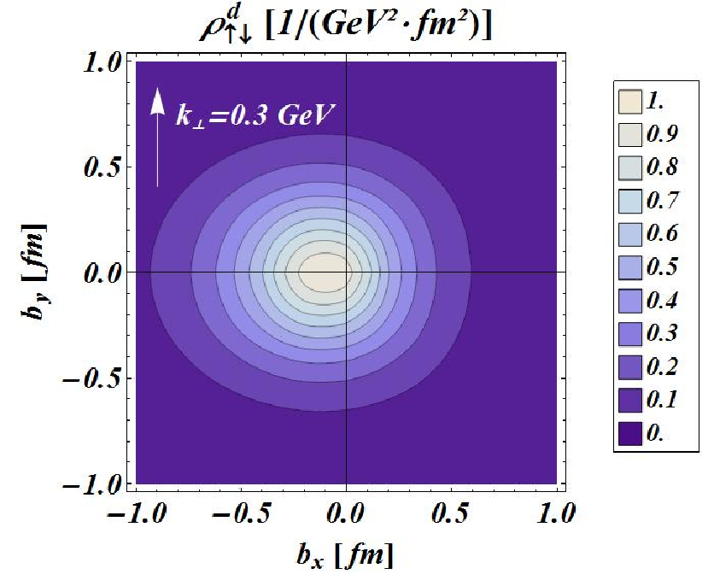
The spin-spin-orbit correlations
[C.L., Pasquini (2011)]

Slide 44
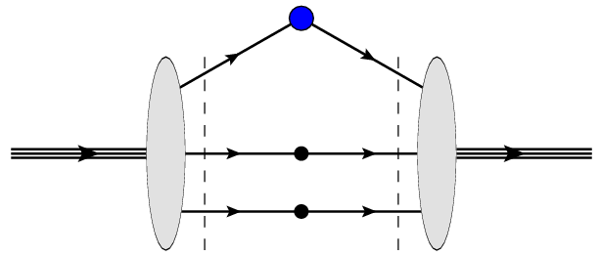
The light-front wave functions
Overlap representation
Momentum
Polarization
Light-front quark models
Wigner rotation
[PRD74 (2006) 054019]
[PRD78 (2008) 034001]
[PRD79 (2009) 074027]

Slide 45
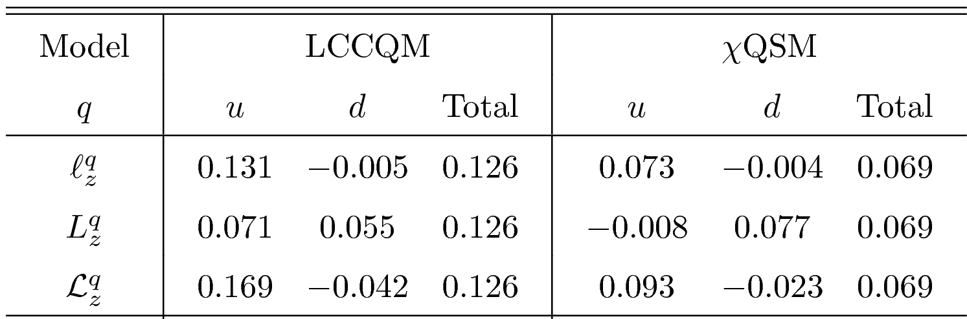
The orbital angular momentum
OAM
Kinetic
GPDs
Canonical (naive)
TMDs
Canonical
GTMDs
Phenomenological comparison
but

Slide 46
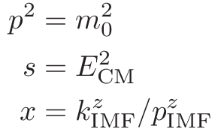
The gauge-invariant extension (GIE)
Gauge-variant operator
GIE2
GIE1
Gauge
« Natural » gauges
Rest
Center-of-mass
Infinite momentum
~
Lorentz-invariant extensions
« Natural » frames

