Slide 1
Observables for quarks and gluons orbital angular momentum distributions
Simonetta Liuti
University of Virginia
QCD Evolution Workshop
Santa Fe, May 12-16, 2014

Slide 2
Outline
Definitions
Measurements/Observables
Partonic interpretation
The parity issue
Spin 1
Conclusions

Slide 3
Collaborators:
Aurore Courtoy, Osvaldo Gonzalez Hernandez, Gary Goldstein,
(Kunal Kathuria), Abha Rajan
Angular momentum in spin 1 ➔arXiv:1101.0581
Observability of OAM➔arXiv:1310.5157,
GPDs from flavor separated form factors ➔arXiv:1206.1876
Chiral odd approach ➔arXiv:1311.0483, submitted
Chiral even approach➔arXiv:1012.3776, submitted
PLB731 (2014)

Slide 4
How does OAM enter the picture?
?

Slide 5
Define Angular Momentum through the QCD Energy Momentum Tensor
AM density
Momentum density
T⁰⁰ | T⁰¹ | T⁰² | T⁰³
T¹⁰ | T¹¹ | T¹² | T¹³
T²⁰ | T²¹ | T²² | T²³
T³⁰ | T³¹ | T³² | T³³
Energy density
Shear stress
Momentum density
Pressure

Slide 6
Sum Rule: Part I
First define the angular momentum components
then parametrize the EMT in terms of form factors A, B, C
Finally, connect of the EMT form factors with AM components
Jaffe Manohar (1990)
Ji (1997)

Slide 7
Sum Rule: Part II
The second part of the sum rule is about finding a Partonic Interpretation and the Observables

Slide 8
1997: X. Ji connects the EMT form factors to the 2nd moments of
generalized parton distributions (GPDs)
e
q'=q+Δ
q
k+q
k
k’= k –Δ
H,E
p
p’
ΔΣ+L_{q}
Notes:
The main step is in that new functions defining the soft matrix elements for DVCS processes were found that match exactly the elements of the SR

Slide 9



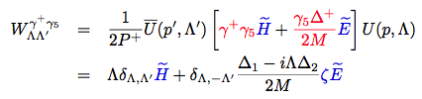
Quark-quark correlator: vector
Quark-quark correlator: axial vector
k,λ
k’,λ’
H,E
p,Λ
p’,Λ’

Slide 10

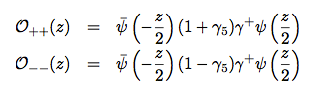
Helicity Amplitudes

Slide 11
z
p
Jacob Wick helicity:
S
x
≠ light front helicity
Parity relations:
(because helicity and LF helicity are related by a unitary transformation the parity relations are invariant, M. Diehl)

Slide 12
Connection with GPDs
Helicity basis
?
Transversity basis

Slide 13
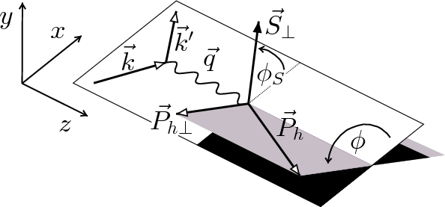
Observables

Slide 14
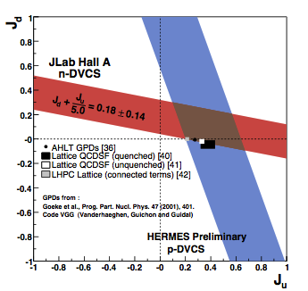
Observables
J_{q} =1/2 ΔΣ+L_{q}

Slide 15
The other approach: Jaffe Manohar
In LC gauge rewrite AM using Dirac eqn. to isolate spin terms
ΔΣ
?
?
ΔG
5/13/14
15

Slide 16
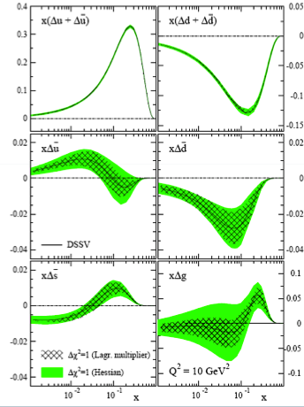
  Jaffe Manohar’s partonic picture:
  quark and gluon spin components are identified with the n=1 moments of spin dependent structure functions from DIS ➔ ΔΣ and ΔG.
Δu
Δd
Observables!
ΔG
Δs

Slide 17
We now know where OAM could enter the picture … but what is OAM in QCD
?

Slide 18

Consider twist 3 contributions
OAM can be defined through a sum rule analogous to Ji’s at tw 2
Polyakov et al. (2000)
Hatta (2011)
-L_{q}
-J_{q}
S_{q}

Slide 19
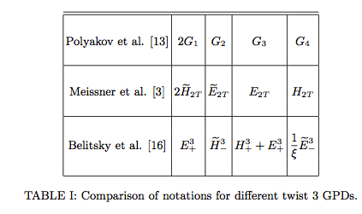
Twist 3 decomposition of hadronic tensor in various notations
arXiv:1310.5157

Slide 20

G₂ can describe both canonical (Jaffe Manohar) and Ji’s OAM
Ji
F-type tw3
JM
D-type tw3
Hatta, 2011
!!

Slide 21
In arXiv:1310.5157 we asked what is the spin configuration
corresponding to quark OAM?
Helicity Amplitudes analysis done using twist 3 GTMDs
contain one bad component
~
G₂
G₂
Knowing the helicities configuration allows us to interpret why we have a net OAM in the proton

Slide 22
G₂
If the proton is polarized longitudinally, the quark distribution is going to be displaced transversely, along Δ
x
Δ
S_{L}
z
y

Slide 23
Distribution of an unpolarized quark in a proton polarized along the longitudinal axis
u quark
d quark
ρ₂
b_{y}
b_{x}

Slide 24

Calculation done in WW approximation using the reggeized diquark model
H
E
H tilde
G₂
-
u
+
d

Slide 25
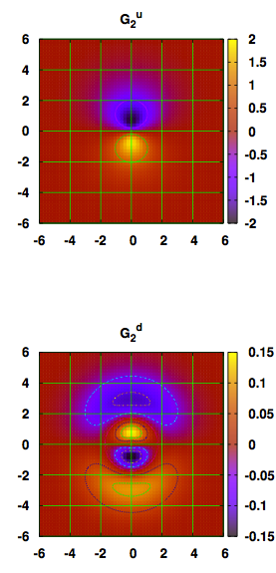
in 2D
ρ₂^{u}
ρ₂^{d}
b_{y}(fm)
b_{y}(fm)

Slide 26
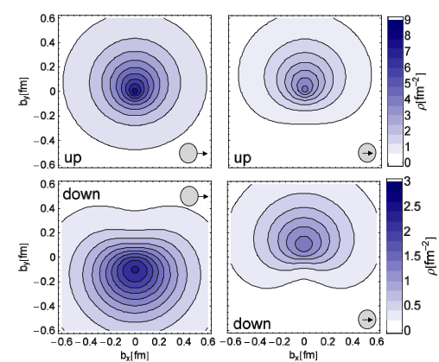
Analogous situation as for E wrt. transverse spin (M. Burkardt)
E
k_{T}
The net b corresponds to net k_{T} in the opposite direction (attractive color force due to FSI)

Slide 27
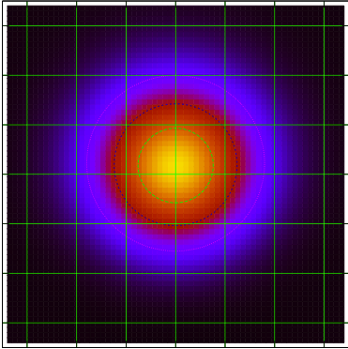
k_{T}
For G₂ there is no preferential/”net” direction of k_{T} wrt. the “net” displacement along the +y axis
No FSI (see gauge link contribution at ∞, M. Burkardt, “torque”)
No k_{T} contribution perpendicular to Δ (parity violating)

Slide 28
“Net” OAM can exist in the transverse (orthogonal) direction!
x
b
k_{z}
L
z
y
This is the physical meaning of G₂

Slide 29
Now that we understand all this, can we measure OAM?
First of all notice that in Wandzura Wilczek approximation
≠F₁₄!

Slide 30
How does Ji sum rule differ from JM in the deuteron?
Effect of evolution
Using GPDs from Goldstein, Gonzalez Hernandez, SL, PRD84

Slide 31

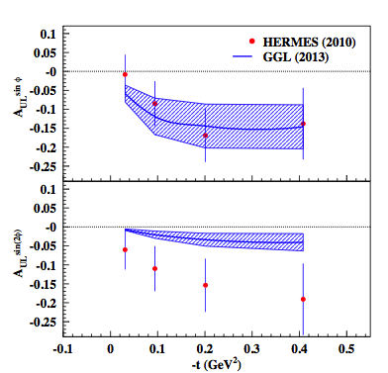
DVCS on a longitudinally polarized target
sin 2φ term is tw 3!
WW, small ξ
Jlab data in progress!
Avakian, Pisano

Slide 32
Parity issues with F₁₄
Parity Odd: proton spin dotted into OAM
The amps will cancel unless they are imaginary:
A_{+ +, + +} = A*_{- -,-} ₋ ; A_{+ - , + -} = A*_{- +,} ₋ ₊
But this cannot be, as seen from CM system - at leading order - these will be real – all in same plane so there can be no relative phase between helicity amps.
VERY IMPORTANT CAVEAT:
On Light Front this does not happen because what is conserved is Light Front Parity, not P and T separately (Carlson&C.R. Ji)
BUT THAT IS NOT PARITY!!!

Slide 33
F₁₄
It is not OAM (naïve identification)
It decouples from direct measurements of TMD/GPD observables
Can it be measured at all?

Slide 34
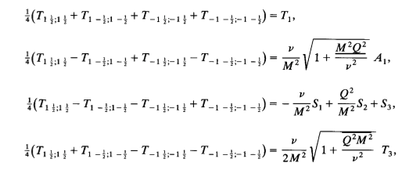
F₁₄ appears in the unintegrated structure functions for deep inelastic scattering with electroweak currents
F₁
A₁
G₁
F₃
W±,Z
X.Ji, NPB402 (1993)
p

Slide 35


g₁
F₁₄
parity odd
F₁₄
g₁
F₁₄ is the parity odd contribution to g₁ and the parity even contribution to A₁!

Slide 36
Conclusions and … to explore …
OAM has (mistakenly) been associated with the leading twist distribution of an unpolarized quark in a longitudinally polarized proton. This quantity is Parity odd and it cannot be observed directly
Even if one could match F₁₄ with a hard part that is also Parity Odd, and generate an observable, however that changes the partonic content of the soft part, it still would not carry the meaning of OAM
G₂, a twist 3 quantity, can be measured directly, and it does have a partonic interpretation, if one views it as.
We showed the helicity and spin structure of this quantity, that it can replace the previously suggested one, and that it does not violate Parity

Slide 37
We need to devise experiments that are sensitive to this contributions (some data already exist, HERMES + S. Pisano)
Question of L vs. T interpretation
How does the tw 3 picture connect to M. Burkardt’s gauge-link-based interpretation (torque experienced by quarks)
We focused mainly on quarks, question of gluon component
One way to shed light on these questions is to look at deuteron
37

Slide 38
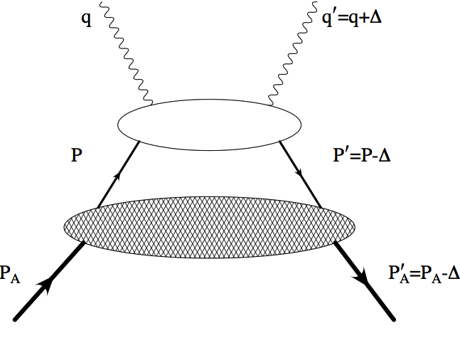

Sum Rules in Deuteron (Kunal Kathuria)
z=p_{N}⁺/P⁺_{D}
λ_{q}
Nucleon DVCS
λ_{N}
Deuteron
λ
Spin 1 systems, due to
The presence of additional L components (S+D-waves)
Isoscalarity
provide a crucial test the working of the angular momentum sum rules

Slide 39


Deuteron Angular Momentum Sum Rule
Phys.Rev. D86 (2012) 036008
Longitudinal
Nucleon
Deuteron
F₁+F₂= G_{M}
G_{M}
Transverse Deuteron
Differently from the nucleon, in the transverse case,
we are not finding the same relation (other GPDs describing
charge and tensor component enter…). More details later…

Slide 40

Observables: DVCS from deuteron
subleading
Can the deuteron help us understand the role of gluon OAM?
(Brodsky, Gardner, 2006)
By connecting L_{g} to SSA in
≈ 0
Both L _{q} and L_{g} contribute! Since L_{q} disappears because of isospin
symmetry, if A^{UT}_{π} is 0 then L_{g} is 0

Slide 41
Angular momentum in spin 1 ➔arXiv:1101.0581
Observability of OAM➔arXiv:1310.5157
GPDs from flavor separated form factors ➔arXiv:1206.1876
Chiral odd approach ➔arXiv:1311.0483, submitted
Chiral even approach➔arXiv:1012.3776, submitted

Slide 42
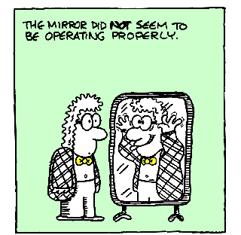

Slide 43
Back up

Slide 44
AM sum rule is obtained by connecting the quark matrix elements of n=2 terms in OPE
with the matrix elements of the energy momentum tensor

