Slide 1
Personal Remarks and Perspectives on the Future of SRF
Peter Kneisel
Jefferson Lab
May 19, 2014

Slide 2
Since I believe that I am much better in talking about the past than “predicting” the future - my view is clouded by the past 47 years – I will start with some remarks about the past
As some of you might recall, there was a session at SRF 2009 in Berlin titled “Hot Topic “
Hasan and myself were asked to discuss two subjects
Is Niobium at the end of the road?
At what front should we do battle?
As usual we both had some different views – Hasan presented a more optimistic view – and gave us his perspective for the next 25-35 years- of possible projects, which would require much higher gradients as presently achieved with Nb. My own view was a little bit more subdued and concentrated more on shorter term needs. Both contributions can be found in the SRF2009 proceedings
Let’s see what the last 5 years in SRF developments have brought us
Here are some slides from my 2009 remarks

Slide 3
Is Nb at the end of the road? Absolutely not
Critical field has been reached in a few cases, but:
Technology far away from routinely reaching the limit, especially in multi-cell cavities
Surface treatment (EP) and fabrication (EBW) are less than reproducible: still large spread in data
FE is still the major problem
For cw application Q-values ( residual resistance) need to be improved and reproducibly achieved
The fact, that work is going on to improve the surface
- ALD, EP of various flavors, fabrication (seamless, LG,EBW), furnace treatments, baking in argon, Nb thin films.. – speaks for itself
Major goal for large projects such as e.g. ILC should be reduction of costs

Slide 4
End of the road? [R.Geng etal]

Slide 5
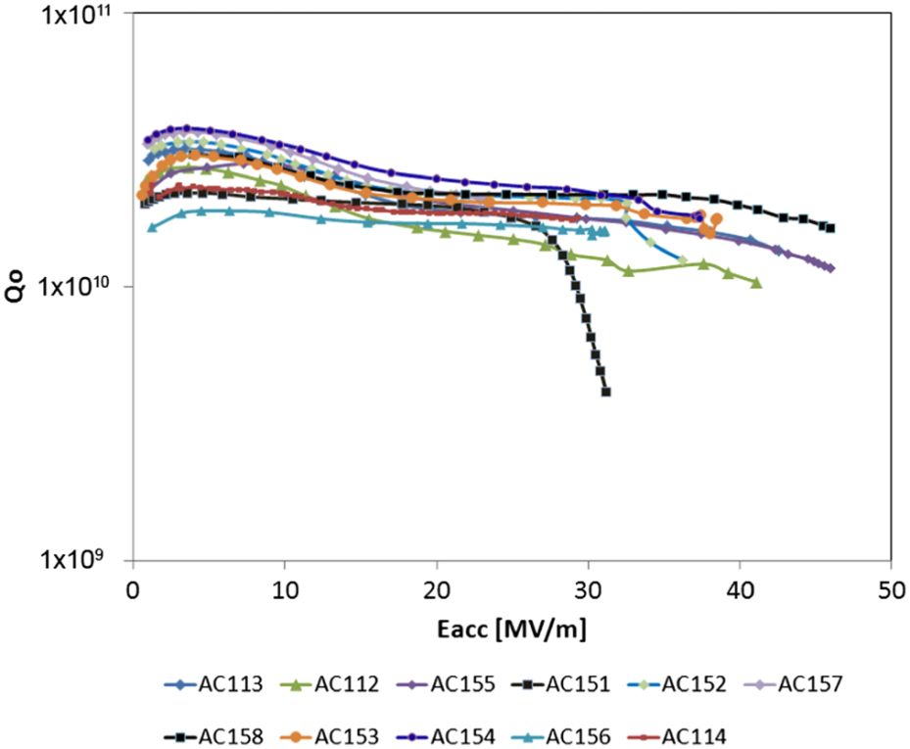
End of the Road?
Best 9-cell performance achieved with ingot Nb at DESY[W.Singer et al,PRST 16,012003(2013)]
A cryomodule has been assembled from these cavities ( 7 ) and the losses in this module is ~ 50% lower than in standard modules [J. Sekutowicz, TTC meeting 2014]

Slide 6
At what front should we do battle?
Obviously there is a tendency to explore other/better superconducting materials, because of lower costs, less sc material (Thin film Nb)
cheaper structure (L.Phillips,3rd thin film workshop, Jlab 2008)
The argument for doing this is often focussing on higher critical fields (multi-layers) and higher T_{c} (other sc materials), which implies higher Q-values??
Is this true?

Slide 7
Choices among Superconducting Materials
Nb compounds
A15 compounds
MgB2
Material | T_{c} (K) | ρ_{n}(μΩcm) | H_{c}(0) [T] | H_{c1}(0) [T] | H_{c2}(0) [T] | λ(0) [nm]
Nb | 9.2 | 2 | 0.2 | 0.17 | 0.4 | 40
NbN | 16.2 | 70 | 0.23 | 0.02 | 15 | 200
NbTiN | 17.5 | 35 |  | 0.03 |  | 151
Nb₃Sn | 18 | 20 | 0.54 | 0.05 | 30 | 85
V₃Si | 17
Mo₃Re | 15 |  | 0.43 | 0.03 | 3.5 | 140
MgB₂ | 40 |  | 0.43 | 0.03 | 3.5 | 140

Slide 8
Other Superconductors
Nb₃Sn:
Most explored alternative material; most successful process:
Vapor diffusion
Siemens : ~ 110 mT in TE cavity ( X-band)
Uni Wuppertal (M.Peiniger, thesis): process improvement, multi
cell cavities; E_{acc} ~ 10 MV/m
Uni Wuppertal/SLAC: pulsed
Uni Wuppertal/Cornell: HPP
Wuppertal/Jlab(G.Mueller et al, Abano Terme): single cell and multi-cell
1.5 GHz cavities,High Q’s at lower fields, strong dependence of Q
on field, reason for stopping development; development picked up again at Cornell and JLab
INFN: co-sputtering and reaction, dipping in liquid tin bath

Slide 9
Multi Layer [A. Gurevich, APL 88 (Jan.2006)]
Shown in Fig. 3 is an example of QB0 calculated from Eqs. 11–14 for bare and 50 nm Nb3Sn clad Nb cavities at 2 K for =2, Rb=20 n, R0=2 n at 2 K, s=0.215, D=3 mm, h=5 kW/m2 K, =10 W/mK, and Q₀ ^{Nb}=10¹⁰. In this case a 50 nm Nb3Sn overlayer more than triples Q at low field and increases Bb from 180 mT to 280 mT,
while a 100 nm multilayer more than doubles Bb to 340 mT, as shown in Fig. 3. For a 100 nm multilayer, Bb is twice of Bc Nb, but still lower than Bc=540 mT of Nb3Sn.
But there are other considerations

Slide 10
Other considerations
Residual resistance
Field dependence of Q
Surface electric fields : field emission
Thermal stability: substrate material
Frozen-in flux due to e.g. MP
Lorentz force detuning: typically – 2 Hz/(MV/m)^2
at E_{acc} ~ 100 MV/m : detuning 20 kHz
at Eacc ~ 200 MV/m: detuning 80 kHz at BW of ~ 100 Hz
What duty cycle is reasonable?
High Power Input couplers, coarse and fine tuners?
High T_{c} : How valid is the claim to operate at 4.2K?
Thermal stability, heating,

Slide 11
Film Niobium
Several new flavors of deposition are being pursued for several years:
ECR
High power pulse Magnetron sputtering ( HiPIMS)
CVD……..
Development and progress is slow
Successful cavity demonstration still in future

Slide 12
Final Remark
There is plenty of development work necessary for the application of bulk Niobium
Most important: reproducibility, cost reduction
Alternative materials:
Okay to learn more about physics – good for PhD’s, but questionable to “sell” these materials for accelerator application in the near future
Nb technology development started 1963 and hundreds of mill. of $ have been spent until now

Slide 13
Perspetives for the Future
For high gradient application and existing cryomodules:
Battling FE is still problem #1
Vulnerable are especially larger assemblies/CM’s
“in situ” processing”
For fabrication/cavity performance:
Electron beam welding
How to avoid “cat eyes”/ defects in the heat effected zone of equator welds?

Slide 14
Perspetives for the Future(2)
High gradients are less “in demand” nowadays compared to high Q and high currents ( power couplers, HOM loads .. )
solidify procedures for high Q’s

Slide 15
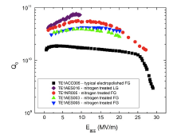
Q-Improvements: Doping of Nb
N-doping at FNAL
[A.Grassellino et al, Supercond.Sci 26(2013),102001
Process courageously adopted for LCLSII
First seen at Jlab Dhakal et al[IPAC2012]

Slide 16
Implications for high Q: musts!?
“Sanitized” hardware ( first “championed” by Curtis Crawford)
Magnetically well shielded cryostats
Well shielded tunnel
Reproducible procedure for large cavities (doping, few micron material removal…cleaning)
Reproducible clean assembly in production environment
Optimized Cooldown conditions (slow vs fast)
No “quenches” due to multipacting barriers
No field emission – FE loading will reduce Q-values
Is rework possible??
Even though the XFEL production by industry is very successful, present yield is ~ 70% after ~200 cavities
Development of Industrialization

Slide 17
Perspetives for the Future
Alternative materials :
Ingot Niobium
Has been demonstrated even in module to have lower losses
Development of inexpensive cutting need to be done
Multi wire cutting exists, but is still expensive for small volume
Other superconductors/multi layers:
tough, how many of us will see an application??
Alternative shape:
Superstructure
Superconducting joint
Seamless Cavities
Alternative injectors
Superconducting photo-injector
Based on e.g. Pb ( no choke joint) or FZD with choke joint
Or high current like for e.g. Berlin ERL, BNL ERL..
It seems to make sense to have a sc injector in an “all superconducting accelerator”

Slide 18
Some Personal remarks (1)
Many thanks to all of the presenters and the attendees to participate in this workshop. I very much appreciate the long travels some of you took to celebrate my retirement. Many thanks also to Jlab and in particular the organizers of this workshop: Bob and Charlie
I want to say a few words about my 47 years in SRF
I started at the Kernforschungszentrum Karlsruhe in Germany in 1967 and had no clue about microwave technology, cavities and waveguides
I had from the start a very good boss – Prof. A. Citron – and a caring mentor in Juergen Halbritter
He arranged my first sabbatical at HEPL in 1973
– the “Mekka” of SRF at the time – where I worked with A .Schwettmann , John Turneaure and Yuzo Kojima in a “swap” arrangement with Claude Lyneis
This was also my first visit to Cornell University, following an invitation by M.Tigner – I met for the first time Ron Sundelin and Hasan Padamsee and we became close friends when I spent another sabbatical in 1978 at Cornell and later moved for good with my family to the US in 1981
In 1987 I joined CEBAF - as some other colleagues from Cornell did – I want to thank Ron that he had enough confidence in my capabilities and asked me to come with him to CEBAF, when he accepted the job of Department Head in SRF

Slide 19
Some personal Remarks (2)
In the 27 years of my Jlab employment I nearly always enjoyed going to work
There were only a handful of occasions, when I was ready to quit
One of those happened recently, when one of my long time supporters – I want to call him my friend – was removed from Jlab staff, because of an unfortunate occurrence outside the Jlab premises
At Jlab, I “survived” seven department heads and three directors
I enjoyed working with my colleagues – most of them – getting their support, guidance and encouragement
With many of them I became friends based on mutual respect – this was one of the things my friend Yuzo Kojima tought me about personal relationships
I enjoyed the “freedom” of doing and starting interesting work, encouraged by most of my “bosses”, which lead to many collaborations outside JLab
I am thankful for all these “benefits” besides having “earned a living” with SRF for 47 years. Without my colleagues at Jlab at any level this would not have been possible

Slide 20
I am still looking to the occasion, where I could predict, whether a cavity – ready for testing – will have a good performance
Good luck to all my colleagues especially the younger one’s to find a way to do this

