Slide 1

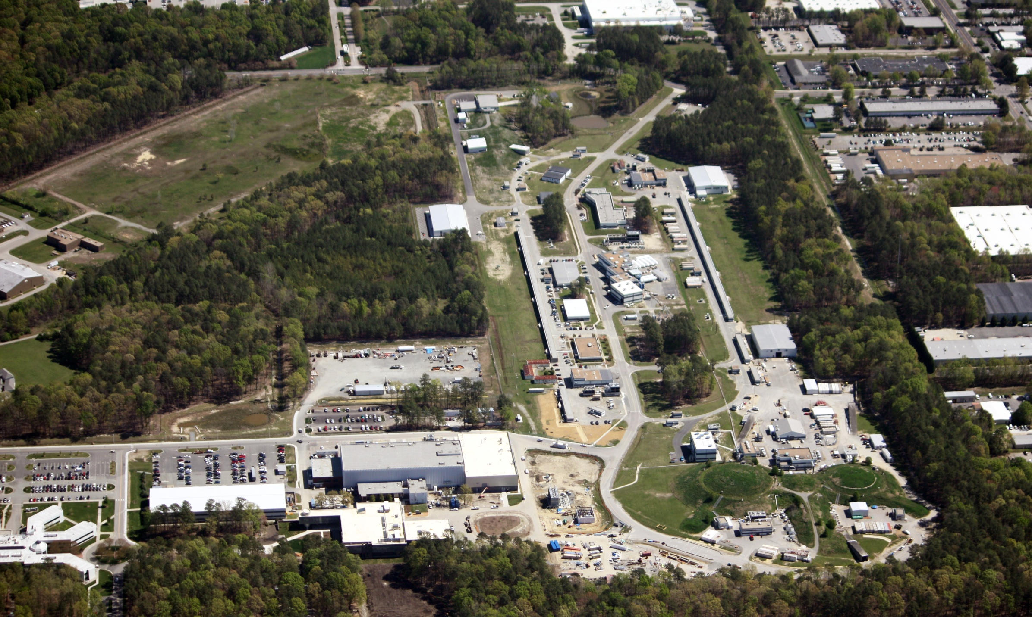
Jefferson Lab Status
R. D. McKeown
Deputy Director For Science
Tensor Polarization Workshop
Mar. 10, 2014

Slide 2
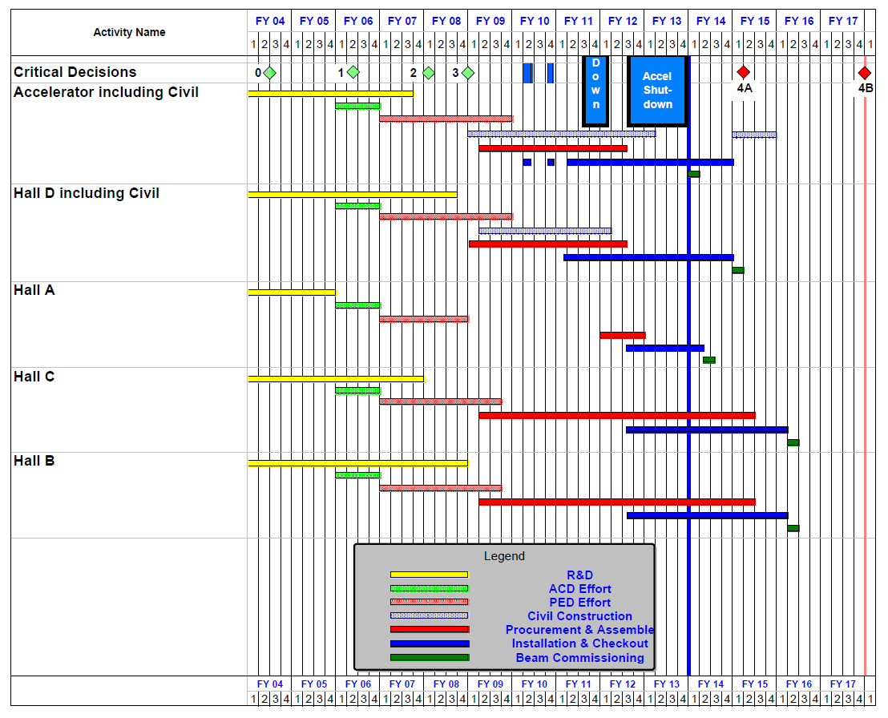
12 GeV Upgrade Project Schedule
FY12: reduction of $16M
FY13: Pres Request – no restoration
    16-month installation
    May 2012 - Sept 2013
    Accelerator commissioning start Oct 2013
    Hall A commissioning start Feb 2014
    Hall D commissioning start
    Oct 2014
    Halls B & C commissioning start Jan/Feb 2016
    Project Completion September 2017
Re-baseline Approved
September 4, 2013

Slide 3
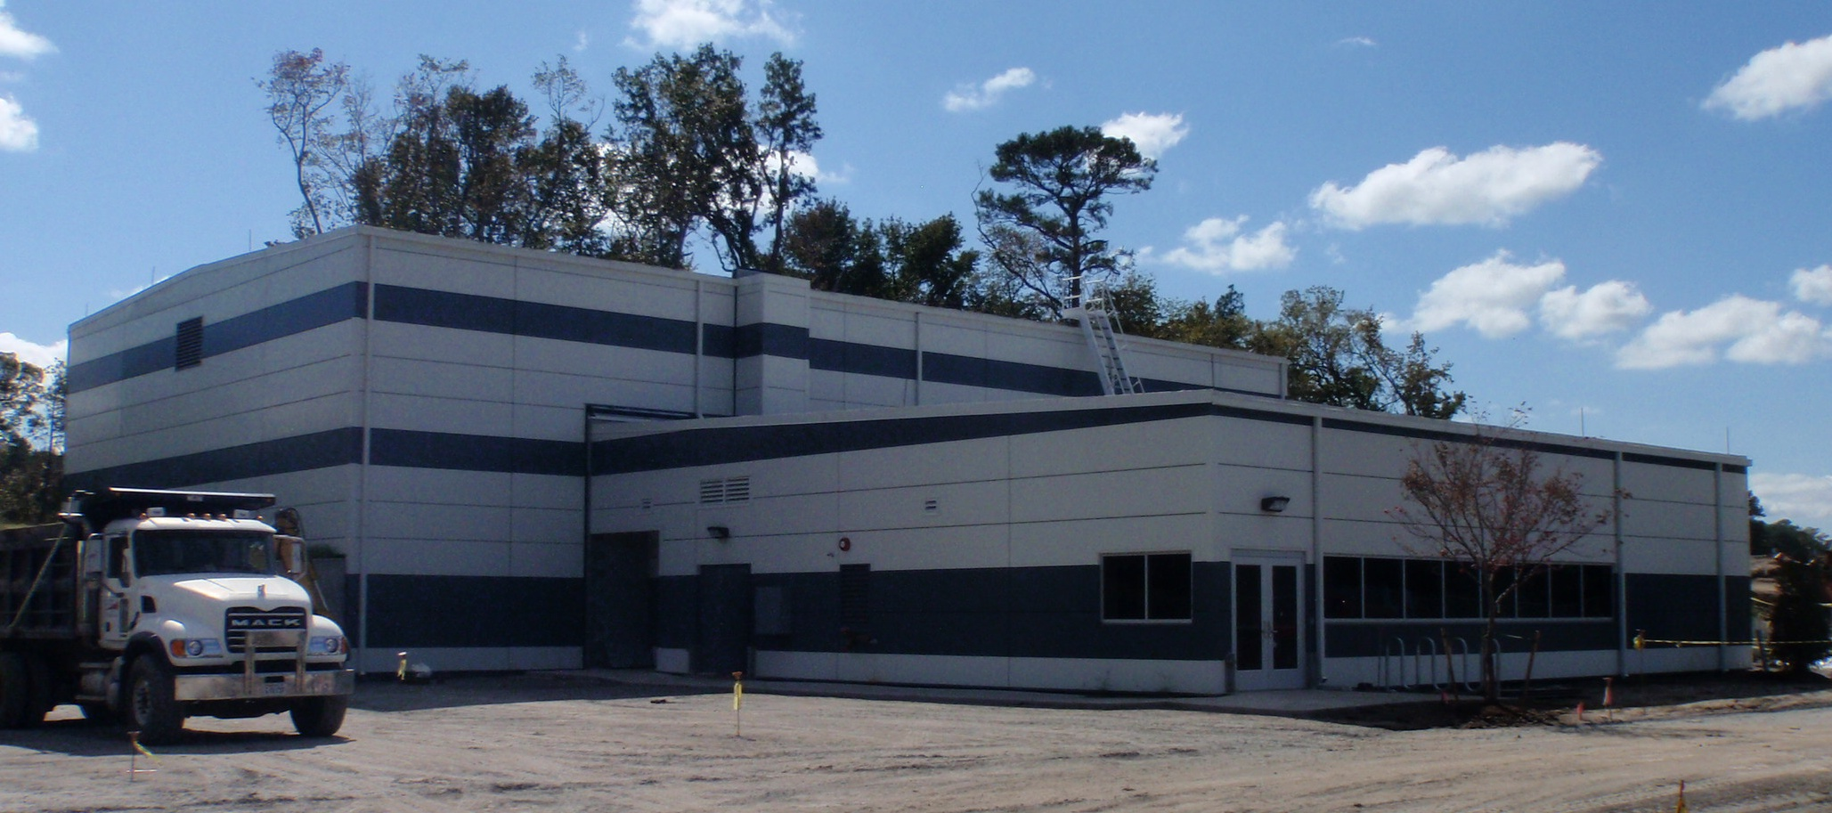
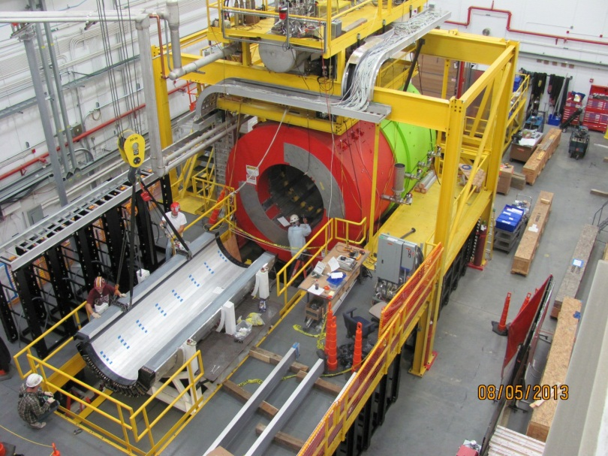
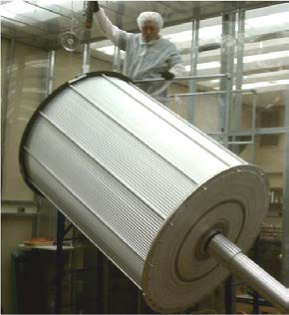
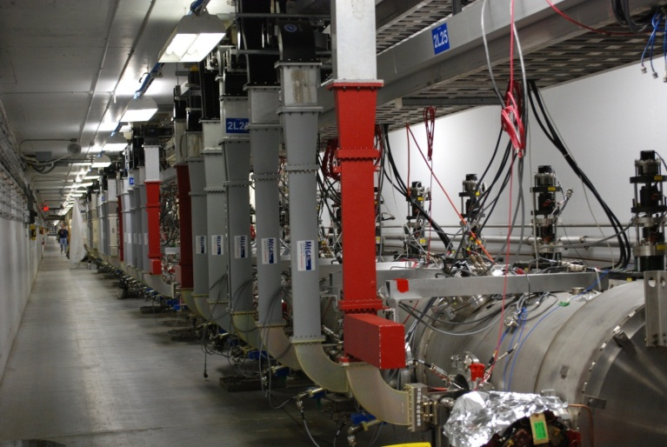
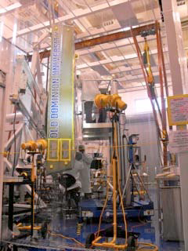
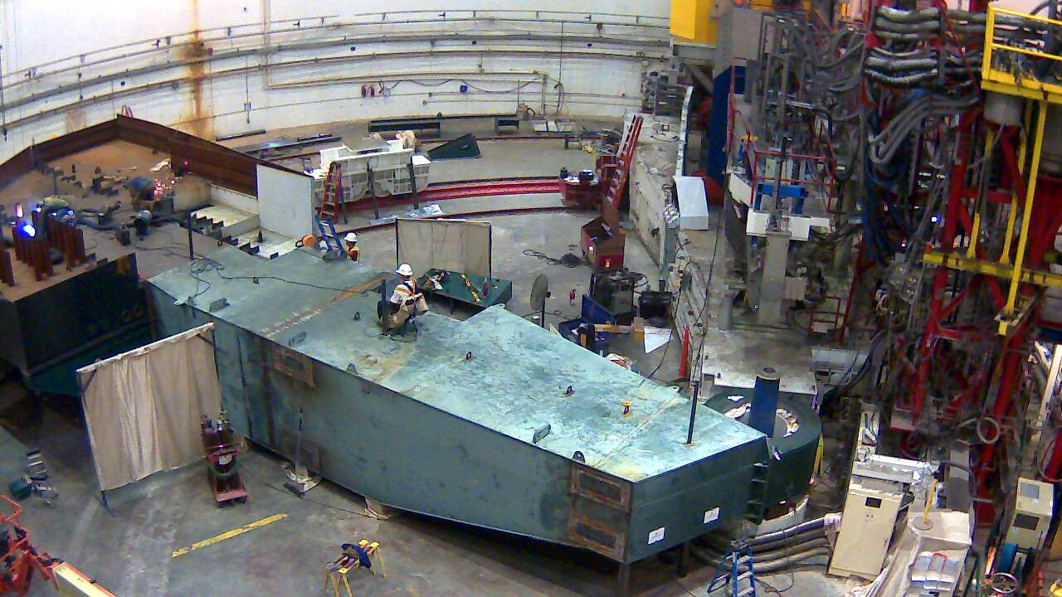
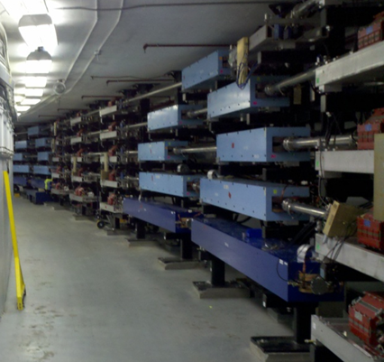
12 GeV Project Highlights
Hall D & Counting House
Hall D
Hall D Central Drift Chamber
12 GeV Cryomodules
Hall C
Arc Magnets
Hall B Drift Chamber

Slide 4
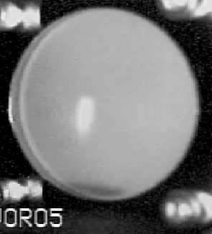
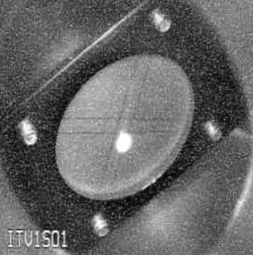
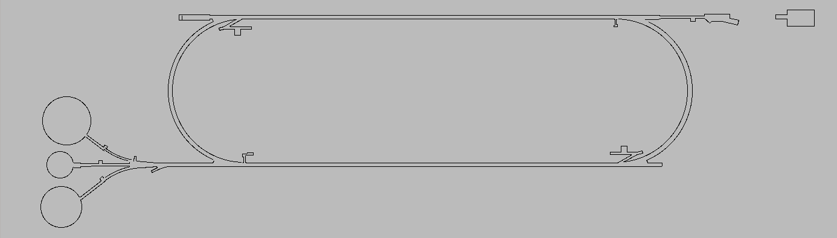
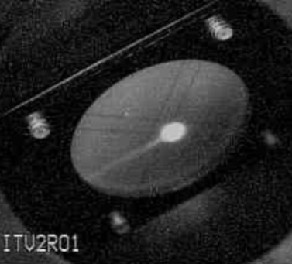
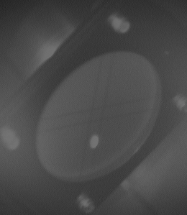
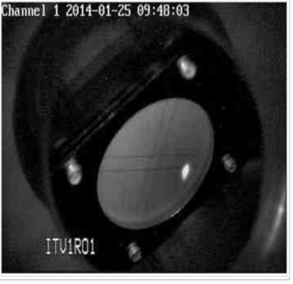
Accelerator KPP 2.2 GeV/pass
34MeV
1124MeV
September 2013 End of long shutdown
October 2013 ARR Phase I
December 2013 Completed Hot Check Out
Re-commissioned injector with beam
January 2014 Linacs cold and ready for beam
February 7 Achieved milestone !
March 2014 Restart commissioning (multi-pass)
Injector
2214MeV !!
KPP: machine capable of 12 GeV
1 pass at 2.2 GeV/pass for 8 hours
with acceptable trip rate (50% uptime)
2214MeV
1124MeV

Slide 5
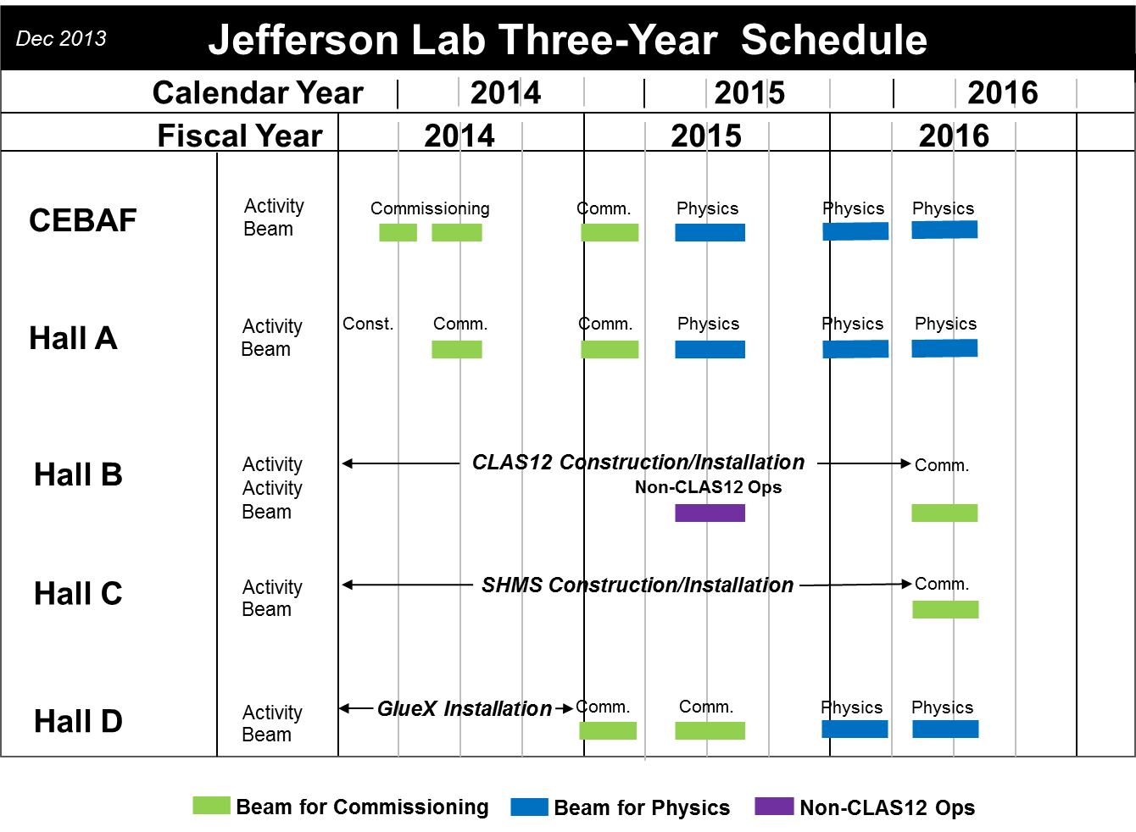
Three year plan

Slide 6
HPS Status
Received Conditional Approval (C2) at PAC39
“Although there is still a substantial amount of work needed to get from this first test run to a full operation of the experiment, the view from the PAC is that the experiment should be promoted to the next level: Conditional Approval 1, which does not require a return to the PAC, but leaves it to the laboratory management to conduct a technical review of the experiment and to schedule beamtime based on the experiment’s readiness. The PAC urges the HPS Collaboration to convince the laboratory to schedule an early test run with electron beam. Ideally, the test run could be performed as soon as beams restart in Hall B, not only to ensure efficient progress toward the full experiment but also to provide an early, high-impact result from 12 GeV operation, thanks to the impressive anticipated reach of the test experiment. The Collaboration should proceed in the meantime to seek funding and acquire the equipment for the full experiment.”
Proposal submitted to DOE March 2013
JLab agreed that DOE review would form basis for HPS full approval

Slide 7
HPS Status (cont’d)
DOE review in July 2013, identified issues:
- A Technical Coordinator may be needed during the installation and operation phase of the HPS experiment.
- HPS needs to fully analyze the test data and publish in peer-reviewed journals. This will help uncover possible problems. This is particularly true for the SVT alignment.
- If you have 30k photoelectrons/GeV in the ECAL, is an APD upgrade going to help overall resolution?
- The DAQ was only tested at 10% of final expected rate. HPS should consider high-rate tests of the full system before the full run.
JLab requests short document (Dec. 2013):
- address the comments from the July DOE review
- update the beam time request
Successful demonstration of HPS performance during the engineering run will be considered a prerequisite for scheduling of additional running time, as advised by PAC39

Slide 8
Going Forward
We expect HPS to receive full approval in the next 2-3 months following receipt of the approval/beamtime request
PAC41 will consider HPS for prioritization, assuming full approval status.
Continue close technical coordination with 12 GeV project and Hall B
We anticipate a readiness review in ~July 2014
We will schedule beam for HPS in Hall B during 2015, subject to priority on schedule for CLAS12 installation activities (as per HPS Implementation Plan)

Slide 9
Prad Status
Collaboration submitted “Implementation Plan
- Install before FY15
- Ready for FY15 beam
Required resources reviewed by Physics Division
Meeting with Prad leadership scheduled for March 21

Slide 10
12 GeV Approved Experiments by Physics Topics
Topic | Hall A | Hall B | Hall C | Hall D | Other | Total
The Hadron spectra as probes of QCD (GluEx and heavy baryon and meson spectroscopy) |  | 1 |  | 2 |  | 3
The transverse structure of the hadrons (Elastic and transition Form Factors) | 4 | 3 | 2 | 1 |  | 10
The longitudinal structure of the hadrons (Unpolarized and polarized parton distribution functions) | 2 | 2 | 6 |  |  | 10
The 3D structure of the hadrons (Generalized Parton Distributions and Transverse Momentum Distributions) | 5 | 10 | 4 |  |  | 19
Hadrons and cold nuclear matter (Medium modification of the nucleons, quark hadronization, N-N correlations, hypernuclear spectroscopy, few-body experiments) | 4 | 2 | 6 |  | 1 | 13
Low-energy tests of the Standard Model and Fundamental Symmetries | 2 |  |  | 1 | 1 | 4
TOTAL | 17 | 18 | 18 | 4 | 2 | 59

Slide 11
12 GeV Approved Experiments by PAC Days
Topic | Hall A | Hall B | Hall C | Hall D | Other | Total
The Hadron spectra as probes of QCD (GluEx and heavy baryon and meson spectroscopy) |  | 119 |  | 320 |  | 439
The transverse structure of the hadrons (Elastic and transition Form Factors) | 144 | 85 | 102 | 25 |  | 356
The longitudinal structure of the hadrons (Unpolarized and polarized parton distribution functions) | 65 | 120 | 165 |  |  | 350
The 3D structure of the hadrons (Generalized Parton Distributions and Transverse Momentum Distributions) | 409 | 982 | 161 |  |  | 1552
Hadrons and cold nuclear matter (Medium modification of the nucleons, quark hadronization, N-N correlations, hypernuclear spectroscopy, few-body experiments) | 159 | 120 | 179 |  | 14 | 472
Low-energy tests of the Standard Model and Fundamental Symmetries | 513 |  |  | 79 | 60 | 652
TOTAL | 1290 | 1426 | 607 | 424 | 74 | 3821
More than 7 years of approved experiments

Slide 12
PAC41
PAC41 will be held during the week of May 19, 2014. This will be a special meeting to discuss the priority of already approved proposals for scheduling during the first 3-5 years of production running (beyond commissioning) in the 12 GeV era of CEBAF. The goal of this meeting is to provide input to the Lab scheduling process from the PAC in order to realize the highest impact program early in the 12 GeV running period.

Slide 13
PAC41
The PAC will consider all such approved and conditionally approved Stage II proposals in each of the six physics categories, and discuss the relative priority of the proposals in each category. Stage II proposals are those expected to be ready, based on equipment and beam availability, for scheduling of production running (beyond commissioning) during the first 3-5 years in the 12 GeV era of CEBAF. The PAC should identify a subset of these proposals that it considers to be "High Impact" for scheduling priority during this time frame.
Please note that the present status (grades and approved running time) of all previously approved proposals will not be changed by this procedure. It is not anticipated that the PAC will need additional input from the proposal collaborations for this meeting. Hall Leaders and JLab management may be consulted by the PAC during their deliberations if necessary.

Slide 14
PAC41
The Hadron spectra as probes of QCD
(GlueX and heavy baryon and meson spectroscopy)
The transverse structure of the hadrons
(Elastic and transition Form Factors)
The longitudinal structure of the hadrons
(Unpolarized and polarized parton distribution functions)
The 3D structure of the hadrons
  4G: Generalized Parton Distributions
  4T: Transverse Momentum Distributions
Hadrons and cold nuclear matter
(Medium modification of the nucleons, quark hadronization, N-N correlations, hypernuclear spectroscopy, few-body experiments)
Low-energy tests of the Standard Model and Fundamental Symmetries
(MOLLER, PVDIS, PRIMEX, ...)

Slide 15
PAC42
Scheduled for July 28-August 1
Proposals will be due early June
Charge:
Review new proposals, previously conditionally approved proposals, and letters of intent for experiments that will utilize the 12 GeV upgrade of CEBAF and provide advice on their scientific merit, technical feasibility and resource requirements.
Identify proposals with high-quality physics that, represent high quality physics within the range of scientific importance represented by the previously approved 12 GeV proposals and recommend for approval.
Also provide a recommendation on scientific rating and beamtime allocation for proposals newly recommended for approval.
Identify other proposals with physics that have the potential for falling into this category pending clarification of scientific and/or technical issues and recommend for conditional approval. Provide comments on technical and scientific issues that should be addressed by the proponents prior to review at a future PAC.

Slide 16


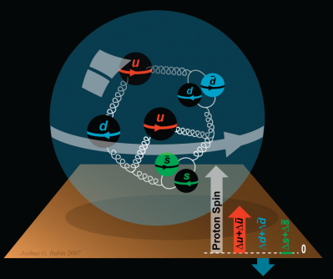
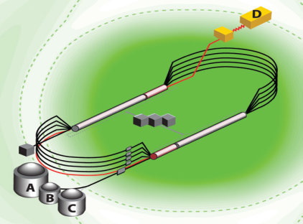

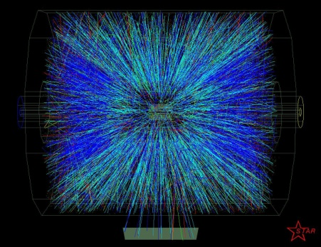


Summary
12 upgrade making good progress – beam commissioning has begun
- beam to Hall A this spring
- beam to Hall D this fall/winter
We have a 3 year plan for beam commissioning and early physics running (budget?)
2 PAC meetings this year
- prioritization (May)
- new proposals (July)
12 GeV physics program is starting soon!

