Slide 1
  Simonetta Liuti
  University of Virginia
  1st Tensor Polarized Solid Target Workshop
  Jefferson Lab
  March 10th - 13th, 2014
b₁ and the Angular Momentum Sum Rule in the Deuteron

Slide 2
The possibility of a tensor polarized solid target brings us to address:
spin physics issues
DIS in nuclei, and the role of ISI/FSI
Exotic hadronic configurations (6q, hidden color…)
Issues on the definition and observability of partonic OAM in both spin ½ and spin 1 systems

Slide 3
One of Jefferson Lab’s main quests:
How do we observe quarks and gluons orbital angular momentum distributions in the proton?
I will focus on this issue in this talk and leave the other topics for coffee break discussions

Slide 4
The spin crisis in a “cartoon”
Jaffe Manohar
Ji
Notes:
There are other components that we identify perhaps with OAM

Slide 5
How does OAM enter the picture?
?

Slide 6
Define Angular Momentum through the QCD Energy Momentum Tensor
AM density
Momentum density
T⁰⁰ | T⁰¹ | T⁰² | T⁰³
T¹⁰ | T¹¹ | T¹² | T¹³
T²⁰ | T²¹ | T²² | T²³
T³⁰ | T³¹ | T³² | T³³
Energy density
Shear stress
Momentum density
Pressure

Slide 7
Sum Rule: Part I
First define the angular momentum components
and parametrize the EMT in terms of form factors A, B, C
Finally, connect the EMT form factors with the AM components
Jaffe Manohar (1990)
Ji (1997)

Slide 8
Sum Rule: Part II
The second part of the sum rule is about finding a Partonic Interpretation and Observables
Ji: define new type of distribution functions for new process, DVCS
J_{q,g}, ΔΣ (3-way pie)

Slide 9
Ji’s partonic picture
e
q'=q+Δ
New processes (DVCS …) were thought of, whose structure functions – the GPDs - admit n=2 moments that were identified with the (spin+OAM) quark and gluon components of the SR
q
p+q
p⁺
p’⁺= p –Δ
H,E
P
P’
ΔΣ+L_{q}
Notes:
The main step is in that new functions defining the soft matrix elements for DVCS processes were found that match exactly the elements of the SR

Slide 10
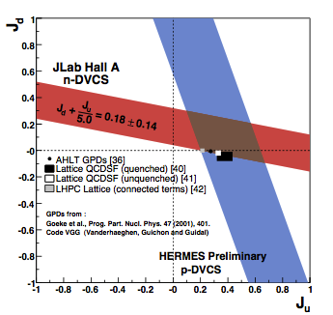
Observables
J_{q} =1/2 ΔΣ+L_{q}

Slide 11
Sum Rule: Part II
The second part of the sum rule is about finding a Partonic Interpretation and Observables
JM: in LC gauge rewrite AM using Dirac eqn. to isolate spin terms
ΔΣ
?
?
ΔG
3/10/14
11

Slide 12
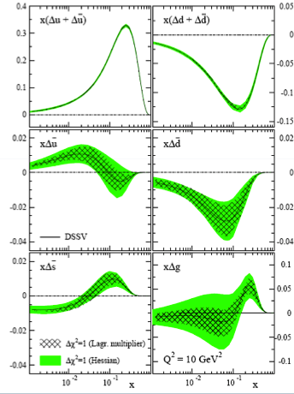
  Jaffe Manohar’s partonic picture:
  quark and gluon spin components are identified with the n=1 moments of spin dependent structure functions from DIS ➔ ΔΣ and ΔG.
?
?
ΔΣ
ΔG
Δu
Δd
Observables!
ΔG
Δs

Slide 13
In a nutshell, we now know where OAM could enter the picture …
….but what is OAM in QCD
?

Slide 14
OAM: The “naive” picture
L_{z} = b×k_{T}
b
Formally, from correlator, leading twist Wigner distribution with gauge link in LC direction
k_{T}
Lorcé, Pasquini
Burkardt

Slide 15
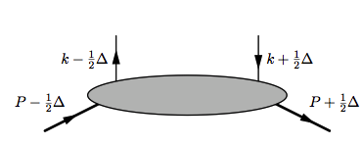
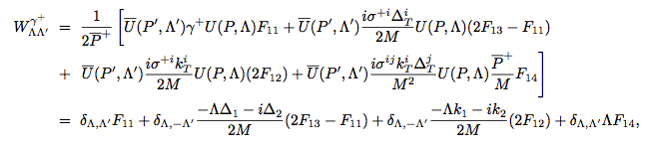
λ'
Technically: GTMD Correlator
λ
A_{Λ’λ’, Λλ}
Λ
Λ'
integrate to GPDs
“New” term
Meissner, Metz, Schlegel
JHEP 2009
Notes:
Update reference

Slide 16

Connect Dirac basis (F₁₁, F₁₂, F₁₃, F₁₄) with helicity basis (A_{Λ’λ’, Λλ})
This is parity odd!! (A.Courtoy et al. PLB 2014)
Notes:
These terms have definite parity: they are parity odd

Slide 17
Clearly seen in CM
Consider Parity transformation on A_{Λ’, 𝜆’; Λ, 𝜆}
A_{Λ’, 𝜆’; Λ, 𝜆} (p₁,k₁;p₂,k₂) = (-1)^{η} A*_{-Λ’, -𝜆’; -Λ, -𝜆} (-p₁,-k₁;-p₂,-k₂)
( η = Λ’-𝜆’-Λ+𝜆 )
p₂
p₁
θ
p₁∙σ₁ → Λ₁
Under Parity
Λ₁ → - Λ₁
k₁
k₂

Slide 18
Parity in CM system
Parity returns momenta to same configuration
after rotation
Can then determine even and odd amplitudes
π rotation
-k₂
-p₂
-k₁
θ
-p₁
θ
-p₁
-k₁
-p₂
-k₂
There are 2 independent amps for the 𝛾⁺ matrix elements

Slide 19

Then what happens to F₁₄ ?
The amps will cancel unless they are imaginary:
A_{+ + ; + +} = A*_{- -;} ₋ ₋ & A_{+ - ; + -} = A*_{- +;} ₋ ₊
But this cannot be, as seen from CM system - at leading order - these will be real – all in same plane so no relative phase between helicity amps .
VERY IMPORTANT CAVEAT:
On Light Front this does not happen because what is conserved is PT, not P and T separately
n⁺→ n⁻ under Parity – forward going become backward moving -- T reverses and complex conjugates
BUT THAT IS NOT PARITY!!!

Slide 20
While it is important to study experimentally the issue of Parity in connection with OAM (get back to possible observables for this later), we proposed an avenue to overcome this problem and connect to observables
“Observability of OAM” ➔arXiv:1310.5157

Slide 21
Consider twist 3 contributions
1. They allow us to move out of a two body scattering picture which underlies tw 2 (and sets the Parity relations)
p’= k-Δ, Λ’
p, Λ
k’= k –Δ. λ’
ϑ
k, λ
2. OAM can be defined through a sum rule similar to Ji’s at tw 2
Polyakov et al. (2000)
Hatta (2011)
-L_{q}
-J_{q}
S_{q}

Slide 22
Consider twist 3 contributions
1. They allow us to move out of a two body scattering picture which underlies tw 2 (and sets the Parity relations)
p’= k-Δ, Λ’
p, Λ
k’= k –Δ. λ’
ϑ
k, λ
2. OAM can be defined through a sum rule similar to Ji’s at tw 2
Polyakov et al. (2000)
Hatta (2011)
-L_{q}
-J_{q}
S_{q}

Slide 23
In arXiv:1310.5157 we asked what is the spin configuration
corresponding to quark OAM?
Analysis done using twist 3 GTMDs
~
G₂
G₂
G₂
This is no longer Parity odd and it has a transverse component, OAM is associated with a transverse spin component in the proton

Slide 24

Now that we understand all this, can we measure OAM?
First of all notice that in Wandzura Wilczek approximation
≠F₁₄!

Slide 25

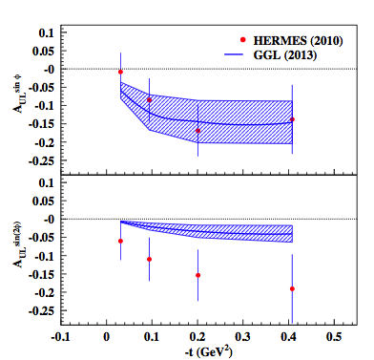
DVCS on a longitudinally polarized target
sin 2φ term is tw 3!
WW, small ξ
Jlab data in progress!
Avakian, Pisano

Slide 26
To explore…
G₂ can be measured directly, and it does have a partonic interpretation, if one views it as a twist 3 quantity.
We need to devise experiments that are sensitive to this contributions (some data already exist, HERMES + S. Pisano)
Question of L vs. T interpretation
We focused mainly on quarks, question of gluon component
Is L_{g}≈0? (Brodsky, Gardner,arXiv:0608219
One way to shed light on these questions is to look at deuteron

Slide 27
Interest in Spin 1 targets: deuterium, ⁶Li, …
In DIS: Unique possibility to study how the deep inelastic structure of nuclei differs from a system of free nucleons.
➔ One more distribution w.r.t. spin 1/2
Tensor Structure Function
Hoodbhoy, Jaffe, Manohar (1989)
M=0
[
]
2
m=0
m=1
m=-1
for free nucleons
Role of D wave, or non
conventional physics!
in bound systems
Sum Rule
Close and Kumano (1990)

Slide 28
Spin One Sum Rule Derivation

Slide 29
OAM Sum Rule: Operators

Slide 30
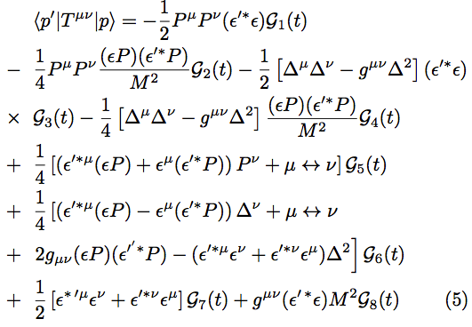
EMT Matrix Element
7 (conserved f.f.’s➔G₁ – G₇) + 1 (non-conserved ➔G₈)

Slide 31
Sum Rule in Deuteron: Part I
Momentum
OAM
Use Ji’s framework, attention must be payed to singularities
(Bakker Leader Trueman), …

Slide 32
Compare to spin 1/2
Momentum
OAM

Slide 33
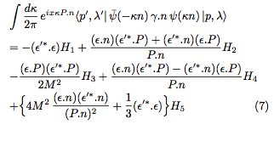
LC Correlation Function for Deuteron
Berger, Cano, Diehl, Pire, PRL(2001), Cano Pire EPJA19(2004)
Compare to spin 1/2

Slide 34
Physical Interpretation of the various deuteron GPDs: Form Factors
*
*In the absence of a tensor polarized sea

Slide 35
Physical Interpretation of the various deuteron GPDs: PDFs

Slide 36
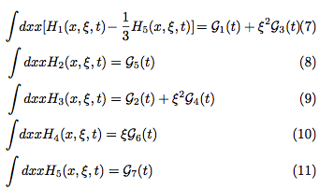
Sum rules
Momentum
Angular Momentum
Quadrupole
Connected to b₁ SR

Slide 37
Sum rule part II: partonic interpretation

Slide 38


If H₂=H+E
F₁+F₂= G_{M}
G_{M}

Slide 39
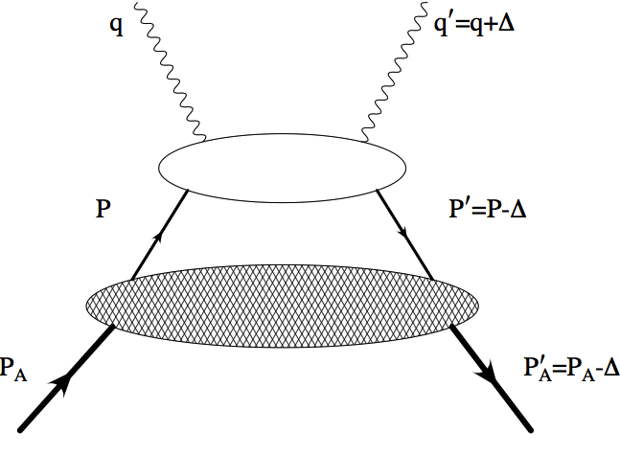

What are the quark and gluon angular momenta in the deuteron?
λ_{q}
Nucleon DVCS
λ_{N}
z=p_{N}⁺/P⁺_{D}
Deuteron
λ

Slide 40
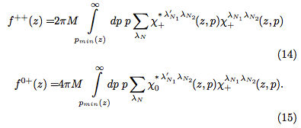
1. H₂ ➔OAM
Deuteron LC Momentum distribution
z=p_{N}⁺/P⁺_{D}
λ_{N}={λ_{N1},λ’_{N1}λ_{N2}}
H_{ISO}=H_{u}+H_{d}
E_{ISO}=E_{u}+E_{d}

Slide 41

Deuteron w.f. (momentum space)
Mixture of S and D components , L=0,2

Slide 42

Observables: DVCS from deuteron
subleading
Can the deuteron help us understand the role of gluon OAM?
(Brodsky, Gardner, 2006)
By connecting L_{g} to SSA in
≈ 0
Both L _{q} and L_{g} contribute! Since L_{q} disappears because of isospin
symmetry, if A^{UT}_{π} is 0 then L_{g} is 0

Slide 43
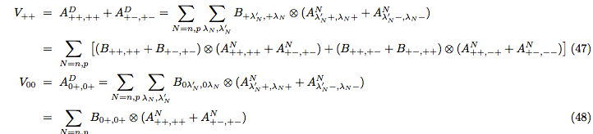
(Kathuria, SL: 2014)
2. H₅ ➔b₁
S+D waves
H
E
H
S wave
GPD E makes b₁ increase!

Slide 44
Finally, a remark on the sum rules

Slide 45
Charge density vs. Matter density
Matter density ➔Baryon number
Interesting to explore this in relation to b₁ sum rule

Slide 46
Conclusions
OAM has been associated with the distribution of an unpolarized quark in a longitudinally polarized proton. This quantity is Parity odd and it cannot be observed directly
One could match F₁₄ with a hard part that is also Parity Odd, and generate an observable, however that does would change the partonic content of the soft part, it still would not carry the meaning of OAM
However, at twist three a new quantity, G₂, representing OAM was found (Polyakov sum rule)
We identified a possible direct measurement of OAM, DVCS on a longitudinally polarized proton
Deuteron is unique in many respects: as a nuclear target (nuclear effects, b₁), and for determining partonic (gluon) spin/OAM content

Slide 47
References
Angular momentum in spin 1 ➔arXiv:1101.0581
Observability of OAM➔arXiv:1310.5157
GPDs from flavor separated form factors ➔arXiv:1206.1876
Chiral odd approach ➔arXiv:1311.0483
Chiral even approach➔arXiv:1012.3776

