Slide 1
Tensor Asymmetry $A_{zz}$ at Jefferson Lab
Elena Long
Tensor Spin Observables Workshop
Jefferson Lab
March 11th, 2014

Slide 2
Today’s Discussion
Overview of the Physics
Rates Calculation
Experimental Set-up
Potential Measurements

Slide 3
Physics Overview

Slide 4
Tensor Polarization
For tensor polarization, need spin-1 particles
For this experiment, we would be using tensor polarized deuterium
Spin-1
System
Spin-½
System
m = +1
m = +½
m = 0
Tensor polarization fills
the m = 0 state
m = -½
m = -1

Slide 5
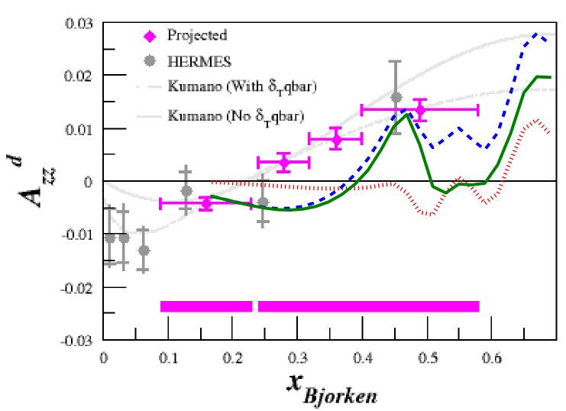
Tensor Asymmetry $A_{zz}$
$$σ_{D}=σ_{D}^{u}\left[1−P_{z}P_{B}A_{∥}+\frac{1}{2}P_{zz}A_{zz}\right]$$
0 for unpolarized beam
$$σ_{D}=σ_{D}^{u}\left[1+\frac{1}{2}P_{zz}A_{zz}\right]$$
Extremely
Preliminary
Preliminary
$$A_{zz}=\frac{2}{P_{zz}}\left[\frac{σ_{D}}{σ_{D}^{u}}−1\right]$$
$$A_{zz}=\frac{2}{{f_{dil}P}_{zz}}\left[\frac{N_{pol}}{N_{unpol}}−1\right]$$

Slide 6
Short Range Correlations
Short range correlations caused by tensor force – why not probe it through tensor polarization?
K. S. Egiyan et al., Phys. Rev. Lett. 96, 082501 (2006)
R. Subedi et al., Science 320, 1476 (2008)

Slide 7
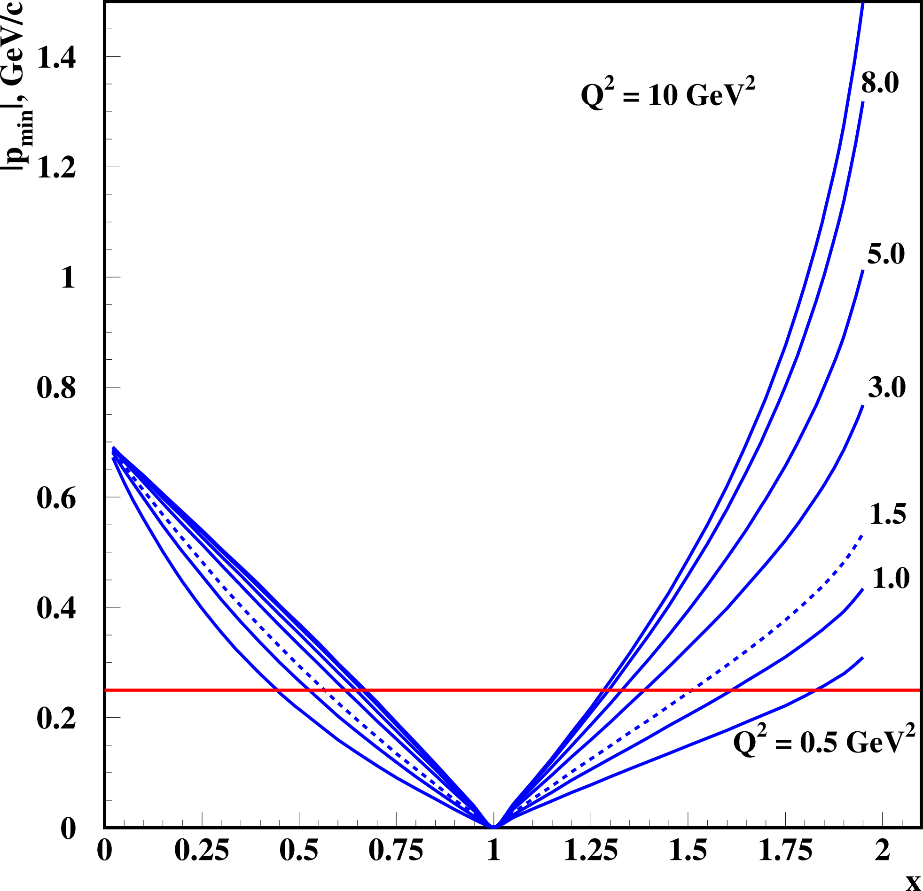
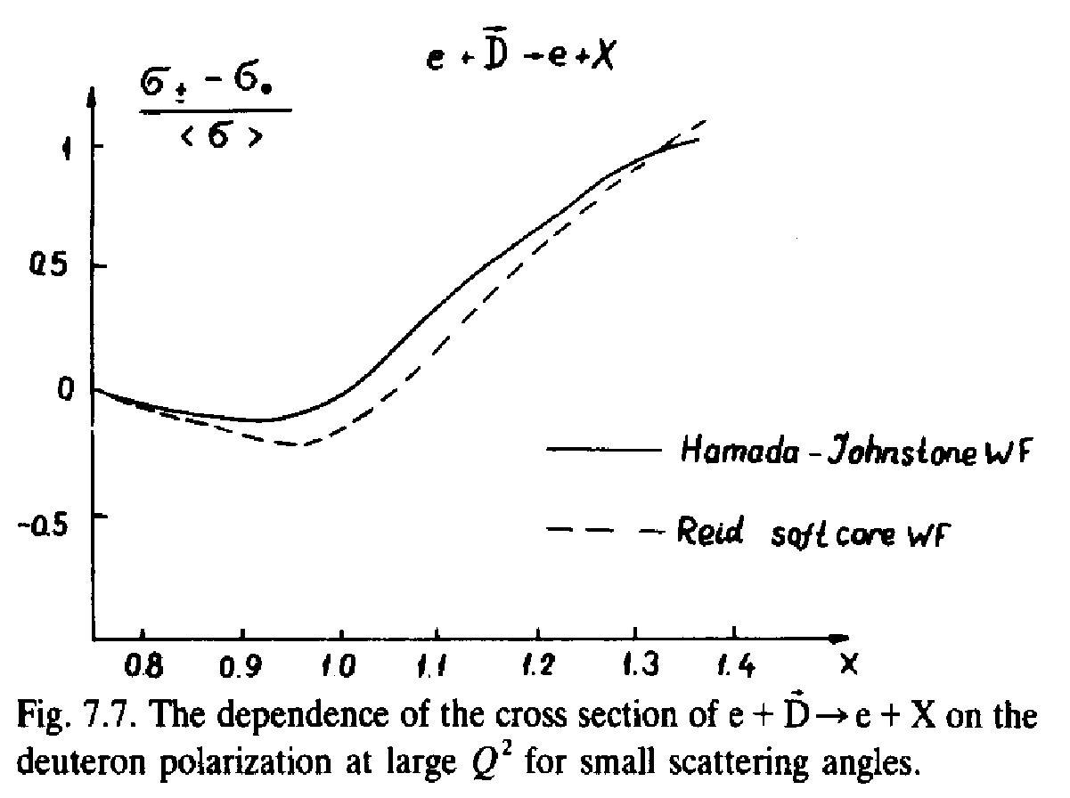
Theoretical Development
Electron scattering from polarized deuterons provides access to short-range NN interactions
At $x>1.4$, an SRC plateau is expected
Recent calculations by M. Sargsian indicate a model-dependence in the high-x region that can differ by a factor of 2
L.L. Frankfurt et al., Int. J. Mod. Phys. A23 (2008) 2991-3055
L.L. Frankfurt, M.I. Strikman, Phys. Rept. 160 (1988) 235-427

Slide 8
Rates Calculations

Slide 9
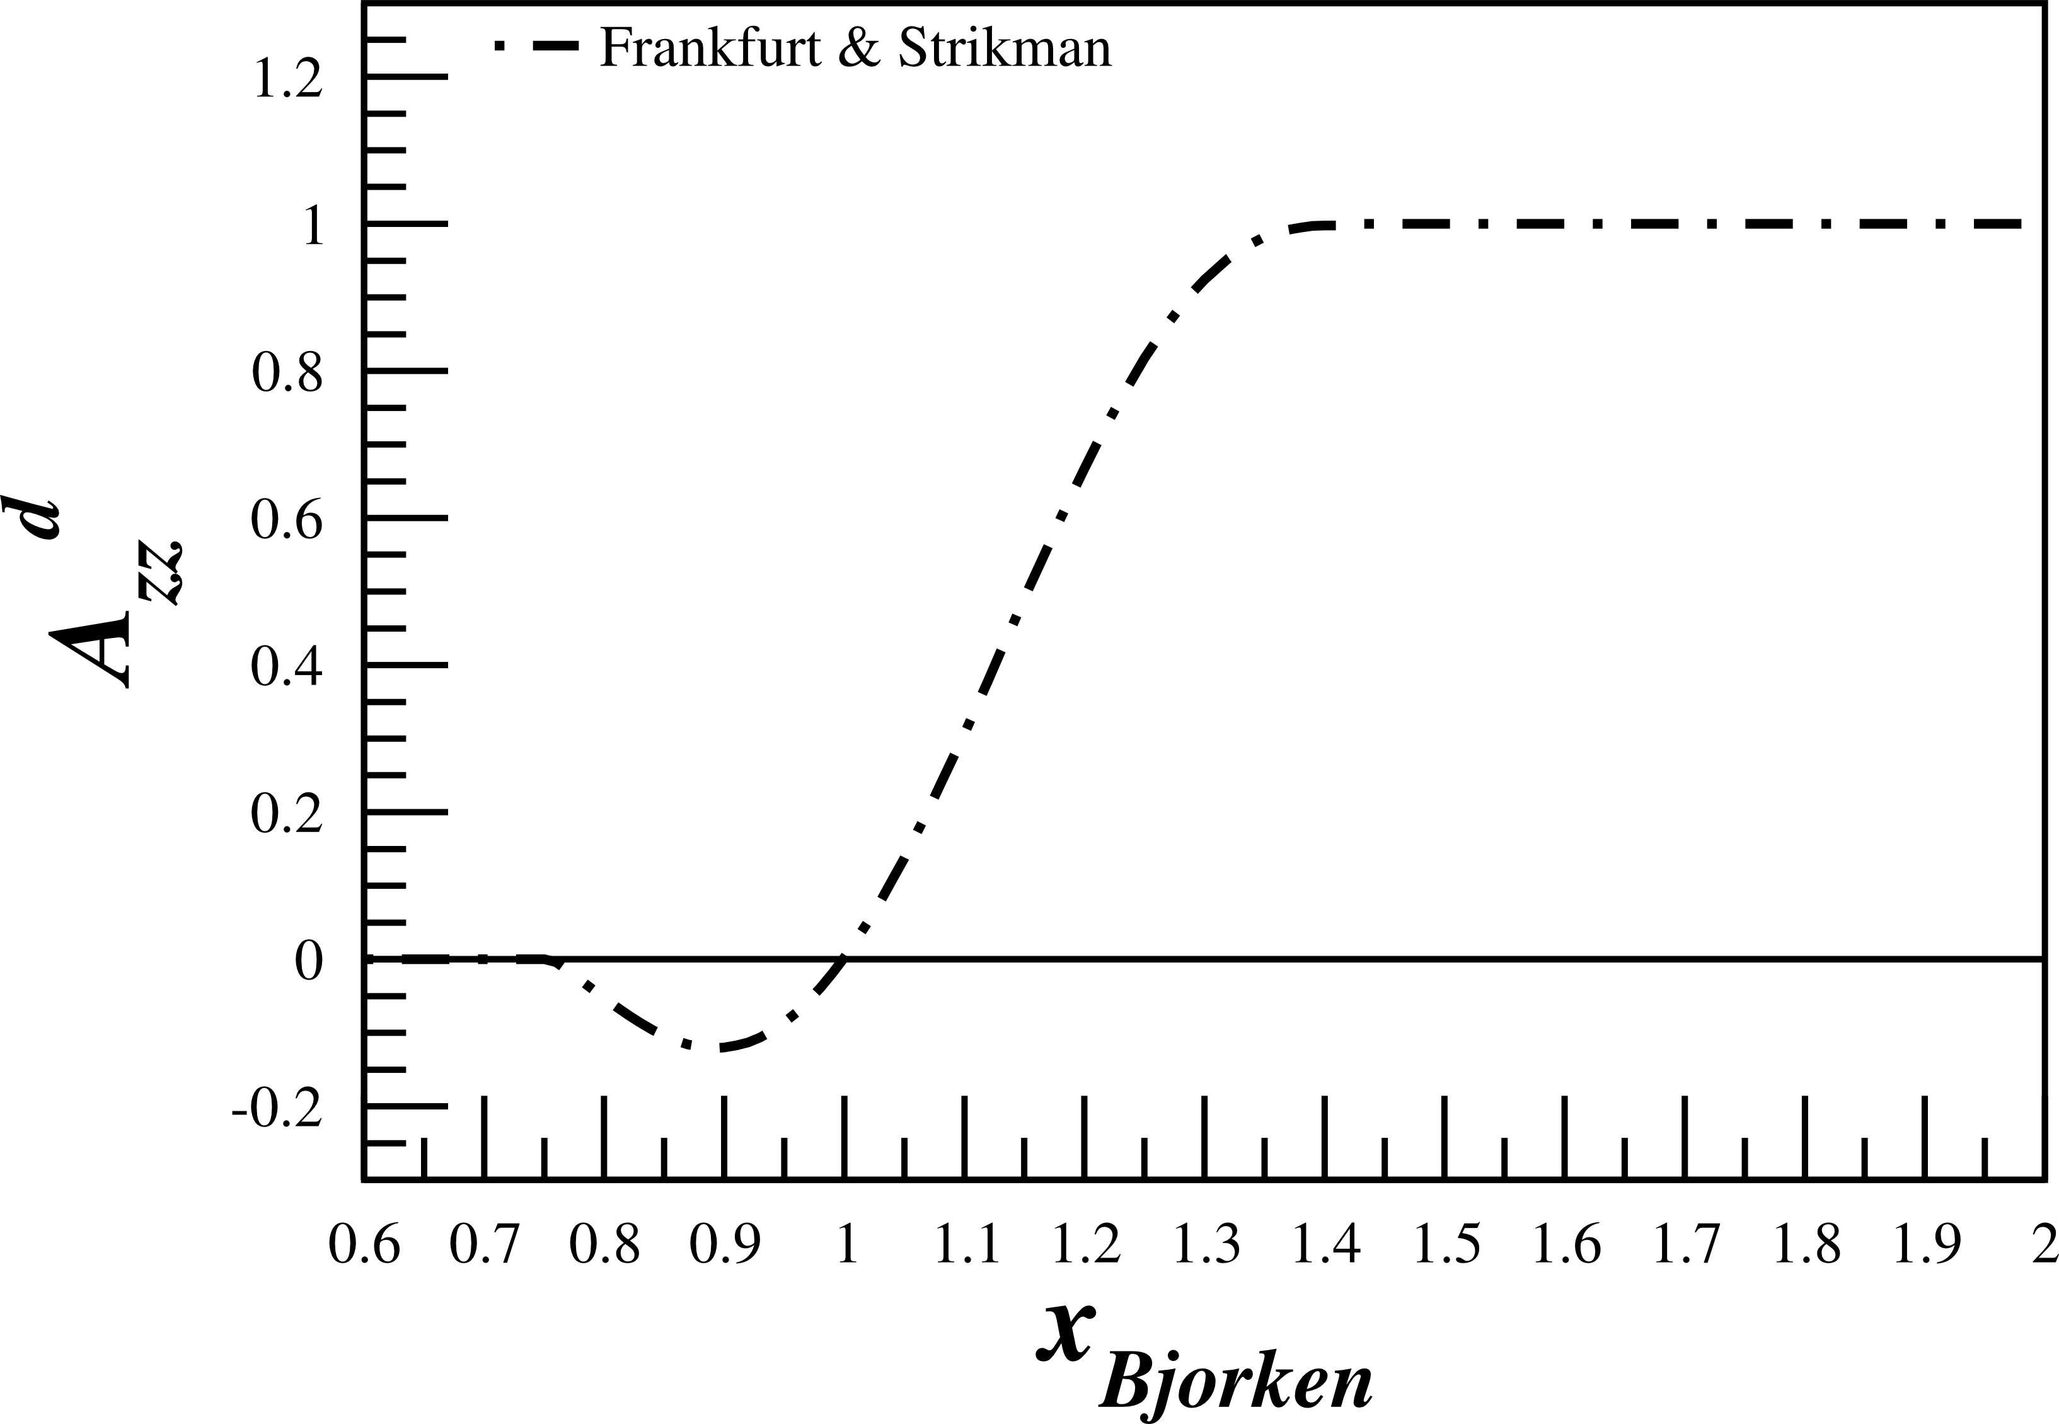
Rates for D(e,e’)X
Assumptions:
$$P_{zz}=30\%$$
$$p_{f}=65\%$$
$$z_{tgt}=3 cm$$
$R_{Pol}=𝒜\left[ℒ_{He}σ_{He}^{u}+ℒ_{N}σ_{N}^{u}+ℒ_{D}σ_{D}^{u}\left(1+\frac{1}{2}P_{zz}A_{zz}\right)\right]$
$R_{Unpol}=𝒜\left[ℒ_{He}σ_{He}^{u}+ℒ_{N}σ_{N}^{u}+ℒ_{D}σ_{D}^{u}\right]$
$N=Rt$
$A_{zz}=\frac{2}{f_{dil}P_{zz}}\left(\frac{N_{Pol}}{N_{Unpol}}−1\right)$
$δA_{zz}^{stat}=\frac{2}{f_{dil}P_{zz}}\sqrt{{\left(\frac{1}{N_{Unpol}}\sqrt{N_{Pol}}\right)}^{2}+{\left(\frac{N_{Pol}}{N_{Unpol}^{2}}\sqrt{N_{Unpol}}\right)}^{2}}$
$δA_{zz}^{sys}=0.10A_{zz}$
E. Long, Technical Note, JLAB-TN-13-029

Slide 10
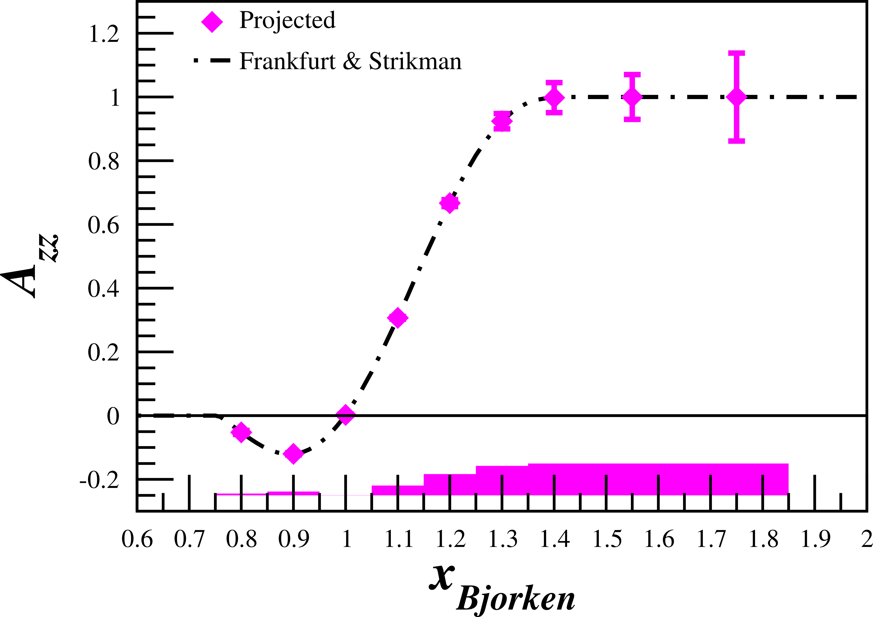
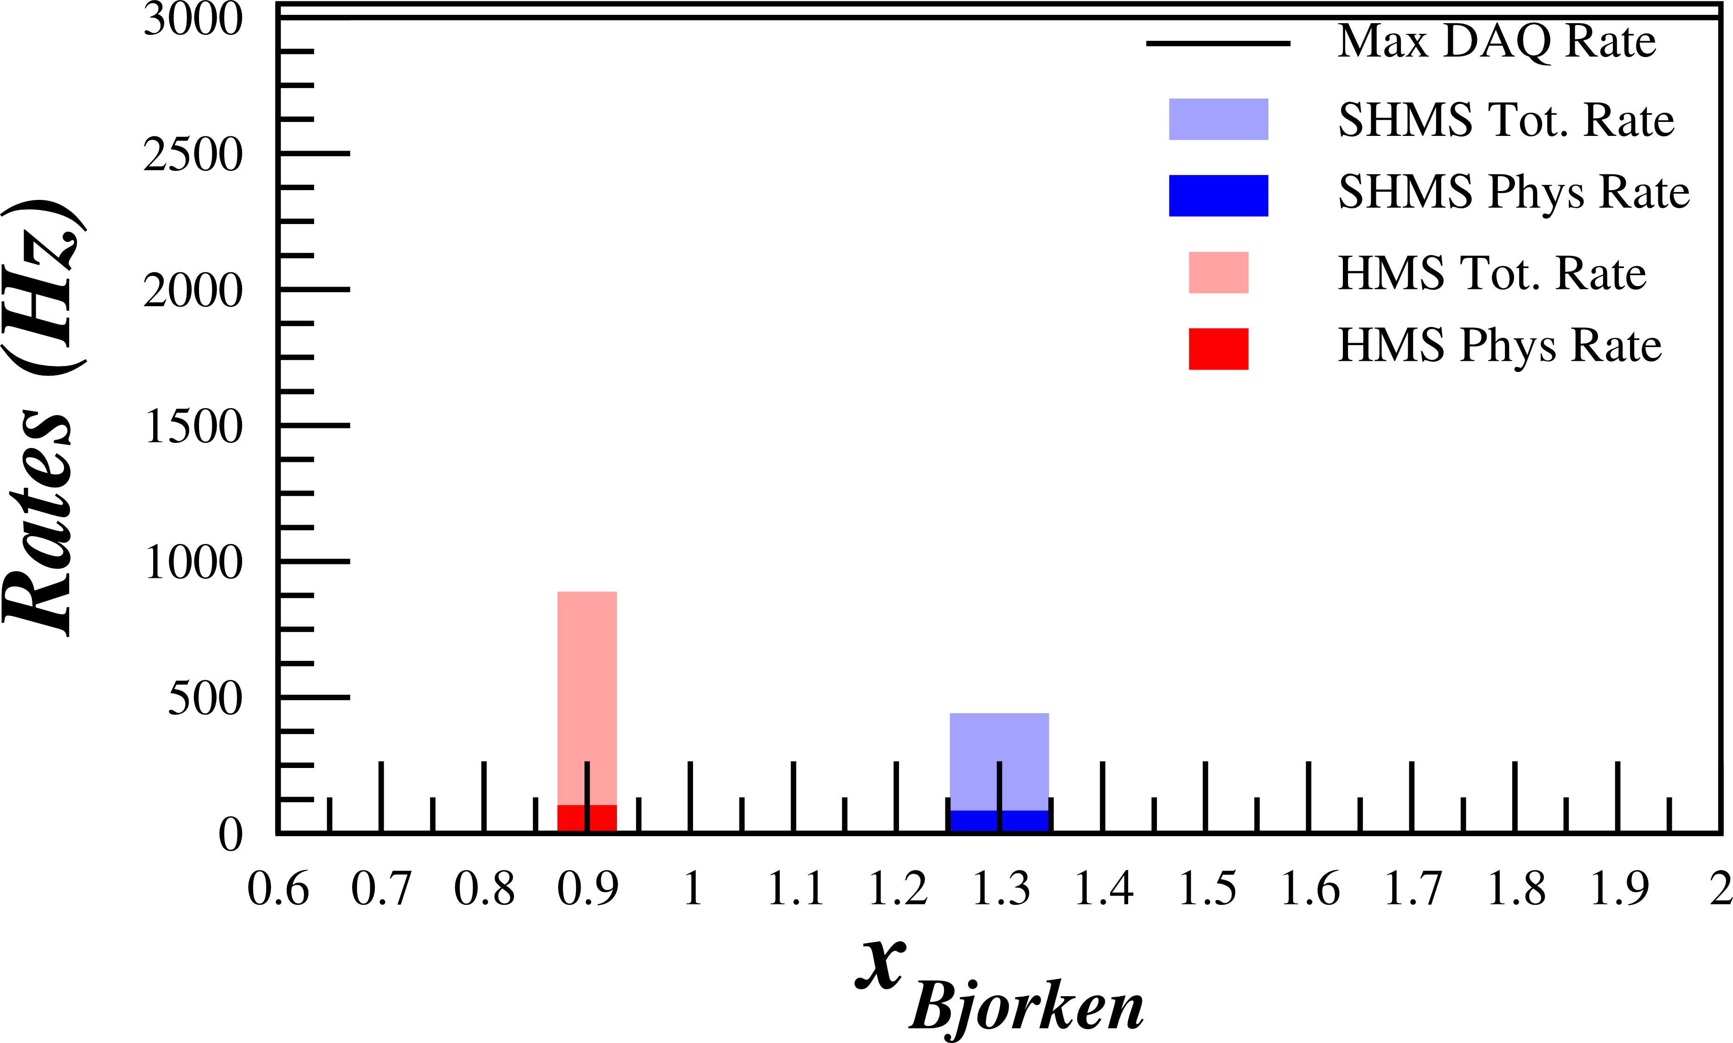
Enticing Possible Measurement
Very
Preliminary

Slide 11
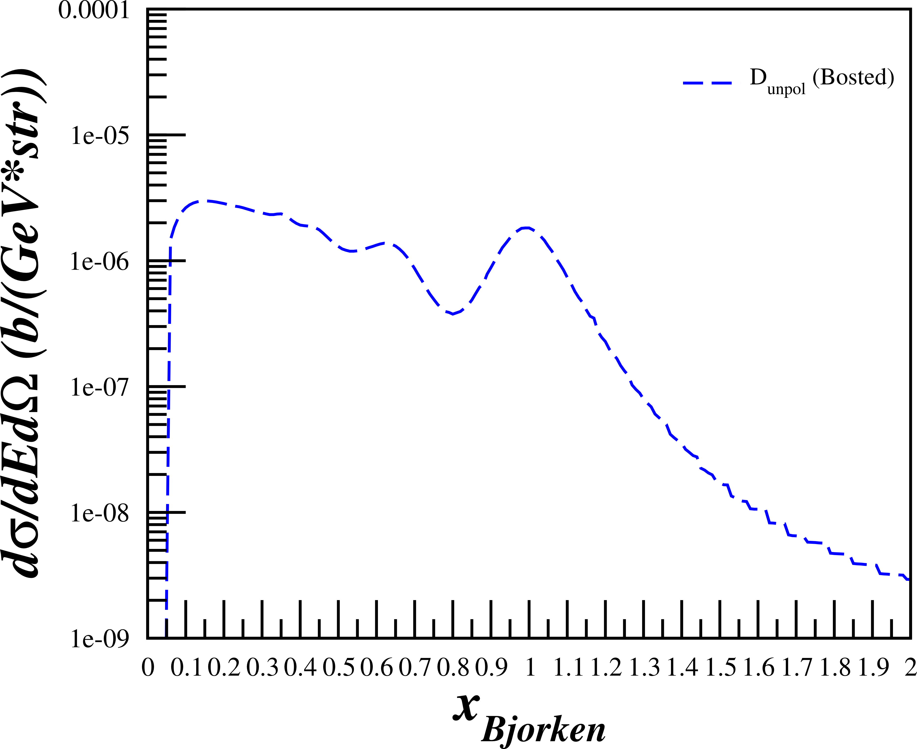
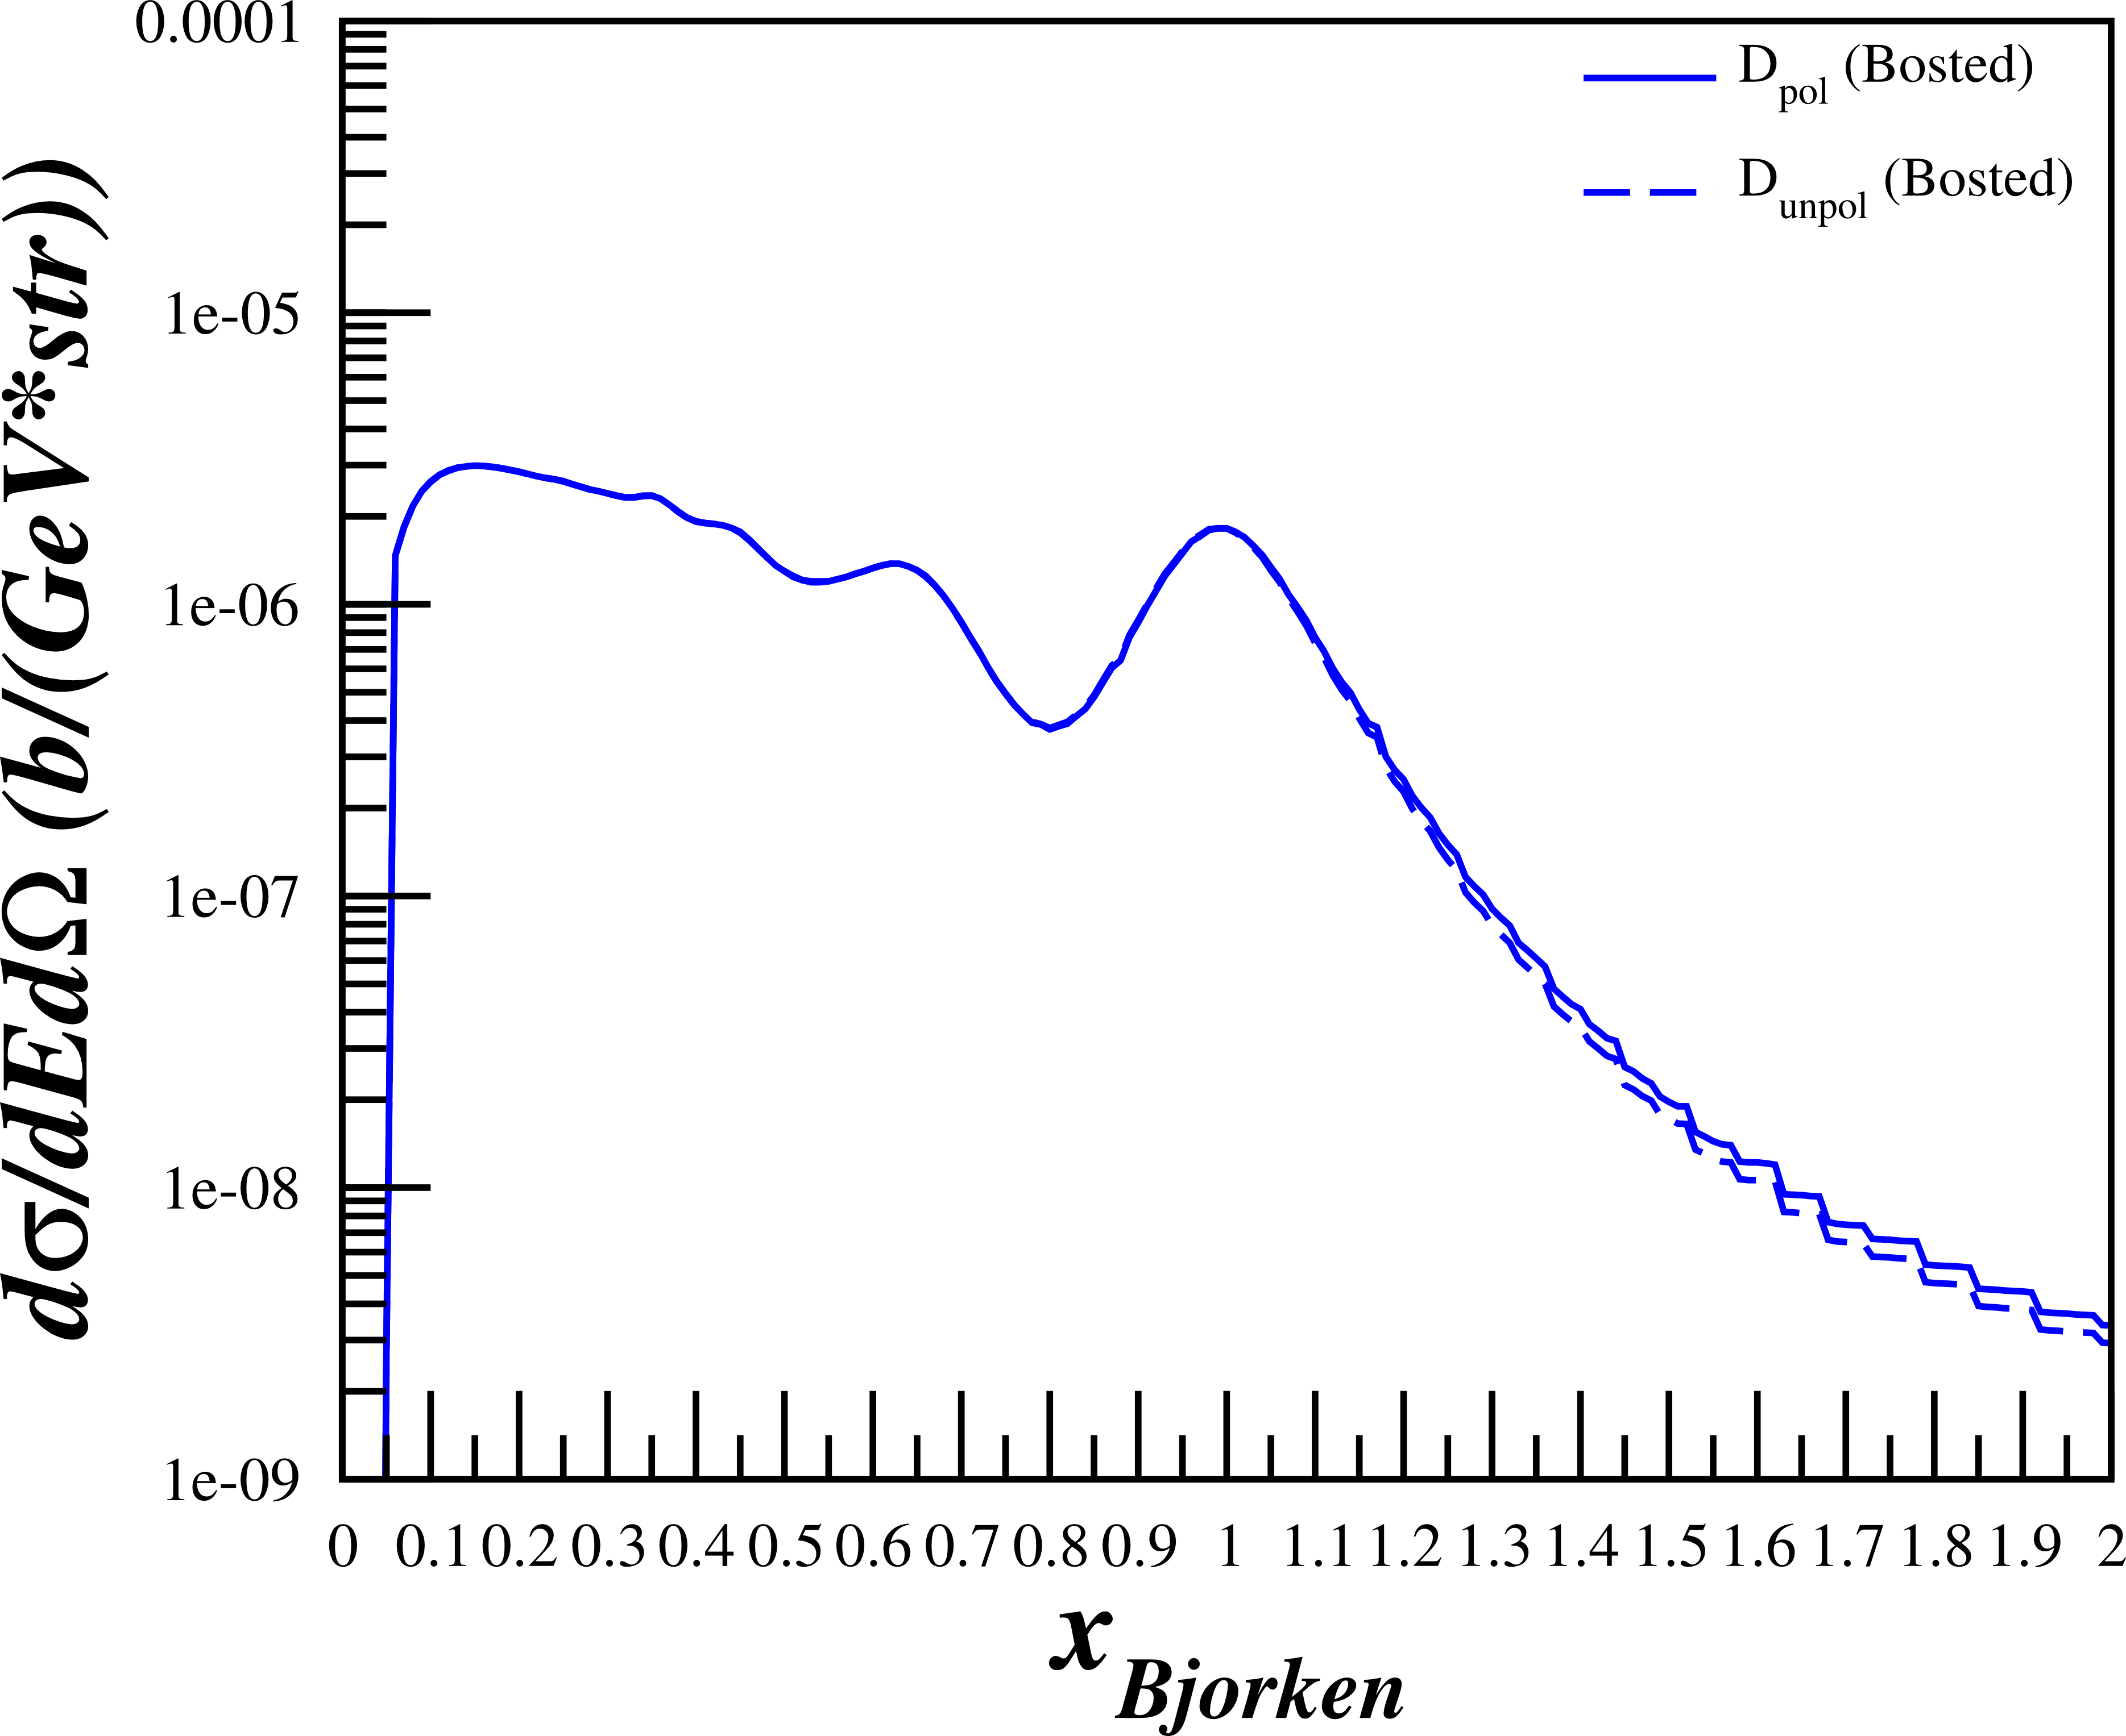
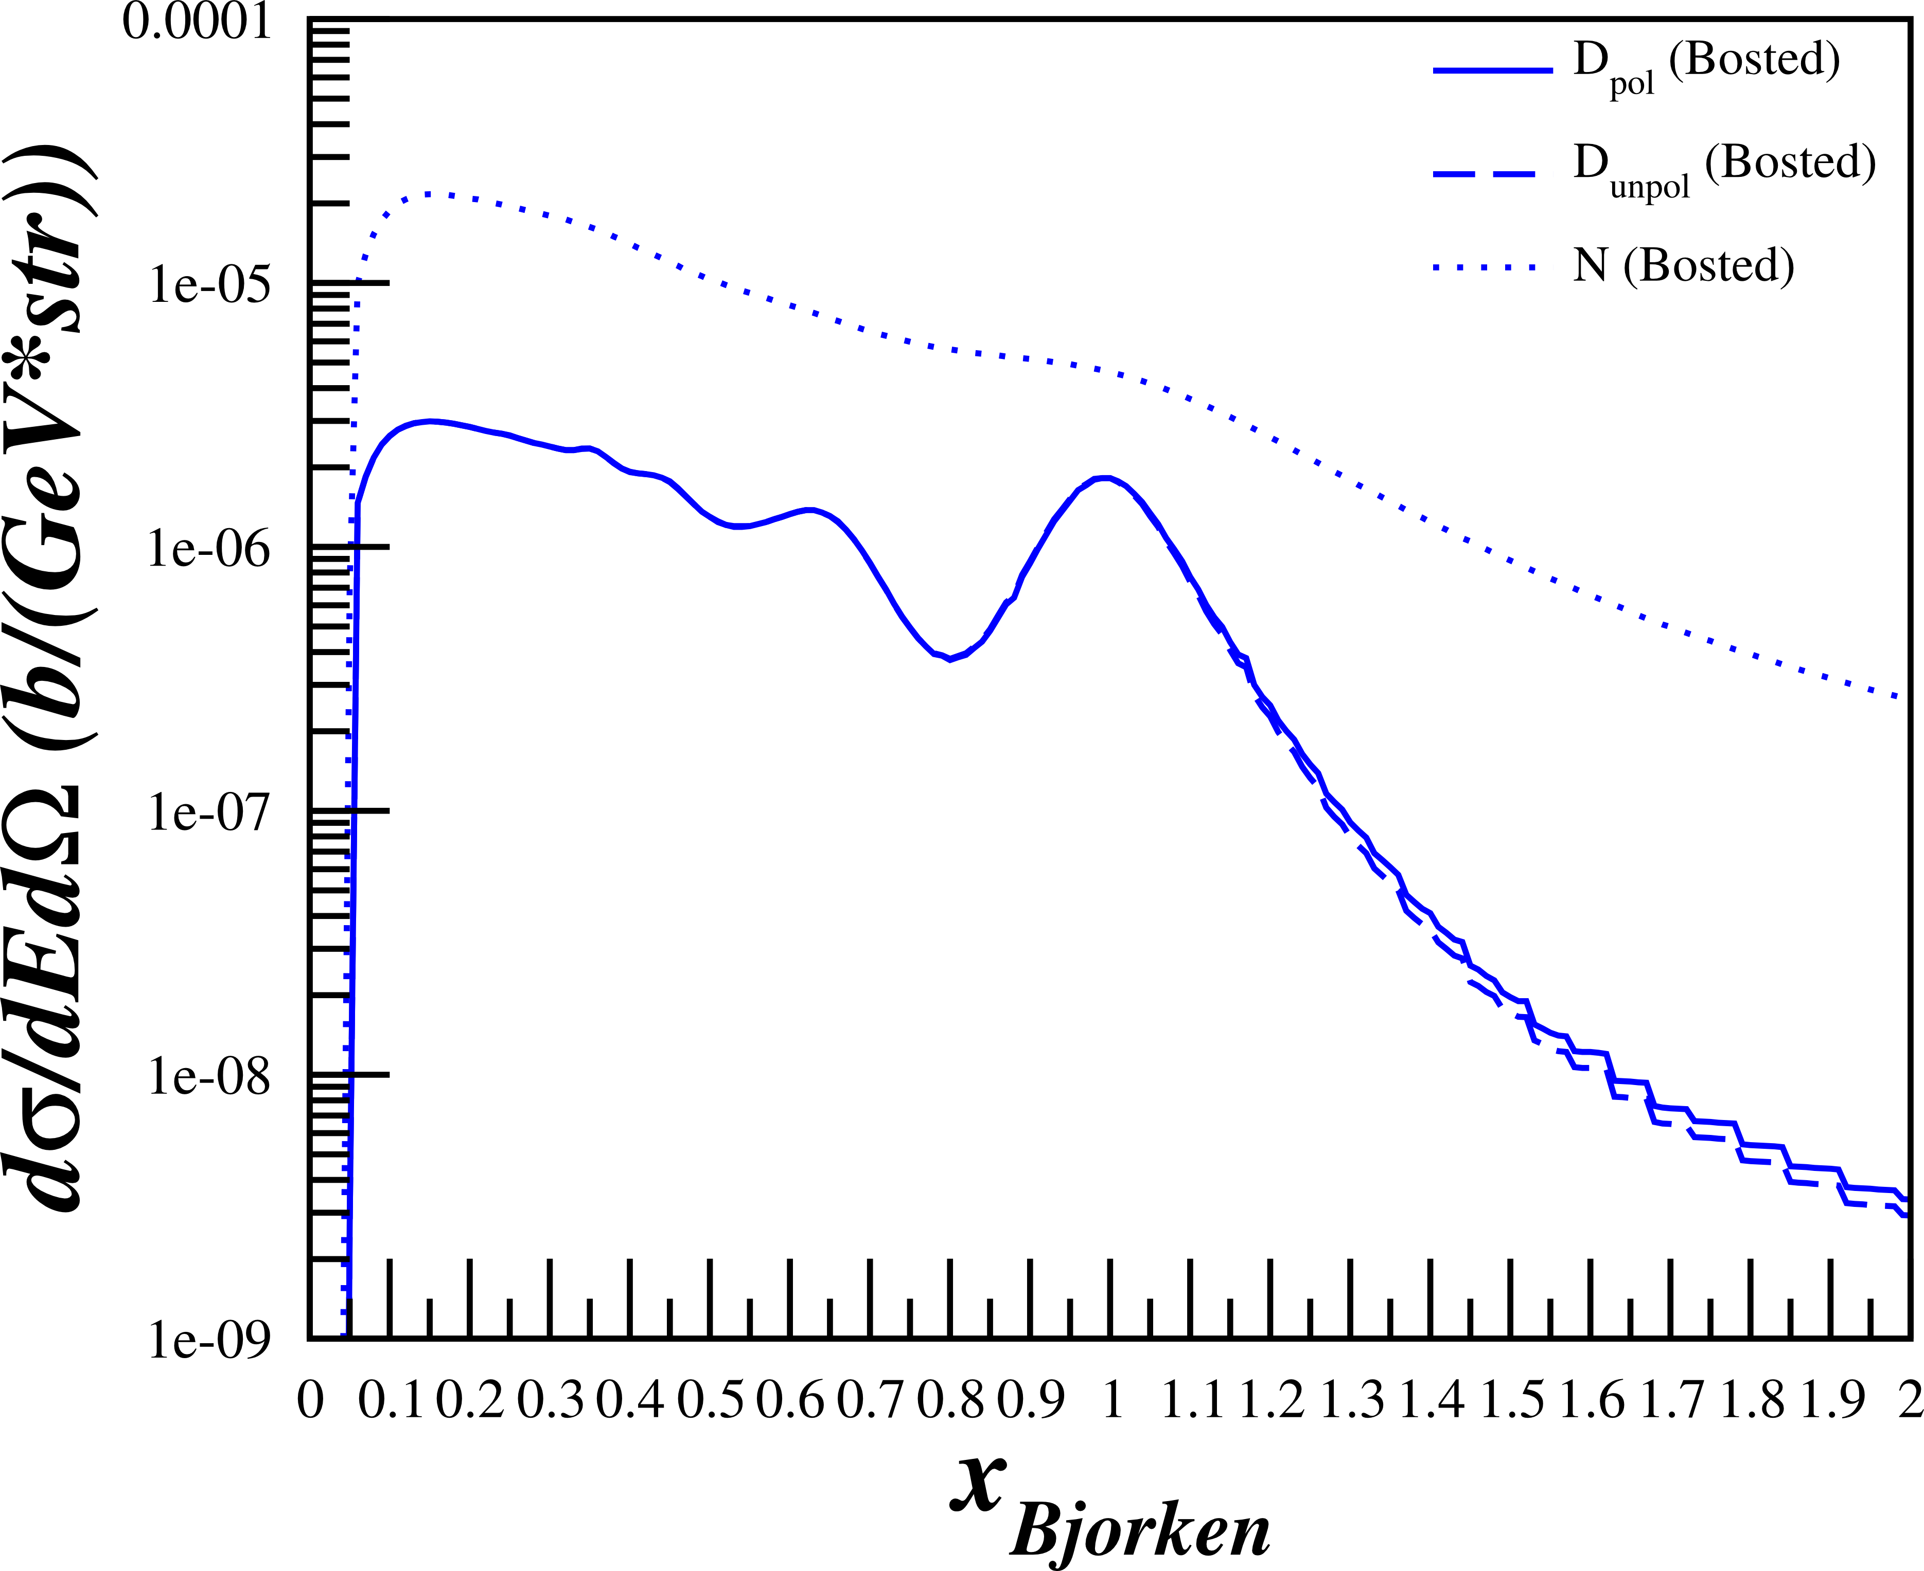
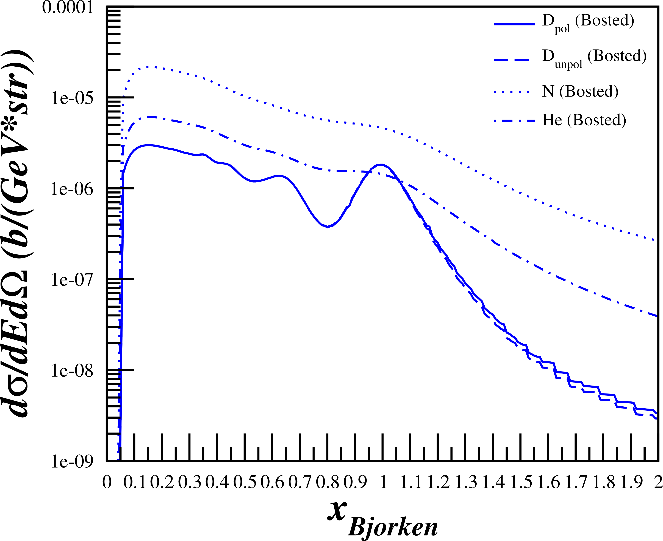
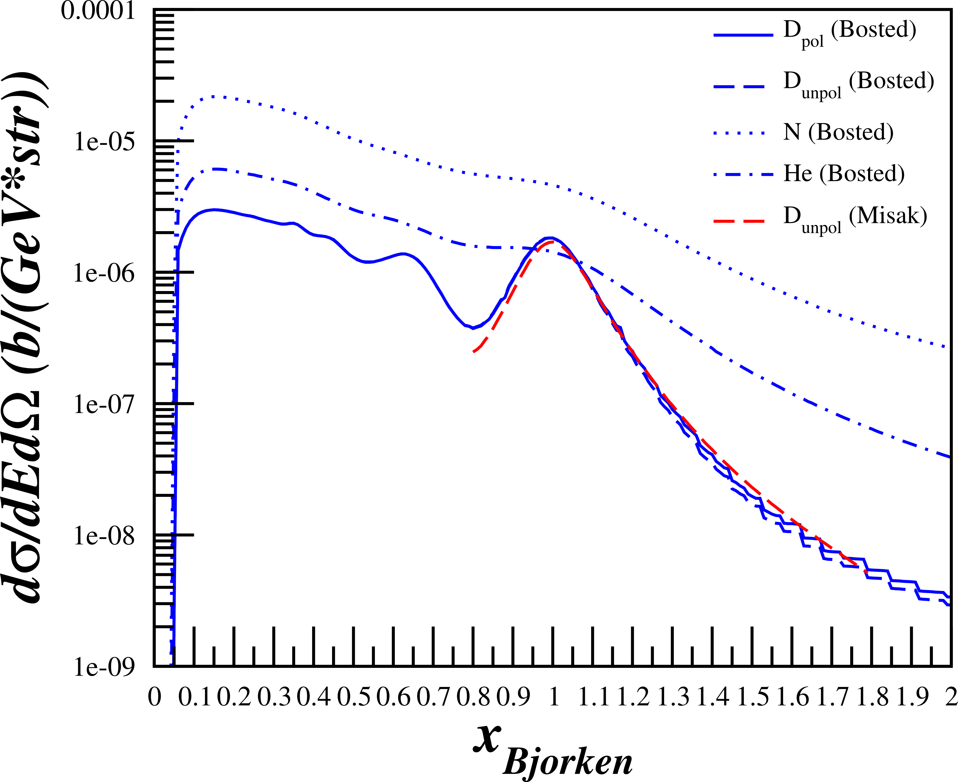
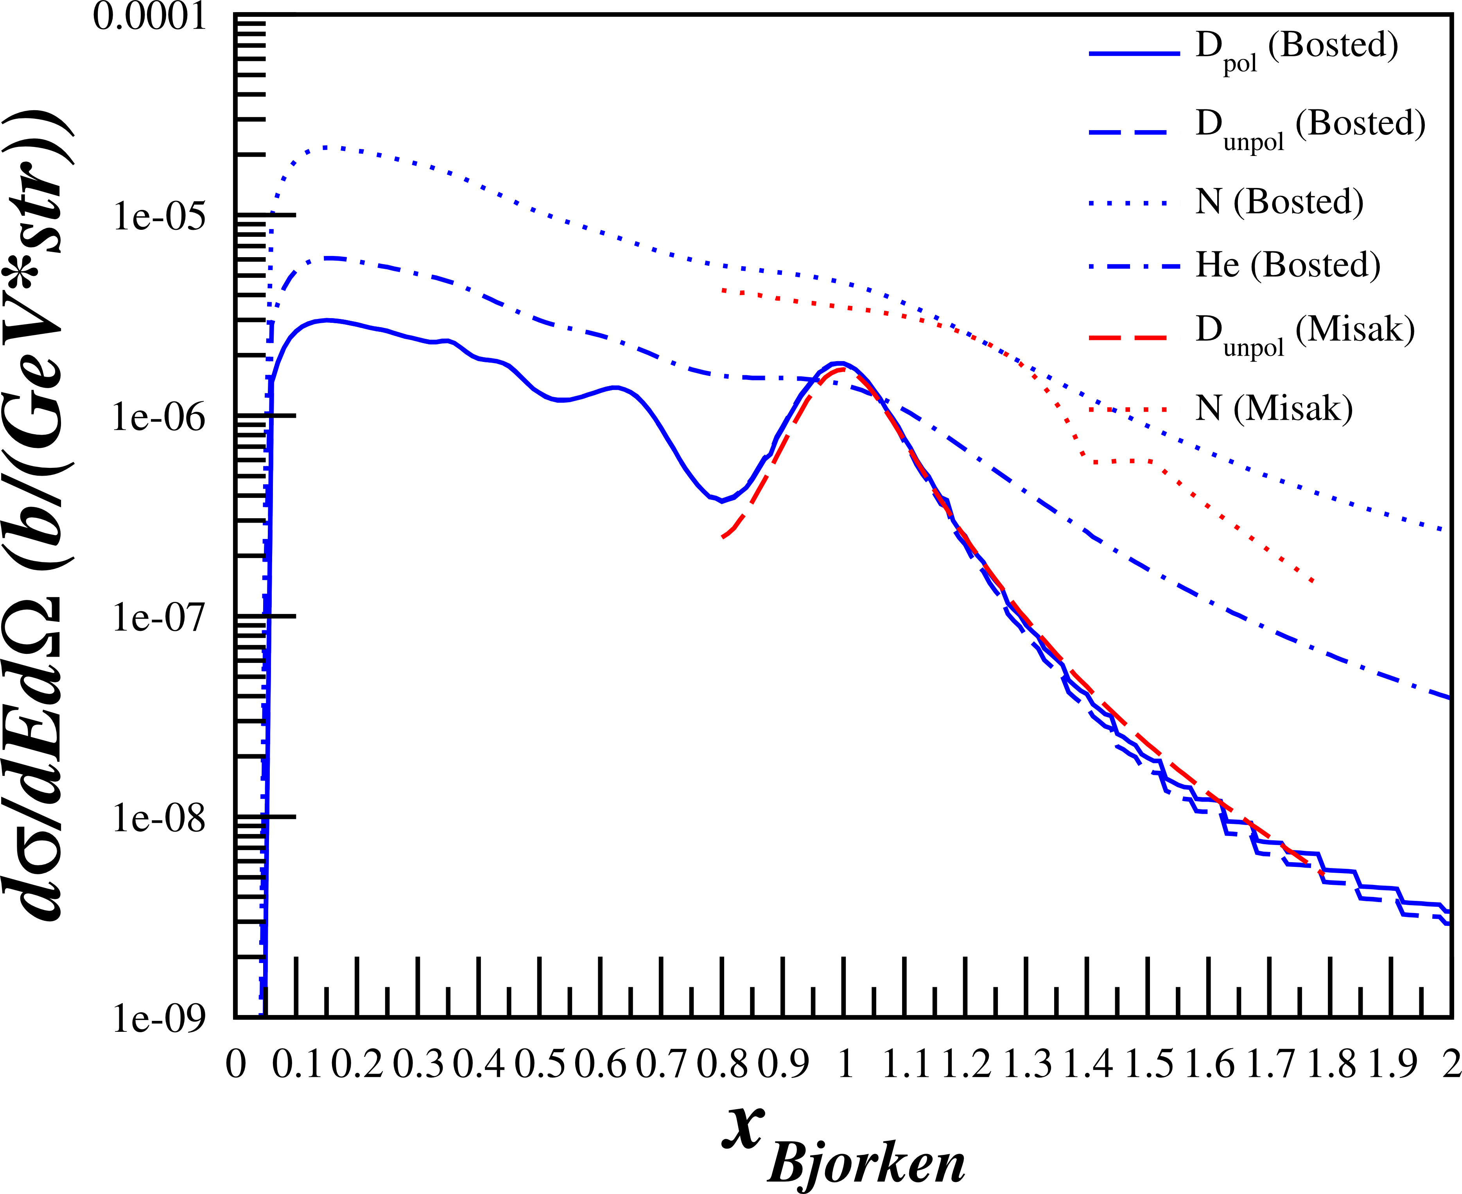
Cross Section Calculations
$$σ_{u}=A_{X}σ_{Mott}\left[\frac{2\left(\frac{F_{1IE}^{X}+F_{1QE}^{X}}{A_{X}}\right)}{m_{p}}\tan^{2}\left(\frac{θ_{e′}}{2}\right)+\frac{\left(\frac{F_{2IE}^{X}+F_{2QE}^{X}}{A_{X}}\right)}{ν}\right]$$
Unpolarized structure functions obtained through Bosted’s code
$σ_{D}=σ_{D}^{u}\left[1+\frac{1}{2}P_{zz}A_{zz}\right]$
Polarized cross sections dependent on unpolarized cross section, tensor polarization, and $A_{zz}$
P.E. Bosted, V. Mamyan, arXiv:1203.2262

Slide 12
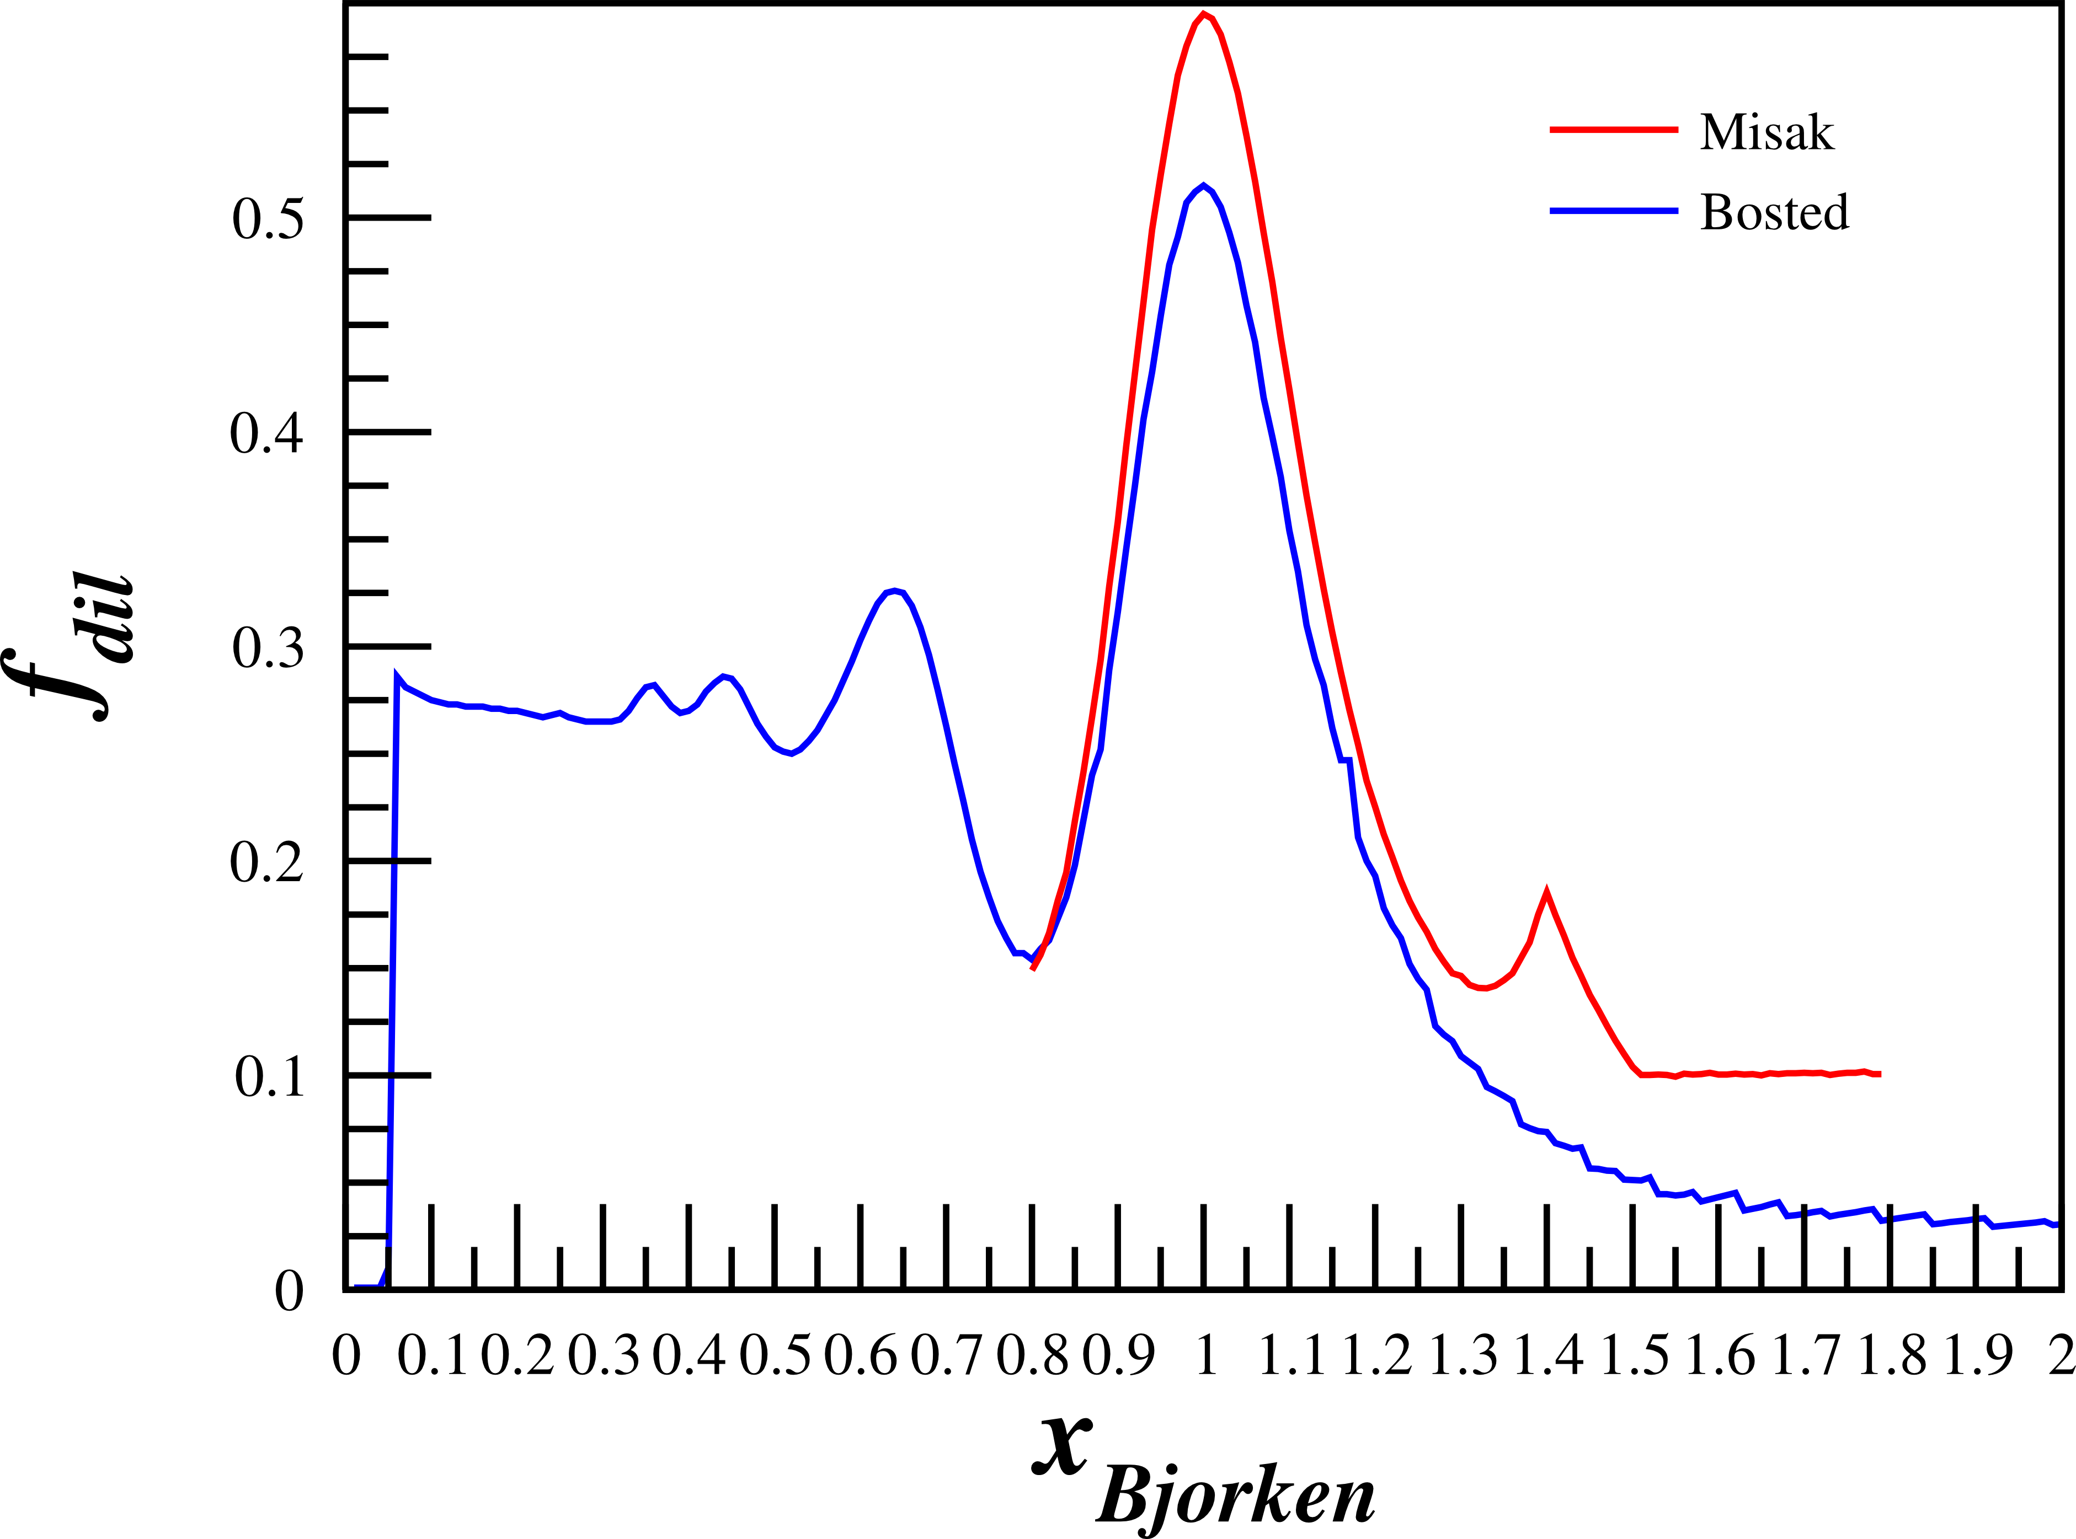
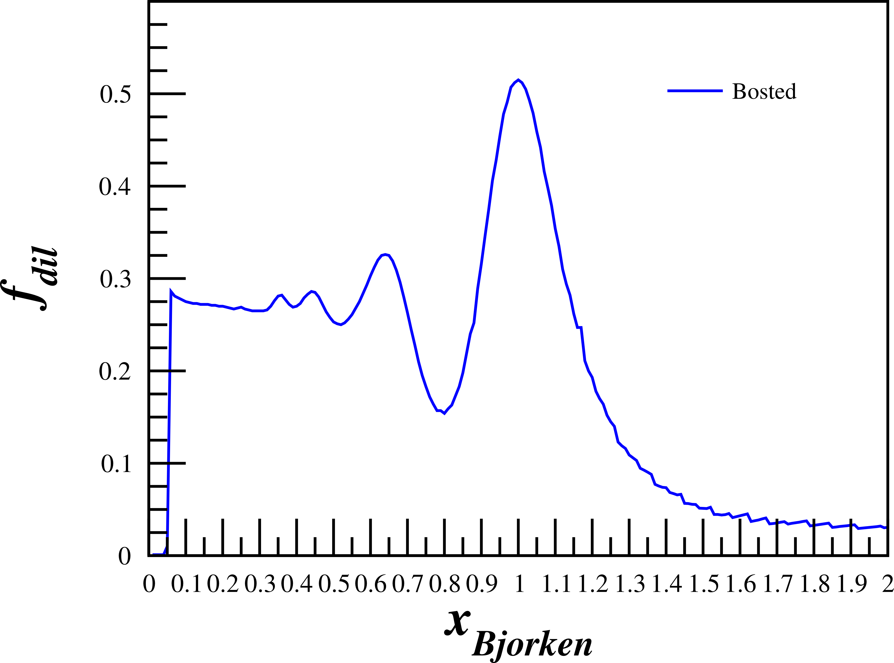
Cross Section Calculations – $f_{dil}$
$$f_{dil}=\frac{ℒ_{D}σ_{D}^{u}}{ℒ_{He}σ_{He}^{u}+ℒ_{N}σ_{N}^{u}+ℒ_{D}σ_{D}^{u}}$$
Preliminary
Compared results from the Bosted fit and Sargsian’s light-cone model
P.E. Bosted, V. Mamyan, arXiv:1203.2262
M. Sargsian, Private Communication

Slide 13
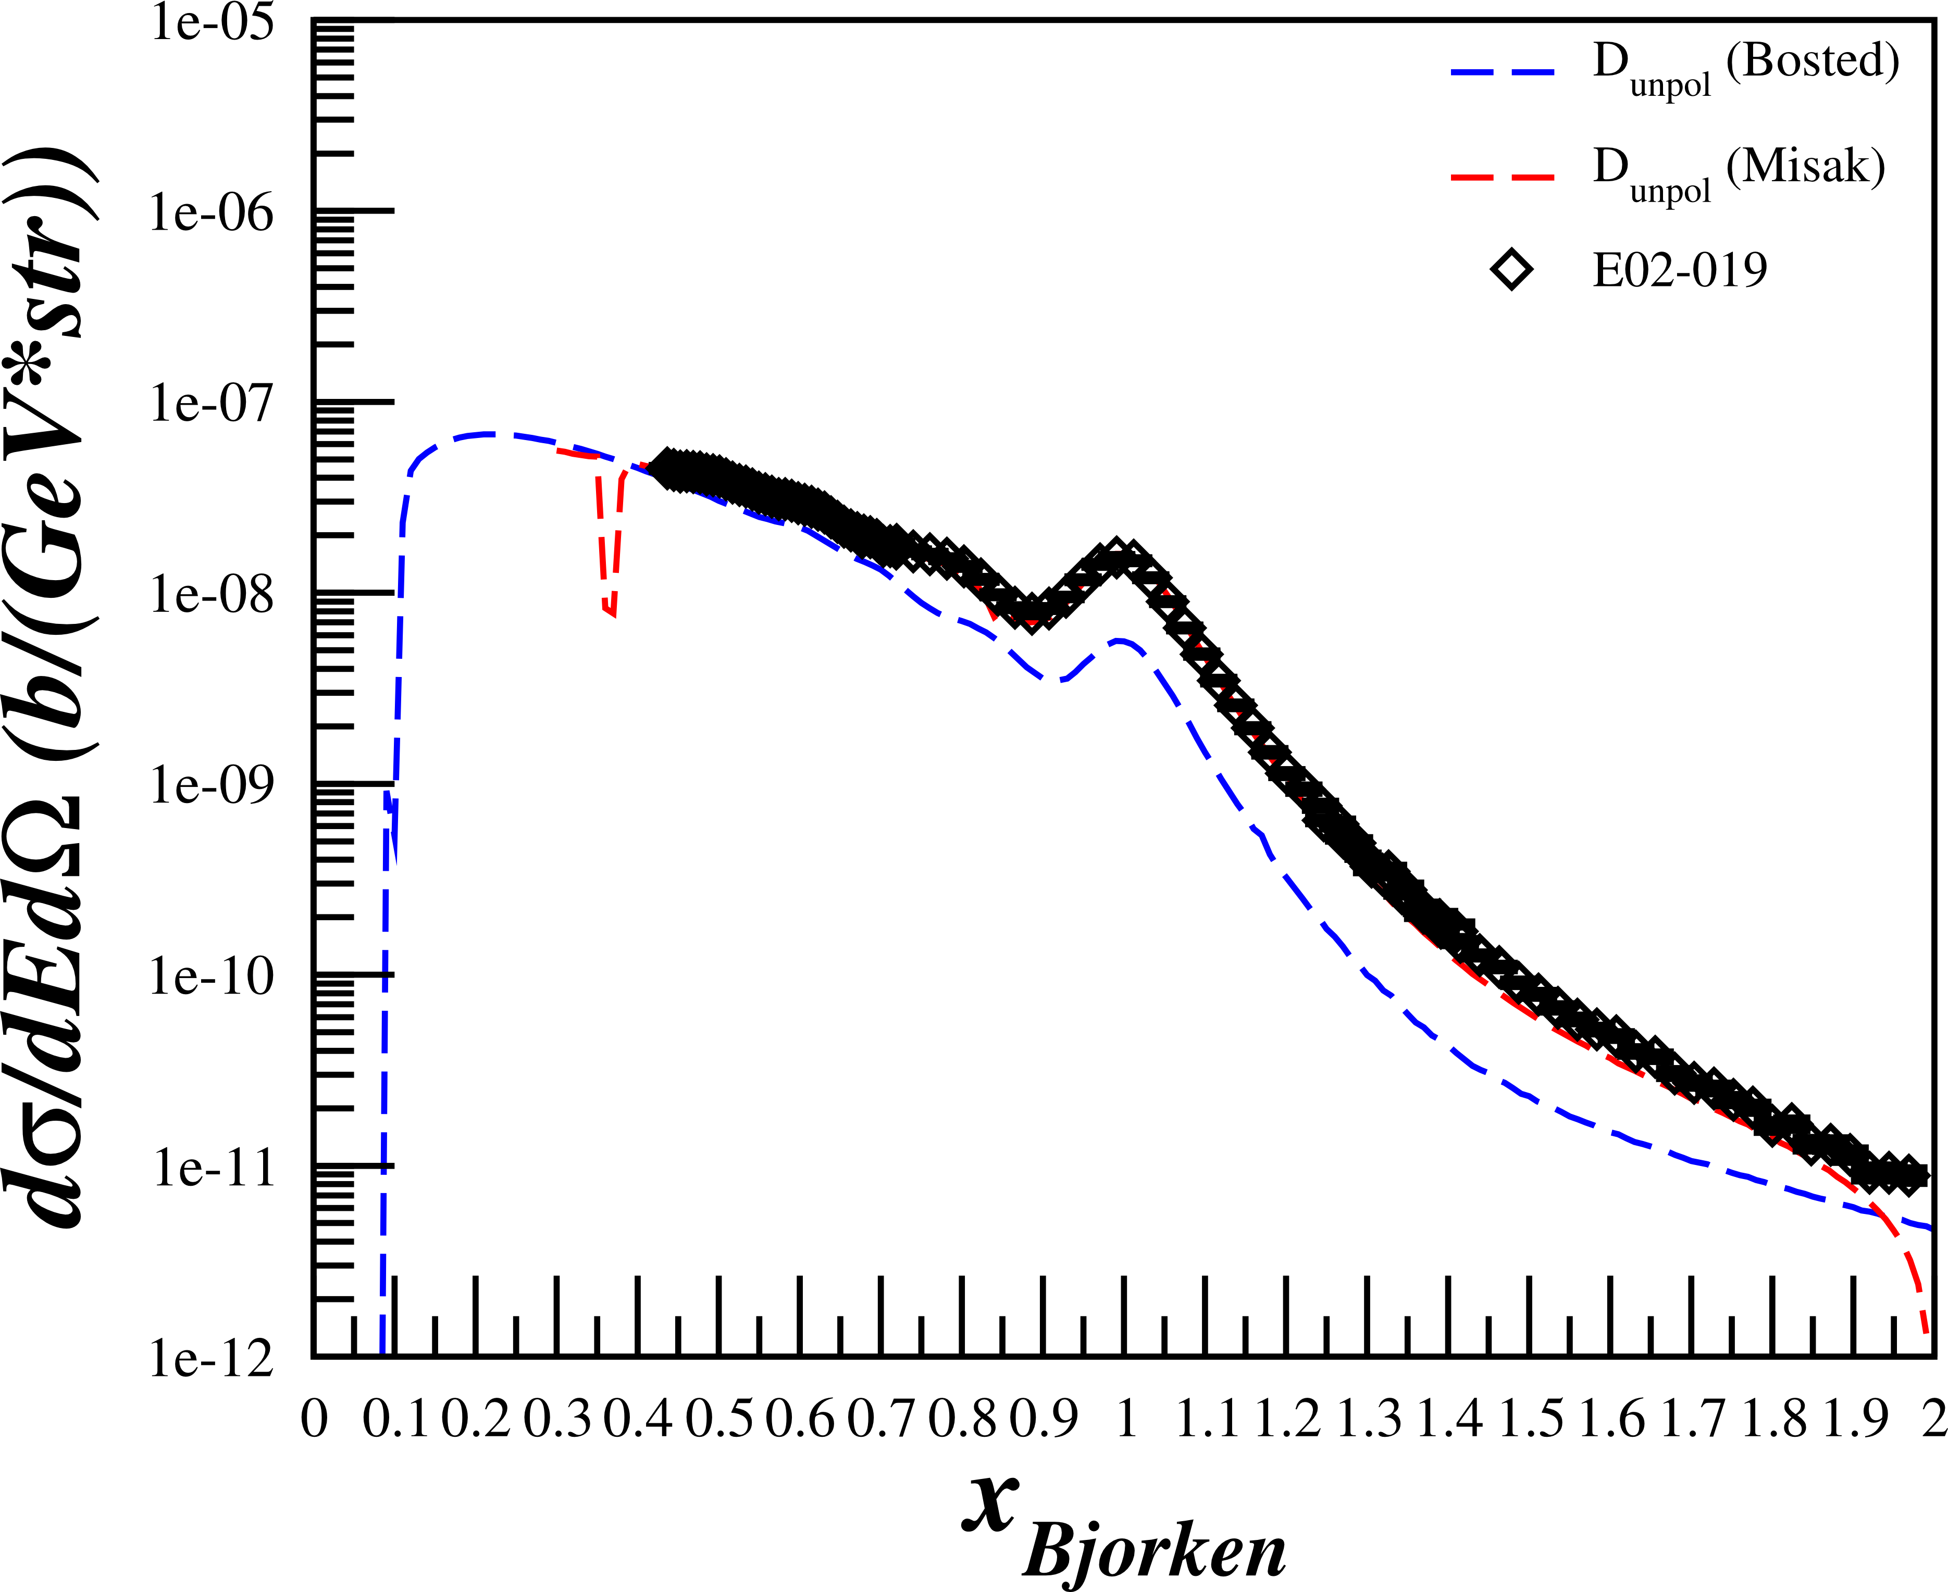
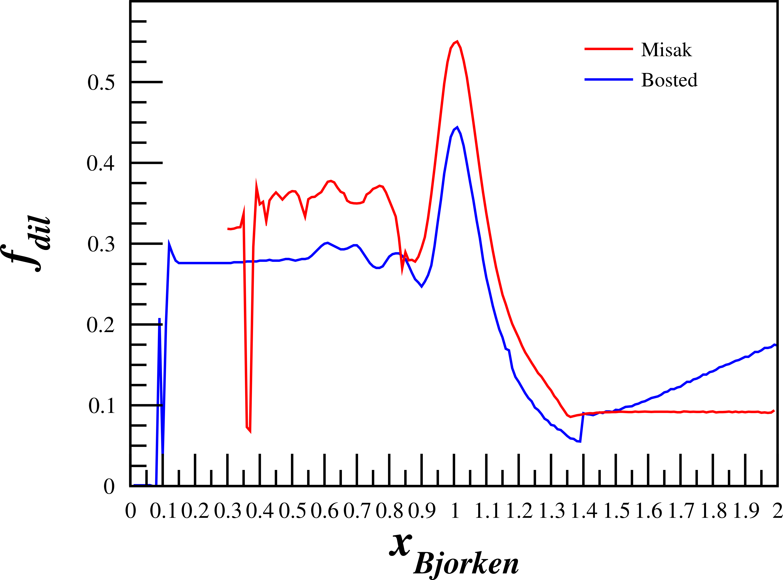
Cross Section Calculations - Deuterium
Compared with data similar to Azz range
$E_{0}=5.766 GeV$
$E′=4.8 GeV$
$θ_{e′}={18.0}^{∘}$
Preliminary
N. Fomin, et al., Phys. Rev. Lett. 108 (2012) 092502
N. Fomin, et al., Phys. Rev. Lett. 105 (2010) 212502

Slide 14
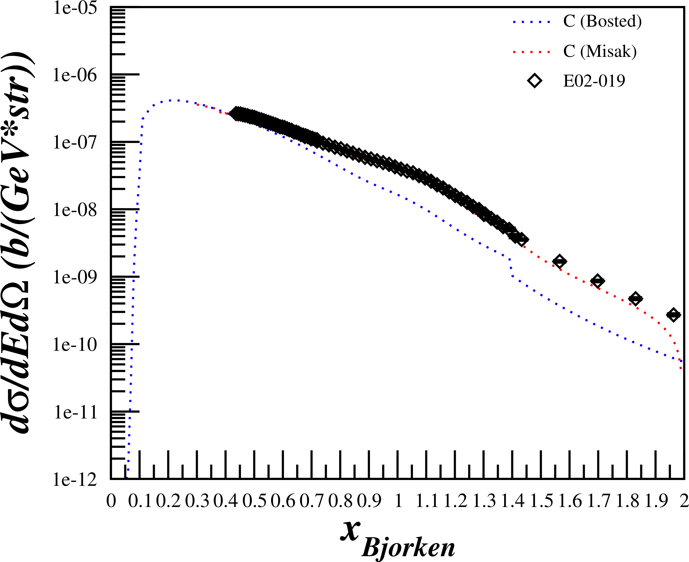
Cross Section Calculations - Carbon
Compared with data similar to Azz range
$E_{0}=5.766 GeV$
$E′=4.8 GeV$
$θ_{e′}={18.0}^{∘}$
Preliminary
N. Fomin, et al., Phys. Rev. Lett. 108 (2012) 092502
N. Fomin, et al., Phys. Rev. Lett. 105 (2010) 212502

Slide 15
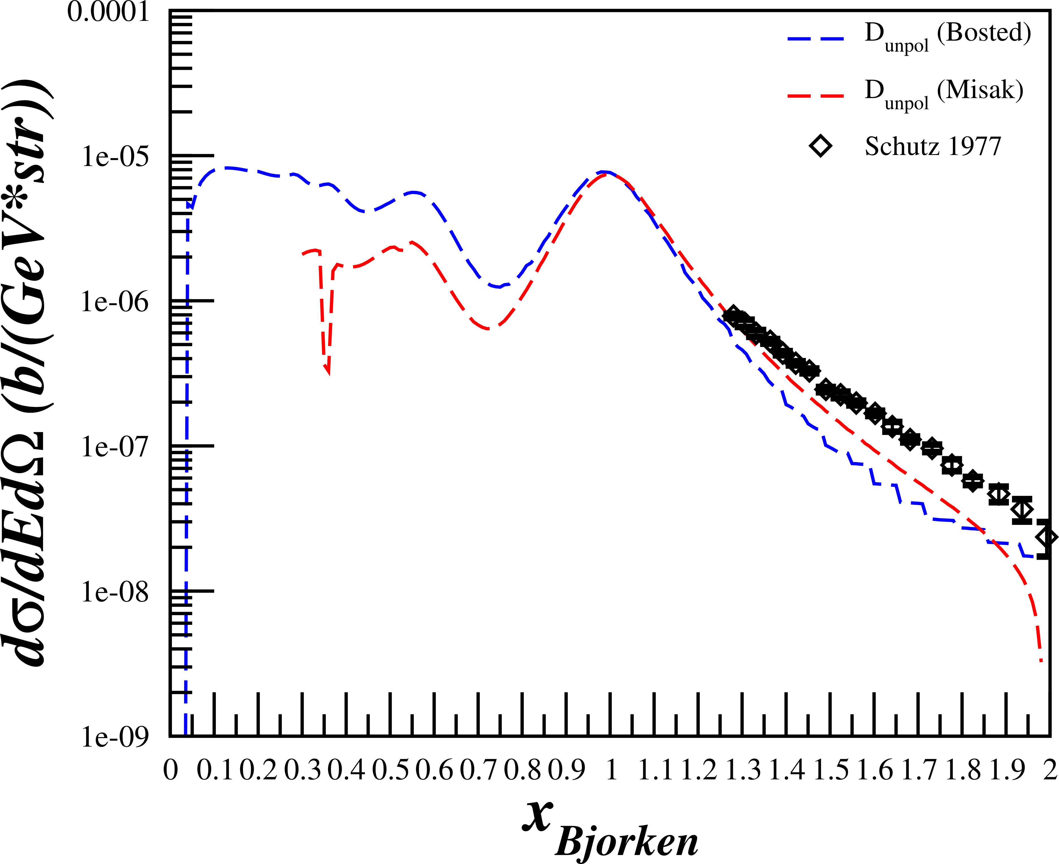
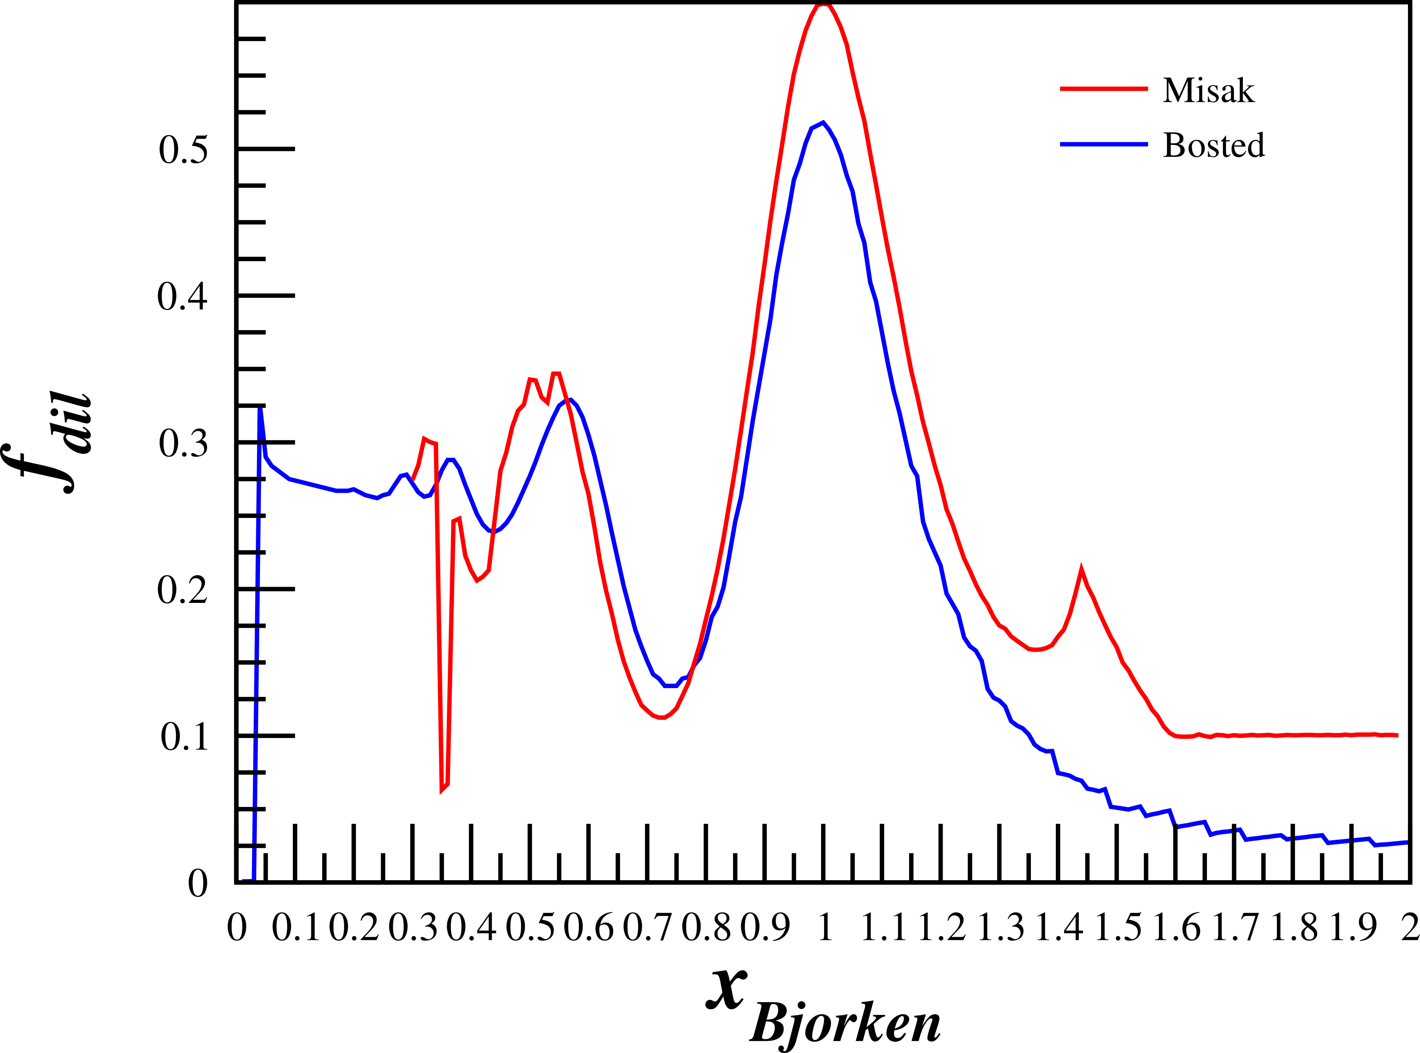
Cross Section Calculations - Deuterium
Compared with data similar to Azz range
$E_{0}=6.519 GeV$
$E′=6.23GeV$
$θ_{e′}={8.0}^{∘}$
Preliminary
W.P. Shutz, et al., Phys. Rev. Lett. 38, 259 (1977)

Slide 16
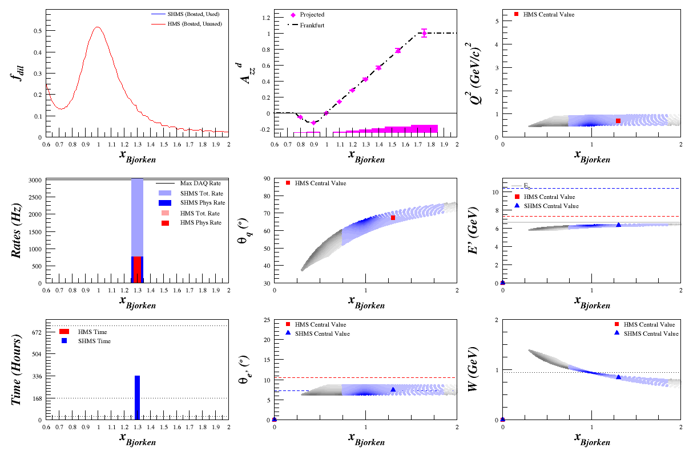
Kinematics Scan
Very
Preliminary

Slide 17
Potential Measurements

Slide 18
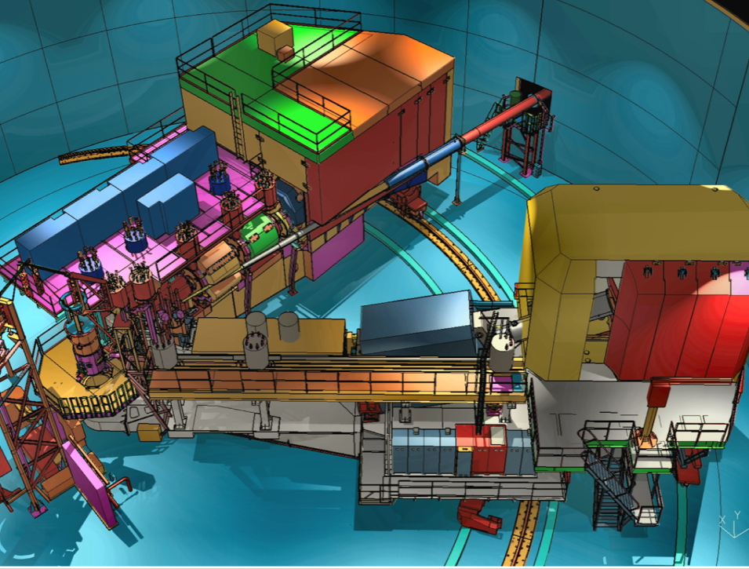
Hall C
Identical equipment as $b_{1}$ (E12-13-011)
SHMS
SHMS
Slow
Raster
Faraday Cup
Lumi
Unpolarized
Beam
Fast
Raster
Polarized
Target
HMS

Slide 19
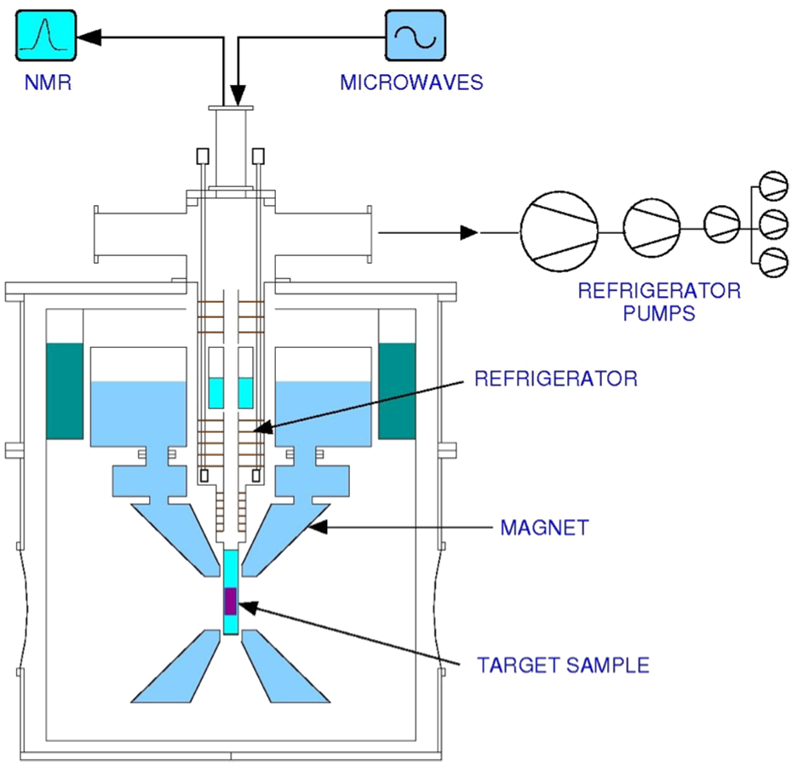
DNP Target
Identical target as $b_{1}$ (E12-13-011)
Dynamic Nuclear Polarization of ND₃
$P_{zz} \sim 30\%$
5 Tesla at 1 K
3cm Target Length
$p_{f} \sim 0.65$
$f_{dil}$ varies with $x$
Figure courtesy of C. Keith

Slide 20
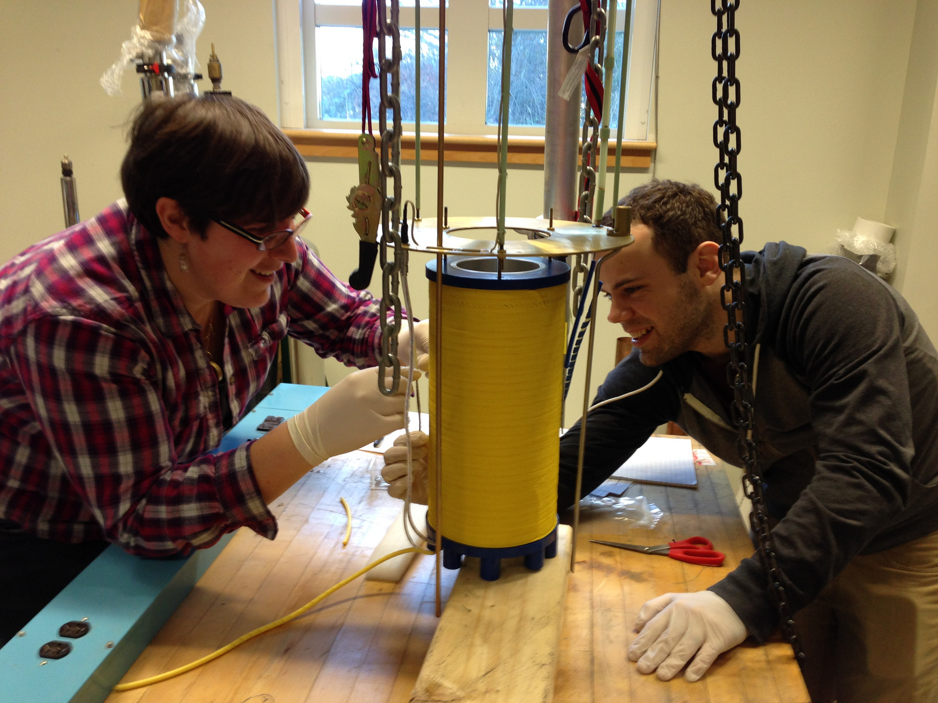
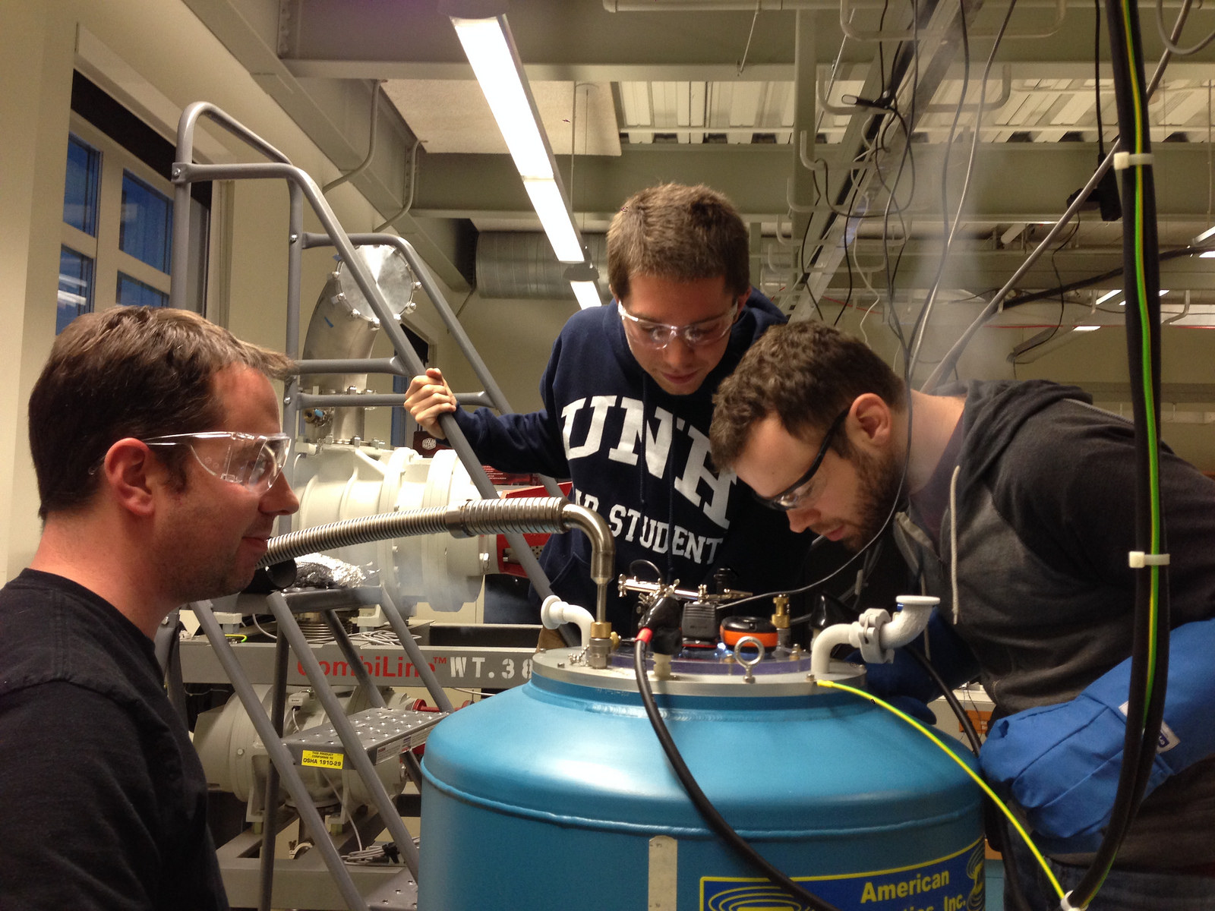
UNH Target Lab is Ramping Up
First cool-down in January
Achieved 7T field

Slide 21
Experimental Details
D(e,e’)X
Same equipment as $b_{1}$ (E12-13-011)
2 Week Experiment
1 Kinematic Setting
Beam Energy = 6.6 GeV
HMS Angle = 10.6 degrees
HMS Momentum = 7.3 GeV/c
SHMS Angle = 10.3 degrees
SHMS Momentum = 6.1 GeV/c

Slide 22
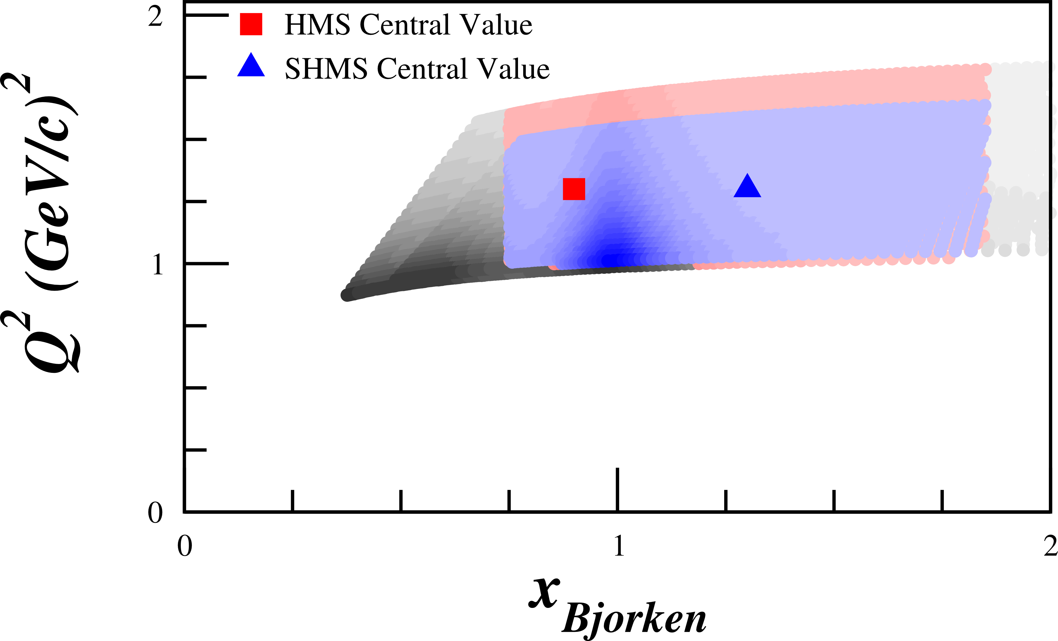
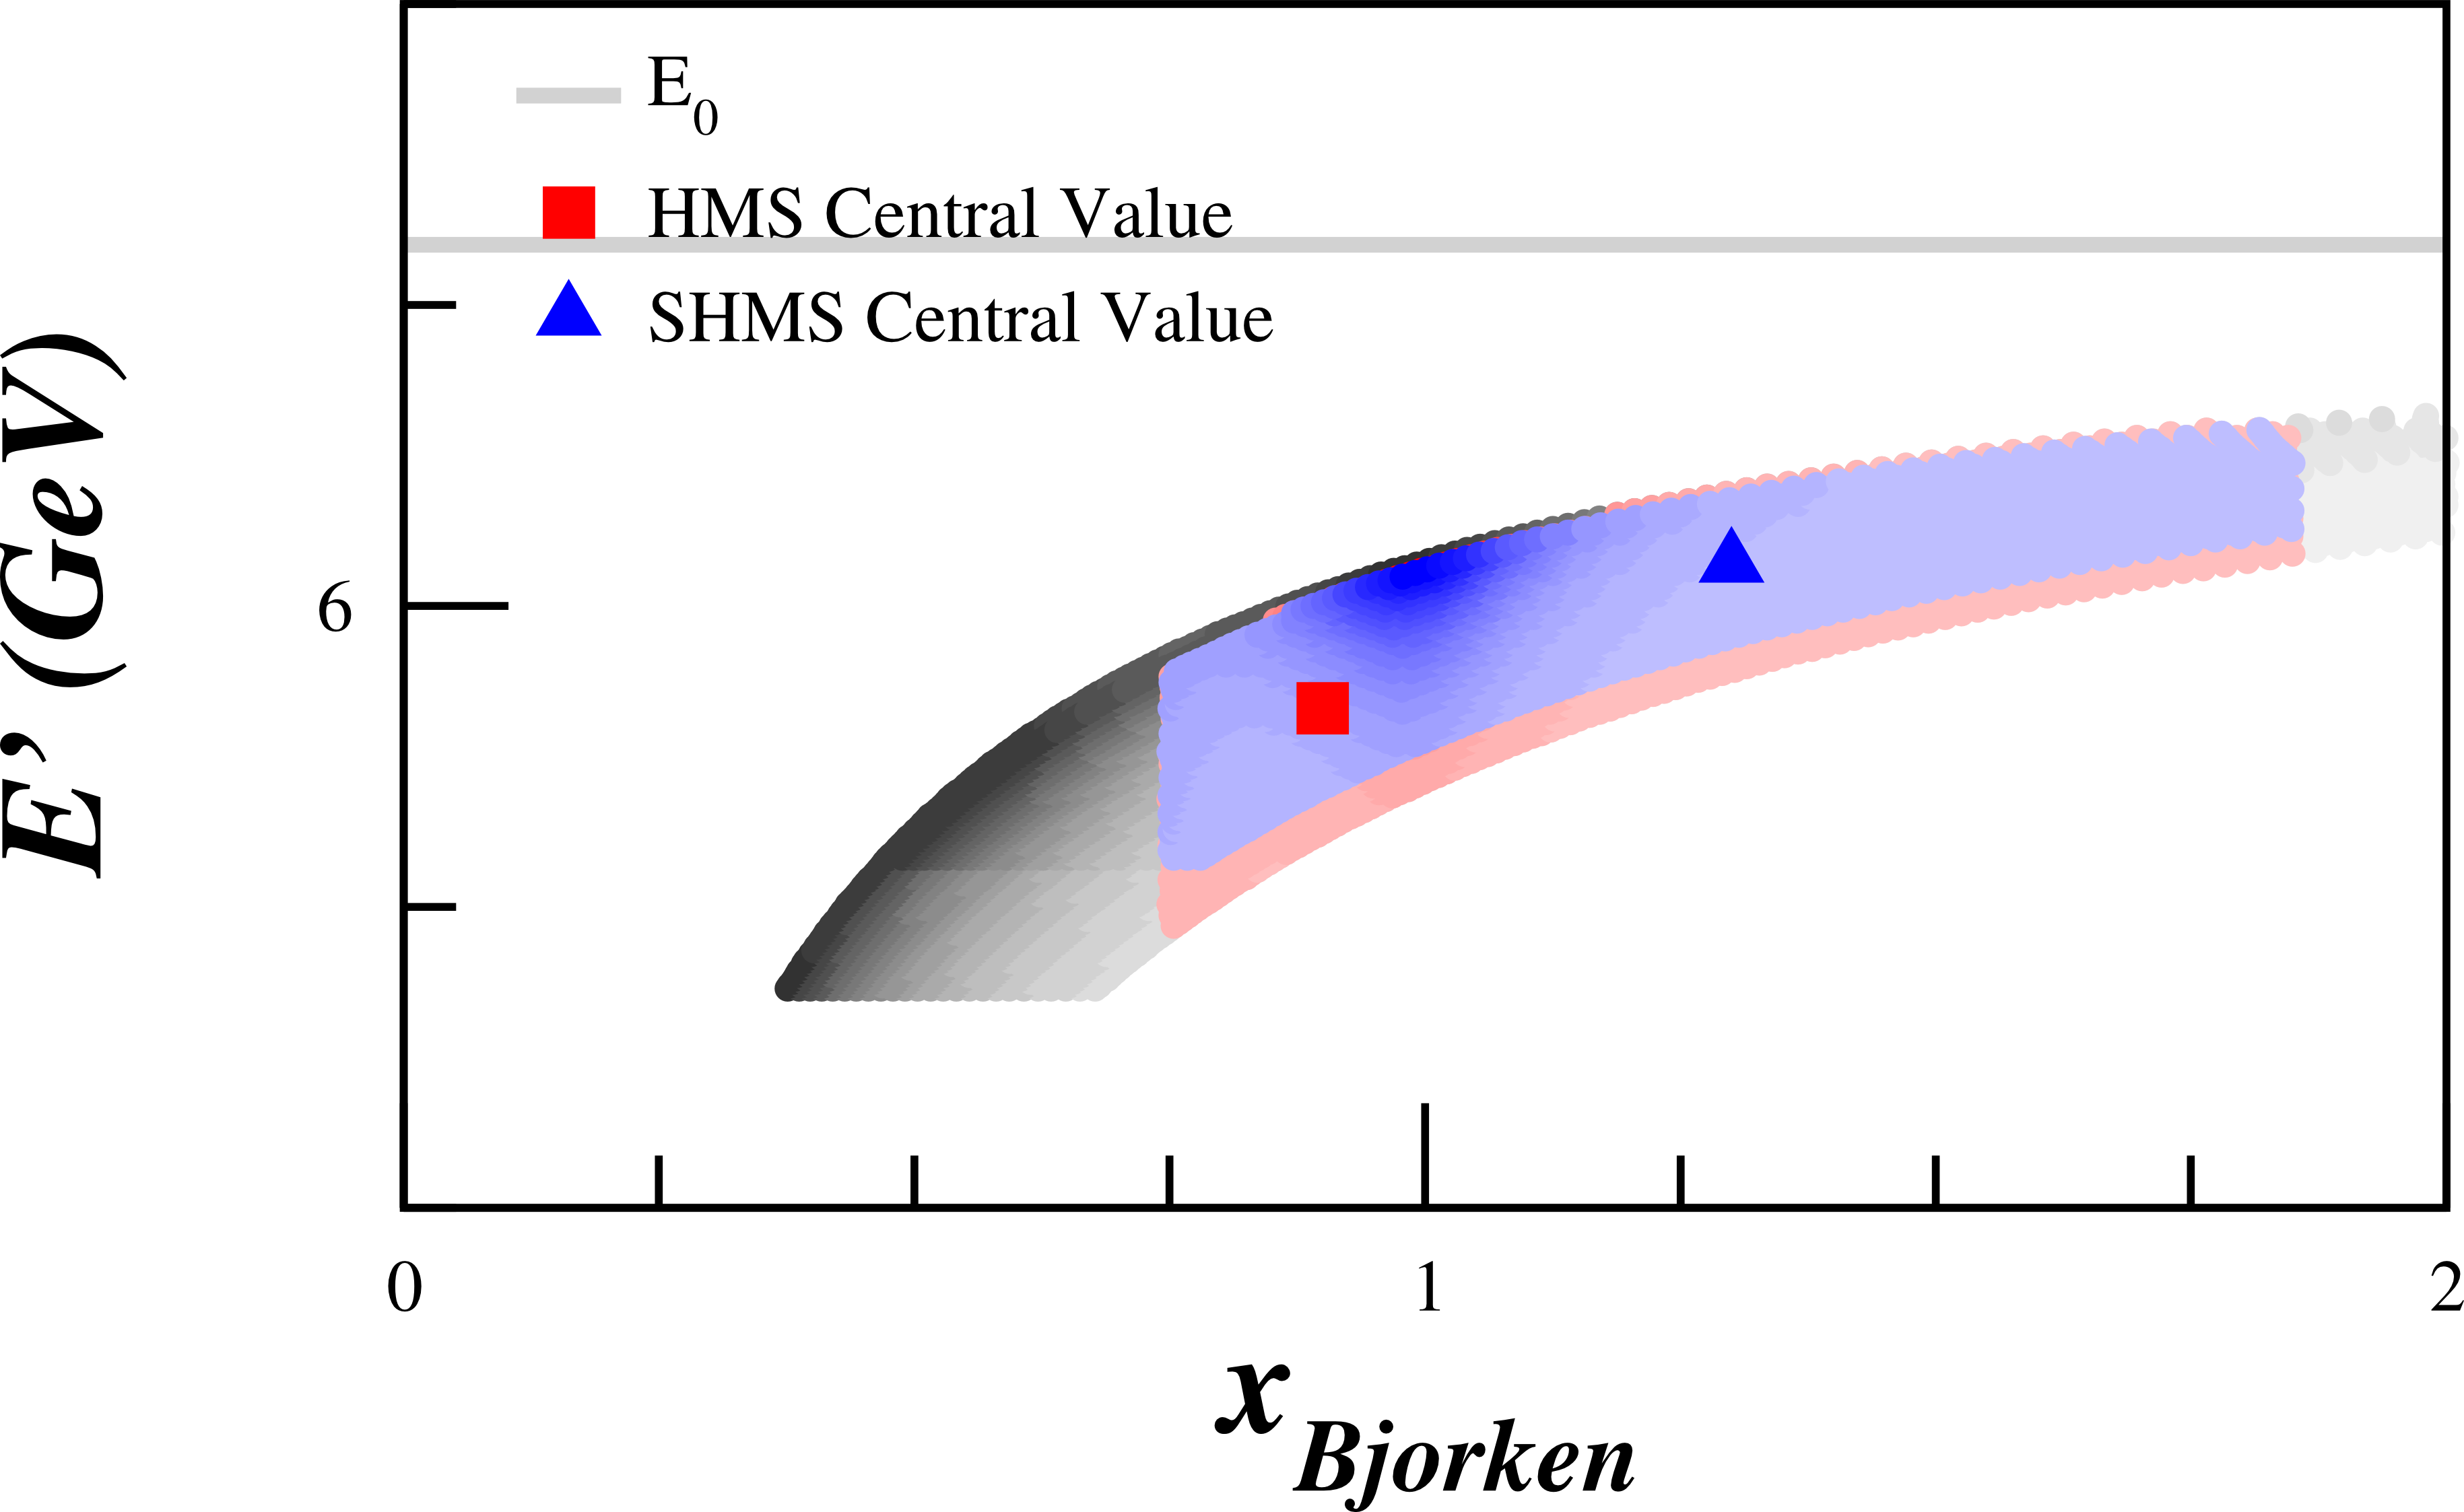
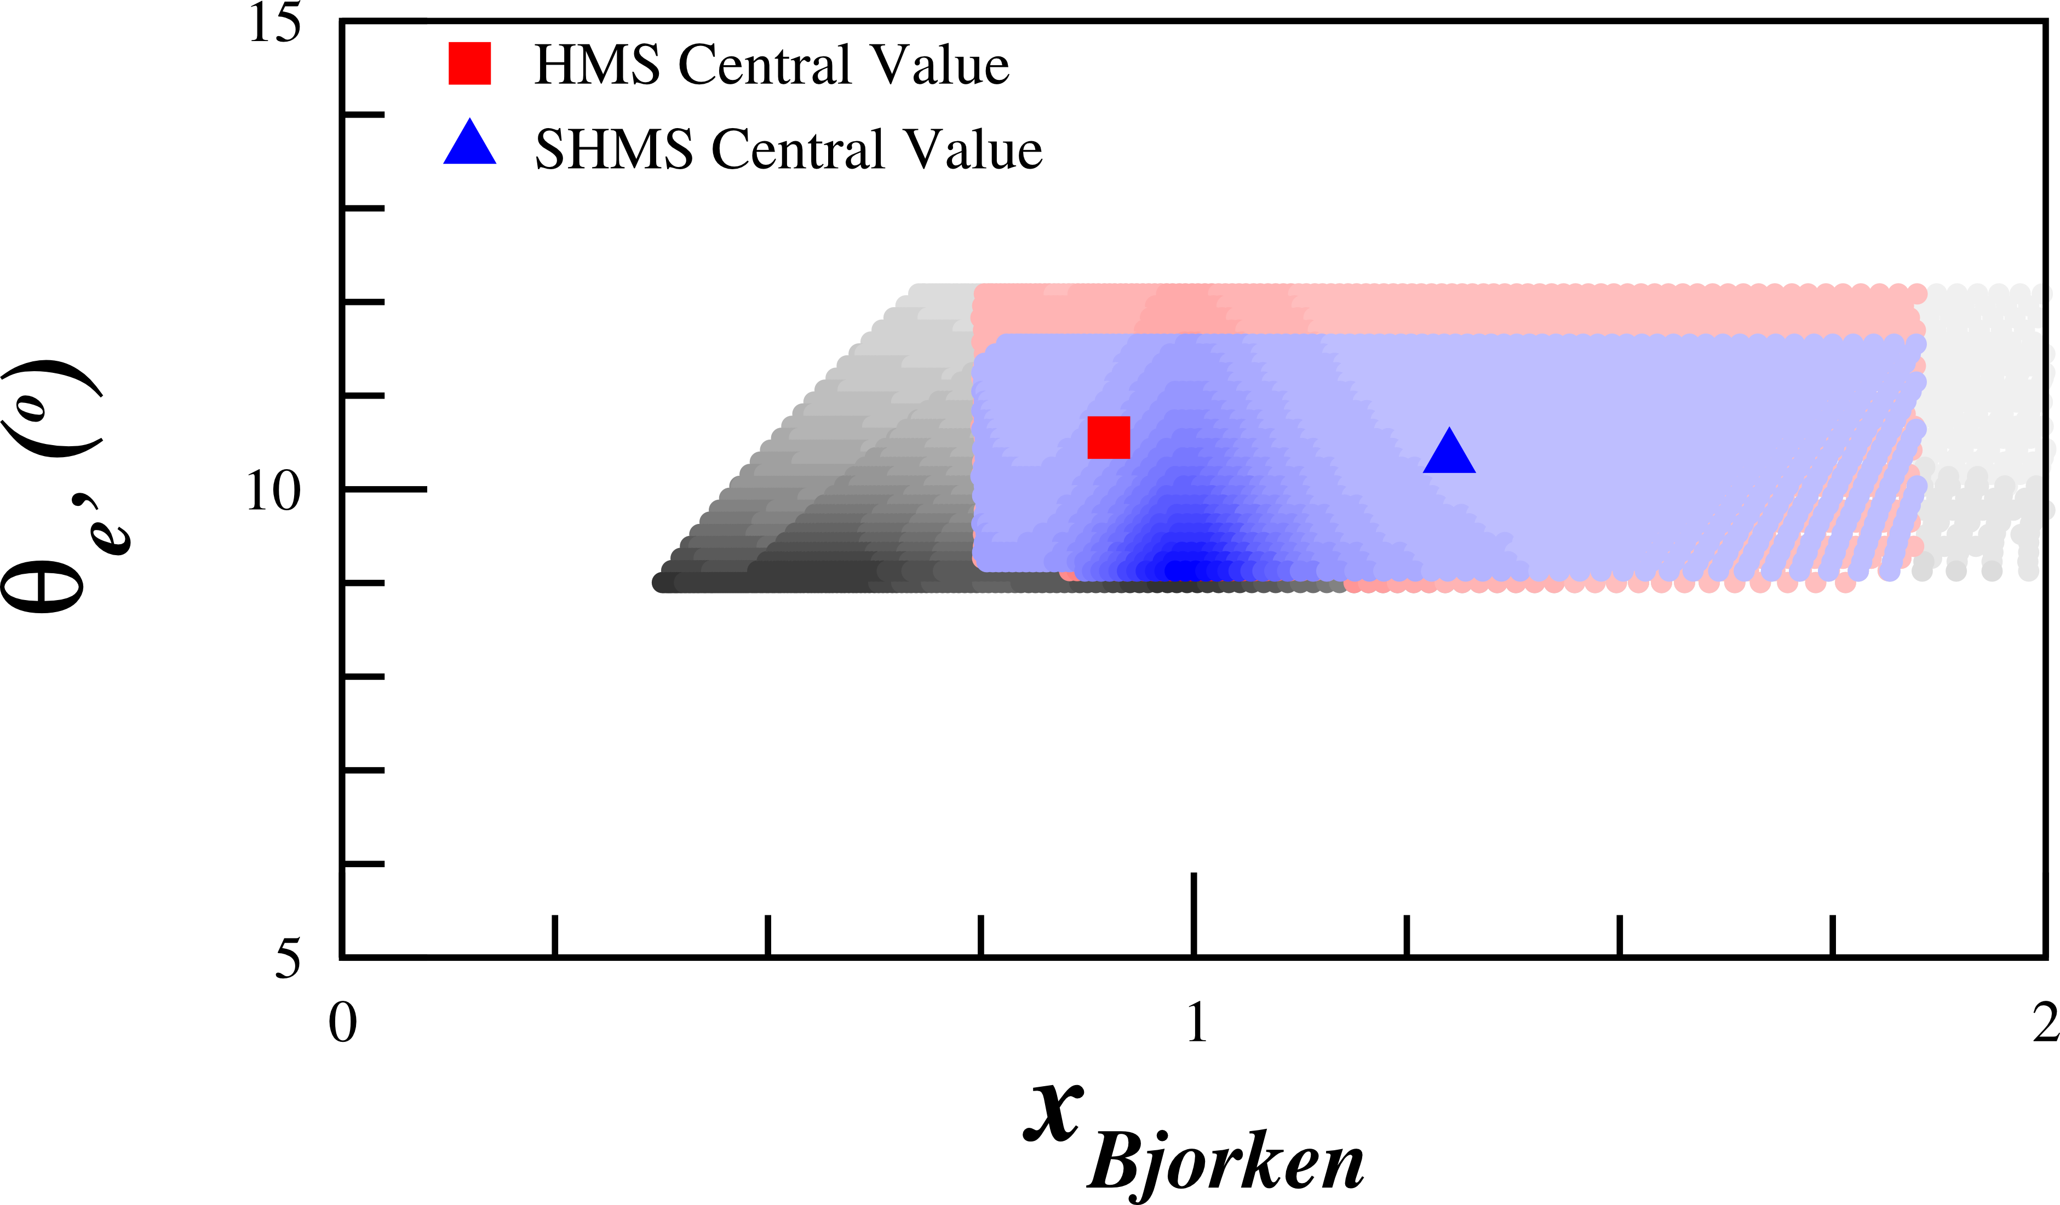
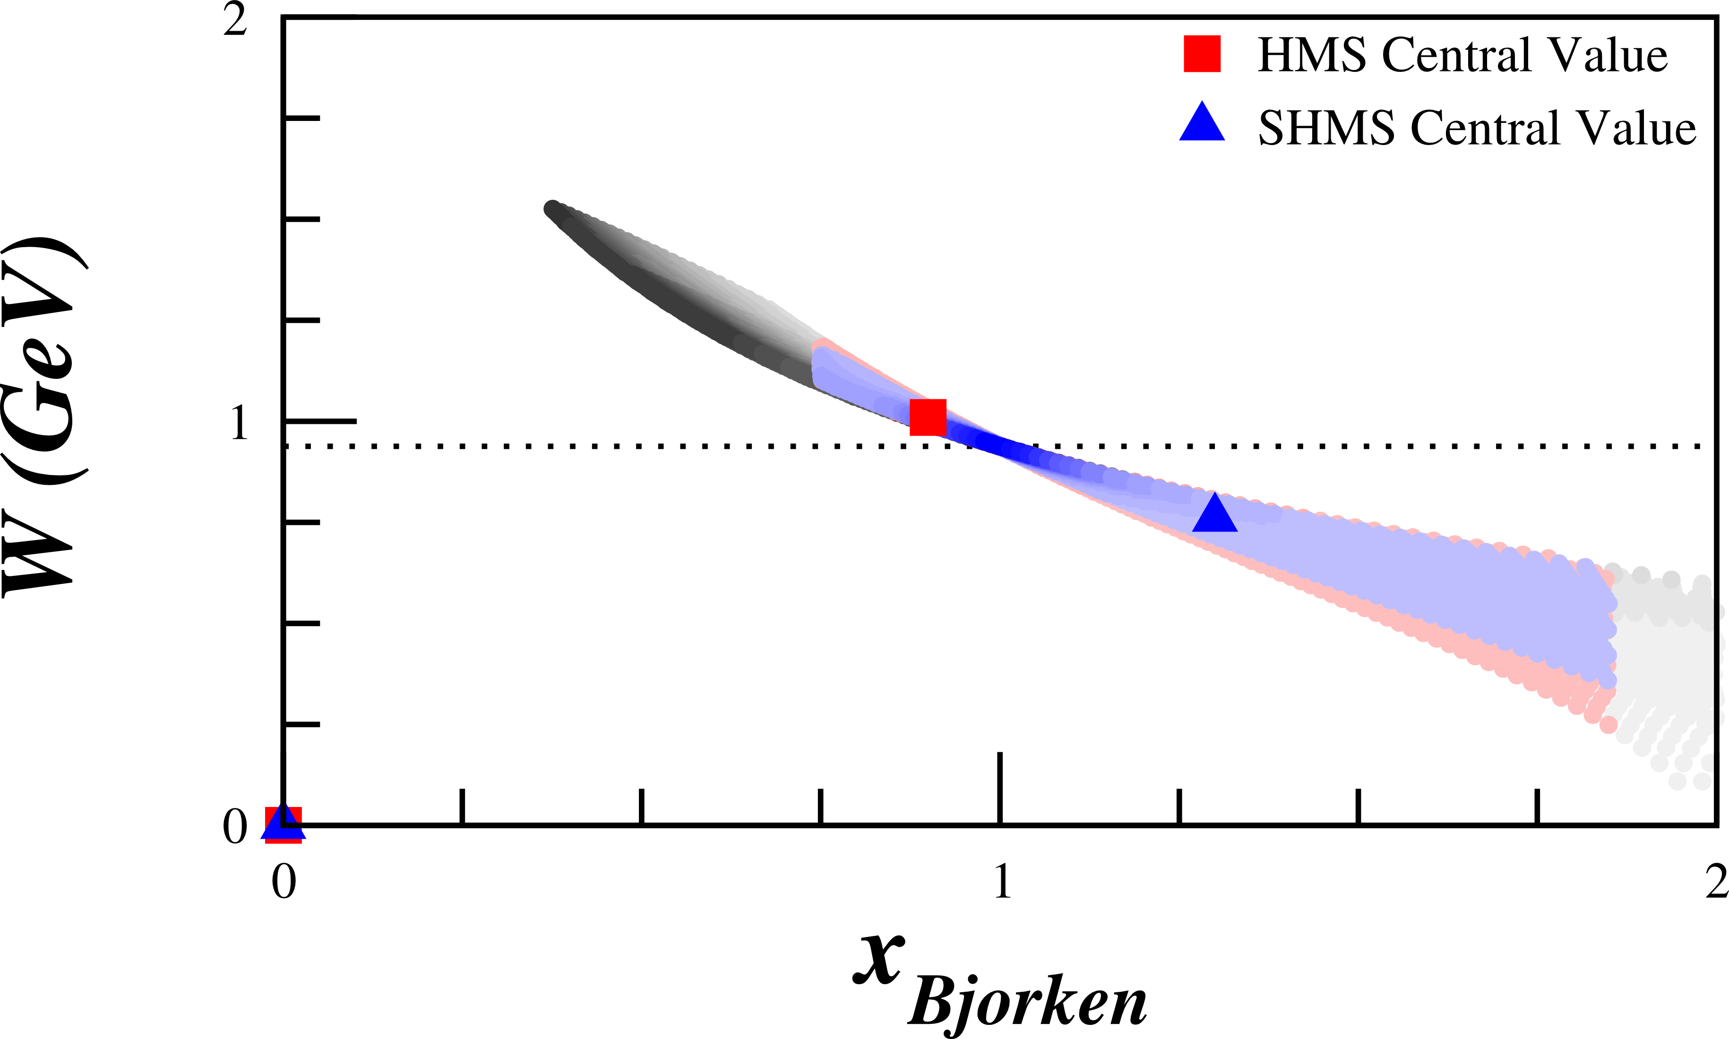
Very
Preliminary

Slide 23
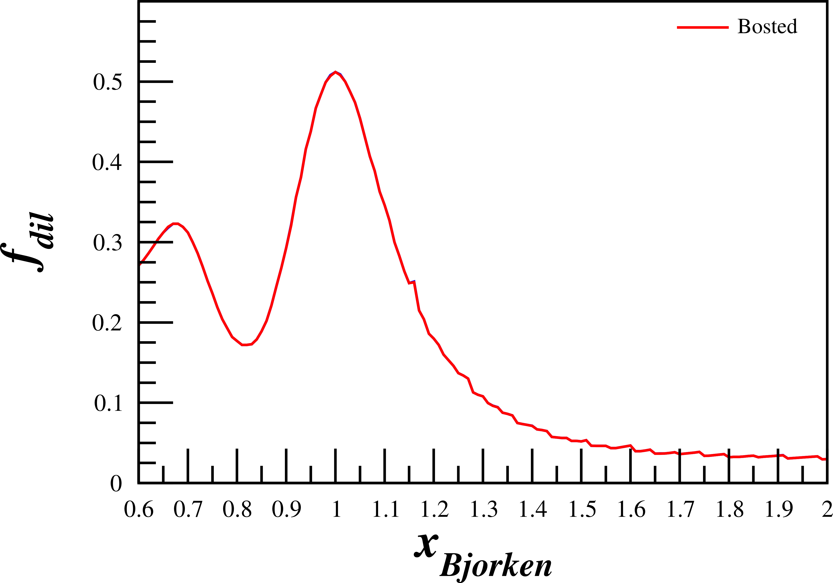
Potential Measurement (2 Weeks)
Very
Preliminary
Very
Preliminary

Slide 24
Challenges to PAC42
Small dilution factor
D(e,e’p) removes the dilution factor, but has smaller acceptance
Calculations have yet to be done
Tensor polarization of 30% not yet achieved, but being worked on
Look into $A_{zz}$ dependence on $Q^{2}$

Slide 25
Path to PAC42
Very large measurement
Less dependent on systematics than $b_{1}$
Potential to be used as commissioning to get a better handle on the $b_{1}$ systematics
Direct access to the tensor component of SRC
2 week measurement
Identical equipment as $b_{1}$
Open for collaboration
Very
Preliminary
Extremely
Preliminary

Slide 26
Tensor Asymmetry $A_{zz}$ (T$A_{zz}$)
Very large measurement
Less dependent on systematics than $b_{1}$
Potential to be used as commissioning to get a better handle on the $b_{1}$ systematics
Direct access to the tensor component of SRC
2 week measurement
Identical equipment as $b_{1}$
Open for collaboration
Extremely
Preliminary

Slide 27
Thank you

Slide 29
Backup Slides

Slide 32
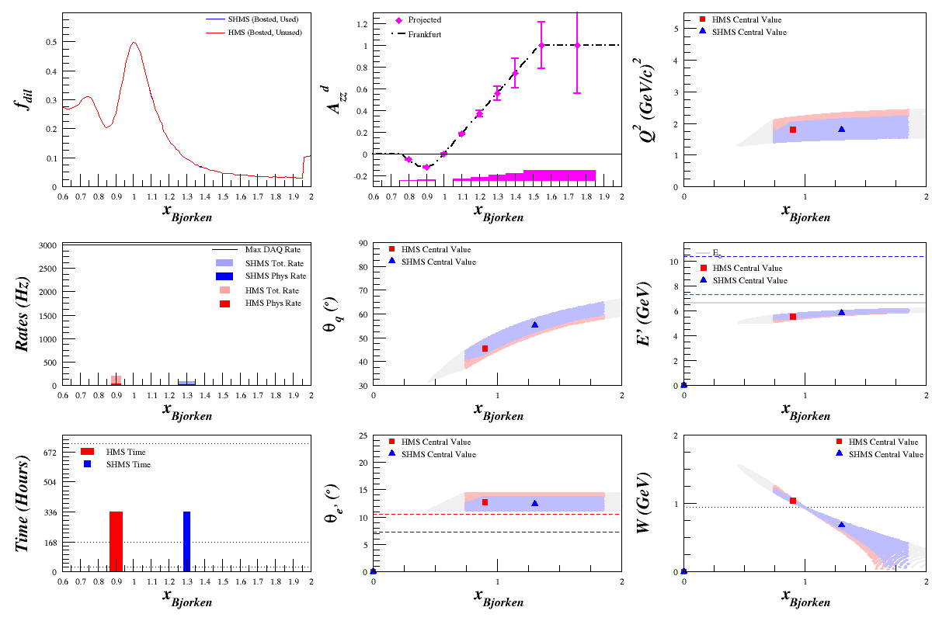

Slide 34
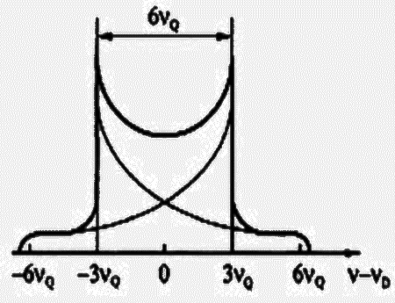
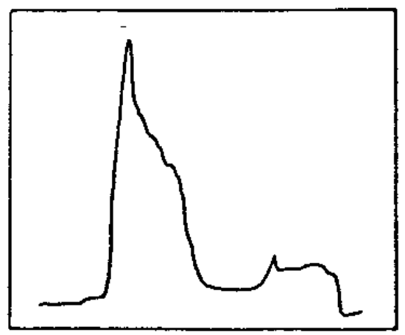
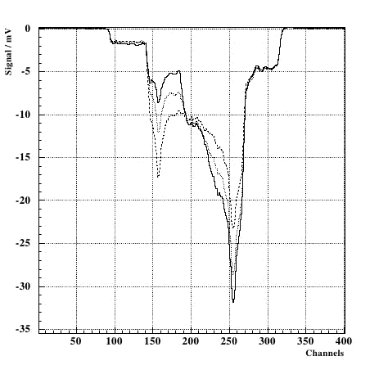
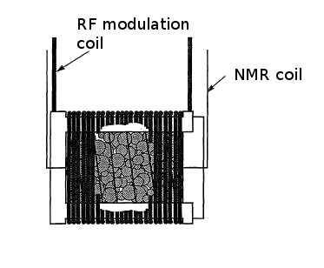
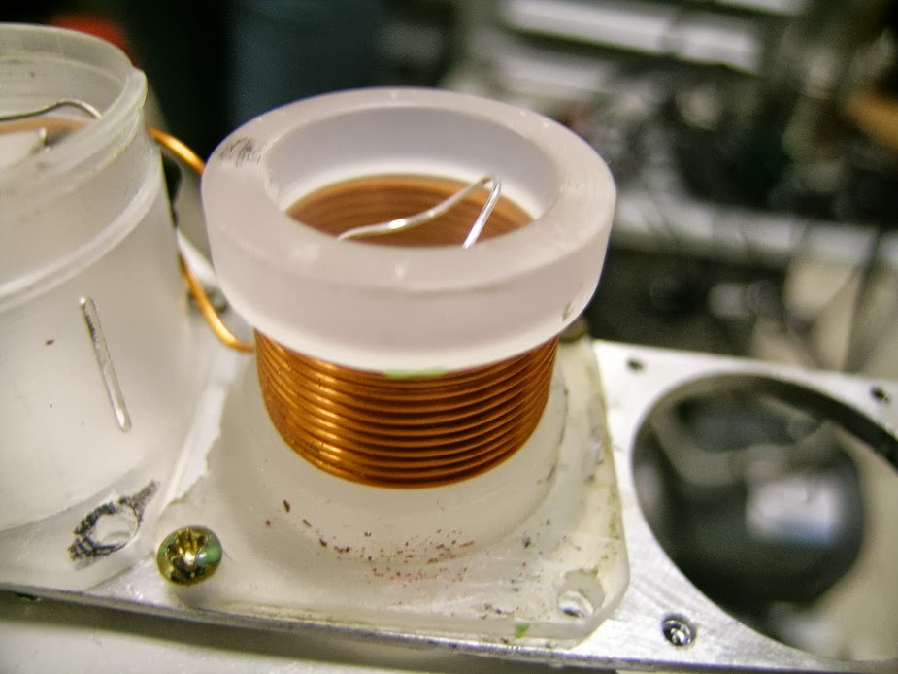
Tensor Polarization Optimization
Born: 20% at 2.5T
UVA: 30% at 5.0T

Slide 35
Brute Force Tensor Polarization
When vector polarizing deuterium, some amount of tensor polarization occurs
$P_{zz}=2−\sqrt{4−3P_{z}^{2}}$
Higher vector polarization → Higher tensor polarization
Effect maxes out at ~20-25%

Slide 36
Tensor Polarization Measurement
Vector optimize with microwaves
Fit peaks with convolution
Tensor optimize with RF
Measure change in peaks using Riemann Sum segments
Ratio of instantaneous to initial NMR signal area
Percentage of initial peak shifted any time (from reduced side)
Available tensor enhancement

Slide 37
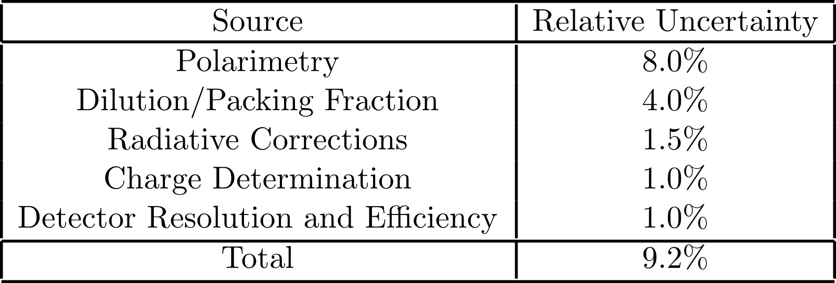
b1 Systematic Contributions

