Slide 1
Deuteron Vector and Tensor Polarizations
Before ~ 1970, no deuteron targets
LMN - water of crystallization. Not aware of any targets with D₂O
After ~ 1970, M. Borghini Revolution
In principle most materials of interest could be combined with a paramagnetic dopant and polarized , not neccesarily well. Borghini (CERN Yellow Report ).
Materials such as Butanol, propane- and ethane- diol, doped with porphyrexide, Cr^{V} complexes, and the like gave polarizations of ~80 %. Only natural then to start looking at the deuterated versions. But generally no better than P _{D} ~ 30% were obtained.
First comprehensive study of Deuteron vector and tensor polarization was done by DeBoer at CERN (W. De Boer, CERN Yellow Report 74-11, May 1974) Other places such as Bonn were also investigating deuterated materials.
By the end of the ’70s, P_{H} ~ 98% and P_{D} ~ 45% had been reached.

Slide 2
1980s
By 1980 both proton and deuteron targets were being used in experiments at many laboratories. It was soon realized that radiation damage was an issue . Some attention turned back to irradiation doping of materials to in the expectation that irradiated materials would be more resistant to damage when the target was operating in an ionizing beam.
Also it was a way of doping materials which were hard to dope chemically, eg CD₂, NH_{3,}, ND₃
Ammonia was a big success
NH₃ > 95%, ND₃ ~ 50% and high radiation Resistance.
G. Court and T. Niinikoski et al and D.Crabb et al

Slide 3
1980s – 1990s
Work on understanding the properties of running in intense beams with ammonia targets continues and at the same time some studies of irradiated Lithium Deuteride (LiD) and Lithium Hydride (LiH).
⁶LiD was used in two experiments at SLAC in the ‘90s and hasn’t been much used since.
First pointed out by Abragam et al at Saclay ⁶Li ~ 70% and D ~ 70%

Slide 4
2000s
One puzzle that had been noted was that as polarized targets started using higher magnetic fields the deuteron polarization went from ~ 50% at 2.5 T t0 ~ 0 % at 5 T using butanol (say) doped with porphyrexide or Cr^{V} but a little better with a newer radical TEMPO.
Solved by Bonn/Bochum people
Polarization related to the width of the radical ESR line.
Turns out the ESR line for some irradiated materials is narrow too, leading to further irradiation studies.
To be continued

Slide 6
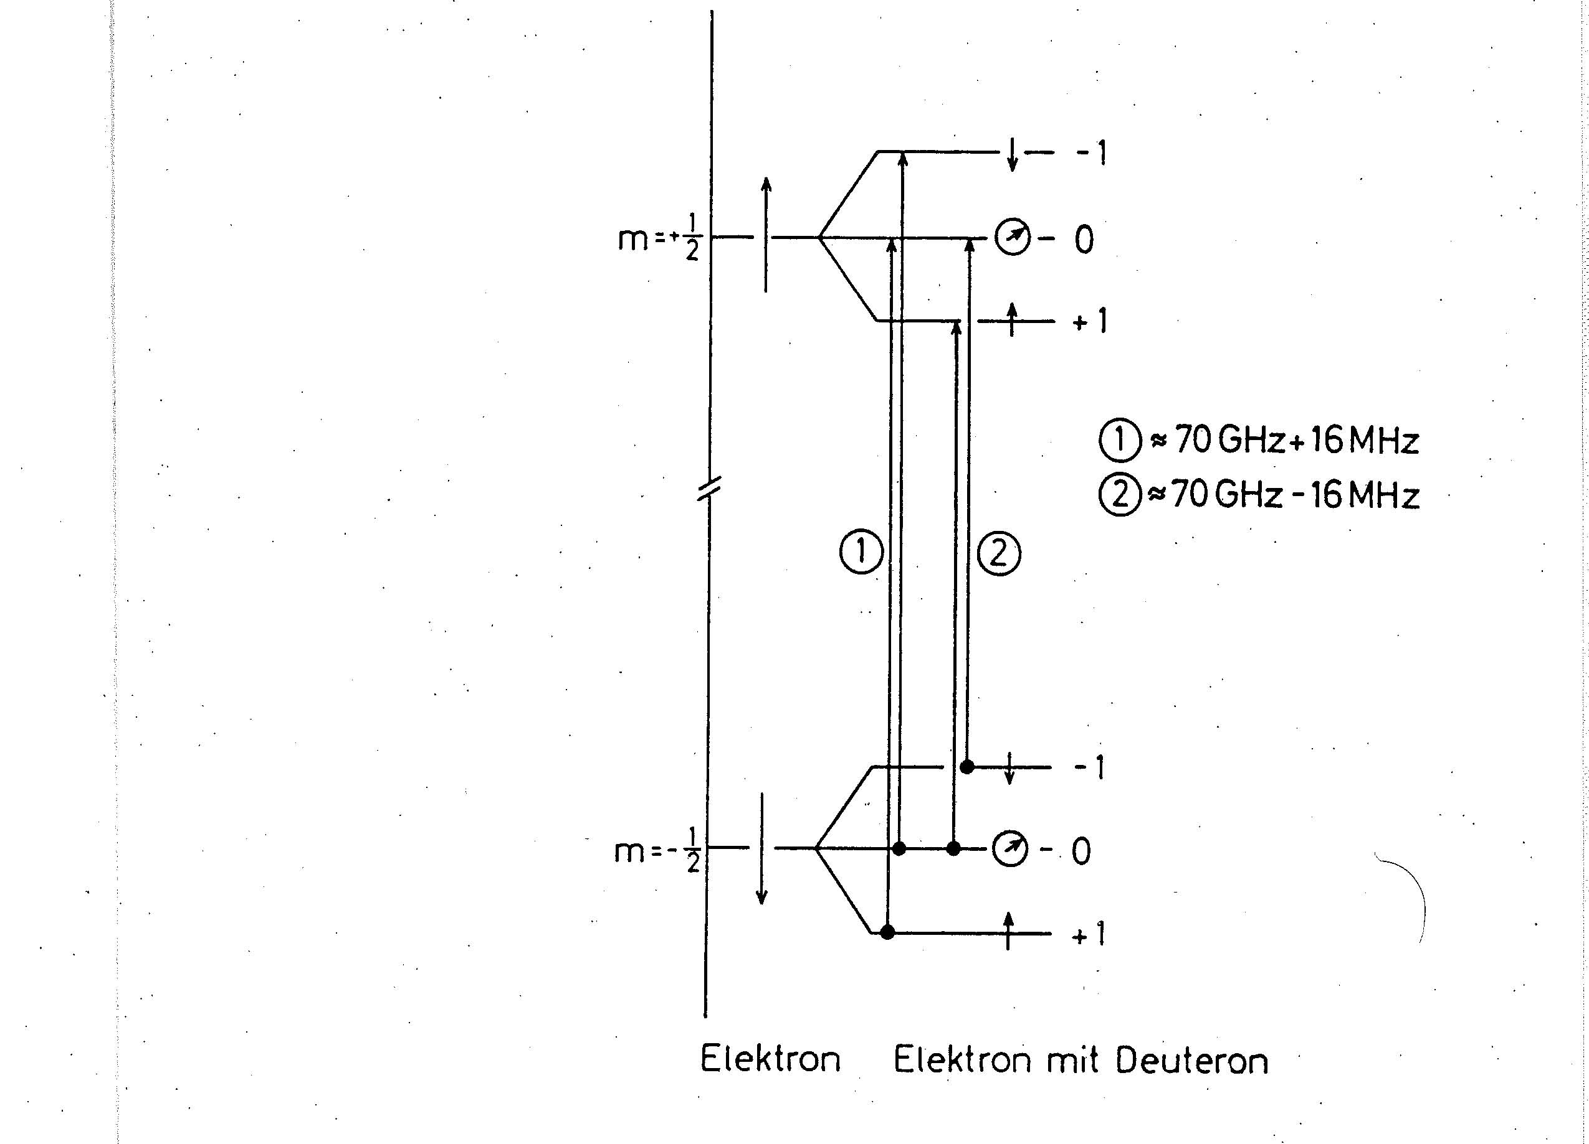

Slide 8
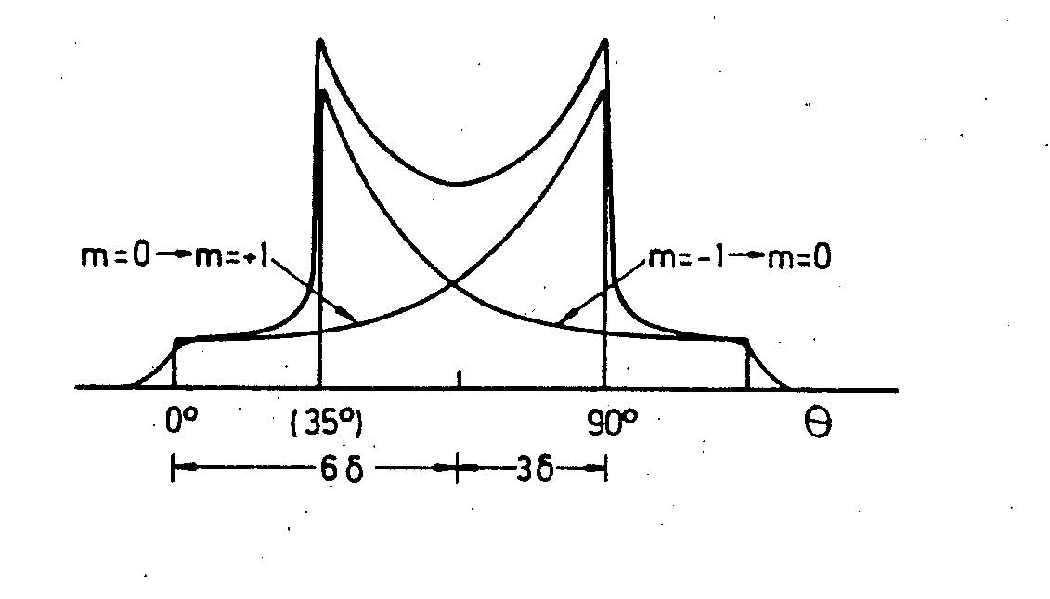

Slide 9
Relations
P = (n₁ - n₋₁ )/(n₁ + n₋₁ + n₀)
A = (n₁ - 2n₀ + n₋₁ )/(n₁ + n₀ + n₋₁)
P = 4 tanh(μB/2kT)/[3 + tanh²(μB/2kT)]
A = 4 tanh²(μB/2kT)/[3 + tanh²(μB/2kT)]
A = 2 – [4 – 3P²]^{1/2}

Slide 10
High Tensor Polarization
Most direct way is through high vector polarizations.
At present for ND₃ P_{D} ~ 50%
How to improve ?
Increase magnetic field ?
Tricks! Tempering!! Better measurement.
Other Materials? Alcohols, diols, ⁶LiD

Slide 11
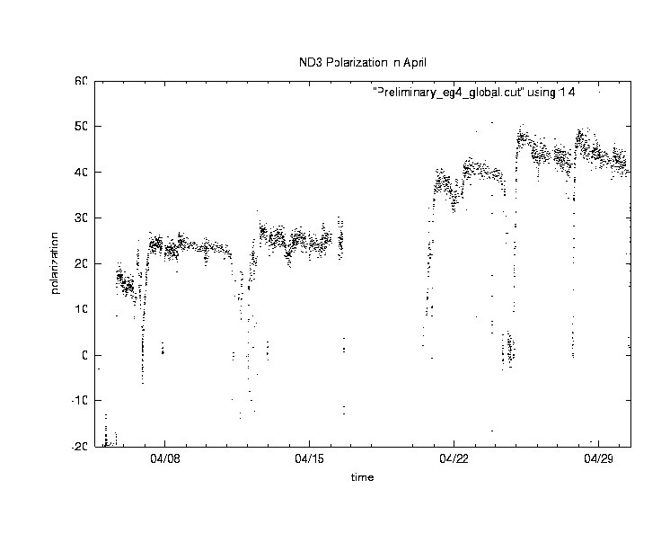

Slide 12
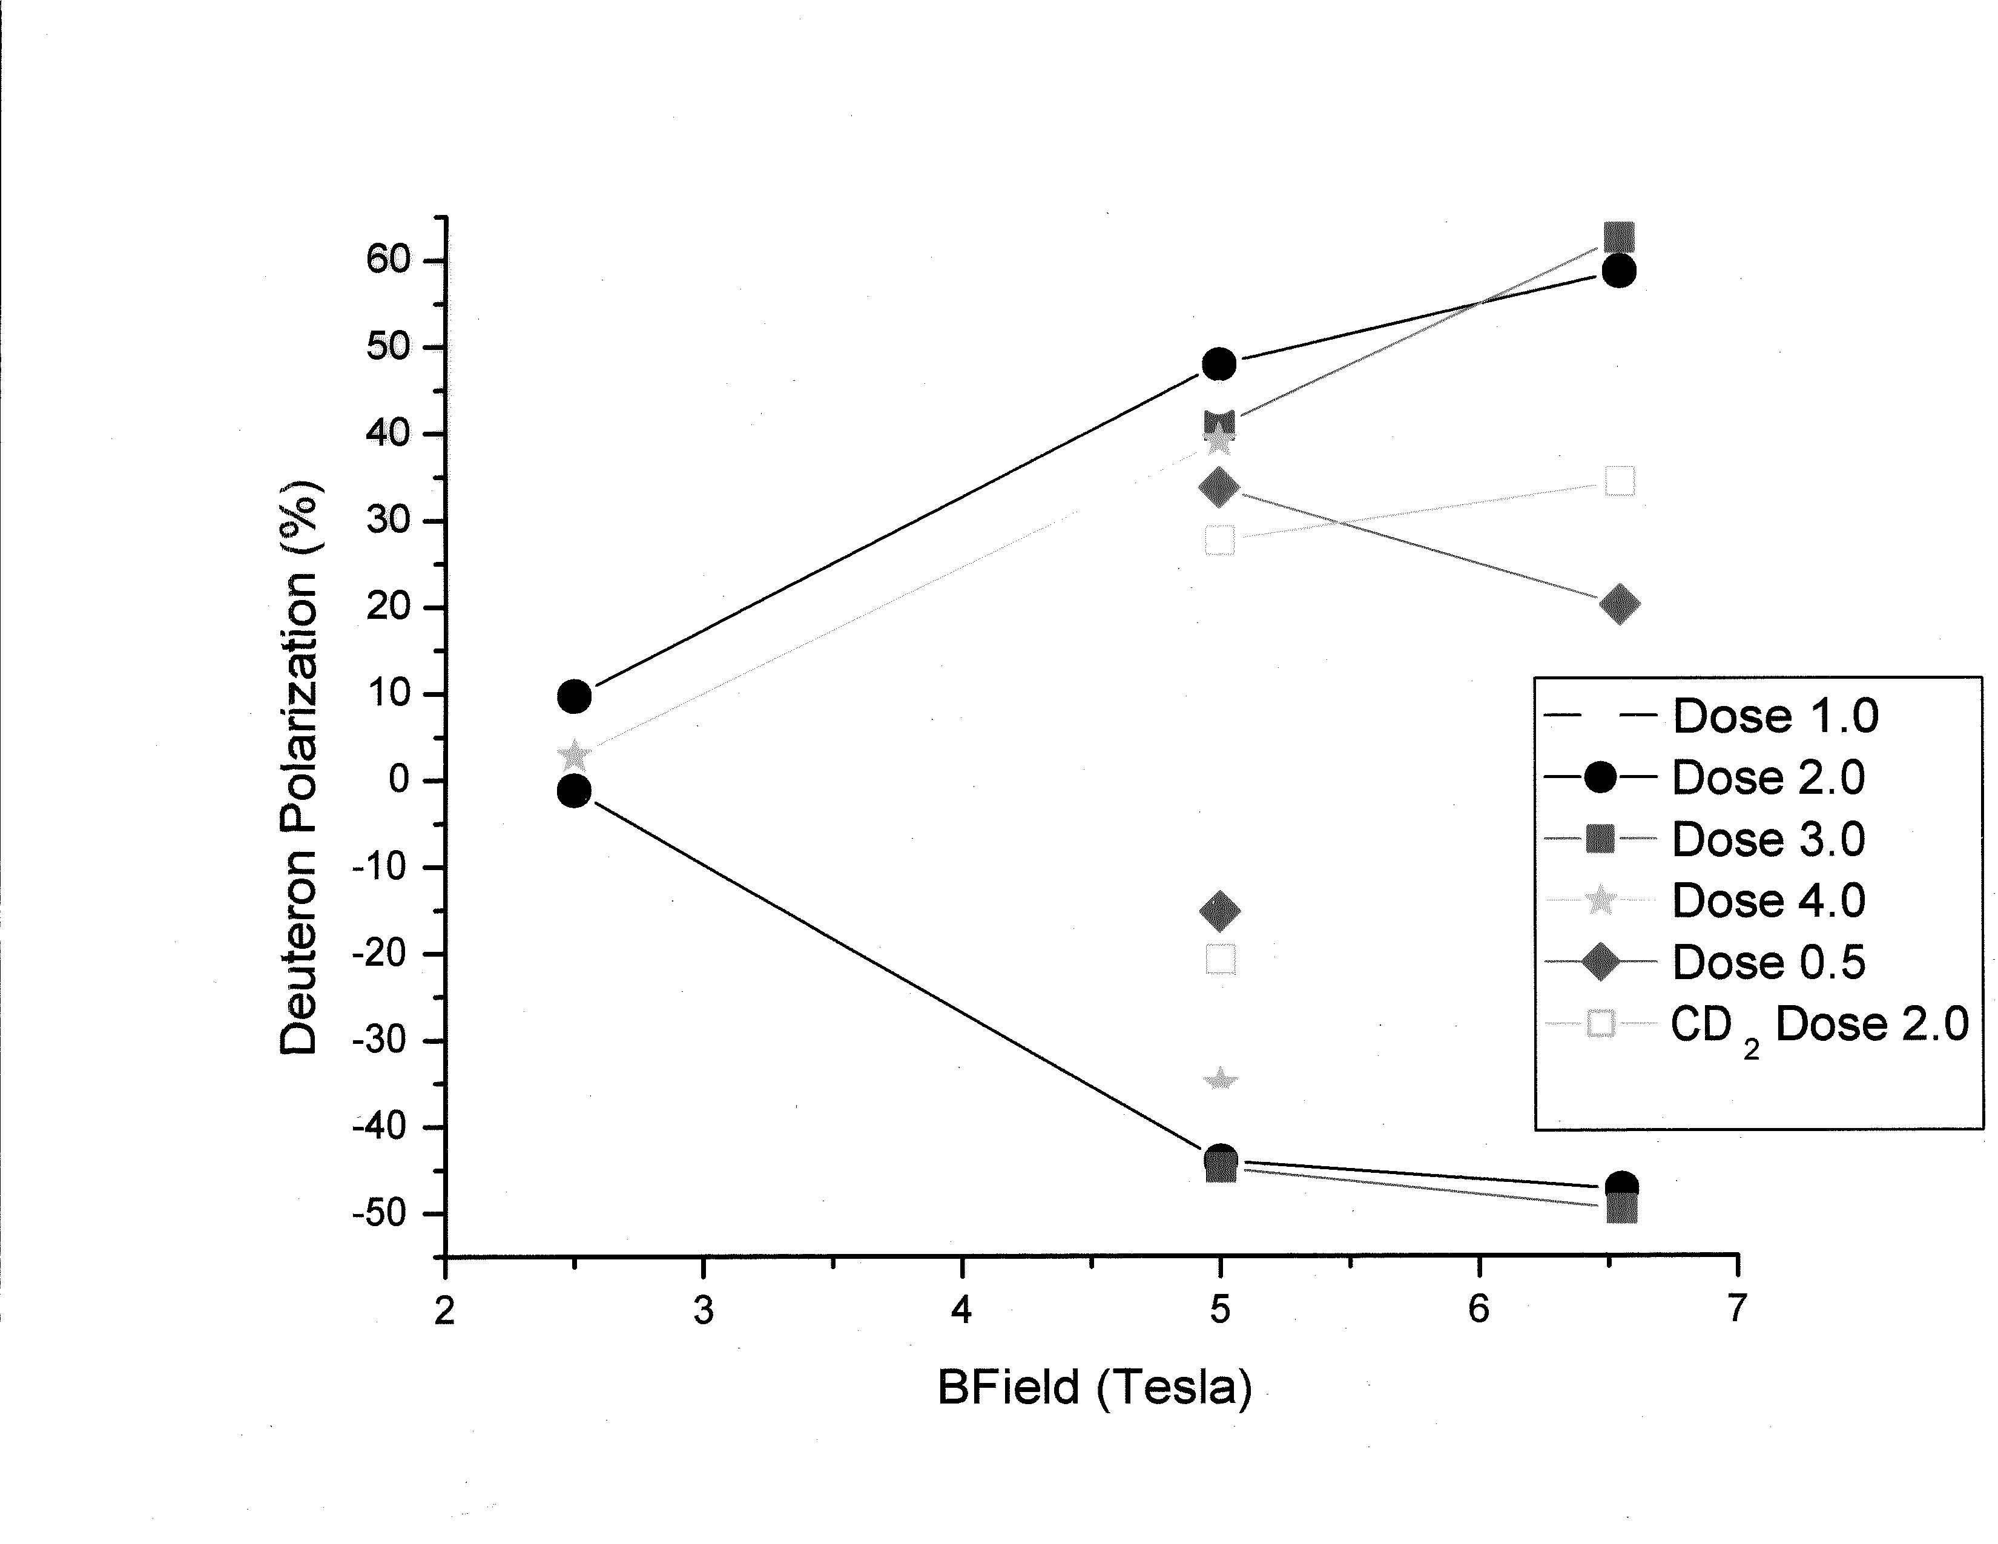
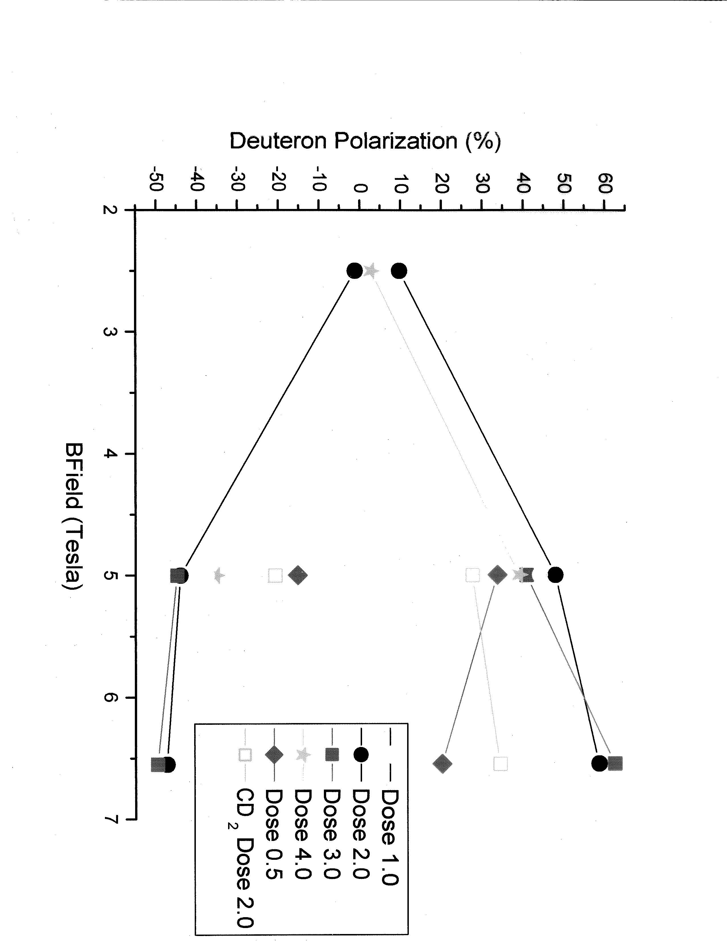

Slide 13
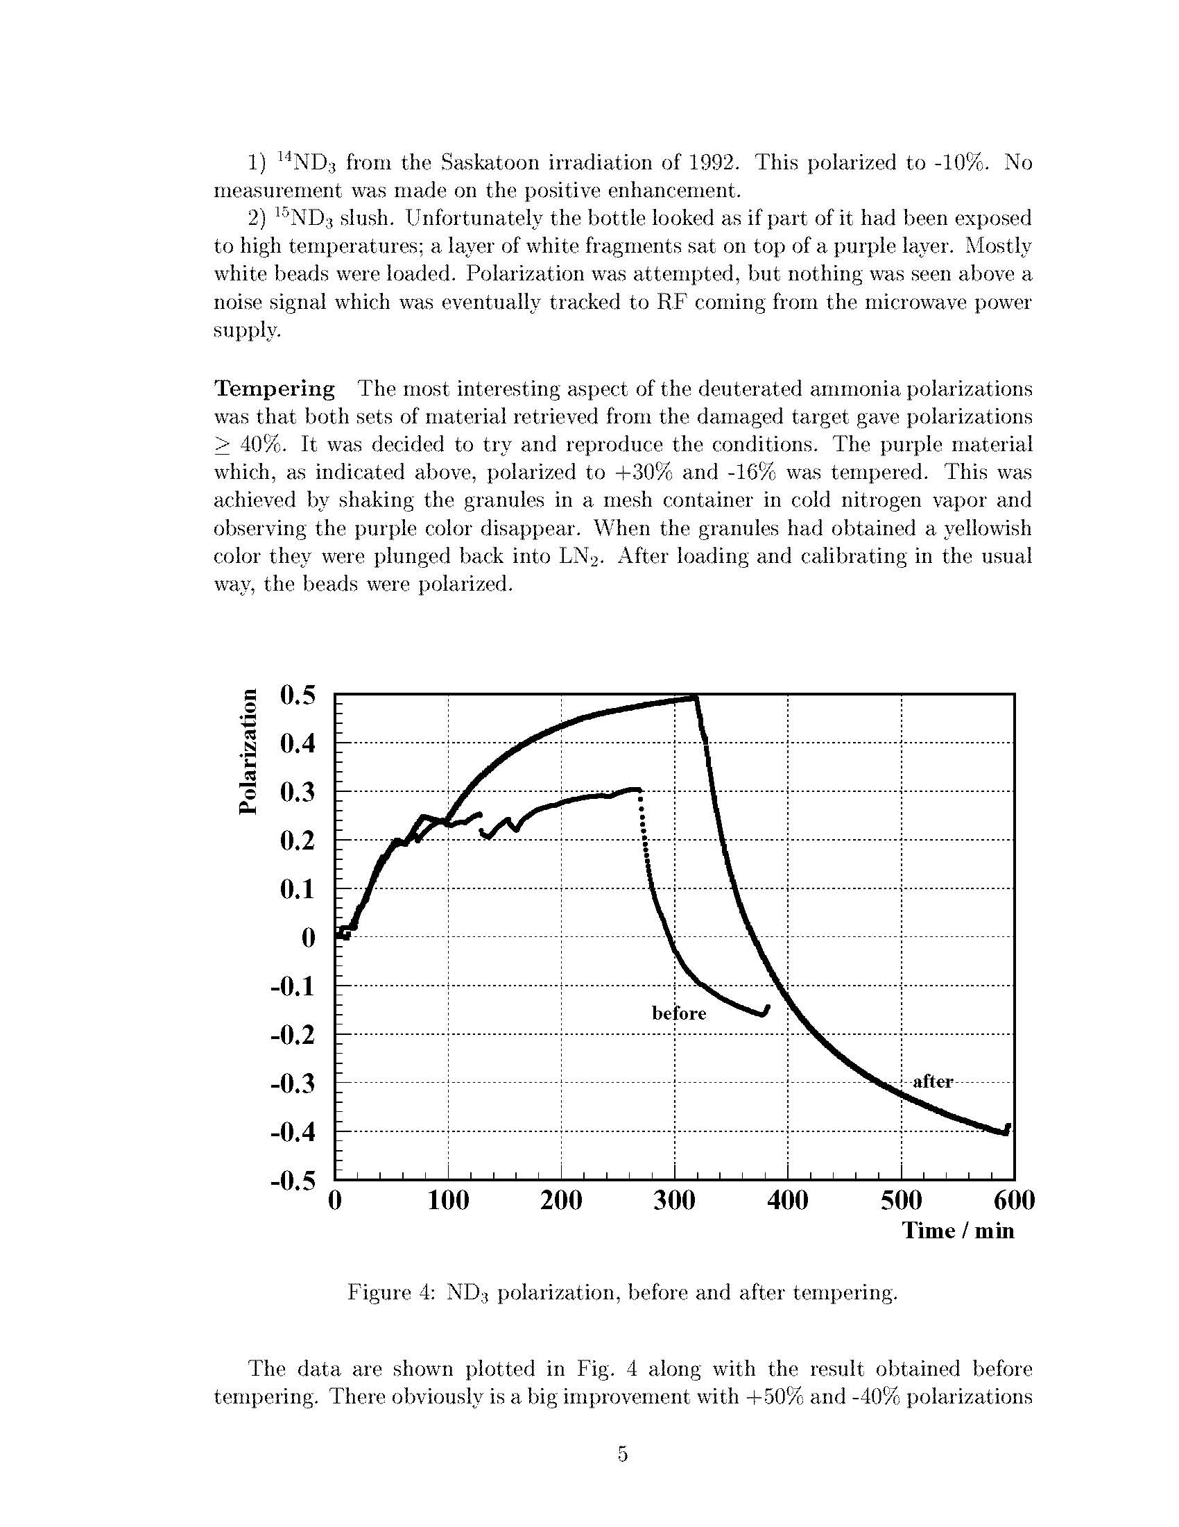

Slide 14
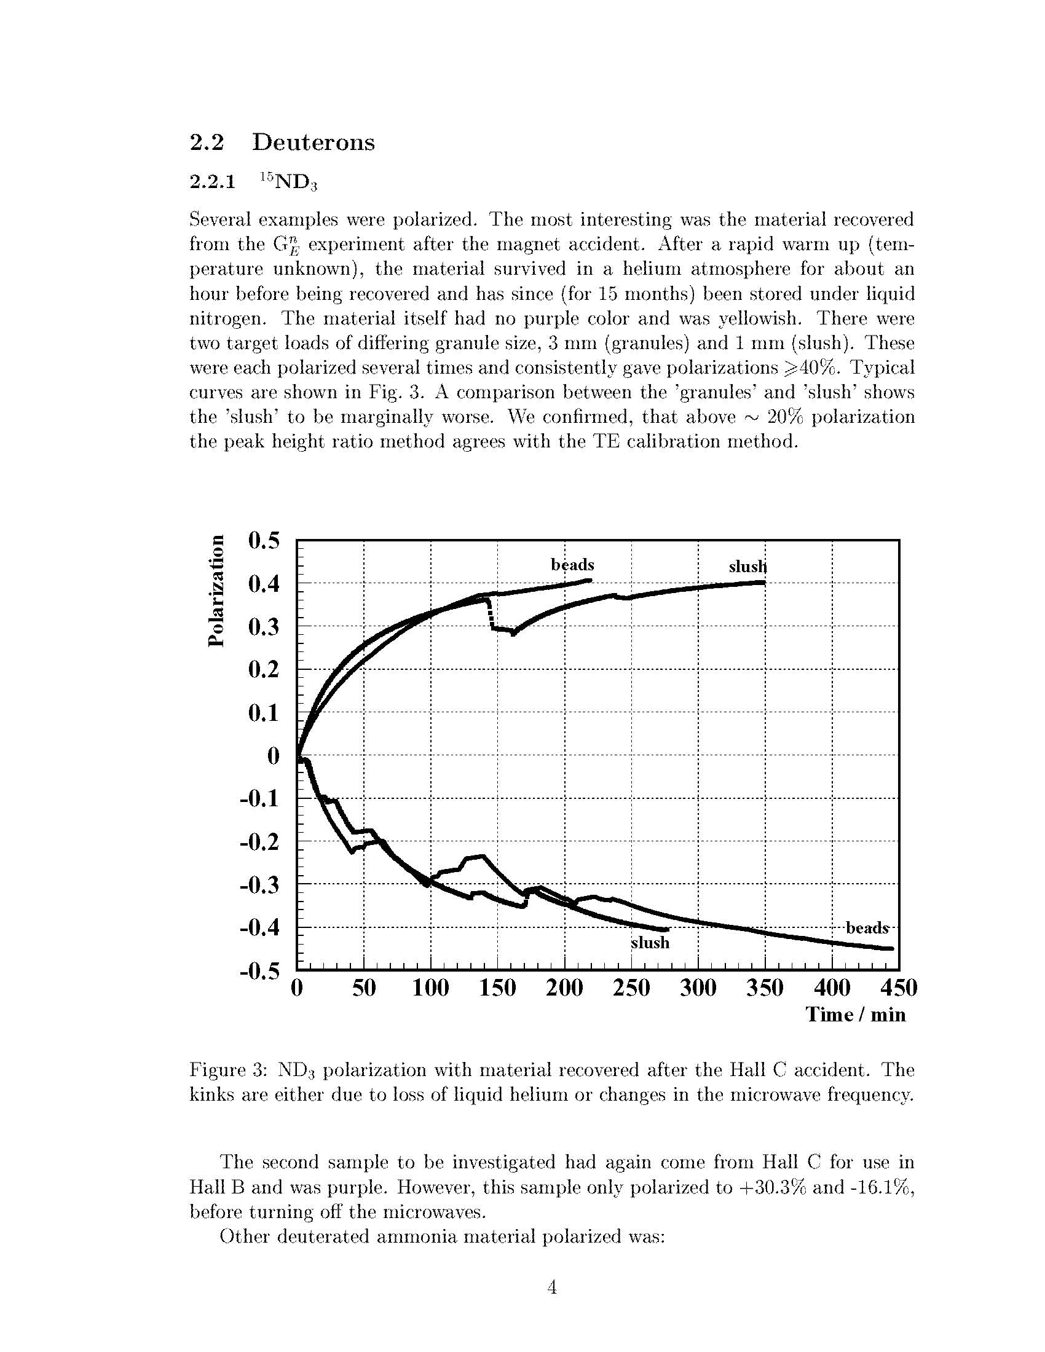

Slide 16
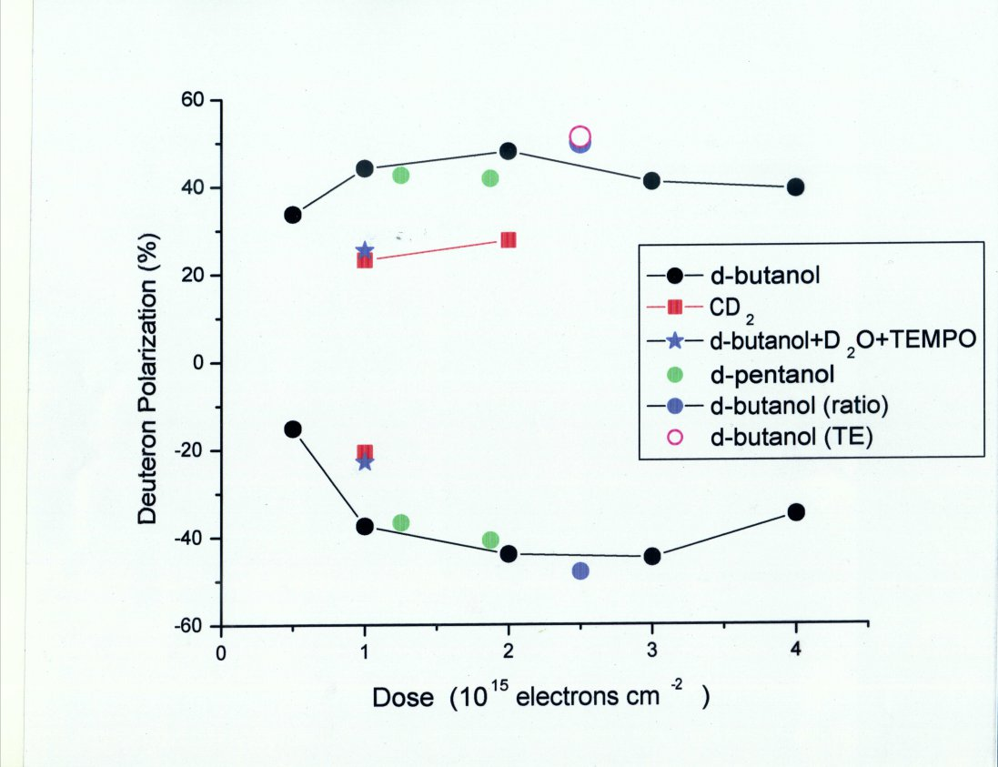

Slide 17
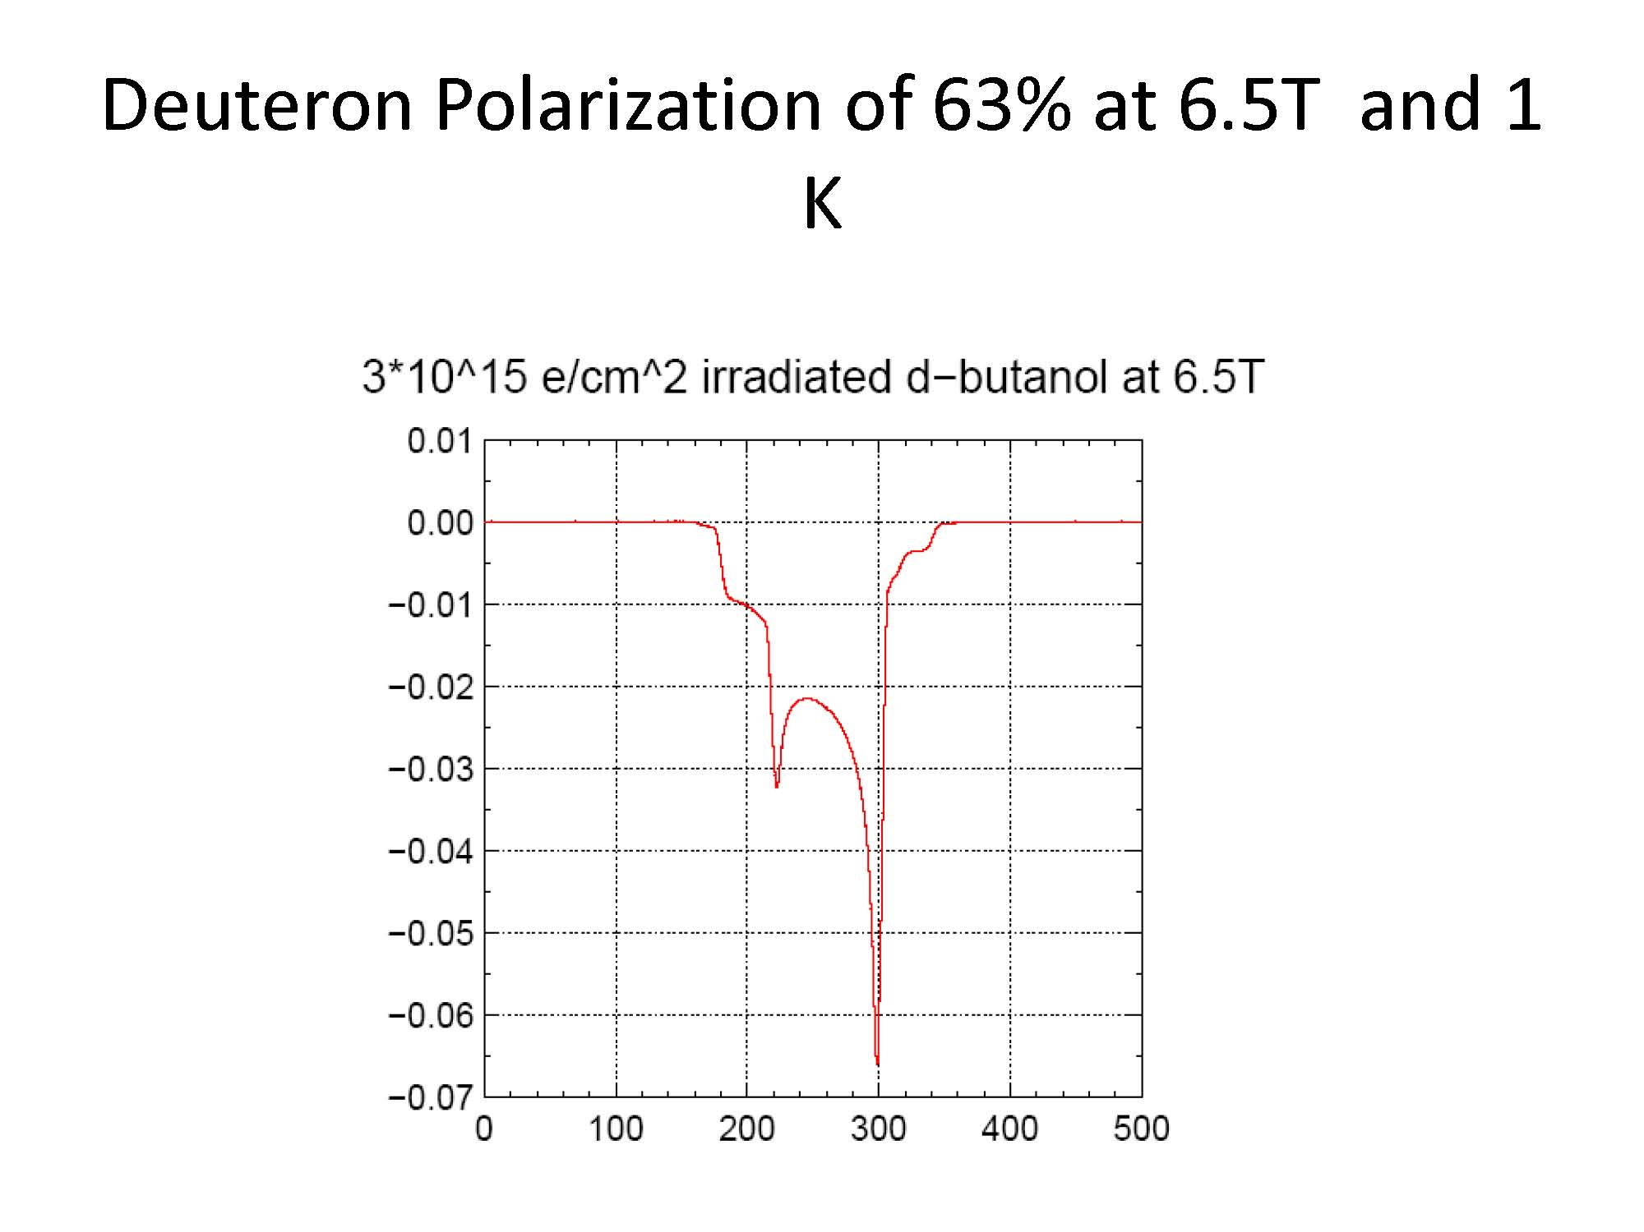

Slide 18
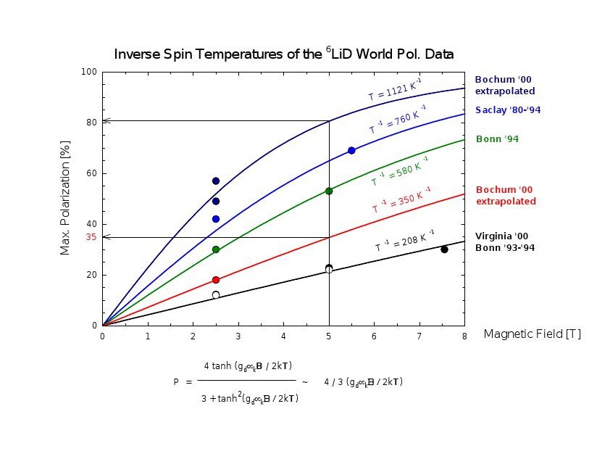

Slide 19
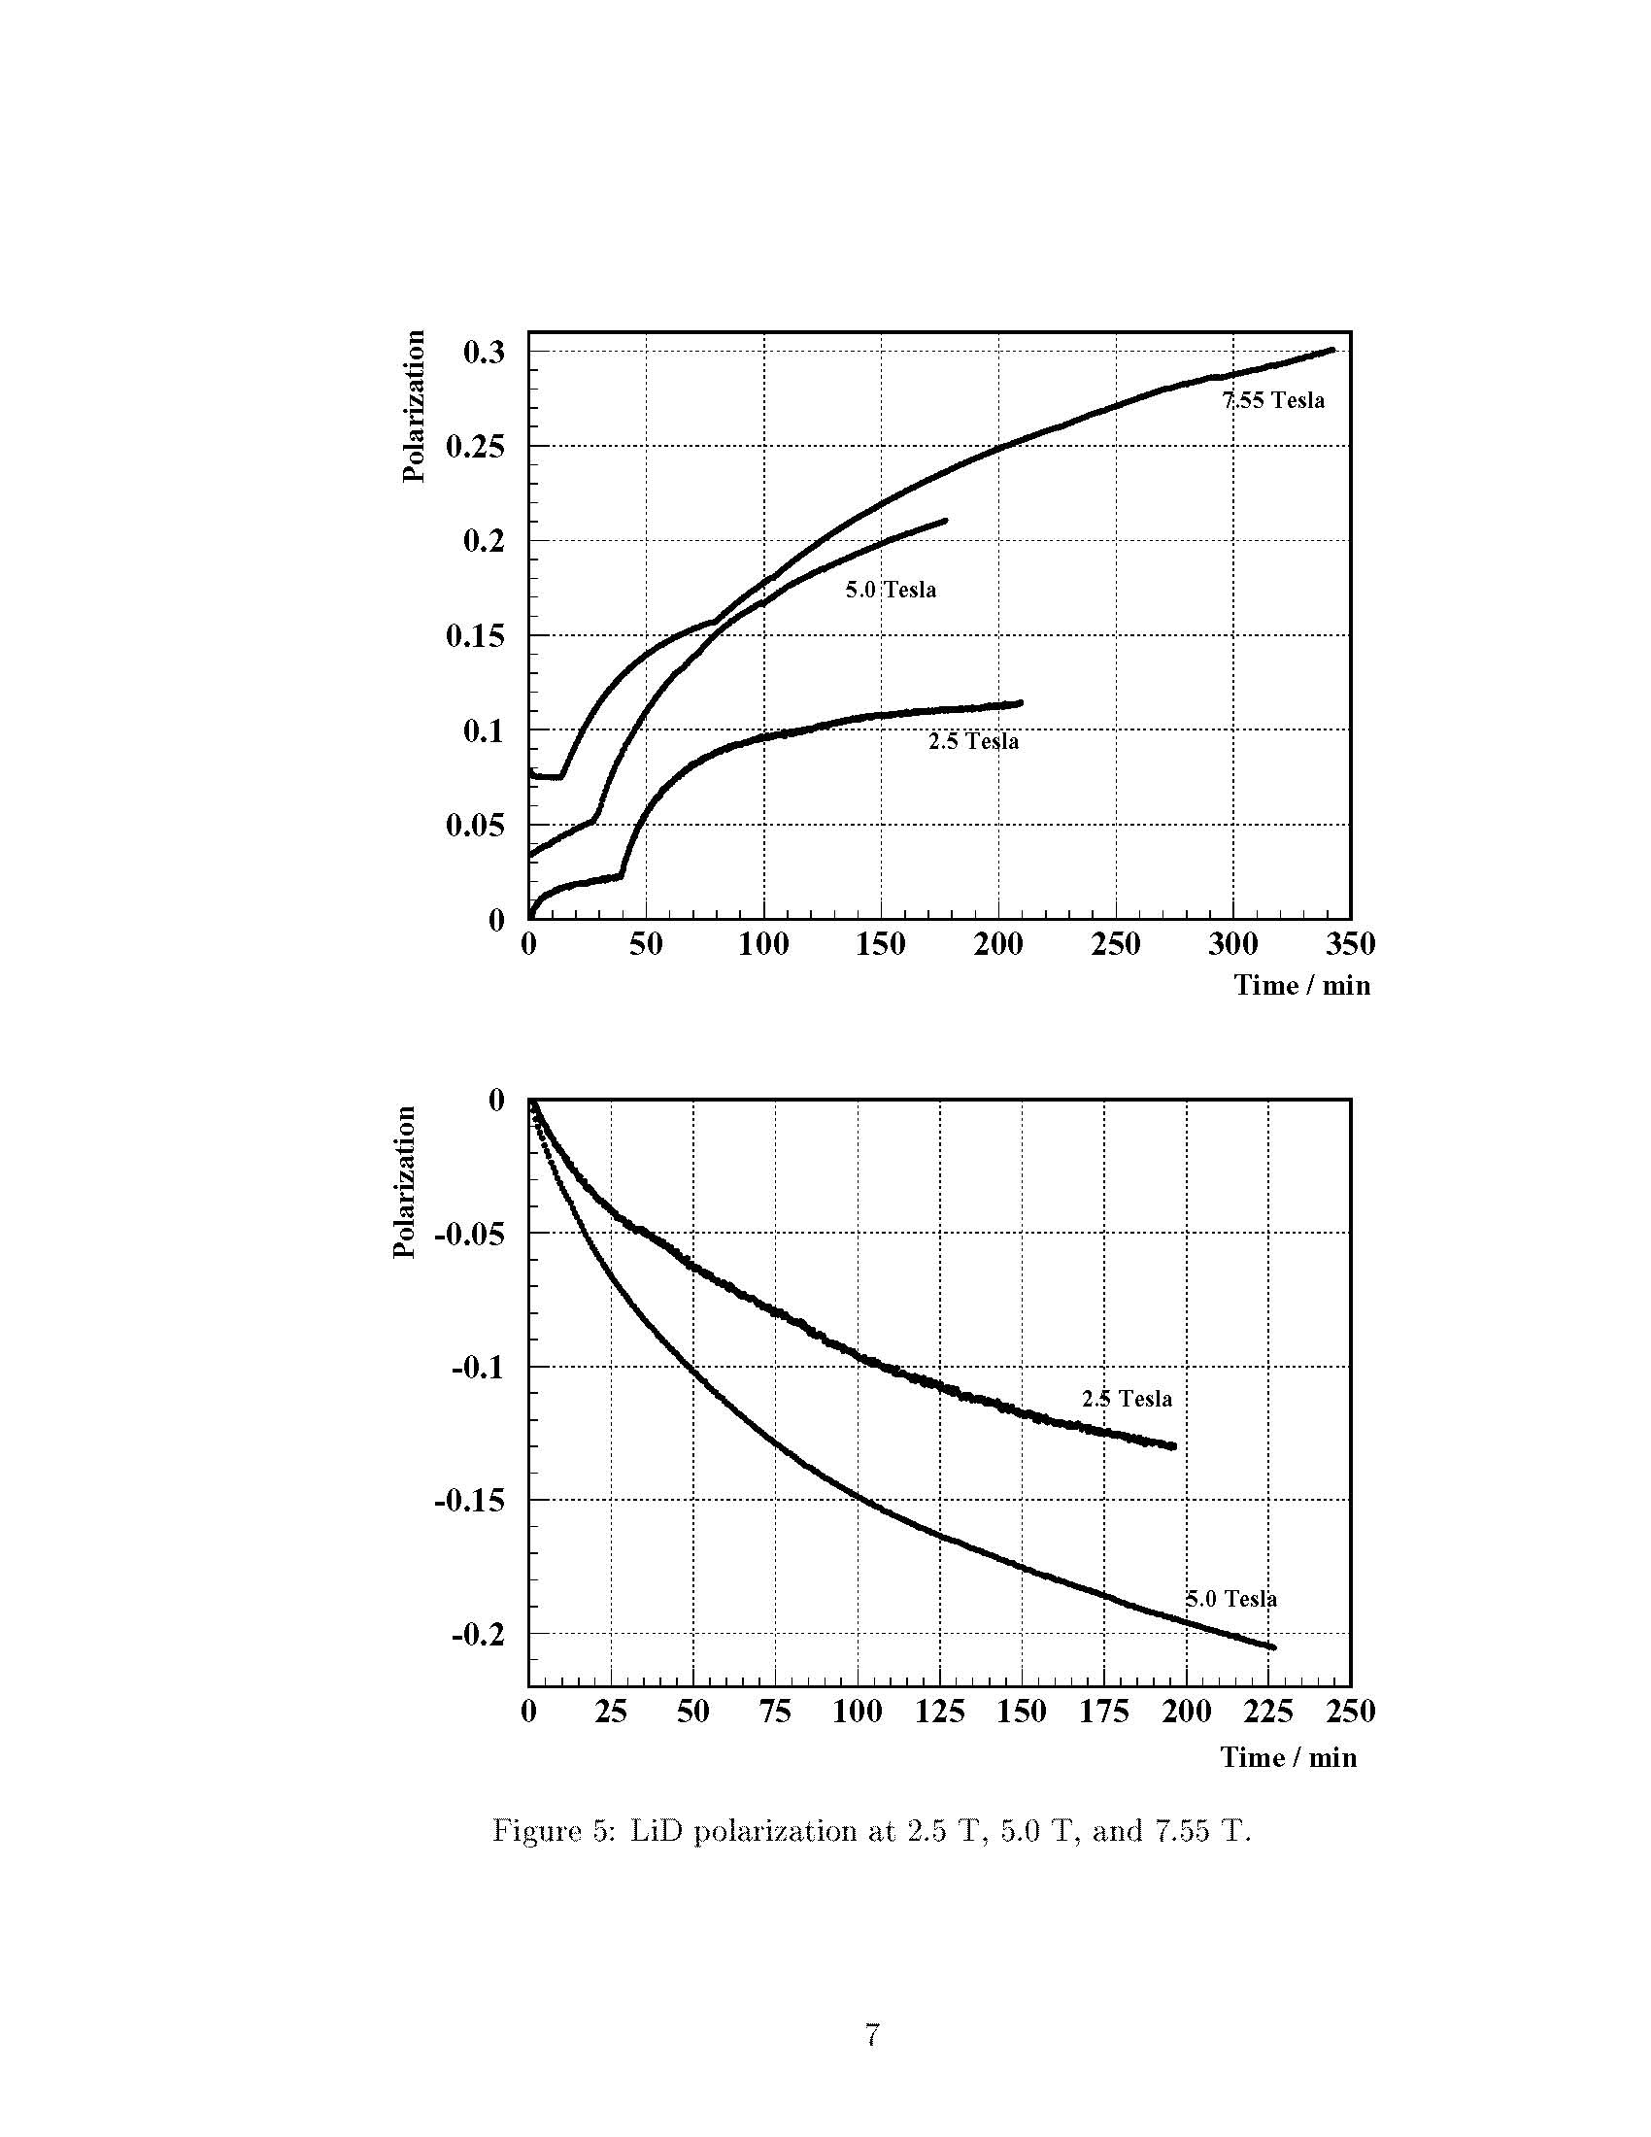

Slide 20
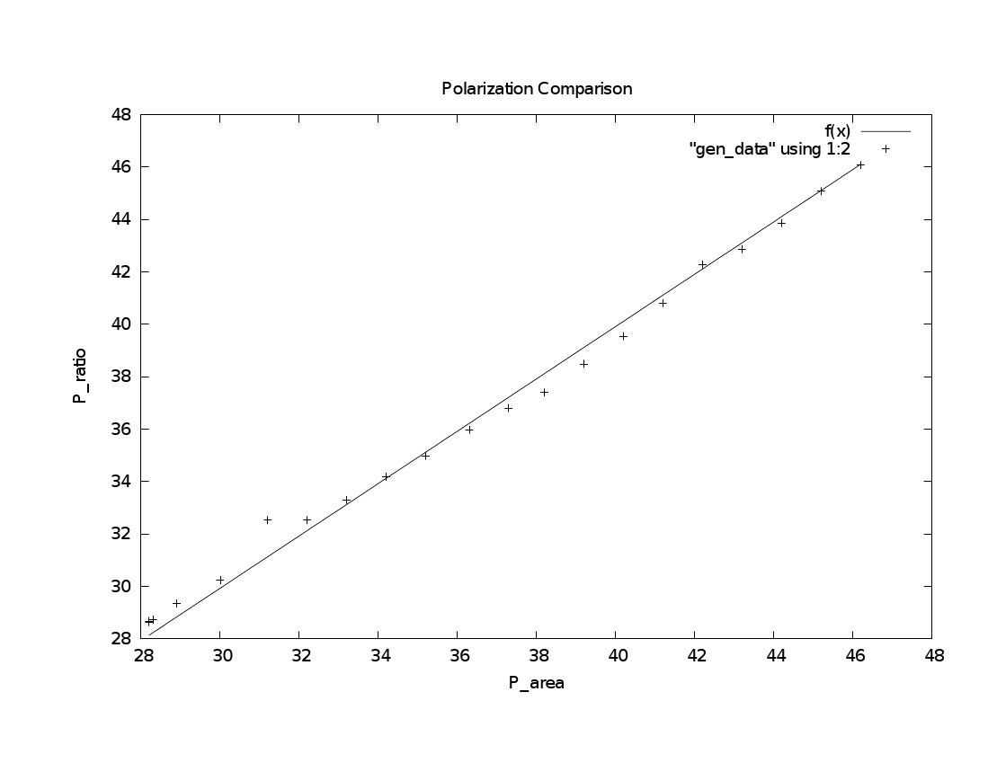

Slide 21
Possibilities for Tensor Polarization (Negative)
RF Sauration (Hole Burning)
AFP
Two microwave tubes
See talk by Dustin Keller

Slide 22
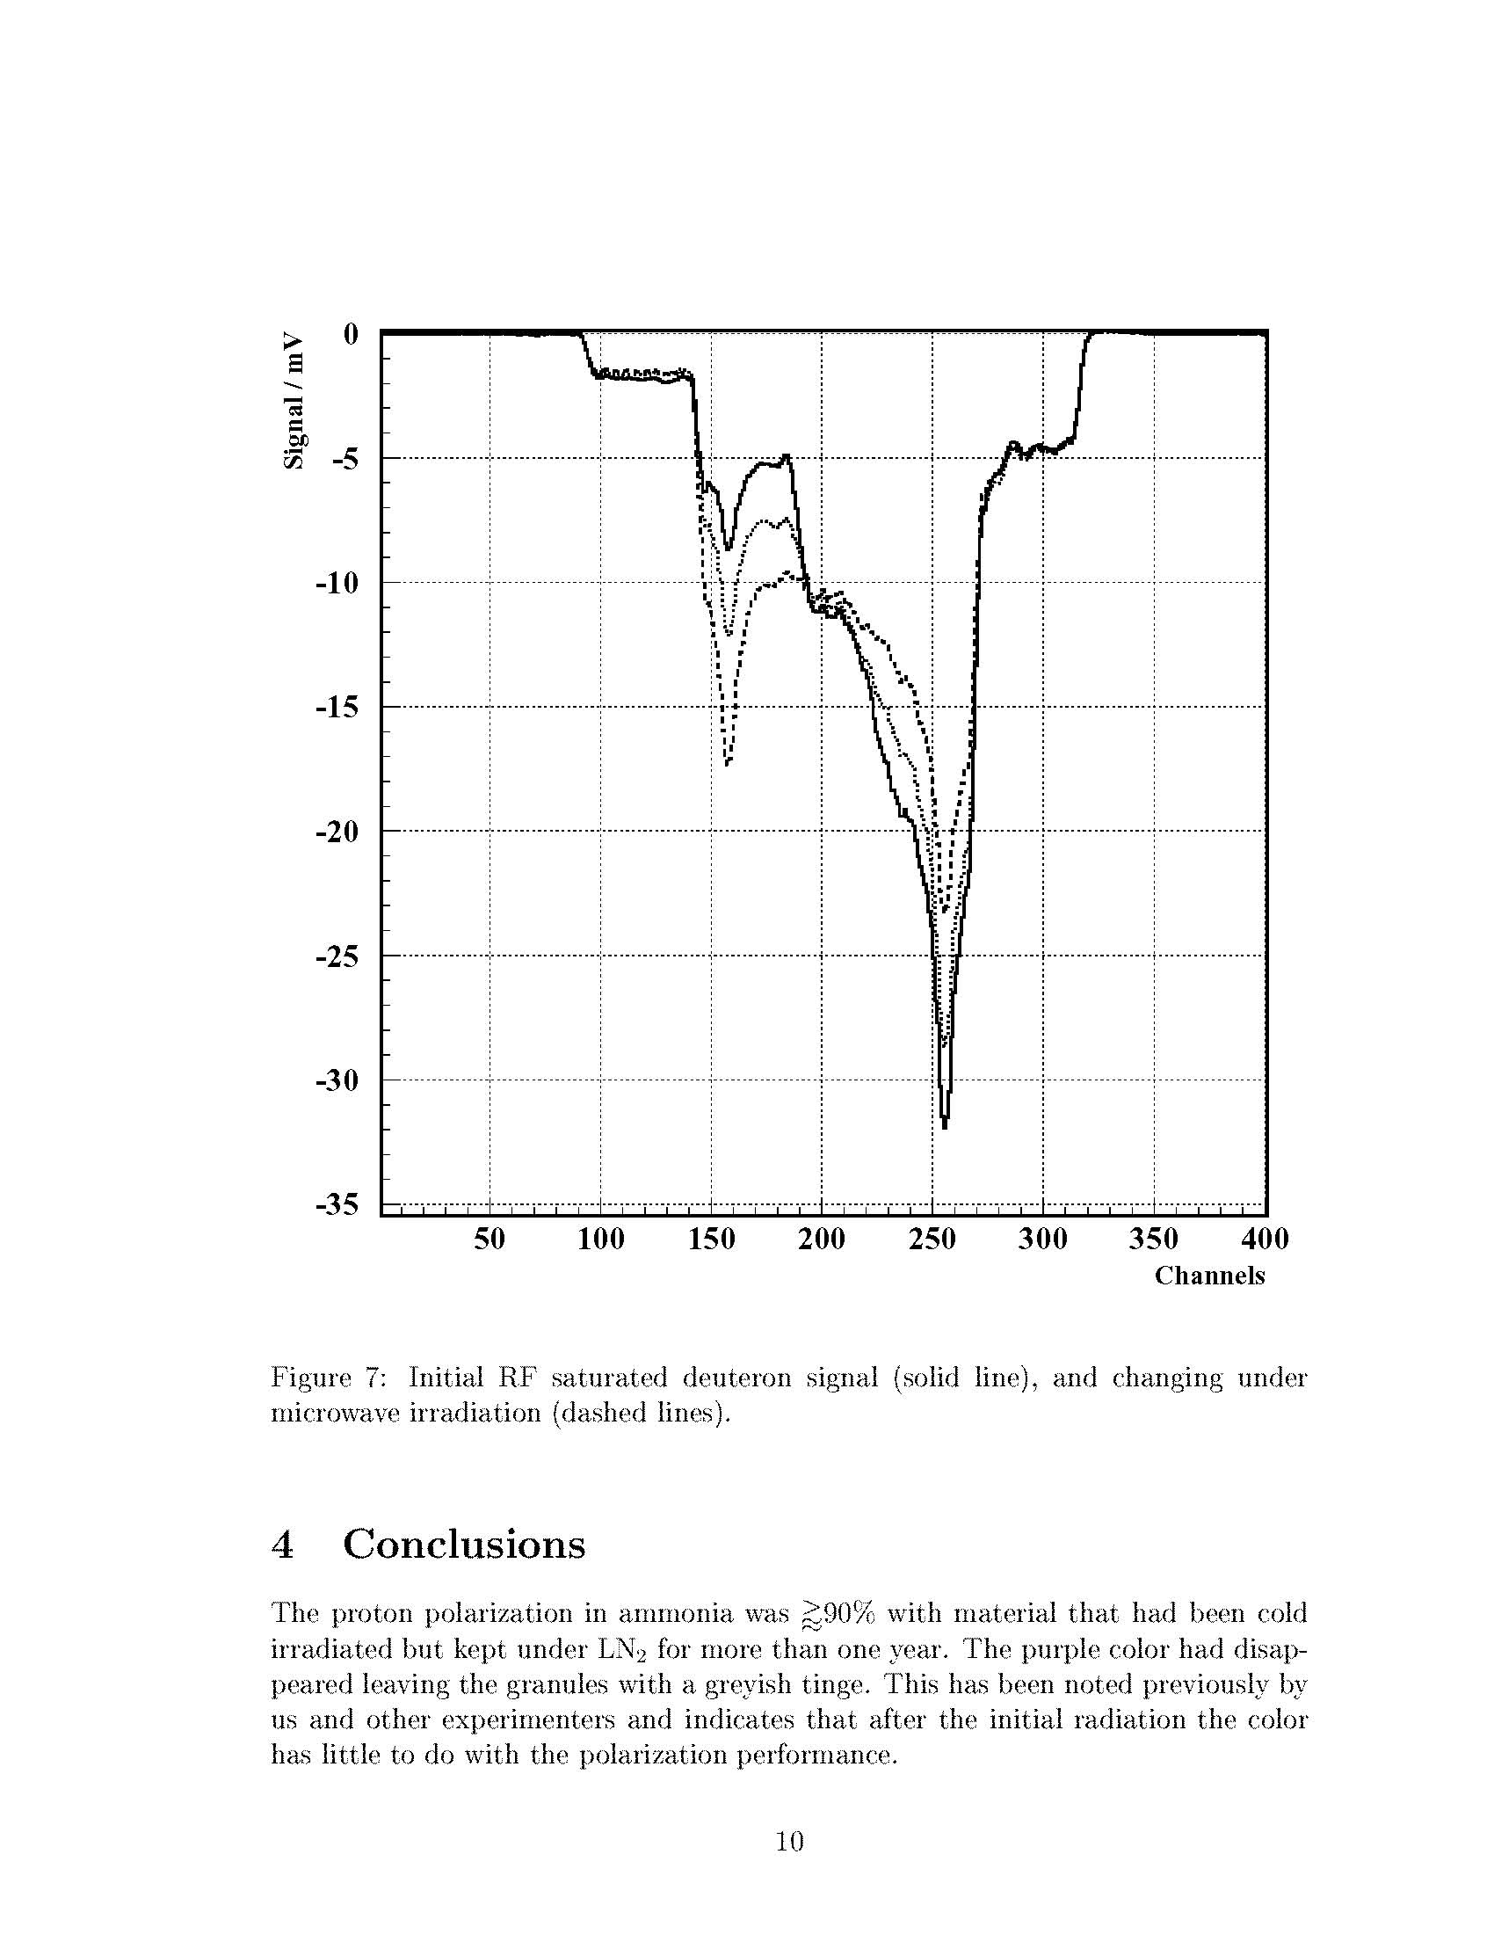

Slide 24
