Slide 1
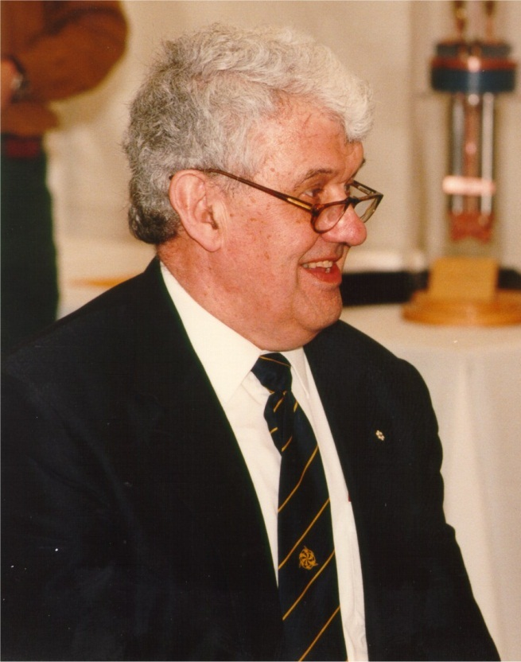
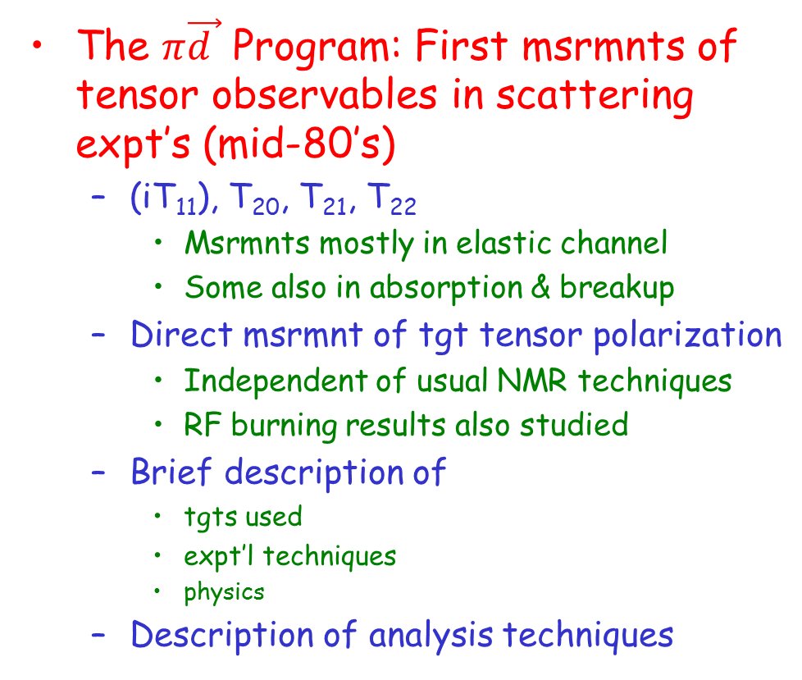
Tensor Target Polarization at TRIUMF
Erich Vogt
TRIUMF director
1981-1994
G. Smith, JLab
The $π\vec{d }$ Program: First msrmnts of tensor observables in scattering expt’s (mid-80’s)
  (iT₁₁), T₂₀, T₂₁, T₂₂
    Msrmnts mostly in elastic channel
    Some also in absorption & breakup
  Direct msrmnt of tgt tensor polarization
    Independent of usual NMR techniques
    RF burning results also studied
  Brief description of
    tgts used
    expt’l techniques
    physics
  Description of analysis techniques
1929-2014

Slide 2
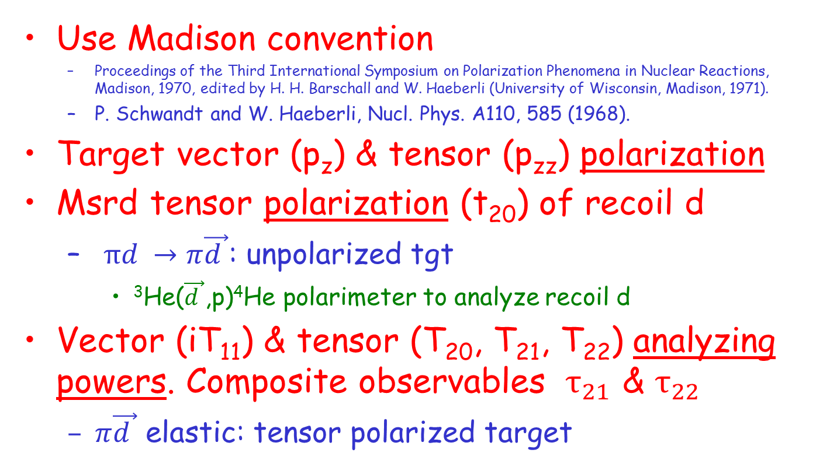
Nomenclature
Use Madison convention
  Proceedings of the Third International Symposium on Polarization Phenomena in Nuclear Reactions, Madison, 1970, edited by H. H. Barschall and W. Haeberli (University of Wisconsin, Madison, 1971).
  P. Schwandt and W. Haeberli, Nucl. Phys. A110, 585 (1968).
Target vector (p_{z}) & tensor (p_{zz}) polarization
Msrd tensor polarization (t₂₀) of recoil d
  $πd →π\vec{d }$: unpolarized tgt
    ³He($\vec{d }$,p)⁴He polarimeter to analyze recoil d
Vector (iT₁₁) & tensor (T₂₀, T₂₁, T₂₂) analyzing powers. Composite observables $τ_{21}$ & $τ_{22}$
  $π\vec{d }$ elastic: tensor polarized target

Slide 3

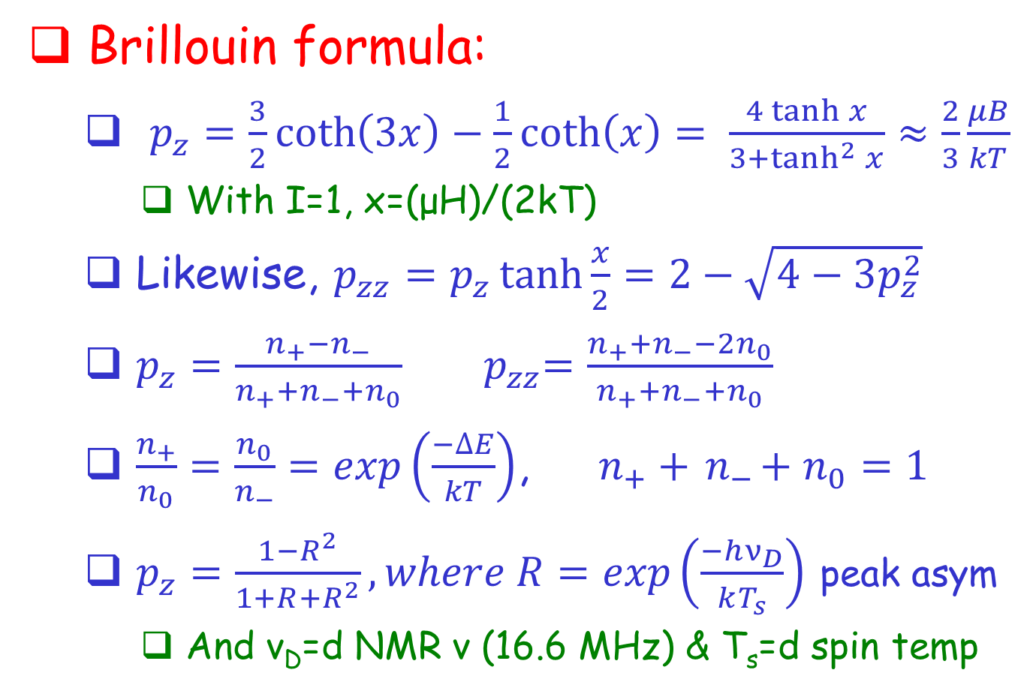
Some Basic Formulas
Brillouin formula:
  $p_{z}=\frac{3}{2}\coth\left(3x\right)−\frac{1}{2}\coth\left(x\right)= \frac{4\tanh{x}}{3+\tanh^{2}{x}}≈\frac{2}{3}\frac{μB}{kT}$
    With I=1, x=(μH)/(2kT)
  Likewise, $p_{zz}=p_{z}\tanh{\frac{x}{2}}=2−\sqrt{4−3p_{z}^{2}}$
  $p_{z}=\frac{n_{+}−n_{−}}{n_{+}+n_{−}{+n}_{0}}$ ${ p}_{zz}=\frac{n_{+}+n_{−}−2n_{0}}{n_{+}+n_{−}{+n}_{0}}$
  $\frac{n_{+}}{n_{0}}=\frac{n_{0}}{n_{−}}=exp\left(\frac{−∆E}{kT}\right)$, ${ n}_{+} +{ n}_{−}+n_{0}=1$
  $p_{z}=\frac{1−R^{2}}{1+R+R^{2}}, where R=exp\left(\frac{−hν_{D}}{kT_{s}}\right)$ peak asym
    And ν_{D}=d NMR ν (16.6 MHz) & T_{s}=d spin temp

Slide 4
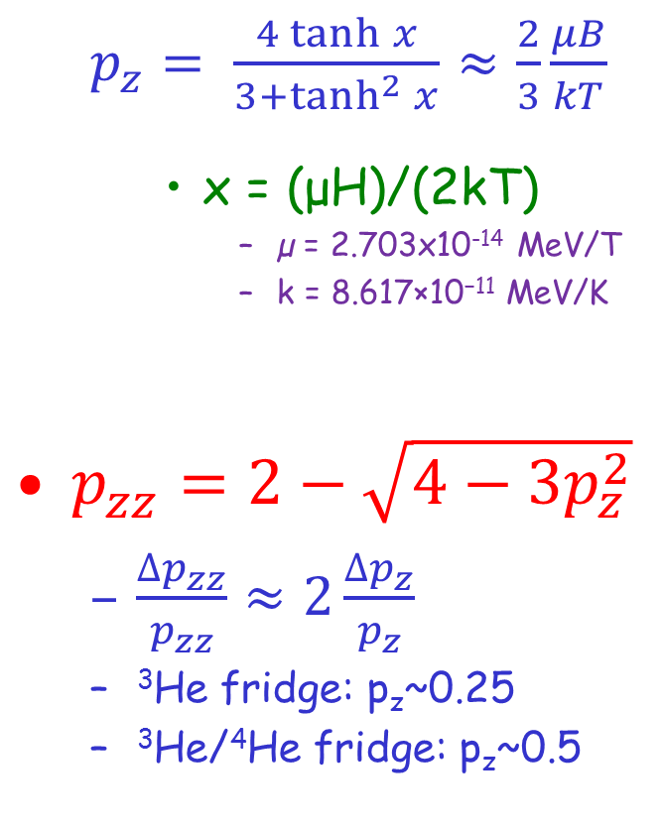
Plots
  $p_{z}= \frac{4\tanh{x}}{3+\tanh^{2}{x}}$ $≈\frac{2}{3}\frac{μB}{kT}$
    x = (μH)/(2kT)
      µ = 2.703x10⁻¹⁴ MeV/T
      k = 8.617×10⁻¹¹ MeV/K
$p_{zz}=2−\sqrt{4−3p_{z}^{2}}$
  $\frac{∆p_{zz}}{p_{zz}}≈2\frac{∆p_{z}}{p_{z}}$
  ³He fridge: p_{z}~0.25
  ³He/⁴He fridge: p_{z}~0.5
Dilution
refrigerator
3He
refrigerator
Not much to work with!

Slide 5
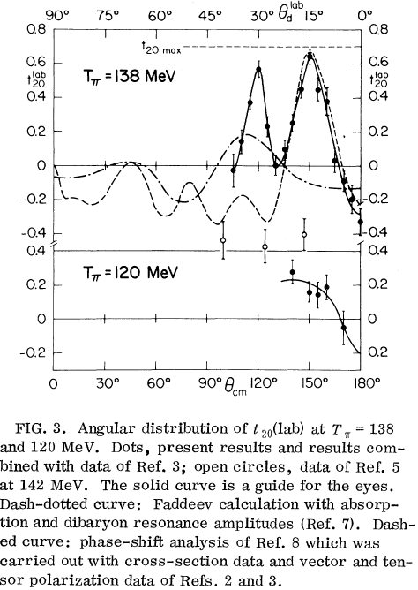
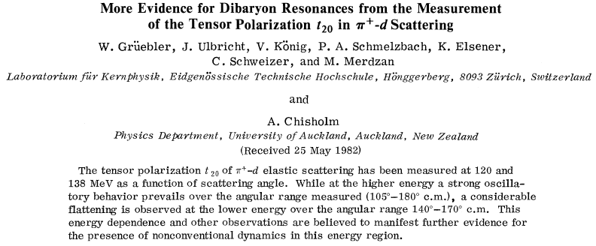
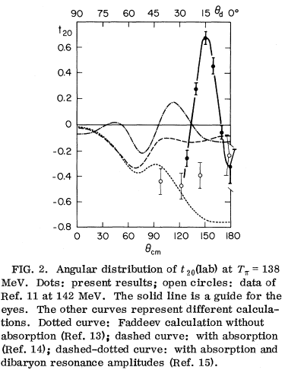
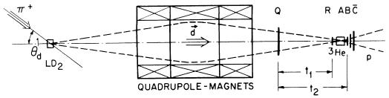
SIN
SIN
LAMPF
SIN
LAMPF

Slide 6
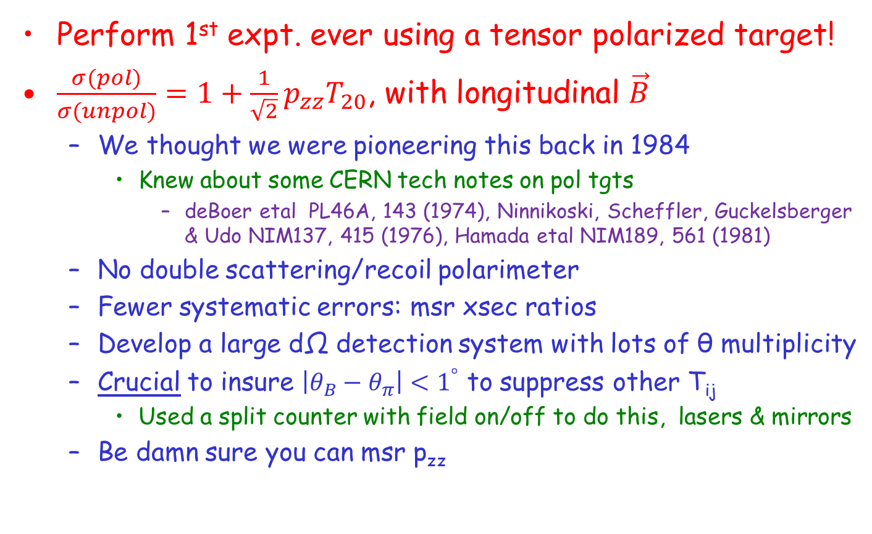
How to resolve this?
Perform 1st expt. ever using a tensor polarized target!
$\frac{σ(pol)}{σ(unpol)}=1+\frac{1}{\sqrt{2}}p_{zz}T_{20}$, with longitudinal $\vec{B}$
  We thought we were pioneering this back in 1984
    Knew about some CERN tech notes on pol tgts
      deBoer etal PL46A, 143 (1974), Ninnikoski, Scheffler, Guckelsberger & Udo NIM137, 415 (1976), Hamada etal NIM189, 561 (1981)
  No double scattering/recoil polarimeter
  Fewer systematic errors: msr xsec ratios
  Develop a large dΩ detection system with lots of θ multiplicity
  Crucial to insure $\left|θ_{B}−θ_{π}\right|<1^{°}$ to suppress other T_{ij}
    Used a split counter with field on/off to do this, lasers & mirrors
  Be damn sure you can msr p_{zz}

Slide 7
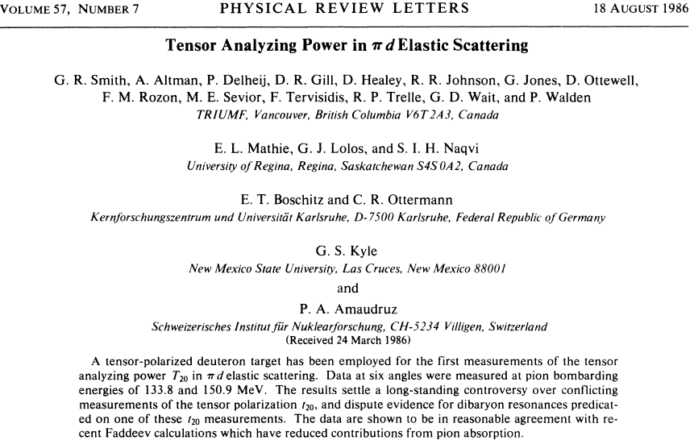

Where the $d_{k}^{i}\left(θ_{d}\right)$ are the Wigner d functions, and
using either calculated values of T₂₁ & T₂₂ ,
or
limiting values $\left(±\frac{\sqrt{3}}{2}\right)$.
Coordinate system rotation needed because
T₂₀ z along incident beam, but t₂₀ z along d momentum.
This rotation mixes in small components from T₂₁ & T₂₂.

Slide 8
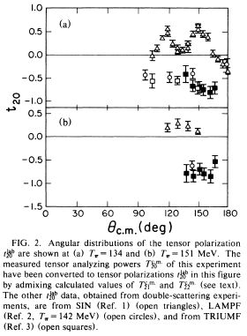
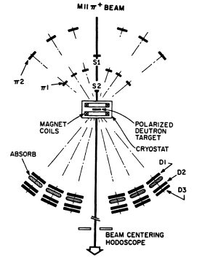
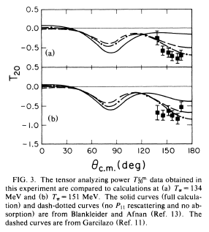
T₂₀ First Results
Full calc
No P₁₁ abs
SIN t₂₀
LAMPF t₂₀
TRIUMF t₂₀
TRIUMF T₂₀

Slide 9
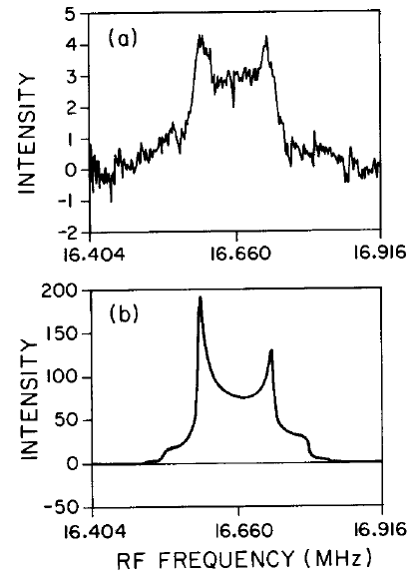
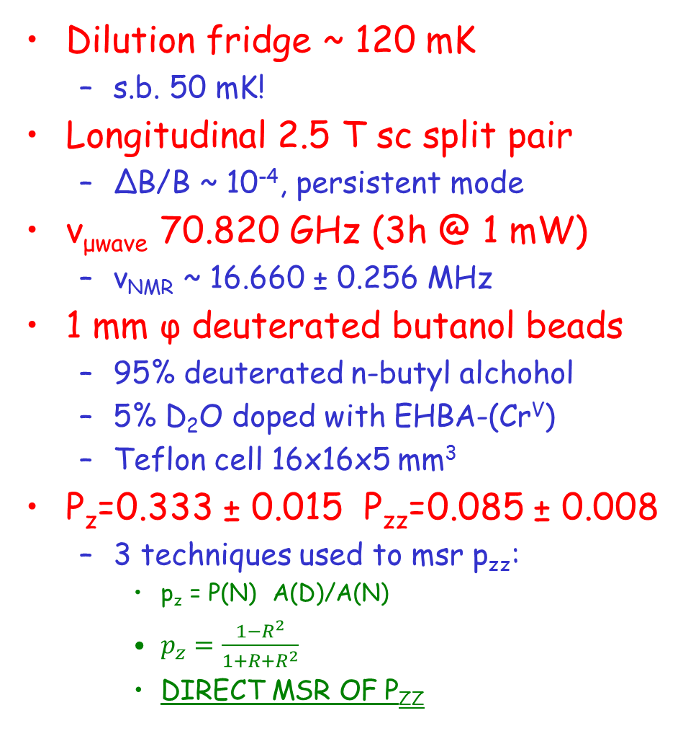

Conditions:
Dilution fridge ~ 120 mK
  s.b. 50 mK!
Longitudinal 2.5 T sc split pair
  ΔB/B ~ 10⁻⁴, persistent mode
ν_{μwave} 70.820 GHz (3h @ 1 mW)
  ν_{NMR} ~ 16.660 ± 0.256 MHz
1 mm φ deuterated butanol beads
  95% deuterated n-butyl alchohol
  5% D₂O doped with EHBA-(Cr^{V})
  Teflon cell 16x16x5 mm³
P_{z}=0.333 ± 0.015 P_{zz}=0.085 ± 0.008
  3 techniques used to msr p_{zz}:
    p_{z} = P(N) A(D)/A(N)
    $p_{z}=\frac{1−R^{2}}{1+R+R^{2}}$
    DIRECT MSR OF P_{ZZ}
$$p_{zz}=2−\sqrt{4−3p_{z}^{2}}$$

Slide 10
p_{zz} is abstract. Can we trust it?
Area & R techniques rely on assumptions:
  D quadrupole moment contribution negligible
    20 kHz vs 16 MHz @ 2.5 T
  Boltzmann dist. (equal spin temps)
    Kiss that goodbye with RF burning
  p_{zz} deduced from msrd p_{z}
  p_{zz} is bloody small…
  NMR system linear over a wide range
    In gain (~3 orders of magnitude)
    In frequency too (16.6 ± 0.3 MHz @ 2.5 T)

Slide 11
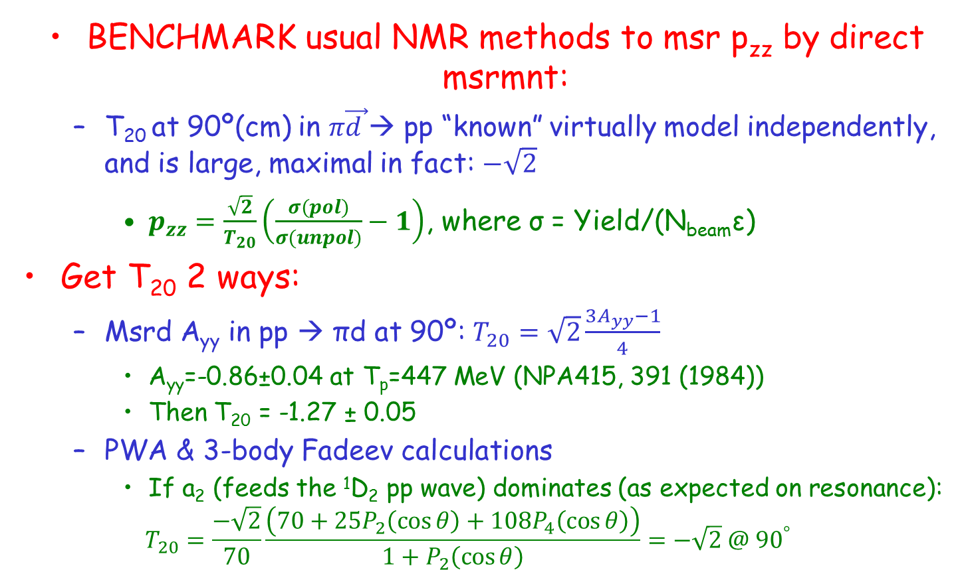
Novel DIRECT msr of p_{zz}
BENCHMARK usual NMR methods to msr p_{zz} by direct msrmnt:
  T₂₀ at 90º(cm) in $π\vec{d }$→ pp “known” virtually model independently, and is large, maximal in fact: $−\sqrt{2}$
    $p_{zz}=\frac{\sqrt{2}}{T_{20}}\left(\frac{σ(pol)}{σ(unpol)}−1\right)$, where σ = Yield/(N_{beam}ε)
Get T₂₀ 2 ways:
  Msrd A_{yy} in pp → πd at 90º: $T_{20}=\sqrt{2}\frac{3A_{yy}−1}{4}$
    A_{yy}=-0.86±0.04 at T_{p}=447 MeV (NPA415, 391 (1984))
    Then T₂₀ = -1.27 ± 0.05
  PWA & 3-body Fadeev calculations
    If a₂ (feeds the ¹D₂ pp wave) dominates (as expected on resonance):
    $$T_{20}=\frac{−\sqrt{2}}{70}\frac{\left(70+25P_{2}\left(\cos{θ}\right)+108P_{4}\left(\cos{θ}\right)\right)}{1+P_{2}\left(\cos{θ}\right)}=−\sqrt{2} @{ 90}^{°}$$

Slide 12
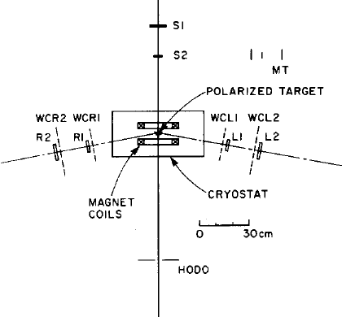
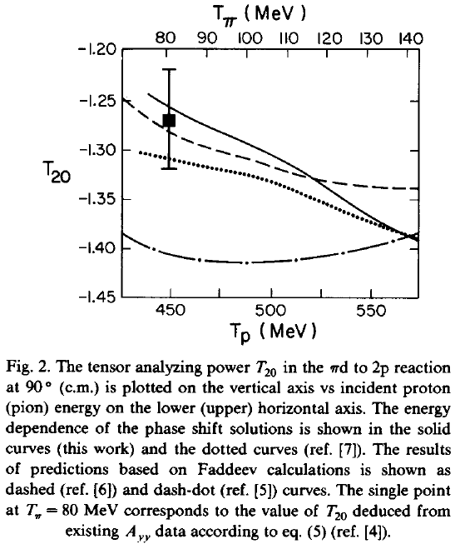
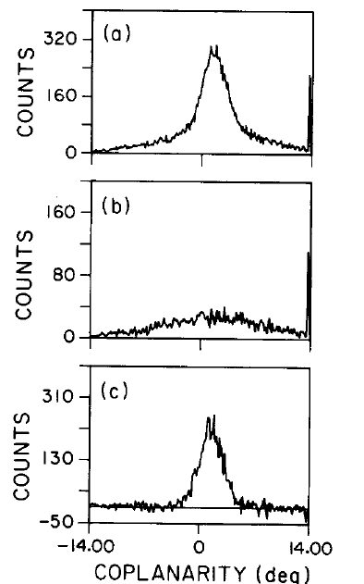
p_{zz} Experiment
Msrd A_{yy} in pp→πd
Our PSA
Flinders PSA
beam
Fadeev
C₄D₉OD
Since no abs on H, this is a perfect bkg tgt!
BKG: QF
abs on ¹²C
C₄H₉OH
(bkg)
Took T₂₀= -1.28 ± 0.03
after accounting for
±2.5º angular acceptance
foreground
minus bkg

Slide 13
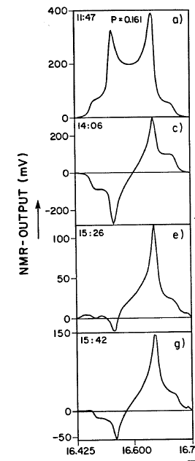
Benchmarking p_{zz} Results
p_{zz}
Analyzed πd → 2p data using:
  TOF: p_{zz} = 0.098 ± 0.024
  Coplanarity: p_{zz} = 0.100 ± 0.022
Using NMR techniques:
  NMR Areas: p_{zz} = 0.083 ± 0.008
  NMR peak ratios: p_{zz} = 0.095 ± 0.008
RF pedestal burning msrd in frozen spin mode (no μw) over 18h after burning. NMR p_{zz} unknown:
  TOF: p_{zz} = 0.10 ± 0.017
  Coplanarity: p_{zz} = 0.11 ± 0.018
  Consistent with unburned
    Either no enhancement, or relaxation times too short
ok
?
?
?

Slide 14
More on Burning
Avg of πd→2p
burned
πd→2p
unburned
Saw no effect
  Within our uncertainties
  Also none from holding field
  But p_{zz} was very small
  Hazy on what NMR predicted burned p_{zz} was
    I think it was Δp_{zz} ~ 0.05 (see TRI-PP-86-027 by Delheij, Healey & Wait)
  Really no effect?
    Msrd burned/unburned = 1.08 ± 0.30
    A larger ratio if comparing burned to NMR… grasping at straws though
  After burning, msrd average polarization over an 18h period
    Did not investigate shorter time periods
Was frozen spin the problem?
  May have had better rslts with MUCH higher B (longer relaxation times)
Need to know p_{zz} during the entire physics msrmnt
  Problematic if burned p_{zz}(time) is hard to msr
NMR
2.5 T
burned
1.25 T
burned

Slide 15
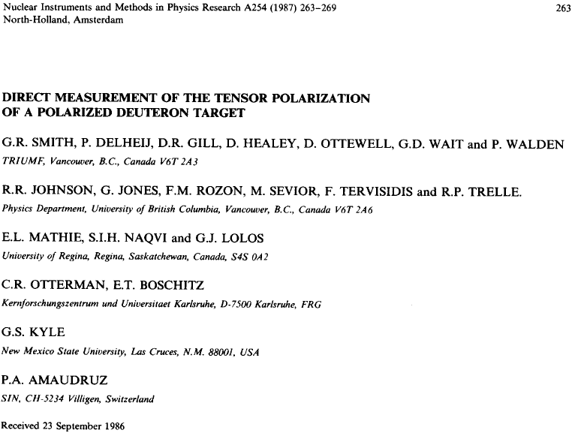
TRIUMF
Tgt Grp

Slide 16
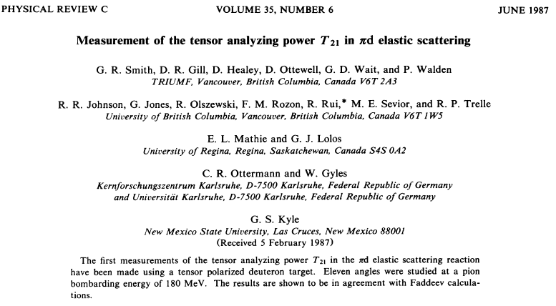
Next: T₂₁

Slide 17
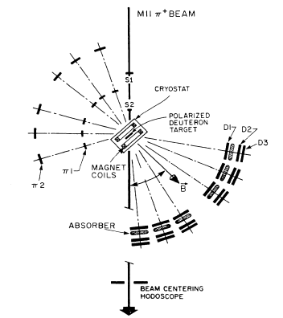
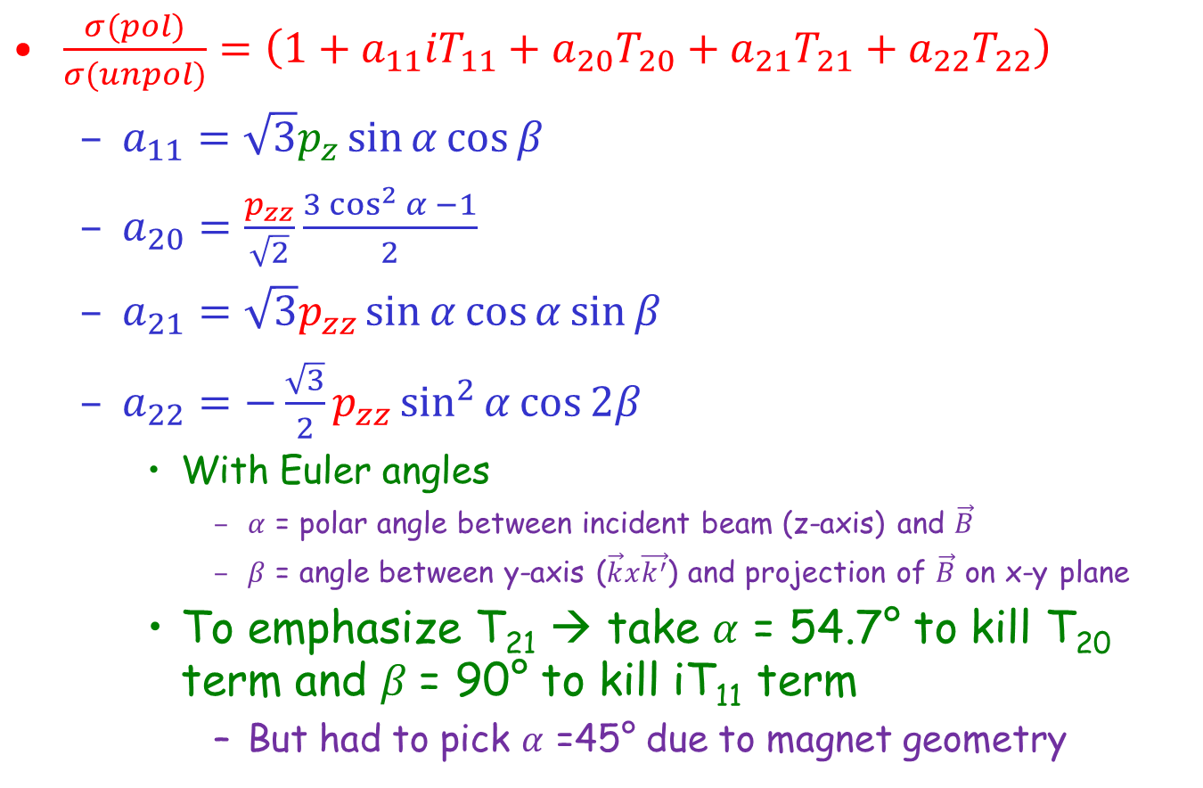

How to get at T₂₁?
$\frac{σ(pol)}{σ(unpol)}=\left(1+a_{11}{iT}_{11}+a_{20}T_{20}+a_{21}T_{21}+a_{22}T_{22}\right)$
  $a_{11}=\sqrt{3}p_{z}\sin{α}\cos{β}$
  $a_{20}=\frac{p_{zz}}{\sqrt{2}}\frac{3\cos^{2}{α −1}}{2}$
  $a_{21}=\sqrt{3}p_{zz}\sin{α}\cos{α}\sin{β}$
  $a_{22}=−\frac{\sqrt{3}}{2}p_{zz}\sin^{2}{α}{\cos{2β}}$
    With Euler angles
      $α$ = polar angle between incident beam (z-axis) and $\vec{B}$
      $β$ = angle between y-axis ($\vec{k}x\vec{k^{′}}$) and projection of $\vec{B}$ on x-y plane
    To emphasize T₂₁ → take $α$ = 54.7° to kill T₂₀ term and $β$= 90° to kill iT₁₁ term
      But had to pick $α$ =45° due to magnet geometry
$$α$$

Slide 18
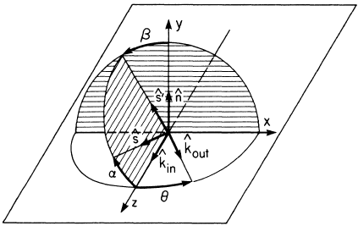





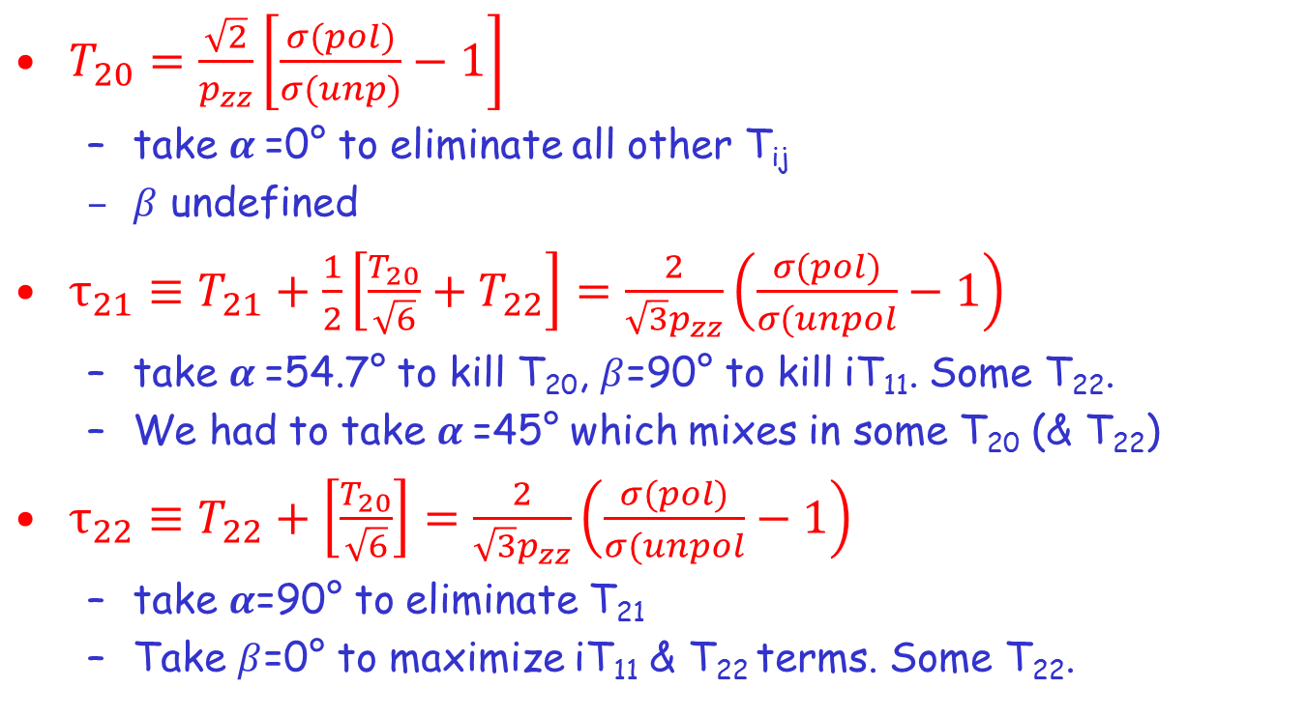
Choice of Euler Angles
Determines the Observables
$$β$$
$$α$$
$T_{20}=\frac{\sqrt{2}}{p_{zz}}\left[\frac{σ(pol)}{σ(unp)}−1\right]$
  take $α$=0° to eliminate all other T_{ij}
  $β$ undefined
$τ_{21}≡T_{21}+\frac{1}{2}\left[\frac{T_{20}}{\sqrt{6}}+T_{22}\right]=\frac{2}{\sqrt{3}p_{zz}}\left(\frac{σ(pol)}{σ(unpol}−1\right)$
  take $α$=54.7° to kill T₂₀, $β$=90° to kill iT₁₁. Some T₂₂.
  We had to take $α$=45° which mixes in some T₂₀ (& T₂₂)
$τ_{22}≡T_{22}+\left[\frac{T_{20}}{\sqrt{6}}\right]=\frac{2}{\sqrt{3}p_{zz}}\left(\frac{σ(pol)}{σ(unpol}−1\right)$
  take $α$=90° to eliminate T₂₁
  Take $β$=0° to maximize iT₁₁ & T₂₂ terms. Some T₂₂.
Can separate T_{ij} after measuring $T_{20}$, composite obs. $τ_{21}$, & $τ_{22}$

Slide 19
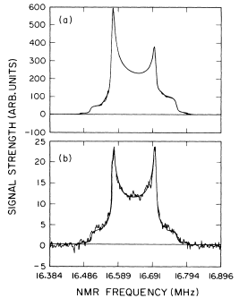
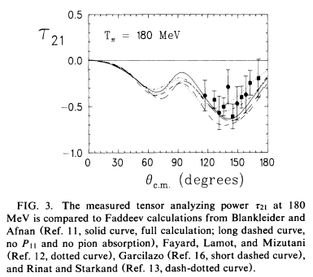
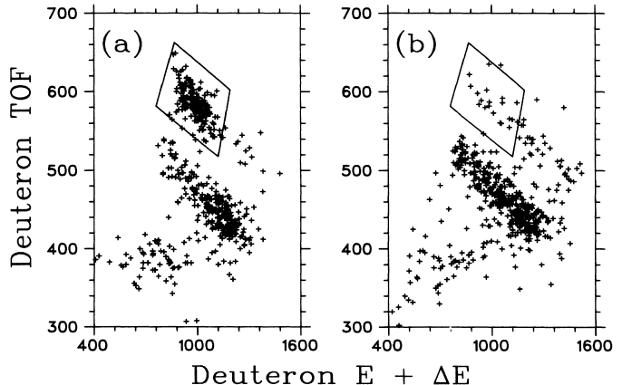

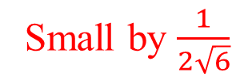

Initial $τ_{21}$Results
p_{zz}=0.17
p_{z}=0.47
TE
With $α$ = 45° and $β$= 90° :
  $τ_{21}≡T_{21}+\frac{1}{2}\left[\frac{T_{20}}{\sqrt{6}}+T_{22}\right]=\frac{2}{\sqrt{3}p_{zz}}\left(\frac{σ(pol)}{σ(unpol}−1\right)$
Small by $\frac{1}{2\sqrt{6}}$
Small at
back angles
C₄D₉OD
C₄H₉OH

Slide 20
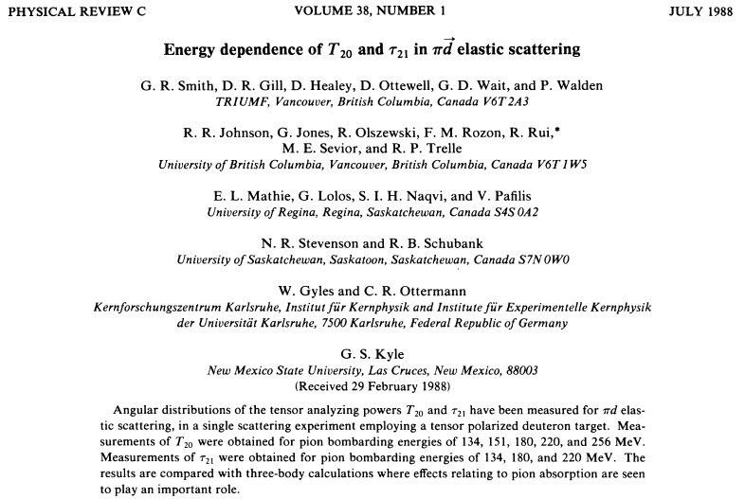
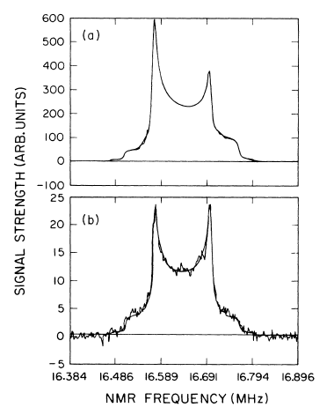
More on T₂₀ & T₂₁
p_{zz} 0.10 up to 0.17
p_{z}=0.47

Slide 21
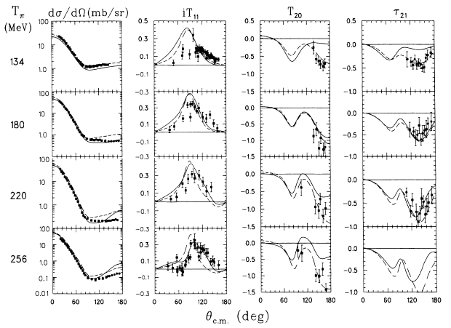
Some Results
Full 3 body
(Flinders)
Same, but w/o P₁₁
Better without the P₁₁ !

Slide 22
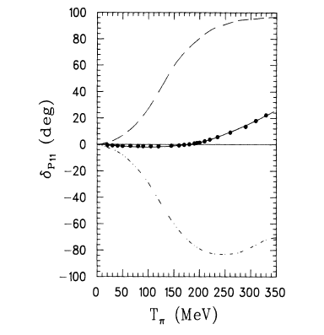
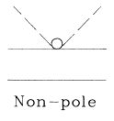
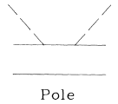
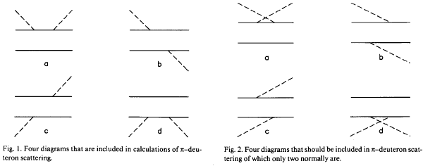
The P₁₁ Phase Shift
NN – πNN system: hard to couple to 2 body cuz π can absorb on one N and be emitted by the other.
  Soln: treat abs. via the P₁₁ πN interaction
3-body calculations sensitive to cancellation of the pole (true π absorption) & non-pole (multiple scattering w/o absorption) in the P₁₁ πN phase shift.
  Problem: cacl’s w/o the P₁₁ generally compare better to data!
  Soln (Jennings, PLB205, 187 (1988): Pole term Pauli blocked. Missing diagrams (different time ordering) cancel ones responsible for the Pauli blocking & improves agreement!
cancels 1b & 1c
missing

Slide 23
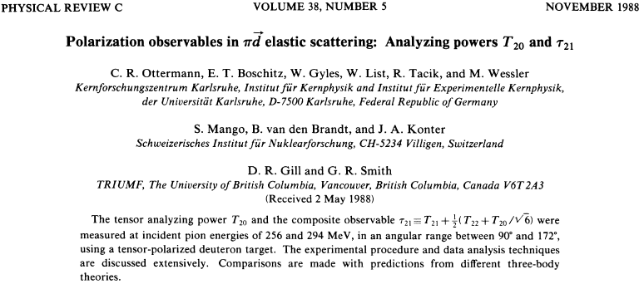
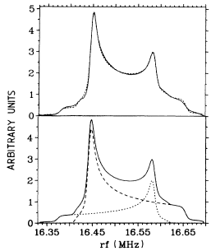
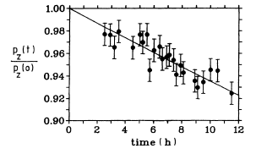
Back to SIN/PSI
Propandiol: C₃D₆(OD)₂ & C₃D₆(OH)₂ 92% deuterated, doped with Cr^{V}
  1 mm beads in a 0.1 mm thick 5x18x18 mm³ brass cell
  4 mW cooling power
  50 mK dilution fridge
  Up to p_{z}=-0.48 (p_{zz}=0.18) after 12 h
150h @ 0.83T

Slide 24
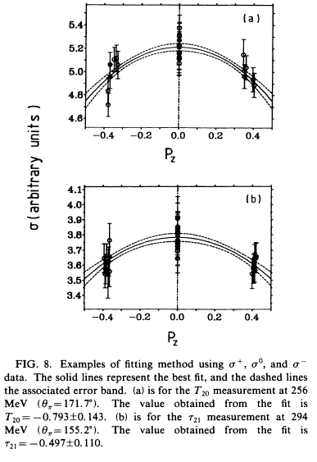
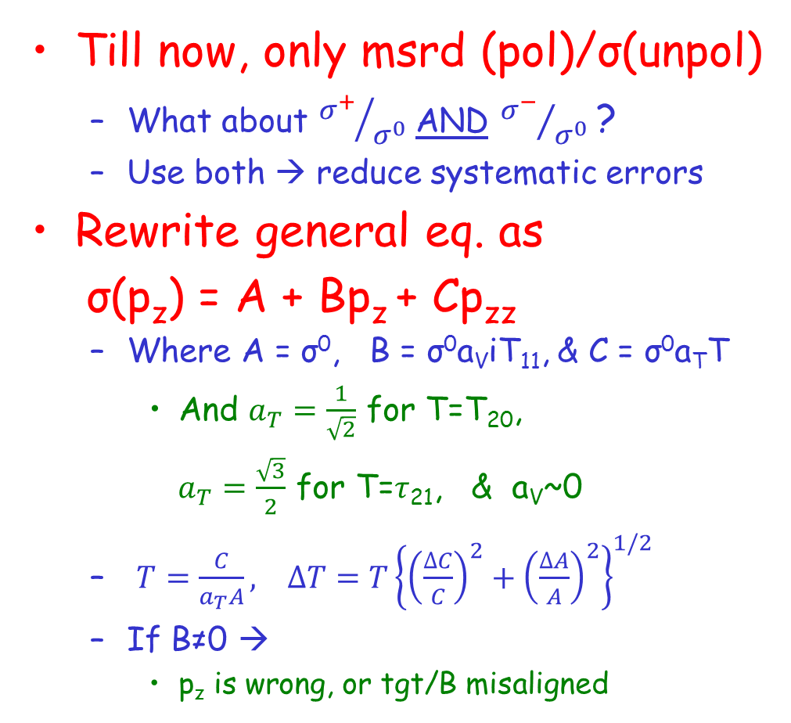

Extraction Method 2: Fitting
Till now, only msrd (pol)/σ(unpol)
  What about ${σ^{+}}/{σ^{0}}$AND ${σ^{−}}/{σ^{0}}$ ?
  Use both → reduce systematic errors
Rewrite general eq. as
σ(p_{z}) = A + Bp_{z} + Cp_{zz}
  Where A = σ⁰, B = σ⁰a_{V}iT₁₁, & C = σ⁰a_{T}T
    And $a_{T}=\frac{1}{\sqrt{2}}$ for T=T₂₀,
    $a_{T}=\frac{\sqrt{3}}{2}$ for T=$τ$₂₁, & a_{V}~0
  $T=\frac{C}{a_{T}A}, ∆T=T{\left\{{\left(\frac{∆C}{C}\right)}^{2}+{\left(\frac{∆A}{A}\right)}^{2}\right\}}^{1/2}$
  If B≠0 →
    p_{z} is wrong, or tgt/B misaligned
T₂₀
$τ$₂₁

Slide 25
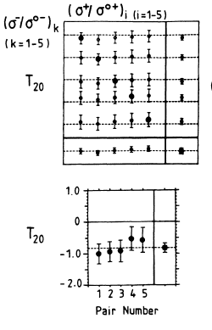
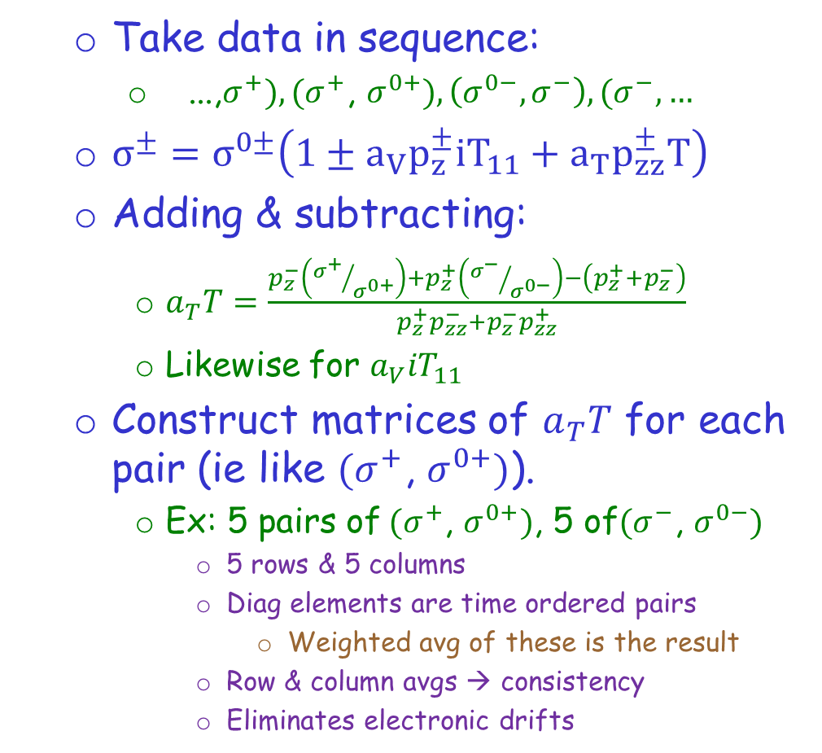
Extraction Method 3: Matrices
Row
averages
  Take data in sequence:
    ...,$σ^{+}),(σ^{+}$, $σ^{0+}),\left(σ^{0−},σ^{−}\right),(σ^{−},…$
  $σ^{±}=σ^{0±}\left(1±a_{V}p_{z}^{±}{iT}_{11}+a_{T}p_{zz}^{±}T\right)$
  Adding & subtracting:
    $a_{T}T=\frac{p_{z}^{−}\left({σ^{+}}/{σ^{0+}}\right)+p_{z}^{+}\left({σ^{−}}/{σ^{0−}}\right)−\left(p_{z}^{+}+p_{z}^{−}\right)}{p_{z}^{+}p_{zz}^{−}+p_{z}^{−}p_{zz}^{+}}$
    Likewise for $a_{V}{iT}_{11}$
  Construct matrices of $a_{T}T$ for each pair (ie like $(σ^{+}$, $σ^{0+})$).
    Ex: 5 pairs of$(σ^{+}$, $σ^{0+})$, 5 of$(σ^{−}$, $σ^{0−})$
      5 rows & 5 columns
      Diag elements are time ordered pairs
        Weighted avg of these is the result
      Row & column avgs → consistency
      Eliminates electronic drifts
Column
averages
Diagonal
matrix
elements &
result =
weighted avg
294 MeV, θ_{π}=151°

Slide 26
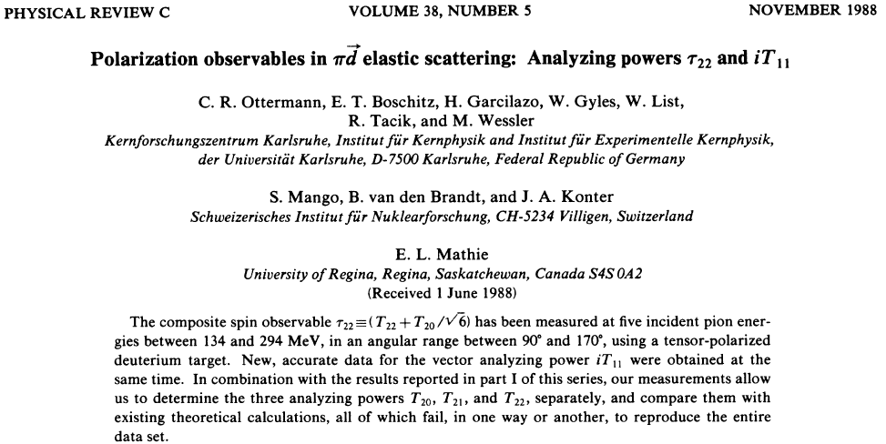
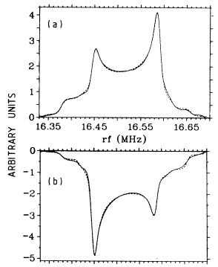
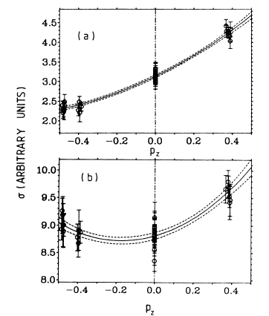




Completing the suite: $τ_{22}$
+41.7%
134º
76º
-48.2%
$σ^{pol}≡{σ^{±}=σ^{0} \left[1±\sqrt{3}p_{z}iT_{11}−\frac{\sqrt{3}}{2}p_{zz}\left[\frac{T_{20}}{\sqrt{6}}+T_{22}\right]\right]}_{}$with α=90º & β=0º
So you get iT₁₁ from the difference of σ±, & τ₂₂ simultaneously from the sum
$τ_{22}≡\left[\frac{T_{20}}{\sqrt{6}}+T_{22}\right]=\frac{2}{\sqrt{3}p_{zz}}\left(\frac{σ(pol)}{σ(unpol}−1\right)$
  With $\vec{B}$ normal to scattering plane (vertical)
400h @ 2.5T

Slide 27







$τ_{22}$ & ${iT}_{11}$
$${iT}_{11}$$
$$τ_{22}$$
$τ_{22}$ $τ_{22}$
134º
76º

Slide 28

Summary
Tensor polarized targets have been used successfully to measure iT₁₁, T₂₀, $τ_{21}$ and $τ_{22}$ in π$\vec{d}$ scattering
  With p_{z}=0.48, get p_{zz}=0.18
    RF burning was a bust (for us) within our (large) uncertainties
  p_{zz} direct msrmnt to confirm NMR techniques
  Target $\vec{B}$ alignment ($≤1^{°}$) with $\vec{k_{in}}$ crucial to select T_{ij}
  Various methods to extract T_{ij} using $σ^{±} \& σ^{0}$
    But can make do just fine with just σ(pol) & σ(unpol)
  Caveats: Beam heating negligible with pions
My b₁ opinion: dangerous to bank on rf burning
  rf burning probably still worth investigating further/better
    But essential to find a way to benchmark it outside NMR
  Backup plan with p_{zz} ~0.2 (you know you can do this)

