Slide 1
The Neutral Pion Lifetime:
Final Result from PrimEx
I. Larin
ITEP, Moscow / Norfolk State University
For the PrimEx Collaboration
Outline:
  Physics motivation
  Experimental methods
  The PrimEx experiment
  - π⁰ analysis
  - Control of systematic errors
  Results
  Future plans

Slide 2
Physics motivation
  π⁰→γγ decay width and lifetime are related with
  expression:
  π⁰→γγ decay proceeds via
  Chiral anomaly in QCD
  Chiral anomaly predicts exact value
  for decay width:
γ
π⁰
γ

Slide 3
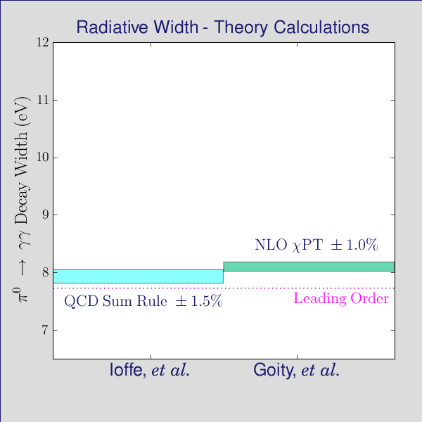
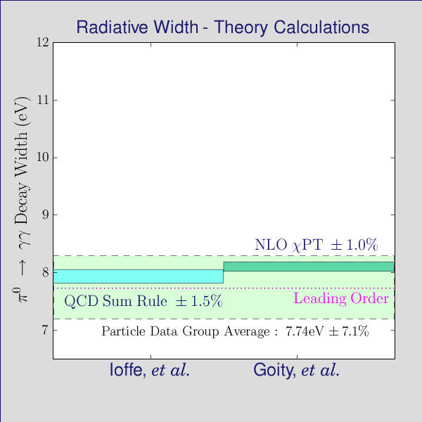
Physics motivation (continued)
  Chiral anomaly next to leading
  order correction taking into
  account difference between quark masses and mixing effects:
(Moussallam 2009):
Γ(π⁰→γγ) = 8.09eV ± 1.4%
(J.Goity, et al. 2002):
Γ(π⁰→γγ) = 8.1eV ± 1.0%
  QCD sum rules:
(Ioffe, et al. 2007):
  Γ(π⁰→γγ) = 7.93eV ± 1.5%
  PDG value for Γ(π⁰→γγ) 7.74eV
  has ~7% error
  Precision measurement of Γ(π⁰→γγ)
  at percent level will provide stringent
  test of QCD prediction

Slide 4
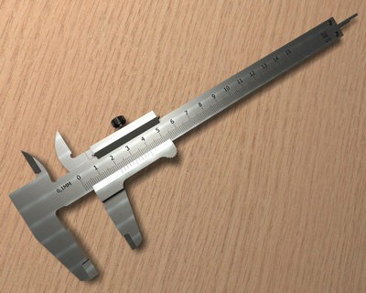
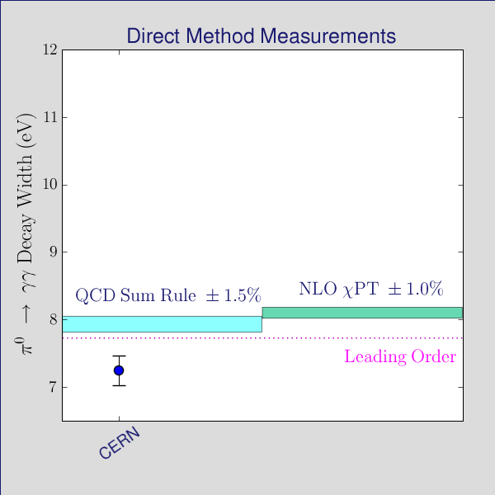
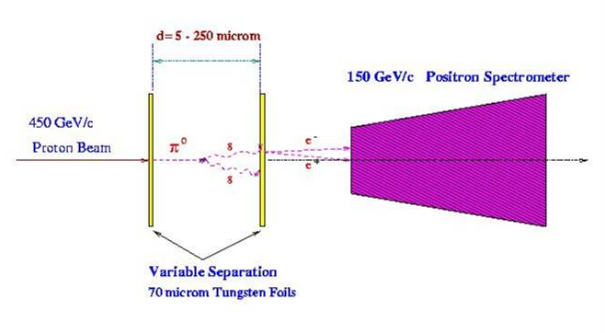
Experimental methods
  Direct method:
  π⁰ decay length measurement
  π⁰ lifetime ~10⁻¹⁶sec –
  too small (~18μm length for 100GeV π⁰)
  CERN 1984: 450GeV proton beam
  Result: Γ(π⁰→γγ) = 7.34eV ± 3.1%
  Limitations: unknown π⁰ momentum spectrum
π
π⁰
π⁰

Slide 5
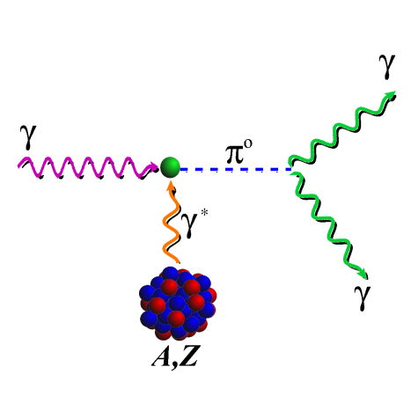
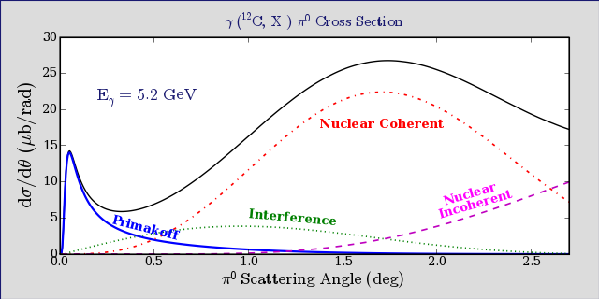
Experimental methods (continued)
  The Primakoff method: coherent photoproduction in the nucleus Coulomb field
Radiative width
Known, measured quantities
  needs absolute cross section measurement
  high resolution in production angle requires high energy and position resolution
  use of targets with different Z
Angular distribution analysis enables separation of amplitudes
and extraction of Primakoff part

Slide 6
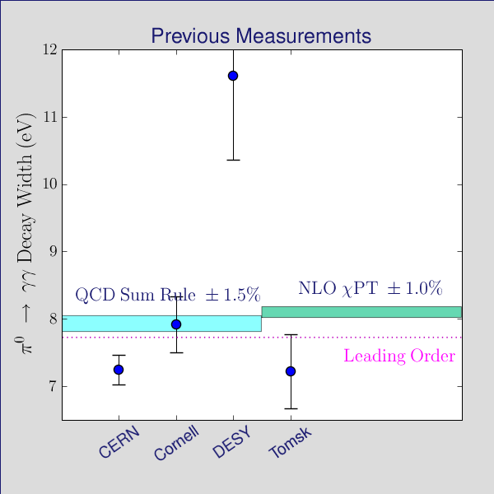
Primakoff experiments
  DESY 1970:
  - Eγ=1.5…2.5GeV
  - targets C, Al, Zn, Pb
  Result: Γ(π⁰→γγ) = 11.7eV ± 10%
  Cornell 1974:
  - Eγ=4…6GeV
  - targets Be, Al, Cu, Ag, U
  Result: Γ(π⁰→γγ) = 7.92eV ± 5.3%
  All previous experiments used
  untagged photon beam and
  conventional Lead Glass calorimetry

Slide 7
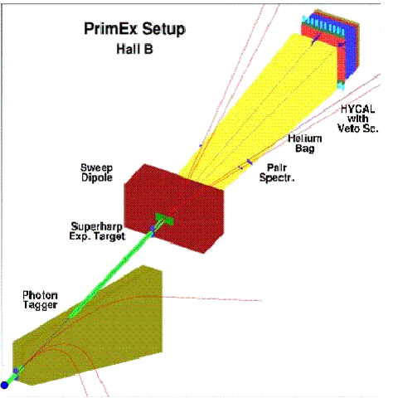
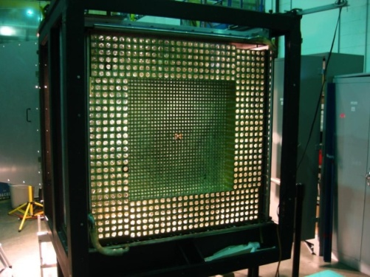
PrimEx experiment
  Primakoff π⁰ production
  Jlab Hall B high resolution, high intensity photon tagging facility
  - Precise photon flux control
  New hybrid electromagnetic calorimeter (HyCal)
  - high energy and position resolution
  - large geometrical acceptance
  Pair spectrometer for additional flux control at high intensities
  Systematical errors are controlled by well known QED processes
  High purity monoisotopic ¹²C and ²⁰⁸Pb targets

Slide 8
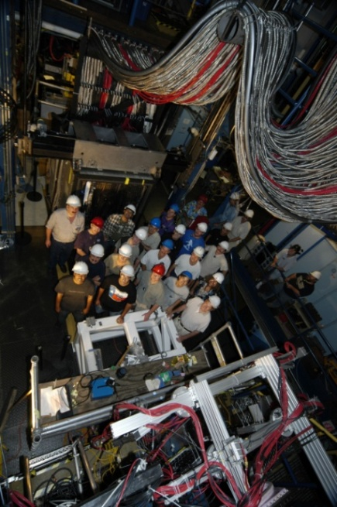
PrimEx Collaboration
Arizona State University, Tempe, AZ, Catholic University of America, Washington, DC, Chinese Institute of Atomic Energy, Beijing, China, Eastern Kentucky University, Richmond, KY, George Washington University, Washington, DC, Hampton University, Hampton, VA, Institute for High Energy Physics, Chinese Academy of Sciences, Beijing, China, Institute for High Energy Physics, Protvino, Moscow region, Russia, Institute for Theoretical and Experimental Physics, Moscow, Russia, Kharkov Institute of Physics and Technology, Kharkov, Ukraine, Massachusetts Institute of Technology, Cambridge, MA, Moscow Engineering Physics Institute, Moscow, Russia, Norfolk State University, Norfolk, VA, North Carolina A&T State University, Greensboro, NC, North Carolina Central University, Durham, NC, Thomas Jefferson National Accelerator Facility, Newport News, VA, Tomsk Polytechnic University, Tomsk, Russia, Idaho State University, Pocatello, ID, University of Illinois, Urbana, IL, University of Kentucky, Lexington, KY, University of Massachusetts, Amherst, MA, University of North Carolina at Wilmington, Wilmington, NC, University of Virginia, Charlottesville, VA, Yerevan Physics Institute, Yerevan, Armenia

Slide 9
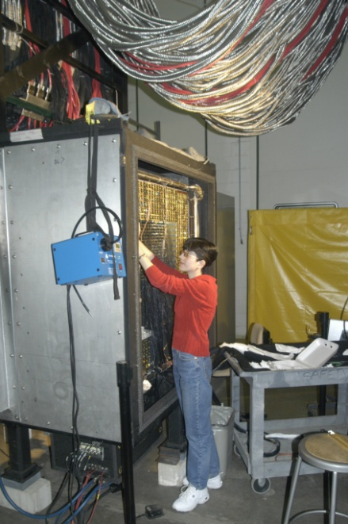
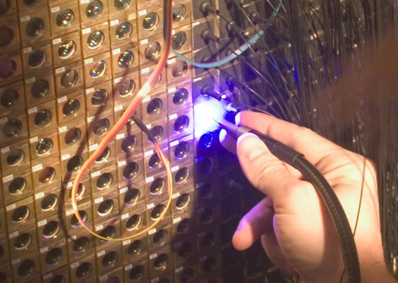
PrimEx Milestones
  1999: Proposal approved by PAC15
  2000: NSF awarded MRI $1M grant to develop experimental setup
  2002: Reapproved by PAC22 (E02-103) with A rating
  2004: August - Installation of setup
  September - Commissioning
  October-November - Data taking (~45 days)
  2007: First preliminary results released at April APS meeting with AIP press conference
  2009: Final result reported
PrimEx data chart
¹² C
π⁰
Commissioning
and special runs
π⁰
²⁰⁸Pb
Compton
e⁺e⁻

Slide 10
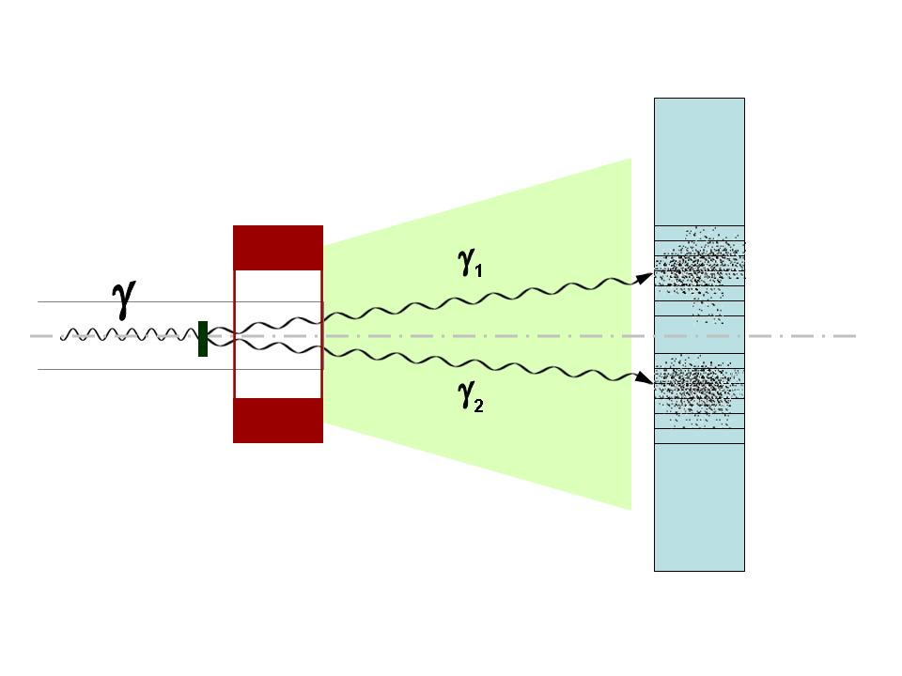
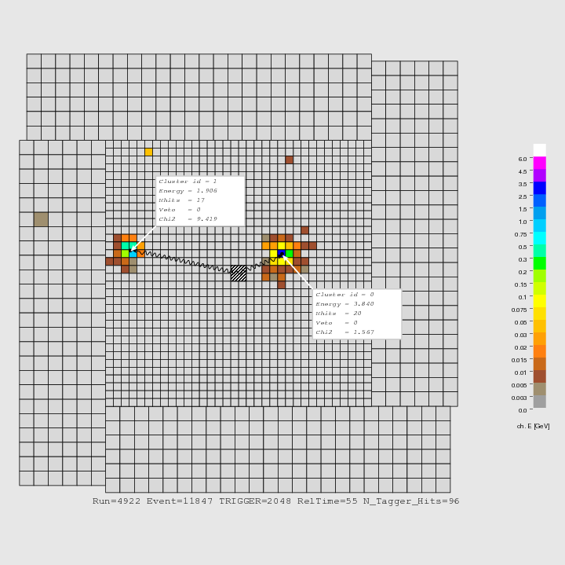
π⁰ analysis
We measure:
incident photon: energy and time
π⁰ decay photons:
energies, coordinates and time
Schematic view of π⁰ event
Kinematical constraints:
Conservation of energy;
m_{γγ} invariant mass
Three groups analyzed the data independently

Slide 11
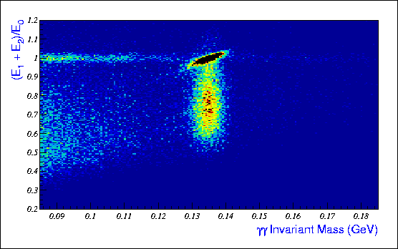
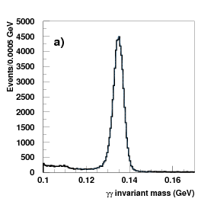
π⁰ event selection
2D events distribution:
2γ energy ratio to beam energy
VS 2γ invariant mass
elastic π⁰s (signal)
π⁰ event signature: two γ invariant mass
elastic non-π⁰ background
Inelastic π⁰s (background)

Slide 12
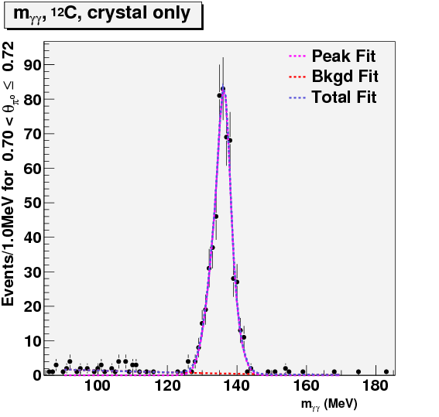
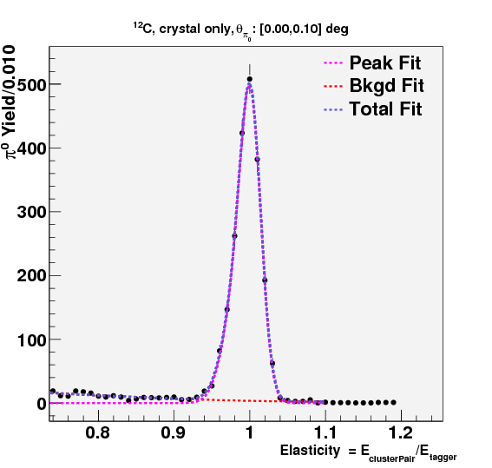
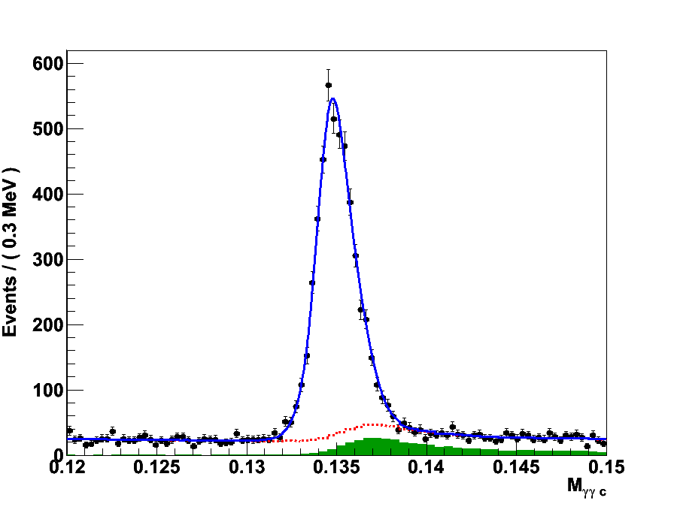
π⁰ event selection (continued)
Task to extract elastic π⁰ yield
as a function of production angle:
2 different methods were used:
For each Δθ bin:
Events were additionally split in elasticity, then
π⁰ yield was extracted for each elasticity bin
Kinematic constraint on elasticity was applied,
then yield was extracted from constrained
invariant mass distribution
two γ invariant mass
π⁰ distribution on elasticity
two γ invariant mass with elasticity constraint

Slide 13
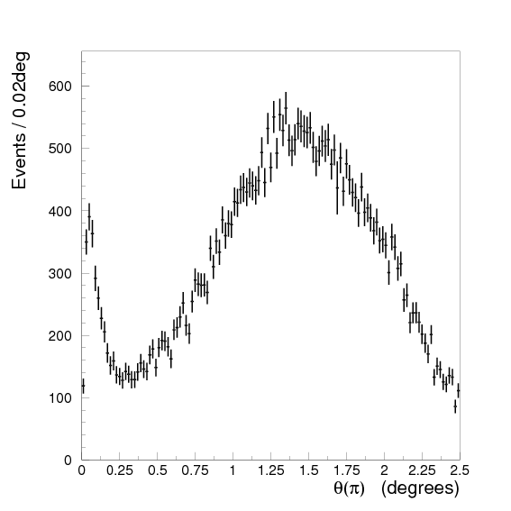
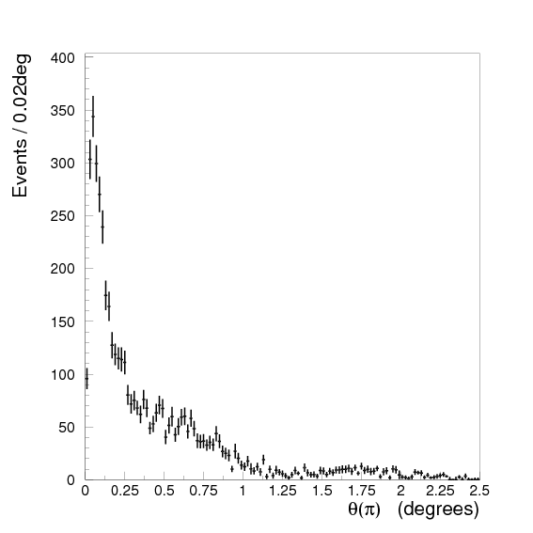
Elastic π⁰ yield
¹²C
²⁰⁸Pb

Slide 14
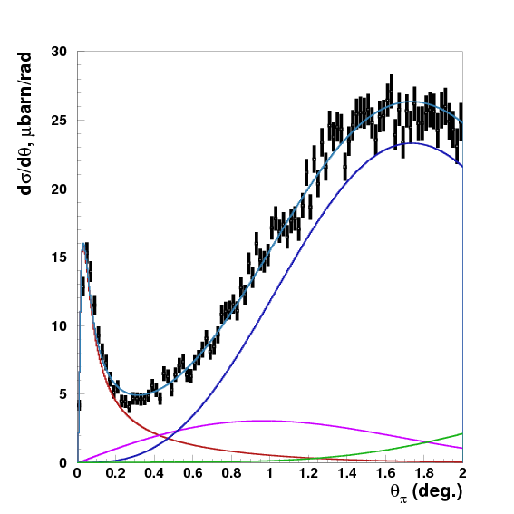
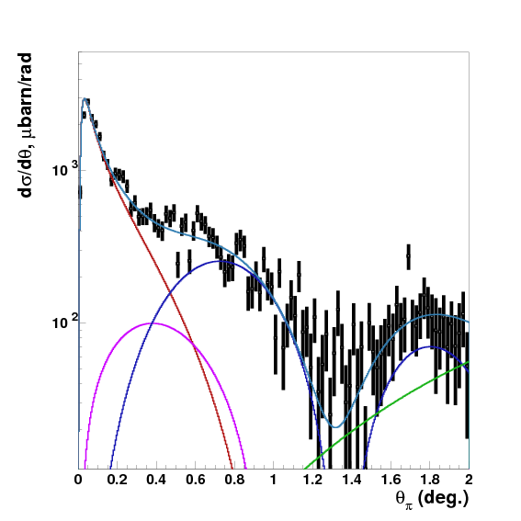
π⁰ photoproduction cross section
  π⁰ photoproduction cross section has been extracted from elastic π⁰ yield using setup acceptance and efficiency
E_{γ} = 5.2GeV
Primakoff ---------
Nuclear coherent ------
Interference ---------
Incoherent ---------
Total ---------
¹²C
²⁰⁸Pb

Slide 15
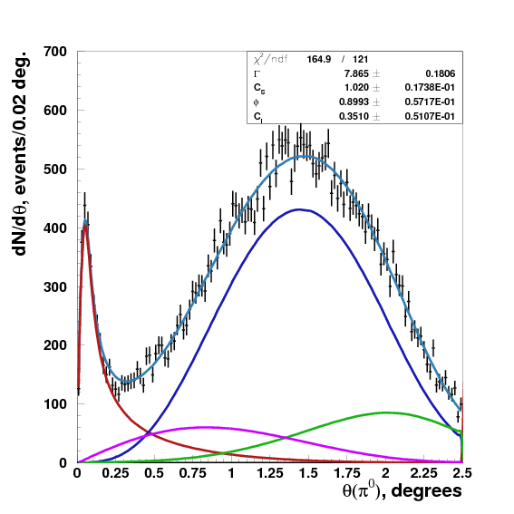
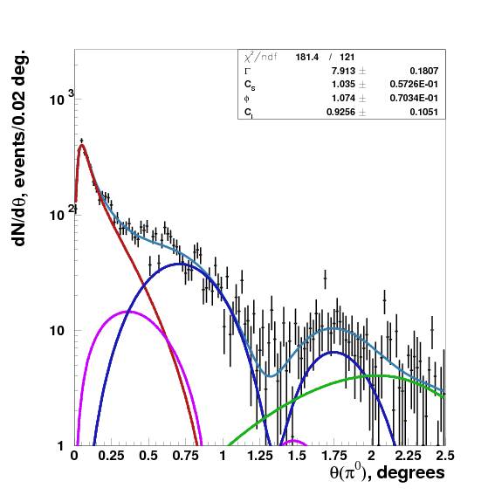
Γ(π⁰→γγ) extraction
  Theoretical distributions folded with experimental resolution and setup acceptance have been used to fit the data
¹²C
²⁰⁸Pb
Primakoff ---------
Nuclear coherent -----
Interference ---------
Incoherent ---------
Total ---------
Combined extracted value Γ(π⁰→γγ) = 7.82eV ± 2.2%stat. (including fit error)

Slide 16
Systematic Errors in Γ(π⁰→γγ)
The Systematic Error ???
  Instrumental (experimental setup)
  Model errors
Independent verification of the extracted
cross sections are needed
The data for the following QED processes had been taken
periodically in this experiment:
  e⁺e⁻ pair production
  Compton scattering

Slide 17
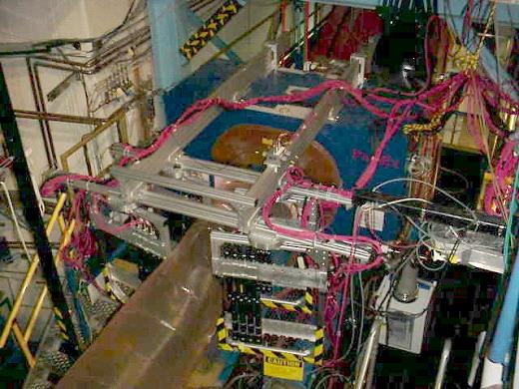
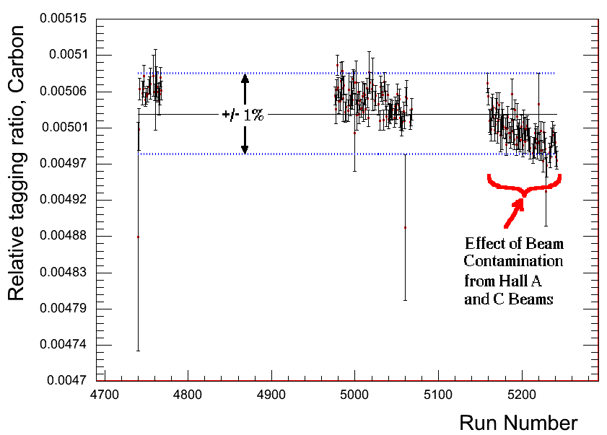
Luminosity Control: Pair Spectrometer
Measured in experiment:
absolute tagging ratios:
  TAC measurements at low intensities
relative tagging ratios:
  pair spectrometer at low and high
  intensities
Scint. Det.
Uncertainty in photon flux at the level of 1% has been reached
Verified by known cross
sections of EM processes
  Compton scattering
  e⁺e⁻ pair production

Slide 18
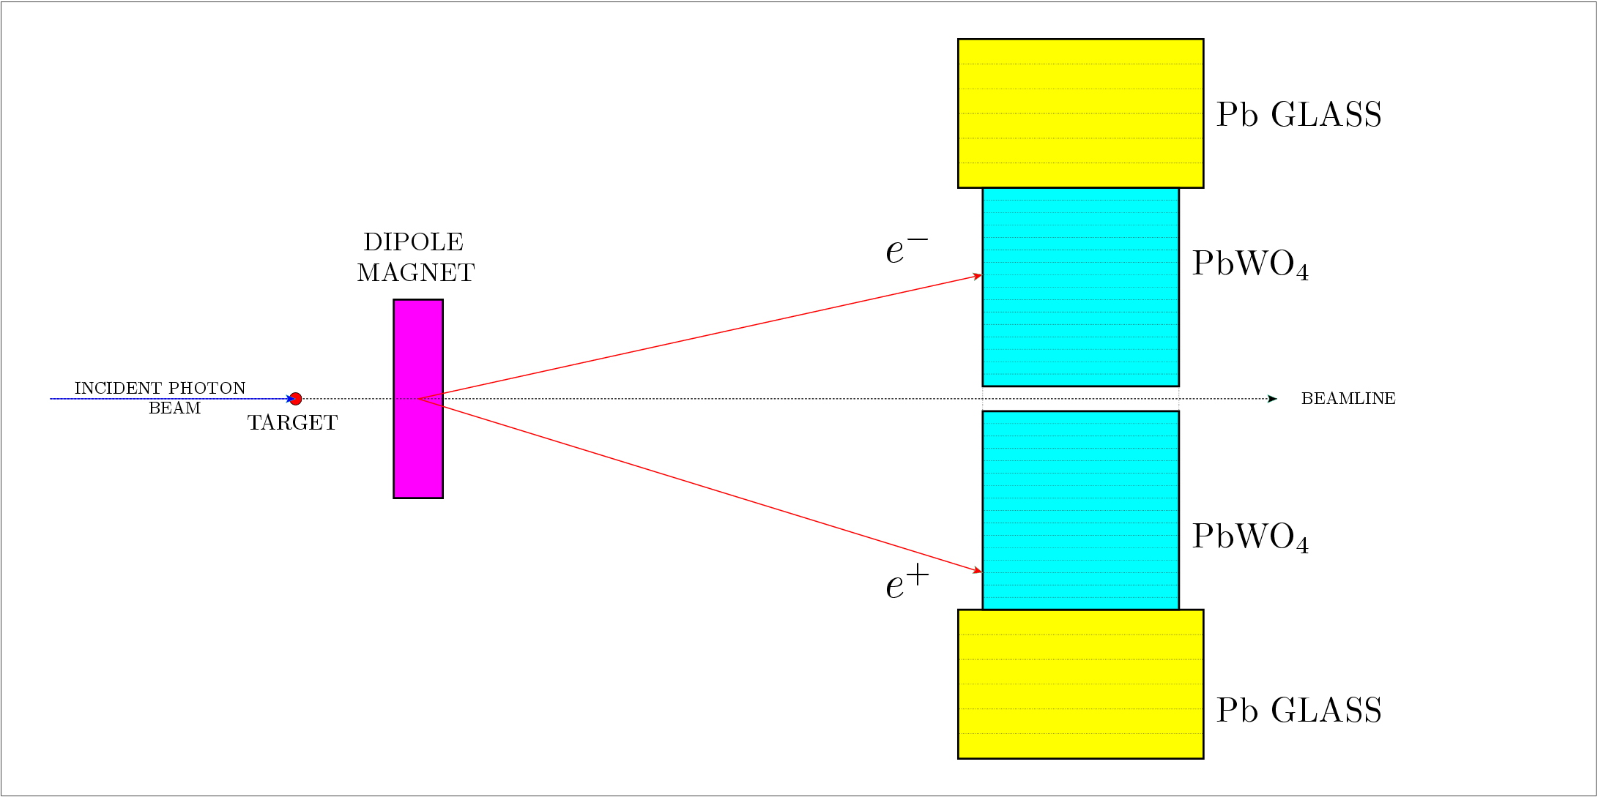
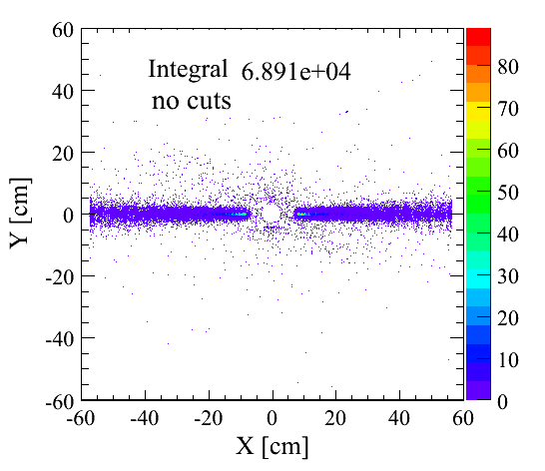
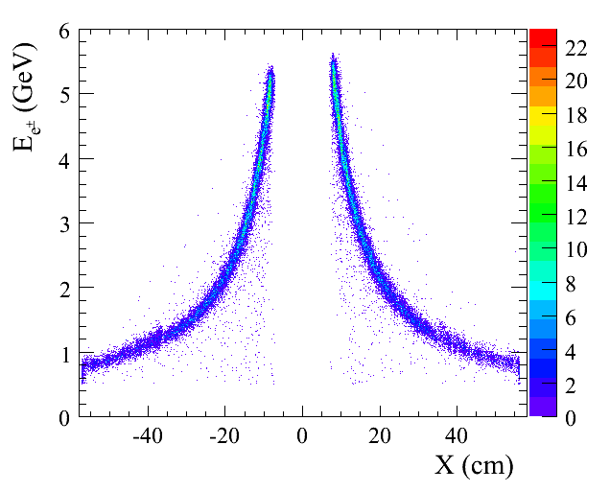
e⁺e⁻ pair production
Schematic view of
pair production event
Pair production event signature:
e⁺ and e⁻ energy dependence
on coordinate
Pair production events population

Slide 19
Pair production cross section
Pair production differential cross section as a function
of fraction of electron energy VS initial γ energy.
Theory prediction shown in black dots
Bethe-Heitler mechanism of pair production on the nucleus with screening effects due to atomic electrons and Coulomb distortion
Pair production off atomic electrons, considering excitation of all atomic states and correlation effects due to presence of other electrons and the nucleus
Radiative corrections (of order α/π) (i) virtual-photon loops and (ii) real-photon process like γ + Α→ e ⁺ + e⁻ + Α + γ
Nuclear incoherent contribution, γ + p →e⁺ + e⁻ + p
Nuclear coherent contribution, i.e. virtual Compton Scattering, a two-step process γ + A → γ ∗ + A → e ⁺ + e⁻ + A
  extracted cross section is in agreement with theory prediction at the level of systematic error of 1.7%

Slide 20
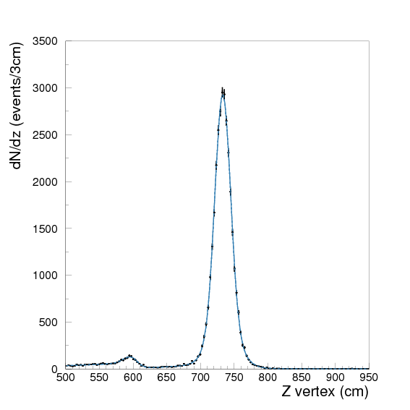
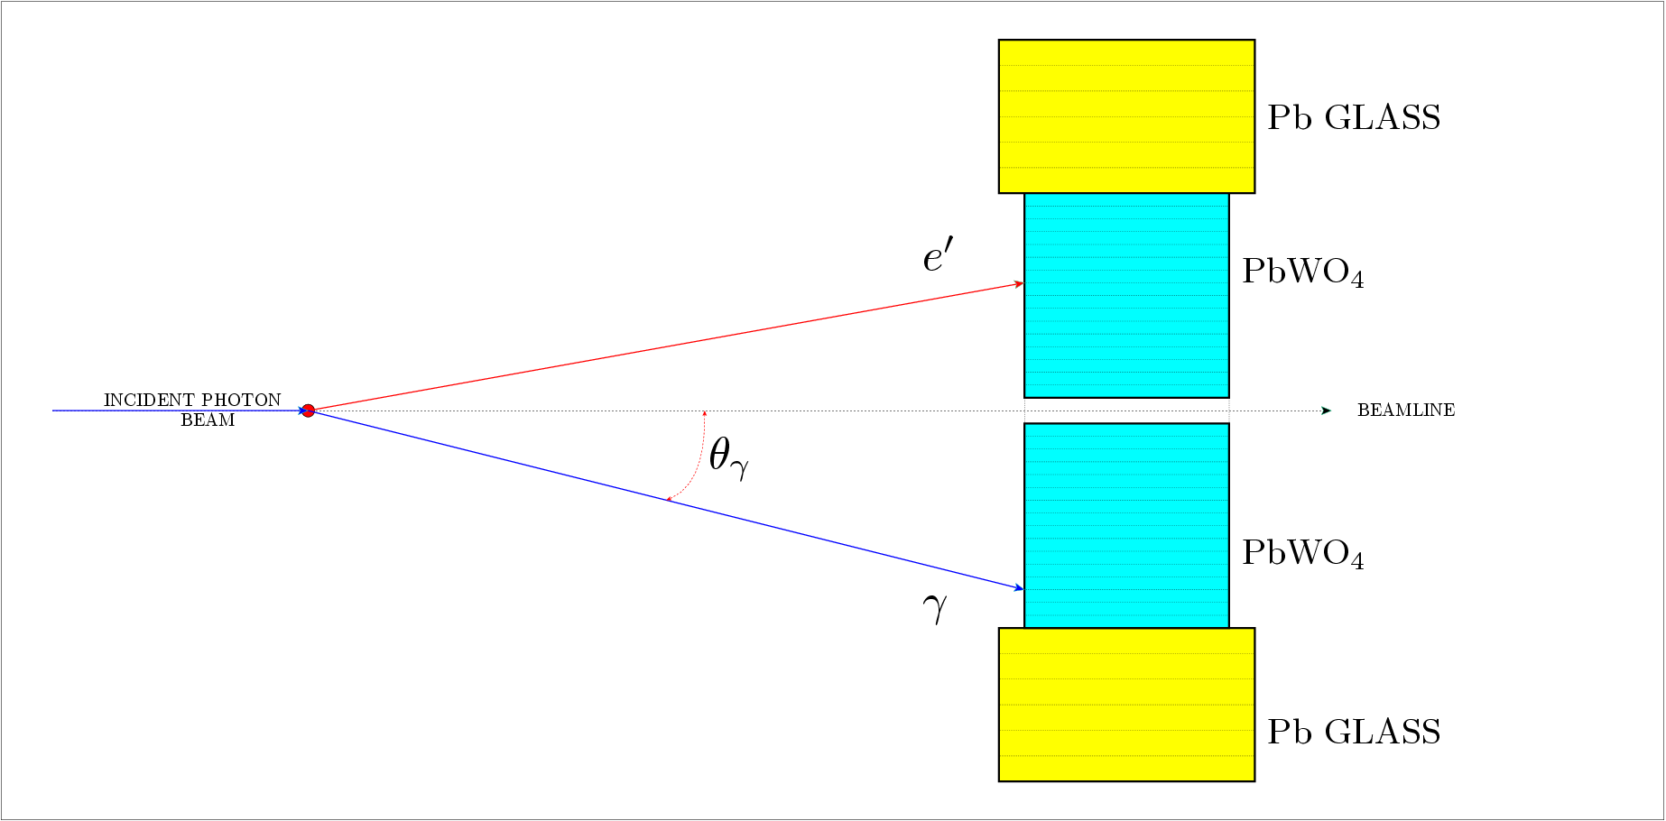
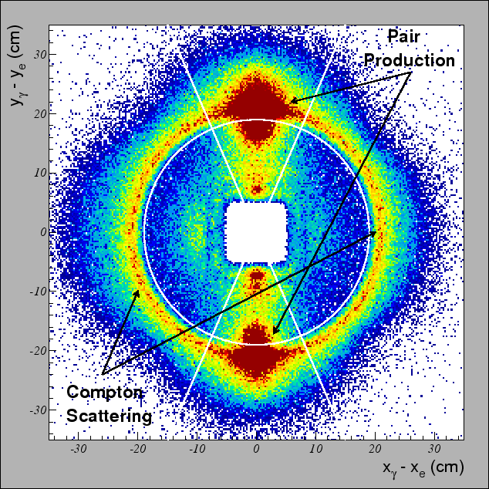
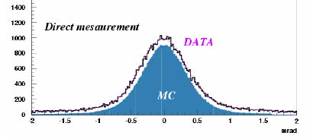
Compton scattering
Schematic view of Compton event
Dipole
Magnet OFF
Compton event signature:
vertex Z-coordinate reconstructed using
Compton kinematics
Compton events population
Production angle resolution measurement
with Compton scattering on thin Be target
Production angle
projection
  σ(θ_{x}) ≈ 0.35mrad

Slide 21
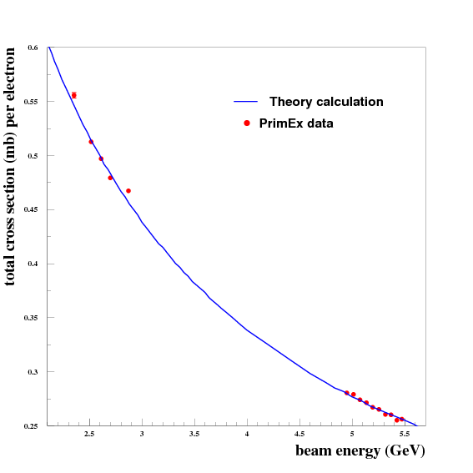
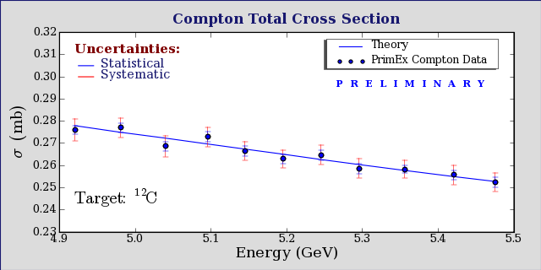
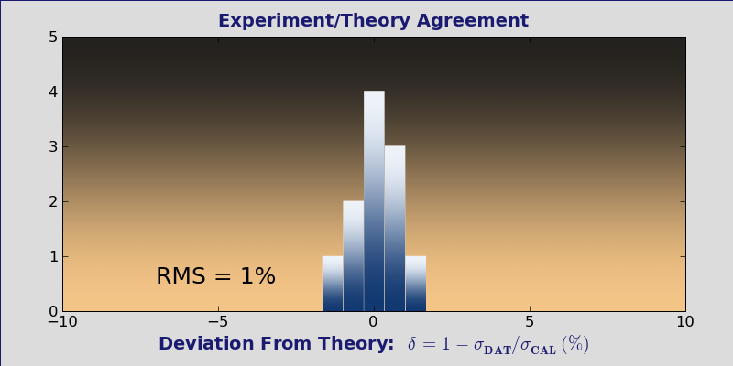
Compton cross section VS incident photon energy
Compton cross section as
a function of γ energy.
Curves show theory
calculation with
rad. corrections
Extracted cross section deviation from calculated value
Projected distribution
  extracted cross section is in agreement with theory prediction at the level of systematic error of 1.5%

Slide 22
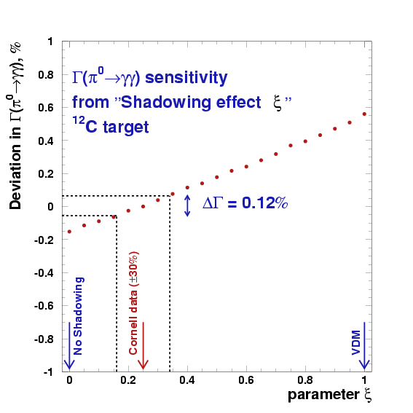
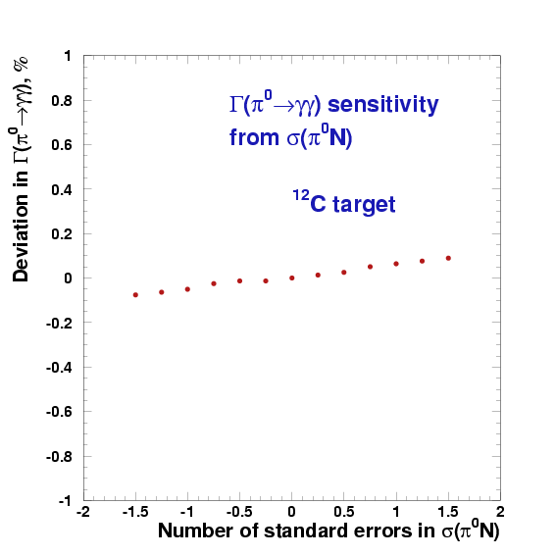
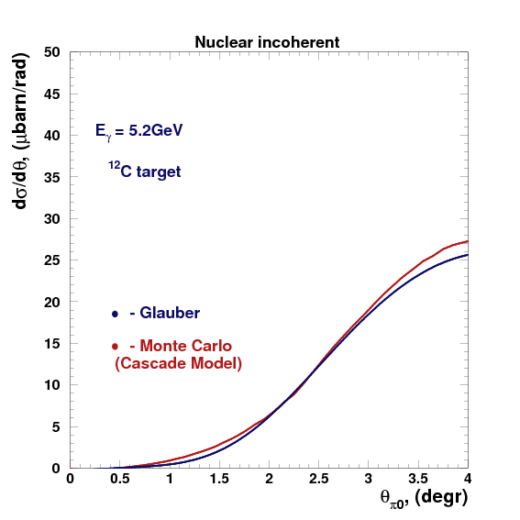
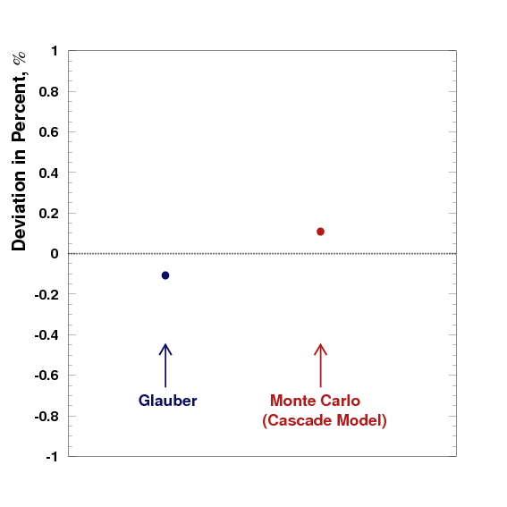
Model dependence of Γ(π⁰→γγ) Extraction
Incoherent π⁰ photoproduction
off complex nuclei (γ+A→π⁰+A´)
model parameter error
Γ(π⁰→γγ) sensitivity to different parameters
Two independent approaches:
  Glauber theory
  Cascade Model (Monte Carlo)
Model error in Γ(π⁰→γγ) extraction is controlled at 0.3% level

Slide 23
Γ(π⁰→γγ) systematic errors
Contributions | Error, [%]
Photon flux | 1.0
Target | 0.1
Yield extraction | 1.6
HYCAL eff. | 0.5
Beam parameters | 0.4
Trigger eff. | 0.1
VETO eff. | 0.4
Acceptance | 0.3
Model errors (theory) | 0.3
Physics background | 0.25
Branching ratio | 0.03
Total | 2.1

Slide 24

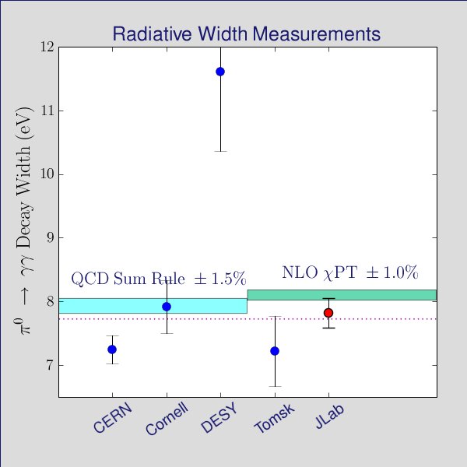
PrimEx Result
  Γ(π⁰→γγ) = 7.82eV ± 2.2%stat. ± 2.1%syst. (± 3.0% total)
PrimEx

Slide 25

PrimEx-II run
Statistical error: 0.44%
Contributions | Error, [%]
Photon flux | 1.0
Target | 0.1
Yield extraction | 0.5
HYCAL eff. | 0.2
Beam parameters | 0.4
Trigger eff. | 0.1
VETO eff. | 0.3
Acceptance | 0.3
Model errors (theory) | 0.3
Physics background | 0.25
Branching ratio | 0.03
Total (syst.) | 1.3
Projected PrimEx-II

Slide 26
Summary
  π⁰ lifetime is one of the few precision QCD predictions. Percent level measurement is a stringent test of QCD
  A high resolution experimental setup including hybrid calorimeter and pair spectrometer has been designed, developed and constructed
  Commissioning and first physics run had been done in Fall-2004
  Compton and pair production measurements demonstrate that the cross section systematical errors are controlled at the 1.5% level
  Control of model error in π⁰ lifetime at 0.3% level has been reached
  PrimEx result: Γ(π⁰→γγ) = 7.82eV ± 2.2% stat. ± 2.1% syst.
    (3.0% total).
    Our result is 2.4 times more precise than current PDG value
  With the PrimEx-II run we will reach the planned precision of 1.4%
This experiment was supported in part by NSF MRI PHY 0079840 grant

