Slide 1
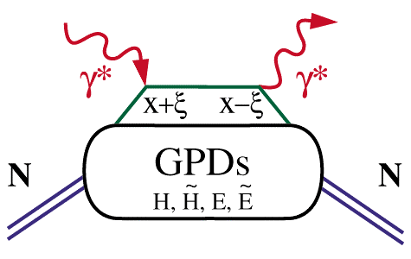
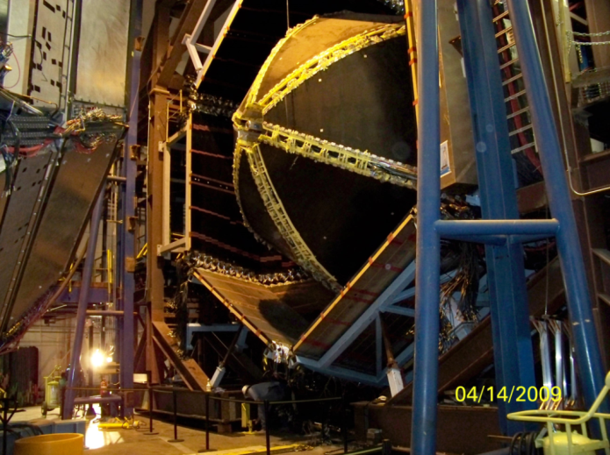
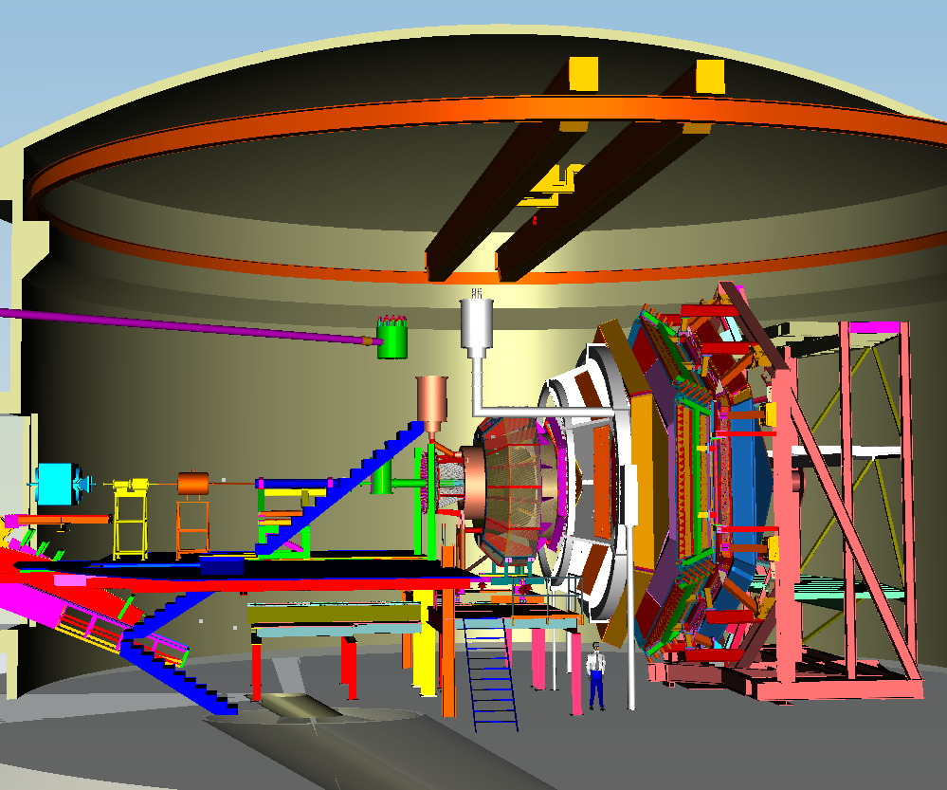
Deeply Virtual Compton Scattering Studies with CLAS and CLAS12
Latifa Elouadrhiri
Jefferson Lab
γ
CLAS
CLAS12
t

Slide 2



Generalized Parton Distributions (GPDs)
D. Mueller, X. Ji, A. Radyushkin,(1994-1997),…
M. Burkardt, A. Belitsky (2000)…
The size and structure of proton.
Proton form factors, transverse charge and current distributions
Nobel prize 1961- R. Hofstadter
Internal constituents of the nucleon
Quark longitudinal momentum and helicity distributions
Nobel prize 1990 - J. Friedman,
H. Kendall, R. Taylor
GPDs connect the quark distribution in transverse space and longitudinal momentum

Slide 3
Deeply Virtual Compton Scattering & GPDs
Deeply Virtual Compton Scattering (DVCS)
hard vertices
γ
x – longitudinal quark
momentum fraction
x+ξ
x-ξ
2ξ – longitudinal
momentum transfer
–t – Fourier conjugate
to transverse impact
parameter
t
GPDs depend on 3 variables, e.g. H(x, ξ, t). They describe
the internal nucleon dynamics.

Slide 4
Link to DIS and Elastic Form Factors
Form factors (sum rules)
1
∑
[
]
∫
dx
H
q
(
x
,
ξ
,
t
)
=
F₁
(
t
) Dirac f.f.
DIS at
ξ
=t=0
q
1
∑
[
]
∫
dx
E
q
(
x
,
ξ
,
t
)
=
F₂
(
t
) Pauli f.f.
H
q
(
x
,
0
,
0
)
=
q
(
x
)
q
~
1
~
1
~
H
q
(
x
,
0
,
0
)
=
Δ
q
(
x
)
∫
dx
H
q
(
x
,
ξ
,
t
)
=
G
(
t
)
,
∫
dx
E
q
(
x
,
ξ
,
t
)
=
G
(
t
)
A
,
q
P
,
q
−
1
−
1
~
~
ξ
H
q
,
E
q
,
H
q
,
E
q
(
x
,
,
t
)
Angular Momentum Sum Rule
1
1
1
[
]
=
− J ^{G} =
∫
ξ
+
ξ
J ^{q}
xdx
H
^{q}(
x
,
,
0
)
E
^{q}(
x
,
,
0
)
2
2
−
1
X. Ji, Phy.Rev.Lett.78,610(1997)

Slide 5
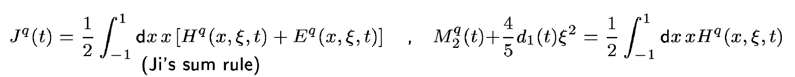
Physical content of GPD E & H
Nucleon matrix element of the Energy-Momentum Tensor of QCD contains 3 scalar form factor:
M₂(t) : Mass distribution inside the nucleon
J (t) : Angular momentum distribution
d₁(t) : Forces and pressure distribution
Directly measured in elastic
graviton-proton scattering!
GPDs are related to these form factors through 2nd moments
Notes:
The nucleon matrix element of the energy-momentum tensor is known to contain 3 form factors (R. Pagels, 1965). For a long time they were of little interest as the only known process where they could be directly measured is elastic scattering of gravitons off the nucleon. However, these form factors appear as moments of the unpolarized GPDs as shown here. The quark angular momentum in the nucleon is given by the 2nd moment of the sum of GPD H and E. The mass and pressure distribution of the quarks are given by the 2nd moment of H where the pressure is probed by parameter xi.

Slide 6
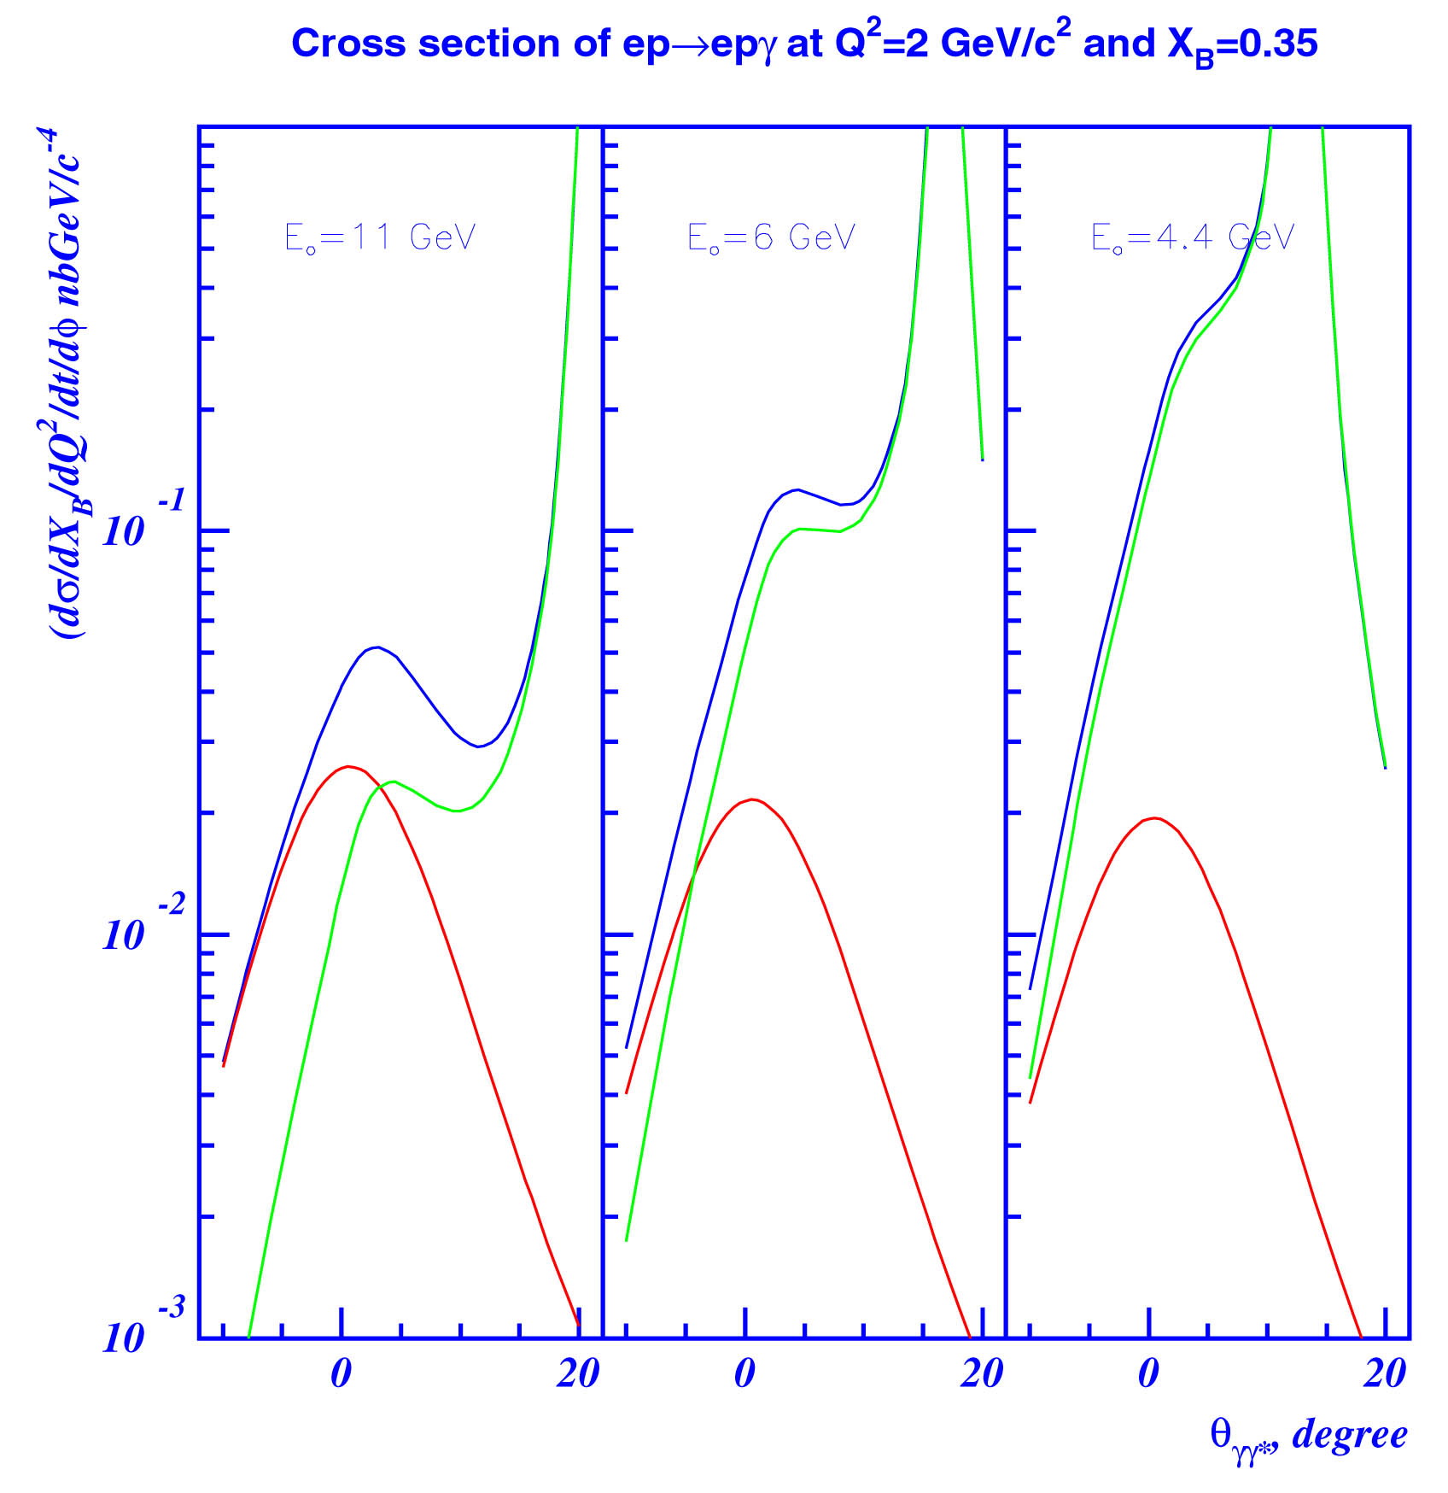
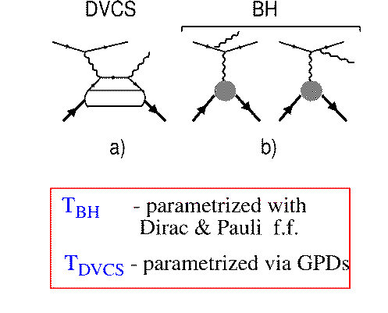
Accessing GPDs Through DVCS
GPDs are universal, they can be
determined in any suitable process
d⁴σ
~ |T^{DVCS} + T^{BH}|²
E_{o} = 11 GeV
dQ²dx_{B}dtdφ
E_{o} = 6 GeV
E_{o} = 4 GeV
DVCS
BH
BH
T^{BH :} given by elastic form factors
T^{DVCS}: determined by GPDs
DVCS
BH-DVCS interference generates
beam and target asymmetries that carry the nucleon structure information.

Slide 7
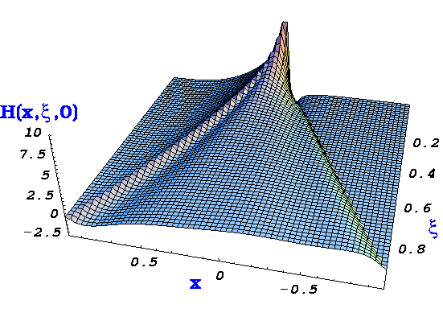
GPDs & DVCS
(at leading order:)
Cross-section measurement
and beam charge asymmetry (ReT)
integrate GPDs over x
Beam or target spin asymmetry
contain only ImT,
therefore GPDs at x = ξ and -ξ
Notes:
Intro

Slide 8
Accessing GPDs through polarization
σ⁺ − σ⁻
σ⁺ + σ⁻
Δσ
2σ
A =
=
Polarized beam, unpolarized target:
~
H
Δσ_{LU} ~ sinφIm{F₁H + ξ(F₁+F₂)H +kF₂E}dφ
Kinematically suppressed
ξ = x_{B}/(2-x_{B})
k = t/4M²
Unpolarized beam, longitudinal target:
~
~
Δσ_{UL} ~ sinφIm{F₁H+ξ(F₁+F₂)(H +ξ/(1+ξ)E) -.. }dφ
H
Kinematically suppressed
Unpolarized beam, transverse target:
Δσ_{UT} ~ cosφIm{k(F₂H – F₁E) + ….. }dφ
H, E
Kinematically suppressed

Slide 9
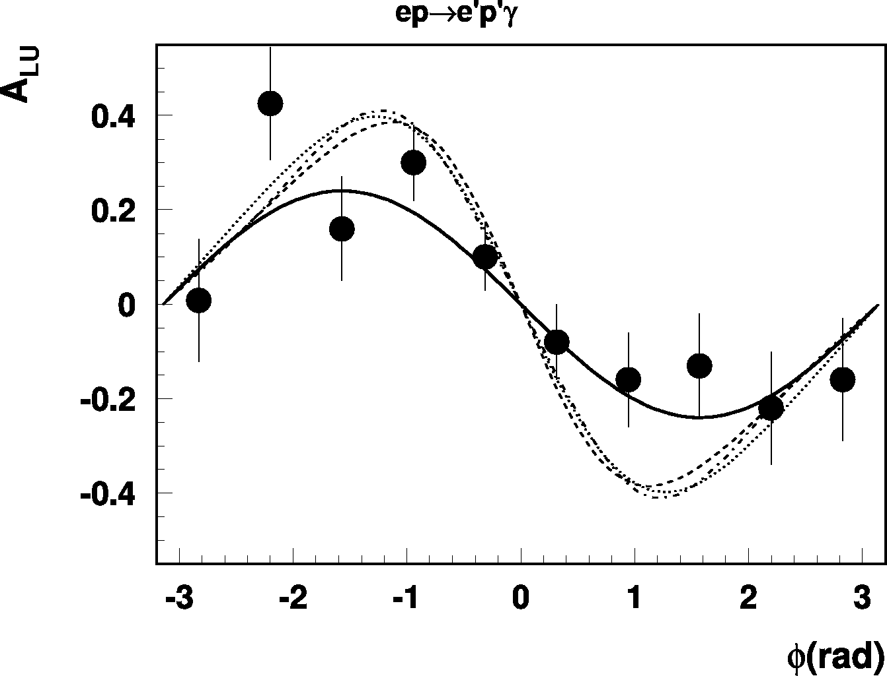
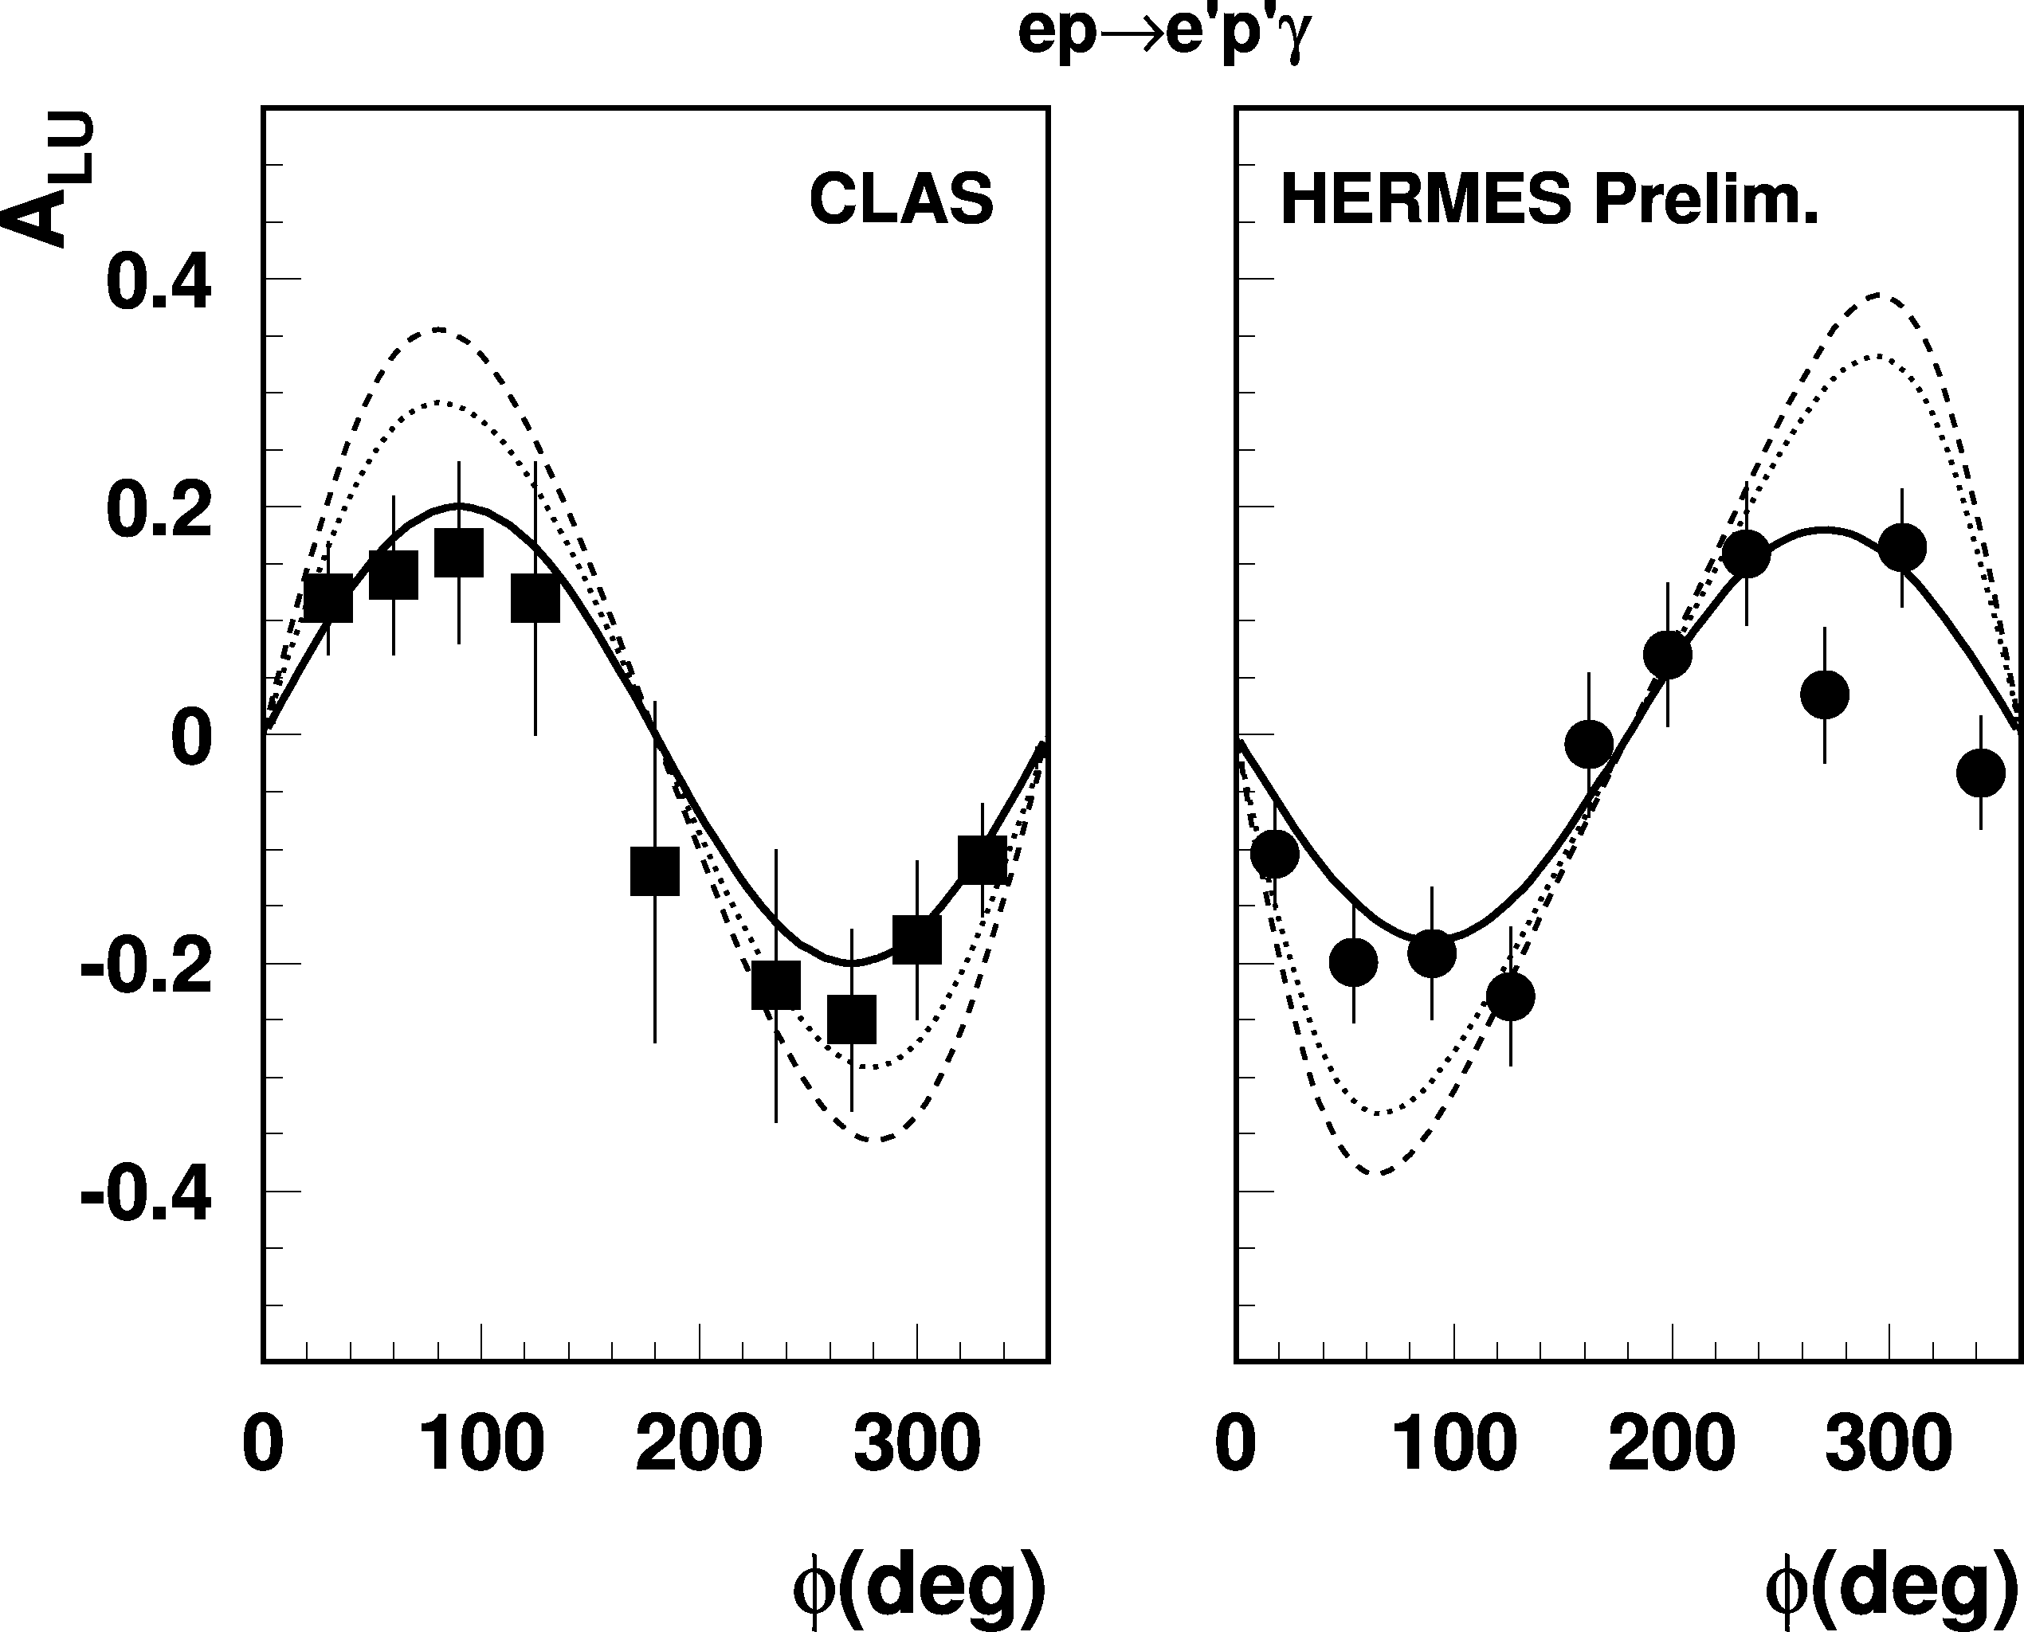
First observation of DVCS/BH beam asymmetry
e⁺p e⁺γX
2001
e⁻p e⁻pX
HERMES
27 GeV
CLAS
4.3 GeV
Q²=2.5 GeV²
0
Q²=1.5 GeV²
-180
φ(deg)
+180
Early GPD analysis of CLAS/HERMES/HERA data in LO/ NLO shows results consistent with handbag mechanism and lowest order pQCD. A. Freund (2003), A. Belitsky, et al. (2003)
Α(φ) = αsinφ + βsin2φ
β/α << 1 twist-3 << twist-2

Slide 10
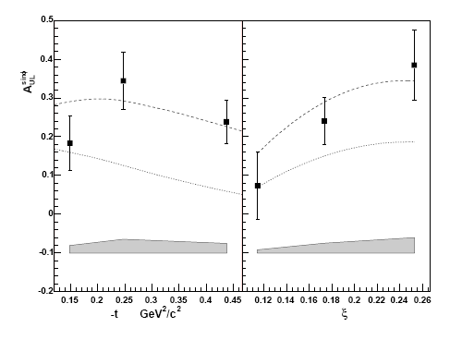
First DVCS measurement with spin-aligned target
Unpolarized beam, longitudinally spin-aligned target:
~
Δσ_{UL} ~ sinφIm{F₁H+ξ(F₁+F₂)H +… }dφ
~
H
A_{UL} is dominated by H and
S. Chen, et al., Phys. Rev. Lett 97, 072002 (2006)
CLAS
fit
model
~
model (H=0)
CLAS preliminary
~
~
H=0
H=0
α = 0.252 ± 0.042
β = -0.022 ± 0.045
Consistent with leading twist
Notes:
The first pioneering DVCS analysis with a spin polarized target shows a large target spin asymmetry. This very difficult analysis was carried out by Paul Eugenio’s graduate student Shifeng Chen as his PhD project. These beautiful data show for the first time the important role GPD H-tilde plays in this polarized target asymmetry as well as the rather strong dependence of the asymmetry on the parameter xi. This first measurement will be followed up with a future experiment with much improved statistical accuracy.

Slide 11
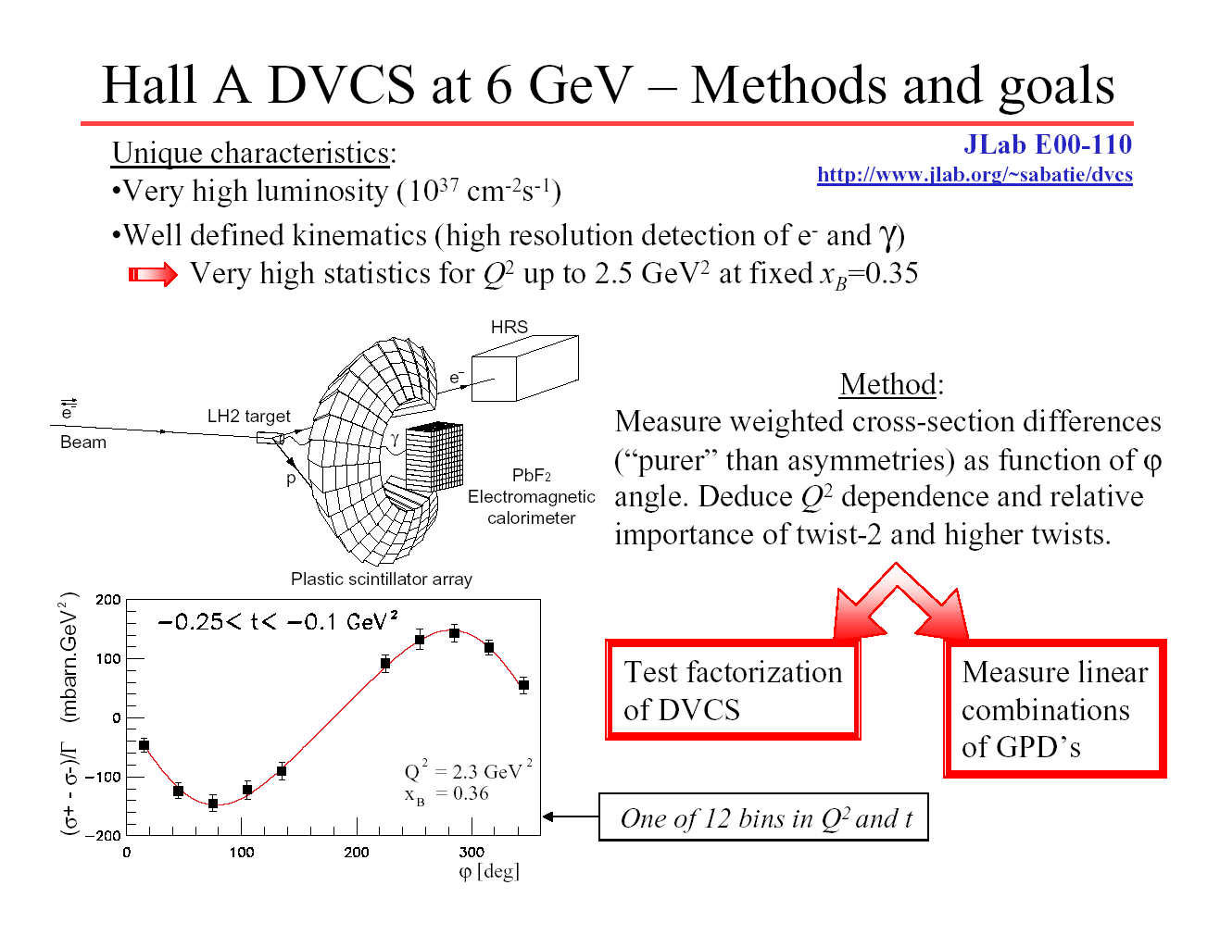
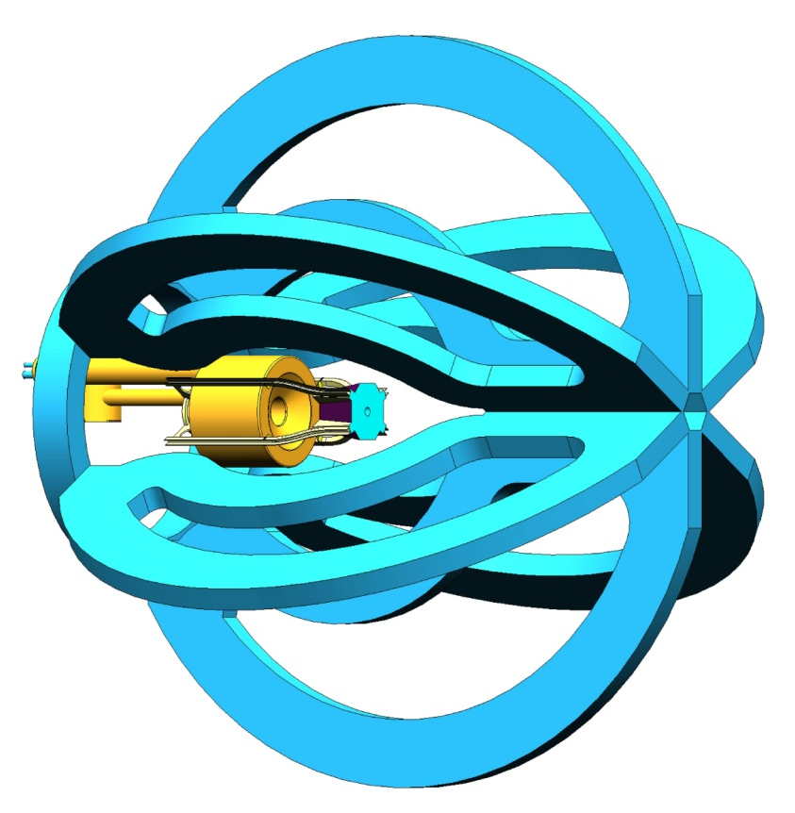
First Dedicated DVCS Experiments at JLab
Full reconstruction of all final state particles e, p, γ
High luminosity
Hall A
CLAS
s.c.
solenoid
PbWO₄
Electromagnetic
calorimeter
Azimuthal and Q² dependence
of Im(T^{DVCS}) at fixed x.
Test Bjorken scaling.
x, t, Q² - dependence of Im(T^{DVCS})
in wide kinematics. Constrain GPD models.

Slide 12
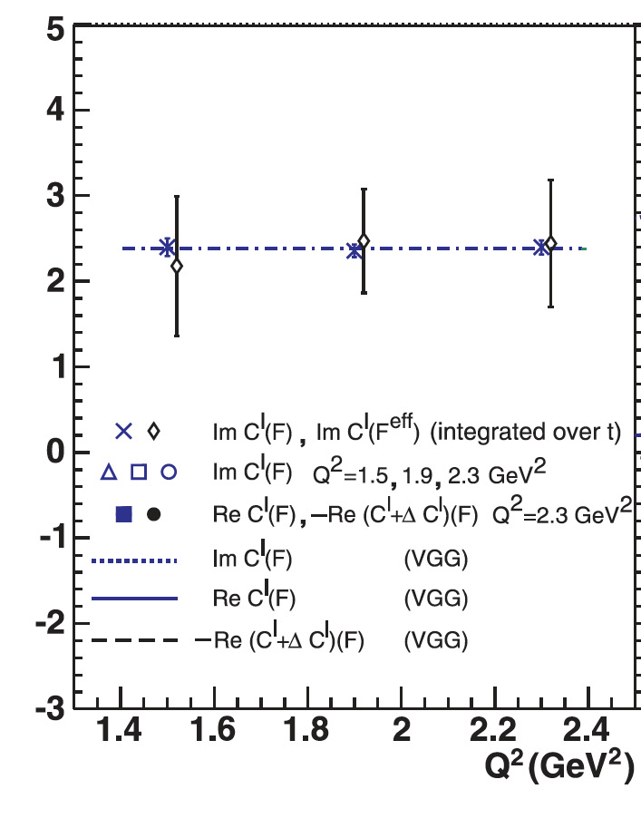
Results of the Hall A DVCS experiment
First absolute cross section measurements in the valence quark regime.
Verify Bjorken scaling of cross section in limited Q² range.
Phys.Rev.Lett.97:262002,2006
Notes:
At low and medium energies DVCS is the cleanest probe of GPDs. A hard virtual photon strikes a quark in the proton, which emits a hard real photon. The prpton remains intact and gets a transverse momentum kick. DVCS is sensitive to all 4 GPDs. Hall A cross section measurements showed that DVCS is consistent with dominance of the handbag mechanism. The CLAS data cover much larger kinematics in x_B, Q2, and t. but are currently limited to polarized beam asymmetries which also depend on the real parts of the Compton amplitude in a convolution integral that are more difficult to model. GPD based description show qualitative agreement with the CLAS asymmetry measurements. Nevertheless, these sets of data have been subjected to a model-independent extraction of the GPD related Compton form factors.

Slide 13
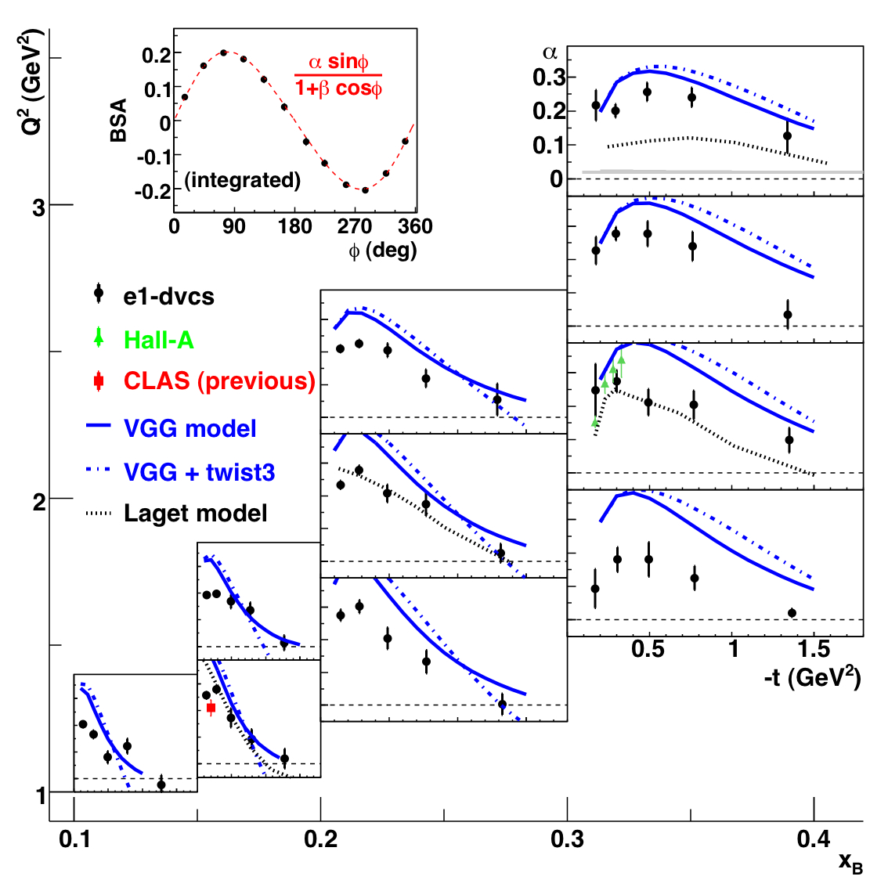
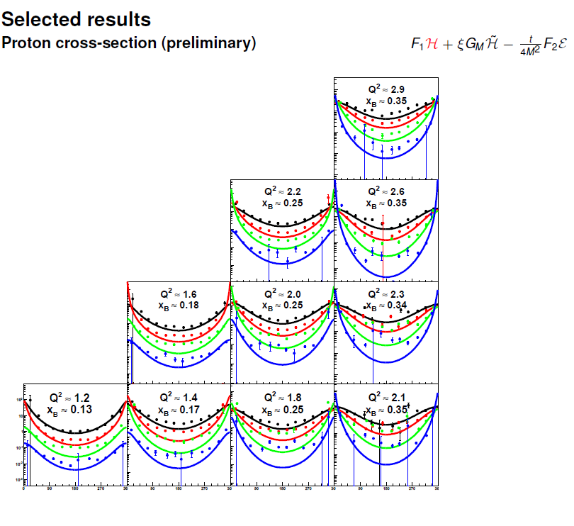
Results of the CLAS E1-DVCS experiment
Beam-spin asymmetries
Δσ_{LU} ~ sinφ{F₁H + ξ(F₁+F₂)H +kF₂E}dφ
Phys.Rev.Lett.100:162002,2008

Slide 14
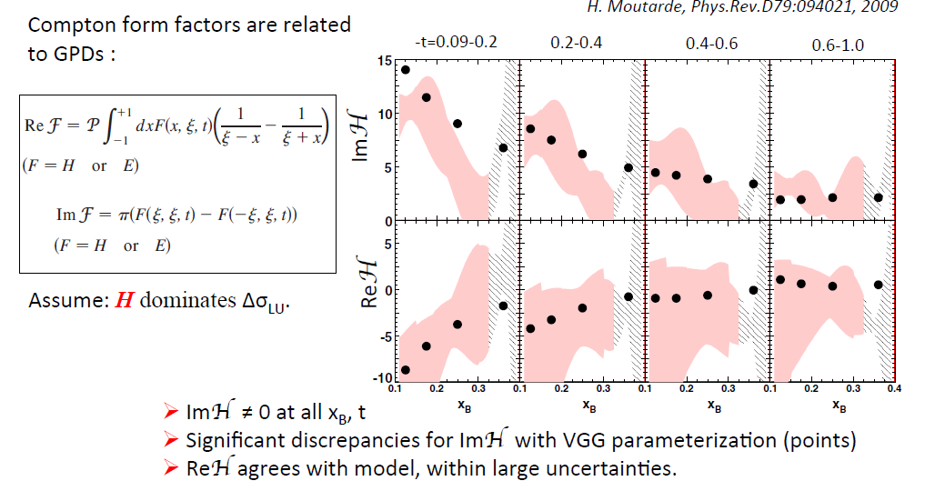
GPD extraction from truncated expansion (H only)
~
Truncation allows analysis of x and t dependences of H, but neglecting H is problematic.
H. Moutarde, Phys.Rev.D79:094021, 2009
Notes:
The CFF are related to GPDs as shown here. The imaginary part has a direct relationship with GPDs, the real part is related through an integral. The analysis assumes dominance of GPD H, which is kinematically unsuppressed in the polarized beam asymmetry while GPD E and H-tilde are kinematically suppressed as xi < 0.2 anf t< 1. The shaded area shows the extracted CFF compared to the VGG model description. The Im part dominates, with the exception of the small t and small x_B values where the Real part is significant. The uncertainties are totally dominated by the approximations. New data on polarized target in CLAS and future data with different beam energies in Hall A should significantly reduce these uncertainties.

Slide 15
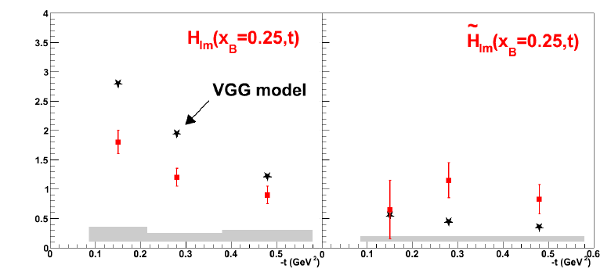
Extractions of GPDs from full expansion
A nearly model-independent GPD analysis in leading twist has become possible due the availability of beam-spin and target-spin asymmetry results at 3 values of t and fixed x.
M. Guidal, Phys.Rev.Lett. B689:156-162,2010
H_{Im} drops with t similar to VGG model but has smaller magnitude
H-tilde tends to be larger than model prediction

Slide 16
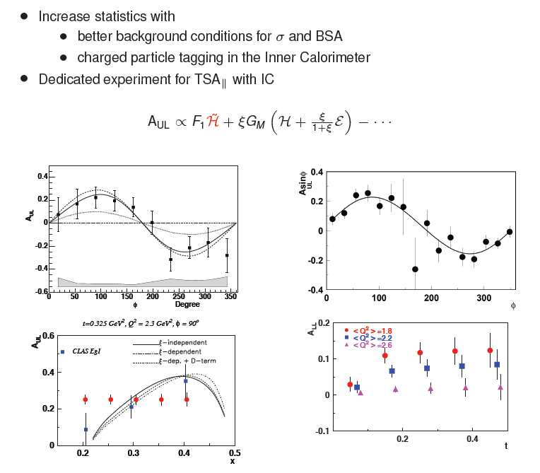
CLAS12 - DVCS – Dedicated longitudinally polarized target experiment
To extend GPD extraction from polarization data improvement of statistics and expansion of kinematical coverage is needed.
A_{UL}
Preliminary data from eg1-dvcs experiment have 10 times previous statistics
Pioneering results from data mining

Slide 17
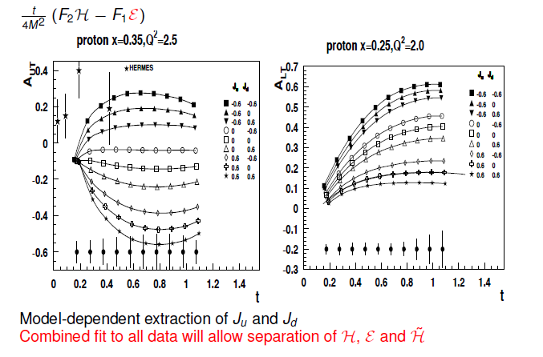
CLAS12 - DVCS with transversely polarized target
Transverse asymmetries A_{UT} and A_{LT} are sensitive to GPD E.
GPDs E and H enter in the angular momentum sum rule.
A precise measurement of A_{UT} will help resolve the proton spin puzzle.

Slide 18








JLab Upgrade to 12 GeV
At 12 GeV, CEBAF is an ideal
laboratory for GPD studies in the valence quark regime.
Add new hall
CHL-2
Enhance equipment in existing halls

Slide 19
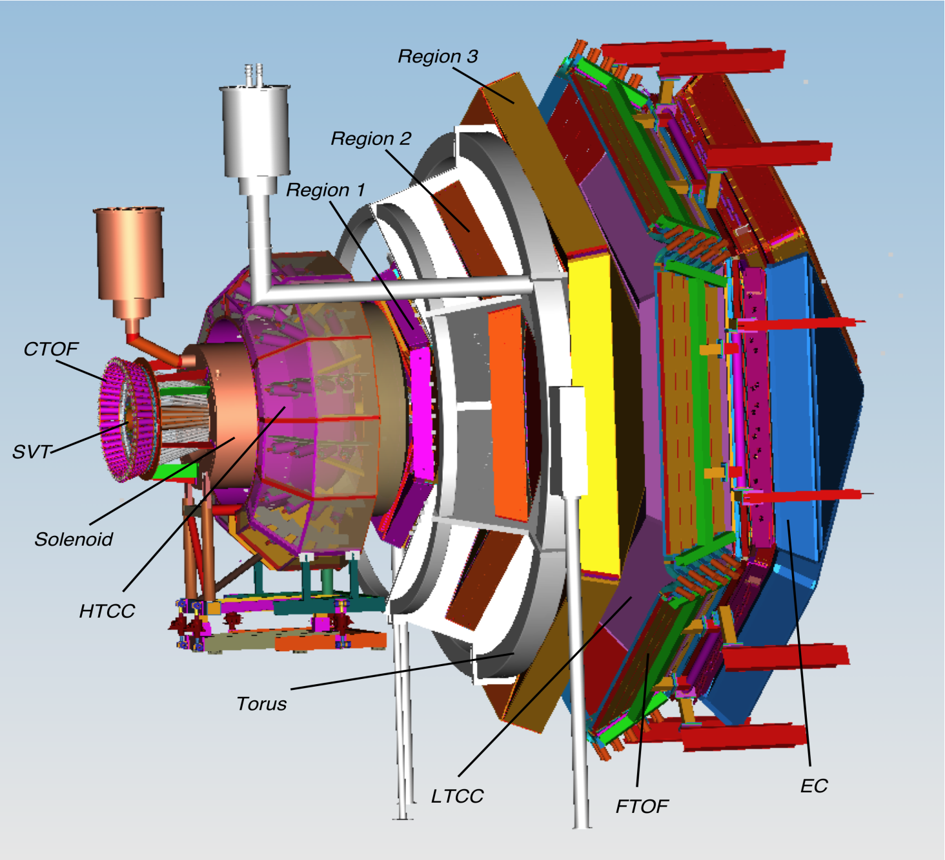

Hall B 12GeV upgrade overview from CLAS to CLAS12
CLAS will be replaced with CLAS12
CLAS12 is designed to operate with order of magnitude higher luminosity.
CLAS12 designed to accommodate polarized solid state targets NH₃, ND₃ and HD.
Present Day
CLAS

Slide 20
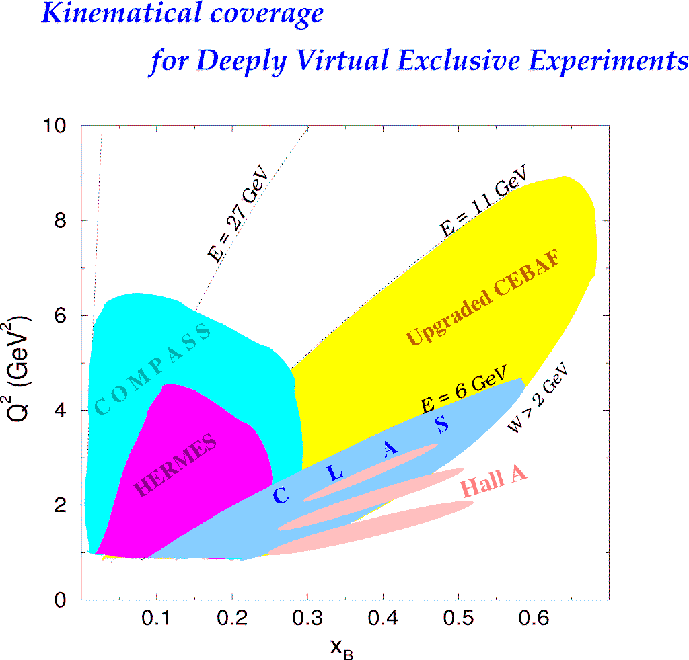
Kinematic reach of the 12 GeV Upgrade
Exclusive Processes
H1, ZEUS
H1, ZEUS
27 GeV
11 GeV
200 GeV
JLab @ 12 GeV
COMPASS
HERMES
Study of high x_{B} domain
requires high luminosity
0.7

Slide 21
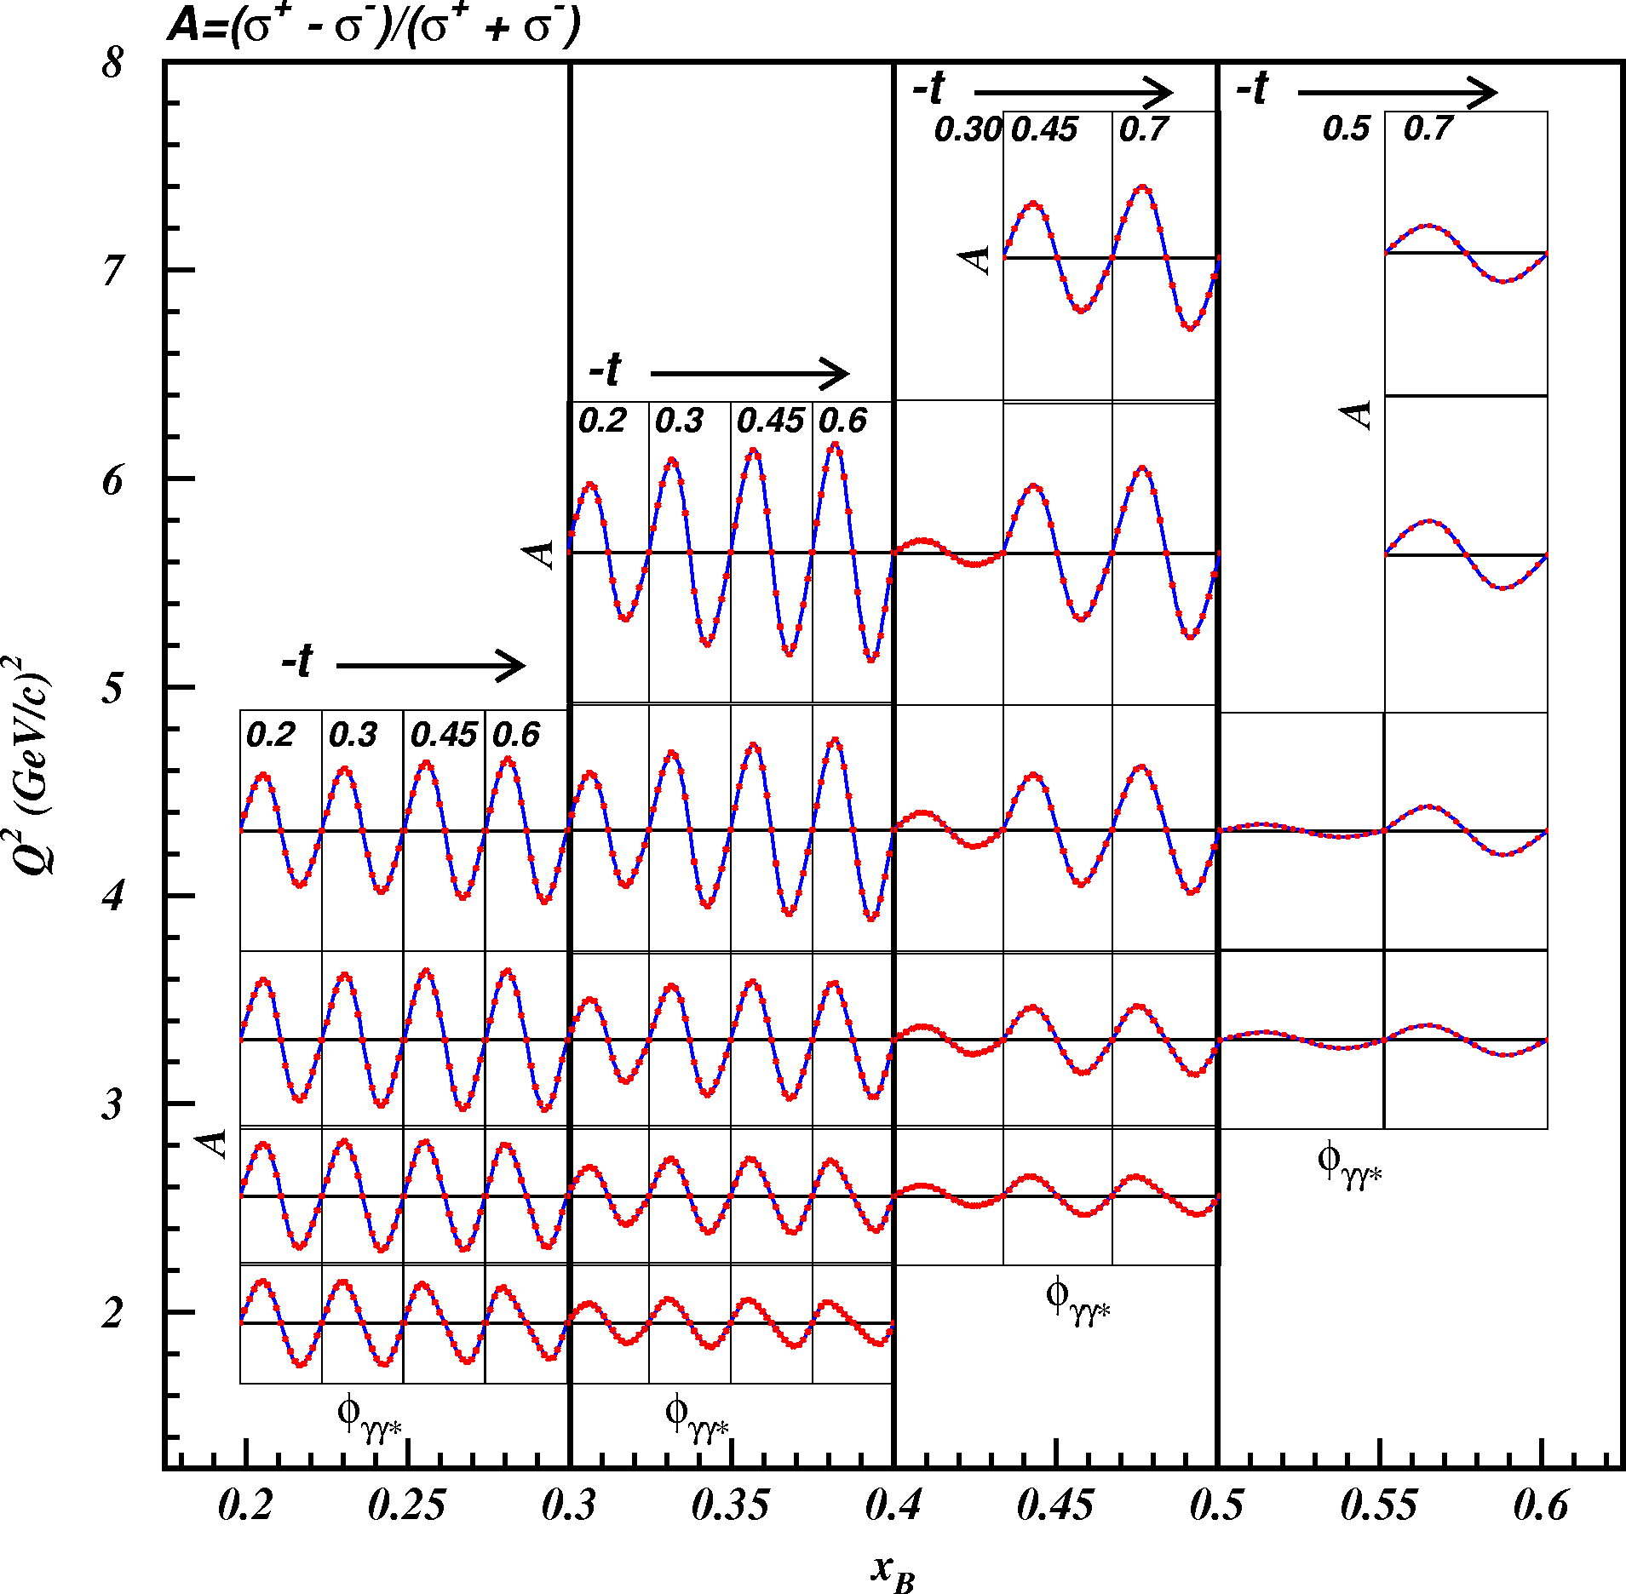
CLAS12 DVCS/BH- Beam Asymmetry at 12 GeV
A_{LU}
With large acceptance,
measure large Q², x_{B}, t
ranges simultaneously.
A(Q²,x_{B},t)
Δσ(Q²,x_{B},t)
σ(Q²,x_{B},t)

Slide 22
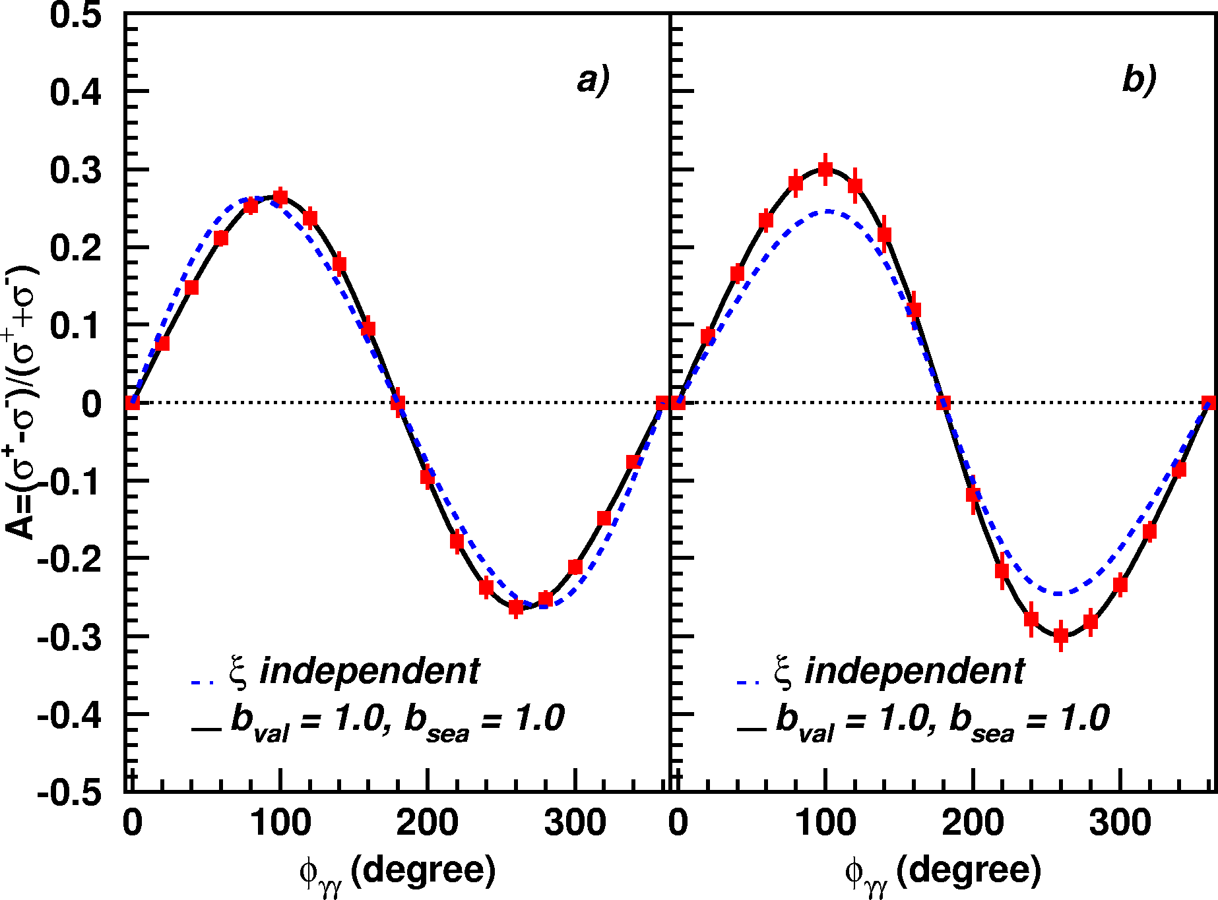
CLAS12 - DVCS/BH- Beam Asymmetry
Q²=5.5GeV²
x_{B} = 0.35
-t = 0.25 GeV²
Luminosity = 720fb⁻¹

Slide 23
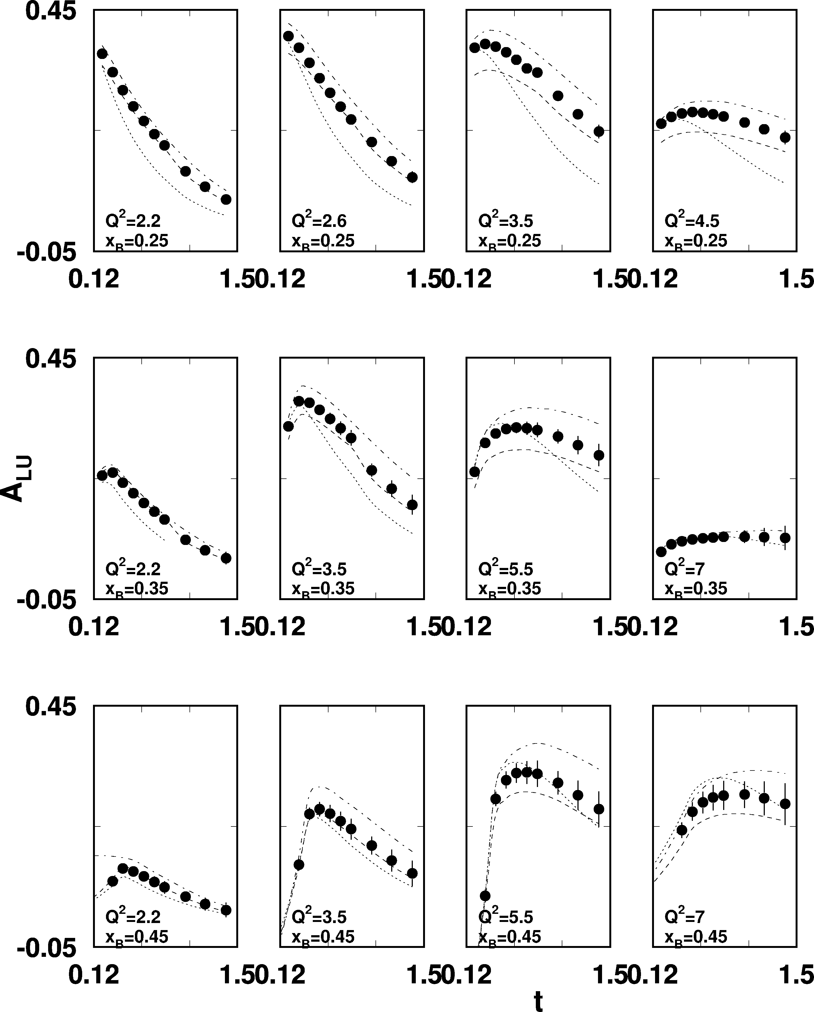
CLAS12 - DVCS/BH Beam Asymmetry
e p epγ
E = 11 GeV
Δσ_{LU}~sinφIm{F₁H+..}dφ
Selected
Kinematics
L = 1x10³⁵
T = 2000 hrs
ΔQ² = 1 GeV²
Δx = 0.05

Slide 24
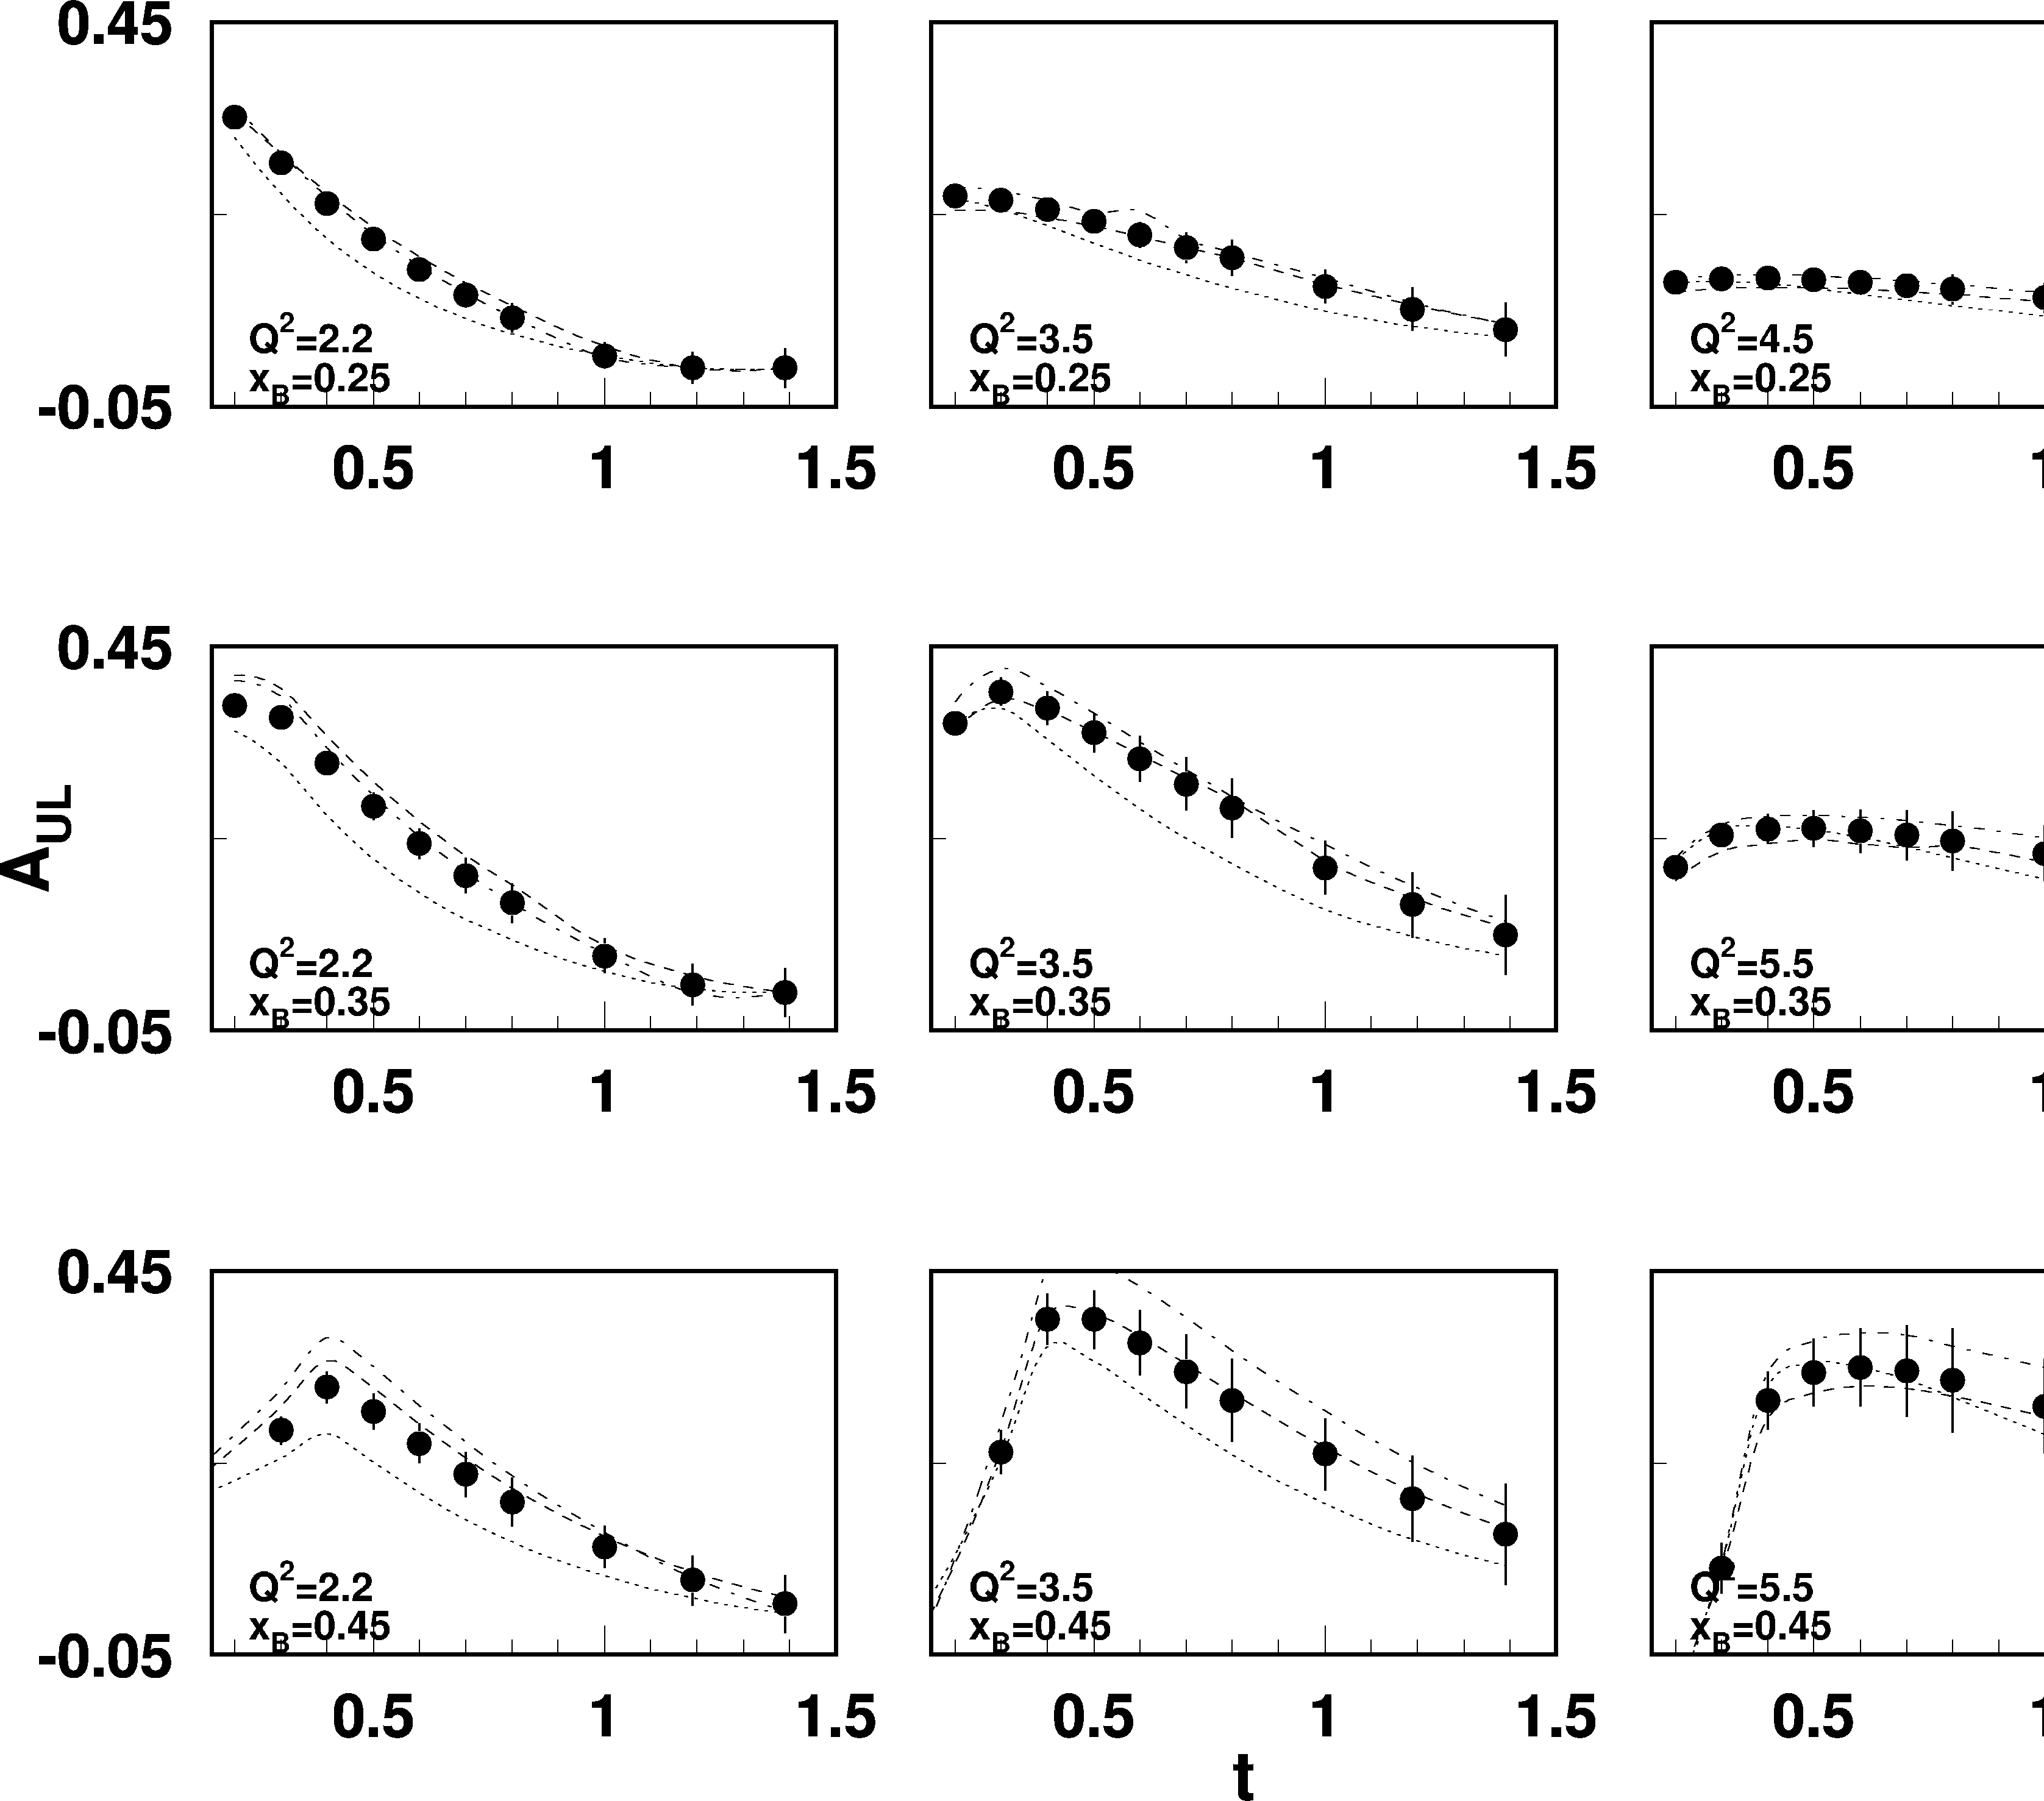
CLAS12 - DVCS/BH Longitudinal Target Asymmetry
L = 2x10³⁵ cm⁻²s⁻¹
T = 1000 hrs
ΔQ² = 1GeV²
Δx = 0.05
E = 11 GeV
e p epγ
~
Δσ~sinφIm{F₁H+ξ(F₁+F₂)H...}dφ

Slide 25
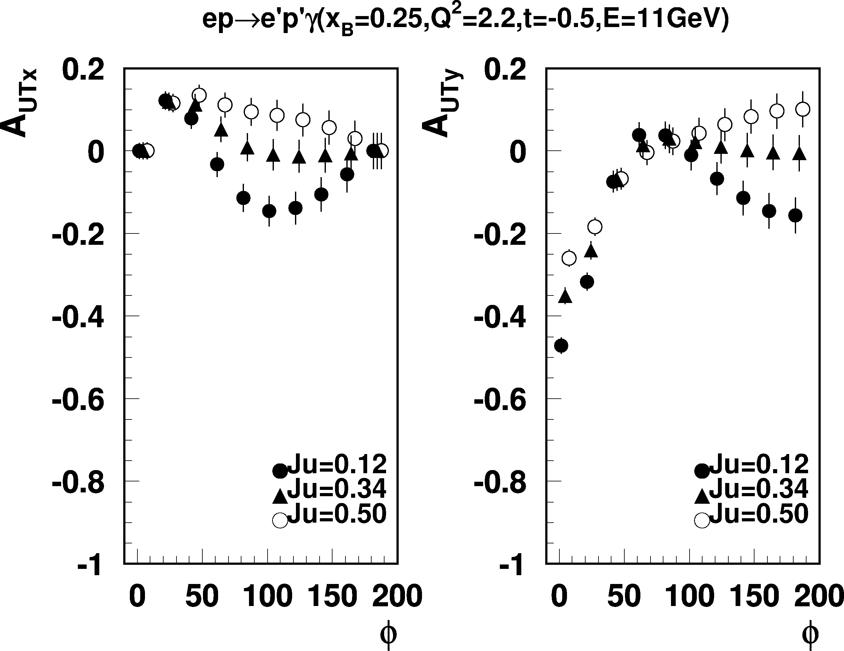
CLAS12 - DVCS/BH Transverse Target Asymmetry
Sample kinematics
e p epγ
E = 11 GeV
Q²=2.2 GeV², x_{B} = 0.25, -t = 0.5GeV²
Transverse polarized target
Δσ ~ cosφIm{k₁(F₂H – F₁E) +…}dφ
A_{UTx} Target polarization in the
scattering plane
A_{UTy} Target polarization perpendicular
to the scattering plane
Asymmetries highly sensitive to the u-quark contributions to the
proton spin.

Slide 26
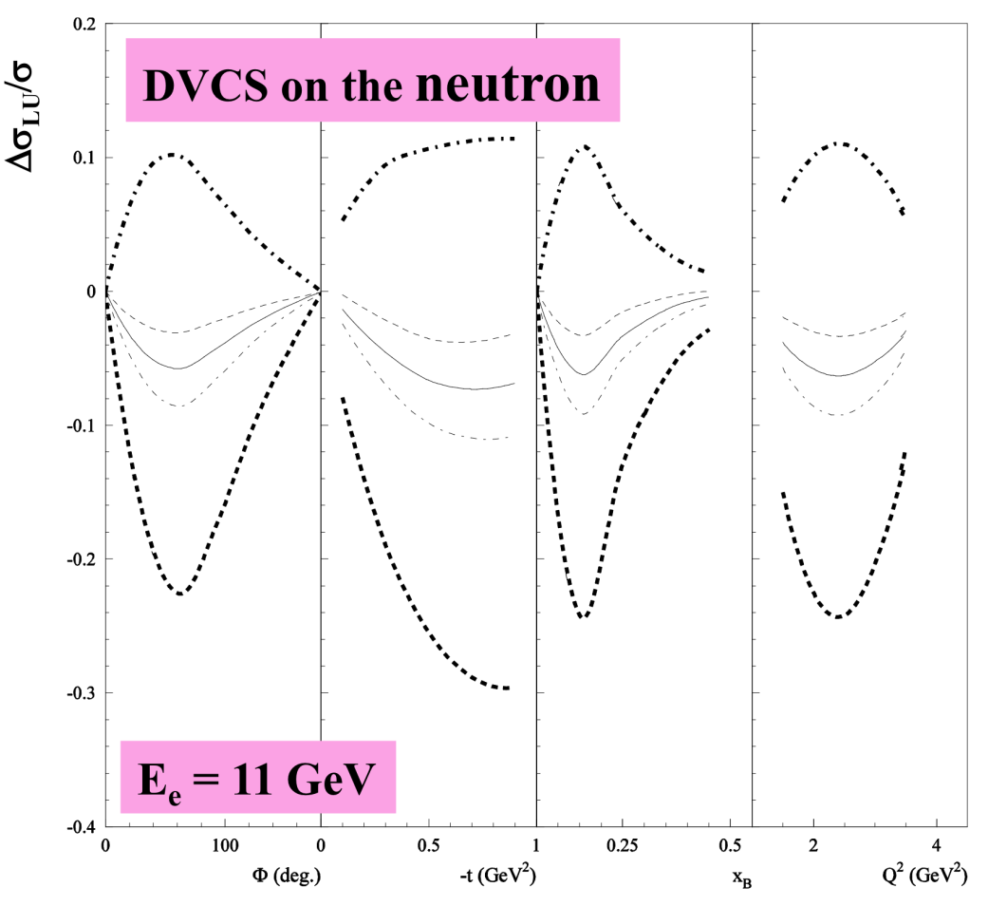
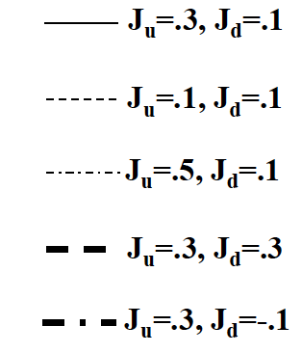
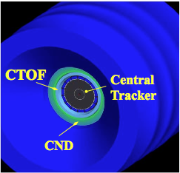
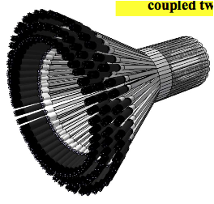
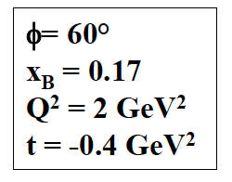
CLAS12 – DVCS/BH beam spin asymmetry on neutrons
This program requires adding a Central Neutron Detector (CDN) to the CLAS12 base equipment.
DVCS on neutrons is sensitive to GPD E^{n} and the d-quark content of the nucleon spin.
CND
European Initiative led by: Orsay University

Slide 27
CLAS12
Forward Detector:
- TORUS magnet
- Forward SVT tracker
HT Cherenkov Counter
Drift chamber system
LT Cherenkov Counter
Forward ToF System
Preshower calorimeter
E.M. calorimeter
Central Detector:
SOLENOID magnet
Barrel Silicon Tracker
Central Time-of-Flight
Polarized target (NSF)
Proposed upgrades:
Micromegas (CD)
Neutron detector (CD)
RICH detector (FD)
Forward Tagger (FD)

Slide 28
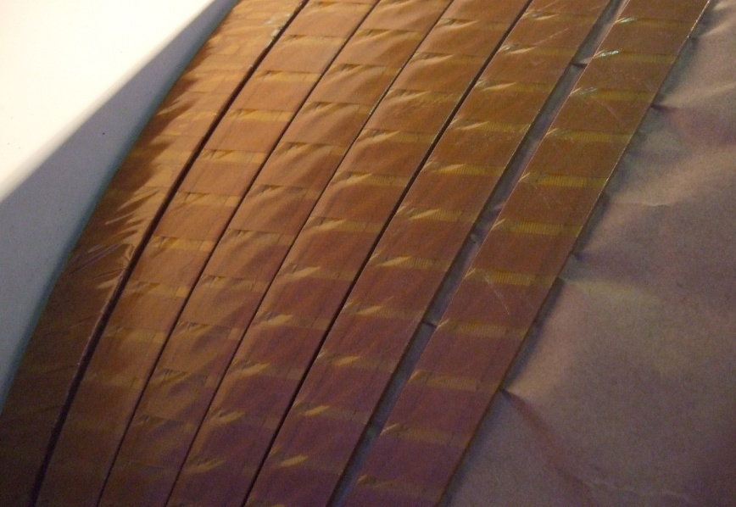
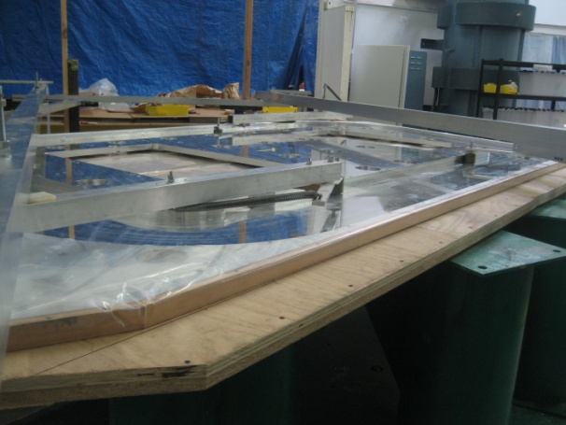
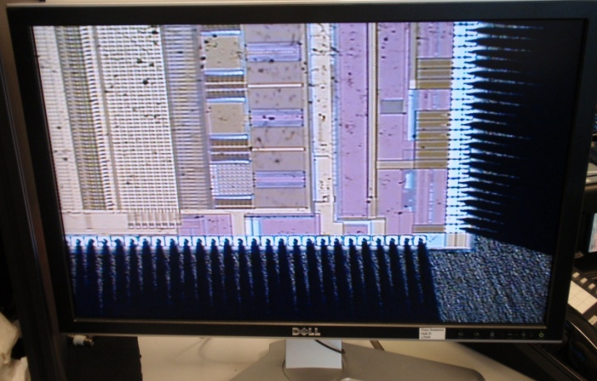
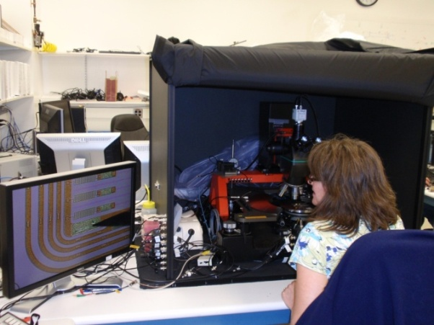
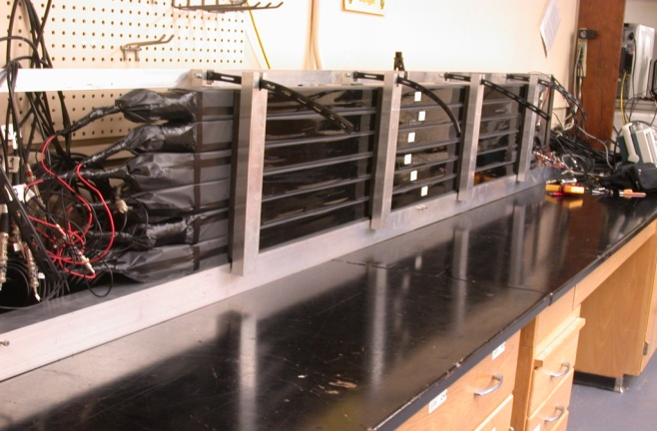
CLAS12 in construction - examples
Super Conducting Magnets
  Conductor ready
  Torus Coil case being prepared for coil winding
Silicon Vertex Tracker
  Testing of the readout chip
  Sensor testing
Forward Time of Flight
  PMT testing at USC
  Scintillator testing at USC

Slide 29
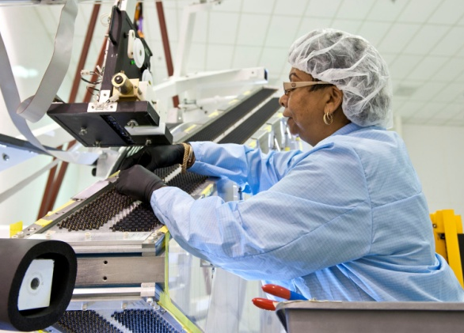
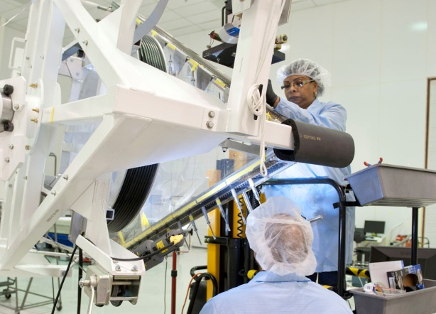
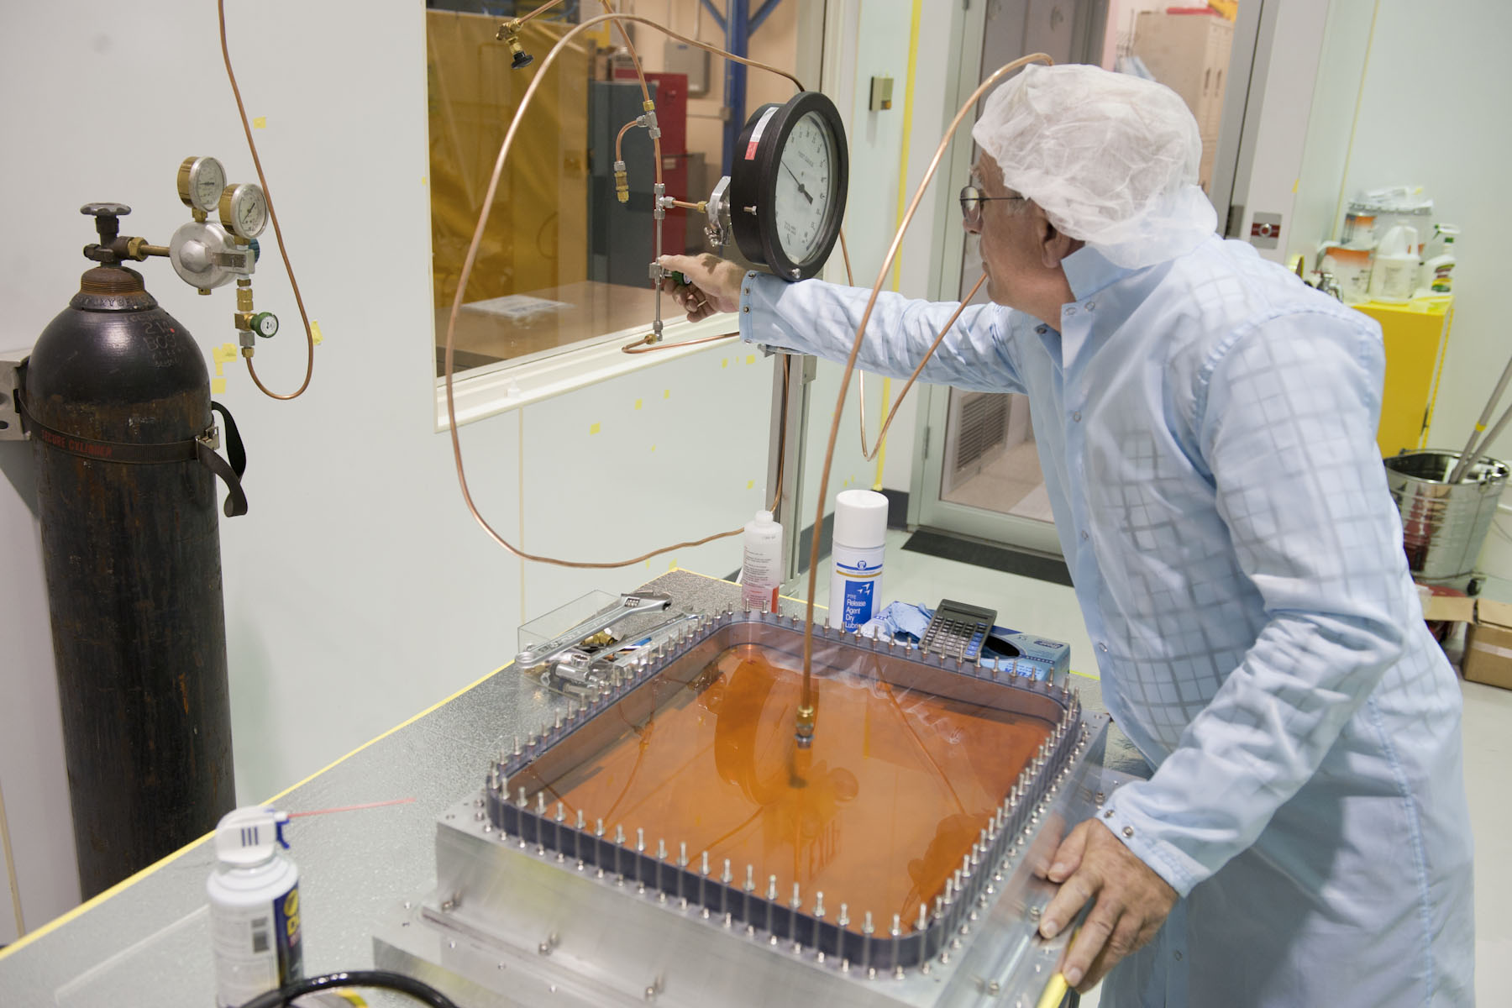
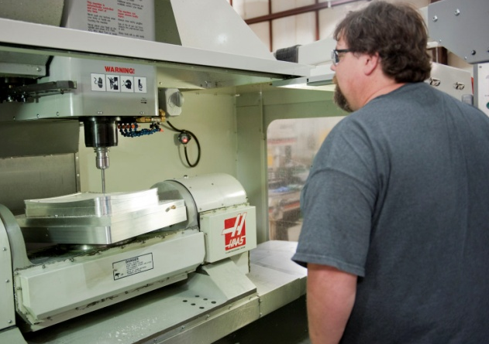
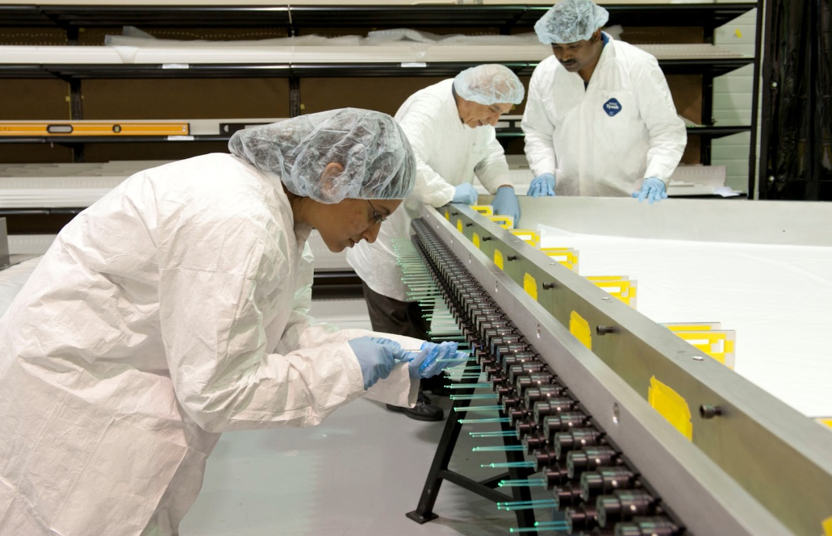
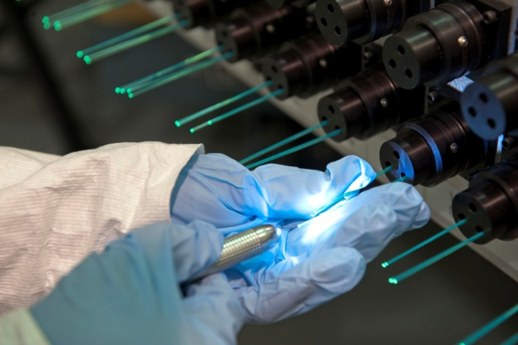
CLAS12 Under Construction - Examples
Drift Chambers
  Wire stringing of RI at JLab
  Wire stringing of RII at ODU
High Threshold Cerenkov
  Mirror fabrication in the JLab Clean room
  Mirror trimming at JLab Machine shop
Pre-Shower Calorimeter
(MRI/NSF)
  Module assembly
  Fibers QA

Slide 30
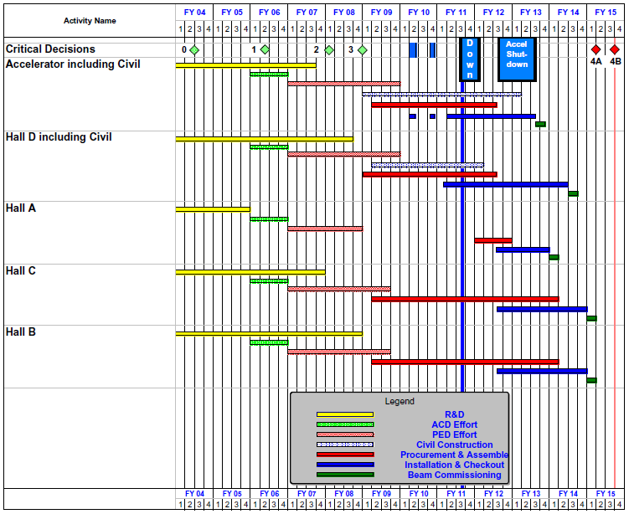
12 GeV Upgrade Project Schedule
    Two short parasitic installation periods in FY10
    6-month installation
    May-Oct 2011
    12-month installation
    May 2012-May 2013
    Hall A commissioning start October 2013
    Hall D commissioning start
    April 2014
    Halls B & C commissioning start October 2014
    Project Completion June 2015

Slide 31
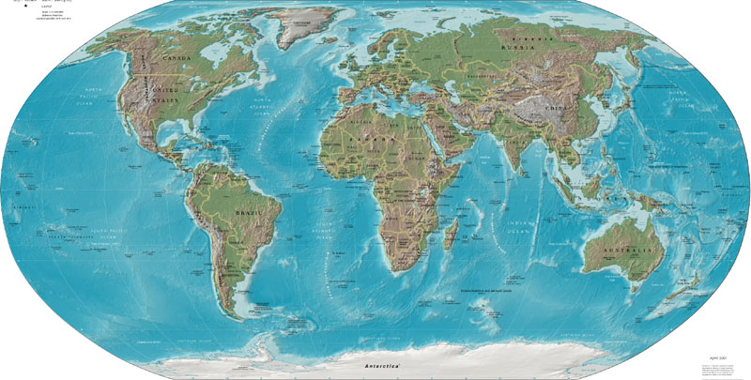












CLAS Collaboration Collaborai Collaboration
Arizona State University, Tempe, AZ
University Bari, Bari, Italy
University of California, Los Angeles, CA
California State University, Dominguez Hills, CA
Carnegie Mellon University, Pittsburgh, PA
Catholic University of America
CEA-Saclay, Gif-sur-Yvette, France
Christopher Newport University, Newport News, VA
University of Connecticut, Storrs, CT
Edinburgh University, Edinburgh, UK
University Ferrara, Ferrara, Italy
Florida International University, Miami, FL
Florida State University, Tallahassee, FL
George Washington University, Washington, DC
University of Glasgow, Glasgow, UK
University of Grenoble, Grenoble, France
Idaho State University, Pocatello, Idaho
INFN, Laboratori Nazionali di Frascati, Frascati, Italy
INFN, Sezione di Genova, Genova, Italy
Institut de Physique Nucléaire, Orsay, France
ITEP, Moscow, Russia
James Madison University, Harrisonburg, VA
Kyungpook University, Daegu, South Korea
University of Massachusetts, Amherst, MA
Moscow State University, Moscow, Russia
University of New Hampshire, Durham, NH
Norfolk State University, Norfolk, VA
Ohio University, Athens, OH
Old Dominion University, Norfolk, VA
Rensselaer Polytechnic Institute, Troy, NY
Rice University, Houston, TX
University of Richmond, Richmond, VA
University of Rome Tor Vergata, Italy
University of South Carolina, Columbia, SC
Thomas Jefferson National Accelerator Facility, Newport News, VA
Union College, Schenectady, NY
University Santa Maria, Valparaiso, Chile
Virginia Polytechnic Institute, Blacksburg, VA
University of Virginia, Charlottesville, VA
College of William and Mary, Williamsburg, VA
Yerevan Institute of Physics, Yerevan, Armenia
Brazil, Germany, Morocco and Ukraine,
, have individuals or groups involved with CLAS,
but with no formal collaboration at this stage.

Slide 32
Summary
The discovery of Generalized Parton Distributions
has opened up a new and exciting avenue of hadron
physics that needs exploration in dedicated experiments.
Moderate to high energy, high luminosity, and large acceptance spectrometers are needed to measure GPDs in deeply virtual exclusive processes.
The JLab 12 GeV Upgrade provides the tools to do this well and explore the nucleon at a much deeper level.

Slide 33
CLAS12 - Institutions
  Armenia:
  - Yerevan Physics Institute, Yerevan, Armenia
United States of America:
Argonne National Laboratory, Argonne, Il
California State University, Dominguez Hills, CA
- Catholic University of America, Washington, DC
- College of William and Mary, Williamsburg, VA
- Christopher Newport University, Newport News, VA
- Fairfield University, Fairfield, CT
Florida International University, Miami, FL
Hampton University, Hampton, VA
- Idaho State University, Pocatella, ID
- James Madison University, Harrisionburg, VA
- Norfolk State University, Norfolk, VA
- Ohio University, Athens, OH
- Old Dominion University, Norfolk, VA
- Rensselaer Polytechnic Institute, Troy, NY
- Temple University, Philadelphia, PA
- Jefferson Lab, Newport News, VA
- University of Connecticut, Storrs, CT
- University of New Hampshire, Durham, NH
- University, of Richmond, Richmond, VA
- University of South Carolina, Columbia, SC
University of Virginia, Charlottesville, VA
Chile:
- University Santa Maria, Valparaiso
France:
- Grenoble University, IN2P3, Grenoble
- Orsay University, IN2P3, Paris
- CEA Saclay, IRFU, Paris
Italy:
- INFN - LNF, Roma
- INFN - Genova, Genova
INFN - University Bari, Bari
INFN - University Ferrara, Ferrara
- INFN - ISS, Roma
- INFN - Roma II, Tor Vergata, Roma
Republic of Korea:
- Kyungpook National University, Daegu, Korea
Russian Federation:
- MSU, Skobeltsin Institute for Nuclear Physics, Moscow
- MSU, Institute for High Energy Physics, SiLab, Moscow
- Institute for Theoretical and Experimental Physics, Moscow
United Kingdom:
- Edinburgh University, Edinburgh, Scotland
- Glasgow University, Glasgow, Scotland
38 Institutions, November 2010

