Slide 1

Nuclear Forces at Short Distances
and the Dynamics of Neutron Stars
Misak Sargsian
Florida International University, Miami
JLab Users Group Meeting
June 6-8 2011, Newport News, VA

Slide 2
Progam of Small Distances in Nuclei
Deuteron at large internal momenta
- the relativistic bound state
- interaction with deeply bound nucleons
- non nucleon degrees of freedom
- hadron-quark transition
Nuclei at Large Internal Momenta and
Excitation Energies
- identifying NN Short Range Correlations
- dynamics of such correlations
- beyond NN correlations
- hadron-quark transition
- Astrophysical Applications
- equation of state of dense nuclear matter
- electro-weak processes in neutron stars
- existence of cold quark matter

Slide 3
(i) Measuring the High Momentum Component of the
Deuteron wave function
(ii) Studies of two-nucleon short range correlations
(iii) Implications: Protons in the superdense nuclear
matter:

Slide 4
How to probe small distances in nuclei
for Deuteron
1. Probe nucleon with large virtuality
2. Probe large relative momenta
High Density Fluctuations

Slide 5
How to probe high density fluctuations in nuclei
for A > 2
Probe large initial momenta of nucleon in the nucleus and large excitation energy of residual A-1 nucleus
If at large k,
Frankfurt MS
Strikman IJMP 08

Slide 6
To Probe large initial nucleon momenta and nuclear
excitation energies
Transferred energy to nuclei
Frankfurt , MS
Strikman IJMP 2008
Transferred momentum to nuclei

Slide 7
(2) Probing Small Distances/High Density Fluctuations
in Nuclei
Probing NN system in the nucleus at high missing
momenta and energies

Slide 8
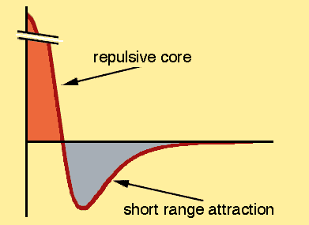
Expectation:
Signatures of nuclear structure at small distances will be those of the NN system at small separations
Nuclear momentum Distributions
Reflecting the dynamics of the NN interaction at short distances

Slide 9
Isospin 1 states
Isospin 0 states
Strong disparity between pp and pn pairs in the
region of tensor correlation

Slide 10
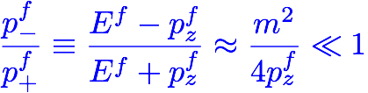

Method High Energy and Momentum Transfer Nuclear Reactions
I. Momenta involved in the reactions q ≈ p_{f} > few GeV/c.
A new small parameters

Slide 11
Interaction with deeply bound nucleon, relativistic effects, etc
(virtual nucleon, Light Cone approximation…)
(a) What we want to study:
(b) Framework
Generalized Eikonal Approximation
(c) Suppress
(d) Framework
Generalized Eikonal Approximation

Slide 12
Generalized Eikonal Approximation
MS, Int. J.Mod.Phys, 2001

Slide 13
Effective Feynman Diagram Rules
Frankfurt, Strikman, MS
Phys. Re. C 1997
MS, Int. J.Mod.Phys, 2001
Ciofi degli Atti, Kaptari, 2001
Ciofi degli Atti, Kaptari, 2007
MS, Abrahamyan, Frankfurt,
Strikman Phys. Rev.C 2005
MS, Phys. Rev. C 2010

Slide 14
(i) Measuring the High Momentum Component of the
Deuteron wave function
knock-out
GEA
L.Frankfurt, M.Strikman
PRC 1997, M.S. IJMP01

Slide 16
Structure of Final State interaction:
GEA
GA
L.Frankfurt, M.S. M.Strikman PRC 1997
Frankfurt, MS, Strikman, PRC1997 ,

Slide 17
et al, PRL07

Slide 18
Werner Boeglin
Luminita Coman, PhD 2007

Slide 19
Measuring Deuteron Momentum Distribution at Large Internal Momenta
Blomqvist et al1998
Ulmer et al 2002
Q2 = 0.33 GeV2
Q2 = 0.667GeV2

Slide 21
JLab HALL A experiment : Boeglin et al ArXiv : 1106:0275, 1 June 2011

Slide 22

II. Two Nucleon Short Range Correlations in Nuclei
First SRC Studies in Nuclei at JLab were
done in inclusive A(e,e’)X reactions at
x > 1
For finite Q2
Light cone momentum fraction of nucleus carried by interacting nucleon
normalized to A

Slide 23






signatures for short range correlations
at least 2 nucleons are needed
at least 3 nucleons are needed
at least j+1 nucleons are neede
Frankfurt & Strikman PR 88
Prediction for Scaling
if only 2 nucleons then
scales
if only 3 nucleons then
scales
if only j+1 nucleons then
scales

Slide 24
First such analysis was done
using different SLAC data sets
Day, Frankfurt ,MS, Strikman PRC 93

Slide 25
More refined experiment at JLAB measured

Slide 26
Egiyan, et al PRC 2004

Slide 28
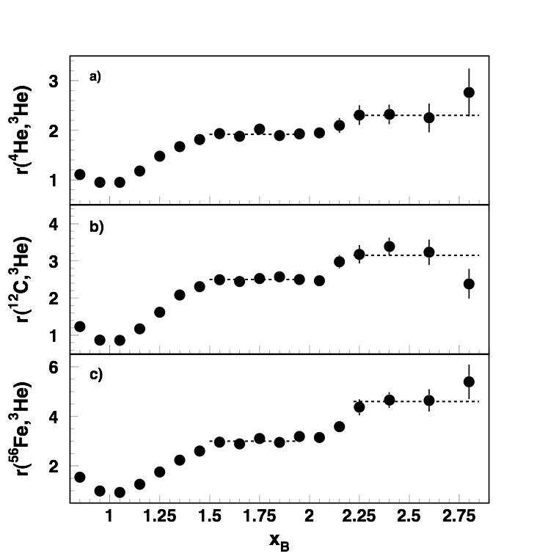
Egiyan, et al PRL 2006

Slide 29
Meaning of the scaling values
In the situation when scaling is established
introduce
where
Probability of finding 2N or 3N SRCs relative to deuteron and helium 3
Fraction of High momentum component of nuclear wave function due to
2N SRC
3N SRC

Slide 30
Egiyan, et al PRL 2006

Slide 31
How to probe high density fluctuations in nuclei
for A > 2
Probe large initial momenta of nucleon in the nucleus and large excitation energy of residual A-1 nucleus
If at large k,
Frankfurt MS
Strikman IJMP 08

Slide 32
Are they really Correlations?

Slide 33
proton
Brookhaven National Lab
A(p,ppn)X Experiment
proton
proton
neutron

Slide 34
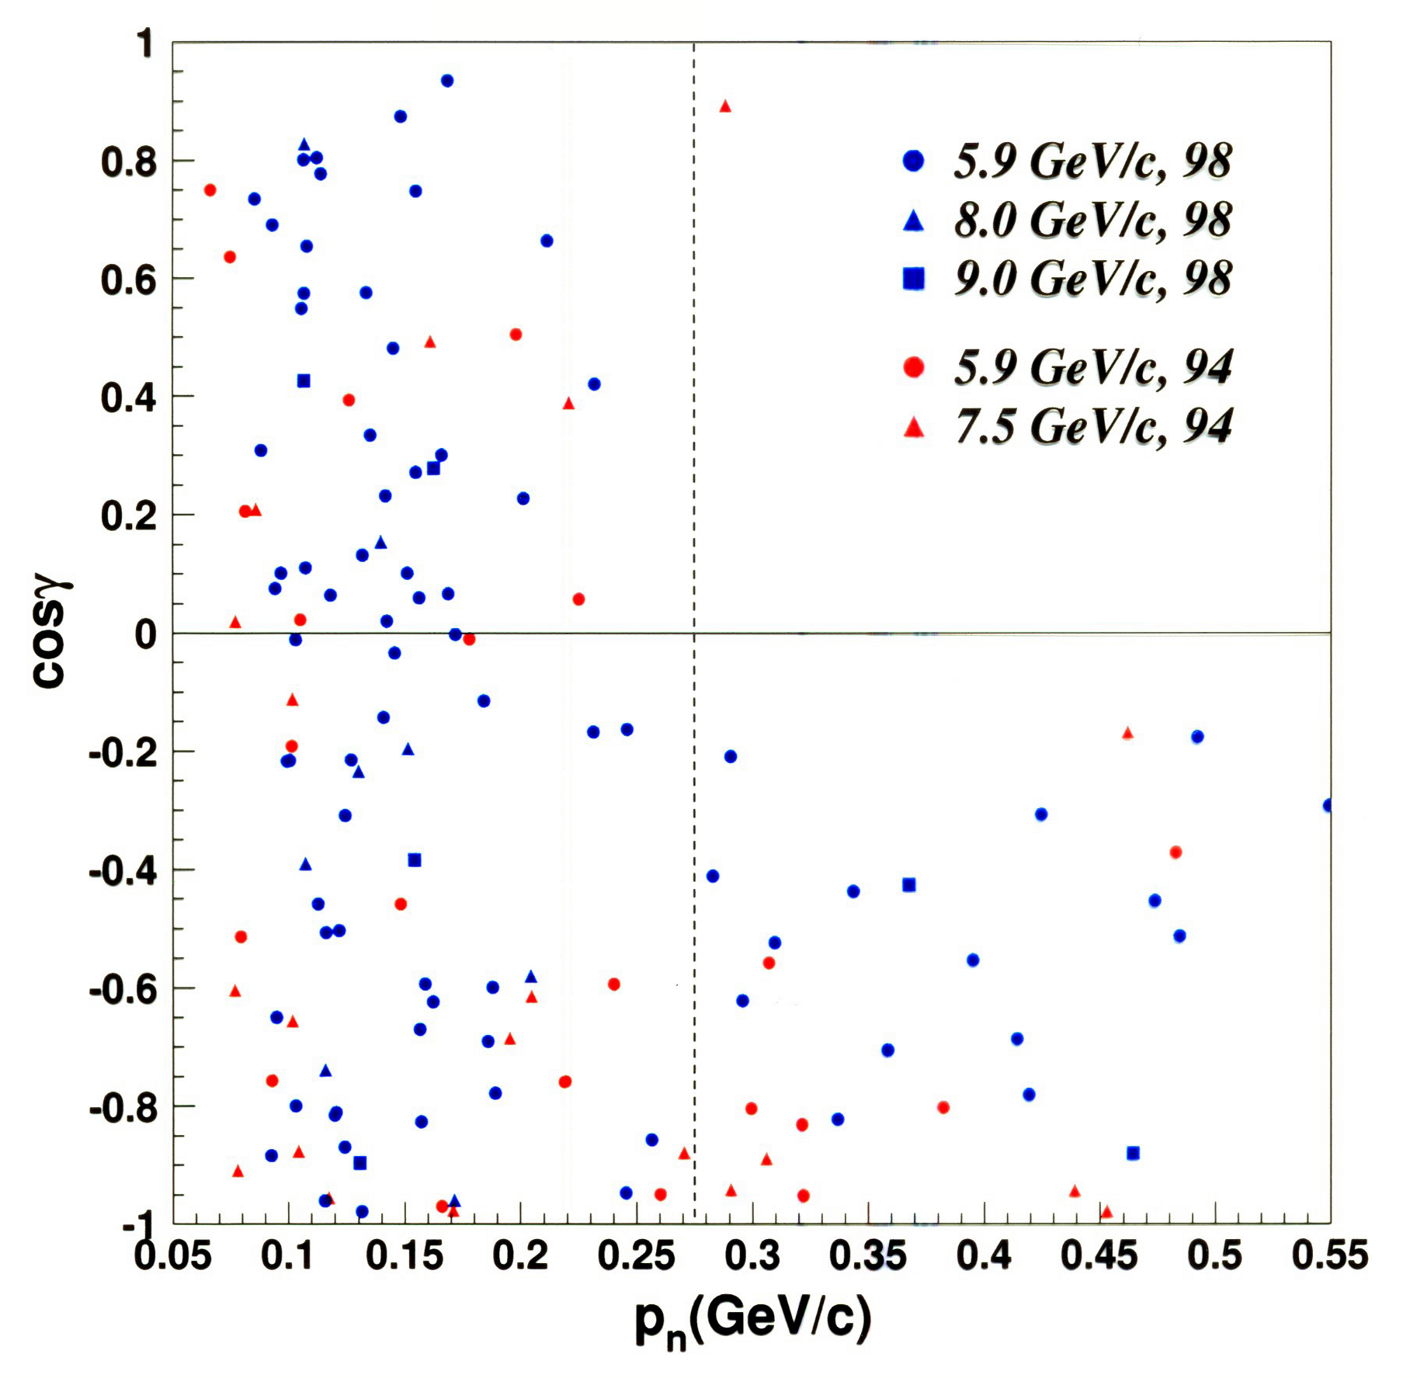
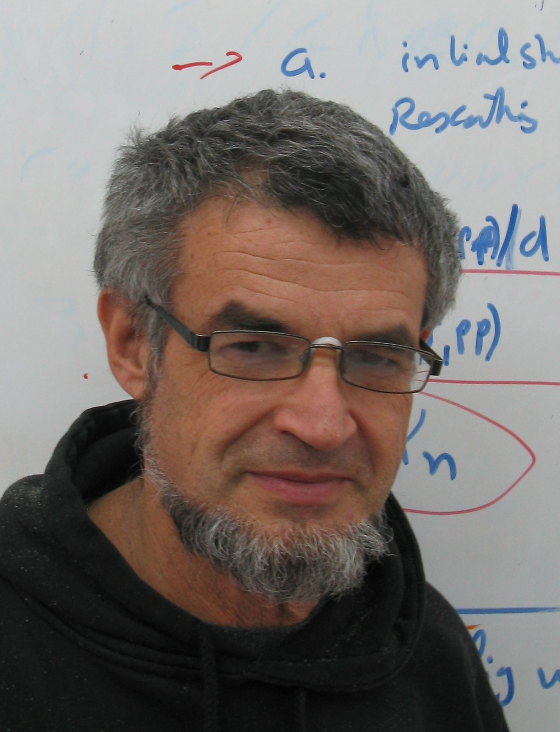
Eli Pasetzky
TAU
A. Tang et al, PRL 2003

Slide 35

Piasetzky, MS, Frankfurt,
Strikman, Watson PRL 2007
92% of the time two-nucleon high density fluctuations
are proton and neutron
at most 4% of the time proton-proton or neutron-neutron

Slide 36
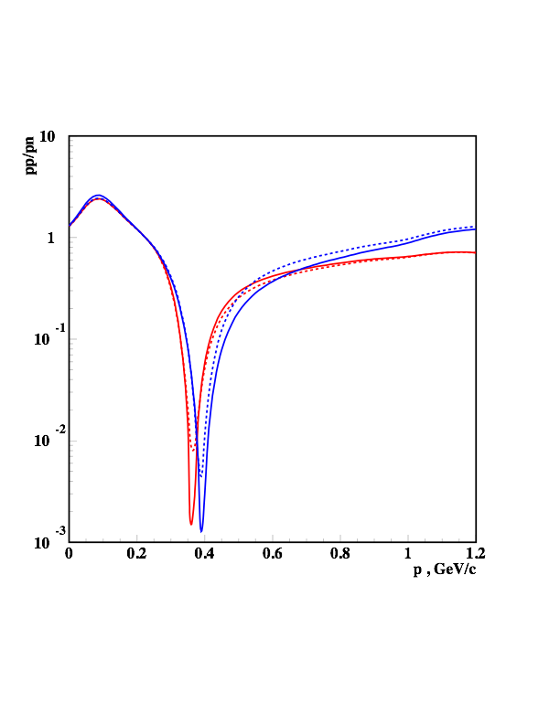
Isospin 1 states
Isospin 0 states

Slide 37


Jeferson Lab Experiment
electron
R. Shneor et al. PRL 07
electron
proton
neutron/proton

Slide 38
BNL data on A(p,2pn)X
Piasetzky, MS, Frankfurt,
Strikman, Watson PRL 2007
92% of the time two-nucleon high density fluctuations
are proton and neutron
at most 4% of the time proton-proton or neutron-neutron
JLAB data A(e,e’pn)X
R. Shneor et al. PRL 07

Slide 39
Combined Analysis
R.Subdei, et al Science , 2008
pn
pp
nn

Slide 40
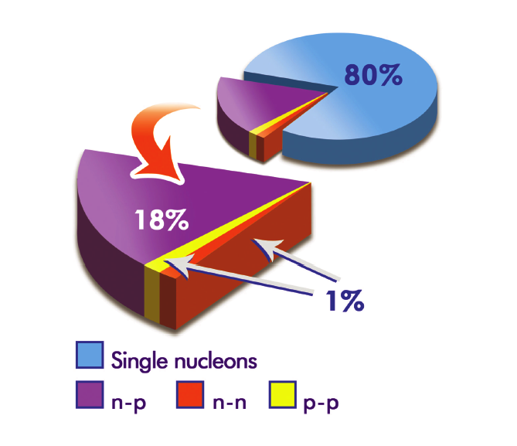
Combined Analysis
R.Subdei, et al Science , 2008

Slide 41
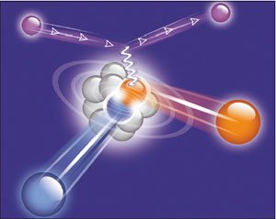

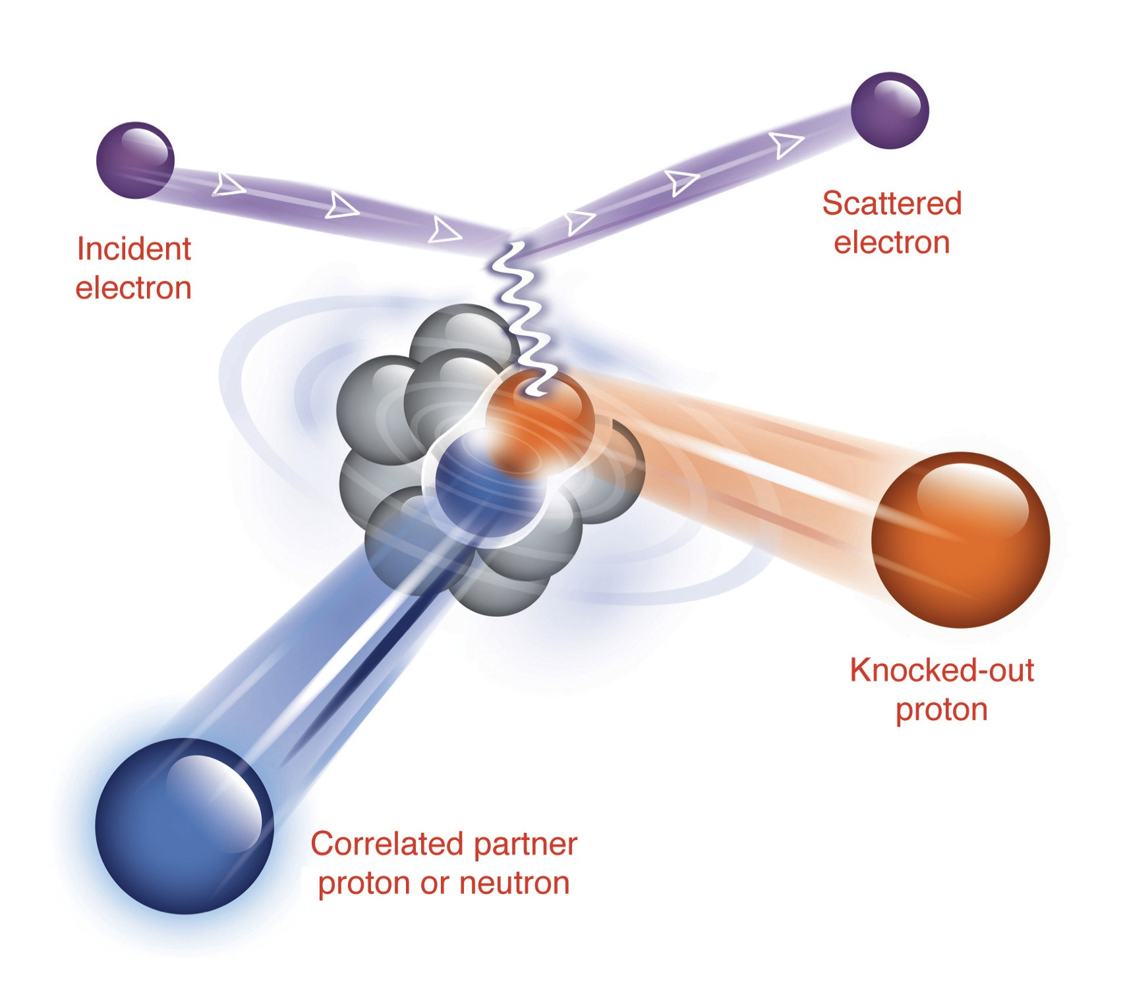
Press releases on SRC:
protonSRCfinal.pdf
EVA-SRC-discoverbnl.pdf
Protons Pair Up with Neutrons (from BNL News, pdf)
Science Magazine: Probing Cold Dense Nuclear Matter (pdf)
Nature Physics (Research Highlights: Unequal pairs (pdf))
Protons Pair Up With Neutrons, EurekAlert, May 29, 2008
Jefferson Lab in the News: Nuclear Pairs
Brookhaven National News: Protons Pair Up with Neutrons
Press release from Kent State University
ScienceDaily (Penn State University)
ScienceDaily (Penn State University)
ScientistLive (Penn State University)
On Target
Physics Today
PHYSORG.com
NFC (in hebrew)
Tel Aviv University Press (in hebrew)
CERN Courier article: "Protons and neutrons certainly prefe each oether's
company"
(July, 2008)
(July, 2008)
R&D magazine
The A to Z of Nanotechnology
analitica-world
Matter News
Softpedia
News @ Old Dominion
from http://tauphy.tau.ac.il/eip

Slide 42
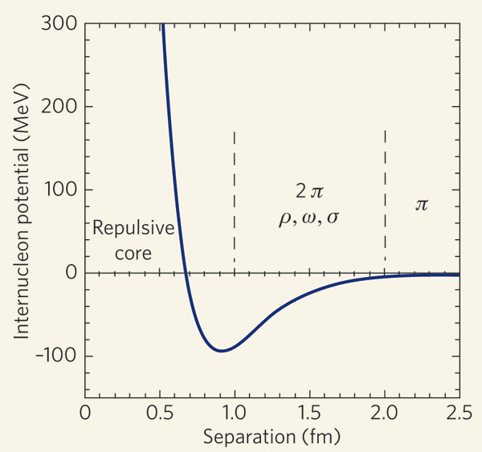
Some Conclusions
- SRCs are directly probed in nuclei with relative momenta
250- 600 MeV/c
- SRC’s are really correlations
- We learned how to deal with Final State Interaction
- There is a strong suppression (factor of 20) of pp and nn
SRCs as compared to pn SRCs
- this disparity is related to the dominance of the
strong tensor force at intermediate to short distances

Slide 43
(III) Implication for Superdense Nuclear Matter
Egiyan, et al PRL 2006

Slide 44
Consequence of the suppression of nn and pp SRCs
Our Goal

Slide 45
Assumption: Neglecting the contributions of nn and pp in the SRC
Prediction is:

Slide 46
Realistic 3He Wave Function
p
n

Slide 47
,
,
(1)
(2)
For
we analyze data for symmetric nuclei
and for other A’s use the relation
where
(3)
Neglecting contributions due to pp and nn SRCs one obtains boundary conditions
M. McGauley, MS Feb. 2011
arxiv 1102.3973

Slide 48
World Data on Inclusive A(e,e’)X and d(e,e’)X Data
for
we found data for
Donal Day
Inclusive Data Compilation

Slide 50
Remaining
where
using
and

Slide 51
Remaining
where
using
and

Slide 52
Using fit of
and the ansatz
estimate f(y) for
Al 27 y = 0.037
Fe56 y = 0.0714
Au197 y = 0.198
He y = 0.333

Slide 53
Fitting f(y)
- 4 data points
- 2 boundary conditions due
to the neglection of pp/nn SRCs
-2 more boundary conditions due to
-1 more, positiveness of f(y)

Slide 55
Checking for 3He

Slide 56
Extrapolation to infinite and superdense nuclear matter
with
C.Ciofi degli Atti, E. Pace, G.Salme, PRC 1991

Slide 57
Asymmetric and superdense nuclear matter:

Slide 59
Some Implication of our Results
Cooling of Neutron Star:
Superfluidity of Protons in the Neutron Stars:

Slide 60
Protons in the Neutron Star Cores:
Isospin Locking and Large Masses of Neutron Stars

