Slide 1


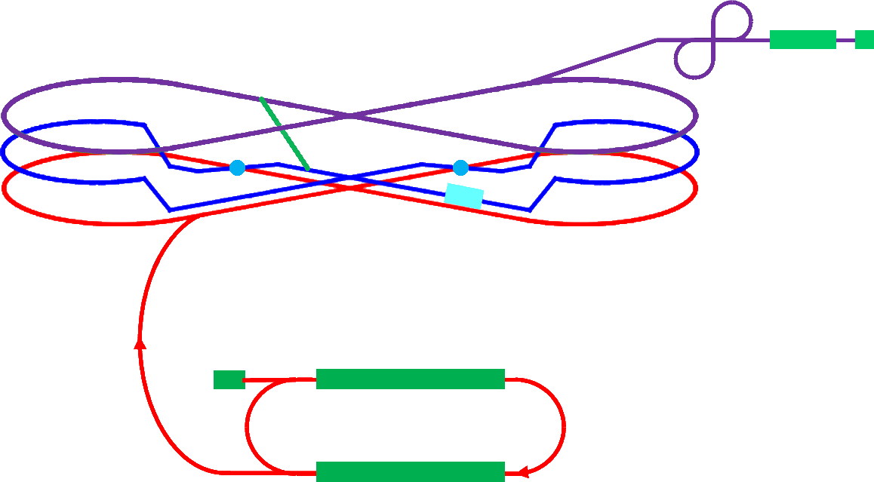
12 GeV Future / EIC
Rolf Ent
Cold ion
collider ring
(up to 100 GeV)
Electron collider ring
(3 to 11 GeV)
JLab Users Group Meeting
June 4, 2012

Slide 2
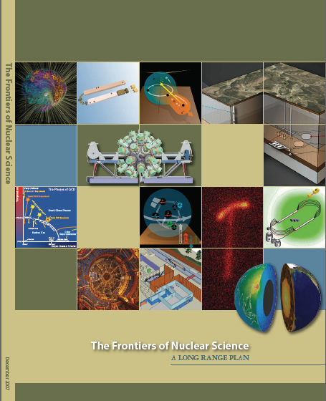
12 GeV Upgrade Project
Upgrade is designed to build on existing facility: vast majority of accelerator and experimental equipment have continued use
New Hall
Upgrade arc magnets
and supplies
Add 5 cryomodules
20 cryomodules
CHL upgrade
Maintain capability to deliver lower pass beam energies: 2.2, 4.4, 6.6….
Add arc
20 cryomodules
The completion of the 12 GeV Upgrade of CEBAF was ranked the highest priority in the 2007 NSAC Long Range Plan.
Add 5 cryomodules
Scope of the project includes:
Doubling the accelerator beam energy
New experimental Hall and beamline
Upgrades to existing Experimental Halls
Enhanced capabilities
in existing Halls

Slide 3
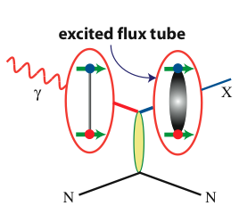
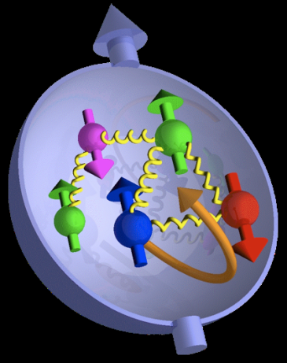

21st Century Science Questions
What is the role of gluonic excitations in the spectroscopy of light mesons?
Where is the missing spin in the nucleon?
What is the role of orbital angular momentum?
Can we reveal a novel landscape of nucleon substructure through measurements of new multidimensional distribution functions?
What is the relation of short-range nuclear structure and parton dynamics?
Can we discover evidence for physics
beyond the standard model
of particle physics?

Slide 4
12 GeV Experiments approved to date
(All approved experiments received scientific rating since last Program Advisory Committee)
 | Hall A | Hall B | Hall C | Hall D
The Hadron Spectra as Probes of QCD (GluEx & heavy baryon and meson spectroscopy) |  | 1 |  | 1
The Transverse Structure of the Hadrons (elastic and transition form factors) | 4 | 2 | 2
The Longitudinal Structure of the Hadrons (Unpolarized and polarized parton distributions) | 2 | 2 | 5
The 3D Structure of the Hadrons (GPDs and TMDs) | 4 | 8 | 3
Hadrons and Cold Nuclear Matter | 2 | 2 | 6
Low-Energy Tests of the Standard Model and Fundamental Symmetries | 3 |  |  | 1
Total | 15 | 15 | 16 | 2
(E12-11-105 has not been included here since it is a test experiment at the injector)
48 approved experiments correspond to 3058 approved days,
of which 638 days in Hall A are associated with the MOLLER and SOLID programs

Slide 5
Planning for 12 GeV – Early Experiments
PAC39* scheduled for week of June 18, 2012
Consider 13 new proposals,
6 conditionally approved experiments returning 3 letters of intent
Please be aware that we will be strict with PAC deadlines
Hall Leaders to present “early running” plans
- Select commissioning experiments
- Discuss early-year physics plans
Discussion of priorities, jeopardy, etc.
(Jeopardy is the process we used to control the 6-GeV science backlog: if an experiment was not on the running schedule for three years, it had to come back for a PAC reevaluation)
* Note that we have maintained an independent technical review (D. Mack, D. Higinbotham, S. Stepanyan, B. Zihlmann) for select (4-5) proposals for benefit of consistency and the PAC

Slide 6
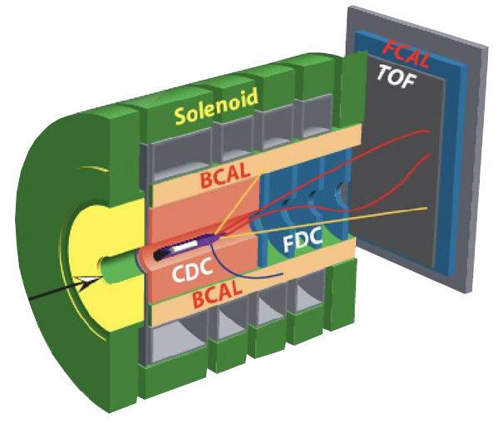
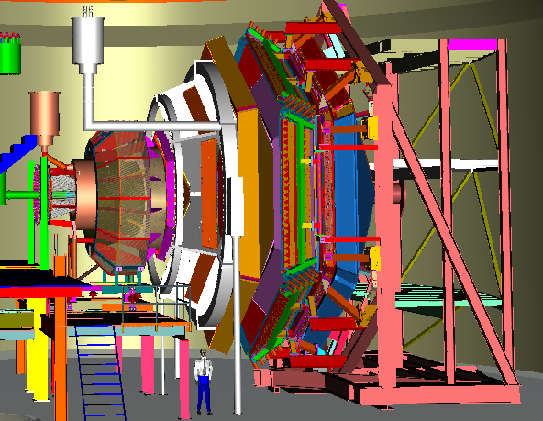
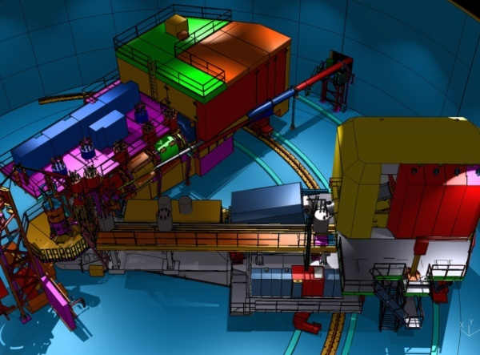

12 GeV Upgrade Physics Instrumentation
GLUEx (Hall D): exploring origin of confinement by studying hybrid mesons
CLAS12 (Hall B): understanding nucleon structure via generalized parton distributions
SHMS (Hall C): precision determination of
valence quark properties in nucleons and nuclei
Hall A: nucleon form factors,
& future new experiments like Moller & SOLID
Notes:
Note BSM not included in project

Slide 7
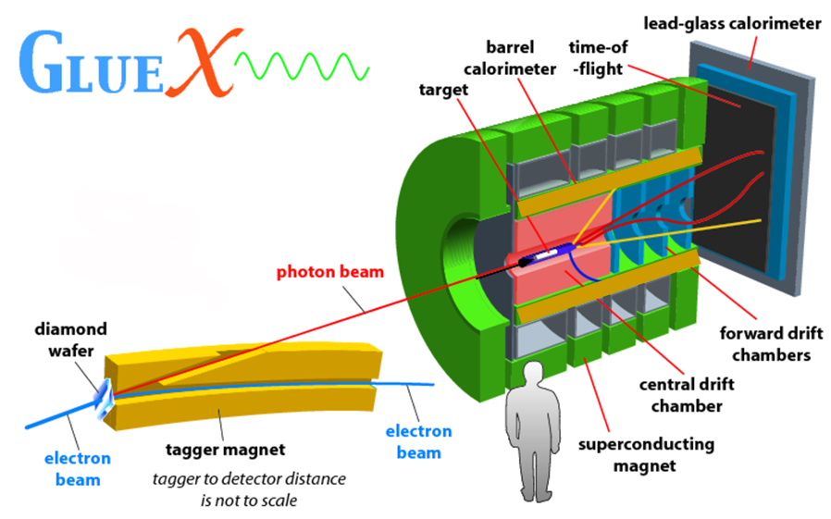
New Hall D – Photon Beam
FCAL
TOF
BCAL
start counter
FDC
CDC
BCAL

Slide 8
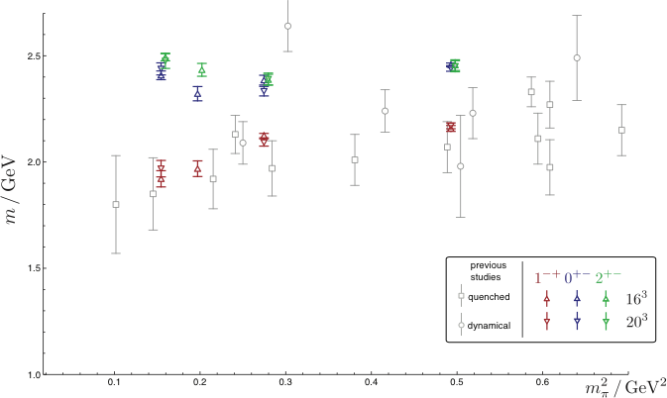
Hall D: Gluonic Excitations
QCD predicts a rich spectrum of as yet to be discovered gluonic excitations - whose experimental verification is crucial for our understanding of QCD in the confinement regime.
With the upgraded CEBAF, a linearly polarized photon beam, and the GlueX detector, Jefferson Lab will be uniquely poised to: - discover these states,
- map out their spectrum, and
- measure their properties
States with Exotic Quantum Numbers
+-
2
0
+-
q
q
-+
1
γ
beam
before
after
q
q

Slide 9
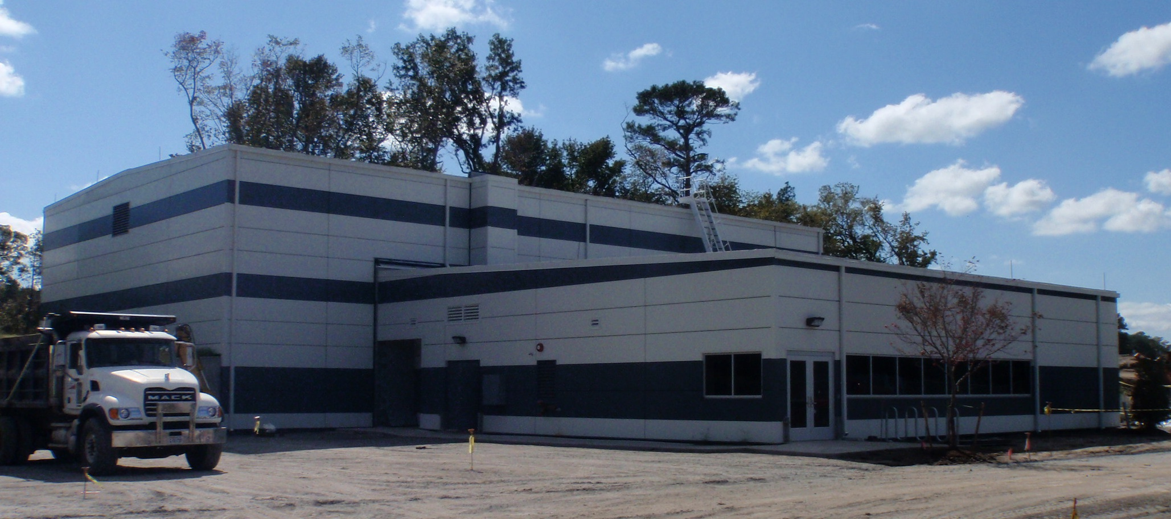
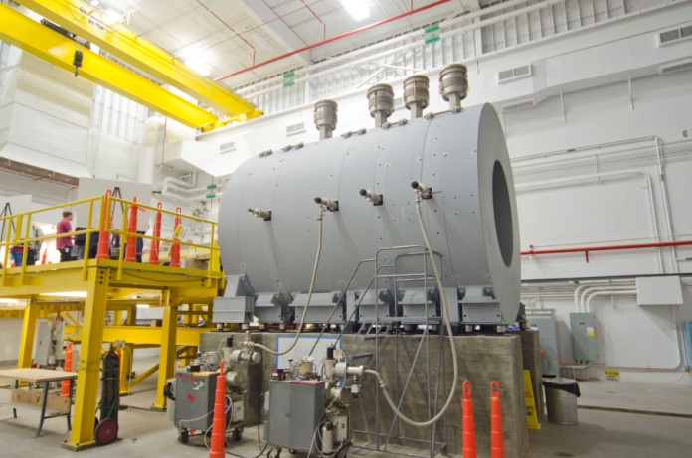
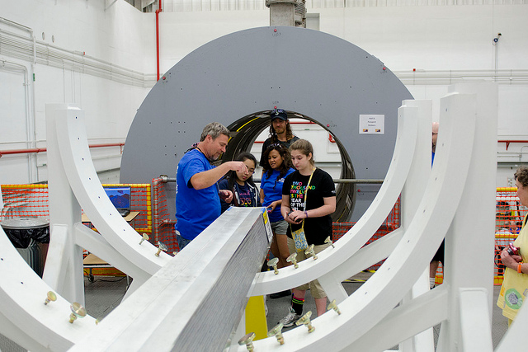
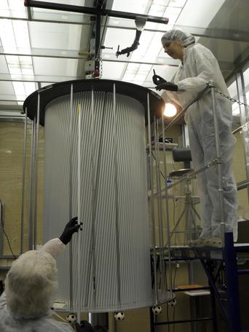
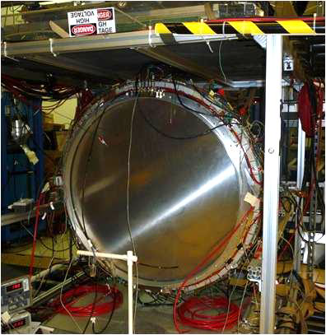
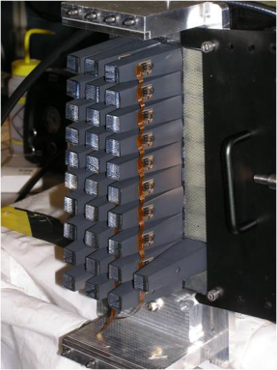
12 GeV Hall D - Highlights
Hall D & Counting House
Hall D Interior
Central Drift Chamber
(Carnegie Mellon)
Forward Drift Chamber
JLab
BCAL Module
(Open House)
Mini-BCAL

Slide 10
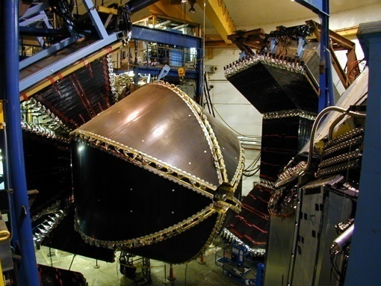
Hall B Equipment
Remove CLAS detector
(recycle many components)
Add CLAS12 detector
Hall B (CLAS)
Hall B (CLAS12)

Slide 11
Hall B at 12 GeV: CLAS12
Utilize multi-purpose large-acceptance device (CLAS12) with (polarized) electron beam and variety of polarized and unpolarized targets to access a broad science program:
Extensive program of Transverse Momentum Dependent and Generalized Parton Distributions
Proton and deuteron polarized and unpolarized structure functions
towards large Bjorken x (A₁^{p}, A₁^{d}, F₂^{d}/F₂^{p},d/u)
Neutron magnetic form factor (G_{M}^{n}) measurement up to high Q²
Hadronization and (ρ) Color Transparency Studies
Quasi-real low-Q² (hybrid) meson and baryon spectroscopy studies

Slide 12
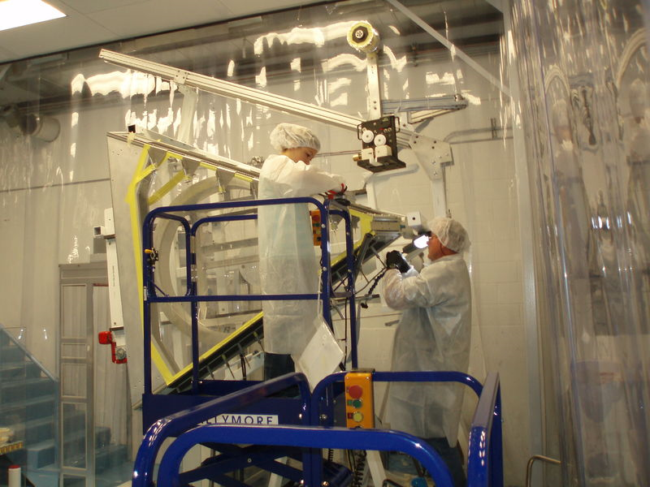
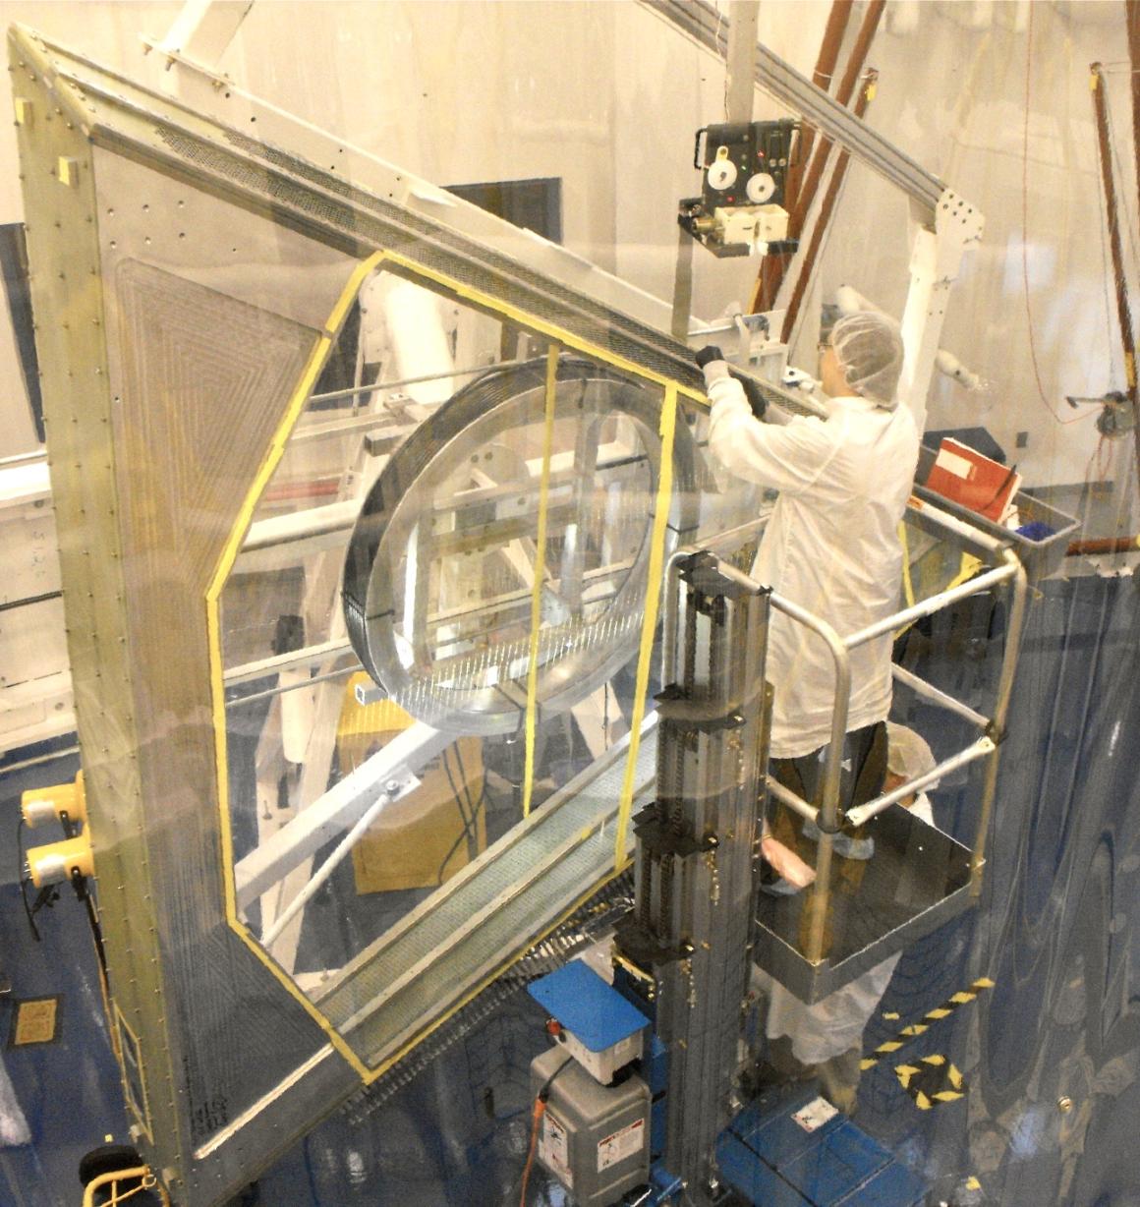
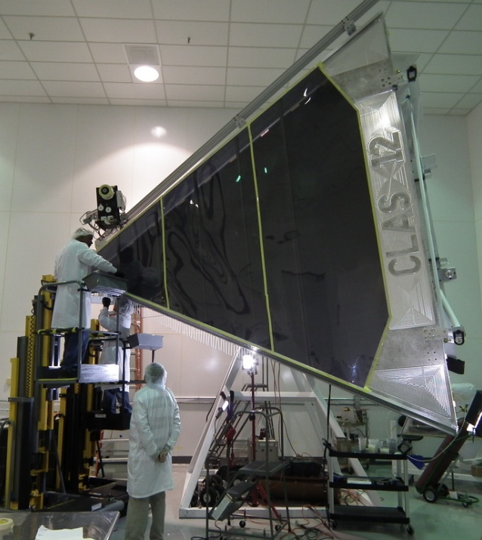
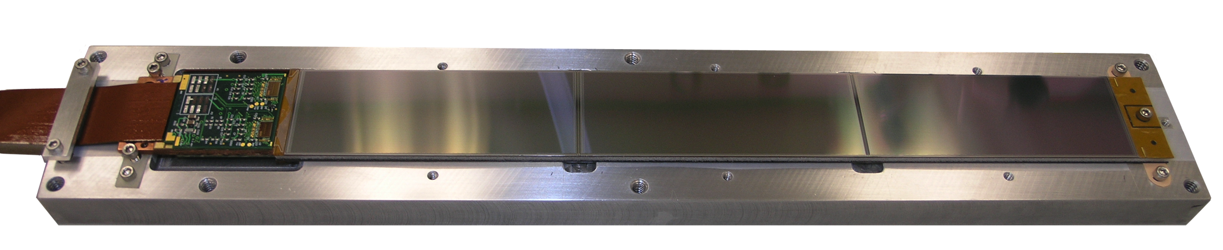
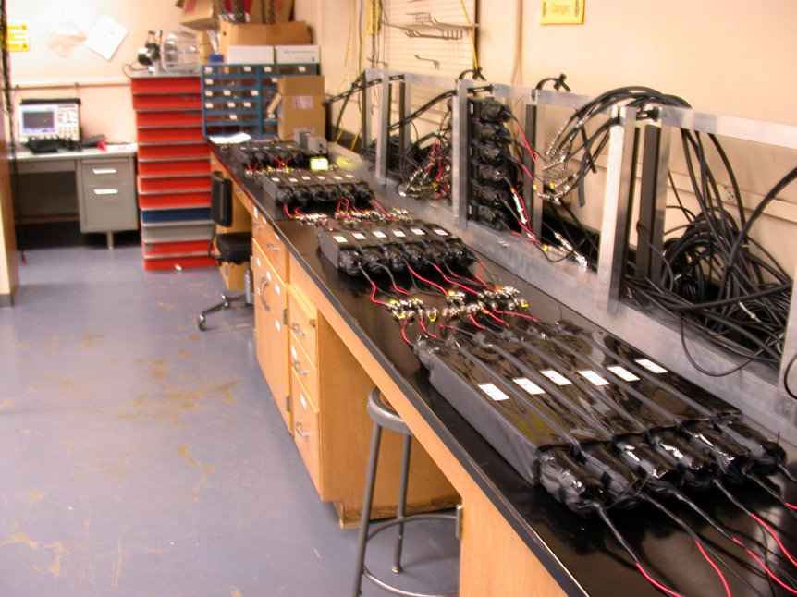
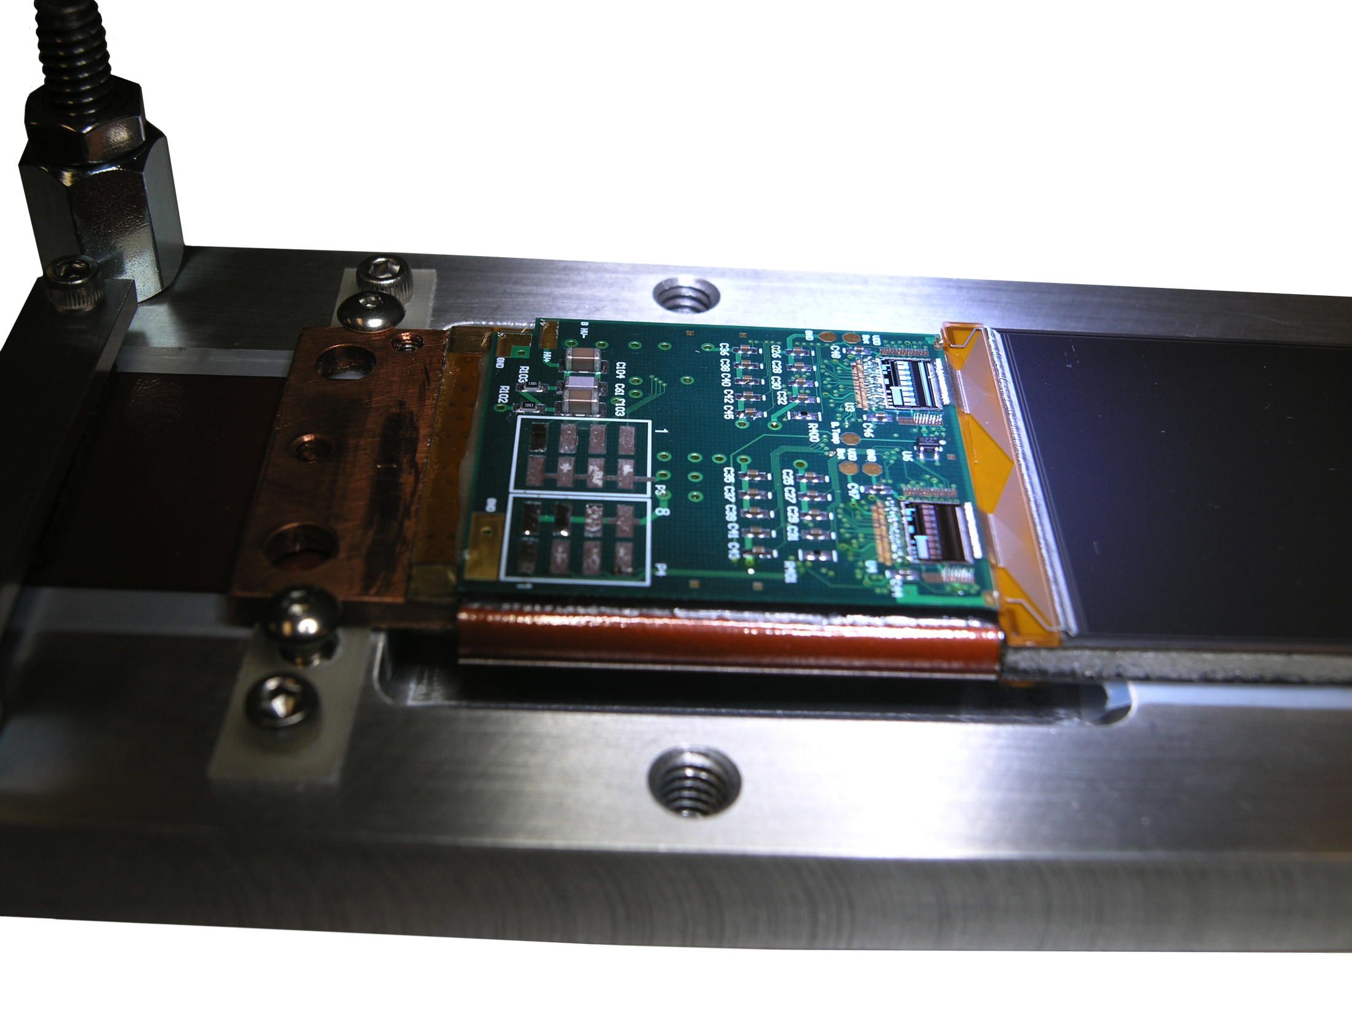
12 GeV Hall B - Highlights
Drift Chamber
Region 1
(Idaho State U)
Drift Chamber
Region 2
(Old Dominion U)
Drift Chamber
Region 3
(Jefferson Lab)
PCAL
(JLab/Ohio/W&M/NSU/JMU)
FTOF
(USC)
Silicon Vertex Tracker
(JLab/FNAL/UNH)

Slide 13
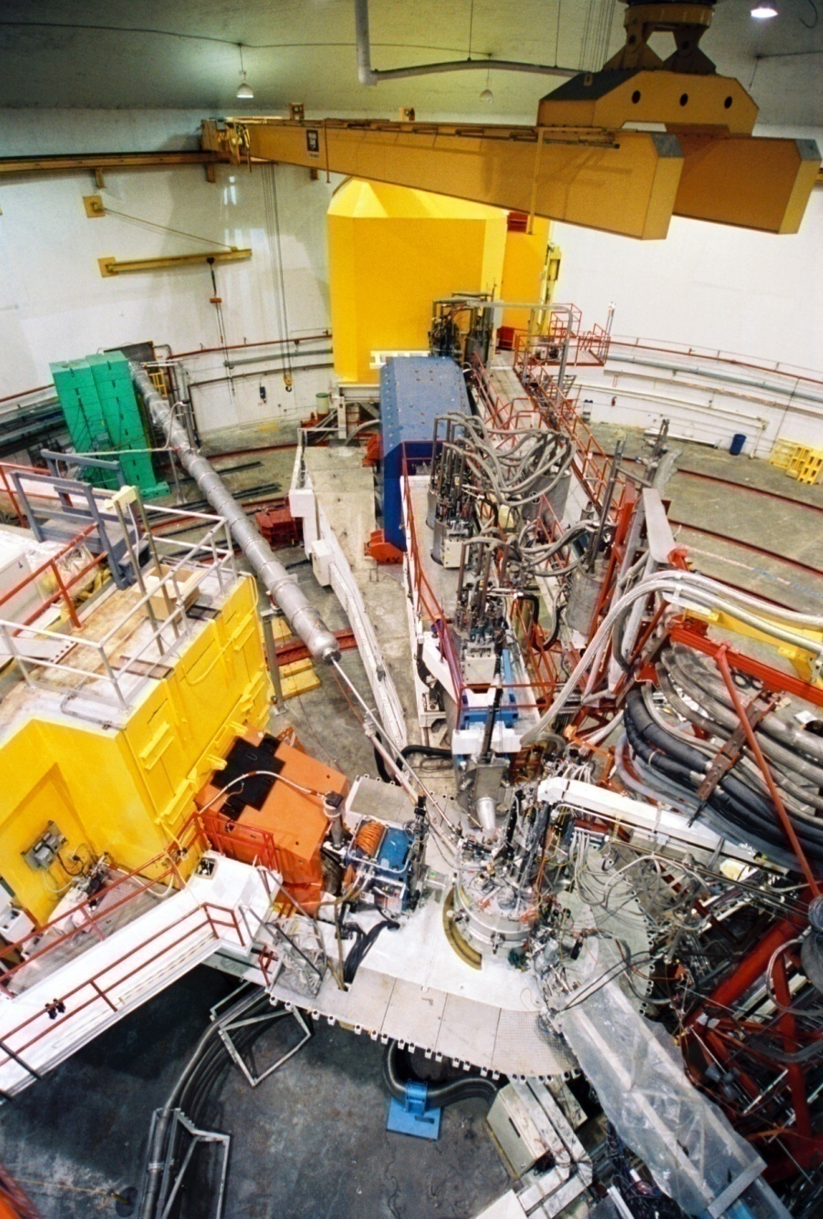
Hall C Equipment
Maintain HMS spectrometer
Remove SOS spectrometer
Add SHMS spectrometer
Hall C (SOS/HMS)
Hall C (SHMS/HMS)

Slide 14
Hall C at 12 GeV: HMS + SHMS
HMS is the same spectrometer between 0.5 and 5 GeV, and extremely well understood, e.g. highlighted by >200 Rosenbluth separations (close to 1,000 kinematics) performed to date. SHMS emulates the essential features of HMS, with angle reach down to 5.5º and central momentum up to 11 GeV/c.
Charged particle detection w. momentum up to beam energy z = E_{h}/ν = 1
Small angle capability essential to measure charged particle along momentum transfer θ_{h} // q ± few º
Precision L/T separations over range of x and Q²
High Luminosity and well-shielded detectors to access small (neutrino-level) nuclear cross sections L = 10³⁸
σ = Γ(σ_{Τ} + εσ_{L} + ε cos(2φ)σ_{TT} + [ε(ε+1)/2]^{1/2}cos(φ)σ_{LT})

Slide 15
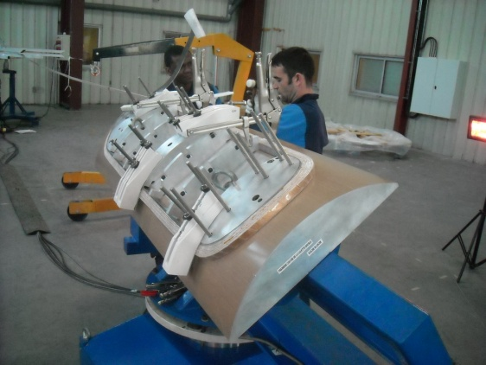
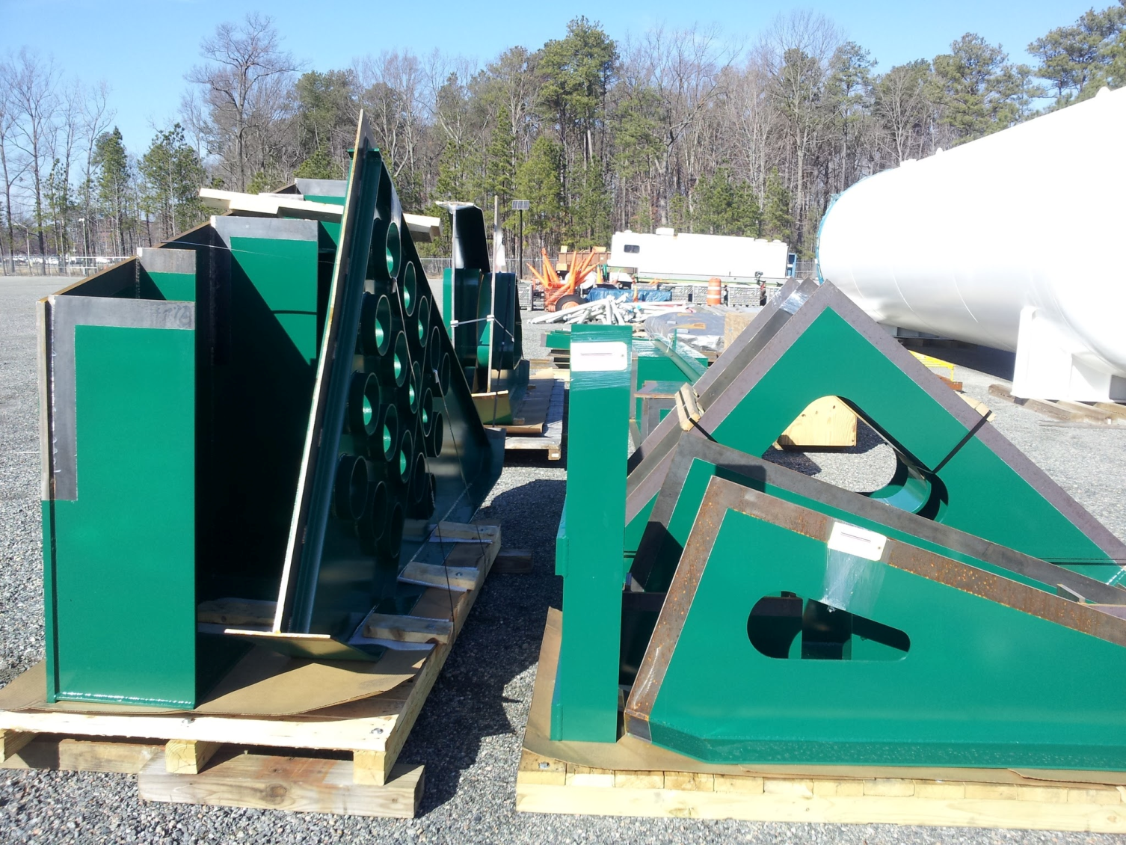
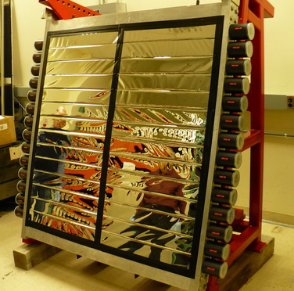
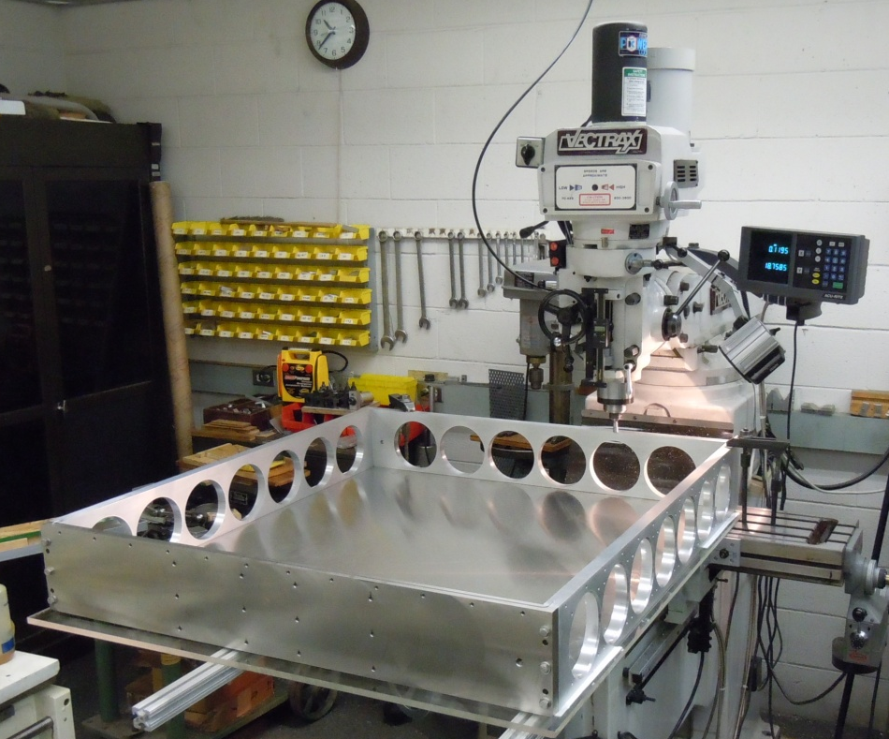
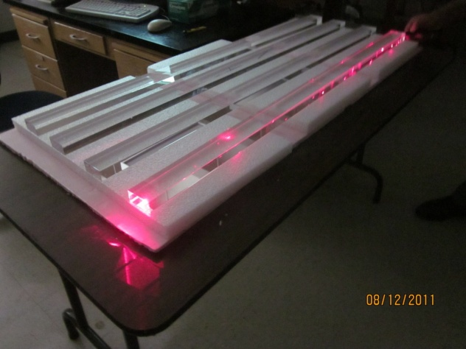
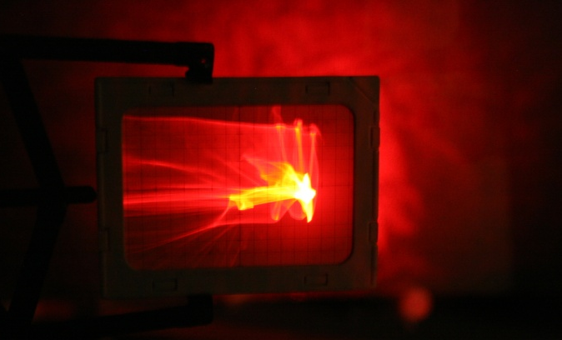
12 GeV Hall C - Highlights
Dipole Magnet Prototype Coil
(SigmaPhi, France)
Spectrometer Carriage Parts
PreShower
(Yerevan/NSL)
All detectors but one from user contributions
Aerogel Detectors
(CUA)
HGC Mirror
(U Regina)
Diffusely illuminated mirror (behind)
1cm screen grid
Quartz Hodoscope
(NCA&T)

Slide 16
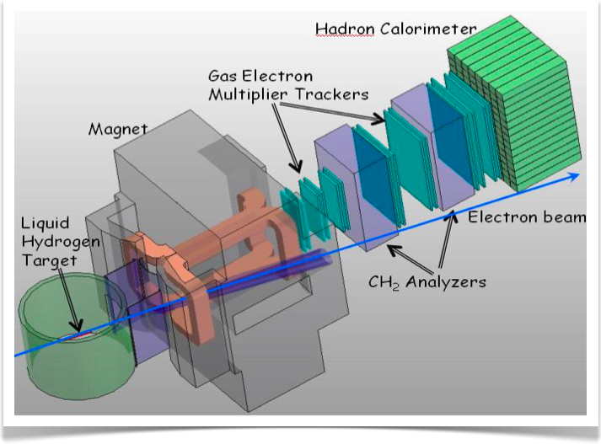
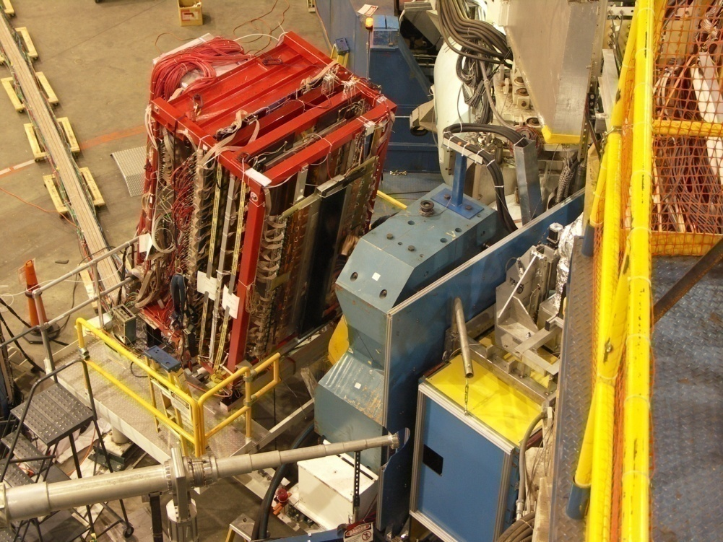
Hall A Equipment
Maintain HRS spectrometer pair
Add SBS spectrometer
(similar as BigBite spectrometer)
Moller & Compton Beam Polarimetry
SBS setup
HRS pair
Space for ancillary apparatus
BigBite setup
Successful review in Oct. 2011
Updated program management plan Dec. 2011
DOE/NP approval Apr. 2012

Slide 17
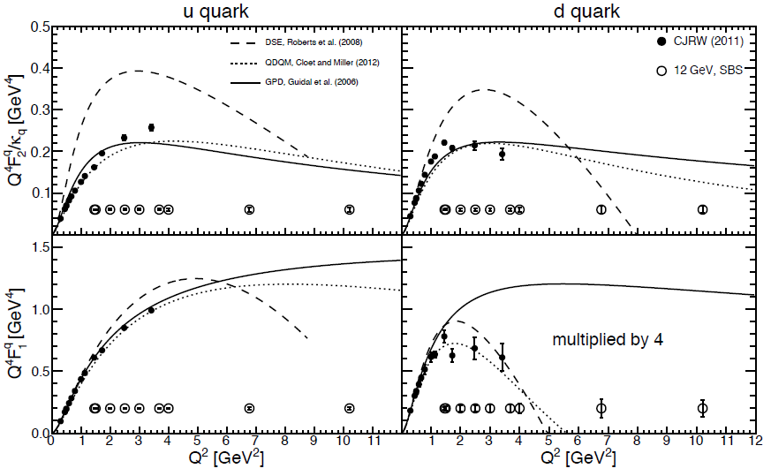
Hall A at 12 GeV: HRS + ancillary apparatus + SBS
Physics Reach of the Super BigBite Spectrometer (SBS) in Hall A:
Electromagnetic Form Factors at high Q²
  Use high luminosity
  + open geometry
  + GEM detectors
  Pushes G_{E}^{p}/G_{M}^{p}, G_{E}^{n}, G_{M}^{n} to high Q²
  Allows for flavor decomposition to distance scales deep inside the nucleon
Semi-Inclusive Deep Inelastic Scattering
  Active program foreseen at 12 GeV in Halls A, B, C
  Approved SBS experiment provides precision data early on with transversely polarized ³He at large x and Q²
Possibly also other proposals

Slide 18
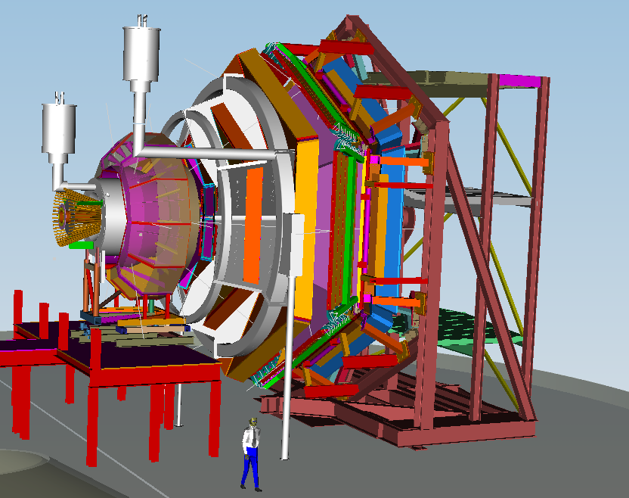
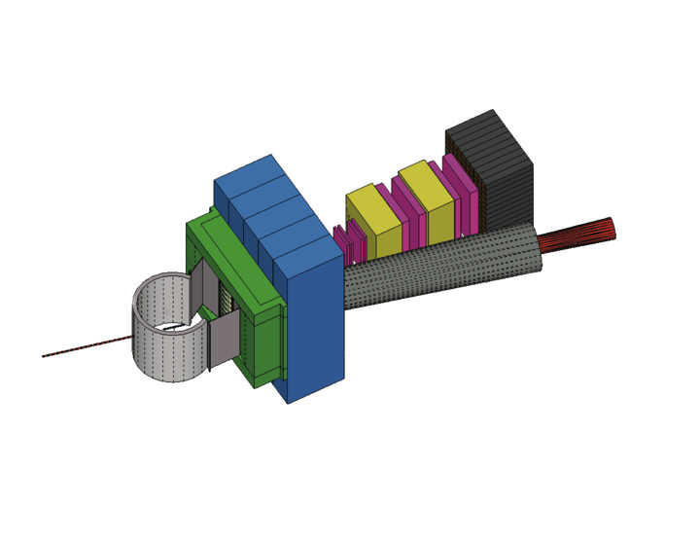

Together stronger: SIDIS Studies with 12 GeV
CLAS12 in Hall B
General survey, medium lumi
SHMS- HMS in Hall C
L-T studies, precise π⁺/π⁻ ratios
SBS in Hall A
High x, High Q², 2-3D
SOLID in Hall A
High Lumi and acceptance – 4D

Slide 19
Planning for 12 GeV
12 GeV Software and Computing Review scheduled for June 7 + 8
    Convened by Bob McKeown
    - Committee: Torre Wenaus (BNL/ATLAS – Chair)
Patricia McBride (FNAL)
Sergei Gerassimov (TU Munchen/COMPASS)
Martin Purschke (BNL/PHENIX)
David Nathan Brown (LBL/Babar)
Plans and Labor planning for CLAS and SOS/Qweak de-installation in place
Plans for storage and recycling of detector components in place
Charge: The committee is asked to review the state of software and computing developments for the 12 GeV program at Jefferson Lab, with particular emphasis upon
Detector simulation, calibration, and event analysis
Workflow tools for production analysis
The review will cover all 4 halls, including data acquisition, planning for computing resources, and management.

Slide 20
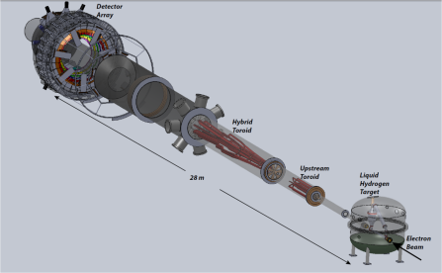
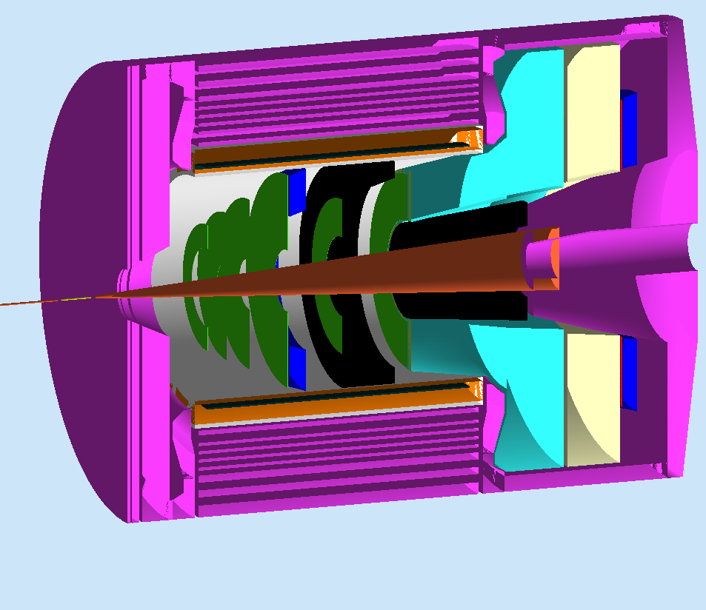
Planning for Future Projects
Future Hall A Large Installation Programs:
MOLLER
Parity Violating (PV) e-e scattering
Precise Standard Model test
- Submitted to DOE-ONP Sep. 2011
SoLID (PV e⁻ - q scattering + SIDIS)
PV e-quark + High Precision TMD Studies
- Chinese collaboration still developing
- CLEO solenoid under negotiation
- Directors review in Fall 2012?
Also ongoing:
HPS (Conditional approval - HEP): Parasitic test run completed
DarkLight : planning for Summer test run at FEL
π⁰ spectrometer (off SHMS carriage) NSF/MRI submitted
Windowless target for proton charge radius experiment NSF/MRI submitted
(Part of) Hall B Forward Tagger NSF/MRI Submitted

Slide 21
Long-Term Planning for Ancillary Equipment
Developed FY13-FY18 capital equipment plan including (parts of)
  Hall A: SBS basic, SBS neutron, SBS proton, Tritium target, …
  Hall B: Forward Tagger, Polarized target, one-sector RICH, HDIce-transverse
  Hall C: Beamline/Compton, Polarized 3He, Target upgrade, large experiments
  Hall D: L3 Farm, Forward Calorimeter upgrade, Cherenkov
  Division: fast pipelined electronics
Still ongoing discussion: planning for new/upgraded End Station Refrigerator for future high cryogenic demand experiments such as the Moller experiment

Slide 22
12 GeV White Paper Under Construction
Physics Opportunities with the 12 GeV Upgrade at Jefferson Lab
Preparation for NSAC subcommittee activity
Update Physics Case for “NSAC” Audience
Overview (3) – McKeown, Pennington, Ent
Meson Spectroscopy and Structure (5) – Meyer, Dudek
• Nucleon Structure and Spectroscopy (10) – Meziani, Richards
• QCD and Nuclei (5) – Weinstein, Miller
• The Standard Model and Beyond (5) – Kumar, Essig
• Appendix A: Experimental Equipment (10) – Young
Complete draft exists (~50 pages),
soon to be circulated amongst wider audience
Thanks to Susan Brown for multiple editing tasks

Slide 23
12 GeV JLab – The Potential
Opportunity to discover and study new exotic mesons to elucidate the mechanism of confinement.
Open a new landscape of nucleon tomography, with potential to identify the missing angular momentum.
Establish the quantitative foundation for the short-distance behavior in nuclei, underpinning the development of precision nuclear structure studies.
Provide stringent new tests of the standard model and extensions, complementing the information obtained at LHC.

Slide 24
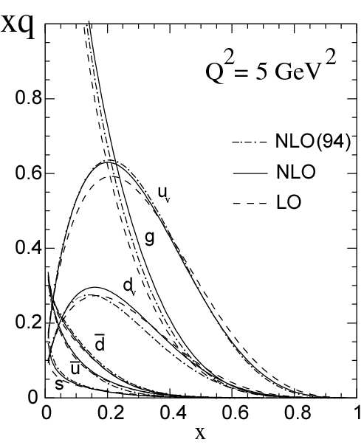

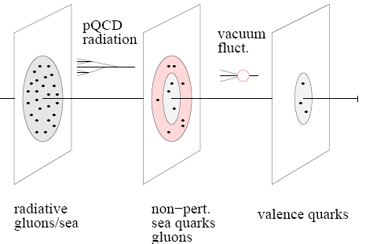
12 GeV ◻ EIC
With 12 GeV we study mostly the valence quark component
An EIC aims to study the sea quarks, gluons, and scale (Q²) dependence.
MEIC
EIC
12 GeV

Slide 25
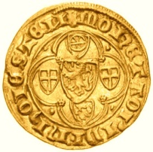
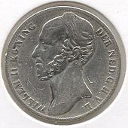
The Physics Program of an EIC
I) Map the spin and spatial structure of quarks and gluons in nucleons
Sea quark and gluon polarization
Transverse spatial distributions
Orbital motion of quarks/gluons
Parton correlations: beyond one-body densities
(show the nucleon structure picture of the day…)
II) Discover the collective effects of gluons in atomic nuclei
Color transparency: Small-size configurations
Nuclear gluons: EMC effect, shadowing
Strong color fields: Unitarity limit, saturation
Fluctuations: Diffraction
(without gluons there are no protons, no neutrons, no atomic nuclei)
III) Understand the emergence of hadronic matter from color charge
Materialization of color: Fragmentation, hadron breakup, color correlations
Parton propagation in matter: Radiation, energy loss
(how does M = E/c² work to create pions and nucleons?)
Needs high luminosity and range of energies
+ some developing ideas for fundamental symmetry tests

Slide 26

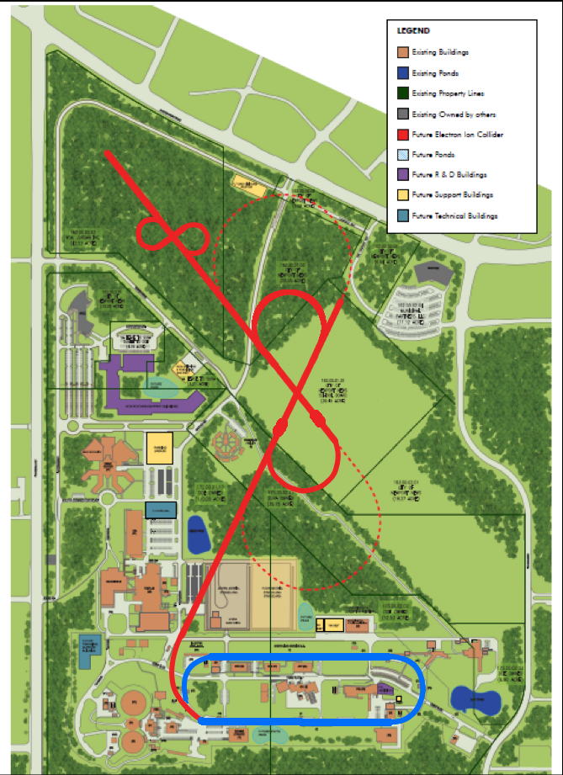
Medium Energy EIC@JLab
Warm large booster
(up to 20 GeV)
Transfer beam line
Pre-booster
SRF linac
Ion
source
Cold ion
collider ring
(up to 100 GeV)
Medium energy IP
Electron collider ring
(3 to 11 GeV)
Injector
12 GeV CEBAF
JLab Concept
Initial configuration (MEIC):
  3-11 GeV on 20-100 GeV ep/eA collider
  fully-polarized, longitudinal and transverse
  luminosity: up to few x 10³⁴ e-nucleons cm⁻² s⁻¹
    Upgradable to higher energies (250 GeV protons)

Slide 27
EIC Realization Imagined
Activity Name | 2010 | 2011 | 2012 | 2013 | 2014 | 2015 | 2016 | 2017 | 2018 | 2019 | 2020 | 2021 | 2022 | 2023 | 2024 | 2025
12 GeV Upgrade
FRIB
EIC Physics Case
NSAC LRP
EIC CD0
EIC Machine Design/R&D
EIC CD1/Downsel
EIC CD2/CD3
EIC Construction

Slide 28
EIC Progress
Close and frequent collaboration between accelerator and nuclear physicists regarding the machine, interaction region and detector requirements has taken place.
    “We are proud to announce that we have achieved a fully integrated detector and interaction region”
Several JLab user proposals for generic detector R&D call
Draft MEIC Intermediate Design Report completed
Concept for regular electron cooling further worked out
    Many aspects of cooling can be tested at JLab/FEL
Cost Estimate developed, estimate anticipated shortly
(3 main cost drivers: Ion Linac, SC Magnets & SRF Cooling, Civil construction)
Steering committee with many JLab users working on EIC white paper accessible to general nuclear science community

Slide 29
MEIC: Full Acceptance Detector
7 meters
(P. Nadel-Turonski, V. Morozov, T. Horn, C. Hyde)
solenoid
detectors
ion dipole w/ detectors
ion FFQs
0 mrad
IP
ions
50 mrad
electron FFQs
electrons
2+3 m
2 m
2 m
Central detector
Three-stage detection
TOF
Solenoid yoke + Muon Detector
Detect particles with angles down to 0.5º before ion FFQs.
Need 1-2 Tm dipole
Detect particles with angles below 0.5º beyond ion FFQs and in arcs.
Need 4 m machine element free region
RICH or DIRC/LTCC
EM Calorimeter
Tracking
RICH
4-5m
HTCC
Muon Detector
Hadron Calorimeter
EM Calorimeter
Very-forward detector
Large dipole bend @ 20 meter from IP (to correct 50 mr ion horizontal crossing angle) allows for very-small angle detection (<0.3º).
Need 20 m machine element free region
Solenoid yoke + Hadronic Calorimeter
2m
3m
2m
All incorporated in MEIC design
Notes:
29
29

Slide 30
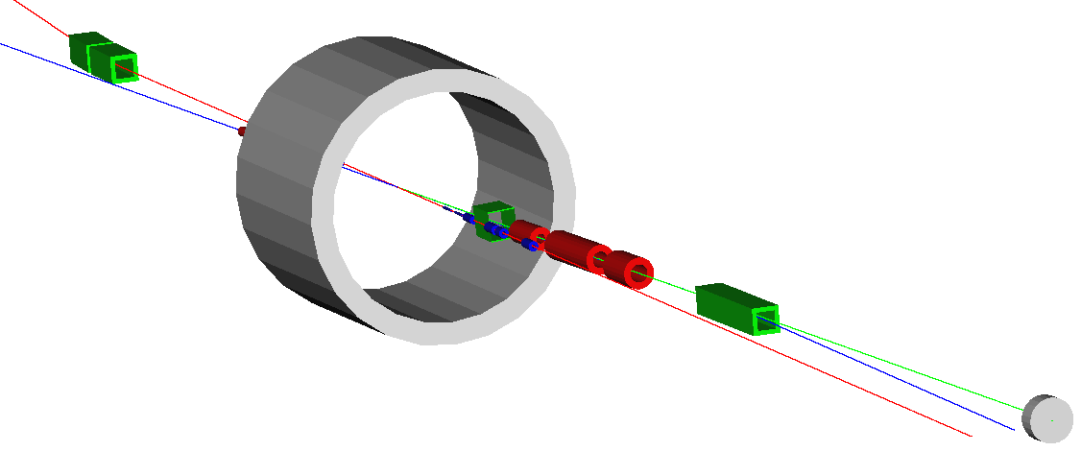
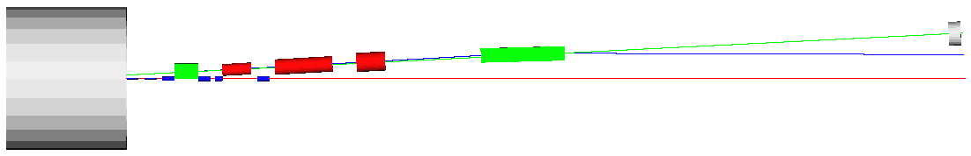
MEIC Detector & Interaction Region
GEANT4 model of extended IR exists
Neutron detection in a 25 mrad cone down to zero degrees
Excellent acceptance for all ion fragments
Recoil baryon acceptance:
  up to 99.5% of beam energy for all angles
  down to 2-3 mrad for all momenta
Momentum resolution < 3x10⁻⁴
  limited by intrinsic beam momentum spread
100 GeV maximum ion energy allows using large-aperture magnets with achievable field strengths
n
e
p
n
2 Tm dipole
20 Tm dipole
p
solenoid
e
More in V. Morozov presentation!

Slide 31
Generic Detector R&D for an EIC
(see https://wiki.bnl.gov/conferences/index.php/EIC_R%25D)
DIRC-based PID – includes tests radiation improved SiPMs
ODU, JLab, CUA, GSI/Darmstadt, USC approved - ongoing
Micro-Pattern Gaseous Detectors for a Vertex Tracker in EIC
Saclay, MIT, Temple approved - ongoing
Detector R&D towards an EIC detector
    BNL-based collaboration + UVa +Temple
    (following two LOIs - funded but encouraged to stronger collaborate with other proposals)
4) Development of a Spin-Light Polarimeter for the EIC
Mississippi State U, ANL, Mainz, Stony Brook U, UVa, W&M
    (resubmitted – modest funds recommended to further develop proposal)
Silicon-Based Tracking System for EIC Detector
JLab, UNH, Moscow State U
    (submitted – no funding but strongly encouraged to come back)
6) RICH detector for Forward Detection
INFN, JLab, CNU, UTFSM
(submitted – modest funding recommended to purchase SiPMTs and HAPD and perform simulations)
A Pre-Shower Detector for Forward Electromagnetic Calorimeters
UTFSM (submitted – funding recommended)

Slide 32
Outlook
The Jefferson Lab electron accelerator is a unique world-leading facility for nuclear physics research
12 GeV upgrade ensures another decade of opportunities
- new vistas in QCD
    growing program to search for new physics beyond the standard model
MEIC design well developed – time scale following 12 GeV program is “natural”.
    - JLab users major contributors to science
    - truly integrated detector/interaction region design is unprecedented

Slide 34
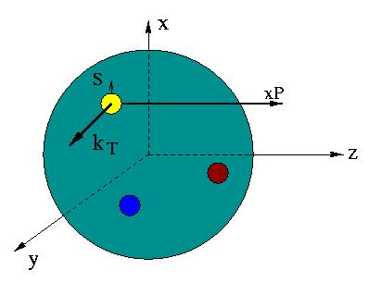

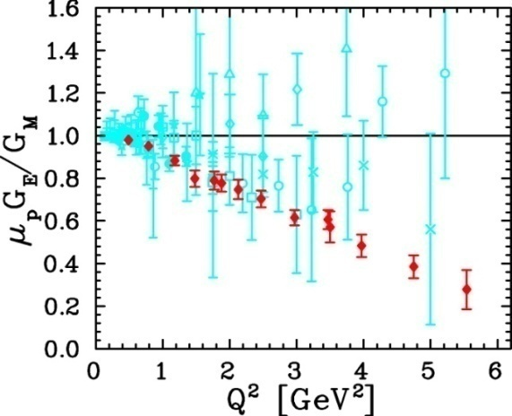
Unified View of Nucleon Structure
W_{p}^{u}(x,k_{T},r ) Wigner distributions
6D Dist.
d³r
d²k_{T} dr_{z}
TMD PDFs f₁^{u}(x,k_{T}), .. h₁^{u}(x,k_{T})‏
GPDs/IPDs
3D imaging
dx &
Fourier Transformation
d²k_{T}
d²r_{T}
Form Factors
G_{E}(Q²),
G_{M}(Q²)‏
PDFs
f₁^{u}(x), .. h₁^{u}(x)‏
1D

Slide 35
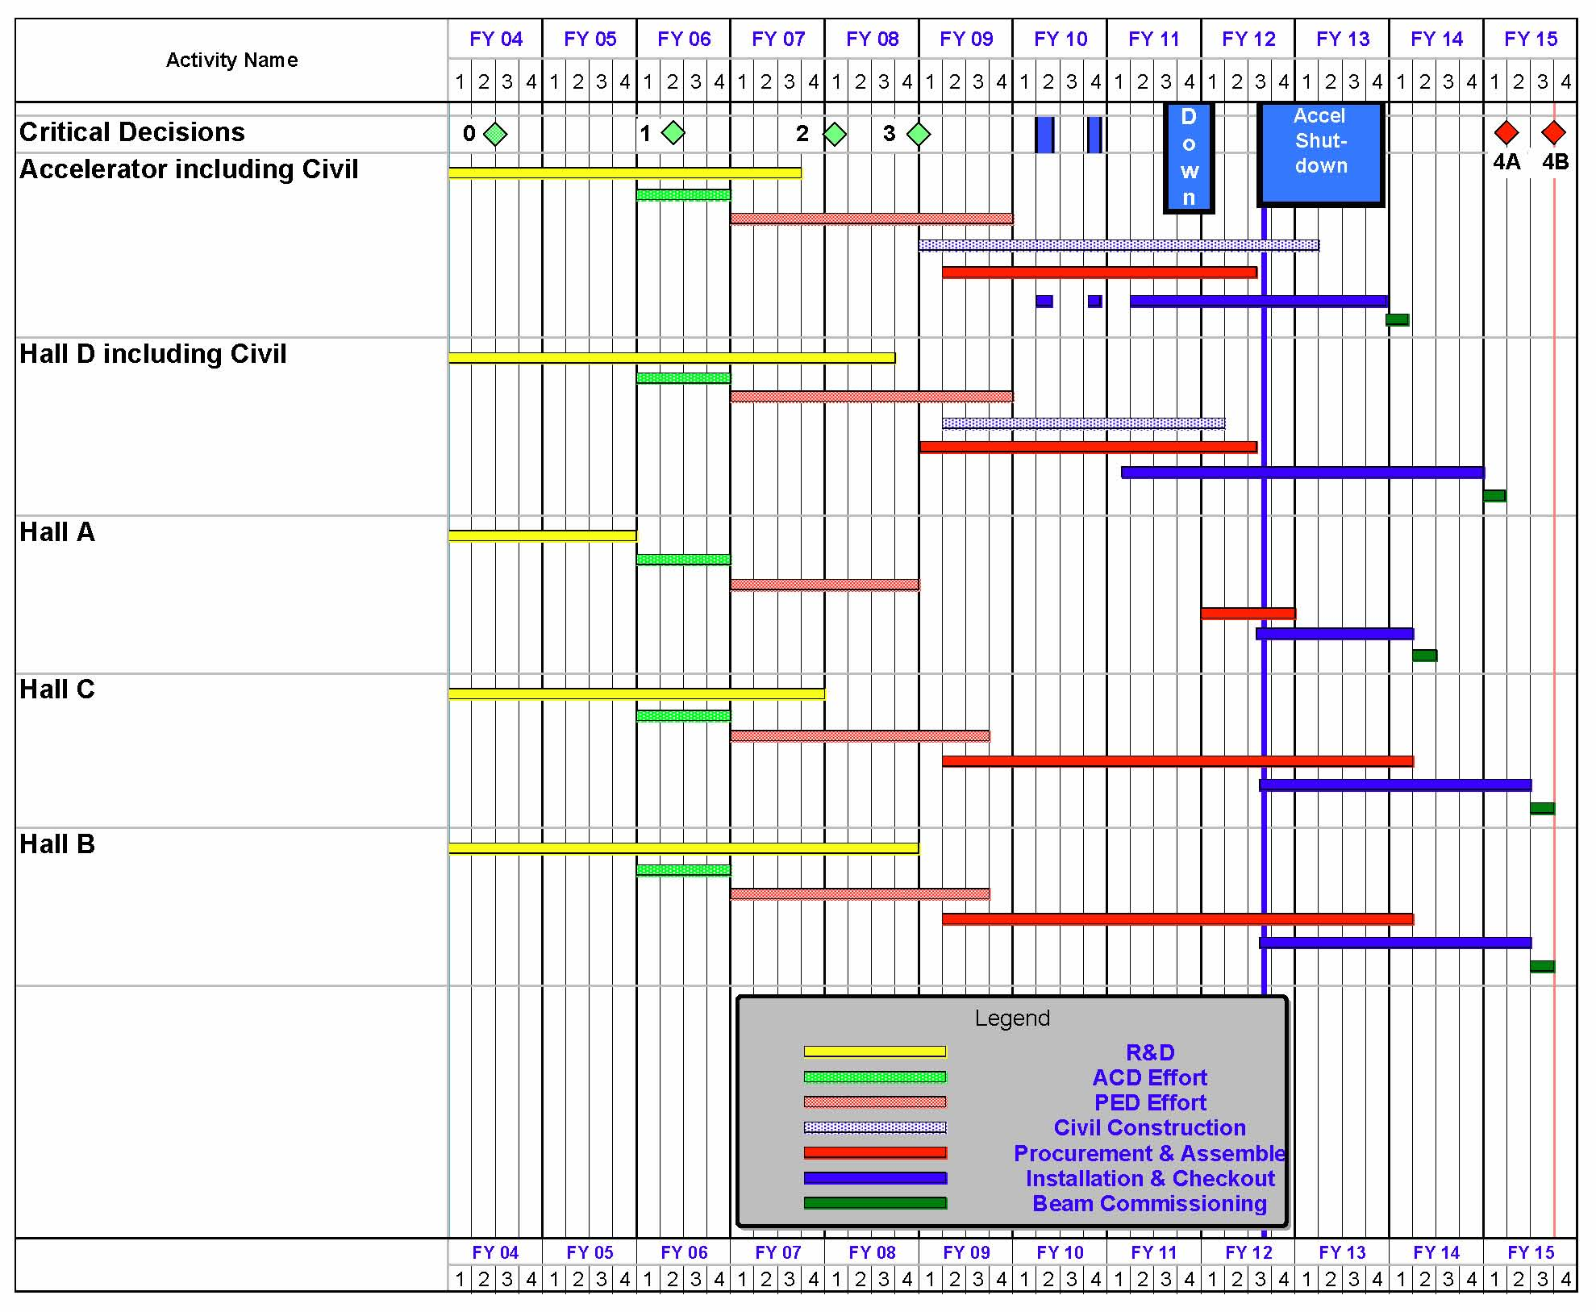
12 GeV Upgrade Project Schedule
May 18: Completed 6 GeV program
FY12: reduction of $16M
→ extended 12 month shutdown
    12 16-month installation
    May 2012 - May Sept 2013
    Hall A commissioning start Oct 2013 Feb 2014
    Hall D commissioning start
    April 2014 Oct 2014
    Halls B & C commissioning start Oct 2014 Apr 2015
    Project Completion June 2015
Next DOE Project Review
June 21, 2012

Slide 36
Early Beam Guidance in PAC Days
Fold in planning of beam development by Accelerator/OPS
The table is split in years, but the exact correlation with FY or CY may shift. Treat the entries simply as one-year blocks to give some guidance on the best expectations for startup.
32 weeks of operations ~ 80 PAC days/Hall (for Hall multiplicity of 3)
YEAR | Hall A | Hall D | Hall B | Hall C
-1 | 25 (15)*
0 | 60 (<10)* | 25
1 | 90 | 90 | 25 | 25
2 | 80 | 80 | 80 | 80
3 | 80 | 80 | 80 | 80
* PAC days between parentheses indicate possible choice of energies < 2 GeV/pass
(While 12 GeV machine development is ongoing, we assumed a conversion of actual days to PAC days of less than 50%)

Slide 37
Generic Detector R&D for an EIC
Approved Detector R&D items after 1st call/meeting
(see also https://wiki.bnl.gov/conferences/index.php/EIC_R%25D)
DIRC-based PID for the EIC Central Detector
Catholic U A, Old Dominion U, GSI/Darmstadt, JLab
2) Proposal to test improved radiation tolerant Silicon PMTs
    JLab Radiation Detector & Imaging (RDI) Group
Letter-of-Intent for detector R&D towards an EIC detector
BNL-based collaboration, includes UVa (+Temple for 2nd call)
Submitted in response to 2nd call for proposals
DIRC-based PID for the EIC Central Detector
Includes SiPMT, augmented with USC & JLab RDI Group
2) Micro-Pattern Gaseous Detectors for a Vertex Tracker in EIC Saclay, MIT, Temple
3) Development of a Spin-Light Polarimeter for the EIC
Mississippi State U, ANL, Mainz, Stony Brook U, UVa, W&M
First two approved, third was well received but got homework assignment to “further develop this very interesting proposal”

Slide 38
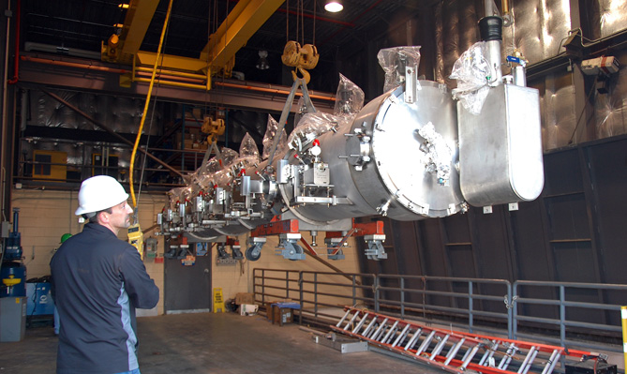
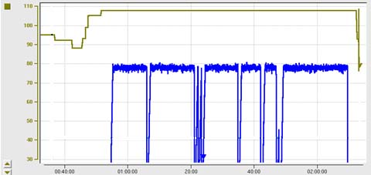
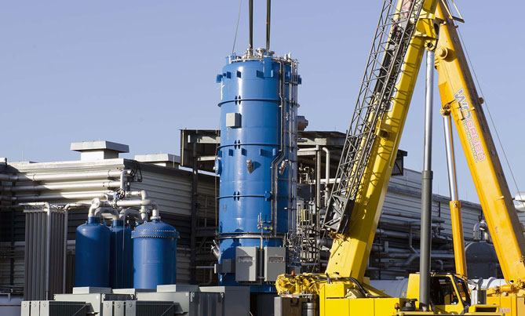
12 GeV Upgrade – Recent Progress
High gradient cryomodule performance
demonstrated in tunnel
◻ Met research beam spec. of 108 MeV @ 465 μA
Central Helium Liquefier-2 equipment in place
Hall D – equipment installation in progress
Superconducting magnets under construction
All major detector systems under construction
C100 Cryomodule Energy Gain – May 18th
Third C100 Cryomodule
transferred to tunnel
108 MeV
– 200
98 MeV
– 150
ENERGY GAIN (MeV)
Beam Current/pass (μA)
– 100
– 50
TIME (in 20 minute increments)
CHL-2
installation

Slide 39
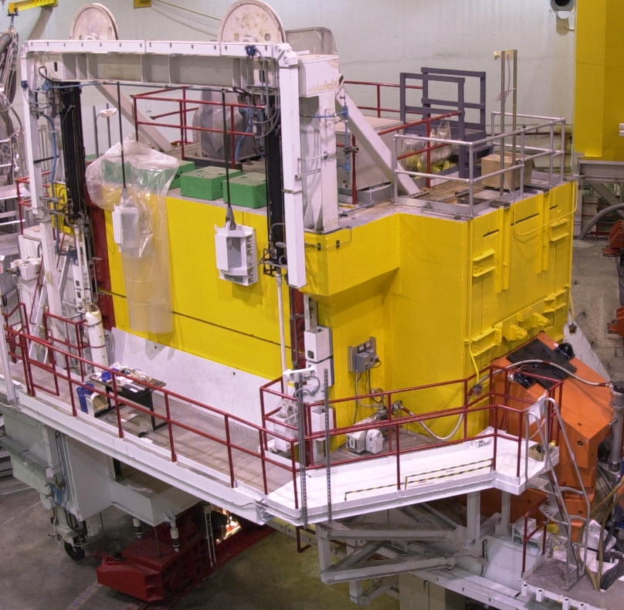

Planning for the Down – De-installation
Plans for CLAS, SOS (and Qweak) de-installation in place
70% of scope planned for FY12
Labor planning completed
  – assistance from Physics and Engineering in crunch time
Plans for storage of detector components to be salvaged in place
  – e.g., frames prepared for CLAS/FTOF components to be used in future Hall C/SRC experiment led by Tel Aviv group
  – and of course for components to be recycled for 12 GeV

Slide 40




Planning for the Down - Space
Experimental Staging Building
15,000 Sq. Ft., temperature controlled
Home for detectors moving in and out of Hall
Hall D/Bcal, Hall B/PCAL, Hall B/DC, HKS/HES
Chalet Building 98
4,400 Sq. Ft., temperature controlled
Future home for various Hall workshops
Hall B/FTOF construction
TEDF High Bay
4,600 Sq. Ft., temperature controlled
Home for detector construction
Hall D space, Hall B/HTCC & LTCC
Physics Storage Building
15,000 Sq. Ft., floor space
5,000 Sq. Ft. mezzanine space
Storage of equipment coming in and out of Hall (but cleaned up, so emergency space)

Slide 41




A High-Luminosity US-Based Electron Ion Collider
eRHIC @ BNL
Stage I
MEIC / ELIC @ JLab
Stage I
(MEIC)
√s = 25 – 71 GeV
E_{e} = 3 – 5 GeV
E_{p} = 50 – 250 GeV
E_{Pb} = up to 100 GeV/A
√s = 15 – 66 GeV
E_{e} = 3 – 11 GeV
E_{p} = 20 – 100 GeV
E_{Pb} = up to 40 GeV/A
eRHIC: take advantage of higher proton/ion energies
E_{e}=5 GeV
Luminosity (x10³²)
MEIC: take advantage of lower proton/ion energies for detector/IR design
E_{e}=10 GeV
eRHIC-1, E_{e}=5 GeV
“world’s first polarized e-p collider and world’s first e-A collider”
Proton Energy (GeV)
Stage 1 MEIC: dedicated ~1 km ring optimized for 20-100 GeV protons

