Slide 1
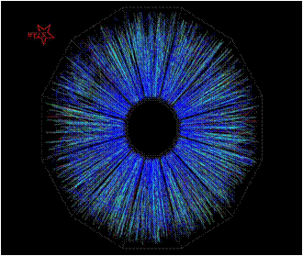
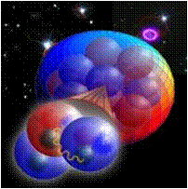
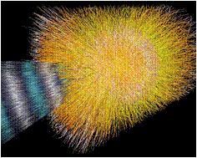
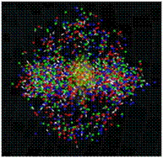
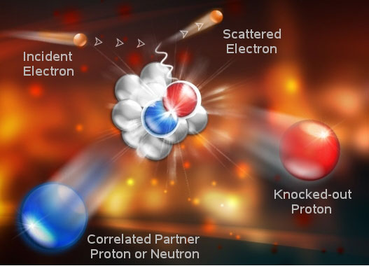
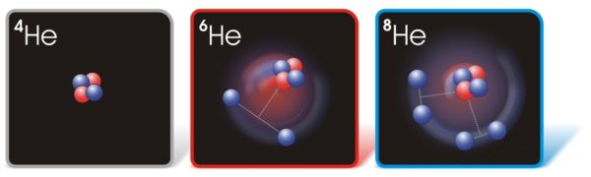
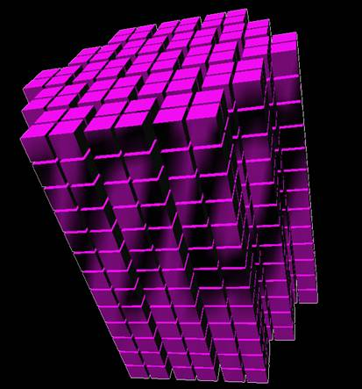
Perspectives from DOE Nuclear Physics
Presentation to the JLAB Users Group
June 5, 2012
Dr. T. J. Hallman
Associate Director for Nuclear Physics
DOE Office of Science

Slide 2
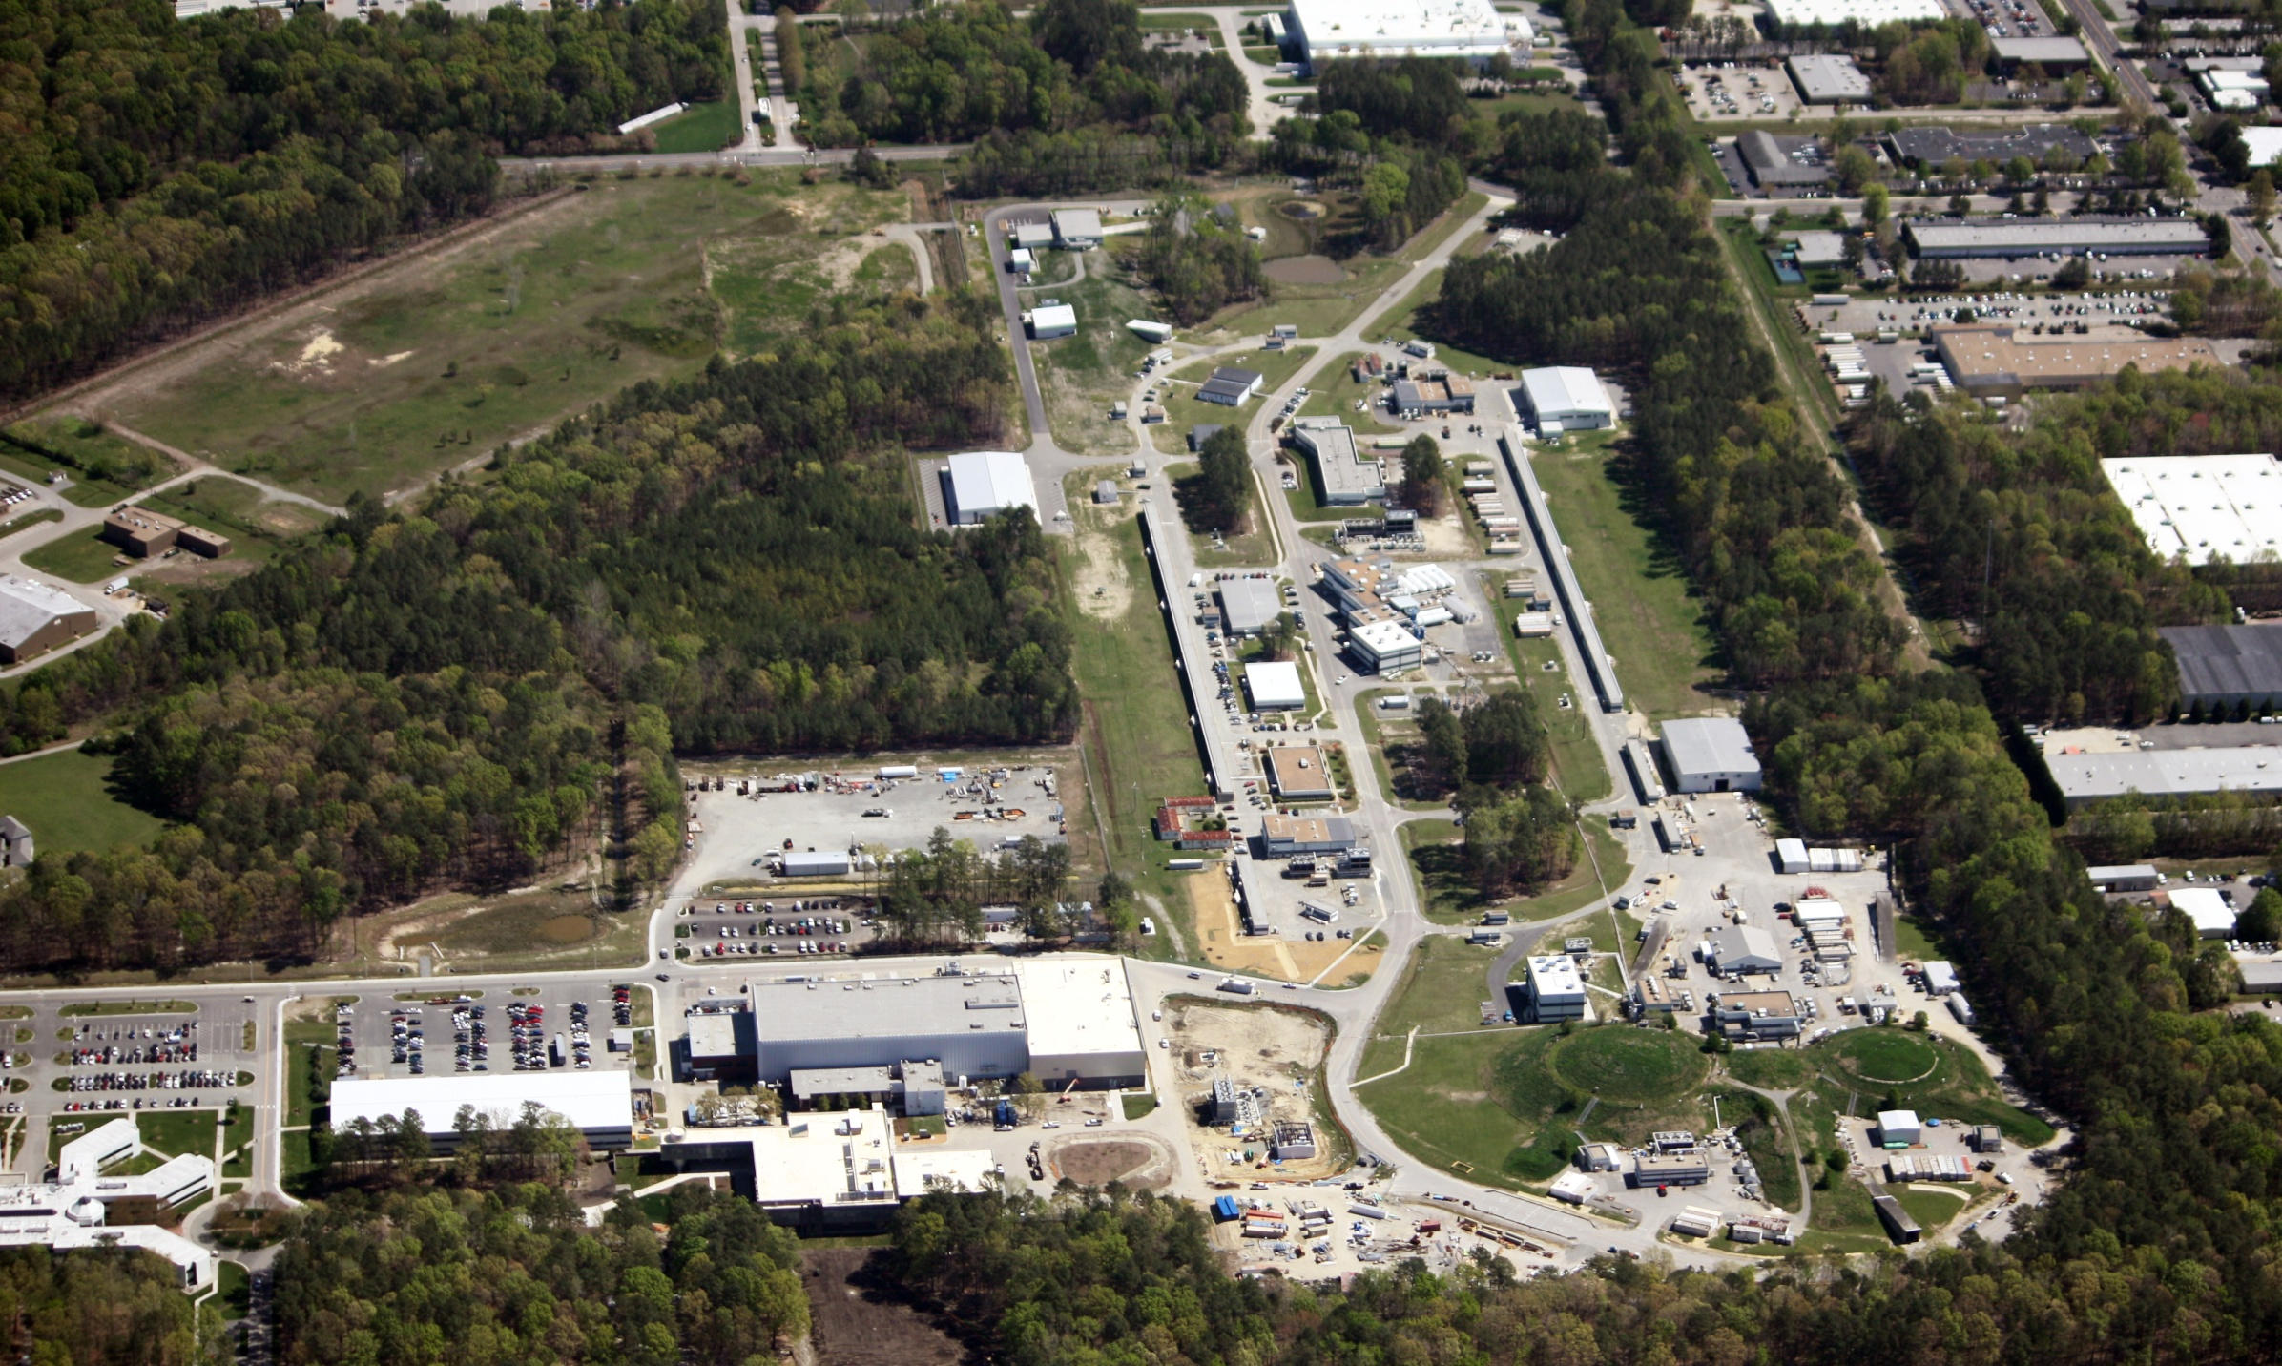
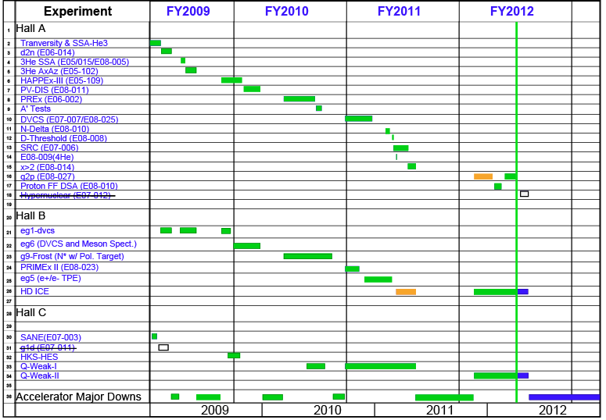
First Comment: Congratulations!
On the successful conclusion of the
6 GeV era and the watershed of high
impact science which resulted !
Presentation to JLAB Users Group June 5, 2012

Slide 3
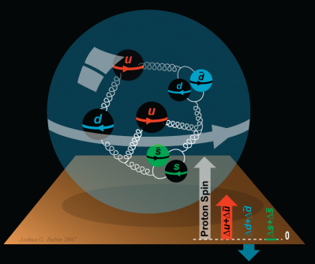


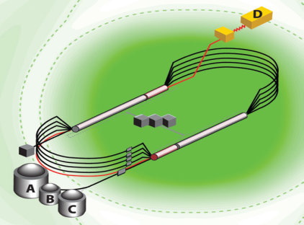
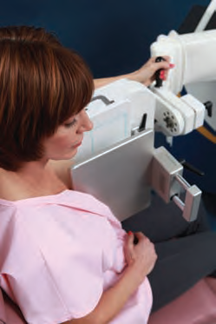

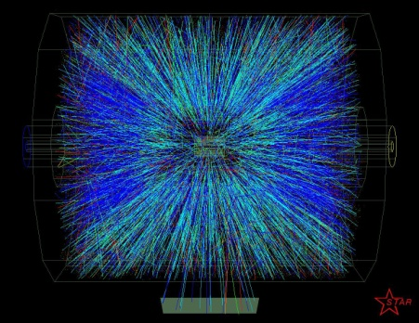

JLAB: A Laboratory for Nuclear Science
Nuclear Structure
Structure
of Hadrons
Fundamental
Forces & Symmetries
Medical
Imaging
Quark Confinement
Accelerator S&T
Hadrons from QGP
Theory and Computation
Presentation to JLAB Users Group June 5, 2012

Slide 4
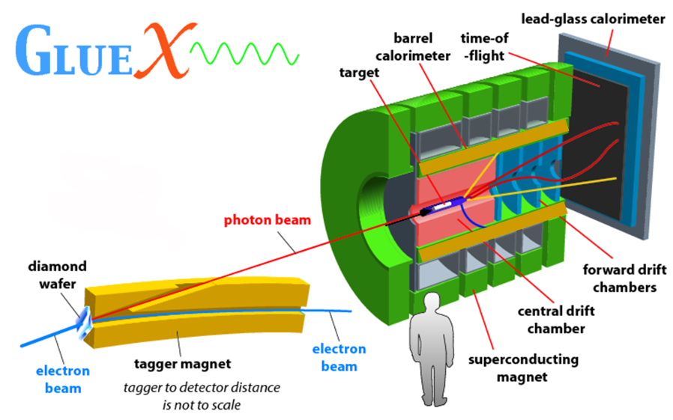
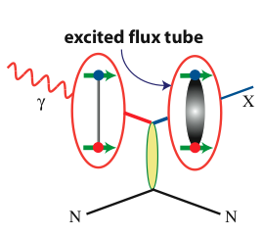
Hall D
FCAL
TOF
BCAL
Start counter
FDC
CDC
BCAL
4
Presentation to JLAB Users Group June 5, 2012

Slide 5
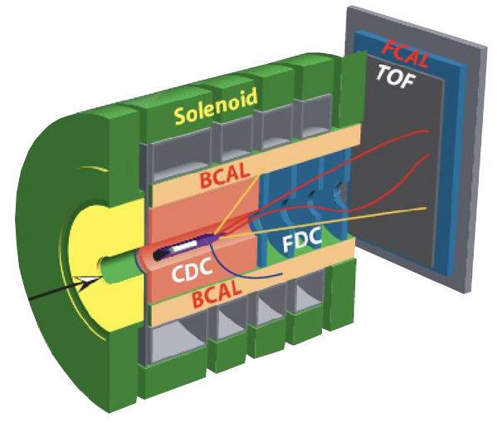

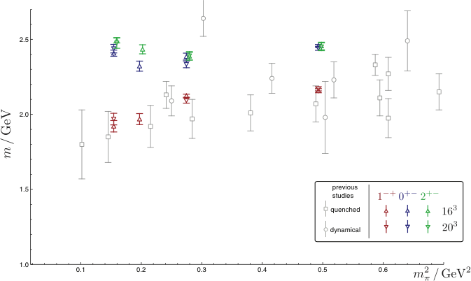
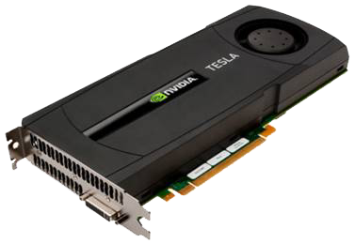

Isovector Meson Spectrum
Hall D@JLab
States with Exotic Quantum Numbers
2
+-
0
+-
1
-+
Dudek et al.
Presentation to JLAB Users Group June 5, 2012

Slide 6
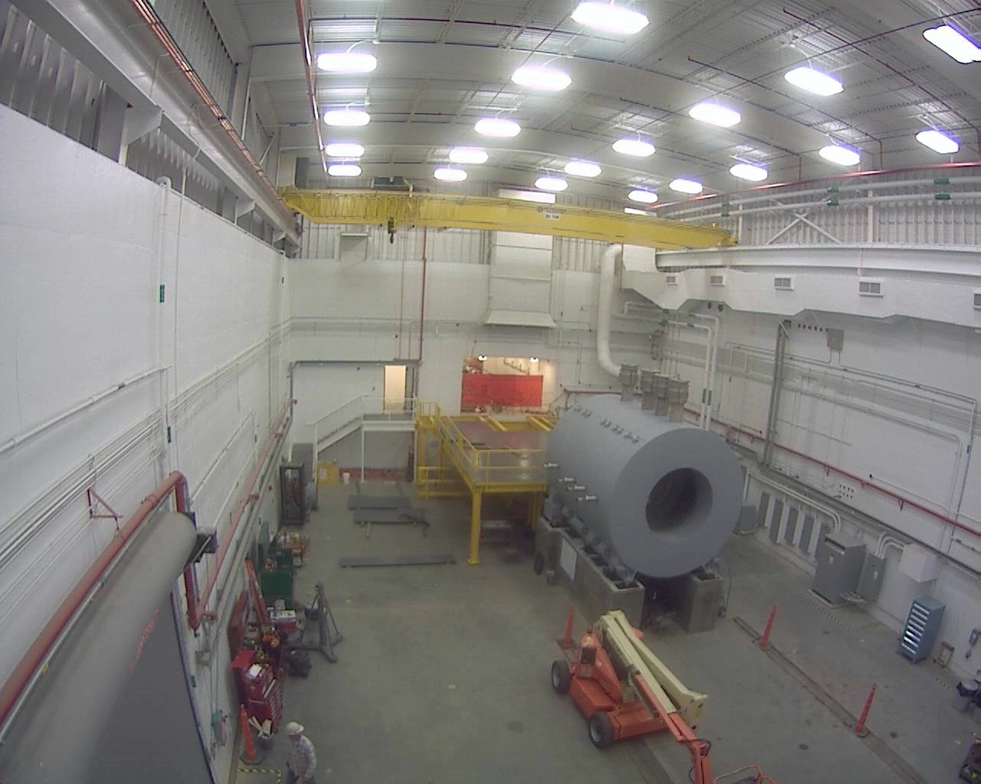
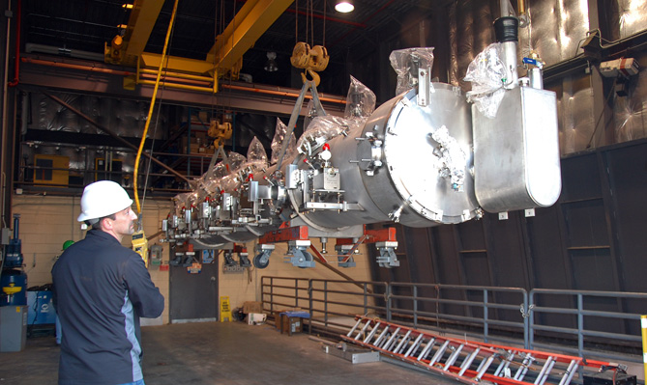
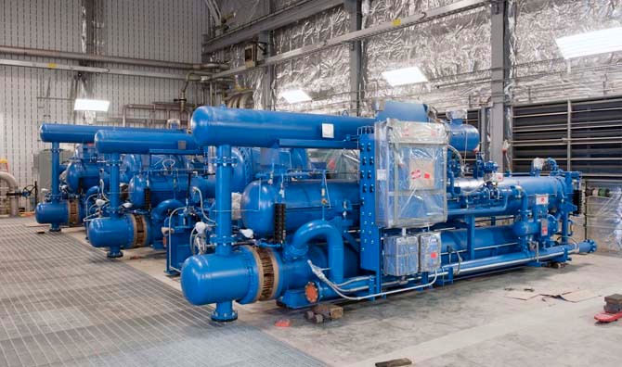
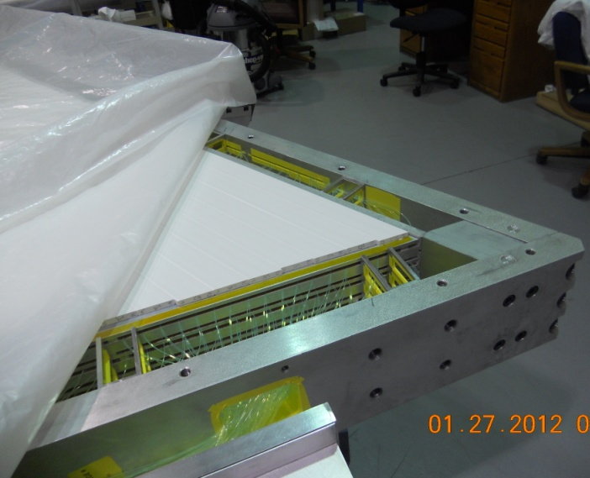
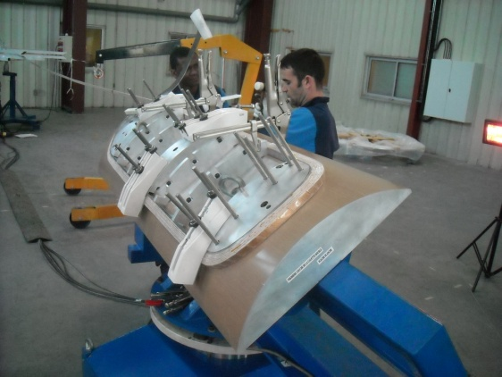
12 GeV Upgrade – Highlights
Hall D – equipment installation in progress
Two high-gradient 12 GeV cryomodules installed
and delivering high quality beam; third moved to tunnel
CHL-2 compressors/coolers/skids in place
Superconducting magnets under construction
All major detector systems under construction
  All 48 Hall D BCAL modules on site (U. Regina)
Performance Index: schedule 95% ; cost 96%
Hall D Interior
Third C-100 Cryomodule
transferred to tunnel
Central Helium Liquefier-2
installation
Hall B Pre-Shower
Calorimeter
Hall C Dipole
Prototype Coil
Presentation to JLAB Users Group June 5, 2012

Slide 7
JLab: 21st Century Science Questions
What is the role of gluonic excitations in the spectroscopy of light mesons? Can these excitations elucidate the origin of quark confinement?
Where is the missing spin in the nucleon? Is there a significant contribution from valence quark orbital angular momentum?
Can we reveal a novel landscape of nucleon substructure through measurements of new multidimensional distribution functions?
What is the relation between short-range N-N correlations and the partonic structure of nuclei?
Can we discover evidence for physics beyond the standard model of particle physics?
Presentation to JLAB Users Group June 5, 2012

Slide 8
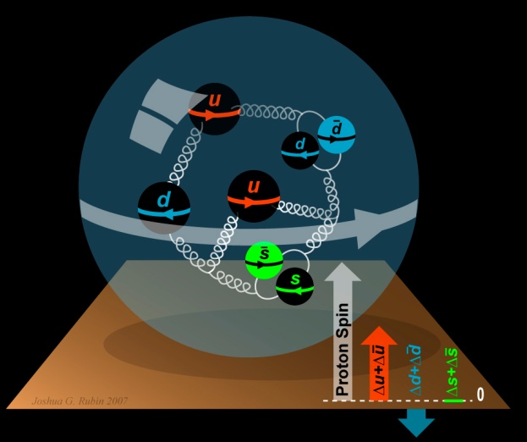
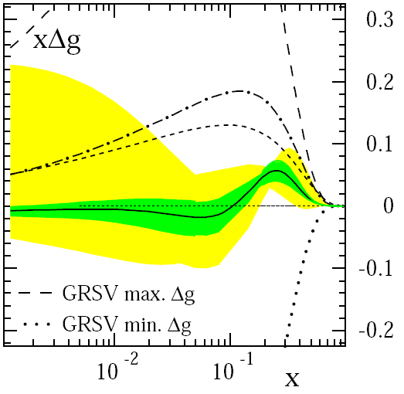
The Incomplete Nucleon: Spin Puzzle
1
1
ΔΣ
+
L_{q}
+
J_{g}
=
2
2
[X. Ji, 1997]
DIS → ΔΣ ≅ 0.25
RHIC + DIS → ΔG« 1
→ L_{q}
D. de Florian et al., PRL 101 (2008) 072001
Presentation to JLAB Users Group June 5, 2012

Slide 9

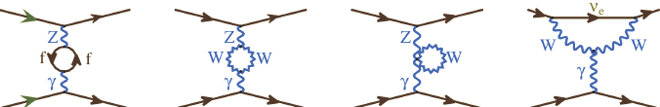
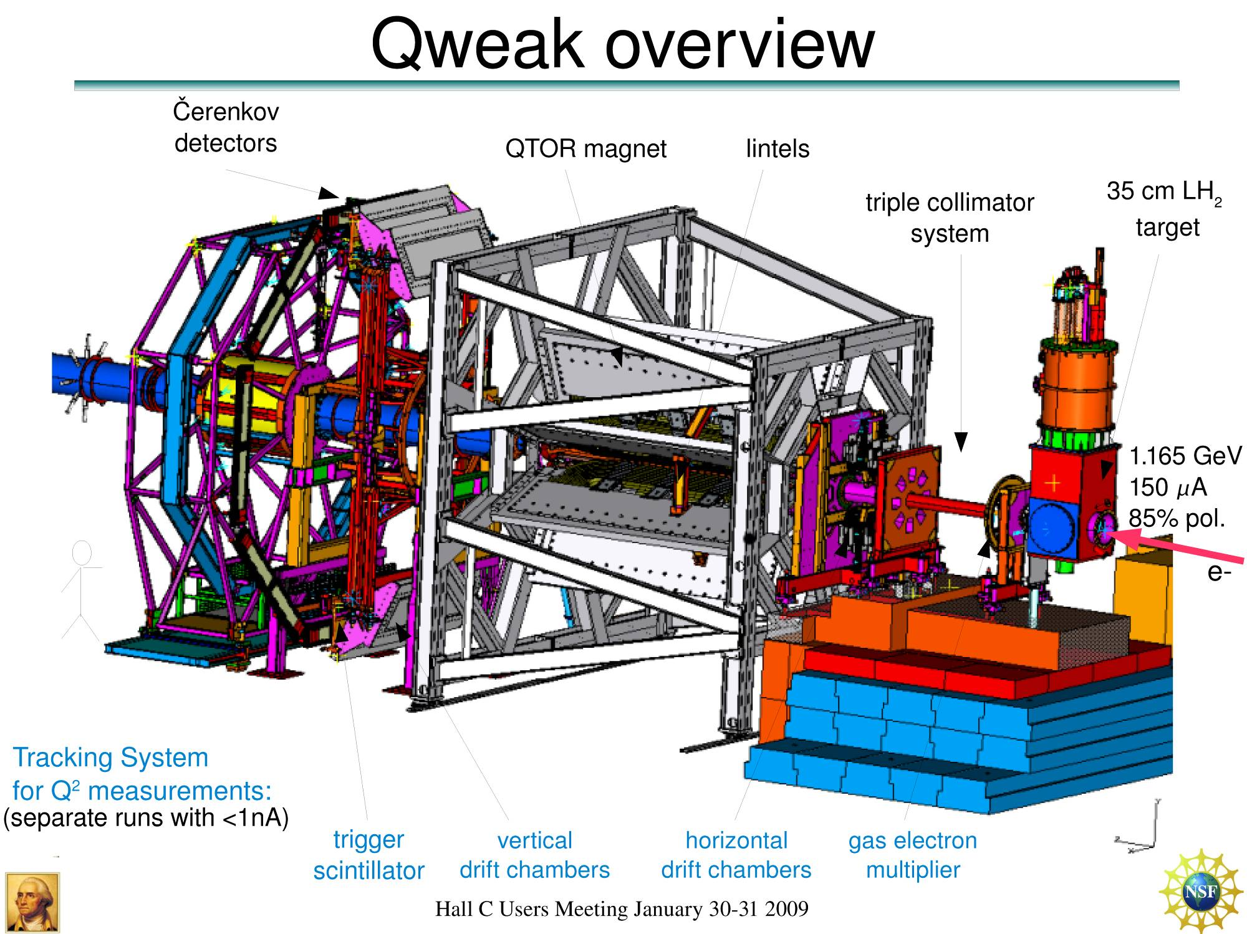
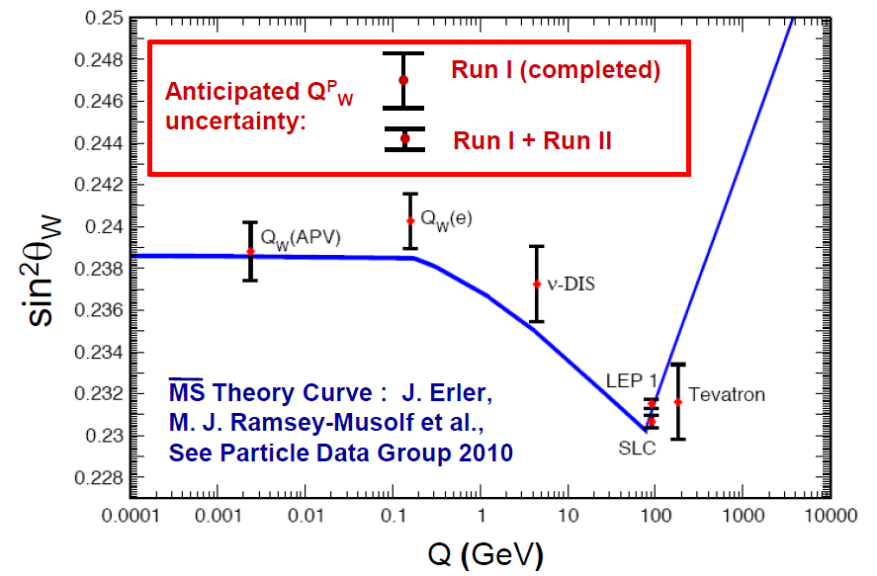
Qweak
Precise determination of
the weak charge of the proton
Q_{w}= -2(2C_{1u}+C_{1d})
=(1 – 4 sin² θ_{W})
2.2 kW
Luminosity
monitors
Luminosity
monitors
scanner
Presentation to JLAB Users Group June 5, 2012

Slide 10
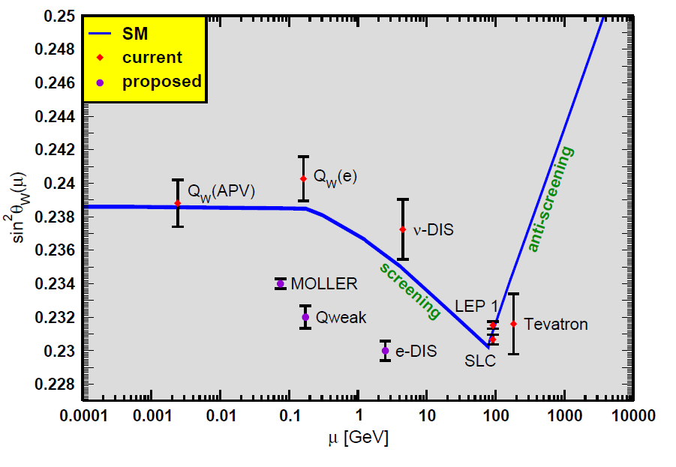
Projected Results
JLab program
Presentation to JLAB Users Group June 5, 2012

Slide 11
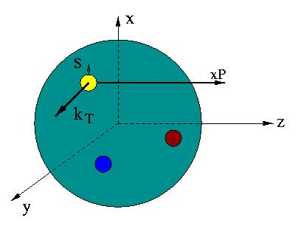

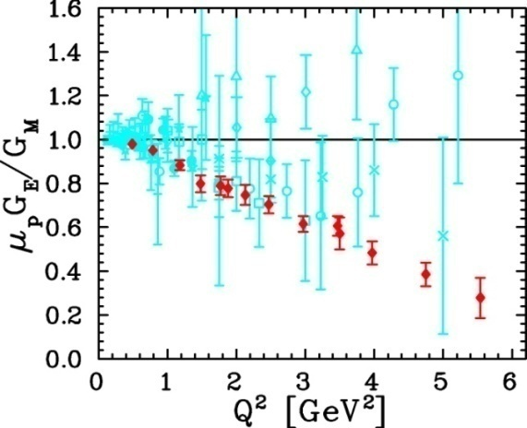
Unified View of Nucleon Structure
W_{p}^{u}(x,k_{T},r ) Wigner distributions
6D Dist.
d³r
d²k_{T} dr_{z}
TMD PDFs f₁^{u}(x,k_{T}), .. h₁^{u}(x,k_{T})‏
GPDs/IPDs
3D imaging
dx &
Fourier Transformation
d²k_{T}
d²r_{T}
Form Factors
G_{E}(Q²),
G_{M}(Q²)‏
PDFs
f₁^{u}(x), .. h₁^{u}(x)‏
1D
Presentation to JLAB Users Group June 5, 2012

Slide 12
EIC Science Frontier
Explore the nuclear landscape at low x to:
Discover the collective effects of gluons in nuclei
Complete the map of the spin and spatial structure of sea quarks and gluons in nucleons
Understand the emergence of hadronic matter from quarks and gluons
Presentation to JLAB Users Group June 5, 2012

Slide 13

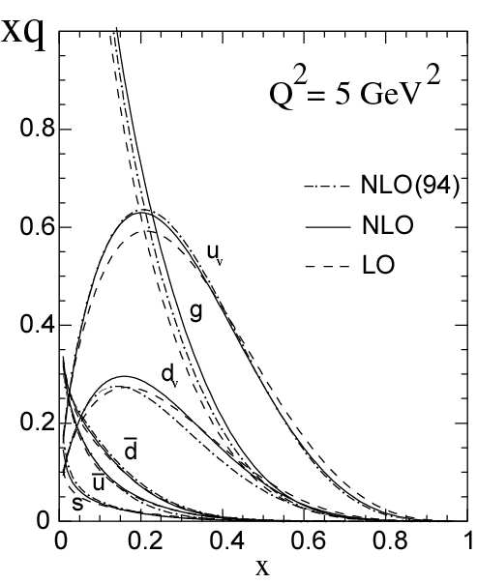
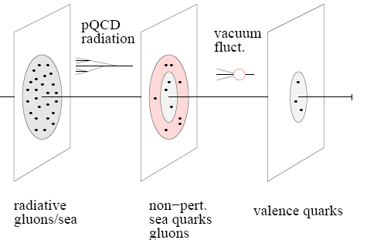
Into the “sea”: EIC
An EIC aims to study the sea quarks, gluons, and scale (Q²) dependence.
With 12 GeV we study mostly the valence quark component
mEIC
EIC
12 GeV
13
Presentation to JLAB Users Group June 5, 2012

Slide 14
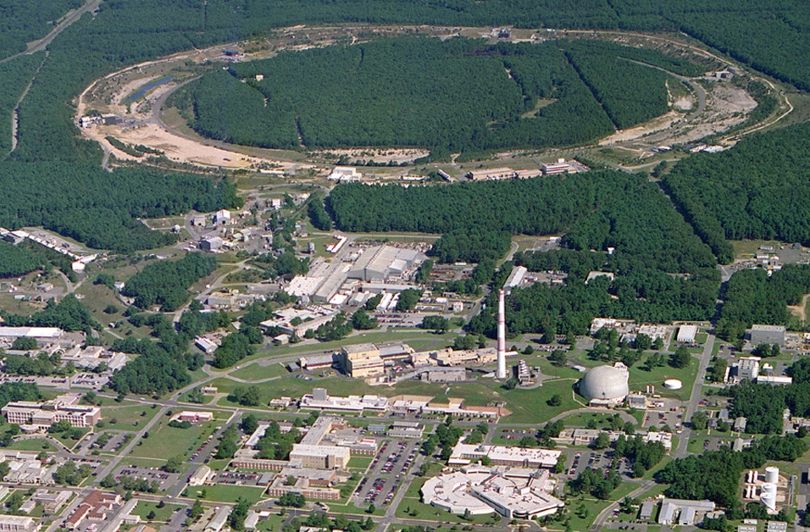
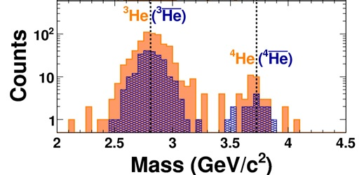
Research Focus of the Relativistic Heavy Ion Collider
To elucidate the fundamenal properties of the Perfect Liquid discovered in Au+Au collisions
To determine the contribution to the proton spin from gluons, sea quarks/anti-quarks; to study transversity and advance understanding of contributions from orbital motion within the proton
To address other scientific “targets of discovery opportunity” afforded by RHIC’s capabilities
RHIC
PHENIX
8:00 o’clock
STAR
6:00 o’clock
LINAC
NSRL
EBIS
Booster
AGS
BLIP
Tandems
NSRL
RHIC also stewards strong core competencies
in accelerator physics
Presentation to JLAB Users Group June 5, 2012

Slide 15
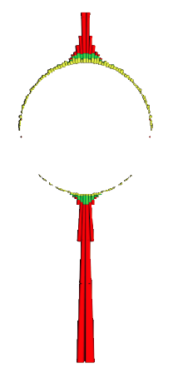
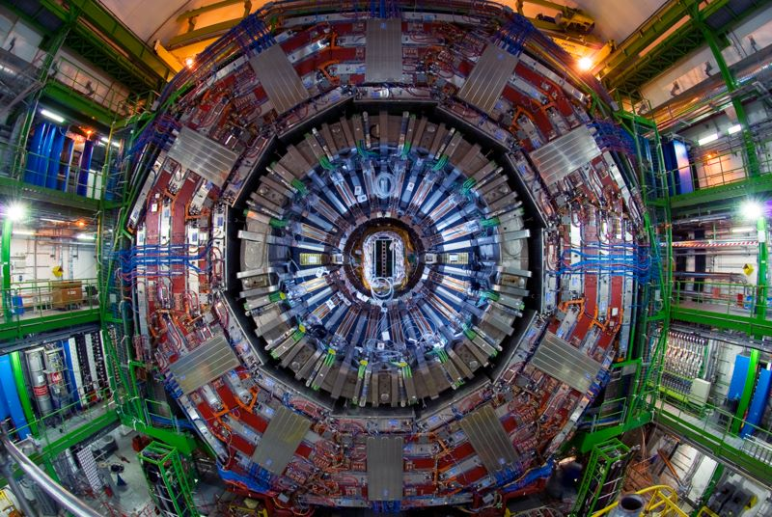
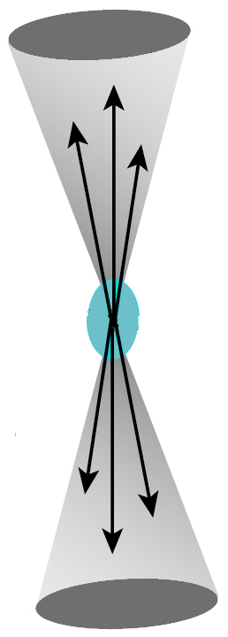
Other NP Investments: Heavy Ion Research at the LHC
Energy deposition in the CMS detector at the Large Hadron Collider (LHC) as a function of angle around the beam direction
Beam’s Eye
View
Heavy ion data at the LHC indicate a new state of opaque, strongly interacting matter similar to that first discovered at RHIC is produced in heavy ion collisions. “Jets” of energetic particles that traverse the new form of matter are disrupted (right) unlike in proton-proton collisions (left).
The results show that this new form of matter, believed to have influenced the evolution of the early universe, has unique properties and interacts more strongly than any matter previously produced in the laboratory.
Schematic of expected symmetric back-to-back energy flow (“jets”) around the beam direction from the interaction of two energetic partons (quarks, gluons) in proton – proton collisions
Observation in CMS of large asymmetric non back-to-back (jet) energy flow around the beam direction from the interaction of two energetic partons (quarks, gluons) in relativistic nucleus-nucleus collisions
Presentation to JLAB Users Group June 5, 2012

Slide 16
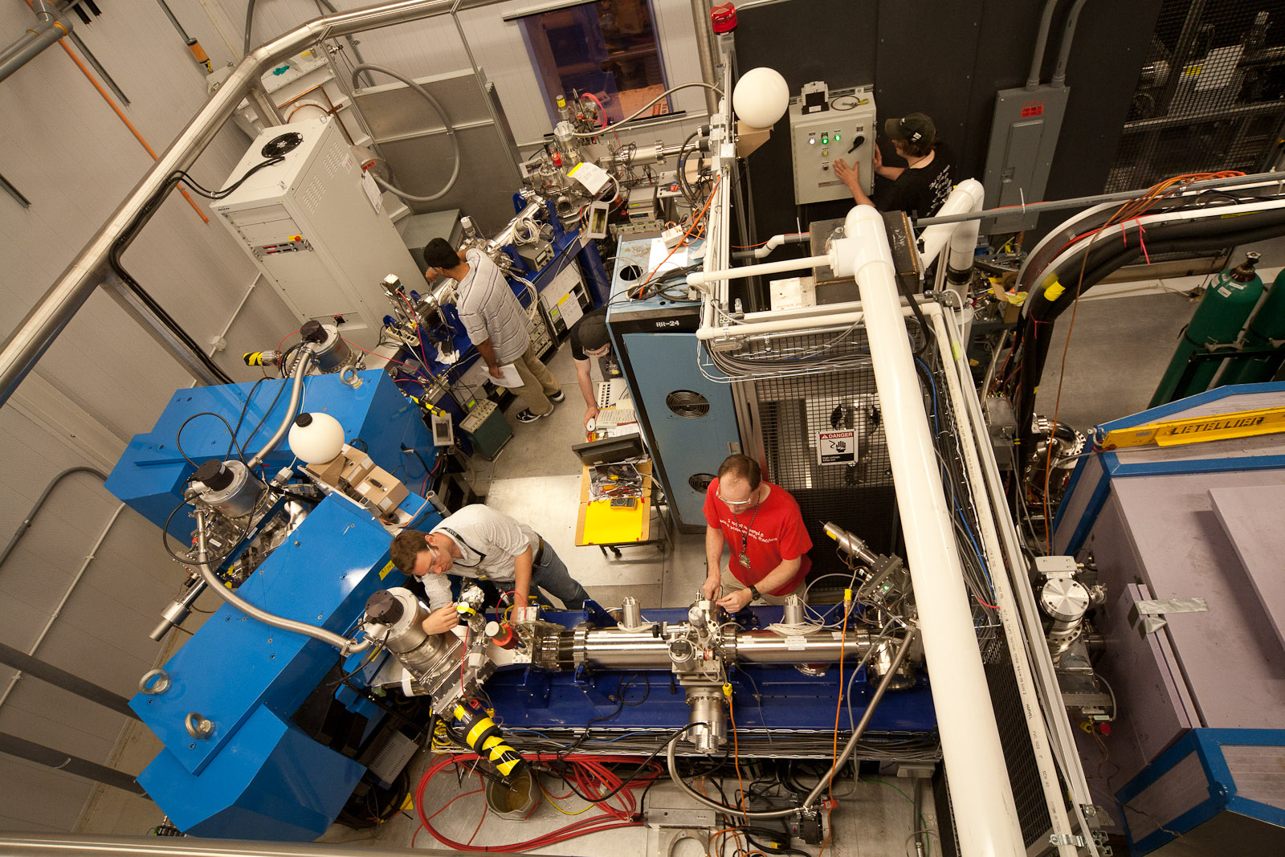
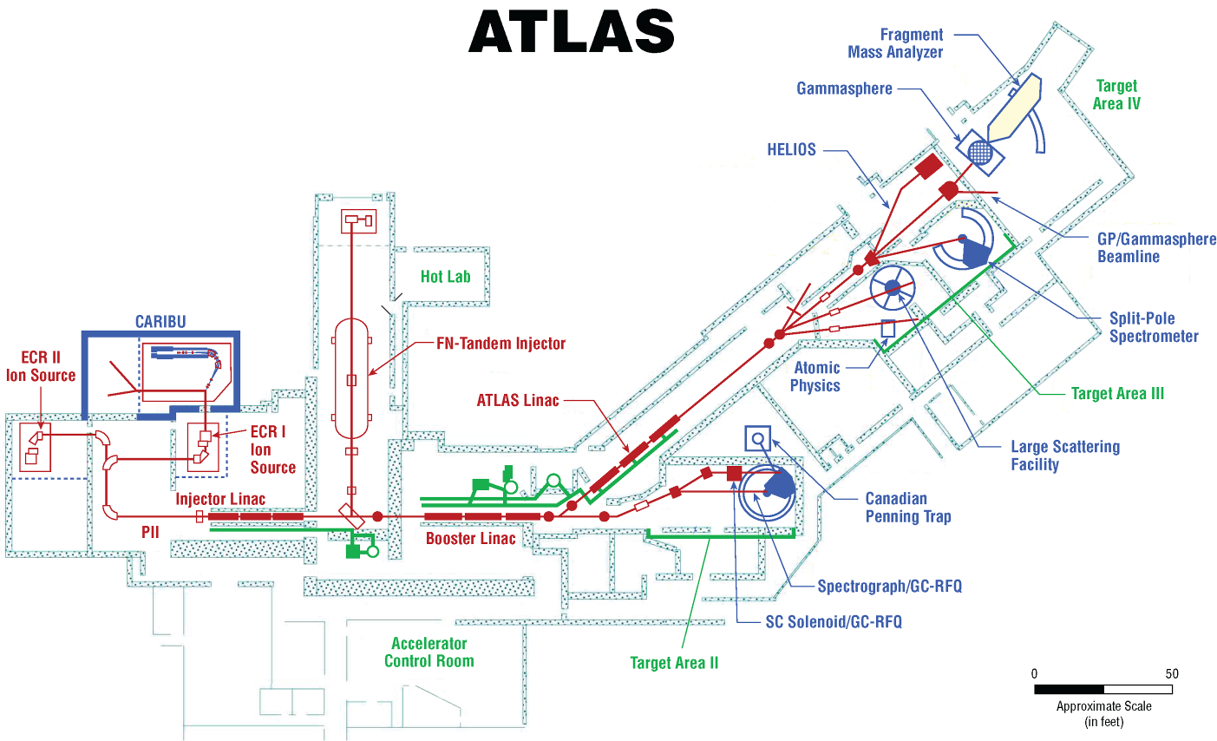
Argonne Tandem Linac Accelerator System Layout
A Unique Premier Stable Beam Facility
For research on Nuclear Structure &
Nuclear Astrophysics
Presentation to JLAB Users Group June 5, 2012

Slide 17
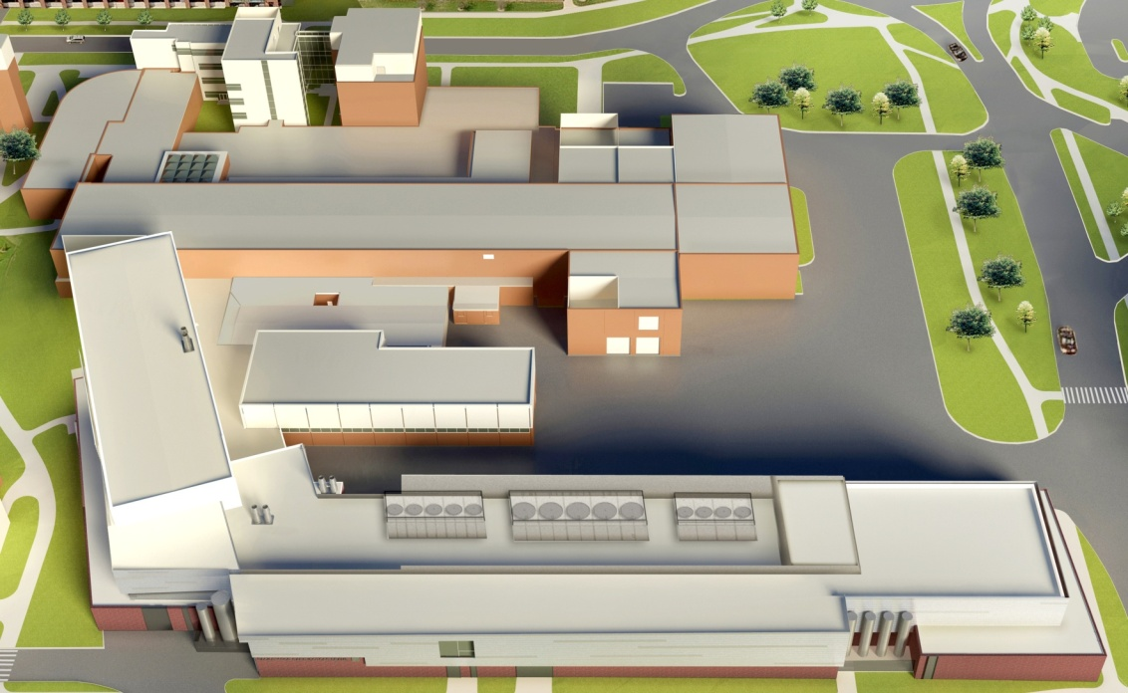
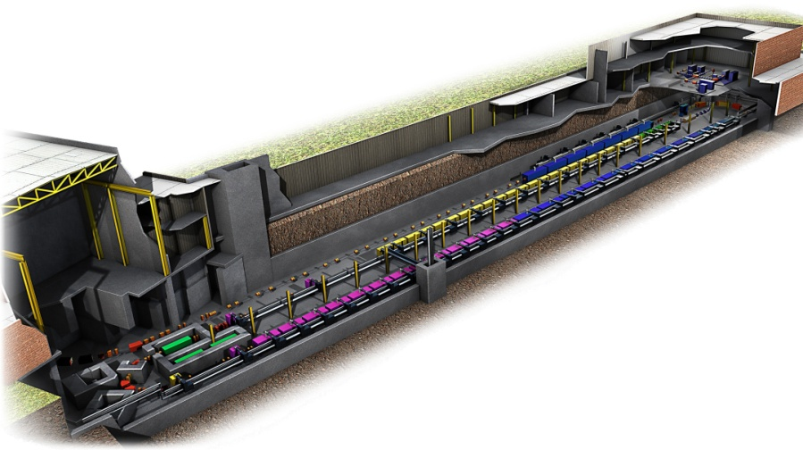
Research Focus of the Facility for Rare Isotope Beams
Existing National Superconducting Cyclotron Laboratory
FRIB will increase the number of isotopes with known properties from ~2,000 observed over the last century to ~5,000 and will provide world-leading capabilities for research on:
Nuclear Structure
  The ultimate limits of existence for nuclei
  Nuclei which have neutron skins
  The synthesis of super heavy elements
Nuclear Astrophysics
  The origin of the heavy elements and explosive nucleo-synthesis
  Composition of neutron star crusts
Fundamental Symmetries
  Tests of fundamental symmetries, Atomic EDMs, Weak Charge
  This research will provide the basis for a model of nuclei and how they interact.
NSCL
New FRIB Linear Accelerator
Front End
Tunnel is
  550 ft long
  70 ft wide
  25 ft underground
Beam Delivery
System
Presentation to JLAB Users Group June 5, 2012

Slide 18
Nuclear Theory
Research in nuclear theory spans the entire NP program.
Theory:
Poses scientific questions that lead to the construction of facilities
Helps make the case for, and guide the design of new facilities, their
research programs and their strategic operations plan
Provides a framework for understanding measurements made at facilities
  Theory effort is key to understanding flow, charmonium, etc. at RHIC
  Ab Initio calculations of nuclear structure, reactions, are essential for
  understanding drip lines, nucleosynthesis, atomic EDMs, …
  Calculations of nuclear and nucleon matrix elements are crucial for:
    Understanding and interpreting weak decays ➔CKM matrix
    elements ➔ new standard model
    Understanding and interpreting neutrinoless double beta decay
Presentation to JLAB Users Group June 5, 2012

Slide 19
Existing Topical Theory Collaborations
Topical Theory Collaborations
Selection announced Dec 14, 2009
“Jet and Electromagnetic Tomography (JET) in Heavy-Ion Collisions “
Principal Investigator/Project Director: X-N. Wang (LBNL), eight collaborating
institutions
“Advancing the Theory of Nuclear Reactions with Rare Isotopes: From the
Laboratory to the Cosmos “
Principal Investigator/Project Director: I. Thompson (LLNL), four collaborating
institutions
“Neutrinos and Nucleosynthesis in Hot and Dense Matter”
Principal Investigator/Project Director: S. Reddy (INT formerly LANL), six
collaborating institutions
Topical Collaborations are fixed-term, multi-institution collaborations established to investigate a specific topic in nuclear physics of special interest to the community, which is well aligned with programmatic NP goals.
Presentation to JLAB Users Group June 5, 2012

Slide 20
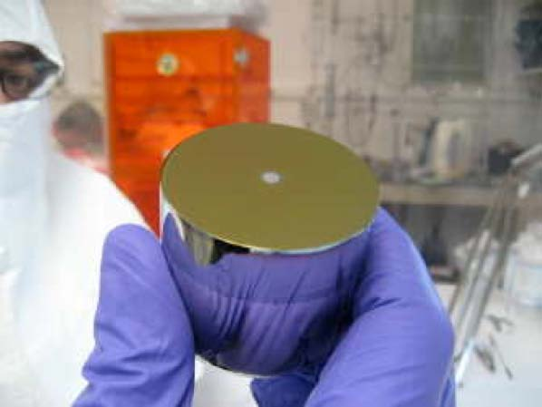
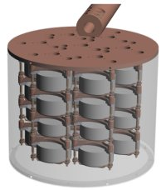
Neutrino-less Double Beta Decay
Grand challenge question: Is the neutrino its own anti-particle?
Germanium detector and the cryostat for the Majorana Demonstrator (MJD 40-kg ultra-clean Ge detector).
An R&D effort on the Majorana Demonstrator (MJD) will help establish the feasibility of a tonne-scale ⁷⁶Ge neutrino-less double beta-decay experiment.
The MJD technology demonstration is planned prior to a down-select with the German GERDA experiment between competing Ge technologies and a planned collaboration together.
MJD is on track with electroforming and with procurement and processing of enriched Ge.
MJD plans to go underground with natural Ge in a prototype cryostat at the Sanford Laboratory (South Dakota) in late spring 2012.
The technology and the location of a future, international tonne-scale experiment is TBD based on the best value and the best science capability.
CUORE
Presentation to JLAB Users Group June 5, 2012

Slide 21
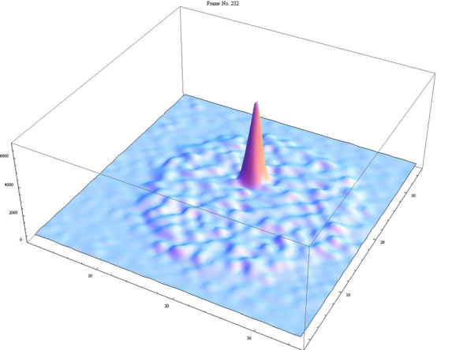
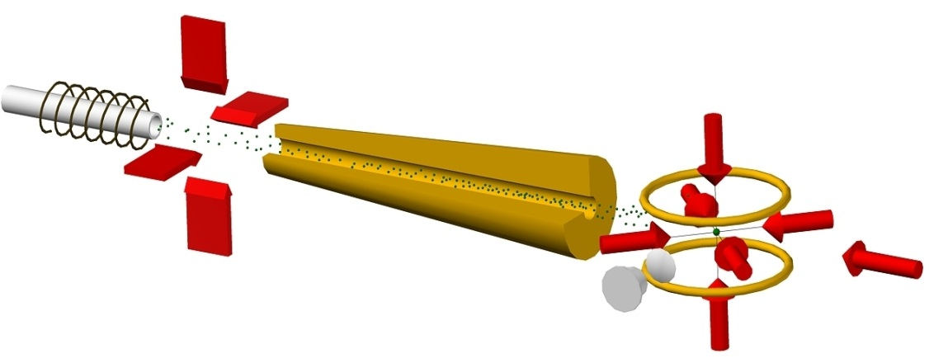
Atom Trap Trace Analysis (ATTA) at ANL
ATTA-3 at ANL to be Used to Map Major Aquifers around the World
Developed ATTA-3 instrument with greatly improved sensitivity and selectivity
Sensitivity: Capable of ⁸¹Kr-dating with a sample of 10 micro-liter (STP) of krypton gas;
Selectivity: Analyzed ³⁹Ar in environmental samples at the isotopic abundance level of 8x10⁻¹⁶.
⁸¹Kr-dating realized with a range of applications in earth & environmental sciences
Samples to be analyzed in 2011-2012
Done: Yellowstone National Park, WIPP sites (with Sandia);
In progress: Great Artesian Basin, Australia;
In plan: Participate in a comprehensive study of world-wide aquifers (with IAEA).
A single ⁸¹Kr atom in the trap
ATTA apparatus
References
ATTA-1: Chen et al., Science (1999)
ATTA-2: Du et al., Geophys. Res. Lett. (2003)
ATTA-3: Jiang et al., Phys. Rev. Lett. (2011)
Featured in the Science Section of New York Times (Nov. 22, 2011)
Presentation to JLAB Users Group June 5, 2012

Slide 22
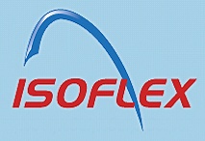



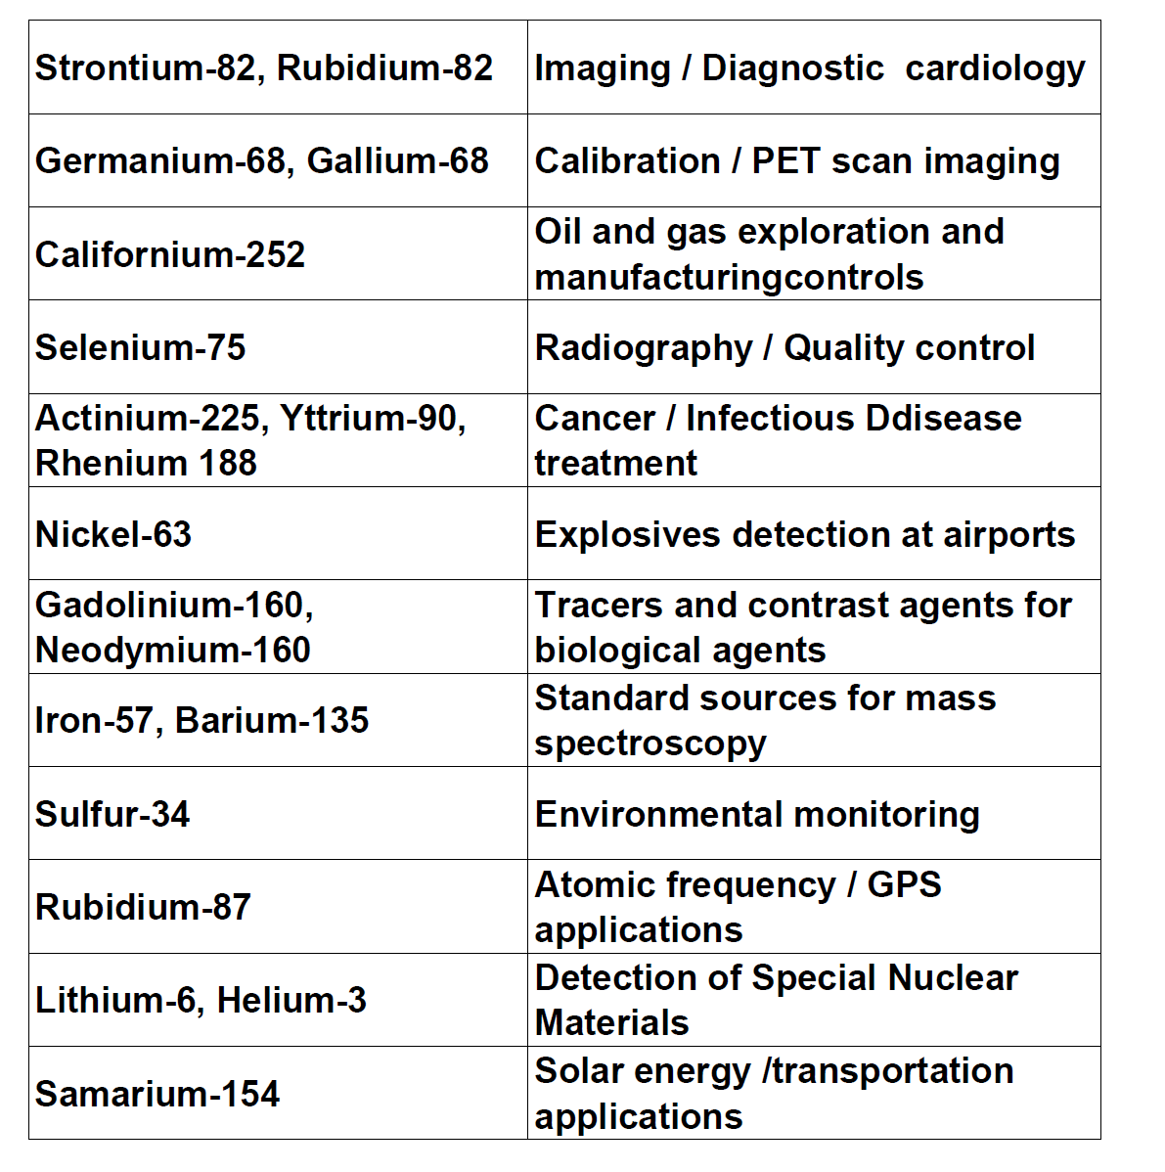

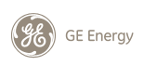






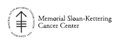













Isotopes and Radioisotopes in Short Supply Provided at Full Cost Recovery by the Office of Science to Support U.S. Needs and Industrial Competitiveness
Some key isotopes and radioisotopes and the companies that use them
Bracco Diagnostics Inc.
Spectrum Techniques
Presentation to JLAB Users Group June 5, 2012

Slide 23




















An SC-NNSA Joint Workshop on Isotope Supply and Demand
A New Era of Communication and Coordination on Isotopes by Federal Agencies
1st Workshop on Isotope Federal
Supply and Demand, Jan 11-12, 2012
Armed Forces Radiobiology Research Institute
Central Intelligence Agency
Defense Threat Reduction Agency
Department of Agriculture
DOE/Office of Environmental Management
DOE/Office of Intelligence
DOE/New Brunswick Laboratory
DOE/Nuclear Energy
DOE/National Nuclear Security Administration
DOE/Office of Science
DOE/Savannah River Operations Office
Department of Health and Human Services
Department of Homeland Security
Department of Transportation
Environmental Protection Agency
Federal Bureau of Investigation
National Aeronautics and Space Administration
National Institutes of Health
National Institute of Standards and Technology
National Science Foundation
National Security Staff
Office of the Assistant Secretary of Defense
Presentation to JLAB Users Group June 5, 2012

Slide 24
Science Early Career Research Award Program Funding
Nuclear Physics
10
11
12
13
14
15
16
FISCAL YEAR
Presentation to JLAB Users Group June 5, 2012

Slide 25
Office of Science Funding History
 | (dollars in thousands)
 | FY 2008 | FY 2009 | FY 2009 ARRA | FY 2010 | FY 2011 | FY 2012 | FY 2013 Pres. Req.
Advanced Scientific Computing Research | 341,774 | 358,772 | 161,795 | 383,199 | 410,317 | 440,868 | 455,593
Basic Energy Sciences | 1,252,756 | 1,535,765 | 555,406 | 1,598,968 | 1,638,511 | 1,688,093 | 1,799,592
Biological and Environmental Research | 531,063 | 585,176 | 165,653 | 588,031 | 595,246 | 609,557 | 625,347
Fusion Energy Sciences | 294,933 | 394,518 | 91,023 | 417,650 | 367,257 | 400,996 | 398,324
High Energy Physics | 702,845 | 775,868 | 232,390 | 790,811 | 775,578 | 790,860 | 776,521
Nuclear Physics | 423,671 | 500,307 | 154,800 | 522,460 | 527,684 | 547,387 | 526,938
Workforce Development for Teachers and Scientists | 8,044 | 13,583 | 12,500 | 20,678 | 22,600 | 18,500 | 14,500
Science Laboratories and Infrastructure | 66,861 | 145,380 | 198,114 | 127,600 | 125,748 | 111,800 | 117,790
Safeguards and Security | 75,946 | 80,603 | … | 83,000 | 83,786 | 80,573 | 84,000
Program Direction | 177,779 | 186,695 | 5,600 | 189,377 | 202,520 | 185,000 | 202,551
Subtotal, Office of Science | 3,875,672 | 4,576,667 | 1,577,281 | 4,721,774 | 4,749,247 | 4,873,634 | 5,001,156
Other (incl SBIR/STTR) | 207,211 | 230,503 | 55,637 | 242,113 | 148,036 | … | -9,104
Total, Office of Science (SC) | 4,082,883 | 4,807,170 | 1,632,918 | 4,963,887 | 4,897,283 | 4,873,634 | 4,992,052
Nuclear Physics - % of SC | 10.4% | 10.4% | 9.5% | 10.5% | 10.8% | 11.2% | 10.6%
Nuclear Physics | 423,671 | 500,307 | 154,800 | 522,460 | 527,684 | 547,387 | 526,938
SBIR/STTR for comparability | 10,555 | 11,773 | 1,100 | 12,540 | 12,430 | … | …
Total, Nuclear Physics (incl SBIR/STTR) | 434,226 | 512,080 | 155,900 | 535,000 | 540,114 | 547,387 | 526,938
% Change year to year |  | +17.9% |  | +4.5% | +1.0% | +1.3% | -3.7%
Presentation to JLAB Users Group June 5, 2012

Slide 26
Office of Nuclear Physics FY 2013 Congressional Request
  The FY 2013 request for Nuclear Physics optimizes, within available resources, scientific productivity by a balance of investments in research, facility operations, new tools, and capabilities.
  It continues support for the two highest priorities in the 2007 Long Range Plan for Nuclear Science:
    12 GeV CEBAF Upgrade
    Facility for Rare Isotope Beams (FRIB)
  The FY 2013 budget is a decrease of $20.4M, or 3.7%, relative to the enacted FY 2012 appropriation.
    Funding for research across the program decreases by $9.9M, or 5.8%, relative to FY 2012.
    NP national user facilities are operated for an estimated 5,360 hours of beam time for research, 38% of optimal utilization for the operating facilities, and a decrease of about 6,800 hours compared with the beam hours planned for FY 2012.
      Reduction in hours is a result of reduced RHIC and ATLAS operations, and a planned shutdown period at CEBAF associated with the construction of the 12 GeV CEBAF Upgrade.
      At RHIC, FY 2013-FY 2014 running will be combined into a single back-to-back run bridging the two fiscal years.
      HRIBF D&D activities are supported.
    Funding for the 12 GeV CEBAF Upgrade project (TEC and OPC) ramps down $6.9M according to the original baseline plan; it does not restore the FY 2012 reduction of $16M.
    Funding for FRIB is flat with the FY 2012 enacted level.
    Funding is provided for the STAR Heavy Flavor Tracker MIE per the project baseline.
Presentation to JLAB Users Group June 5, 2012

Slide 27
Nuclear Physics Funding Distribution
FY 2008 – FY 2013
Presentation to JLAB Users Group June 5, 2012
Notes:
Use either this or the previous slide – not both (same data)

Slide 28


From the DOE―NSF Charge to NSAC
…
Presentation to JLAB Users Group June 5, 2012

Slide 29
NSAC Subcommittee Members
Professor Adam Burrows, Department of Astrophysical Sciences, Princeton University
Dr. Joseph Carlson, Los Alamos National Laboratory
Dr. George Crabtree Material Science Division, Argonne National Laboratory/ University of Illnois
Professor Brad Fillippone, Department of Physics, California Institute of Technology
Professor Stuart Freedman Department of Physics University of California
Professor Haiyan Gao, Triangle Universities Nuclear Laboratory Duke University
Dr. Donald Geesaman (NSAC Chair), Physics Division, Argonne National Laboratory
Professor Barbara Jacak Department of Physics & Astronomy State University of New York
Dr. Peter Jacobs, Nuclear Science Division, Lawrence Berkeley National Laboratory
Professor David Kaplan Institute of Nuclear Theory University of Washington
Professor Kirby Kemper Department of Physics Florida State University
Professor Krishna Kumar Department of Physics University of Massachusetts Amherst
Professor Naomi C. R. Makins Department of Physics University of Illinois
Professor Curtis Meyer Department of Physics Carnegie Mellon University
Professor Jamie Nagle Physics Department University of Colorado
Professor Witold Nazarewicz Department of Physics & Astronomy University of Tennessee
Professor Krishna Rajagopal Department of Physics Massachusetts Institute of Technology
Professor Michael Ramsey-Musolf Department of Physics University of Wisconsin
Professor Lee Sobotka Department of Chemistry Washington University
Professor Robert Tribble (Chair)Cyclotron Institute Texas A&M University
Professor Michael Wiescher Department of Physics University of Notre Dame Notre Dame
Professor John Wilkerson Department of Physics & Astronom University of North Carolina
Presentation to JLAB Users Group June 5, 2012

Slide 30
Message to the DNP from NSAC Subcommittee Chair, Bob Tribble
To members of the DNP:
The first meeting of a new NSAC subcommittee was held on May 15, 2012. The subcommittee has been charged to provide advice on implementing the priorities and recommendations of the 2007 NSAC Long Range Plan in light of projected budgetary constraints and for guidance on developing a plan to implement the highest priority science in the context of likely available funding and world-wide capabilities. The subcommittee used its first meeting to hear presentations from DOE and NSF representatives and to begin setting the agenda for the next meeting, which will mostly focus on presentations from the four major areas of science that were covered in the 2007 Long Range Plan. Also some significant time in the first meeting was devoted to the issue of community input to the process.
While the subcommittee is not carrying out a new LRP, it recognizes that the impact of the present effort will be significant for the field. We welcome input from individual members of the community and have a link on the subcommittee website
http://cyclotron.tamu.edu/nsac-subcommittee-2012
for DNP members to post comments to the subcommittee.
Presentation to JLAB Users Group June 5, 2012

Slide 31
Message to the DNP from NSAC Subcommittee Chair, Bob Tribble
For those interested in using this mechanism, comments will need to be submitted with your name and email address so that they can be approved by a moderator before they are posted. For those of you who are involved in a program at a major US user facility, it may be more appropriate to work through your User Group to provide input to the subcommittee. Other groups may want to 'self organize' in order to have their collective voice heard.
Since this is not a new LRP exercise, extended White Papers detailing all of the potential avenues of research will likely not be very useful to the subcommittee. More concise summaries putting the importance of the science in clear language would be particularly valuable. In addition, the DNP Executive Committee has agreed to set aside time at the fall DNP meeting in Newport Beach (likely in conjunction with the Town Meeting) for community input to the process. More information on the Fall Meeting plans will be forthcoming.
Bob Tribble
NSAC Subcommittee Chair
Presentation to JLAB Users Group June 5, 2012

Slide 32





Setting Science Priorities – NSAC Long Range Plans
1979
The Long Range Plans have:
    Identified the scientific opportunities
    Recommended scientific priorities
    The plans have been informed
    by a number of sources
    including important
    National Academy Studies
1983
1989
1996
2002
2007
The record of important accomplishments and
successes today is largely a result of:
The responsible/visionary strategic planning embodied in the
NSAC Long Range Plans
Federal government’s decision to utilize the guidance
and provide the needed resources
Presentation to JLAB Users Group June 5, 2012

Slide 33
Timeline of DOE Nuclear Physics Facilities
88-Inch Cyclotron 1962-2003
Bevelac 1971-1993
Bates 1971-2005
LAMPF 1972-1993
ATLAS 1985-Present
LEGS at BNL 1987-2007
AGS HI 1992-98
TJNAF 1994-Present
HRIBF 1996-2012
RHIC 2000-Present
1960
1970
1980
1990
2000
2010
2013
Additional Comments:
Other opportunities passed over due to prioritization in the field are not shown: e.g., KAON, LISS, ORLAND
The community has envisioned a Facility for Rare Isotope Beams beginning operation near the end of this decade
NSF facilities are not shown.
Presentation to JLAB Users Group June 5, 2012

Slide 34
Conclusion
The United States continues to provide resources for and to expect:
U.S. world leadership in discovery science illuminating the properties of nuclear matter in all of its manifestations.
Tools necessary for scientific and technical advances which will lead to new knowledge, new competencies, and groundbreaking innovation and applications.
Strategic investments in tools and research to provide the U.S. with premier research capabilities in the world.
NSAC’s advice is sought in developing a plan to continue to support a high impact world-class research effort with world leading facilities and research tools. Meaningful input will be essential.
Nuclear Physics, similar to all Federally supported programs, is facing very challenging budgets. NP will work with the community to mitigate impacts and ensure continuation of the highest priority, highest impact nuclear science research.
Presentation to JLAB Users Group June 5, 2012

Slide 35

The Breadth of the Horizon for Discovery in Nuclear Science
Evolution of the Universe
Neutron-rich Nuclei;
Structure Of Nuclei;
Reactions in Core
Collapse Super Novae;
Super Heavy Element 117
Heavy Nuclei Formation;
Density Effects in
Nuclei;
Neutron Skins;
Nuclear-Reactions;
NP
Discovery
Horizon
Anti-Helium 4;
Proton Spin
Majorana/DIRAC Neutrino;
Perfect QGP Liquid
Neutron Beta Decay;
Neutron EDM;
Parity Violation
Searches;
Presentation to JLAB Users Group June 5, 2012

Slide 36
Additional Information

Slide 37
Nuclear Physics
Discovering, exploring, and understanding all forms of nuclear matter
The Scientific Challenges:
Understand:
  The existence and properties of nuclear matter under extreme conditions, including that which existed at the beginning of the universe
  The exotic and excited bound states of quarks and gluons, including new tests of the Standard Model
  The ultimate limits of existence of bound systems of protons and neutrons
  Nuclear processes that power stars and supernovae, and synthesize the elements
  The nature and fundamental properties of neutrinos and neutrons and their role in the matter-antimatter asymmetry of the universe
FY 2013 Highlights:
Operations and research at three national nuclear science user facilities (RHIC, CEBAF, ATLAS).
12 GeV CEBAF Upgrade to study systems of quarks and gluons and the force that creates protons and neutrons.
Continued preparation for construction of the Facility for Rare Isotope Beams to study the limits of nuclear existence.
Research, development, and production of stable and radioactive isotopes for science, medicine, industry, and national security.
New strategic planning activity begins in
FY 2012.

Slide 38

Research Focus of the 12 GeV CEBAF Upgrade
The 12 GeV CEBAF Upgrade will enable world-leading research on:
The search for exotic new quark-
anti-quark particles to advance our
understanding of the strong force
Evidence of new physics from sensitive searches for violations of nature’s fundamental symmetries
A detailed microscopic understanding of the internal structure of the proton, including the origin of its spin, and how this structure is modified when the proton is inside a nucleus
Main Elements of the
12 GeV CEBAF Upgrade
New Hall D
Add 5 C100 cryomodules
20 cryomodules
Refurbished arc magnets
Add arc
20 cryomodules
Add 5 C100 cryomodules
Enhanced capabilities
in existing Halls
A photograph of one of the superconducting radio frequency (SRF) cavities developed and constructed at Thomas Jefferson National Laboratory (TJNAF) to increase the energy of the CEBAF electron beam. There are eight such cavities in each of the ten C100 cyromodules installed as part of the 12 GeV CEBAF Upgrade (above schematic)
Presentation to JLAB Users Group June 5, 2012

Slide 39



The Frontiers of Nuclear Science from the 2007 Long Range Plan
QCD and its implications and predictions for the state of
matter in the early universe, quark confinement, the role of gluons, and the structure of the proton and neutron;
The structure of atomic nuclei and nuclear astrophysics,
which addresses the origin of the elements, the structure and limits of nuclei, and the evolution of the cosmos; and
Developing a New Standard Model of nature’s fundamental
interactions, and understanding its implications for the origin of matter and the properties of neutrinos and nuclei.
Presentation to JLAB Users Group June 5, 2012

Slide 40
Major Recommendations of the 2007 NSAC Long Range Plan
We recommend completion of the 12 GeV CEBAF Upgrade at Jefferson Lab. The Upgrade will enable new insights into the structure of the nucleon, the transition between the hadronic and quark/gluon descriptions of nuclei, and the nature of confinement.
  Construction underway
We recommend construction of the Facility for Rare Isotope Beams (FRIB), a world-leading facility for the study of nuclear structure, reactions, and astrophysics. Experiments with the new isotopes produced at FRIB will lead to a comprehensive description of nuclei, elucidate the origin of the elements in the cosmos, provide an understanding of matter in the crust of neutron stars, and establish the scientific foundation for innovative applications of nuclear science to society.
  Project received CD-1 on August 31, 2010
We recommend a targeted program of experiments to investigate neutrino properties and fundamental symmetries. These experiments aim to discover the nature of the neutrino, yet-unseen violations of time-reversal symmetry, and other key ingredients of the New Standard Model of fundamental interactions. Construction of a Deep Underground Science and Engineering Laboratory is vital to U.S. leadership in core aspects of this initiative.
  Projects underway (KATRIN, CUORE, Majorana Demonstrator, FNPB, neutron EDM)
The experiments at the Relativistic Heavy Ion Collider have discovered a new state of matter at extreme temperature and density—a quark-gluon plasma that exhibits unexpected, almost perfect liquid dynamical behavior. We recommend implementation of the RHIC II luminosity upgrade, together with detector improvements, to determine the properties of this new state of matter.
  RHIC luminosity upgrade largely achieved and detector upgrades in progress
Presentation to JLAB Users Group June 5, 2012

