Slide 1

THE RHIC SPIN Program
Achievements and future Opportunities
arXiv: 1304.0079

Slide 2
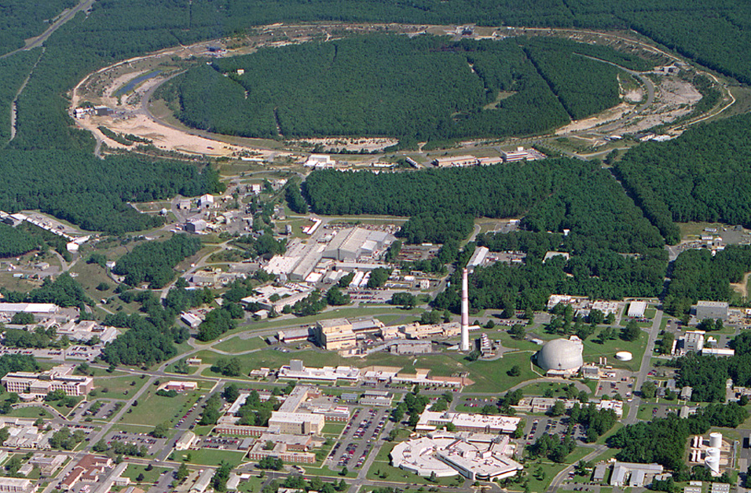
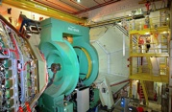
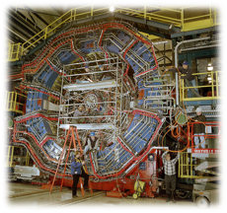

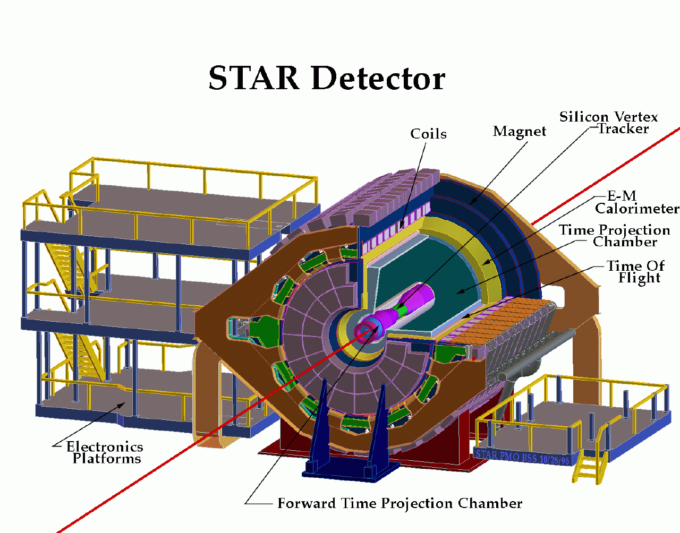
RHIC@BNL Today
Electron-Lenses
Jet/C-Polarimeters
RHIC
CeC-TF
Beams: √s 200 - 500 GeV pp;
50-60% polarization
Lumi: ~10 pb⁻¹/week
PHENIX
RF
STAR
LINAC
NSRL
STAR
EBIS
Booster
ERL Test Facility
AGS
Tandems

Slide 3
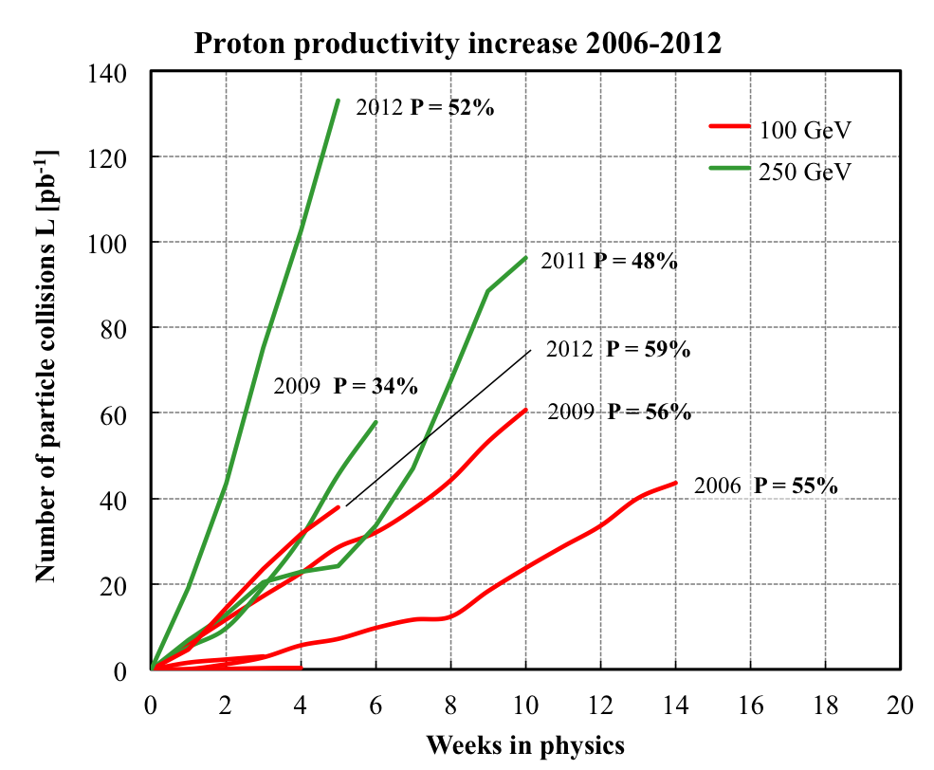
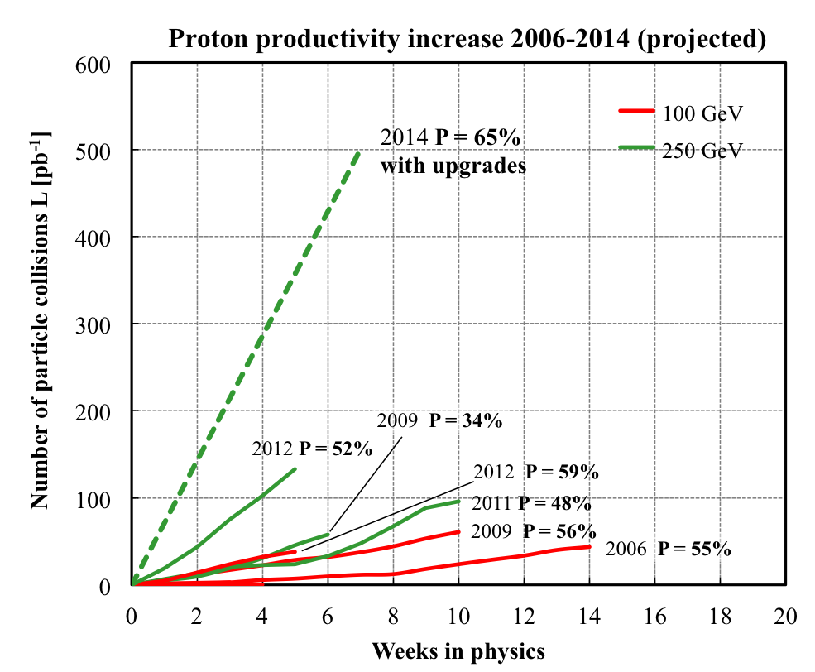
RHIC polarised p+p performance
2012:
golden year for polarized
proton operation
100 GeV:
new records for L_{peak}, L_{avg}, P
255 GeV:
new records for L_{peak}, L_{avg}, P
highest E for pol. p beam
>=
L_{avg}: +15%
P_{avg}: +8%
2013 P~55%
What will come:
increased Luminosity and
polarization through
OPPIS new polarized source
Electron lenses to
compensate beam-beam
effects
many smaller incremental
improvements
will make luminosity hungry processes,
i.e. DY, easier accessible

Slide 4



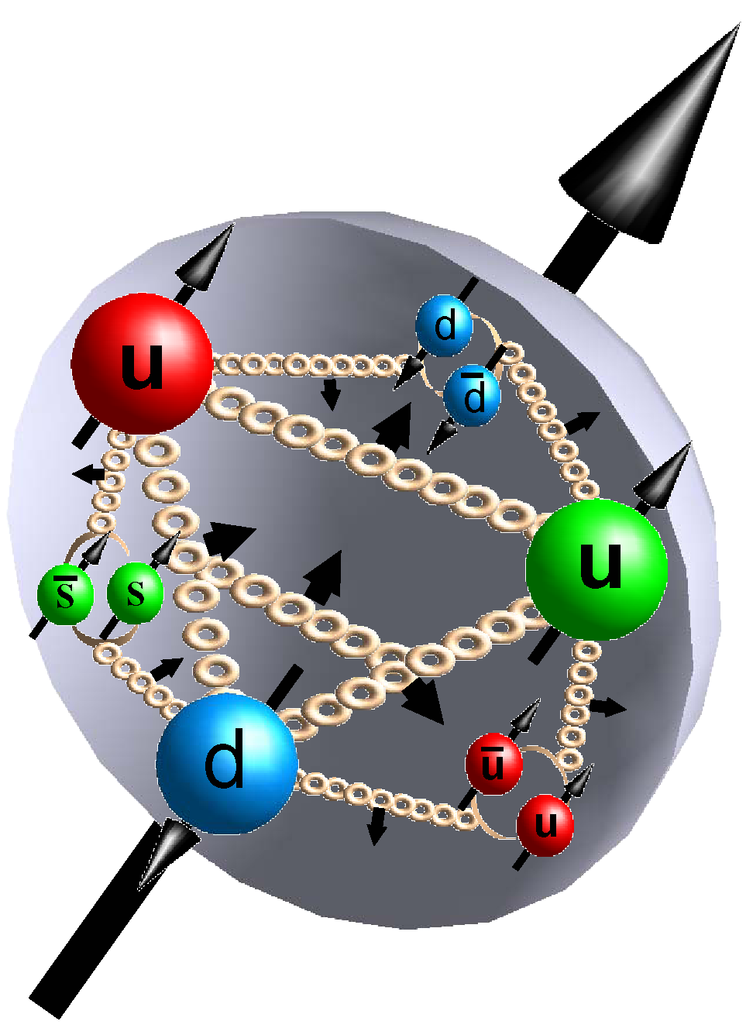



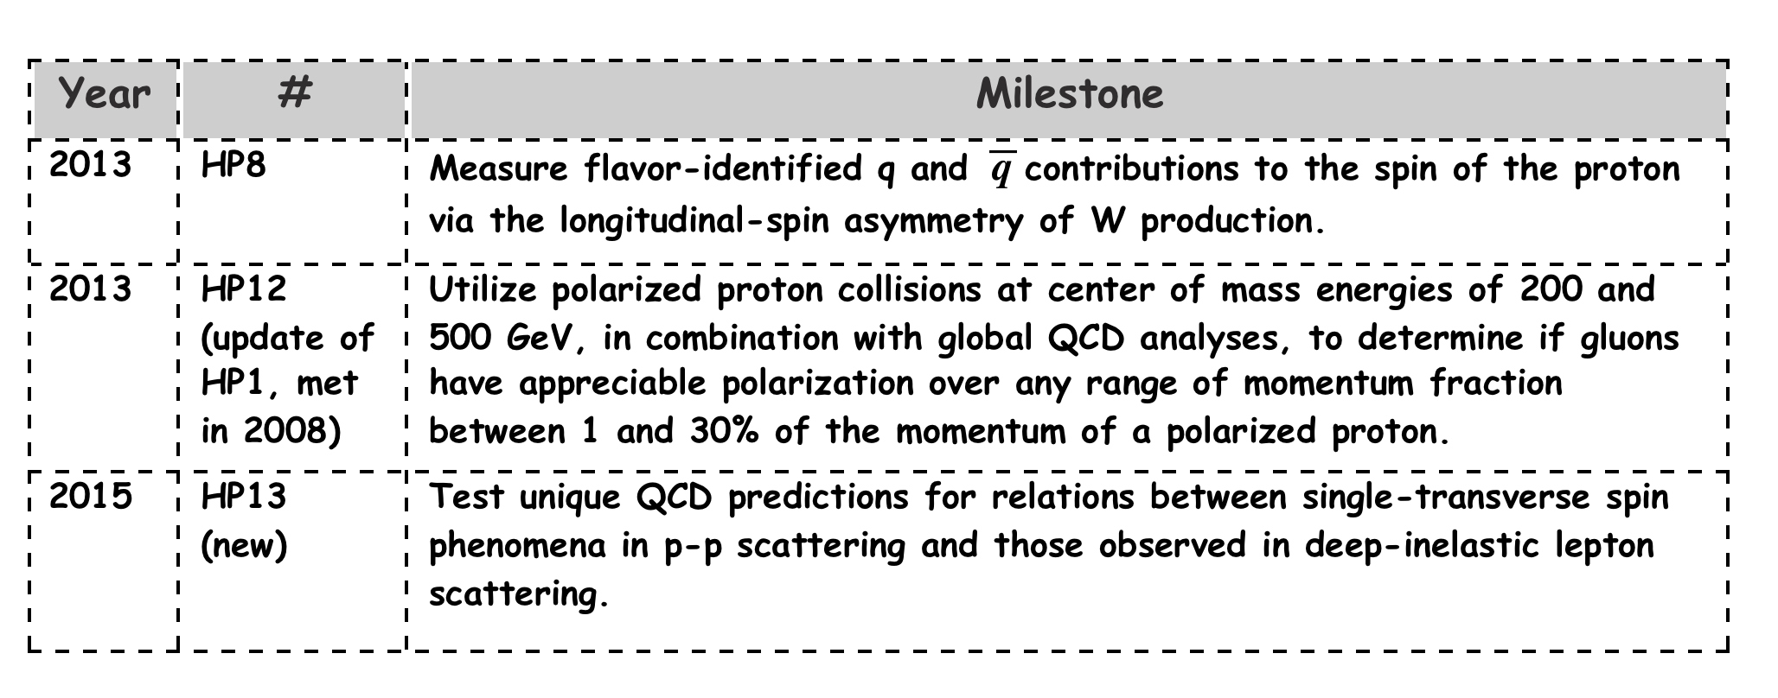
How do the partons form the spin of protons
Is the proton looking like this?
ΔG
Σ_{q}L_{q}
L_{g}
Σ_{q}Δq
Σ_{q}L_{q}
δq
δq
Σ_{q}Δq
ΔG
L_{g}
“Helicity sum rule”
gluon
spin
Where do we stand
solving the “spin puzzle” ?
total u+d+s
quark spin
angular
momentum

Slide 5
Predictive power of pQCD
q(x₁)
Hard Scattering Process
X
g(x₂)
“Hard” (high-energy) probes have predictable rates given:
    Partonic hard scattering rates (calculable in pQCD)
    Parton distribution functions (need experimental input)
    Fragmentation functions (need experimental input)
Universal non-perturbative functions
DIS, pp
pQCD
e+e-

Slide 6
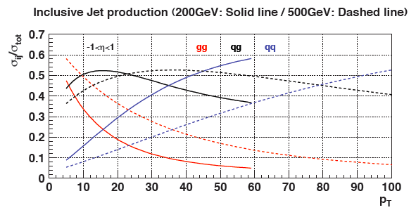
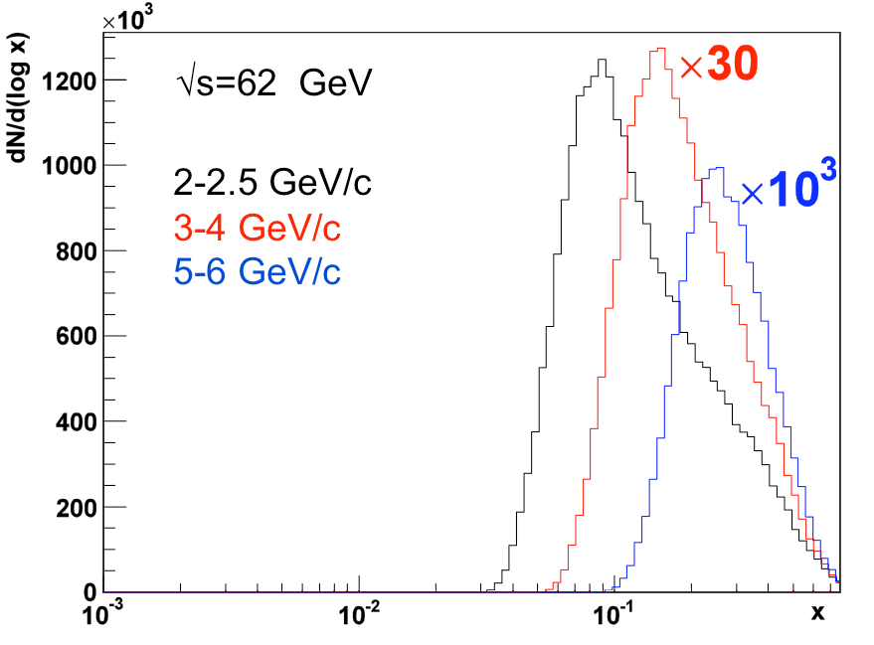
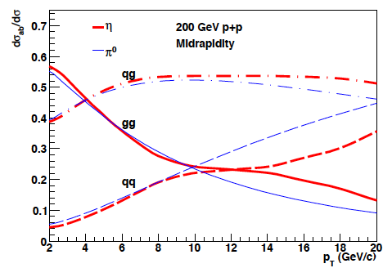
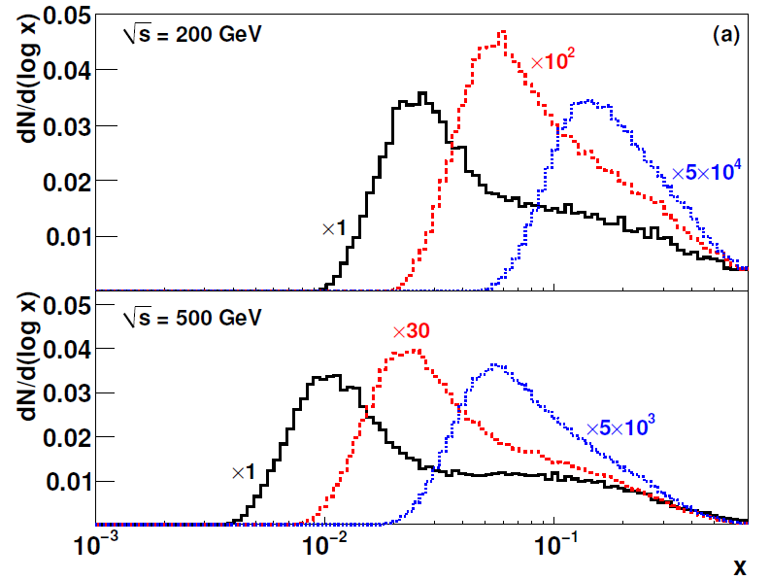
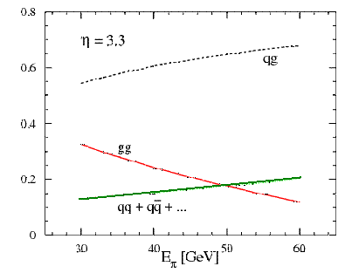
Correlation p_{T} – x and √s
contributing sub-processes:
changing vs p_{T} and rapidity
low p_{T} → low x
  scale uncertainty
high √s → low x
forward rapidity → low x
2-2.5 GeV/c
4-5 GeV/c
9-12 GeV/c
2-2.5 GeV/c
4-5 GeV/c
9-12 GeV/c
η=3.3, √s=200 GeV

Slide 7
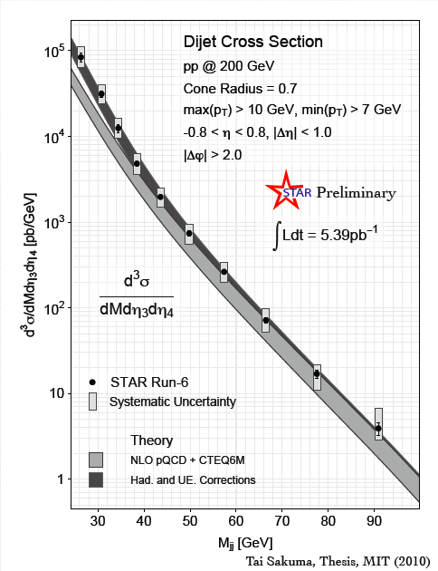
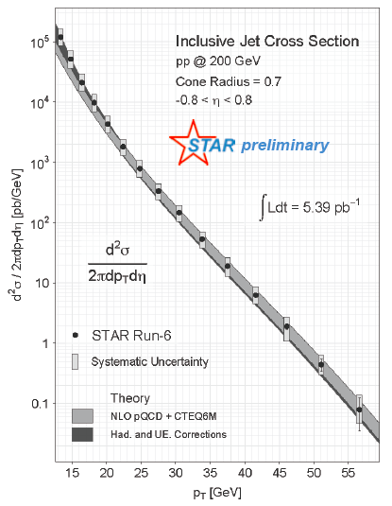
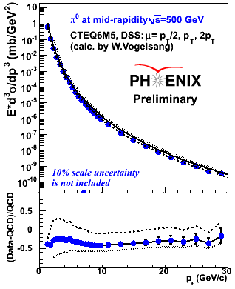

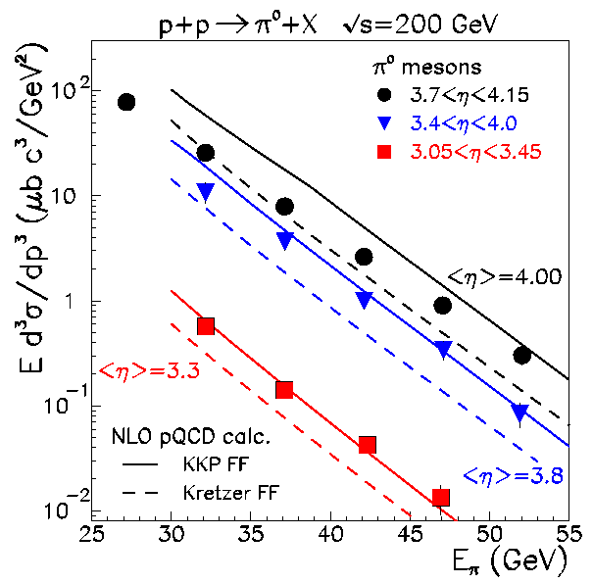
Does QCD work: Cross Sections
√s=62 GeV (PRD79, 012003)
√s=200 GeV (PRD76, 051106)
√s=500 GeV (Preliminary)
PRL 97, 152302
Data compared to NLO pQCD calculations:
√s=62 GeV calculations may need inclusion of NLL (effects of threshold logarithms)
√s=200 and 500 GeV: NLO agrees with data within ~30%
Input to qcd fits of gluon fragmentation functions → DSS
√s=200 GeV Jet Cross Sections agree with data in ~20%

Slide 8
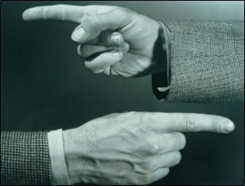
Helicity Structure
Can ΔΣ and ΔG explain it all ?

Slide 9
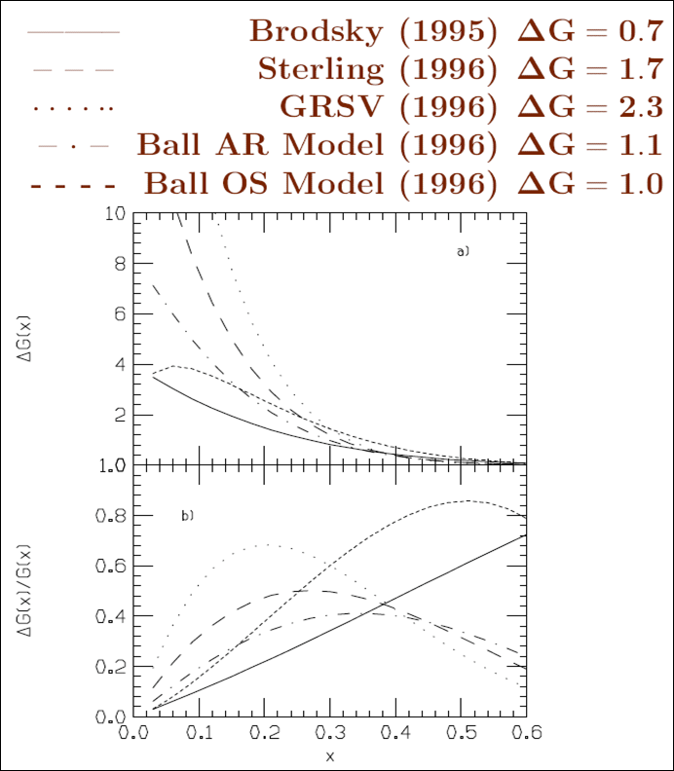
The Gluon Polarization
theory predictions before RHIC
Theoretical Predictions

Slide 10
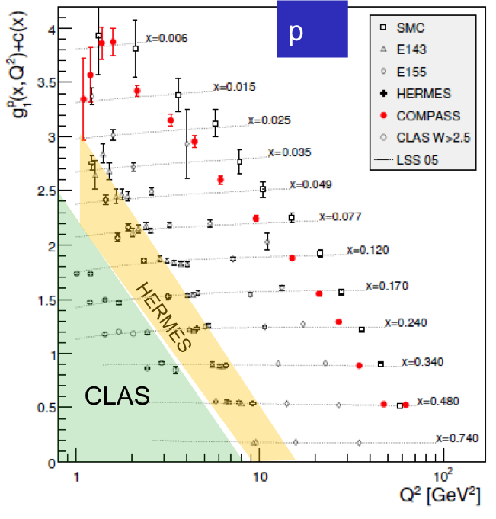
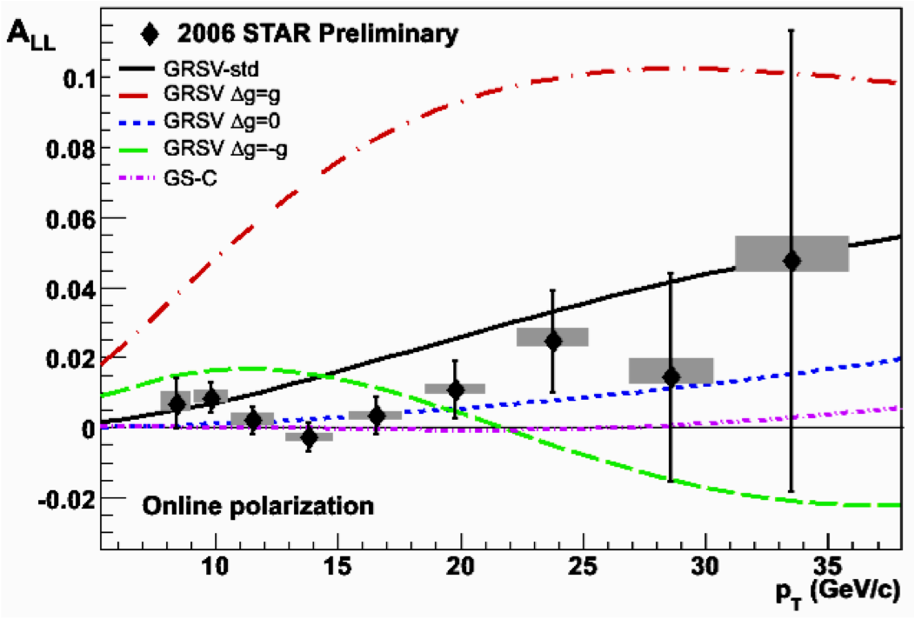
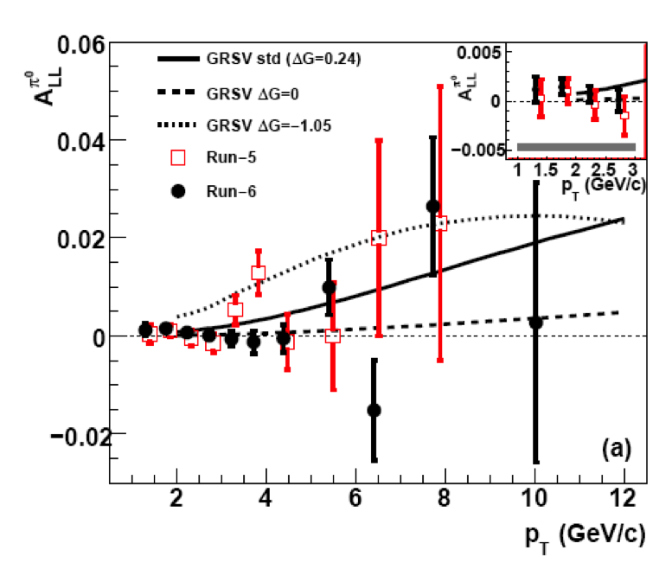
Δg from inclusive DIS and polarized pp
xΔg
RHIC
200 GeV
DIS
Scaling violations of g₁
(Q²-dependence) give indirect access to the gluon distribution via DGLAP evolution.
RHIC polarized pp collisions at midrapidity direct access to gluons (gg,qg)
Rules out large ΔG for 0.05 < x < 0.2
Integral in RHIC x-range:

Slide 11
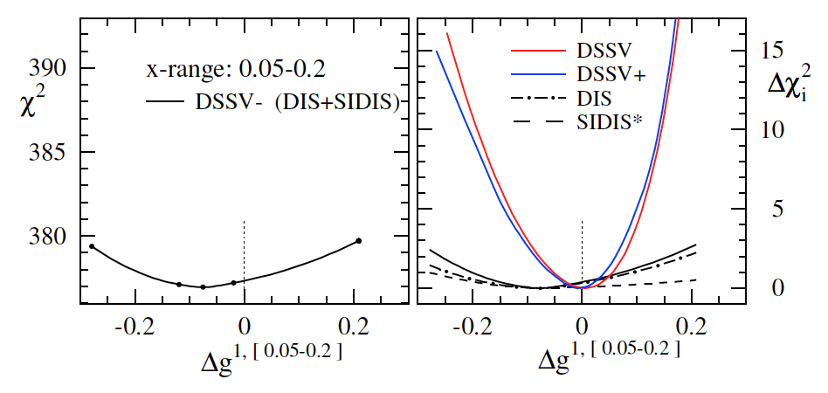
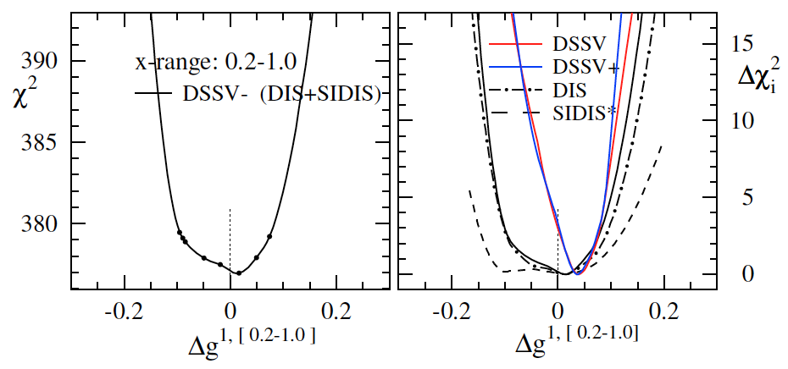
Δg and the relevance of RHIC data
truncated moment
(“RHIC pp region”)
DSSV: Phys.Rev.D80:034030,2009
DSSV+: DSSV+new DIS/SIDIS data
truncated moment
(“high x”)
bottom line:
RHIC pp data clearly needed (current DIS+SIDIS data alone do not constrain Δg)
new (SI)DIS data do not change much for Δg
trend for positive Δg at large x (as before)

Slide 12
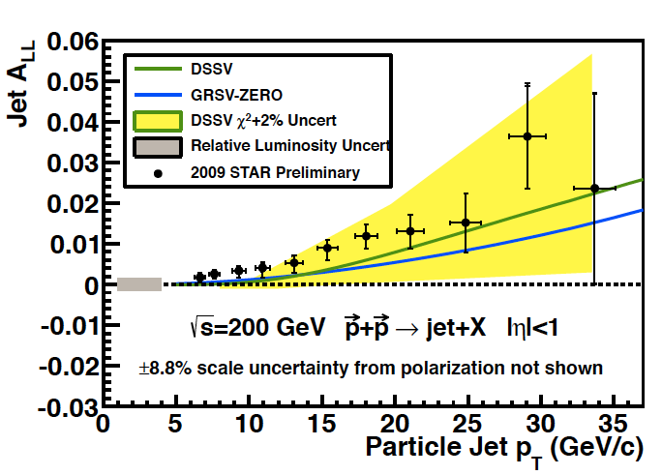
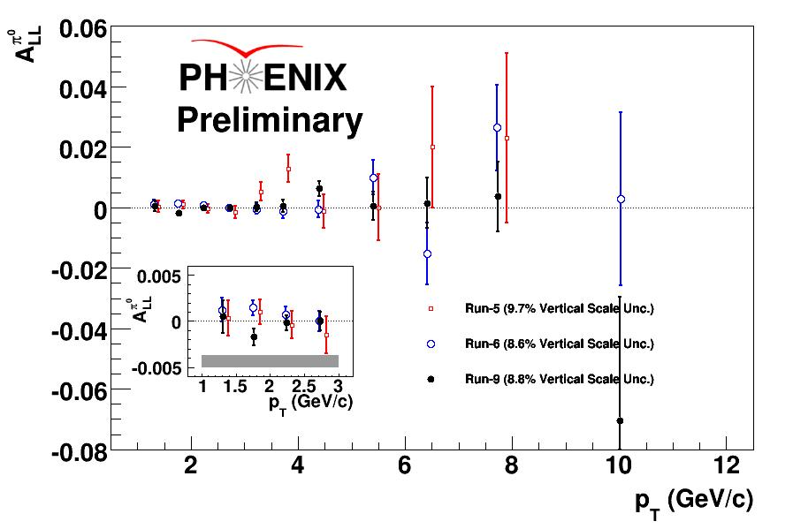
High Precision 2009 RHIC DATA→∫Δg(x)
DSSV: arXiv:0904.3821
DSSV+: DSSV+COMPASS
DSSV++: DSSV+ & RHIC 2009
strong constrain on
first
completely consistent with
DSSV+ in Δ𝛘²/𝛘²=2%
QCD
fit
PHENIX & STAR
fully consistent

Slide 13

What is the Impact on ∫Δg(x)
DSSV: arXiv:0904.3821
DSSV+: DSSV+COMPASS
DSSV++: DSSV+ & RHIC 2009
DSSV
Getting significantly closer to understand the gluon contribution to the proton spin
BUT
need to reduce low-x (<10⁻²) uncertainties for ∫Δg(x)
Do things add up?
First time a significant
non-zero Δg(x)
Spin of the proton
forward η
RHIC
500 GeV
DIS
RHIC
200 GeV

Slide 14
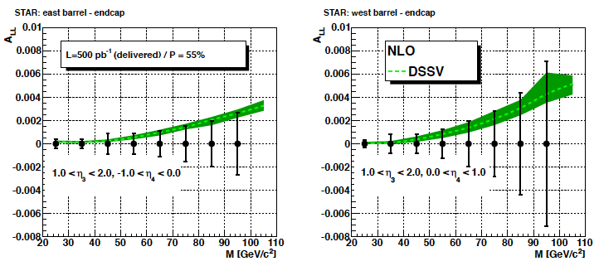

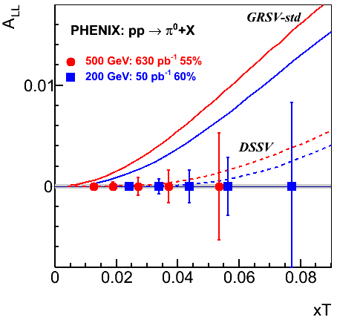
Theme for the Future
Reduce uncertainties and go to low x
measure correlations (di-jets, di-hadrons) → constrain shape of Δg(x)
A_{LL} π⁰ and jet at √s = 500 GeV → x_{min} > 0.01
measure A_{LL} at forward rapidities → x_{min} > 0.001
Experimentally Challenging
A_{LL} ≲ 0.001
high Lumi
good control of systematics
Run 2009 - 2015:
Many more probes:
π± → sign of Δg(x)
direct photon
heavy flavour
…..
theoretically clean
luminosity hungry

Slide 15
Impact of new Jet Data
Impact of inclusive jet data 2009 to 2015 at √s=200 GeV and √s=500 GeV
on Δg(x) → uncertainties reduce by factor 2
Δχ²=2%
Δχ²=2%
2013 500 GeV
2015 200 GeV
2013 500 GeV
2015 200 GeV

Slide 16
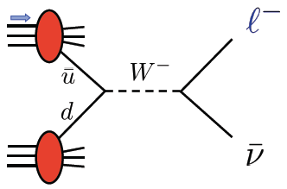



THE Beauty of Colliders: Kinematic Coverage
novel electroweak
probe
0.05<x<0.4
Evolution
RHIC pp data
constraining Δg(x)
0.01 < x <0.2
data plotted at x_{T}=2p_{T}/√s

Slide 17
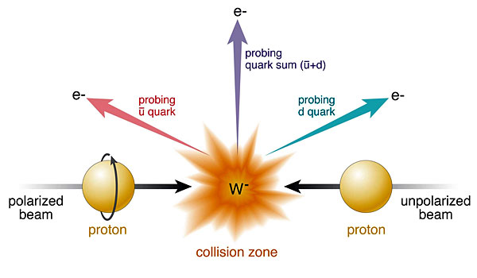
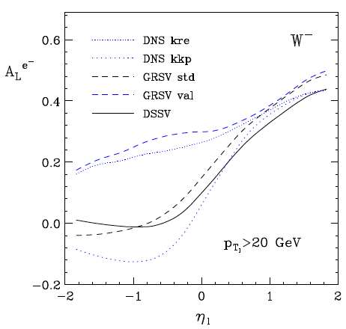
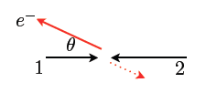
Δq: W Production Basics
Since W is maximally parity violating
→ W’s couple only to one parton helicity
large Δu and Δd result in large asymmetries.
Complementary to SIDIS:
very high Q2-scale
extremely clean theoretically
No Fragmentation function
backward
forward
x₁ small
t large
x₁ large
u large

Slide 18
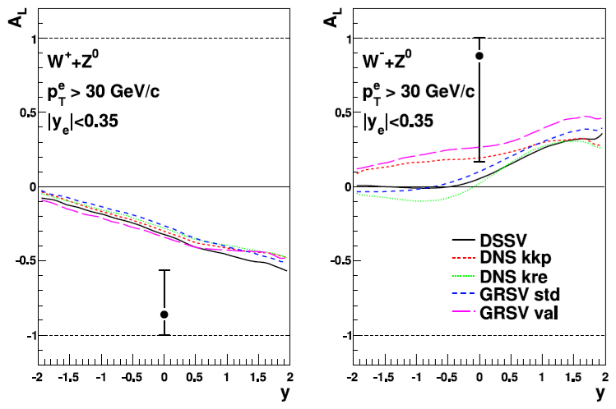

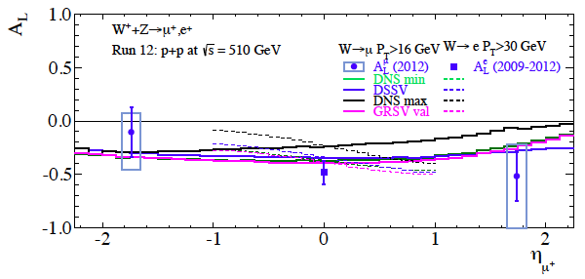
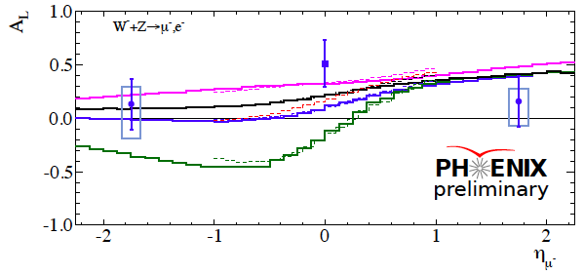
Current W-Results
Run-2009:
And then came Run-2012
∫L_{del} = 130 pb⁻¹ and P_{B} ~ 55%
PHENIX Run 2009-2012:
first result from
muon arms

Slide 19
2012 ReSULTS
DSSV
Already Run-2012 data alone
have a significant impact on
and
DSSV+: DSSV+COMPASS
DSSV++: DSSV+ & STAR-W 2009
DSSV++: DSSV+ & RHIC-W proj.

Slide 20
Future W-Results
pseudo-data randomized around DSSV
RHIC W±-data will constrain
and
DSSV+: DSSV+COMPASS
DSSV++: DSSV+ & STAR-W 2009
DSSV++: DSSV+ & RHIC-W proj.

Slide 21
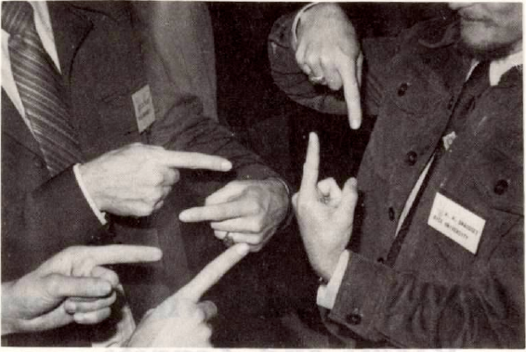
Transverse SPin Structure

Slide 22
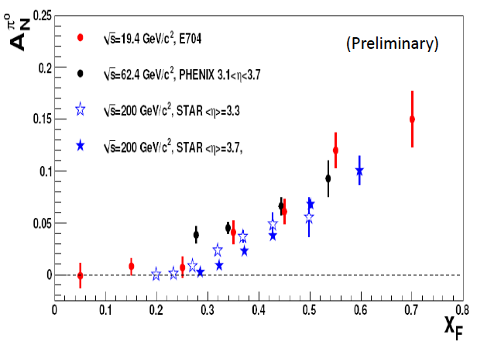
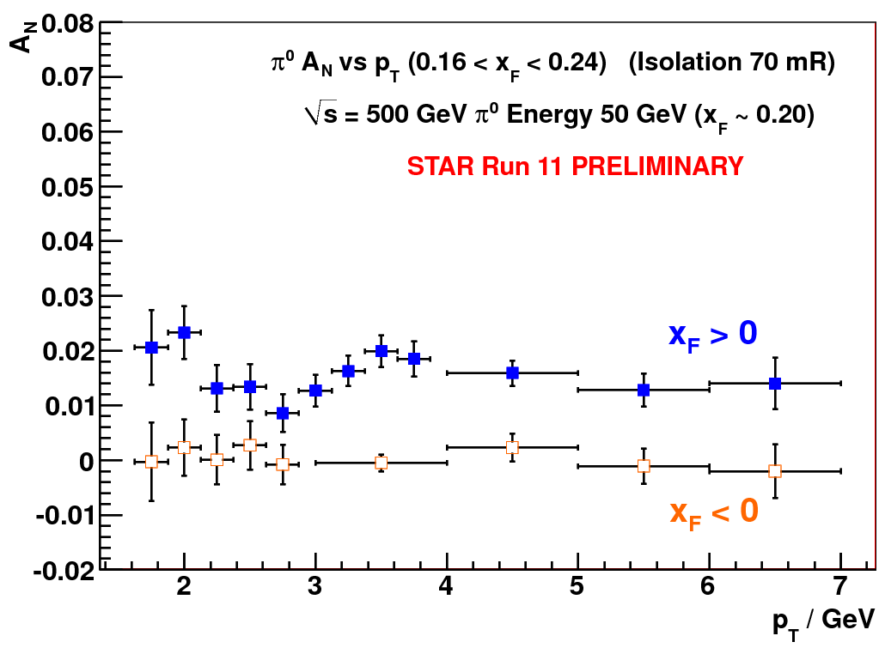

New puzzles in forward physics: large A_{N} at high √s
Big single spin asymmetries in pp !!
Naive pQCD (in a collinear picture)
predicts A_{N} ~ α_{s}m_{q}/sqrt(s) ~ 0
Do they survive at high √s ? YES
Is observed p_{t} dependence as expected
from p-QCD? NO
What is the underlying process?
Sivers / Twist-3 or Collins or ..
till now only hints
Left
Right
ANL ZGS
√s=4.9 GeV
BNL AGS
√s=6.6 GeV
FNAL
√s=19.4 GeV
BRAHMS@RHIC
√s=62.4 GeV

Slide 23
Sivers and Collins effects in pp collisions
Sivers/twist-3 mechanism:
asymmetry in jet or γ production
Collins mechanism:
asymmetry in jet fragmentation
S_{P}
S_{P}
k_{T,q}
p
p
p
p
Sensitive to proton spin – parton transverse motion correlations
S_{q}
k_{T,π}
Sensitive to transversity
Signatures:
  A_{N} for jets or direct photons
NOT universal
  Sign change from SIDIS to DY
Signatures:
  Collins effect
  Interference fragmentation functions
Believed to be universal

Slide 24
Transverse PHYSICS: What else do we know
Collins / Transversity:
  conserve universality in hadron hadron interactions
  FF_{unf} = - FF_{fav} and δu ~ -2δd
  evolve ala DGLAP, but soft because no gluon contribution (i.e. non-singlet)
Sivers, Boer Mulders, ….
  do not conserve universality in hadron hadron interactions
  k_{t} evolution → can be strong
    till now predictions did not account for evolution
  FF should behave as DSS, but with k_{t} dependence unknown till today
  u and d Sivers fct. opposite sign d >~ u
  Sivers and twist-3 are correlated
    global fits find sign mismatch, possible explanations,
    like node in k_{t} or x don’t work

Slide 25
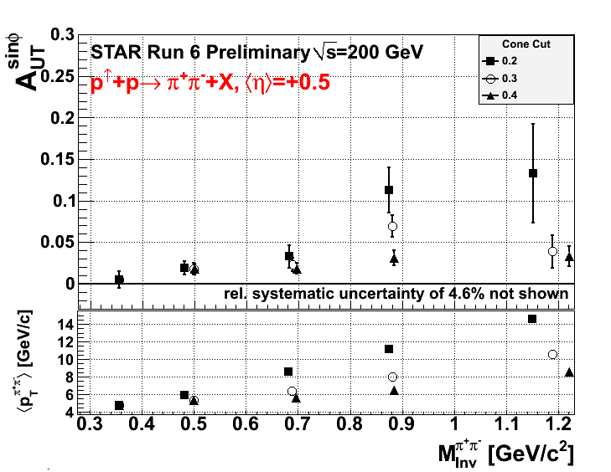
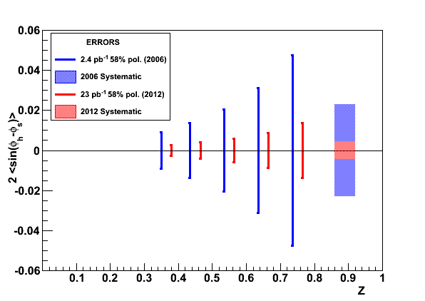
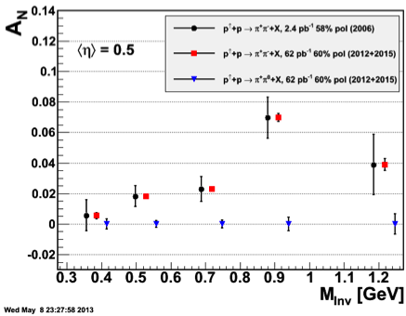
A_{N}: How to get to THE underlying Physics
SIVERS
Transversity x Collins
Rapidity dependence of
A_{N} for π⁰ and eta with increased p_{t} coverage
A_{N} for jets
A_{N} for direct photons
A_{N} for heavy flavour → gluon
π^{+/-}π⁰ azimuthal distribution in jets
Interference fragmentation function
TransversityxInterference FF

Slide 26
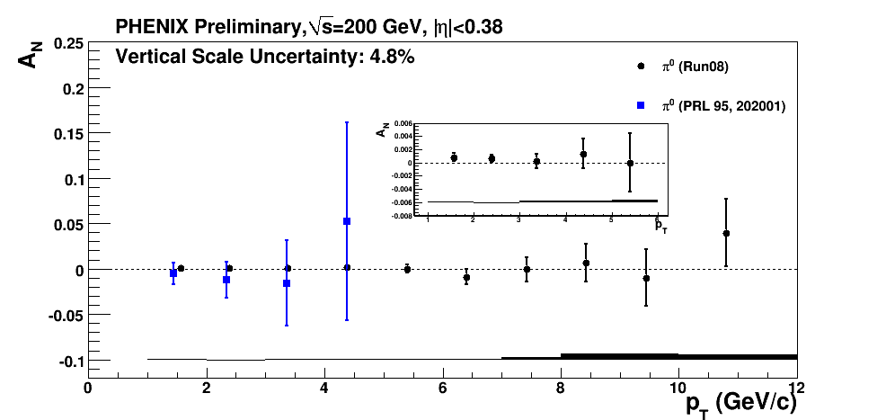
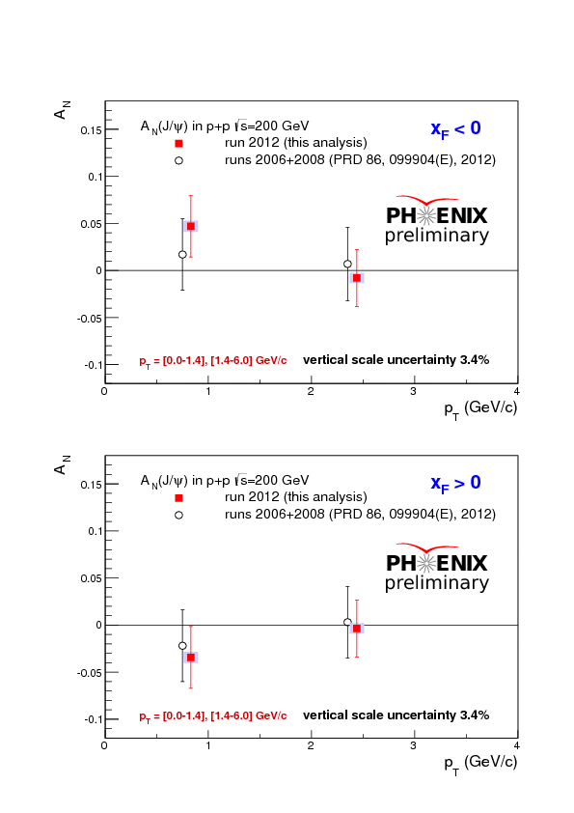
Hints for Gluon Sivers function
Central Rapidity A_{N}(π⁰) dominated by gg and qg
no hint of a
non-zero
A_{N}(π⁰)
Forward Rapidity A_{N}(J/Ψ) only gg:
no hint of a
non-zero
A_{N}(J/Ψ)

Slide 27
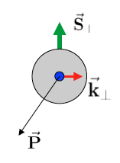
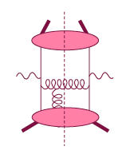
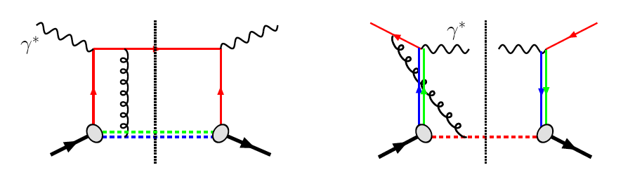
The sign change of the Sivers fct.
Intermediate Q_{T}
Q>>Q_{T}/p_{T}>>Λ_{QCD}
Transverse
momentum
dependent
Q>>Q_{T}>=Λ_{QCD}
Q>>p_{T}
Collinear/
twist-3
Q,Q_{T}>>Λ_{QCD}
p_{T}~Q
Efremov, Teryaev;
Qiu, Sterman
Sivers fct.
Q_{T}/P_{T}
Λ_{QCD}
<<
Q_{T}/P_{T}
<<
Q
critical test for our understanding of TMD’s and TMD factorization
QCD:
DIS:
attractive FSI
Drell-Yan:
repulsive ISI
Sivers_{DIS} = - Sivers_{DY} or Sivers_{W} or Sivers_{Z0}

Slide 28
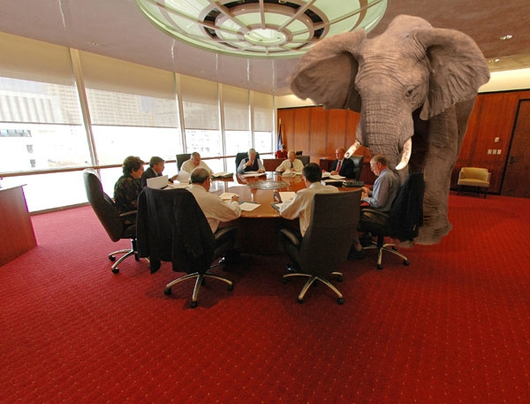
What Can PHENIX and STAR DO
Delivered Luminosity: 500pb⁻¹ (~6 weeks for Run14+)
STAR A_{N}(W):
-1.0 < y < 1.5
W-fully reconstructed
PHENIX A_{N}(DY):
1.2<|y|<2.4
The pink elephant in the room is
what are the evolution effects for A_{N}^{DY}
→ lets see what we know
Extremely clean measurement of δA_{N}(Z₀)+/-10%
for <y> ~0

Slide 29
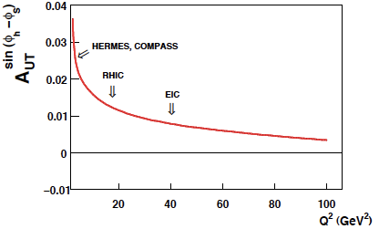
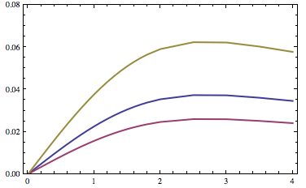
Directly working on TMDs
Aybat-Prokudin-Rogers, 2011
Many calculations on energy dependence of DY and now TMDs
Collins-Soper Evolution, 1981
Collins-Soper-Sterman, 1985
Boer, 2001
Idilbi-Ji-Ma-Yuan, 2004
Kang-Xiao-Yuan, 2011
Collins 2011
Aybat-Collins-Rogers-Qiu, 2011
Aybat-Prokudin-Rogers,2012
Idilbi, et al., 2012
Boer 2013
Sun, Yuan, arXiv: 1304.5037
Need Measurements:
to see how strong evolution effects
for TMDs are
till now many predictions neglect
TMD evolution effects
Sun-Yuan, 2013
W⁺ √s=500 GeV
DY √s=200 GeV

Slide 30
The Beauty of RHIC
mix and match beams as one likes
polarised p↑A
→ unravel the underlying sub-processes to A_{N}
getting the first glimpse of GPD E for gluons
  A_{UT}(J/ψ) in p↑A

Slide 31

Generalized Parton Distributions
the way to 3d imaging of the proton and the orbital angular momentum L_{q} & L_{g}
Measure them through exclusive reactions
golden channel: DVCS
e’
γ
e
γ_{L}*
(Q²)
x+ξ
x-ξ
~
~
p
H, H, E, E (x,ξ,t)
p’
t
Spin-Sum-Rule in PRF:
from g₁
GPDs:
Correlated quark momentum
and helicity distributions in
transverse space
responsible for orbital angular momentum

Slide 32
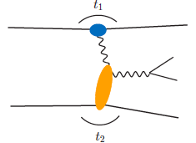

From ep tO pp to γ p/A
Get quasi-real photon from one proton
Ensure dominance of g from one identified proton
by selecting very small t₁, while t₂ of “typical hadronic
size”
small t₁ ←→ large impact parameter b (UPC)
Final state lepton pair ←→ timelike compton scattering
timelike Compton scattering: detailed access to GPDs
including E^{q/g} if have transv. target pol.
Challenging to suppress all backgrounds
Final state lepton pair not from γ* but from J/ψ
  Done already in AuAu
  Estimates for J/ψ (hep-ph/0310223)
transverse target spin asymmetry → calculable with GPDs
information on helicity-flip distribution E for gluons
golden measurement for eRHIC
Z²
A²
Gain in statistics doing polarized p↑A

Slide 33




Forward Proton Tagging at STAR/RHIC
at 55-58m
at 15-17m
Planned 2015 p↑A run will give
1000 exclusive J/Ψs
enough to measure A_{UT} to see it is different from zero
Roman Pot detectors to measure forward scattered protons in diffractive processes
Staged implementation to cover wide kinematic coverage
Phase I (Installed): for low-t coverage
Phase II (ongoing) : for higher-t coverage
    8(12) Roman Pots at ±15 and ±17m
No special β* running needed any more
→ 250 GeV to 100 GeV
scale t-range by 0.16

Slide 34


Do Gluons Saturate
Gluon density dominates at x<0.1
small x
Gluon density dominates at x<0.1
x=10⁻⁵
QCD
FIT
large x
x=1
Rapid rise in gluons described naturally by linear pQCD evolution equations
This rise cannot increase forever - limits on the cross-section
  → non-linear pQCD evolution equations provide a natural way to tame this growth and lead to a saturation of gluons, characterised by the saturation scale Q²_{s}(x)
Notes:
Counter-intuitively the best way is through an EM process: DIS
y = inelasticity = fraction of the incoming electron energy carried by photon in the rest frame of the nucleon
The structure function F2 is sensitive to the sum of quark and anti-quark momentum distribution in the nucleon.
The apparent scaling of the data with Q2 at large x in early DIS data from SLAC was termed “Bjorken scaling” and motivated the parton model.
In the parton model, FL = 0, while in QCD, it is directly proportional to the gluon structure function, FL(x,Q2) ~ aS xG(x,Q2), at low x.
DGLAP: fixed x -> evolution along Q2
sigma (gamma N) = sig_T + sig_L
sig_L ~ FL
sig_tot ~ F2/Q^2
\frac{d^2 \sigma^{ep \rightarrow eX}}{dx dQ^2} = \frac{4 \pi \alpha^2_{e.m.}}{xQ^4} \left[ \left(1-y+\frac{y^2}{2} \right ) F_2(x,Q^2) - \frac{y^2}{2} F_L(x,Q^2) \right]

Slide 35






di-hadron correlations in dA
At y=0, suppression of away-side
jet is observed in A+A collisions
No suppression in p+p or d+A
  → x~10⁻²
∼π
However, at forward
rapidities (y ~ 3.1), an away-
side suppression is observed
in dAu
Away-side peak also much
wider in d+Au compared to pp
→ x ~ 10⁻³

Slide 36

A_{N} in p↑A or Shooting Spin Through CGC
Yuri Kovchegov et al.
strong suppression of odderon STSA in nuclei.
Q_{s}=1GeV
Very unique RHIC possibility p↑A
Synergy between CGC based
theory and transverse spin physics
A_{N}(direct photon) = 0
The asymmetry is larger for
peripheral collisions
r=1fm
r=1.4fm
r=2fm
π⁰
STAR: projection for upcoming pA run
Curves: Feng & Kang arXiv:1106.1375
solid: Q_{s}^{p} = 1 GeV
dashed: Q_{s}^{p} = 0.5 GeV

Slide 37

Summary and Outlook
Multi Year Run Plan
ΔG
Σ_{q}L_{q}
L_{g}
Σ_{q}Δq
Σ_{q}L_{q}
δq
δq
Σ_{q}Δq
ΔG
L_{g}
RHIC SPIN Program
the unique science program addresses
all important open questions in spin physics
uniquely tied to a polarized pp-collider
never been measured before & never without

Slide 38
ADDITIONAL Material

Slide 39




helicity structure - open questions
significant experimental and theoretical progress in past 25+ years, yet many unknows …
Δg(x,Q²)
can hide one
unit of here
found to be not big at 0.05 < x < 0.2
RHIC/EIC can extend x range & reduce uncertainties
[500 GeV running & particle correlations]
yet, will full 1st moment [proton spin sum]
still will remain to have significant uncertainties
from unmeasured small x region?
DIS
&
pp
RHIC
pp
Δq’s (x,Q²)
x
known: quarks contribute much less to proton spin
than expected from quark models
large uncertainties in ΔΣ from unmeasured small x
surprisingly small/positive Δs from SIDIS: large SU(3)
breaking?
_
_
flavor separation not well known, e.g., Δu - Δd

Slide 40







the path to imaging quarks and gluons
PDFs do not resolve transverse momenta or positions in the nucleon
transverse
plane
fast moving nucleon turns into a `pizza’ but transverse size remains about 1 fm
compelling questions
how are quarks and gluons spatially distributed
how do they move in the transverse plane
do they orbit and do we have access to spin-orbit correlations
→ required set of measurements & theoretical concepts
1-D
form factor
parton densities
not related by
Fourier transf.
2+1-D
transv. mom. dep. PDF
impact par. dep. PDF
generalized PDF
semi-inclusive DIS
exclusive processes
Wigner function
high-level connection
4+1-D
measurable ?
important in other branches of Physics

Slide 41
The sPHENIX forward Upgrade
Detector Layout for forward physics studies
Use open sPHENIX central barrel geometry to introduce
tracking
charged particle identification
electromagnetic calorimeter
hadron calorimeter
muon detection
→ Use existing equipment where possible

Slide 42
STAR Forward Instrumentation UpGrade
Forward instrumentation optimized for p+A and transverse spin physics
– Charged‐particle tracking
– e/h and γ/π⁰ discrimination
– Possibly Baryon/meson separation

Slide 43




meanwhile, new data became available …
how well are we doing ?
refit/new analysis necessary ?
impact on uncertainties ?
DIS: A₁^{p} from COMPASS
arXiv:1001.4654
SIDIS: A_{1,d}^{π,K} from COMPASS
arXiv:0905.2828
SIDIS: A_{1,p}^{π,K} from COMPASS
arXiv:1007.4061
extended x coverage w.r.t. HERMES

Slide 44


coping with new data: SIDIS A₁^{d,π,K}
x-range
not covered
by HERMES
DSSV works well:
no surprises at small x
χ² numerology:
 | DSSV 08 data sets | with A₁^{d,π,K}
DSSV 2008 | 392.5 | 420.8
DSSV+ |  | 418.9
arXiv:0905.2828

Slide 45

coping with new data: SIDIS A₁^{p,π,K}
1st kaon data on p-target
(not available from HERMES)
x-range
not covered
by HERMES
χ² numerology:
 | DSSV 08 data sets | with A₁^{p&d,π,K}
DSSV 08 | 392.5 | 456.4
DSSV+ |  | 453.0
arXiv:1007.4061
no refit required
(Δχ²=1 does not reflect
faithful PDF uncertainties)
trend for somewhat less
polarization of sea quarks;
less significant

Slide 46
Are Strange Quarks STARNGE?
Δq’s (x,Q²)
known: quarks contribute much less to proton spin
than expected from quark models
large uncertainties in ΔΣ from unmeasured small x
surprisingly small/positive Δs from SIDIS: large SU(3)
breaking?
_
_
flavor separation not well known, e.g., Δu - Δd

Slide 47





Δs revisited: impact of COMPASS data
current value for ΔΣ strongly depends on assumptions on low-x behavior of Δs
new COMPASS data support
small/positive Δs(x) at x > 0.01
they also prefer a sign change
at around x=0.01
>0
<0
but large negative 1st moment entirely driven by assumptions on SU(3)
caveat: dependence on FFs
COMPASS
0.004 < x < 0.3

Slide 48
GPD H^{g}: J/ψ
M. Diehl
To improve imaging on gluons
add J/ψ observables
cross section
A_{UT}
…..
Fourier
Transform

Slide 49

A_{N}: Z0
300 pb⁻¹ -> ~10% on a single bin of A_{N}
Generator: PYTHIA 6.8
Clean experimental momentum reconstruction
Negligible background
electrons rapidity peaks within tracker acceptance (|η|< 1)
Statistics limited

Slide 50




Spectator proton from ³He with the current RHIC optics
Momentum smearing mainly due
to Fermi motion + Lorentz boost
Angle <~3mrad (>99.9%)
Angle [rad]
Study: JH Lee
generated
Passed DX aperture
Accepted in RP
The same RP configuration with the current RHIC optics (at z ~ 15m between DX-D0)
Acceptance ~ 98%

Slide 51
Collected Luminosity with longitudinal Polarization
Year | √s [GeV] | Recorded PHENIX | Recorded STAR | Pol [%]
2002 (Run 2) | 200 | / | 0.3 pb⁻¹ | 15
2003 (Run 3) | 200 | 0.35 pb⁻¹ | 0.3 pb⁻¹ | 27
2004 (Run 4) | 200 | 0.12 pb⁻¹ | 0.4 pb⁻¹ | 40
2005 (Run 5) | 200 | 3.4 pb⁻¹ | 3.1 pb⁻¹ | 49
2006 (Run 6) | 200 | 7.5 pb⁻¹ | 6.8 pb⁻¹ | 57
2006 (Run 6) | 62.4 | 0.08 pb⁻¹ |  | 48
2009 (Run9) | 500 | 10 pb⁻¹ | 10 pb⁻¹ | 39
2009 (Run9) | 200 | 14 pb⁻¹ | 25 pb⁻¹ | 55
2011 (Run11) | 500 | 27.5 / 9.5pb⁻¹ | 12 pb⁻¹ | 48
2012 (Run12) | 500 | 30 / 15 pb⁻¹ | 82 pb⁻¹ | 50/54

Slide 52
Collected Luminosity with transverse Polarization
Year | √s [GeV] | Recorded PHENIX | Recorded STAR | Pol [%]
2001 (Run 2) | 200 | 0.15 pb⁻¹ | 0.15 pb⁻¹ | 15
2003 (Run 3) | 200 | / | 0.25 pb⁻¹ | 30
2005 (Run 5) | 200 | 0.16 pb⁻¹ | 0.1 pb⁻¹ | 47
2006 (Run 6) | 200 | 2.7 pb⁻¹ | 8.5 pb⁻¹ | 57
2006 (Run 6) | 62.4 | 0.02 pb⁻¹ |  | 53
2008 (Run8) | 200 | 5.2 pb⁻¹ | 7.8 pb⁻¹ | 45
2011 (Run11) | 500 | / | 25 pb⁻¹ | 48
2012 (Run12) | 200 | 9.2/4.3 pb⁻¹ | 22 pb⁻¹ | 61/58

Slide 53

What pHe³ can teach us
Polarized He³ is an effective neutron target → d-quark target
  Polarized protons are an effective u-quark target
Therefore combining pp and pHe³ data will allow a full
quark flavor separation u, d, ubar, dbar
Two physics trusts for a polarized pHe3 program:
Measuring the sea quark helicity distributions through W-production
  Access to Δdbar
  Caveat maximum beam energy for He³: 166 GeV
    Need increased luminosity to compensate for lower W-cross section
Measuring single spin asymmetries A_{N} for pion production and Drell-Yan
  expectations for A_{N} (pions)
    similar effect for π± (π⁰ unchanged)
³He: helpful input for understanding
of transverse spin phenomena
Critical to tag spectator protons from 3He with roman pots

