Slide 1
Hadron Physics Perspectives at ELSA (Bonn),
MAMI (Mainz), MESA (Mainz) and FAIR (Darmstadt)
2013 JLab Users Group Meeting
Frank Maas (Director HIM)
GSI / HIM/ U Mainz

Slide 2
Overview
ELSA (BONN)
ELECTRON STRETCHER
MAMI (MAINZ)
ELECTRON MICROTORN
MESA (MAINZ)
ER ELECTRON LINAC
FAIR (DARMSTADT)
Facility for Antiproton and Ion Research

Slide 3
Overview
Location | Institutes | Facilities | Physics | Group-Applications
Mainz | IKP (University) | MAMI MESA | Nucleon/Meson Structure and Spectroscopy | CRC1044 PRISMA
Mainz | HIM IKP (University) | FAIR-accelerator GSI-accelerator MESA | Hadron Physics Particle Physics | PRISMA
Darmstadt | GSI (National Lab.) | FAIR-accelerator | Nuclear Physics Atomic Physics Hadron Physics
Bonn | HISKP IP (University) | ELSA | Nucleon/Meson Spectroscopy

Slide 4
ELSA (BONN)

Slide 5
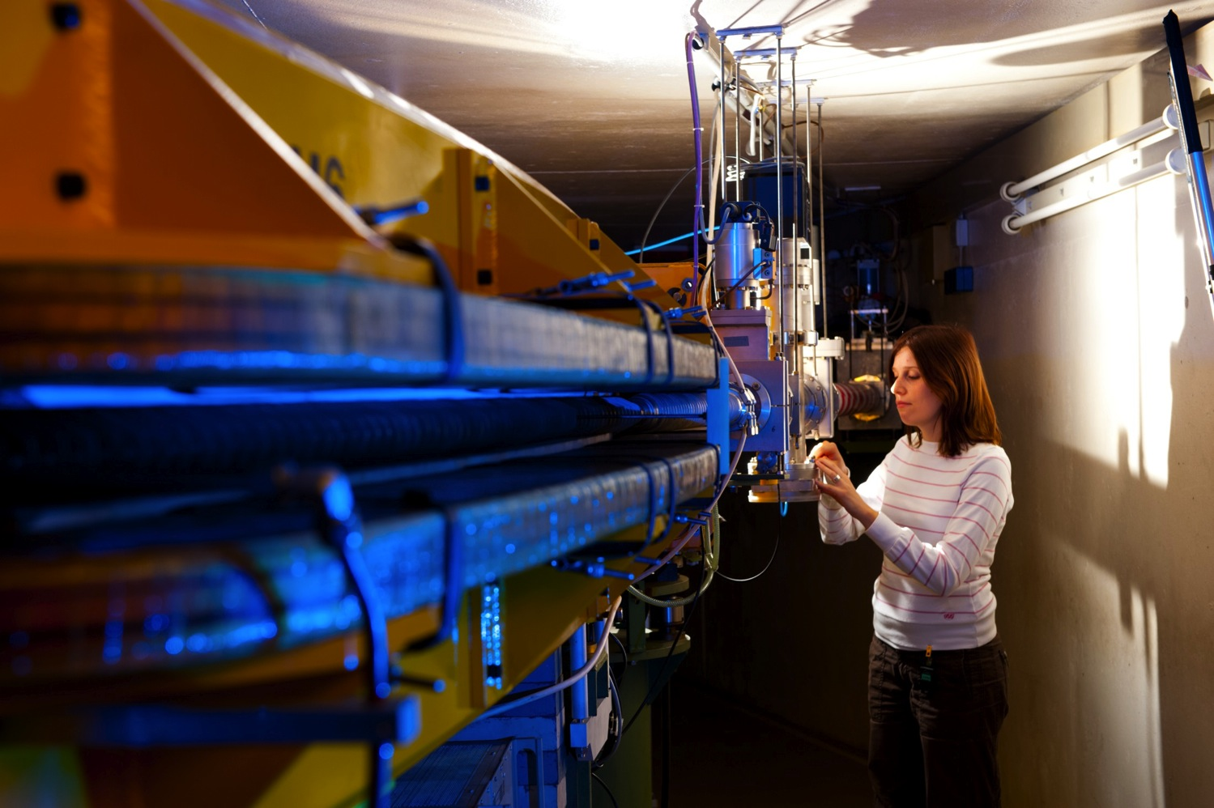
ELSA (BONN)
Beam Energy
unpolarized: E < 3.2 GeV
polarized (65%): E < 2.4 GeV
Beam Current
internal: I < 100 mA
external: I < 1 nA
Operation
typ. 3000 hours/year
(limited by operating funds)

Slide 6
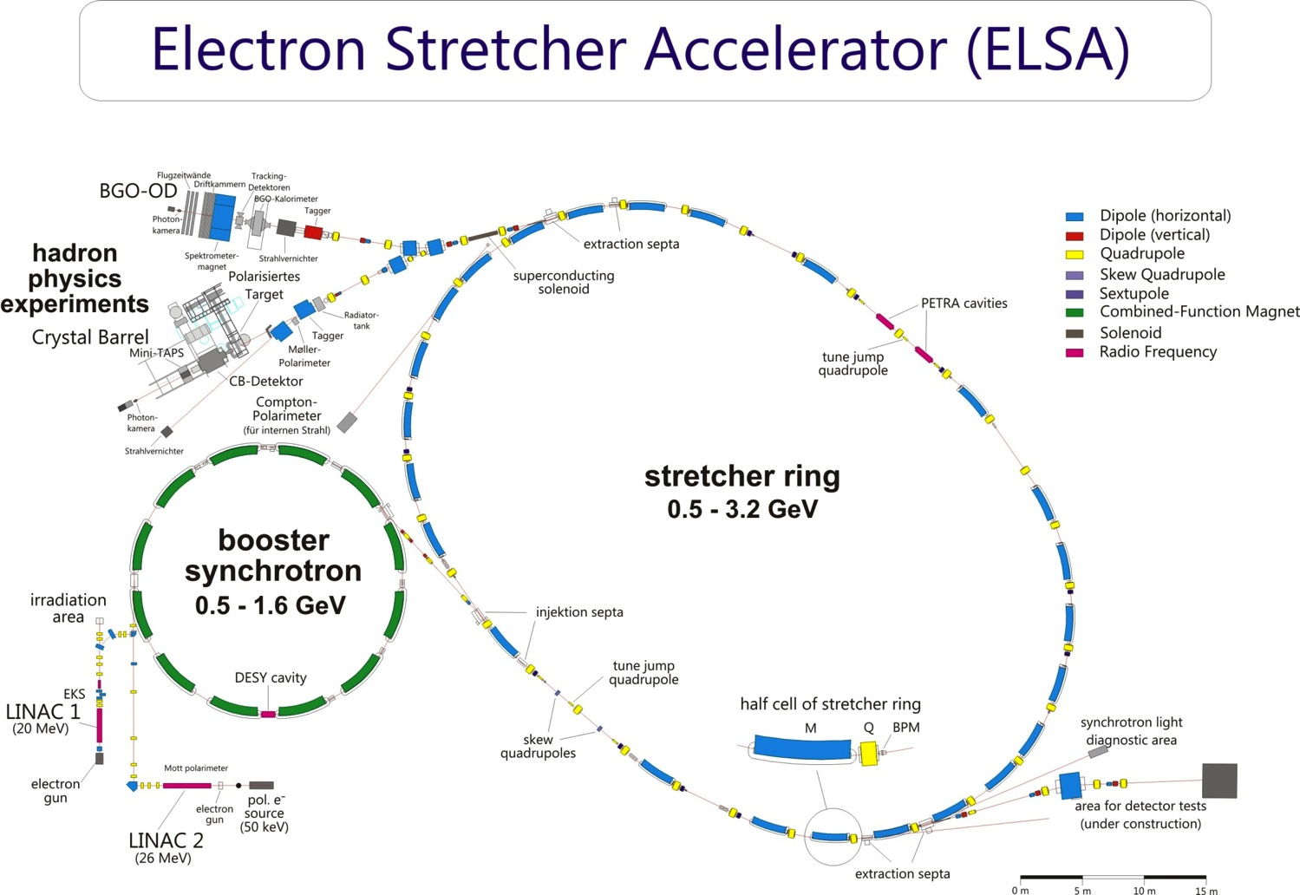

Slide 7
Acceleration of Polarized Electrons
Polarization preserving crossing of depolarizing resonances:
fast ramping (up to 2 Tesla/s)
precise closed orbit correction on fast ramp (rms < 80μm)
compensation of tune-shifts (caused by eddy currents)
harmonic correction of resonance driving horizontal fields
tune jumping
→ Dedicated beam control and diagnostics implemented:
feed forward techniques for fast orbit corrections
harmonic correction based on spin response matrix
fast correctors (10ms), tune kickers, pulsed quadrupoles
fast BPM’s (1kHz) for CO measurement on energy ramp
polarimetry
Simulation of spin dynamics, development of dedicated software

Slide 8
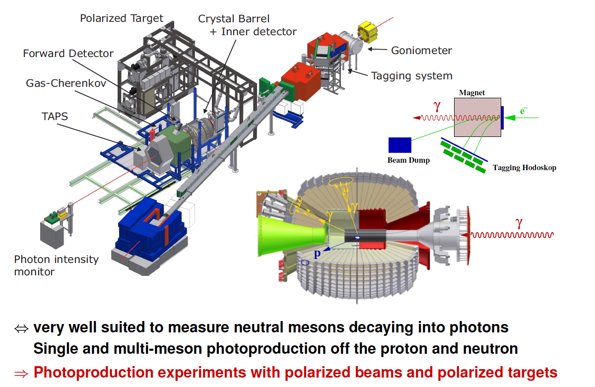
Crystal Ball/TAPS Setup at ELSA (BONN)

Slide 9
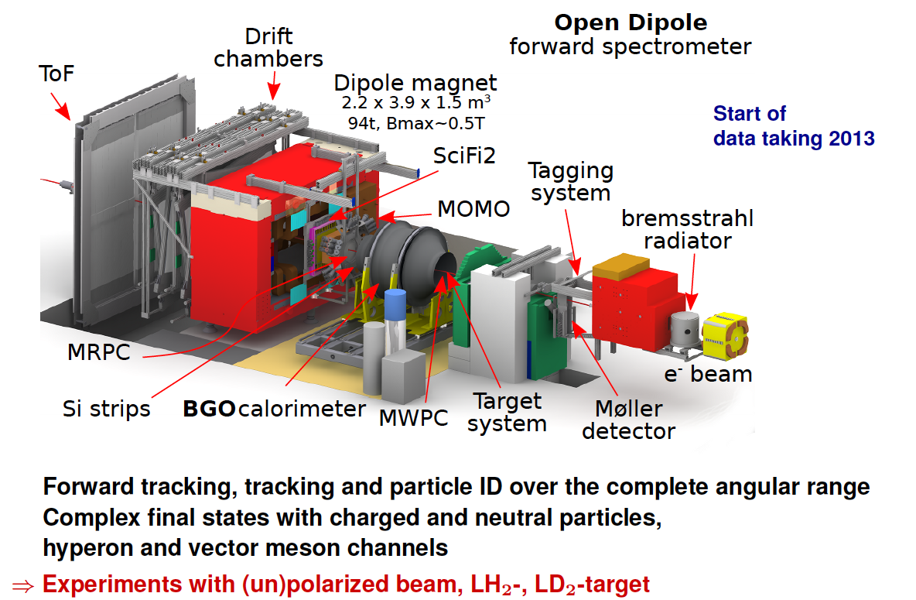
BGO-OD Setup at ELSA (BONN)

Slide 10
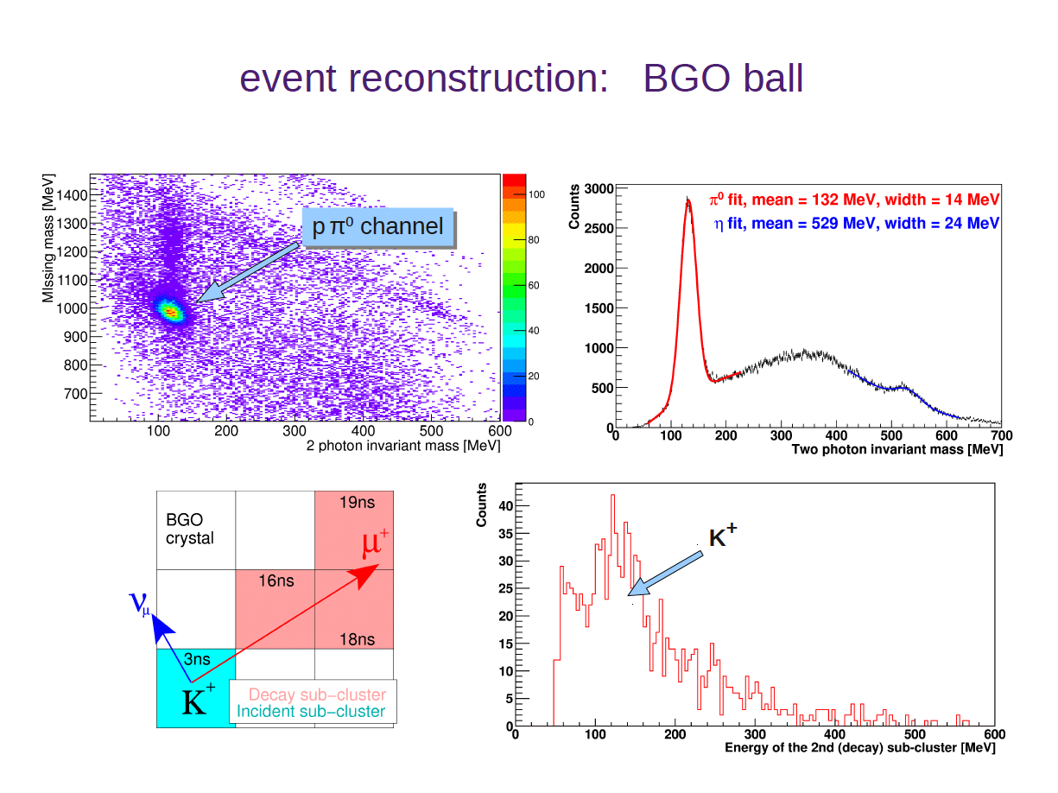
BGO-OD Setup at ELSA (BONN)

Slide 11
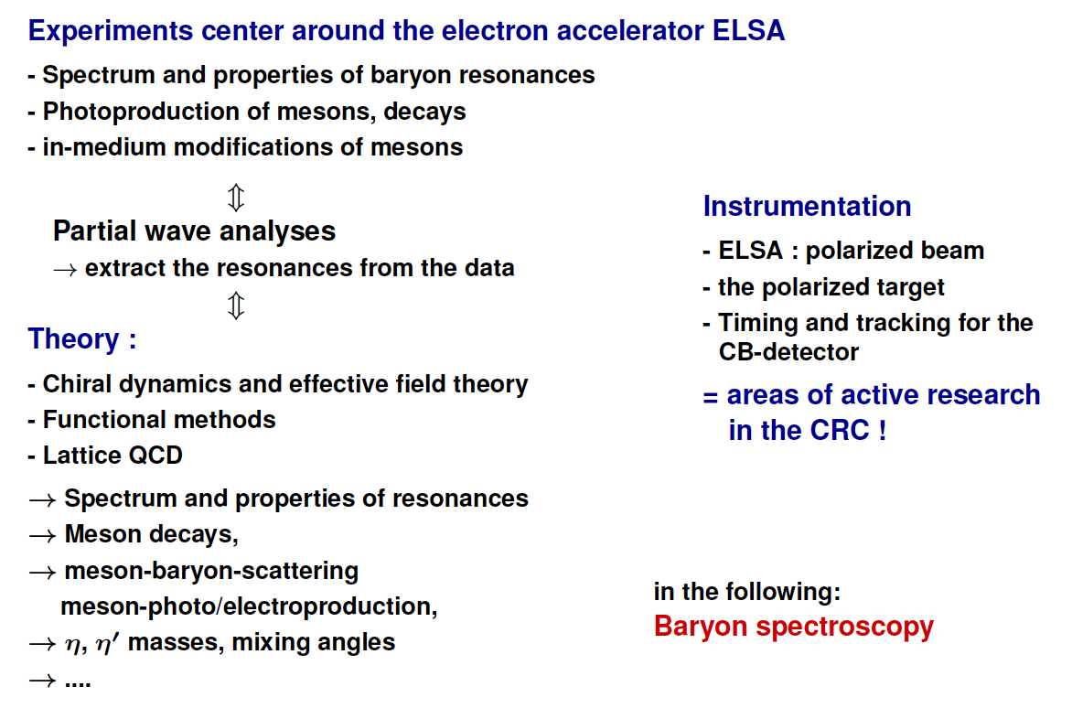
Physics at ELSA (BONN)

Slide 12
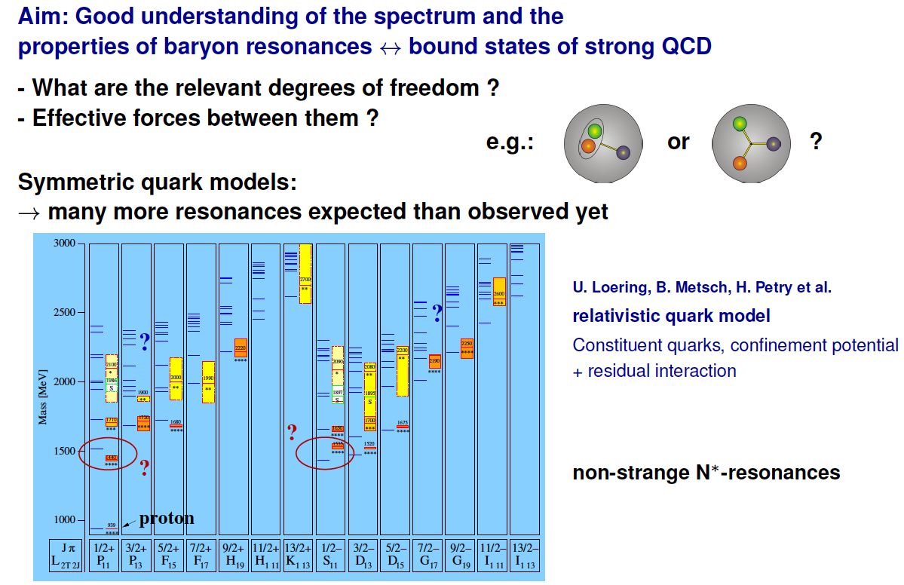
Example: Baryon Spectroscopy at ELSA (Bonn)

Slide 13
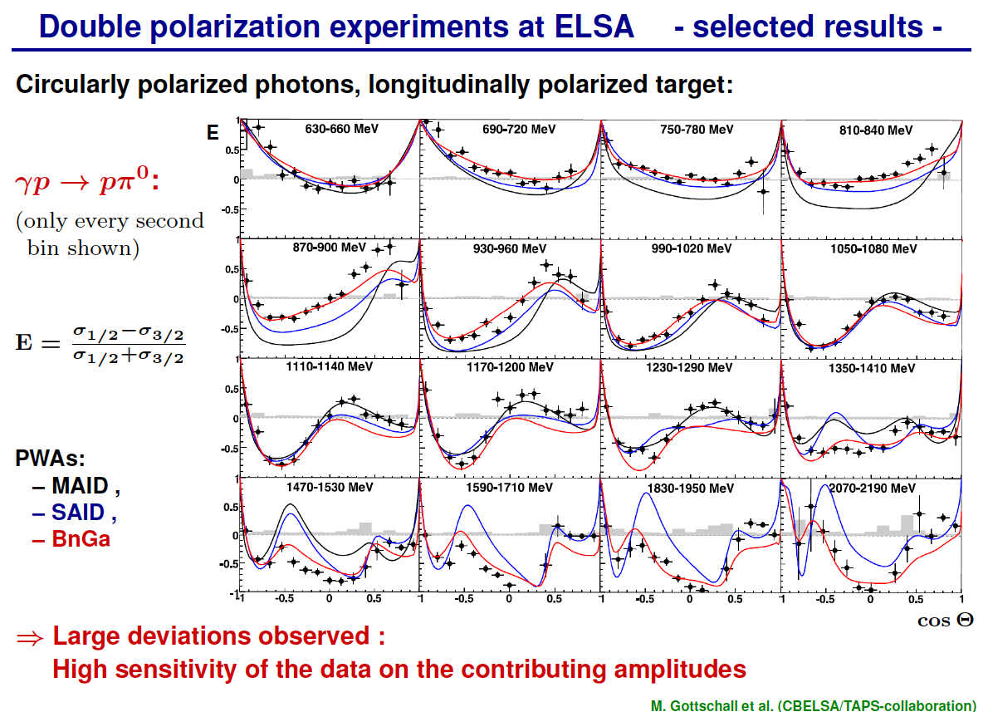

Slide 14
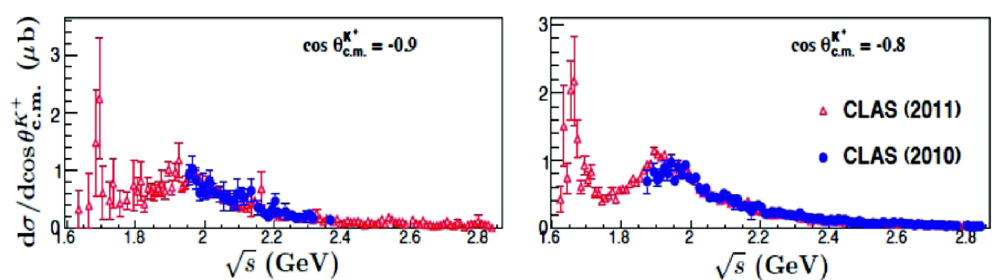
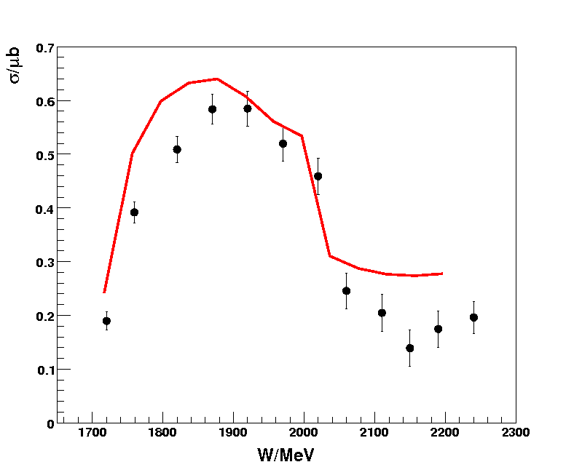
BGO-OD strangeness production
K⁺ Λ @ extreme angles
structure assigned
to narrow P₁₁(1650)
arXiv:1209.2402v1 (2012)
not seen in Crystal
Ball data
T. Jude, PhD thesis
→ accessible with
BGO-OD
K⁰ Σ⁺ across K* threshold
K⁰⁽*⁾ Σ⁺photoproduction
mesurement of
beam asymmetry
determines nature
of t-exchange
neutron target
sensitive to dyn.
generated state
CB-ELSA/TAPS
→ cusp at K* threshold
Ewald et al., PLB 713 (2012)
associated with
t-exchange K⁺ ↔ K*
K* thr.

Slide 15
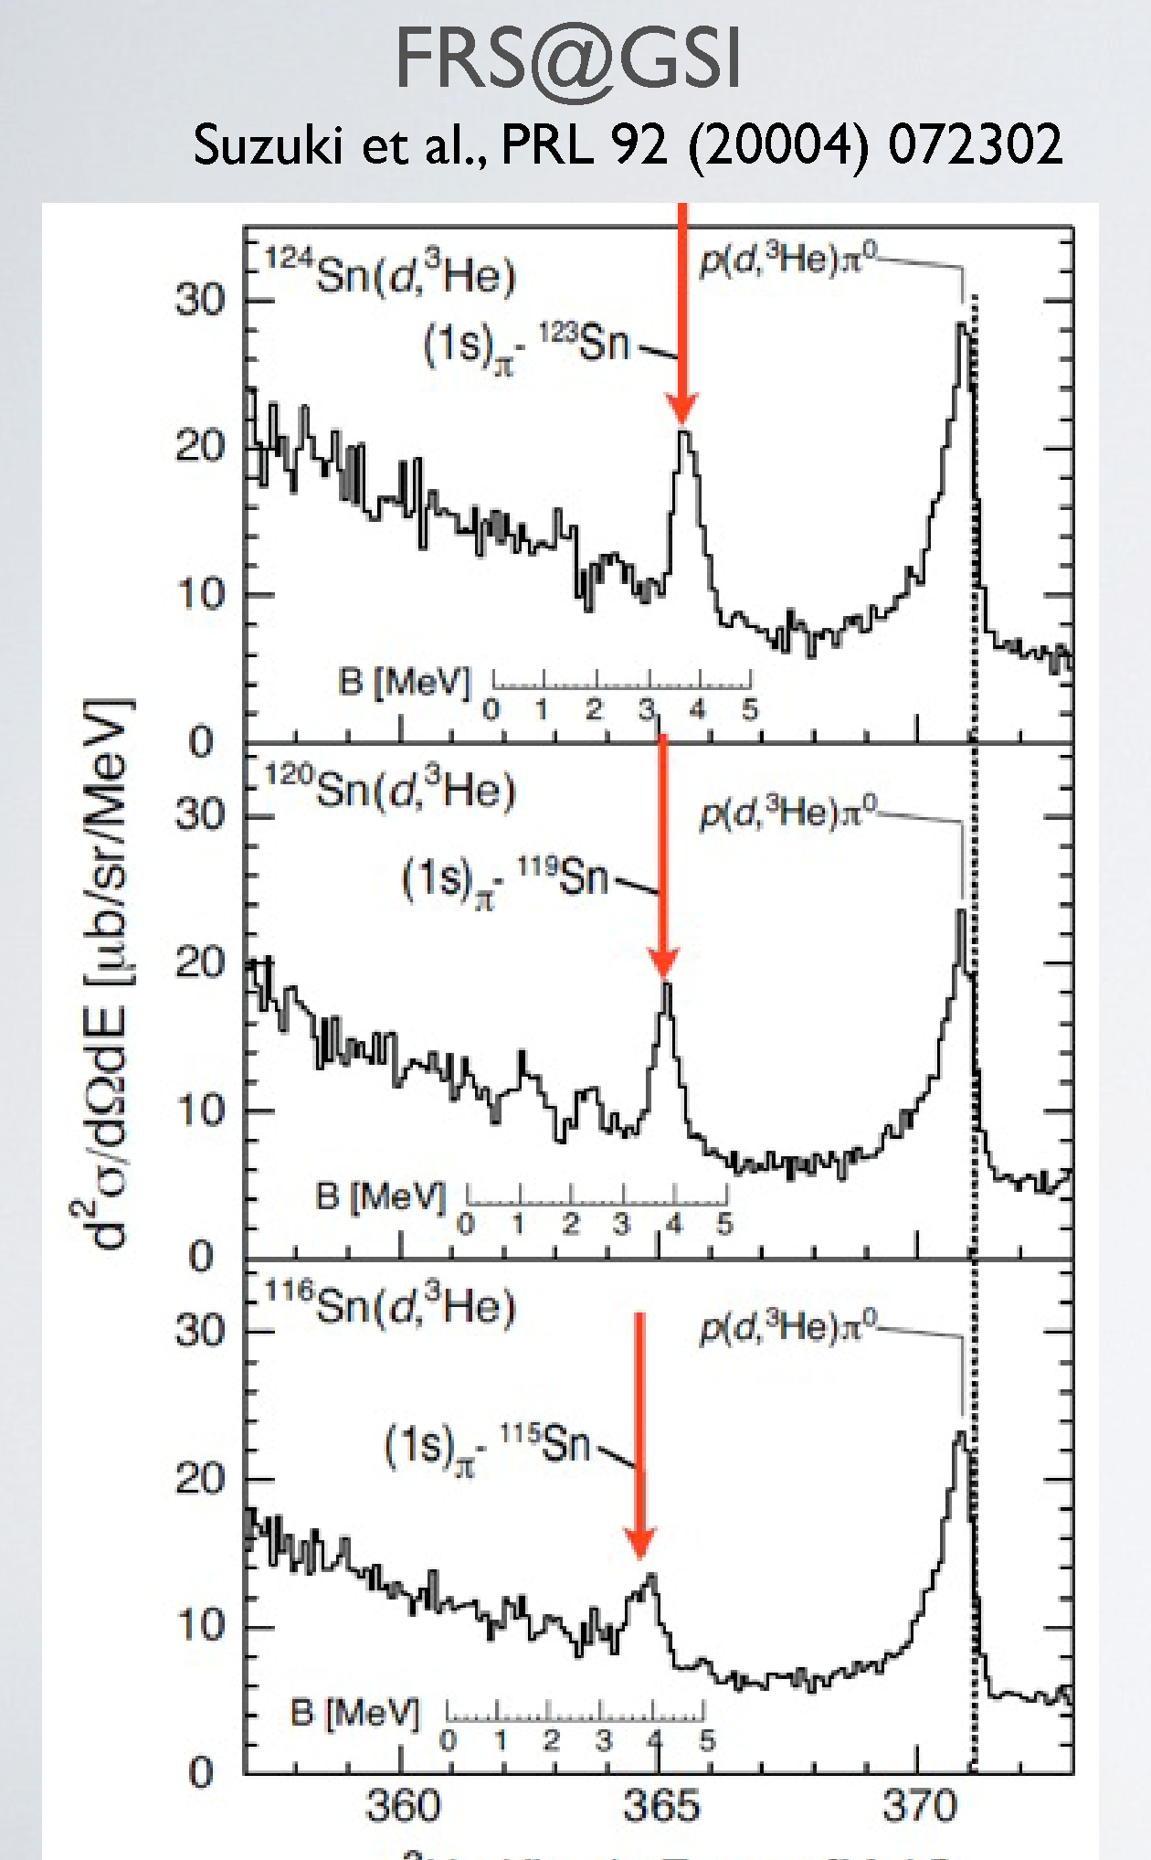
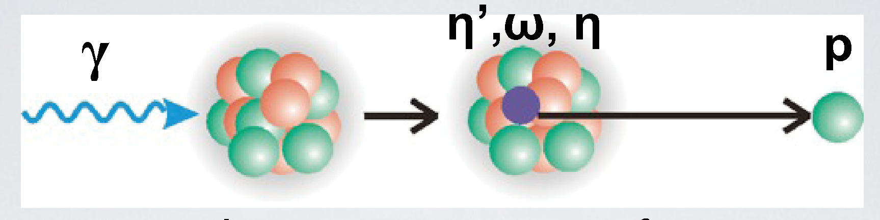
BGO-OD medium effects
properties of hadrons ↔ hadronic medium ?
→ mass, lifetime
deeply bound states ?
→ pions: recoil free production in (d, ³He)
− repulsive s-wave strong interaction
− attractive Coulomb
→ eta' ??
− attractive strong interaction ??
− no Coulomb
BGO-OD
→ search for η' mesic states in ¹²C
³He kinetic energy /MeV
  forward spectrometer
  meson decay:
central calorimeter

Slide 16
FAIR Facility Darmstadt

Slide 17
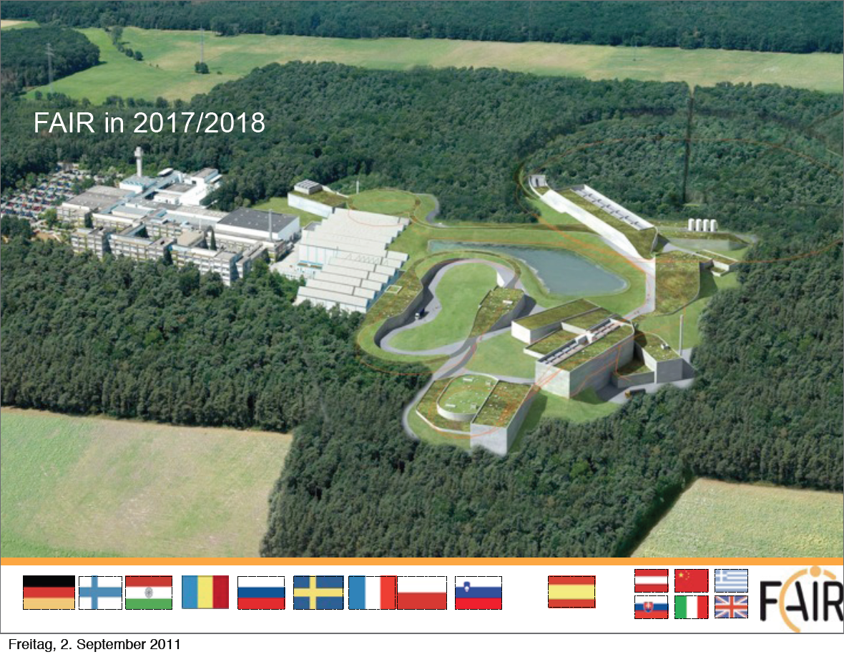

Slide 18
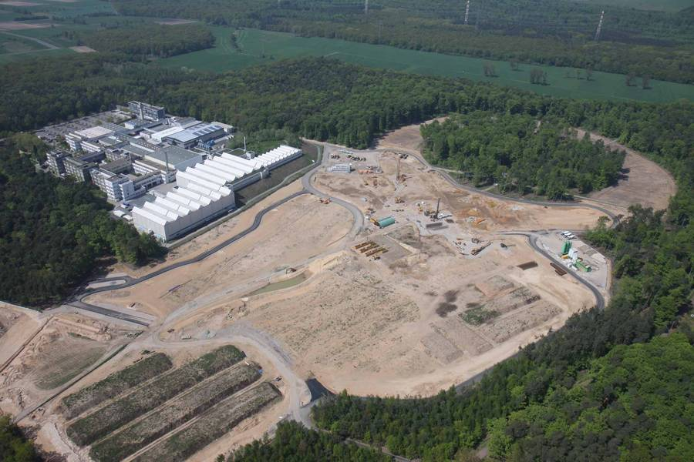

Slide 19
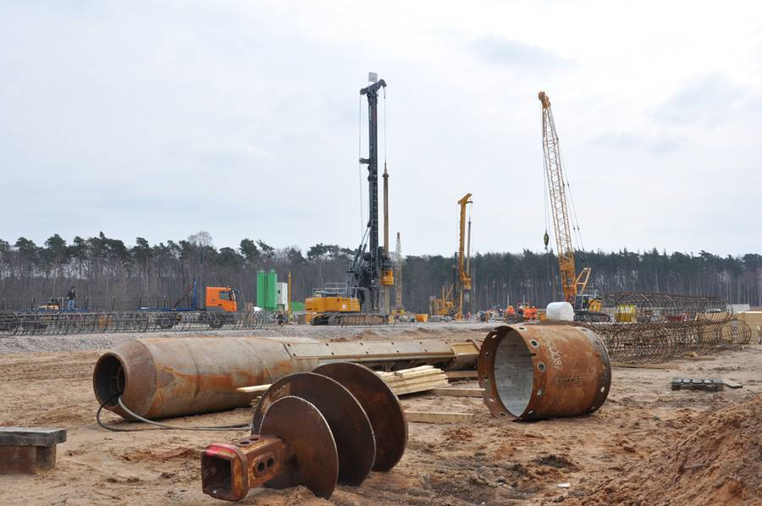

Slide 20
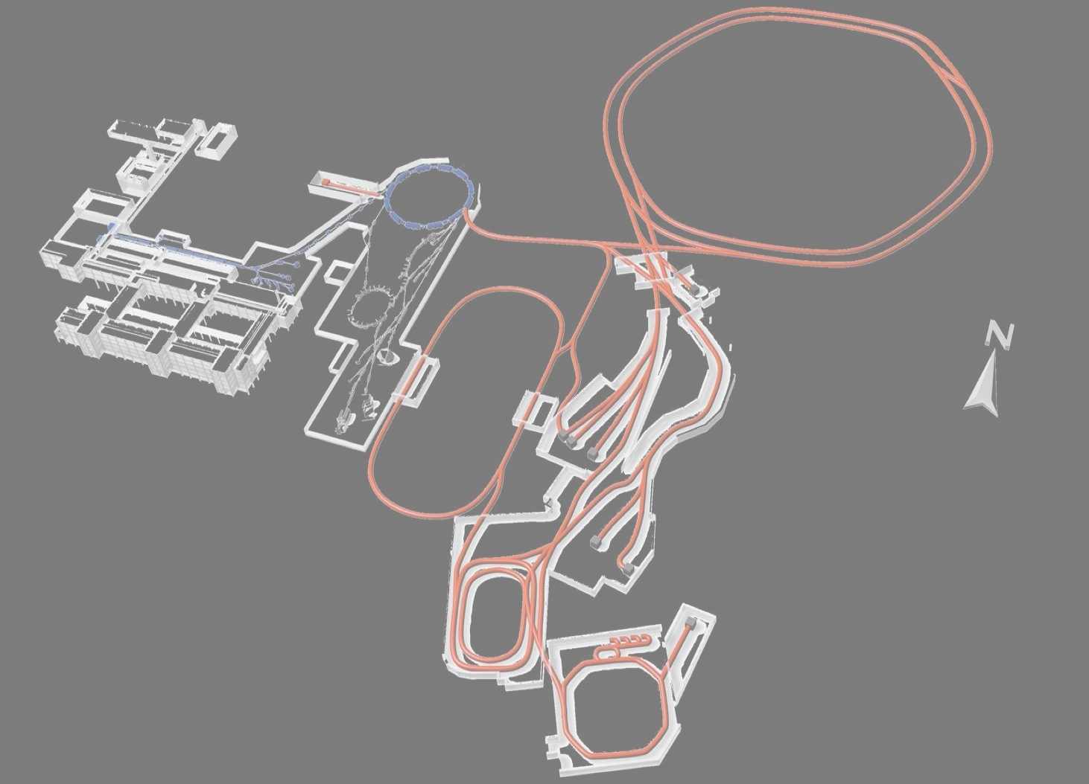
FAIR Facility Darmstadt
GSI today
FAIR
- antiprotons
- rare isotopes
- heavy ion beams
- plasma physics

Slide 23
PANDA Physics Program

Slide 24
PANDA Physics Program

Slide 25
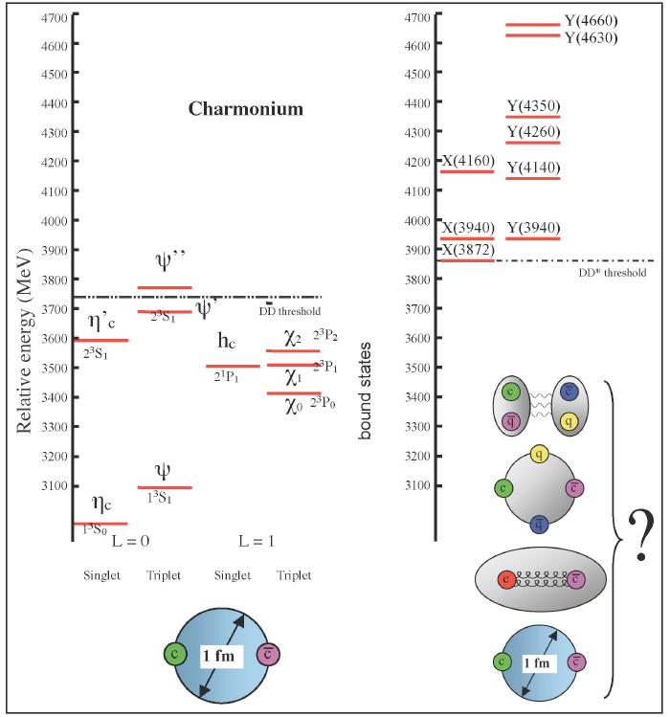
Hadron Dynamics (spectroscopy)
Revolution:
X,Y,Z – states: not understood,
new form of matter
Narrow, above open charm decay
Decays not from two quark meson

Slide 26
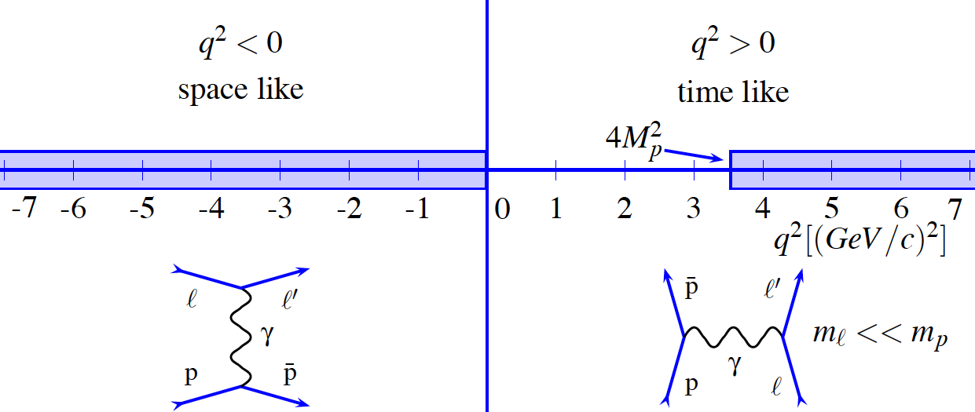
Hadron Structure (Nucleon Form Factors)
Hot Topics in Form Factor Research (Radius, Threshold, Large Q², Unphys. Region)
Time Like Domain: Hadronic processes 10⁶ times larger

Slide 27
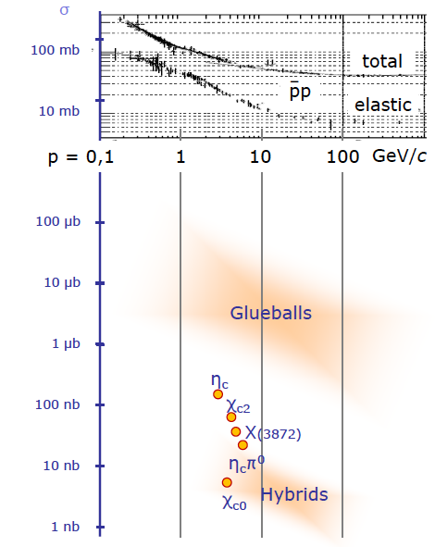
Detector Requirements from Physics Case
High luminosity and hadronic cross sections
High rate capability, 2 · 10⁷ s⁻¹ interactions
High data rate
High degree of radiation resistance
Cross section for electromagnetic Processes

Slide 28
Detector Requirements from Physics Case
4π acceptance
Momentum resolution: 1%
  central tracker in magnetic field
Photon detection: 1 MeV - 10 GeV
  high dynamic range
  good energy resolution
Particle identification: γ, e, μ, π, K, p
  Cherenkov detector
  time of flight, dE/dx, muon counter
Displaced vertex info
  cτ = 317 µm for D±
  γβ ≈ 2

Slide 29
PANDA Detector

Slide 33
Particle Identification in PANDA

Slide 34
Time Like Electromagnetic Form Factors in PANDA

Slide 35
Future Upgrade Possibilty of FAIR

Slide 36
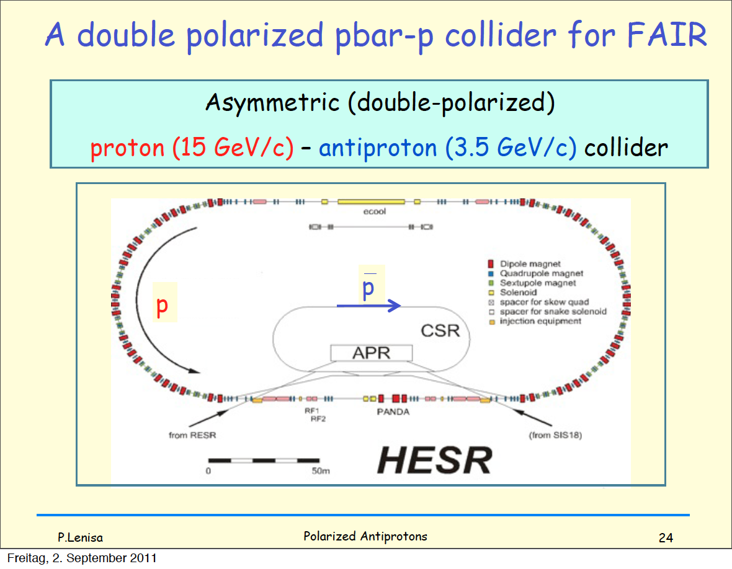

Slide 37
Helmholtz-Institute Mainz

Slide 38
Helmholtz-Institute Mainz (founded in 2009)
Collaboration from newly founded groups with physics institute, nuclear physics institute, nuclear chemistry institute and GSI
6 Research Sections
- nucleon spectroscopy and structure using high energy antiprotons
- atomic physics using low energy antiprotons
- synthesis of superheavy elements
- accelerator physics
- theory
2 Young Investigator Groups
Guest Scientist Program
Workshop program
Budget: about 10 M€ (5.5M€ institutional + 5 M€ infrastructure)
At present 65 heads staff (excluding undergraduate stud.)
Use infrastructure of partner institutes and university
State funds new building (> 23 M€)

Slide 39
Helmholtz-Institute Mainz (founded in 2009)

Slide 40
Helmholtz-Institute Mainz (founded in 2009)
Theory Floor
Accelerator and
Integrated Detector:
SHE LINAC Demonstrator
HESR Cooler, ENC
THFL
ACID
Antiprotons at FAIR
Electromagnetic Processes in
Antiproton Annihilation:
PANDA, HypHi, ENC
Physics and Chemistry of
Superheavy Elements
Z=120, 119
EMP
SHE
Superheavy
Elements
Matter-Antimatter
Symmetry in Atomic Physics:
FLAIR
Spectroscopy and
Flavor:
PANDA, ENC
MAM
SPECF

Slide 41
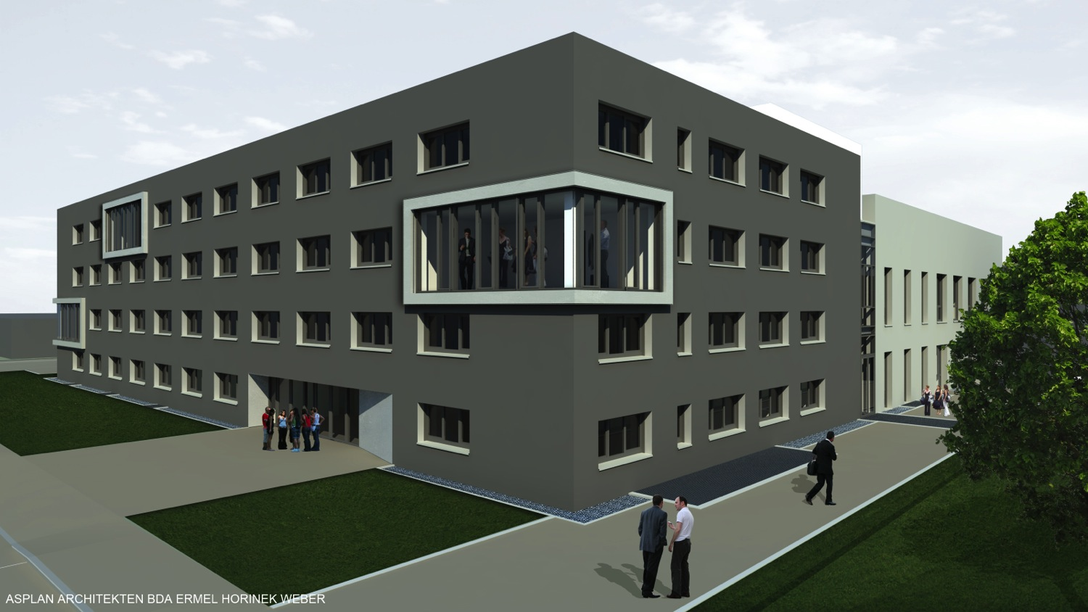
Helmholtz-Institute Mainz (start of constr. 2013)

Slide 42
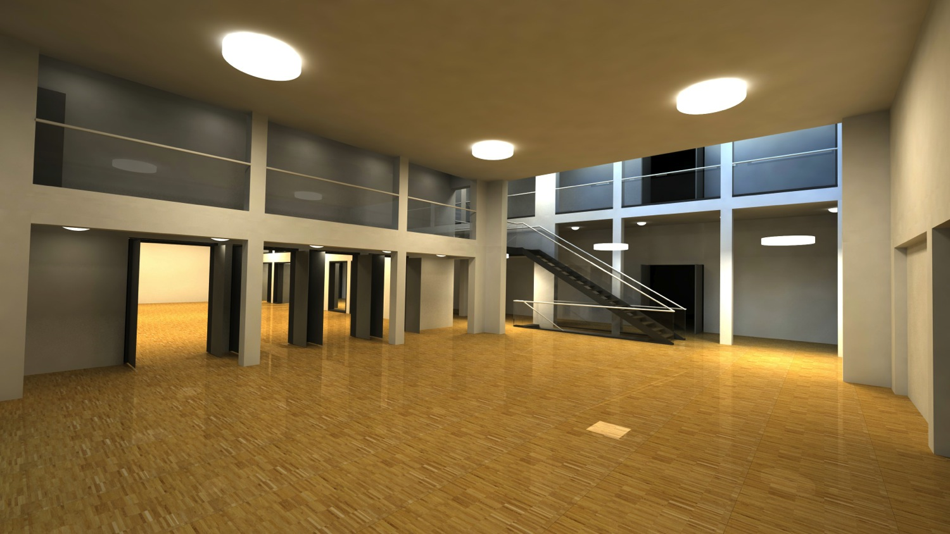
Helmholtz-Institute Mainz (start of constr. 2013)

Slide 43
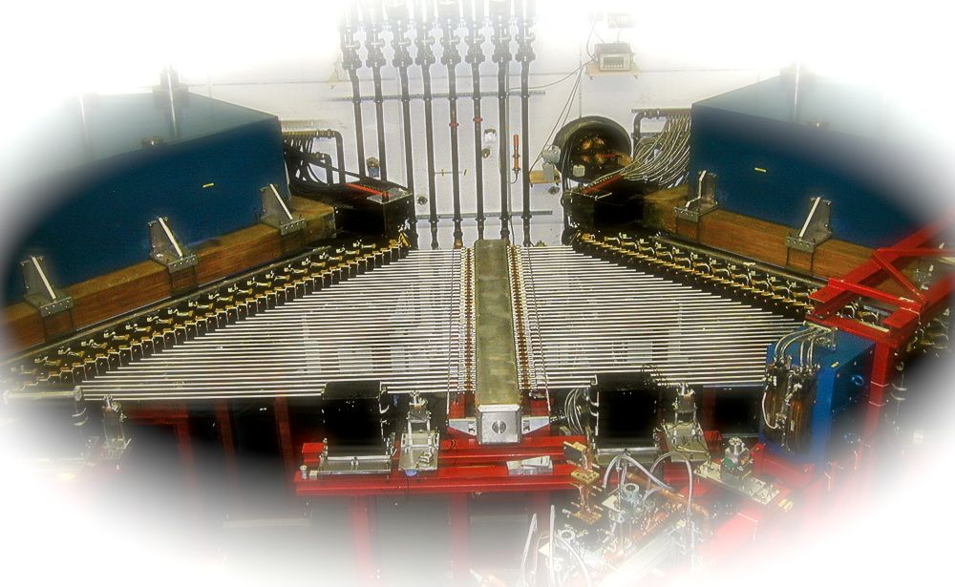
The Mainz Microtron MAMI (Operated by IKP Mainz)

Slide 44

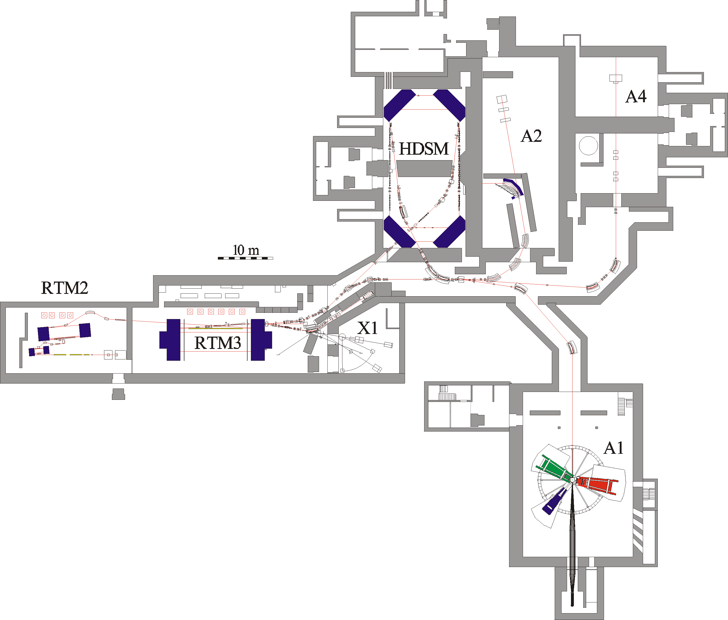
The Mainz Microtron MAMI (Operated by IKP Mainz)
MAMI-C:
since 2007 in routine operation
→ Beam energy E_{γ}^{max} = 1.604 GeV
MAMI total (1991 – 2012):
129,592 hours of operation
HIGH Intensity (max. 100 µA)
HIGH Resolution (σ_{E}<0.100MeV)
HIGH Polarization (ca. 80% Polarization)
HIGH Reliability

Slide 45
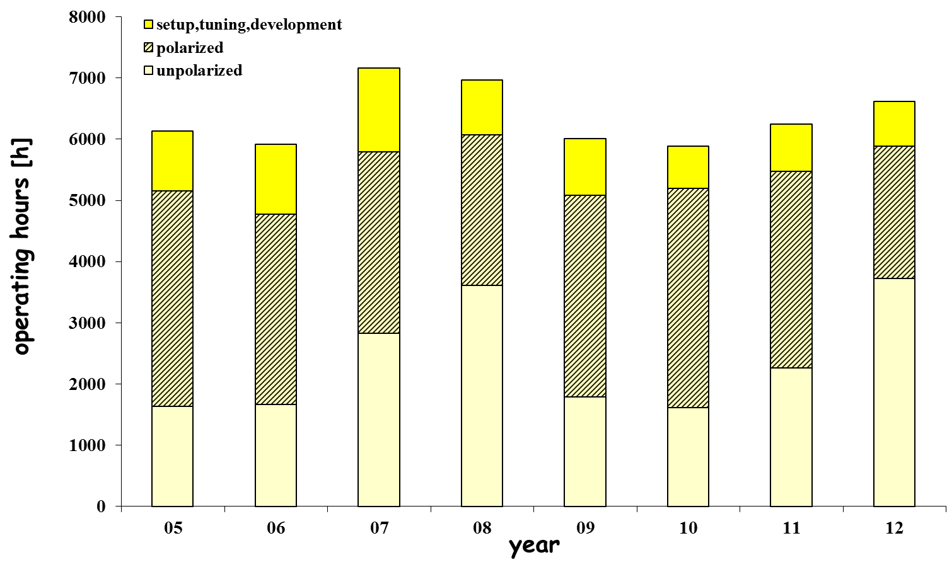
The Mainz Microtron MAMI (Operated by IKP Mainz)
61%
72%
Operating Hours [hours]
46%
51%
40%
36%
MAMI-C -operation
1%

Slide 46
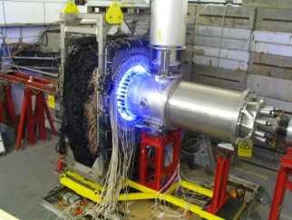
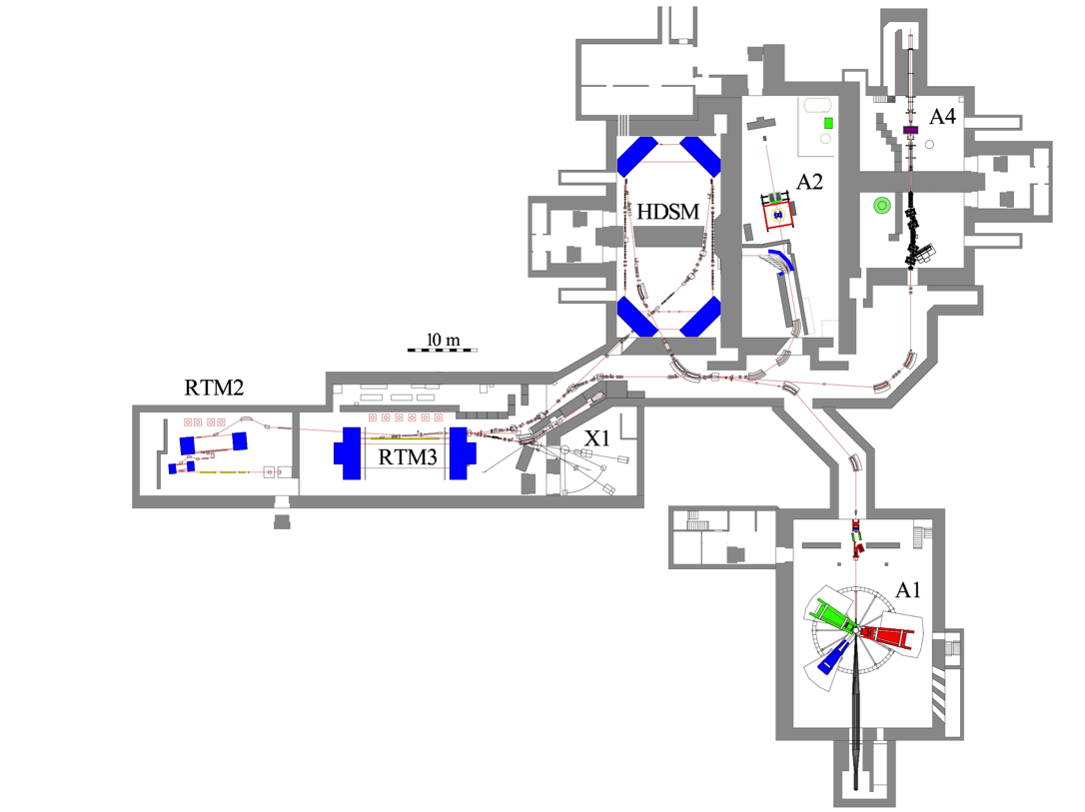
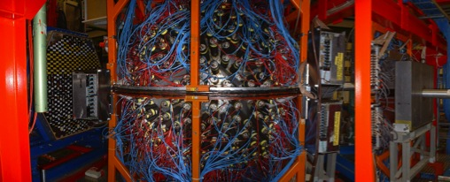
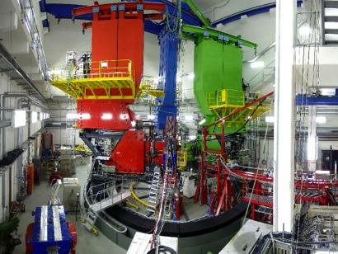
Instrumentation at MAMI
A4: Parity violation in elastic ep scattering
Single-Spin-Asymmetry <10⁻⁵
PbF₂ Calorimeter
A2: Photonen-Excitation
Tagged Bremsstrahl.-Photons
4π-Setup: Crystal Ball, TAPS
A1: Electron-Scattering
3 magnetic Spectrometer
Δp/p< 10⁻⁴ FWHM

Slide 47
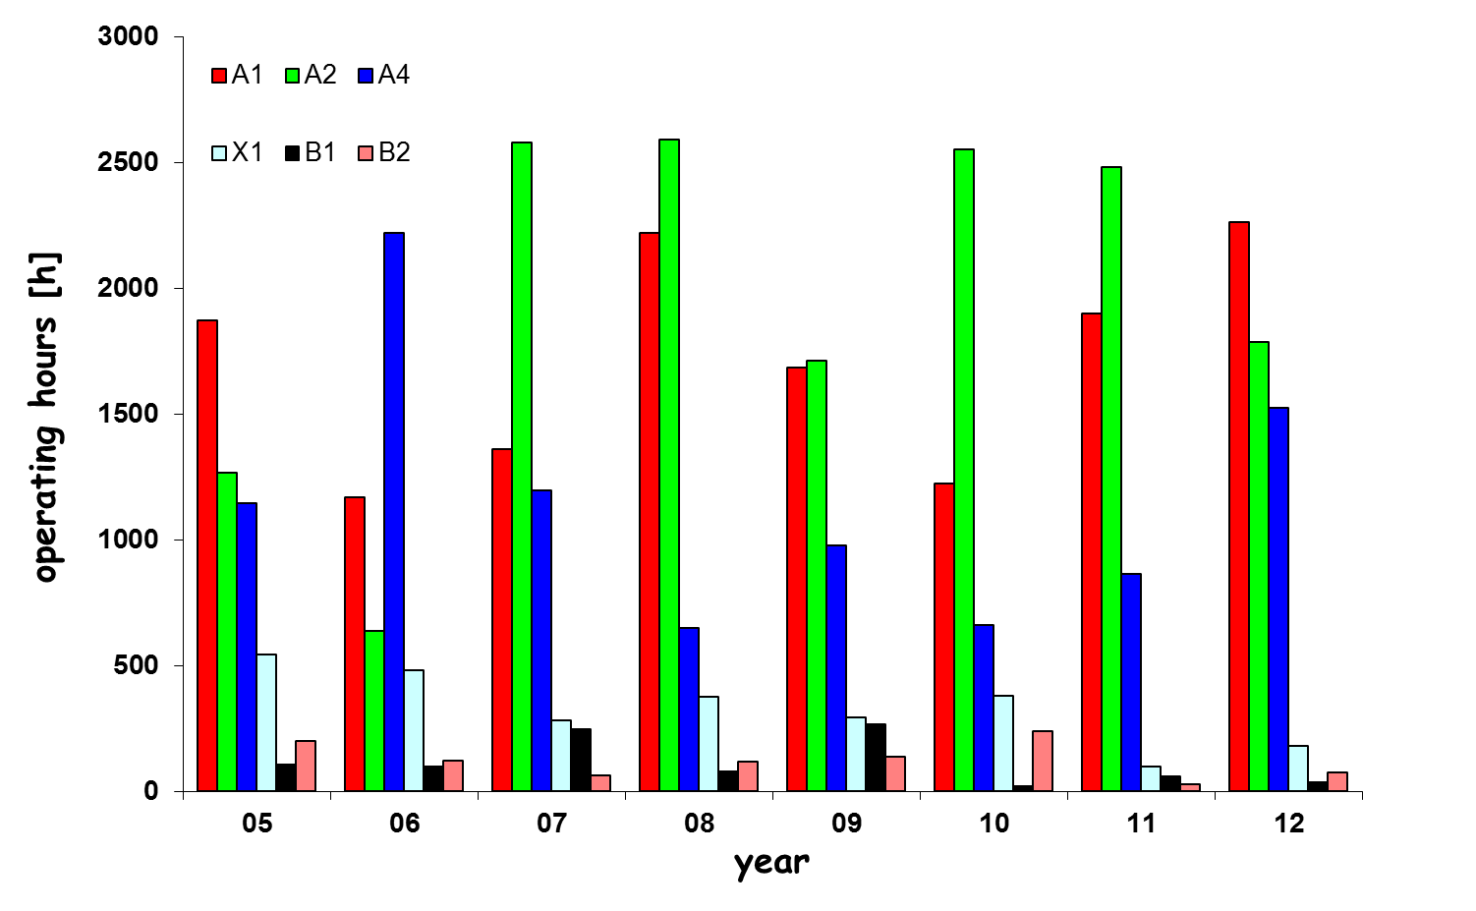
Beam hours per Colabopration
A1: 13700h
A2: 15616h
A4: 9242h
X1: 2643h

Slide 48
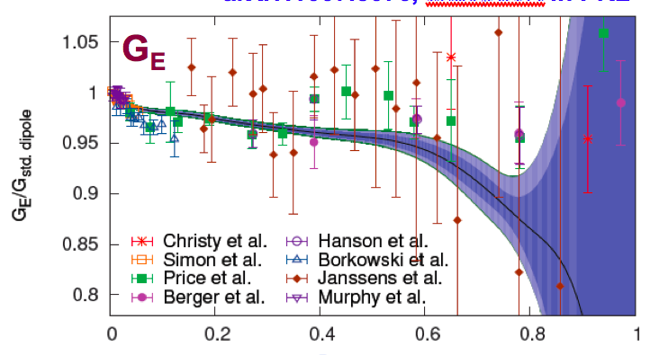
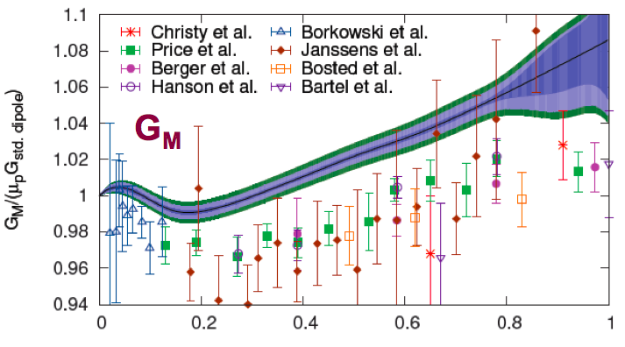
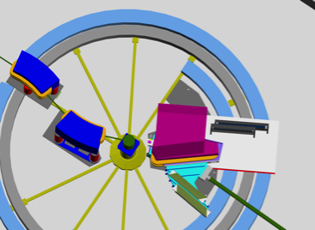
Selected Highlights at MAMI: Form Factors
High-precision determination of the electric and magnetic proton form factors
→ Super-Rosenblugh fit → extraction of proton radius to ~1% precision
Q²/GeV² Q²/GeV²
Successful installation of beam line chicane for
0° operation of KAOS
Elementary kaon production
Start of hypernuclei programme
(missing mass & π decay spectroscopy)

Slide 49
Selected Highlights at MAMI: Search for Dark Photon
Search for a new massive force carrier of extra U(1)_{d} : Dark Photon
Could explain large number of astrophysical anomalies
Could explain deviation of 3.6σ btw. SM value and direct measurement of (g-2)_{μ}
Exclusion range from
MAMI / A1 spectrometers
during 4-day pilot run
14 days run
preliminary
A1/MAMI
Merkel et al. PRL 2011
Future: Low mass region <50 MeV/c² and small dark photon coupling ε²

Slide 50
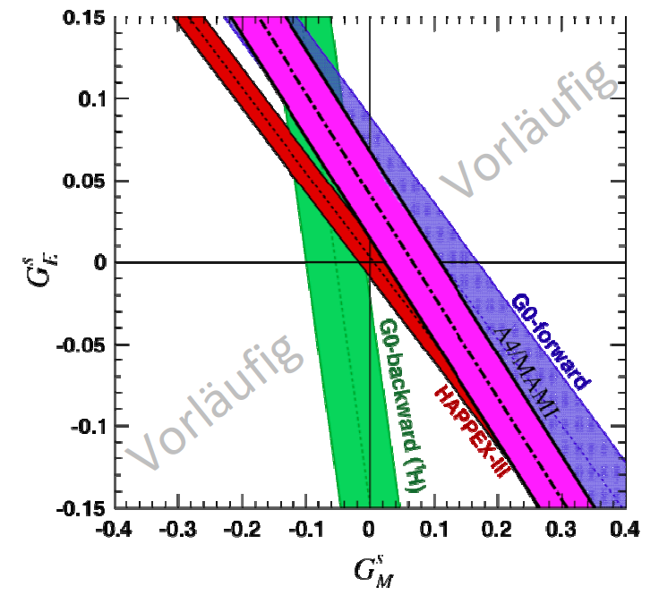
Selected Highlights at MAMI: Parity Violation
Measurement of parity-violating
cross section asymmetry @ Q²=0.62 GeV²
→ EM strangeness form factors
(preliminary)
A4
preliminary
Recent measurement @ Q²=0.1 GeV²
→ extrapolation to Q² → 0
A4 experiment has successfully completed physics programme
Preparation for a new experiment P2 to measure sin²θ_{W} at
low Q² with unprecedented precision
→ Project within CRC-1044 (personnel) and PRISMA (MESA accel.)

Slide 51




Context in Mainz
MAMI
BES-III
CRC 1044
PANDA
ENC
HIM: committed to GSI/FAIR
→ No funding for MAMI

Slide 52
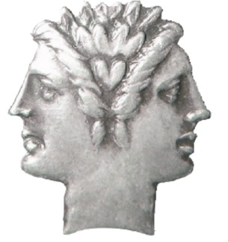
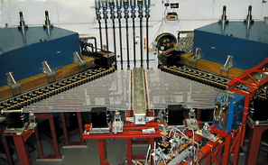
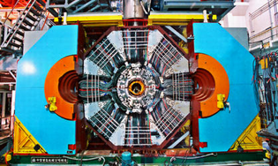
Program of group application CRC1044
Novel concept of CRC1044:
Interplay btw. Spacelike and Timelike Measurements
Insights into Hadron Structure
MAMI
e⁻ Fixed Target
BES-III @ BEPC-II
e⁺e⁻ Collider
Spacelike Timelike
measurements measurements

Slide 53
Program of group application CRC1044
P=Precision Physics, S=Hadron Structure, M=Internal Symmetries & Structure of Mesons, N=Nuclear Physics
 | Projects
 | P1 | Precision hadron physics : (g-2)_{μ} and α_{em}(M_{Z}²)
 | P2 | The weak charge of the proton @ MESA
 | S1 | Baryon form factors
 | S2 | Polarizabilities
 | S3 | Low-energy excitations of light hadrons
 | M1 | γγ physics and meson structure
 | M2 | Light meson dynamics (e.g. η, η’ decays)
 | N | Interactions in few-baryon systems

Slide 54
New Group Application PRISMA
A new cluster of excellence within the German excellence initiative
Mainz and Munich (TU and LMU) only successful proposals in our field
PRISMA: group application of Institute of Nuclear Physics and Mainz HEP group
(and related fields: atomic physics, UCN group, mathematics)
Based on strenght of (existing) local research infrastructure:
Electron accelerator MAMI (pivotal role!)
→ TRIGA research reactor
→ High-Performance Clusters WILSON and HIMster
Total Budget: ca. 39 M€ (Funding Period Nov. 2012 – Oct. 2017 )
Structural initiatives
Foundation of Mainz Institute for Theoretical Physics (MITP)
9 new professorships

Slide 55
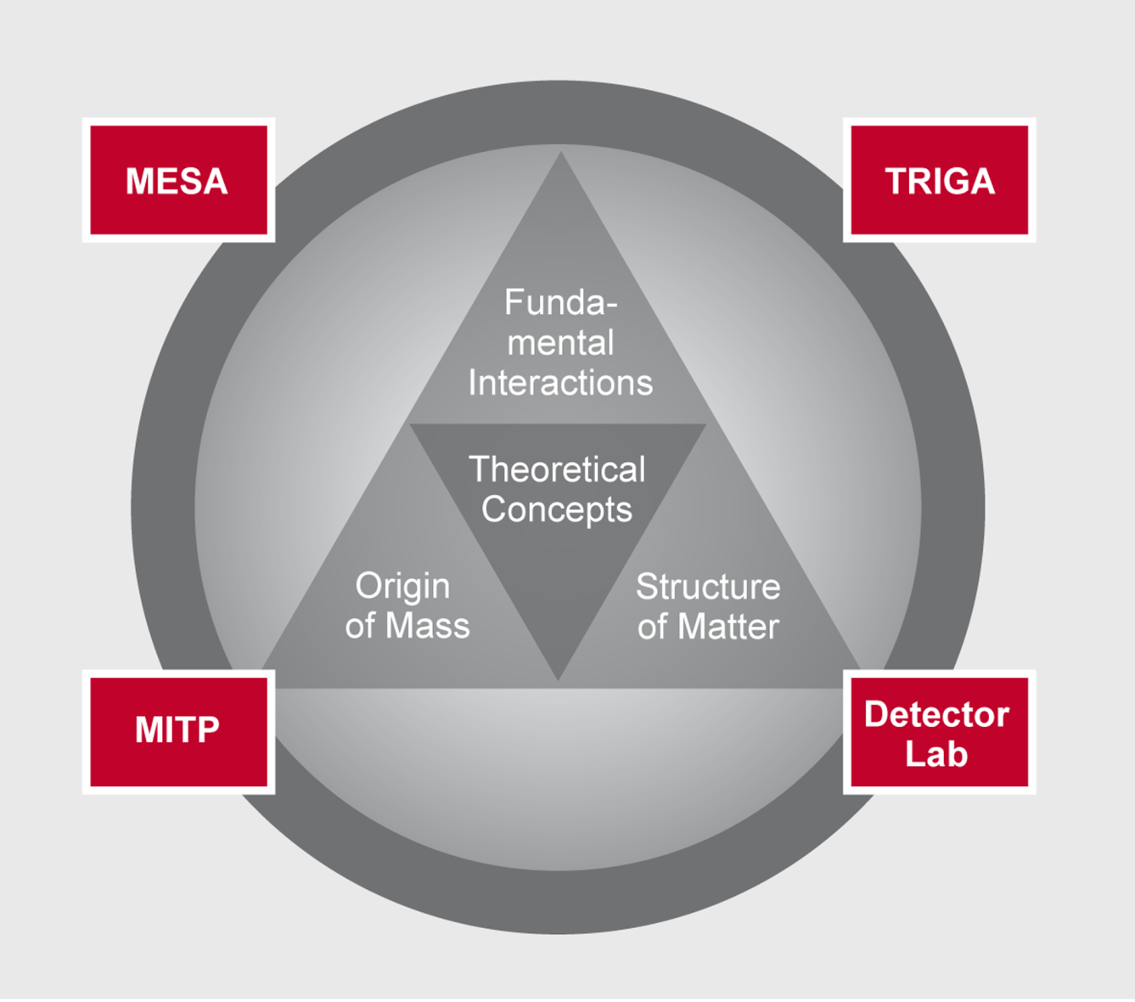
PRISMA
UCNs at
TRIGA
Atom & Ion
Traps
MESA, MAMI
BES-III, NA62
PANDA
ATLAS
XENON
IceCube
Energy
10⁻²³ eV
1 MeV
1 GeV
1 TeV
10¹¹ TeV
Symmetry Tests
New Forces
Hadronic Properties
Dark Sector
New Particle Searches
Flavour Sector, Dark Matter
Particle
Astrophysics

Slide 56
New Group Application PRISMA
Scientific Research Areas
A: Fundamental Interactions
B: Origin of Mass and Physics beyond the Standard Model
C: Structure of Matter
D: Theoretical Concepts & Mathematical Foundations
Structural Initiatives
E: MESA Accelerator and Experimental Facility
F: TRIGA User Facility
G: Mainz Institute for Theoretical Physics (MITP)
H: Detector Laboratory

Slide 57
IKP (MAMI) in PRISMA
Scientific Research Areas
MESA experiments (P2,
Dark Photon search, …)
A: Fundamental Interactions
B:
C: Structure of Matter
D: Theoretical Concepts
Hadron/Nuclear Physics
Theoretical Physics
Structural Initiatives
E: MESA
F:
G: MITP
H: Detector Laboratory
Mainz Energy-Recovering Superconduct-
ing Accelerator (25% of PRISMA budget)
Workshops, Guests

Slide 58
Accelerator MESA: key initiative in PRISMA
Mainz Energy-Recovering Superconducting Accelerator
High-Intensity Electron Accelerator: 200 MeV @ >1 mA current
Location: existing halls of Institute (former A4 hall)
Challenging accelerator project
→ superconducting technology (50 MeV gain)
→ Energy-Recovering (ERL) technology
Frontier experiments
Precision measurement of sin²Θ_{W}
→ extracted beam mode
Search for the Dark Photon
→ ERL mode
Frontier projects in Particle, Hadron, Nuclear Physics ….

Slide 59
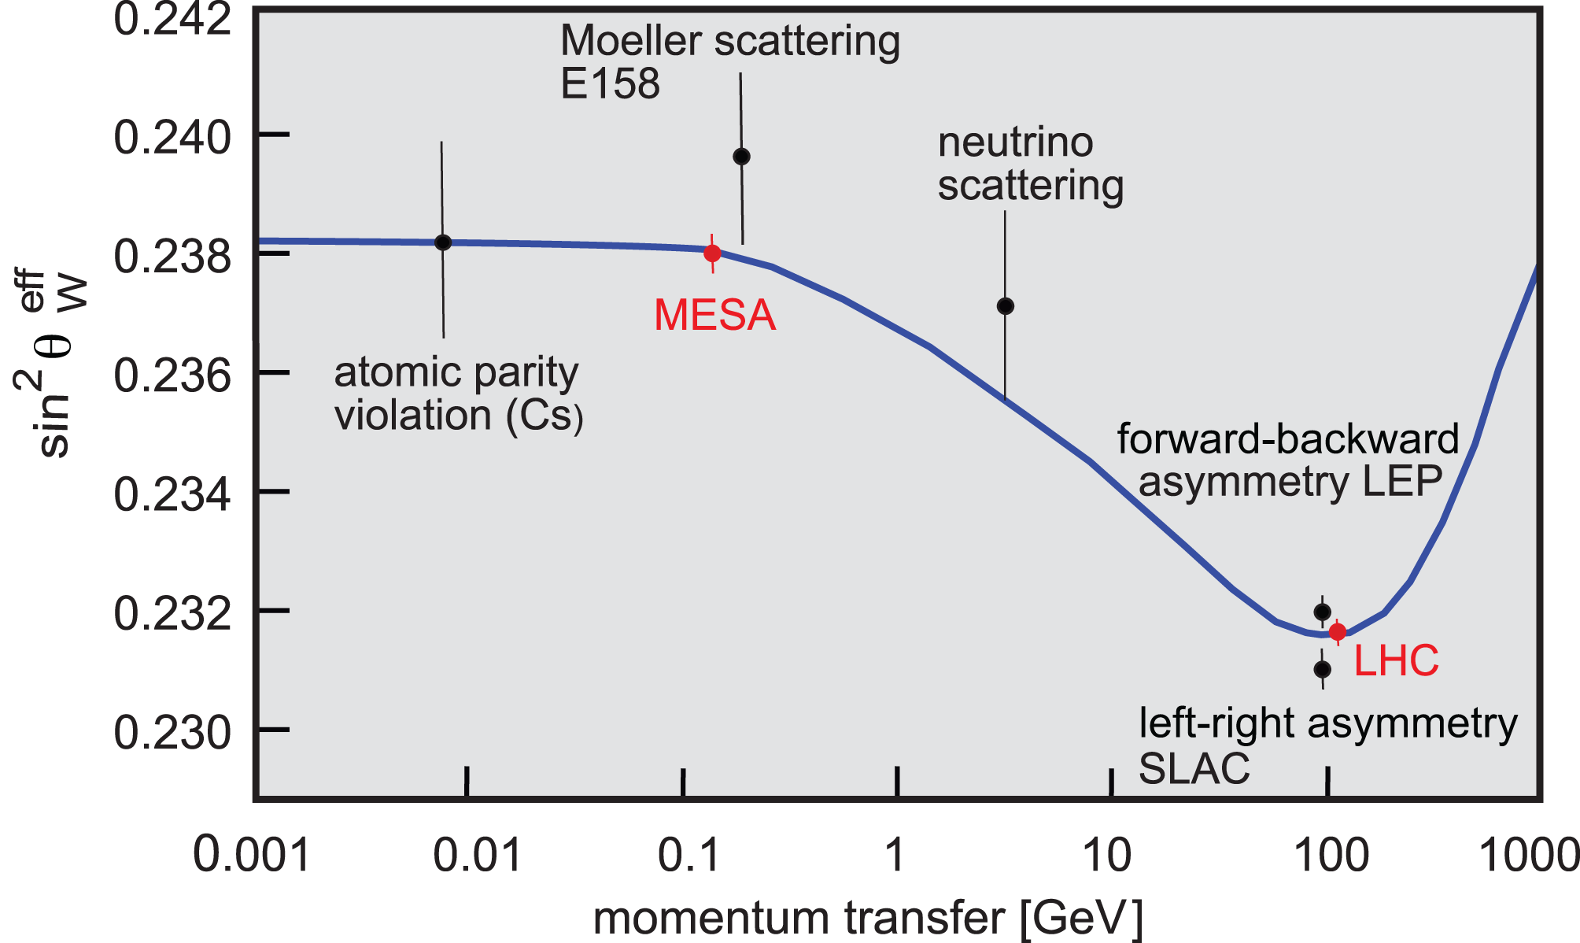
Flagship Experiment at MESA: sin²Θ_{W}
P2 goal: Measure parity-violating Left-Right asymmetry
A_{LR} of 20 x 10⁻⁹ with 1.8% precision at low Q²
→ P2@MESA: Δsin²θ_{W} = 4 x 10⁻⁴ (0.15 % , 0.1%)
MESA
Standard Model
Running of sin²θ_{W}
→ Significant test of SM with sensitivity to New Physics up to 7 TeV

Slide 60
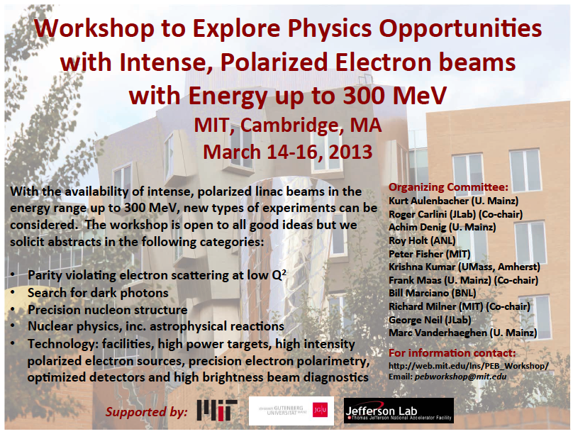
MESA as low energy electron accelerator facility

Slide 61
Summary: Perspectives are Excellent
Location | Institutes | Facilities | Physics | Group-Applications
Mainz | IKP (University) | MAMI MESA (new) | Nucleon/Meson Structure and Spectroscopy | CRC1044 (new) PRISMA (new)
Mainz | HIM (new) IKP (University) | FAIR-accelerator (new) GSI-accelerator MESA (new) | Hadron Physics Particle Physics | PRISMA (new)
Darmstadt | GSI (National Lab.) | FAIR-accelerator (new) | Nuclear Physics Atomic Physics Hadron Physics
Bonn | HISKP IP (University) | ELSA | Nucleon/Meson Spectroscopy

