Slide 1
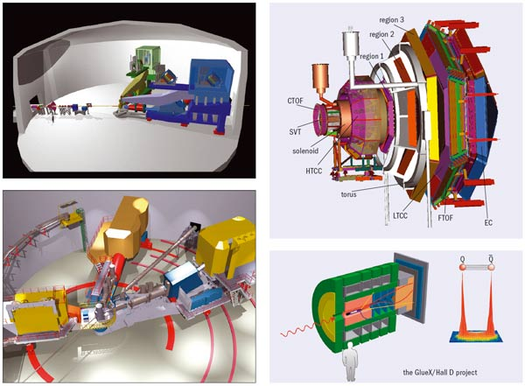

Report from NSF
Allena K. Opper
Budget
Funding Opportunities
Final Notes

Slide 2
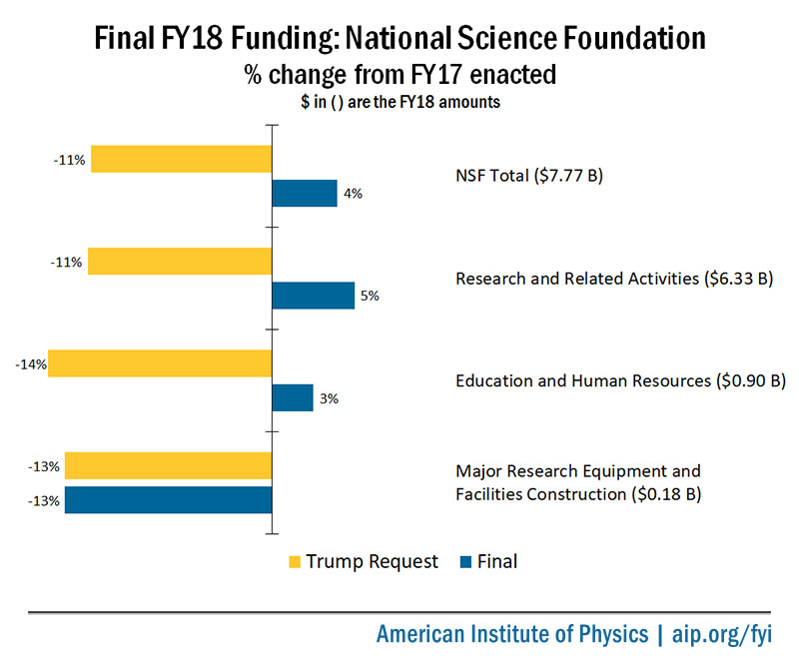
Final FY18 Funding: National Science Foundation
% change from FY17 enacted
$ in ( ) are the FY18 amounts
~ $300M above FY17 enacted
DKIST, LSST, Regional Class Research Vessels

Slide 3
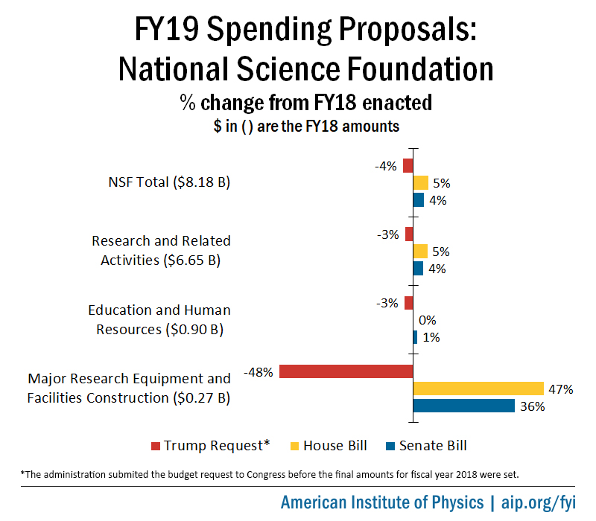
NSF FY19 Spending Proposals
(% change from FY18 enacted)
$ in ( ) are the FY18 House Marks

Slide 4
FY19 NSF Request $7,472 M

Slide 5


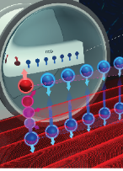


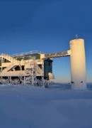
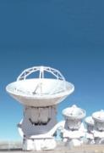



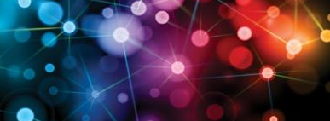

NSF’s 10 Big Ideas
RESEARCH IDEAS
Work at the
Human-Technology
Frontier: Shaping the Future
Windows on the Universe:
The Era of Multi-messenger Astrophysics
The Quantum Leap:
Leading the Next Quantum Revolution
Harnessing Data for 21st Century Science and Engineering
Navigating the
New Arctic
Understanding the Rules of Life:
Predicting Phenotype
PROCESS IDEAS
Mid-scale Research Infrastructure
NSF 2026
Growing Convergence Research at NSF
NSF INCLUDES: Enhancing STEM through Diversity and Inclusion

Slide 6
FY19 Funding for NSF Big Ideas

Slide 7
FY19 PHY $266.73M

Slide 8
Solicitation for NSF Physics Division
Investigator-Initiated Research Projects 18-564
All proposals submitted to the Division of Physics programs must go through this solicitation.
Deadlines:
  December 5, 2018 for Particle Astrophysics, Elementary Particle Physics Experimental & Theoretical Nuclear Physics
Text on Midscale Instrumentation and Long Duration Efforts
Follow Proposal & Award Policies & Procedures Guide (PAPPG) https://www.nsf.gov/pubs/policydocs/pappg17_1/index.jsp
  Follow the Proposal Preparation checklist
Collaborators and Other Affiliations Template
Follow instructions that are specific to this solicitation

Slide 9
PHY Midscale Instrumentation
Design and Construction or Acquisition of Instrumentation
  R & early D, operations funded by research programs
~ $4M < TPC < ~ $15M; over multiple years
Selection based on
  merit review
  exceptional opportunity
  research community priorities.
Currently 6 Midscale projects (SCDMS, ATLAS, CMS, LHCb, 2 Nuclear Physics)
For more info, see PHY Solicitation

Slide 10

Midscale: nEDM

Critical Component Design → Large Subsystem Integration
Prepare polarized ³He
Isotopically purify ⁴He; each meas’t cycle
Generate electric field
Store ³He & neutrons
Monitor ³He & neutron precession frequencies
Generate uniform B-field
PIs: Brad Filippone (Caltech) and Doug Beck (UIUC)

Slide 11
Midscale: MUSE
Proton Radius Problem: Atomic meas’t μ-H → p radius 7 σ smaller than e-H and e-p scattering
Precise comparison of e-p and μ-p
scattering @ PSI
Preparing for full commissioning run (late Fall 2018)
Data taking: 20 weeks, May – Dec, 2019
Goal: σ for elastic scattering of μ+/- and e+/- with sub sub-1% relative precision over Q² from 0.002 to 0.07 GeV
PIs: R. Gilman (Rutgers), E. Downie (GWU), M. Kohl (Hampton), W. Lorenzon (U Mich), S. Strauch (USC)

Slide 12
Midscale: MUSE
Proton Radius Problem: Atomic meas’t μ-H → p radius 7 σ smaller than e-H and e-p scattering
Precise comparison of e-p and μ-p
scattering @ PSI
Straw Tube Tracker Frame
lowered into place
Preparing for full commissioning run (late Fall 2018)
Data taking: 20 weeks, May – Dec, 2019
Goal: σ for elastic scattering of μ+/- and e+/- with sub sub-1% relative precision over Q² from 0.002 to 0.07 GeV
PIs: R. Gilman (Rutgers), E. Downie (GWU), M. Kohl (Hampton), W. Lorenzon (U Mich), S. Strauch (USC)

Slide 13
Midscale: MUSE
Proton Radius Problem: Atomic meas’t μ-H → p radius 7 σ smaller than e-H and e-p scattering
Precise comparison of e-p and μ-p
scattering @ PSI
Preparing for full commissioning run (late Fall 2018)
Data taking: 20 weeks, May – Dec, 2019
Goal: σ for elastic scattering of μ+/- and e+/- with sub sub-1% relative precision over Q² from 0.002 to 0.07 GeV
Cryotarget
PIs: R. Gilman (Rutgers), E. Downie (GWU), M. Kohl (Hampton), W. Lorenzon (U Mich), S. Strauch (USC)

Slide 14
Major Research Instrumentation (MRI) NSF 18-513
Two tracks:
  Track 1 $100 k < $ from NSF < $1 M; max of 2/university
  Track 2 $1 M < $ from NSF < $4M; max of 1/university
Two types: development and acquisition
Contact program directors well ahead of submission to discuss (avoid pitfalls)
Maximum award is $4M; awards above $1M compete across the entire Foundation
FY18
Physics: 34 proposals, 10 in ENP (7 for > $1M)
  Review process complete
  Funding recommendations soon

Slide 15
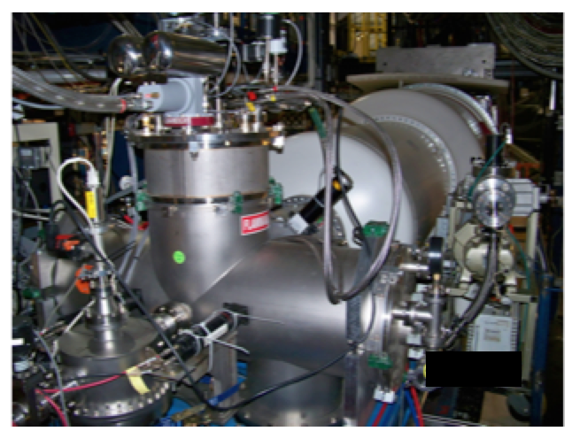

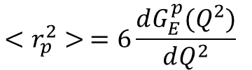
PRad
Proton Charge Radius Experiment @ JLab
Instrumentation
  Novel H₂ gas flow windowless target (funded by NSF MRI)
  HyCal calorimeter refurbished and tested (funded by DOE)
  Integrated high-speed DAQ
Data taking May-June 2016
  Lowest Q² data set in ep
  Simultaneous meas’t of Moller and Mott scattering → control systematic uncertainties
e - beam
Target installed in Hall B beam line
$$<r_{p}^{2}> =6\frac{dG_{E}^{p}(Q^{2})}{dQ^{2}}$$
$Q^{2}=$ 0

Slide 16
PRad
Proton Charge Radius Experiment @ JLab
Instrumentation
  Novel H₂ gas flow windowless target (funded by NSF MRI)
  HyCal calorimeter refurbished and tested (funded by DOE)
  Integrated high-speed DAQ
Data taking May-June 2016
  Lowest Q² data set in ep
  Simultaneous meas’t of Moller and Mott scattering → control systematic uncertainties
e - beam
Target installed in Hall B beam line
$$<r_{p}^{2}> =6\frac{dG_{E}^{p}(Q^{2})}{dQ^{2}}$$
Preliminary G_{E} slope seems to favor smaller radius
$Q^{2}=$ 0

Slide 17
Career Program
Solicitation: 17-537
Must include excellent research proposal as well as excellent educational plan
There are eligibility requirements: e.g., must be assistant professor, untenured
5 year awards, $400,000 minimum
Proposal deadline: July 20, 2018
PECASE nominees are chosen from CAREER winners
Contact program officer for information/advice ahead of time (budget, scope)

Slide 18
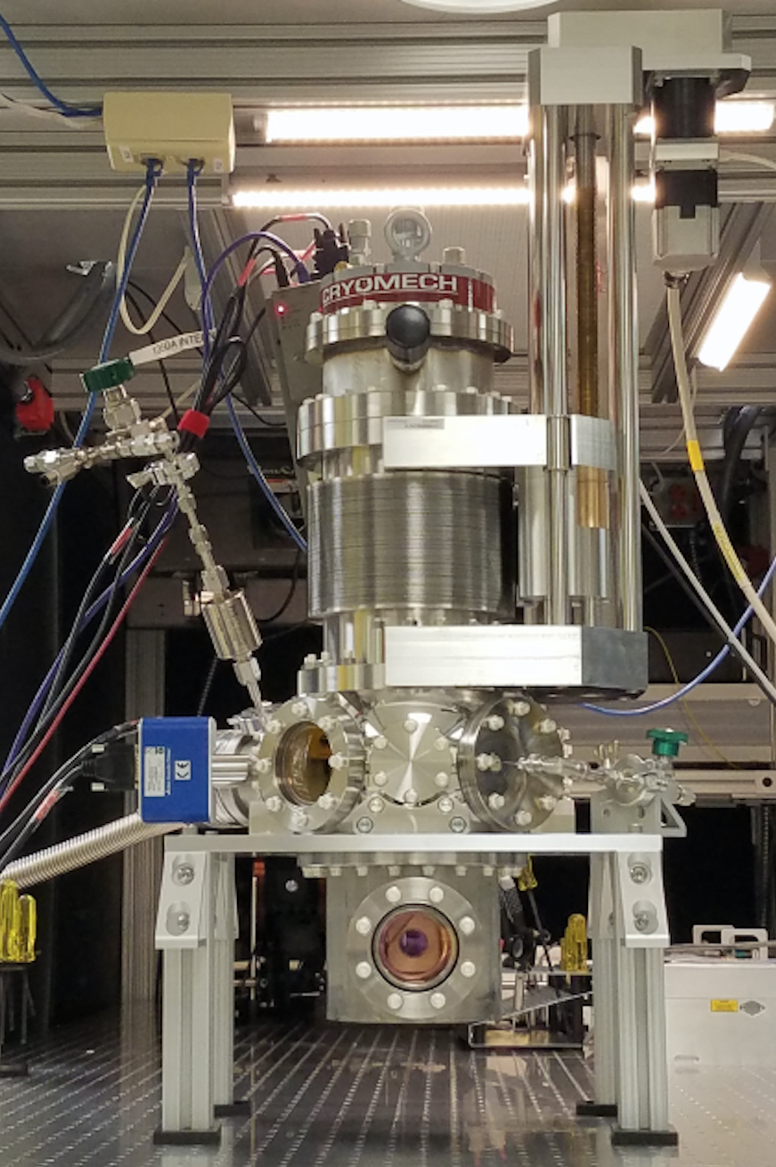
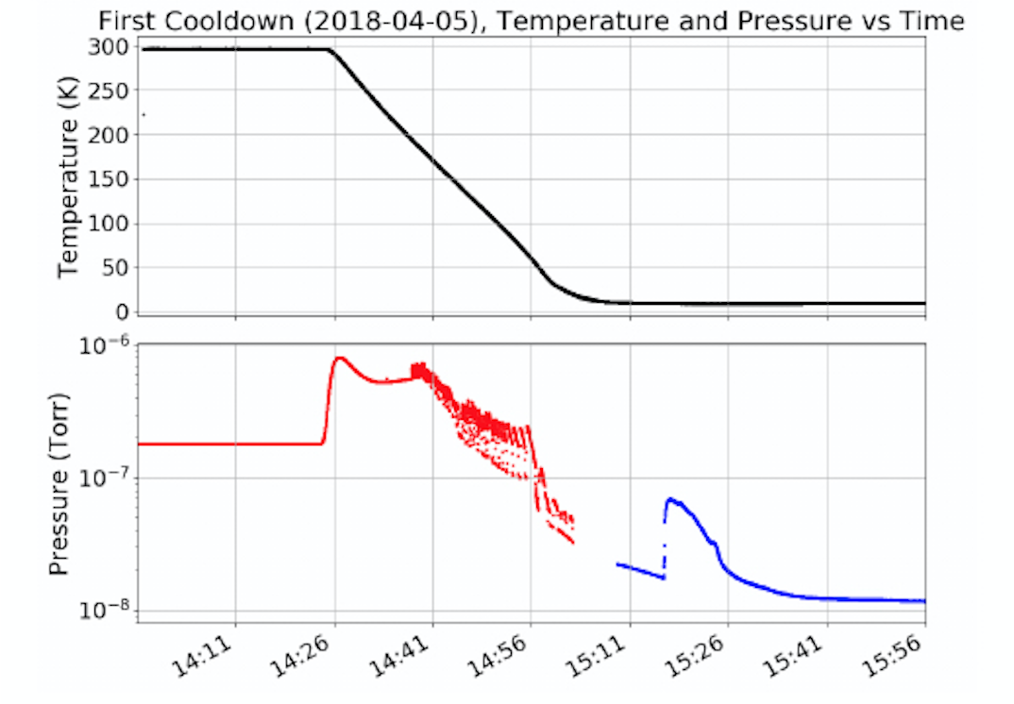

Optical Single Atom Microscope
– Rare Nuclear Reactions in Nuclear Astrophysics & 0νββ
Capture recoil products in noble gas solid
Use resonant laser excitation to optically detect
Goal: detect single atom of Yb in solid Ne
  Detect ²⁶Mg in ²²Ne(α,n) & ²²Ne(α,γ) to understand slow n-capture in massive stars
Cryo-cooler
Linear Shift Mechanism
Successful neon film growth on 1st attempt!
60 cm
Substrate temperature:
< 7 K
Base pressure:
< 10⁻⁸ Torr
63 mm
PI: Jaideep Singh PhD Student: Ben Loseth

Slide 19
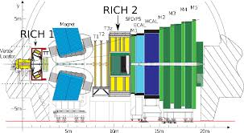
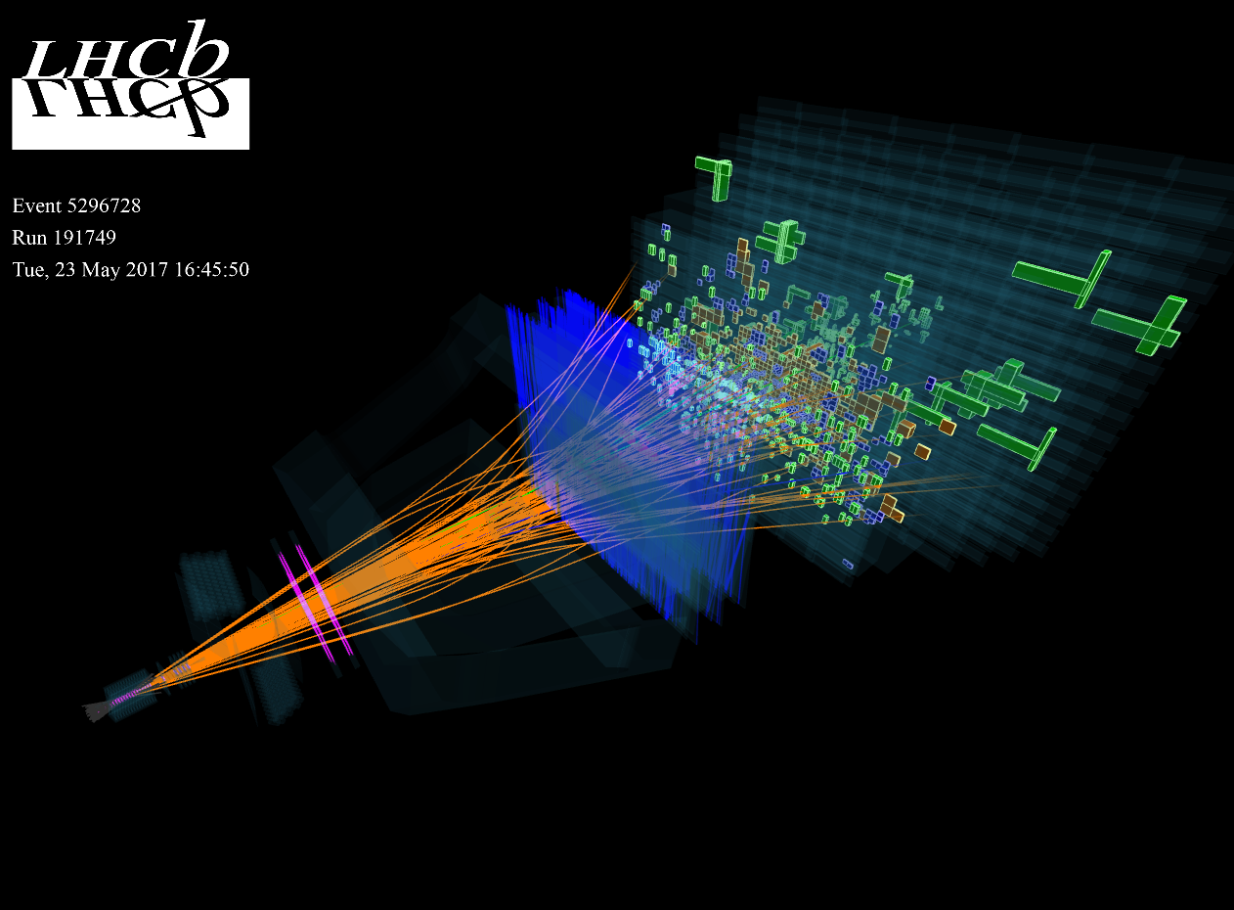

LHCb
– Study Proton Structure and QCD
Far forward acceptance → both high-x and low-x partons in p and Pb beams
Extensive hadron PID + full jet reconstruction → detailed hadronization studies
D-Y p_{T} and ang dist → constrain ┴ mom dependent PDFs
Identified hadron production within reconstructed jets
Contribute to Upstream Tracker silicon upgrade
PI: Christine Aidala
PhD Students: William Dean, Kara Mattioli, Jordan Roth

Slide 20
AGEP GR Supplements
Available to PIs at AGEP or AGEP Legacy Institutions https://www.nsf.gov/mps/broadening_participation/index.jsp
Graduate Student Eligibility
  Emphasis placed on under-represented groups
  Not currently supported by federal government (NSF, DOE, NIH, …)
  US Citizen, US National, or US Permanent Resident
Stipend, tuition, benefits, and IDC (~$60k)
Renewable up to two times
See us and DCL 16-125 for more information

Slide 21
Writing proposals: Mentoring program
GOAL: make the proposal writing expertise of senior researchers available to junior investigators
How does it work?
  The Mentee requests a Mentor (email us at aopper@nsf.gov or ejgarcia@nsf.gov ).
  We will send a list of Mentor Volunteers to Mentee, who contacts Mentors without identifying them to NSF.
  The Mentor will read the Mentee’s proposal and provide feedback once. Send the proposal early – Mentors are busy people!
  NSF accepts no responsibility on the interaction/outcome of the program!
Needed: Mentors!
  email us at aopper@nsf.gov or ejgarcia@nsf.gov

Slide 22
NSF/MPS/Physics Personnel
France Córdova – Director
Anne L Kinney – Assistant Director for MPS
Denise Caldwell – Physics Division Director
Brad Keister – Deputy Division Director; after 21 years of service, will retire from NSF at the end of June. Acting D³ to be named soon.
Bogdan Mihaila – Nuclear Theory Program Director
Edmundo Garcia – Expt’l Nuclear Physics Program Director
Allena Opper – Expt’l Nuclear Physics Program Director
http://www.nsf.gov/pubs/2015/phy15001/phy15001.jsp?org=PHY
http://www.nsf.gov/careers/rotator/index.jsp

Slide 23
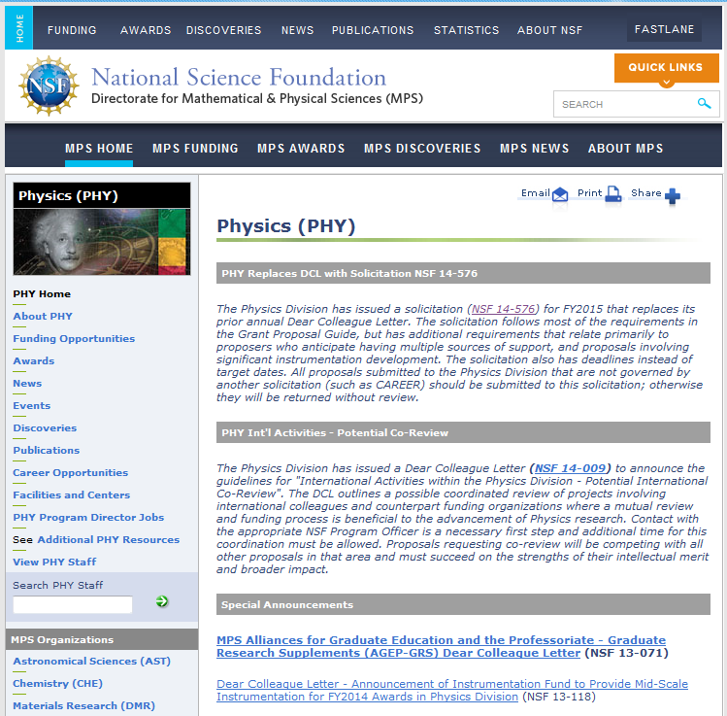
For the latest updates, check out
http://www.nsf.gov/div/index.jsp?div=PHY
Contact us:
bmihaila@nsf.gov
or call (703)292-8235
ejgarcia@nsf.gov
or call (703)292-8095
aopper@nsf.gov
or call (703)292-8958

Slide 24
Backup Slides

Slide 25
Budget Trends – NSF Nuclear Physics
~ 25% = Research
~ 75% = Operations
Includes co-funding and other leveraged funds
FY | Nucleon & Hadron QCD (k$) | Nuclear Astroph, Reactions, Structure (k$) | Prec Meas’ts & Fund. Symm. (k$) | Total Exp’t Nuclear Physics (k$) | Nuclear Theory (k$) | Nuclear Program Total (k$) | NSCL (k$) | JINA & JINA -CEE (k$) | MRI (K$) | Mid- Scale (K$) | Total Nuclear Physics (k$)
2012 | 7,969 | 4,185 | 6,343 | 18,497 | 3,829 | 22,326 | 21,500 | 2,150 | 2,744 |  | 48,720
2013 | 6,183 | 4,693 | 5,653 | 16,509 | 3,474 | 20,008 | 21,500 | 2,150 | 2,996 | 490 | 47,144
2014 | 5,826 | 5,189 | 5,999 | 17,014 | 3,514 | 20,528 | 22,500 | 2,280 | 1,038 | 1,188 | 47,533
2015 | 6,769 | 4,702 | 7,304 | 18,774 | 4,183 | 22,957 | 23,000 | 2,280 | 1,801 | 1,367 | 51,406
2016 | 7,141 | 5,046 | 7,391 | 19,579 | 4,223 | 23,802 | 24,000 | 2,280 | 1,869 | 3,238 | 55,189
2017 | 6,955 | 6,273 | 6,692 | 19,920 base = 17,800 | 4,344 | 24,264 | 24,000 | 2,280 | 530 | 2,990 | 54,064
FY15 Fundamental Symmetries: + $1.32M for 0νββ
MRI: competes each year; one-time acquisition/development funds
Mid-scale: ad hoc competition; design and construction funds (nEDM & MUSE)

Slide 26
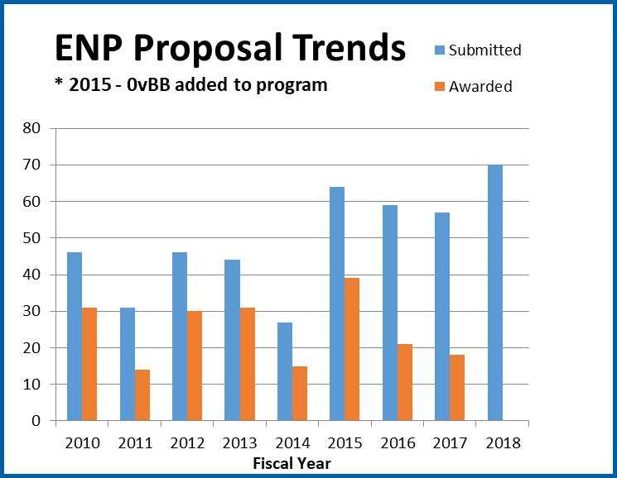
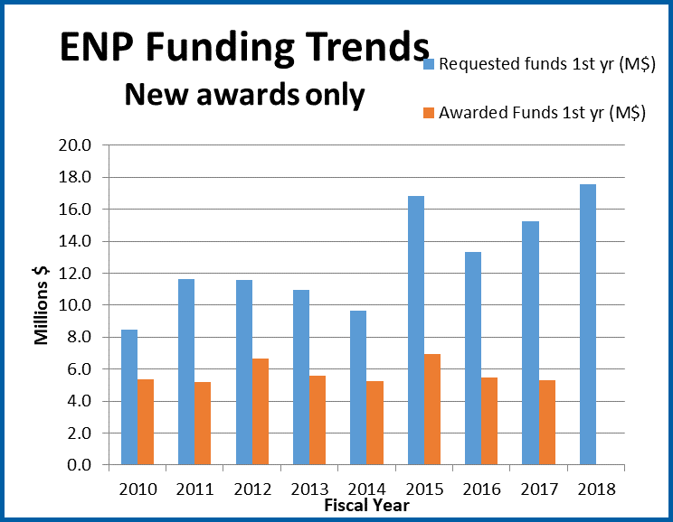
Experimental Nuclear Physics

