Slide 1
Rajesh Sangem
IIT Bombay, India
JSA/HUGS Fellowship Seminar-2016

Slide 2
Outline
Gluon TMDs
Quarkonium Models
Conclusion

Slide 3
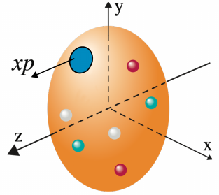
Parton Distribution Functions (PDFs)
Collinear pdf
Universality
ANL
√s=4.9 GeV
BNL
√s=6.6 GeV
FNAL
√s=19.4 GeV
RHIC
√s=62.4 GeV
1D
Figure by C. Aidala
In 1990, D. Sivers proposed that SSA can be explained by considering
correlation between transverse momentum of parton and polarization of
hadron.

Slide 4
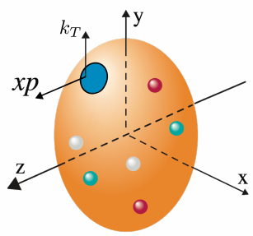
Transverse Momentum Dependent (TMD) Distributions
1D
3D
Collinear pdf
TMD pdf
Universality
Non-trivial Universality

Slide 5
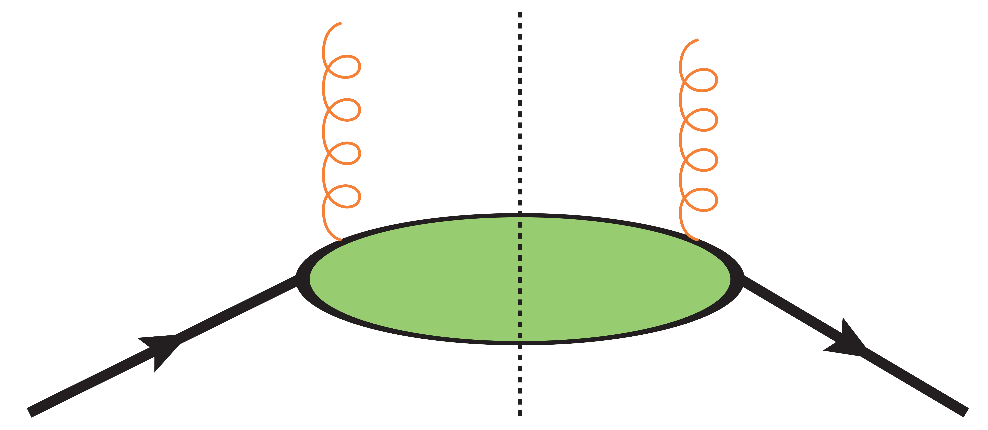
Gluon Correlator
P. J. Mulders and J. Rodrigues PRD 63 094021(2001)
Parameterization of gluon correlator at “Leading Twist ” is
Unpolarized gluon TMD
Linearly polarized gluon TMD

Slide 6
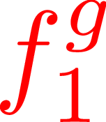
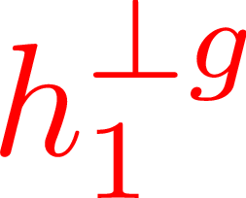
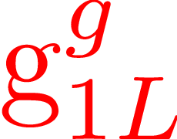
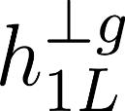
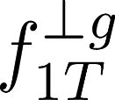
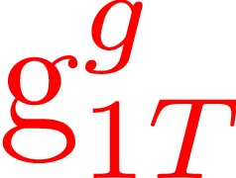
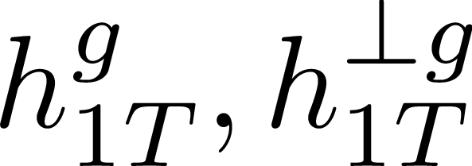
Leading Twist Gluon TMDs
Gluons Target | Unpolarized | Circularly | Linearly
Unpolarized
Longitudinal
Transverse
Boer-Mulders
Kotzinian-Mulders
Pretzelosity
Sivers
D. Boer et al arXive 1507.05267

Slide 7
Linearly Polarized Gluons
No experimental investigation has been carried out to extract the until now .
Theoretical upper bound
In proton-proton collision
D. Boer et al. PRL 106 132001 (2011)
Qiu, Schlegel, Vogelsang, PRL 107, 062001 (2011)
Dunnen, Lansberg, Pisano, Schlegel, PRL 112, 212001 (2014)
D. Boer et al. PRL 108, 032002 (2012)
D. Boer, C. Pisano, PRD 86, 094007 (2012)
In electron-proton scattering
C. Pisano et al. JHEP 10 (2013) 024

Slide 8
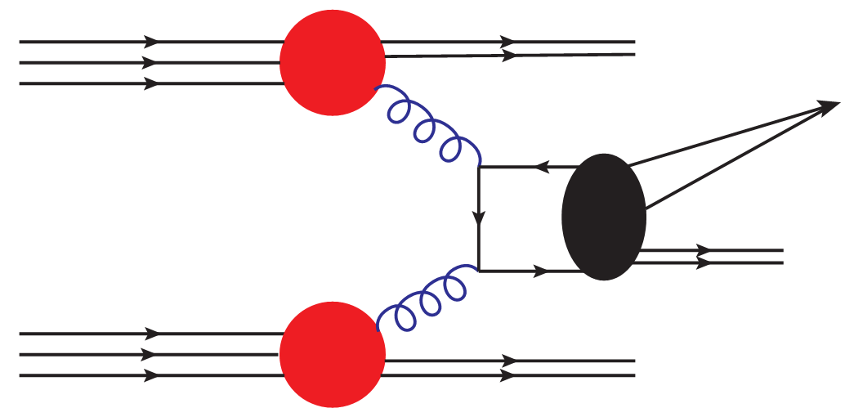
Quarkonium Models
PDF
X
P
Non
pert
X
PDF
X
P
Color Singlet Model (CSM)
Color Octet Model (COM)
Color Evaporation Model (CEM)

Slide 9
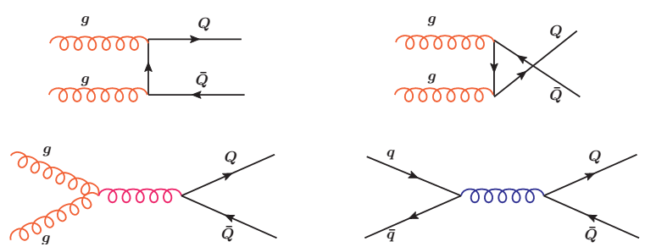
The cross section for Quarkonium production in CEM is

Slide 10
Using QCD factorization theorem
Convolution of TMDs is
Model Independent property
Linearly polarized gluons do not affect the -integrated cross section
At least two nodes in

Slide 11
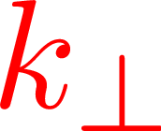
TMDs Parameterization
TMDs exhibit Gaussian distribution
Evolution in collinear PDFs
No Evolution in
DGLAP Evolution
D. Boer, C. Pisano, PRD 86, 094007 (2012)

Slide 12
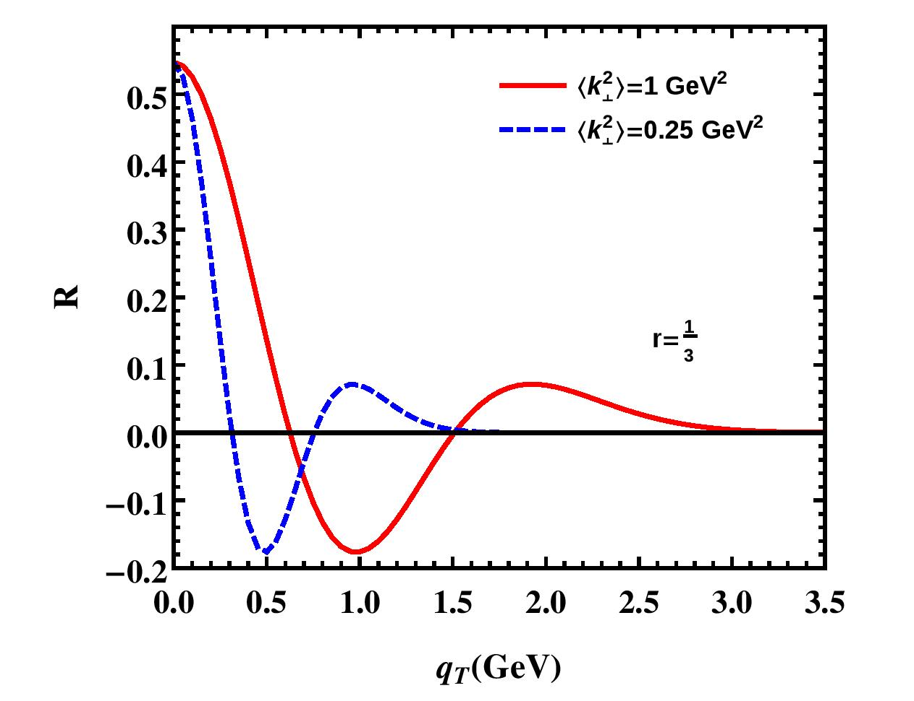
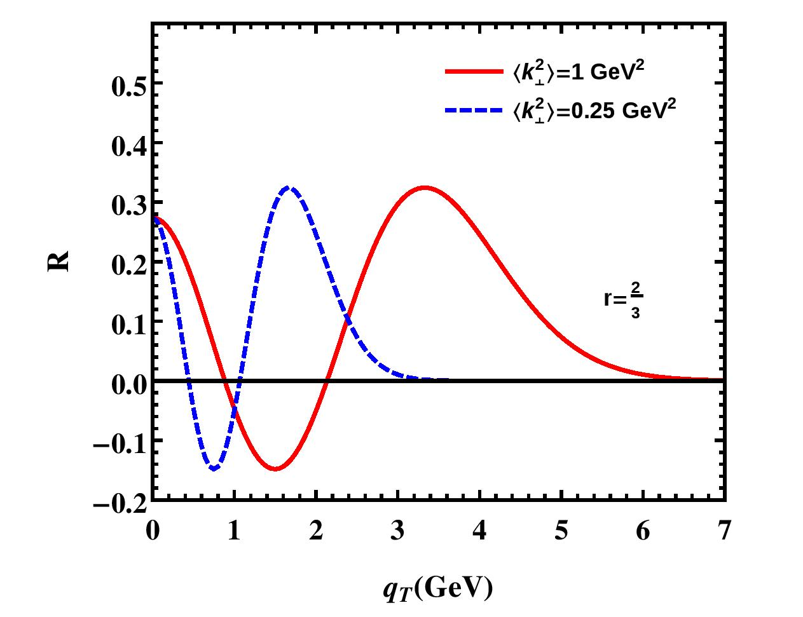
Define

Slide 13
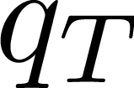
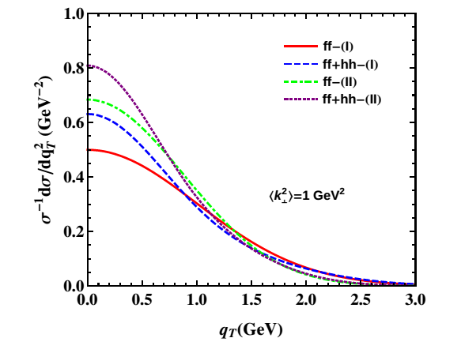
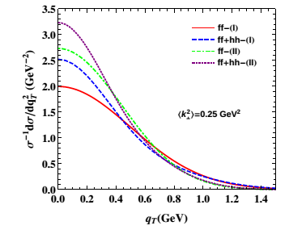
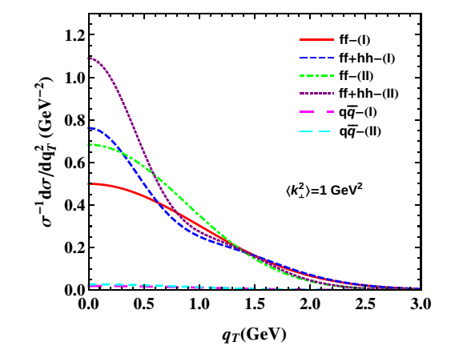
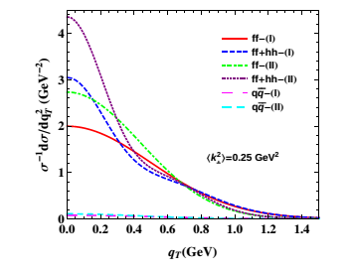
Spectrum in DGLAP Evolution
SR Asmita PRD 93 054018 (2016)

Slide 14
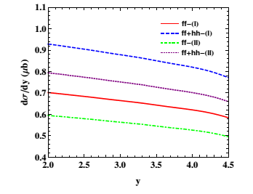
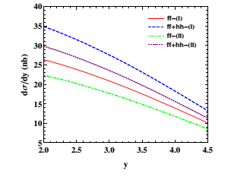
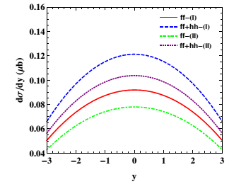
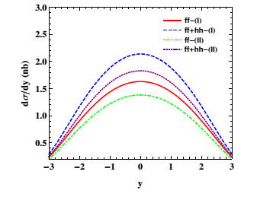
Rapidity Spectrum in DGLAP Evolution
SR Asmita PRD 93 054018 (2016)

Slide 15
TMD Evolution
In Collins-Soper-Sterman (CSS) Evolution formalism, TMD pdfs depends on
Collins-Soper equation and RGE for TMD
No integral as in DGLAP
J. Collins, Foundations of Perturbative QCD, 2011 S. M. Aybat et al. PRD 85 034043 (2012)

Slide 16
TMD Evolution
CSS TMD Evolution
J. Collins, Foundations of Perturbative QCD, 2011
S. M. Ayabt et al. PRD 83 114042 (2011)
,
,

Slide 17
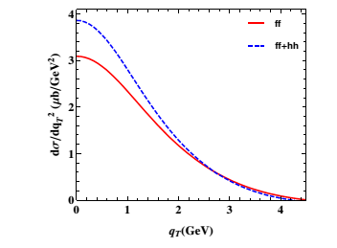
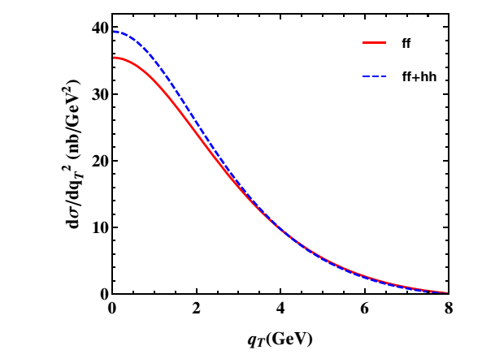
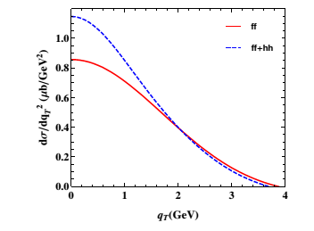
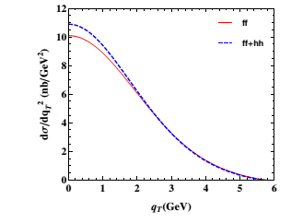
Spectrum in TMD Evolution

Slide 18
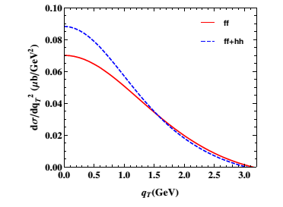
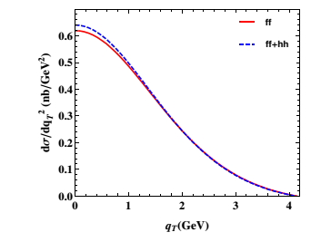
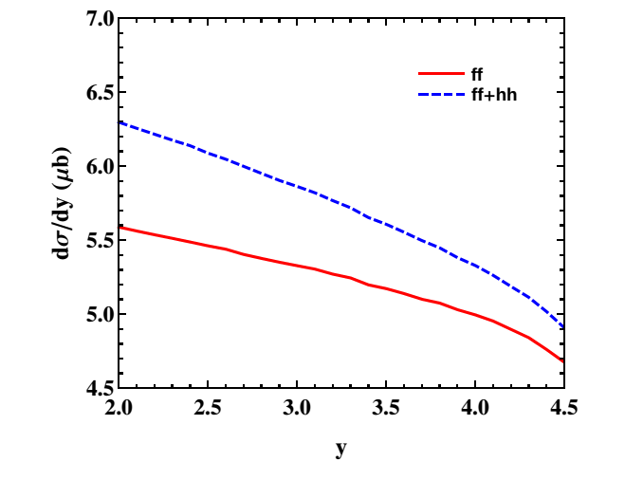
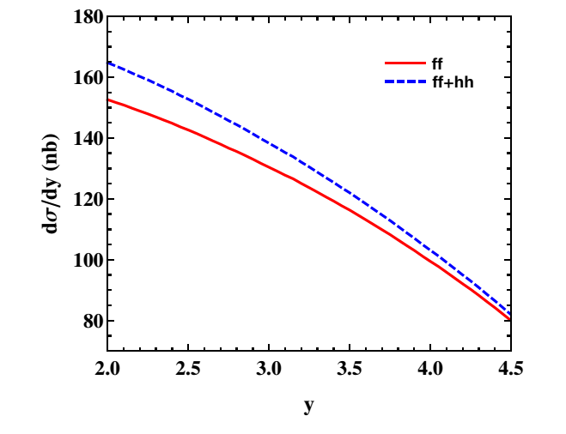
Results in TMD Evolution

Slide 19
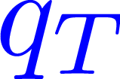
Conclusion
The and distributions of quarkonium can been modulated by the
presence of linearly polarized gluons in unpolarized proton proton collision.
Hence, the production of quarkonium is a promising process to probe the
No angular analysis is needed to probe linearly polarized gluons

Slide 20
Comments & Suggestions
Thank You

Slide 21
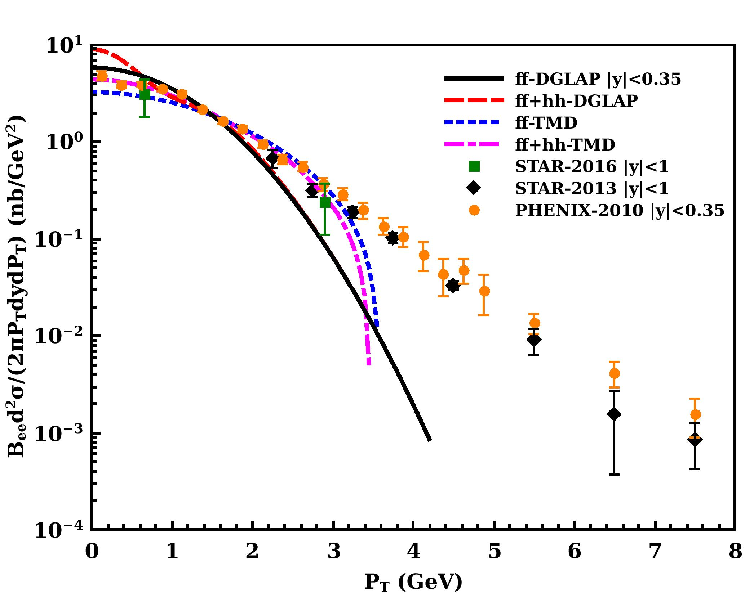
Matching with Experimental data

Slide 22
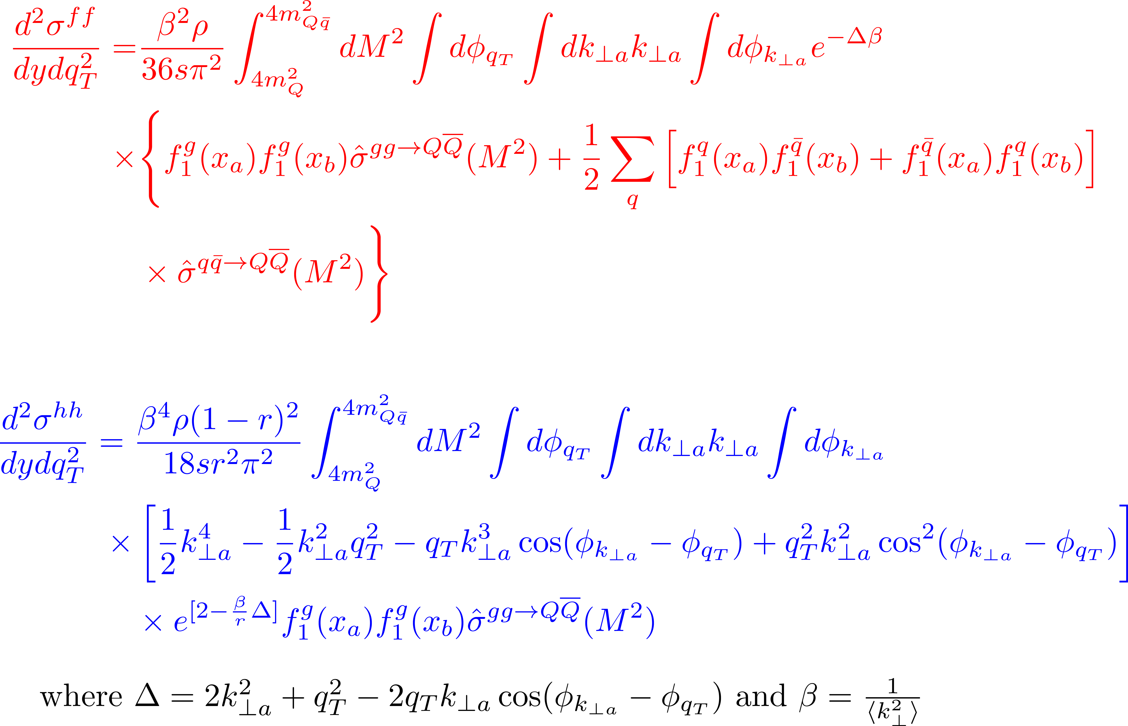
Differential Cross Section in DGLAP approach

Slide 23
Differential Cross Section in TMD Evolution approach

Slide 24
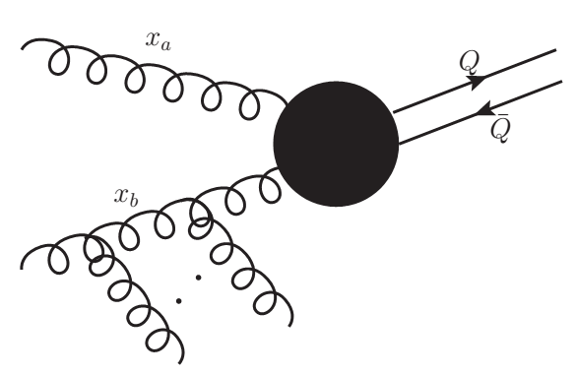
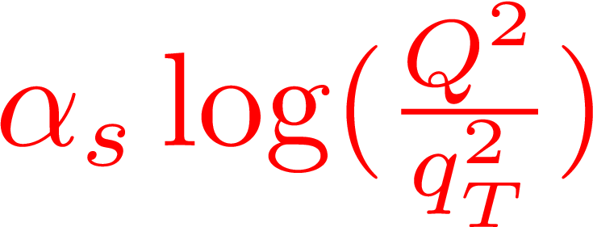
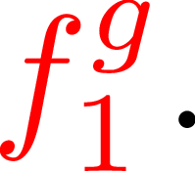
Resummation of Sudakov logarithms
The region of low is strongly influenced
by initial state gluon radiation showers
These additional gluon radiation from initial state partons leads to
logarithmic corrections for each gluon radiation of the form
Collins Soper Sterman (CSS) Evolution formalism has been
used to resum the large logarithmic terms to all order in

Slide 25
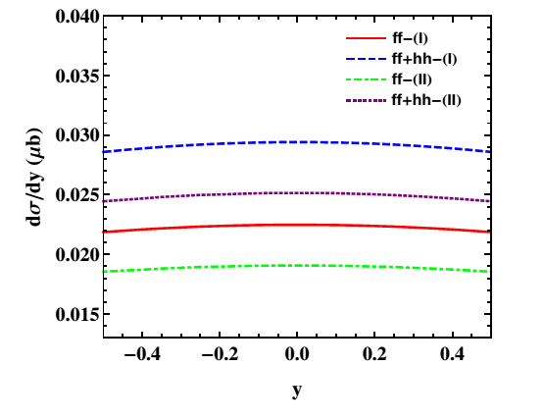
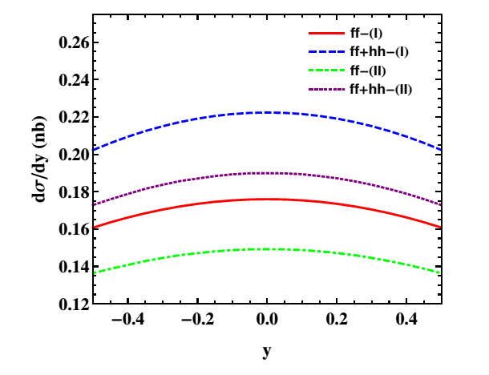
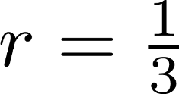
Backup Rapidity Spectrum in DGLAP Evolution

Slide 26
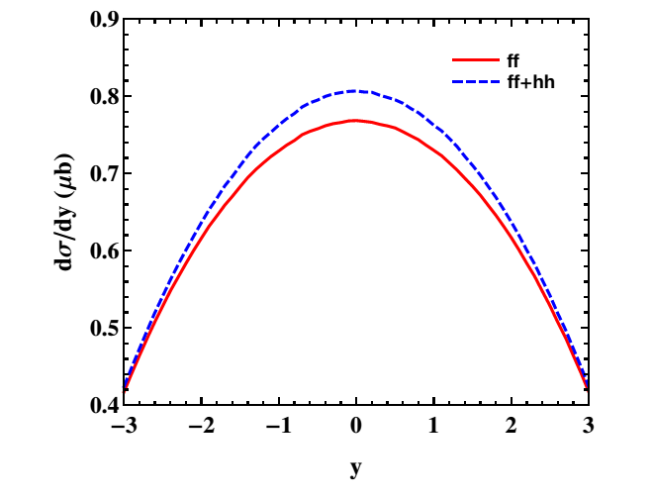
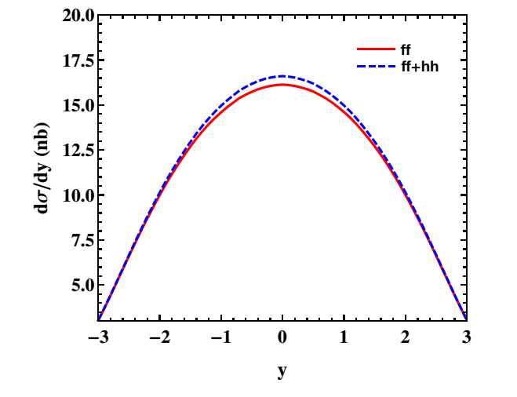
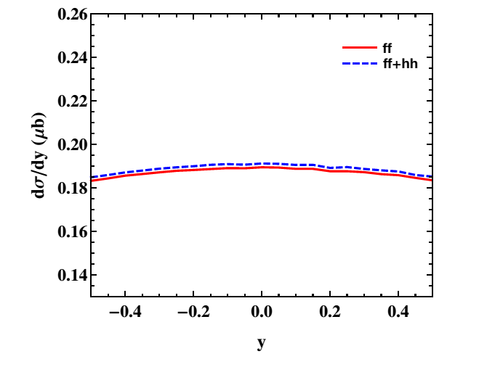
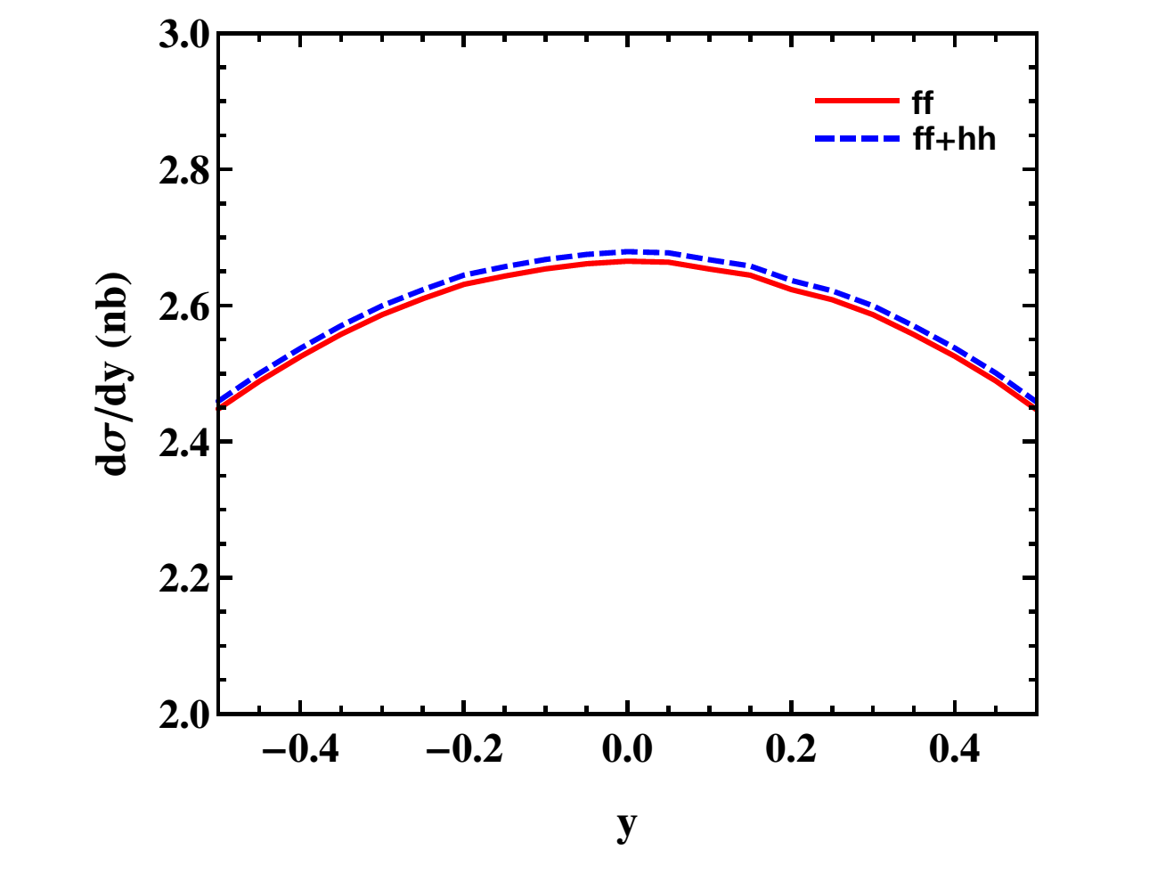
Backup Rapidity Spectrum in TMD Evolution

Slide 27
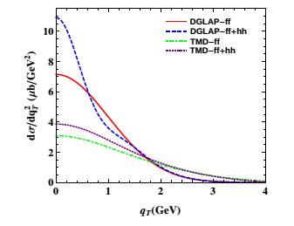
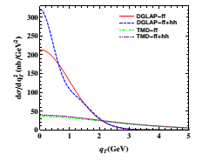
Backup DGLAP and TMD Comparison

