Slide 1
Jefferson Lab Status
Hugh Montgomery
January 10, 2011

Slide 2
Outline
Strategic Planning Budget Remarks TEDF Project 12 GeV Project Status FEL/Photon Science EIC Summary

Slide 3
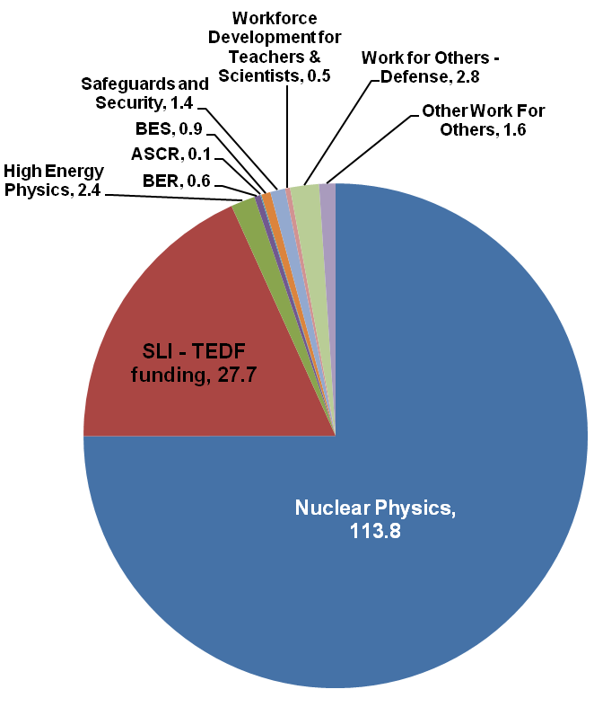
Jefferson Lab At-A-Glance
Created to build and Operate the Continuous Electron Beam Accelerator Facility (CEBAF), world-unique user facility for Nuclear Physics Mission is to gain a deeper understanding of the structure of matter Through advances in fundamental research in nuclear physics Through advances in photon science and related research In operation since 1995 1,289 Active Users (World’s largest Nuclear Physics User Community) 168 Completed (and 12 Partially Completed) Experiments (end of CY10); 10 remaining to run in 6 GeV program Produces ~1/3 of US PhDs in Nuclear Physics (351 PhDs granted, 207 more in progress) (end of CY10) Managed for DOE by Jefferson Science Associates, LLC (JSA) Human Capital: 781 FTEs (as of 9/30/10) 18 Joint faculty, 19 Post docs, 30 Undergraduate; 47 Graduate students 1,289 Users (end of CY10) 1,110 Visiting Scientists K-12 Science Education program serves as national model Site is 169 Acres, and includes: 63 Buildings; 685K SF in DOE Buildings Replacement Plant Value: $318M
FY2010
Total Lab Operating Budget: $99.7M
Total Lab Construction Budget: $47.7M Non-DOE Budget: $4.4M

Slide 4
Vision, Mission, Strategy
Vision
To be the provider of choice for world-class science and facilities in support of the DOE Office of Science’s mission. To enable breakthroughs that ensure our nation’s future
Mission
Advance fundamental research in nuclear physics to gain a deeper understanding of the structure of matter
Advance photon science and related research into the nature of materials.
Strategy
Develop the key technology and position Jefferson Lab’s user facilities for continued leadership roles
SRF
Technology
JLAMP and
4th GLS
Major Laboratory Initiatives
12 GeV Upgrade Project
Exp. Nuclear
Physics Program
ELectron Ion
Collider
Nuclear Physics
Accelerator Science
Core Capability Groupings
Applied Nuclear Science & Tech
Large Scale User Fac./Adv. Instr.
Photon Science

Slide 5
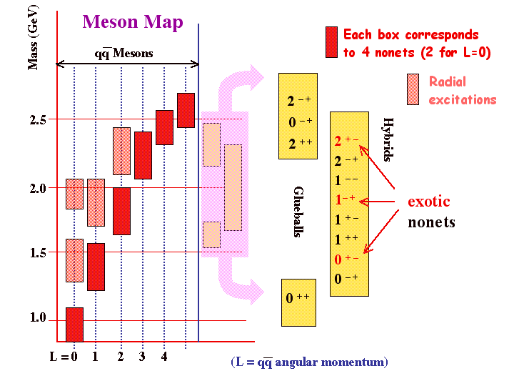
Science Strategy for the Future
Science in the 21st Century
Physics, Chemistry, Biology – major progress based on: Advanced accelerator facilities Operation as international user facilities Nuclear Physics: Execute the 12 GeV Upgrade Project Highly recommended by NSAC Experimental Nuclear Physics Program, 6 GeV, 12 GeV Nuclear physics into 2020s Develop Electron Ion Collider, extend beyond CEBAF scope Photon Science: 4th Generation Light Sources: JLAMP facility User driven photon science, accelerator R&D Program Development and participation in future light sources

Slide 6
Jefferson Lab Strategic Plan
E-mail to Division Leaders, Senior Management on December 22, 2010
Dear All,
As you know, each year we develop a plan, which is officially called the Department of Energy Laboratory Plan – TJNAF, for submission and presentation to the DOE Office of Science. This we expect to do again in FY2011 and we will soon receive the adjustments which are desired for this year’s process. A year ago, in developing that plan, we laid out for the Laboratory community, the sense of the different programs or components of programs. This consisted of a series of presentations in the CEBAF center auditorium.
This year, we have ambitions to go further in an exercise, which, in its initial edition, will be independent of the Office of Science process.

Slide 7
Jefferson Lab Strategic Plan
I have asked Bob McKeown to lead the development of the Jefferson Lab Strategic Plan. The goal is to produce a concise document, perhaps not more than 20 pages, which would start with a vision statement and a set of goals for the laboratory as a whole and would then delve deeper into what we do, developing visions, goals, and outcomes at multiple levels. The intent is that we engage our owners, both the science and operations components of the lab, the laboratory leadership more broadly, the staff, and the user community, essentially all of our stakeholders, in the process.
While for the lab as a whole, we imagine a vision which is robust against the winds of fortune, one can also imagine that what we do becomes something that could be readily updated on an annual basis. We look forward to your participation in the development of the plan.

Slide 8
Funding FY09, FY10, FY11
Funding | FY09 Approp | FY10 Approp | FY11 Pres. Budg. | Summary Comments
ME Research | 6,150 | 6,200 | 6,265
Theory Research | 3,400 | 3,599 | 4,150
Accel Ops | 47,120 | 47,140 | 49,328
Accel Capital Equipment | 130 | 200 | 200
SRF R&D | 1,635 | 1,365 | 1,400
Accel AIP | 950 | 1,050 | 1,050
Exp Sup Ops | 24,559 | 25,567 | 24,800
Exp Support Capital Equipment | 4,500 | 5,200 | 4,700
GPP | 1,800 | 2,000 | 2,000
Subtotal NP Base | 90,244 | 92,321 | 93,893
12 GeV | 28,623 | 20,000 | 36,000
Subtotal NP Base & 12 GeV | 118,867 | 112,321 | 129,893
National LQCD Ops & CE | 380 | 223 | 231
SciDAC | 371 | 299 | 309
Total NP | 119,618 | 112,843 | 130,433
Favorable President’s Budget Request
$1.8M up from FY10, but less than cost of living
$2M pressure
Receiving supplemental funding to enable g2p/gep

Slide 9
FY11 Budget and Consequences
Continuing Resolution in force for FY11
“6 month” CR (was favorable)
Started running as planned
Anticipate running at least through end of March
Will seek to complete running through mid-May if possible (decide by March 1)
12 GeV Project has ridden 4 months OK
“12 month” CR, ( or worse ???)
We are uncertain about conditions of CR
Will need to contemplate curtailing running
May need major reduction in 12 GeV Project work, major delay
But ONP has been very supportive
12 GeV Project is very high priority in the department
The value of the 6 GeV Program is recognized
We have no guidance yet on FY12

Slide 10
Strategy To Modernize JLab
Facilities: Resolve critical shortage and poor quality of space by constructing 278,000 sq ft and refurbishing 280,000 sq ft of work space; addressing safety and building code issues by updating outdated building systems; reducing deferred maintenance; and increasing energy efficiency.
Technology Engineering Development Facility (TEDF) (SLI) provides 38% of new and 31% of refurbished space (CD-3A approved 3/26/10)
CEBAF Center Expansion and Rehab (SLI 2016) ~ 34% of new space
Lab’s $32M GPP investment provides ~28% of new space.
Utilities: Replace/upgrade 20-40 year old site utilities to meet SC mission requirements by increasing cryogenics capability; increasing capacity and adding redundancy to the power distribution system; increasing cooling water capacity to meet mission requirements and replacing site cooling towers.
Utility Infrastructure Modernization Project (SLI 2011)
Communications: Upgrade 1960s subsurface communications systems with 627 miles of fiber optic cable and 42 miles of building computer cable (SLI 2011).

Slide 11
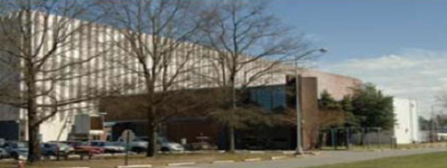
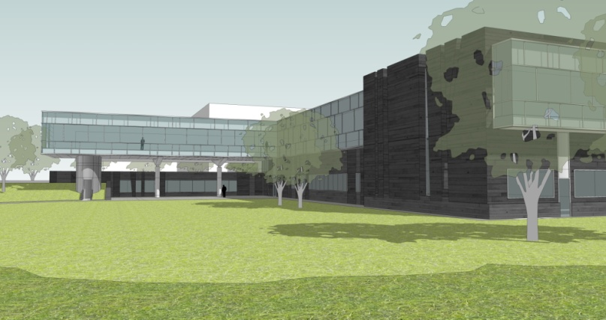
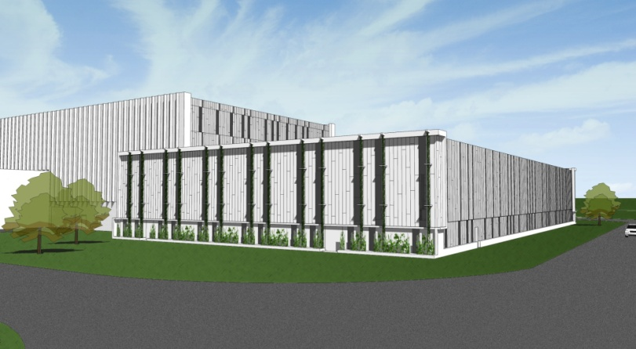
Technology and Engineering Development Facility
Addition to Test Lab for SRF
TED Bldg for Engineering & Shops
Rehab Test Lab
Eliminate Unsuitable Space
Test Lab Rehab
TED Building
SRF Addition

Slide 12
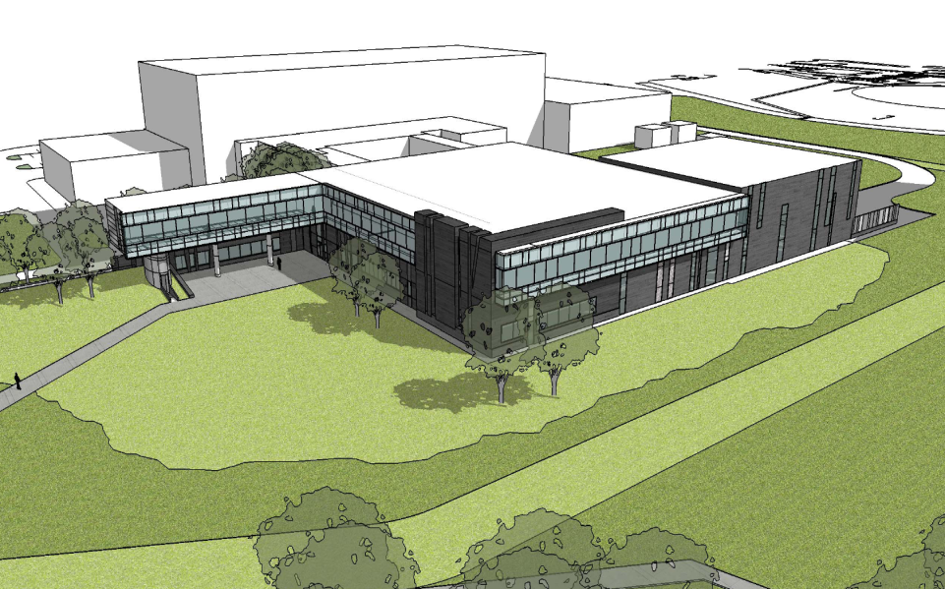
TEDF+ Project Status
Status
Project Construction Phase is underway
Schedule
CD-1 Sep 08 (complete)
CD-2 Jul 09 (done)
CD-3 A
2nd Qtr FY 2010 (done)
CD-3 B
4th Qtr FY 2010 (done)
CD-4
New construction 4th Qtr FY 2012
Rehab 4th Qtr FY 2014
General Plant Project ARRA Funding from Office of Nuclear Physics
Important ancillary work on buildings such as End Station Refrig. Buiilding

Slide 13
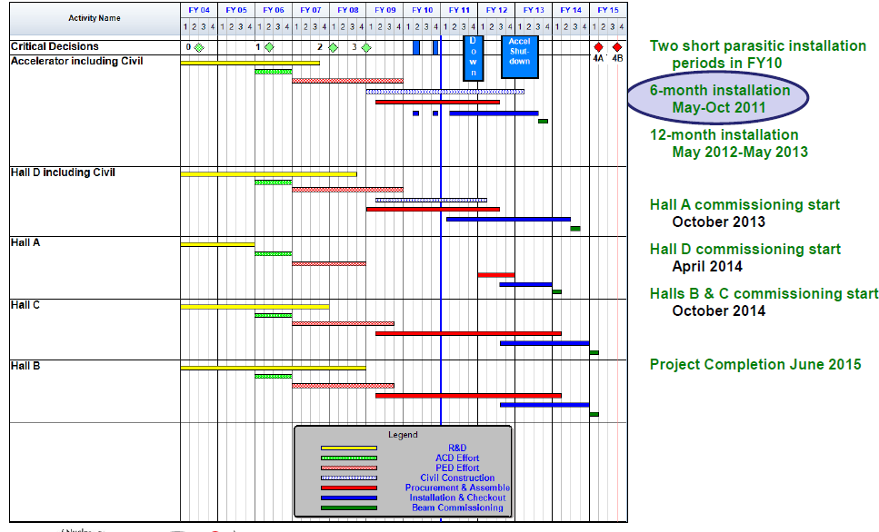
12 GeV Upgrade Schedule
Start of Commissioning:
Hall A October 2013
Hall D April 2014
Halls B and C October 2014

Slide 14
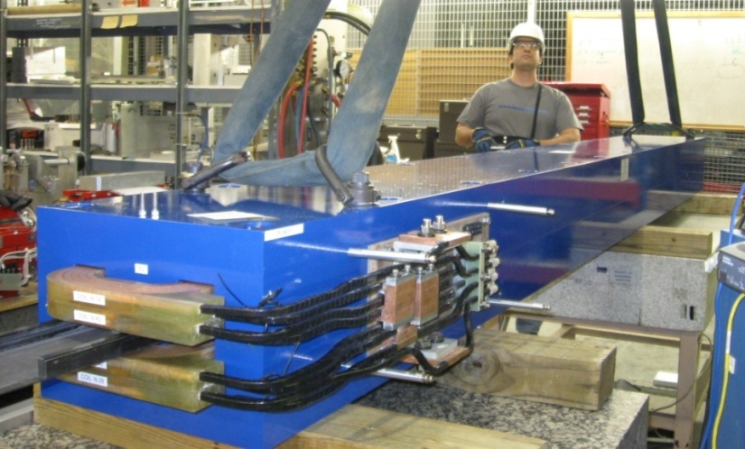
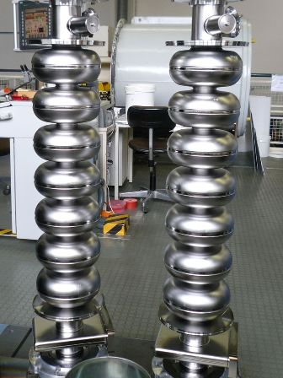
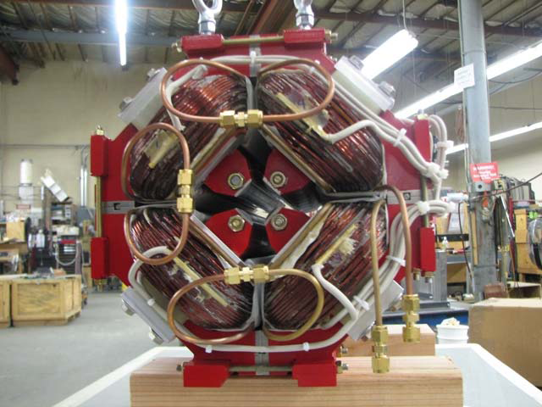
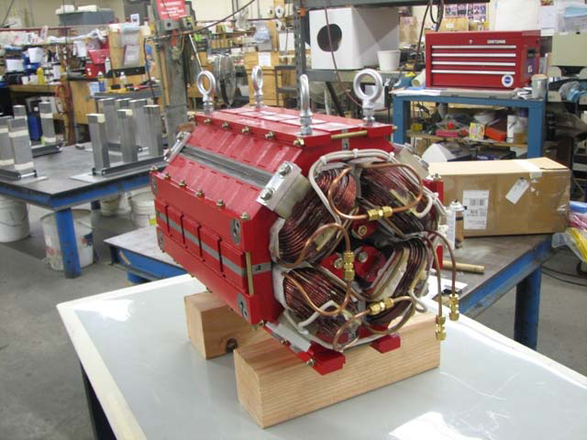
ACCELERATOR CONSTRUCTION
Major Procurements (> $500K) nearly complete:
cryomodule cavities
beam transport magnets
cryogenics coldbox
vacuum valves
cold tuner
etc. etc. etc.
Cryomodule Cavities
(12 of 80 ordered on site)
4-meter Dipole Magnets
(23 of 37 ordered on site)
Beam Transport
Quadrupole Magnets
(114 - total order - on site)

Slide 15
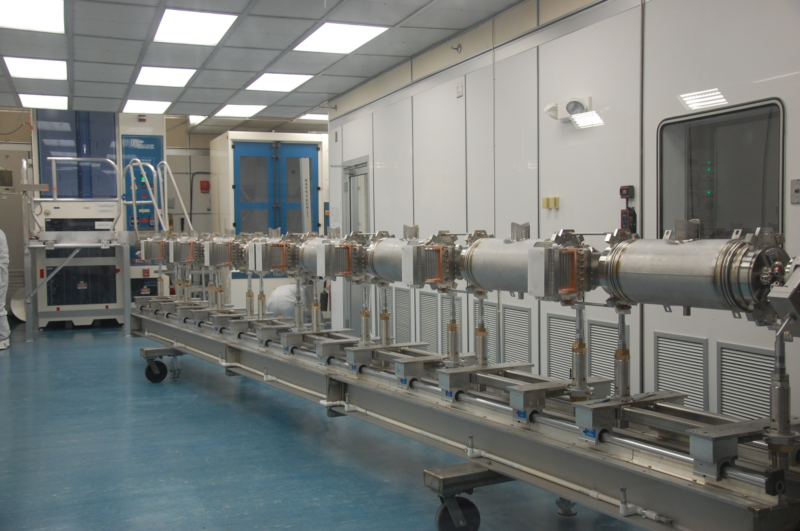
12 GeV Upgrade – Cryomodule Cavity String
January 4, 2011

Slide 16
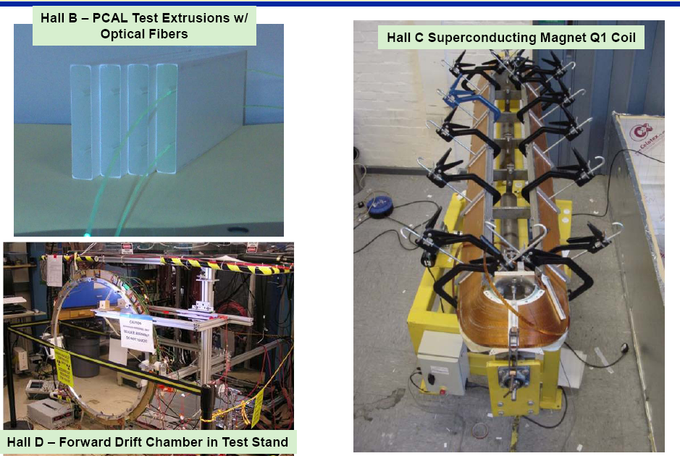
Physics Equipment Construction

Slide 17
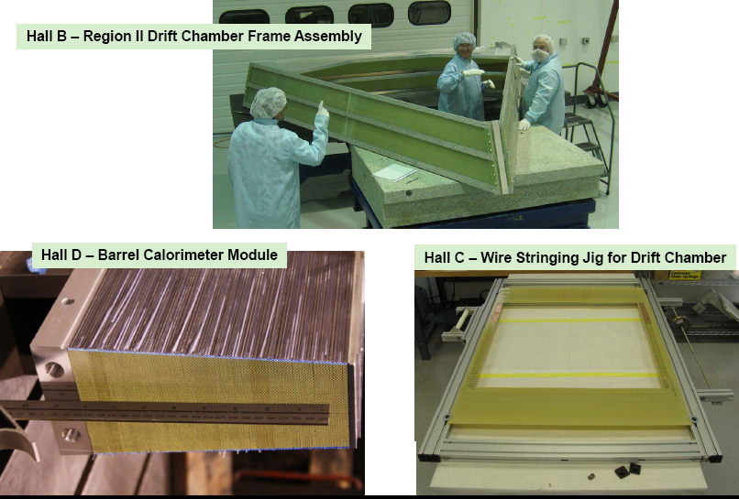
Physics Equipment Construction

Slide 18
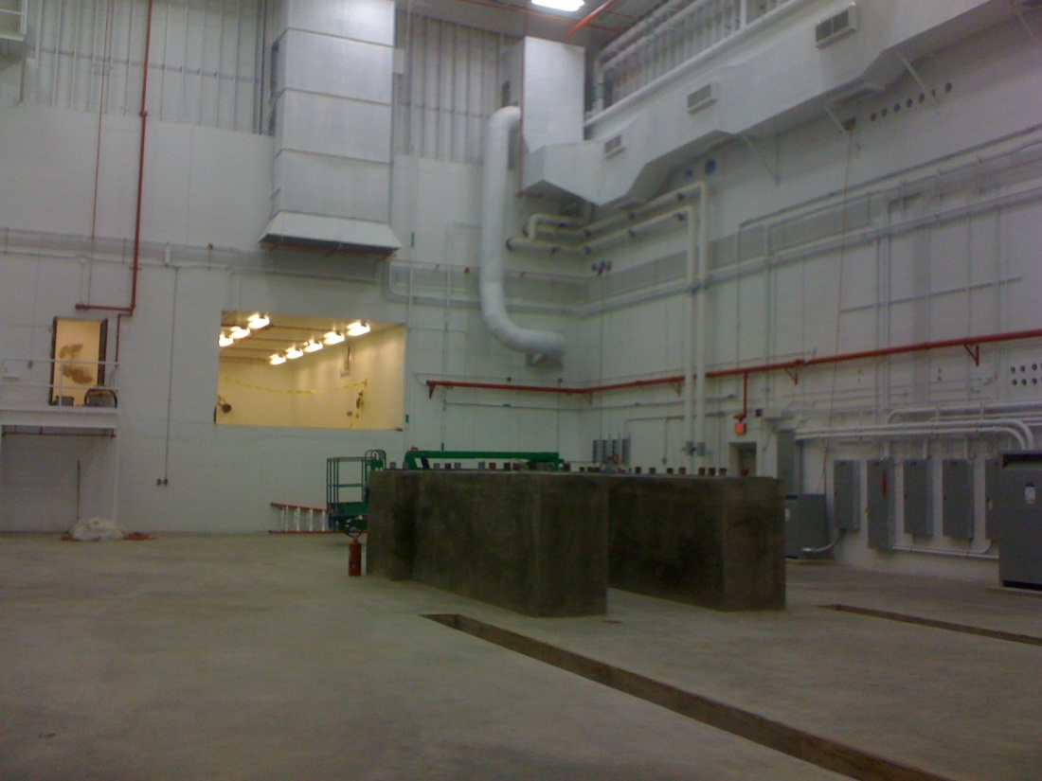
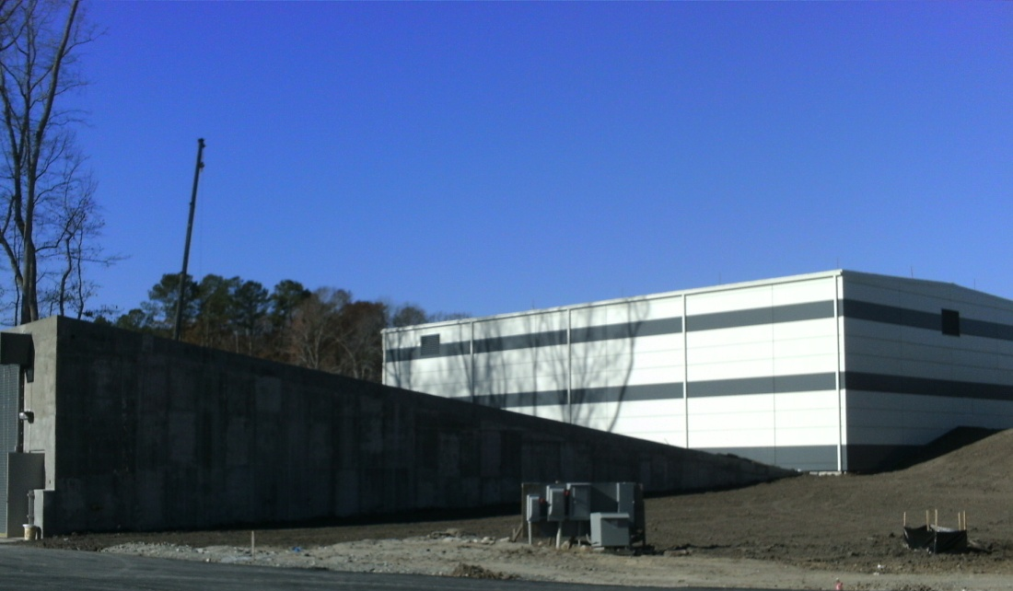
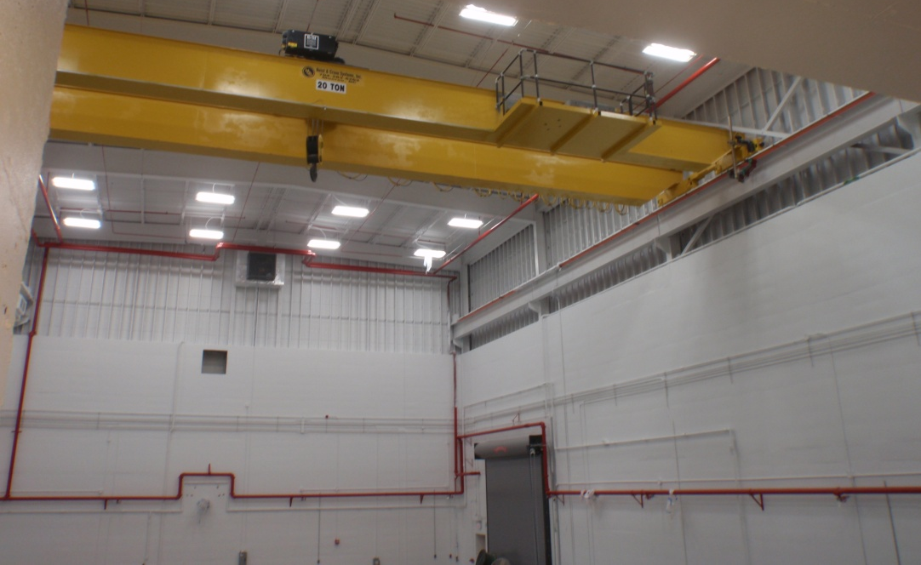
Hall D Status – Dec. 2010
Ready For Equipment (RFE)
Dec. 28, 2010

Slide 19
Upgrade Project Comments
12 GeV Project Status
Funding was $145M through FY10 and has risen with CR Financial Plan transfers (not full 2011)
Performance measures continue to be good
Staffing continues to grow appropriately, currently 140-150 FTE.

Slide 20
12 GeV Project Comments
A Fall Lehman review was held which was critical of the Hall D Solenoid progress and of the SVT plans.
Following strengthening of the Hall D Solenoid team, considerable progress was made, one coil was successfully tested at 85% full current (sufficient for physics) before the holidays.
Design work on “backup” magnet enabled by new engineer hire.
A December Lehman mini-review gave us a clean bill of health.
Separate discussions with ONP about our contingency deployment plan were very positive.
The current plan calls for (if all goes well, only) a mini review in May 2011.
Next Full review in September 2011.
Hall D Ready For Equipment – December 28, 2010
On track for six-month 12 GeV Upgrade installation starting May 2011 including tunnel stub connection to Hall D

Slide 21
Existing JLab IR/UV Light Source
E = 135 MeV present limit
Up to135 pC pulses @ 75 MHz
20 μJ/pulse in (250)–700 nm UV-VIS
120 μJ/pulse in 1-10 μm IR
1 μJ/pulse in THz
The first high current ERL
14 kW average power
Ultra-fast (150 fs)
Ultra-bright

Slide 22
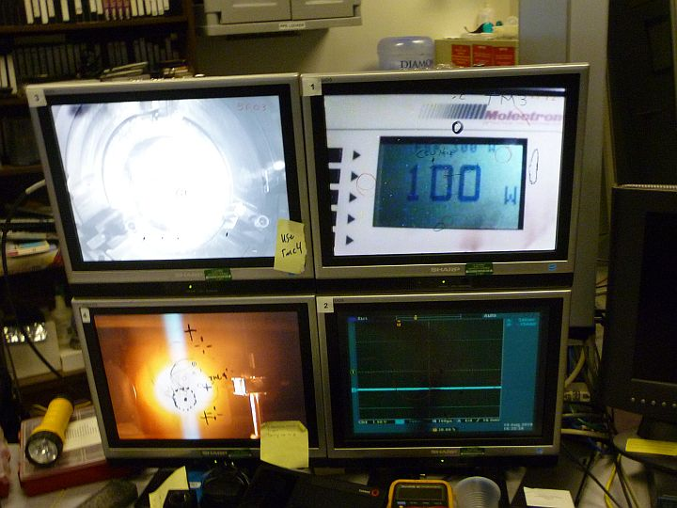
Images while lasing at 100W
Light scattered from HR mirror
Power meter
Light scattered from power probe
Time dependent diagnostics

Slide 23
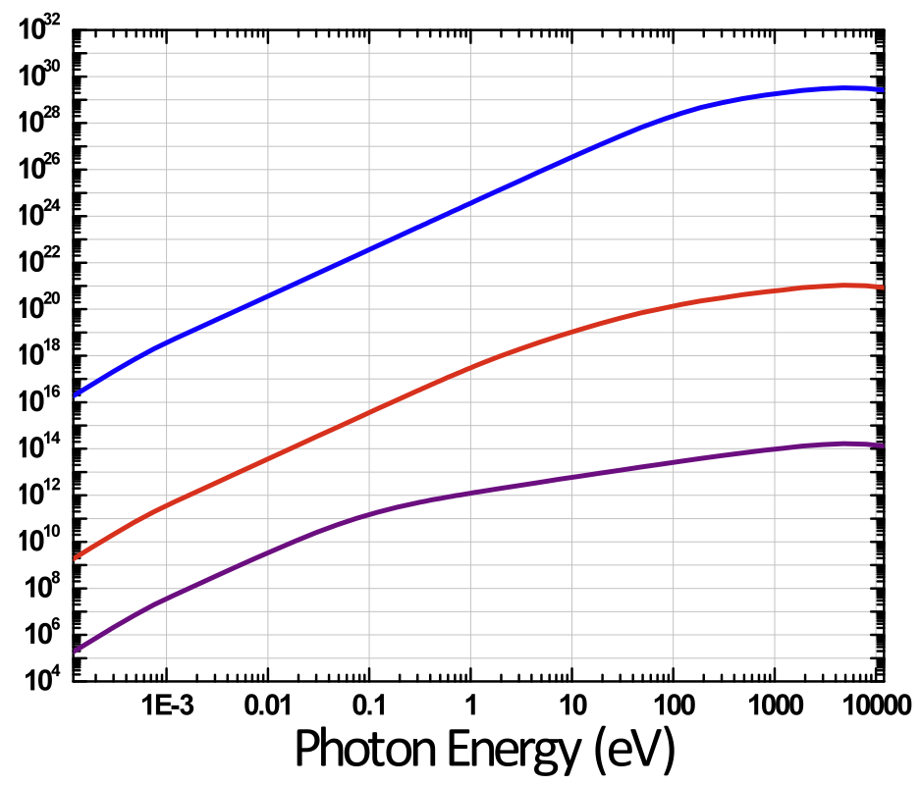
JLab FEL VUV Opportunities
JLab FEL
potential
upgrade path
JLab FEL
Average Brightness
(photons/sec/mm2/mrad2)
harmonics
JLab THz
VUV Ops Target
Work function of metals
Table-top laser limit
Photon Energy (eV)

Slide 24
A Vision for Photon Science at Jefferson Lab
Ultraviolet Laser
(10 eV)
Today
Soft X-ray Laser
(500 eV)
5 years
“Next Generation
Light Source”
(2000 eV X-rays)
10 years

Slide 25
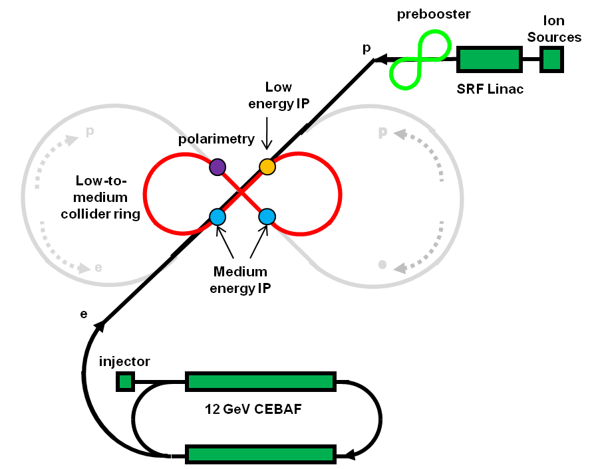
MEIC : Medium Energy EIC
medium-energy IPs
polarimetry
low-energy IP
Three compact rings:
3 to 11 GeV electron
Up to 12 GeV/c proton (warm)
Up to 60 GeV/c proton (cold)
Note: conservative assumptions
6T dipole fields
Synch. Power < 20 kW/m
β_{max} < 2.5 km

Slide 26
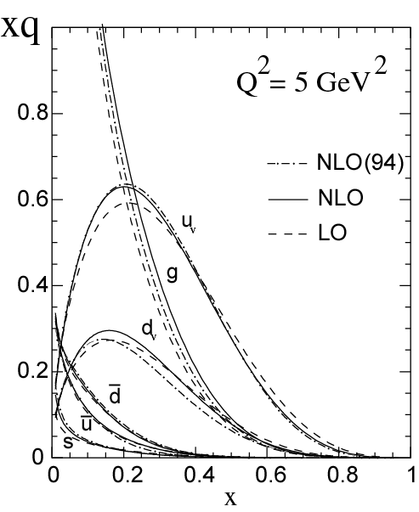
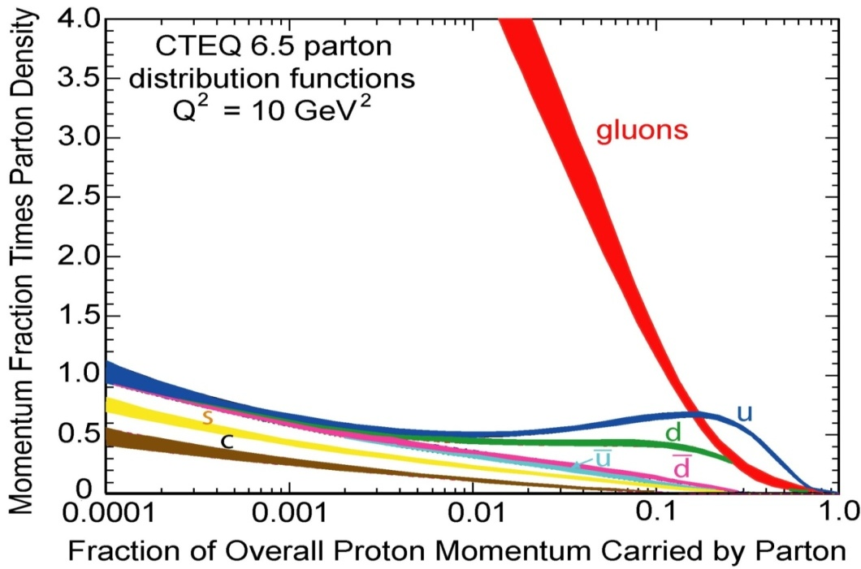
EIC Physics Overview
Hadrons in QCD are relativistic many-body systems, with a fluctuating number of elementary quark/gluon constituents and a very rich structure of the wave function.
With 12 GeV we study mostly the valence quark component, which can be described with methods of nuclear physics (fixed number of particles).
With an (M)EIC we enter the region where the many-body nature of hadrons, coupling to vacuum excitations, etc., become manifest and the theoretical methods are those of quantum field theory. An EIC aims to study the sea quarks, gluons, and scale (Q²) dependence.
mEIC
EIC
12 GeV

Slide 27
JLAB EIC Workshops
Nucleon spin and quark-gluon correlations: Transverse spin, quark and gluon orbital motion, semi-inclusive processes (Duke U., March 12-13, 2010 )
3D mapping of the glue and sea quarks in the nucleon (Rutgers U., March 14-15, 2010)
3D tomography of nuclei, quark/gluon propagation and the gluon/sea quark EMC effect (Argonne National Lab, April 7-9, 2010)
Electroweak structure of the nucleon and tests of the Standard Model (College of W&M , May 17-18, 2010)
EIC Detectors/Instrumentation (JLab, June 04-05, 2010)
4/5 will produce white paper for publication

Slide 28
EIC Realization Imagined
(Mont@INT)
Activity Name | 2010 | 2011 | 2012 | 2013 | 2014 | 2015 | 2016 | 2017 | 2018 | 2019 | 2020 | 2021 | 2022 | 2023 | 2024 | 2025
12 Gev Upgrade
FRIB
EIC Physics Case
NSAC LRP
EIC CD0
EIC Machine Design/R&D
EIC CD1/Downsel
EIC CD2/CD3
EIC Construction
Note: 12 GeV LRP recommendation in 2002 – CD3 in 2008

Slide 29
EIC Action
Considerable convergence on
Key Parameters (E, L)
Physics Goals
INT Workshop, 10 weeks, Fall 2010
Jefferson Lab “Friendly MEIC Review (Hoffstaetter and Chao)
MEIC Accelerator R&D funded by NP
Outline of Plan to produce Science White Paper
Includes definition of downselect mechanism
Draft of call for Detector R&D proposals (BNL)
Plan (proposed by BNL) to hold next EICAC at Jefferson Lab before or after DIS Workshop, April 2011

Slide 30
Summary
This picture of the issues in play at Jefferson Lab did not directly address the role we expect of the PAC Let me assure you Whenever we discuss the program of physics at Jefferson Lab we get questions about how we handle the priorities, the conflicts, the allocation of time, the run-time developments. Our answer always starts from our Program Advisory Committee. Its not that you do the management; you provide much of the basis on which we rely to do the management. This was the case only last Friday when we were asked just such questions by our Science Council.

